Slide 1
Dr. Yifeng Zhu Electrical and Computer Engineering University of Maine
Embedded Systems with ARM Cortex-M Microcontrollers in Assembly Language and C
Chapter 22
SPI: Serial Peripheral Interface
Spring 2020

Slide 2
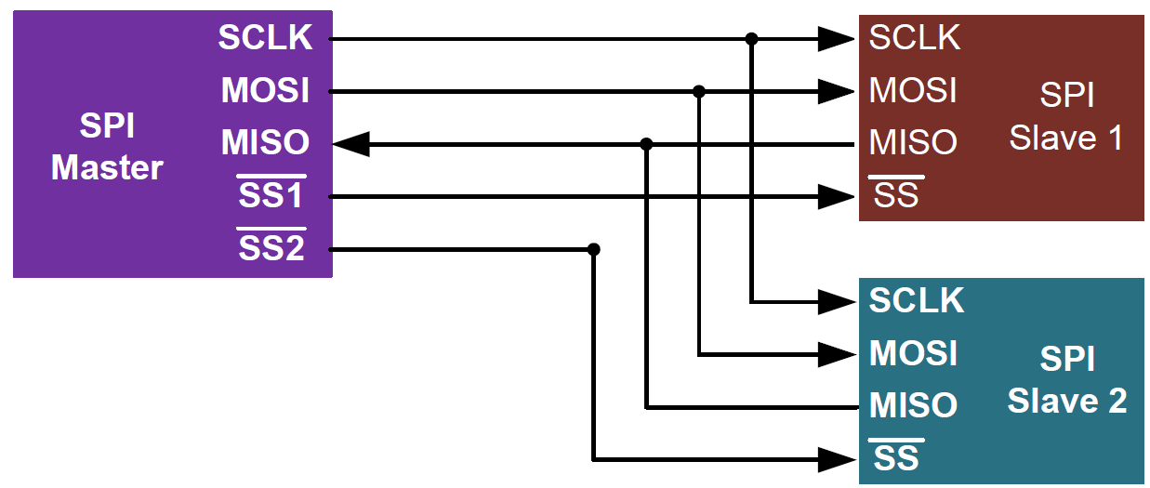
Serial Peripheral Interface (SPI)
Synchronous full-duplex communication
Single master, multiple slaves
No hardware flow control or slave acknowledgment
Slave cannot communicate with slave directly
Higher throughput than I2C
SCLK: serial clock
SS: slave select (active low)
MOSI: master out slave in
MISO: master in slave out

Slide 3
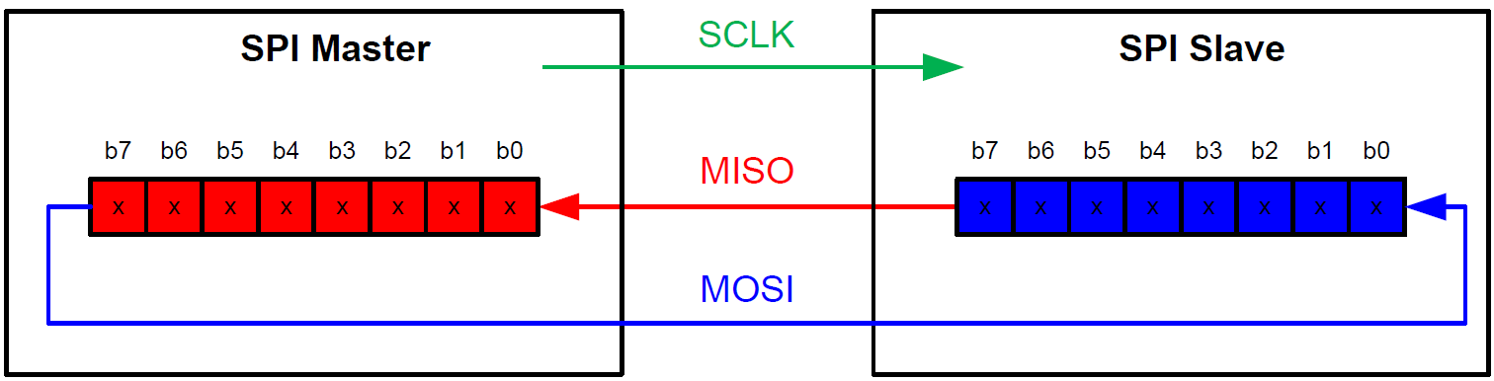
SPI Synchronous Data Exchange
Master has to provide clock to slave
Synchronous exchange
Master shift out a bit to slave, and shifts in a bit from slave.
Only master can start the data transfer. Thus no arbitration required.

Slide 4
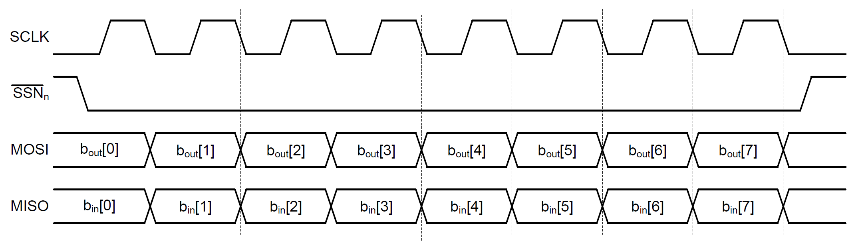
SPI Timing Diagram
Sample

Slide 5
SPI Clock Phase and Polarity
Combination of CPOL and CPHA determines the clock edge for transmitting and receiving.
CPOL = 0 ⟶ SCLK is pushed to low during idle. Otherwise, pulled to high during idle.
CPHA = 0 ⟶ the first clock transition (either rising or falling) is the first data capture edge. Otherwise, the second clock transition is the first data capture edge.

Slide 6
SPI Clock Phase and Polarity

Slide 7
Gyro Sensors

Slide 8
L3GD20

Slide 9
SPI vs I2C
SPI by Motorola and I2C by Philips
Both are synchronous protocols for short distance communications
Generally operates on 3.3 V or 5V
 | SPI | I2C
Advantages | Faster speed. Can be 10 Mbps or more. Full duplex | Simplicity. Commonly used as a 2-wire bus. Adding new slave is easy
Notes:
I2C originally defined data transfer rates at 100kbps, though we have seen it bump up to 400kbps or even up to 5Mbps in Ultra Fast-mode.
I2C is half-duplex

