Slide 1
Dr. Yifeng Zhu Electrical and Computer Engineering University of Maine
Embedded Systems with ARM Cortex-M Microcontrollers in Assembly Language and C
Chapter 22
Serial Communication
Spring 2020

Slide 2
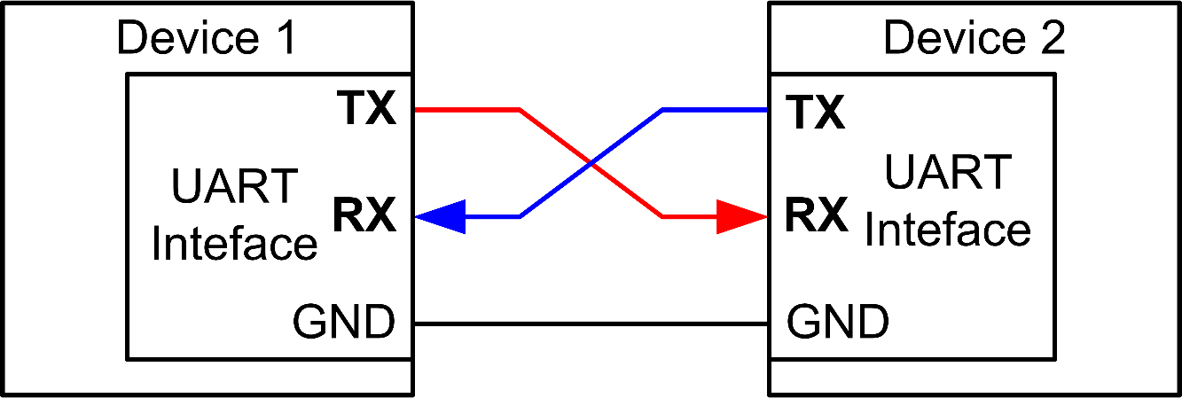
Universal Asynchronous Receiver and Transmitter (UART)
Universal
UART is programmable.
Asynchronous
Sender provides no clock signal to receivers

Slide 3
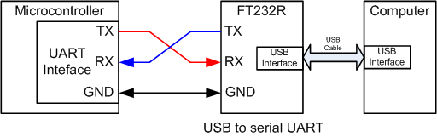
Connecting to PC
FT232R converts the UART port to a standard USB interface

Slide 4
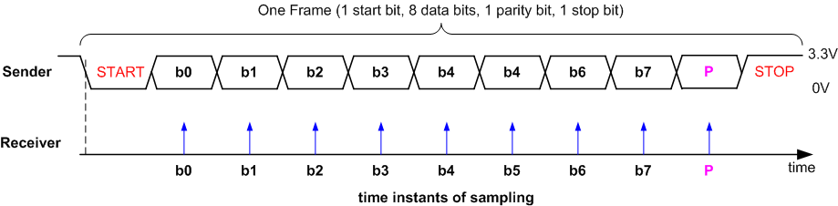
Data Frame
Tolerate 10% clock shift during transmission
Data frame
One logic-low start bit
Data (LSB first or MSB first, and size of 7, 8, 9 bits)
One optional parity bit
One or two logic-high stop bits

Slide 5
Data Frame
Tolerate 10% clock shift during transmission
Receiver must know the transmission rate
Receiver uses a timer to time when it should sample
To tolerate clock shift, receiver only samples at the middle of each bit
The start bit inform receiver to reset its timer
Receiver is only synchronized with the sender on every start bit.
Only has to be accurate enough to read up to 9 bits

Slide 6
Data Frame
Tolerate 10% clock shift during transmission
Receiver reports “frame error” if the stop bit is not detected
Another start bit can appear immediately after stop bit
Receiver then resynchronizes with sender on the new start bit

Slide 7
Baud Rate
Historically used in telecommunication to represent the number of pulses physically transferred per second
In digital communication, baud rate is the number of bits physically transferred per second
Example:
Baud rate is 9600
each frame: a start bit, 8 data bits, a stop bit, and no parity bit.
Transmission rate of actual data
9600/8 = 1200 bytes/second
9600/(1 + 8 + 1) = 960 bytes/second
The start and stop bits are the protocol overhead

Slide 8
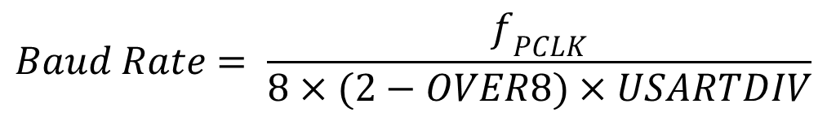
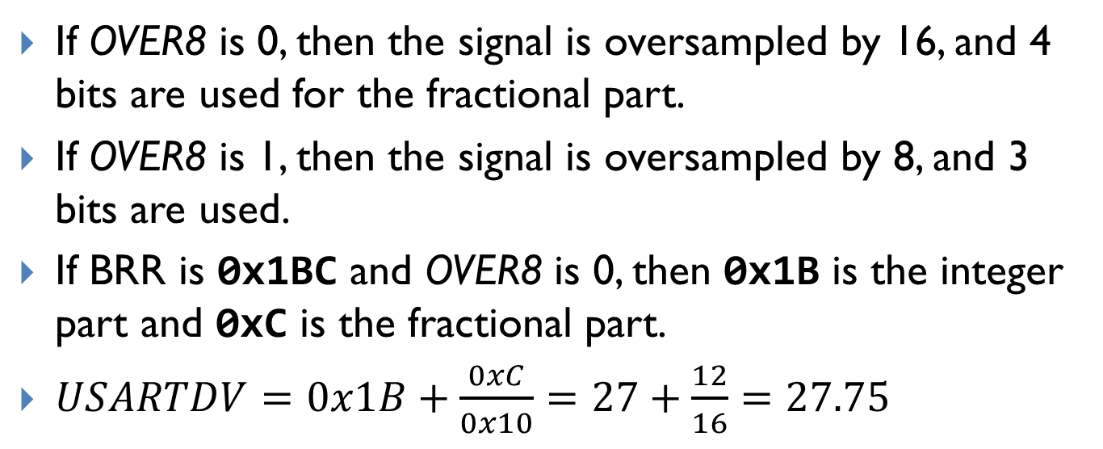
Baud Rate
$$Baud Rate= \frac{f_{PCLK}}{8×(2−OVER8)×USARTDIV}$$
If OVER8 is 0, then the signal is oversampled by 16, and 4 bits are used for the fractional part.
If OVER8 is 1, then the signal is oversampled by 8, and 3 bits are used.
If BRR is 0x1BC and OVER8 is 0, then 0x1B is the integer part and 0xC is the fractional part.
$USARTDV=0x1B+\frac{0xC}{0x10}=27+\frac{12}{16}=27.75$

Slide 9
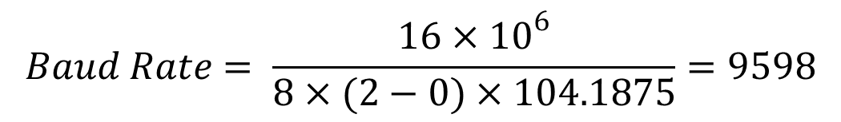
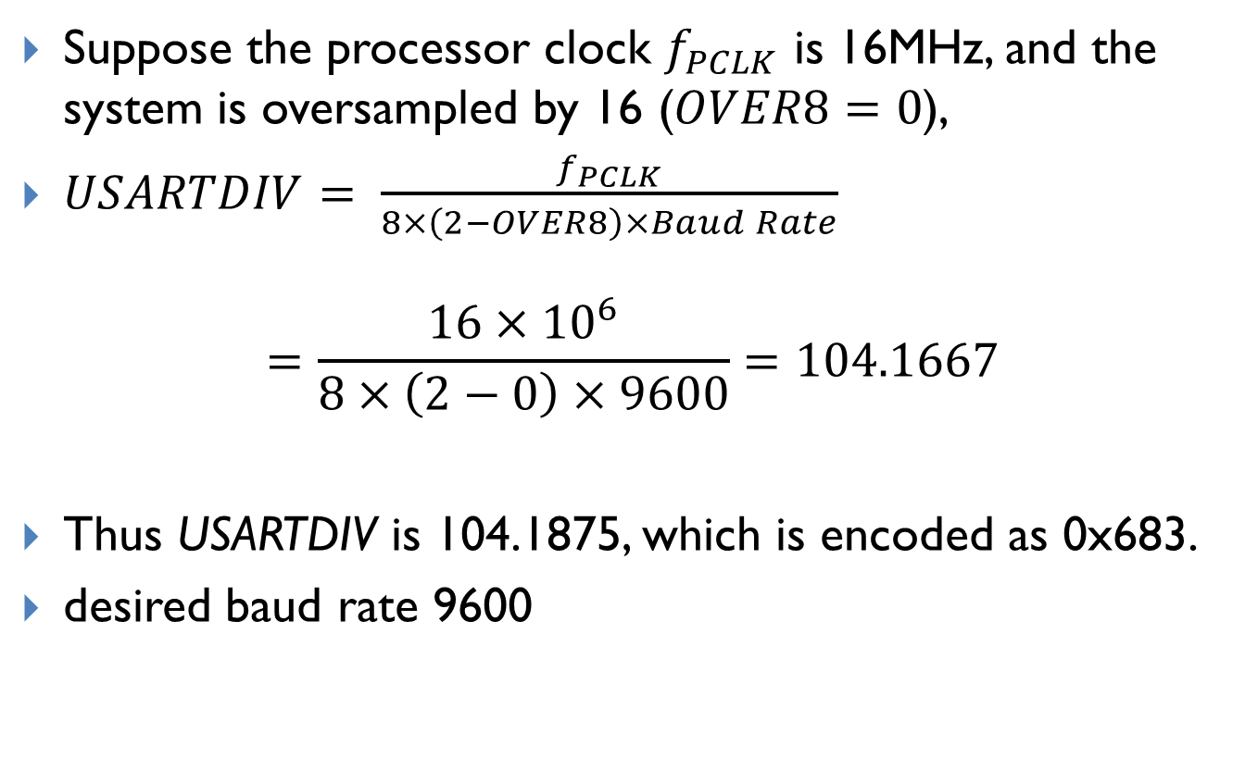
Baud Rate
Suppose the processor clock $f_{PCLK}$ is 16MHz, and the system is oversampled by 16 ($OVER8=0$),
$USARTDIV= \frac{f_{PCLK}}{8×\left(2−OVER8\right)×Baud Rate}$
$$=\frac{16×{10}^{6}}{8×\left(2−0\right)×9600}=104.1667$$
Thus USARTDIV is 104.1875, which is encoded as 0x683.
desired baud rate 9600
$$Baud Rate= \frac{16×{10}^{6}}{8×(2−0)×104.1875}=9598$$

Slide 10
Error Detection
Even Parity: total number of “1” bits in data and parity is even
Odd Parity: total number of “1” bits in data and parity is odd
Example: Data = 10101011 (five “1” bits)
The parity bit should be 0 for odd parity and 1 for even parity
This can detect single-bit data corruption

Slide 11
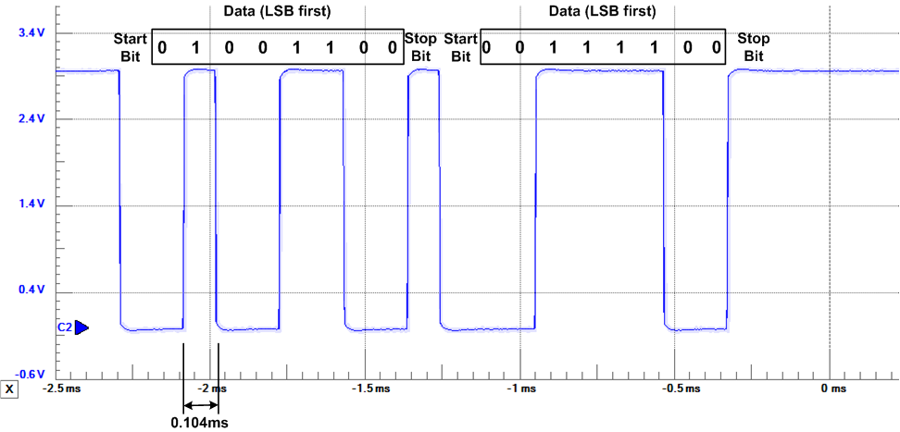

Transmitting 0x32 and 0x3C
$$\frac{1}{9600}=0.10417×{10}^{−3}$$
1 start bit, 1 stop bit, 8 data bits, LSB first, no parity, baud rate = 9600

Slide 12
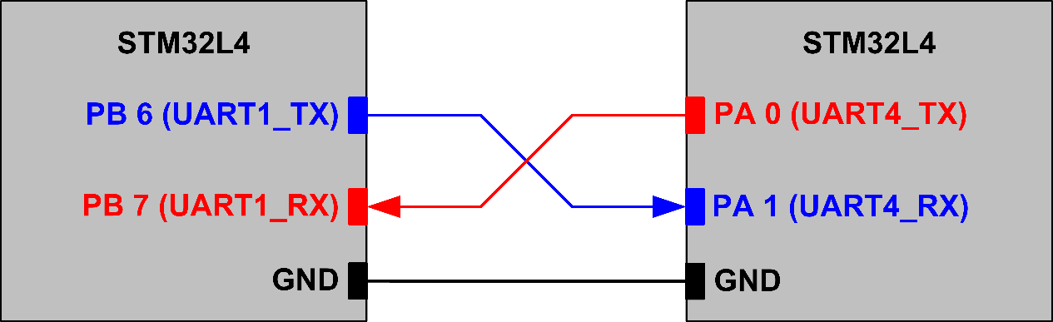
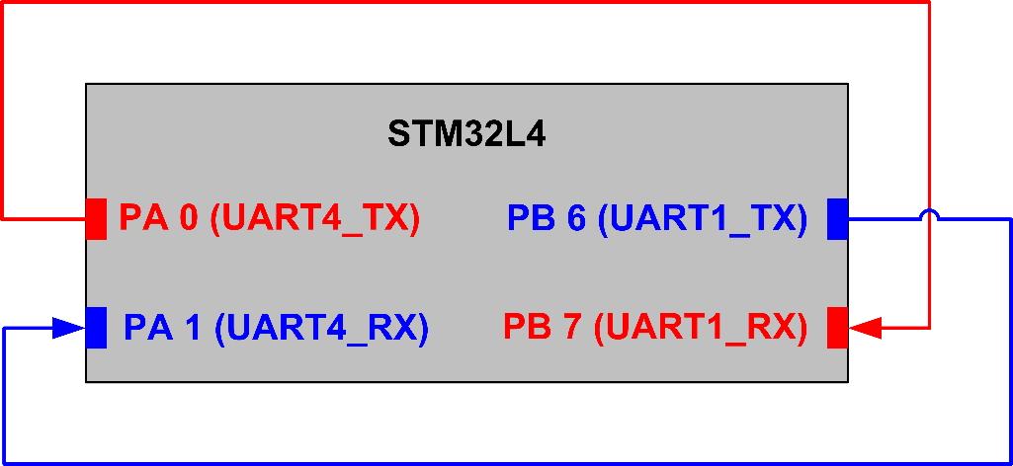
UART Connection
Two boards:
Single board:

Slide 13
Sending Data
void USART_Write(USART_TypeDef * USARTx, uint8_t * buffer, int nBytes) { int i; // TXE is cleared by a write to the USART_DR register. // TXE is set by hardware when the content of the TDR // register has been transferred into the shift register. for (i = 0; i < nBytes; i++) { // wait until TXE (TX empty) is set // Writing USART_DR automatically clears the TXE flag while (!(USARTx->SR & USART_SR_TXE)); USARTx->DR = (buffer[i] & 0x1FF); } while (!(USARTx->SR & USART_SR_TC)); // wait until TC bit is set USARTx->SR &= ~USART_SR_TC; }

Slide 14
Receiving Data
void USART_IRQHandler(USART_TypeDef * USARTx, uint8_t * buffer, uint8_t * pRx_counter){ if(USARTx->SR & USART_SR_RXNE) { // Received data buffer[*pRx_counter] = USARTx->DR; // Reading USART_DR automatically clears the RXNE flag (*pRx_counter)++; if((*pRx_counter) >= BufferSize ) (*pRx_counter) = 0; } } void USART1_IRQHandler(void) { USART_IRQHandler(USART1, USART1_Buffer_Rx, &Rx1_Counter); } void USART2_IRQHandler(void) { USART_IRQHandler(USART2, USART2_Buffer_Rx, &Rx2_Counter); }

Slide 15
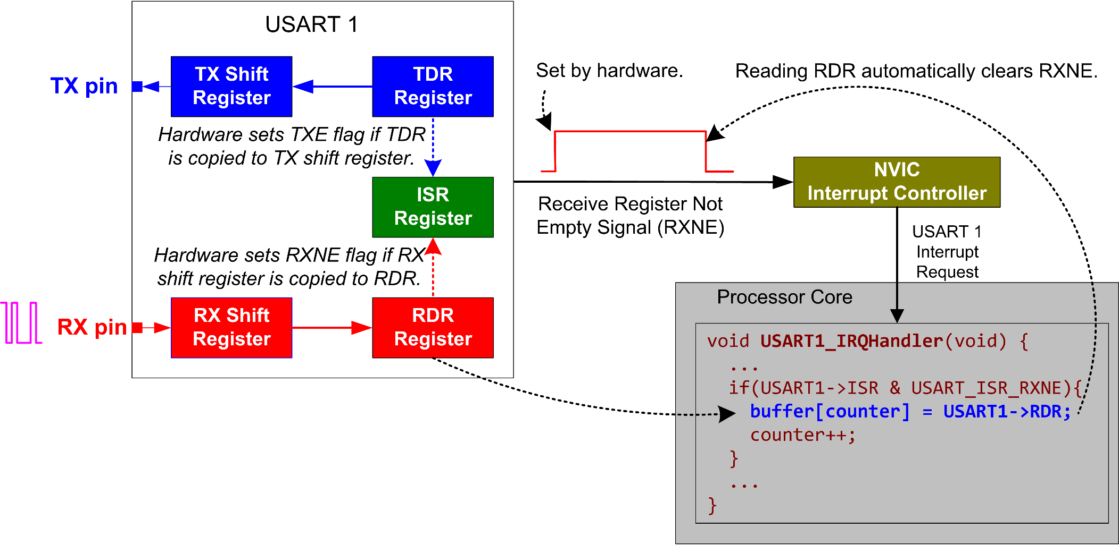
UART Interrupt: Receiving Data

Slide 16
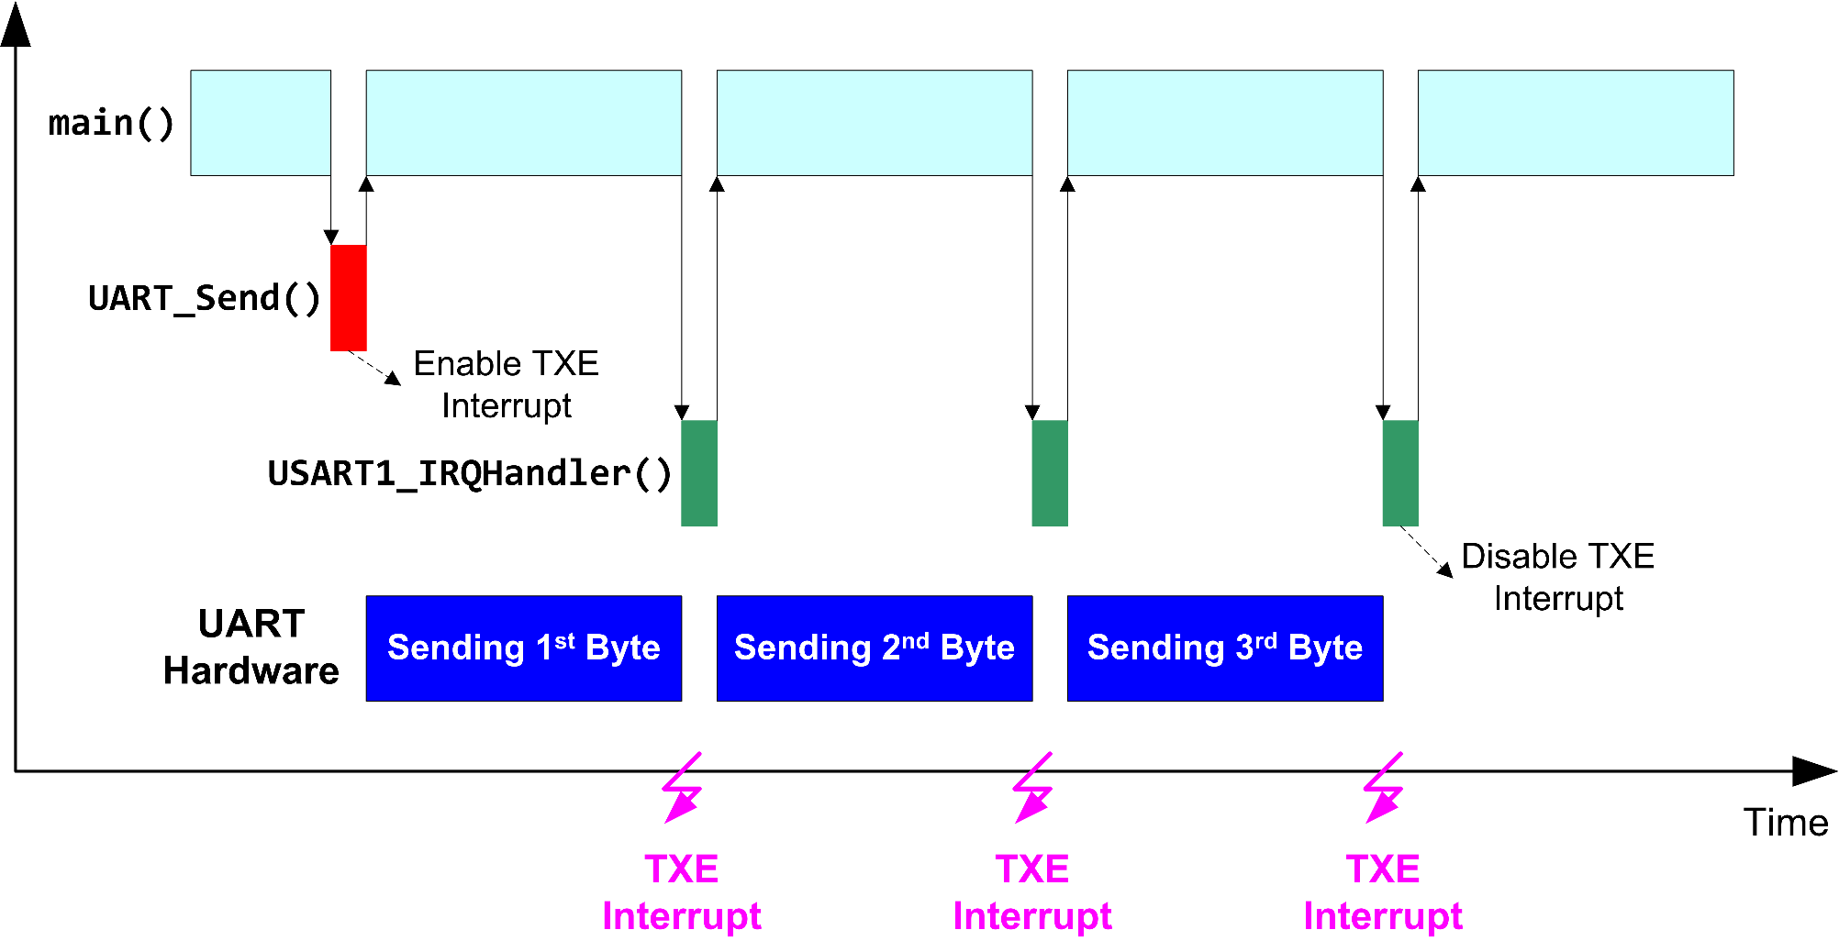
UART Interrupt: Receiving Data

Slide 17
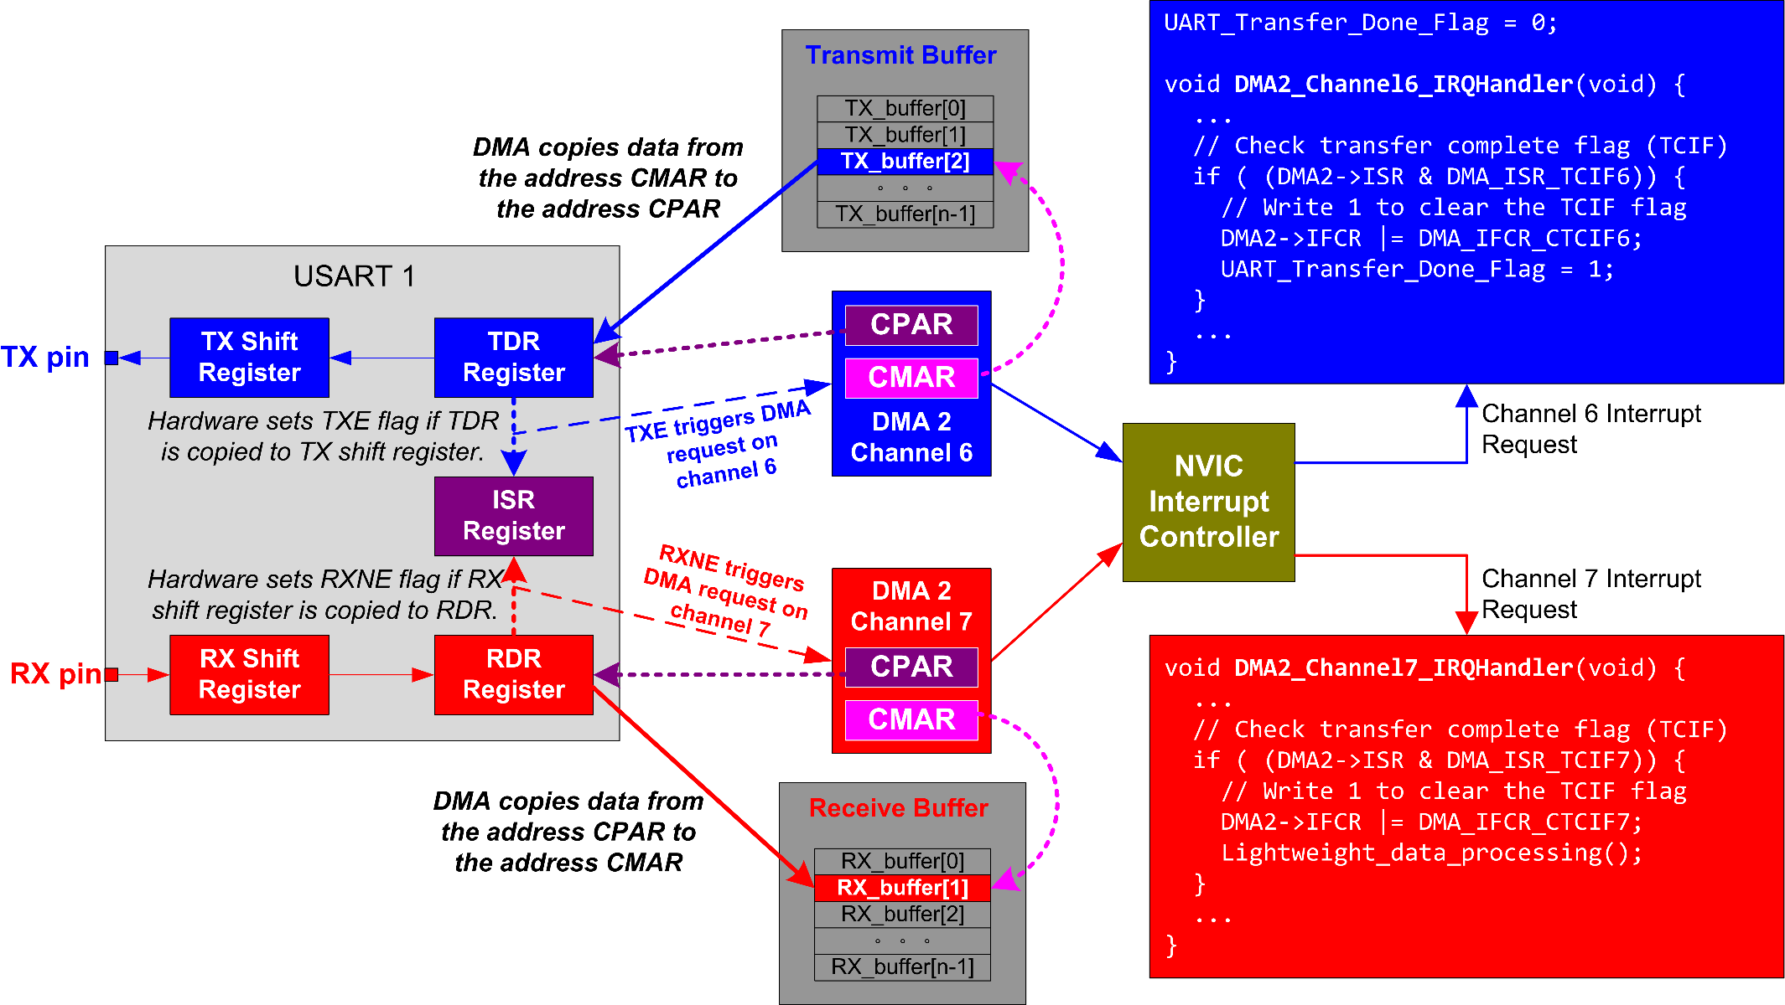
UART DMA: Receiving & Sending

Slide 18
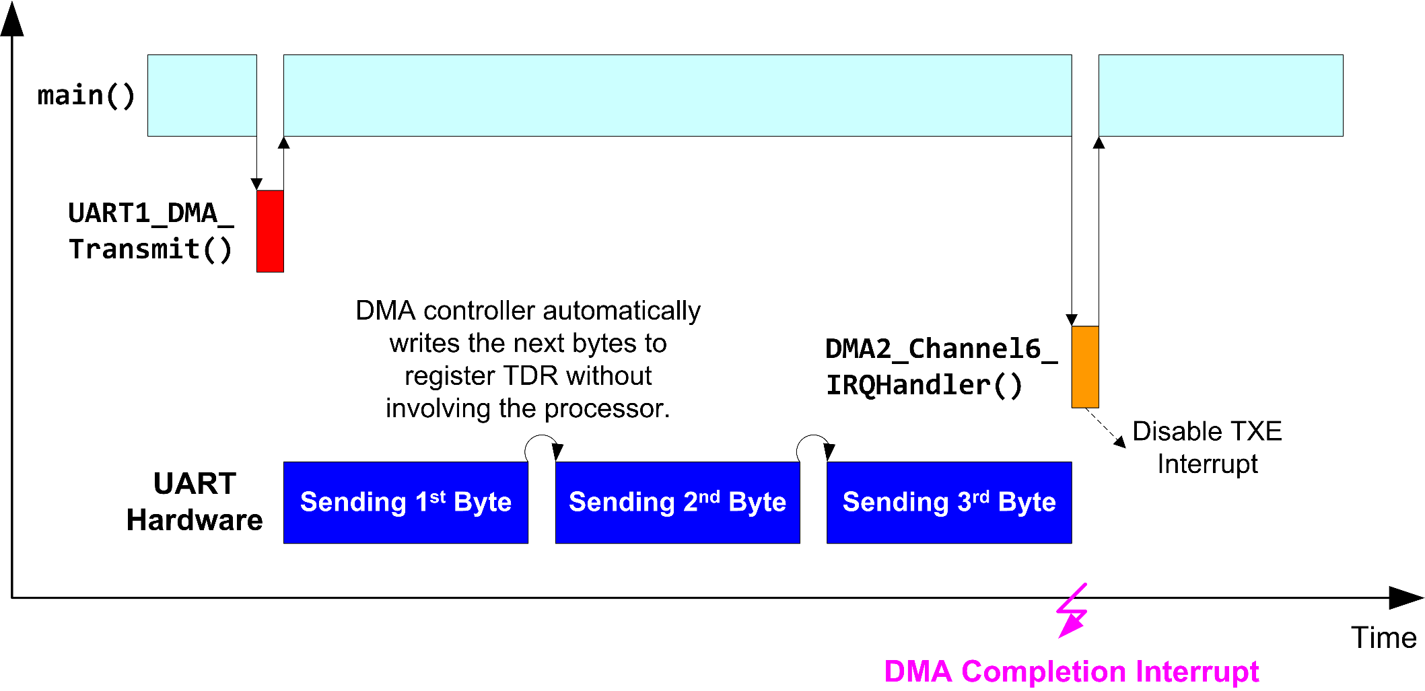
UART DMA: Receiving & Sending

Slide 19
Voltage Levels
Standard | Voltage signal | Max distance | Max speed | Number of devices supported per port
RS-232 | Single end ( logic 1: +5 to +15V, logic 0: -5 to -15 V) | 100 feet | 115Kbit/s | 1 master, 1 receiver
RS-422 | Differential (-6V to +6V) | 4000 feet | 10Mbit/s | 1 master, 10 receivers
RS-485 | Differential (-7V to +12V) | 4000 feet | 10Mbit/s | 32 masters, 32 receivers
Standards:
How far can signal transfer?
How fast can it transfer data?
How many devices supported per port?
How many masters allowed?

Slide 20
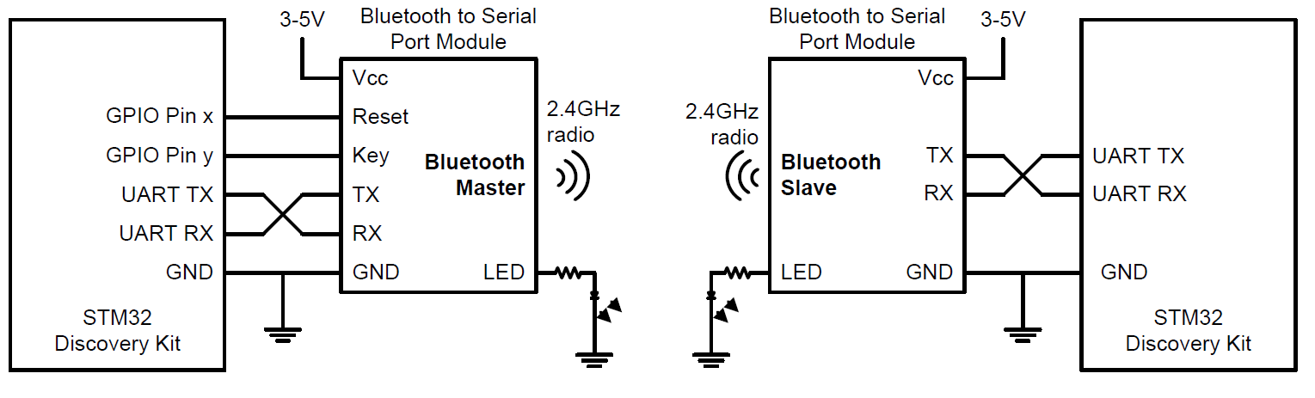
Bluetooth

