Slide 1
Dr. Yifeng Zhu Electrical and Computer Engineering University of Maine
Embedded Systems with ARM Cortex-M Microcontrollers in Assembly Language and C
Chapter 23
Concurrent Software
Spring 2020

Slide 2
Processor Modes
Handler mode is always privileged.
The privileged state allows software to access all resources
The unprivileged state prevents software from configuring or controlling some protected resources directly.

Slide 3
CONTROL register
__asm uint32_t get_CONTROL(void) {
MRS r0, CONTROL ; MRS: Move to register from status register
BX lr
}

Slide 4
CONTROL register
__asm void select_PSP(void) {
; Assume PSP has already been initialized.
MRS r0, CONTROL ; MRS: Move to register from status register
ORRS r0, r0, #2 ; Set bit 1 to 1
MSR CONTROL, r0 ; MSR: Move to status register from register
ISB ; Ensure subsequent instructions use the new SP
BX lr
}

Slide 5
CONTROL register
__asm void select_Unprivileged(void) {
; Assume PSP has already been initialized.
MRS r0, CONTROL ; MRS: Move to register from status register
ORRS r0, r0, #1 ; Set bit 0 to 1
MSR CONTROL, r0 ; MSR: Move to status register from register
ISB ; Ensure subsequent instructions at the new privilege level
BX lr
}

Slide 6
Exception Return Value (EXC_RETURN)
At the entry of a subroutine, LR stores the return address.
At the entry of an interrupt handler, LR holds EXC_RETURN.
At the entry of an interrupt handler, the processor generates a special 32-bit value called exception return value and automatically stores this value in the link register (LR).
Without FPU, three valid values: 0xFFFFFFF1, 0xFFFFFFF9, and 0xFFFFFFFD.
With FPU, three additional valid values: 0xFFFFFFE1, 0xFFFFFFE9, and 0xFFFFFFED.

Slide 7

CPU Scheduling

Slide 8
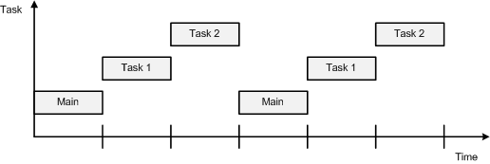
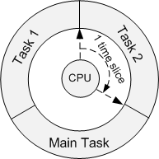
Time Sharing
Round Robin Scheduling

Slide 9
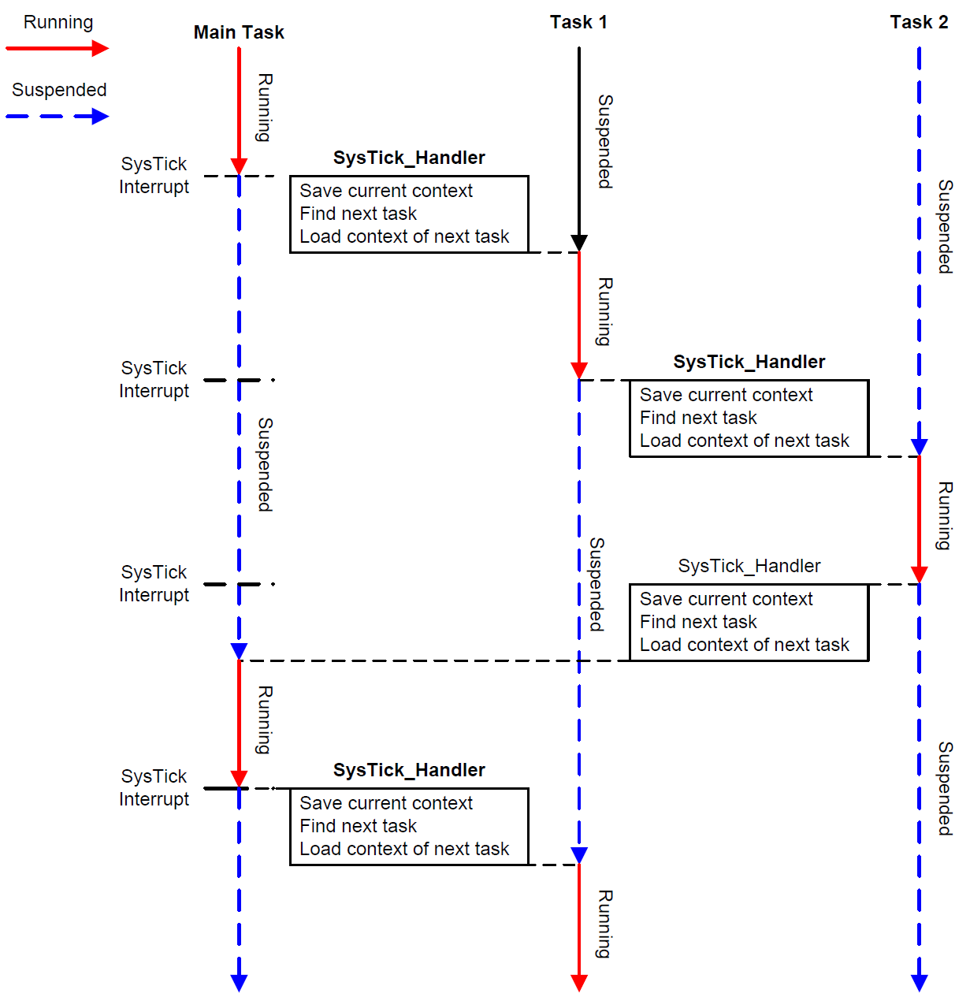
Context Switch

Slide 10
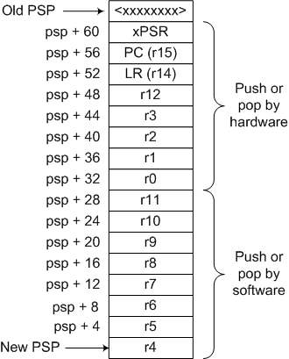
Frame

Slide 11
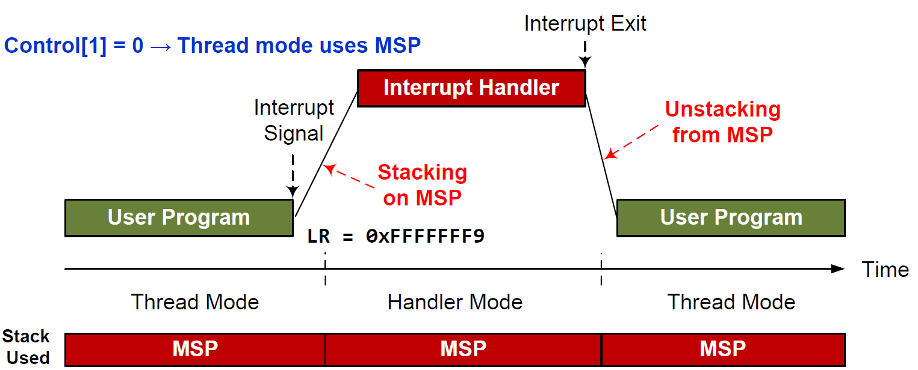
MSP and PSP

Slide 12
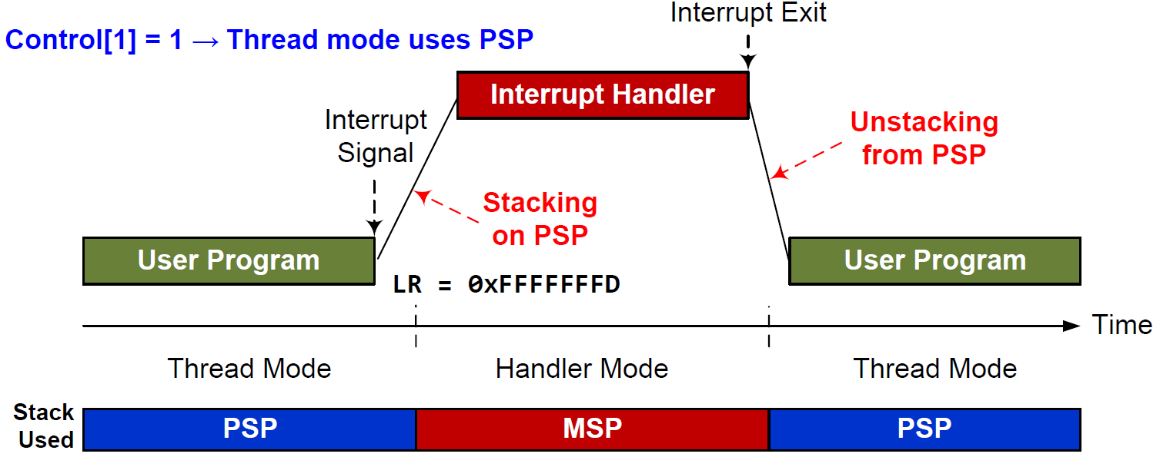
MSP and PSP

Slide 13
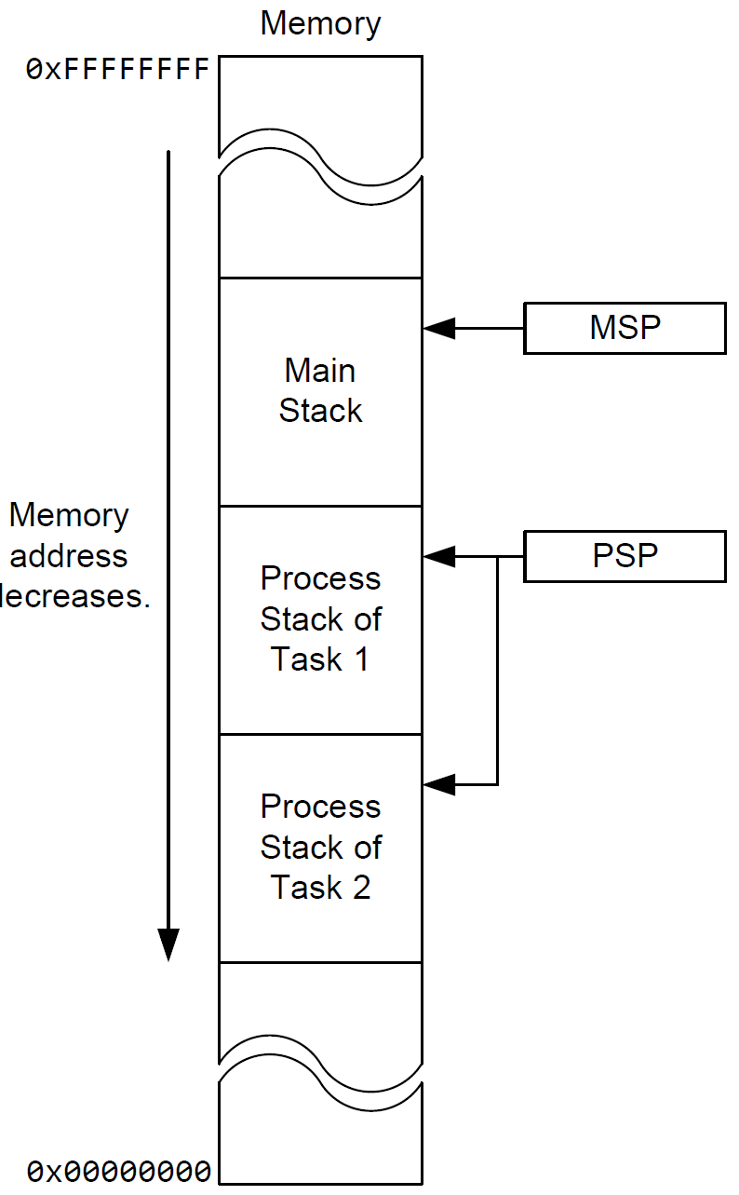
MSP and PSP

Slide 14
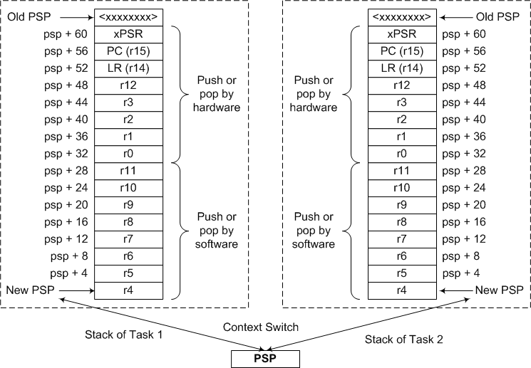
Context Switch

