Slide 1
Dr. Yifeng Zhu Electrical and Computer Engineering University of Maine
ECE 271 - Microcomputer Architecture and Applications
Lecture 13
Booting
Spring 2020

Slide 2
Interrupt Service Routine (ISR)
0x20001BB0
Stack
void main() {
...
}
0x08001384
void Reset_Handler() {
...
main();
...
}
0x08000268
...
0x00000008
Bit 0 is 1, indicating Thumb state.
0x00000004
0x08000269
Initialize PC
0x00000000
0x20001BB0
Initialize MSP
Memory
address
Memory
content
Notes:
{{Pause=2}} Here is the interrupt vector table of STM32L4. {{Pause=0.5}} The first word holds the top of the main stack. {{Pause=0.5}} The next 15 words hold the pointers of 15 system exception handlers. {{Pause=0.5}} The next are pointers to vender-specific interrupt handlers. The size of the interrupt vector table, varies among different processor chips.

Slide 3
Power on or Reset
When power on or reset, the processor fetches the first two words from the memory,
MSP = word stored at the address 0x00000000
PC = word stored at the address 0x00000004
The word stored at 0x00000004 is the memory address of the first instruction of the reset_handler() procedure, which is determined by the compiler and link script.
Typically the reset_handler() procedure calls the main() procedure, which is the user’s application code. After PC is initialized, the program starts the execution.
The reset_handler() has the highest priority and its has a priority number of -3.
Notes:
Interrupts are widely used in microcontrollers for applications to efficiently response hardware requests.
While the very first word in the memory stores the memory address used to initialize the main stack pointer (MSP), the following words starting at 0x00000004 represent a vector table, which store the memory address of the first instruction of all interrupt and exception handling routines.
All interrupts are managed by the Nested Vectored Interrupt Controller (NVIC). NVIC allows applications to enable specific interrupts and program their priority levels dynamically if needed. All interrupts are served based on their priority levels. The current running interrupt handler is stopped if a new interrupt with a higher priority occurs. The current lower-priority task is preempted by the new interrupt task, and resumes the computation when the handler of the new interrupt completes. A higher value of interrupt priority number actually represents a lower priority. The reset_handler() has the highest priority and its has a priority number of -3.

Slide 4
System exceptions, External interrupts
Among all interrupts defined in the interrupt vector table, the first 15 interrupts are to support systems, called system exceptions, while the others, 16 and above, are to support peripherals, called external interrupts.
Examples for system exceptions include fault-handling interrupts (bus faults for prefetch and memory management, memory management faults, instruction usage faults, hard faults), supervisor call interrupts, and system tick timer interrupt.
The others, such as ADC interrupts, USB interrupts, and serial communication interrupts (SPI, I2C, USART), are to inform the microcontroller external events efficiently. Without these interrupts, the microcontroller then would rely inefficient polling to repeatedly check peripherals, wasting precious computation cycles.

Slide 5
Define MSP Stack Size
Stack_Size EQU 0x00000400
AREA STACK, NOINIT, READWRITE, ALIGN=3
Stack_Mem SPACE Stack_Size
__initial_sp
startup_stm32lxx_md.s

Slide 6
Define Vector Table
; Vector Table Mapped to Address 0 at Reset
AREA RESET, DATA, READONLY
EXPORT __Vectors
EXPORT __Vectors_End
EXPORT __Vectors_Size
__Vectors DCD __initial_sp ; Top of Stack
DCD Reset_Handler ; Reset Handler
DCD NMI_Handler ; NMI Handler
DCD HardFault_Handler ; Hard Fault Handler
DCD MemManage_Handler ; MPU Fault Handler
DCD BusFault_Handler ; Bus Fault Handler
DCD UsageFault_Handler ; Usage Fault Handler
DCD 0 ; Reserved
DCD 0 ; Reserved
DCD 0 ; Reserved
DCD 0 ; Reserved
DCD SVC_Handler ; SVCall Handler
DCD DebugMon_Handler ; Debug Monitor Handler
DCD 0 ; Reserved
DCD PendSV_Handler ; PendSV Handler
DCD SysTick_Handler ; SysTick Handler
...
__Vectors_End
__Vectors_Size EQU __Vectors_End - __Vectors
startup_stm32lxx_md.s

Slide 7
On Reset
PC = mem[0x00000004]
LR = 0xFFFFFFFF
MSP = Mem[0x00000000]
PSR = 0x01000000
R0-R12: Unknown

Slide 8
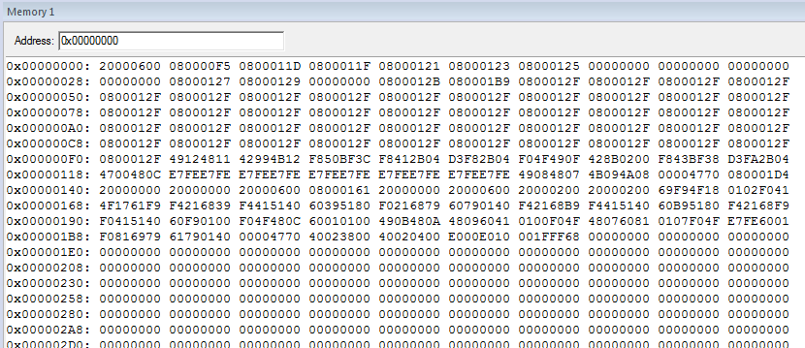
__initial_sp
Instruction
Memory
Reset_Handler
SysTick_Handler

Slide 9
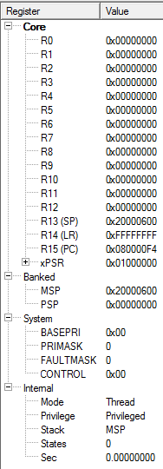
__initial_sp
Instruction
Memory
Reset_Handler
SysTick_Handler
The first word is used to initialize SP.

Slide 10
__initial_sp
Instruction
Memory
Reset_Handler
SysTick_Handler
The second word is used to initialize PC.
Instruction if halfword aligned, thus bit 0 of PC is 0.
Bit 0 of Reset_Handler is 1, indicating Thumb state.

Slide 11
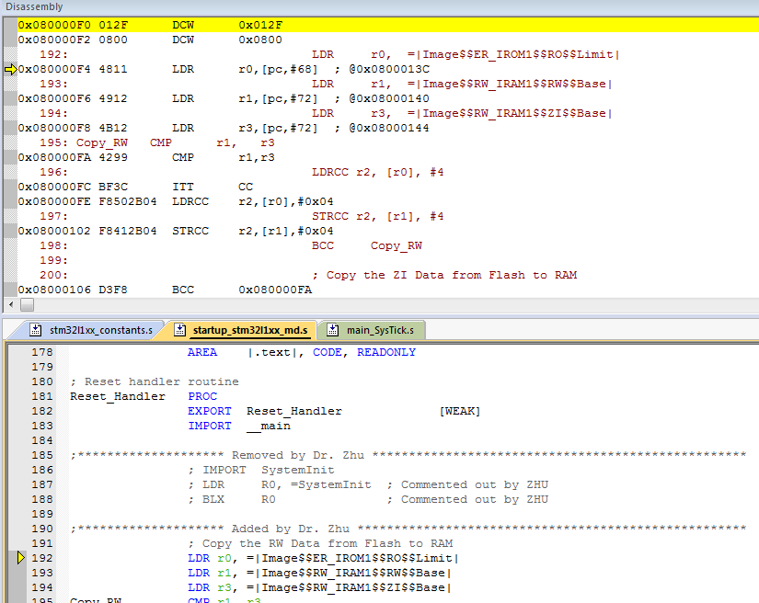
__initial_sp
Instruction
Memory
Reset_Handler
SysTick_Handler

Slide 12
__initial_sp
Instruction
Memory
Reset_Handler
SysTick_Handler

