Slide 1
Dr. Yifeng Zhu Electrical and Computer Engineering University of Maine
ECE 271 - Microcomputer Architecture and Applications
Last
Lecture ☺
Spring 2020

Slide 2
Software Engineering Code of Ethics and Professional Practice (IEEE & ACM)
Approve software only if they have a well-founded belief it is safe and meets specifications
Accept full responsibility for their own work
Not knowingly use software that is obtained or retained either illegally or unethically
Identify, define, and address ethical, economic, cultural, legal and environmental issues related to work projects
Ensure that specifications for software on which they work satisfy the users’ requirements and they have the appropriate approvals
Ensure adequate testing, debugging and review of software
Not engage in deceptive financial practices such as bribery, double billing, or other improper financial practices
Improve their ability to create safe, reliable, and useful quality software

Slide 3
Software Engineering Code of Ethics and Professional Practice (IEEE & ACM)
Approve software only if they have a well-founded belief it is safe and meets specifications
Accept full responsibility for their own work
Not knowingly use software that is obtained or retained either illegally or unethically
Identify, define, and address ethical, economic, cultural, legal and environmental issues related to work projects
Ensure that specifications for software on which they work satisfy the users’ requirements and they have the appropriate approvals
Ensure adequate testing, debugging and review of software
Not engage in deceptive financial practices such as bribery, double billing, or other improper financial practices
Improve their ability to create safe, reliable, and useful quality software

Slide 4
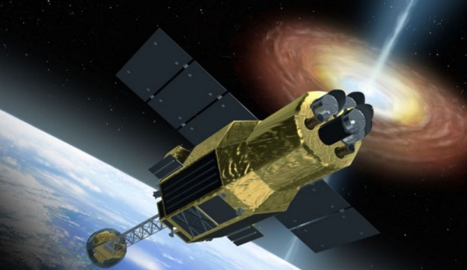
Human Error Blamed for Loss of Japan's Hitomi Satellite
Hitomi launched on 17 February 2016
Failed to operate on 26 March 2016
JAXA ceased efforts to restore it on 28 April 2016
Loss: $364 million

Slide 5
Human Error Blamed for Loss of Japan's Hitomi Satellite
Software errors caused by incorrect programming that commanded the satellite to spin faster than intended.
AXA believes Hitomi apparently had problems orienting itself correctly in space. Hitomi's control system commanded a thruster jet to fire to correct this disorientation. The thruster did fire -- but in the wrong direction, causing Hitomi to accelerate the spin.
This violent spin apparently broke off both of the satellite's solar panels, depriving it of power.
As a result, JAXA has ceased efforts to regain control over the satellite and gave it up for lost on April 28.

Slide 6
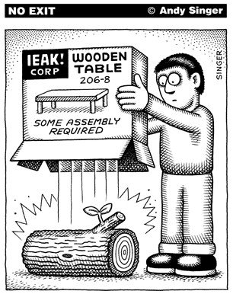
Assembly Programming

Slide 7
Why do we learn Assembly?
Assembly isn’t “just another language”.
Help you understand how does the processor work
Assembly program runs faster than high-level language. Performance critical codes must be written in assembly.
Use the profiling tools to find the performance bottle and rewrite that code section in assembly
Latency-sensitive applications, such as aircraft controller
Standard C compilers do not use some operations available on ARM processors, such ROR (Rotate Right) and RRX (Rotate Right Extended).
Hardware/processor specific code,
Processor booting code
Device drivers
A test-and-set atomic assembly instruction can be used to implement locks and semaphores.
Cost-sensitive applications
Embedded devices, where the size of code is limited, wash machine controller, automobile controllers
The best applications are written by those who've mastered assembly language or fully understand the low-level implementation of the high-level language statements they're choosing.

Slide 8
Example 1: Need to Know Assembly to Optimizing Program
Observation: 90% of time spend on 10% of code
int rotateRight(int x, int n) {
return (x >> n) | (x << (32 - n));
}
Compiler with Optimization level 3
Manual Optimization
ASR r2,r0,r1
RSB r1,r1,#32
LSLS r0,r0,r1
ORRS r0,r0,r2
BX lr
ROR r0,r0,r1
BX lr

Slide 9
Example 2: Need to Know Assembly to Write Kernel Functions

Slide 10
Fundamental to Future Courses
ECE 473 Computer Architecture and Organization
ECE 331 Operating System Engineering
ECE 471 Embedded Systems
ECE 477 Hardware Application of C
ECE 486 Digital Signal Processing

