Slide 1
Dr. Yifeng Zhu Electrical and Computer Engineering University of Maine
ECE 271 - Microcomputer Architecture and Applications
ECE271
Final Review
Spring 2020

Slide 2
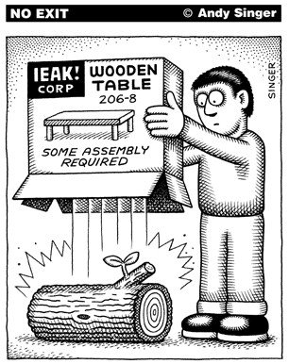
Assembly Programs
http://www.andysinger.com/

Slide 3
Why do we learn Assembly?
Assembly isn’t “just another language”.
Help you understand how does the processor work
Assembly program runs faster than high-level language. Performance critical codes must be written in assembly.
Use the profiling tools to find the performance bottle and rewrite that code section in assembly
Latency-sensitive applications, such as aircraft controller
Standard C compilers do not use some operations available on ARM processors, such ROR (Rotate Right) and RRX (Rotate Right Extended).
Hardware/processor specific code,
Processor booting code
Device drivers
A test-and-set atomic assembly instruction can be used to implement locks and semaphores.
Cost-sensitive applications
Embedded devices, where the size of code is limited, wash machine controller, automobile controllers
The best applications are written by those who've mastered assembly language or fully understand the low-level implementation of the high-level language statements they're choosing.

Slide 4
Character String
Memory Address | Memory Content | Letter
str + 12→ | 0x00 | \0
str + 11→ | 0x79 | y
str + 10→ | 0x6C | l
str + 9→ | 0x62 | b
str + 8→ | 0x6D | m
str + 7→ | 0x65 | e
str + 6→ | 0x73 | s
str + 5→ | 0x73 | s
str + 4→ | 0x41 | A
str + 3→ | 0x20 | space
str + 2→ | 0x4D | M
str + 1→ | 0x52 | R
str → | 0x41 | A
char str[13] = “ARM Assembly”;

Slide 5
Data Representation
Integers
Binary in different bases: binary, octal, hex, decimal
Signed Integers
Signed magnitude
One’s complement
Two’s complement
Arithmetic Operations
N, V, C, Z flags
Big Endian vs Little Endian
ASCII values
Null-terminated string
Converting between numbers and ASCII
Upper case, lower case
Fixed pointer numbers
Qm.n format
Addition, subtract, multiplication, division

Slide 6
Basic Assembly Programming
Load-modify-store sequence
Accessing nemory
Memory addressing mode
Pre-index
Post-index
Pre-index with update
Data processing
Arithmetic, Logic, Comparison, Data Movement
Barrel Shifter:
ADD r1, r0, r0, LSL 2
Bit operations
Set a bit, Reset a bit, Toggle a bit, Check a bit
LSL, LSR, ASR, ROR, RRX
Flow control: if, if-then-else, for loop, while loop
Unconditional Branch: B
Conditional Branch: CMP, TEQ,TST, BEQ, BNE, BMI, BLS, BHI, etc.
Conditional Execution: MOVEQ, MOVNE

Slide 7
Subroutine Without Floating Numbers
Calling Subroutine & Exiting Subroutine
BL and BX
How PC, LR, and SP registers are updated?
Embedded application binary interface (EABI) Protocol
Save and restore R4-R11,LR if your subroutine wishes to modify
Parameters passing in registers R0,R1,R2,R3
Extra parameters passing in stack
Return parameter in R0
Recursive functions
How does the stack work?
Pay special attention to LR register

Slide 8
Subroutine with Float Arguments
Each number is assigned in turn to the next free register of the corresponding type
Example:
double fun(double a1, float a2, double a3, float a4, float a5, double a6, float a7, double a8)

Slide 9


Interrupt
Interrupt vs Polling
Interrupt Service Routine
Interrupt Enable and Disable
Interrupt Stacking and Unstacking
Eight registers (R0-R3, R12, LR, PC, PSR) are automatically pushed into the stack before the hander starts
These registers are automatically popped when exiting the handler
What does the LR register mean when exiting a hander?
If LR = 0xFFFFFFF9, then SP = MSP
If LR = 0xFFFFFFFD, then SP = PSP
http://www.istockphoto.com/

Slide 10
Stacking & Unstacking
Interrupt
Exit
Interrupt Handler
Interrupt
Signal
Unstacking
User Program
User Program
Stacking
Time
Thread Mode
Handler Mode
Thread Mode

Slide 11
Stacking & Unstacking
Old SP
SP + 0x20 | xxxxxxxx
SP + 0x1C | xPSP
SP + 0x18 | PC (r15)
SP + 0x14 | LR (r14)
SP + 0x10 | r12
SP + 0x0C | r3
SP + 0x08 | r2
SP + 0x04 | r1
SP + 0x00 | r0
The processor automatically pushes these eight registers into the main stack before an interrupt handler starts
The processor automatically pops these eight register out of the main stack when an interrupt hander exits.
Stack descends.
New SP
Two SPs: Main SP (MSP) and Process SP (PSP)
Determined by operating mode, and CONTROL[0]
Thread mode ⟶ SP = PSP
Handler mode ⟶ SP = MSP if CONTROL[0] = 0; Otherwise SP = PSP

Slide 12
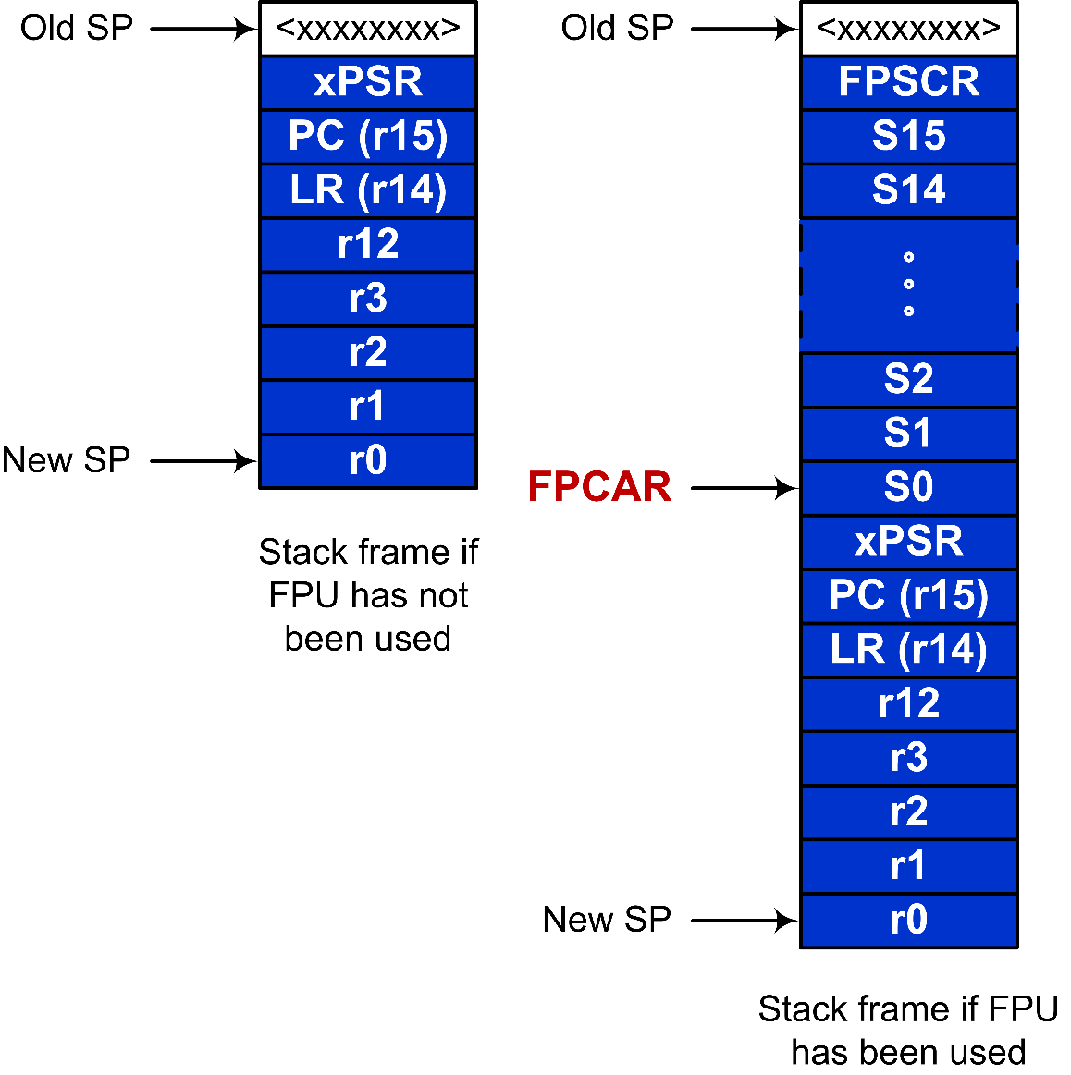
Stacking and Unstacking upon Interrupt with FPU

Slide 13
Mixing C and Assembly
Accessing C variables
Struct & Data alignment
Static variables
Inline Assembly
C calling assembly functions
C: extern assembly functions and variables
Assembly: Export
Assembly calling C functions
Assembly: Import C function and variables
Export variables to C functions

Slide 14
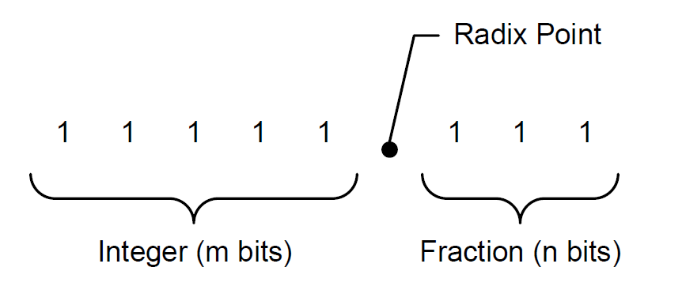
Unsigned Fixed-point Representation UQm.n
$$f=A_{h}+A_{l}×2^{−n}$$
$$10101.101_{2 }= A_{h}+A_{l}×2^{−3}$$
$$=21+5×2^{−3}$$
$$=21.625$$

Slide 15
Signed Fixed-point Representation Qm.n
$$A=−1×b_{N−1}×2^{N−1}+\sum_{i=0}^{N−2}{\left(b_{i}×2^{i}\right)}$$
$$f=\frac{A}{2^{n}}$$
where $N=m+n+1$

Slide 16
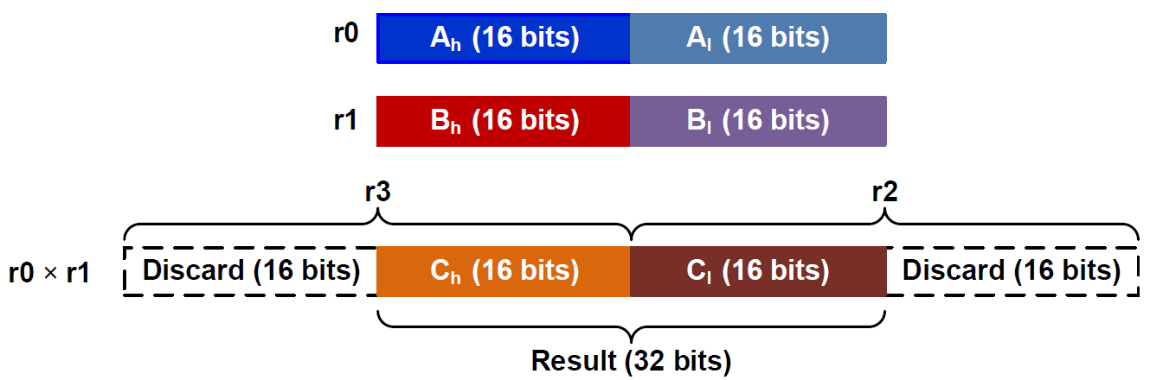
Fixed-point Multiplication in Q15.16
; r0 = fixed-point number A
; r1 = fixed-point number B
; r4 = fixed-point product = A × B
SMULL r2, r3, r0, r1 ; Unsigned long multiply
; r2 = low word, r3 = high word
LSLS r3, r3, #16 ; Shift left high word
LSRS r2, r2, #16 ; Shift right low word
ORR r4, r2, r3 ; Pack two halfwords into a word

Slide 17
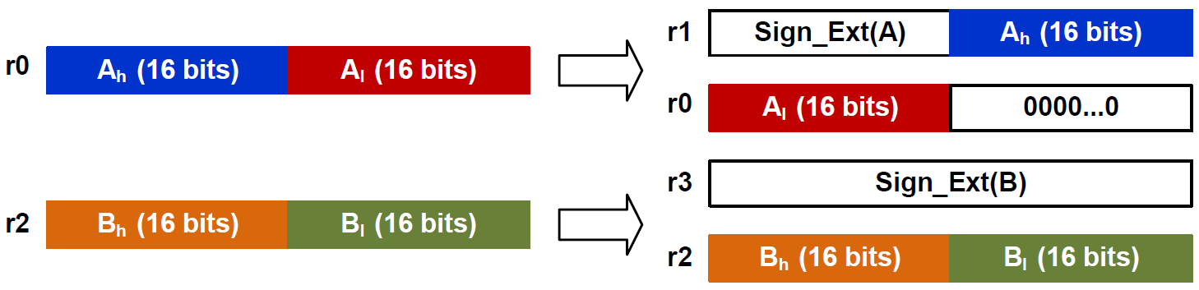
Fixed-point Division in UQ16.16 or Q15.16
r4 = fixed-point quotient
= A ÷ B
ASRS r1, r0, #31 ; r1[31:0] = sign bits of A
LSLS r1, r1, #16 ; put sign bits in upper half word
ORR r1, r1, r0, LSR #16
LSLS r0, r0, #16 ; [r1:r0] stores sign extended A
ASRS r3, r2, #31 ; [r4:r3] stores sign extended B
BL division_64_bits ; Take four input register (r0:r1, r3:r4)
MOV r4, r0 ; division_64_bits places result in r0

Slide 18
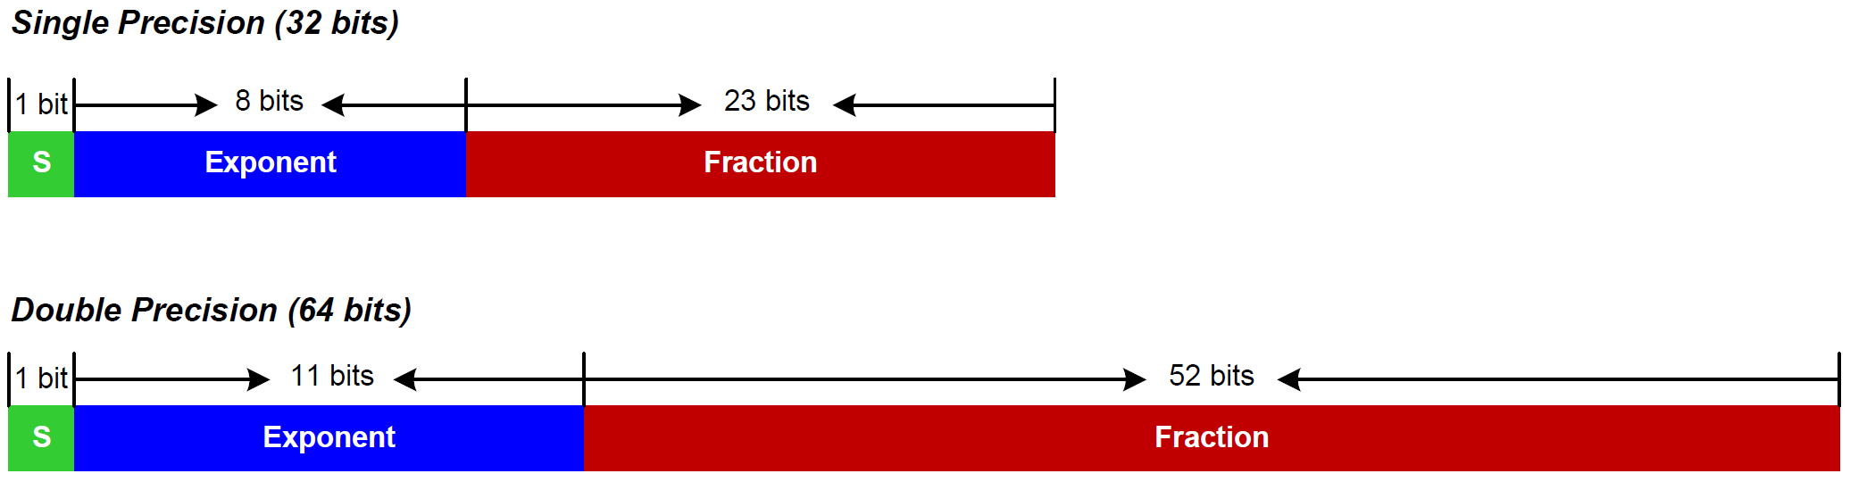
IEEE Std 754
IEEE 754 value:
$${(−1)}^{S}×(1+Fraction)×2^{Exponent−Bias}$$
where Bias = 127 for single precision
Bias = 1023 for double precision

Slide 19
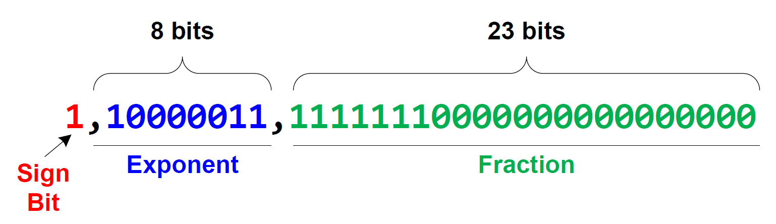
Decoding 0xC1FF0000 into a floating-point number
0.9921875
$$f={\left(−1\right)}^{S}×\left(1+Fraction\right)×2^{Exponent−127} \\ ={\left(−1\right)}^{1}×\left(1+0.9921875\right)×2^{131−127} \\ =−1×1.9921875×2^{4} \\ =−31.875$$

Slide 20
Encoding 14.5 into IEEE Std 754 Single-Precision
Normalization:
$$14.5=1.8125×2^{3}$$
$$=(1+0.8125)×2^{3}$$
$Sign=0$
$Exponent=3+127=130={1000010}_{2}$
$Fraction={0.1101}_{2}$
$0.8125×2=1.625=1+0.625$
$0.625×2=1.25=1+0.25$
$0.25×2=0.5=0+0.5$
$0.5×2=1$
14.5 = 01000001011010000000000000000000 in binary or 0x41680000 in hex

Slide 21
Single-precision comparisons
VCMP.F32 Sd, <Sm | #0.0> | Compare two floating-point registers, or one floating-point register and zero
VCMPE.F32 Sd, <Sm | #0.0> | Compare two floating-point registers, or one floating-point register and zero, and raise exception for a signaling NaN
C Program | Assembly Program
float max(float a, float b){ if (a > b) return a; else return b; } | max_of_two PROC VCMPE.F32 s0, s1 ; Copy NZCV flags to APSR VMRS APSR_nzcv, FPSCR BGT exit VMOV.F32 s0, s1 exit BX LR ENDP

Slide 22
Lab Components
GPIO Input, Output, Alternative Function
Push pull, open drain, pull up, pull down
Timer Configuration (PSC, ARR, CCR)
Compare output
Input capture
PWM output: Duty Ratio
Trigger
System Timer
Processor clock
External clock: Processor clock/8
ADC & DAC
Successive-approximation (SAR) ADC
Resolution, Speed
Step motors
Full stepping, half stepping
LCD
How to reduce the number I/O pins used for LCD?
Bias and duty ratio

Slide 23
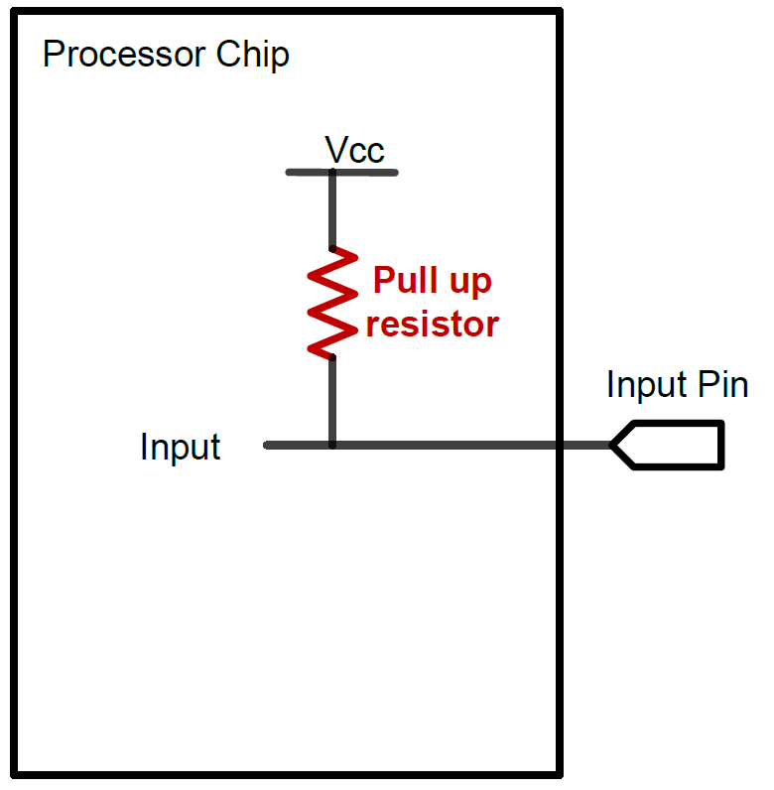
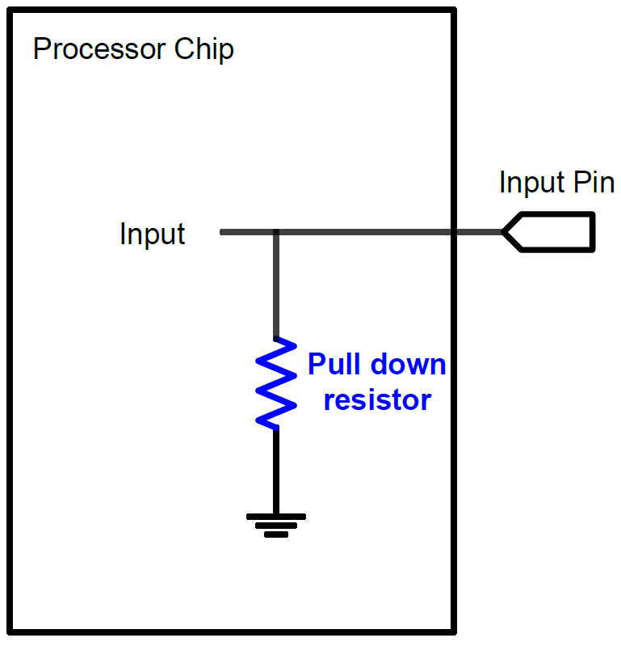
GPIO Input: Pull Up and Pull Down
A digital input can have three states: High, Low, and High-Impedance (also called floating, tri-stated, HiZ)
Pull-Up
Pull-Down
If external input is HiZ, the input is read as a valid HIGH.
If external input is HiZ, the input is read as a valid LOW.

Slide 24
GPIO Output Modes: Push-Pull and Open-Drain
Push-Pull
If 0, connect to ground
If 1, connect to Vcc

Slide 25
GPIO Output Modes: Push-Pull and Open-Drain
Open-Drain
If 0, connect to ground
If 1, connect to Vcc

Slide 26
Timer’s Clock
Reload Value
TIMx_ARR
Reload
f_{CL_PSC}
f_{CL_CNT}
TIMx_CNT
TIMx_PSC
ISR
Resume
Interrupt
clock
Prescaler
Current Count
$$f_{CK_CNT}=\frac{f_{CL_PSC}}{Prescaler+1}$$

Slide 27
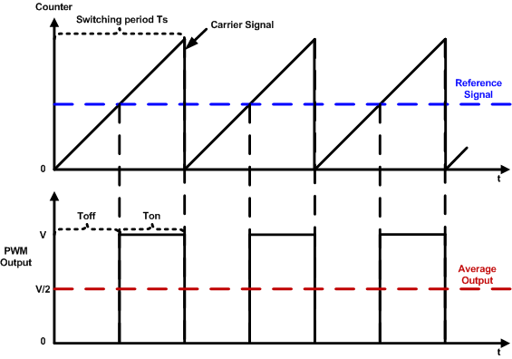
PWM Duty Cycle = Ton/Time Period
$$duty cycle=\frac{pulse on time}{pulse switching period}×100\%=\frac{T_{on}}{T_{s}}×100\%$$

Slide 28
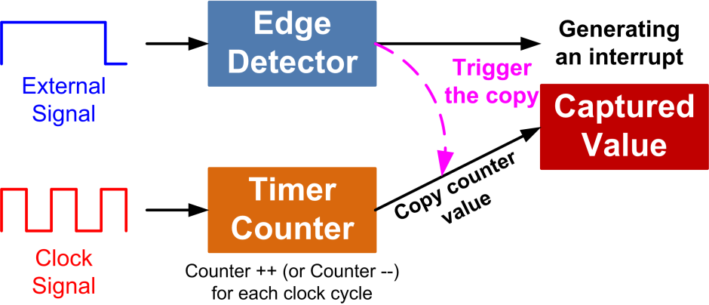
Input Capture

Slide 29
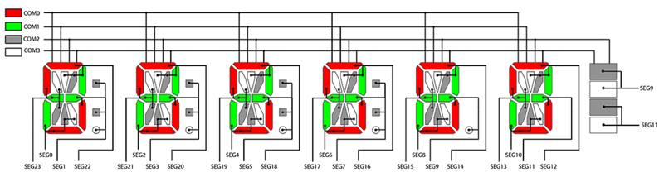
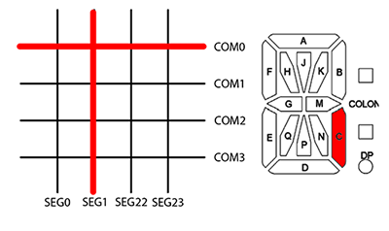
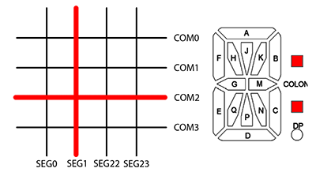
STM32L1/STM32L4 Discovery Kit LCD Module
from https://habrahabr.ru/post/173709/

Slide 30
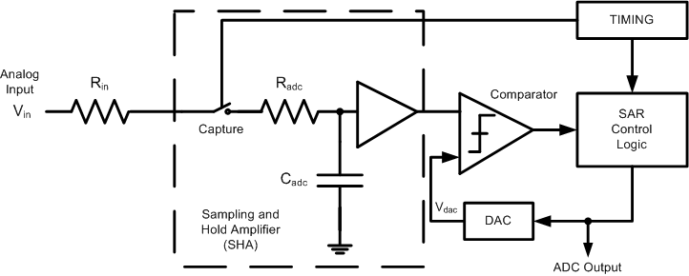
Successive-approximation (SAR) ADC

Slide 31
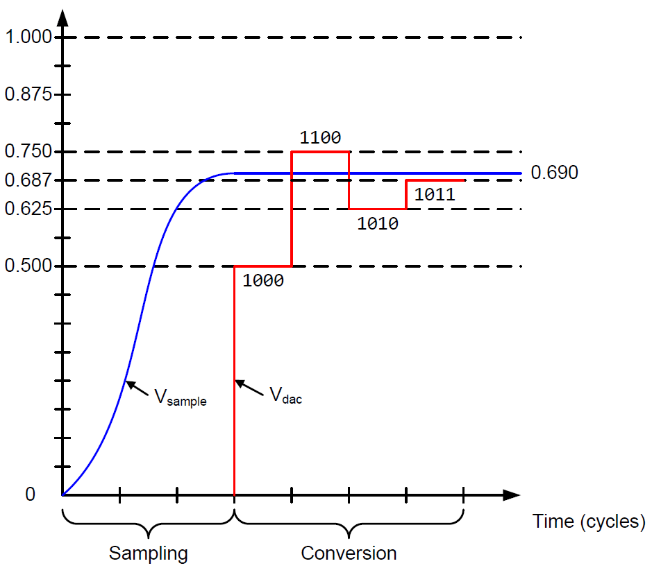
Successive-approximation (SAR) ADC
Binary search algorithm to gradually approaches the input voltage
Settle into ±½ LSB bound within the time allowed
$$T_{ADC}=T_{sampling}+T_{Conversion}$$
$$T_{Conversion}=N×T_{ADC_Clock}$$
$$T_{sampling}$$
is software configurable

Slide 32
Basic DAC Architecture
$$V_{out}=V_{ref}×\frac{R_{ref}}{R}×(D_{3}×2^{3}+ D_{2}×2^{2}+ D_{1}×2+ D_{0})$$

