Slide 1
Z. Gu
Embedded Systems with ARM Cortex-M Microcontrollers in Assembly Language and C
Chapter 11
Interrupt
Fall 2026
Acknowledgement: Lecture slides based on Embedded Systems with ARM Cortex-M Microcontrollers in Assembly Language and C, University of Maine https://web.eece.maine.edu/~zhu/book/

Slide 2
Polling vs Interrupt
Interrupt-driven operations
  Allows CPU to perform other tasks until external/internal devices require service
  CPU stops the current code and starts to execute an ISR
Polling | Interrupt
Software periodically checks | CPU takes action only if an event occurs
Wastes a lot of CPU cycles | Does not waste CPU cycles
Triggered by software | Triggered by hardware or software
Occurs periodically | Can occur any time

Slide 3

Interrupts
Motivations
  Inform a program of some external events timely
  Implement multi-tasking with priority support
// Polling
while (1) {
read_button_input;
if (pushed)
exit;
}
turn_on_LED;
Suppose you are waiting for an important phone call.
Polling:
You pick up the phone every three seconds to check whether you are getting a call.
Interrupt:
Do whatever you should do and pick up the phone when it rings.
// Interrupt
interrupt_handler(){
turn_on_LED;
exit;
}

Slide 4
Example: Push a button to turn on a LED
Check whether a button has been pressed?
Polling
  Repeatedly read IDR and check whether bit 3 is set (i.e., busy wait)
  OK if CPU has nothing else to do
Interrupt
  When hardware detects a rising or falling edge, hardware generates a service request
  CPU responds to the service request and starts to execute the corresponding service subroutine
Voltage on PA.3

Slide 5
Polling vs Interrupt
Interrupt-driven operations
  Allows CPU to perform other tasks until external/internal devices require service
  CPU automatically stops the current code and starts to execute an ISR
device
CPU
Busy
main()
interrupt
request
Ready
ISR()
time

Slide 6
How to support interrupt?
Edge Detector
ARM Cortex-M
Interrupt Controller
Interrupt Request
Execution
Core
Interrupt Request
Flash
Stop the current code
Service the interrupt request (i.e. turn on the LED)
Resume the previous code
ISR
ISR: Interrupt Service Routine
Microcontroller Chip

Slide 7
How to support interrupt?
Edge Detector
ARM Cortex-M
Interrupt Controller
Interrupt Request
Execution
Core
Interrupt Request
UART
Coordinates multiple interrupt sources
Enable and disable a specific interrupt
Which one service first (interrupt priority)
How to locate the corresponding ISR?
How to resume the code that has been suspended?
Microcontroller Chip

Slide 8
How to support interrupt?
Edge Detector
ARM Cortex-M
NVIC
Interrupt Request
Execution
Core
Interrupt Request
Nested Vectored Interrupt Controller
UART
Coordinates multiple interrupt sources
Enable and disable a specific interrupt
Which one service first (interrupt priority)
How to locate the corresponding ISR?
How to resume the code that has been suspended?
Microcontroller Chip
Notes:
(NVIC: Nested Vectored Interrupt Controller)

Slide 9
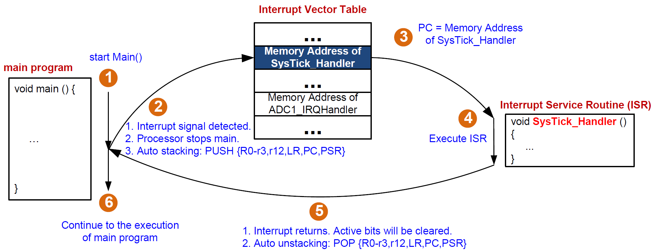
Interrupt

Slide 10
Interrupt Service Routine Vector Table
Start address for the exception handler for each exception type is fixed and pre-defined
Processor loads PC with this fixed, pre-defined address
Exception Vector Table typically starts at memory address 0x00000000 (or relocated depending on Vector Table Offset Register (VTOR))
Program Counter pc = mem[0x00000004] initially
Address | Priority | Type of priority | Acronym | Description
0x0000_0000 | - | - | - | Stack Pointer
0x0000_0004 | -3 | fixed | Reset | Reset Vector
0x0000_0008 | -2 | fixed | NMI_Handler | Non maskable interrupt. The RCC Clock Security System (CSS) is linked to the NMI vector.
0x0000_000C | -1 | fixed | HardFault_Handler | All class of fault
0x0000_0010 | 0 | settable | MemManage_Handler | Memory management
0x0000_0014 | 1 | settable | BusFault_Handler | Pre-fetch fault, memory access fault
0x0000_0018 | 2 | settable | UsageFault_Handler | Undefined instruction or illegal state
0x0000_001C-0x0000_002B | - | - | - | Reserved
0x0000_002C | 3 | settable | SVC_Handler | System service call via SVC instruction
0x0000_0030 | 4 | settable | DebugMon_Handler | Debug Monitor
0x0000_0034 | - | - | - | Reserved
0x0000_0038 | 5 | settable | PendSV_Handler | Pendable request for system service
0x0000_003C | 6 | settable | SysTick_Handler | System tick timer
…

Slide 11
ISR Vector Table
For CMSIS interrupt number n (as in the figure):
Cortex Microcontroller Software Interface Standard (CMSIS). Interrupt Number in xPSR = 16 + n

Slide 12
Automatic Stacking & Unstacking
Interrupt
Exit
Interrupt Handler
Interrupt
Signal
Unstacking
User Program
User Program
Stacking
Time
Thread Mode
Handler Mode
Thread Mode
Stacking: hardware automatically pushes eight registers into the stack
(xPSR,PC,LR,r12,r3,r2,r1,r0)
(additional registers if Floating Point unit is active)
Unstacking: hardware automatically pops these eight registers off the stack

Slide 13
Automatic Stacking & Unstacking
Full descending stack
Old SP
SP + 0x20 | xxxxxxxx
SP + 0x1C | xPSR
SP + 0x18 | PC (r15)
SP + 0x14 | LR (r14)
SP + 0x10 | r12
SP + 0x0C | r3
SP + 0x08 | r2
SP + 0x04 | r1
SP | r0
New SP
Stacking
Unstacking
New SP
Old SP

Slide 14
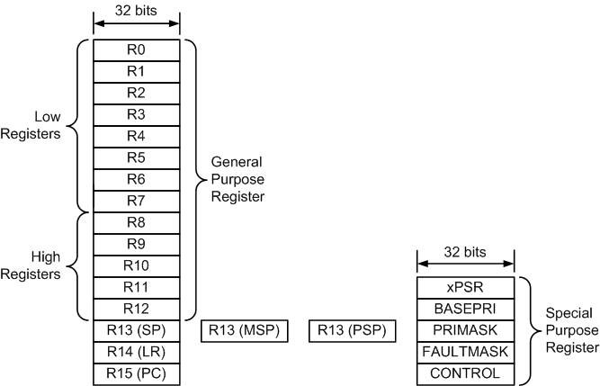
Stack Pointer: MSP vs PSP
For interrupts, which stack does auto stacking/unstacking use?
Depends on
processor mode: thread vs handler
setting in the control register
MSP: Main Stack Pointer (selected at reset)
PSP: Process Stack Pointer
R13 (SP) refers to whichever SP is active, either MSP or PSP
Notes:
indicate “hardware saves these automatically” vs “software saves rest if needed.”

Slide 15
Control Register
31 - 3 | 2 | 1 | 0
Reserved | FPCA | SPSEL | nPRIV
0: FP inactive (default)
1: FP active
By default, MSP is used.
0: SP = MSP (default)
1: SP = PSP if in Thread Mode
0: Thread mode has privileged access (default)
1: Thread mode has unprivileged access
 | SP | Privileged
Handler Mode | SP = MSP and SPSEL = 0 | Privileged
Thread Mode | Depending on SPSEL | Depending on nPRIV
For simple applications, MSP is used.
Notes:
Software can use the MRS instruction to read the register, and the MSR instruction to write to the register.

Slide 16
Automatic Stacking & Unstacking
Old SP
SP + 0x20 | xxxxxxxx
SP + 0x1C | xPSR
SP + 0x18 | PC (r15)
SP + 0x14 | LR (r14)
SP + 0x10 | r12
SP + 0x0C | r3
SP + 0x08 | r2
SP + 0x04 | r1
SP + 0x00 | r0
Stacking: The processor automatically pushes these eight registers into the currently selected stack before ISR
starts
Unstacking: The processor automatically pops these eight registers out of the currently selected stack when an interrupt handler exits.
Full Descending Stack
New SP

Slide 17
MSP vs PSP
Handler Mode
How does the processor know which stack was selected?
SPSEL = 0
MSP is used.
Use LR to indicate
Auto stacking by using currently selected stack
Start to execute ISR
Exit ISR
Auto unstacking by using currently selected stack
Thread Mode
Start of main()
SPSEL = 0
MSP is used.
SPSEL = 1
PSP is used.

Slide 18
Recall: Link Register for calling functions
void foo(void) ;
int main(void){
● ● ●
foo();
● ● ●
}
void foo (void) {
● ● ●
● ● ●
return;
}
Transfer control to callee
Resume suspended caller
Compiler
LR = PC + 4
PC = foo
● ● ●
BL foo
● ● ●
PC
foo PROC
● ● ●
● ● ●
BX LR
ENDP
PC + 4

Slide 19
Which stack to use when an interrupt returns?
When an interrupt (ISR) occurs on an ARM Cortex-M core:
  The CPU automatically saves (stacks) part of the current context — registers R0-R3, R12, LR, PC, and xPSR — to the stack.
  It then loads the ISR’s address into PC, and sets LR to a special EXC_RETURN value — not a normal function return address.
Link Register (LR) now has two usages:
  For subroutine calls: LR holds the return address (the instruction after BL).
  For interrupts: LR holds EXC_RETURN value indicating how to restore context when exiting the interrupt. The CPU recognizes this special pattern (bits [31:28] = 0xF) and performs an exception return sequence rather than a regular branch. It returns to the original PC before the interrupt occurred.
    Thread mode: Normal program execution; Handler mode: ISR execution.
    If an interrupt occurs while already in Handler mode (nested interrupt), LR is set to a different EXC_RETURN value (0xFFFFFFF1) to indicate that the CPU should return to Handler mode when that ISR completes.
EXC_RETURN value | Meaning
0xFFFFFFF1 | Return to Handler mode, using MSP (for nested interrupts)
0xFFFFFFF9 | Return to Thread mode, using MSP
0xFFFFFFFD | Return to Thread mode, using PSP
Notes:
When an interrupt (ISR) occurs on an ARM Cortex-M core:
The CPU automatically stacks registers R0–R3, R12, LR, PC, and xPSR.
It then loads the ISR’s address into PC, and sets LR to a special EXC_RETURN value (not a normal return address).
EXC_RETURN encodes how the CPU should return from the interrupt — whether to Thread mode or Handler mode, and which stack pointer (MSP or PSP) to use.
The Link Register (LR) therefore serves two purposes:
In normal subroutine calls: LR holds the return address (the instruction after BL).
In interrupts: LR holds the EXC_RETURN code, indicating how to restore context when exiting the interrupt.
The CPU recognizes this special pattern (bits [31:28] = 0xF) and performs an exception return sequence rather than a normal branch, restoring the stacked registers and resuming at the original PC.
Thread mode = normal program execution; Handler mode = interrupt or exception execution.

Slide 20
Stacking & Unstacking
Assume SPSEL = 0 and no FP is used ⟹ User program uses MSP.
xPSR,PC,LR,R12,R3,R2,R1,R0
Interrupt
Exit
Interrupt Handler
Interrupt
Signal
Unstacking
from MSP
User Program
User Program
Stacking
onto MSP
Time
Thread Mode
Handler Mode
Thread Mode
MSP
MSP
MSP
LR = Some Value
LR = 0xFFFFFFF9
LR is recovered to old value

Slide 21
Stacking & Unstacking
Assume SPSEL = 1 and no FP is used ⟹ User program uses PSP.
xPSR,PC,LR,R12,R3,R2,R1,R0
Interrupt
Exit
ISR
Interrupt
Signal
Unstacking
from PSP
User Program
User Program
Stacking
onto PSP
Time
Thread Mode
Handler Mode
Thread Mode
PSP
MSP
PSP
LR = Some Value
LR = 0xFFFFFFFD
LR is recovered to old value
Notes:
If the ISR calls push or pop, the MSP is used.

Slide 22
An example to illustrate stacking and unstacking
(assuming MSP is used by the main program)

Slide 23
Interrupt: Stacking & Unstacking
__main PROC
…
MOV r3,#0
…
ENDP
SysTick_Handler PROC
EXPORT SysTick_Handler
ADD r4, #1
BL sine
BX lr
ENDP
R0
0
xxxxxxxx
0x20000200
addr = 0x08000044
R1
1
0x200001FC
R2
2
0x200001F8
R3
3
0x200001F4
addr = 0x0800001C
R4
4
0x200001F0
R12
12
0x200001EC
R13(SP)
MSP
0x200001E8
0x0800001C
R14(LR)
0x08001000
0x200001E4
0x08000020
R15(PC)
0x08000044
0x200001E0
0x08000024
0x200001DC
xPSR
0x21000000
0x200001D8
MSP
0x20000200
0x200001D4
0x200001D0
PSP
0x00000000
0x200001CC
Memory

Slide 24
Interrupt: Stacking & Unstacking
__main PROC
…
MOV r3,#0
…
ENDP
SysTick_Handler PROC
EXPORT SysTick_Handler
ADD r3, #1
ADD r4, #1
BX lr
ENDP
R0
0
xxxxxxxx
0x20000200
addr = 0x08000044
R1
1
0x200001FC
R2
2
0x200001F8
R3
3
0x200001F4
addr = 0x0800001C
R4
4
0x200001F0
R12
12
0x200001EC
R13(SP)
MSP
0x200001E8
R14(LR)
0x08001000
0x200001E4
R15(PC)
0x08000044
0x200001E0
0x200001DC
xPSR
0x21000000
0x200001D8
MSP
0x20000200
0x200001D4
0x200001D0
PSP
0x00000000
0x200001CC
Memory

Slide 25
Interrupt: Stacking & Unstacking
Suppose SysTick interrupt occurs when PC = 0x08000044
__main PROC
…
MOV r3,#0
…
ENDP
SysTick_Handler PROC
EXPORT SysTick_Handler
ADD r3, #1
ADD r4, #1
BX lr
ENDP
R0
0
xxxxxxxx
0x20000200
addr = 0x08000044
R1
1
0x200001FC
R2
2
0x200001F8
R3
3
0x200001F4
addr = 0x0800001C
R4
4
0x200001F0
R12
12
0x200001EC
R13(SP)
MSP
0x200001E8
R14(LR)
0x08001000
0x200001E4
R15(PC)
0x08000044
0x200001E0
0x200001DC
xPSR
0x21000000
0x200001D8
MSP
0x20000200
0x200001D4
0x200001D0
PSP
0x00000000
0x200001CC
Memory

Slide 26
Interrupt: Stacking & Unstacking
STACKING
__main PROC
…
MOV r3,#0
…
ENDP
SysTick_Handler PROC
EXPORT SysTick_Handler
ADD r3, #1
ADD r4, #1
BX lr
ENDP
R0
0
xxxxxxxx
0x20000200
addr = 0x08000044
R1
1
xPSR
0x21000000
0x200001FC
R2
2
PC
0x08000044
0x200001F8
R3
3
LR
0x08001000
0x200001F4
addr = 0x0800001C
R4
4
R12
12
0x200001F0
R12
12
R3
3
0x200001EC
R13(SP)
MSP
R2
2
0x200001E8
R14(LR)
0xFFFFFFF9
R1
1
0x200001E4
R15(PC)
0x0800001C
R0
0
0x200001E0
0x200001DC
xPSR
0x21000000
0x200001D8
MSP
0x200001E0
0x200001D4
0x200001D0
PSP
0x00000000
0x200001CC
Memory

Slide 27
Interrupt: Stacking & Unstacking
STACKING
__main PROC
…
MOV r3,#0
…
ENDP
SysTick_Handler PROC
EXPORT SysTick_Handler
ADD r3, #1
ADD r4, #1
BX lr
ENDP
R0
0
xxxxxxxx
0x20000200
addr = 0x08000044
R1
1
xPSR
0x21000000
0x200001FC
R2
2
PC
0x08000044
0x200001F8
R3
3
LR
0x08001000
0x200001F4
addr = 0x0800001C
R4
4
R12
12
0x200001F0
R12
12
R3
3
0x200001EC
R13(SP)
MSP
R2
2
0x200001E8
R14(LR)
0xFFFFFFF9
R1
1
0x200001E4
R15(PC)
0x0800001C
R0
0
0x200001E0
0x200001DC
xPSR
0x21000000
0x200001D8
MSP
0x200001E0
0x200001D4
LR = 0xFFFFFFF9 to indicate MSP is used.
0x200001D0
PSP
0x00000000
0x200001CC
Memory

Slide 28
Interrupt: Stacking & Unstacking
__main PROC
…
MOV r3,#0
…
ENDP
SysTick_Handler PROC
EXPORT SysTick_Handler
ADD r3, #1
ADD r4, #1
BX lr
ENDP
R0
0
xxxxxxxx
0x20000200
addr = 0x08000044
R1
1
xPSR
0x21000000
0x200001FC
R2
2
PC
0x08000044
0x200001F8
R3
4
LR
0x08001000
0x200001F4
addr = 0x0800001C
R4
4
R12
12
0x200001F0
R12
12
R3
3
0x200001EC
R13(SP)
MSP
R2
2
0x200001E8
R14(LR)
0xFFFFFFF9
R1
1
0x200001E4
R15(PC)
0x0800001C
R0
0
0x200001E0
0x200001DC
xPSR
0x21000000
0x200001D8
MSP
0x200001E0
0x200001D4
0x200001D0
PSP
0x00000000
0x200001CC
Memory

Slide 29
Interrupt: Stacking & Unstacking
__main PROC
…
MOV r3,#0
…
ENDP
SysTick_Handler PROC
EXPORT SysTick_Handler
ADD r3, #1
ADD r4, #1
BX lr
ENDP
R0
0
xxxxxxxx
0x20000200
addr = 0x08000044
R1
1
xPSR
0x21000000
0x200001FC
R2
2
PC
0x08000044
0x200001F8
R3
4
LR
0x08001000
0x200001F4
addr = 0x0800001C
R4
5
R12
12
0x200001F0
R12
12
R3
3
0x200001EC
R13(SP)
MSP
R2
2
0x200001E8
R14(LR)
0xFFFFFFF9
R1
1
0x200001E4
R15(PC)
0x08000020
R0
0
0x200001E0
0x200001DC
xPSR
0x21000000
0x200001D8
MSP
0x200001E0
0x200001D4
0x200001D0
PSP
0x00000000
0x200001CC
Memory

Slide 30
Interrupt: Stacking & Unstacking
__main PROC
…
MOV r3,#0
…
ENDP
SysTick_Handler PROC
EXPORT SysTick_Handler
ADD r3, #1
ADD r4, #1
BX lr
ENDP
R0
0
xxxxxxxx
0x20000200
addr = 0x08000044
R1
1
xPSR
0x21000000
0x200001FC
R2
2
PC
0x08000044
0x200001F8
R3
4
LR
0x08001000
0x200001F4
addr = 0x0800001C
R4
5
R12
12
0x200001F0
R12
12
R3
3
0x200001EC
R13(SP)
MSP
R2
2
0x200001E8
R14(LR)
0xFFFFFFF9
R1
1
0x200001E4
R15(PC)
0x08000024
R0
0
0x200001E0
0x200001DC
xPSR
0x21000000
0x200001D8
MSP
0x200001E0
0x200001D4
LR = 0xFFFFFFF9 to indicate MSP is used.
0x200001D0
PSP
0x00000000
0x200001CC
Memory

Slide 31
Interrupt: Stacking & Unstacking
UNSTACKING
__main PROC
…
MOV r3,#0
…
ENDP
SysTick_Handler PROC
EXPORT SysTick_Handler
ADD r3, #1
ADD r4, #1
BX lr
ENDP
R0
0
xxxxxxxx
0x20000200
addr = 0x08000044
R1
1
xPSR
0x21000000
0x200001FC
R2
2
PC
0x08000044
0x200001F8
R3
4
LR
0x08001000
0x200001F4
addr = 0x0800001C
R4
5
R12
12
0x200001F0
R12
12
R3
3
0x200001EC
R13(SP)
MSP
R2
2
0x200001E8
R14(LR)
0xFFFFFFF9
R1
1
0x200001E4
R15(PC)
0x08000024
R0
0
0x200001E0
0x200001DC
xPSR
0x21000000
0x200001D8
MSP
0x200001E0
0x200001D4
LR = 0xFFFFFFF9 to indicate MSP is used.
0x200001D0
PSP
0x00000000
0x200001CC
Memory

Slide 32
Interrupt: Stacking & Unstacking
UNSTACKING
__main PROC
…
MOV r3,#0
…
ENDP
SysTick_Handler PROC
EXPORT SysTick_Handler
ADD r3, #1
ADD r4, #1
BX lr
ENDP
R0
0
xxxxxxxx
0x20000200
addr = 0x08000044
R1
1
0x200001FC
R2
2
0x200001F8
R3
3
0x200001F4
addr = 0x0800001C
R4
5
0x200001F0
R12
12
0x200001EC
R13(SP)
MSP
0x200001E8
R14(LR)
0x08001000
0x200001E4
R15(PC)
0x08000044
0x200001E0
0x200001DC
xPSR
0x21000000
0x200001D8
MSP
0x20000200
0x200001D4
Note the new value of R3 is lost!!!
0x200001D0
PSP
0x00000000
0x200001CC
Memory

Slide 33
Interrupt: Stacking & Unstacking
__main PROC
…
MOV r3,#0
…
ENDP
SysTick_Handler PROC
EXPORT SysTick_Handler
ADD r3, #1
ADD r4, #1
BX lr
ENDP
R0
0
xxxxxxxx
0x20000200
addr = 0x08000044
R1
1
0x200001FC
R2
2
0x200001F8
R3
3
0x200001F4
addr = 0x0800001C
R4
5
0x200001F0
R12
12
0x200001EC
R13(SP)
MSP
0x200001E8
R14(LR)
0x08001000
0x200001E4
R15(PC)
0x08000044
0x200001E0
0x200001DC
xPSR
0x21000000
0x200001D8
MSP
0x20000200
0x200001D4
The Main program resumes!!!
0x200001D0
PSP
0x00000000
0x200001CC
Memory

Slide 34
Explanations
The value of R3 updated in ISR is lost because during the interrupt unstacking (return from interrupt), the processor restores R3 (and other registers) from the stack — overwriting whatever changes were made to R3 inside ISR.
1. Before the interrupt (in main)
  The main program is about to execute MOV r3, #0 (R3 = 3 at this moment)
2. Interrupt occurs (SysTick_Handler)
  The processor automatically pushes (stacks) certain registers onto the stack: xPSR,PC,LR,R12,R3,R2,R1,R0
3. Inside ISR
  R3 = 3+1 = 4, R4 = 4+1 = 5 — but R3 is stacked, so its new value is lost on return, whereas R4 is not stacked, so its new value (5) persists
4. Returning from interrupt (unstacking)
  When BX lr executes with LR = 0xFFFFFFF9, the CPU knows: “Return to Thread mode using MSP.” It then automatically pops (unstacks) the previously saved registers. This restores the pre-interrupt state:R3 ← (the saved value from the stack, which was 3 before the interrupt); R4 remains 5 (not part of automatic stacking/unstacking); PC ← 0x08000044 (returns to main); xPSR restored.
Step | Action | Effect on R3
Before interrupt | R3 = 3 in main | —
Interrupt entry | R3 = 3 stacked | Saved on MSP
ISR executes | R3 = 4 (incremented) | Temporary
ISR returns | R3 restored from stack | R3 = 3 again

Slide 35
Nested Subroutines: Solution #1
Review
foo saves and restores its LR for returning to its caller, before calling bar.
Caller Program | Subroutine foo | Subroutine bar
MOV r4, #100 ... BL foo ... ADD r4, r4, #1 | foo PROC PUSH {r4, LR} ... MOV r4, #10 ... BL bar ... POP {r4, LR} BX LR ENDP | bar PROC ... BX LR ENDP

Slide 36
Nested Subroutines: Solution #2
Review
POP {r4, PC} is equivalent to POP {r4, LR} followed by BX LR.
Caller Program | Subroutine foo | Subroutine bar
MOV r4, #100 ... BL foo ... ADD r4, r4, #1 | foo PROC PUSH {r4, LR} ... MOV r4, #10 ... BL bar ... POP {r4, PC} BX LR ENDP | bar PROC ... BX LR ENDP

Slide 37
An example where an ISR calls a subroutine, similar to the nested subroutines example

Slide 38
Interrupt: Stacking & Unstacking
STACKING
__main PROC
…
MOV r3,#0
…
ENDP
SysTick_Handler PROC
EXPORT SysTick_Handler
ADD r4, #1
BL sine
BX lr
ENDP
R0
0
xxxxxxxx
0x20000200
addr = 0x08000044
R1
1
xPSR
0x21000000
0x200001FC
R2
2
PC
0x08000044
0x200001F8
R3
3
LR
0x08001000
0x200001F4
addr = 0x0800001C
R4
4
R12
12
0x200001F0
R12
12
R3
3
0x200001EC
R13(SP)
MSP
R2
2
0x200001E8
0x0800001C
R14(LR)
0xFFFFFFF9
R1
1
0x200001E4
0x08000020
R15(PC)
0x0800001C
R0
0
0x200001E0
0x08000024
0x200001DC
xPSR
0x21000000
0x200001D8
MSP
0x200001E0
0x200001D4
LR = 0xFFFFFFF9 to indicate MSP is used.
0x200001D0
PSP
0x00000000
0x200001CC
Memory

Slide 39
Interrupt: Stacking & Unstacking
__main PROC
…
MOV r3,#0
…
ENDP
SysTick_Handler PROC
EXPORT SysTick_Handler
ADD r4, #1
BL sine
BX lr
ENDP
R0
0
xxxxxxxx
0x20000200
addr = 0x08000044
R1
1
xPSR
0x21000000
0x200001FC
R2
2
PC
0x08000044
0x200001F8
R3
3
LR
0x08001000
0x200001F4
addr = 0x0800001C
R4
5
R12
12
0x200001F0
R12
12
R3
3
0x200001EC
R13(SP)
MSP
R2
2
0x200001E8
0x0800001C
R14(LR)
0xFFFFFFF9
R1
1
0x200001E4
0x08000020
R15(PC)
0x08000020
R0
0
0x200001E0
0x08000024
0x200001DC
xPSR
0x21000000
0x200001D8
MSP
0x200001E0
0x200001D4
LR = 0xFFFFFFF9 to indicate MSP is used.
0x200001D0
PSP
0x00000000
0x200001CC
Memory

Slide 40
Interrupt: Stacking & Unstacking
__main PROC
…
MOV r3,#0
…
ENDP
SysTick_Handler PROC
EXPORT SysTick_Handler
ADD r4, #1
BL sine
BX lr
ENDP
R0
0
xxxxxxxx
0x20000200
addr = 0x08000044
R1
1
xPSR
0x21000000
0x200001FC
R2
2
PC
0x08000044
0x200001F8
R3
3
LR
0x08001000
0x200001F4
addr = 0x0800001C
R4
4
R12
12
0x200001F0
R12
12
R3
3
0x200001EC
R13(SP)
MSP
R2
2
0x200001E8
0x0800001C
R14(LR)
0x08000024
R1
1
0x200001E4
0x08000020
R15(PC)
0x080000F0
R0
0
0x200001E0
0x08000024
0x200001DC
xPSR
0x21000000
0x200001D8
MSP
0x200001E0
0x200001D4
BL sine
Updates LR
0x200001D0
PSP
0x00000000
0x200001CC
Memory
Assume sine() is located at 0x080000F0.

Slide 41
Interrupt: Stacking & Unstacking
__main PROC
…
MOV r3,#0
…
ENDP
SysTick_Handler PROC
EXPORT SysTick_Handler
ADD r4, #1
BL sine
BX lr
ENDP
R0
0
xxxxxxxx
0x20000200
addr = 0x08000044
R1
1
xPSR
0x21000000
0x200001FC
R2
2
PC
0x08000044
0x200001F8
R3
3
LR
0x08001000
0x200001F4
addr = 0x0800001C
R4
4
R12
12
0x200001F0
R12
12
R3
3
0x200001EC
R13(SP)
MSP
R2
2
0x200001E8
0x0800001C
R14(LR)
0x08000024
R1
1
0x200001E4
0x08000020
R15(PC)
0x080000F0
R0
0
0x200001E0
0x08000024
0x200001DC
xPSR
0x21000000
0x200001D8
MSP
0x200001E0
0x200001D4
BL sine
Updates LR
0x200001D0
PSP
0x00000000
0x200001CC
Memory

Slide 42
Interrupt: Stacking & Unstacking
UNSTACKING won’t occur!
__main PROC
…
MOV r3,#0
…
ENDP
SysTick_Handler PROC
EXPORT SysTick_Handler
ADD r4, #1
BL sine
BX lr
ENDP
R0
0
xxxxxxxx
0x20000200
addr = 0x08000044
R1
1
xPSR
0x21000000
0x200001FC
R2
2
PC
0x08000044
0x200001F8
R3
3
LR
0x08001000
0x200001F4
addr = 0x0800001C
R4
4
R12
12
0x200001F0
R12
12
R3
3
0x200001EC
R13(SP)
MSP
R2
2
0x200001E8
0x0800001C
R14(LR)
0x08000024
R1
1
0x200001E4
0x08000020
R15(PC)
0x080000F0
R0
0
0x200001E0
0x08000024
0x200001DC
xPSR
0x21000000
0x200001D8
MSP
0x200001E0
0x200001D4
BL sine
Updates LR
0x200001D0
PSP
0x00000000
0x200001CC
Memory

Slide 43
Fixing the Bug
LR has two different usages for function calls and for interrupts.
After calling function sine(), LR points to the return address 0x08000024; the previous value of 0xFFFFFFF9 is overwritten and lost.
Fix the bug:
  Method 1: PUSH{lr}/POP{lr} in the function to save and restore the original LR value of 0xFFFFFFF9
  Method 2: PUSH{lr}/POP{PC}
    POP {PC} is equivalent to POP {lr} followed by BX lr
__main PROC
…
MOV r3,#0
…
ENDP
SysTick_Handler PROC
EXPORT SysTick_Handler
PUSH {lr}
ADD r4, #1
BL sine
POP {lr}
BX lr
ENDP
__main PROC
…
MOV r3,#0
…
ENDP
SysTick_Handler PROC
EXPORT SysTick_Handler
PUSH {lr}
ADD r4, #1
BL sine
POP {PC}
ENDP
Method 1
Method 2

Slide 44
Enable an Interrupt
Peripheral
Interrupt Request
ARM Cortex-M
NVIC
Interrupt Request
Execution
Core
Two steps:
Program the peripheral control register to allow it to generate interrupts
Program NVIC to allow it to accept interrupts
Nested Vectored Interrupt Controller

Slide 45
Enable an Interrupt
Peripheral
Interrupt Request
ARM Cortex-M
NVIC
Interrupt Request
Execution
Core
Two steps:
Program the peripheral control register to allow it to generate interrupts
Program NVIC to allow it to accept interrupts
Nested Vectored Interrupt Controller
How?

Slide 46
Interrupt Number in PSR
Application PSR (APSR), Interrupt PSR (IPSR), Execution PSR (EPSR)
31
30
29
28
27
26
25
24
23
22
21
20
19
18
17
16
15
14
13
12
11
10
9
8
7
6
5
4
3
2
1
0
APSR
N
Z
C
V
Q
Reserved
GE
Reserved
IPSR
Reserved
ISR number
EPSR
ICI/IT
T
Reserved
ICI/IT
Combine them together into one register (PSR = APSR | IPSR | EPSR (“|” stands for bitwise OR))
PSR
N
Z
C
V
Q
ICI/IT
T
Reserved
GE
Reserved
ICI/IT
ISR number
8-bit interrupt number in PSR
Range: 0 - 255

Slide 47
Interrupt Number in CMSIS vs in PSR
Cortex-M supports up to 256 interrupts.
  Interrupt numbers -16 to -1 denote system exceptions, as defined by ARM CMSIS (Cortex Microcontroller Software Interface Standard);
  Interrupt numbers 0-239 denote peripheral interrupts, as defined by chip manufacturers
Interrupt Number in PSR = 16 + Interrupt Number for CMSIS
System
Exceptions
Peripheral
Interrupts
interrupt
number
-16
-1
0
239
Interrupt Numbers defined by ARM CMSIS or chip manufacturers
System
Exceptions
Peripheral
Interrupts
0
15
16
255
Interrupt Numbers in PSR
Notes:
Interrupt number defined in ARM software library
First 16 are system exceptions
CMSIS defines their interrupt numbers as negative
Defined by ARM core
The rest 240 are peripheral interrupts
Peripheral interrupt number starts with 0.
Defined by chip manufacturers.
{{Pause=2}} A Cortex M microcontroller supports up to 256 interrupts. Each interrupt, except the interrupt reset, has an interrupt number.
0-15 denote system exceptions, as defined by ARM
16-255 denote peripheral interrupts, as defined by chip manufacturers.
The first 16 interrupts are system interrupts, also called system exceptions. Exceptions are the interrupts that come from the core. C M S I S defines all system exceptions by using negative values. C M S I S stands for Cortex Microcontroller Software Interface Standard.
The rest 240 interrupts are peripheral interrupts, also called non-system exceptions. The peripheral interrupt number starts with 0.
This number scheme allows software to easily distinguish system exceptions and peripheral interrupts.
Peripheral interrupts are defined by chip manufacturers. The total number of peripheral interrupts supported varies among chips.

Slide 48
Interrupt Number
Interrupt number for CMSIS functions
NVIC_DisableIRQ (IRQn); // Disable interrupt
NVIC_EnableIRQ (IRQn); // Enable interrupt NVIC_ClearPendingIRQ (IRQn); // clear pending status NVIC_SetPriority (IRQn, priority); // set priority level
Interrupt number is stored in the last Byte of Program Status Register (PSR)
31
30
29
28
27
26
25
24
23
22
21
20
19
18
17
16
15
14
13
12
11
10
9
8
7
6
5
4
3
2
1
0
N
Z
C
V
Q
IT
[
1
:
0
]
T
Reserved
GE
[
3
:
0
]
IT
[
7
:
2
]
Interrupt Number
IT
[
7
:
0
]:
If
-
Then bits
Thumb state flag
GE
[
3
:
0
]:
Greater or equal flags
(
only available on Cortex
-
M
4
and M
7
)
Sticky saturation flag for SSAT and USAT
Overflow flag
Carry
/
Borrow flag
Zero flag
Negative or less than flag
Notes:
{{Pause=2}}Several C M S I S functions use the interrupt number as an input parameters, such as the function of N V I C disable interrupt, and N V I C enable interrupt. N V I C stands for Nested Vector Interrupt Controller.
On the other hand, when an interrupt is serviced, the current interrupt or exception number is recorded in the program status register (PSR). However, the definition of interrupt numbers in PSR is different from the definition of interrupt number in C M S I S functions.
Specifically, interrupt number of PSR equals 16 plus the interrupt number for C M S I S.
In this video, when we say interrupt number, we mean the interrupt number defined for C M S I S. Interrupt Number in PSR = 16 + Interrupt Number for CMSIS

Slide 49
Interrupt Numbers in ARM CMSIS library
/****** Cortex-M4 System Exceptions ********************************************************/
NonMaskableInt_IRQn = -14, /* 2 Cortex-M4 Non Maskable Interrupt */
HardFault_IRQn = -13, /* 3 Cortex-M4 Hard Fault Interrupt */
MemoryManagement_IRQn = -12, /* 4 Cortex-M4 Memory Management Interrupt */
BusFault_IRQn = -11, /* 5 Cortex-M4 Bus Fault Interrupt */
UsageFault_IRQn = -10, /* 6 Cortex-M4 Usage Fault Interrupt */
SVCall_IRQn = -5, /* 11 Cortex-M4 SV Call Interrupt */
DebugMonitor_IRQn = -4, /* 12 Cortex-M4 Debug Monitor Interrupt */
PendSV_IRQn = -2, /* 14 Cortex-M4 Pend SV Interrupt */
SysTick_IRQn = -1, /* 15 Cortex-M4 System Tick Interrupt */
/****** Peripheral Interrupt Numbers *******************************************************/
WWDG_IRQn = 0, /* Window WatchDog Interrupt */
PVD_PVM_IRQn = 1, /* PVD/PVM1,2,3,4 through EXTI Line detection Interrupts */
TAMP_STAMP_IRQn = 2, /* Tamper and TimeStamp interrupts through the EXTI line */
RTC_WKUP_IRQn = 3, /* RTC Wakeup interrupt through the EXTI line */
FLASH_IRQn = 4, /* FLASH global Interrupt */
RCC_IRQn = 5, /* RCC global Interrupt */
EXTI0_IRQn = 6, /* EXTI Line0 Interrupt */
...
System
Exceptions
Defined by ARM
Peripheral Interrupts
Defined by chip vendor
stm32l476xx.h
Notes:
{{Pause=2}}For a given microprocessor, the definition of the interrupt numbers is usually given in its device header file. This is the interrupt number definition for STM 32 L4 Cortex-M4 microprocessors. It includes negative values for system exceptions, and non-negative values for peripheral interrupts.

Slide 50
NVIC Registers
ISER (Interrupt Set-Enable Register)
  Used to enable interrupts or to determine which interrupts are currently enabled
ICER (Interrupt Clear-Enable Register)
  Used to disable interrupts or to determine which interrupts are currently disabled
ISPR (Interrupt Set-Pending Register)
  Used to force interrupts into the pending state, or to determine which interrupts are currently pending
ICPR (Interrupt Clear-Pending Register)
  Used to clear pending interrupts, or to determine which interrupts are currently pending
Interrupt Priority Registers
  Used to set interrupt priority (importance)

Slide 51
Enable/Disable Interrupts
Enable a system interrupt
  Some are always enabled (cannot be disabled)
  No centralized registers for enabling/disabling
  Each is controlled by its corresponding components, such as SysTick module
Enable a peripheral interrupt
  Centralized register arrays for enabling/disabling
  ISER registers for enabling
  ICER registers for disabling
  They are separate registers that control the same enable flip-flops inside the NVIC:
  Writing 1 to a bit in ISER[x] → sets the enable bit (enables interrupt)
  Writing 1 to a bit in ICER[x] → clears the enable bit (disables interrupt)
  Writing 0 to a bit in ISER[x] or ICER[x] has no effect, so we never do it.
  Separating enable bits and disable bits in two separate sets of registers, ICER and ISER, provides great convenience and flexibility for programmers.
Notes:
{{Pause=2}} Enabling a system exception is different from enabling a peripheral interrupt. There is no centralized enabling/disabling registers for system exceptions. Some system exceptions, such as reset and hard fault, cannot be disabled. They are always enabled. The other system exceptions can be enabled or disabled by their corresponding module, such as system timer.
On the other hand, the enabling and disabling all peripheral interrupts are implemented by modifying two sets of registers: ISER registers and ICER registers. Specifically, ISER registers are used to enable peripheral interrupts. ICER registers are used to disable peripheral interrupts

Slide 52
Enable/Disable Peripheral Interrupts
For all peripheral interrupts: IRQn ≥ 0
Method 1 (Interrupt number for CMSIS):
These functions are defined in the ARM Cortex core header file
    NVIC_DisableIRQ (IRQn);
    NVIC_EnableIRQ (IRQn);
Method 2 (Interrupt number for CMSIS):
We enable (disable) a peripheral interrupt by setting the corresponding bit of the ISER (ICER) register. To enable a given IRQn, we divide it by 32 to find out in which ISER register the target enable bit is located, since each ISER register has 32 bits and can enable 32 interrupts. The bit offset within the target ISER register is determined by the result of IRQn mod 32.
  Enable:
    NVIC->ISER[IRQn / 32] |= 1 << (IRQn % 32);
    Better solution (IRQn / 32 = IRQn >> 5, IRQn % 32 = IRQn & 0x1F):
    NVIC->ISER[IRQn >> 5] |= 1 << (IRQn & 0x1F);
  Disable:
    NVIC->ICER[IRQn >> 5] |= 1 << (IRQn & 0x1F);
Notes:
NVIC_ClearPendingIRQ (IRQn);
NVIC_SetPriority (IRQn, priority);
Similarly, we set the corresponding bit in the ICER to disable interrupt IRQn.
{{Pause=2}} In this slide, we will summarize how to enable or disable a peripheral interrupt. As discussed previously, the interrupt number of all peripherals is larger than or equal to zero.
There are two approaches to enable or disable a peripheral interrupt.
In the first approach, we can use the NVIC Enable and Disable functions. These two functions are provided in the ARM Cortex core header file.
In the second approach, we can directly set the corresponding bit in the ISER or ICER register.
To enable a given peripheral interrupt IRQn, we can divide it by 32 to find out in which ISER register the target enable bit is located. This is because each ISER register has 32 bits. Thus, each ISER register can enable 32 interrupts. The bit offset within the target ISER register is determined by the result of IRQn mod 32.
A better solution is to use the shift and bit-wise logic & operation, instead of the division and modulus operations. This new approach tends to run faster.
Similarly, we can directly set the corresponding bit in the target ICER register to disable interrupt IRQn.

Slide 53
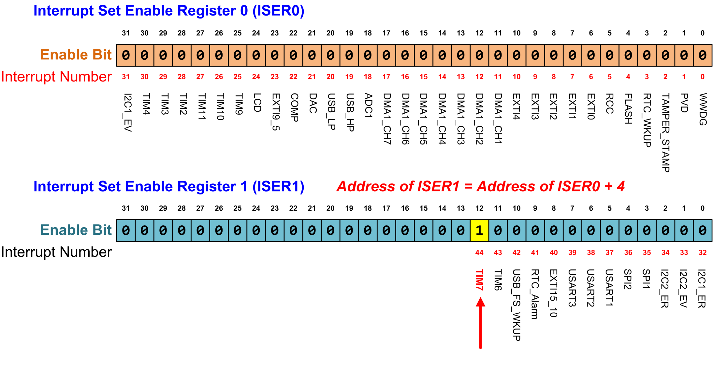
Enabling Peripheral Interrupts
TIM7_IRQn = 44
NVIC->ISER[1] |= 1 << 12; // Enable Timer 7 interrupt
Notes:
{{Pause=2}}We can enable a peripheral interrupt by writing 1 to the corresponding bit of the ISER register. {{Pause=0.5}} ISER stands for interrupt set enable register. For example, we will show how to enable the interrupt Timer 7.
The interrupt number of Timer 7 is 44 for STM 32 L1 processor. ISER0 enables interrupts 0 to 31. ISER1 enables interrupts 32 to 63. To enable interrupt 44, we need to set bit 12 of ISER1 to 1.
Note that, write 0 to a bit in a ISER register does not disable the corresponding interrupt.

Slide 54
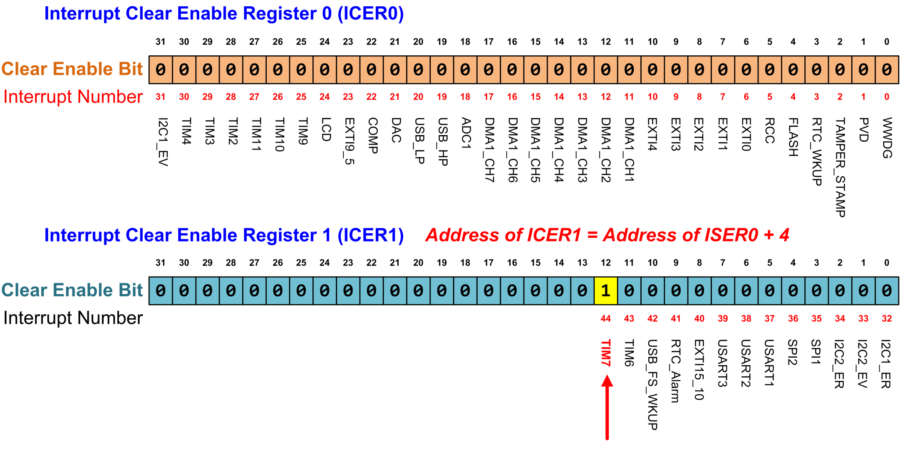
Disabling Peripheral Interrupts
TIM7_IRQn = 44
NVIC->ICER[1] |= 1 << 12; // Disable Timer 7 interrupt
Notes:
{{Pause=2}}Similarly, we can disable a peripheral interrupt by writing 1 to the corresponding bit of the ICER register. {{Pause=0.5}} ICER stands for the interrupt clear-enable register.
The interrupt number of Timer 7 is 44. To disable interrupt 44, we need to set bit 12 of ICER1 to 1. {{Pause=0.5}} Note that writing 1 to a bit in ICER disables the corresponding interrupt. Writing 0 to ICER has no impacts.
Separating enable bits and disable bits in two separate sets of registers, ICER and ISER, provides great convenience for software programmers. It allows us to enable or disable an interrupt flexibly, without worrying about writing zero to the other bits in the target register.

Slide 55
Explanations
To enable interrupt “Timer 7” with interrupt number 44:
  ISER0 controls interrupts 0 to 31; ISER1 controls interrupts 32 to 63.
  To enable interrupt 44, we set bit 12 (44-32) of ISER1 to 1 by executing NVIC->ISER[1] |= 1 << 12.
To disable interrupt “Timer 7” with interrupt number 44:
  To disable interrupt 44, we set bit 12 (44-32) of ICER1 to 1 by executing NVIC->ICER[1] |= 1 << 12.
Notes:
ISER and ICER access the same enable bit: writing 1 to ISER sets it (both registers then read back 1), writing 1 to ICER clears it (both then read back 0).

Slide 56
Interrupt Priority
Inverse Relationship:
  Lower priority value means higher urgency.
    Priority of Interrupt A = 5,
    Priority of Interrupt B = 2,
    B has a higher priority/urgency than A.
Fixed priority for Reset, HardFault, and NMI.
Adjustable for all the other interrupts
Exception | IRQn | Priority
Reset | N/A | -3 (the highest)
Non-maskable Interrupt (NMI) | -14 | -2 (2nd highest)
Hard Fault | -13 | -1
Notes:
{{Pause=2}}What should the processor do if multiple interrupts arrive at the same time? ARM processors allow software to set priority levels for almost every interrupt. Accordingly, interrupts that needs to be responded more urgently than others, will be serviced quickly.
For ARM Cortex processors, numerically low priority values are used to specify logically high interrupt priorities. In other words, a lower priority value represents a higher urgency. This is very counterintuitive.
For example, if the priority value of interrupt A is 5, and the priority value of interrupt B is 2, then B has a higher urgency than A. Therefore, the processor will service B first if interrupt A and B arrive at the same time.
The priority of some interrupts are fixed. Specifically, the priority of three system exceptions, including reset, non-masktable interrupt (NMI), and hard fault, are fixed. Their priority levels are negative, and they have the highest urgency.
The priority level of all the other interrupts are adjustable.

Slide 57
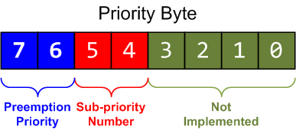
Interrupt Priority
Interrupt priority is configured by Interrupt Priority Register (IP)
Each priority consists of two fields, including preempt priority number and sub-priority number.
  The preempt priority number defines the priority for preemption.
  The sub-priority number determines the order when multiple interrupts are pending with the same preempt priority number.
default setting
Notes:
{{Pause=2}}ARM Cortex-M processors use a byte to represent the priority level. Therefore, it allows a maximum of 256 different priority levels, ranging from priority 0 to priority 255. However, the total number of available priority levels depends on the manufacturer.
For example, STM 32 L4 processors implement four priority bits, which are placed as the most significant bits of the priority byte. Therefore, the N V I C module of STM 32 L4 supports up to 16 interrupt priority levels for peripherals.
In addition, the priority bits are divided into two parts, including preempt priority and sub priority. By default, the preempt priority has the upper two bits, and the sub-priority has the lower two bits. However, the number of bits assigned to each part is configurable.
The preempt priority defines whether an interrupt can preempt an already executing interrupt. In other words, preempt priority determines if one interrupt can preempt another.
The sub priority determines which interrupt will be handled first, when two interrupts of the same preempt priority arrive at the same time. That is to say, the sub priority is used, only when two interrupts with the same preempt priority value are pending. Specifically, the interrupt with the lower sub priority value will be handled first.

Slide 58
Interrupt Priority Levels
Configure interrupt priority for IRQ number 7 to be level 6 (01100000 in binary, or 96 in decimal):
NVIC_SetPriority(7, 6);
core_cm4.h or core_cm3.h
0 | 1 | 1 | 0 | 0 | 0 | 0 | 0
typedef struct {
...
// Interrupt Priority Register
volatile uint8_t IP[240];
...
} NVIC_Type;
IP = 0x60 = 96
It is equivalent to (Priority value is shifted left by 4 bits, and the result is stored in the corresponding interrupt priority byte):
NVIC->IP[7] = (6 << 4) & 0xff;
Notes:
{{Pause=2}} Again, the priority is stored as the most significant four bits of the interrupt priority byte. For example, the statement NVIC Set Priority (7, 6) will set the priority byte of interrupt 7 to 01100000 in binary, or 96 in decimal.
In the NVIC data structure, the interrupt priority registers are mapped to a byte array. Each register holds four priority bytes. The NVIC Set Priority statement is equivalent to the following C statement. First, we shifts left, the priority value four bits, and then store the result in the corresponding interrupt priority byte.

Slide 59
Preemption and Sub-priority
Configuration
NVIC_SetPriorityGrouping(n)
  Perform unlock, and update AIRCR register
n | # of bits in preemption priority | # of bits in sub-priority
0 | 0 | 4
1 | 1 | 3
2 (default) | 2 | 2
3 | 3 | 1
4 | 4 | 0
Default
n = 2
Notes:
{{Pause=2}}. Within an interrupt priority byte, the number of bits in the preemption priority field and the sub-priority field can be configured by software.
For STM 32 L4 processors, there are two bits in each field. However, we can use the function NVIC Set Priority Grouping to change the size of each field. This function will change the A I R C R, register, after performing a sequence of unlocking process. A I R C R, stands for Application Interrupt and Reset Control Register.
For example, if the input n is 4, we set all 4 bits to the preemption priority. As result, the preemption priority has a total of 16 priority levels.

Slide 60
Masking Priority
We have discussed enabling/disabling individual interrupts by setting NVIC registers. ARM also provides mechanisms to enable/disable a group of interrupts.
3 Interrupt Mask Registers:
Register Name | Description
PRIMASK | A 1-bit register. When this is set, it allows Reset, NMI and Hard Fault; all other interrupts and exceptions are disabled (masked); default is 0 (no masking)
FAULTMASK | A 1-bit register. When this is set, it allows only Reset and NMI; all other interrupts and exceptions (including Hard Fault) are disabled; default is 0 (no masking)
BASEPRI | A register of up to 8 bits. It defines the masking priority level. When this is set, it disables all interrupts of the same or lower importance (same or larger priority values)
Notes:
{{Pause=2}}In embedded systems, we often have to perform some critical operations, in which data should not be corrupted by other interrupts. Therefore, we need to disable all interrupts with less urgency to ensure that the execution of the critical code will not be interrupts by other interrupts.
We can use the Base Priority Mask Register(BASEPRI) to achieve the protection of critical code. In this example, we disable all interrupts with a priority value of 5 or higher. After executing the critical code, we can remove the interrupt masking by resetting the BASEPRI register to zero.

Slide 61
Exception-masking registers (PRIMASK, FAULTMASK and BASEPRI)
PRIMASK: Used to disable all exceptions except Non-maskable interrupt (NMI) and hard fault.
  Write 1 to PRIMASK to disable all interrupts except NMI and hard fault
  Write 0 to PRIMASK to enable all interrupts
FAULTMASK: Like PRIMASK but change the current priority level to -1, so that even hard fault handler is blocked
BASEPRI: Disable interrupts only with priority equal to or lower than a certain level
  Example, disable all exceptions with priority value of 0x60 or larger (MSR moves the value in R0 into the BASEPRI special register.)
  MOV R0, #1
  MSR PRIMASK, R0
  MOV R0, #0
  MSR PRIMASK, R0
  MOV R0, #0x60
  MSR BASEPRI, R0

Slide 62
References
Lecture 9: Interrupts
  https://www.youtube.com/watch?v=uFBNf7F3l60&list=PLRJhV4hUhIymmp5CCeIFPyxbknsdcXCc8&index=9

