Slide 1
Embedded Systems with ARM Cortex-M Microcontrollers in Assembly Language and C
Chapter 16
General Purpose Timer and PWM
Z. Gu
Fall 2026
Acknowledgement: Lecture slides based on Embedded Systems with ARM Cortex-M Microcontrollers in Assembly Language and C, University of Maine https://web.eece.maine.edu/~zhu/book/

Slide 2
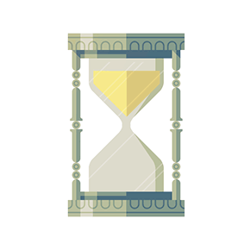
Timer
A timer is a hardware module that generates periodic clock ticks at a fixed time interval
Example Usages:
  To measure time elapsed, e.g., to implement a time delay function Delay (100ms).
  To implement periodic polling to check peripheral device status, or to implement CPU scheduler, which periodically selects a new process, from the ready queue, to run next.
Timer interrupts
time
Fixed time interval
Notes:
{{Pause=2}} The system timer, also called System Tick, or, SysTick, is to generate SysTick interrupts at a fixed time interval. {{Pause=1}} Here I give two example applications of the system timer. {{Pause=1}} The first example is that, the system timer can measure time elapsed. For instance, software can use the system timer, to implement a time delay function. {{Pause=1}} The second example is that we can execute some specific tasks periodically. For instance, we can use system timer, to implement periodic polling, to check peripheral status, or read external inputs, with a regular timed interval. In addition, operating systems rely on the system timer to implement CPU scheduler. In order to support multitasking and improve the CPU utilization, the CPU scheduler periodically selects a new process, from the ready queue, to run next.

Slide 3

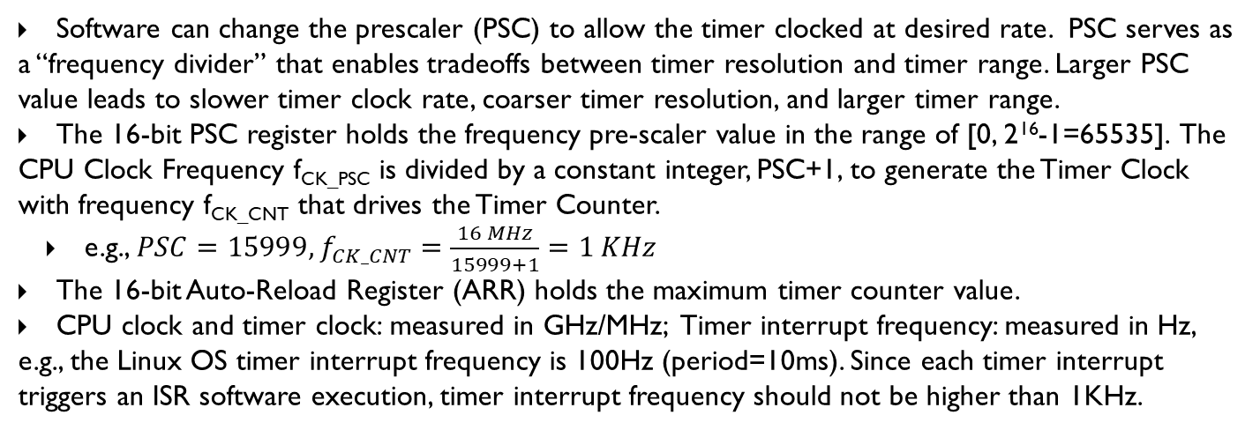
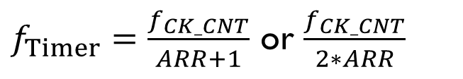
Timer: Prescaler (PSC)
Reload Value
ARR
Reload
CPU Clock
Timer Clock
Timer Interrupt
f_{CK_PSC}
f_{CK_CNT}
Timer
Counter
PSC
ISR
Prescaler
$$f_{CK_CNT}=\frac{f_{CK_PSC}}{PSC+1}$$
$f_{Timer}=\frac{f_{CK_CNT}}{ARR+1}$ or $\frac{f_{CK_CNT}}{2∗ARR}$
Software can change the prescaler (PSC) to allow the timer clocked at desired rate. PSC serves as a “frequency divider” that enables tradeoffs between timer resolution and timer range. Larger PSC value leads to slower timer clock rate, coarser timer resolution, and larger timer range.
The 16-bit PSC register holds the frequency pre-scaler value in the range of [0, 2¹⁶-1=65535]. The CPU Clock Frequency f_{CK_PSC} is divided by a constant integer, PSC+1, to generate the Timer Clock with frequency f_{CK_CNT} that drives the Timer Counter.
  e.g., $PSC=15999, f_{CK_CNT}=\frac{16 MHz}{15999+1}=1 KHz$
The 16-bit Auto-Reload Register (ARR) holds the maximum timer counter value.
CPU clock and timer clock: measured in GHz/MHz; Timer interrupt frequency: measured in Hz, e.g., the Linux OS timer interrupt frequency is 100Hz (period=10ms). Since each timer interrupt triggers an ISR software execution, timer interrupt frequency should not be higher than 1KHz.
Notes:
A timer is a hardware component in ARM Cortex-M microprocessor. Each timer has a special register, which is called the timer counter. The counter runs freely. If enabled, it automatically counts upwards or downwards, under the driven of a clock source. Pay attention. It is hardware, not software, which keeps repeatedly incrementing or decrementing the counter value. For each rising edge in the clock signal, the value of the counter increments or decrements by one automatically. That is why, we say the counter of a timer, is the free-running counter.
By updating the PSC register, we set the timer to be clocked at the rate we desire. The PSC register holds the frequency pre-scaler value, or the frequency divider. The frequency of the clock source is divided by a constant integer, PSC plus 1, before the input clock is fed to the counter. The prescaler enables a tradeoff between timer resolution and timer range. High timer resolution requires a high clock rate. However, high clock rates cause the timer to overflow or underflow more quickly.

Slide 4
Prescaler
Assume capture only rising edge
External Signal
Capture every rising edge
Capture every 2 rising edges
Capture every 4 rising edges

Slide 5
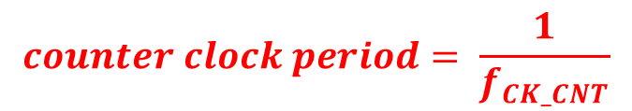

Example
$$f_{CK_CNT}=\frac{f_{CK_PSC}}{PSC+1}$$
f_{CK_PSC}
f_{CK_CNT}
Timer
Counter
PSC
clock
Prescaler
Counter is incremented/decremented once per cycle.
Timer: Upcounting mode, ARR = 6
$$counter clock period= \frac{1}{f_{CK_CNT}}$$
Clock
6
6
6
6
5
5
5
5
4
4
4
4
Counter
3
3
3
3
2
2
2
2
1
1
1
1
0
0
0
0
Notes:
A single timer can generate up to 4 PWM signals with independent duty cycles and identical frequency. When multiple PWM signals are generated by the same timer, all rising edges occur at the same time. That is why it is called edge-aligned.

Slide 6
Timer: Output
Reload Value
ARR
Reload
CPU Clock
Timer Clock
Timer Interrupt
f_{CK_PSC}
f_{CK_CNT}
Timer
Counter
PSC
ISR
Prescaler
=
Timer Output
(OCREF)
Compare & Capture Register (CCR)

Slide 7
Timer: Input Capture
Reload Value
ARR
Reload
CPU Clock
Timer Clock
Timer Interrupt
f_{CK_PSC}
f_{CK_CNT}
Timer
Counter
PSC
ISR
Prescaler
Compare & Capture Register (CCR)

Slide 8
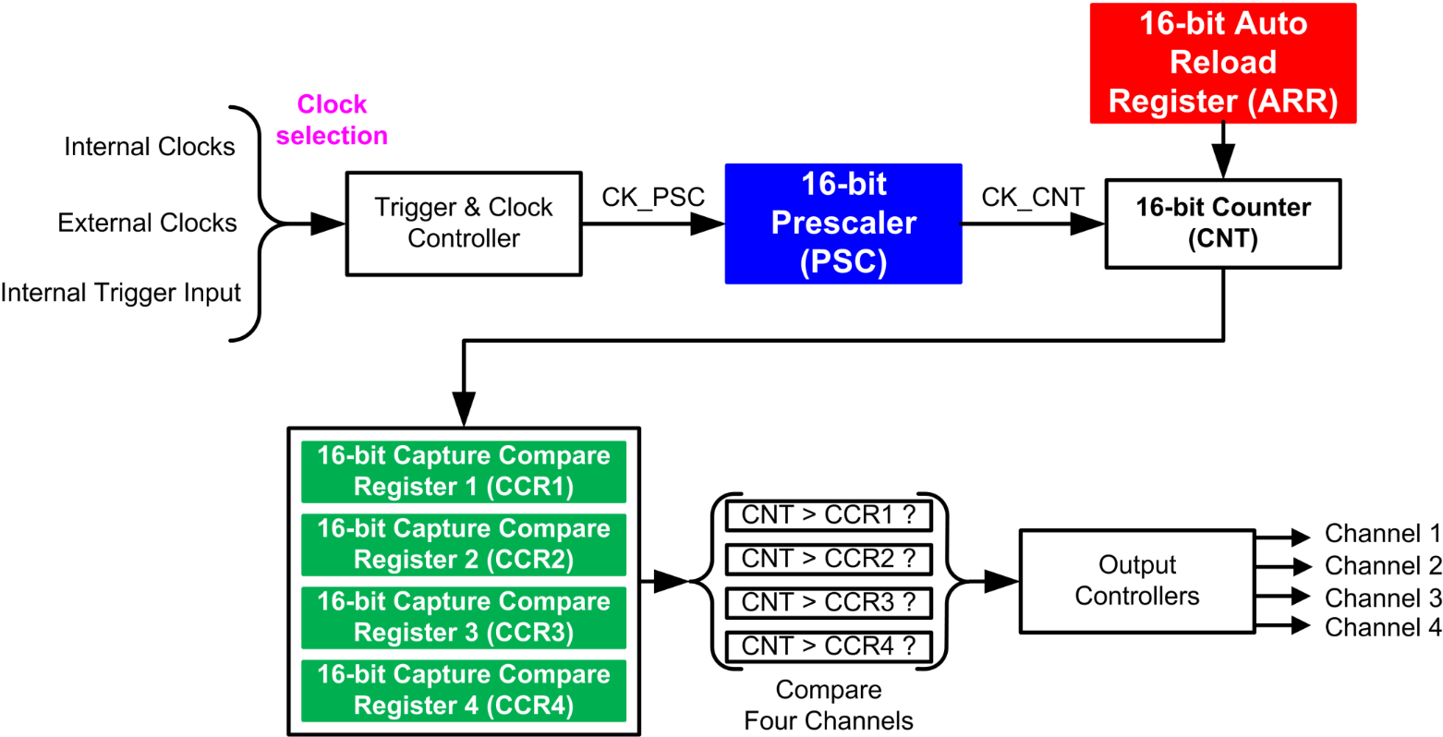
Multi-Channel Outputs
Notes:
{{Pause=2}} Typically, a single timer can generate, up to 4 PWM signals, with independent duty cycles, and identical frequency. Each timer has four channels. Each channel has its own Compare and Capture Register. CCR1, CCR2, CCR3, CCR4. These four channels share the timer counter, and the auto-reload register (ARR). Therefore, these PWM outputs have exactly the same period. However, their duty cycle can be different, because the value of these CCR registers can differ from each other.

Slide 9
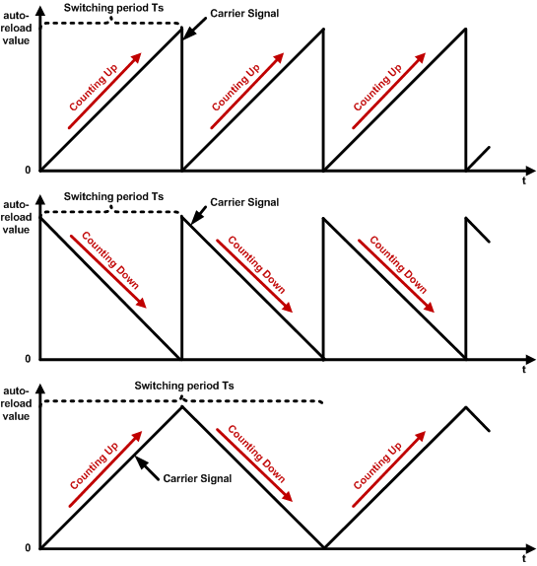
3 Modes
A general-purpose timer can be configured in 3 modes:
  Up-counting mode
  Down-counting mode
  Center-aligned counting mode (Alternating up-counting and down-counting)
Related registers include:
  Counter register (TIMx_CNT)
  Prescaler register (TIMx_PSC)
  Auto-reload register (TIMx_ARR)
  Their values are denoted as CNT, PSC and ARR.
SysTick timer can be down-counting mode only.

Slide 10
Up-counting Mode
ARR = 6
Timer
clock
6
6
6
6
5
Counter overflow
5
Counter overflow
5
Counter overflow
5
4
4
4
4
Counter
3
3
3
3
2
2
2
2
1
1
1
1
0
0
0
0
Counter overflow
Update event (UEV)
Timer Period = (ARR + 1) * Clock Period
= 7 * Clock Period
Auto-Reload Register ARR=6. In up-counting mode, the counter counts up, from 0 to 6. When the counter is reset to 0 from 6, counter overflow occurs, and a Update event (UEV) is generated. On the next clock cycle, the counter counts up again. The Timer Period is 1+ARR clock ticks, with duration of (1+ARR)*Clock Period.
Notes:
We can configure the timer to repeatedly count up, count down, or, count up and down. Let’s first take a look at the up-counting mode. The auto-reload register (ARR) holds the maximum counter value, which is also called the auto-reload value. The counter counts from 0 to the auto-reload value, then restarts from 0, and generates a counter overflow event. This figure shows an example of the counter behavior when ARR is 6, and the repetition counter is not used. In the up-counting mode, the counter rolls over and is reset when it exceeds 6. When the counter resets, it triggers a counter overflow and an update event (UEV). After that, a new period starts. The counting period is determined by the auto-reload value, as well as the clock period.
, RCR = 0

Slide 11
Down-counting Mode
ARR = 6
Timer
clock
6
6
6
6
5
5
5
5
4
4
4
4
Counter
3
3
3
3
2
Counter underflow
2
Counter underflow
2
Counter underflow
2
1
1
1
1
0
0
0
0
Counter underflow
Update event (UEV)
Timer Period = (ARR + 1) * Clock Period
= 7 * Clock Period
ARR=6. In down-counting mode, the counter counts down, from 6 to 0. When the counter is reset to 6 from 0, counter underflow occurs, and a UEV is generated. On the next clock cycle, the counter counts down again. The Timer Period is 1+ARR clock ticks, with duration of (1+ARR)*Clock Period.
Notes:
In the down-counting mode, the counter counts from the auto-reloaded value down to 0. After the counter has reached 0, hardware automatically reloads the counter with the auto-reloaded value, and generate a counter underflow event and an update event (UEV). The counting period of the down-counting mode is exactly the same as the counting period of the up-counting mode.
, RCR = 0

Slide 12
Center-aligned Counting Mode
ARR = 6
Timer
clock
6
6
5
5
5
5
4
4
4
4
Counter
3
3
3
3
2
2
2
2
1
1
1
1
0
0
0
Counter underflow
Update event (UEV)
Counter overflow
Counter underflow
Counter overflow
Counter underflow
Timer Period = 2 * ARR * Clock Period
= 12 * Clock Period
ARR=6. In center-aligned counting mode, the counter first counts up, from 0 to 6, then counts down, from 6, to 0. When the counter makes transition from 1 to 0, a UEV (Update Event) is generated. On the next clock cycle, the counter repeats the up/down counting process. The Timer Period is 2*ARR clock ticks, with duration of 2*ARR*Clock Period.
Notes:
In center-aligned mode, the counter counts from 0 to the auto-reload value minus 1, generates a counter overflow event, then counts from the auto-reload value down to 1 and generates a counter underflow event. Then it restarts counting
from 0. In this mode, the counting direction changes automatically on counter overflow and underflow. , RCR = 0

Slide 13
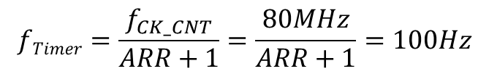

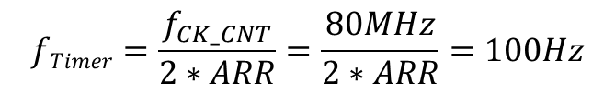

Example: Calculating ARR
Suppose Timer Clock Frequency = 80MHz
Goal: Timer Frequency = 100Hz
What should the ARR value be for 1. up-counting mode; 2. down-counting mode; 3. center-aligned counting mode?
For up-counting or down-counting mode:
For center-aligned counting mode:
$$fTimer=\frac{f_{CK_CNT}}{ARR+1}=\frac{80MHz}{ARR+1}=100Hz$$
$$fTimer=\frac{f_{CK_CNT}}{2∗ARR}=\frac{80MHz}{2∗ARR}=100Hz$$
$$ARR=799999$$
$$ARR=400000$$
But a 16-bit ARR register has value range of [0, 65535], so ARR value of 799999 or 400000 is out of range → cannot generate a 10ms timer from a 80MHz Timer Clock!
Solution: use prescaler (PSC) to reduce Timer Clock Frequency
Notes:
{{Pause=2}} Suppose the clock source that drives the timer counter has a frequency of 80 MHz. We want to generate a SysTick interrupt every 10 milliseconds. What is the reload value? {{Pause=2}} Here is the diagram of SysTicks. {{Pause=0.5}} This is the clock signal, which has a frequency of 80 MHz. A SysTick interrupt is generated every 10 milliseconds. {{Pause=0.5}} An interrupt is generated when the counter makes the transition from 1 to 0. {{Pause=1} It takes a total of, reload plus 1, cycles to count down from the reload value to 0. {{Pause=0.5}} The reload value is calculated in this way. Reload value equals to 10 milliseconds, divided by the clock period, minus 1. This is equivalent to 10 milliseconds, multiply the clock frequency, minus 1. {{Pause=0.5}} The final result is 799999.

Slide 14
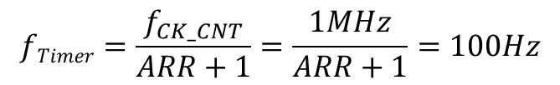

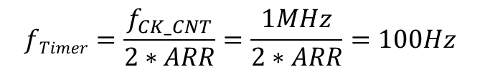

Example: Calculating ARR with Prescaler
Suppose CPU Clock Frequency = 80MHz, prescaler PSC=79
Goal: Timer Frequency = 100Hz
What should the ARR value be for 1. up-counting mode; 2. down-counting mode; 3. center-aligned counting mode?
$${Timer Clock Freq f}_{CK_CNT}=\frac{f_{CK_{PSC}}}{PSC+1}=\frac{80MHz}{80}=1MHz$$
For up-counting or down-counting mode:
For center-aligned counting mode:
$$fTimer=\frac{f_{CK_CNT}}{ARR+1}=\frac{1MHz}{ARR+1}=100Hz$$
$$fTimer=\frac{f_{CK_CNT}}{2∗ARR}=\frac{1MHz}{2∗ARR}=100Hz$$
$$ARR=9999$$
$$ARR=5000$$
With prescaler, the ARR value of 9999 or 5000 is now within the range of 16-bit ARR register.
Notes:
{{Pause=2}} Suppose the clock source that drives the timer counter has a frequency of 80 MHz. We want to generate a SysTick interrupt every 10 milliseconds. What is the reload value? {{Pause=2}} Here is the diagram of SysTicks. {{Pause=0.5}} This is the clock signal, which has a frequency of 80 MHz. A SysTick interrupt is generated every 10 milliseconds. {{Pause=0.5}} An interrupt is generated when the counter makes the transition from 1 to 0. {{Pause=1} It takes a total of, reload plus 1, cycles to count down from the reload value to 0. {{Pause=0.5}} The reload value is calculated in this way. Reload value equals to 10 milliseconds, divided by the clock period, minus 1. This is equivalent to 10 milliseconds, multiply the clock frequency, minus 1. {{Pause=0.5}} The final result is 799999.

Slide 15
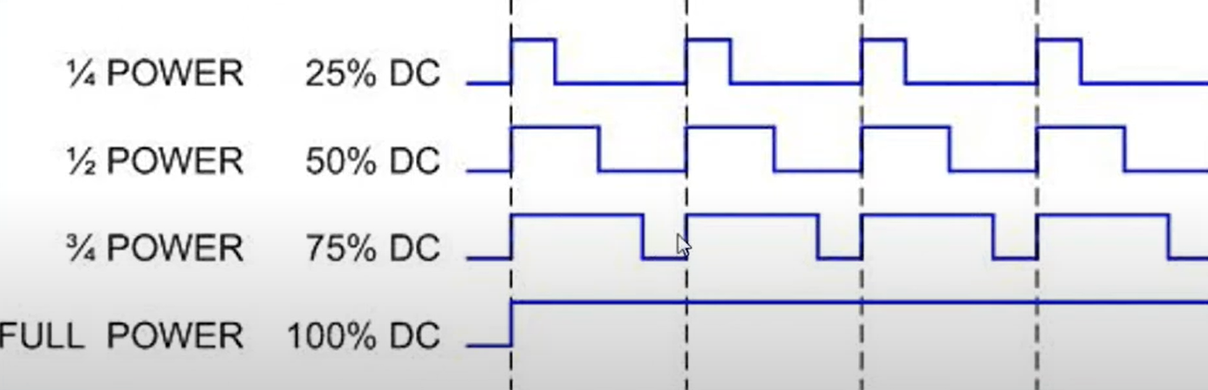
Pulse-Width Modulation (PWM) as DAC
A closed-loop control system consisting of a CPU-based controller (digital) interacting with a physical plant (analog) needs
  Sensors with ADC (Analog-to-Digital Converter) functionality to convert analog signals into digital domain, e.g., temperature, humidity…
  Actuators with DAC (Digital-to-Analog Converter) functionality to convert digital signals into analog domain, e.g., output voltage to control a motor…(real DAC requires low-pass filtering)
PWM is a type of DAC. It uses a rectangular waveform to periodically switch on and off a voltage source to produce a desired average voltage output.
Sensor w/ ADC
Controller (Digital)
Physical Plant
(Analog)
PWM for DC motor control
Actuator w/ DAC

Slide 16
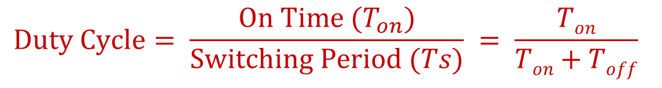
Pulse-Width Modulation (PWM)
Pulse Width refers to the time interval when the output signal is On; Duty Cycle is the percentage of time that the output signal is On:
Higher Duty Cycle means higher average output:
$$Duty Cycle= \frac{On Time (T_{on})}{Switching Period (Ts)} = \frac{Ton}{Ton+Toff}$$
$$Average Output=Duty Cycle ∗Output in On State$$

Slide 17
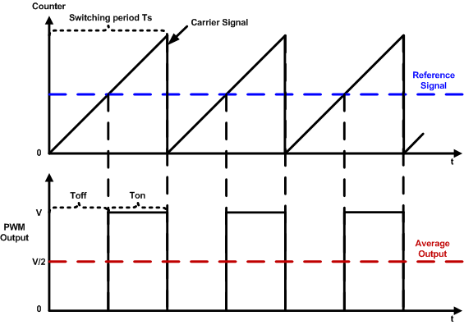
Pulse-Width Modulation (PWM)
The PWM output signal is determined by:
  Reference signal stored in Compare and Capture Register (CCR); and the PWM mode
PWM mode 1 (Low True): if the timer counter is (< or ≤) reference signal stored in CCR, the PWM output is on; otherwise it is off.
  Higher CCR → higher duty cycle
PWM mode 2 (High True): if the timer counter is (> or ≥) reference signal stored in CCR, the PWM output is on; otherwise it is off.
  Higher CCR → lower duty cycle
PWM mode 2 Example
Notes:
Comparison between timer counter (CNT) and given reference value stored in
A single timer can generate up to 4 PWM signals with independent duty cycles and identical frequency.
Polarity bit
When multiple PWM signals are generated by the same timer, all rising edges occur at the same time. That is why it is called edge-aligned.

Slide 18
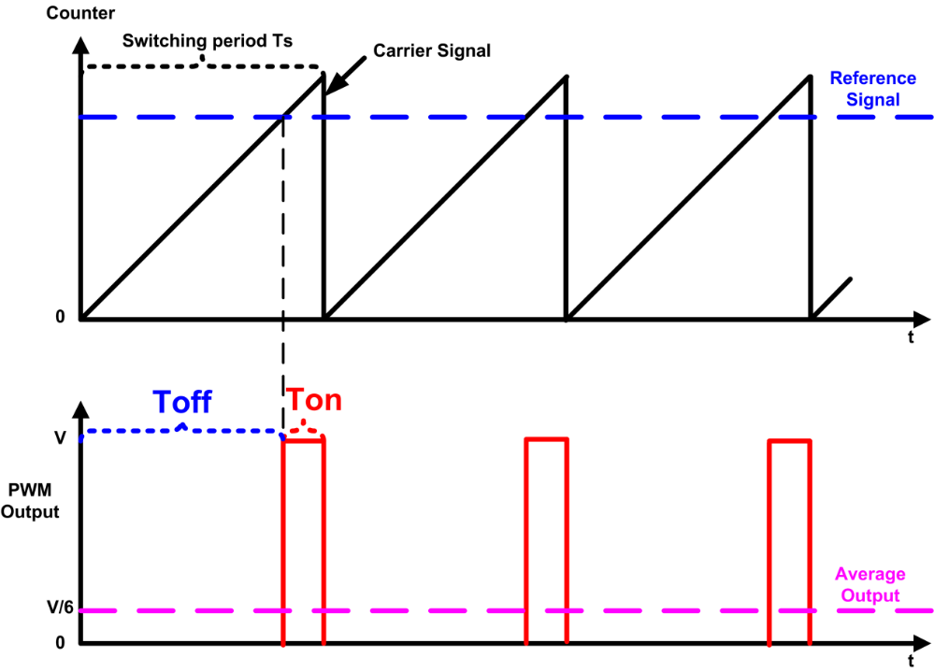
PWM Mode Summary
PWM mode 2 Example
Mode | Counter < or ≤ Reference | Counter > or ≥ Reference
PWM mode 1 (Low True) | Active | Inactive
PWM mode 2 (High True) | Inactive | Active

Slide 19
Edge-aligned Mode (Up-counting)
ARR = 6, RCR = 0
clock
6
6
6
6
5
Counter overflow
5
Counter overflow
5
Counter overflow
5
4
4
4
4
counter
3
3
3
3
2
2
2
2
1
1
1
1
0
0
0
0
Counter overflow
Update event (UEV)
Period = (1 + ARR) * Clock Period
= 7 * Clock Period
Clock Period = 1/f_{CNT}
f_{CNT} = f_{SOURCE}/(1 + PSC)
Notes:
We can configure the timer to repeatedly count up, count down, or, count up and down. Let’s first take a look at the up-counting mode. The auto-reload register (ARR) holds the maximum counter value, which is also called the auto-reload value. The counter counts from 0 to the auto-reload value, then restarts from 0, and generates a counter overflow event. This figure shows an example of the counter behavior when ARR is 6, and the repetition counter is not used. In the up-counting mode, the counter rolls over and is reset when it exceeds 6. When the counter resets, it triggers a counter overflow and an update event (UEV). After that, a new period starts. The counting period is determined by the auto-reload value, as well as the clock period.

Slide 20
Edge-aligned Mode (down-counting)
ARR = 6, RCR = 0
Clock
6
6
6
6
5
5
5
5
4
4
4
4
Counter
3
3
3
3
2
Counter underflow
2
Counter underflow
2
Counter underflow
2
1
1
1
1
0
0
0
0
Counter underflow
Update event (UEV)
Period = (1 + ARR) * Clock Period
= 7 * Clock Period
Notes:
In the down-counting mode, the counter counts from the auto-reloaded value down to 0. After the counter has reached 0, hardware automatically reloads the counter with the auto-reloaded value, and generate a counter underflow event and an update event (UEV). The counting period of the down-counting mode is exactly the same as the counting period of the up-counting mode.

Slide 21
Center-aligned Mode
ARR = 6, RCR = 0
Clock
6
6
5
5
5
5
4
4
4
4
Counter
3
3
3
3
2
2
2
2
1
1
1
1
0
0
0
Counter overflow
Counter underflow
Counter overflow
Counter underflow
Update event (UEV)
Period = 2 * ARR * Clock Period
= 12 * Clock Period
Notes:
In center-aligned mode, the counter counts from 0 to the auto-reload value minus 1, generates a counter overflow event, then counts from the auto-reload value down to 1 and generates a counter underflow event. Then it restarts counting
from 0. In this mode, the counting direction changes automatically on counter overflow and underflow.

Slide 22
Explanations
We can configure the timer to repeatedly count up, count down, or, count up and down.
In up-counting mode, auto-reload register (ARR) holds the maximum counter value, which is also called the auto-reload value. The counter counts from 0 to the auto-reload value, then restarts from 0, and generates a counter overflow event. This figure shows an example of the counter behavior when ARR is 6. In the up-counting mode, the counter rolls over and is reset when it exceeds 6. When the counter resets, it triggers a counter overflow and an update event (UEV). After that, a new period starts. The counting period is determined by the auto-reload value, as well as the clock period.
In the down-counting mode, the counter counts from the auto-reloaded value down to 0. After the counter has reached 0, hardware automatically reloads the counter with the auto-reloaded value, and generate a counter underflow event and an UEV. The counting period of the down-counting mode is exactly the same as the counting period of the up-counting mode.
In center-aligned mode, the counter counts from 0 to the auto-reload value minus 1, generates a counter overflow event, then counts from the auto-reload value down to 1 and generates a counter underflow event. Then it restarts counting from 0. In this mode, the counting direction changes automatically on counter overflow and underflow.
Notes:
, and the repetition counter is not used

Slide 23
PWM Mode: Rigorous Definition
PWM Mode | Timer Counting Mode | On | Off
Mode 1 (Low True) | Up-counting | CNT < CCR | CNT ≥ CCR
 | Down-counting | CNT ≤ CCR | CNT > CCR
Mode 2 (High True) | Up-counting | CNT ≥ CCR | CNT < CCR
 | Down-counting | CNT > CCR | CNT ≤ CCR

Slide 24
PWM Mode 1 (Low-True)
PWM | Timer Counting | On | Off
Mode 1 (Low True) | Up-counting | CNT < CCR | CNT ≥ CCR
 | Down-counting | CNT ≤ CCR | CNT > CCR
Mode 2 (High True) | Up-counting | CNT ≥ CCR | CNT < CCR
 | Down-counting | CNT > CCR | CNT ≤ CCR
High if counter < CCR
Timer Output =
Low if counter ≥ CCR
Up-counting mode, ARR = 6, CCR = 3
Clock
6
6
6
6
5
5
5
5
CCR = 3
4
4
4
4
Counter
3
3
3
3
2
2
2
2
1
1
1
1
0
0
0
0
PWM
Output
On for 3
Off for 4
CCR
Duty Cycle =
Timer Period = (ARR + 1) * Clock Period = 7 * Clock Period
ARR + 1
3
=
7
Notes:
A single timer can generate up to 4 PWM signals with independent duty cycles and identical frequency. When multiple PWM signals are generated by the same timer, all rising edges occur at the same time. That is why it is called edge-aligned. , RCR = 0

Slide 25
PWM Mode 2 (High-True)
PWM | Timer Counting | On | Off
Mode 1 (Low True) | Up-counting | CNT < CCR | CNT ≥ CCR
 | Down-counting | CNT ≤ CCR | CNT > CCR
Mode 2 (High True) | Up-counting | CNT ≥ CCR | CNT < CCR
 | Down-counting | CNT > CCR | CNT ≤ CCR
Low if counter < CCR
Timer Output =
High if counter ≥ CCR
Up-counting mode, ARR = 6, CCR = 3
Clock
6
6
6
6
5
5
5
5
CCR = 3
4
4
4
4
Counter
3
3
3
3
2
2
2
2
1
1
1
1
0
0
0
0
PWM
Output
On for 4
Off for 3
CCR
Duty Cycle = 1 -
Timer Period = (ARR + 1) * Clock Period = 7 * Clock Period
ARR + 1
4
=
7

Slide 26
PWM Mode 2 (High-True)
PWM | Timer Counting | On | Off
Mode 1 (Low True) | Up-counting | CNT < CCR | CNT ≥ CCR
 | Down-counting | CNT ≤ CCR | CNT > CCR
Mode 2 (High True) | Up-counting | CNT ≥ CCR | CNT < CCR
 | Down-counting | CNT > CCR | CNT ≤ CCR
Up-counting mode, ARR = 6, CCR = 5
Clock
CCR = 5
6
6
6
6
5
5
5
5
4
4
4
4
Counter
3
3
3
3
2
2
2
2
1
1
1
1
0
0
0
0
On for 2
PWM
Output
Off for 5
CCR
Duty Cycle = 1 -
Timer Period = (ARR + 1) * Clock Period = 7 * Clock Period
ARR + 1
2
=
7

Slide 27
PWM Mode 2 (High-True)
PWM | Timer Counting | On | Off
Mode 1 (Low True) | Up-counting | CNT < CCR | CNT ≥ CCR
 | Down-counting | CNT ≤ CCR | CNT > CCR
Mode 2 (High True) | Up-counting | CNT ≥ CCR | CNT < CCR
 | Down-counting | CNT > CCR | CNT ≤ CCR
Low if counter < CCR
Timer Output =
High if counter ≥ CCR
Center-aligned mode, ARR = 6, CCR = 3
Clock
6
6
5
5
5
5
CCR = 3
4
4
4
4
Counter
3
3
3
3
2
2
2
2
1
1
1
1
0
0
0
On for 6
The timer counter value of 3 corresponds to different PWM outputs (on or off) depending on the phase (up-counting or down-counting)
PWM
Output
Off for 6
CCR
Duty Cycle = 1 -
Timer Period = 2 * ARR * Clock Period = 12 * Clock Period
ARR
1
=
2

Slide 28
PWM Mode 2 (High-True)
PWM | Timer Counting | On | Off
Mode 1 (Low True) | Up-counting | CNT < CCR | CNT ≥ CCR
 | Down-counting | CNT ≤ CCR | CNT > CCR
Mode 2 (High True) | Up-counting | CNT ≥ CCR | CNT < CCR
 | Down-counting | CNT > CCR | CNT ≤ CCR
Center-aligned mode, ARR = 6, CCR = 1
Clock
6
6
5
5
5
5
4
4
4
4
Counter
3
3
3
3
2
2
2
2
CCR = 1
1
1
1
1
0
0
0
On for 10
The timer counter value of 1 corresponds to different PWM outputs (on or off) depending on the phase (up-counting or down-counting)
PWM
Output
Off for 2
CCR
Duty Cycle = 1 -
Timer Period = 2 * ARR * Clock Period = 12 * Clock Period
ARR
5
=
6

Slide 29
PWM Mode 1: Left Edge-aligned
PWM | Timer Counting | On | Off
Mode 1 (Low True) | Up-counting | CNT < CCR | CNT ≥ CCR
 | Down-counting | CNT ≤ CCR | CNT > CCR
Mode 2 (High True) | Up-counting | CNT ≥ CCR | CNT < CCR
 | Down-counting | CNT > CCR | CNT ≤ CCR
Up-counting mode, ARR = 6, CCR = 3
Clock
CCR = 6
5
6
5
6
5
6
5
6
CCR = 3
3
4
3
4
3
4
3
4
Counter
2
2
2
2
0
1
0
1
0
1
0
1
CCR = 3
PWM
Output 1
CCR = 6
PWM
Output 2
Left-aligned
All rising edges occur at the same time!
PWM Period
In the up-counting mode, when multiple PWM signals are generated by the same timer, the PWM pulses are left edge aligned, because all rising edges are aligned to the left side of the PWM period.
Notes:
{{Pause=2}} In the up-counting mode, when multiple PWM signals are generated by the same timer, all rising edges occur at the same time. {{Pause=1}} That is why the up-counting mode is edge-aligned. This example shows the PWM output when CCR is 3 and 6. All rising edges of the PWM signals are aligned with the overflow events of the timer counter. {{Pause=1}} More specifically, the PWM outputs are left edge aligned, because all pulses are aligned to the left side of the PWM period. The outputs go to their active state at the beginning of the period, {{Pause=0.5}} stay on, for an amount of time determined by their duty cycle, {{Pause=0.5}} then turn off for the remainder of the period. After that, this process repeats. {{Pause=0.5}} In summary, If a timer is configured to count up, its PWM signals are edge-aligned, and more specifically, left-aligned.

Slide 30
PWM Mode 2: Right Edge-aligned
PWM | Timer Counting | On | Off
Mode 1 (Low True) | Up-counting | CNT < CCR | CNT ≥ CCR
 | Down-counting | CNT ≤ CCR | CNT > CCR
Mode 2 (High True) | Up-counting | CNT ≥ CCR | CNT < CCR
 | Down-counting | CNT > CCR | CNT ≤ CCR
Up-counting mode, ARR = 6, CCR = 3
Clock
CCR = 5
5
6
5
6
5
6
5
6
CCR = 3
3
4
3
4
3
4
3
4
Counter
2
2
2
2
0
1
0
1
0
1
0
1
PWM
Output 1
CCR = 3
PWM
Output 2
CCR = 5
All falling edges occur at the same time!
Right-aligned
PWM Period
In the up-counting mode with PWM mode 2, when multiple PWM signals are generated by the same timer, the PWM pulses are right edge aligned, because all falling edges are aligned to the right side of the PWM period.
Notes:
{{Pause=2}} When multiple PWM signals are generated by the same timer in mode 2, all falling edges occur at the same time. That is why mode 2 is edge-aligned. This example shows the PWM output when CCR is 3, and 5. {{Pause=1}} All falling edges of the PWM signals are aligned with the overflow events. {{Pause=1.5}} More specifically, the PWM outputs are right edge aligned, because all pulses are aligned to the right side of the PWM period.

Slide 31
PWM Mode 2: Center aligned
PWM | Timer Counting | On | Off
Mode 1 (Low True) | Up-counting | CNT < CCR | CNT ≥ CCR
 | Down-counting | CNT ≤ CCR | CNT > CCR
Mode 2 (High True) | Up-counting | CNT ≥ CCR | CNT < CCR
 | Down-counting | CNT > CCR | CNT ≤ CCR
Low if counter < CCR
Center-aligned counting mode, ARR = 6, CCR = 3
Timer Output =
High if counter ≥ CCR
Clock
5
6
5
5
6
5
CCR = 3
3
4
3
4
3
4
3
4
Counter
2
2
2
2
CCR = 1
0
1
0
1
1
0
1
PWM
Output 1
CCR = 3
CCR = 1
PWM
Output 2
PWM signals are center aligned!
Center-aligned
PWM Period
In the center-aligned counting mode, when multiple PWM signals are generated by the same timer, the PWM pulses are center aligned, because their centers are aligned with peaks of the timer counter.
Notes:
{{Pause=2}} When a timer generates multiple PWM signals, the centers of the PWM pulses are aligned with, the peak value of the timer counter. In other words, the active pulse of, all output channels, are placed at the center of each PWM period. {{Pause=2}} Center-aligned PWM signals are often used in electronic circuits, such as motor control and power supplies. The signals are symmetrical and thus have less harmonics. It helps reduce noise interference and power consumption.

Slide 32
PWM Pulse Alignment
PWM Mode | Timer Counting Mode | Pulse Alignment
Mode 1 (Low True) | Up-counting | Left edge
 | Down-counting | Right edge
 | Center-aligned Counting | Center aligned
Mode 2 (High True) | Up-counting | Right edge
 | Down-counting | Left edge
 | Center-aligned Counting | Center aligned
Notes:
Can you work out the down-counting cases by hand?

Slide 33
PWM Output Polarity
Each timer has two PWM modes, Mode 1 and Mode 2. These two modes are complementary to each other. However, software can select the output polarity by writing the CCxP bit in the CCER register.
Software can select either active high or active low. If it is active high, the output is high voltage for the active state, and low voltage for the inactive state. On the other hand, for active low, the output is low voltage for the active state, and high voltage for the inactive state.
Mode | Counter < CCR | Counter ≥ CCR
PWM mode 1 (Low True) | Active | Inactive
PWM mode 2 (High True) | Inactive | Active
Output Polarity | Active | Inactive
Active High | High Voltage | Low Voltage
Active Low | Low Voltage | High Voltage
Notes:
Output Polarity:
Software can program the CCxP bit in the TIMx_CCER register
{{Pause=2}} Software can program the polarity of PWM signals. Each timer has two PWM modes, mode 1 and mode 2. These two modes are complementary to each other. However, software can select the output polarity by writing the CCxP bit in the C C E R register. {{Pause=1}} Software can select either active high or active low. If it is active high, the output is high voltage for the active state, and low voltage for the inactive state. {{Pause=1}} On the other hand, for active low, the output is low voltage for the active state, and high voltage for the inactive state.

Slide 34

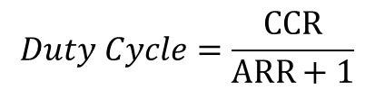

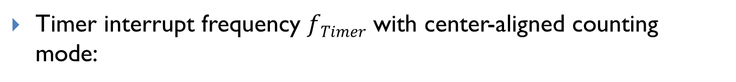
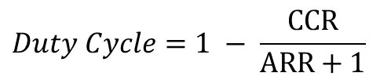
Summary of Equations
Timer clock frequency $f_{CK_CNT}$ vs. CPU Clock Frequency $f_{SOURCE}$
$$f_{CK_CNT}=\frac{f_{SOURCE}}{PSC+1}$$
Timer interrupt frequency $fTimer$ with up-counting or down-counting mode:
$$fTimer=\frac{f_{CK_CNT}}{ARR+1}; Timer Period=\frac{ARR+1}{f_{CK_CNT}}= \left(ARR+1\right)∗Clock Period$$
Timer interrupt frequency $fTimer$ with center-aligned counting mode:
$$fTimer=\frac{f_{CK_CNT}}{2∗ARR};Timer Period=\left(2∗ARR\right)∗Clock Period$$
PWM duty cycle for Mode 1 (Low-True):
$$Duty Cycle=\frac{CCR}{ARR+1}$$
PWM duty cycle for Mode 2 (High-True):
$$Duty Cycle=1 − \frac{CCR}{ARR+1}$$

Slide 35
References
Lecture 13: Timer PWM Output
  https://www.youtube.com/watch?v=zkrVHIcLGww&list=PLRJhV4hUhIymmp5CCeIFPyxbknsdcXCc8&index=13
Notes:
Lecture 12: System Timer (SysTick)
https://www.youtube.com/watch?v=aLCUDv_fgoU&list=PLRJhV4hUhIymmp5CCeIFPyxbknsdcXCc8&index=12

