Slide 1
Z. Gu
Hofstra University
Embedded Systems with ARM Cortex-M Microcontrollers in Assembly Language and C
Chapter 2
Data Representation
Fall 2026

Slide 2
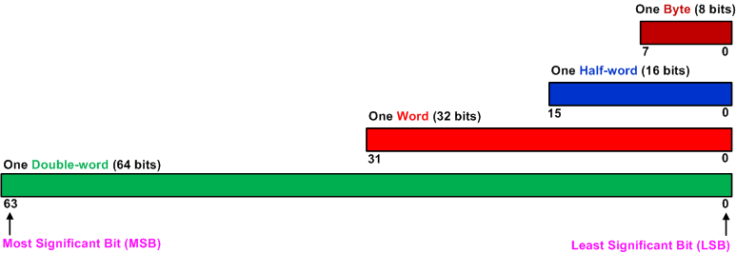
Bit, Byte, Half-word, Word, Double-Word

Slide 3
Binary, Decimal and Hex
Decimal | Binary | Hex
0 | 0000 | 0x0
1 | 0001 | 0x1
2 | 0010 | 0x2
3 | 0011 | 0x3
4 | 0100 | 0x4
5 | 0101 | 0x5
6 | 0110 | 0x6
7 | 0111 | 0x7
8 | 1000 | 0x8
9 | 1001 | 0x9
10 | 1010 | 0xA
11 | 1011 | 0xB
12 | 1100 | 0xC
13 | 1101 | 0xD
14 | 1110 | 0xE
15 | 1111 | 0xF
0x: Hex

Slide 4
Range of Unsigned Integers
Storage Size | Range | Powers of 2
Unsigned Byte | 0 to 255 | 0 to 2⁸-1
Unsigned Half-word | 0 to 65,535 | 0 to 2¹⁶-1
Unsigned Word | 0 to 4,294,967,295 | 0 to 2³²-1
Unsigned Double-word | 0 to 18,446,744,073,709,551,615 | 0 to 2⁶⁴-1

Slide 5
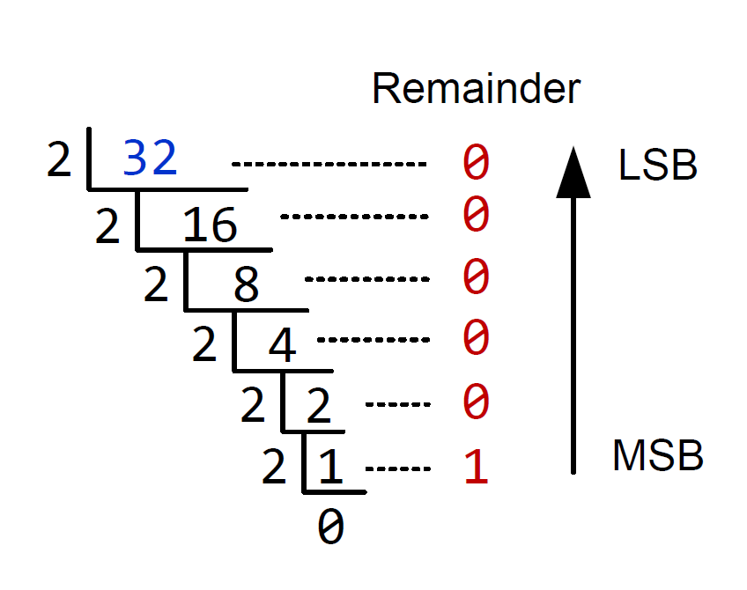
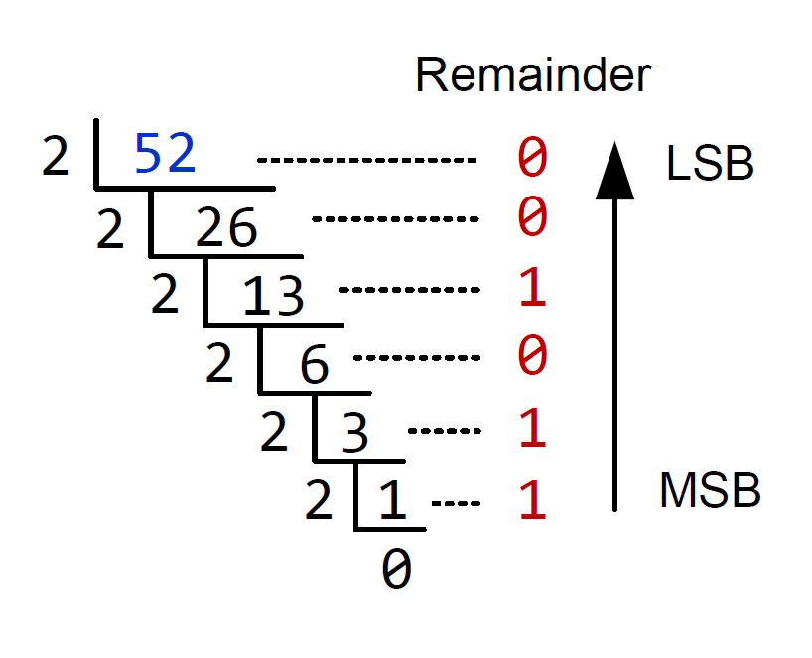
Unsigned Integers
Convert Decimal to Binary
Example 1
Example 2
52₁₀ = 110100₂
32₁₀ = 100000₂

Slide 6
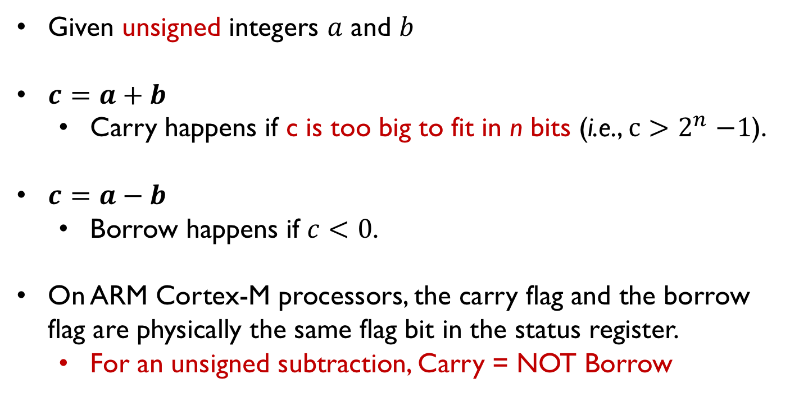
Carry/borrow flag bit for unsigned arithmetic
Given unsigned integers $a$ and $b$
$c=a+b$
  Carry happens if c is too big to fit in n bits (i.e., $c{>2}^{n}−1$).
$c=a−b$
  Borrow happens if $c<0$.
On ARM Cortex-M processors, the carry flag and the borrow flag are physically the same flag bit in the status register.
  For an unsigned subtraction, Carry = NOT Borrow

Slide 7
Carry/borrow flag bit for unsigned numbers
If the traverse crosses the boundary between 0 and $2^{n}−1=31 (n=5)$, the carry flag is set on addition and is cleared on subtraction.
Carry flag = 1, indicating carry has occurred on unsigned addition.
Carry flag is 1 because the result crosses the boundary between 31 and 0.
A carry occurs when adding 28 and 6
Notes:
For unsigned numbers, the carry flag is set when adding two numbers and the result is larger than the maximum that can be represented. For subtraction, the carry flag is set (C = 1, i.e., borrow = 0) when the result is non-negative, representing that no borrowing occurs. The carry flag is cleared (C = 0, i.e., borrow = 1) when the result is negative. On the ARM processor, the carry bit and borrow bit are the same flag bit in the status register.

Slide 8
Carry/borrow flag bit for unsigned numbers
If the traverse crosses the boundary between 0 and $2^{n}−1$, the carry flag is set on addition and is cleared on subtraction.
Carry flag = 0, indicating borrow has occurred on unsigned subtraction.
For subtraction, carry = NOT borrow.
A borrow occurs when subtracting 5 from 3.
Notes:
For unsigned numbers, the carry flag is set when adding two numbers and the result is larger than the maximum that can be represented. For subtraction, the carry flag is set (C = 1, i.e., borrow = 0) when the result is non-negative, representing that no borrowing occurs. The carry flag is cleared (C = 0, i.e., borrow = 1) when the result is negative. On the ARM processor, the carry bit and borrow bit are the same flag bit in the status register.

Slide 9
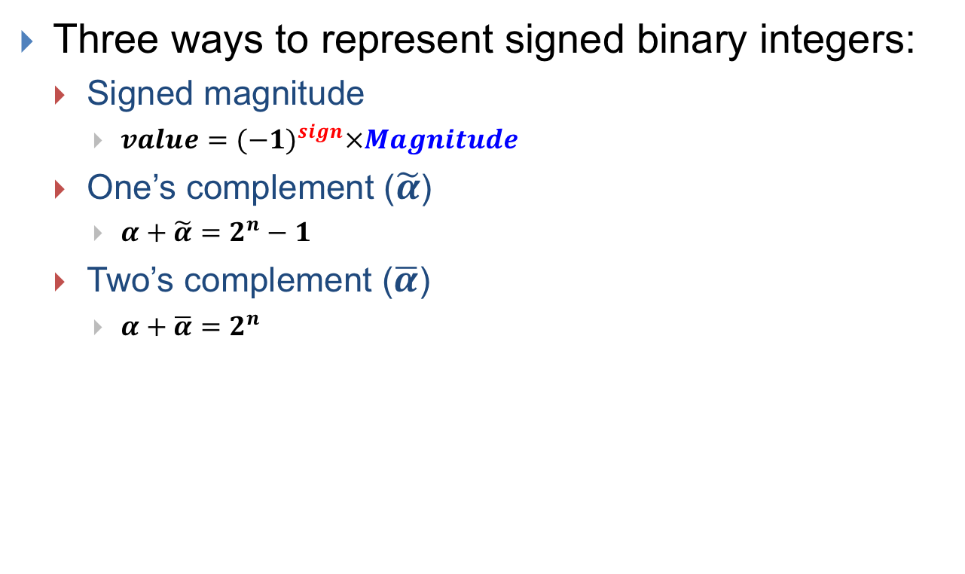
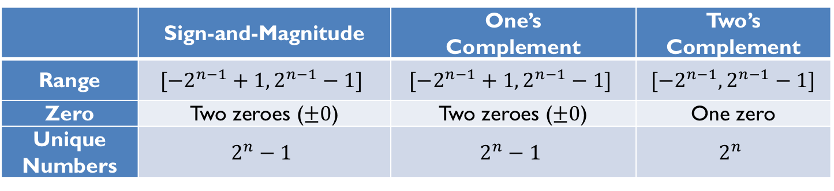
Signed Integer Representation
Three ways to represent signed binary integers:
  Signed magnitude
    $value={(−1)}^{sign}×Magnitude$
  One’s complement ($\tilde{α}$)
    $α+\tilde{α}=2^{n}−1$
  Two’s complement ($\overline{α}$)
    $α+\overline{α}=2^{n}$
 | Sign-and-Magnitude | One’s Complement | Two’s Complement
Range | $$[−2^{n−1}+1, 2^{n−1}−1]$$ | $$[−2^{n−1}+1, 2^{n−1}−1]$$ | $$[−2^{n−1}, 2^{n−1}−1]$$
Zero | Two zeroes ($±0$) | Two zeroes ($±0$) | One zero
Unique Numbers | $$2^{n}−1$$ | $$2^{n}−1$$ | $$2^{n}$$

Slide 10
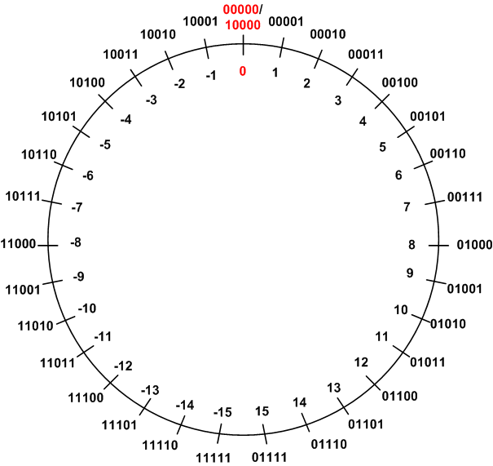
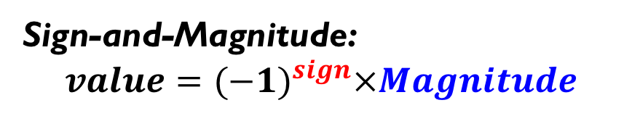
Signed Integers
Method 1: Signed Magnitude
Sign-and-Magnitude:
$$value={(−1)}^{sign}×Magnitude$$
The most significant bit is the sign.
The rest bits are magnitude.
Example: in a 5-bit system
  +7₁₀ = 00111₂
  -7₁₀ = 10111₂
Two ways to represent zero
  +0₁₀ = 00000₂
  -0₁₀ = 10000₂
Not used in modern systems
  Hardware complexity
  Two zeros

Slide 11
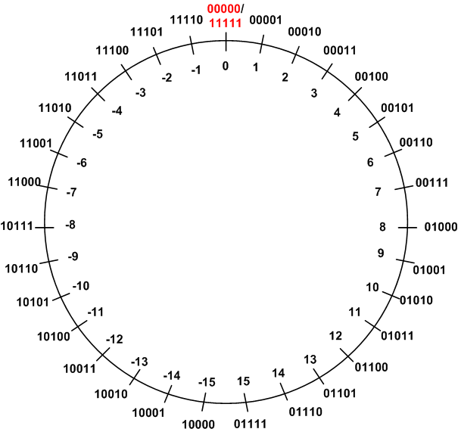

Signed Integers
Method 2: One’s Complement
One’s Complement ($\tilde{α}$):
$$α+\tilde{α}=2^{n}−1$$
The one's complement representation of a negative binary number is the bitwise NOT of its positive counterpart.
Example: in a 5-bit system
  +7₁₀ = 00111₂
  -7₁₀ = 11000₂
  +7₁₀ + (-7₁₀) = 00111₂ + 11000₂
  = 11111₂
  = 2⁵ - 1

Slide 12
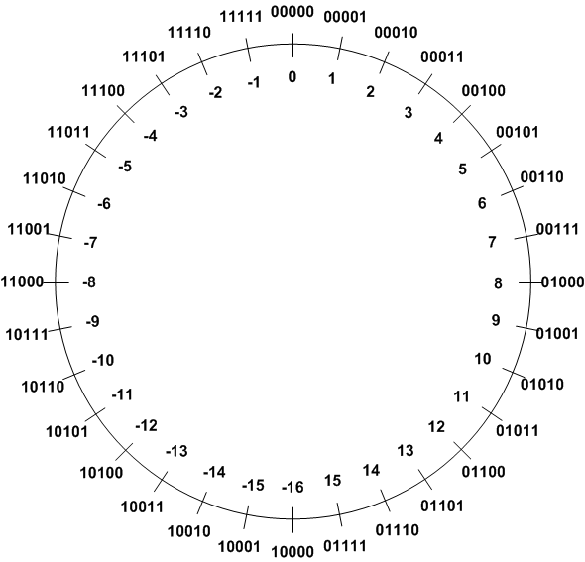
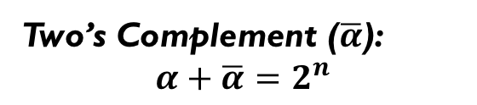
Signed Integers
Method 3: Two’s Complement (TC)
Two’s Complement ($\overline{α}$):
$$α+\overline{α}=2^{n}$$
TC of a negative number can be obtained by the bitwise NOT of its positive counterpart plus one.
Example 1: TC(3)
 | Binary | Decimal
Original number | 0b00011 | 3
Step 1: Invert every bit | 0b11100
Step 2: Add 1 | + 0b00001
Two’s complement | 0b11101 | -3

Slide 13
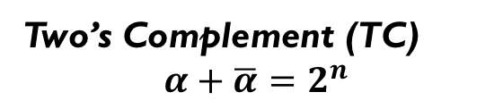
Signed Integers
Method 3: Two’s Complement (TC)
Two’s Complement (TC)
$$α+\overline{α}=2^{n}$$
TC of a negative number can be obtained by the bitwise NOT of its positive counterpart plus one.
Example 2: TC(-3)
 | Binary | Decimal
Original number | 0b11101 | -3
Step 1: Invert every bit | 0b00010
Step 2: Add 1 | + 0b00001
Two’s complement | 0b00011 | 3

Slide 14
Signed Integers
Method 3: Two’s Complement (TC)
Two’s Complement (TC)
$$α+\overline{α}=2^{n}$$
TC of a negative number can be obtained by the bitwise NOT of its positive counterpart plus one.
Example 3: TC(-16)
 | Binary | Decimal
Original number | 10000 | -16
Step 1: Invert every bit | 01111
Step 2: Add 1 | + 10000
Two’s complement | 10000 | -16
Negation of -16 in 5-bit two's complement wraps back to itself, meaning the most negative number's two's complement is itself. (Number range is [-16, 15], so 16 is out of range)

Slide 15
Quiz
Calculate TC(-16) for a 6-bit system
Notes:
For a 6-bit two's complement number:
The range of representable integers is from $−32$ to $+31$.
To represent $−16$ in 6 bits:
Write $16$ in binary: $010000$
Take the two's complement (invert bits and add 1):
Invert bits: $101111$
Add 1: $101111+1=110000$
So, $−16$ in 6-bit two's complement is $110000$.
To take the negation of this (i.e., find the two's complement of $110000$):
Invert bits: $001111$
Add 1: $001111+1=010000$
This is $16$ in binary, so the negation of $−16$ is $+16$ as expected.
Unlike the 5-bit case where $−16$ is the minimum and its negation wraps onto itself, in 6 bits $−16$ behaves normally with correct negation.

Slide 16
Quiz ANS
Calculate TC(-16) for a 6-bit system
For a 6-bit two's complement number: the range of representable integers is from −32 to +31.
−16 in 6-bit two's complement is 110000
  Write 16 in binary: 010000
  Take the two's complement (invert bits and add 1):
  Invert bits: 101111, Add 1: 101111+1=110000
To take the negation of this (i.e., find the two's complement of 110000):
  Invert bits: 001111, Add 1: 001111+1=010000
  This is 16 in binary, so the negation of −16 is +16 as expected
Unlike the 5-bit case where −16 is the minimum and its negation wraps onto itself, in 6 bits −16 behaves normally with correct negation
TC(-32) for a 6-bit system is itself (since +32 is out of range of [-32, 31])
Notes:
For a 6-bit two's complement number:
The range of representable integers is from $−32$ to $+31$.
To represent $−16$ in 6 bits:
Write $16$ in binary: $010000$
Take the two's complement (invert bits and add 1):
Invert bits: $101111$
Add 1: $101111+1=110000$
So, $−16$ in 6-bit two's complement is $110000$.
To take the negation of this (i.e., find the two's complement of $110000$):
Invert bits: $001111$
Add 1: $001111+1=010000$
This is $16$ in binary, so the negation of $−16$ is $+16$ as expected.
Unlike the 5-bit case where $−16$ is the minimum and its negation wraps onto itself, in 6 bits $−16$ behaves normally with correct negation.

Slide 17

Two’s Complement (TC)
Two's complement gets its name from the rule that “the unsigned sum of an n-bit number and its n-bit negative is $2^{n}$”; hence, the negation or complement of a number x is $2^{n}−x$, or its “Two's complement”
Signed arithmetic:
  For 5-bit system, signed number x = 00011 = 3, TC(x) = 11101 = -3, so their signed sum is 00011 + 11101 = 00000 (in decimal 3 + (-3) = 0)
Unsigned arithmetic:
  Unsigned number 00011=3, 11101=29, so their unsigned sum is 00011 + 11101 = 00000 (in decimal 3 + 29 = 32 = $2^{5}$). The result is incorrect as Carry flag = 1: 32 cannot be represented in 5 bits since it exceeds the largest unsigned value of $2^{5}−1$
Notes:
Signed number x = 10000 = -16, TC(x) = 10000 = -16, so their signed sum is 10000 + 10000 = 00000 (in decimal -16 + (-16) = 0). The result is incorrect as Overflow flag = 1
Unsigned number 10000 = 16, 10000 = 16, so their unsigned sum is 10000 + 10000 = 00000 (in decimal 16 + 16 = 32), Carry flag = 1

Slide 18
Two’s Complement for 8-bit System
8-bit signed Int (Two’s Complement) | 8-bit unsigned Int | Binary
-128 | 128 | 1000 0000
-127 | 129 | 1000 0001
… | … | …
-2 | 254 | 1111 1110
-1 | 255 | 1111 1111
0 | 0 | 0000 0000
1 | 1 | 0000 0001
… | … | ...
127 | 127 | 0111 1111
Note: Most significant bit (MSB) is the sign bit for signed int
18

Slide 19
Sign Extension
Decimal | Binary
 | 4-bit | 8-bit | 32-bit
3_{ten} | 0011_{two} | 0000 0011_{two} | 0000 0000 0000 0011_{two}
-3_{ten} | 1101_{two} | 1111 1101_{two} | 1111 1111 1111 1101_{two}
Sign extension for unsigned int: fill in 0’s from the left
Sign extension for signed int: fill in the sign bit from the left
Notes:
Different assembly instructions for copying signed/unsigned data

Slide 20
Comparison
Signed magnitude representation
0 = positive
1 = negative
One’s complement representation
Negative = invert all bits of a positive
Two’s Complement representation
TC = invert all bits, then plus 1
Used in modern computers!

Slide 21
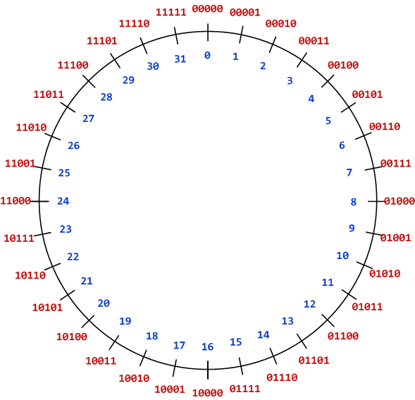
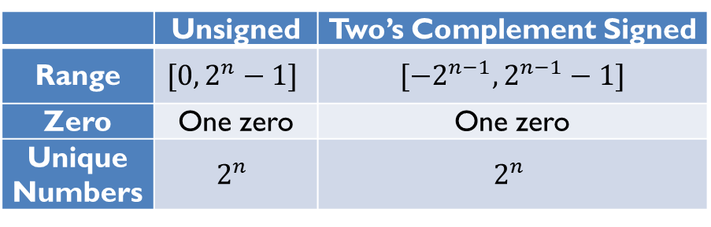
Comparison: unsigned vs. signed
 | Unsigned | Two’s Complement Signed
Range | $$[0, 2^{n}−1]$$ | $$[−2^{n−1}, 2^{n−1}−1]$$
Zero | One zero | One zero
Unique Numbers | $$2^{n}$$ | $$2^{n}$$
Unsigned int representation
Range [0, 31]
Two’s Complement representation
Range [-16,15]
TC = invert all bits, then add 1

Slide 22
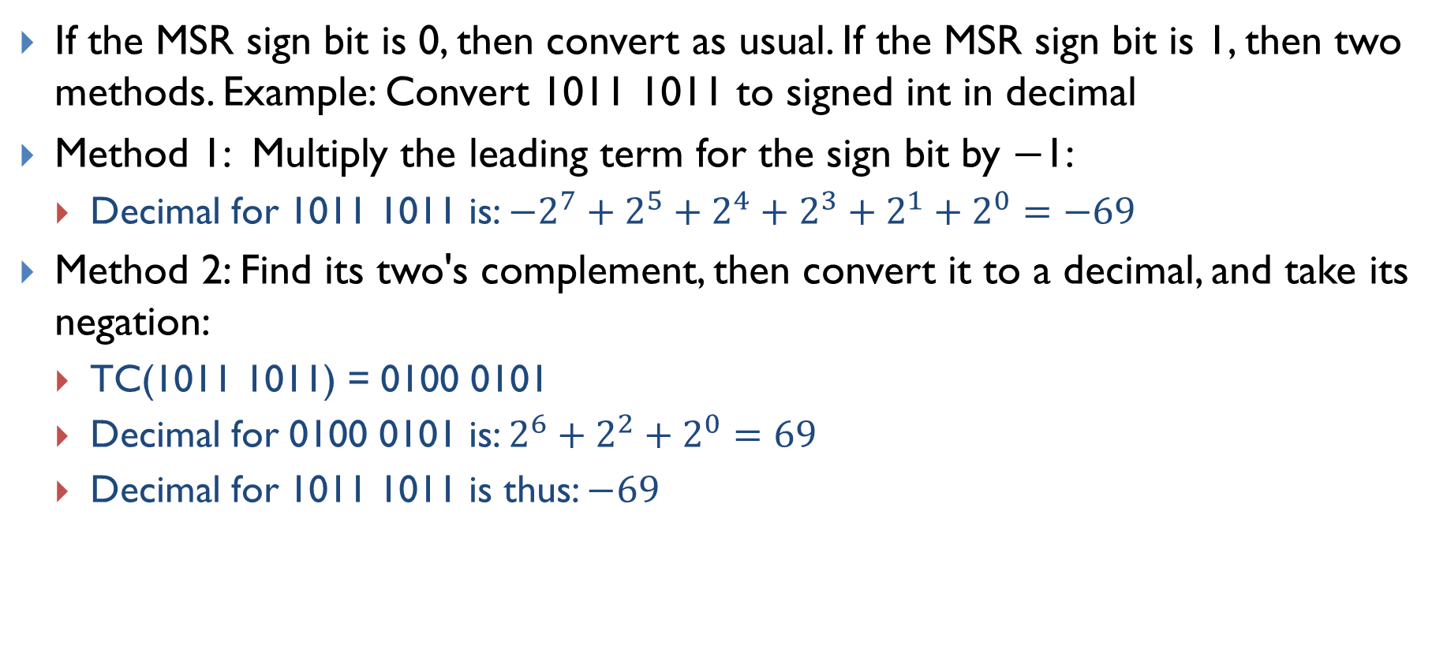
Binary to Decimal Conversion
If the MSB sign bit is 0, then convert as usual. If the MSB sign bit is 1, then two methods. Example: Convert 1011 1011 to signed int in decimal
Method 1: Multiply the leading term for the sign bit by −1:
  Decimal for 1011 1011 is: $−2^{7}+2^{5}+2^{4}+2^{3}+2^{1}+2^{0}=−69$
Method 2: Find its two's complement, then convert it to a decimal, and take its negation:
  TC(1011 1011) = 0100 0101
  Decimal for 0100 0101 is: $2^{6}+2^{2}+2^{0}=69$
  Decimal for 1011 1011 is thus: $−69$

Slide 23
Range of Signed Integers
(Two’s Complement)
Storage Size | Range | Powers of 2
Signed Byte | -128 to +127 | -2⁷ to 2⁷-1
Signed half-word | -32,768 to +32,767 | -2¹⁵ to 2¹⁵-1
Signed Word | -2,147,483,648 to +2,147,483,647 | -2³¹ to 2³¹-1
Signed Double-word | -9,223,372,036,854,775,808 to +9,223,372,036,854,775,807 | -2⁶³ to 2⁶³-1

Slide 24
Overflow Flag for Signed Arithmetic
When adding signed numbers represented in two’s complement, overflow occurs only in two scenarios:
  adding two positive numbers but getting a negative result, or
  adding two negative numbers but yielding a non-negative result.
Similarly, when subtracting signed numbers, overflow occurs in two scenarios:
  subtracting a positive number from a negative number but getting a positive result, or
  subtracting a negative number from a positive number but producing a negative result.
Overflow cannot occur when adding operands with different signs or when subtracting operands with the same signs.
  Why?

Slide 25
Overflow Flag for Signed Arithmetic
Overflow cannot occur when adding 2 operands with different signs or when subtracting 2 operands with the same sign. Proof:
An n-bit signed int has the range [-2^{n-1}, 2^{n-1}-1]
  n = 5, number range [-16, 15]
2 operands with different signs: positive one in the range of [0, 2^{n-1}-1], negative one in the range of [-2^{n-1}, -1]. So the range of their sum must be within range [0-2^{n-1}, 2^{n-1}-1+(-1)]=[-2^{n-1}, 2^{n-1}-2] ∈[-2^{n-1}, 2^{n-1}-1] → No overflow!
  Positive number range [0, 15], negative number range [-16, -1]. Range of their sum [0-16, 15-1]=[-16, 14]
2 operands with the same sign: if both are positive and in the range of [0, 2^{n-1}-1], then the range of their difference must be within range [0-(2^{n-1}-1), 2^{n-1}-1-0]=[-(2^{n-1}-1), 2^{n-1}-1]; if both are negative and in the range of [-2^{n-1}, -1], then the range of their difference must be within range [-2^{n-1}-(-1), -1-(-2^{n-1})]=[-2^{n-1}+1, 2^{n-1}-1] ∈ [-2^{n-1}, 2^{n-1}-1] → No overflow!
  Both positive numbers [0, 15], range of difference [0-15, 15-0]=[-15, 15]
  Both negative numbers [-16, -1], range of difference [-16-(-1), -1-(-16)]=[-15, 15]

Slide 26
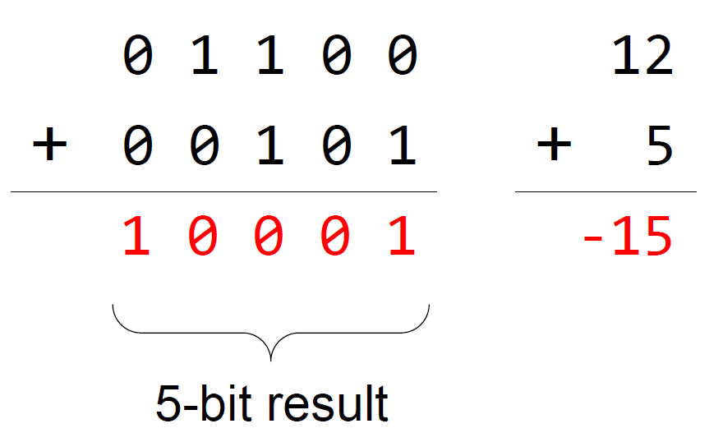
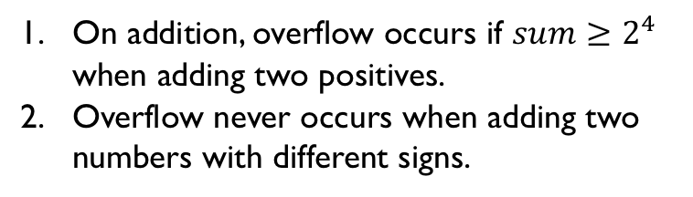
Overflow for Signed Add
On addition, overflow occurs if $sum≥2^{4}$ when adding two positives.
Overflow never occurs when adding two numbers with different signs.
Overflow occurs when adding two positive integers but getting a negative result.
Notes:
For signed numbers represented in two’s complement, an overflow occurs only in two scenarios:
Add two positive numbers and get a negative result
Add two negative numbers and get a positive result

Slide 27
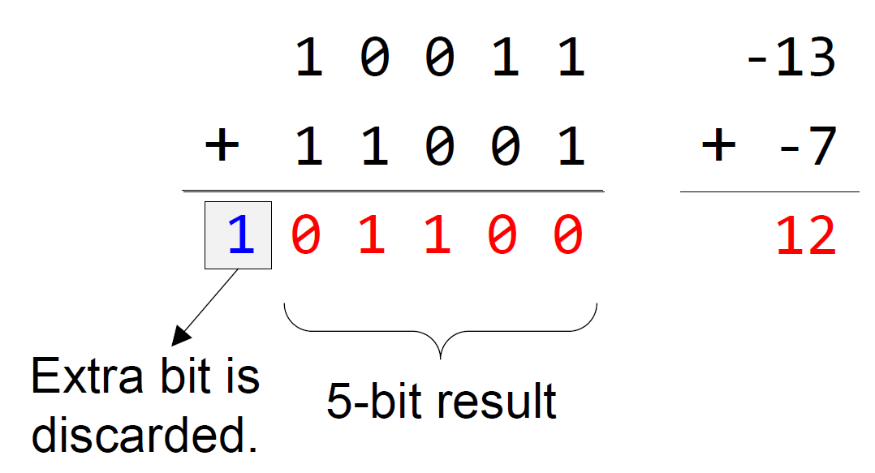
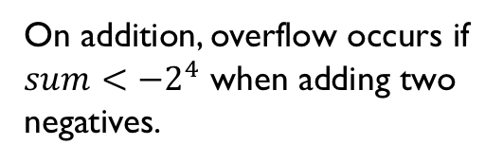
Overflow for Signed Add
On addition, overflow occurs if $sum<−2^{4}$ when adding two negatives.
Overflow occurs when adding two negative integers but getting a positive result.
Notes:
For signed numbers represented in two’s complement, an overflow occurs only in two scenarios:
Add two positive numbers and get a negative result
Add two negative numbers and get a positive result

Slide 28
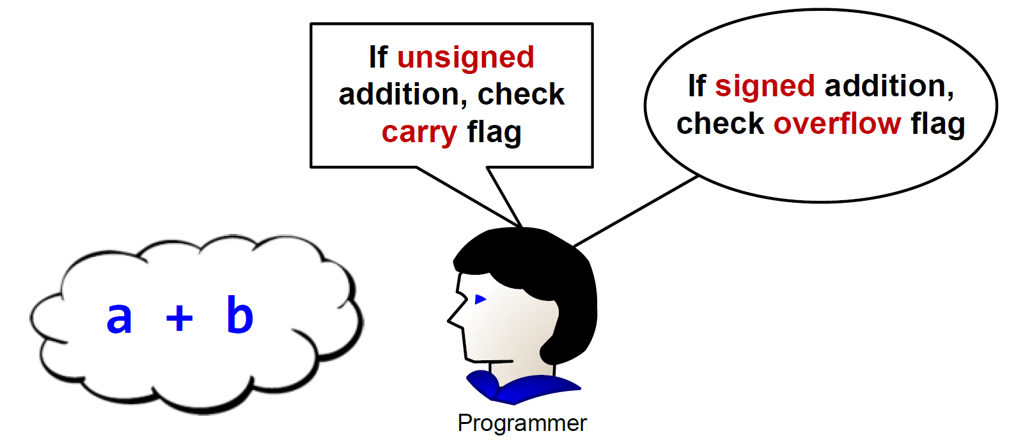
Signed or unsigned
Whether the carry flag or the overflow flag should be used depends on the programmer’s intention.
When programming in high-level languages such as C, the compiler automatically chooses to use the carry or overflow flag based on how this integer is declared in source code (“int” or “unsigned int”).

Slide 29
Signed or Unsigned (5-bit System)
a = 0b10000
b = 0b10000
c = a + b
Whether the carry flag or the overflow flag should be used depends on the programmer’s intention: Are a and b signed or unsigned numbers?
uint a;
uint b;
…
c = a + b
…
int a;
int b;
…
c = a + b
…
Check the carry flag!
Check the overflow flag!
C Program
C Program

Slide 30
Signed or Unsigned (5-bit System)
a = 0b10000
b = 0b10000
c = a + b
If unsigned:
uint a, b;
a = 16
b = 16
c = a + b
= 32 > 2⁵-1
Carry flag set
Are a and b signed or unsigned numbers?
CPU does not know and does not care; it sets up both carry flag and overflow flags.
  10000 + 10000 = 00000, and carry/overflow flags.
It is software’s (programmer/compiler) responsibility to interpret the flags.
  The C compiler uses either the carry or the overflow flag based on how this integer is declared in source code ( “uint” or “int”).
If signed:
int a, b;
a = -16
b = -16
c = a + b
= -32 < -2⁴
Overflow flag set

Slide 31
Two’s Complement Simplifies Hardware Implementation
In two’s complement, the same hardware works correctly for both signed and unsigned addition/subtraction.
If the product is required to keep the same number of bits as operands, unsigned multiplication hardware works correctly for signed numbers.
However, this is not true for division. (not discussed in this course)
Operation | Are signed and unsigned operations the same?
Addition | Yes
Subtraction | Yes
Multiplication | Yes if the product is required to keep the same number of bits as operands
Division | No

Slide 32
Adding two signed integers:
(-9) + 6
-9
+
6
9
flip
+1
-9
1 | 0 | 1 | 1 | 1
0 | 0 | 1 | 1 | 0
01001
10110
10111
23
6
Two’s Complement
Same binary arithmetic: 10111 + 00110 = 11101 can represent:
  Either signed arithmetic : (-9) + 6 = -3
  Or unsigned arithmetic : 23 + 6 = 29
Simple Hardware Adder
29
flip
+1
3
1 | 1 | 1 | 0 | 1
00010
00011
Two’s Complement Counterpart
-3
Notes:
{{Pause=1}} We will use a very simple example to show that, the hardware adder for adding unsigned numbers, also works correctly for adding signed numbers. {{Pause=0.5}}
Suppose we are adding negative nine and six. {{Pause=0.5}} These two signed numbers are represented in two’s complement in computers. {{Pause=0.5}}
Specifically, we can obtain the two’s complement representation of negative nine by flipping all bits and adding one. {{Pause=0.5}} The two’s complement of a positive number is itself. {{Pause=0.5}}
Let’s see what will happen if the hardware treats these two inputs as unsigned numbers. If these binary bits represent unsigned numbers, they are 23 and 6, respectively. Therefore, the hardware adds 23 and 6, and produces 29, in decimal, {{Pause=0.3}} or one, one, one, zero, one, in binary. {{Pause=0.5}}
If the output represents a signed integer in two’s complement, it actually represents negative 3. This can be proved by inverting all the bits and adding one. The result, negative three, is exactly the sum of the original signed inputs. {{Pause=0.5}}
This example shows that, without any modification, the hardware adder designed for adding unsigned numbers, works correctly for adding signed numbers.

Slide 33
Subtracting two signed integers:
(-9) - 6
-9
-
6
9
flip
+1
-9
1 | 0 | 1 | 1 | 1
0 | 0 | 1 | 1 | 0
01001
10110
10111
23
6
Two’s Complement
Same binary arithmetic: 10111 - 00110 = 10001 can represent:
  Either signed arithmetic : (-9) - 6 = -15
  Or unsigned arithmetic : 23 - 6 = 17
Simple Hardware Subtractor
17
15
flip
+1
-15
1 | 0 | 0 | 0 | 1
01111
10000
10001
-15
Notes:
{{Pause=1}} Similarly, the same subtraction hardware works correctly for both signed and unsigned subtraction, even though the sign of input operands is not examined. {{Pause=0.3}} This example subtracts 6 from negative 9. The hardware ignores the sign of the inputs, and subtracts 6 from 23. The result is 17, in decimal, {{Pause=0.3}} or one, zero, zero, zero, one, in binary. If the result represents a signed integer in two’s complement, then the result is negative 15. This is exactly the result of subtracting the original signed integers.

Slide 34
Condition Codes
Bit | Name | Meaning after add or sub
N | negative | Result’s MSB = 1 (signed result < 0)
Z | zero | Result == 0
C | carry | Unsigned arithmetic out of range
V | overflow | Signed arithmetic out of range
31
0
N
Z
C
V
CPSR (Current Program Status Register)
C is set upon an unsigned addition if the result is out of range
C is cleared upon an unsigned subtract if the result is out of range
V is set upon a signed addition or subtraction if the result is out of range
Why do we care about these bits?
34

Slide 35
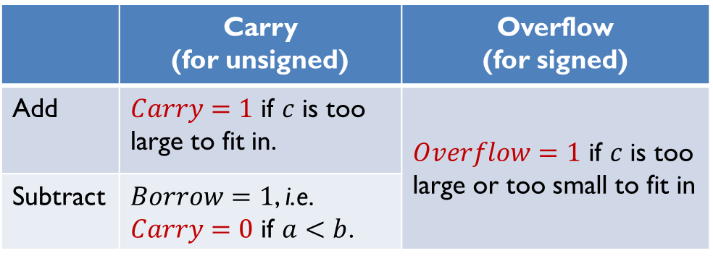
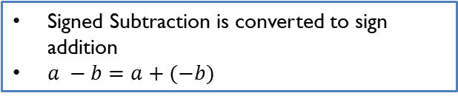
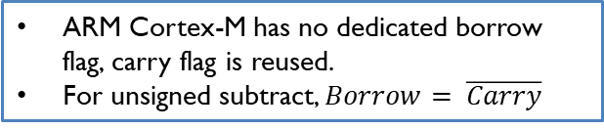

Carry and Overflow Flags
IMPORTANT
Carry flag C = 1 (Borrow flag = 0) upon an unsigned addition if the result is out of range (true result > 2^{n}-1)
Carry flag C = 0 (Borrow flag = 1) upon an unsigned subtraction if the result is out of range (true result < 0)
Overflow flag V =1 upon a signed addition or subtraction if the result is out of range (true result > 2^{n-1}-1 or true result < -2^{n-1})
$$c=a±b$$
 | Carry (for unsigned) | Overflow (for signed)
Add | $Carry=1$ if $c$ is too large to fit in. | $Overflow=1$ if $c$ is too large or too small to fit in
Subtract | $Borrow=1$, i.e. $Carry=0$ if $a<b$.
ARM Cortex-M has no dedicated borrow flag, carry flag is reused.
For unsigned subtract, $Borrow= \overline{Carry}$
Signed Subtraction is converted to sign addition
$a −b=a+(−b)$
Notes:
C is set when the true unsigned result exceeds the representable range.

Slide 36
Characters
Dec | Hex | Char | Dec | Hex | Char | Dec | Hex | Char | Dec | Hex | Char
0 | 00 | NUL | 32 | 20 | SP | 64 | 40 | @ | 96 | 60 | `
1 | 01 | SOH | 33 | 21 | ! | 65 | 41 | A | 97 | 61 | a
2 | 02 | STX | 34 | 22 | " | 66 | 42 | B | 98 | 62 | b
3 | 03 | ETX | 35 | 23 | # | 67 | 43 | C | 99 | 63 | c
4 | 04 | EOT | 36 | 24 | $ | 68 | 44 | D | 100 | 64 | d
5 | 05 | ENQ | 37 | 25 | % | 69 | 45 | E | 101 | 65 | e
6 | 06 | ACK | 38 | 26 | & | 70 | 46 | F | 102 | 66 | f
7 | 07 | BEL | 39 | 27 | ' | 71 | 47 | G | 103 | 67 | g
8 | 08 | BS | 40 | 28 | ( | 72 | 48 | H | 104 | 68 | h
9 | 09 | HT | 41 | 29 | ) | 73 | 49 | I | 105 | 69 | i
10 | 0A | LF | 42 | 2A | * | 74 | 4A | J | 106 | 6A | j
11 | 0B | VT | 43 | 2B | + | 75 | 4B | K | 107 | 6B | k
12 | 0C | FF | 44 | 2C | , | 76 | 4C | L | 108 | 6C | l
13 | 0D | CR | 45 | 2D | - | 77 | 4D | M | 109 | 6D | m
14 | 0E | SO | 46 | 2E | . | 78 | 4E | N | 110 | 6E | n
15 | 0F | SI | 47 | 2F | / | 79 | 4F | O | 111 | 6F | o
16 | 10 | DLE | 48 | 30 | 0 | 80 | 50 | P | 112 | 70 | p
17 | 11 | DC1 | 49 | 31 | 1 | 81 | 51 | Q | 113 | 71 | q
18 | 12 | DC2 | 50 | 32 | 2 | 82 | 52 | R | 114 | 72 | r
19 | 13 | DC3 | 51 | 33 | 3 | 83 | 53 | S | 115 | 73 | s
20 | 14 | DC4 | 52 | 34 | 4 | 84 | 54 | T | 116 | 74 | t
21 | 15 | NAK | 53 | 35 | 5 | 85 | 55 | U | 117 | 75 | u
22 | 16 | SYN | 54 | 36 | 6 | 86 | 56 | V | 118 | 76 | v
23 | 17 | ETB | 55 | 37 | 7 | 87 | 57 | W | 119 | 77 | w
24 | 18 | CAN | 56 | 38 | 8 | 88 | 58 | X | 120 | 78 | x
25 | 19 | EM | 57 | 39 | 9 | 89 | 59 | Y | 121 | 79 | y
26 | 1A | SUB | 58 | 3A | : | 90 | 5A | Z | 122 | 7A | z
27 | 1B | ESC | 59 | 3B | ; | 91 | 5B | [ | 123 | 7B | {
28 | 1C | FS | 60 | 3C | < | 92 | 5C | \ | 124 | 7C | |
29 | 1D | GS | 61 | 3D | = | 93 | 5D | ] | 125 | 7D | }
30 | 1E | RS | 62 | 3E | > | 94 | 5E | ^ | 126 | 7E | ~
31 | 1F | US | 63 | 3F | ? | 95 | 5F | _ | 127 | 7F | DEL
American
Standard
Code for
Information
Interchange
Standard ASCII
  0 - 127
Extended ASCII
0 - 255
ANSI
0 - 255
Unicode
0 - 65535
Standard ASCII: Encoding 128 characters

Slide 37
Null-terminated String
Memory Address | Memory Content | Letter
str + 12 → | 0x00 | \0
str + 11 → | 0x79 | y
str + 10 → | 0x6C | l
str + 9 → | 0x62 | b
str + 8 → | 0x6D | m
str + 7 → | 0x65 | e
str + 6 → | 0x73 | s
str + 5 → | 0x73 | s
str + 4 → | 0x41 | A
str + 3 → | 0x20 | space
str + 2 → | 0x4D | M
str + 1 → | 0x52 | R
str → | 0x41 | A
char str[13] = "ARM Assembly"; // The length has to be at least // 13 even though it has 12 // letters. The NULL terminator // should be included. or simply char str[] = "ARM Assembly";

Slide 38
String Comparison
Strings are compared based on their ASCII values
“j” < “jar” < “jargon” < “jargonize”
“CAT” < “Cat” < “DOG” < “Dog” < “cat” < “dog”
“12” < “123” < “2”< “AB” < “Ab” < “ab” < “abc”

Slide 39
String Length
Strings are terminated with a null character (NUL, ASCII value 0x00)
Pointer dereference operator *
int strlen (char *pStr){ int i = 0; // loop until *pStr is NULL while( *pStr ) { i++; pStr++; } return i; }
Array subscript operator [ ]
int strlen (char *pStr){ int i = 0; // loop until pStr[i] is NULL while( pStr[i] ) i++; return i; }

Slide 40
Convert to Upper Case
A | B | C | D | E | F | G | H | I | J | K | L | M | N | O | P | Q | R | S | T | U | V | W | X | Y | Z
41 | 42 | 43 | 44 | 45 | 46 | 47 | 48 | 49 | 4A | 4B | 4C | 4D | 4E | 4F | 50 | 51 | 52 | 53 | 54 | 55 | 56 | 57 | 58 | 59 | 5A
a | b | c | d | e | f | g | h | i | j | k | l | m | n | o | p | q | r | s | t | u | v | w | x | y | z
61 | 62 | 63 | 64 | 65 | 66 | 67 | 68 | 69 | 6A | 6B | 6C | 6D | 6E | 6F | 70 | 71 | 72 | 73 | 74 | 75 | 76 | 77 | 78 | 79 | 7A
‘a’ – ‘A’ = 0x61 – 0x41 = 0x20 = 32
Pointer dereference operator *
void toUpper(char *pStr){ char *p = pStr; for(; *p; ++p){ if(*p >= 'a' && *p <= 'z') *p -= 'a' - 'A'; //or: *p -= 32; } }
Array subscript operator [ ]
void toUpper(char *pStr){ int i; char c = pStr[0]; for(i = 0; c; i++, c = pStr[i]) { if(c >= 'a' && c <= 'z') pStr[i] -= 'a' - 'A'; // or: pStr[i] -= 32; } }

Slide 42
Summary
Unsigned integer arithmetic
Signed integer arithmetic
  2’s complement
Carry and Overflow Flags
  Carry answers: “Did unsigned math overflow?”
  Overflow answers: “Did signed math overflow?”
  Hardware sets both. Software decides which one is used
ASCII strings

Slide 43
References
Lecture 1. Why use two's complement?
  https://www.youtube.com/watch?v=lJCefqV80ck&list=PLRJhV4hUhIymmp5CCeIFPyxbknsdcXCc8&index=1
Lecture 2: Carry flag for unsigned addition and subtraction
  https://www.youtube.com/watch?v=MxGW2WurKuM&list=PLRJhV4hUhIymmp5CCeIFPyxbknsdcXCc8&index=2
Lecture 3: Overflow flag for signed addition and subtraction
  https://www.youtube.com/watch?v=BIn6iyYIGio&list=PLRJhV4hUhIymmp5CCeIFPyxbknsdcXCc8&index=3

