Slide 1
Zonghua Gu
Embedded Systems with ARM Cortex-M Microcontrollers in Assembly Language and C
Chapter 5
Memory Access
Exercises
Fall 2026
Acknowledgement: Lecture slides based on Embedded Systems with ARM Cortex-M Microcontrollers in Assembly Language and C, University of Maine https://web.eece.maine.edu/~zhu/book/

Slide 2
Endianness
32-bit
Words
Bytes
Addr.
0x000F
Addr
=
??
0x000E
Word 3
0x000D
0x000C
What are the memory address of these four words?
0x000B
Addr
=
??
0x000A
Word 2
0x0009
0x0008
0x0007
Addr
=
??
0x0006
Word 1
0x0005
0x0004
0x0003
Addr
=
??
0x0002
Word 0
0x0001
0x0000

Slide 3
Endianness
Q: Assume Big-Endian ordering. If a 32-bit word resides at memory address N, what is the address of:
  (a) The MSB (Most Significant Byte)
  (b) The 16-bit half-word corresponding to the most significant half of the word
Q: Redo the question assuming Little-Endian ordering.
N+3
LSB
N+2
Big-Endian
N+1
N
MSB
N+3
MSB
N+2
Little-Endian
N+1
N
LSB

Slide 4
Endianness
The word stored at address 0x20008000
with Big-Endian ordering is
Memory Address | Memory Data
0x20008003 | 0xA7
0x20008002 | 0x90
0x20008001 | 0x8C
0x20008000 | 0xEE
?
The word stored at address 0x20008000
with Little-Endian ordering is
?
Notes:
Halfword access and signed halfword/byte accesses were added to the architecture in v4T, this is the reason the offset field is not as flexible as the normal word/byte load/store - not a problem because these accesses are less common.
Link: diagram on next slide

Slide 5
Endianness
LDR r11, [r0]
; r0 = 0x20008000
r11 before load
0x12345678
Memory Address | Memory Data
0x20008003 | 0xA7
0x20008002 | 0x90
0x20008001 | 0x8C
0x20008000 | 0xEE
r11 after load w/ Big-Endian ordering
r11 after load w/ Little-Endian ordering
Notes:
Halfword access and signed halfword/byte accesses were added to the architecture in v4T, this is the reason the offset field is not as flexible as the normal word/byte load/store - not a problem because these accesses are less common.
Link: diagram on next slide

Slide 6
Endianness
Memory Address | Memory Data
0x20008003 | 0xA7
0x20008002 | 0x90
0x20008001 | 0x8C
0x20008000 | 0xEE
Assume little endian for the following questions: r0 = 0x20008000
LDRH r1, [r0]
  r1 after load:
LDRSB r1, [r0]
  r1 after load:
STR r1, [r0], #4
  Assume r1 = 0x76543210
  r0 after store:
  Memory content after store:
STR r1, [r0, #4]
  Assume r1 = 0x76543210
  r0 after store:
  Memory content after store:
STR r1, [r0, #4]!
  Assume r1 = 0x76543210
  r0 after store:
  Memory content after store:

Slide 7
Data Alignment
Q: Assume a byte-addressable memory with a data bus that is 32 bits (4 bytes) wide. How many memory cycles are required to read each of the following from memory?
  (a) A 2-Byte operand read from decimal address 5
  (b) A 2-Byte operand read from decimal address 15
  (c) A 4-Byte operand read from decimal address 10
  (d) A 4-Byte operand read from decimal address 20

Slide 8
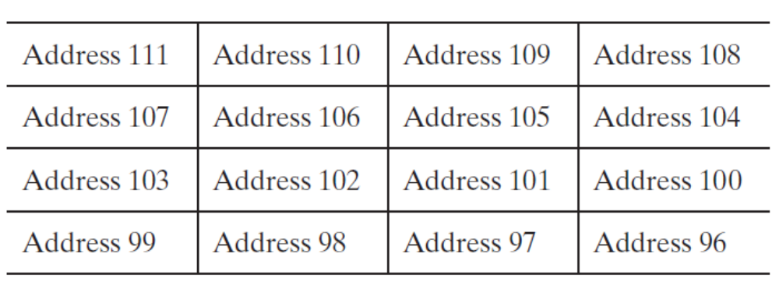
Data Alignment
Q: Assume a byte-addressable memory with a data bus that is 32 bits (4 bytes) wide. Consider 16 bytes of memory (addresses 96 to 111) arranged as four 32-bit words (4 bytes each).
  (a) What is the address of MSB of the word at address 102, assuming Little-Endian ordering?
  (b) What is the address of LSB of the word at address 102, assuming Little-Endian ordering?
  (c) How many memory cycles are required to read the word at address 102?
  (d) How many memory cycles are required to read the half word at address 102?

Slide 9
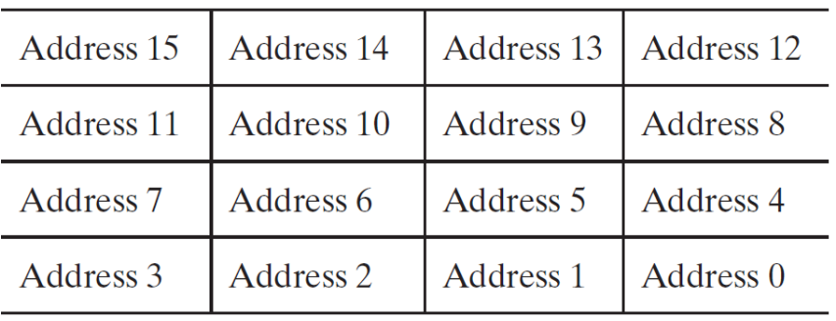
Memory Cycles
Q: Assume a byte-addressable memory with a data bus that is 32 bits (4 bytes) wide.
  It takes ____ memory cycle(s) to read a Byte from memory
  It takes ____ memory cycle(s) to read a half-word from memory
  It takes ____ memory cycle(s) to read a word from memory
  It takes ____ memory cycle(s) to read a double word from memory

Slide 10
Arrays
Q: If the first element of a one-dimensional array x[] is stored at memory address 0x12345678, what is address of the second element if the array x[] contains
  (a) chars
  (b) shorts
  (c) ints
  (d) longs (32-bit ARM/Cortex-M: long = 4 bytes)
  (e) long longs (8 bytes)

Slide 11
LDM
Assume that memory and registers r0 through r3 appear as follows. Suppose r3 = 0x8000 (for LDMDB: r3 = 0x800C). Describe the memory and register contents after executing each instruction (individually, not sequentially):
  LDMIA r3!, {r0, r1, r2}
  Or LDMIA r3!, {r2, r1, r0}
  LDMDB r3!, {r0, r1, r2}
Memory Address | Memory Data
0x8010 | 0x00000001
0x800c | 0xFEEDDEAF
0x8008 | 0x00008888
0x8004 | 0x12340000
0x8000 | 0xBABE0000
r3
Notes:
Address Register^{[1]}
0x8010 0x00000001 0x13 r0^{[1]}
0x800c 0xFEEDDEAF 0xFFFFFFFF r1^{[1]}
0x8008 0x00008888 0xEEEEEEEE r2^{[1]}
0x8004 0x12340000 0x8000 r3^{[1]}
0x8000 0xBABE0000^{[1]}

Slide 12
LDR
Suppose R2 and R5 hold the values 8 and 0x23456789. After following code runs with big-endian ordering, what value is in R7? How about with little-endian ordering? (Assume Cortex-M3/M4, which allow unaligned halfword access.)
  STR R5, [R2, #0]
  LDRB R7, [R2, #1]
  LDRSH R7, [R2, #1]
  LDRSH R7, [R2, #2]

Slide 13
Program Understanding 1
Compute register and memory values at each step of this program, given initial register values and memory contents, assuming little-endian ordering. (Memory addresses increase from bottom to top, and from left to right in the table.)
R0 | 0x00000000
R1 | 0x10000200
R2 | 0x0000FFFF
R3 | 0x18675309
R4 | 0x00000000
R5 | 0x00000000
…
R13 | 0x10000200
MOVW R0, #0xAFE1
MOVT R0, #0xBADC
MOVT R2, #0xABCD
STR R3, [R1]
LDRSH R4, [R1, #0xC]
Initial Register Values
0x10000200 | 60 | 1B | 11 | 12 | EE | FF | 11 | 22 | 33 | 44 | 55 | 66 | 77 | 88 | 99 | 92
0x100001F0 | 10 | 11 | 12 | 13 | 14 | 15 | 16 | 17 | 18 | 19 | 1A | 1B | 1C | 1D | 1E | 1F
0x100001E0 | 00 | 01 | 02 | 03 | 04 | 05 | 06 | 07 | 08 | 09 | 0A | 0B | 0C | 0D | 0E | 0F
Initial Memory Contents

Slide 14
Program Understanding 2
LDR R1, =0x10000010
LDR R2, [R1]
LDR R3, [R1,#4]
BL max
SUBS R4, R2, R0 @NZCV =
MOVW R5, #1
LSL R6, R5, #4
BIC R7, R2, R6
ANDS R8, R7, R6 @NZCV =
ROR R9, R3, #12
REV R10, R9
RBIT R11, R10
ADDS R12, R3, R9 @NZCV =
STR R12, [R1,#8]
loop B loop
ENDP
max PROC
CMP R2, R3 @NZCV =
BLT second
first MOV R0, R2
B done
second MOV R0, R3
done BX LR
ENDP
Show all updates to registers as the assembly code shown below runs, assuming little-endian ordering. (Memory addresses increase from bottom to top, and from left to right in the table.) Show the NZCV flags next to the instruction if they change. Each instruction is 32 bits.
R0 |  | R4 |  | R8 |  | R12
R1 |  | R5 |  | R9 |  | R13
R2 |  | R6 |  | R10 |  | R14
R3 |  | R7 |  | R11 |  | R15
0x10000010 | FF | EF | CD | AB | 00 | 00 | CD | AB | 00 | 00 | 00 | 00
Notes:
0x10000010 FF EF CD AB 00 00 CD AB D0 BC D7 A8

