Slide 1
Z. Gu
Embedded Systems with ARM Cortex-M3 Microcontrollers in Assembly Language and C
Chapter 9
64-bit Data Processing
Fall 2026

Slide 2
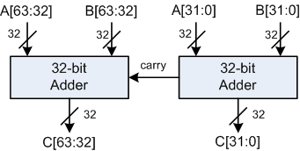
64-bit Addition
It uses ADDS (add and update flags, including Carry) and ADC (add with carry) instructions to compute the 64-bit result across two 32-bit parts with carry propagation.
; Adding two 64-bit integers A (r1:r0) and B (r3:r2)
; C (r5:r4) = A (r1:r0) + B (r3:r2)
; A = 00002222FFFFFFFF, B = 0000044400000001
LDR r0, =0xFFFFFFFF ; A’s lower 32 bits
LDR r1, =0x00002222 ; A’s upper 32 bits
LDR r2, =0x00000001 ; B’s lower 32 bits
LDR r3, =0x00000444 ; B’s upper 32 bits
; Add A and B
ADDS r4, r2, r0 ; C[31:0] = A[31:0] + B[31:0], update Carry
ADC r5, r3, r1 ; C[63:32] = A[63:32] + B[63:32] + Carry

Slide 3
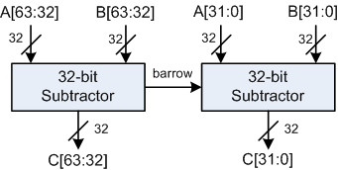
64-bit Subtraction
It uses SUBS (subtract and update flags, including Carry) and SBC (subtract with carry) instructions with borrow (= not Carry) to handle the two-part subtraction.
; Subtracting two 64-bit integers A (r1:r0) and B (r3:r2).
; C (r5:r4) = A (r1:r0) - B (r3:r2)
; A = 00000002FFFFFFFF, B = 0000000400000001
LDR r0, =0xFFFFFFFF ; A’s lower 32 bits
LDR r1, =0x00000002 ; A’s upper 32 bits
LDR r2, =0x00000001 ; B’s lower 32 bits
LDR r3, =0x00000004 ; B’s upper 32 bits
; Subtract B from A
SUBS r4, r0, r2 ; C[31:0] = A[31:0] - B[31:0], update Carry
SBC r5, r1, r3 ; C[63:32] = A[63:32] - B[63:32] + Carry - 1

Slide 4
64-bit Counting Leading Zeroes
; 64-bit input data = (r1:r0), r1 = upper word, r0 = lower word
; r2 = # of leading zero bits in the 64-bit data
; Counting # of leading zeroes in upper word
CLZ r2, r1 ; CLZ = Count leading zeroes
; Counting # of leading zeroes in lower word
CMP r2, #32
ITT EQ ; next 2 instrs run only if EQ
CLZEQ r3, r0 ; if r2 == 32, then count leading zero
; bits of the lower word
ADDEQ r2, r2, r3 ; if all bits of the upper word are zero,
; add the leading zeroes of the lower word

Slide 5
64-bit Counting Leading Zeroes: Explanations
Run CLZ on the upper 32 bits: CLZ r2, r1; if r1 ≠ 0, r2 already equals the 64-bit leading-zero count since leading zeros must lie entirely in the upper half for a nonzero upper word.
Compare r2 with 32: CMP r2, #32; if equal, the upper word is zero, so count lower: ITT EQ (on Cortex-M, makes the next two instructions conditional on EQ); CLZEQ r3, r0; then ADDEQ r2, r2, r3 to add the lower’s leading zeros for the total over 64 bits.
Edge cases:
  If r1 ≠ 0, the lower word is ignored because the first 1-bit lies in the upper word, making r2 the final answer directly from CLZ r1.
  If r1 = 0 and r0 ≠ 0, the total is 32 + CLZ(r0), as there are 32 leading zeros from the upper word plus those from the lower word until its first 1-bit.
  If r1 = 0 and r0 = 0, the total is 64; the slide’s conditional path computes r2 = 32 + 32 = 64 via CLZ on both halves.

Slide 6
64-bit Sign Extension
; r0 = Lower word of 64-bit data
; r1 = Upper word of 64-bit data
TST r0, #0x80000000 ; Check the sign bit
ITE NE ; LDRNE runs if NE, LDREQ (inverse) if EQ
LDRNE r1, =0xFFFFFFFF ; If MSB is 1, duplicate 1 in upper word
LDREQ r1, =0x00000000 ; If MSB is 0, duplicate 0 in upper word
TST (test) performs a bitwise AND between operands to test bits, updates condition flags (notably Z and N), and discards the result. This is effectively “ANDS without write-back,” used to check whether specific bits are set or clear before a conditional operation.
TST r0, #0x80000000 checks the sign bit of the low 32 bits by ANDing r0 with the mask and sets condition flags without storing a result. Z=0 implies MSB=1 (negative), Z=1 implies MSB=0 (non-negative).
ITE NE, then LDRNE r1, =0xFFFFFFFF ; if Z=0, sign bit set MSB=1(result non-zero → NE), set upper 32 = all 1s
LDREQ r1, =0x00000000 (the E slot of ITE NE) ; if Z=1, sign bit clear MSB=0 (result zero → EQ), set upper 32 = all 0s
Notes:
What TST does
Operation: computes $Rn \& \text{Operand}\text{2}$, updates N and Z from the result; C is set from any shift applied to Operand2; V is unaffected. No registers are modified.
Z flag: set to 1 if the AND result is zero (i.e., none of the tested bits were set); cleared to 0 otherwise.
N flag: copies bit 31 of the AND result (useful when testing sign or high bits).
C flag: if Operand2 uses a shift (e.g., LSL #k), C becomes the last bit shifted out; if no shift, C is unchanged.’
What NE means
NE is the “not equal” condition code tied to the Zero flag Z being 0 after a prior flag-setting instruction like CMP, TST, ADDS, SUBS.
If that prior operation’s result was zero, Z = 1 and NE fails; if the result was nonzero, Z = 0 and NE succeeds.
Examples
After CMP r0, #5: NE is true when r0 ≠ 5 because the subtraction result wasn’t zero, so Z = 0.
After TST r0, #0x80000000: NE is true when the tested bit(s) produce a nonzero AND, e.g., the sign bit is 1, so Z = 0.

Slide 7
64-bit Logical Shift Left

Slide 8
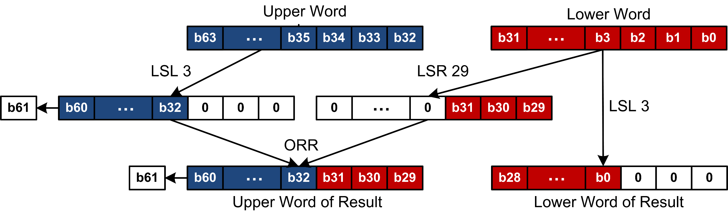
64-bit Logical Shift Left
Example of Logical Shift Left by 3

Slide 9

64-bit Logical Shift Left
r1
r0
r1
r4
r1
r0
Write the assembly code

Slide 10
64-bit Logical Shift Left
r1
r0
r1
R4 (R3, LSR #29)
r1
r0
Write the assembly code
  ; r0 = Lower word of 64-bit data
  ; r1 = Upper word of 64-bit data
  MOV r3, r0 ; Backup the lower word
  MOVS r1, r1, LSL #3 ; Shift left the upper word
  MOV r0, r0, LSL #3 ; Shift left the lower word
  ORR r1, r1, r3, LSR #29 ; upper |= lower >> (32 - 3)

Slide 11
64-bit Logical Shift Right

Slide 12
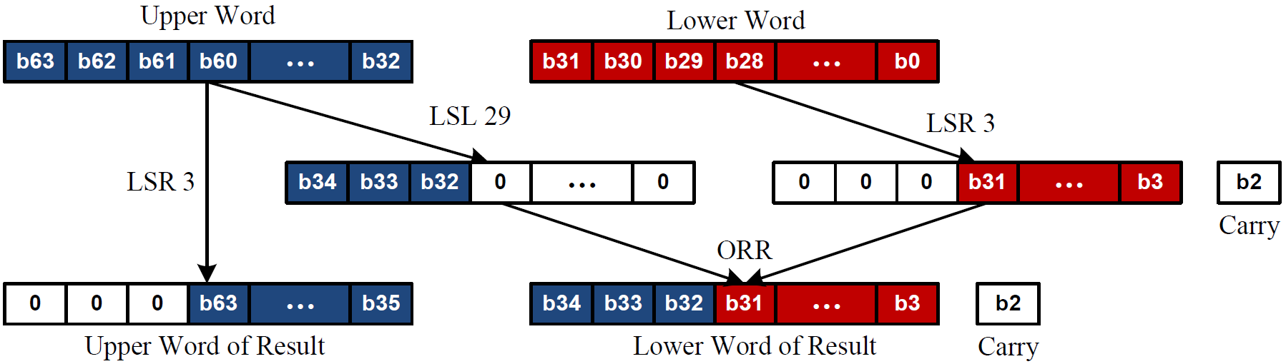
64-bit Logical Shift Right
Example of Logical Shift Right by 3

Slide 13
64-bit Logical Shift Right
r1
r0
r1
r0
Write the assembly code
  ; r0 = Lower word of 64-bit data
  ; r1 = Upper word of 64-bit data
  MOV r3, r1 ; Backup the upper word
  MOV r1, r1, LSR #3 ; Shift right upper word
  MOV r0, r0, LSR #3 ; Shift right lower word
  ORR r0, r0, r3, LSL #29 ; lower |= upper << (32 - 3)

Slide 14
64-bit Multiplication
; product (r5:r4) = multiplier (r1:r0) × multiplicand (r3:r2)
; (r5:r4) = r0 × r2 + 2³² × (r1 × r2 + r0 × r3) + 2⁶⁴ × r1 × r3
; The last item exceeds 64 bits and thus it is ignored.
UMULL r4, r5, r0, r2 ; (r5:r4) = r0 * r2
MLA r5, r1, r2, r5 ; r5 = r5 + r1 * r2
MLA r5, r0, r3, r5 ; r5 = r5 + r0 * r3
UMULL r4, r5, r0, r2 computes the 64-bit product of the low words and places the low 32 bits in r4 and the high 32 bits in r5, establishing the initial 64-bit accumulator.
MLA Multiply Accumulate: MLA Rd, Rn, Rm, Ra computes Rd = (Ra + (Rn × Rm)) mod 2^32. Only the least-significant 32 bits of the sum are written to Rd; any higher bits are discarded.
MLA r5, r1, r2 adds the cross term r1·r2 (which conceptually belongs at bit position 32) into the high half r5
MLA r5, r0, r3, r5 similarly adds the other cross term r0·r3 into r5, completing the contribution of both cross terms at the correct alignment; overflow beyond 32 bits of r5 is discarded, ignoring the 2^64·(r1·r3) part.
Notes:
MLA R9, R2, R1, R5 → R9 = R5 + (R2 × R1).
since r0·r2 already filled r4:r5, adding r1·r2 to r5 correctly accumulates the 2^32 shift of that cross term without disturbing r4.

