Slide 1
Z. Gu
Embedded Systems with ARM Cortex-M Microcontrollers in Assembly Language and C
Chapter 6
Control Flow in Assembly
Fall 2025
Acknowledgement: Lecture slides based on Embedded Systems with ARM Cortex-M Microcontrollers in Assembly Language and C, University of Maine https://web.eece.maine.edu/~zhu/book/

Slide 2
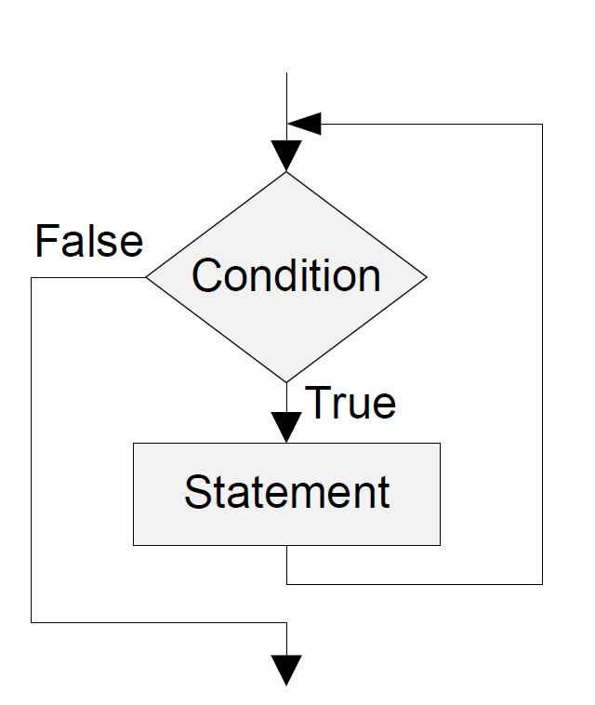
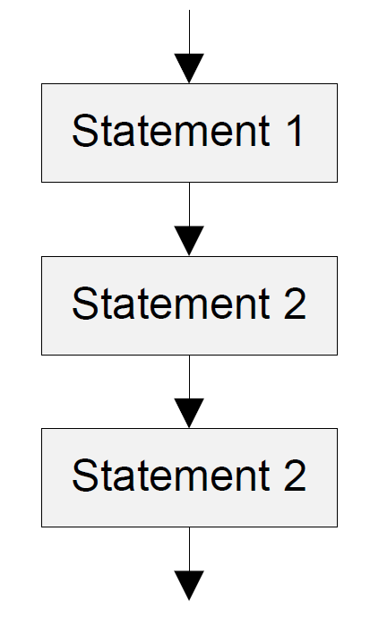
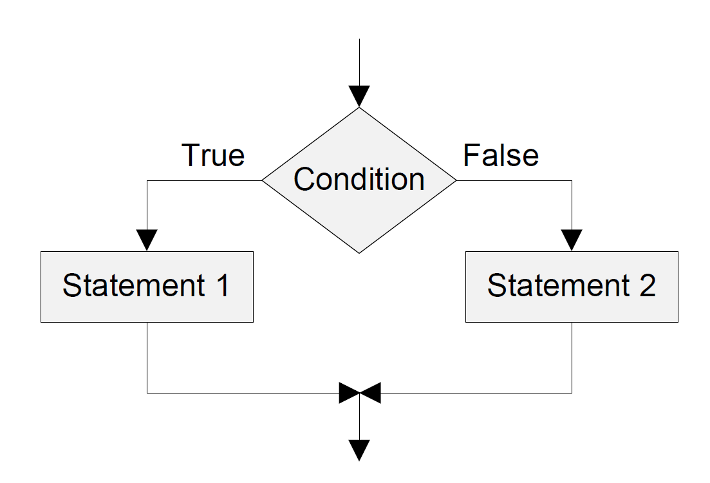
Three Control Structures
Sequence Structure
Computer executes statements (instructions), one after another, in the order listed in the program
Selection Structure
If-then-else
Loop Structure
while loop
for loop
Sequence Structure
Selection Structure
Loop Structure

Slide 3
Combined Program Status Registers (xPSR)
Review
Notes:
The Q flag is sticky in that, when set to 1 by an instruction, it remains set until explicitly cleared to 0 by an MSR instruction writing to the CPSR. Instructions cannot execute conditionally on the status of the Q flag.
Saturation arithmetic is a version of arithmetic in which all operations such as addition and multiplication are limited to a fixed range between a minimum and maximum value. If the result of an operation is greater than the maximum it is set ("clamped") to the maximum, while if it is below the minimum it is clamped to the minimum. The name comes from how the value becomes "saturated" once it reaches the extreme values; further additions to a maximum or subtractions from a minimum will not change the result.
For example, if the valid range of values is from -100 to 100, the following operations produce the following values:
60 + 43 = 100
(60 + 43) − 150 = −50
43 − 150 = −100
60 + (43 − 150) = −40
10 × 11 = 100
99 × 99 = 100
30 × (5 − 1) = 100
30×5 − 30×1 = 70
Green psr bits are only in certain versions of the ARM architecture
ALU status flags (set if "S" bit set, implied in Thumb state).
Sticky overflow flag (Q flag) is set either when
saturation occurs during QADD, QDADD, QSUB or QDSUB, or
the result of SMLAxy or SMLAWx overflows 32-bits
Once flag has been set can not be modified by one of the above instructions and must write to CPSR using MSR instruction to cleared
PSRs split into four 8-bit fields that can be individually written:
Control (c) bits 0-7
Extension (x) bits 8-15 Reserved for future use
Status (s) bits 16-23 Reserved for future use
Flags (f) bits 24-31
Bits that are reserved for future use should not be modified by current software. Typically, a read-modify-write strategy should be used to update the value of a status register to ensure future compatibility. Note that the T/J bits in the CPSR should never be changed directly by writing to the PSR (use the BX/BXJ instruction to change state instead).
However, in cases where the processor state is known in advance (e.g. on reset, following an interrupt, or some other exception), an immediate value may be written directly into the status registers, to change only specific bits (e.g. to change mode).
New ARM V6 bits now shown.

Slide 4
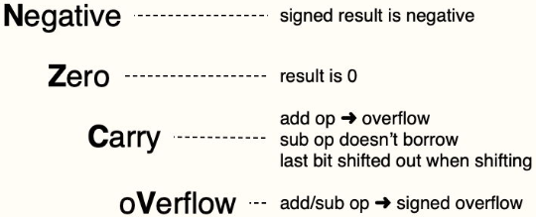
Condition Flags
Review
Program Status Register (PSR)
N
Z
C
V
Q
ICI/IT
T
Reserved
GE
Reserved
ICI/IT
ISR number
Negative bit
N = 1 if most significant bit of result is 1
Zero bit
Z = 1 if all bits of result are 0
Carry bit
For unsigned addition, C = 1 if carry takes place
For unsigned subtraction, C = 0 (carry = not borrow) if borrow takes place
For shift/rotation, C = last bit shifted out
oVerflow bit
V = 1 if adding 2 same-signed numbers produces a result with the opposite sign
Positive + Positive = Negative, or
Negative + negative = Positive
Non-arithmetic operations does not touch V bit, such as MOV,AND,LSL,MUL
Notes:
N (negative) – set (1) when a signed result is negative, otherwise cleared (0).
Z (zero) – set (1) when a result is 0, otherwise cleared (0).
C (carry) – set (1) when an add-based operation produces an overflow, when a subtract-based operation doesn’t require a borrow; when shifting, holds the last bit that’s been shifted out; otherwise cleared (0).
V (overflow) – set (1) when an add- or subtract-based operation generates a signed overflow, otherwise cleared (0).

Slide 5
Carry and Overflow Flags w/ Arithmetic Instructions
Review
Carry flag C = 1 (Borrow flag = 0) upon an unsigned addition if the answer is wrong (true result > 2^{n}-1)
Carry flag C = 0 (Borrow flag = 1) upon an unsigned subtraction if the answer is wrong (true result < 0)
Overflow flag V =1 upon a signed addition or subtraction if the answer is wrong (true result > 2^{n-1}-1 or true result < -2^{n-1})
Overflow may occur when adding 2 operands with the same sign, or subtracting 2 operands with different signs; Overflow cannot occur when adding 2 operands with different signs or when subtracting 2 operands with the same sign.
 | Unsigned Addition | Unsigned Subtraction | Signed Addition or Subtraction
Carry flag | true result > 2^{n}-1 ➔ Carry flag=1 Borrow flag=0 (Result incorrect) | true result < 0 ➔ Carry flag=0 Borrow flag=1 (Result incorrect) | N/A
Overflow flag | N/A | N/A | true result > 2^{n-1}-1 or true result < -2^{n-1} Overflow flag=1 (Result incorrect)
5
Notes:
C is cleared upon an unsigned subtract if the answer is wrong
The carry flag (CF) is set differently for unsigned addition and subtraction:
When adding or subtracting two signed numbers in an n-bit system, an overflow occurs if the true result is larger than the maximum signed integer (i.e. $2^{n−1}−1$) or smaller than the minimum signed integer (i.e. ${−2}^{n−1}$) that can be represented
Overflow may occur when adding 2 operands with the same sign, or subtracting 2 operands with different signs, including:
adding two positive numbers
adding two negative numbers
subtracting a positive number from a negative number
subtracting a negative number from a positive number
Overflow cannot occur when adding 2 operands with different signs or when subtracting 2 operands with the same sign.
Why?
Unsigned Addition:
The carry flag is set to 1 if there is a carry out from the most significant bit (MSB) during the addition.
This means the sum exceeds the maximum value that can be represented in the given number of bits.
Example: Adding two 8-bit numbers resulting in a value greater than 255 will set CF = 1.
Unsigned Subtraction:
The carry flag acts as a borrow indicator for subtraction.
CF is cleared (set to 0) if a borrow is needed (i.e., if the minuend is less than the subtrahend).
CF is set to 1 if no borrow is needed, meaning the subtraction did not underflow.
Summary:
For unsigned addition, CF = 1 means an overflow beyond the MSB (carry out).
For unsigned subtraction, CF = 0 means a borrow (underflow), CF = 1 means no borrow.
The carry flag thus helps detect unsigned overflow or underflow conditions.
This behavior contrasts with signed arithmetic, where the overflow flag (OF) signals signed overflow, and the carry flag is generally not used.
References from teaching and documentation explain this clearly: The carry flag signals actual carry for addition and borrow for subtraction in unsigned arithmetic scenarios.

Slide 6
Updating Condition Flags
Method 1: append “S”: updates destination register, and sets flags
ADD r0,r1,r2 → ADDS r0,r1,r2
SUB r0,r1,r2 → SUBS r0,r1,r2
Performs operation, writes the result into Rd, and also updates NZCV flags
Method 2: compare instructions: sets flags only
CMP/CMN/TEQ/TST: performs operation to update NZCV flags, but the computation result is not saved and discarded
Notes:
it’s a “compare-only” operation for branching or predication.
; it both computes and compares in one step
Flag Setting Instructions:
CMP: R1 - R2 (result discarded)
TST: R1 & R2 (result discarded)
TEQ: R1 ⊕ R2 (result discarded)
CMN: R1 + R2 (result discarded)

Slide 7
Updating Condition Flags
Instruction | Operands | Brief description | Flags
CMP | R1 - R2 | Compare | N,Z,C,V
CMN | R1 + R2 | Compare Negative | N,Z,C,V
TST | R1 & R2 | Test | N,Z,C
TEQ | R1 ⊕ R2 | Test Equivalence | N,Z,C
Update flags
No need to add S. No need to specify destination register.
Operations are:
CMP R1 – R2: Same as SUBS, except result discarded (not written to destination register)
CMN R1 + R2: Same as ADDS, except result discarded
TST R1 & R2: Same as ANDS, except result discarded
TEQ R1 ⊕ R2: Same as EORS, except result discarded
Examples:
CMP r0, r1
TST r2, #5
Notes:
SUBS Rd, R1, R2: performs subtraction $Rn − Op2$, writes the result into Rd, and also updates NZCV flags; it both computes and compares in one step.
CMP/CMN/TEQ/TST: performs operations to update NZCV flags, but the computation result is not saved and discarded; it’s a “compare-only” operation for branching or predication.
CMP R1, R2
CMN R1, R2
Update N, Z, C and V according to the result
CMP subtracts R2 from R1.
Same as SUBS, except result is discarded.
CMN adds R2 to R1.
Same as ADDS, except result is discarded.

Slide 8

Example of CMP
$$f\left(x\right)=|x|$$
Area absolute, CODE, READONLY
EXPORT __main
ENTRY
__main PROC
CMP r1, #0 ; r1 = x
RSBLT r0, r1, #0
done B done ; deadloop, end of program
ENDP
END
RSBLT r0, r1, #0:: conditional execution of the RSB instruction with condition code LT. If r1 < 0, then set r0 = 0 − r1 = -r1
Notes:
Note: RSB = Reverse SuBtract

Slide 9
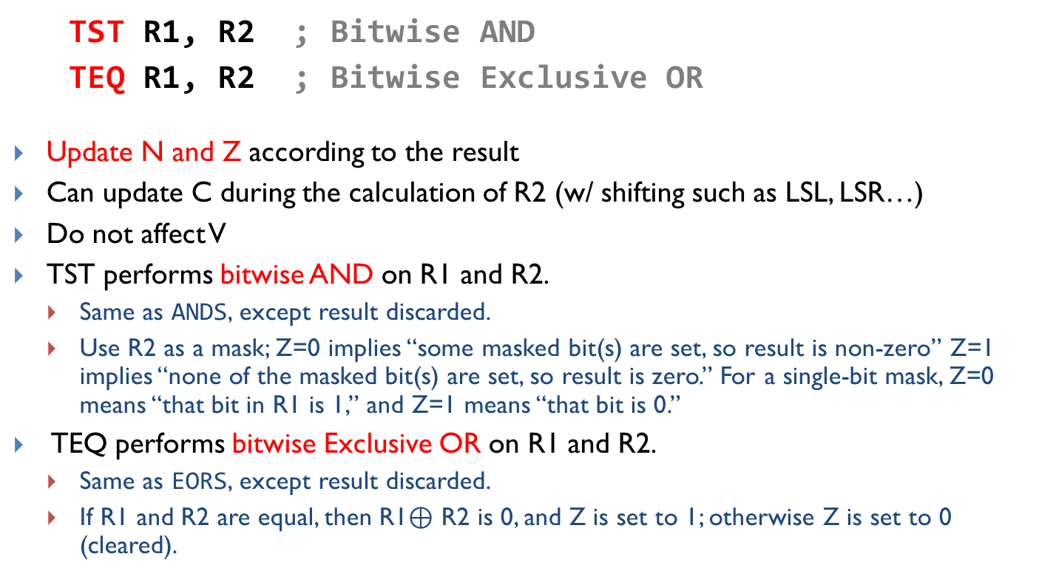
Updating Condition Flags: TST and TEQ
TST R1, R2 ; Bitwise AND
TEQ R1, R2 ; Bitwise Exclusive OR
Update N and Z according to the result
Can update C during the calculation of R2 (w/ shifting such as LSL, LSR…)
Do not affect V
TST performs bitwise AND on R1 and R2.
Same as ANDS, except result discarded.
Use R2 as a mask; Z=0 implies “some masked bit(s) are set, so result is non-zero” Z=1 implies “none of the masked bit(s) are set, so result is zero.” For a single-bit mask, Z=0 means “that bit in R1 is 1,” and Z=1 means “that bit is 0.”
TEQ performs bitwise Exclusive OR on R1 and R2.
Same as EORS, except result discarded.
If R1 and R2 are equal, then R1$⊕$ R2 is 0, and Z is set to 1; otherwise Z is set to 0 (cleared).
x | y | x AND y
0 | 0 | 0
0 | 1 | 0
1 | 0 | 0
1 | 1 | 1
x | y | x XOR y
0 | 0 | 0
0 | 1 | 1
1 | 0 | 1
1 | 1 | 0
Notes:
It computes logical operation $Rd⊕Op$ internally, writes no result to a register, and updates the condition flags based on that XOR.
If $Rn \text{∧} Operand2$ is 0x0, then R1 and R2 are equal, Z is set to 1; otherwise Z is cleared.

Slide 10
Example of TEQ
Translate C code into assembly:
C Code | Assembly
if (char==‘!’||char==‘?’) found++; | TEQ r0, #‘!’ TEQNE r0, #‘?’ ADDEQ r1, r1, #1
TEQ r0, #‘!’ performs a test-equal by computing r0 - ‘!’ and setting condition flags; Z=1 when r0 equals ‘!’.
TEQNE r0, #‘?’ executes only if the previous Z=0 (i.e., char was not ‘!’); it tests r0 against ‘?’ and sets Z accordingly. This achieves the logical OR without branches by conditionally running the second test only when needed.
Logical OR operator (||) employs short-circuit evaluation, meaning it evaluates expressions from left to right and stops as soon as the result of the entire expression is determined. For (cond1||cond2): If cond1 evaluates to true (non-zero), the overall result of the || operation is already known to be true, so cond2 is not evaluated. If cond1 evaluates to false (zero), the evaluation proceeds to the next operand cond2.
ADDEQ r1, r1, #1 executes only if Z=1 after the tests, meaning char matched either ‘!’ or ‘?’.
If r0 == ‘!’, then TEQ sets Z = 1. TEQNE is skipped, and ADDEQ is executed
The 2nd TEQNE executes only if the first comparison failed (Z=0). If r0 == ‘?’, then TEQNE is executed and sets Z = 1, and ADDEQ is executed
If r0 != ‘!’ && r0 != ‘?’, then TEQ sets Z = 0, TEQNE is executed and sets Z = 0, and ADDEQ is not executed

Slide 11
Unconditional Branch Instructions
Instruction | Operands | Brief description
B, BAL | label | Branch
BL | label | Branch with Link
BLX | Rm | Branch indirect with Link
BX | Rm | Branch indirect
B label or BAL label
cause a branch to label.
BL label
copy the address of the next instruction into r14 (lr, the link register), and
cause a branch to label.
BX Rm
branch to the address held in Rm
BLX Rm:
copy the address of the next instruction into r14 (lr, the link register) and
branch to the address held in Rm

Slide 12
Unconditional Branch Instructions: A Simple Example
MOVS r1, #1
B target ; Branch to target
MOVS r2, #2 ; Not executed
MOVS r3, #3 ; Not executed
MOVS r4, #4 ; Not executed
target MOVS r5, #5
A label marks the location of an instruction
Labels help human to read the code
In machine program, labels are converted to numeric offsets by assembler
Here MOVS can be replaced by MOV since the flags are not used

Slide 13
Condition Codes
The possible condition codes are listed below:
Suffix
Description
Flags tested
EQ
EQual
Z==1
NE
Not Equal
Z==0
CS: Carry Set
CS/HS
Unsigned Higher or Same
C==1
CC: Carry Clear
CC/LO
Unsigned LOwer
C==0
MI
MInus (Negative)
N==1
PL
PLus (Positive or Zero)
N==0
VS
oVerflow Set
V==1
VC
oVerflow Clear
V==0
HI
Unsigned HIgher
C==1 and Z==0
LS
Unsigned Lower or Same
C==0 or Z==1
GE
Signed Greater or Equal
N==V
LT
Signed Less Than
N!=V
GT
Signed Greater Than
Z==0 and N==V
LE
Signed Less than or Equal
Z==1 or N!=V
AL
ALways
Note AL is the default and does not need to be specified
Notes:
Condition codes are simply a way of testing the ALU status flags.
Note AL is the default and does not need to be specified

Slide 14
Signed vs. Unsigned Comparison
Op | Cond (Signed) | Flags | Explanation | Cond (Unsigned) | Flags | Explanation
R1 > R2 | GT (Greater Than) | Z=0 & N=V | Non-zero result and signs agree | HI (Higher) | C=1 & Z=0 | No borrow and not equal
R1 ≥ R2 | GE (Greater or Equal) | N=V | See next page | HS (Higher or Same) | C=1 | No borrow (R1 ≥ R2)
R1 < R2 | LT (Less Than) | N≠V | See next page | LO (Lower) | C=0 | Borrow occurred (R1 < R2)
R1 ≤ R2 | LE (Less or Equal) | Z=1 or N≠V | Zero or overflow mismatch | LS (Lower or Same) | C=0 or Z=1 | Borrow or equal
R1==R2 | EQ (Equal) |  |  |  | Z=1 | Zero
R1 ≠ R2 | NE (Not Equal) |  |  |  | Z=0 | Non-Zero
CMP R1, R2
perform subtraction R1 – R2, set flags without saving result
Notes:
Key Condition Codes:
EQ/NE: Z=1 / Z=0 (Equal/Not Equal)
LT/GE: N≠V / N=V (Signed Less Than/Greater Equal)
GT/LE: Z=0 & N=V / Z=1 or N≠V (Signed Greater/Less Equal)
LO/HS: C=0 / C=1 (Unsigned Lower/Higher Same)
HI/LS: C=1 & Z=0 / C=0 or Z=1 (Unsigned Higher/Lower Same)
Flag Setting Instructions:
CMP: R1 - R2 (result discarded)
TST: R1 & R2 (result discarded)
TEQ: R1 ⊕ R2 (result discarded)
CMN: R1 + R2 (result discarded)

Slide 15
Signed Comparison Explanations
Condition (signed) | N | V | CMP R1, R2 returns | Meaning
GE (Greater or Equal) | 0 | 0 | 1 | Result non-negative (R1 – R2 ≥ 0), no overflow → R1 ≥ R2
GE (Greater or Equal) | 1 | 1 | 1 | Result negative (R1 – R2 < 0), but overflowed so sign is flipped → true result ≥ 0 → R1 ≥ R2
LT (Less Than) | 1 | 0 | 0 | Result negative (R1 – R2 < 0), no overflow → R1 < R2
LT (Less Than) | 0 | 1 | 0 | Result non-negative (R1 – R2 ≥ 0), but overflowed so sign is flipped → true result < 0 → R1 < R2
If N = V, then GE (CMP R1, R2 returns 1)
If N ≠ V, then LT (CMP R1, R2 returns 0)

Slide 16
Signed Comparison Examples (5-bit system)
 | N = 0 | N = 1
V = 0 | R1 = +7 (00111) R2 = +3 (00011) R1 − R2 = +4 (00100); result non‑negative and no signed overflow, so N=0, V=0 ⇒ GE holds | R1 = +3 (00011) R2 = +7 (00111) R1 − R2 = −4 (11100) result negative with no overflow, so N=1, V=0 ⇒ LT holds
V = 1 | R1 = −10 (10110) R2 = +7 (00111) R1 − R2 = −17, outside range [−16,+15]; result is 00111 (decimal 7), whose sign bit is 0 so N=0, but signed overflow occurs so V=1 ⇒ LT holds | R1 = +10 (01010) R2 = −7 (11001) R1 − R2 = +17, outside range [−16,+15]; result is 10001 (decimal −15), whose sign bit is 1 so N=1, but signed overflow occurs so V=1 ⇒ GE holds
If N = V, then GE (CMP R1, R2 returns 1)
If N ≠ V, then LT (CMP R1, R2 returns 0)
If Z=0 & N=V, then GT (result non-zero)
If Z=1 or N≠V, then LE (result may be 0)
Notes:
GT (Greater Than)
Z=0 & N=V
Non-zero result and signs agree
LE (Less or Equal)
Z=1 or N≠V
In the CPSR (Current Program Status Register) of ARM processors, the N and V flags are status flags used to reflect the result of operations:
N flag (Negative flag): This flag is set to 1 if the result of an operation is negative when interpreted as a signed number. In practice, it is set to the most significant bit (bit 31) of the result. If this bit is 1, the number is negative in two's complement representation. Otherwise, it is 0.sciencedirect+1youtube
V flag (Overflow flag): This flag is set to 1 if a signed overflow has occurred in the operation—meaning the signed result does not fit in the number of bits allowed. For example, adding two large positive signed integers that produce a negative result sets V. Likewise, subtracting a large negative from a large positive can also set V. It indicates that the sign bit has been corrupted due to overflow. If no overflow occurs, V is cleared to 0.armyoutube
Together, N and V help the processor and programmers detect and handle signed arithmetic conditions like overflow and sign changes, which are critical for signed condition codes and branching decisions.
https://arm-software.github.io/CMSIS_5/Core_A/html/group__CMSIS__CPSR.html
https://www.sciencedirect.com/topics/computer-science/current-program-status-register
https://developer.arm.com/documentation/ddi0406/b/System-Level-Architecture/The-System-Level-Programmers--Model/ARM-processor-modes-and-core-registers/Program-Status-Registers--PSRs-
https://community.arm.com/arm-community-blogs/b/architectures-and-processors-blog/posts/condition-codes-1-condition-flags-and-codes
https://goiabada.github.io/docs/sections/arm-cpu/flags.html
https://heyrick.eu/assembler/psr.html
https://users.ece.utexas.edu/~valvano/EE345M/Arm_EE382N_4.pdf
https://www.youtube.com/watch?v=28MMaELXRZ0
https://azeria-labs.com/arm-conditional-execution-and-branching-part-6/
https://ece.eng.wayne.edu/~smahmud/ECECourses/ECE5620/Manuals/ARM_InstructionSet.pdf

Slide 17
Number Interpretation
Which is greater?
0xFFFFFFFF or 0x00000001
If they represent signed numbers, the latter is greater.
(1 > -1).
If they represent unsigned numbers, the former is greater
(2³²⁻¹ > 1).

Slide 18
Which is Greater: 0xFFFFFFFF or 0x00000001?
It’s software’s responsibility to tell computer how to interpret data:
If written in C, declare the signed vs unsigned variable
If written in Assembly, use signed vs unsigned branch instructions
int32_t x, y; x = -1;
y = 1; if (x > y)
...
MOV r5, #0xFFFFFFFF MOV r6, #0x00000001
CMP r5, r6 BLE Then_Clause
...
BLE: Branch if less than or equal, signed ≤
uint32_t x, y;
x = 4294967295;
y = 1;
if (x > y)
...
MOV r5, #0xFFFFFFFF MOV r6, #0x00000001
CMP r5, r6 BLS Then_Clause
...
BLS: Branch if lower or same, unsigned ≤

Slide 19
Conditional Branch Instructions
Conditional codes applied to branch instructions
Compare | Signed | Unsigned
> | GT | HI
≥ | GE | HS
< | LT | LO
≤ | LE | LS
== | EQ
≠ | NE
Compare | Signed | Unsigned
> | BGT | BHI
≥ | BGE | BHS
< | BLT | BLO
≤ | BLE | BLS
== | BEQ
≠ | BNE
Notes:
Key Condition Codes:
EQ/NE: Z=1 / Z=0 (Equal/Not Equal)
LT/GE: N≠V / N=V (Signed Less Than/Greater Equal)
GT/LE: Z=0 & N=V / Z=1 or N≠V (Signed Greater/Less Equal)
LO/HS: C=0 / C=1 (Unsigned Lower/Higher Same)
HI/LS: C=1 & Z=0 / C=0 or Z=1 (Unsigned Higher/Lower Same)
Flag Setting Instructions:
CMP: R1 - R2 (result discarded)
TST: R1 & R2 (result discarded)
TEQ: R1 ⊕ R2 (result discarded)
CMN: R1 + R2 (result discarded)

Slide 20
If-then Statement
C Program | Assembly Program 1 | Assembly Program 2
// a is signed integer if (a < 0 ) { a = 0 – a; } x = x + 1; | ; r1 = a, r2 = x CMP r1, #0 ; Compare a with 0 BGE endif ; Go to endif if a ≥ 0 RSB r1, r1, #0 ; a = - a endif: ADD r2, r2, #1 ; x = x + 1 | ; r1 = a, r2 = x CMP r1, #0 RSBLT r1, r1, #0 ; a = - a if a < 0 ADD r2, r2, #1 ; x = x + 1
C Program | Assembly Program 1 | Assembly Program 2
// a is signed integer if(a <= 20 || a >= 25){ x = 1 } | ; r1 = a, r2 = x CMP r1, #20 ; compare a and 20 BLE then ; go to then if a ≤ 20 CMP r1, #25 ; compare a and 25 BLT endif ; go to endif if a < 25 then: MOV r2, #1 ; x = 1 Endif ; implements short circuit evaluation of || condition (if 1st condition is true, 2nd condition checking is skipped) | ; r1 = a, r2 = x CMP r1, #20 ; compare a and 20 MOVLE r2, #1 ; a <= 20 → x = 1 CMP r1, #25 ; compare a and 25 MOVGE r2, #1 ; a >= 25 → x = 1 ; else (21 <= a <= 24) → no MOV executed. Does not implement short circuit evaluation. Both conditions will always be evaluated, and r2 is possibly assigned twice. This code only works if the loop body instruction is idempotent, i.e., executing it multiple times gives same result

Slide 21
If-then-else
C Program | Assembly Program 1
// a is signed integer if (a == 1) x = 3; else x = 4; | ; r1 = a, r2 = b CMP r1, #1 ; compare a and 1 BNE else ; go to else if a ≠ 1 then: MOV r2, #3 ; x = 3 B endif ; go to endif else: MOV r2, #4 ; x = 4 endif:

Slide 22
For Loop
C Program
int i; //signed int int sum = 0;//signed int for(i = 0; i < 10; i++){ sum += i; }
C Program (equivalent)
int i = 0; //signed int int sum = 0;//signed int while (i < 10) { sum += i; i++; }
Implementation 1 (Classic compare-and-branch):
MOV r0, #0 % sum = 0
MOV r1, #0 % i = 0
loop:
CMP r1, #10 % i < 10 ?
BGE done % exit if i >= 10
ADD r0, r0, r1 % sum += i
ADD r1, r1, #1 % i++
B loop
done: % : is optional after a label
Notes:
MOV r0, #0 ; i
MOV r1, #0 ; sum
loop CMP r0, #10 ; check whether i < 10
BGE endloop ; skip if ≥
ADD r1, r1, r0 ; sum += i
ADD r0, r0, #1 ; i++
B loop
endloop

Slide 23
For Loop
C Program
int i; int sum = 0; for(i = 0; i < 10; i++){ sum += i; }
C Program (equivalent)
int i = 0; int sum = 0; while (i < 10) { sum += i; i++; }
Implementation 2a:
MOV r0, #0 % sum = 0
MOV r1, #0 % i = 0
B check
loop:
ADD r0, r0, r1 % sum += i
ADD r1, r1, #1 % i++
check: CMP r1, #10 % check whether i < 10
BLT loop % loop if i less than 10.

Slide 24
For Loop
C Program
int i; int sum = 0; for(i = 0; i < 10; i++){ sum += i; }
C Program (equivalent)
int i = 0; int sum = 0; do { sum += i; i++; } while (i < 10);
Implementation 2b:
MOV r0, #0 % sum = 0
MOV r1, #0 % i = 0
%B check deleted
Loop:
ADD r0, r0, r1 % sum += i
ADD r1, r1, #1 % i++
CMP r1, #10 % check whether i < 10
BLT loop % loop if i less than 10.

Slide 25
Explanations for 2a and 2b
2a and 2b implement two different loop structures:
Version with “B check” is a pre-test loop (while/for): it tests i < 10 before the first iteration, so the body may execute zero times if the condition is false initially
Version without “B check” is a post-test loop (do-while): it executes the body once before testing, then repeats while i < 10
Because i starts at 0 and the condition is i < 10, and loop iterates from i=0 to i=9, even though the control-flow order differs.
If the while condition is initially true (i < 10), program 2b has same behavior as 2a. But if the while condition is initially false (i >= 10), program 2b executes for 1 iteration while program 2a executes for 0 iteration.
Notes:
If the initial condition were false, only the pre-test version would skip the loop entirely.

Slide 26
For Loop
C Program (equivalent)
int sum = 0; // r0 int count = 10; // r1 int i = 0; // r2 while (count != 0) { sum += i; i += 1; count -= 1; }
C Program
int i; int sum = 0; for(i = 0; i < 10; i++){ sum += i; }
Implementation 3 (Count-down with SUBS/BNE):
MOV r0, #0 % sum = 0
MOV r1, #10 % loop count = 10
MOV r2, #0 % i = 0
loop:
ADD r0, r0, r2 % sum += i
ADD r2, r2, #1 % i++
SUBS r1, r1, #1 % --count, set flags
BNE loop % repeat until loop count==0
SUBS r1, r1, #1
Is equivalent to:
SUB r1, r1, #1
CMP r1, #0

Slide 27
For Loop
C Program
int i; int sum = 0; for(i = 0; i < 10; i++){ sum += i; }
C Program (equivalent)
int i = 0; int sum = 0; while (i < 10) { sum += i; i++; }
Implementation 4 (Use conditional execution, i goes from 0 to 9 to execute ADDLT 10 times):
MOV r0, #0 % sum = 0
MOV r1, #0 % i = 0
loop:
CMP r1, #10 % set flags from i-10
ADDLT r0, r0, r1 % if i<10: sum += i
ADDLT r1, r1, #1 % if i<10: i++
BLT loop % if i<10: loop

Slide 28
Condition Codes
The possible condition codes are listed below:
Suffix
Description
Flags tested
EQ
Equal
Z=1
NE
Not equal
Z=0
CS/HS
Unsigned higher or same
C=1
CC/LO
Unsigned lower
C=0
MI
Negative
N=1
PL
Positive or Zero
N=0
VS
Overflow
V=1
VC
No overflow
V=0
HI
Unsigned higher
C=1 & Z=0
LS
Unsigned lower or same
C=0 or Z=1
GE
Signed Greater or equal
N=V
LT
Signed Less than
N!=V
GT
Signed Greater than
Z=0 & N=V
LE
Signed Less than or equal
Z=1 or N!=V
AL
Always
Note AL is the default and does not need to be specified
Notes:
Condition codes are simply a way of testing the ALU status flags.
Note AL is the default and does not need to be specified

Slide 29
Conditional Execution
Add instruction | Condition | Flag tested
ADDEQ r3, r2, r1 | Add if EQual | Add if Z = 1
ADDNE r3, r2, r1 | Add if Not Equal | Add if Z = 0
ADDHS r3, r2, r1 | Add if Unsigned Higher or Same | Add if C = 1
ADDLO r3, r2, r1 | Add if Unsigned LOwer | Add if C = 0
ADDMI r3, r2, r1 | Add if Minus (Negative) | Add if N = 1
ADDPL r3, r2, r1 | Add if PLus (Positive or Zero) | Add if N = 0
ADDVS r3, r2, r1 | Add if oVerflow Set | Add if V = 1
ADDVC r3, r2, r1 | Add if oVerflow Clear | Add if V = 0
ADDHI r3, r2, r1 | Add if Unsigned HIgher | Add if C = 1 & Z = 0
ADDLS r3, r2, r1 | Add if Unsigned Lower or Same | Add if C = 0 or Z = 1
ADDGE r3, r2, r1 | Add if Signed Greater or Equal | Add if N = V
ADDLT r3, r2, r1 | Add if Signed Less Than | Add if N != V
ADDGT r3, r2, r1 | Add if Signed Greater Than | Add if Z = 0 & N = V
ADDLE r3, r2, r1 | Add if Signed Less than or Equal | Add if Z = 1 or N = !V

Slide 30
Conditional Execution Examples
C Program | Assembly Program
// a, x are signed integers int32_t a, y if (a <= 0) y = -1; else y = 1; | ; r0 = a, r1 = y CMP r0, #0 MOVLE r1, #-1 ; executed if LE MOVGT r1, #1 ; executed if GT
if(a <= 20 || a >= 25){ y = 1; } | CMP r0, #20 ; compare a and 20 MOVLE r1, #1 ; y=1 if less or equal CMP r0, #25 ; CMP if greater than MOVGE r1, #1 ; y=1 if greater or equal
if (a==1 || a==7 || a==11) y = 1; else y = -1; | CMP r0, #1 CMPNE r0, #7 ; executed if r0 != 1 CMPNE r0, #11 ; executed if r0 != 1 ; and r0 != 7 MOVEQ r1, #1 MOVNE r1, #-1
LE:Signed Less than or Equal
GT:Signed Greater Than
NE: Not Equal
EQ: Equal
Notes:
Sequence of conditional instructions:
- no instruction must reset cond code flags
- BL corrupts flags so must be last
- limit sequence to max 3 or so instrs
Can use different condition codes. Give if then else example. Note GCD practical coming later.
Conditional compare
- resets condition code when executed
- compiler will make use of this
- can be difficult for a human to understand!
Not just for compare, using data processing with condition code and S bit is useful in some circumstances.
LDM/LDR instruction cannot set flags due to datapath issues (data comes back only at the very end of the cycle, so there is no opportunity to perform a comparison and set the status flags).
a ⟶ r0
y ⟶ r1

Slide 31
Thought Experiments
This version (top) does not work, since we cannot use any condition code ?? in MOV?? . CMPGT compares r0 with 25 only if the previous result was >.That already changes the flags set by CMP. So by the time you reach MOV?? r1, #1, the CPU has only one current set of flags, and those flags cannot represent both comparisons at once.
If we have MOVGE, then if r0 <= 20, then y = 1 should be executed but it is not.
If we have MOVLE, then if r0 >= 25, then y = 1 should be executed but it is not.
if(a <= 20 || a >= 25){
y = 1;
}
CMP r0, #20 ; compare a and 20
CMPGT r0, #25 ; CMP if greater than
MOVGE r1, #1 ; executed when r0 >= 25
a | CMP r0,#20 result | Does CMPGT r0,#25 run? | Final flags mean | Should y=1? | Is y assigned 1
10 | a < 20 | No | still “less than 20” | Yes | NO
22 | a > 20 | Yes | now “22 < 25” | No | No
27 | a > 20 | Yes | now “27 > 25” | Yes | Yes

Slide 32
This version (bottom) is incorrect, since only the last “CMP r0, #11” sets the Z flag, overwriting flags set by previous two CMP instructions.
CMP r0, #1
CMP r0, #7
CMP r0, #11
MOVEQ r1, #1
MOVNE r1, #-1

Slide 33
Explanations for Compound Boolean Expression
Compound condition (a==1 || a==7 || a==11):
CMP r0, #1
CMPNE r0, #7 ; executed if r0 != 1
CMPNE r0, #11 ; executed if r0 != 7
MOVEQ r1, #1
MOVNE r1, #-1
CMP r0, #1 compares a with 1 and sets Z=1 if equal, else Z=0.
CMPNE r0, #7 runs only if the previous compare was not equal, and if it runs, it refreshes the flags by comparing a with 7.
CMPNE r0, #11 runs only if a was not 1 and not 7, and if it runs, it compares a with 11 to set Z accordingly.
MOVEQ r1, #1 executes only when Z=1 from any of the comparisons, so y becomes 1 if a matched 1, 7, or 11.
MOVNE r1, #-1 executes only when Z=0 after all relevant compares, so y becomes -1 when none of the values matched.

Slide 34
Conditional Execution Examples Con’t
C Program | Assembly Program w/ Branching | Assembly Program w/ Conditional Execution
int32_t x, y; …… if (x + y < 0) x = 0; else x = 1; | % r0 = x, r1 = y ADDS r0, r0, r1 BPL PosOrZ MOV r0, #0 B done PosOrZ MOV r0, #1 done %Could use BGE if you assign negative r1 to r2, then SUBS r0, r0, r2 | ADDS r0, r0, r1 MOVMI r0, #0 ;return 0 if N = 1 MOVPL r0, #1 ;return 1 if N = 0
uint32_t x, y; …… while (x != y) { if (x > y) x = x – y; else y = y – x; } | gcd CMP r0, r1 BEQ end ; if x = y, done BLO less ; x < y SUB r0, r0, r1 ; x = x – y B gcd less SUB r1, r1, r0 ; y = y – x B gcd End | gcd CMP r0, r1 SUBHI r0, r0, r1 SUBLO r1, r1, r0 BNE gcd
Notes:
BPL PosOrZ: Branch to PosOrZ if condition PL is true (N == 0 indicating Positive or Zero) for ADDS r0, r0, r1
MOVPL r0, #1: conditional move that executes only when condition PL is true
MOVMI r0, #0: conditional move that executes only when condition MI (N == 1 indicating Negative) is true

Slide 35
Combination
Instruction | Operands | Brief description
CBZ | R1, label | Compare and Branch if Zero
CBNZ | R1, label | Compare and Branch if Non Zero
Except that it does not change the status flags, CBZ R1,label is equivalent to:
CMP R1, #0
BEQ label
Except that it does not change the status flags, CBNZ R1,label is equivalent to:
CMP R1, #0
BNE label

Slide 36
Break vs. Continue
Example code for break | Example code for continue
for(int i = 0; i < 5; i++){ if (i == 2) break; printf(“%d, ”, i) } | for(int i = 0; i < 5; i++){ if (i == 2) continue; printf(“%d, ”, i) }
Output: 0, 1 | Output: 0, 1, 3, 4

Slide 37
Break Example
C Program | Assembly Program 1 | Assembly Program 2
// Find string length char str[] = "hello"; int len = 0; for( ; ; ) { if (*str == '\0') break; str++; len++; } | ;r0 = string memory address ;r1 = string length ADR r0, str MOV r1, #0 Loop: LDRB r2, [r0] CBNZ r2, notZero B endloop notZero: ADD r0, r0, #1 ; str++ ; to let r0 point to the next char. This works since each char is 1 byte (need to increment by 4 if it was an integer array) ADD r1, r1, #1 ; len++ B loop endloop: | ;r0 = string memory address ;r1 = string length ADR r0, str MOV r1, #0 Loop: LDRB r2, [r0] CBZ r2, endloop ADD r0, r0, #1 ADD r1, r1, #1 B loop endloop:

Slide 38
Break Example
C Program | Assembly Program
// Count characters that are not 'l' until the null terminator char str[] = "hello"; int count = 0; for (; ; ) { if (*str == '\0') break; count++; str++; } | ; r0 = string address (str) ; r1 = count = 0 ADR r0, str MOV r1, #0 Loop: LDRB r2, [r0] CBZ r2, endloop ; if '\0' => break CMP r2, #’l’ ; if char == 'l' ADD r1, r1, #1 ; count++ ADD r0, r0, #1 ; str++ B loop endloop:

Slide 39
Break and Continue Example
C Program | Assembly Program 3
// Count characters that are not 'l' until the null terminator char str[] = "hello"; int count = 0; for (; ; ) { if (*str == '\0') break; if (*str == 'l') continue; count++; str++; } | ; r0 = string address (str) ; r1 = count = 0 ADR r0, str MOV r1, #0 Loop: LDRB r2, [r0] CBZ r2, endloop ; if '\0' => break CMP r2, #’l’ ; if char == 'l' BEQ contLoop ; continue and skip count++ ADD r1, r1, #1 ; count++ contLoop: ADD r0, r0, #1 ; str++ B loop endloop:

Slide 40
IT (If-Then) instruction
You do not need to write IT instructions in your code.
The assembler generates them for you automatically according to the conditions specified.
On smaller ARM cores (Cortex-M0), not all data instructions support condition suffixes directly; instead you must use an IT instruction (Thumb-2) or branches.
"IT" (If-Then) instruction in the ARM Thumb-2 instruction set (16 bits) allows conditional execution of up to four instructions based on a condition flag (like EQ, NE, etc.).
IT{x{y{z}}} {cond}, where x, y, and z specify the existence of the optional second, third, and fourth conditional instruction respectively. x, y, and z are either T (Then) or E (Else). T = execute the following instruction if condition is True; E = execute the following instruction if condition is False
IT — 1 following instruction (If)
ITT — 2 following instructions (If-Then)
ITE — 2 following instructions (If-Else)
ITTE, ITEEE, etc. — up to 4 instructions total
ITTE NE ; If-Then-Then-Else
ANDNE r0,r0,r1 ; executed if Not Equal
ADDNE r2,r2,#1 ; executed if Not Equal
MOVEQ r2,r3 ; executed if Equal
ITT EQ ; Executes both instructions only if Equal condition is true
MOVEQ r0,r1
BEQ dloop ; branch at end of IT block is permitted
ITT EQ ; Executes both instructions only if Equal condition is true
MOVEQ r0,r1
ADDEQ r0,r0,#1
ITT AL ; AL (Always) condition executes two 16-bit instructions unconditionally; the last ADD is outside the IT block.
ADDAL r0,r0,r1 ; 16-bit ADD, not ADDS
SUBAL r2,r2,#1 ; 16-bit SUB, not SUB
ADD r0,r0,r1 ; expands into 32-bit ADD, and is not in IT block
Notes:
You do not need to write IT instructions in your code.
The assembler generates them for you automatically according to the conditions specified.

Slide 41
Summary: Condition Codes
Suffix
Description
Flags tested
EQ
EQual
Z=1
NE
Not Equal
Z=0
CS/HS
Unsigned Higher or Same
C=1
CC/LO
Unsigned LOwer
C=0
MI
MInus (Negative)
N=1
PL
PLus (Positive or Zero)
N=0
VS
oVerflow Set
V=1
VC
oVerflow Cleared
V=0
HI
Unsigned HIgher
C=1 & Z=0
LS
Unsigned Lower or Same
C=0 or Z=1
GE
Signed Greater or Equal
N=V
LT
Signed Less Than
N!=V
GT
Signed Greater Than
Z=0 & N=V
LE
Signed Less than or Equal
Z=1 or N!=V
AL
ALways
Note AL is the default and does not need to be specified
Notes:
Condition codes are simply a way of testing the ALU status flags.
Note AL is the default and does not need to be specified

Slide 42
Summary: Branch Instructions
 | Instruction | Description | Flags tested
Unconditional Branch | B label | Branch to label
Conditional Branch | BEQ label | Branch if EQual | Z = 1
 | BNE label | Branch if Not Equal | Z = 0
 | BCS/BHS label | Branch if unsigned Higher or Same | C = 1
 | BCC/BLO label | Branch if unsigned LOwer | C = 0
 | BMI label | Branch if MInus (Negative) | N = 1
 | BPL label | Branch if PLus (Positive or Zero) | N = 0
 | BVS label | Branch if oVerflow Set | V = 1
 | BVC label | Branch if oVerflow Clear | V = 0
 | BHI label | Branch if unsigned HIgher | C = 1 & Z = 0
 | BLS label | Branch if unsigned Lower or Same | C = 0 or Z = 1
 | BGE label | Branch if signed Greater or Equal | N = V
 | BLT label | Branch if signed Less Than | N != V
 | BGT label | Branch if signed Greater Than | Z = 0 & N = V
 | BLE label | Branch if signed Less than or Equal | Z = 1 or N = !V

Slide 43
Summary: Conditionally Executed
Add instruction | Condition | Flag tested
ADDEQ r3, r2, r1 | Add if EQual | Add if Z = 1
ADDNE r3, r2, r1 | Add if Not Equal | Add if Z = 0
ADDHS r3, r2, r1 | Add if Unsigned Higher or Same | Add if C = 1
ADDLO r3, r2, r1 | Add if Unsigned LOwer | Add if C = 0
ADDMI r3, r2, r1 | Add if Minus (Negative) | Add if N = 1
ADDPL r3, r2, r1 | Add if PLus (Positive or Zero) | Add if N = 0
ADDVS r3, r2, r1 | Add if oVerflow Set | Add if V = 1
ADDVC r3, r2, r1 | Add if oVerflow Clear | Add if V = 0
ADDHI r3, r2, r1 | Add if Unsigned HIgher | Add if C = 1 & Z = 0
ADDLS r3, r2, r1 | Add if Unsigned Lower or Same | Add if C = 0 or Z = 1
ADDGE r3, r2, r1 | Add if Signed Greater or Equal | Add if N = V
ADDLT r3, r2, r1 | Add if Signed Less Than | Add if N != V
ADDGT r3, r2, r1 | Add if Signed Greater Than | Add if Z = 0 & N = V
ADDLE r3, r2, r1 | Add if Signed Less than or Equal | Add if Z = 1 or N = !V

Slide 44
Summary: Condition Codes
Condition Codes:
EQ/NE: Z=1 / Z=0 (Equal/Not Equal)
LT/GE: N≠V / N=V (Signed Less Than/Greater Equal)
GT/LE: Z=0 & N=V / Z=1 or N≠V (Signed Greater/Less Equal)
LO/HS: C=0 / C=1 (Unsigned Lower/Higher Same)
HI/LS: C=1 & Z=0 / C=0 or Z=1 (Unsigned Higher/Lower Same)
Flag Setting Instructions:
CMP: R1 - R2 (result discarded)
TST: R1 & R2 (result discarded)
TEQ: R1 ⊕ R2 (result discarded)
CMN: R1 + R2 (result discarded)

Slide 45
References
Lecture 27. Branch instructions
https://www.youtube.com/watch?v=_QKD7f1cmRI&list=PLRJhV4hUhIymmp5CCeIFPyxbknsdcXCc8&index=27
Lecture 28. Conditional Execution
https://www.youtube.com/watch?v=9hlxG8L5-G4&list=PLRJhV4hUhIymmp5CCeIFPyxbknsdcXCc8&index=28

