Slide 1
Z. Gu
CSC111
Final Review
Fall 2025
Acknowledgement: Lecture slides based on Embedded Systems with ARM Cortex-M Microcontrollers in Assembly Language and C, University of Maine https://web.eece.maine.edu/~zhu/book/

Slide 2
Data Representation
Integers
Binary in different bases: binary, octal, hex, decimal
Signed Integers
Signed magnitude
One’s complement
Two’s complement
Arithmetic Operations
N, V, C, Z flags
Big Endian vs Little Endian
ASCII values
Null-terminated string
Converting between numbers and ASCII
Upper case, lower case
Notes:
Fixed point numbers
Qm.n, UQm.n
Addition, subtract, multiplication, division
Floating point numbers
IEEE 754 Standard
Single Precision, Double Precision

Slide 3
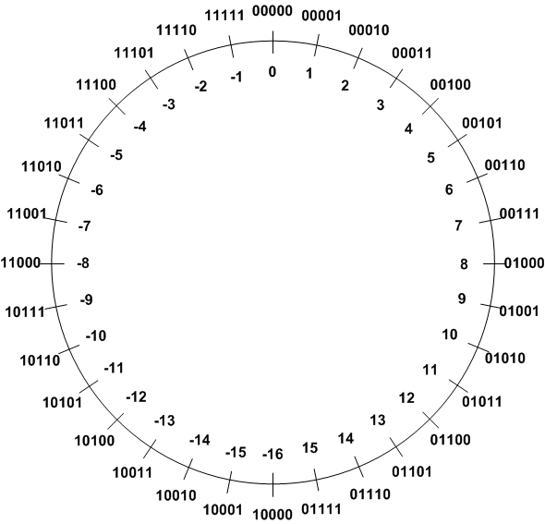
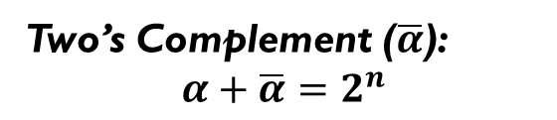
Signed Integers Method 3: Two’s Complement
Two’s Complement ($\overline{α}$):
$$α+\overline{α}=2^{n}$$
TC of a number can be obtained by its bitwise NOT plus one.
Example 1: TC(3)
 | Binary | Decimal
Original number | 00011 | 3
Step 1: Invert every bit | 11100
Step 2: Add 1 | + 00001
Two’s complement | 11101 | -3

Slide 4
Adding two integers
-9
+
6
9
flip
+1
-9
1 | 0 | 1 | 1 | 1
0 | 0 | 1 | 1 | 0
01001
10110
10111
23
6
Two’s Complement
Hardware Adder
29
flip
+1
3
1 | 1 | 1 | 0 | 1
00010
00011
Two’s Complement Counterpart
-3
Same bit patterns, different interpretation.
Unsigned addition: 23+6=29
Signed addition: -9+6=-3
This example shows that the hardware adder for adding unsigned numbers, also works correctly for adding signed numbers.
Notes:
{{Pause=1}} We will use a very simple example to show that, the hardware adder for adding unsigned numbers, also works correctly for adding signed numbers. {{Pause=0.5}}
Suppose we are adding negative nine and six. {{Pause=0.5}} These two signed numbers are represented in two’s complement in computers. {{Pause=0.5}}
Specifically, we can obtain the two’s complement representation of negative nine by flipping all bits and adding one. {{Pause=0.5}} The two’s complement of a positive number is itself. {{Pause=0.5}}
Let’s see what will happen if the hardware treats these two inputs as unsigned numbers. If these binary bits represent unsigned numbers, they are 23 and 6, respectively. Therefore, the hardware adds 23 and 6, and produces 29, in decimal, {{Pause=0.3}} or one, one, one, zero, one, in binary. {{Pause=0.5}}
If the output represents a signed integer in two’s complement, it actually represents negative 3. This can be proved by inverting all the bits and adding one. The result, negative three, is exactly the sum of the original signed inputs. {{Pause=0.5}}
This example shows that, without any modification, the hardware adder designed for adding unsigned numbers, works correctly for adding signed numbers.

Slide 5
Basic Assembly Programming
Load-modify-store sequence
Accessing memory
Memory addressing mode
Pre-index
Post-index
Pre-index with update
Data processing
Arithmetic, Logic, Comparison, Data Movement
Barrel Shifter:
ADD r1, r0, r0, LSL 2
Bit operations
Set a bit, Reset a bit, Toggle a bit, Check a bit
LSL, LSR, ASR, ROR, RRX
Flow control: if, if-then-else, for loop, while loop
Unconditional Branch: B
Conditional Branch: CMP, TEQ,TST, BEQ, BNE, BMI, BLS, BHI, etc.
Conditional Execution: MOVEQ, MOVNE

Slide 6
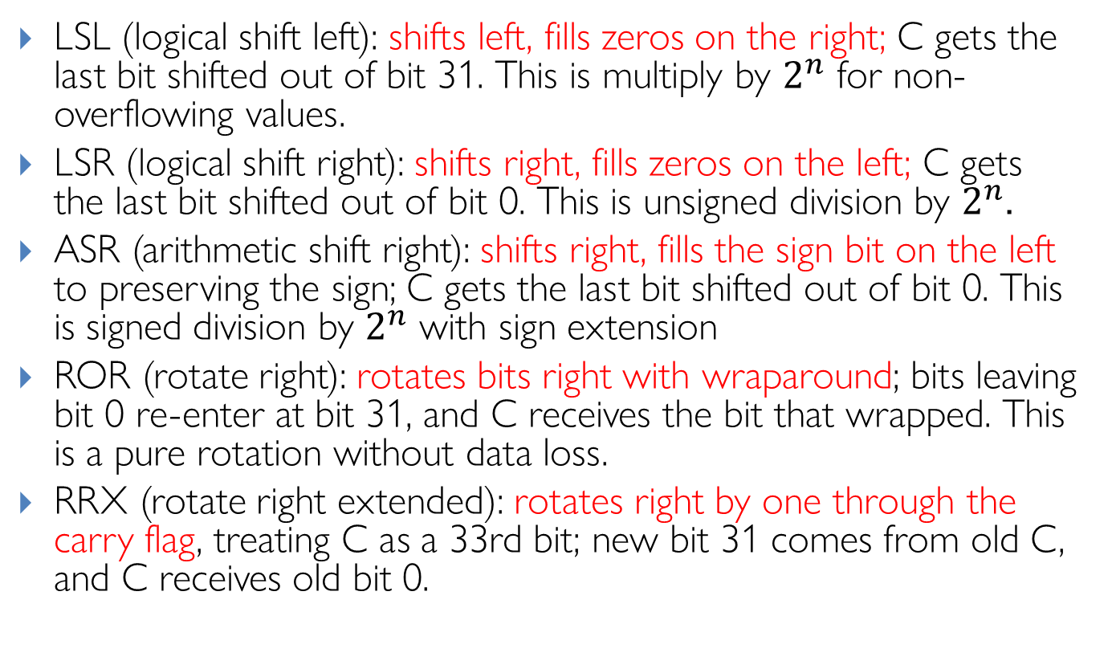
Barrel Shifter: Explanations
LSL (logical shift left): shifts left, fills zeros on the right; C gets the last bit shifted out of bit 31. This is multiply by $2^{n}$ for non-overflowing values.
LSR (logical shift right): shifts right, fills zeros on the left; C gets the last bit shifted out of bit 0. This is unsigned division by $2^{n}$.
ASR (arithmetic shift right): shifts right, fills the sign bit on the left to preserving the sign; C gets the last bit shifted out of bit 0. This is signed division by $2^{n}$ with sign extension
ROR (rotate right): rotates bits right with wraparound; bits leaving bit 0 re-enter at bit 31, and C receives the bit that wrapped. This is a pure rotation without data loss.
RRX (rotate right extended): rotates right by one through the carry flag, treating C as a 33rd bit; new bit 31 comes from old C, and C receives old bit 0.
Notes:
Useful for multiword shifts and certain crypto/bit-manip patterns
LSR (used here): Always fills with zeros, converting the negative value to a large positive number
ASR: Would preserve the sign bit, maintaining the negative value (-4096)

Slide 7
Load/Store a Byte, Halfword, Word
LDRxxx R0, [R1]
; Load data from memory into a 32-bit register
LDR | Load Word | uint32_t/int32_t | unsigned or signed int
LDRB | Load Byte | uint8_t | unsigned char
LDRH | Load Halfword | uint16_t | unsigned short int
LDRSB | Load Signed Byte | int8_t | signed char
LDRSH | Load Signed Halfword | int16_t | signed short int
STRxxx R0, [R1]
; Store data extracted from a 32-bit register into memory
STR | Store Word | uint32_t/int32_t | unsigned or signed int
STRB | Store Lower Byte | uint8_t/int8_t | unsigned or signed char
STRH | Store Lower Halfword | uint16_t/int16_t | unsigned or signed short

Slide 8
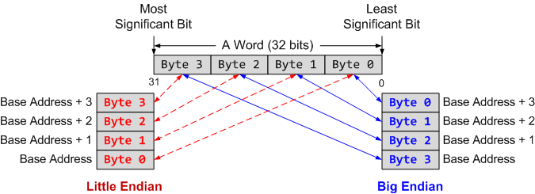
ARM Load Store Summary
Memory address is always in terms of bytes.
How data is organized in memory?
How data is addressed?
Addressing Format | Example | Equivalent
Pre-index | LDR r1, [r0, #4] | r1 ← memory[r0 + 4], r0 is unchanged
Pre-index with update | LDR r1, [r0, #4]! | r1 ← memory[r0 + 4] r0 ← r0 + 4
Post-Index | LDR r1, [r0], #4 | r1 ← memory[r0] r0 ← r0 + 4

Slide 9
Character String
Memory Address | Memory Content | Letter
str + 12→ | 0x00 | \0
str + 11→ | 0x79 | y
str + 10→ | 0x6C | l
str + 9→ | 0x62 | b
str + 8→ | 0x6D | m
str + 7→ | 0x65 | e
str + 6→ | 0x73 | s
str + 5→ | 0x73 | s
str + 4→ | 0x41 | A
str + 3→ | 0x20 | space
str + 2→ | 0x4D | M
str + 1→ | 0x52 | R
str → | 0x41 | A
char str[13] = “ARM Assembly”;
This diagram does not indicate big-endian or little-endian. Endianness is irrelevant for single-byte char arrays.
If you want to detect endianness, you must inspect a multi-byte value in memory, e.g.:
int x = 0x12345678;
That will reveal the byte order.

Slide 10
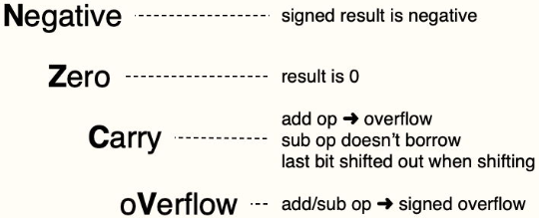
Condition Flags
Program Status Register (PSR)
N
Z
C
V
Q
ICI/IT
T
Reserved
GE
Reserved
ICI/IT
ISR number
Negative bit
N = 1 if most significant bit of result is 1
Zero bit
Z = 1 if all bits of result are 0
Carry bit
For unsigned addition, C = 1 if carry takes place
For unsigned subtraction, C = 0 (carry = not borrow) if borrow takes place
For shift/rotation, C = last bit shifted out
oVerflow bit
V = 1 if adding 2 same-signed numbers produces a result with the opposite sign
Positive + Positive = Negative, or
Negative + negative = Positive
Non-arithmetic operations does not touch V bit, such as MOV,AND,LSL,MUL
Notes:
N (negative) – set (1) when a signed result is negative, otherwise cleared (0).
Z (zero) – set (1) when a result is 0, otherwise cleared (0).
C (carry) – set (1) when an add-based operation produces an overflow, when a subtract-based operation doesn’t require a borrow; when shifting, holds the last bit that’s been shifted out; otherwise cleared (0).
V (overflow) – set (1) when an add- or subtract-based operation generates a signed overflow, otherwise cleared (0).

Slide 11
Carry and Overflow Flags w/ Arithmetic Instructions
Carry flag C = 1 (Borrow flag = 0) upon an unsigned addition if the answer is wrong (true result > 2^{n}-1)
Carry flag C = 0 (Borrow flag = 1) upon an unsigned subtraction if the answer is wrong (true result < 0)
Overflow flag V =1 upon a signed addition or subtraction if the answer is wrong (true result > 2^{n-1}-1 or true result < -2^{n-1})
Overflow may occur when adding 2 operands with the same sign, or subtracting 2 operands with different signs; Overflow cannot occur when adding 2 operands with different signs or when subtracting 2 operands with the same sign.
Tip: Convert subtraction to addition with Two’s complement. If two operands have same sign, and the result has opposite sign, then V = 1; else V = 0
 | Unsigned Addition | Unsigned Subtraction | Signed Addition or Subtraction
Carry flag | true result > 2^{n}-1 ➔ Carry flag=1 Borrow flag=0 (Result incorrect) | true result < 0 ➔ Carry flag=0 Borrow flag=1 (Result incorrect) | N/A
Overflow flag | N/A | N/A | true result > 2^{n-1}-1 or true result < -2^{n-1} Overflow flag=1 (Result incorrect)
11
Notes:
Convert subtraction to addition with Two’s complement. If two operands have same sign, and the result has opposite sign, then V = 1; else V = 0.”
convert subtraction to addition with Two’s complement. If two operands have same sign, and the result has opposite sign, then V = 1; for all other cases, V = 0
C is cleared upon an unsigned subtract if the answer is wrong
The carry flag (CF) is set differently for unsigned addition and subtraction:
When adding or subtracting two signed numbers in an n-bit system, an overflow occurs if the true result is larger than the maximum signed integer (i.e. $2^{n−1}−1$) or smaller than the minimum signed integer (i.e. ${−2}^{n−1}$) that can be represented
Overflow may occur when adding 2 operands with the same sign, or subtracting 2 operands with different signs, including:
adding two positive numbers
adding two negative numbers
subtracting a positive number from a negative number
subtracting a negative number from a positive number
Overflow cannot occur when adding 2 operands with different signs or when subtracting 2 operands with the same sign.
Why?
Unsigned Addition:
The carry flag is set to 1 if there is a carry out from the most significant bit (MSB) during the addition.
This means the sum exceeds the maximum value that can be represented in the given number of bits.
Example: Adding two 8-bit numbers resulting in a value greater than 255 will set CF = 1.
Unsigned Subtraction:
The carry flag acts as a borrow indicator for subtraction.
CF is cleared (set to 0) if a borrow is needed (i.e., if the minuend is less than the subtrahend).
CF is set to 1 if no borrow is needed, meaning the subtraction did not underflow.
Summary:
For unsigned addition, CF = 1 means an overflow beyond the MSB (carry out).
For unsigned subtraction, CF = 0 means a borrow (underflow), CF = 1 means no borrow.
The carry flag thus helps detect unsigned overflow or underflow conditions.
This behavior contrasts with signed arithmetic, where the overflow flag (OF) signals signed overflow, and the carry flag is generally not used.
References from teaching and documentation explain this clearly: The carry flag signals actual carry for addition and borrow for subtraction in unsigned arithmetic scenarios.

Slide 12
Link Register (LR)
void foo(void) ;
int main(void{
● ● ●
foo();
● ● ●
}
void foo (void) {
● ● ●
● ● ●
return;
}
Transfer control to callee
Resume suspended caller
Compiler
● ● ●
BL foo
● ● ●
Transfer control to callee
foo PROC
● ● ●
● ● ●
BX LR
ENDP
Resume suspended caller

Slide 13
Passing Arguments and Returning Value
Each argument with size ≤ 32 bits, e.g., 8-bit char, or 16-bit short, or 32-bit int, is passed in a 32-bit register.
Cannot pack multiple arguments into one register.
The subroutine can take arguments larger than 32 bits. For example, a double-word variable, such as 64-bit long, is passed in two consecutive registers (e.g. R0 and R1, or R2 and R3). A 128-bit variable is passed in four consecutive registers.
int64_t add_64(int64_t a, int64_t b)
R0 and R1 are used to store the variable a
The return result is stored in registers (R0-R3), depending on the size of the return variable. If it is less than 32 bits, it is stored in R0. If it is a double-word sized variable, such as long long or double variables in C, it is stored in R0 and R1.
int128_t multiply_64(int64_t a, int64_t b)
R0, R1, R2, and R3 are used to store the result

Slide 14
Callee Saved Registers vs Caller Saved Registers
Caller Saved Registers
Callee can freely modify R0, R1, R2, and R3
If caller expects their values are retained, caller should push them onto the stack before calling the callee
Callee Saved Registers
Caller expects these values are retained .
If Callee modifies them, callee must restore their values upon leaving the function.

Slide 15
Full Descending Stack

Slide 16
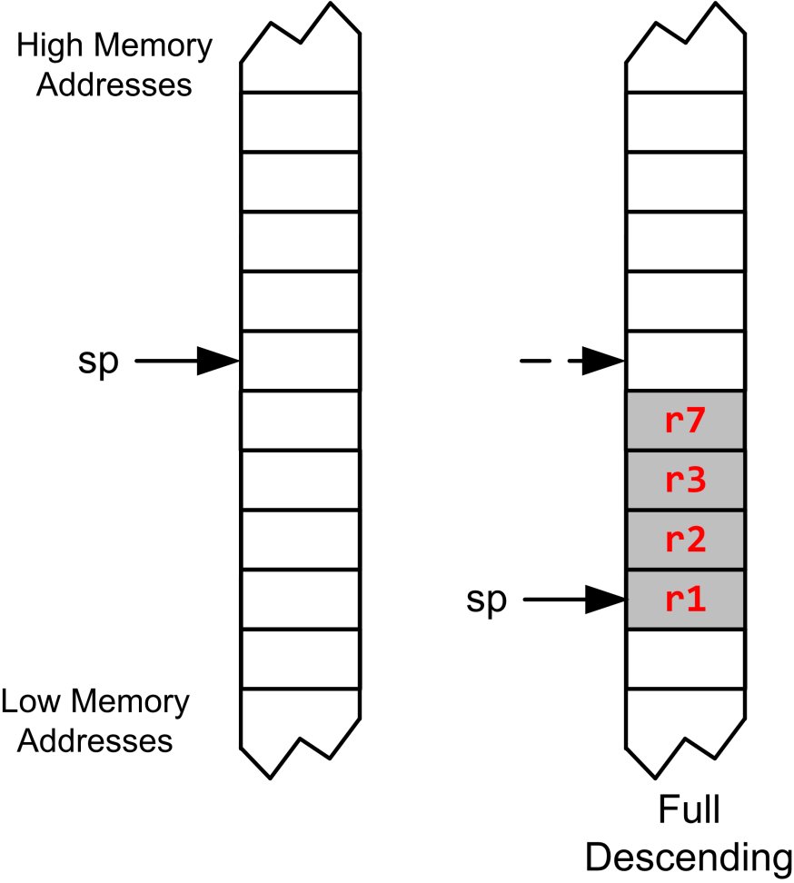
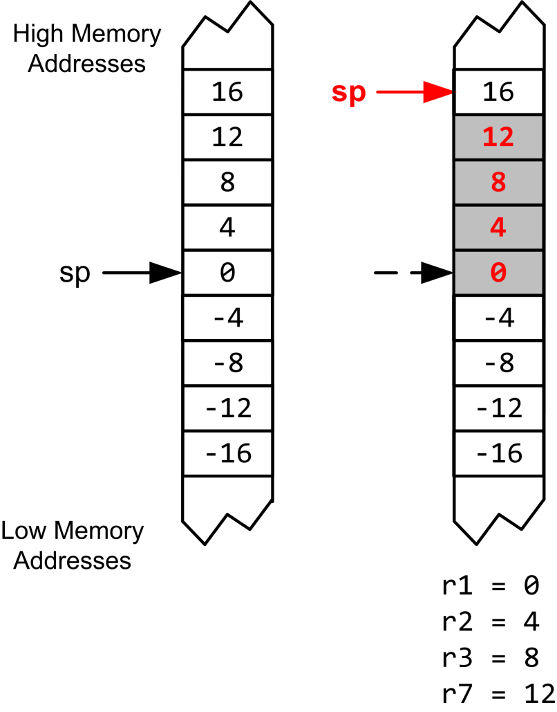
Stack Recap
Largest-numbered register is pushed first but popped last.
PUSH {r3, r1, r7, r2}
POP {r3, r1, r7, r2}
Pop to the smallest-numbered register first.

Slide 17
Calling a Subroutine
Caller: BL label (Branch and Link)
Step 1: LR = PC + 4
Step 2: PC = label
label is name of subroutine
Compiler translates label to memory address
After call, LR holds return address (the instruction following the call)
Callee: BX LR (Branch and Exchange) at end of procedure
PC = LR
Return to caller by setting PC to LR
Equivalently:
PUSH {LR} at start of procedure
POP {PC} at end of procedure
Caller Program | Subroutine/Callee
... BL foo ... | foo PROC ... BX LR EDP | foo PROC PUSH {LR} ... POP {PC} ; pops LR into PC (returns) EDP

Slide 18
Caller-saved Registers vs Callee-saved Registers
Caller-saved registers
Not saved by subroutine
Hold arguments/result
Callee-saved registers
Caller expects their values are retained
Callee must save and store it if callee modifies it
Callee-saved registers
Register Bank
Special Registers

Slide 19
Chapter 8 Subroutines Summary I
How to call a subroutine?
Branch with link: BL subroutine
How to return the control back to the caller?
Branch and exchange: BX LR
How to pass arguments into a subroutine?
Each 8-, 16- or 32-bit variables is passed via r0, r1, r2, r3
Extra parameters are passed via stack
How to return a value in a subroutine?
Value is returned in r0
How to preserve the running environment for the caller?
On the stack

Slide 20
Chapter 8 Subroutines Summary II
ARM Cortex-M uses full descending stack
How to pass arguments into a subroutine?
Each 8-, 16- or 32-bit parameter is passed via r0, r1, r2, r3
Extra parameters are passed via the stack
What registers should be preserved?
Caller-saved registers vs callee-saved registers
How to preserve the running environment for the caller?
Via stack

Slide 21
Timer’s Clock
Reload Value
TIMx_ARR
Reload
f_{CL_PSC}
f_{CL_CNT}
TIMx_CNT
TIMx_PSC
ISR
Resume
Interrupt
clock
Prescaler
Current Count
$$f_{CK_CNT}=\frac{f_{CL_PSC}}{Prescaler+1}$$

Slide 22
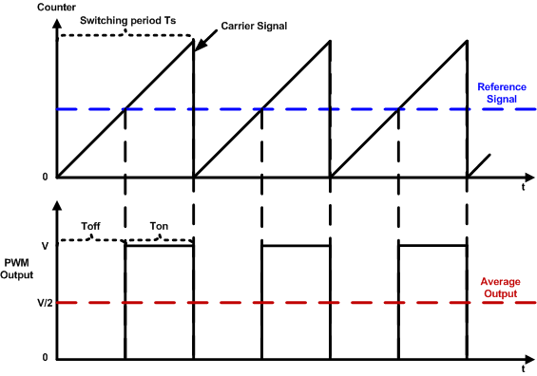
PWM Duty Cycle = Ton/Time Period
$$duty cycle=\frac{pulse on time}{pulse switching period}×100\%=\frac{T_{on}}{T_{s}}×100\%$$

Slide 23
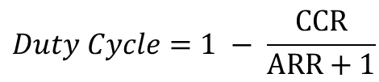

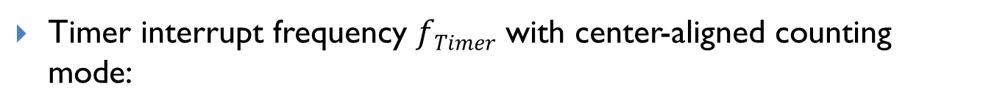

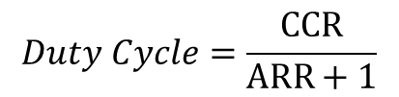
Summary of Equations
Timer clock frequency $f_{CK_CNT}$ vs. CPU Clock Frequency $f_{SOURCE}$ ($f_{CL_PSC}$)
$$f_{CK_CNT}=\frac{f_{SOURCE}}{PSC+1}$$
Timer interrupt frequency $fTimer$ with up-counting or down-counting mode:
$$fTimer=\frac{f_{CK_CNT}}{ARR+1}; Timer Period=\frac{ARR+1}{f_{CK_CNT}}= \left(ARR+1\right)∗Clock Period$$
Timer interrupt frequency $fTimer$ with center-aligned counting mode:
$$fTimer=\frac{f_{CK_CNT}}{2∗ARR};Timer Period=\left(2∗ARR\right)∗Clock Period$$
PWM duty cycle for Mode 1 (Low-True):
$$Duty Cycle=\frac{CCR}{ARR+1}$$
PWM duty cycle for Mode 2 (High-True):
$$Duty Cycle=1 − \frac{CCR}{ARR+1}$$

