Slide 1
Zonghua Gu
Embedded Systems with ARM Cortex-M Microcontrollers in Assembly Language and C
Chapter 4
ARM Arithmetic and Logic Instructions
Fall 2025
Acknowledgement: Lecture slides based on Embedded Systems with ARM Cortex-M Microcontrollers in Assembly Language and C, University of Maine https://web.eece.maine.edu/~zhu/book/

Slide 2
Signed Integer Representation Method 3: Two’s Complement
Assume a four-bit system:
Expression | Result | Carry? | Overflow? | Correct Result?
0100 + 0010 | 0110 | No | No | Yes
0100 + 0110 | 1010 | No | Yes | No
1100 + 1110 | 1010 | Yes | No | Yes
1100 + 1010 | 0110 | Yes | Yes | No

Slide 3
Summary: Condition Codes
Review
Suffix
Description
Flags tested
EQ
EQual
Z=1
NE
Not Equal
Z=0
CS/HS
Unsigned Higher or Same
C=1
CC/LO
Unsigned LOwer
C=0
MI
MInus (Negative)
N=1
PL
PLus (Positive or Zero)
N=0
VS
oVerflow Set
V=1
VC
oVerflow Cleared
V=0
HI
Unsigned HIgher
C=1 & Z=0
LS
Unsigned Lower or Same
C=0 or Z=1
GE
Signed Greater or Equal
N=V
LT
Signed Less Than
N!=V
GT
Signed Greater Than
Z=0 & N=V
LE
Signed Less than or Equal
Z=1 or N!=V
AL
ALways
Note AL is the default and does not need to be specified
Notes:
Condition codes are simply a way of testing the ALU status flags.
Note AL is the default and does not need to be specified

Slide 4
Signed Comparison
CMP r0, r1
perform subtraction r0 – r1, without saving the result
 | N = 0 | N = 1
V = 0 | No overflow, implying the result is correct. The result is non-negative, Thus r0 – r1 ≥ 0, i.e., r0 ≥ r1 | No overflow, implying the result is correct. The result is negative. Thus r0 – r1 < 0, i.e., r0 < r1
V = 1 | Overflow occurs, implying the result is incorrect. The result is mistakenly reported as non-negative and in fact it should be negative. Thus r0 – r1 < 0 in reality, i.e., r0 < r1 | Overflow occurs, implying the result is incorrect. The result is mistakenly reported as negative and in fact it should be non-negative. Thus r0 – r1 ≥ 0 in reality., i.e. r0 ≥ r1
Conclusions:
If N == V, then it is signed greater or equal (GE).
Otherwise, it is signed less than (LT)
Notes:
CMP a, b computes a - b and sets flags without keeping the result.
For unsigned subtraction, borrow happens when a < b. ARM encodes “no borrow” (a ≥ b) as C=1, and “borrow” (a < b) as C=0, while Z distinguishes equality.
HI (unsigned higher >): the subtraction needs no borrow, so C=1, and it’s not equal, so Z=0.
HS/CS (higher or same/carry set ≥) : no borrow → C=1; equality allowed.
LO/CC (unsigned lower/carry clear <): subtraction borrows → C=0.
LS (unsigned lower or same ≤): “lower or same” means either borrowed or equal → C=0 or Z=1.
For signed subtraction a - b, the sign bit N is correct if a ≥ b (no overflow, V = 0); the sign bit N is incorrect if a < b (overflow, V = 1).
GE (signed greater or equal ≥): N == V. If there’s no overflow (V=0), non‑negative (N=0) means ≥; if there is overflow (V=1), N=1 (incorrect) also indicates the ≥ relation.
LT (signed less than <): N != V. If there’s no overflow (V=0), negative (N=1) means <; if there is overflow (V=1), N=0 (incorrect) also indicates the < relation.
GT (signed greater than >): N==V and Z=0. Strictly greater excludes equality, so combine GE with not equal.
LE (signed less or equal ≤): N != V or Z=1. Either strictly less, or equal.

Slide 5
Signed Comparison
CMP r0, r1
perform subtraction r0 – r1, without saving the result
 | N = 0 | N = 1
V = 0 | r0 ≥ r1 CMP returns 1 | r0 < r1 CMP returns 0
V = 1 | r0 < r1 CMP returns 0 | r0 ≥ r1 CMP returns 1
Conclusions:
If N == V, then it is signed greater or equal (GE).
Otherwise, it is signed less than (LT)

Slide 6
Summary of Carry and Overflow Flags
Review
Bit | Name | Meaning after add or sub
N | negative | result is negative
Z | zero | result is zero
V | overflow | signed overflow
C | carry | unsigned overflow
Carry flag C = 1 upon an unsigned addition if the answer is wrong (true result > 2^{n}-1)
Carry flag C = 0 (Borrow flag = 1) upon an unsigned subtraction if the answer is wrong (true result < 0)
Overflow flag V =1 upon a signed addition if the answer is wrong (true result > 2^{n-1}-1 or true result < -2^{n-1})
31
0
N
Z
C
V
6
CPSR (Current Program Status Register)
Notes:
C is cleared upon an unsigned subtract if the answer is wrong

Slide 7
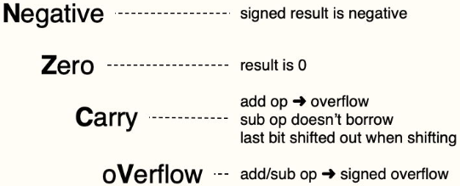
NZCV Flags in xPSR
Review
N (negative) – set (1) when a signed result is negative, otherwise cleared (0).
Z (zero) – set (1) when a result is 0, otherwise cleared (0).
C (carry) – set (1) when an add-based operation produces an overflow, when a subtract-based operation doesn’t require a borrow; when shifting, holds the last bit that’s been shifted out; otherwise cleared (0).
V (overflow) – set (1) when an add- or subtract-based operation generates a signed overflow, otherwise cleared (0).
Notes:
https://eclecticlight.co/2021/06/23/code-in-arm-assembly-controlling-flow/
N (Negative): Copies the most significant bit of the last result; 1 means the result’s sign bit is 1, which for two’s‑complement indicates a negative value in signed interpretation.
Z (Zero): 1 if the result was exactly zero; otherwise 0.
C (Carry): For addition, 1 means an unsigned carry out; for subtraction (a − b or CMP), 1 means “no borrow,” and 0 means a borrow occurred. For shifts/rotates, it holds the last bit shifted out.
V (oVerflow): 1 when signed overflow occurred, i.e., the true signed result didn’t fit in the destination width (e.g., positive + positive → negative, or negative + negative → positive in 32‑bit two’s‑complement).
Why C=1 and Z=0 corresponds to “unsigned higher” (HI):
After a CMP a, b (which computes a − b for flags), C=1 means the subtraction needed no borrow, so a ≥ b in unsigned arithmetic; Z=0 rules out equality, leaving a > b. That composite condition is named HI.

Slide 8
Example 1: Greatest Common Divider (GCD)
Euclid’s Algorithm
gcd CMP r0, r1
SUBHI r0, r0, r1
SUBLO r1, r1, r0
BNE gcd
uint32_t a, b;
while (a != b ) {
if (a > b)
a = a – b;
else
b = b – a;
}
CMP r0, r1 compares r0 and r1, setting Z=1 if r0 == r1, which is the termination condition when tested by BNE later.
SUBHI r0, r0, r1 executes only if the previous compare set HI (unsigned “higher”), i.e., r0 > r1 for unsigned ints r0 and r1. Flags C=1 and Z=0 (“no borrow” and “not equal”).
SUBLO r1, r1, r0 executes only if the previous compare of unsigned ints set LO (unsigned “lower”), i.e., r0 < r1 for unsigned ints r0 and r1. Flag C=0 (“borrow”).
BNE gcd branches back to the label if Z=0 from the CMP, i.e., while r0 != r1; when they become equal, Z=1 and the loop falls through, leaving r0 == r1 == gcd(a, b).
; suppose r0 = a and r1 = b
gcd CMP r0, r1 ; a > b?
BEQ end ; if a = b, done
BLO less ; a < b
SUB r0, r0, r1 ; a = a – b
B gcd
less SUB r1, r1, r0 ; b = b – a
B gcd
end

Slide 9
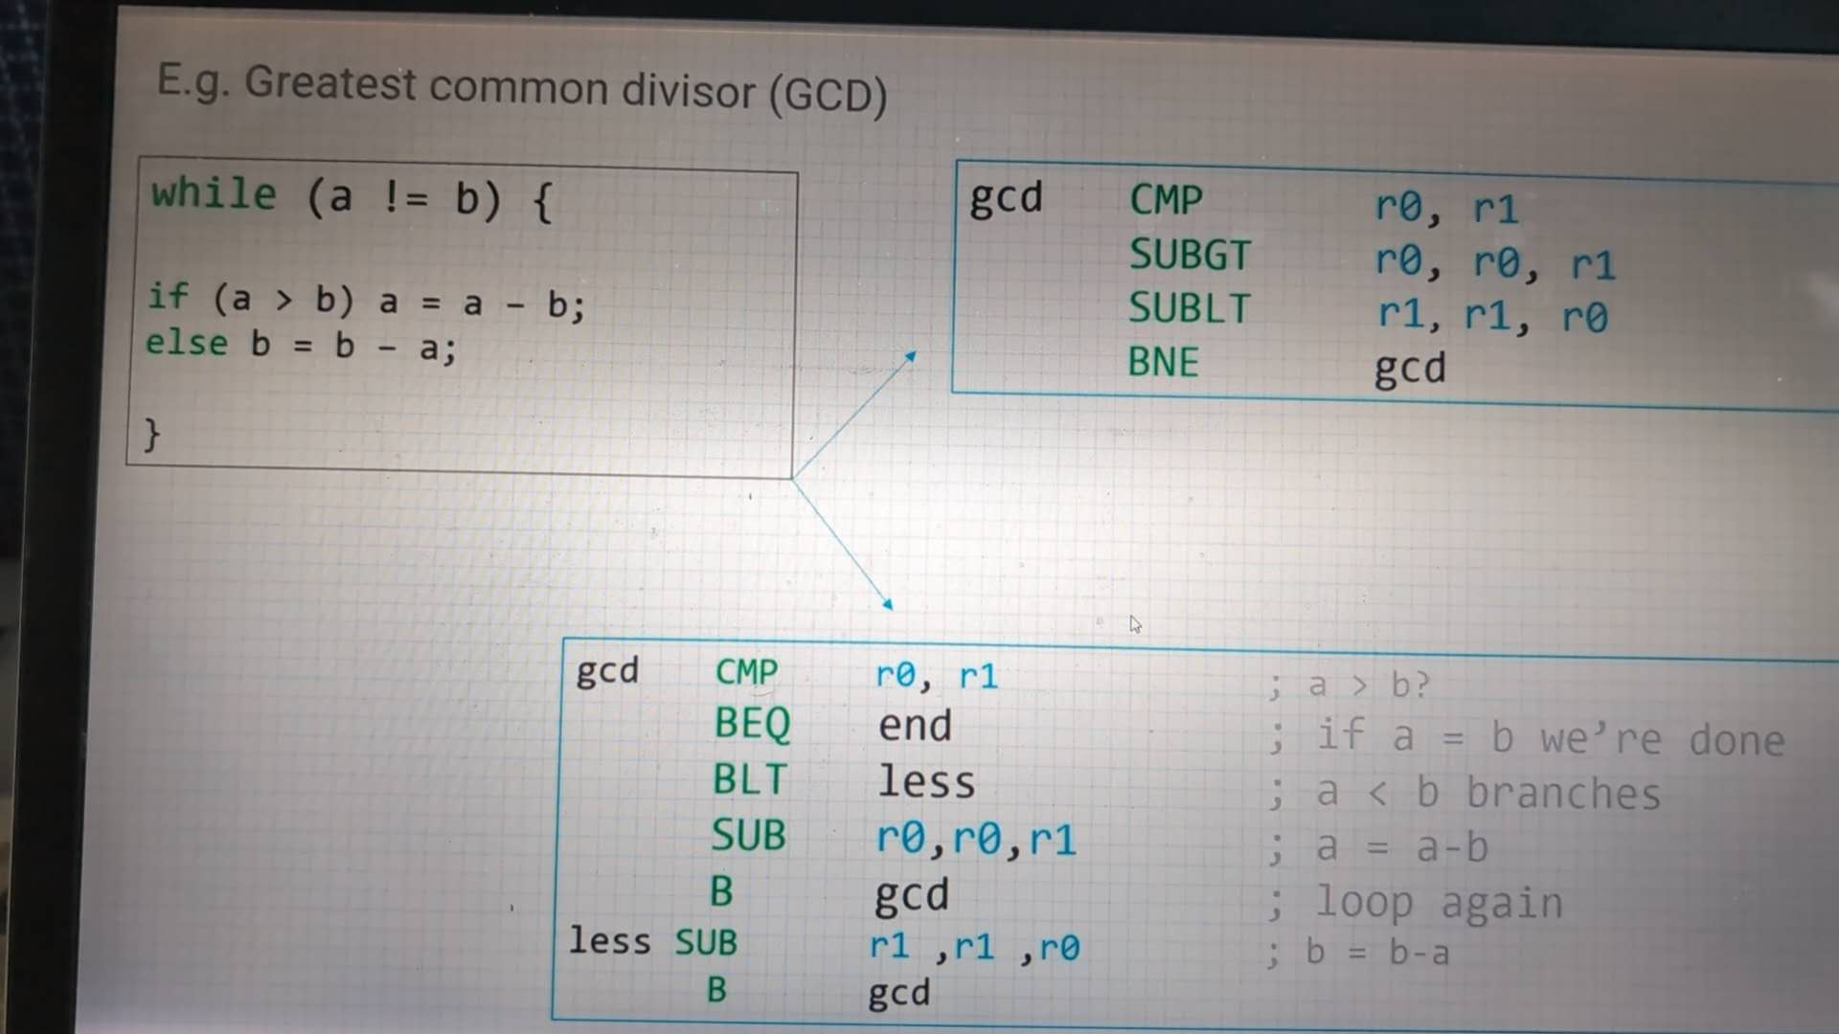
GCD

Slide 10
Logic View of Memory
Can we store a word anywhere in memory?
NO on most computers!
A word can only be stored at an address that's divisible by 4.
8 bits
High Address
0x20000007
01110010
0x20000006
00100101
Word-address mod 4 = 0
0x20000005
11100010
0x20000004
10000100
We cannot store a word at address 0x20000002.
0x20000003
01100001
0x20000002
10001111
0x20000001
00010010
0x20000000
10010100
Low Address

Slide 11
Logic View of Memory
Can you store a halfword anywhere? NO.
A halfword can only be stored at an address that's divisible by 2.
Memory address of a halfword is the lowest address of its two bytes.
8 bits
High Address
0x20000007
01110010
Halfword-address mod 2 = 0
0x20000006
00100101
0x20000005
11100010
0x20000004
10000100
0x20000003
01100001
We cannot store a halfword at address 0x20000001.
0x20000002
10001111
0x20000001
00010010
0x20000000
10010100
Low Address

Slide 12
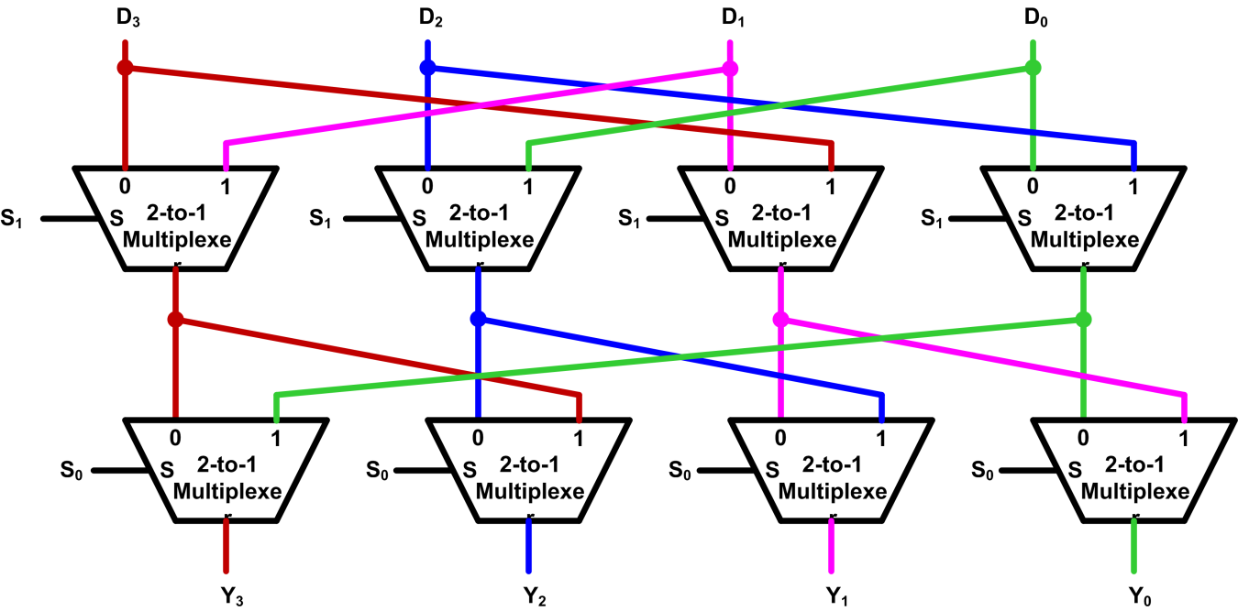
Implementation of Barrel Shifter
Typically, Barrel shifters are implemented as a cascade of parallel 2-to-1 multiplexers.
S₁ | S₀ | Y₃ | Y₂ | Y₁ | Y₀
0 | 0 | D₃ | D₂ | D₁ | D₀
0 | 1 | D₀ | D₃ | D₂ | D₁
1 | 0 | D₁ | D₀ | D₃ | D₂
1 | 1 | D₂ | D₁ | D₀ | D₃
Example four-bit Barrel shifter that performs rotate right

Slide 13
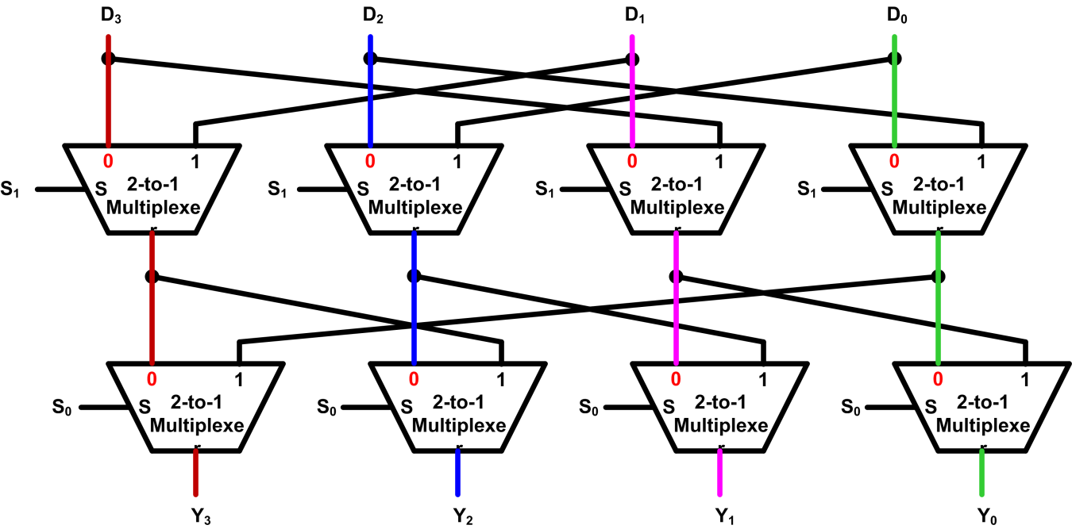
Implementation of Barrel Shifter
Example: S₁S₀ = 00
S₁ | S₀ | Y₃ | Y₂ | Y₁ | Y₀
0 | 0 | D₃ | D₂ | D₁ | D₀
0 | 1 | D₀ | D₃ | D₂ | D₁
1 | 0 | D₁ | D₀ | D₃ | D₂
1 | 1 | D₂ | D₁ | D₀ | D₃
Example four-bit Barrel shifter that performs rotate right

Slide 14
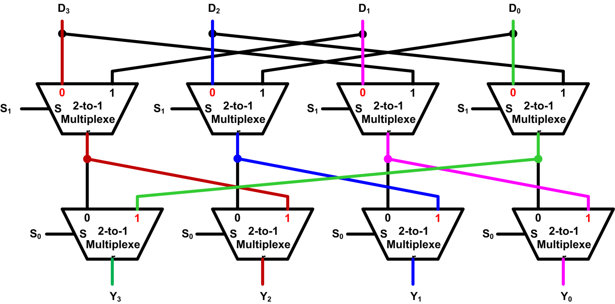
Implementation of Barrel Shifter
Example: S₁S₀ = 01
S₁ | S₀ | Y₃ | Y₂ | Y₁ | Y₀
0 | 0 | D₃ | D₂ | D₁ | D₀
0 | 1 | D₀ | D₃ | D₂ | D₁
1 | 0 | D₁ | D₀ | D₃ | D₂
1 | 1 | D₂ | D₁ | D₀ | D₃
Example four-bit Barrel shifter that performs rotate right

Slide 15
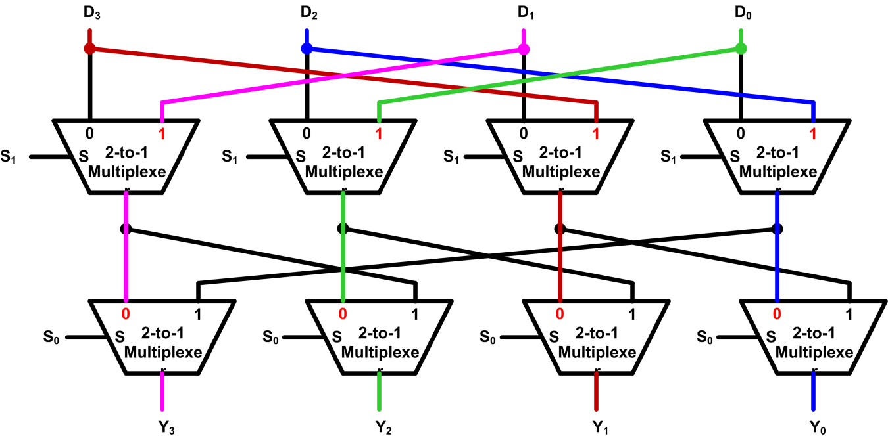
Implementation of Barrel Shifter
Example: S₁S₀ = 10
S₁ | S₀ | Y₃ | Y₂ | Y₁ | Y₀
0 | 0 | D₃ | D₂ | D₁ | D₀
0 | 1 | D₀ | D₃ | D₂ | D₁
1 | 0 | D₁ | D₀ | D₃ | D₂
1 | 1 | D₂ | D₁ | D₀ | D₃
Example four-bit Barrel shifter that performs rotate right

Slide 16
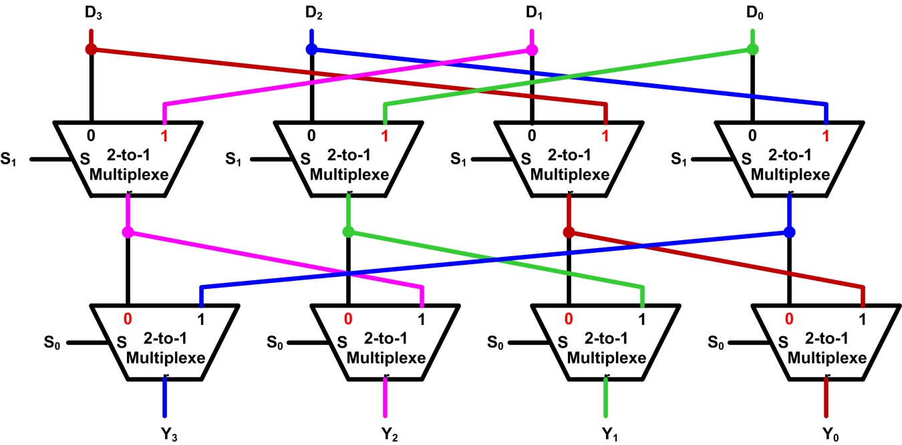
Implementation of Barrel Shifter
Example: S₁S₀ = 11
S₁ | S₀ | Y₃ | Y₂ | Y₁ | Y₀
0 | 0 | D₃ | D₂ | D₁ | D₀
0 | 1 | D₀ | D₃ | D₂ | D₁
1 | 0 | D₁ | D₀ | D₃ | D₂
1 | 1 | D₂ | D₁ | D₀ | D₃
Example four-bit Barrel shifter that performs rotate right

Slide 17
ADR Pseudo-instruction
ADR: loads a program-relative or register-relative address into a register
start MOV r0,#10 ; 32-bit instruction
ADR r4,start ; 32-bit instruction
; => SUB r4,pc,#0xc

Slide 18
64-bit Logic Shift Left

Slide 19
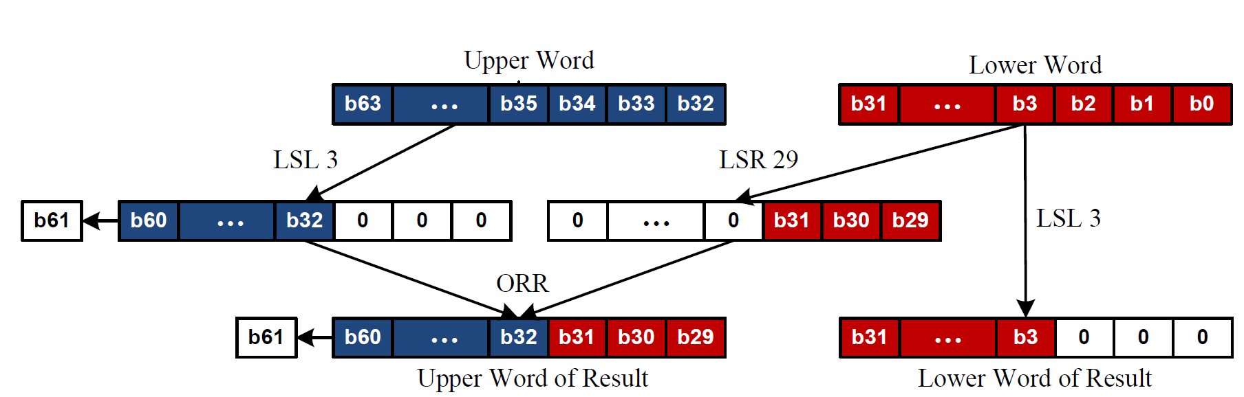
64-bit Logic Shift Left
Example of Logic Shift Left by 3

Slide 20
64-bit Logic Shift Right

Slide 21
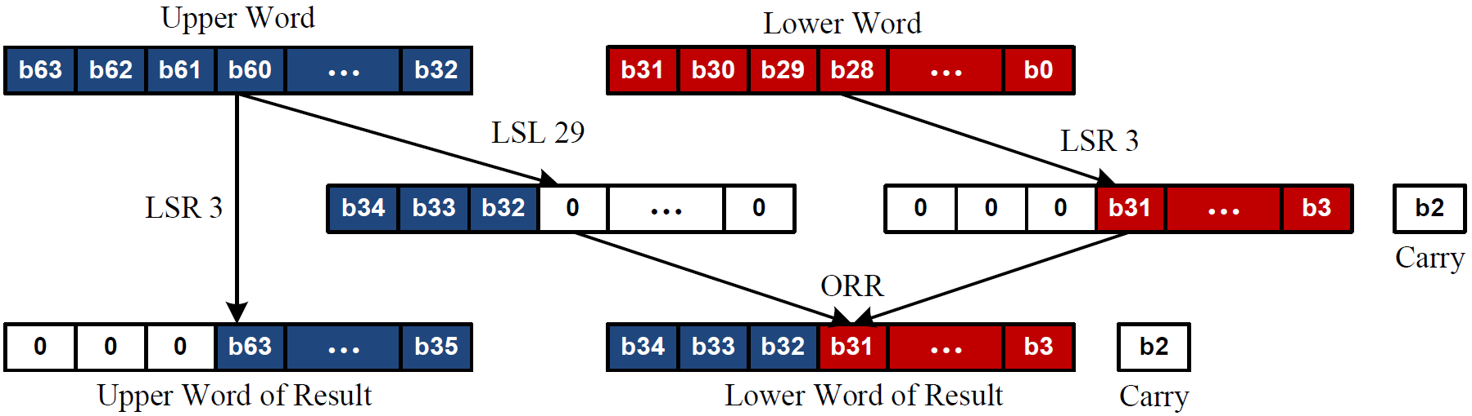
64-bit Logic Shift Right
Example of Logic Shift Right by 3

Slide 22
ARM Register Conventions (APCS-Application Procedure Call Standard)
Reg. # | APCS Name | Role in Procedure Calls | Comments
r0 - r3 | a1 - a4 | First 4 arguments into a procedure / Scratch pad / Return result(s) from a function (not preserved across call) | Caller-saved registers - subprogram can use them as scratch registers, but it must also save any needed values before calling another subprogram.
r4 - r8 | v1 - v5 | Register Variables (preserved across call | Callee-saved registers - it can rely on an subprogram it calls not to change them (so a subprogram wishing to use these registers must save them on entry and restore them before it exits)
r9 – r12 | Omitted | Details omitted | Details omitted
r11 | fp | Frame pointer (if used) / Register Variable (preserved across call) | Callee-saved register - pointer to bottom of call-frame
r13 | sp | Stack pointer - points to the top of the stack
r14 | lr | Link register - holds the return address | Receives return address on BL call to procedure
r15 | pc | Program counter

Slide 23
Passing Extra Arguments via Stack
int32_t sum(int32_t a, int32_t b, int32_t c, int32_t d,
int32_t h, int32_t i, int32_t j, int32_t k);
s = sum(1, 2, 3, 4, 5, 6, 7, 8);
Caller
Stack
MOVS r0, #5
MOVS r1, #6
MOVS r2, #7
MOVS r3, #8
PUSH {r0, r1, r2, r3}
MOVS r0, #1
MOVS r1, #2
MOVS r2, #3
MOVS r3, #4
BL sum
...
POP {r0, r1, r2, r3}
Old SP | <xxxxxxxx>
SP+12 | 0x00000008
SP+8 | 0x00000007
SP+4 | 0x00000006
SP | 0x00000005

Slide 24
Passing Extra Arguments via Stack
int32_t sum(int32_t a, int32_t b, int32_t c, int32_t d,
int32_t h, int32_t i, int32_t j, int32_t k);
s = sum(1, 2, 3, 4, 5, 6, 7, 8);
Stack
Callee
Old SP | <xxxxxxxx>
SP+24 | 0x00000008
SP+20 | 0x00000007
SP+16 | 0x00000006
SP+12 | 0x00000005
SP+8 | lr
SP+4 | r6
SP | r5
sum PROC
EXPORT sum
PUSH {r5, r6, lr}
ADD r0, r0, r1 ; add a + b
ADD r0, r0, r2 ; add c
ADD r0, r0, r3 ; add d
LDRD r5,r6, [sp, #12] ; r5=mem[sp+12],r6=mem[sp+16]
ADD r0, r0, r5 ; add h
ADD r0, r0, r6 ; add i
LDRD r5,r6, [sp, #20] ; r5=mem[sp+20],r6=mem[sp+24]
ADD r0, r0, r5 ; add j
ADD r0, r0, r6 ; add k
POP {r5, r6, pc}
ENDP

