Slide 1
Z. Gu
Embedded Systems with ARM Cortex-M Microcontrollers in Assembly Language and C
Chapter 13
Floating-point Numbers
Fall 2025
Acknowledgement: Lecture slides based on Embedded Systems with ARM Cortex-M Microcontrollers in Assembly Language and C, University of Maine https://web.eece.maine.edu/~zhu/book/

Slide 2
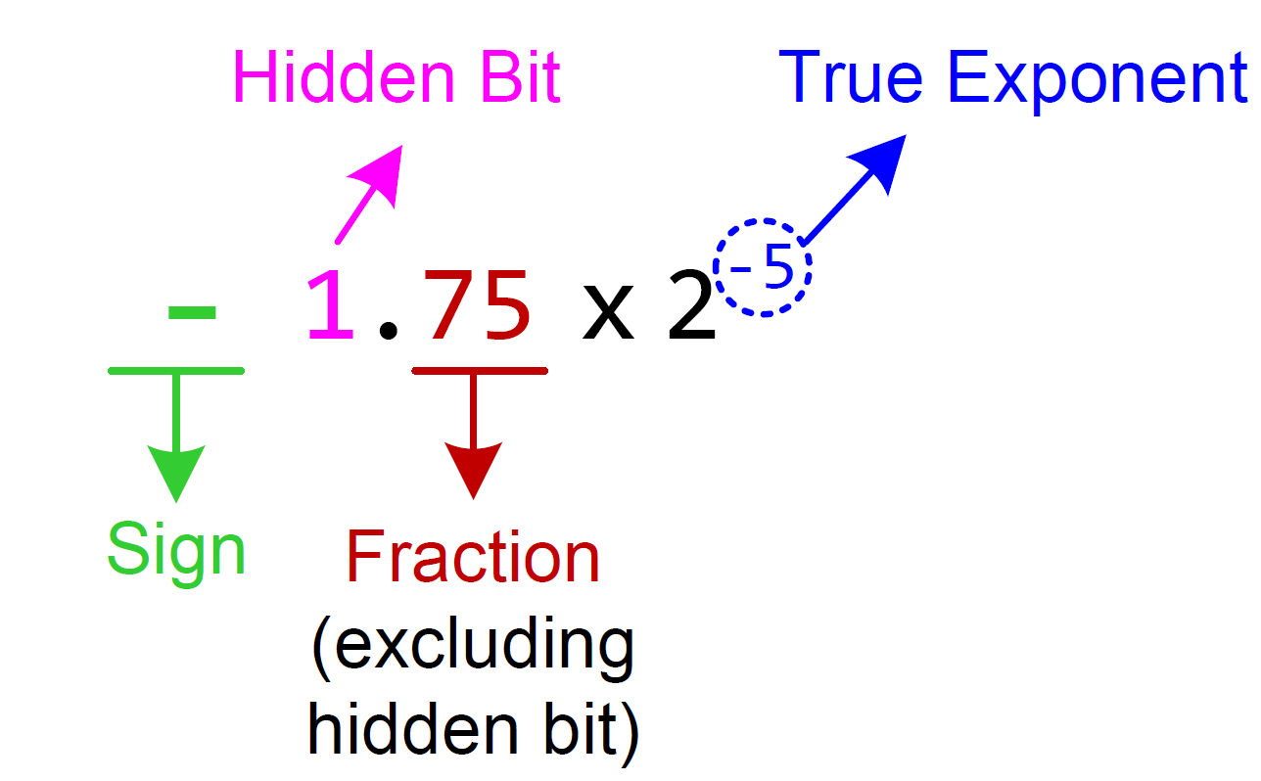
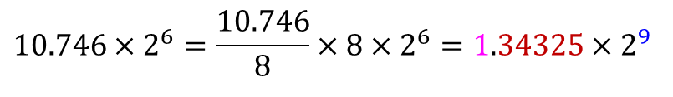
Normalization
We can convert 10.746×2⁶ to normalized format as follows:
$$10.746×2^{6}=\frac{10.746}{8}×8×2^{6}=1.34325×2^{9}$$

Slide 3
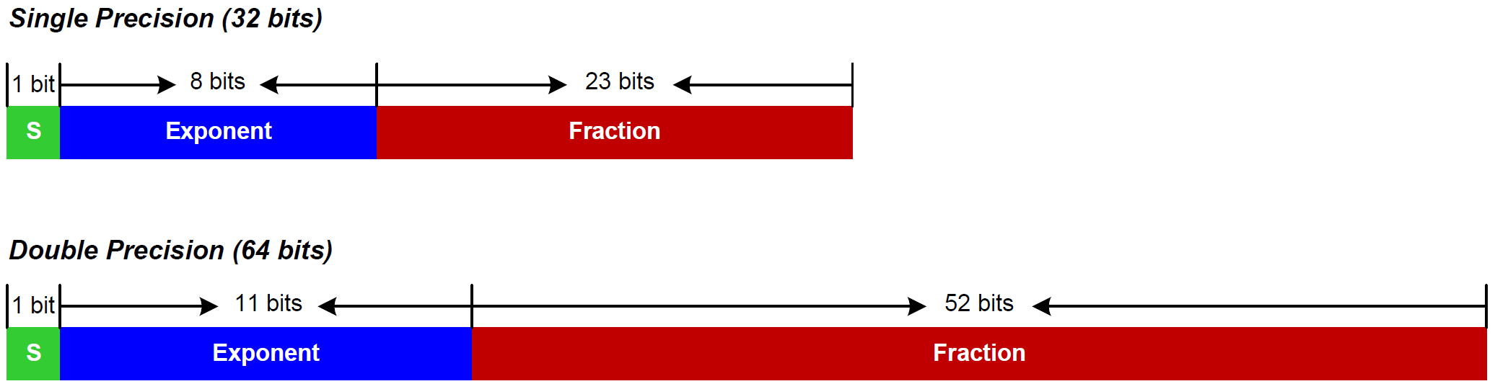
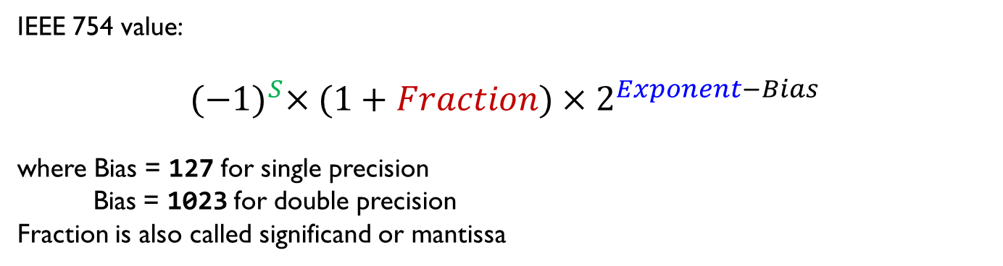
IEEE Standard 754
IEEE 754 value:
$${(−1)}^{S}×(1+Fraction)×2^{Exponent−Bias}$$
where Bias = 127 for single precision
Bias = 1023 for double precision
Fraction is also called significand or mantissa

Slide 4
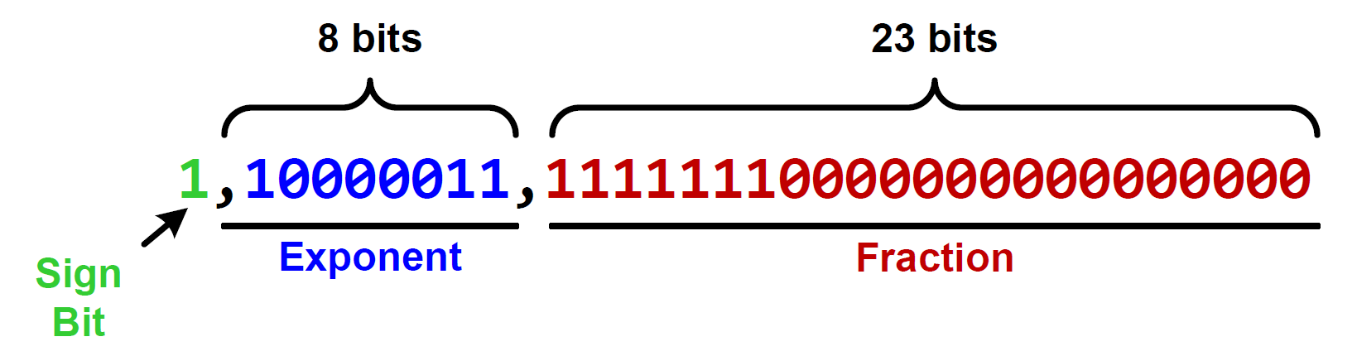
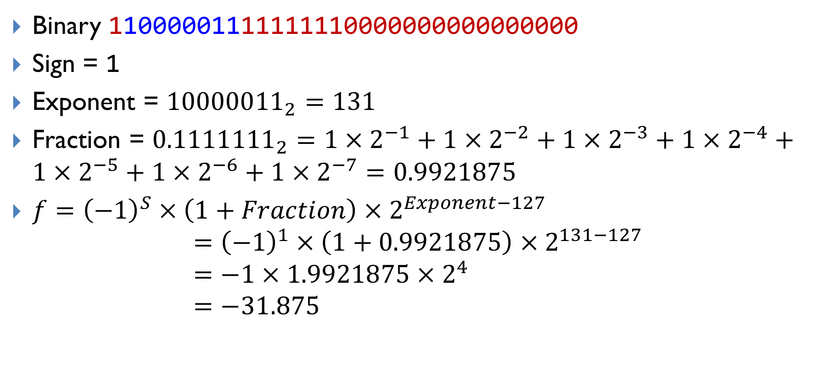
Decoding 0xC1FF0000 into a floating-point number
Binary 11000001111111110000000000000000
Sign = 1
Exponent = ${10000011}_{2}=131$
Fraction = ${0.1111111}_{2}=1×2^{−1}+1×2^{−2}+1×2^{−3}+1×2^{−4}+1×2^{−5}+1×2^{−6}+1×2^{−7}=0.9921875$
$f={\left(−1\right)}^{S}×\left(1+Fraction\right)×2^{Exponent−127}$
$$={\left(−1\right)}^{1}×\left(1+0.9921875\right)×2^{131−127} \\ =−1×1.9921875×2^{4} \\ =−31.875$$

Slide 5
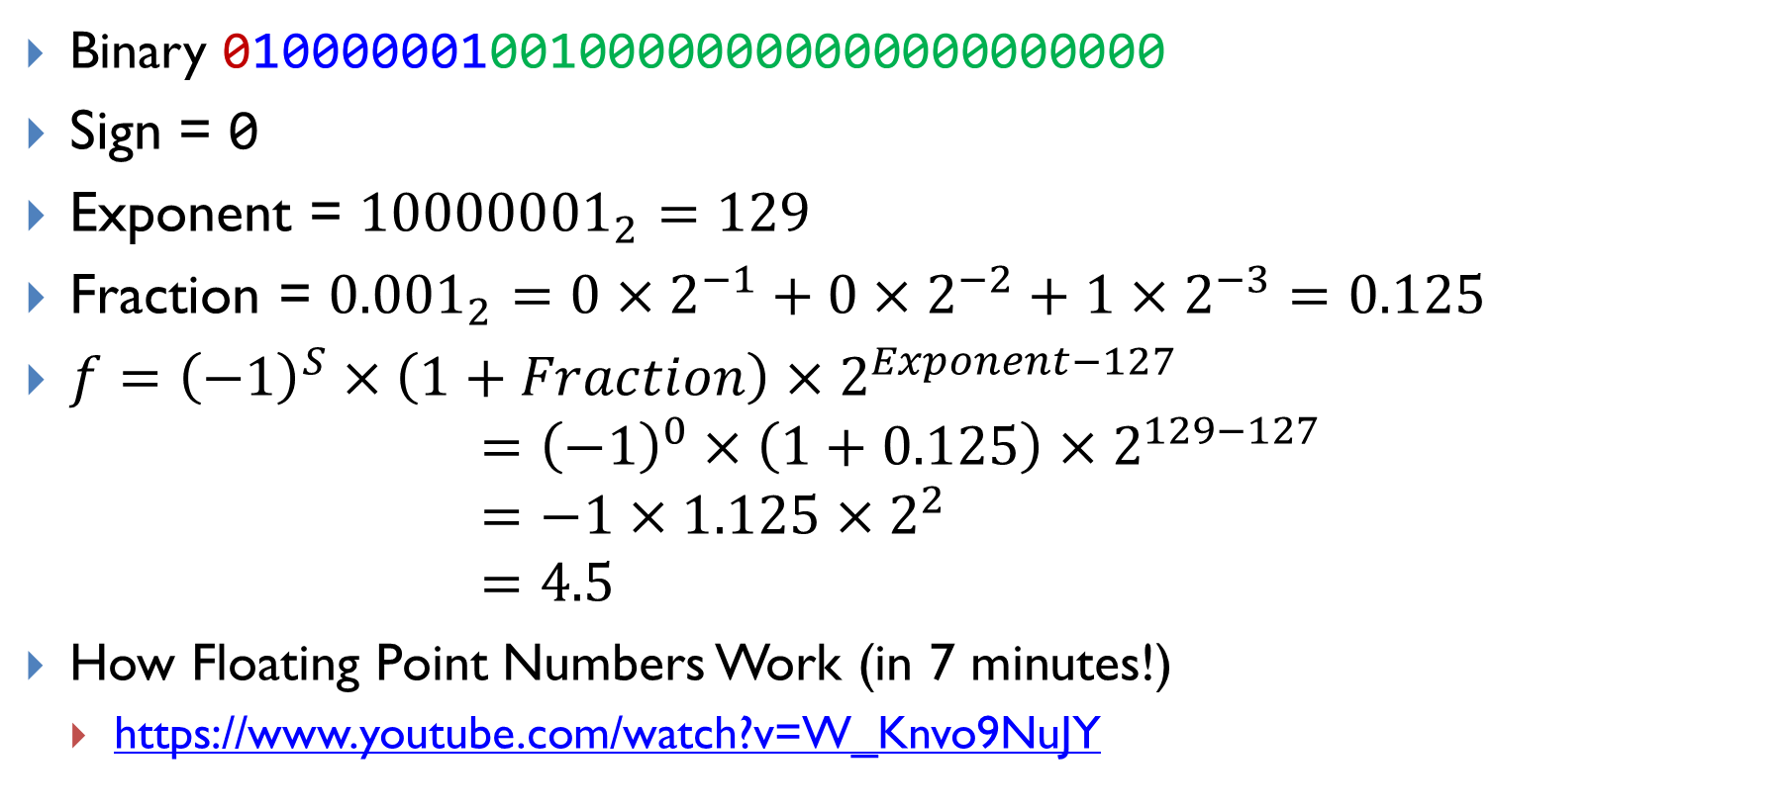
Decoding 0x40920000 into a floating-point number
Binary 01000000100100000000000000000000
Sign = 0
Exponent = ${10000001}_{2}=129$
Fraction = ${0.001}_{2}=0×2^{−1}+0×2^{−2}+1×2^{−3}=0.125$
$f={\left(−1\right)}^{S}×\left(1+Fraction\right)×2^{Exponent−127}$
$$={\left(−1\right)}^{0}×\left(1+0.125\right)×2^{129−127} \\ =−1×1.125×2^{2} \\ =4.5$$
How Floating Point Numbers Work (in 7 minutes!)
https://www.youtube.com/watch?v=W_Knvo9NuJY

Slide 6

Decoding 0x3F800000 into a floating-point number
Binary 00111111100000000000000000000000
Sign = 0
Exponent = ${01111111}_{2}=127$
Fraction = $0$
$f={\left(−1\right)}^{S}×\left(1+Fraction\right)×2^{Exponent−127}$
$$={\left(−1\right)}^{0}×\left(1+0\right)×2^{127−127} \\ =−1×1×2^{0} \\ =1.0$$
How Floating Point Numbers Work (in 7 minutes!)
https://www.youtube.com/watch?v=W_Knvo9NuJY

Slide 7
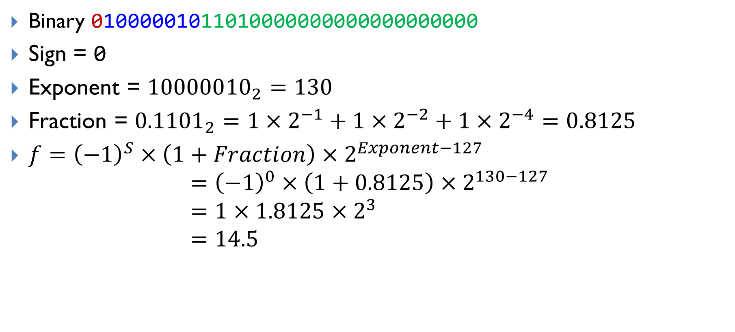
Decoding 0x41680000 into a floating-point number
Binary 01000001011010000000000000000000
Sign = 0
Exponent = ${10000010}_{2}=130$
Fraction = ${0.1101}_{2}=1×2^{−1}+1×2^{−2}+1×2^{−4}=0.8125$
$f={\left(−1\right)}^{S}×\left(1+Fraction\right)×2^{Exponent−127}$
$$={\left(−1\right)}^{0}×\left(1+0.8125\right)×2^{130−127} \\ =1×1.8125×2^{3} \\ =14.5$$

Slide 8
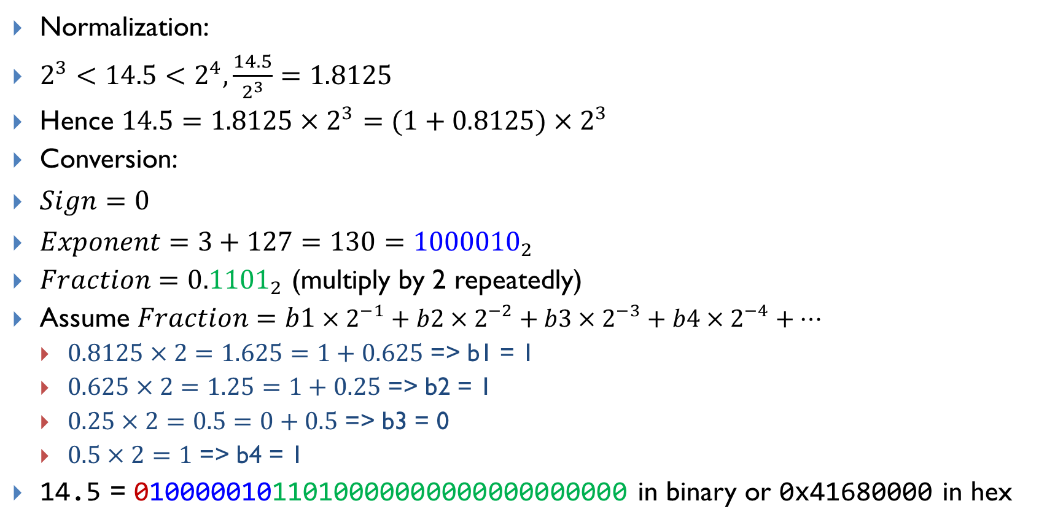
Encoding 14.5 into IEEE Std 754 Single-Precision
Normalization:
$2^{3}<14.5<2^{4},\frac{14.5}{2^{3}}=1.8125$
Hence $14.5=1.8125×2^{3}=(1+0.8125)×2^{3}$
Conversion:
$Sign=0$
$Exponent=3+127=130={1000010}_{2}$
$Fraction={0.1101}_{2}$ (multiply by 2 repeatedly)
Assume $Fraction=b1×2^{−1}+b2×2^{−2}+b3×2^{−3}+b4×2^{−4}+…$
$0.8125×2=1.625=1+0.625$ => b1 = 1
$0.625×2=1.25=1+0.25$ => b2 = 1
$0.25×2=0.5=0+0.5$ => b3 = 0
$0.5×2=1$ => b4 = 1
14.5 = 01000001011010000000000000000000 in binary or 0x41680000 in hex

Slide 9
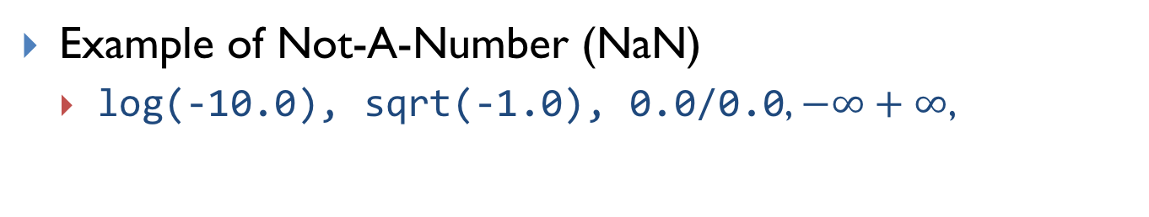
Special Values
Exponents 00000000 and 111111111 are reserved.
Example of Not-A-Number (NaN)
log(-10.0), sqrt(-1.0), 0.0/0.0, $−∞+∞$,

Slide 10

Subnormalized Float Number
To represent numbers between 0 and the minimum positive number that the normalized format can represent.
Normalized Format
Sub-normalized Format
$${\left(−1\right)}^{S}×(1+Fraction)×2^{Exponent−127}$$
$${\left(−1\right)}^{S}×Fraction×2^{−126}$$

Slide 11
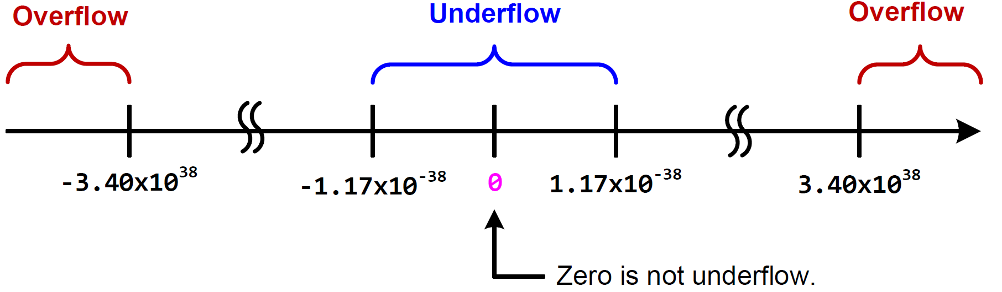
Overflow and Underflow
Smallest Positive Normal Number:
0 00000001 00000000000000000000000
$${(−1)}^{0}×\left(1+0\right)×2^{1−127}=2^{−126}≈1.18×{10}^{−38}$$
Smallest Positive Subnormal Number:
0 00000000 00000000000000000000001
$${(−1)}^{0}×\left(0+2^{−23}\right)×2^{1−127}=2^{−149}≈1.40×{10}^{−45}$$

Slide 12
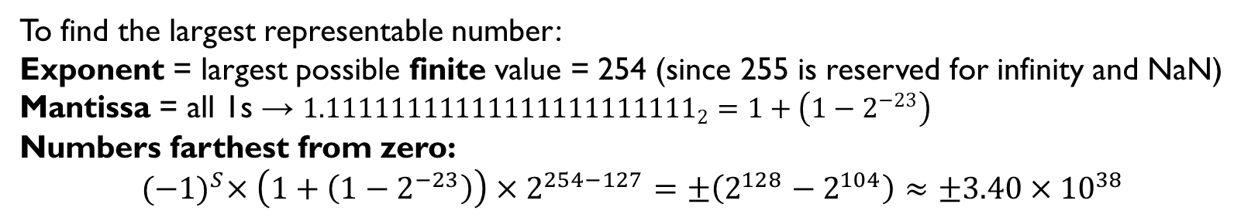
Overflow and Underflow
To find the largest representable number:
Exponent = largest possible finite value = 254 (since 255 is reserved for infinity and NaN)
Mantissa = all 1s → ${1.11111111111111111111111}_{2}=1+\left(1−2^{−23}\right)$
Numbers farthest from zero:
$${(−1)}^{S}×\left(1+\left(1−2^{−23}\right)\right)×2^{254−127}=±\left(2^{128}−2^{104}\right)≈±3.40×{10}^{38}$$
Notes:
Numbers farthest from zero

Slide 13
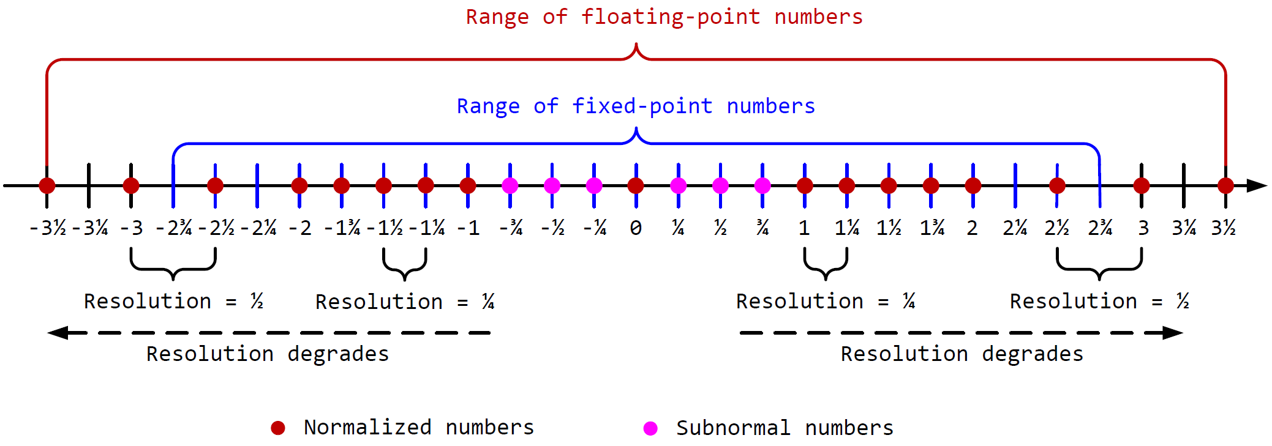
Resolution
Given a hypothetical five-bit floating-point system (similar to IEEE 754).
the sign bit, an exponent (2 bits), and a fraction (2 bits)

Slide 14
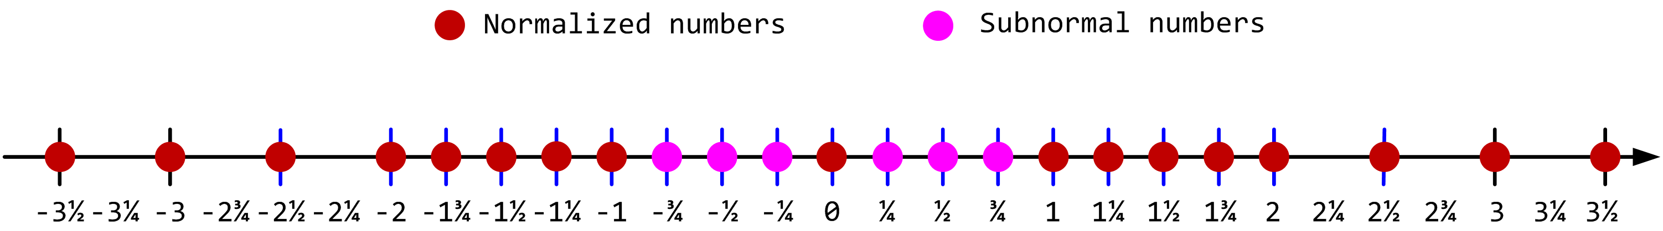
Tradeoff between Range and Precision
A simplified 5-bit floating-point (IEEE 754 style)
Floating-Point
Resolution: difference between two neighbor numbers
Precision decreases as the magnitude increases
Fixed-Point
Numbers are evenly distributed among the representable range
Precision is fixed

