Slide 1
CSC 112: Computer Operating Systems
Lecture 5
Scheduling
Exercises
Department of Computer Science,
Hofstra University
Acknowledgement: Lecture slides based on UC Berkeley CS 162: Operating Systems and System Programming

Slide 2
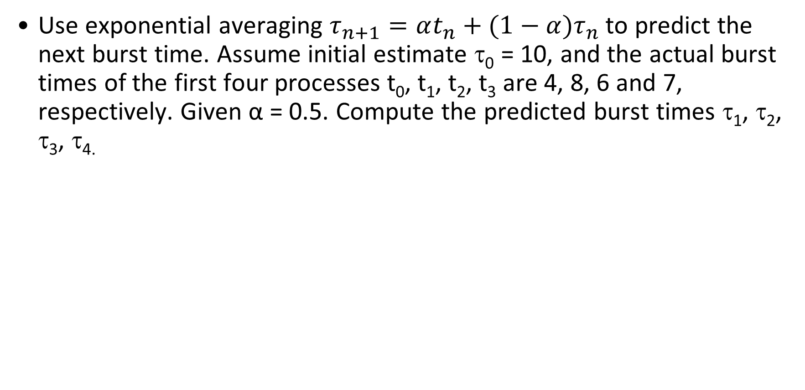
Predicting Burst Time
Use exponential averaging $τ_{n+1}=αt_{n}+(1−α)τ_{n}$ to predict the next burst time. Assume initial estimate τ₀ = 10, and the actual burst times of the first four processes t₀, t₁, t₂, t₃ are 4, 8, 6 and 7, respectively. Given α = 0.5. Compute the predicted burst times τ₁, τ₂, τ₃, τ_{4.}

Slide 3
Scheduling
Here is a table of processes and their arrival and execution times.
1) Draw the Gantt chart under 4 policies: First Come First Serve (FCFS), Shortest Job First (SJF), Shortest-Remaining-Time-First (SRTF), Round-Robin (RR) with time quantum = 1. Assume that context switch overhead is 0. For RR, assume that an arriving process is scheduled to run at the beginning of its arrival time, i.e., it is added to the head of the queue upon arrival.
2) Compute the finish times and response times for all processes, and the average response time. (If the division is hard, write a fraction like 28/5 instead of 5.6)

Slide 4
Scheduling I
PID | Arriv. time | Exec Time | FCFS Finish Time | FCFS Response Time | SJF Finish Time | SJF Response Time | SRTF Finish Time | SRTF Response Time | RR Finish Time | RR Response Time
1 | 0 | 2
2 | 1 | 6
3 | 4 | 2
 |  | Average Turnaround |  | Avg RT |  | Avg RT |  | Avg RT |  | Avg RT
FCFS
SJF
SRTF
RR
Time | 0 | 1 | 2 | 3 | 4 | 5 | 6 | 7 | 8 | 9 | 10
Gantt Chart

Slide 5
Scheduling II
PID | Arriv. time | Exec Time | FCFS Finish Time | FCFS Response Time | SJF Finish Time | SJF Response Time | SRTF Finish Time | SRTF Response Time | RR Finish Time | RR Response Time
1 | 0 | 3
2 | 1 | 5
3 | 3 | 2
4 | 9 | 2
 |  | Average Turnaround |  | Avg RT |  | Avg RT |  | Avg RT |  | Avg RT
FCFS
SJF
SRTF
RR
Time | 0 | 1 | 2 | 3 | 4 | 5 | 6 | 7 | 8 | 9 | 10 | 11 | 12
Gantt Chart

Slide 6
Scheduling III
Consider the set of 3 processes whose arrival time and CPU burst times are given below. If the CPU scheduling policy is FCFS, draw the Gantt chart and calculate the average response time.
PID | Arriv. time | Exec Time | FCFS Finish Time | FCFS Response Time
1 | 0 | 2
2 | 3 | 1
3 | 5 | 6
 |  | Average Turnaround |  | Avg RT

Slide 7
Scheduling with Bursts I
Consider the set of 3 processes whose arrival time and CPU/IO burst times are given below. If the CPU scheduling policy is Shortest Remaining Time First (SRTF), draw the Gantt chart and calculate the average response time. (Note: consider the overlap of computation and IO bursts of different processes)
PID | Arriv. time | IO Burst | CPU Burst | IO Burst
1 | 0 | 2 | 7 | 1
2 | 0 | 4 | 14 | 2
3 | 0 | 6 | 21 | 3
 |  |  |  | Avg RT

Slide 8
Scheduling with Bursts II
Consider the set of 3 processes whose arrival time and CPU/IO burst times are given below. If the CPU scheduling policy is Fixed-Priority Scheduling (larger number denotes higher priority), draw the Gantt chart and calculate the average response time.
PID | Arriv. time | Priority | CPU Burst | IO Burst | CPU Burst
1 | 0 | 2 | 1 | 5 | 3
2 | 2 | 1 | 3 | 3 | 1
3 | 3 | 3 | 2 | 3 | 1
 |  |  | Avg RT |  | Avg RT

