Slide 1
CSC 112: Computer Operating Systems
Lecture 3
Synchronization
Department of Computer Science,
Hofstra University
Acknowledgement: Lecture slides based on UC Berkeley CS 162: Operating Systems and System Programming
And NTNU course on Operating Systems

Slide 2
Concurrency I
int x = 0;
//Thread T0
for (int i=0; i<5; i++) {
x = x + 1;
}
//Thread T1
for (int j=0; j<5; j++) {
x = x + 2;
}
Consider two concurrent threads T0, T1, which access a shared variable x that has been initialized to 0. There is no mutex protection.
Q: What are the minimum, maximum, and all possible values of x after the two threads have completed execution?
Notes:
for (i=0; i

Slide 3
Concurrency II
Consider three concurrent threads T1, T2, T3, which access a shared variable D that has been initialized to 100. There is no mutex protection. What are the minimum and maximum possible values of D after the three threads have completed execution?
ANS:
//Initialization
int D=100;
//Thread T1
void main(){
D=D+20;
}
//Thread T2
void main(){
D=D-50;
}
//Thread T3
void main(){
D=D+10;
}

Slide 4
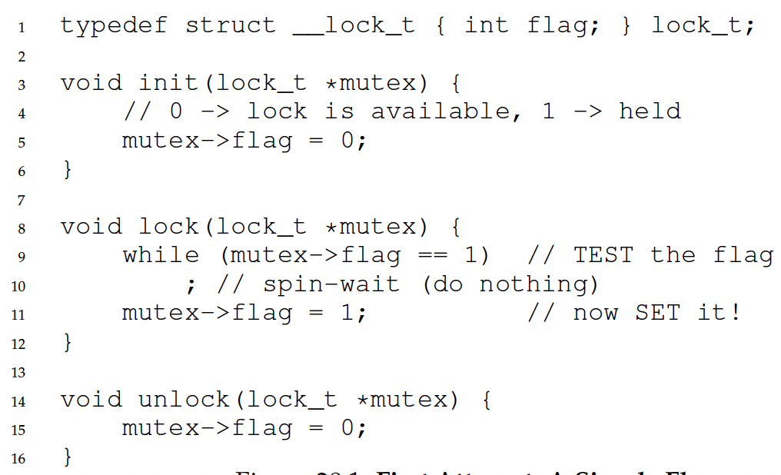
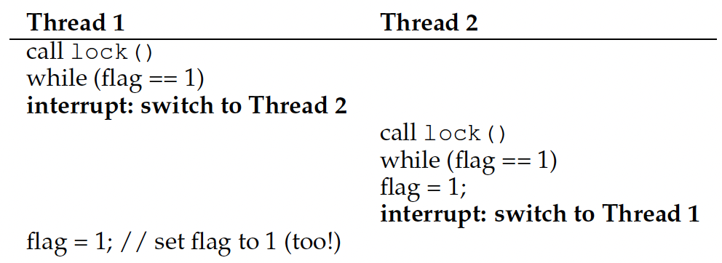
Recall: Locks: Loads/Stores
This implementation does not ensure mutual exclusion, since both threads may grab the lock:
After Thread 1 reads flag==0 and exits the while loop, it is preempted/interrupted by Thread 2, which also reads flag==0 and exits the while loop. Then both threads set flag=1 and enter the critical section.
Root cause: Lock is not an atomic operation!
flag = 0
Notes:
Another problem: performance overhead!

Slide 5
Mutual Exclusion I
Boolean S0, S1;
S0=false, S1=false;
//Thread T0
while (true) {
while (S0 == S1);
//Critical section
S0 = S1;
}
//Thread T1
while (true) {
while (S0 != S1);
//Critical section
S1 = !S0;
}
Does it achieve one or more of the correctness properties of a concurrent program:
  Mutual exclusion: Only one thread in critical section at a time
  Progress (deadlock-free): If several simultaneous requests, must allow one to proceed
  Bounded waiting (starvation-free): Must eventually allow each waiting thread to enter
Does it need the TestAndSet() instruction for atomic execution like the previous slide “Locks: Loads/Stores”?
What is its major flaw?
ANS:
Notes:
Consider the methods used by threads T1 and T2 for accessing their critical sections whenever needed, as given below. (These are the only methods for accessing the critical section, and T1 and T2 each runs a separate higher-level program that uses these methods which is not shown.) The initial values of S1 and S2 are arbitrary.
Which of the following is true?
(a) Mutual exclusion but not progress
(b) Progress but not mutual exclusion
(c) Neither mutual exclusion nor progress
ANS:

Slide 6
Mutual Exclusion II
Boolean flag[2];
flag[0]=false, flag[1]=false;
//Thread T0
while (true) {
flag[0] = true;
while (flag[1]==true);
/* Critical Section */
flag[0] = false;
}
//Thread T1
while (true) {
flag[1] = true;
while (flag[0]==true);
/* Critical Section */
flag[1] = false;
}
Does it achieve one or more of the correctness properties of a concurrent program:
  Mutual exclusion: Only one thread in critical section at a time
  Progress (deadlock-free): If several simultaneous requests, must allow one to proceed
  Bounded waiting (starvation-free): Must eventually allow each waiting thread to enter
ANS:
Notes:
Boolean flag[2] = {false, false};
// Thread T0
while (true) {
flag[0] = true;
while (flag[1] == true);
/* Critical Section */
flag[0] = false;
}
// Thread T1
while (true) {
flag[1] = true;
while (flag[0] == true);
/* Critical Section */
flag[1] = false;
}

Slide 7
Mutual Exclusion III (Peterson’s Solution)
Boolean flag[2];
flag[0]=false, flag[1]=false;
int turn = 0;
//Thread T0
while (true) {
flag[0] = true;
turn = 1;
while (flag[1]==true && turn==1);
/* Critical Section */
flag[0] = false;
}
//Thread T1
while (true) {
flag[1] = true;
turn = 0;
while (flag[0]==true && turn==0);
/* Critical Section */
flag[1] = false;
}
Does it achieve one or more of the correctness properties of a concurrent program:
  Mutual exclusion: Only one thread in critical section at a time
  Progress (deadlock-free): If several simultaneous requests, must allow one to proceed
  Bounded waiting (starvation-free): Must eventually allow each waiting thread to enter
ANS:
Notes:
int i=0, j=1;

Slide 8
Mutual Exclusion III (Peterson’s Solution Variation)
Boolean flag[2];
flag[0]=false, flag[1]=false;
int turn = 0;
//Thread T0
while (true) {
flag[0] = true;
turn = 0;
while (flag[1]==true && turn==1);
/* Critical Section */
flag[0] = false;
}
//Thread T1
while (true) {
flag[1] = true;
turn = 1;
while (flag[0]==true && turn==0);
/* Critical Section */
flag[1] = false;
}
Does it achieve one or more of the correctness properties of a concurrent program:
  Mutual exclusion: Only one thread in critical section at a time
  Progress (deadlock-free): If several simultaneous requests, must allow one to proceed
  Bounded waiting (starvation-free): Must eventually allow each waiting thread to enter
ANS:
Notes:
int i=0, j=1;

Slide 9
Readers/Writers Solution using Monitors, Prefers Writers
int AR=0: Number of active readers;
int WR=0: Number of waiting readers;
int AW=0: Number of active writers;
int WW=0: Number of waiting writers;
Condition okToRead, okToWrite;
mutex_t mutex = 1;
Q: Rewrite it to prefer readers
(See lecture slides)
Reader() {
mutex_lock(&mutex);
while ((AW + WW) > 0) {//Is it safe to read?
WR++; //No. Writers exist
cond_wait(&okToRead,&mutex);
WR--; //No longer waiting
}
AR++; //Reader active!
mutex_unlock(&mutex);
AccessDatabase(ReadOnly);
mutex_lock(&mutex);
AR--; //No longer active
if (AR == 0 && WW > 0)//No other active readers
cond_signal(&okToWrite);//Wake up one writer
mutex_unlock(&mutex);
}
Writer() {
mutex_lock(&mutex);
while ((AW + AR) > 0) {//Is it safe to write?
WW++; //No. Active users exist
cond_wait(&okToWrite,&mutex);
WW--; //No longer waiting
}
AW++; //Writer active!
mutex_unlock(&mutex); AccessDatabase(ReadWrite);
mutex_lock(&mutex);
AW--; //No longer active
if (WW > 0){//Give priority to writers
cond_signal(&okToWrite);//Wake up one writer
} else if (WR > 0) {//Otherwise, wake reader
cond_broadcast(&okToRead);//Wake all readers
}
mutex_unlock(&mutex);
}
9

Slide 10
Race Conditions
Consider the two threads each executing t1 and t2. Values of shared variables y and z are initialized to 0
int y=0, z=0;
1 t1(){ |  |  | 1 | t2(){
2 | int x; |  | 2 |  | y = 1;
3 | x = y + z; |  | 3 |  | z = 2;
4 } |  |  | 4 | }
Q. Give all possible final values for x and the corresponding order of execution of instructions in t1 and t2.
1) t1 runs to the end first; then t2 runs to the end: x = 0+0 = 0
2) t2 to line 2; then t1 to the end; then t2 to the end: x = 1+0 = 1
3) t2 to the end; then t1 to the end: x = 1+2 = 3
Are there other possibilities giving additional values?
10

Slide 11
Race Conditions
Addition operation x=y+z consists of multiple machine instructions in assembly language:
  fetch operand y into register r1
  fetch operand z into register r2
  add r1 + r2, store result in r3
  store r3 in memory location of x
If a task switch to t2 occurs between machine instructions A and B; then t2 runs to completion before switching back to t1, then:
y is read as 0 (t2 didn’t set y yet)
z is read as 2 (t2 sets z before t1 executes instruction B of the addition)
the sum is then x = 0 + 2 = 2
int y=0, z=0;
1 t1(){ |  |  | 1 | t2(){
2 | int x; |  | 2 |  | y = 1;
3 | x = y + z; |  | 3 |  | z = 2;
4 } |  |  | 4 | }
11

Slide 12
Race Conditions
Q. Give a solution using semaphores.
Solution: we protect the addition x = y + z within a critical section, using a binary semaphore (mutex). This code guarantees that x can never have the value 1 or 2, possible values are x = 0, 3
(Line “int x” can be outside or inside the critical section with no difference. We use a slightly different notation of s.wait()/s.signal() to denote sem_wait(&s) and sem_post(&s)).
int y=0, z=0;
semaphore s = 1;
1 t1() { |  | 1 t2() {
2 | int x; | 2 s.wait();
3 | s.wait(); | 3 y = 1;
4 | x = y + z; | 4 z = 2;
5 | s.signal(); | 5 s.signal();
6 } |  | 6 }
12

Slide 13
Semaphores I
t1:
1 int t1() { |  | t2: | 1 int t2() {
2 | printf("w"); |  | 2 | printf("o");
3 | printf("d"); |  | 3 | printf("r");
4 } |  |  | 4 | printf("l");
 |  |  | 5 6 } | printf("e");
Q. Use semaphores and insert wait/signal calls into the two threads so that only “wordle” is printed.
semaphore s1=1, s2=0
1 int t1(){
1 int t2(){
t1 has to run first to print "w", so s1 should be initialized to 1.
t2 has to wait until the "w" has been printed by t1, then it is woken up by t1 calling s2.signal(), so s2 should be initialized to 0.
2
3
4
5
6
7
8 }
s1.wait();
2
3
4
5
6
7
8
9 }
s2.wait();
printf("o");
printf("r");
s1.signal();
s2.wait();
printf("l");
printf("e");
printf("w");
s2.signal();
s1.wait();
printf("d");
s2.signal();
13
Notes:
It is signalled by t1, so the initial value of s2 has to be 0.

Slide 14
Semaphores II
The following three functions of a program f1(), f2(), f3() run in separate threads each and print some prime numbers. All three threads are ready to run at the same time. Use synchronization using the semaphores S1, S2 and S3 and wait/signal operations on the semaphores to ensure that the program outputs the prime numbers in increasing order (2, 3, 5, 7, 11, 13).
Semaphore S1=0;
Semaphore S2=0;
Semaphore S3=0; f1() {
printf("3");
printf("5");
}
f2() {
printf("2");
printf("13");
}
f3() {
printf("7");
printf("11");
}
Notes:
Insert appropriate wait or signal operations in the code lines indicated with // SYNC and give the correct initial values for the semaphores. Give the completed functions and the initial values for the semaphores.
Hint: Note that it might not be required to add a wait or signal operations in all of the places indicated.

Slide 15
Semaphores II Solution
semaphore S1=0;
semaphore S2=0;
semaphore S3=0;
f1() {
S1.wait();
printf("3");
printf("5");
S3.signal();
}
f2() {
printf("2");
S1.signal();
S2.wait();
printf("13");
}
f3() {
S3.wait();
printf("7");
printf("11");
S2.signal();
}
semaphore S1=0;
semaphore S2=1;
semaphore S3=0;
f1() {
S1.wait();
printf("3");
printf("5");
S3.signal();
}
f2() {
S2.wait();
printf("2");
S1.signal();
S2.wait();
printf("13");
}
f3() {
S3.wait();
printf("7");
printf("11");
S2.signal();
}
Solution 1 (left): With initial values of all semaphores = 0, only f2 can run, prints 2, signals S1 and then waits for S2. S1.signal() starts f1, which was waiting for S1 and can now print 3 and 5 and then signal S3. S3.signal() now starts f3, which prints 7 and 11 and signals S2. This returns execution to f2, which can then finally print 13.
Solution 2 (right): S2 has initial value 1, so f2 calls S2.wait() and runs first. The rest is the same as in Solution 1. You can see that initializing S2=0 has the same effect as initializing S2=1 and let f2 call S2.wait() first. So Solution 1 is better with one less call to wait().
Notes:
Insert appropriate wait or signal operations in the code lines indicated with // SYNC and give the correct initial values for the semaphores. Give the completed functions and the initial values for the semaphores.
Hint: Note that it might not be required to add a wait or signal operations in all of the places indicated.

Slide 16
Semaphores III
semaphore s_a=0, s_b=0, s_c=0;
int t3() {
while(1) {
s_c.wait();
s_c.wait();
printf("C");
s_a.signal();
s_b.signal();
8 }
9 }
int t1() {
while(1) {
printf("A");
s_c.signal();
s_a.wait();
6 }
7 }
int t2() {
while(1) {
printf("B");
s_c.signal();
s_b.wait();
6 }
7 }
Q. Which strings can be output when running the 3 threads in parallel?
Either t1 or t2 could start first, so the first letter can be A or B
Then both t1 and t2 signal s_c, only after both have signalled s_c, t3 can start and print C
t3 signals s_a and s_b, which start in arbitrary order again
Accordingly, the output is a regular expression ((AB|BA)C)+
  Print A or B in arbitrary order, then print C, then the process repeats
16
Notes:
Here, we have used a regular expression to indicate the structure of a text pattern. Regular expressions (short: regexps) are a common tool in Unix

Slide 17
Deadlocks I
//Initialization
int x=0, y=0, z=0; semaphore lock1=1, lock2=1;
//Initialization
int x=0, y=0, z=0; semaphore lock1=1, lock2=1;
1 int t1() {
2 z = z + 2;
lock1.wait();
x = x + 2;
lock2.wait();
lock1.signal();
y = y + 2;
lock2.signal();
9 }
1 int t2() {
1 int t1() { 1 int t2() {
2
3
lock2.wait();
2
3
4
5
6
7
8
9 }
z = z + 2; lock1.wait(); x = x + 2;
2
3
4
5
6
7
8
9 }
lock2.wait();
y = y + 1; lock1.wait(); x = x + 1;
lock1.signal(); lock2.signal(); z = z + 1;
y = y + 1; lock1.wait(); x = x + 1;
lock1.signal(); lock2.signal(); z = z + 1;
4
5
6
7
8
9 }
lock2.wait(); lock1.signal(); y = y + 2; lock2.signal();
Deadlock scenario 1:
t2 runs first until line 2 (so lock2=0, lock1=1); switch to t1
t1 starts and runs until line 3 (so lock1=0, lock2=0); back to t2
t2 waits for lock1 in line 4; switch to t1, waits for lock2 in line 5
This results in a circular waiting condition, where each thread grabs one lock and requests the other.
Deadlock scenario 2:
t1 runs first until line 4 (so lock1=0, lock2=1); switch to t2
t2 starts and runs until line 3 (so lock1=0, lock2=0); back to t1
t1 waits for lock2 in line 5; switch to t2, waits for lock1 in line 4
(Other interleavings are possible, e.g., t1 grabs lock1, t2 grabs lock2 and requests lock1, t1 requests lock2)
To prevent deadlocks, every thread should acquire locks in the same order, e.g. both acquire lock1 before lock2, or both acquire lock2 before lock1
17
Notes:
Are there other execution orders leading to a deadlock?
You can remove all other statements and only leave the lock wait() instructions and get into this deadlock.)

Slide 18
Deadlocks II
int x=0, y=0, z=0; semaphore lock1=1, lock2=1;
Q. What are the possible values of x, y and z in the deadlock state?
t1 runs until Line 5 lock2.wait() and t2 runs until Line 4 lock1.wait(), so x = 2, y = 1, z = 2
Q. What are the possible values of x, y and z if the program finishes successfully without a deadlock?
t1 runs first to the end, then t2 (or vice versa): x=3, y=3, z=3 (z can also be 1 or 2, see below)
In t1, lock1.signal() sets lock1=1, lock2.signal() sets lock2=1, thus exiting the critical sections protected by lock1 and lock2.
Since Line 2 of t1 “z=z+2”, and Line 8 of t2 “z=z+1” are not protected within a critical section, a thread switch may occur in the middle of each line, e.g.,
  t2 Line 8 reads z=0; before z is written back; switch to t1 Line 2, run t1 to the end; switch to t2 Line 8, write back z=0+1=1.
  Or, t1 Line 2 reads z=0; before z is written back; switch to t2 Line 2, run t2 to the end; switch to t1 Line 2, write back z=0+2=2.
1 int t1() { |  |  | 1 | int t2() {
2 | z = z + 2; |  | 2 |  | lock2.wait();
3 | lock1.wait(); |  | 3 |  | y = y + 1;
4 | x = x + 2; |  | 4 |  | lock1.wait();
5 | lock2.wait(); |  | 5 |  | x = x + 1;
6 | lock1.signal(); |  | 6 |  | lock1.signal();
7 | y = y + 2; |  | 7 |  | lock2.signal();
8 | lock2.signal(); |  | 8 |  | z = z + 1;
9 } |  |  | 9 | }
18
Notes:
Semaphores -> locks + condition variables
Binary semaphores -> locks
Semaphore for ordering
Semaphore for P/C

