Slide 1
CSC 112: Computer Operating Systems
Lecture 5
Scheduling
Zonghua Gu
Department of Computer Science,
Hofstra University
Acknowledgement: Lecture slides based on UC Berkeley CS 162: Operating Systems and System Programming

Slide 2
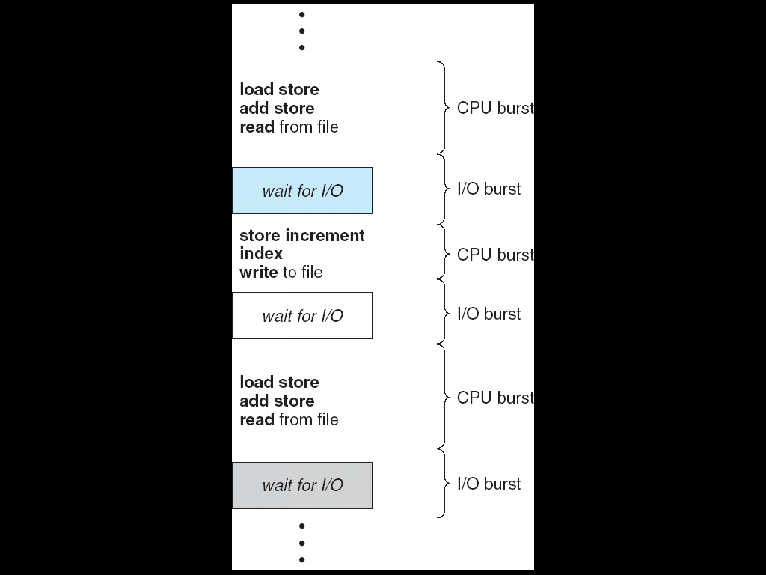
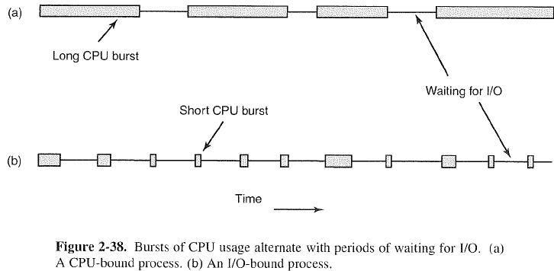
CPU/IO Bursts
A typical task alternates between bursts of CPU and I/O
  It uses the CPU for some period of time, then does I/O, then uses CPU again (A job may be pre-empted and forced to give up CPU before finishing current CPU burst)
A CPU bound job
An I/O bound job
Notes:
Execution model: programs alternate between bursts of CPU and I/O
Program typically uses the CPU for some period of time, then does I/O, then uses CPU again
Each scheduling decision is about which job to give to the CPU for use by its next CPU burst
With timeslicing, thread may be forced to give up CPU before finishing current CPU burst
By convention, we use the term “process” in this section, assuming that each process is single-threaded
The scheduling algorithms can be applied to threads as well
The term “job” is often used to refer to a CPU burst, or a compute-only process

Slide 3
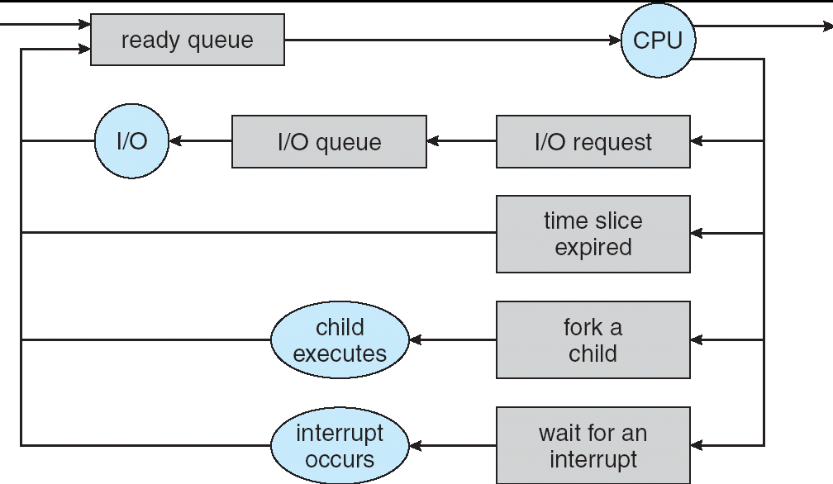
The Scheduling Problem
T1
T2
T3
T1
T2
Time
Scheduling: When multiple jobs are ready, the scheduling algorithm decides which one is given access to the CPU
  We use the term “task” to refer to a runnable entity in the OS, which may be a process or a thread. We use the term “job” to refer to a CPU burst of a task
Notes:
Question: How is the OS to decide which of several tasks to take off a queue?
When multiple processes are ready, the scheduling algorithm decides which one is given access to the CPU
deciding which jobs are given access to resources from moment to moment
Resource often refers to CPU time, but may also be network BW or disk access

Slide 4
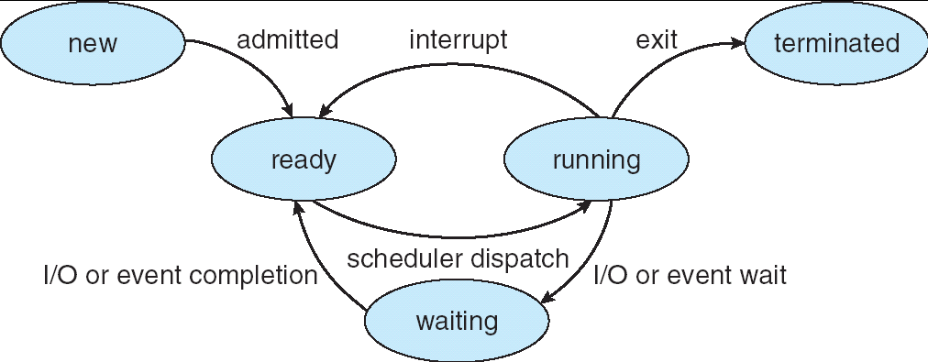
Preemptive vs. Non-Preemptive Scheduling
With non-preemptive scheduling, once the CPU has been allocated to a process, it keeps the CPU until it releases the CPU either by terminating or by blocking for IO.
With preemptive scheduling, the OS can forcibly remove a process from the CPU without its cooperation
Transition from “running” to “ready” only exists for preemptive scheduling

Slide 5
Performance Metrics
Response time = CompletionTime – ArrivalTime: the total time taken for a job to complete its execution, starting from its arrival time until it finishes. It includes all phases of the process lifecycle: waiting in queues, execution on the CPU, and any I/O operations.
  Called turnaround time in most textbooks (Please use my definition in this class!)
Initial waiting time: the time a job spends waiting in the ready queue before it gets its first chance to execute on the CPU
  Called response time in most textbooks (Please use my definition in this class!)
Waiting time: the total time a job spends waiting in the ready queue until it finishes
CPU utilization: percent of time when CPU is busy
Throughput: # of jobs that complete their execution per time unit
Different systems may have different objectives. Typically, they cannot be optimized simultaneously by a single scheduling algorithm
  Maximize CPU utilization
  Maximize Throughput
  Minimize Average Response time
  Minimize Average Waiting time
Notes:
amount of time a process waits in the ready queue before it starts execution
Wait
Minimize Response Time
Response Time=Time at which job first gets CPU−Arrival Time
Defined as the amount of time from when a job or request is submitted to the system (enters the ready queue) until it gets the CPU for the first time. It measures how quickly a system starts responding to a job after it arrives.
Fairness
Share CPU among users in some equitable way
Fairness is not minimizing average response time:
Better average response time by making system less fair
In real-time scheduling theory, response time really does correspond to what OS textbooks call turnaround time:
R = finish time − release (arrival) time.
Real-time researchers care about the worst-case latency until a job completes, because completion must meet a deadline.
In interactive OS scheduling, response time means something different:
response time = time until the first system reaction,
not the time until the job completes.
So yes, in real-time scheduling:
• “Response time” ≈ OS “turnaround time”.
• It does not match the interactive-scheduling meaning of response time.
Note that my definition of Response time is different from most textbooks,

Slide 6
Common Scheduling Algorithms
First-Come-First-Served (FCFS) Scheduling
Round-Robin (RR) Scheduling
Shortest-Job-First (SJF) Scheduling
Priority-Based Scheduling
Multilevel Queue Scheduling
Multilevel Feedback-Queue Scheduling

Slide 7
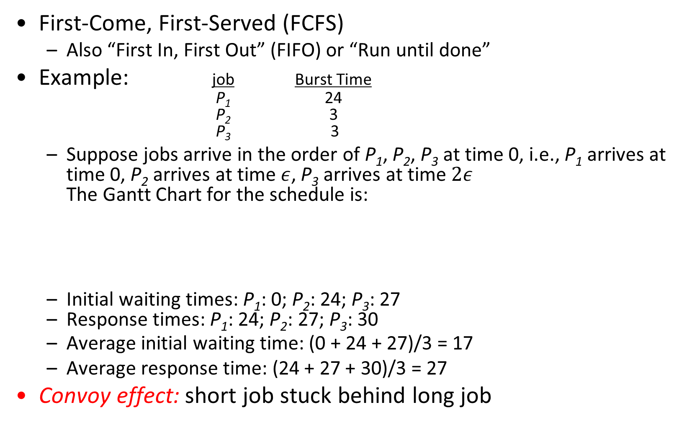
First-Come, First-Served (FCFS) Scheduling
First-Come, First-Served (FCFS)
  Also “First In, First Out” (FIFO) or “Run until done”
Example: job Burst Time
P₁ 24
P₂ 3
P₃ 3
  Suppose jobs arrive in the order of P₁, P₂, P₃ at time 0, i.e., P₁ arrives at time 0, P₂ arrives at time $ε$, P₃ arrives at time $2ε$
  The Gantt Chart for the schedule is:
  Initial waiting times: P₁: 0; P₂: 24; P₃: 27
  Response times: P₁: 24; P₂: 27; P₃: 30
  Average initial waiting time: (0 + 24 + 27)/3 = 17
  Average response time: (24 + 27 + 30)/3 = 27
Convoy effect: short job stuck behind long job
P₁
P₂
P₃
0
24
27
30
Notes:
In early systems, FCFS meant one program
scheduled until done (including I/O)
Now, means keep CPU until thread blocks

Slide 8
FCFS Scheduling (Cont.)
Example continued:
  Suppose jobs arrive in the order: P2 , P3 , P1 at time 0:
  Initial waiting times: P₁: 6; P₂: 0; P₃: 3
  Response times: P₁: 30; P₂: 3; P₃: 6
  Average initial waiting time: (6 + 0 + 3)/3 = 3 (vs. 17 before)
  Average response time: (30 + 3 + 6)/3 = 13 (vs. 27 before)
P₂
P₃
P₁
0
3
6
30
Notes:
Safeway: Getting milk, always stuck behind cart full of items!
Upside: get to read about Space Aliens!
FCFS scheduling
Pro: Simple
Con: Short jobs get stuck behind long ones (Convoy effect)
In second case:
Average initial waiting time is much better (before it was 17)
Average response time is better (before it was 27)

Slide 9




Convoy Effect
Scheduled Job
time
Scheduling queue
Job arrivals
With FCFS non-preemptive scheduling, convoys of small tasks tend to build up when a large one is running.
Long job
Short job
Short job

Slide 10
Round Robin (RR) Scheduling
Round Robin Scheme:
  Each job gets a small unit of CPU time (time slice or time quantum), usually 10-100 milliseconds
  When quantum expires, the job is preempted and added to the end of the ready queue
  If the current CPU burst finishes before quantum expires, the job blocks for IO and is added to the end of the ready queue when its IO completes
  n jobs in ready queue and time quantum is q ⇒
    Each job gets (roughly) 1/n of the CPU time
    In chunks of at most q time units
    No job waits more than (n-1)q time units
OS implementation:
  Use a periodic timer interrupt to preempt the running job every time quantum, and send it to the back of the ready queue
Notes:
Each process gets a small unit of CPU time
(time quantum or time slice), usually 10-100 milliseconds
When quantum expires, if the current CPU burst has not finished, the process is preempted and added to the end of the ready queue.
n processes in ready queue and time quantum is q ⇒
Each process gets (roughly) 1/n of the CPU time
In chunks of at most q time units
No process waits more than (n-1)q time units
FCFS Scheme: Potentially bad for short jobs!
Depends on submit order
If you are first in line at supermarket with milk, you don’t care who is behind you, on the other hand…
q small ⇒ Interleaved (really small ⇒ hyperthreading?)

Slide 11
Example of RR with Time Quantum = 20
Example: job Burst Time
P₁ 53
P₂ 8
P₃ 68
P₄ 24
  Suppose jobs arrive in the order of P₁, P₂, P₃, P₄ at time 0. Gantt chart:
  Waiting times: P₁=(68-20)+(112-88)=72 P₂=(20-0)=20
  P₃=(28-0)+(88-48)+(125-108)=85
  P₄=(48-0)+(108-68)=88
  Average waiting time = (72+20+85+88)/4=66¼
  Response times: P₁: 125; P₂: 28; P₃: 153; P₄: 112
  Average response time = (125+28+153+112)/4 = 104½
Round-Robin scheduling
  Pro: Better for short jobs, Fair
  Con: Context-switching overhead adds up for long jobs
P₁
P₂
P₃
P₄
P₁
P₃
P₄
P₁
P₃
P₃
0
20
28
48
68
88
108
112
125
145
153

Slide 12
Quantum size
Choice of time quantum size q:
  q must be large with respect to context-switching overhead,
  q too large: fairness is reduced. RR with infinite time quantum is equivalent to FCFS
  q too small: too many context-switches with high overhead
Typical time quantum in modern OSes is between 10ms – 100ms
Typical context-switching overhead is 0.1ms – 1ms
  Roughly 1% overhead due to context-switching
Notes:
otherwise overhead is too high
How do you choose time quantum (slice)?
Too big
Response time suffers
What if infinite (∞)?
Get back FIFO
What if time slice too small?
Throughput suffers! Need to balance short-job performance and long-job throughput:

Slide 13
Decrease Response Time w. Decreasing Quantum
T₁: Burst Length 10
T₂: Burst Length 1
Suppose jobs arrive in the order of T₁, T₂ at time 0
Q = 10
  Average Response Time = (10 + 11)/2 = 10.5
Q = 5
  Average Response Time = (11 + 6)/2 = 8.5
T₁
T₂
0
10
11
T₁
T₂
T₁
0
5
6
11
Notes:
Suppose jobs arrive in the order of P₁, P₂, P₃ at time 0

Slide 14
Response Time vs. Time Quantum
T₁: Burst Length 1
T₂: Burst Length 1
Suppose jobs arrive in the order of T₁, T₂ at time 0
Q = 10
  Average Response Time = (1 + 2)/2 = 1.5
Q = 1
  Average Response Time = (1 + 2)/2 = 1.5
Q = 0.5
  Average Response Time = (1.5 + 2)/2 = 1.75
T₁
T₂
0
1
2
Q = 10
T₁
T₂
0
1
2
Q = 1
0
2
Q = 0.5

Slide 15
FCFS vs. Round Robin
Assuming zero-cost context-switching time, RR may not be better than FCFS, e.g., when all jobs have equal execution time
Simple example: 10 jobs, each take 100s of CPU time
RR scheduler quantum of 1s
All jobs start at the same time
response times:
  Both RR and FCFS finish at the same time
  Average response time is much worse under RR than FCFS
Frequent context switches under RR hurts cache locality and increases job execution time due to increased cache miss rate
Job # | FIFO | RR
1 | 100 | 991
2 | 200 | 992
… | … | …
9 | 900 | 999
10 | 1000 | 1000
Notes:
Also: Cache state must be shared between all jobs with RR but can be devoted to each job with FIFO
Total time for RR longer even for zero-cost switch!

Slide 16
Consider the Previous Example
Job Burst Time
P₁ 53
P₂ 8
P₃ 68
P₄ 24
P₁
P₂
P₃
P₄
P₁
P₃
P₄
P₁
P₃
P₃
RR q=20:
0
20
28
48
68
88
108
112
125
145
153
P₂
[8]
P₄
[24]
P₁
[53]
P₃
[68]
Best FCFS:
0
8
32
85
153
P₃
[68]
P₁
[53]
P₄
[24]
P₂
[8]
Worst FCFS:
0
68
121
145
153
When jobs have uneven length, it seems to be a good idea to run short jobs first!

Slide 17
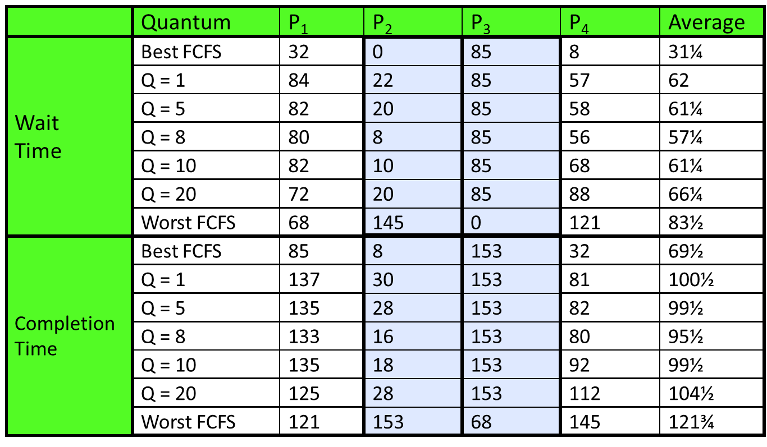
Earlier Example with Different Time Quantum
Average Wait Time and Response Time (Completion Time) may increase or decrease with varying time quantum

Slide 18
SJF and SRTF
If we know job execution times at arrival time (predict the future), then we can implement SJF and SRTF
Shortest Job First (SJF):
  Non-preemptive scheduling: Run whatever job has least amount of computation to do
  Still suffers from convoy effect due to non-preemption
Shortest Remaining Time First (SRTF):
  Preemptive scheduling: if a new job arrives with remaining time less than remaining time of currently-executing job, preempt the current job
    In case of a tie (a new job arrives with remaining time equal to remaining time of currently-executing job), then do not preempt the current job
Key idea: Give higher priority to short jobs and finish them quickly
  Big benefit for short jobs, only small delay effect on long ones
  Result is better average response time
Notes:
Rich get richer, and poor get poorer = short jobs get through the system faster, long jobs take even longer
These can be applied to whole program or current CPU burst
Sometimes called “Shortest Remaining Time to Completion” (SRTC)
Sometimes called “Shortest Time to Completion First” (STCF)
if a new job arrives with remaining time less than remaining time of currently-executing job, preempt the current job.
if job arrives and has a shorter time to completion than the remaining time of currently-executing job, preempt the current job

Slide 19
SJF and SRTF Example
SRTF achieves shorter average response time (Avg RT) than SJF, thanks to preemptive scheduling
Job | Arrival time | Exec Time | SJF Finishing Time | SJF Response Time | SRTF Finishing Time | SRTF Response Time
A | 0 | 70 | 70 | 70 | 90 | 90
B | 10 | 10 | 80 | 70 | 20 | 10
C | 20 | 10 | 90 | 70 | 30 | 10
 |  | Average Turnaround |  | Avg RT 70 |  | Avg RT 37
SJF
A
B
C
0
70
80
90
10
20
SRTF
A
B
C
A
0
30
90
10
20
B arrives
C arrives

Slide 20
Optimality of SJF and SRTF
SJF is the optimal scheduling algorithm for minimizing the average response time under the following assumptions:
  All jobs only use the CPU (no I/O)
  All jobs arrive at the same time
  Job execution times are known in advance
  Non-preemptive scheduling
SRTF is the optimal scheduling algorithm for minimizing the average response time under the following assumptions:
  All jobs only use the CPU (no I/O)
  Job execution times are known in advance
  Preemptive scheduling
Comparison of SRTF with FCFS
  If all jobs have the same length (execution time)
    SRTF becomes the same as FCFS (i.e. FCFS is optimal if all jobs the same length)
  If jobs have varying length
    SRTF is better, since short jobs are not stuck behind long ones
Notes:
SJF/SRTF are provably optimal (SJF among non-preemptive algorithms, SRTF among preemptive algorithms) for minimizing average response time
SJF is the optimal scheduling algorithm for minimizing the average turnaround time under the following assumptions:
All Jobs Arrive at the Same Time.
This ensures that the scheduler can make a complete decision about the order of execution based on job lengths without interruptions from newly arriving tasks.
Job Execution Times Are Known in Advance
The algorithm requires precise knowledge of each job’s run-time (execution time) to determine which job is the shortest. This assumption is often unrealistic in practice, as predicting exact execution times is challenging.
Non-Preemptive Scheduling
Once a job starts, it runs to completion without being interrupted by other jobs. This avoids complications like context switching but can lead to issues like starvation for longer jobs if shorter ones keep arriving.

Slide 21
Example to illustrate benefits of SRTF
A or B
C
C’s
I/O
C’s
I/O
C’s
I/O
Three jobs:
  A, B: both CPU bound, run for an hour
  C: I/O bound, runs in a loop of 1ms CPU followed by 9ms disk I/O
  If each job runs alone without interference, then C uses 90% of disk, A or B uses 100% of CPU
With FCFS:
  A and B may arrive and keep CPU busy for two hours before C is scheduled
What about RR or SRTF?

Slide 22


SRTF Example continued:
C runs every 201 ms
Disk Utilization:
9/201≈4.5%
C
C
A
B
RR w/ 100 ms time slice
C runs every 10 ms
Disk Utilization:
9/10=90%, but frequent CPU context switches
C’s
I/O
C’s
I/O
CABAB…
C
RR w/ 1 ms time slice
C’s
I/O
C’s
I/O
C runs every 10 ms
Disk Utilization:
9/10=90%, infrequent CPU context switches
C
A
A
A
C
B
B
B
SRTF
C’s
I/O
C’s
I/O
C’s
I/O
C’s
I/O

Slide 23
SRTF Discussions
How to predict job execution time?
  Runtime measurement and profiling for typical inputs
  Offline static analysis
  Difficult and error-prone in general
Unfair
  SRTF can lead to starvation if many small jobs arrive so large jobs never get to run
SRTF Pros & Cons
  Pros: Optimal in minimizing average response time
  Cons: Hard to predict job execution time; Unfair
Notes:
How can we do this?
Some systems ask the user
When you submit a job, have to say how long it will take
To stop cheating, system kills job if takes too long
But: hard to predict job’s runtime even for non-malicious users
Bottom line, can’t really know how long job will take
However, can use SRTF as a yardstick
for measuring other policies
Optimal, so can’t do any better

Slide 24
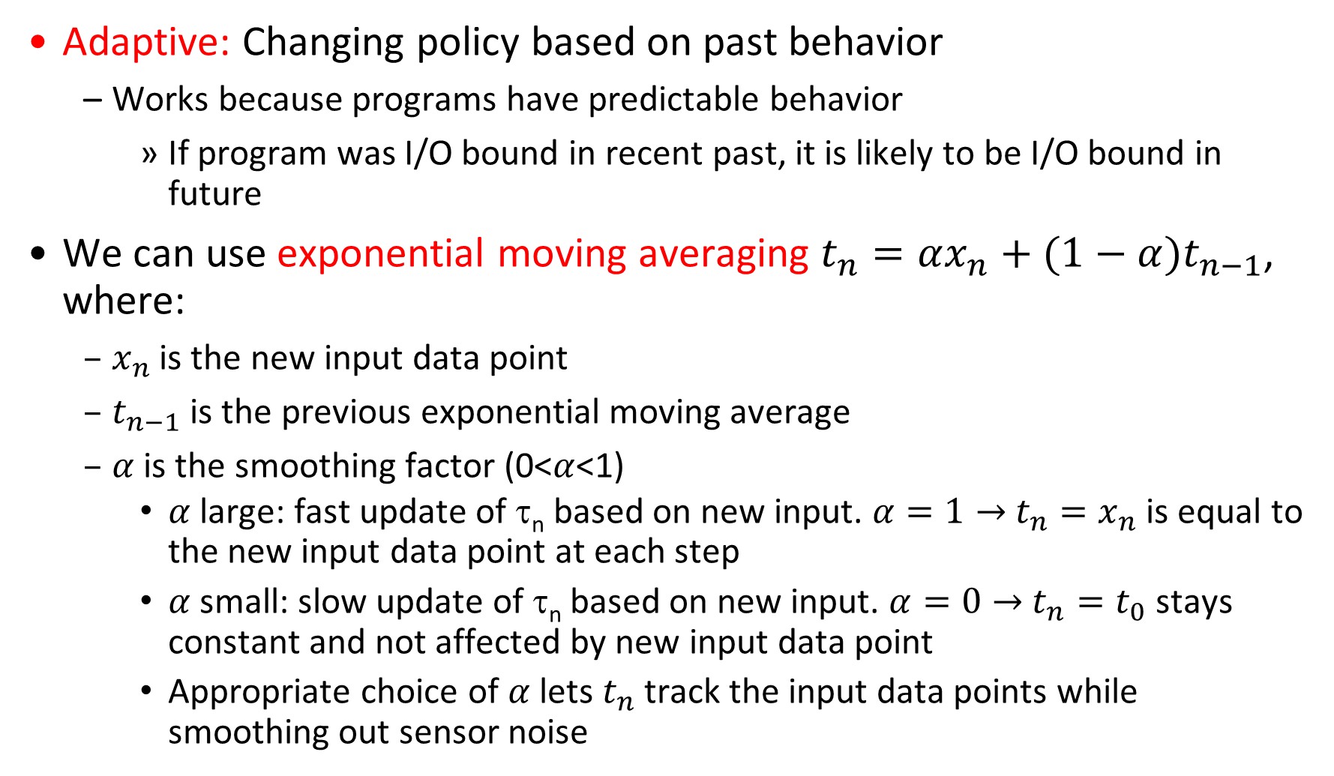
Predicting Length of the Next CPU Burst
Adaptive: Changing policy based on past behavior
  Works because programs have predictable behavior
    If program was I/O bound in recent past, it is likely to be I/O bound in future
We can use exponential moving averaging ${t_{n}=αx_{n}+(1−α)t}_{n−1}$, where:
  $x_{n}$ is the new input data point
  $t_{n−1}$ is the previous exponential moving average
  $α$ is the smoothing factor (0<$α$<1)
    $α$ large: fast update of τ_{n} based on new input. $α=1→$ $t_{n}=x_{n}$ is equal to the new input data point at each step
    $α$ small: slow update of τ_{n} based on new input. $α=0→$ $t_{n}=t_{0}$ stays constant and not affected by new input data point
    Appropriate choice of $α$ lets $t_{n}$ track the input data points while smoothing out sensor noise
Notes:
CPU scheduling, in virtual memory, in file systems, etc
Let t_{n-1}, t_{n-2}, t_{n-3}, etc. be previous CPU burst lengths. We need to estimate/predict next burst length τ_{n} = f(t_{n-1}, t_{n-2}, t_{n-3}, …) based on previous burst lengths.
Function f may be one of many different time series estimators
(Kalman filters, etc)
where t_{n-1}, t_{n-2}, t_{n-3}, etc. are previous CPU burst lengths, and τ_{n} is the predicted next CPU burst length.
t_{i} = actual burst time of process P_{i}, i = n, n-1, n-2, …
τ_{n} = predicted burst time for process P_{n}
α is the smoothing factor (0 <= α <=1)
For instance, exponential averaging
τ_{n} = αt_{n-1}+(1-α)τ_{n-1}
with (0<α≤1)
α large: fast update of τ_{n} based on
new input.
α small: slow update of τ_{n} based on
new input.

Slide 25
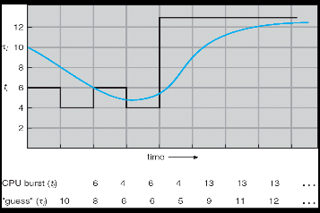
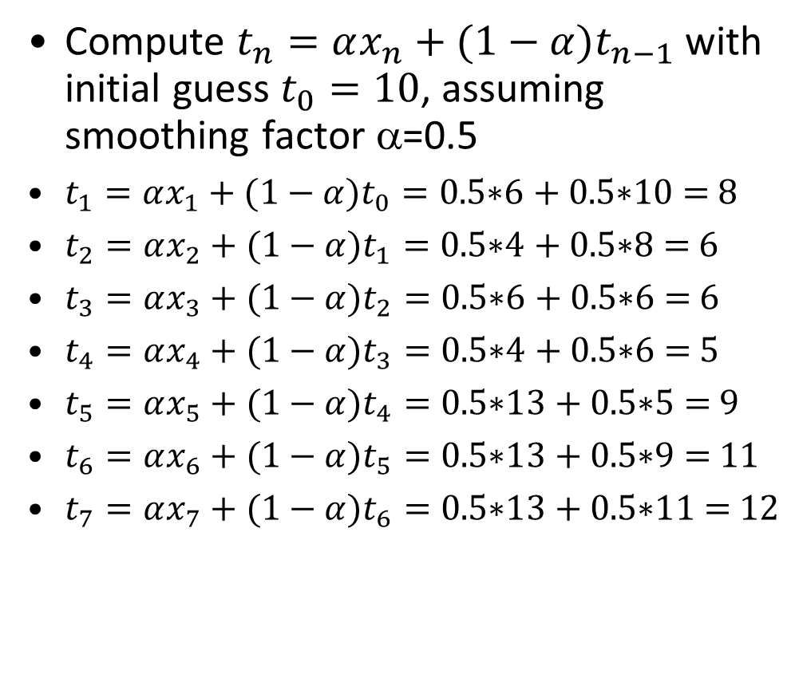
Predicting Length of the Next CPU Burst: α=0.5
Compute ${t_{n}=αx_{n}+(1−α)t}_{n−1}$ with initial guess $t_{0}=10$, assuming smoothing factor α=0.5
${t_{1}=αx_{1}+(1−α)t}_{0}=\text{0.5}\text{∗}\text{6 }\text{+ }\text{0.5}\text{∗}\text{10 }\text{= }\text{8}$
${t_{2}=αx_{2}+(1−α)t}_{1}=\text{0.5}\text{∗}\text{4 }\text{+ }\text{0.5}\text{∗}\text{8 }\text{= }\text{6}$
${t_{3}=αx_{3}+(1−α)t}_{2}=\text{0.5}\text{∗}\text{6 }\text{+ }\text{0.5}\text{∗}\text{6 }\text{= }\text{6}$
${t_{4}=αx_{4}+(1−α)t}_{3}=\text{0.5}\text{∗}\text{4 }\text{+ }\text{0.5}\text{∗}\text{6 }\text{= }\text{5}$
${t_{5}=αx_{5}+(1−α)t}_{4}=\text{0.5}\text{∗}\text{13 }\text{+ }\text{0.5}\text{∗}\text{5 }\text{= }\text{9}$
${t_{6}=αx_{6}+(1−α)t}_{5}=\text{0.5}\text{∗}\text{13 }\text{+ }\text{0.5}\text{∗}\text{9 }\text{= }\text{11}$
${t_{7}=αx_{7}+(1−α)t}_{6}=\text{0.5}\text{∗}\text{13 }\text{+ }\text{0.5}\text{∗}\text{11 }\text{= }\text{12}$
Time Series 101: Exponential Moving Average, A Visual Guide
https://www.youtube.com/watch?v=joHKNtPYtLo
Notes:
τ₁ = αt₀+(1-α)τ₀= 0.5*6 + 0.5*10 = 8
τ₂ = αt₁+(1-α)τ₁= 0.5*4 + 0.5*8 = 6
τ₃ = αt₂+(1-α)τ₂= 0.5*6 + 0.5*6 = 6
τ₄ = αt₃+(1-α)τ₃= 0.5*4 + 0.5*6 = 5
τ₅ = αt₄+(1-α)τ₄= 0.5*13 + 0.5*5 = 9
τ₆ = αt₅+(1-α)τ₅= 0.5*13 + 0.5*9 = 11
τ₇ = αt₆+(1-α)τ₆= 0.5*13 + 0.5*11 = 12

Slide 26
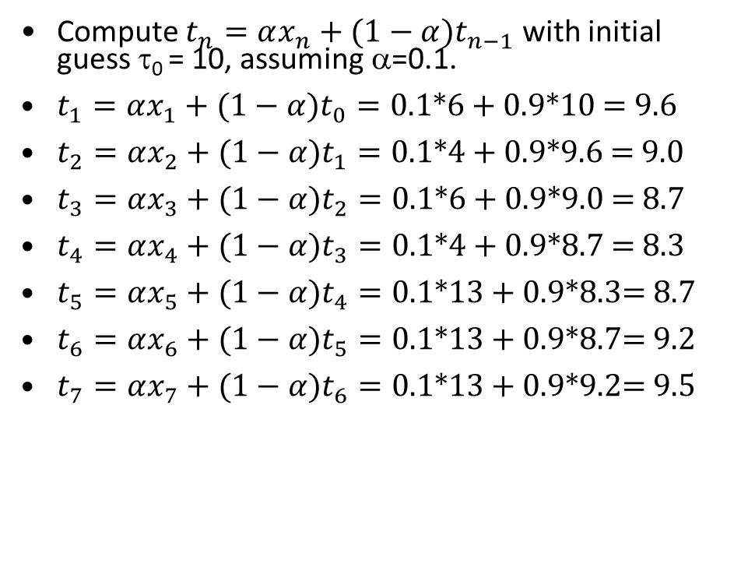
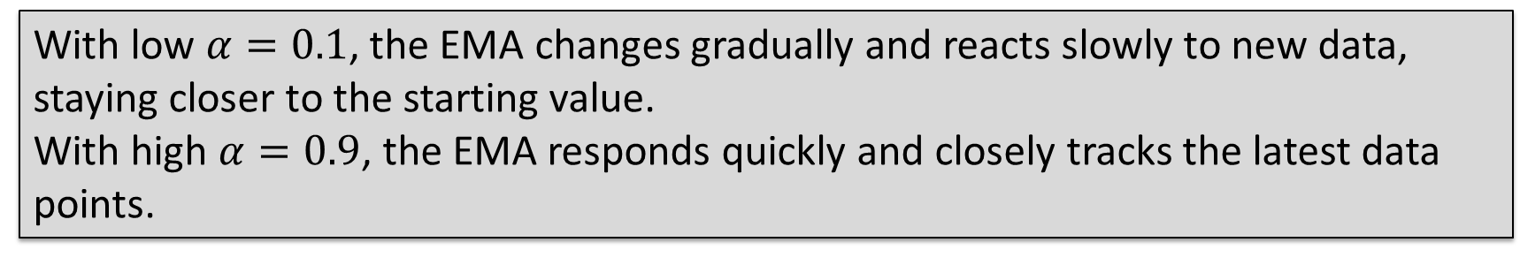
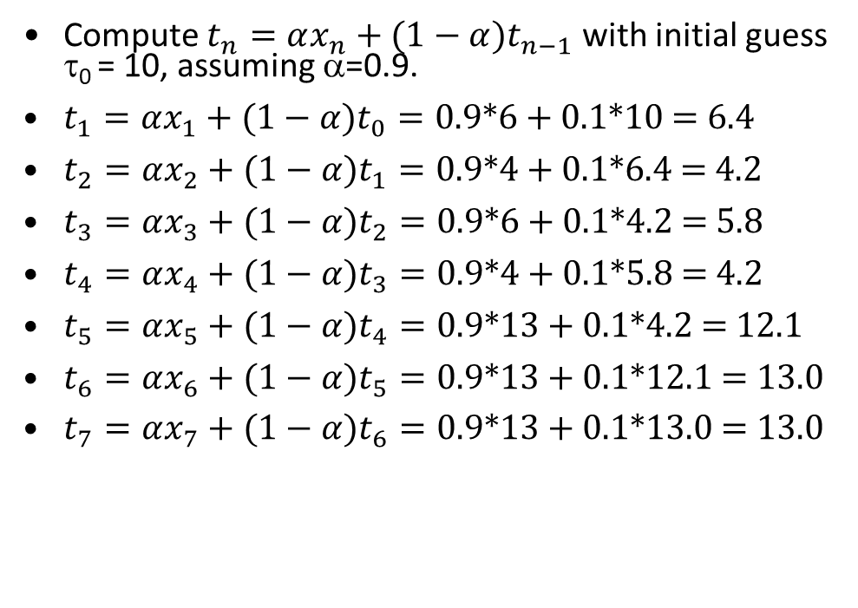
Predicting the Length of the Next CPU Burst: α=0.1 or 0.9
Compute ${t_{n}=αx_{n}+(1−α)t}_{n−1}$ with initial guess τ₀ = 10, assuming α=0.1.
${t_{1}=αx_{1}+(1−α)t}_{0}=\text{0.}\text{1}\text{∗}\text{6 }\text{+ }\text{0.9}\text{∗}\text{10 }\text{= }\text{9.6}$
${t_{2}=αx_{2}+(1−α)t}_{1}=\text{0.}\text{1}\text{∗}\text{4 }\text{+ }\text{0.9}\text{∗}\text{9.6} \text{= }\text{9.0}$
${t_{3}=αx_{3}+(1−α)t}_{2}=\text{0.}\text{1}\text{∗}\text{6 }\text{+ }\text{0.9}\text{∗}\text{9.0 }\text{= }\text{8.7}$
${t_{4}=αx_{4}+(1−α)t}_{3}=\text{0}\text{.}\text{1}\text{∗}\text{4 }\text{+ }\text{0.9}\text{∗}\text{8.7} \text{= }\text{8.3}$
${t_{5}=αx_{5}+(1−α)t}_{4}=\text{0.}\text{1}\text{∗}\text{13 }\text{+ }\text{0.9}\text{∗}\text{8.3}\text{= }\text{8.7}$
${t_{6}=αx_{6}+(1−α)t}_{5}=\text{0.}\text{1}\text{∗}\text{13 }\text{+ }\text{0.9}\text{∗}\text{8.7}\text{= }\text{9.2}$
${t_{7}=αx_{7}+(1−α)t}_{6}=\text{0.}\text{1}\text{∗}\text{13 }\text{+ }\text{0.9}\text{∗}\text{9.2}\text{= }\text{9.5}$
Compute ${t_{n}=αx_{n}+(1−α)t}_{n−1}$ with initial guess τ₀ = 10, assuming α=0.9.
${t_{1}=αx_{1}+(1−α)t}_{0}=\text{0.}\text{9}\text{∗}\text{6 }\text{+ }\text{0.1}\text{∗}\text{10 }\text{=} \text{6.4}$
${t_{2}=αx_{2}+(1−α)t}_{1}=\text{0.}\text{9}\text{∗}\text{4 }\text{+ }\text{0.1}\text{∗}\text{6.4} \text{= }\text{4.2}$
${t_{3}=αx_{3}+(1−α)t}_{2}=\text{0.}\text{9}\text{∗}\text{6 }\text{+ }\text{0.1}\text{∗}\text{4.2 }\text{= }\text{5.8}$
${t_{4}=αx_{4}+(1−α)t}_{3}=\text{0.}\text{9}\text{∗}\text{4 }\text{+ }\text{0.1}\text{∗}\text{5.8 }\text{= }\text{4.2}$
${t_{5}=αx_{5}+(1−α)t}_{4}=\text{0.}\text{9}\text{∗}\text{13 }\text{+ }\text{0.1}\text{∗}\text{4.2} \text{= }\text{12.1}$
${t_{6}=αx_{6}+(1−α)t}_{5}=\text{0.}\text{9}\text{∗}\text{13 }\text{+ }\text{0.1}\text{∗}\text{12.1} \text{= }\text{12.9}$
${t_{7}=αx_{7}+(1−α)t}_{6}=\text{0.}\text{9}\text{∗}\text{13 }\text{+ }\text{0.1}\text{∗}\text{12.9} \text{= }\text{13.0}$
With low $α=0.1$, the EMA changes gradually and reacts slowly to new data, staying closer to the starting value.
With high $α=0.9$, the EMA responds quickly and closely tracks the latest data points.
Notes:
τ₁ = αt₀+(1-α)τ₀= 0.5*6 + 0.5*10 = 8
τ₂ = αt₁+(1-α)τ₁= 0.5*4 + 0.5*8 = 6
τ₃ = αt₂+(1-α)τ₂= 0.5*6 + 0.5*6 = 6
τ₄ = αt₃+(1-α)τ₃= 0.5*4 + 0.5*6 = 5
τ₅ = αt₄+(1-α)τ₄= 0.5*13 + 0.5*5 = 9
τ₆ = αt₅+(1-α)τ₅= 0.5*13 + 0.5*9 = 11
τ₇ = αt₆+(1-α)τ₆= 0.5*13 + 0.5*11 = 12

Slide 27

Comparison Chart
Property | FCFS | SJF | SRTF | RR
Optimize Average Response Time
Prevent Starvation
Prevent Convoy Effect
No Need to Predict Exec Time

Slide 28
Fixed-Priority Scheduling
Priority 3
Job 1
Job 2
Job 3
Priority 2
Job 4
Priority 1
Priority 0
Job 5
Job 6
Job 7
Fixed-Priority Scheduling
  Each job is assigned a fixed priority
  Run the highest-priority job in the ready queue at any given time (may be preemptive or non-preemptive)
  Jobs of equal priority are scheduled with RR
SJF/SRTF are special cases of priority-based scheduling where priority is the predicted (remaining) job execution time
Problem: starvation – low priority jobs may never execute
  Sometimes this is the desired behavior!
Notes:
Deadlock: Priority Inversion
Happens when low priority task has lock needed by high-priority task
Usually involves third, intermediate priority task preventing high-priority task from running
Each queue can be processed in RR with some time-quantum
next/remaining CPU burst time
Problem: starvation
Lower priority jobs don’t get to run because higher priority jobs
How to fix problems?
Dynamic priorities – adjust job priority at runtime based on heuristics about interactivity, burst behavior, etc…
A priority number (integer) is associated with each process; CPU is allocated to the process with the highest priority
(Convention: smallest integer ≡ highest priority)

Slide 29
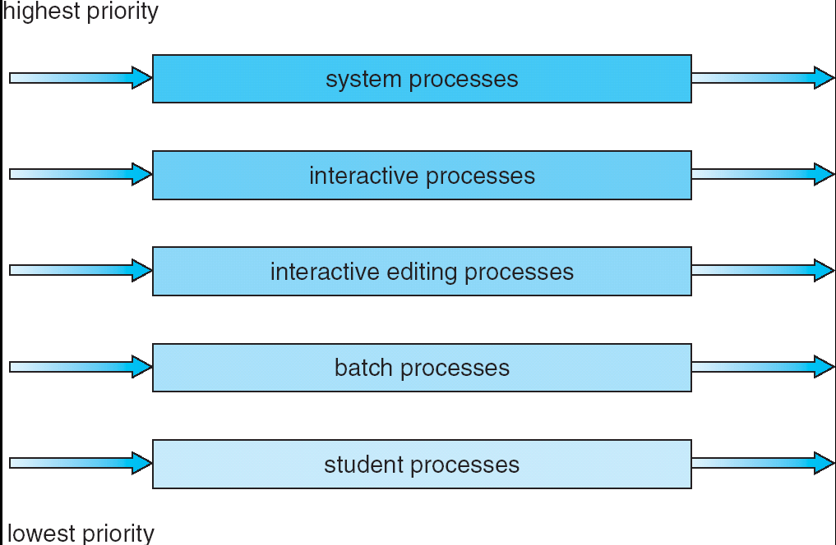
Multi-Level Queue Scheduling
Ready queue is partitioned into multiple queues, each with different priority
  Higher priority queues often considered “foreground” tasks
Each queue has its own scheduling algorithm
  e.g., foreground queue (interactive jobs/processes) with RR scheduling; background queue (batch jobs/processes) with FCFS scheduling
  Typically time quantum increases with decreasing priority
  (highest:1ms, next: 2ms, next: 4ms, etc)
Scheduling between the queues
  Fixed priority, e.g., serve all from foreground queue, then from background queue
Notes:
Exploit past behavior to make scheduling decisions
Multiple queues, each with different priority
Higher priority queues often considered “foreground” tasks
Each queue has its own scheduling algorithm
e.g. foreground – RR, background – FCFS
Sometimes multiple RR priorities with quantum increasing exponentially
(highest:1ms, next: 2ms, next: 4ms, etc)
Adjust each job’s priority as follows
Job starts in highest priority queue
If timeout expires, drop one level
If timeout doesn’t expire, push up one level

Slide 30
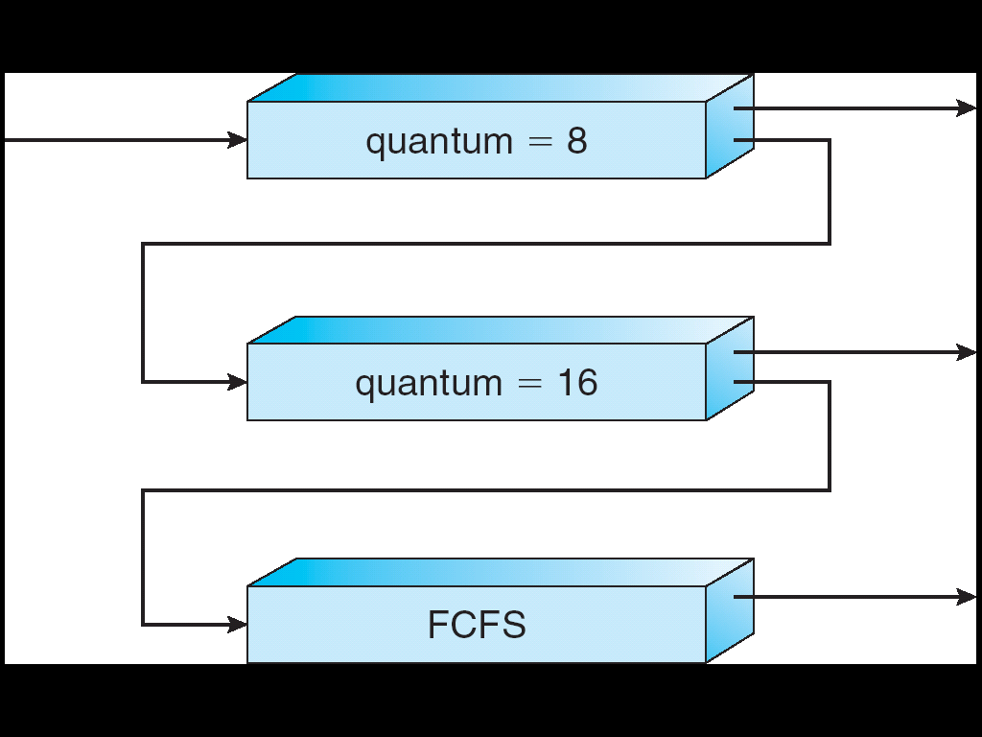
Multi-Level Feedback Queue Scheduling
Based on Multi-Level Queue Scheduling, but dynamically adjust each job’s priority as follows:
  It starts in highest-priority queue
  If quantum expires before the CPU burst finishes, drop down one level
  If it blocks for I/O before quantum expires, push up one level (or to top, depending on implementation)
  Time quantum increases with decreasing priority, from 8, to 16, to infinity (RR with infinite time quantum is equivalent to FCFS)
Notes:
Exploit past behavior to make scheduling decisions
Multiple queues, each with different priority
Higher priority queues often considered “foreground” tasks
Each queue has its own scheduling algorithm
e.g. foreground – RR, background – FCFS
Sometimes multiple RR priorities with quantum increasing exponentially
(highest:1ms, next: 2ms, next: 4ms, etc)
Adjust each job’s priority as follows
Job starts in highest priority queue
If timeout expires, drop one level
If timeout doesn’t expire, push up one level

Slide 31
Multi-Level Feedback Queue Scheduling Discussions
MLFQ approximates SRTF:
  Long-running CPU-bound jobs/processes are punished and drop down like a rock
  Short-running I/O-bound processes are rewarded and stay near top
  No need for prediction of job execution time; rely on past behavior to make decision
User can game the scheduler:
  e.g., put in a bunch of meaningless I/O like printf() to keep process in the high-priority queue
  Of course, if everyone did this, this trick wouldn’t work!
Notes:
demoted to lower priority
CPU-bound processes

Slide 32
Conclusion
FCFS Scheduling:
  Run jobs in the order of arrival
  Cons: Short jobs can get stuck behind long ones
Round-Robin Scheduling:
  Give each thread a small amount of CPU time when it executes; cycle between all ready threads
  Pros: Better for short jobs
Shortest Job First (SJF)/Shortest Remaining Time First (SRTF):
  Run whatever job has the least execution time/least remaining execution time
  Pros: Optimal (in terms of average response time)
  Cons: Hard to predict execution time, Unfair
Priority-Based Scheduling
  Each job is assigned a fixed priority
Multi-Level Queue Scheduling
  Multiple queues of different priorities and scheduling algorithms
Multi-Level Feedback Queue Scheduling:
  Automatic promotion/demotion of jobs between queues to approximate SJF/SRTF
Notes:
Many textbooks use the “old model”—one thread per job
Usually it's really: threads (e.g., in Linux)
One point to notice: switching threads vs. switching jobs incurs different costs:
Switch threads: Save/restore registers
Switch jobs: Change active address space too!
Expensive
Disrupts caching
Scheduling: selecting a waiting process from the ready queue and allocating the CPU to it
FCFS Scheduling:
Pros: Simple
Cons: Short jobs can get stuck behind long ones
Round-Robin Scheduling:
Pros: Better for short jobs
Cons: Poor performance when jobs have same length
Pros: Simple
Shortest Job First (SJF) and Shortest Remaining Time First (SRTF)
Run the job with least amount of computation to do/least remaining amount of computation to do
Pros: Optimal (average response time)
Cons: Hard to predict future, Unfair
Priority-Based Scheduling
Each process is assigned a fixed priority
Multi-Level Queue Scheduling
Multiple queues of different priorities
Multi-Level Feedback Queue Scheduling:
Automatic promotion/demotion of process between queues
Lottery Scheduling:
Give each process a number of tickets (short tasks ⇒ more tickets)
Reserve a minimum number of tickets for every process to ensure forward progress
See animations of common scheduling algorithms

