Slide 1
CSC 112: Computer Operating Systems Lecture 3 Synchronization
Department of Computer Science,
Hofstra University
Acknowledgement: Lecture slides based on UC Berkeley CS 162: Operating Systems and System Programming
And NTNU course on Operating Systems

Slide 2
Outline
Concurrency & Spinlocks
Semaphores
Monitors

Slide 3
Different Types of Concurrencies
Multiprocessing → multiple CPUs running in parallel
Multiprogramming → multiple processes scheduled on a single processor by time-sharing
Multithreading → multiple threads per process scheduled on a single processor by time-sharing
A
Multiprocessing on
multiprocessor
B
C
Multiprogramming or
Multithreading on a
single processor
A
B
C
A
B
C
B

Slide 4
Concurrency
#include <stdio.h>
#include <stdlib.h>
#include "common.h"
#include "common_threads.h”
int counter = 0;
int loops;
void *worker(void *arg) {
int i;
for (i = 0; i < loops;i++) {counter++; }
return NULL;
}
int main(int argc, char *argv[])
{
if (argc != 2){
fprintf(stderr, "usage: threads <loops>\n");
exit(1); }
loops = atoi(argv[1]);
pthread_t p1, p2;
printf("Initial value : %d\n", counter); pthread_create(&p1, NULL, worker, NULL); pthread_create(&p2, NULL, worker, NULL); pthread_join(p1, NULL);
pthread_join(p2, NULL);
printf("Final value : %d\n", counter);
return 0;
}
T1
T1
T1
T2
T2
T2
This concurrent program has a race condition, and may produce different final values of counter for different runs, depending on different non-deterministic interleavings of worker threads
T1
T2
T2
T1
T1
T2
T2
T2
T2
T1
T1
T1

Slide 5
Race Condition
Incrementing counter has 3 instructions in assembly code:
ld w8, [x9]: Read the value of counter at memory address x9 into register w8
add w8, w8, #0x1: increment the value of register w8 by 1
st w8, [x9]: write the new value of counter in register w8 to memory address x9
When both threads read the same value of counter before writing to it, counter is incremented only by 1 instead of by 2!
Note: threads in the same process share the same memory space, but have separate registers. So in both threads, [x9] refers to the same memory address at x9, but w8 refers to different registers in each thread.
counter
Thread 1
Thread 2
ld w8, [x9]
add w8, w8, #0x1
st w8, [x9]
100
101
100
ld w8, [x9]
add w8, w8, #0x1
st w8, [x9]
101
101
counter++;
st w8, [x9]
101
ld w8, [x9]
add w8, w8, #0x1
st w8, [x9]
ld w8, [x9]
add w8, w8, #0x1
st w8, [x9]
Thread 1
Thread 2

Slide 6
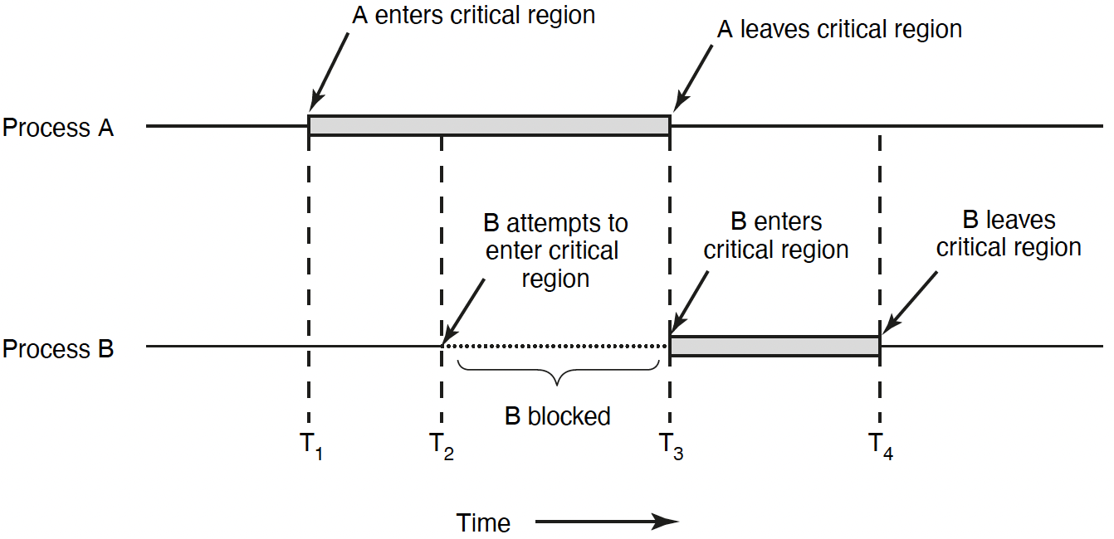

Race Condition & Critical Section
Race condition:
Multiple threads of execution update shared data variables, and final results depend on the execution order
Race condition leads to non-deterministic results: different results even for the same inputs
To prevent race condition, a critical section should be used to protect shared data variables
A critical section is executed atomically
Mutual exclusion (mutex) ensures that when one thread is executing in its critical section, no other thread is allowed to execute in that critical section
Thread A
Thread B
Notes:
The execution of the critical sections by the threads is mutually exclusive in time
Programmers must make sure that some high-level code sections are executed atomically
Atomic operation: It completes in its entirety without worrying about interruption by any other potentially conflict-causing thread
1. Mutual exclusion. If process Pi is executing in its critical section, then no other processes can be executing in their critical sections.
2. Progress. If no process is executing in its critical section and some processes wish to enter their critical sections, then only those processes that are not executing in their remainder sections can participate in deciding which will enter its critical section next, and this selection cannot be postponed indefinitely.
3. Bounded waiting. There exists a bound, or limit, on the number of times that other processes are allowed to enter their critical sections after a process has made a request to enter its critical section and before that request is granted.

Slide 7

Lock to Protect a Critical Section
Count
Value
Thread 1
Thread 2
ld w8, [x9]
add w8, w8, #0x1
st w8, [x9]
100
101
101
101
ld w8, [x9]
add w8, w8, #0x1
st w8, [x9]
102
Lock it
102
Critical section: a piece of code that accesses a shared resource, usually a variable or data structure
Correctness of a concurrent program:
Mutual exclusion: Only one thread in critical section at a time
Progress (deadlock-free): If several simultaneous requests, must allow one to proceed
Bounded (starvation-free): Must eventually allow each waiting thread to enter
Lock it
Notes:
Solution:
Mutual exclusion: Only one thread in critical section at a time
Progress (deadlock-free): If several simultaneous requests, must allow one to proceed
Bounded (starvation-free): Must eventually allow each waiting thread to enter

Slide 8
Locks
A lock is a variable
Objective: Provide mutual exclusion (mutex)
Two states
Available or free
Locked or held
lock(): tries to acquire the lock
unlock(): releases the lock that was previously acquired
lock_t mutex
void *worker(void *arg) {
int i;
for (i = 0; i < loops;i++) {
lock(&mutex);
counter++;
unlock(&mutex)}
return NULL;
}
Notes:
mutual exclusionA good lock:
Mutual exclusion
Fairness: progress, no starvation
Performance: overhead to grab and release lock

Slide 9
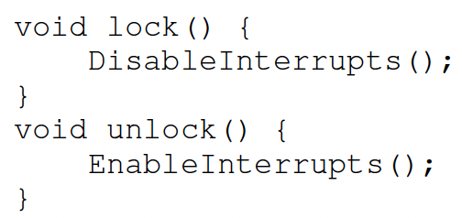
Locks: Disable Interrupts
An early solution: disable interrupts for critical sections
Problems:
System becomes irresponsive if interrupts are disabled for a long time
Does not work on multiprocessors, as disabling interrupts on all processor cores requires inter-core messages and would be very time consuming
Notes:
Abused usage

Slide 10
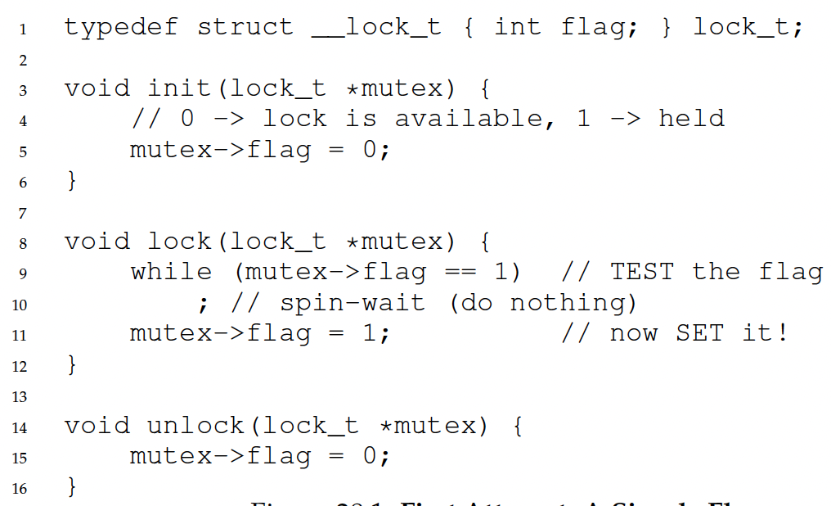
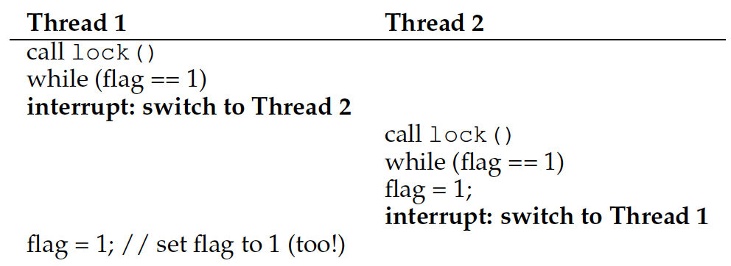
Locks: Loads/Stores
This implementation does not ensure mutual exclusion, since both threads may grab the lock:
After Thread 1 reads flag==0 and exits the while loop, it is preempted/interrupted by Thread 2, which also reads flag==0 and exits the while loop. Then both threads set flag=1 and enter the critical section.
Root cause: Lock is not an atomic operation!
flag = 0
Notes:
Another problem: performance overhead!

Slide 11
Locks: Test-and-Set
How to provide mutual exclusion for locks?
Get help from hardware!
CPUs provide special hardware instructions to help achieve mutual exclusion
The Test-and-Set (TAS) instruction tests and modifies the content of a memory word atomically
Locking with TAS: TAS fetches the old value of lock->flag into variable old, sets lock->flag to 1, then return variable old, all in one atomic operation
If lock-flag==0, then lock() sets it to 1 and returns old==0, so the thread exits the while loop and enters critical section
If lock-flag==1, then lock() returns old==1, so the thread spin-waits in the while loop and does not enter critical section
If multiple threads call TAS when lock-flag==0, only one thread will see lock-flag==0 , set it to 1 and enter the critical section, and all the other threads will see lock-flag==1 and spin-wait.
typedef struct __lock_t{
int flag;
} lock_t;
int TestAndSet(int *old_ptr, int new){
int old = *old_ptr; // fetch old value at old_ptr
*old_ptr = new; // store new into old_ptr
return old; // return the old value
}
void lock(lock_t *lock){
while (TestAndSet(&lock->flag, 1) == 1)
; // spin-wait
}
void unlock(lock_t *lock){
lock->flag = 0;
}

Slide 12
Locks: Compare-and-Swap
Another hardware primitive: Compare-and-Swap (CAS)
Locking with CAS: CAS fetches the old value of lock-flag into variable original, compares original with expected (0), and if they are equal (lock-flag==0), sets lock->flag to 1, then return variable original, all in one atomic operation
If lock-flag==0, then lock() sets it to 1 and returns old==0, so the thread exits the while loop and enters critical section
If lock-flag==1, then lock() returns old==1, so the thread spins in the while loop and does not enter critical section
int CompareAndSwap(int *ptr, int expected, int new){
int old = *ptr;
if (old == expected)
*ptr = new;
return old;
}
void lock(lock_t *lock){
while (CompareAndSwap(&lock->flag, 0, 1) == 1)
; //spin-wait
}

Slide 13
TAS vs. CAS
Feature | Test-and-Set (TAS) | Compare-and-Swap (CAS)
Operation | Sets a bit and returns its old value | Compares current value with expected value and swaps if equal
Parameters | Single memory location | Memory location, expected value, new value
Consensus Number | Limited to 2 | Arbitrary number of processes
Efficiency | Faster for simple locks | More versatile but computationally heavier
Notes:
Use Cases
Simple spinlocks
Complex synchronization primitives like mutexes

Slide 14
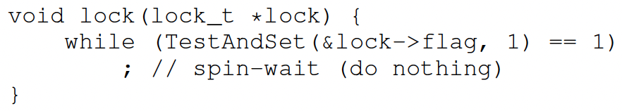
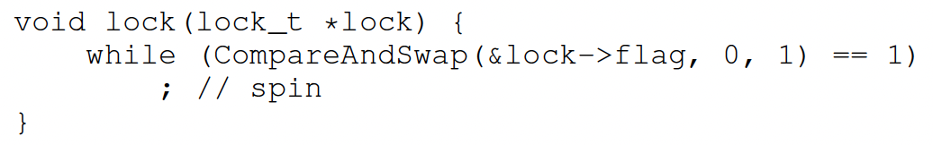
Locks: Busy Waiting
Both TAS and CAS are spinlocks based on busy waiting
A thread is stuck in a while loop endlessly checking lock->flag if the lock is held by others
Goals achieved?
Mutual exclusion (Yes!)
Fairness (NO!!)
Performance?

Slide 15
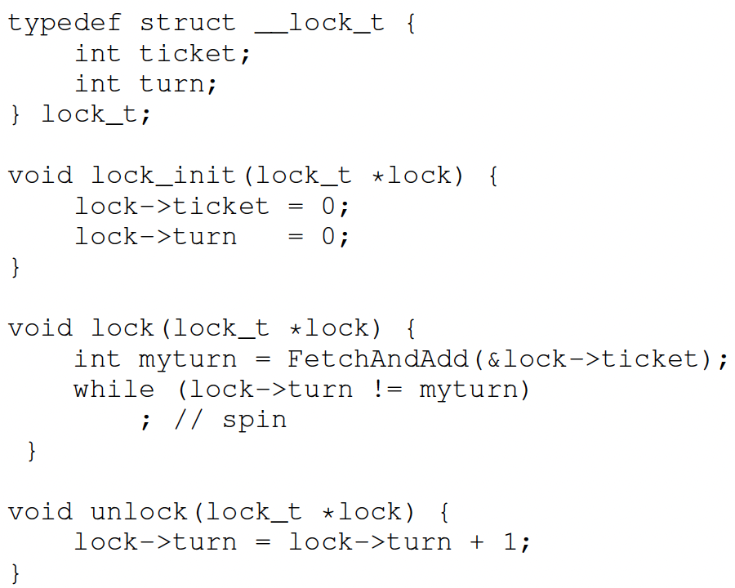
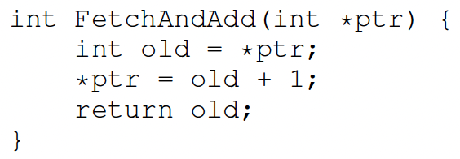
Ticket Lock
Basic spinlocks are not fair and may cause starvation
Ticket lock uses hardware primitive fetch-and-add to guarantee fairness
Lock:
Use fetch-and-add on the ticket value
The return value is the thread’s ”turn” value
Unlock:
Increment the turn
Notes:
ticket and turn

Slide 16
Ticket Lock
A ticket lock is a synchronization mechanism used in multithreaded programming to ensure that threads acquire a lock in the order they request it. It uses two counters:
tickets (or next_ticket): Tracks the next "ticket number" to be assigned to a thread requesting the lock.
turn: Tracks the "ticket number" of the thread currently holding the lock.
Lock Acquisition (lock()):
A thread atomically increments the tickets counter (using fetch-and-add) and receives its "ticket number.“
The thread then spin-waits until its ticket number matches the turn counter, indicating it is its turn to enter the critical section.
Lock Release (unlock()):
When a thread finishes its critical section, it increments the turn counter, signaling that the next thread in line can proceed.
This ensures that threads are served in a first-come, first-served (FCFS) manner, preventing starvation and ensuring fairness.
Notes:
Ticket lock is designed to ensure mutual exclusion while avoiding starvation. Here's a detailed explanation of the example:
What is a Ticket Lock?

Slide 17
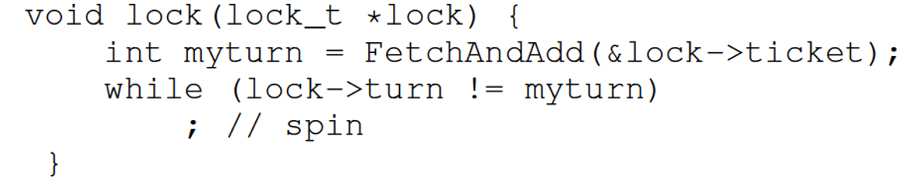
Ticket Lock
Initial value tickets=0 turn=0
 | Ticket | Turn
A lock(), A enters CS | 1 | 0
B lock(), spin-waits | 2 | 0
C lock(), spin-waits | 3 | 0
 | myturn
A | 0
B | 1
C | 2

Slide 18
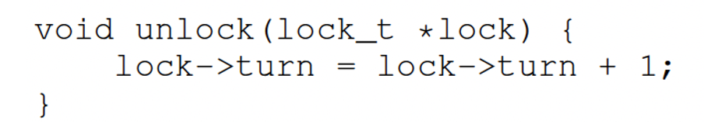
Ticket Lock
Initial value tickets=0 turn=0
 | Ticket | Turn
A lock(), A enters CS | 1 | 0
B lock(), spin-waits | 2 | 0
C lock(), spin-waits | 3 | 0
A unlock(), B enters CS | 3 | 1
A lock(), spin-waits | 4 | 1
 | myturn
A | 3
B | 1
C | 2

Slide 19
Ticket Lock
Initial value tickets=0 turn=0
 | Ticket | Turn
A lock(), A enters CS | 1 | 0
B lock(), spin-waits | 2 | 0
C lock(), spin-waits | 3 | 0
A unlock(), B enters CS | 3 | 1
A lock(), spin-waits | 4 | 1
B unlock(), C enters CS | 4 | 2
C unlock(), A enters CS | 4 | 3
A unlock() | 4 | 4
 | myturn
A | 3
B | 1
C | 2
Notes:
Initial State:
tickets = 0: No threads have requested the lock yet.
turn = 0: No threads are currently holding the lock.
Step-by-Step Execution:
Thread A Calls lock(): Thread A increments tickets to 1.
Thread A's ticket number is 0 (the value of tickets before incrementing).
Since turn = 0, Thread A enters the critical section immediately.
Thread B Calls lock(): Thread B increments tickets to 2.
Thread B's ticket number is 1.
Since turn = 0, Thread B spins, waiting for its turn.
Thread C Calls lock(): Thread C increments tickets to 3.
Thread C's ticket number is 2.
Since turn = 0, Thread C also spins, waiting for its turn.
Thread A Calls unlock(): Thread A increments turn to 1, signaling that it's now Thread B's turn.
Thread B stops spinning and enters the critical section.
Thread B Calls unlock(): Thread B increments turn to 2, signaling that it's now Thread C's turn.
Thread C stops spinning and enters the critical section.
Thread C Calls unlock(): Thread C increments turn to 3, signaling that no threads are currently waiting for the lock.
Fairness in Ticket Locks
Threads acquire locks in the exact order they request them, as determined by their ticket numbers.
This prevents starvation because every thread will eventually get its turn once it has acquired a ticket.
Unlike basic spinlocks (e.g., Test-and-Set or Compare-and-Swap), ticket locks provide fairness by maintaining an explicit order of access.
Advantages of Ticket Locks
Fairness: Ensures threads are served in FCFS order.
Starvation-Free: Every thread holding a ticket will eventually acquire the lock.
Simple Implementation: Relies on atomic operations like fetch-and-add.
Disadvantages of Ticket Locks
Busy Waiting (Spin-Waiting): Threads waiting for their turn spin continuously, consuming CPU resources.
Scalability Issues: On systems with many CPUs, cache contention can arise because all threads frequently read and write shared variables (tickets and turn).

Slide 20
Recap
Locks --- mutual execution
Only one thread must execute critical section
Hardware support – atomical execution
Test-and-set and compare-and-swap
Busy-waiting --- spinlock
Metrics to evaluate locks:
Correctness: mutual execution
Fairness: no starvation
Performance: no high cost to acquire and release a lock
Ticket locks --- No starvation

Slide 21

Semaphores
Semaphores were proposed by a Dutch computer scientist Dijkstra in late 60s
Definition: a semaphore has a non-negative integer value and supports the following operations:
sem_t sem or semaphore sem: Declare a semaphore
sem_init(&sem, 0, N): Initialize the semaphore with an initial value of 1, shared among threads (indicated by the middle 0)
sem_wait(&sem): also called down() or P(), an atomic operation that decrements it by 1 if non-zero. If the semaphore is equal to 0, go to sleep waiting to be signaled by another thread
sem_post(&sem): also called signal(), up() or V(), an atomic operation that increments it by 1, and wakes up a waiting/sleeping thread, if any
Semaphores are also called sleeping locks, since the waiting thread goes to sleep instead of spin-waiting
If the waiting time is long, then sleeping is more efficient since the thread gives up the CPU to other threads, but incurs system call (kernel) overhead to go to sleep and wake up; if waiting time is short, then spin-waiting is more efficient since it does not involve the kernel.
21
Notes:
sem_wait(): Wait/sleep if zero; decrement when becomes non-zero
sem_post(): also called signal(). Increment and wake up a waiting/sleeping task (if one exists)
sem_wait()
Performs a blocking wait (decrement) on the semaphore; if the counter is zero, the calling thread will block.
text
semaphorerywait()
Attempts to perform a non-blocking wait on the semaphore, returning an error if the semaphore is unavailable.
text
sem_post()
Increments (signals) the semaphore, potentially unblocking waiting threads.
Main synchronization primitive used in original UNIX
This of this as the signal() operation
No otjhTechnically examining value after initialization is not allowed.
An object with an integer value
Introduced by E. W. Dijkstra
Manipulate with two routines
sem_wait(s) P(s) down(s)
sem_post(s) V(s) up(s)
Motivation: Avoid busy waiting by blocking a process execution until some condition is satisfied

Slide 22
POSIX pthreads API
A Portable Operating System Interface (POSIX) library (IEEE 1003.1c), written in C language
In this lecture, we sometimes use some simpler notations for brevity, e.g.,
sem_init(&sem, 0, N)
written as: semaphore sem=N;
sem_wait(&sem)
written as sem.wait()
sem_post(&sem)
written as sem.signal()
API | Functionality
pthread_create | Create a new thread in the caller’s address space
pthread_exit | Terminate the calling thread
pthread_join | Wait for a thread to terminate
pthread_mutex_lock | Lock a mutex
pthread_mutex_unlock | Unlock a mutex
sem_wait | Wait on a semaphore
sem_post | Signal or post on a semaphore
pthread_cond_wait | Wait on a condition variable
pthread_cond_signal | Wake up one thread waiting on a condition variable
pthread_cond_broadcast | Wake up all threads waiting on a condition variable
Notes:
pthread_mutex_init
Create a new mutex
pthread_mutex_destroy
Destroy a mutex
t = pthread_create(attributes, start_procedure)
creates a new thread of control
new thread begins executing at start_procedure
pthread_cond_wait(condition_variable)
the calling thread blocks, sometimes called thread_block()
pthread_signal(condition_variable)
starts the thread waiting on the condition variable
pthread_exit()
terminates the calling thread
pthread_wait(t)
waits for the named thread to terminate

Slide 23
Semaphores Like Integers Except…
Semaphores are like integers, except:
No negative values
Only operations allowed are sem_wait() and sem_post() – cannot read or write value, except initialization
Operations must be atomic
Two calls to sem_wait() together can’t decrement value below zero
A thread going to sleep in sem_wait() won’t miss wakeup from sem_post () – even if both happen concurrently
Semaphore from railway analogy
Here is a semaphore initialized to 2, to allow two trains to enter the two tracks in the middle
Value=2
Value=2
Value=1
Value=0
23

Slide 24
Implementing Semaphores with TestAndSet
Use TAS, but only spin-wait to atomically check guard value (very short waiting time)
int guard = 0;
int value = 0;
sem_wait() {
//While guard is true, spin-wait while (TestAndSet(guard)); if (value == 0) {
guard = 0;
put thread on wait queue;
sleep(); } else { value = value - 1; guard = 0; } }
sem_post() { //While guard is true, spin-wait while (TestAndSet(guard)); if any thread in wait queue { take thread off wait queue; place on ready queue; } else { value = value + 1; } guard = 0;
}
24
Notes:
Note: sleep() and release the lock (set guard=0) must be atomic. Similar to the case on slide “Interrupt re-enable in going to sleep”. (can do this in software without hardware support).

Slide 25
Two Uses of Semaphores
Mutual Exclusion (value = 0 or 1)
Called “Binary Semaphore” or “mutex”. Can be used for mutual exclusion as a lock
Example: sem is initialized to 1. The first thread that calls sem_wait() decrements sem to 0 and enters the critical section: other threads will be blocked when they see sem==0. When the first thread calls sem_post() to increment sem to 1, one of the waiting threads will wake up, decrement sem to 0 and enter the critical section.
Equivalently, pthread_mutex_t is designed specifically for mutual exclusion, meaning only one thread can hold the lock at a time. Only the thread that locks the mutex can unlock it, with strict ownership semantics.
Scheduling Constraints (value >= 0)
Called “Counting Semaphore”.
Any thread can signal or release the semaphore, regardless of which thread acquired it. Can be used as signaling mechanisms, such as notifying other threads that a resource is available or an event has occurred.
See next slide for an example.
//Mutual exclusion using binary semaphore
sem_t sem;
sem_init(&sem, 0, 1); // Initialize to 1 for mutex-like behavior
sem_wait(&sem);
// Critical section
sem_post(&sem);
//Mutual exclusion using mutex
pthread_mutex_t mutex = PTHREAD_MUTEX_INITIALIZER; // Initialize mutex to 1 (unlocked)
pthread_mutex_lock(&mutex);
//Critical section
pthread_mutex_unlock(&mutex);
25
Notes:
Let thread 1 wait for a signal from thread 2

Slide 26
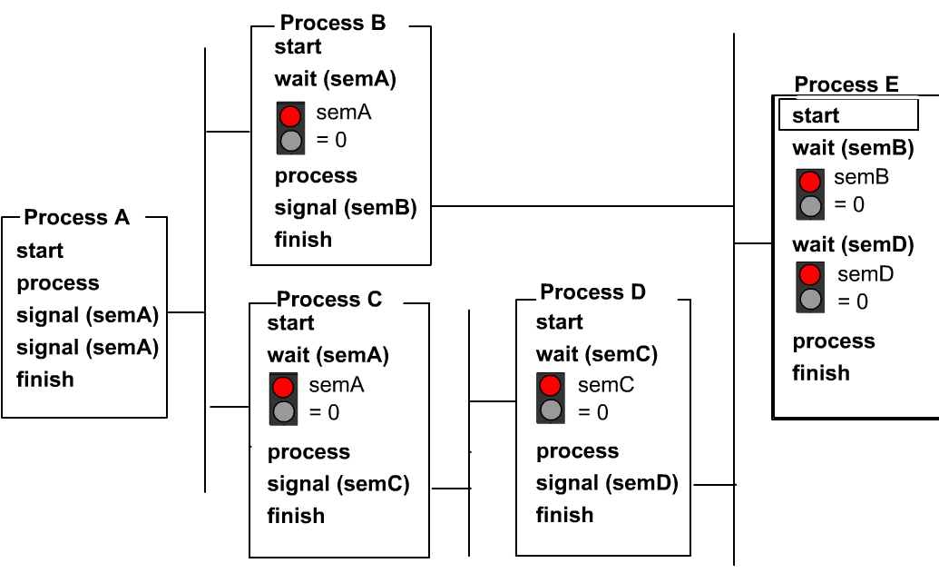
Using Semaphores for Scheduling
Consider 5 threads A, B, C, D, E. They must execute based on the partial ordering below, regardless of the ordering of process start (e.g., if E starts before B and D finishes, it will be blocked waiting for B and D to finish before it can execute)
Thread B
Thread B
Thread E
Thread A
Thread E
Thread C
Thread D
Thread A
Thread C
Thread D
Syntax in the figure is slightly different: wait(sem) and signal(sem) instead of sem_wait(&sem) and sem_post(&sem).

Slide 27
Readers/Writers Problem
We have two classes of concurrent processes:
Writers: they change data, so only one writer can be active
Readers: these only read data, thus multiple readers can be active, as long as there is no active writer
Shared Resource Conflict:
Multiple readers can safely access the resource at the same time, but if any writer is modifying the resource, no other process (either reader or writer) should access it. This ensures data consistency.
Readers vs. Writers Priority:
If a reader is already accessing the resource, additional readers are allowed to enter immediately. A writer, however, must wait until all readers have finished. Consequently, readers are favoured over writers, which can lead to writer starvation if new readers keep arriving.
27
Notes:
As with mutual exclusion, a critical section also has to be protected in this example
However,
and thus need a guarantee for mutual exclusion
are allowed to enter the critical section at the same time

Slide 28
Readers/Writers Problem Solution
This program ensures mutual exclusion between writers, and between the 1st reader and any writers, but not between multiple readers.
A semaphore named mutex is used to ensure mutual exclusion when readers update a shared counter called readcount, which tracks the number of active readers. Another semaphore named wrt is used to control access to the shared resource. It is acquired by writers and by the first reader.
First Reader Behavior: If the reader finds that it is the first one to enter (i.e., readcount increments from 0 to 1), it calls sem_wait(&wrt) to acquire the lock wrt. This prevents any writer from entering the critical section while at least one reader is present.
Last Reader Behavior: If the reader finds that it has been the last to exit (i.e., readcount becomes 0), it calls sem_post(&wrt) to allow a writer (if any are waiting) to acquire the lock wrt and enter the critical section.
Writer Behavior: A writer begins by calling sem_wait(&wrt) to acquire the lock wrt and enter the critical section to write data. Since a writer must have exclusive access, it will block until wrt is available—that is, until no reader holds it (because the first reader acquired it) and no other writer is active. Upon exiting the critical section, it calls sem_post(&wrt) to allow waiting readers or writers to continue.
Readers-Preference and Its Consequences: Because the first reader blocks any writer until all readers have exited, if new readers continuously arrive, a writer may starve. This readers-preference model is efficient for systems primarily performing read operations but might cause fairness issues when writes are necessary.
/* shared memory */ semaphore mutex; semaphore wrt;
int readcount;
/* reader */ sem_wait(&mutex); readcount++;
if(readcount==1) sem_wait(&wrt);
sem_post(&mutex);
… read data …
sem_wait(&mutex); readcount--;
if(readcount==0)
sem_post(&wrt);
sem_post(&mutex);
/* initialization.*/ mutex = 1;
wrt = 1;
readcount = 0;
/* writer */ sem_wait(&wrt);
… critical section to write data …
sem_post(&wrt);
28
Notes:
We use informal notation of declaration with semaphore and assignment with = sign, instead of using semaphore and sem_init()

Slide 29




Producer/Consumer Problem
A classical synchronization problem, also called the bounded-buffer problem
A buffer has a bounded size
Examples of Producer/Consumer Problems:
Web servers:
Producer puts requests in a queue
Consumers picks requests from the queue to process
Linux Pipes
Coke vending machine
Producer can put limited number of cokes in machine
Consumer can’t take cokes out if machine is empty
Different from Readers/Writers problem
There is a queue of items
Consumer performs destructive read: reading an item removes it from the queue
producer
consumer

Slide 30
Producer/Consumer Problem
Correctness Constraints:
When buffer is full, producer must wait
When buffer is empty, consumer must wait
Only one thread can manipulate buffer at a time (mutual exclusion)
Use a separate semaphore for each constraint
semaphore fullSlots; // consumer’s constraint
semaphore emptySlots;// producer’s constraint
semaphore mutex; // mutual exclusion
Consumer reads and removes data items from buffer (destructive read)
Producer writes data items to buffer
Bounded buffer
fullSlots==3, emptySlots==4
30
Notes:
Consumer must wait for producer to fill buffers, if no full slots (fullSlots == 0)
Producer must wait for consumer to empty buffers, if no empty slots (emptySlots == 0)
Synchronization between producers
Synchronization between producers and consumers
Producing/Consuming to/from buffer require locking
Remember why we need mutual exclusion
Because computers are stupid
Imagine if in real life: the delivery person is filling the machine and somebody comes up and tries to stick their money into the machine

Slide 31
Full Solution to Bounded Buffer (coke machine)
semaphore fullSlots=0; //Initially, no full slots
semaphore fullSlots=bufSize; //Initially, all slots empty
semaphore mutex=1;
Producer(item) { sem_wait(&emptySlots);//Wait until emptySlots non-zero sem_wait(&mutex); enqueue(item); sem_post(&mutex); sem_post(&fullSlots); }
Consumer() { sem_wait(&fullSlots);//Wait until fullSlots non-zero sem_wait(&mutex); item = dequeue(); sem_post(&mutex); sem_post(&emptySlots); return item; }
mutex protects integrity of the queue within critical sections
Indicates 1 more full slot
Indicates 1 more empty slot
emptySlots==0: Producer waits; fullSlots ==0: Consumer waits.
fullSlots>0 && emptySlots>0: Producer and Consumer can enqueue/dequeue items. concurrently (within critical section protected by mutex).
Notes:
sem_init(&fullSlots, 0, 0); //Initially, no data item
sem_init(&emptySlots, 0, bufSize)://Initially, all slots empty
sem_init(&mutex, 0, 1):
Semaphore fullSlots = 0; // Initially, no coke
Semaphore emptySlots = bufSize; // Initially, num empty slots
Semaphore mutex = 1; // No one using machine

Slide 32
Discussions
Decrease # of empty slots
Increase # of occupied slots
Two semaphores
Producer does: sem_wait(&emptySlots), sem_post(&fullSlots)
Consumer does: sem_wait(&fullSlots), sem_post(&emptySlots)
Decrease # of occupied slots
Increase # of empty slots
Can we put sem_wait()/sem_post() for mutex outside of sem_wait()/sem_post() for emptySlots and fullSlots?
No! This may cause deadlock. Suppose the queue is initially empty. Producer enters the critical section, calls sem_wait(&emptySlots) and is blocked waiting for Consumer to put items into the queue; Consumer calls sem_wait(&mutex) and is blocked waiting to enter the critical section. But Producer will never exit the critical section and call sem_post(&mutex) to wake up Consumer!
Similar deadlock situation when the queue is full, Consumer is blocked on sem_wait(&fullSlots) and Producer is blocked on sem_wait(&mutex).
//Incorrect code
Producer(item) { sem_wait(&mutex); sem_wait(&emptySlots); enqueue(item); sem_post(&fullSlots); sem_post(&mutex); } Consumer(item) { sem_wait(&mutex); sem_wait(&fullSlots); enqueue(item); sem_post(&emptySlots); sem_post(&mutex); }
32
Notes:
Is order of V’s important?
No, except that it might affect scheduling efficiency What if we have 2 producers or 2 consumers?
Do we need to change anything?

Slide 33

Deadlock
Definition: A set of threads are said to be in a deadlock state when every thread in the set is waiting for an event that can be caused only by another thread in the set
Conditions for Deadlock
Mutual exclusion
Only one thread at a time can use a given resource
Hold-and-wait
Threads hold resources allocated to them while waiting for additional resources
No preemption
Resources cannot be forcibly removed from threads that are holding them; can be released only voluntarily by each holder
Circular wait
There exists a circle of threads such that each holds one or more resources that are being requested by next thread in the circle
Wanted
Resource 1
Held
Thread 1
Thread 2
Resource 2
Held
Wanted
Not a perfect analogy, just a fun image!
Notes:
Permanent blocking of a set of processes that share multiple resources. Each process in the set is waiting for a resource that only another process in the set can make available
Blocking is caused by processes waiting for resources that are in use by other processes waiting for other resources
e.g., Process A owns Res 1 and is waiting for Res 2 Process B owns Res 2 and is waiting for Res 1
Neither process can proceed, so they are in a deadlock
Four conditions for deadlock
Mutual exclusion
Only one process at a time can use a resource
Hold and wait
Process holding at least one resource is waiting to acquire additional resources held by other processes
No preemption
Resources are released only voluntarily by the processes
Circular wait
Cyclic waiting pattern
Mutual exclusion
Only one process at a time can use a resource.
Hold and wait
Process holding at least one resource is waiting to acquire additional resources held by other processes.
No preemption
Resource cannot be forcibly removed from a process; can be released only voluntarily by the process.
Circular wait
A circle of processes exists such that each process holds at least one resource needed by the previous process in the circle

Slide 34
Semaphores are good but…Monitors are better!
Semaphores are dual purpose, used for both mutex and scheduling constraints
Monitors provide a higher-level abstraction that naturally encapsulates shared state and condition variables.
Monitor: a mutex lock and one or more condition variables for managing concurrent access to shared data
A paradigm for concurrent programming
Use lock for mutual exclusion and condition variables for scheduling constraints. (Must hold lock when doing condition operations!)
Java supports monitors natively
Notes:
Example: the fact that flipping of P’s in bounded buffer gives deadlock is not immediately obvious. How do you prove correctness to someone?
Some languages like Java provide this natively
Most others use actual locks and condition variables
Mutual exclusion
No two threads access a critical section at the same time
Thread A and B don’t run at the same time
Locks
Condition
A thread wishes to check whether a condition is true before execution
Thread B runs after thread A completes
Condition variables and semaphores

Slide 35
Monitor with Condition Variables (CV)
thread_mutex_t mutex: a mutex lock
Provides mutual exclusion to critical section
Acquire before entering, release upon exiting critical section
pthread_cond_t cond: one or more condition variables:
For each condition variable, a queue of threads may be waiting for it to be signaled inside the critical section.
Key idea: allow threads to wait on a condition variable (sleeping) inside the critical section, since the mutex lock is released (implicitly) when a thread goes to sleep
Contrast with semaphores: cannot wait on a semaphore inside critical section, otherwise it leads to a deadlock since mutex lock is still held
There may be an entry queue of threads waiting on the lock outside of the critical section
Condition operations:
pthread_cond_wait(&cond, &mutex): it releases the mutex lock temporarily and enters the monitor's wait queue to go to sleep. This allows other threads to acquire the lock and proceed with their tasks. When the waiting/sleeping thread is signaled, it re-acquires the lock before resuming execution.
pthread_cond_signal(&cond): Wake up one waiter, if any (if no waiter thread, then the signal is lost/has no effect)
pthread_cond_broadcast(&cond): Broadcast(): Wake up all waiters (if no waiter thread, then the signal is lost/has no effect)
Notes:
pthread_cond_wait(pthread_cond_t *cond, pthread_mutex_t *mutex); Atomically release lock and go to sleep. Re-acquire lock later, before returning.
pthread_cond_signal(pthread_cond_t *cond);
Semaphores are dual purpose: They are used for both mutex and scheduling constraints
Condition variables are synchronization primitives:
A queue of waiting threads
A thread waits for a condition to be true and can put itself into the queue
Other thread can wake up one or more waiting threads
Used with mutex to prevent race conditions
(If a condition is false, the thread releases the lock and goes to sleep waiting to become true signaled)
Condition Variable: a queue of threads waiting for something inside a critical section
Contrast to semaphores: cannot wait inside critical section

Slide 36
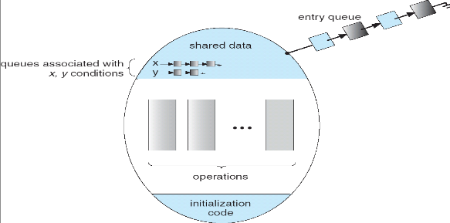
Monitor with Condition Variables (CV)

Slide 37
CV Common Usage Pattern
pthread_mutex_t mutex = PTHREAD_MUTEX_INITIALIZER;
pthread_cond_t cond = PTHREAD_COND_INITIALIZER;
bool flag; //Initialization value is application-specific, hence omitted here
// Signaler thread
Signaler(){
pthread_mutex_lock(&mutex);
update_flag();
//Either signal 1 thread, or broadcast to all threads, but not both
pthread_cond_signal(&cond);
//pthread_cond_broadcast(&cond);
pthread_mutex_unlock(&mutex);
}
// Waiter thread
Waiter(){
pthread_mutex_lock(&mutex);
//Thread goes to sleep during waiting
while (!flag){pthread_cond_wait(&cond, &mutex);}
// Process data
pthread_mutex_unlock(&mutex);
}
Notes:
pthread_mutex_t mutex = PTHREAD_MUTEX_INITIALIZER;

Slide 38
P/C Problem with Condition Variable
pthread_mutex_t mutex = PTHREAD_MUTEX_INITIALIZER;
pthread_cond_t prod_CV = PTHREAD_COND_INITIALIZER;
pthread_cond_t cons_CV = PTHREAD_COND_INITIALIZER;
Producer(item) {
pthread_mutex_lock(&mutex);
while(buffer full){pthread_cond_wait(&prod_CV, &mutex);}
enqueue(item);
pthread_cond_signal(&cons_CV); pthread_mutex_unlock(&mutex);
}
Wake up any waiting consumer thread blocked on an empty buffer (if any)
Consumer() {
pthread_mutex_lock(&mutex);
while(buffer empty){pthread_cond_wait(&cons_CV, &mutex);}
item = dequeue();
pthread_cond_signal(&prod_CV);
pthread_mutex_unlock(&mutex);
return item
}
Wake up any waiting producer thread blocked on a full buffer (if any)
This program has the same behavior as previous program using semaphores.
(Code for updating buffer status and setting Boolean flags “buffer full” or “buffer empty” are omitted)
Notes:
lock buf_lock = <initially unlocked>
condition producer_CV = <initially empty waiting queue>
condition consumer_CV = <initially empty waiting queue>

Slide 39
While vs. if for Checking Boolean flag
Consider the dequeue code in Consumer thread:
while(buffer empty){ //Why not if(buffer empty) here
cond_wait(&cons_CV, &mutex);
} item = dequeue(&queue); // Get next item
Why do we use a while loop to check the Boolean flag “buffer empty”?
Most OSes use Mesa-style monitor (named after Xerox-Park Mesa Operating System), where the waiter thread may start to run some time after Signaler thread calls cond_signal()
Notes:
depends on the type of scheduling
Hoare-style: Named after British logician Tony Hoare
Mesa-style:
Need to be careful about precise definition of signal and wait.

Slide 40
Mesa monitors
Inside cond_wait(), Waiter thread releases the mutex lock temporarily and enters the monitor's wait queue to go to sleep. This allows Signaler thread to acquire the mutex lock and proceed with its task.
When Signaler thread calls cond_signal() to signal Waiter thread, Waiter thread is put on the ready queue (not woken up immediately). Signaler thread continues execution and releases the mutex lock. When Waiter thread gets to run on the CPU when OS actually schedules it, it re-acquires the mutex lock, exits cond_wait(), enters the critical section, and finally releases the mutex lock.
Waiter thread must use a while loop to re-check condition upon wakeup
Another thread may be scheduled before Waiter thread gets to run, and "sneak in" to modify the state (e.g., empty the queue), so the condition may be false again (called “spurious wakeups”).
Put Waiter
thread on ready queue
…
lock(&mutex);
…
cond_signal(&cons_CV);
…
unlock(&mutex);
unlock(&mutex);
…
while(buffer empty) { cond_wait(&cons_CV,&mutex); } …
unlock(&mutex);
OS schedules thread (sometime later)
Signaler thread
Waiter thread
Notes:
when a thread is woken up by signal(), it is simply put on the ready queue
It may or may not reacquire the lock immediately!
Another thread could be scheduled first and "sneak in" to empty the queue
Need a loop to re-check condition on wakeup

Slide 41
The Thread Join Problem
A parent waits for the child by calling thr_join(); the child signals completion by calling thr_exit(). We need to implement functions thr_join() and thr_exit().
int main(int argc, char *argv[]) {
printf("parent: begin\n");
pthread_t p;
pthread_create(&p, NULL, child, NULL);
thr_join(); // wait
printf("parent: end\n");
return 0;
}
void *child(void *arg) {
printf("child\n");
thr_exit(); // signal
return NULL;
}
Parent
Child

Slide 42
Thread Join with Semaphore
Semaphore sem acts as the synchronization flag.
Works correctly regardless of whether parent or child executes first:
If child finishes first: sem_post(&sem) increases sem to 1, subsequent sem_wait(&sem) decrements it and parent thread continues immediately
If parent waits first: sem_wait(&sem) blocks until child's sem_post(&sem) wakes it up
No Race Condition:
Unlike condition variables, semaphores maintain state; No need for additional flags or mutex protection.
semaphore sem = 0;
//Child
void thr_exit(){
sem_post(&sem); //Signal parent
}
//Parent
void thr_join(){
sem_wait(&sem); // Wait for child
}
Notes:
Semaphore sem is initialized to 0. Parent thread calls sem_wait() in thr_join(&sem) and is blocked; when Child thread calls sem_post(&sem) in thr_exit(), parent thread will wake up and continue.
This program works whether thr_join() is called before or after thr_exit(). Child thread calls sem_post(&sem) in thr_exit(), sem is incremented to 1;when parent thread calls sem_wait() in thr_join(&sem), sem is decremented to 0, so parent thread will not block
#include <semaphore.h>
sem_t sem;
void thr_init() {
sem_init(&sem, 0, 0);
}
void thr_exit() {
sem_post(&sem);
}
void thr_join() {
sem_wait(&sem);
}
int main(int argc, char *argv[]) {
printf("parent: begin\n");
thr_init(); // Initialize semaphore
pthread_t p;
pthread_create(&p, NULL, child, NULL);
thr_join();
printf("parent: end\n");
sem_destroy(&sem);
return 0;
}

Slide 43
Thread Join with Condition Variable
Boolean flag done is a state variable to track whether the child thread has completed. It ensures that even if pthread_cond_signal occurs before pthread_cond_wait, the parent will not block indefinitely because it will detect that done is already set. While loop around pthread_cond_wait ensures correctness in case of spurious wakeups.
Condition variables don't preserve state like semaphores do, so we need explicit mutex protection, and a shared boolean flag to track completion status of child. (similar to Boolean flags “buffer full” and “buffer empty” in P/C problem.)
pthread_mutex_t m = PTHREAD_MUTEX_INITIALIZER;
pthread_cond_t c = PTHREAD_COND_INITIALIZER;
bool done = false;
//Child
void thr_exit() {
pthread_mutex_lock(&m);
done = true;
pthread_cond_signal(&c);
pthread_mutex_unlock(&m);
}
//Parent
void thr_join() {
pthread_mutex_lock(&m);
while (!done) {//Check if child has finished
pthread_cond_wait(&c, &m);
}
pthread_mutex_unlock(&m);
}
Notes:
int main(int argc, char *argv[]) {
printf("parent: begin\n");
pthread_t p;
pthread_create(&p, NULL, child, NULL);
thr_join(); // wait
printf("parent: end\n");
return 0;
}
// Need a state variable with monitors
void *child(void *arg) {
printf("child\n");
thr_exit(); // signal
return NULL;
}
pthread_mutex_t m = PTHREAD_MUTEX_INITIALIZER;
pthread_cond_t c = PTHREAD_COND_INITIALIZER;
bool done = false; // Need a state variable with monitors
void thr_exit() {
pthread_mutex_lock(&m);
done = true;
pthread_cond_signal(&c);
pthread_mutex_unlock(&m);
}
void thr_join() {
pthread_mutex_lock(&m);
while (!done) { // While loop for spurious wakeups
pthread_cond_wait(&c, &m);
}
pthread_mutex_unlock(&m);
}
and using while(!child_done) to check the flag, makes the program robust and avoids race conditions.
child_done flag

Slide 44
Thread Join with Condition Variables: Incorrect
If we remove Boolean flag done, then the program is incorrect. If child calls thr_exit() before parent calls thr_join(), the signal will be lost because condition variables don't maintain state, and Parent will wait forever.
In contrast, semaphores maintain state; No need for additional flags or mutex protection.
pthread_mutex_t m = PTHREAD_MUTEX_INITIALIZER;
pthread_cond_t c = PTHREAD_COND_INITIALIZER;
//Child
void thr_exit(){
pthread_mutex_lock(&m);//A
pthread_cond_signal(&c);//B
Pthread_mutex_unlock(&m);}//C
//Parent
void thr_join(){
pthread_mutex_lock(&m);//X
pthread_cond_wait(&c, &m);//Y
pthread_mutex_unlock(&m);}//Z
Scenario 1: Parent calls thr_join() first. Works OK.
Parent | X | Y |  |  |  | Z
Child |  |  | A | B | C
Scenario 2: Child calls thr_exit() first. Parent blocks forever!
Parent |  |  |  | X | Y
Child | A | B | C
Notes:
The program assumes that the parent will always call thr_join() (and thus wait on the condition variable) before the child calls thr_exit() to signal. If this ordering is not guaranteed, there is a race condition:
If the child calls thr_exit() before the parent starts waiting on pthread_cond_wait, the signal (pthread_cond_signal) may be missed because condition variables do not queue signals if no thread is waiting at that moment. As a result, the parent could block indefinitely on pthread_cond_wait.
int main(int argc, char *argv[]) {
printf("parent: begin\n");
pthread_t p;
pthread_create(&p, NULL, child, NULL);
thr_join(); // wait
printf("parent: end\n");
return 0;
}
// Need a state variable with monitors
void *child(void *arg) {
printf("child\n");
thr_exit(); // signal
return NULL;
}
pthread_mutex_t m = PTHREAD_MUTEX_INITIALIZER;
pthread_cond_t c = PTHREAD_COND_INITIALIZER;
bool done = false; // Need a state variable with monitors
void thr_exit() {
pthread_mutex_lock(&m);
done = true;
pthread_cond_signal(&c);
pthread_mutex_unlock(&m);
}
void thr_join() {
pthread_mutex_lock(&m);
while (!done) { // While loop for spurious wakeups
pthread_cond_wait(&c, &m);
}
pthread_mutex_unlock(&m);
}
and using while(!child_done) to check the flag, makes the program robust and avoids race conditions.
child_done flag

Slide 45
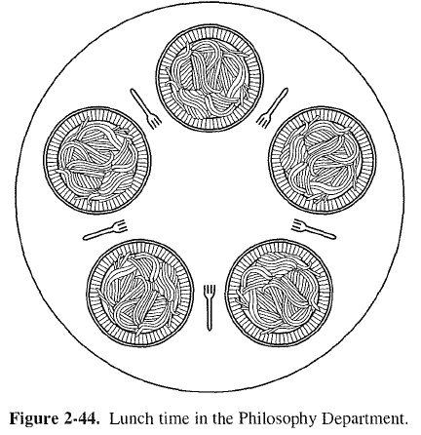
Dinning Philosophers
N philosophers sit at a round table.
They spend their lives alternating thinking and eating.
They do not communicate with their neighbors.
Each philosophers occasionally tries to pick up his left and right forks (one at a time) to eat.
Needs both forks to eat, then releases both when done eating.
Suppose we have 5 philosophers numbered 1-5, and 5 forks numbered 1-5; philosopher i has left fork numbered i, and right fork (i+1)%5.
3
4
3
4
2
0
2
0
1
1
Notes:
In the case of 5 philosophers, the shared data
Bowl of rice (data set)
Semaphore chopstick [5] initialized to 1
State is safe if when a philosopher tries to take a fork, either
It is not the last fork,
Or it is the last fork, but someone will have 2 forks afterwards.
Equivalently: do not let a philosopher take the last fork if no one will have 2 forks afterwards.
Consider N philosophers
If each of the N-1 philosophers holds his left fork, then the N^{th} philosopher will be prevented from taking the last fork.
If a philosopher is holding his left fork, he can safely pick up his right fork if available, and vice versa.
If one or more philosophers are holding 2 forks and eating, then any remaining forks can be picked up safely by any other philosopher.
Banker’s algorithm can be used to verify each of these scenarios

Slide 46
Semaphore-based Solution: Deadlock
Each fork (or chopstick) is modeled as a binary semaphore that is initially set to 1, meaning it is available. When a philosopher wants to eat, they perform a wait (or P) operation to pick up a fork and a signal (or V) operation to release it afterward.
Deadlock situation: Each philosopher first executes a blocking wait to pick up the left fork and then tries to pick up the right fork. If all philosophers adopt this pattern simultaneously, every philosopher may pick up their left fork and then block waiting for the right fork (which is held by its neighbor), resulting in a deadlock, circular wait where none can proceed.
#define N 5 // Number of philosophers and forks
semaphore fork[N] = {1, 1, 1, 1, 1};
void philosopher(int i) {
while (true) {
think();
sem_wait(&fork[i]); // Pick up left fork
sem_wait(&fork[(i + 1) % N]); // Pick up right fork
eat();
sem_post(&fork[i]); // Put down left fork
sem_post(&fork[(i + 1) % N]); // Put down right fork
}
}
Notes:
This program is subject to deadlock if every philosopher simultaneously picks up his left fork.
#define N 5 // Number of philosophers and forks
semaphore fork[N] = {1, 1, 1, 1, 1};
void philosopher(int i) {
while (true) {
think();
sem_wait(&fork[i]); // Pick up left fork
sem_wait(&fork[(i + 1) % N]); // Pick up right fork
eat();
sem_post(&fork[i]); // Put down left fork
sem_post(&fork[(i + 1) % N]); // Put down right fork
}
}

Slide 47
Semaphore-based Solution 0: Global Lock
We use the global semaphore mutex to ensure that only one philosopher can pick up forks and eat at any one time.
This solution works, but is very inefficient, since only one philosopher can be eating at one time; it should be possible for two philosophers to eat at the same time, since there are 5 forks.
#define N 5 // Number of philosophers and forks
semaphore mutex = 1;
semaphore fork[N] = {1, 1, 1, 1, 1};
void philosopher(int i) {
while (true) {
think();
sem_wait(&mutex); // Pick up both forks in one atomic operation
sem_wait(&fork[i]); // Pick up left fork
sem_wait(&fork[(i + 1) % N]); // Pick up right fork
eat();
sem_post(&fork[i]); // Put down left fork
sem_post(&fork[(i + 1) % N]); // Put down right fork
sem_post(&mutex);
}
}
Notes:
In other words, a philosopher enters a critical section where it picks up its left fork and then its right fork without interruption. This guarantees that the action is atomic, meaning no other philosopher interleaves their pick‑up operations during this period.
This guarantees that both left fork[i] and right fork[(i + 1) % N] are picked up without any interference from other philosophers.

Slide 48
Semaphore-based Solution: Deadlock
One solution is to let each philosopher pick up (and put down) both left and right forks within a critical section, protected by the global semaphore mutex.
Deadlock situation: This solution is flawed because it can lead to deadlock, similar to the deadlock situation in the P/C problem.
Philosopher A gets mutex, is blocked trying to get a fork (left or right); meanwhile, his neighbor Philosopher B (who has both forks) finishes eating and tries to put down forks. But B is blocked trying to get mutex (which A holds). Now we have a circular wait condition: A holds mutex, waiting for fork; B holds fork, waiting for mutex.
Philosopher B does not have to be A’s direct neighbor. There may be a chain of philosophers starting from A, each holding his left fork, and B may be the last one’s neighbor.
#define N 5 // Number of philosophers and forks
semaphore mutex = 1;
semaphore fork[N] = {1, 1, 1, 1, 1};
void philosopher(int i) {
while (true) {
think();
sem_wait(&mutex); // Pick up both forks within a critical section
sem_wait(&fork[i]); // Pick up left fork
sem_wait(&fork[(i + 1) % N]); // Pick up right fork
sem_post(&mutex);
eat();
sem_wait(&mutex); // Put down both forks within a critical section
sem_post(&fork[i]); // Put down left fork
sem_post(&fork[(i + 1) % N]); // Put down right fork
sem_post(&mutex);
}
}
Notes:
In other words, a philosopher enters a critical section where it picks up its left fork and then its right fork without interruption. This guarantees that the action is atomic, meaning no other philosopher interleaves their pick‑up operations during this period.
This guarantees that both left fork[i] and right fork[(i + 1) % N] are picked up without any interference from other philosophers.
If philosopher i is in the critical section protected by mutex, blocked in sem_wait() waiting for any fork (left or right), the neighbor who is holding the requested fork and eating has just finished, but is blocked on sem_wait(&mutex), and cannot put down any fork by calling sem_post().

Slide 49
Semaphore-based Solution I
The solution is to let each philosopher pick up, but not put down, both left and right forks within a critical section, protected by the global semaphore pickup_mutex.
No deadlock: If philosopher i is in the critical section protected by mutex, blocked in sem_wait() waiting for any fork (left or right), the neighbor who is holding the requested fork and eating can freely put down both forks without blocking, thus allowing philosopher i to pick up both forks.
Poor efficiency: If philosopher i is in the critical section protected by pickup_mutex, waiting for any fork (left or right), then no other philosopher can enter the critical section before some other philosopher finishes eating and puts down his forks to let philosopher i exit the critical section and start eating, even for a philosopher with both left and right forks free. This is unnecessary blocking that reduces concurrency.
#define N 5 // Number of philosophers and forks
semaphore pickup_mutex = 1;
semaphore fork[N] = {1, 1, 1, 1, 1};
void philosopher(int i) {
while (true) {
think();
sem_wait(&pickup_mutex); // Pick up both forks in one atomic operation
sem_wait(&fork[i]); // Pick up left fork
sem_wait(&fork[(i + 1) % N]); // Pick up right fork
sem_post(&pickup_mutex);
eat();
sem_post(&fork[i]); // Put down left fork
sem_post(&fork[(i + 1) % N]); // Put down right fork
}
}
Notes:
In other words, a philosopher enters a critical section where it picks up its left fork and then its right fork without interruption. This guarantees that the action is atomic, meaning no other philosopher interleaves their pick‑up operations during this period.
#define N 5 // Number of philosophers and forks
semaphore mutex = 1;
semaphore fork[N] = {1, 1, 1, 1, 1};
void philosopher(int i) {
while (true) {
think();
sem_wait(&mutex); // Enter critical section
sem_wait(&fork[i]); // Pick up left fork
sem_wait(&fork[(i + 1) % N]); // Pick up right fork
sem_post(&mutex); // Exit critical section
eat();
sem_post(&fork[i]); // Put down left fork
sem_post(&fork[(i + 1) % N]); // Put down right fork
}
}

Slide 50
Semaphore-based Solution II
One solution is to introduce an additional “room” semaphore that limits the number of philosophers permitted to start eating concurrently. For example, if there are N=5 philosophers, room is initialized to N-1=4. With 5 forks and at most 4 philosophers competing, at least one philosopher can always get both forks
#define N 5 // Number of philosophers and forks
semaphore room = N-1;
semaphore fork[N] = {1, 1, 1, 1, 1};
void philosopher(int i) {
while (true) {
think();
sem_wait(&room); // Limit number of philosophers simultaneously hungry to 4
sem_wait(&fork[i]); // Pick up left fork
sem_wait(&fork[(i + 1) % N]); // Pick up right fork
eat();
sem_post(&fork[i]); // Put down left fork
sem_post(&fork[(i + 1) % N]); // Put down right fork
sem_post(&room); // Leave the room
}
}
Notes:
One solution is to introduce an additional “room” semaphore that limits the number of philosophers permitted to start eating concurrently. For example, if there are N=5 philosophers, initializing room to 4 guarantees that at least one philosopher can acquire both forks, thus breaking the circular wait condition.
guarantees that at least one philosopher can acquire both forks, thus breaking the circular wait condition.

Slide 51
Semaphore-based Solution III
#define N 5 // Number of philosophers and forks
semaphore fork[N] = {1, 1, 1, 1, 1};
void philosopher(int i) {
while (true) {
think();
if (id == N - 1) {//One of the philosophers
//or if (i % 2 == 0){// Even numbered philosophers
sem_wait(&fork[i+1]); // Pick up right fork
sem_wait(&fork[(i) % N]);} // Pick up left fork
else {
sem_wait(&fork[i]); // Pick up left fork
sem_wait(&fork[(i + 1) % N]);} // Pick up right fork
eat();
if (id == N - 1) {
//or if (i % 2 == 0){// Even numbered philosophers
sem_post(&fork[i+1]); // Put down right fork
sem_post(&fork[(i) % N]);} // Put down left fork
else {
sem_post(&fork[i]); // Put down left fork
sem_post(&fork[(i + 1) % N]);} // Put down right fork
}
}
Another option is to adjust the order in which resources are requested (for instance, having one philosopher, the (N-1)-th philosopher, pick up his right fork first while all the others pick up the left fork first), which disrupts the cycle that could lead to deadlock.
This method forces each philosopher to pick up lower-numbered fork before higher-numbered fork (modulo N), i.e., assign a total order to the resources, and establish the convention that all resources will be requested in the same order. Here the order of forks is 0, 1, 2, …, N-1. Philosopher 0 picks up left fork 0 before right fork 1; Philosopher 2 picks up left fork 1 before right fork 2;…; Philosopher N-1 picks up right fork 0 before left fork N-1.
A variant is to let even-numbered philosophers pick up right fork first.
The order of acquiring resources (forks) must be controlled to prevent deadlock, but the release order doesn't matter. So this program can be simplified to let all philosophers put down left fork first.
Notes:
4 philosophers pick up left fork before right fork, but 1 philosopher picks up right fork (1) before left fork (5).

Slide 52
Semaphore-based Solution IV
#define N 5 // Number of philosophers and forks
enum { THINKING, HUNGRY, EATING } state[N];
mutex_t mutex = 1;
semaphore self[N] = {0, 0, 0, 0, 0}; // Semaphore for each philosopher
// Initialize to 0
void philosopher(int i) {
while (true) {
think();
pickup(i);
eat();
putdown(i);
}
}
void pickup(int i) {
mutex_lock(&mutex);
state[i] = HUNGRY;
test(i);
mutex_unlock(&mutex);
sem_wait(&self[i]); //Block if forks weren't acquired
}
void putdown(int i) {
mutex_lock(&mutex);
state[i] = THINKING;
test((i + 4) % N); // Test left neighbor
test((i + 1) % N); // Test right neighbor
mutex_unlock(&mutex);
}
void test(int i) {
if (state[i] == HUNGRY &&
state[(i + 4) % N] != EATING &&
state[(i + 1) % N] != EATING) {
state[i] = EATING;
sem_post(&self[i]);
}
}
A semaphore self[i] is created for each philosopher i.
Each philosopher can be in any one of three states (THINKING, HUNGRY, or EATING). All philosophers have initial state of THINKING.
When philosopher i becomes hungry, he calls pickup(i), which sets their state to HUNGRY and calls test(i) to check if any of its two neighbors are eating.
If both adjacent philosophers are not eating, philosopher i’s state is changed to EATING, and calls sem_post(&self[i]) to increment self[i] by 1, and it next calls sem_wait(&self[i]) to decrement self[i] by 1, and start eating. Otherwise, philosopher i’s state stays to be HUNGRY, and it is blocked on sem_wait(&self[i]).
Upon finishing eating, philosopher i calls putdown(i), updates their state to THINKING, and then tests if adjacent philosophers can now eat by signaling their semaphore variables. This structure prevents the circular waiting condition that leads to deadlock.
Since state is explicitly maintained in an array state[N], we need mutex protection in both pickup() and putdown() methods.
Notes:
Because the monitor enforces mutual exclusion within its procedures, the synchronization code becomes easier to reason about and maintain.4
This solution requires that both forks are available before the philosopher can begin eating, thus naturally avoiding deadlock. Although monitors simplify mutual exclusion by bundling synchronization within a single construct, they may still allow for starvation if a waiting condition is triggered arbitrarily by the signal mechanism.

Slide 53
Monitor-based Solution
#define N 5 // Number of philosophers and forks
enum { THINKING, HUNGRY, EATING } state[N];
mutex_t mutex = 1; // Monitor's mutex
condition self[N]; // Condition variable for each philosopher
void philosopher(int i) {
while (true) {
think();
pickup(i);
eat();
putdown(i);
}
}
void pickup(int i) {
mutex_lock(&mutex);
state[i] = HUNGRY;
test(i);
while (state[i] != EATING)
cond_wait(&self[i], &mutex); //Block if forks weren't acquired
mutex_unlock(&mutex);
}
void putdown(int i) {
mutex_lock(&mutex);
state[i] = THINKING;
test((i + 4) % N); // Test left neighbor
test((i + 1) % N); // Test right neighbor
mutex_unlock(&mutex);
}
void test(int i) {
if (state[i] == HUNGRY &&
state[(i + 4) % N] != EATING &&
state[(i + 1) % N] != EATING) {
state[i] = EATING;
cond_signal(&self[i]);
}
}
A monitor self[i] is created for each philosopher i.
Each philosopher can be in any one of three states (THINKING, HUNGRY, or EATING). All philosophers have initial state of THINKING.
When philosopher i becomes hungry, he calls pickup(i) inside the monitor, which sets their state to HUNGRY and calls test(i) to check if any of its two neighbors are eating.
If both adjacent philosophers are not eating, philosopher i’s state is changed to EATING; otherwise, the philosopher waits on a condition variable.
Upon finishing eating, philosopher i calls putdown(i), updates their state to THINKING, and then tests if adjacent philosophers can now eat by signaling their condition variables. This structure prevents the circular waiting condition that leads to deadlock.
Notes:
Because the monitor enforces mutual exclusion within its procedures, the synchronization code becomes easier to reason about and maintain.4
Must check the condition while (state[i] != EATING) before waiting on self[i]: If philosopher i changes its state[i] to EATING, calls signal(&self[i]) and no one is waiting on condition self[i], then the signal is lost. If philosopher i then calls wait(&self[i]), it will be blocked incorrectly.
This solution requires that both forks are available before the philosopher can begin eating, thus naturally avoiding deadlock. Although monitors simplify mutual exclusion by bundling synchronization within a single construct, they may still allow for starvation if a waiting condition is triggered arbitrarily by the signal mechanism.
#define N 5 // Number of philosophers and forks
enum { THINKING, HUNGRY, EATING } state[N];
condition self[N]; // Condition variable for each philosopher
mutex_t mutex = 1; // Monitor's mutex
void pickup(int i) {
mutex_lock(&mutex);
state[i] = HUNGRY;
test(i);
while (state[i] != EATING) // Using while for Mesa semantics
cond_wait(&self[i], &mutex);
mutex_unlock(&mutex);
}
void putdown(int i) {
mutex_lock(&mutex);
state[i] = THINKING;
test((i + 4) % N); // Test left neighbor
test((i + 1) % N); // Test right neighbor
mutex_unlock(&mutex);
}
void test(int i) {
if (state[i] == HUNGRY &&
state[(i + 4) % N] != EATING &&
state[(i + 1) % N] != EATING) {
state[i] = EATING;
cond_signal(&self[i]);
}
}
void philosopher(int i) {
while (true) {
think();
pickup(i);
eat();
putdown(i);
}
}
// Initialization would be done in main:
void main() {
// Initialize state array to THINKING
for (int i = 0; i < N; i++) {
state[i] = THINKING;
}
// Create N philosopher threads
for (int i = 0; i < N; i++) {
create_thread(philosopher, i);
}
}

Slide 54
Semaphores vs. Monitors
Semaphores: Like integers with restricted interface
Initialize value to any non-negative value
Two operations:
sem_wait(): Wait/sleep if zero; decrement when becomes non-zero
sem_post(): also called signal(). Increment and wake up a waiting/sleeping thread (if one exists)
Use a separate semaphore for each constraint
Monitors: A mutex lock plus one or more condition variables
Always acquire lock before accessing shared data
Use condition variables to wait inside critical section
Three operations: wait(), signal(), and broadcast()
Wait if necessary (inside a while loop to check a Boolean flag)
Signal (or broadcast) when something is changed to wake up one waiting thread (or all waiting threads)
Notes:
Important concept: Atomic Operations
An operation that runs to completion or not at all
These are the primitives on which to construct various synchronization primitives
Locks: provide mutual exclusion
Spinlocks:
Test-And-Set()
Compare-and-swap()
Producer/consumer problem
Condition variable
Properly use CVs
Have a state
Use mutex to ensure no race condition
Recheck the state (while)

Slide 55
Quiz: Race Conditions
Consider the two threads each executing t1 and t2. Values of shared variables y and z are initialized to 0
int y=0, z=0;
1 t1(){ |  |  | 1 | t2(){
2 | int x; |  | 2 |  | y = 1;
3 | x = y + z; |  | 3 |  | z = 2;
4 } |  |  | 4 | }
Q. Give all possible final values for x and the corresponding order of execution of instructions in t1 and t2.
1) t1 runs to the end first; then t2 runs to the end: x = 0+0 = 0
2) t2 to line 2; then t1 to the end; then t2 to the end: x = 1+0 = 1
3) t2 to the end; then t1 to the end: x = 1+2 = 3
Are there other possibilities giving additional values?
55

Slide 56
Quiz: Race Conditions
Addition operation x=y+z consist of multiple machine instructions in assembly language:
fetch operand y into register r1
fetch operand z into register r2
add r1 + r2, store result in r3
store r3 in memory location of x
If a task switch to t2 occurs between machine instructions A and B; then t2 runs to completion before switching back to t1, then:
y is read as 0 (t2 didn’t set y yet)
z is read as 2 (t2 sets z before execution instruction B of add. in t1)
the sum is then x = 0 + 2 = 2
int y=0, z=0;
1 t1(){ |  |  | 1 | t2(){
2 | int x; |  | 2 |  | y = 1;
3 | x = y + z; |  | 3 |  | z = 2;
4 } |  |  | 4 | }
56

Slide 57
Quiz: Race Conditions
Q. Give a solution using semaphores.
Solution: we protect the addition x = y + z within a critical section, using a binary semaphore (mutex). This code guarantees that x can never have the value 1 or 2, possible values are x = 0, 3
(Line “int x” can be outside or inside the critical section with no difference. We use a slightly different notation of s.wait()/s.signal() to denote sem_wait(&s) and sem_post(&s).
int y=0, z=0;
semaphore s = 1;
1 t1() { |  | 1 t2() {
2 | int x; | 2 s.wait();
3 | s.wait(); | 3 y = 1;
4 | x = y + z; | 4 z = 2;
5 | s.signal(); | 5 s.signal();
6 } |  | 6 }
57

Slide 58
Quiz: Semaphores
t1:
1 int t1() { |  | t2: | 1 int t2() {
2 | printf("w"); |  | 2 | printf("o");
3 | printf("d"); |  | 3 | printf("r");
4 } |  |  | 4 | printf("l");
 |  |  | 5 6 } | printf("e");
Q. Use semaphores and insert wait/signal calls into the two threads so that only “wordle” is printed.
semaphore s1=1, s2=0
1 int t1(){
1 int t2(){
t1 has to run first to print "w", so s1 should be initialized to 1.
t2 has to wait until the "w" has been printed by t1, then it is woken up by t1 calling s2.signal(), so s2 should be initialized to 0.
2
3
4
5
6
7
8 }
s1.wait();
2
3
4
5
6
7
8
9 }
s2.wait();
printf("o");
printf("r");
s1.signal();
s2.wait();
printf("l");
printf("e");
printf("w");
s2.signal();
s1.wait();
printf("d");
s2.signal();
58
Notes:
It is signalled by t1, so the initial value of s2 has to be 0.

Slide 59
Quiz: Semaphores II
The following three functions of a program f1(), f2(), f3() run in separate threads each and print some prime numbers. All three threads are ready to run at the same time. Use synchronization using the semaphores S1, S2 and S3 and wait/signal operations on the semaphores to ensure that the program outputs the prime numbers in increasing order (2, 3, 5, 7, 11, 13).
Semaphore S1=0;
Semaphore S2=0;
Semaphore S3=0; f1() {
printf("3");
printf("5");
}
f2() {
printf("2");
printf("13");
}
f3() {
printf(“7");
printf("11");
}
Notes:
Insert appropriate wait or signal operations in the code lines indicated with // SYNC and give the correct initial values for the semaphores. Give the completed functions and the initial values for the semaphores.
Hint: Note that it might not be required to add a wait or signal operations in all of the places indicated.

Slide 60
Quiz: Semaphores II Solution
semaphore S1=0;
semaphore S2=1;
semaphore S3=0;
f1() {
S1.wait();
printf("3");
printf("5");
S3.signal();
}
f2() {
S2.wait();
printf("2");
S1.signal();
S2.wait();
printf("13");
}
f3() {
S3.wait();
printf("7");
printf("11");
S2.signal();
}
semaphore S1=0;
semaphore S2=0;
semaphore S3=0;
f1() {
S1.wait();
printf("3");
printf("5");
S3.signal();
}
f2() {
printf("2");
S1.signal();
S2.wait();
printf("13");
}
f3() {
S3.wait();
printf("7");
printf("11");
S2.signal();
}
Solution 1 (left): With initial values of all semaphores = 0, only f2 can run, prints 2, signals S1 and then waits for S2. S1.signal() starts f1, which was waiting for S1 and can now print 3 and 5 and then signal S3. S3.signal() now starts f3, which prints 7 and 11 and signals S2. This returns execution to f2, which can then finally print 13.
Solution 2(right): s2 has initial value 1, so f2 calls S2.wait() and runs first. The rest of the same as Solution 1. You can see that initializing s2=0 has the same effect as initializing s2=1 and let f2 call S2.wait() first. So Solution 1 is better with one less call to wait().
Notes:
Insert appropriate wait or signal operations in the code lines indicated with // SYNC and give the correct initial values for the semaphores. Give the completed functions and the initial values for the semaphores.
Hint: Note that it might not be required to add a wait or signal operations in all of the places indicated.

Slide 61
Quiz: Semaphores III
semaphore s_a=0, s_b=0, s_c=0;
int t3() {
while(1) {
s_c.wait();
s_c.wait();
printf("C");
s_a.signal();
s_b.signal();
8 }
9 }
int t1() {
while(1) {
printf("A");
s_c.signal();
s_a.wait();
6 }
7 }
int t2() {
while(1) {
printf("B");
s_c.signal();
s_b.wait();
6 }
7 }
Q. Which strings can be output when running the 3 threads in parallel?
Either t1 or t2 could start first, so the first letter can be A or B
Then both t1 and t2 signal s_c, only after both have signalled s_c, t3 can start and print C
t3 signals s_a and s_b, which start in arbitrary order again
Accordingly, the output is a regular expression ((AB|BA)C)+
Print A or B in arbitrary order, then print C, then the process repeats
61
Notes:
Here, we have used a regular expression to indicate the structure of a text pattern. Regular expressions (short: regexps) are a common tool in Unix

Slide 62
Quiz: Deadlocks
int x=0, y=0, z=0; semaphore lock1=1, lock2=1;
1 int t1() { 1 int t2() {
2
3
4
5
6
7
8
9 }
z = z + 2; lock1.wait(); x = x + 2;
2
3
4
5
6
7
8
9 }
lock2.wait();
y = y + 1; lock1.wait(); x = x + 1;
lock1.signal(); lock2.signal(); z = z + 1;
lock2.wait(); lock1.signal(); y = y + 2; lock2.signal();
a. Executing the threads in parallel could result in a deadlock. Why?
t1 runs first until line 4 (so lock1=0, lock2=1); switch to t2
t2 starts and runs until line 3 (so lock1=0, lock2=0); back to t1
t1 waits for lock2 in line 5 ↯ switch to t2, waits for lock1 in line 4
This results in a circular waiting condition which is not resolved
62

Slide 63
Quiz: Deadlocks
int x=0, y=0, z=0; semaphore lock1=1, lock2=1;
1 int t1() {
2 z = z + 2;
lock1.wait();
x = x + 2;
lock2.wait();
lock1.signal();
y = y + 2;
lock2.signal();
9 }
1 int t2() {
2
3
lock2.wait();
y = y + 1; lock1.wait(); x = x + 1;
lock1.signal(); lock2.signal(); z = z + 1;
4
5
6
7
8
9 }
Q. Executing the threads in parallel could result in a deadlock. Why?
t2 runs first until line 2 (so lock2=0, lock1=1); switch to t1
t1 starts and runs until line 3 (so lock1=0, lock2=0); back to t2
t2 waits for lock2 in line 4; switch to t1, waits for lock1 in line 5
Note: There are other possible interleavings, as long as each thread grabs one lock and requests the other. You can remove all other statements and only leave the lock wait() instructions and get into this deadlock.)
63
Notes:
Are there other execution orders leading to a deadlock?

Slide 64
Quiz: Deadlocks
int x=0, y=0, z=0; semaphore lock1=1, lock2=1;
Q. What are the possible values of x, y and z in the deadlock state?
t1 runs until Line 5 lock2.wait() and t2 runs until Line 4 lock1.wait(), so x = 2, y = 1, z = 2
Q. What are the possible values of x, y and z if the program finishes successfully without a deadlock?
t1 runs first to the end, then t2 (or vice versa): x=3, y=3, z=3
In t1, lock1.signal() sets lock1=1, lock2.signal() sets lock2=1, this exiting the critical sections protected by lock1 and lock2.
Since Line 2 of t1 “z=z+2”, and Line 8 of t2 “z=z+1” are not protected within a critical section, a thread switch may occur in the middle of each line, e.g.,
t2 Line 8 reads z=0; before z is written back; switch to t1 Line 2, run t1 to the end; switch to t2 Line 8, write back z=0+1=1.
Or, t1 Line 2 reads z=0; before z is written back; switch to t2 Line 2, run t2 to the end; switch to t1 Line 2, write back z=0+2=2.
Note: to prevent deadlocks, every thread should acquire locks in the same order, e.g. both acquire lock1 before lock2, or both acquire lock2 before lock1
1 int t1() { |  |  | 1 | int t2() {
2 | z = z + 2; |  | 2 |  | lock2.wait();
3 | lock1.wait(); |  | 3 |  | y = y + 1;
4 | x = x + 2; |  | 4 |  | lock1.wait();
5 | lock2.wait(); |  | 5 |  | x = x + 1;
6 | lock1.signal(); |  | 6 |  | lock1.signal();
7 | y = y + 2; |  | 7 |  | lock2.signal();
8 | lock2.signal(); |  | 8 |  | z = z + 1;
9 } |  |  | 9 | }
64
Notes:
Semaphores -> locks + condition variables
Binary semaphores -> locks
Semaphore for ordering
Semaphore for P/C

