Slide 1
CS162 Operating Systems and Systems Programming Lecture 4 Systems Programming Processes and Communication
Professor Natacha Crooks & Matei Zaharia
https://cs162.org/
Slides based on prior slide decks from David Culler, Ion Stoica, John Kubiatowicz, Alison Norman and Lorenzo Alvisi

Slide 2

Admistratrivia
This Photo by Unknown Author is licensed under CC BY-SA-NC

Slide 3
Admistratrivia
Early Drop Deadline is tomorrow!
Homework 0 is due today! Project 0 has been released, Due 09/02.
This is an individual assignment, but future projects will be in assigned teams.

Slide 4
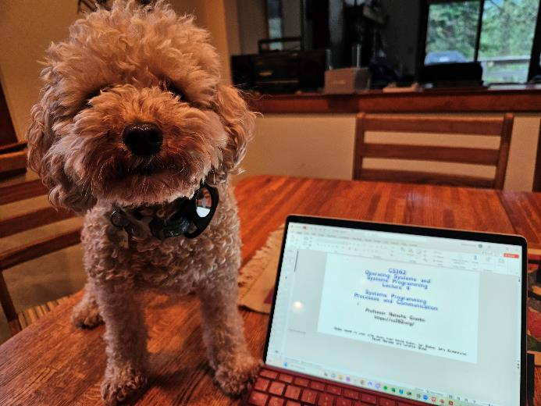
We (still) don’t bite!
Lectures go fast.
When reviewing the material, ask questions on EdStem now!
You can do so anonymously.

Slide 5
Recall: Hardware must support
Privileged Instructions
Unsafe instructions cannot be executed in user mode
2) Memory Isolation
Memory accesses outside a process’s address space prohibited
3) Interrupts
Ensure kernel can regain control from running process
4) Safe Transfers
Correctly transfer control from user-mode to kernel-mode and back

Slide 6
Recall: Really Really Really Big Idea
The state of a program’s execution is succinctly and completely represented by CPU register state
EIP, ESP, EBP, Eflags/PSW

Slide 7
Recall: Interrupt Summary
1) Device sends signal to APIC
2) Processor detects interrupt
3) CPU saves Recovery State and switch to Kernel Stack
(setting kernel mode)
4) CPU jumps to interrupt handler table at appropriate vector.
5) Kernel runs interrupt handler
6) Restore user program

Slide 8
Recall: System Call/Exceptions
1) Processor traps
2) CPU saves Recovery State, sets kernel mode and switch to Kernel Stack
3) CPU jumps to interrupt handler table at appropriate vector.
4) Kernel runs interrupt handler
5) Restore user program

Slide 9
Recall: User Stack/Kernel Stack (User Mode)
User-Level Process
Kernel
Registers
foo() {
int x, y;
while(..) {
x=x+1;
Y=y-2;
}
esp
interrupt_handler(){
push eax
push ebx
…
}
eip
eflags
User Stack
Kernel (Exception) Stack
eax
x
ebx
y
…

Slide 10
Recall: User Stack/Kernel Stack (Kernel Mode)
User-Level Process
Kernel
Registers
foo() {
int x, y;
while(..) {
x=x+1;
Y=y-2;
}
esp
interrupt_handler(){
push eax
push ebx
…
}
eip
eflags
User Stack
Kernel (Exception) Stack
eax
x
esp
ebx
eip
y
Saved by CPU
…
eflags
Error Code
eax
ebx

Slide 11
Three “Prongs” for the Class
Understanding OS principles
System Programming
Map Concepts to Real Code

Slide 12
Goals for Today
What APIs should the OS present for process creation and control?
“Everything is a file”: says Unix. What does IO look like in Unix?

Slide 13
Goal 1: The Process API

Slide 14
Simple is Beautiful
Can describe majority of process management (and input/output) using only a small number of system calls
System calls (mostly) unchanged since 1973

Slide 15
Keeping it in the family
Processes in Linux form a family tree
Each process in Linux has exactly one parent
Each process in Linux can have many children
All processes start from the main init process
Init
PID1
PID2
PID3
PID4

Slide 16
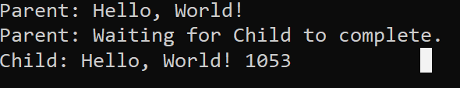

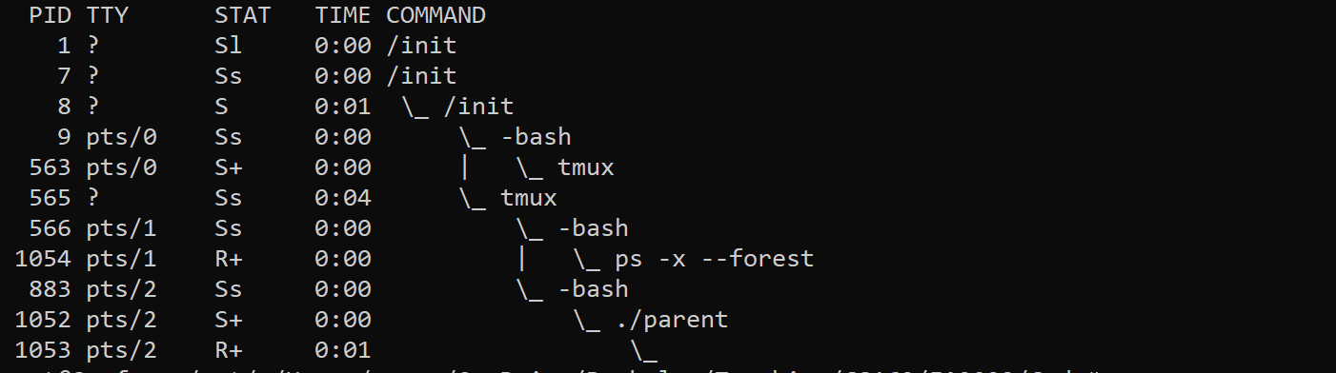
Examples
A parent process spawns a child process

Slide 17
Children in the Wild (well, in the Kernel)
enum procstate { UNUSED, EMBRYO, SLEEPING, RUNNABLE, RUNNING, ZOMBIE };
// Per-process state
struct proc {
uint sz; // Size of process memory (bytes)
pde_t* pgdir; // Page table
char *kstack; // Bottom of kernel stack for this process
enum procstate state; // Process state
int pid; // Process ID
struct proc *parent; // Parent process
struct trapframe *tf; // Trap frame for current syscall
struct context *context; // swtch() here to run process
void *chan; // If non-zero, sleeping on chan
int killed; // If non-zero, have been killed
struct file *ofile[NOFILE]; // Open files
struct inode *cwd; // Current directory
char name[16]; // Process name (debugging)
};
enum procstate { UNUSED, EMBRYO, SLEEPING, RUNNABLE, RUNNING, ZOMBIE };
// Per-process state
struct proc {
uint sz; // Size of process memory (bytes)
pde_t* pgdir; // Page table
char *kstack; // Bottom of kernel stack for this process
enum procstate state; // Process state
int pid; // Process ID
struct proc *parent; // Parent process
struct trapframe *tf; // Trap frame for current syscall
struct context *context; // swtch() here to run process
void *chan; // If non-zero, sleeping on chan
int killed; // If non-zero, have been killed
struct file *ofile[NOFILE]; // Open files
struct inode *cwd; // Current directory
char name[16]; // Process name (debugging)
};
…
Xv6 Kernel (proc.h)

Slide 18
Children in the Wild (well, in the Kernel)
struct task_struct *task;
for (task = current; task != &init_task; task = task->parent) {
printk(“%s[%d]\n”, task->comm, task->pid);
}
printk(“%s[%d]\n”, task->comm, task->pid);
What does the final print statement print?
In Linux task_struct defined in <linux/sched.h>

Slide 19
Process Management API
exit – terminate a process
fork – copy the current process
exec – change the program being run by the current process
wait – wait for a process to finish
kill – send a signal (interrupt-like notification) to another process
sigaction – set handlers for signals

Slide 20
Process Management API
exit – terminate a process
fork – copy the current process
exec – change the program being run by the current process
wait – wait for a process to finish
kill – send a signal (interrupt-like notification) to another process
sigaction – set handlers for signals

Slide 21
Exit()
#include <stdlib.h>
#include <stdio.h>
#include <string.h>
#include <unistd.h>
#include <sys/types.h>
int main(int argc, char *argv[])
{
/* get current processes PID */
pid_t pid = getpid();
printf("My pid: %d\n", pid);
}
Is this valid C code?
No need to explicitly call exit(). OS Library (more on this later) implicitly calls exit() when main returns
See Project 0

Slide 22
Process Management API
exit – terminate a process
fork – copy the current process
exec – change the program being run by the current process
wait – wait for a process to finish
kill – send a signal (interrupt-like notification) to another process
sigaction – set handlers for signals

Slide 23
A fork in the road
Creates a new child process from an original parent process
Child is copy of parent process
Fork call makes complete copy of process state
Address Space
Code/Data Segments
Registers (including PC and SP)
Stack
- Pointers to Files/IO (File descriptors – see later)

Slide 24
Forking under the hood
1. Allocate a new PCB.
2. Duplicates:
Register Values
Address Space
Flags
Register State
Open Files
3. Allocates new PID
4. Mark process as in the READY state
In Linux do_fork() defined in <kernel/fork.c>

Slide 25
Using Fork
#include <stdlib.h>
#include <stdio.h>
#include <unistd.h>
#include <sys/types.h>
int main(int argc, char *argv[]) {
pid_t cpid, mypid;
pid_t pid = getpid(); /* get current processes PID */
printf("Parent pid: %d\n", pid);
cpid = fork();
if (cpid > 0) { /* Parent Process */
mypid = getpid();
printf("[%d] parent of [%d]\n", mypid, cpid);
} else if (cpid == 0) { /* Child Process */
mypid = getpid();
printf("[%d] child\n", mypid);
} else {
perror("Fork failed");
}
}
What do you think this code does?

Slide 26
Forked Processes & Identical Twins
#include <stdlib.h>
#include <stdio.h>
#include <unistd.h>
#include <sys/types.h>
int main(int argc, char *argv[]) {
pid_t cpid, mypid;
pid_t pid = getpid(); /* get current processes PID */
printf("Parent pid: %d\n", pid);
cpid = fork();
if (cpid > 0) { /* Parent Process */
mypid = getpid();
printf("[%d] parent of [%d]\n", mypid, cpid);
} else if (cpid == 0) { /* Child Process */
mypid = getpid();
printf("[%d] child\n", mypid);
} else {
perror("Fork failed");
}
}
ebp
ebp
FP
FP
cpid
cpid
mypid
mypid
pid
pid
SP
SP
Stack
Stack
EIP = fork()
EIP = fork()
Heap
Heap
Data
Data
Code
Code
Parent Process
Child Process

Slide 27
Forking: Where to restart?
#include <stdlib.h>
#include <stdio.h>
#include <unistd.h>
#include <sys/types.h>
int main(int argc, char *argv[]) {
pid_t cpid, mypid;
pid_t pid = getpid(); /* get current processes PID */
printf("Parent pid: %d\n", pid);
cpid = fork();
if (cpid > 0) { /* Parent Process */
mypid = getpid();
printf("[%d] parent of [%d]\n", mypid, cpid);
} else if (cpid == 0) { /* Child Process */
mypid = getpid();
printf("[%d] child\n", mypid);
} else {
perror("Fork failed");
}
}
Where does the child process start executing?
From int main?
If (cpid > 0)?
Remember! Instruction pointer is pointing to the same fork() instruction

Slide 28
Forked Process: Who am I?
#include <stdlib.h>
#include <stdio.h>
#include <unistd.h>
#include <sys/types.h>
int main(int argc, char *argv[]) {
pid_t cpid, mypid;
pid_t pid = getpid(); /* get current processes PID */
printf("Parent pid: %d\n", pid);
cpid = fork();
if (cpid > 0) { /* Parent Process */
mypid = getpid();
printf("[%d] parent of [%d]\n", mypid, cpid);
} else if (cpid == 0) { /* Child Process */
mypid = getpid();
printf("[%d] child\n", mypid);
} else {
perror("Fork failed");
}
}
How do you determine whether you are the parent or the child?
Fork() returns PID of child to parent
If returns 0 then are child

Slide 29
Fork Ordering
What does this print?
Would adding the calls to sleep() matter?
int i;
pid_t cpid = fork();
if (cpid > 0) {
for (i = 0; i < 10; i++) {
printf("Parent: %d\n", i);
// sleep(1);
}
} else if (cpid == 0) {
for (i = 0; i > -10; i--) {
printf("Child: %d\n", i);
// sleep(1);
}
}
Remember! Full copy of address space. Once forked, modify different memory locations.
Arbitrary interleaving of processes

Slide 30
Review: The Life of a Fork() Syscall
1. Fork() is a System Call! Invoke int 0x80 instruction
2. CPU switches to kernel stack and copies recovery state
3. CPU Jumps to interrupt vector table (index 128).
Invokes system_call_handler()
4. Handler idenfies fork() using system call dispatch table
(syscall number stored in %eax register)
5. do_fork() creates a new child PCB with duplicated memory context and *same* EIP
6. Schedule either child or parent process

Slide 31
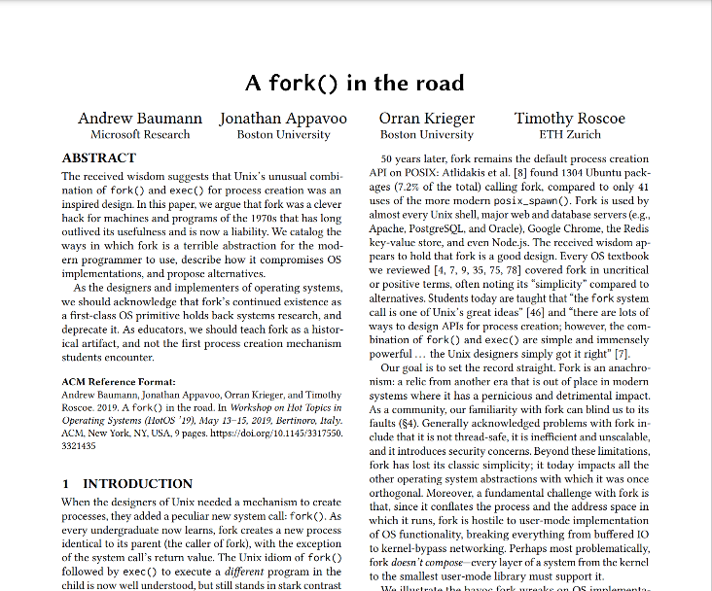
The Battle Continues

Slide 32
Process Management API
exit – terminate a process
fork – copy the current process
exec – change the program being run by the current process
wait – wait for a process to finish
kill – send a signal (interrupt-like notification) to another process
sigaction – set handlers for signals

Slide 33
Exec()
Call to Exec replaces running program!
…
cpid = fork();
if (cpid > 0) { /* Parent Process */
……
} else if (cpid == 0) { /* Child Process */
char *args[] = {“ls”, “-l”, NULL};
execv(“/bin/ls”, args);
/* execv doesn’t return when it works.
So, if we got here, it failed! */
perror(“execv”);
exit(1);
}
…
Exec System Call handler will:
Replace the code and data segment
2. Set EIP to point to start of new program/reinitialize SP and FP
3. Push arguments to program onto stack.

Slide 34
Isn’t this wasteful?
OS copies entire memory of process, only to overwrite it with new process
Can actually be made quite fast using intelligent copy-on-write mechanisms
(Only physically copy memory when content is different)

Slide 35
Fork/Exec Pattern
(./Prog)
(./Prog2)
Fork
Exec
Fork
Exec
(./Prog)
(./Prog2)
(./Prog2)
(./Prog3)

Slide 36
Process Management API
exit – terminate a process
fork – copy the current process
exec – change the program being run by the current process
wait – wait for a process to finish
kill – send a signal (interrupt-like notification) to another process
sigaction – set handlers for signals
exit – terminate a process
fork – copy the current process
exec – change the program being run by the current process
wait – wait for a process to finish
kill – send a signal (interrupt-like notification) to another process
sigaction – set handlers for signals

Slide 37
Wait()
Wait blocks parent process until one of its children processes exits
int status;
pid_t tcpid;
…
cpid = fork();
if (cpid > 0) { /* Parent Process */
mypid = getpid();
printf("[%d] parent of [%d]\n", mypid, cpid);
tcpid = wait(&status);
printf("[%d] Parent says bye %d(%d)\n",
mypid, tcpid, status);
} else if (cpid == 0) { /* Child Process */
mypid = getpid();
printf("[%d] child\n", mypid);
printf("[%d] Child says bye %d \n",
mypid);
exit(42);
}
…
In what order will the (parent/child) says bye sentences be outputted?
Question: how would parent wait for all children to finish?

Slide 38
Process Management API
exit – terminate a process
fork – copy the current process
exec – change the program being run by the current process
wait – wait for a process to finish
kill – send a signal (interrupt-like notification) to another process
sigaction – set handlers for signals

Slide 39
What is a Signal?
A signal is a very short message that may be sent to a process or a group of processes.
Make process aware that specific event has occurred
2) Allow process to execute a signal handler function when event has occurred
Example of a kernel-> user mode transition

Slide 40
What is a Signal?
#include <stdlib.h>
#include <stdio.h>
#include <sys/types.h>
#include <unistd.h>
#include <signal.h>
void signal_callback_handler(int signum) {
printf(“Caught signal!\n”);
exit(1);
}
int main() {
struct sigaction sa;
sa.sa_flags = 0;
sigemptyset(&sa.sa_mask);
sa.sa_handler = signal_callback_handler;
sigaction(SIGINT, &sa, NULL);
while (1) {}
}
Each signal has a default action. Can override default action with signal handler
Program jumps to signal handler function.
Control of the program resumes at the previously interrupted instructions.

Slide 41
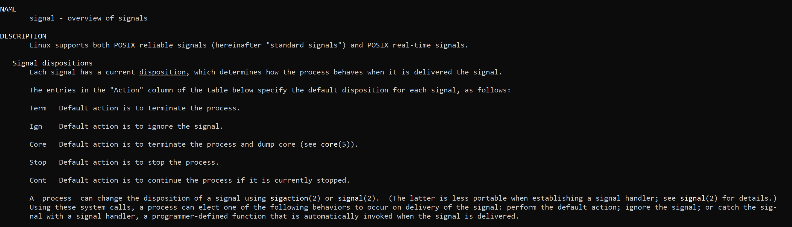
Signals in the Wild (in the Linux Kernel)
Ctr + C . Sends SIGINT signal. Default actual is to kill the program
Timer signal. Check every T seconds that a condition still holds
crooks@laptop> man 7 signal

Slide 42
Process Management API
exit – terminate a process
fork – copy the current process
exec – change the program being run by the current process
wait – wait for a process to finish
kill – send a signal (interrupt-like notification) to another process
sigaction – set handlers for signals

Slide 43
Goal 2: Input/Output in Linux

Slide 44
Goal 2: Input/Output in Linux
UNIX offers the same IO interface for:
All device Input/Output
Reading/Writing Files
Interprocess communication
Printers
Mouse
Disk
Pipes
Socket
Everything is a file!

Slide 45
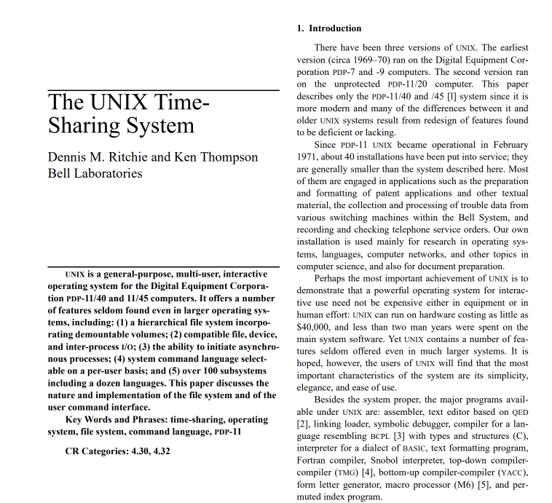



Radical in 1974!

Slide 46
Core tenants of UNIX/IO interface
Uniformity
Same set of system calls
Open, read, write, close
Open Before Use
Must explicitly open file/device/channel
Byte-Oriented
All devices, even block devices, are access through byte arrays
Kernel Buffered Reads/Writes
Data is buffered at kernel to decouple internals from application
Explicit Close
Must explicitly close resource

Slide 47
Introducing the File Descriptor
Number that uniquely identifies an open IO resource in the OS
It’s another index!
File descriptors index into
a per-process file descriptor table

Slide 48
FDs in the Wild (well, in the Kernel)
enum procstate { UNUSED, EMBRYO, SLEEPING, RUNNABLE, RUNNING, ZOMBIE };
// Per-process state
struct proc {
uint sz; // Size of process memory (bytes)
pde_t* pgdir; // Page table
char *kstack; // Bottom of kernel stack for this process
enum procstate state; // Process state
int pid; // Process ID
struct proc *parent; // Parent process
struct trapframe *tf; // Trap frame for current syscall
struct context *context; // swtch() here to run process
void *chan; // If non-zero, sleeping on chan
int killed; // If non-zero, have been killed
struct file *ofile[NOFILE]; // Open files
struct inode *cwd; // Current directory
char name[16]; // Process name (debugging)
};
In Linux struct fdtable defined in <include/kernel/fdtable.h>
enum procstate { UNUSED, EMBRYO, SLEEPING, RUNNABLE, RUNNING, ZOMBIE };
// Per-process state
struct proc {
uint sz; // Size of process memory (bytes)
pde_t* pgdir; // Page table
char *kstack; // Bottom of kernel stack for this process
enum procstate state; // Process state
int pid; // Process ID
struct proc *parent; // Parent process
struct trapframe *tf; // Trap frame for current syscall
struct context *context; // swtch() here to run process
void *chan; // If non-zero, sleeping on chan
int killed; // If non-zero, have been killed
struct file *ofile[NOFILE]; // Open files
struct inode *cwd; // Current directory
char name[16]; // Process name (debugging)
};
…
Xv6 Kernel (proc.h)

Slide 49
Table of Open File Description
Each FD points to an
open file description in a system-wide table
of open files
File offset
File access mode (from open())
File status flags (from open())
Reference to physical location (inode – more later)
Number of times opened
In Linux struct file defined in <include/linux/fs.h>

Slide 50
Manipulating FDs
Open/Create All files explicitly opened via open or create. Return the lowest-numbered file descriptor not currently open for the process. Creates new open file description
Close
Closes a file descriptor, so that it no longer refers to any file and may be reused
#include <fcntl.h>
#include <unistd.h>
#include <sys/types.h>
int open (const char *filename, int flags, [mode_t mode]);
int creat (const char *filename, mode_t mode);
int close (int filedes);

Slide 51
Manipulating FDs (2)
Read data from open file using file descriptor: ssize_t read (int filedes, void *buffer, size_t maxsize)
Write data to open file using file descriptor ssize_t write (int filedes, const void *buffer, size_t size)
Reposition file offset within kernel
off_t lseek (int filedes, off_t offset, int whence)

Slide 52
Example
char buffer1[100];
char buffer2[100];
O: STDIN
Mode
Flags
Offset
Phys
1: STDOUT
2: STDERR
Per-Process File Descriptor Table
Global Open File Description Table

Slide 53
Example
char buffer1[100];
char buffer2[100];
int fd = open(“foo.txt”, O_RDONLY);
O: STDIN
Mode
Flags
Offset
Phys
1: STDOUT
U
R
0
2: STDERR
3
Per-Process File Descriptor Table
Global Open File Description Table

Slide 54
Example
char buffer1[100];
char buffer2[100];
int fd = open(“foo.txt”, O_RDONLY);
read(fd, buffer1, 100);
O: STDIN
Mode
Flags
Offset
Phys
1: STDOUT
U
R
100
2: STDERR
3
Per-Process File Descriptor Table
Global Open File Description Table

Slide 55
Example
char buffer1[100];
char buffer2[100];
int fd = open(“foo.txt”, O_RDONLY);
read(fd, buffer1, 100);
read(fd, buffer2, 100);
O: STDIN
Mode
Flags
Offset
Phys
1: STDOUT
U
R
200
2: STDERR
3
Per-Process File Descriptor Table
Global Open File Description Table

Slide 56
Example
char buffer1[100];
char buffer2[100];
int fd = open(“foo.txt”, O_RDONLY);
read(fd, buffer1, 100);
read(fd, buffer2, 100);
int fd2 = open(“bar.txt”, O_RDWR);
O: STDIN
Mode
Flags
Offset
Phys
1: STDOUT
U
R
200
2: STDERR
U
RW
0
3
4
Per-Process File Descriptor Table
Global Open File Description Table

Slide 57
Example
char buffer1[100];
char buffer2[100];
int fd = open(“foo.txt”, O_RDONLY);
read(fd, buffer1, 100);
read(fd, buffer2, 100);
int fd2 = open(“bar.txt”, O_RDWR);
read(fd2, buffer1, 100);
O: STDIN
Mode
Flags
Offset
Phys
1: STDOUT
U
R
200
2: STDERR
U
RW
100
3
4
Per-Process File Descriptor Table
Global Open File Description Table

Slide 58
Example
char buffer1[100];
char buffer2[100];
int fd = open(“foo.txt”, O_RDONLY);
read(fd, buffer1, 100);
read(fd, buffer2, 100);
int fd2 = open(“bar.txt”, O_RDWR);
read(fd2, buffer1, 100);
write(fd2, buffer2, 100);
O: STDIN
Mode
Flags
Offset
Phys
1: STDOUT
U
R
200
2: STDERR
U
RW
100
3
4
Per-Process File Descriptor Table
Global Open File Description Table
Type man 2 write in terminal. What do you think?

Slide 59
Example
char buffer1[100];
char buffer2[100];
int fd = open(“foo.txt”, O_RDONLY);
read(fd, buffer1, 100);
read(fd, buffer2, 100);
int fd2 = open(“bar.txt”, O_RDWR);
read(fd2, buffer1, 100);
write(fd2, buffer2, 100);
O: STDIN
Mode
Flags
Offset
Phys
1: STDOUT
U
R
200
2: STDERR
U
RW
200
3
4
Per-Process File Descriptor Table
Global Open File Description Table

Slide 60
Example
char buffer1[100];
char buffer2[100];
int fd = open(“foo.txt”, O_RDONLY);
read(fd, buffer1, 100);
read(fd, buffer2, 100);
int fd2 = open(“bar.txt”, O_RDWR);
read(fd2, buffer1, 100);
write(fd2, buffer2, 100);
close(fd)
O: STDIN
Mode
Flags
Offset
Phys
1: STDOUT
2: STDERR
U
RW
200
4
Per-Process File Descriptor Table
Global Open File Description Table

Slide 61
Example
char buffer1[100];
char buffer2[100];
int fd = open(“foo.txt”, O_RDONLY);
read(fd, buffer1, 100);
read(fd, buffer2, 100);
int fd2 = open(“bar.txt”, O_RDWR);
read(fd2, buffer1, 100);
write(fd2, buffer2, 100);
close(fd); close(fd2)
O: STDIN
Mode
Flags
Offset
Phys
1: STDOUT
2: STDERR
Per-Process File Descriptor Table
Global Open File Description Table

