Slide 1
CSC 112: Computer Operating Systems Lecture 4 Deadlocks Exercises
Department of Computer Science,
Hofstra University
Acknowledgement: Lecture slides based on UC Berkeley CS 162: Operating Systems and System Programming

Slide 2
Quiz: Deadlocks II
Is there a possible deadlock?
1 Semaphore L1=1, L2=1, L3=1;
2
// Thread 1:
L1.wait();
L2.wait();
// critical section requiring L1 and L2 locked.
L2.post();
L1.post();
9
// Thread 2:
L3.wait();
L1.wait();
// critical section requiring L3 and L1 locked.
L1.post();
L3.post();
16
// Thread 3:
L2.wait();
L3.wait();
// critical section requiring L2 and L3 locked.
L3.post();
L2.post();

Slide 3
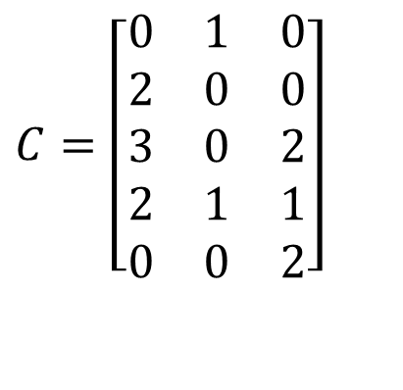
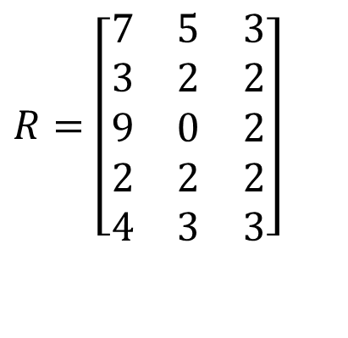

Quiz: Banker’s Algorithm I
4 processes P1 through P5; 3 resource types R1, R2, R3 with 7, 3, 6 instances each.
Run Banker’s algorithm to check if the current state is safe. If yes, give a safe sequence of process completions and fill in the table with the sequence of process completions without deadlock, and available resources after the completion of each process.
(You will be graded on “Need matrix”, and “Available resources after completion of each process”.)
Max
Allocation
$$R=\left[\begin{matrix}7 & 5 & 3 \\ 3 & 2 & 2 \\ 9 & 0 & 2 \\ 2 & 2 & 2 \\ 4 & 3 & 3\end{matrix}\right]$$
$$C=\left[\begin{matrix}0 & 1 & 0 \\ 2 & 0 & 0 \\ 3 & 0 & 2 \\ 2 & 1 & 1 \\ 0 & 0 & 2\end{matrix}\right]$$
Total
Available resources after completion of each process
$$E=\left[7\begin{matrix} & 3 & 6\end{matrix}\right]$$
 | R1 | R2 | R3
Init

Slide 4

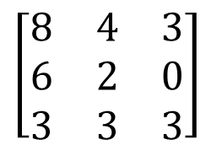
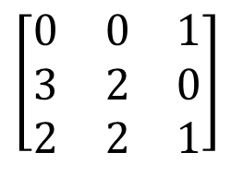
Quiz: Banker’s algorithm II
4 processes P1, P2, P3; 3 resource types R1, R2, R3 with 8, 6, 4 instances each.
1) Run Banker’s algorithm to check if the current state is safe. If yes, give a safe sequence of process completions and fill in the table with the sequence of process completions without deadlock, and available resources after the completion of each process.
2) Starting from the initial state, if P1 makes request for 2 more instances of resource 3, should we grant it?
3) Starting from the initial state, if P2 makes request for 2 more instances of resource 1, should we grant it?
Max
Allocation
$$\left[\begin{matrix}8 & 4 & 3 \\ 6 & 2 & 0 \\ 3 & 3 & 3\end{matrix}\right]$$
$$\left[\begin{matrix}0 & 0 & 1 \\ 3 & 2 & 0 \\ 2 & 2 & 1\end{matrix}\right]$$
Total
$$E=\left[8\begin{matrix} & 6 & 4\end{matrix}\right]$$
Available resources after completion of each process
 | R1 | R2 | R3
Init

Slide 5

Banker’s Algorithm: 4 philosophers each holding his left fork
Max
Allocation
Need
0
1
0
1
$$R−C$$
0
1
0
1
1
1
Available resources after completion of each process
Total
Available
 | R1 | R2 | R3 | R4 | R5
 | 0 | 0 | 0 | 0 | 1
Suppose we have 5 philosophers P1-P5, and 5 forks R1-R5; philosopher Pi has left fork Ri, and right fork R(i+1)%5. Philosophers P1-P4 each is holding his left fork.
Run Banker’s algorithm to check if the current state is safe. If yes, give a safe sequence of process completions and fill in the table with the sequence of process completions without deadlock, and available resources after the completion of each process.

Slide 6
Banker’s Algorithm: 5 philosophers each holding his left fork
Max
Allocation
Need
0
1
0
1
0
1
0
1
1
Total
Available
Run Banker’s algorithm to check if the current state is safe.

Slide 7
Multi-Armed Lawyers
Consider a large table with identical multi-armed alien lawyers. There is a pile of chopsticks at the center of the table. In order to eat, a lawyer must have one chopstick in each hand. Assume total number of chopsticks >= number of hands of each lawyer, so at least one lawyer can eat.
It is not a generalization of the 2-armed Dining Philosophers problem. Since the chopsticks are in a pile at center of the table, we should model them as a single resource with multiple instances, instead of multiple resources for the Dining Philosophers, where each fork (chopstick) has a fixed position in-between two philosophers. Hence the R and C matrices have a single column.
Ack: this example is taken from UC Berkeley CS162 course.
Notes:
https://people.eecs.berkeley.edu/~kubitron/courses/cs162-F07/exams/fa07mt1-solutions.pdf
The lawyers are so busy talking that they can only grab one chopstick at a time. Design a deadlock-free algorithm using monitors and Bankers algorithm.

Slide 8
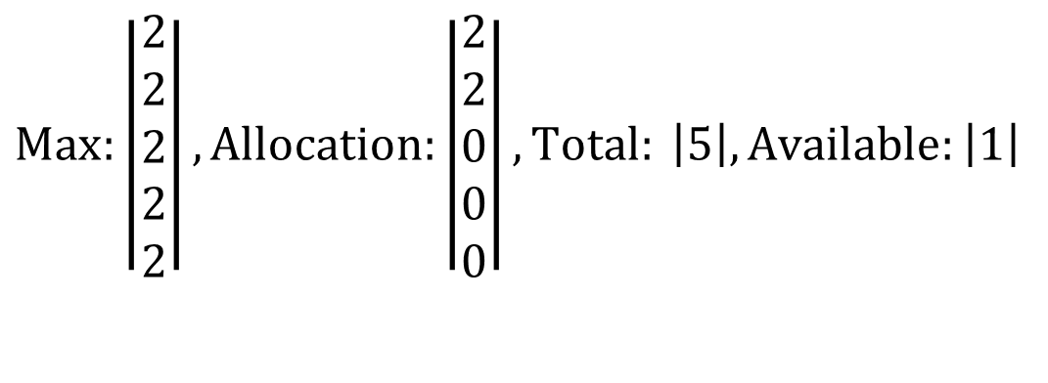
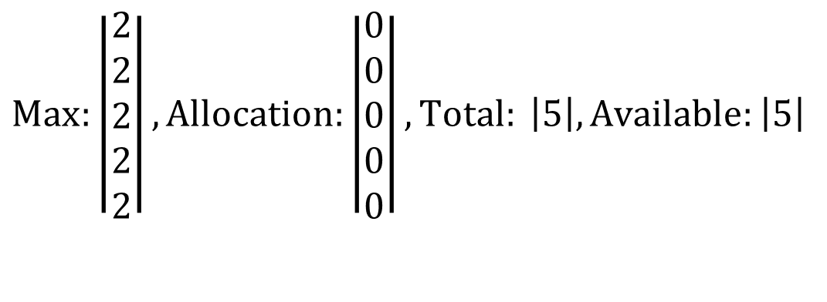
Example: 5 Lawyers, each with 2 arms, 5 chopsticks
$$Max:\left|\begin{matrix}2 \\ 2 \\ 2 \\ 2 \\ 2\end{matrix}\right|, Allocation:\left|\begin{matrix}0 \\ 0 \\ 0 \\ 0 \\ 0\end{matrix}\right|, Total: \left|5\right|, Available:\left|5\right|$$
Initially, all chopsticks are free.
$$Max:\left|\begin{matrix}2 \\ 2 \\ 2 \\ 2 \\ 2\end{matrix}\right|, Allocation:\left|\begin{matrix}2 \\ 2 \\ 0 \\ 0 \\ 0\end{matrix}\right|, Total: \left|5\right|, Available:\left|1\right|$$
Two lawyers each grab two chopsticks and start eating. No other lawyers can eat.

Slide 9
Quiz: Dining Lawyers I
If each lawyer has 2 arms, and there is a pile of chopsticks at the center of the table. Assume there are at least 2 chopsticks, so at least one lawyer can eat. Each lawyer follows the following steps:
(1) Pick up a chopstick
(2) Pick up another chopstick
(3) Eat
(4) Return both chopsticks to the pile
Q: Can the system be deadlocked?

Slide 10
Quiz: Dining Lawyers II
If each lawyer has 2 arms, and there is a pile of knives and forks at center of the table. Assume there are at least 1 knife and 1 fork, so at least one lawyer can eat. Each lawyer follows the following steps:
(1) Pick up a knife
(2) Pick up a fork
(3) Eat
(4) Return the knife and fork to the pile
Q: Can the system be deadlocked?

Slide 11
Quiz: Dining Lawyers III
If each lawyer has 4 arms, and there is a pile of knives and forks at center of the table. Assume there are at least 2 knives and 2 forks, so at least one lawyer can eat. Each lawyer follows the following steps:
(1) Pick up 2 knives atomically
(2) Pick up 2 forks atomically
(3) Eat
(4) Return the knives and forks to the pile
Q: Can the system be deadlocked?

Slide 12
Quiz: Dining Lawyers III
If each lawyer has 4 arms, and there is a pile of knives and forks at center of the table. Assume there are at least 2 knives and 2 forks, so at least one lawyer can eat. Each lawyer follows the following steps:
(1) Pick up a knife
(2) Pick up another knife
(3) Pick up a fork
(4) Pick up another fork
(5) Eat
(6) Return the knife and fork to the pile
Q1: Can the system be deadlocked?
Q2: What if each lawyer may have a different number of arms, and may request a different ratio of knives vs. forks?

