Slide 1
Zonghua Gu
Embedded Systems with ARM Cortex-M Microcontrollers in Assembly Language and C
Chapter 5
Memory Access
Fall 2025
Acknowledgement: Lecture slides based on Embedded Systems with ARM Cortex-M Microcontrollers in Assembly Language and C, University of Maine https://web.eece.maine.edu/~zhu/book/

Slide 2
Overview
How is data organized in memory?
Big Endian vs Little Endian
How is data addressed?
Register offset
LDR r1, [r0, r3] ; offset = r3
LDR r1, [r0, r3, LSL #2] ; offset = r3 * 4
Immediate offset
Pre-index: LDR r1, [r0, #4]
Post-index: LDR r1, [r0], #4
Pre-index with update: LDR r1, [r0, #4]!

Slide 3
Logic View of Memory
By grouping bits, we can store more values
8 bits = 1 byte
16 bits = 2 bytes = 1 halfword
32 bits = 4 bytes = 1 word
8 bits
High Address
0x20000007
01110010
0x20000006
00100101
0x20000005
11100010
0x20000004
10000100
0x20000003
01100001
0x20000002
10001111
0x20000001
00010010
0x20000000
10010100
Low Address

Slide 4
Logic View of Memory
By grouping bits, we can store more values
8 bits = 1 byte
16 bits = 2 bytes = 1 halfword
32 bits = 4 bytes = 1 word
From the software perspective, memory is an addressable array of bytes.
The byte stored at the memory address 0x20000004 is 0b10000100
8 bits
High Address
0x20000007
01110010
0x20000006
00100101
0x20000005
11100010
0x20000004
10000100
0x20000003
01100001
0b10000100
0x84
132
0x20000002
10001111
Binary
Hexadecimal
Decimal
0x20000001
00010010
0x20000000
10010100
Computer memory is byte-addressable!
Low Address

Slide 5
Logic View of Memory
When we refer to memory locations by address, we can only do so in units of bytes, halfwords or words
Words
32 bits = 4 bytes = 1 word = 2 halfwords
Memory address of a word is the lowest address of all four bytes in that word.
8 bits
High Address
0x20000007
01110010
0x20000006
00100101
0x20000005
11100010
The address of this word is 0x20000004
0x20000004
10000100
0x20000003
01100001
0x20000002
10001111
0x20000001
00010010
The address of this word is 0x20000000
0x20000000
10010100
Low Address

Slide 6
Logic View of Memory
Can you store a word anywhere?
8 bits
High Address
0x20000007
01110010
0x20000006
00100101
0x20000005
11100010
0x20000004
10000100
0x20000003
01100001
0x20000002
10001111
0x20000001
00010010
0x20000000
10010100
Low Address

Slide 7
Logic View of Memory
Can we store a word anywhere in memory?
NO on most computers!
A word can only be stored at an address that's divisible by 4.
8 bits
High Address
0x20000007
01110010
0x20000006
00100101
Word-address mod 4 = 0
0x20000005
11100010
0x20000004
10000100
0x20000003
01100001
We cannot store a word at address 0x20000002.
0x20000002
10001111
0x20000001
00010010
0x20000000
10010100
Low Address

Slide 8
Logic View of Memory
Halfwords
16 bits = 2 bytes = 1 halfword
The right diagram has four halfwords at addresses of:
0x20000000
0x20000002
0x20000004
0x20000006
8 bits
High Address
0x20000007
01110010
0x20000006
00100101
0x20000005
11100010
0x20000004
10000100
0x20000003
01100001
0x20000002
10001111
0x20000001
00010010
0x20000000
10010100
Low Address

Slide 9
Logic View of Memory
Can you store a halfword anywhere? NO.
A halfword can only be stored at an address that's divisible by 2.
Memory address of a halfword is the lowest address of its two bytes.
8 bits
High Address
0x20000007
01110010
0x20000006
00100101
Halfword-address mod 2 = 0
0x20000005
11100010
0x20000004
10000100
0x20000003
01100001
We cannot store a halfword at address 0x20000001.
0x20000002
10001111
0x20000001
00010010
0x20000000
10010100
Low Address

Slide 10
Quiz
Memory
High Address
uint32_t X[4];
What are their memory address offsets?
Low Address
1 byte

Slide 11
Quiz
Memory
High Address
Offset = ???
X[3]
uint32_t X[4];
What are their memory address offsets?
Offset = ???
X[2]
Offset = ???
X[1]
Offset = ???
X[0]
Low Address
1 byte

Slide 12
Quiz
Memory
0015
0014
Offset = ???
X[3]
0013
uint32_t X[4];
0012
0011
What are their memory address offsets?
0010
Offset = ???
X[2]
0009
0008
0007
X[1]
0006
Offset = ???
0005
0004
0003
Offset = ???
0002
X[0]
0001
0000
Offset of bytes
1 byte

Slide 13
Quiz
Memory
0015
0014
Offset = 12
X[3]
0013
uint32_t X[4];
0012
0011
What are their memory address offsets?
0010
Offset = 8
X[2]
0009
0008
0007
X[1]
0006
If the array starts at address pAddr,
Memory address of X[0] is pAddr
Memory address of X[1] is pAddr + 4
Memory address of X[2] is pAddr + 8
Memory address of X[3] is pAddr + 12
Offset = 4
0005
0004
0003
Offset = 0
0002
X[0]
Sequential words are at addresses incremented by 4, not by 1!
0001
0000
Offset of bytes
1 byte

Slide 14
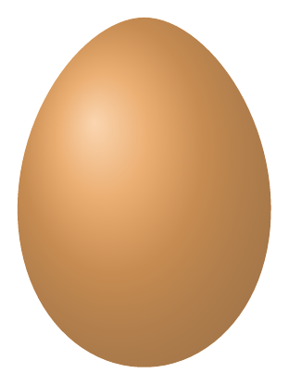
Which end do you break to eat a boiled egg?
Little Endian
Big Endian
Notes:
These terms are originated from a very old story. The little endians break their boiled eggs on the smaller end. The big endians break their eggs on the larger end.

Slide 15
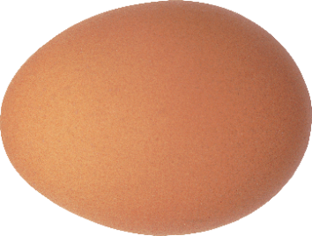

Endianess
High address
MSB
LSB
Little Endian
Big Endian
byte 3
byte 2
byte 1
LSB
MSB
byte 0
LSB is at least address
MSB is at least address
Low address
Gulliver’s Travels (by Jonathan Swift, published in 1726):
Two religious sects of Lilliputians
The Little-Endians crack open their eggs from the little end
The Big-Endians break their on the big end

Slide 16
Endianess
Endian: byte order, not bit order!
High address
MSB
LSB
Little Endian
Big Endian
byte 3
byte 2
byte 1
LSB
MSB
byte 0
LSB is at least address
MSB is at least address
Low address
Little-Endian
uint32_t a = 0x87654321
Big-Endian
High address
High address
Reading from the top
0x87
byte 3 byte 2 byte 1 byte 0
0x21
0x65
0x87
0x65
0x43
0x21
0x43
0x43
0x65
0x21
byte 0 byte 1 byte 2 byte 3
0x87
Reading from the bottom
Low address
Low address

Slide 17
Little Endian vs Big Endian
MSB
LSB
Byte 3
Byte 3
Byte 2
Byte 2
Byte 1
Byte 1
Byte 0
Byte 0
High address
Low address
Little Endian
LSB is at least address!
Notes:
In a little-endian system, the least significant byte of a word is stored at the smallest memory address, and the most significant byte at the largest.

Slide 18
Little Endian vs Big Endian
MSB
LSB
Byte 3
Byte 3
Byte 2
Byte 2
Byte 1
Byte 1
Byte 0
Byte 0
High address
High address
Byte 3
Byte 2
Byte 1
Byte 0
LSB
MSB
Low address
Low address
Little Endian
Big Endian
LSB is at least address!
MSB is at least address!
Notes:
In a big-endian system, the most significant byte of a word is stored at the smallest memory address, and the least significant byte at the largest.

Slide 19
Little Endian vs Big Endian
MSB
LSB
Byte 3
Byte 2
Byte 1
Byte 0
High address
High address
Byte 3
Byte 0
Byte 2
Byte 1
Byte 1
Byte 2
Byte 0
LSB
MSB
Byte 3
Low address
Low address
Little Endian
Big Endian
LSB is at least address!
MSB is at least address!
Notes:
Again, for little endian, the Least significant byte (LSB) is stored at the lowest address. For big endian, the Most significant byte (MSB) is stored at the lowest address. The little endian stores the bytes of a word in the opposite order as the big endian.

Slide 20
Word stored at 0x20000000?
Address
Contents
If Little Endian
value = 0x04030201
If Big Endian
value = 0x01020304
0x20000003
0x04
0x20000002
0x03
0x20000001
0x02
0x20000000
0x01
8 bits

Slide 21
Example
If big endianess is used
The word stored at address 0x20008000 is
Memory Address | Memory Data
0x20008003 | 0xA7
0x20008002 | 0x90
0x20008001 | 0x8C
0x20008000 | 0xEE
0xEE8C90A7
Notes:
Halfword access and signed halfword/byte accesses were added to the architecture in v4T, this is the reason the offset field is not as flexible as the normal word/byte load/store - not a problem because these accesses are less common.
Link: diagram on next slide

Slide 22
Example
If little endianess is used
The word stored at address 0x20008000 is
Memory Address | Memory Data
0x20008003 | 0xA7
0x20008002 | 0x90
0x20008001 | 0x8C
0x20008000 | 0xEE
0xA7908CEE
Endian only specifies byte order, not bit order in a byte!
Notes:
Halfword access and signed halfword/byte accesses were added to the architecture in v4T, this is the reason the offset field is not as flexible as the normal word/byte load/store - not a problem because these accesses are less common.
Link: diagram on next slide

Slide 23
Endian on Modern Architecture
Intel x86 and AMD64/x86-64 use little endian.
Atmel AVR32 and OpenRISC use big endian.
Arm Cortex-M supports both Little Endian and Big Endian. However, endian maybe fixed for specific chips.
ST’s L4 Series, TI’s Tiva C, and NXP’s K64 only supports only Little Endian.
MSB
LSB
Little Endian
Big Endian
LSB
MSB
LSB is at least address
MSB is at least address
Notes:
Which endian is better? In modern computers, some computers use little endian, some use little endian, some support both. There are no significant advantages of one over the other. While Arm Cortex-M supports both, a specific Arm chip might only support only one endian. For example, ST’s L4, TI’s Tiva C, and NXP’s K64 support only Little Endian.

Slide 24

Loading Data from Memory
Memory
Memory
Registers
ALU
ALU
Load
Notes:
In modern computers, a value in the memory cannot directly be the source operands of the processor core. When we need to perform an arithmetic or logic operation on a value in the memory, the processor needs to execute the load instruction to load the data from the memory into one of the processor registers firstly.

Slide 25
Storing Data to Memory
Memory
Memory
Registers
ALU
ALU
Store
Notes:
Similarly, the result of the ALU cannot be directly saved into the memory. Instead, the result is saved into a register first, then the processor executed a store instruction to save the value to the memory. The key reasons that registers are much faster than memory. Saving values in registers temporally help improves the processor speed if those values are used repeatedly within a short timeframe.

Slide 26
Load-Modify-Store
C statement
x = x + 1;
Assume variable X resides in memory and is a 32-bit integer
; Assume the memory address of x is stored in r1
LDR r0, [r1] ; load value of x from memory
ADD r0, r0, #1 ; x = x + 1
STR r0, [r1] ; store x into memory
Notes:
Assume x is a 32-bit integer stored in the memory

Slide 27
3 Steps: Load, Modify, Store
Registers
ALU
2
Modify
x = x + 1;
Load
Store
1
3
Variable x resides in memory!
ALU cannot directly operate memory data!
Memory

Slide 28
Load Instructions
LDR rt, [rs]
Read from memory
Mnemonic: LoaD to Register (LDR)
rs specifies the memory address
rt holds the 32-bit value fetched from memory
For Example:
; Assume r0 = 0x08200004
; Load a word:
LDR r1, [r0] ; r1 = Memory.word[0x08200004]

Slide 29
Store Instructions
STR rt, [rs]
Write into memory
Mnemonic: STore from Register (STR)
rs specifies memory address
Save the content of rt into memory
For Example:
; Assume r0 = 0x08200004
; Store a word
STR r1, [r0] ; Memory.word[0x08200004] = r1

Slide 30
Loading Word from Memory
LDR r1, [r0] ; r1 = memory.word[r0]
; LDR stands for Load to Register
Contents
Address
Registers
r0 | 0x20000000
r1
r2
r3
. . . | . . .
r15
0xDEADBEEF
0x8B
0x20000007
0xAD
0x20000006
ALU
0xF0
0x20000005
0x0D
0x20000004
0xDE
0x20000003
0xAD
0x20000002
0xBE
0x20000001
0xEF
0x20000000
32 bits
Processor Core
Memory
Notes:
The ALU in the processor core cannot directly use values stored in memory as source or destination operands. When software needs to perform an arithmetic or logical operation on a value stored in the memory, software needs to load the target value from the memory to one of the core registers. Note that every processor core register has 32 bits. Here gives an example of the LDR instruction. LDR stands for load to register, and it reads a 32-bit word from the memory and saves the value into the destination register. For example, in this instruction, register r0 specifies the memory address where we will read data. Register r1 is the destination register. In this example, suppose register r0 holds this memory address, which points to this location.
This LDR instruction will load a word, i.e., 4 bytes, into the destination register r1. If we assume the system uses little-endian, then the value of register r1 will be this value: Dead beef.

Slide 31
Storing Word to Memory
STR r1, [r0] ; memory.word[r0] = r1
; STR stands for Store Register
Contents
Address
Registers
r0 | 0x20000000
r1
r2
r3
. . . | . . .
r15
0xBADDCAFE
0x8B
0x20000007
0xAD
0x20000006
ALU
0xF0
0x20000005
0x0D
0x20000004
0x20000003
0x20000002
0x20000001
0x20000000
32 bits
Processor Core
Memory
Notes:
When software needs to save a word into the memory, the processor core needs to run the STR instruction. STR stands for store to register. In this example, it saves the 32-bit value held in register r1 into the memory at the address specified in register r0. Assume register r0 has this value, pointing to this memory location. Suppose register r1 holds a special value, Bad Café.

Slide 32
Storing Word to Memory
STR r1, [r0] ; memory.word[r0] = r1
; STR stands for Store Register
Contents
Address
Registers
r0 | 0x20000000
r1
r2
r3
. . . | . . .
r15
0xBADDCAFE
0x8B
0x20000007
0xAD
0x20000006
ALU
0xF0
0x20000005
0x0D
0x20000004
0xBA
0x20000003
0xDD
0x20000002
0xCA
0x20000001
0xFE
0x20000000
32 bits
Processor Core
Memory
Notes:
Assume the system uses little endian, here are the memory values if the STR instruction completes. The least significant byte 0xFE is stored at the lowest memory address.

Slide 33
Load/Store a Byte, Halfword, Word
LDRxxx R0, [R1]
; Load data from memory into a 32-bit register
LDR | Load Word | uint32_t/int32_t | unsigned or signed int
LDRB | Load Byte | uint8_t | unsigned char
LDRH | Load Halfword | uint16_t | unsigned short int
LDRSB | Load Signed Byte | int8_t | signed char
LDRSH | Load Signed Halfword | int16_t | signed short int
STRxxx R0, [R1]
; Store data extracted from a 32-bit register into memory
STR | Store Word | uint32_t/int32_t | unsigned or signed int
STRB | Store Lower Byte | uint8_t/int8_t | unsigned or signed char
STRH | Store Lower Halfword | uint16_t/int16_t | unsigned or signed short

Slide 34
Load a Byte, Half-word, Word
Load a Byte
LDRB r1, [r0]
0x02000003
0x87
0x00
0x00
0x00
0xE1
0x02000002
0x65
31
0
0x02000001
0xE3
0x02000000
0xE1
Load a Halfword
Little Endian
LDRH r1, [r0]
0x00
0x00
0xE3
0xE1
31
0
Assume
r0 = 0x20000000
Load a Word
LDR r1, [r0]
0x87
0x65
0xE3
0xE1
31
0

Slide 35
Sign Extension
Load a Signed Byte
LDRSB r1, [r0]
0x20000003
0x87
0xFF
0xFF
0xFF
0xE1
0x20000002
0x65
31
0
0x20000001
0xE3
0x20000000
0xE1
Load a Signed Halfword
Little Endian
LDRSH r1, [r0]
0xFF
0xFF
0xE3
0xE1
Assume
r0 = 0x20000000
31
0
Facilitate subsequent 32-bit signed arithmetic!

Slide 36
Address Modes: Offset in Register
Address accessed by LDR/STR is specified by a base register plus an offset
Offset can be hold in a register
LDR r0,[r1,r2]
Base memory address hold in register r1
Offset hold r2
Target address = r1 + r2
LDR r0,[r1,r2,LSL #2]
Base memory address hold in register r1
Offset = r2, LSL #2
Target address = r1 + r2 * 4

Slide 37
Address Modes: Immediate Offset
Address accessed by LDR/STR is specified by a base register plus an offset
Offset can be an immediate value
LDR r0,[r1,#8]
Base memory address hold in register r1
Offset is an immediate value
Target address = r1 + 8
Three modes for immediate offset:
Pre-index,
Post-index,
Pre-index with Update

Slide 38
Addressing Mode: Pre-index vs Post-index
Pre-index
LDR r1, [r0, #4]
Post-index
LDR r1, [r0], #4
Pre-index with Update
LDR r1, [r0, #4]!

Slide 39
Pre-index
Pre-Index: LDR r1, [r0, #4]
Assume: r0 = 0x20008000
Offset: range is -255 to +255
Memory Address | Memory Data
0x20008007 | 0x88
0x20008006 | 0x79
0x20008005 | 0x6A
0x20008004 | 0x5B
0x20008003 | 0x4C
0x20008002 | 0x3D
0x20008001 | 0x2E
0x20008000 | 0x1F

Slide 40
Pre-index
Pre-Index: LDR r1, [r0, #4]
Assume: r0 = 0x20008000
Offset: range is -255 to +255
Memory Address | Memory Data
0x20008007 | 0x88
0x20008006 | 0x79
0x20008005 | 0x6A
0x20008004 | 0x5B
0x20008003 | 0x4C
0x20008002 | 0x3D
0x20008001 | 0x2E
0x20008000 | 0x1F
r0
0x20008000

Slide 41
Pre-index
Pre-Index: LDR r1, [r0, #4]
Assume: r0 = 0x20008000
Offset: range is -255 to +255
Memory Address | Memory Data
0x20008007 | 0x88
0x20008006 | 0x79
0x20008005 | 0x6A
0x20008004 | 0x5B
0x20008003 | 0x4C
0x20008002 | 0x3D
0x20008001 | 0x2E
0x20008000 | 0x1F
r0 + offset
0x20008004
offset=4
r0
0x20008000

Slide 42
Pre-index
Pre-Index: LDR r1, [r0, #4]
Assume: r0 = 0x20008000
Offset: range is -255 to +255
Memory Address | Memory Data
0x20008007 | 0x88
0x20008006 | 0x79
0x20008005 | 0x6A
0x20008004 | 0x5B
0x20008003 | 0x4C
0x20008002 | 0x3D
0x20008001 | 0x2E
0x20008000 | 0x1F
r1
0x88796A5B
r0 + offset
Assume Little Endian
0x20008004
offset=4
r0
0x20008000

Slide 43
Accessing an Array
C code
uint32_t array[10];
array[0] += 5;
array[1] += 5;
Assume the memory address of the array starts at 0x20008000.
Pre-index
Assume r0 = 0x20008000.
LDR r1, [r0] ; Read array[0]
ADD r1, r1, #5
STR r1, [r0] ; Write to array[0]
LDR r1, [r0, #4] ; Read array[1]
ADD r1, r1, #5
STR r1, [r0, #4] ; Write to array[1]

Slide 44
Post-index
Post-Index: LDR r1, [r0], #4
Assume: r0 = 0x20008000
Offset: range is -255 to +255
Memory Address | Memory Data
0x20008007 | 0x88
0x20008006 | 0x79
0x20008005 | 0x6A
0x20008004 | 0x5B
0x20008003 | 0x4C
0x20008002 | 0x3D
0x20008001 | 0x2E
0x20008000 | 0x1F

Slide 45
Post-index
Post-Index: LDR r1, [r0], #4
Assume: r0 = 0x20008000
Offset: range is -255 to +255
Memory Address | Memory Data
0x20008007 | 0x88
0x20008006 | 0x79
0x20008005 | 0x6A
0x20008004 | 0x5B
0x20008003 | 0x4C
0x20008002 | 0x3D
0x20008001 | 0x2E
0x20008000 | 0x1F
r0
0x20008000

Slide 46
Post-index
Post-Index: LDR r1, [r0], #4
Assume: r0 = 0x20008000
Offset: range is -255 to +255
Memory Address | Memory Data
0x20008007 | 0x88
0x20008006 | 0x79
0x20008005 | 0x6A
0x20008004 | 0x5B
0x20008003 | 0x4C
0x20008002 | 0x3D
0x20008001 | 0x2E
0x20008000 | 0x1F
r1
0x4C3D2E1F
r0
0x20008000
Assume Little Endian

Slide 47
Post-index
Post-Index: LDR r1, [r0], #4
Assume: r0 = 0x20008000
Offset: range is -255 to +255
Memory Address | Memory Data
0x20008007 | 0x88
0x20008006 | 0x79
0x20008005 | 0x6A
0x20008004 | 0x5B
0x20008003 | 0x4C
0x20008002 | 0x3D
0x20008001 | 0x2E
0x20008000 | 0x1F
Update r0 after
reading memory
r0 = r0 + offset
r1
0x4C3D2E1F
r0
0x20008004
Assume Little Endian

Slide 48
Pre-index with Update
Pre-Index with Update: LDR r1, [r0, #4]!
Assume: r0 = 0x20008000
Offset: range is -255 to +255
Memory Address | Memory Data
0x20008007 | 0x88
0x20008006 | 0x79
0x20008005 | 0x6A
0x20008004 | 0x5B
0x20008003 | 0x4C
0x20008002 | 0x3D
0x20008001 | 0x2E
0x20008000 | 0x1F

Slide 49
Pre-index
Pre-Index with Update: LDR r1, [r0, #4]!
Assume: r0 = 0x20008000
Offset: range is -255 to +255
Memory Address | Memory Data
0x20008007 | 0x88
0x20008006 | 0x79
0x20008005 | 0x6A
0x20008004 | 0x5B
0x20008003 | 0x4C
0x20008002 | 0x3D
0x20008001 | 0x2E
0x20008000 | 0x1F
r1
0x88796A5B
r0 + offset
Assume Little Endian
0x20008004
r0
0x20008000

Slide 50
Pre-index
Pre-Index with Update: LDR r1, [r0, #4]!
Assume: r0 = 0x20008000
Offset: range is -255 to +255
Memory Address | Memory Data
0x20008007 | 0x88
0x20008006 | 0x79
0x20008005 | 0x6A
0x20008004 | 0x5B
0x20008003 | 0x4C
0x20008002 | 0x3D
0x20008001 | 0x2E
0x20008000 | 0x1F
r1
0x88796A5B
r0 + offset
Assume Little Endian
0x20008004
Update r0 after
reading memory
r0
0x20008004

Slide 51
Summary of Pre-index and Post-index
Index Format | Example | Equivalent
Pre-index | LDR r1, [r0, #4] | r1 ← memory[r0 + 4], r0 is unchanged
Pre-index with update | LDR r1, [r0, #4]! | r1 ← memory[r0 + 4] r0 ← r0 + 4
Post-index | LDR r1, [r0], #4 | r1 ← memory[r0] r0 ← r0 + 4
Offset range is -255 to +255
Notes:
Halfword access and signed halfword/byte accesses were added to the architecture in v4T, this is the reason the offset field is not as flexible as the normal word/byte load/store - not a problem because these accesses are less common.
Link: diagram on next slide

Slide 52
Example
LDRH r1, [r0]
; r0 = 0x20008000
Memory Address | Memory Data
0x20008003 | 0x89
0x20008002 | 0xAB
0x20008001 | 0xCD
0x20008000 | 0xEF
r1 before load
0x12345678
r1 after load
0x0000CDEF
Notes:
Halfword access and signed halfword/byte accesses were added to the architecture in v4T, this is the reason the offset field is not as flexible as the normal word/byte load/store - not a problem because these accesses are less common.
Link: diagram on next slide

Slide 53
Example
LDSB r1, [r0]
; r0 = 0x20008000
Memory Address | Memory Data
0x20008003 | 0x89
0x20008002 | 0xAB
0x20008001 | 0xCD
0x20008000 | 0xEF
r1 before load
0x12345678
r1 after load
0xFFFFFFEF
Notes:
Halfword access and signed halfword/byte accesses were added to the architecture in v4T, this is the reason the offset field is not as flexible as the normal word/byte load/store - not a problem because these accesses are less common.
Link: diagram on next slide

Slide 54
Example
STR r1, [r0], #4
; r0 = 0x20008000, r1=0x76543210
Memory Address | Memory Data
0x20008007 | 0x00
0x20008006 | 0x00
0x20008005 | 0x00
0x20008004 | 0x00
0x20008003 | 0x00
0x20008002 | 0x00
0x20008001 | 0x00
0x20008000 | 0x00
r0 before store
0x20008000
r0 after store
Notes:
Halfword access and signed halfword/byte accesses were added to the architecture in v4T, this is the reason the offset field is not as flexible as the normal word/byte load/store - not a problem because these accesses are less common.
Link: diagram on next slide

Slide 55
Example
STR r1, [r0], #4
; r0 = 0x20008000, r1=0x76543210
Memory Address | Memory Data
0x20008007 | 0x00
0x20008006 | 0x00
0x20008005 | 0x00
0x20008004 | 0x00
0x20008003 | 0x76
0x20008002 | 0x54
0x20008001 | 0x32
0x20008000 | 0x10
r0 before store
0x20008000
r0 after store
0x20008004
Notes:
Halfword access and signed halfword/byte accesses were added to the architecture in v4T, this is the reason the offset field is not as flexible as the normal word/byte load/store - not a problem because these accesses are less common.
Link: diagram on next slide

Slide 56
Example
STR r1, [r0, #4]
; r0 = 0x20008000, r1=0x76543210
Memory Address | Memory Data
0x20008007 | 0x00
0x20008006 | 0x00
0x20008005 | 0x00
0x20008004 | 0x00
0x20008003 | 0x00
0x20008002 | 0x00
0x20008001 | 0x00
0x20008000 | 0x00
r0 before the store
0x20008000
r0 after the store
Notes:
Halfword access and signed halfword/byte accesses were added to the architecture in v4T, this is the reason the offset field is not as flexible as the normal word/byte load/store - not a problem because these accesses are less common.
Link: diagram on next slide

Slide 57
Example
STR r1, [r0, #4]
; r0 = 0x20008000, r1=0x76543210
Memory Address | Memory Data
0x20008007 | 0x76
0x20008006 | 0x54
0x20008005 | 0x32
0x20008004 | 0x10
0x20008003 | 0x00
0x20008002 | 0x00
0x20008001 | 0x00
0x20008000 | 0x00
r0 before store
0x20008000
r0 after store
0x20008000
Notes:
Halfword access and signed halfword/byte accesses were added to the architecture in v4T, this is the reason the offset field is not as flexible as the normal word/byte load/store - not a problem because these accesses are less common.
Link: diagram on next slide

Slide 58
Example
STR r1, [r0, #4]!
; r0 = 0x20008000, r1=0x76543210
Memory Address | Memory Data
0x20008007 | 0x00
0x20008006 | 0x00
0x20008005 | 0x00
0x20008004 | 0x00
0x20008003 | 0x00
0x20008002 | 0x00
0x20008001 | 0x00
0x20008000 | 0x00
r0 before store
0x20008000
r0 after store
Notes:
Halfword access and signed halfword/byte accesses were added to the architecture in v4T, this is the reason the offset field is not as flexible as the normal word/byte load/store - not a problem because these accesses are less common.
Link: diagram on next slide

Slide 59
Example
STR r1, [r0, #4]!
; r0 = 0x20008000, r1=0x76543210
Memory Address | Memory Data
0x20008007 | 0x76
0x20008006 | 0x54
0x20008005 | 0x32
0x20008004 | 0x10
0x20008003 | 0x00
0x20008002 | 0x00
0x20008001 | 0x00
0x20008000 | 0x00
r0 before store
0x20008000
r0 after store
0x20008004
Notes:
Halfword access and signed halfword/byte accesses were added to the architecture in v4T, this is the reason the offset field is not as flexible as the normal word/byte load/store - not a problem because these accesses are less common.
Link: diagram on next slide

Slide 60
Example
If big endianess is used
LDR r11, [r0]
; r0 = 0x20008000
Memory Address | Memory Data
0x20008003 | 0xEE
0x20008002 | 0x8C
0x20008001 | 0x90
0x20008000 | 0xA7
r11 before load
0x12345678
r11 after load
0xA7908CEE
Notes:
Halfword access and signed halfword/byte accesses were added to the architecture in v4T, this is the reason the offset field is not as flexible as the normal word/byte load/store - not a problem because these accesses are less common.
Link: diagram on next slide

Slide 61
Addressing Modes for Load/Store Multiple Registers
STMxx rn{!}, {register_list}
LDMxx rn{!}, {register_list}
xx = IA, IB, DA, or DB
Addressing Modes | Description | Instructions
IA | Increment After | STMIA, LDMIA
IB | Increment Before | STMIB, LDMIB
DA | Decrement After | STMDA, LDMDA
DB | Decrement Before | STMDB, LDMDB
IA: address is incremented by 4 after a word is loaded or stored.
IB: address is incremented by 4 before a word is loaded or stored.
DA: address is decremented by 4 after a word is loaded or stored.
DB: address is decremented by 4 before a word is loaded or stored.

Slide 62
Load/Store Multiple Registers
The following are synonyms.
STM = STMIA (Increment After) = STMEA (Empty Ascending)
LDM = LDMIA (Increment After) = LDMFD (Full Descending)
The order in which registers are listed does not matter
For STM/LDM, the lowest-numbered register is stored/loaded at the lowest memory address.

Slide 63
Store Multiple Registers

Slide 64
Load Multiple Registers

Slide 65
Cortex-M3 & Cortex-M4 Memory Map
32-bit Memory Address
2³² bytes of memory space (4 GB)
Harvard architecture: physically separated instruction memory and data memory
0xFFFFFFFF
Vendor Specific
0.5GB
External Peripheral Bus
0xE0100000
Internal Peripheral Bus
0xE0040000
0xE0000000
1GB
External Device
0xA0000000
1GB
External RAM
Peripheral
0x60000000
0.5GB
0x40000000
0.5GB
SRAM
0x20000000
0.5GB
Code
0x00000000

Slide 66
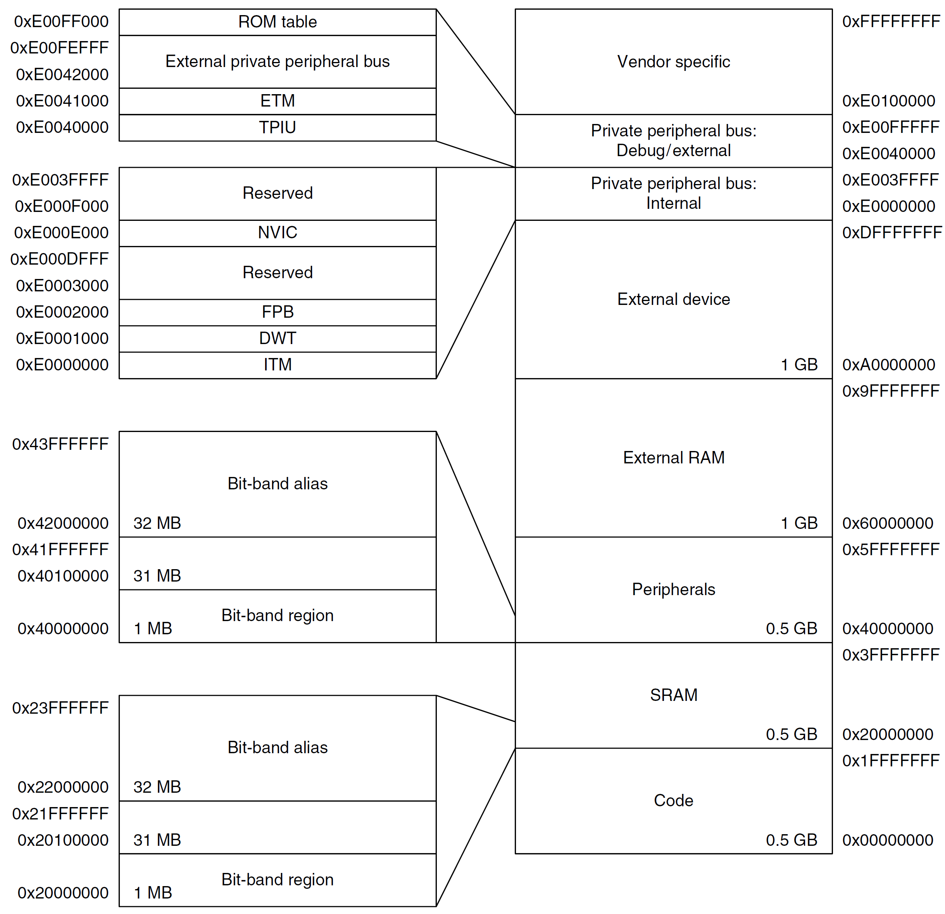
Cortex-M3 Fixed Memory Map

Slide 67
Cortex-M4 Fixed Memory Map

Slide 68
Pseudo-instructions
Pseudo instruction: available to use in an assembly program, but not directly supported by hardware.
Pseudo → not real
Compilers translate it to one or multiple actual machine instructions
Pseudo instructions are provided for the convenience of programmers.

Slide 69
LDR Pseudo-instruction
LDR Rt, =expr
LDR Rt, =label
If the value of expr can be loaded with MOV, MVN (16-bit instruction) or MOVW (32-bit instruction), the assembler uses that instruction.
If a valid MOV, MVN, MOVW instruction cannot be used, or if the label_expr syntax is used, the assembler places the constant in a literal pool and generates a PC-relative LDR instruction that reads the constant from the literal pool.
LDR r1,=0xFF0 ; loads 0xFF0 into R1
; => MOV r1,#0xFF0
LDR r2,=0xFFF ; loads 0xFFF into R2
; => MOVW r2, #0xFFF
LDR r3,=array ; loads the address of array into R3
; => LDR r3,[pc, offset_to_litpool]
; ...
; litpool DCD array
Software uses this pseudo instruction to set a register to some value without worrying about the size of the value.

Slide 70
12-bit Encoding of Immediate Numbers
MOV supports all 8-bit immediate numbers
Range of 8-bit immediate number: 0 – 255
Numbers out of this range but with some patterns can be encoded.

Slide 71
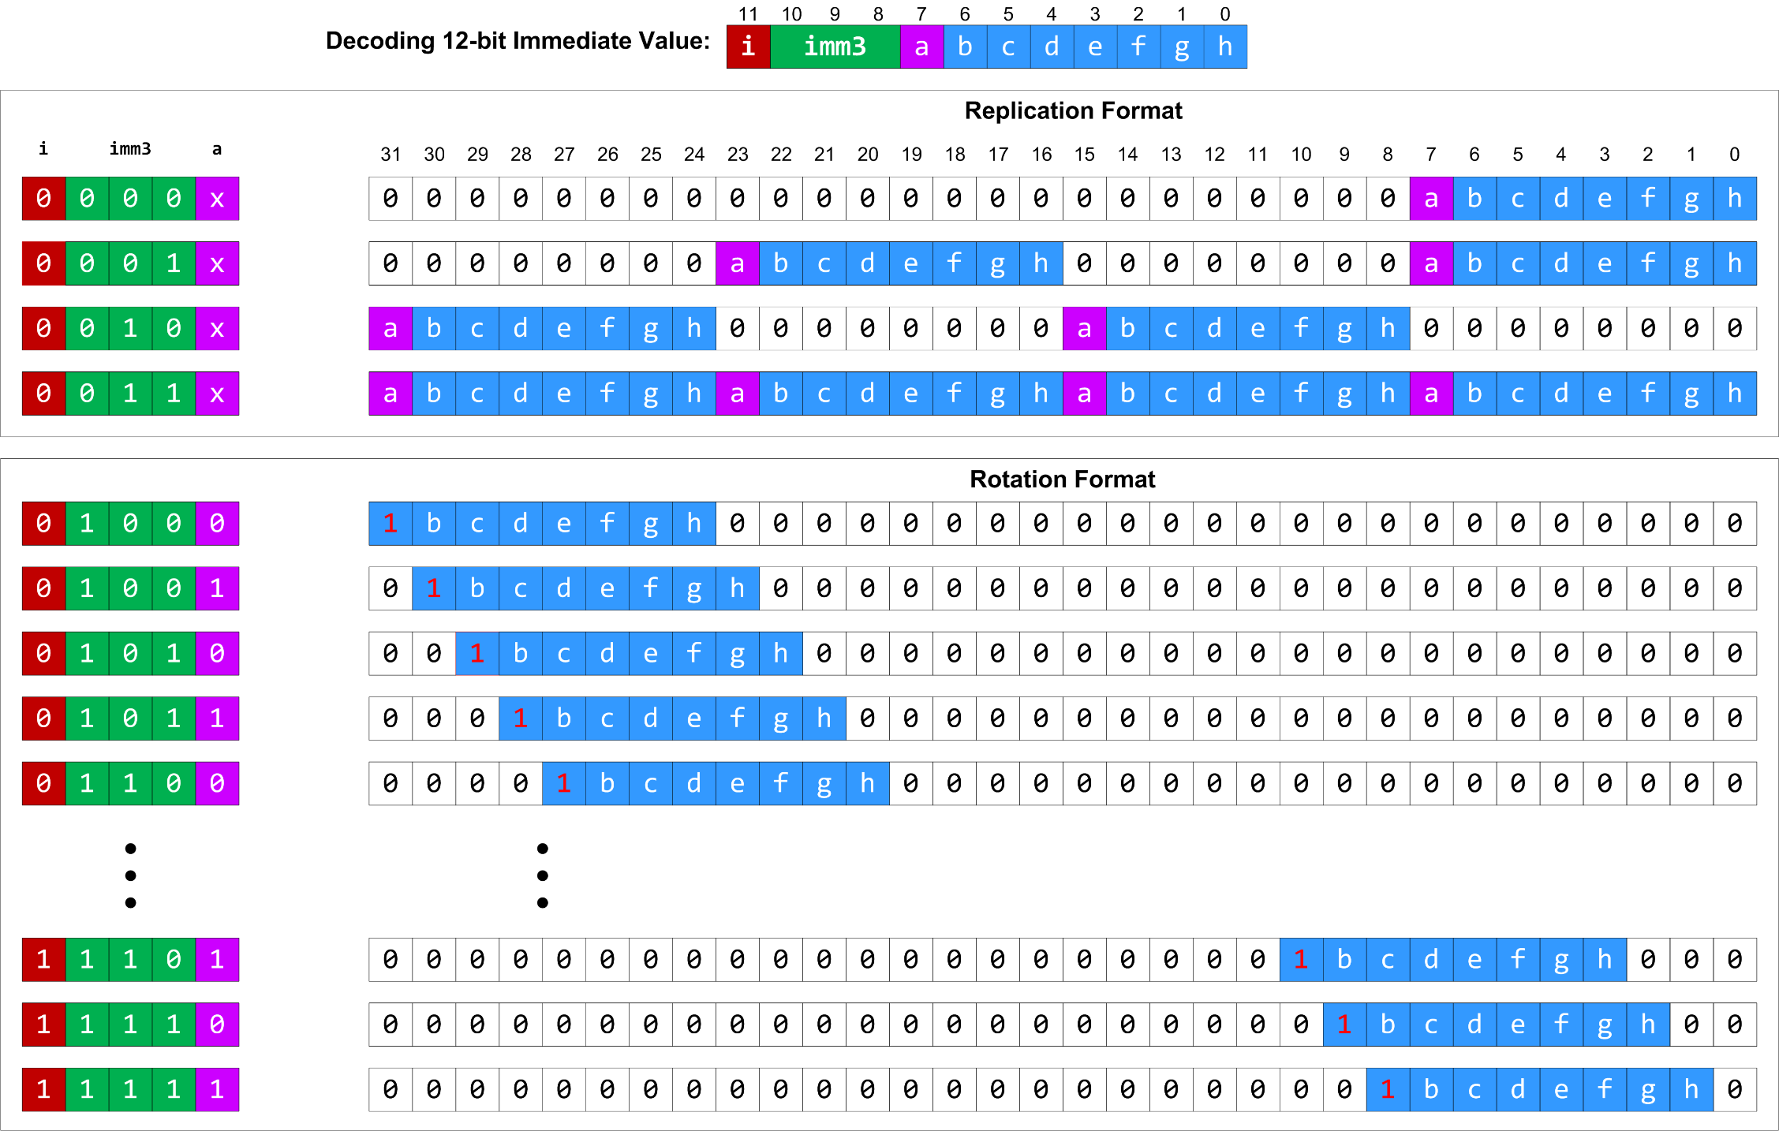

Slide 72
ADR Pseudo-instruction
ADR: loads a program-relative or register-relative address into a register
start MOV r0,#10 ; 32-bit instruction
ADR r4,start ; 32-bit instruction
; => SUB r4,pc,#0xc

Slide 73
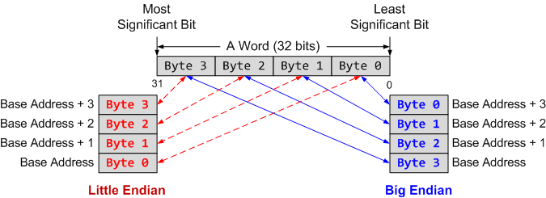
Summary
Memory address is always in terms of bytes.
How is data organized in memory?
How data is addressed?
Addressing Format | Example | Equivalent
Pre-index | LDR r1, [r0, #4] | r1 ← memory[r0 + 4], r0 is unchanged
Pre-index with update | LDR r1, [r0, #4]! | r1 ← memory[r0 + 4] r0 ← r0 + 4
Post-Index | LDR r1, [r0], #4 | r1 ← memory[r0] r0 ← r0 + 4

