Slide 1
Lecture 11 Shortest Paths
Department of Computer Science
Hofstra University

Slide 2
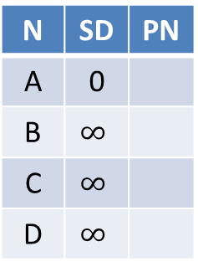
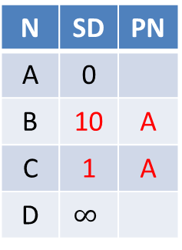
Dijkstra’s Algorithm does not work for Negative Edge Weights
Dijkstra’s Algorithm is greedy and optimal: any node that has been visited should have its shortest distance to the source. After visiting A, C, D, we have got D’s shortest distance to A is 2, but after visiting D, D’s distance to A is updated to -10, which violates the greedy optimal assumption of Dijkstra’s Algorithm.
N | SD | PN
A | 0
B | $$∞$$
C | $$∞$$
D | $$∞$$
N | SD | PN
A | 0
B | 10 | A
C | 1 | A
D | $$∞$$
N | SD | PN
A | 0
B | 10 | A
C | 1 | A
D | 2 | C
N | SD | PN
A | 0
B | 10 | A
C | 1 | A
D | 2 | C
Visit A
Visit C
Visit D
Visit B
B
N | SD | PN
A | 0
B | 10 | A
C | 1 | A
D | -10 | B
10
-20
A
D
Incorrect
1
1
C
Notes:
Run Dijkstra’s algorithm on this graph, starting from node A. Run it anyway.
• A → B: 10
• A → C: 1
• B → D: -20
• C → D: 1
Since Dijkstra’s Algorithm is a greedy algorithm, it visits A, C, D, then finishes. I

Slide 3
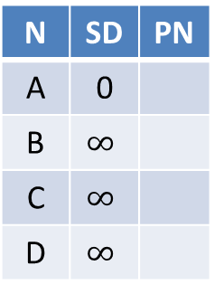
Bellman Ford Algorithm works for Negative Edge Weights
We run for V-1=3 iterations, then run one more iteration with no change. Hence we conclude that The Bellman-Ford algorithm successfully calculated the shortest paths from node A to all other nodes, and There are no negative weight cycles.
N | SD | PN
A | 0
B | $$∞$$
C | $$∞$$
D | $$∞$$
N | SD | PN
A | 0
B | 10 | A
C | 1 | A
D | -10 | B
N | SD | PN
A | 0
B | 10 | A
C | 1 | A
D | -10 | B
N | SD | PN
A | 0
B | 10 | A
C | 1 | A
D | -10 | B
Iter 1
Iter 2
Iter 3
No change
No change
Iter 4
No change
B
N | SD | PN
A | 0
B | 10 | A
C | 1 | A
D | -10 | B
10
-20
A
D
1
1
C
Notes:
The shortest path from node A to node D goes through node B with a total cost of -10.

Slide 4
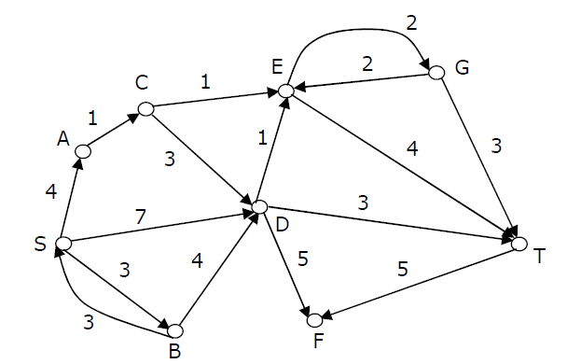
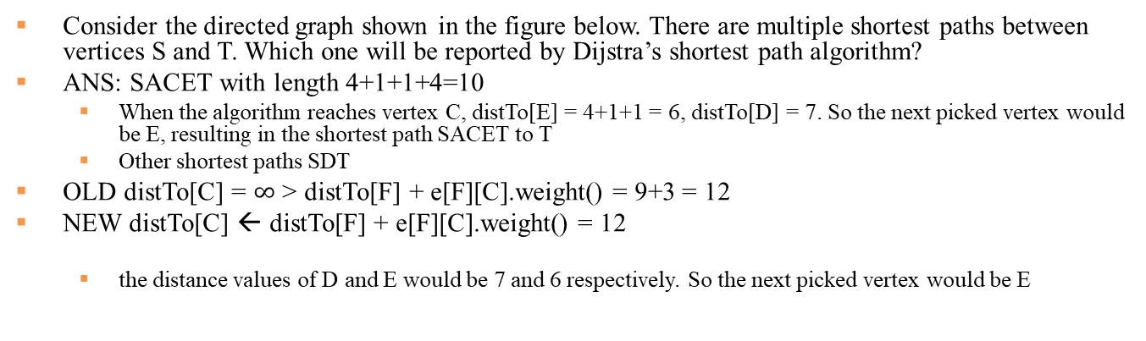
Quiz: Dijstra’s Algorithm
Consider the directed graph shown in the figure below. There are multiple shortest paths between vertices S and T. Which one will be reported by Dijstra’s shortest path algorithm?
ANS: SACET with length 4+1+1+4=10
When the algorithm reaches vertex C, distTo[E] = 4+1+1 = 6, distTo[D] = 7. So the next picked vertex would be E, resulting in the shortest path SACET to T
Other shortest paths SDT
OLD distTo[C] = $∞$ > distTo[F] + e[F][C].weight() = 9+3 = 12
NEW distTo[C] ← distTo[F] + e[F][C].weight() = 12
the distance values of D and E would be 7 and 6 respectively. So the next picked vertex would be E

Slide 5
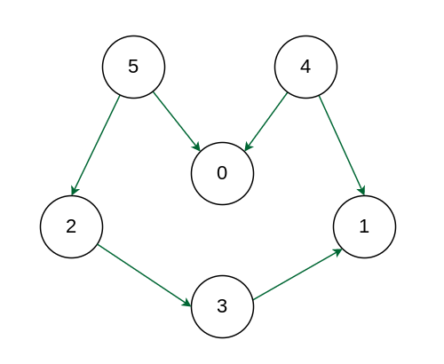
Example 3: Topological Sort
Starting from node 5:
Pre-order traversal is “”.
Post-order traversal is “”.
A topological sort is reverse order of Post-order traversal: “4 5 0 2 3 1”.
Starting from node 4:
Pre-order traversal is “4 0 1 5 2 3”
Post-order traversal is “0 1 4 3 2 5”.
Another topological sort is reverse order of Post-order traversal: “5 2 3 4 1 0”.
Starting from node 0:
Starting from node 3:
Undirected Graph

