Slide 1
Zonghua Gu
Embedded Systems with ARM Cortex-M Microcontrollers in Assembly Language and C
Chapter 4
ARM Arithmetic and Logic Instructions
Fall 2025
Acknowledgement: Lecture slides based on Embedded Systems with ARM Cortex-M Microcontrollers in Assembly Language and C, University of Maine https://web.eece.maine.edu/~zhu/book/

Slide 2

Adding Two Integers
int x = 1;
int y = 2;
int z;
If values are in registers
Value of x in r0
Value of y in r1
Value of z in r2
C Statement
Assembly Statement
z = x + y;

Slide 3
Adding Two Integers
int x = 1;
int y = 2;
int z;
If values are in registers
Value of x in r0
Value of y in r1
Value of z in r2
C Statement
Assembly Statement
z = x + y;
r1
r0
ADD , ,
r2
Destination
Source Operand 2
Source Operand 1

Slide 4
Adding Two Integers
uint x = 1;
uint y = 2;
uint z;
If values are in registers
Value of x in r0
Value of y in r1
Value of z in r2
C Statement
Assembly Statement
z = x + y;

Slide 5
Adding Two Integers
uint x = 1;
uint y = 2;
uint z;
If values are in registers
Value of x in r0
Value of y in r1
Value of z in r2
C Statement
Assembly Statement
z = x + y;
r1
r0
ADD , ,
r2
ADD works for both signed and unsigned add operations.

Slide 6
Adding Two Integers
int x = 1;
int y = 2;
int z;
If addresses are in registers
Address of x in r0
Address of y in r1
Address of z in r2
Assembly Statements
C Statement
z = x + y;

Slide 7
Adding Two Integers
int x = 1;
int y = 2;
int z;
If addresses are in registers
Address of x in r0
Address of y in r1
Address of z in r2
Assembly Statements
C Statement
LDR r3, [r0] ; Read x
LDR r4, [r1] ; Read y
ADD r5, r3, r4
STR r5, [r2] ; Write z
z = x + y;
Load, modify, and store

Slide 8
Example Arithmetic Instructions
ADD r0, r1, r2 ; r0 = r1 + r2
ADC r0, r1, r2 ; Add with carry, r0 = r1 + r2 + carry
SUB r0, r1, r2 ; r0 = r1 - r2
SBC r0, r1, r2 ; Subtract with borrow, r0 = r1 - r2 – (1 – carry)
MUL r0, r1, r2 ; r0 = r1 * r2, product limited to 32 bits
UDIV r0, r1, r2 ; Unsigned divide, r0 = r1 / r2
SDIV r0, r1, r2 ; Signed divide, r0 = r1 / r2
SMULL r0, r1, r2, r3 ; Signed multiply (64-bit product), r1:r0 = r2 * r3
UMULL r0, r1, r2, r3 ; Unsigned multiply (64-bit product), r1:r0 = r2 * r3

Slide 9
Example Logical Instructions
AND r0, r1, r2 ; Bitwise AND, r0 = r1 AND r2
ORR r0, r1, r2 ; Bitwise OR, r0 = r1 OR r2
EOR r0, r1, r2 ; Bitwise Exclusive OR, r0 = r1 EOR r2
ORN r0, r1, r2 ; Bitwise OR NOT, r0 = r1 ORN r2
BIC r0, r1, r2 ; Bit clear, r0 = r1 & ~r2
AND r0, r1, r2
32 bits
r1
1 1 0 1 0 1 0 1 0 1 0 1 0 1 0 1 0 1 0 1 0 1 0 1 0 1 0 1 0 1 0 1
1 0 1 0 1 0 1 0 1 0 1 0 1 0 1 1 1 0 1 0 1 0 1 0 1 0 1 0 1 0 1 1
1 0 0 0 0 0 0 0 0 0 0 0 0 0 0 1 0 0 0 0 0 0 0 0 0 0 0 0 0 0 0 1
r2
r0
Bit-wise Logic AND

Slide 10





Example Shift & Rotate Instructions
LSL r0, r1, r2 ; Logical shift left,
r0 = r1 << r2
LSR r0, r1, r2 ; Logical shift right,
r0 = r1 >> r2
ASR r0, r1, r2 ; Arithmetic shift right, r0 = r1 >> r2
ROR r0, r1, r2 ; Rotate right,
r0 = r1 rotate by r2 bits
RRX r0, r1, r2 ; Extended rotate right, {C, r0} = {C, r1} rotate by r2 bits
Logical Shift Left (LSL)
Logical Shift Right (LSR)
Arithmetic Shift Right (ASR)
Rotate Right (ROR)
Rotate Right Extended (RRX)

Slide 11
Example Data Transfer Instructions
MOV r0, r1 ; Move, r0 = r1
MVN r0, r1 ; Move NOT, r0 = bitwise NOT r1
MVN r0, r1
r1
0 0 0 0 0 0 0 0 0 0 0 0 0 0 0 0 0 0 0 0 0 0 0 0 0 0 0 0 1 1 1 1
r0
1 1 1 1 1 1 1 1 1 1 1 1 1 1 1 1 1 1 1 1 1 1 1 1 1 1 1 1 0 0 0 0
Bit-wise Logic NOT

Slide 12
Overview: Arithmetic and Logic Instructions
Shift : LSL (logic shift left), LSR (logic shift right), ASR (arithmetic shift right), ROR (rotate right), RRX (rotate right with extend)
Logic: AND (bitwise and), ORR (bitwise or), EOR (bitwise exclusive or), ORN (bitwise or not), MVN (move not)
Bit set/clear: BFC (bit field clear), BFI (bit field insert), BIC (bit clear), CLZ (count leading zeroes)
Bit/byte reordering: RBIT (reverse bit order in a word), REV (reverse byte order in a word), REV16 (reverse byte order in each half-word independently), REVSH (reverse byte order in each half-word independently)
Addition: ADD, ADC (add with carry)
Subtraction: SUB, RSB (reverse subtract), SBC (subtract with carry)
Multiplication: MUL (multiply), MLA (multiply-accumulate), MLS (multiply-subtract), SMULL (signed long multiply-accumulate), SMLAL (signed long multiply-accumulate), UMULL (unsigned long multiply-subtract), UMLAL (unsigned long multiply-subtract)
Division: SDIV (signed), UDIV (unsigned)
Saturation: SSAT (signed), USAT (unsigned)
Sign extension: SXTB (signed), SXTH, UXTB, UXTH
Bit field extract: SBFX (signed), UBFX (unsigned)
Syntax
<Operation>{<cond>}{S} Rd, Rn, Operand2
Notes:
BIC bit clear
ORR bit set
AND bit mask
EOR bit invert
Comparisons produce no results - just set condition codes.
CMP like SUB
CMN like ADD (subtract of a negative number is the same as add)
TST like AND
TEQ like EOR (eor of identical numbers gives result of zero)
Generally single-cycle execution (except write to PC and register-controlled shift). Mention ARM NOP & Thumb NOP.
Explain RSB and RSC which do subtract in other order (e.g. y-x not x-y)
Does not include multiply (separate instr format). No divide - compiler uses run-time library or barrel shifter to perform division.
Can combine “S” bit with conditional execution, e.g.
ADDEQS r0, r1, r2

Slide 13
Example: Add
Unified Assembler Language (UAL) Syntax
ADD r1, r2, r3 ; r1 = r2 + r3
ADD r1, r2, #4 ; r1 = r2 + 4
Traditional Thumb Syntax
ADD r1, r3 ; r1 = r1 + r3
ADD r1, #15 ; r1 = r1 + 15

Slide 14
Commonly Used Arithmetic Operations
ADD {Rd,} Rn, Op2 | Add Rd ← Rn + Op2
ADC {Rd,} Rn, Op2 | Add with carry Rd ← Rn + Op2 + Carry
SUB {Rd,} Rn, Op2 | Subtract Rd ← Rn - Op2
SBC {Rd,} Rn, Op2 | Subtract with carry Rd ← Rn - Op2 + Carry - 1
RSB {Rd,} Rn, Op2 | Reverse subtract Rd ← Op2 - Rn
MUL {Rd,} Rn, Rm | Multiply Rd ← (Rn × Rm)[31:0]
MLA Rd, Rn, Rm, Ra | Multiply with accumulate Rd ← (Ra + (Rn × Rm))[31:0]
MLS Rd, Rn, Rm, Ra | Multiply and subtract Rd ← (Ra – (Rn × Rm))[31:0]
SDIV {Rd,} Rn, Rm | Signed divide Rd ← Rn ÷ Rm
UDIV {Rd,} Rn, Rm | Unsigned divide Rd ← Rn ÷ Rm
SSAT Rd, #n, Rm {,shift #s} | Signed saturate
USAT Rd, #n, Rm {,shift #s} | Unsigned saturate

Slide 15
Program Status Register (PSR)
Application PSR (APSR), Interrupt PSR (IPSR), Execution PSR (EPSR)
31
30
29
28
27
26
25
24
23
22
21
20
19
18
17
16
15
14
13
12
11
10
9
8
7
6
5
4
3
2
1
0
APSR
N
Z
C
V
Q
Reserved
GE
Reserved
IPSR
Reserved
ISR number
EPSR
ICI/IT
T
Reserved
ICI/IT
Note:
GE flags are only available on Cortex-M4 and M7

Slide 16
Program Status Register (PSR)
Application PSR (APSR), Interrupt PSR (IPSR), Execution PSR (EPSR)
31
30
29
28
27
26
25
24
23
22
21
20
19
18
17
16
15
14
13
12
11
10
9
8
7
6
5
4
3
2
1
0
APSR
N
Z
C
V
Q
Reserved
GE
Reserved
IPSR
Reserved
ISR number
EPSR
ICI/IT
T
Reserved
ICI/IT
Combine them together into one register (PSR)
PSR
N
Z
C
V
Q
ICI/IT
T
Reserved
GE
Reserved
ICI/IT
ISR number
Note:
GE flags are only available on Cortex-M4 and M7
Use PSR in code

Slide 17
Updating NZCV flags in PSR
Flags not changed |  | Flags updated
ADD | ⟶ | ADDS
SUB | ⟶ | SUBS
MUL | ⟶ | MULS
UDIV | ⟶ | UDIVS
AND | ⟶ | ANDS
ORR | ⟶ | ORRS
LSL | ⟶ | LSLS
MOV | ⟶ | MOVS
CMP r1, r2 vs SUBS r0, r1, r2
Some instructions update NZCV flags even if no S is specified.
CMP: Compare, like SUBS but without destination register
CMN: Compare Negative, like ADDS but without destination register
TST: Test, like ANDS but without destination register
TEQ: Test equivalence, like EORS but without destination register
Most instructions update NZCV flags
only if S suffix is present

Slide 18
ADD vs ADDS
ADD r0, r1, r2 ; r0 = r1 + r2, NZCV flags unchanged
ADDS r0, r1, r2 ; r0 = r1 + r2, NZCV flags updated
ADD does not update flags
ADDS updates flags
xPSR.N = bit 31 of result
xPSR.Z = IsZero(result)
xPSR.C = carry, assuming r1 and r2 representing unsigned integers
xPSR.V = overflow, assuming r1 and r2 representing signed integers

Slide 19
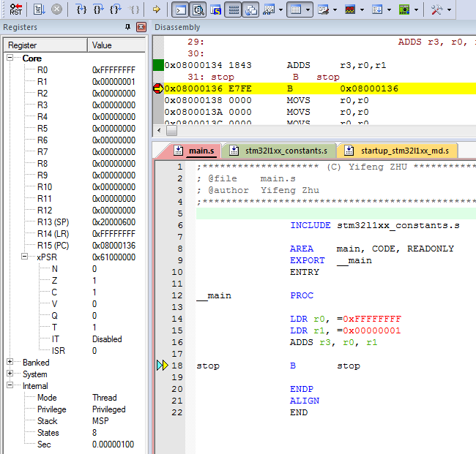
Suffix S: Update Flags
LDR r0, =0xFFFFFFFF
LDR r1, =0x00000001
ADDS r0, r0, r1
0xFFFFFFFF r0
+
0x00000001 r1
0x00000000 sum
N (Negative) = 0
Z (Zero) = 1
C (Carry) = 1
V (oVerflow) = 0
Notes:
Combined Program Status Register (xPSR)

Slide 20
Example: 64-bit Addition
Most-significant (Upper) 32 bits
Least-significant (Lower) 32 bits
0 0 0 0 0 0 0 2 F F F F F F F F
0 0 0 0 0 0 0 4 0 0 0 0 0 0 0 1
0 0 0 0 0 0 0 7 0 0 0 0 0 0 0 0
+
Carry out
A register can only store 32 bits
A 64-bit integer needs two registers
Split 64-bit addition into two 32-bit additions

Slide 21
Example: 64-bit Addition
start
; C = A + B
; Two 64-bit integers A (r1,r0) and B (r3,r2).
; Result C (r5, r4)
; A = 00000002FFFFFFFF
; B = 0000000400000001
LDR r0, =0xFFFFFFFF ; A’s lower 32 bits
LDR r1, =0x00000002 ; A’s upper 32 bits
LDR r2, =0x00000001 ; B’s lower 32 bits
LDR r3, =0x00000004 ; B’s upper 32 bits
; Add A to B
ADDS r4, r2, r0 ; C[31..0] = A[31..0] + B[31..0], update Carry
ADC r5, r3, r1 ; C[64..32] = A[64..32] + B[64..32] + Carry
stop B stop
Upper 32 bits
Lower 32 bits
r1
r0
Addend1
r3
r2
Addend2
r5
r4
Sum
Carry out

Slide 22
Example: 64-bit Subtraction
start
; C = A - B
; Two 64-bit integers A (r1,r0) and B (r3,r2).
; Result C (r5, r4)
; A = 00000002FFFFFFFF
; B = 0000000400000001
LDR r0, =0xFFFFFFFF ; A’s lower 32 bits
LDR r1, =0x00000002 ; A’s upper 32 bits
LDR r2, =0x00000001 ; B’s lower 32 bits
LDR r3, =0x00000004 ; B’s upper 32 bits
; Subtract B from A
SUBS r4, r0, r2 ; C[31..0]= A[31..0] - B[31..0], update Carry
SBC r5, r1, r3 ; C[64..32]= A[64..32] - B[64..32] – (1 – Carry)
stop B stop
r1
r0
A
r3
r2
B
r5
r4
C

Slide 23
Example: 96-bit Subtraction
SUBS r6, r0, r3
SBCS r7, r1, r4
SBC r8, r2, r5

Slide 24
Example: Short Multiplication and Division
MUL: Signed multiply
MUL r6, r4, r2 ; r6 = LSB32( r4 × r2 )
UMUL: Unsigned multiply
UMUL r6, r4, r2 ; r6 = LSB32( r4 × r2 )
MLA: Multiply with accumulation
MLA r6, r4, r1, r0 ; r6 = LSB32( r4 × r1 ) + r0
MLS: Multiply with subtract
MLS r6, r4, r1, r0 ; r6 = LSB32( r4 × r1 ) - r0
LSB32: Least significant 32 bits

Slide 25
Example: Long Multiplication
UMULL RdLo, RdHi, Rn, Rm | Unsigned long multiply RdHi,RdLo ← unsigned(Rn × Rm)
SMULL RdLo, RdHi, Rn, Rm | Signed long multiply RdHi,RdLo ← signed(Rn × Rm)
UMLAL RdLo, RdHi, Rn, Rm | Unsigned multiply with accumulate RdHi,RdLo ← unsigned(RdHi,RdLo + Rn × Rm)
SMLAL RdLo, RdHi, Rn, Rm | Signed multiply with accumulate RdHi,RdLo ← signed(RdHi,RdLo + Rn × Rm)
The result has 64 bits, placed in two registers.
UMULL r3, r4, r0, r1 ; r4:r3 = r0 × r1, r4 = MSB bits, r3 = LSB bits
SMULL r3, r4, r0, r1 ; r4:r3 = r0 × r1
UMLAL r3, r4, r0, r1 ; r4:r3 = r4:r3 + r0 × r1
SMLAL r3, r4, r0, r1 ; r4:r3 = r4:r3 + r0 × r1

Slide 26
Bitwise Logic
AND {Rd,} Rn, Op2 | Bitwise logic AND Rd ← Rn & operand2
ORR {Rd,} Rn, Op2 | Bitwise logic OR Rd ← Rn | operand2
EOR {Rd,} Rn, Op2 | Bitwise logic exclusive OR Rd ← Rn ^ operand2
ORN {Rd,} Rn, Op2 | Bitwise logic NOT OR Rd ← Rn | (NOT operand2)
BIC {Rd,} Rn, Op2 | Bit clear Rd ← Rn & NOT operand2
BFC Rd, #lsb, #width | Bit field clear Rd[(width+lsb–1):lsb] ← 0
BFI Rd, Rn, #lsb, #width | Bit field insert Rd[(width+lsb–1):lsb] ← Rn[(width-1):0]
MVN Rd, Op2 | Move NOT, logically negate all bits Rd ← 0xFFFFFFFF EOR Op2

Slide 27
Example: AND r2, r0, r1
32 bits
r0
1 1 0 1 0 1 0 1 0 1 0 1 0 1 0 1 0 1 0 1 0 1 0 1 0 1 0 1 0 1 0 1
1 0 1 0 1 0 1 0 1 0 1 0 1 0 1 1 1 0 1 0 1 0 1 0 1 0 1 0 1 0 1 1
1 0 0 0 0 0 0 0 0 0 0 0 0 0 0 1 0 0 0 0 0 0 0 0 0 0 0 0 0 0 0 1
r1
r2
Bit-wise Logic AND

Slide 28
Example: ORR r2, r0, r1
32 bits
r0
1 1 0 1 0 1 0 1 0 1 0 1 0 1 0 1 0 1 0 1 0 1 0 1 0 1 0 1 0 1 0 1
1 0 1 0 1 0 1 0 1 0 1 0 1 0 1 1 1 0 1 0 1 0 1 0 1 0 1 0 1 0 1 1
1 1 1 1 1 1 1 1 1 1 1 1 1 1 1 1 1 1 1 1 1 1 1 1 1 1 1 1 1 1 1 1
r1
r2
Bit-wise Logic OR

Slide 29
Example: BIC r2, r0, r1
Bit Clear
r2 = r0 & NOT r1
Step 1:
r1
0 0 0 0 0 0 0 0 0 0 0 0 0 0 0 0 0 0 0 0 0 0 0 0 0 0 0 0 1 1 1 1
NOT r1
1 1 1 1 1 1 1 1 1 1 1 1 1 1 1 1 1 1 1 1 1 1 1 1 1 1 1 1 0 0 0 0
Step 2:
r0
1 1 1 1 1 1 1 1 1 1 1 1 1 1 1 1 1 1 1 1 1 1 1 1 1 1 1 1 1 1 1 1
1 1 1 1 1 1 1 1 1 1 1 1 1 1 1 1 1 1 1 1 1 1 1 1 1 1 1 1 0 0 0 0
1 1 1 1 1 1 1 1 1 1 1 1 1 1 1 1 1 1 1 1 1 1 1 1 1 1 1 1 0 0 0 0
NOT r1
r2

Slide 30
Example: BFC and BFI
Bit Field Clear (BFC) and Bit Field Insert (BFI).
Syntax
BFC Rd, #lsb, #width
BFI Rd, Rn, #lsb, #width
Examples:
BFC R4, #8, #12
; Clear bit 8 to bit 19 (a total of 12 bits) of R4
BFI R9, R2, #8, #12
; Replace bit 8 to bit 19 (12 bits) of R9
; with bit 0 to bit 11 from R2.

Slide 31
Bit Operators (&, |, ~) vs Boolean Operators (&& ,||, !)
A && B | Boolean and | A & B | Bitwise and
A||B | Boolean or | A|B | Bitwise or
!B | Boolean not | ~B | Bitwise not
The Boolean operators perform word-wide operations, not bitwise.
For example,
“0x10 & 0x01” = 0x00, but “0x10 && 0x01” = 0x01. (2 && 1 = 1)
“~0x01” = 0xFFFFFFFE, but “!0x01” = 0x00. (!1 = 0)

Slide 32
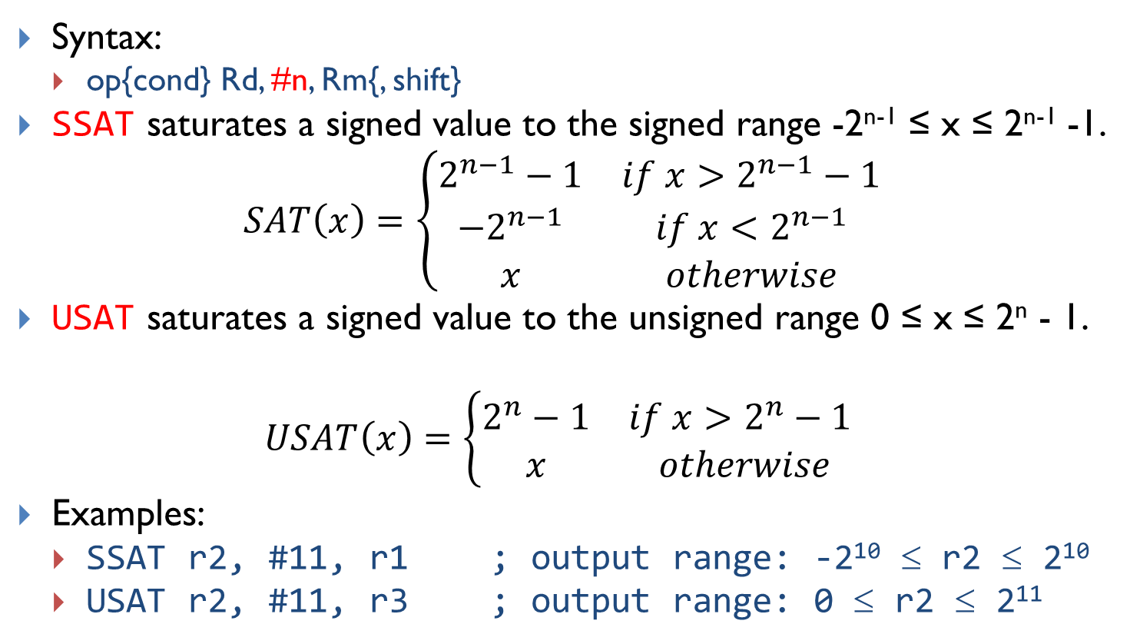
Saturating Instruction: SSAT and USAT
Syntax:
op{cond} Rd, #n, Rm{, shift}
SSAT saturates a signed value to the signed range -2^{n-1} ≤ x ≤ 2^{n-1} -1.
$$SAT\left(x\right)=\left\{\begin{matrix}2^{n−1}−1 & if x>2^{n−1}−1 \\ −2^{n−1} & if x<2^{n−1} \\ x & otherwise\end{matrix}\right.$$
USAT saturates a signed value to the unsigned range 0 ≤ x ≤ 2^{n} - 1.
$$USAT\left(x\right)=\left\{\begin{matrix}2^{n}−1 & if x>2^{n}−1 \\ x & otherwise\end{matrix}\right.$$
Examples:
SSAT r2, #11, r1 ; output range: -2¹⁰ ≤ r2 ≤ 2¹⁰
USAT r2, #11, r3 ; output range: 0 ≤ r2 ≤ 2¹¹

Slide 33
Example of Saturation
Assume data are limited to 16 bits
Without saturation
With saturation

Slide 34
Reverse Order
RBIT Rd, Rn | Reverse bit order in a word for (i = 0; i < 32; i++) Rd[i] ← RN[31– i]
REV Rd, Rn | Reverse byte order in a word Rd[31:24] ← Rn[7:0], Rd[23:16] ← Rn[15:8], Rd[15:8] ← Rn[23:16], Rd[7:0] ← Rn[31:24]
REV16 Rd, Rn | Reverse byte order in each half-word Rd[15:8] ← Rn[7:0], Rd[7:0] ← Rn[15:8], Rd[31:24] ← Rn[23:16], Rd[23:16] ← Rn[31:24]
REVSH Rd, Rn | Reverse byte order in bottom half-word and sign extend Rd[15:8] ← Rn[7:0], Rd[7:0] ← Rn[15:8], Rd[31:16] ← Rn[7] & 0xFFFF
RBIT Rd, Rn
Rn
Rd
Example:
LDR r0, =0x12345678 ; r0 = 0x12345678
RBIT r1, r0 ; Reverse bits, r1 = 0x1E6A2C48

Slide 35

Reverse Order
RBIT Rd, Rn | Reverse bit order in a word for (i = 0; i < 32; i++) Rd[i] ← RN[31– i]
REV Rd, Rn | Reverse byte order in a word Rd[31:24] ← Rn[7:0], Rd[23:16] ← Rn[15:8], Rd[15:8] ← Rn[23:16], Rd[7:0] ← Rn[31:24]
REV16 Rd, Rn | Reverse byte order in each half-word Rd[15:8] ← Rn[7:0], Rd[7:0] ← Rn[15:8], Rd[31:24] ← Rn[23:16], Rd[23:16] ← Rn[31:24]
REVSH Rd, Rn | Reverse byte order in bottom half-word and sign extend Rd[15:8] ← Rn[7:0], Rd[7:0] ← Rn[15:8], Rd[31:16] ← Rn[7] & 0xFFFF
REV Rd, Rn
Rn
Rd
Example:
LDR R0, =0x12345678 ; R0 = 0x12345678
REV R1, R0 ; R1 = 0x78563412

Slide 36

Reverse Order
RBIT Rd, Rn | Reverse bit order in a word for (i = 0; i < 32; i++) Rd[i] ← RN[31– i]
REV Rd, Rn | Reverse byte order in a word Rd[31:24] ← Rn[7:0], Rd[23:16] ← Rn[15:8], Rd[15:8] ← Rn[23:16], Rd[7:0] ← Rn[31:24]
REV16 Rd, Rn | Reverse byte order in each half-word Rd[15:8] ← Rn[7:0], Rd[7:0] ← Rn[15:8], Rd[31:24] ← Rn[23:16], Rd[23:16] ← Rn[31:24]
REVSH Rd, Rn | Reverse byte order in bottom half-word and sign extend Rd[15:8] ← Rn[7:0], Rd[7:0] ← Rn[15:8], Rd[31:16] ← Rn[7] & 0xFFFF
REV16 Rd, Rn
Rn
Rd
Example:
LDR R0, =0x12345678 ; R0 = 0x12345678
REV16 R2, R0 ; R2 = 0x34127856

Slide 37

Reverse Order
RBIT Rd, Rn | Reverse bit order in a word for (i = 0; i < 32; i++) Rd[i] ← RN[31– i]
REV Rd, Rn | Reverse byte order in a word Rd[31:24] ← Rn[7:0], Rd[23:16] ← Rn[15:8], Rd[15:8] ← Rn[23:16], Rd[7:0] ← Rn[31:24]
REV16 Rd, Rn | Reverse byte order in each half-word Rd[15:8] ← Rn[7:0], Rd[7:0] ← Rn[15:8], Rd[31:24] ← Rn[23:16], Rd[23:16] ← Rn[31:24]
REVSH Rd, Rn | Reverse byte order in bottom half-word and sign extend Rd[15:8] ← Rn[7:0], Rd[7:0] ← Rn[15:8], Rd[31:16] ← Rn[7] & 0xFFFF
REVSH Rd, Rn
Rn
Rd
Example:
LDR R0, =0x33448899 ; R0 = 0x33448899
REVSH R1, R0 ; R0 = 0xFFFF9988

Slide 38
Sign and Zero Extension
int8_t a = -1; // a signed 8-bit integer, a = 0xFF
int16_t b = -2; // a signed 16-bit integer, b = 0xFFFE
int32_t c; // a signed 32-bit integer
c = a; // sign extension required, c = 0xFFFFFFFF
c = b; // sign extension required, c = 0xFFFFFFFE

Slide 39
Sign and Zero Extension
SXTB {Rd,} Rm {,ROR #n} | Sign extend a byte Rd[31:0] ← Sign Extend((Rm ROR (8 × n))[7:0])
SXTH {Rd,} Rm {,ROR #n} | Sign extend a half-word Rd[31:0] ← Sign Extend((Rm ROR (8 × n))[15:0])
UXTB {Rd,} Rm {,ROR #n} | Zero extend a byte Rd[31:0] ← Zero Extend((Rm ROR (8 × n))[7:0])
UXTH {Rd,} Rm {,ROR #n} | Zero extend a half-word Rd[31:0] ← Zero Extend((Rm ROR (8 × n))[15:0])
LDR R0, =0x55AA8765
SXTB R1, R0 ; R1 = 0x00000065
SXTH R1, R0 ; R1 = 0xFFFF8765
UXTB R1, R0 ; R1 = 0x00000065
UXTH R1, R0 ; R1 = 0x00008765

Slide 40
Move Data between Registers
MOV | Rd ← operand2
MVN | Rd ← NOT operand2
MRS Rd, spec_reg | Move from special register to general register
MSR spec_reg, Rm | Move from general register to special register
MOV r4, r5 ; Copy r5 to r4
MVN r4, r5 ; r4 = bitwise logical NOT of r5
MOV r1, r2, LSL #3 ; r1 = r2 << 3
MOV r0, PC ; Copy PC (r15) to r0
MOV r1, SP ; Copy SP (r14) to r1

Slide 41
Move Immediate Number to Register
MOVW Rd, #imm16 | Move Wide, Rd ← #imm16
MOVT Rd, #imm16 | Move Top, Rd ← #imm16 << 16
MOV Rd, #const | Move, Rd ← const
Example: Load a 32-bit number into a register
MOVW r0, #0x4321 ; r0 = 0x00004321
MOVT r0, #0x8765 ; r0 = 0x87654321
Order does matter!
MOVW will zero the upper halfword
MOVT won’t zero the lower halfword
MOVT r0, #0x8765 ; r0 = 0x8765xxxx
MOVW r0, #0x4321 ; r0 = 0x00004321

Slide 42
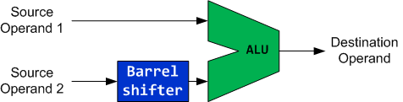
Flexible 2nd Source Operand
LSL,LSR,ASR,
ROR,RRX
ADD r0, r1, Operand2
Add r0, r1, r2 ; r0 = r1 + r2
Add r0, r1, #1 ; r0 = r1 + 1
Add r0, r1, r2 LSL #2 ; r0 = r1 + r2 << 2

Slide 43
Trick
Use Barrel shifter to speed up multiplication and division
Shifting left 1 bit multiplies a number by 2
Examples:
r1 = 9 × r0
ADD r1, r0, r0, LSL #3 <=> MOV r2, #9 ; r2 = 9
MUL r1, r0, r2 ; r1 = r0 * 9
r0 + r0 << 3 = r0 + 8 × r0
ADD r1, r0, r0, LSR #3
; r1 = r0 + r0 >> 3 = r0 + r0/8 (unsigned)
ADD r1, r0, r0, ASR #3
; r1 = r0 + r0 >> 3 = r0 + r0/8 (signed)

Slide 44
Barrel Shifter
Logical Shift Left (LSL)
Arithmetic Shift Right (ASR)
Logical Shift Right (LSR)
Rotate Right (ROR)
Rotate Right Extended (RRX)
Why is there rotate right but no rotate left?
Rotate left can be replaced by a rotate right with a different rotate offset.

Slide 45
Updating APSR Flags
If “S” is present, the instruction update flags. Otherwise, the flags are not updated.
Let R be the final 32-bit result
N | Z | C | V
R<31> | IsZeroBit(R) | carry | unchanged
LSLS
ASRS
LSRS
RORS
RRXS

Slide 46
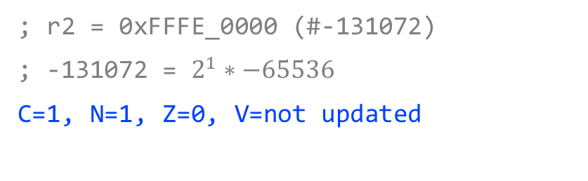
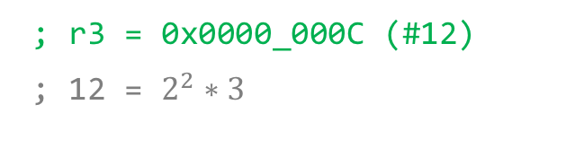
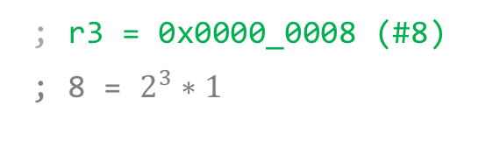
Shift Operations
Logical Shift Left (LSL)
Example 2
; r2 = 0x0000_0003 (#3)
LSL r3, r2, #2
LSL {S} Rd, Rn, <shift>
; r3 = 0x0000_000C (#12)
; 12 = $2^{2}∗3$
moves all the bits of a register by n positions to the left and inserts n zeros in the right end
0 ≤ n ≤ 31
Example 3
; r3 = 0xFFFF_0000 (#-65536)
LSLS r2, r3, #1
Example 1
; r2 = 0x0000_0001 (#1)
LSL r3, r2, #3
; r2 = 0xFFFE_0000 (#-131072)
; -131072 = $2^{1}∗−65536$
C=1, N=1, Z=0, V=not updated
; r3 = 0x0000_0008 (#8)
; 8 = $2^{3}∗1$
Note: If the suffix S is used, the carry flag is updated to the value of the last shifted bit.

Slide 47
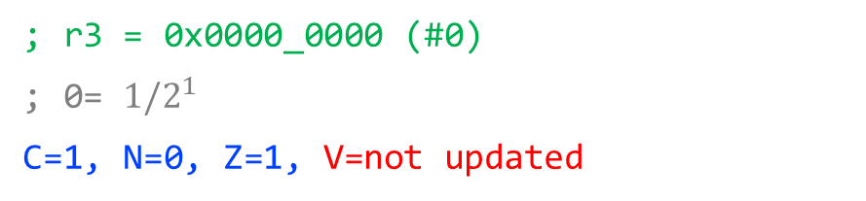
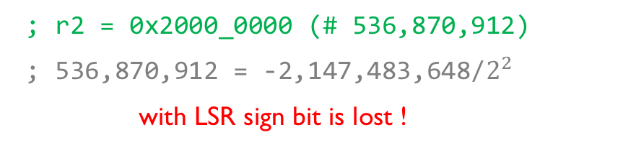
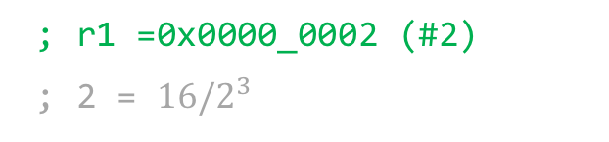
Shift Operations
Logical Shift Right (LSR)
Example 2
; r2 = 0x8000_0000 (# -2,147,483,648)
LSR r2, r2, #2
LSR{S} Rd, Rn, <shift>
; r2 = 0x2000_0000 (# 536,870,912)
; 536,870,912 = -2,147,483,648/$2^{2}$
with LSR sign bit is lost !
moves all the bits of a register by n positions to the right and inserts n zeros in the left end
1 ≤ n ≤ 32
Example 3
; r2 = 0x0000_0001 (#1)
LSRS r3, r2, #1
Example 1
; r2 = 0x0000_0010 (#16)
LSR r1, r2, #3
; r3 = 0x0000_0000 (#0)
; 0= ${1/2}^{1}$
C=1, N=0, Z=1, V=not updated
; r1 =0x0000_0002 (#2)
; 2 = ${16/2}^{3}$
Note: If the suffix S is used, the carry flag is updated to the value of the last shifted bit.

Slide 48
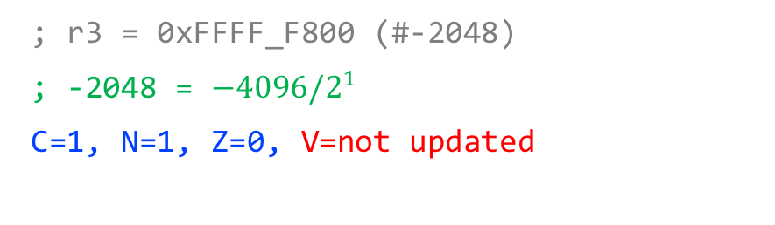
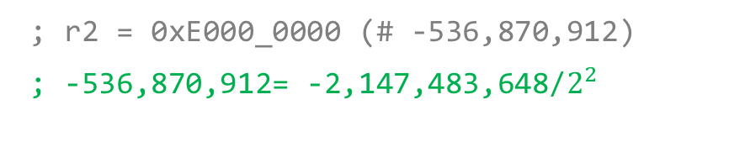
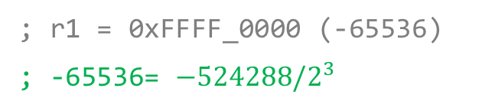
Shift Operations
Arithmetic Shift Right (ASR)
Example 2
; r2 = 0x8000_0000 (-2,147,483,648)
ASR r2, r2, #2
ASR{S} Rd, Rn, <shift>
; r2 = 0xE000_0000 (# -536,870,912)
; -536,870,912= -2,147,483,648/$2^{2}$
moves all the bits of a register by n positions to the right and inserts n copies of the sign bit in the left end
1 ≤ n ≤ 32
Example 3
; r2 = 0xFFFF_F001 (#-4095)
ASRS r3, r2, #1
Example 1
; r0 = 0xFFF8_0000 (-524288)
ASR r1, r0, #3
; r3 = 0xFFFF_F800 (#-2048)
; -2048 = ${−4096/2}^{1}$
C=1, N=1, Z=0, V=not updated
; r1 = 0xFFFF_0000 (-65536)
; -65536= ${−524288/2}^{3}$
ASR is equivalent to signed integer division
Note: If the suffix S is used, the carry flag is updated to the value of the last shifted bit.

Slide 49
Rotate Operations
Rotate Right (ROR)
Example 2: rotate left by 12 bits
; r0 = 0xF000_0000
ROR r2, r0, #20
; r2 = 0x0000_0F00
ROR{S} Rd, Rn, <shift>
Rotate left by m bits is equivalent to rotate right ROR by 32-m bits
Circular shifts of all the bits of a register by n positions to the right as if the right end of the register is joined with its left end. The last shifted bit updates the carry bit
1 ≤ n ≤ 31
Example 3
; r2 = 0xF0F0_F001
; r1 = 0x0000_000E
RORS r3, r2, r1
Example 1
; r2 = 0x0008_0000
ROR r2, r2, #10
; r3 = 0xC007_C3C3
C=1, N=1, Z=0, V=not updated
; r2 = 0x0000_0200
Note: If the suffix S is used, the carry flag is updated to the value of the last shifted bit.

Slide 50
Rotate Operations
Rotate Right Extended (RRX)
Example 2:
; r2 = 0xF000_0001, c = 0
RRX r1, r2
RRX{S} Rd, Rn
; r1 = 0x7800_0000, c = 0
This is a one-bit rotate instruction.
Example 3
; r2 = 0xF0F0_F001, c = 0
RRXS r3,r2
Example 1
; r2 = 0x0008_0003, c = 1
RRX r2, r2
; r3 = 0x7878_7800, c = 1
; r2 = 0x8004_0001, c = 1
C=1, N=0, Z=0, V= not updated
Note: the carry flag is updated by b0 only if the suffix S is used, otherwise it keeps its original value

Slide 51
Quiz 1: ANDS
LDR r0, =0xFFFFFF00
LDR r1, =0x00000001
ANDS r2, r1, r0, LSL #1
N = ?, Z = ?, C = ?, V = ?

Slide 52
Quiz 1: ANDS
LDR r0, =0xFFFFFF00
LDR r1, =0x00000001
ANDS r2, r1, r0, LSL #1
Update carry flag
N = 0, Z = 1, C = 1, V = 0
AND{S}<c><q> {<Rd>,} <Rn>, <Rm> {,<shift>}
if ConditionPassed() then
EncodingSpecificOperations();
(shifted, carry) = Shift_C(R[m], shift_t, shift_n, APSR.C);
result = R[n] AND shifted;
R[d] = result;
if setflags then
APSR.N = result<31>;
APSR.Z = IsZeroBit(result);
APSR.C = carry;
// APSR.V unchanged
ARMv7-M Architecture Reference Manual

Slide 53
Quiz 2: ADDS
LDR r0, =0xFFFFFF00
LDR r1, =0x00000001
ADDS r2, r1, r0, LSL #1
N = ?, Z = ?, C = ?, V = ?

Slide 54
Quiz 2: ADDS
LDR r0, =0xFFFFFF00
LDR r1, =0x00000001
ADDS r2, r1, r0, LSL #1
Does NOT update carry flag
N = 1, Z = 0, C = 0, V = 0
ADD{S}<c><q> {<Rd>,} <Rn>, <Rm> {,<shift>}
if ConditionPassed() then
EncodingSpecificOperations();
shifted = Shift(R[m], shift_t, shift_n, APSR.C);
(result, carry, overflow) = AddWithCarry(R[n], shifted, '0');
if d == 15 then
ALUWritePC(result); // setflags is always FALSE here
else
R[d] = result;
if setflags then
APSR.N = result<31>;
APSR.Z = IsZeroBit(result);
APSR.C = carry;
APSR.V = overflow;
ARMv7-M Architecture Reference Manual

Slide 55
Implementation of Barrel Shifter
Can we shift or shift or rotate n bits within a single clock cycle?

Slide 56
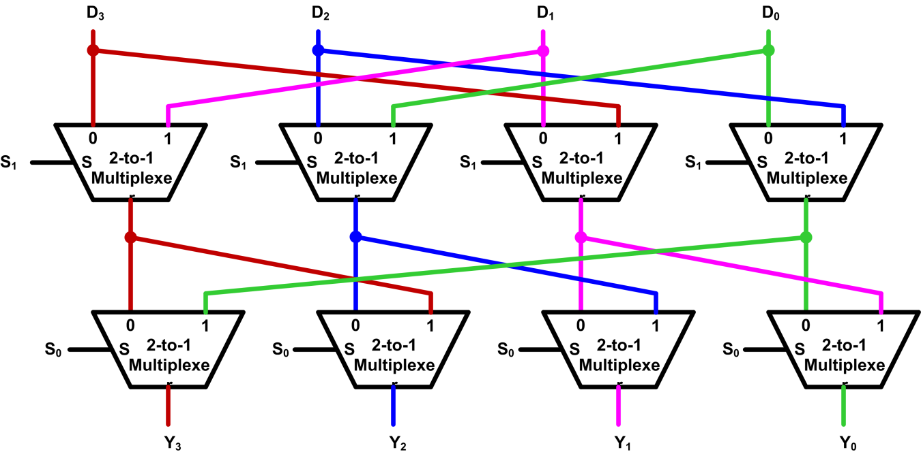
Implementation of Barrel Shifter
Typically, Barrel shifters are implemented as a cascade of parallel 2-to-1 multiplexers.
S₁ | S₀ | Y₃ | Y₂ | Y₁ | Y₀
0 | 0 | D₃ | D₂ | D₁ | D₀
0 | 1 | D₀ | D₃ | D₂ | D₁
1 | 0 | D₁ | D₀ | D₃ | D₂
1 | 1 | D₂ | D₁ | D₀ | D₃
Example four-bit Barrel shifter that performs rotate right

Slide 57
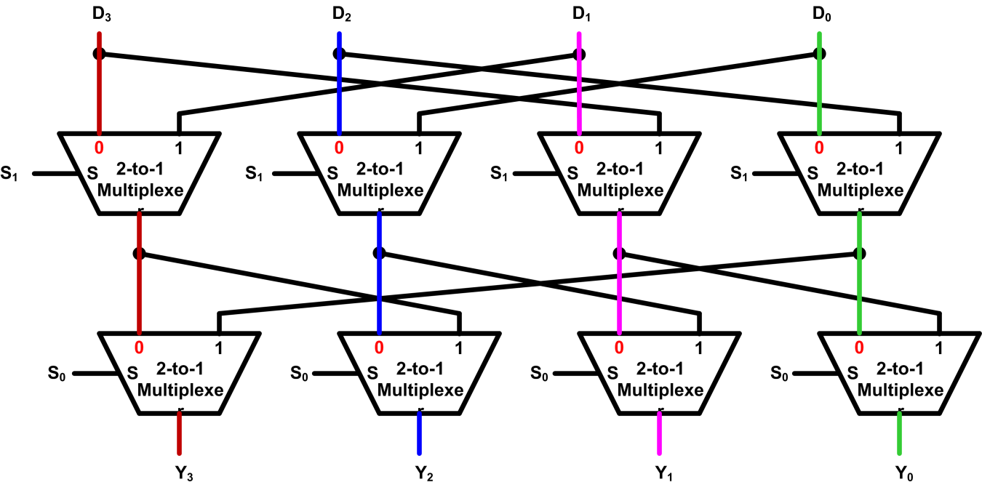
Implementation of Barrel Shifter
Example: S₁S₀ = 00
S₁ | S₀ | Y₃ | Y₂ | Y₁ | Y₀
0 | 0 | D₃ | D₂ | D₁ | D₀
0 | 1 | D₀ | D₃ | D₂ | D₁
1 | 0 | D₁ | D₀ | D₃ | D₂
1 | 1 | D₂ | D₁ | D₀ | D₃
Example four-bit Barrel shifter that performs rotate right

Slide 58
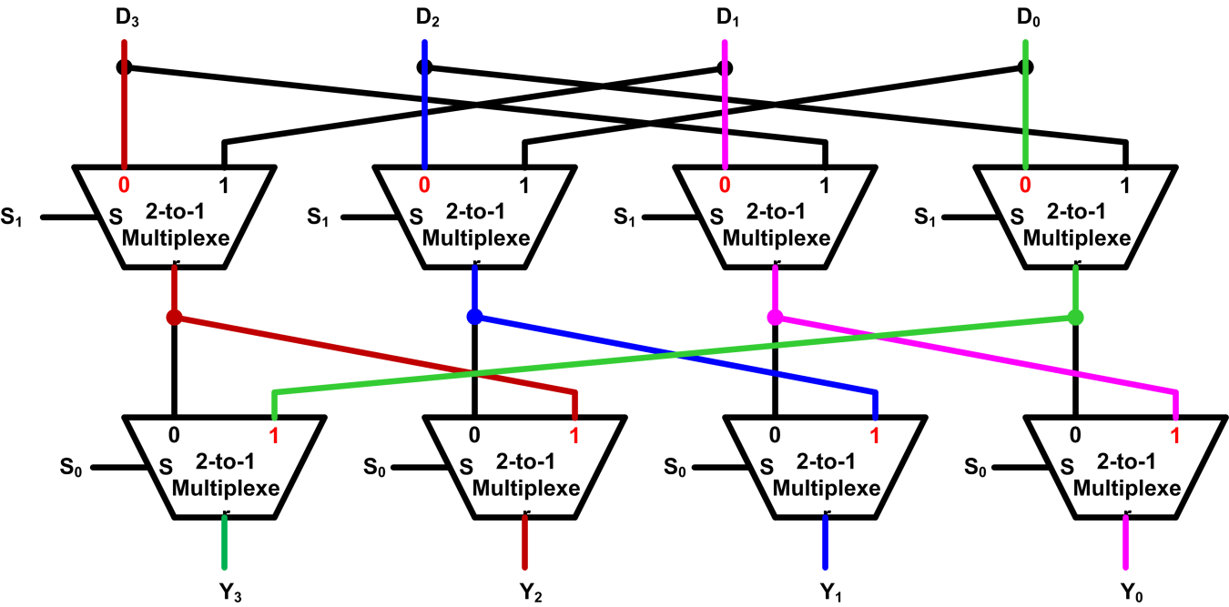
Implementation of Barrel Shifter
Example: S₁S₀ = 01
S₁ | S₀ | Y₃ | Y₂ | Y₁ | Y₀
0 | 0 | D₃ | D₂ | D₁ | D₀
0 | 1 | D₀ | D₃ | D₂ | D₁
1 | 0 | D₁ | D₀ | D₃ | D₂
1 | 1 | D₂ | D₁ | D₀ | D₃
Example four-bit Barrel shifter that performs rotate right

Slide 59
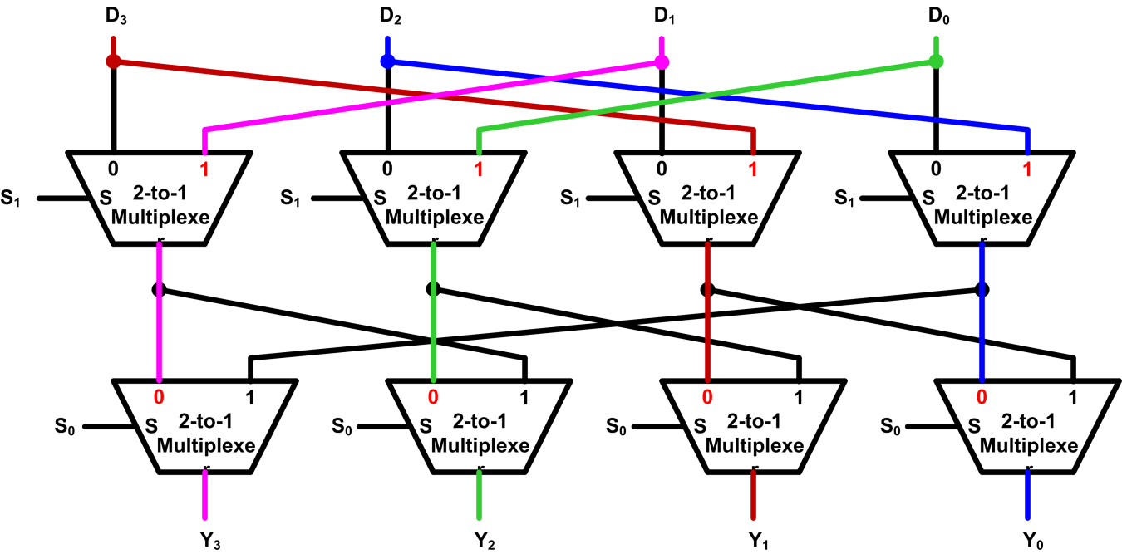
Implementation of Barrel Shifter
Example: S₁S₀ = 10
S₁ | S₀ | Y₃ | Y₂ | Y₁ | Y₀
0 | 0 | D₃ | D₂ | D₁ | D₀
0 | 1 | D₀ | D₃ | D₂ | D₁
1 | 0 | D₁ | D₀ | D₃ | D₂
1 | 1 | D₂ | D₁ | D₀ | D₃
Example four-bit Barrel shifter that performs rotate right

Slide 60
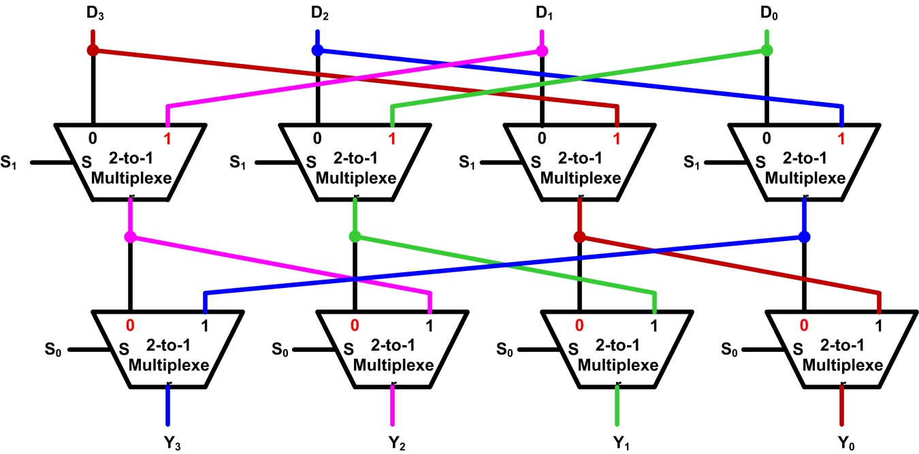
Implementation of Barrel Shifter
Example: S₁S₀ = 11
S₁ | S₀ | Y₃ | Y₂ | Y₁ | Y₀
0 | 0 | D₃ | D₂ | D₁ | D₀
0 | 1 | D₀ | D₃ | D₂ | D₁
1 | 0 | D₁ | D₀ | D₃ | D₂
1 | 1 | D₂ | D₁ | D₀ | D₃
Example four-bit Barrel shifter that performs rotate right

Slide 61
Set a Bit in C
a |= (1 << k)
or
a = a | (1 << k)
Example: k = 5
a
a₇ | a₆ | a₅ | a₄ | a₃ | a₂ | a₁ | a₀
0 | 0 | 1 | 0 | 0 | 0 | 0 | 0
a₇ | a₆ | 1 | a₄ | a₃ | a₂ | a₁ | a₀
1 << k
a | (1 << k)
The other bits should not be affected.

Slide 62
Set a Bit in Assembly
a |= (1 << 5)
Solution 1:
MOVS r4, #1 ; r4 = 1
LSLS r4, r4, #5 ; r4 = 1<<5
ORRS r0, r0, r4 ; r0 = r0 | 1<<5
Solution 2:
MOVS r4, #1 ; r4 = 1
ORRS r0, r0, r4, LSL #5 ; r0 = r0 | 1<<5

Slide 63
Clear a Bit in C
a &= ~(1<<k)
Example: k = 5
a
a₇ | a₆ | a₅ | a₄ | a₃ | a₂ | a₁ | a₀
1 | 1 | 0 | 1 | 1 | 1 | 1 | 1
a₇ | a₆ | 0 | a₄ | a₃ | a₂ | a₁ | a₀
~(1 << k)
a & ~(1<<k)
The other bits should not be affected.

Slide 64
Clear a Bit in Assembly
a &= ~(1<<5)
Solution 1:
MOVS r4, #1 ; r4 = 1
LSLS r4, r4, #5 ; r4 = 1<<5
MVNS r4, r4 ; r4 = not (1<<5)
ANDS r0, r0, r4 ; r0 = r0 & not (1<<5)
Solution 2:
MOVS r4, #1 ; r4 = 1
MVNS r4, r4, LSL #5 ; r4 = not (1<<5)
ANDS r0, r0, r4 ; r0 = r0 & not (1<<5)
Solution 3:
MOVS r4, #1 ; r4 = 1
BICS r0, r0, r4, LSL #5 ; r0 = r0 & not (1<<5)

Slide 65
Toggle a Bit in C
Without knowing the initial value, a bit can be toggled by XORing it with a “1”
a ^= 1<<k
Example: k = 5
a
a₇ | a₆ | a₅ | a₄ | a₃ | a₂ | a₁ | a₀
0 | 0 | 1 | 0 | 0 | 0 | 0 | 0
a₇ | a₆ | NOT(a₅) | A₄ | a₃ | a₂ | a₁ | a₀
1 << k
a ^ (1<<k)
m | n | m⊕n
0 | 0 | 0
0 | 1 | 1
1 | 0 | 1
1 | 1 | 0
Truth table of Exclusive OR
Notes:
A bit can be ‘toggled’ (changed) – without knowing its initial value – by XORing it with a “1”.

Slide 66
Toggle a Bit in Assembly
a ^= 1<<5
Solution:
MOVS r4, #1 ; r4 = 1
EORS r0, r0, r4, LSL #5 ; r0 = r0 ^ 1<<5
Notes:
A bit can be ‘toggled’ (changed) – without knowing its initial value – by XORing it with a “1”.

Slide 67
Mask
Bits 8-11 and bits 16-23 are masked.
All the rest bits are unmasked

Slide 68
Clear all unmasked bits
Data &= Mask;

Slide 69
Clear all masked bits
Data &= ~Mask;

Slide 70
Set all masked bits
Data |= Mask;

Slide 71
Toggle all tasked bits
Data ^= Mask;

