Slide 1
CSC 112: Computer Operating Systems Lecture 3 Synchronization
Department of Computer Science,
Hofstra University
Acknowledgement: Lecture slides based on UC Berkeley CS 162: Operating Systems and System Programming
And NTNU course on Operating Systems

Slide 2
Outline
Concurrency & Locks
Spinlocks

Slide 3
Concurrency
#include <stdio.h>
#include <stdlib.h>
#include "common.h"
#include "common_threads.h”
int counter = 0;
int loops;
void *worker(void *arg) {
int i;
for (i = 0; i < loops;i++) {counter++; }
return NULL;
}
int main(int argc, char *argv[])
{
if (argc != 2){
fprintf(stderr, "usage: threads <loops>\n");
exit(1); }
loops = atoi(argv[1]);
pthread_t p1, p2;
printf("Initial value : %d\n", counter); pthread_create(&p1, NULL, worker, NULL); pthread_create(&p2, NULL, worker, NULL); pthread_join(p1, NULL);
pthread_join(p2, NULL);
printf("Final value : %d\n", counter);
return 0;
}
This concurrent program has a race condition, and may produce different final values of counter for different runs, depending on different interleavings of worker threads

Slide 4
Race Condition
Incrementing counter has 3 instructions in assembly code:
ldr w8, [x9]: Read the value of counter at memory address x9 into register w8
add w8, w8, #0x1: increment the value of register w8 by 1
str w8, [x9]: write the new value of counter in register w8 to memory address x9
When both threads read the same value of counter before writing to it, counter is incremented only by 1 instead of by 2!
Note: threads in the same process share the same memory space, but have separate registers. So in both threads, [x9] refers to the same memory address at x9, but w8 refers to different registers in each thread.
counter
Thread 1
Thread 2
ldr w8, [x9]
add w8, w8, #0x1
str w8, [x9]
100
101
100
ldr w8, [x9]
add w8, w8, #0x1
str w8, [x9]
101
101
counter++;
str w8, [x9]
101
ldr w8, [x9]
add w8, w8, #0x1
str w8, [x9]
ldr w8, [x9]
add w8, w8, #0x1
str w8, [x9]
Thread 1
Thread 2

Slide 5
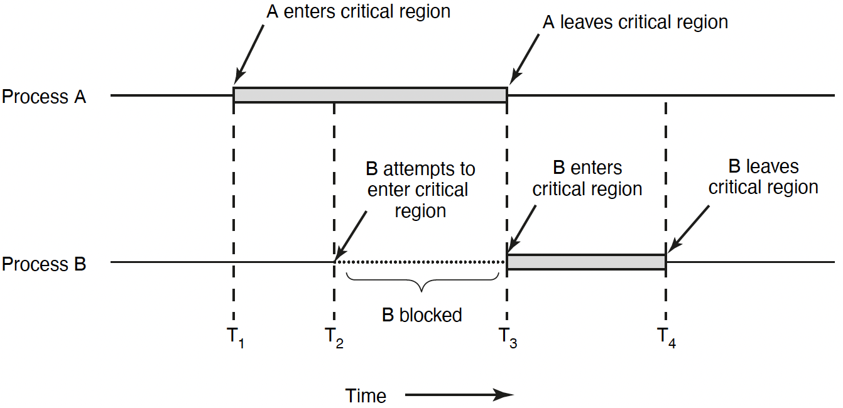
Race Condition & Critical Section
Race condition:
Multiple threads of execution update shared data variables, and final results depend on the execution order
Race condition leads to non-deterministic results: different results even for the same inputs
To prevent race condition, a critical section should be used to protect shared data variables
A critical section is executed atomically
Mutual exclusion (mutex) ensures that when one thread is executing in its critical section, no other thread is allowed to execute in that critical section
Thread A
Thread B
Notes:
The execution of the critical sections by the threads is mutually exclusive in time
Programmers must make sure that some high-level code sections are executed atomically
Atomic operation: It completes in its entirety without worrying about interruption by any other potentially conflict-causing thread
1. Mutual exclusion. If process Pi is executing in its critical section, then no other processes can be executing in their critical sections.
2. Progress. If no process is executing in its critical section and some processes wish to enter their critical sections, then only those processes that are not executing in their remainder sections can participate in deciding which will enter its critical section next, and this selection cannot be postponed indefinitely.
3. Bounded waiting. There exists a bound, or limit, on the number of times that other processes are allowed to enter their critical sections after a process has made a request to enter its critical section and before that request is granted.

Slide 6

Lock to Protect a Critical Section
Count
Value
Thread 1
Thread 2
ldr w8, [x9]
add w8, w8, #0x1
str w8, [x9]
100
101
101
101
ldr w8, [x9]
add w8, w8, #0x1
str w8, [x9]
102
Lock it
102
Critical section: a piece of code that accesses a shared resource, usually a variable or data structure
Correctness of a concurrent program:
Mutual exclusion: Only one thread in critical section at a time
Progress (deadlock-free): If several simultaneous requests, must allow one to proceed
Bounded (starvation-free): Must eventually allow each waiting thread to enter
Lock it
Notes:
Solution:
Mutual exclusion: Only one thread in critical section at a time
Progress (deadlock-free): If several simultaneous requests, must allow one to proceed
Bounded (starvation-free): Must eventually allow each waiting thread to enter

Slide 7
Locks
A lock is a variable
Objective: Provide mutual exclusion (mutex)
Two states
Available or free
Locked or held
lock(): tries to acquire the lock
unlock(): releases the lock that was previously acquired
lock_t mutex
void *worker(void *arg) {
int i;
for (i = 0; i < loops;i++) {
lock(&mutex);
counter++;
unlock(&mutex)}
return NULL;
}
Notes:
mutual exclusionA good lock:
Mutual exclusion
Fairness: progress, no starvation
Performance: overhead to grab and release lock

Slide 8
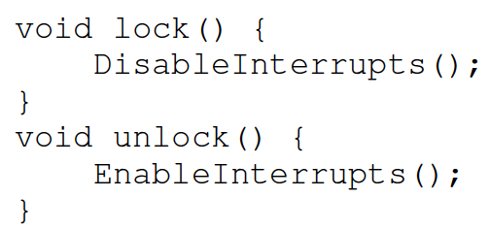
Locks: Disable Interrupts
An early solution: disable interrupts for critical sections
Problems:
System becomes irresponsive if interrupts are disabled for a long time
Does not work on multiprocessors, as disabling interrupts on all processor cores requires inter-core messages and would be very time consuming
Notes:
Abused usage

Slide 9
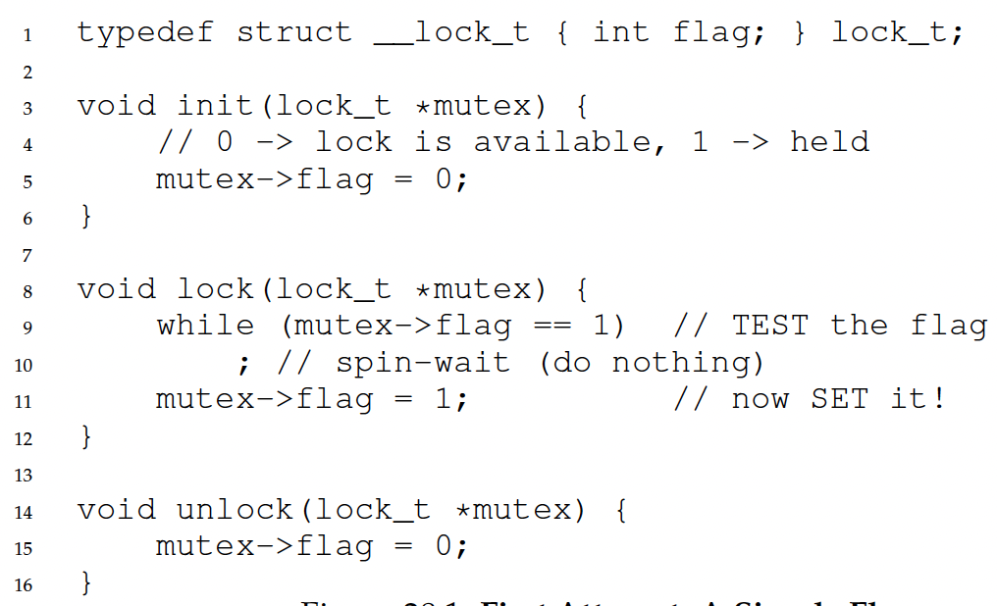
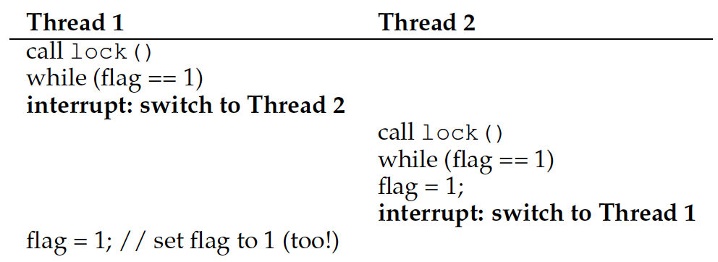
Locks: Loads/Stores
This implementation does not ensure mutual exclusion, since both threads may grab the lock:
After Thread 1 reads flag==0 and exits the while loop, it is preempted/interrupted by Thread 2, which also reads flag==0 and exits the while loop. Then both threads set flag=1 and enter the critical section.
Root cause: Lock is not an atomic operation!
flag = 0
Notes:
Another problem: performance overhead!

Slide 10
Locks: Test-and-Set
How to provide mutual exclusion for locks?
Get help from hardware!
CPUs provide special hardware instructions to help achieve mutual exclusion
The Test-and-Set (TAS) instruction tests and modifies the content of a memory word atomically
Locking with TAS: TAS fetches the old value of lock->flag into variable old, sets lock->flag to 1, then return variable old, all in one atomic operation
If lock-flag==0, then lock() sets it to 1 and returns old=0, so the thread exits the while loop and enters critical section
If lock-flag==1, then lock() returns old=1, so the thread spin-waits in the while loop and does not enter critical section
If multiple threads call TAS when lock-flag==0, only one thread will see lock-flag==0 , set flag=1 and enter the critical section, and all the other threads will see flag==1 and spin-wait.
typedef struct __lock_t{
int flag;
} lock_t;
int TestAndSet(int *old_ptr, int new){
int old = *old_ptr; // fetch old value at old_ptr
*old_ptr = new; // store 'new' into old_ptr
return old; // return the old value
}
void lock(lock_t *lock){
while (TestAndSet(&lock->flag, 1) == 1)
; // spin-wait
}
void unlock(lock_t *lock){
lock->flag = 0;
}

Slide 11
Locks: Compare-and-Swap
Another hardware primitive: Compare-and-Swap (CAS)
Locking with CAS: CAS fetches the old value of lock-flag into variable original, compares original with expected (0), and if they are equal (lock-flag==0), sets lock->flag to 1, then return variable original, all in one atomic operation
If lock-flag==0, then lock() sets it to 1 and returns original=0, so the thread exits the while loop and enters critical section
If lock-flag==1, then lock() returns original=1, so the thread spins in the while loop and does not enter critical section
int CompareAndSwap(int *ptr, int expected, int new){
int old = *ptr;
if (old == expected)
*ptr = new;
return old;
}
void lock(lock_t *lock){
while (CompareAndSwap(&lock->flag, 0, 1) == 1)
; //spin-wait
}

Slide 12
TAS vs. CAS
Feature | Test-and-Set (TAS) | Compare-and-Swap (CAS)
Operation | Sets a bit and returns its old value | Compares current value with expected value and swaps if equal
Parameters | Single memory location | Memory location, expected value, new value
Consensus Number | Limited to 2 | Arbitrary number of processes
Use Cases | Simple spinlocks | Complex synchronization primitives like mutexes
Efficiency | Faster for simple locks | More versatile but computationally heavier

Slide 13
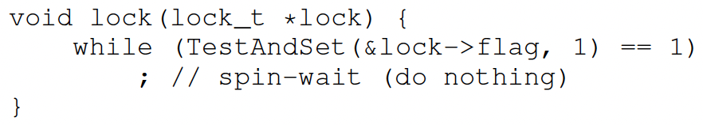
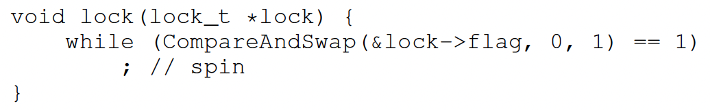
Locks: Busy Waiting
Both TAS and CAS are spinlocks based on busy waiting
A thread is stuck in a while loop endlessly checking lock->flag if the lock is held by others
Goals achieved?
Mutual exclusion (Yes!)
Fairness (NO!!)
Performance (NO!!)

Slide 14
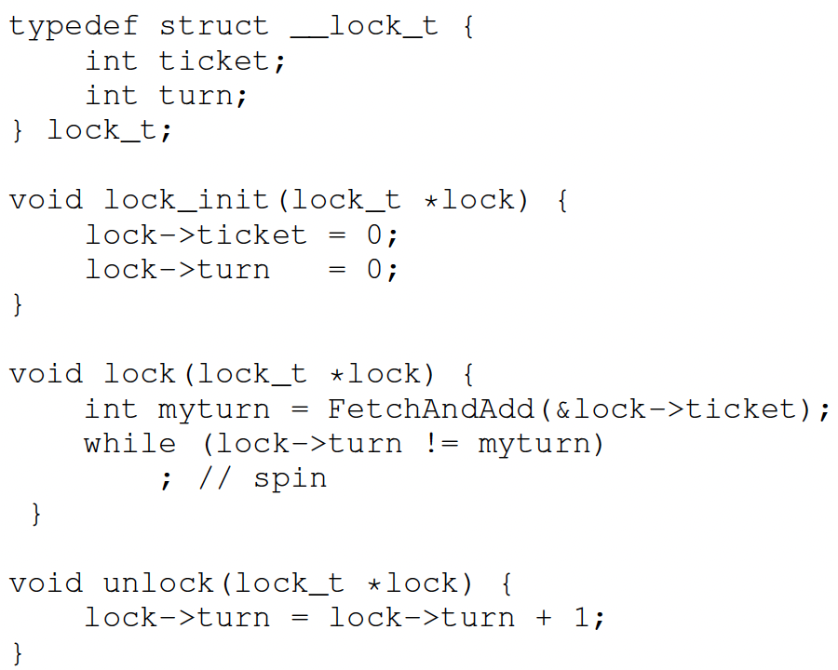
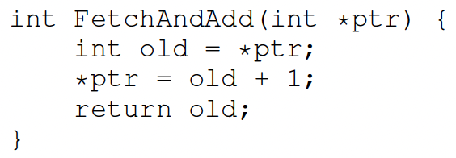
Ticket Lock
Basic spinlocks are not fair and may cause starvation
Ticket lock uses hardware primitive fetch-and-add to guarantee fairness
Lock:
Use fetch-and-add on the ticket value
The return value is the thread’s ”turn” value
Unlock:
Increment the turn
Notes:
ticket and turn

Slide 15
Ticket Lock
A ticket lock is a synchronization mechanism used in multithreaded programming to ensure that threads acquire a lock in the order they request it. It uses two counters:
tickets (or next_ticket): Tracks the next "ticket number" to be assigned to a thread requesting the lock.
turn: Tracks the "ticket number" of the thread currently holding the lock.
Lock Acquisition (lock()):
A thread atomically increments the tickets counter (using fetch-and-add) and receives its "ticket number.“
The thread then spin-waits until its ticket number matches the turn counter, indicating it is its turn to enter the critical section.
Lock Release (unlock()):
When a thread finishes its critical section, it increments the turn counter, signaling that the next thread in line can proceed.
This ensures that threads are served in a first-come, first-served (FCFS) manner, preventing starvation and ensuring fairness.
Notes:
Ticket lock is designed to ensure mutual exclusion while avoiding starvation. Here's a detailed explanation of the example:
What is a Ticket Lock?

Slide 16
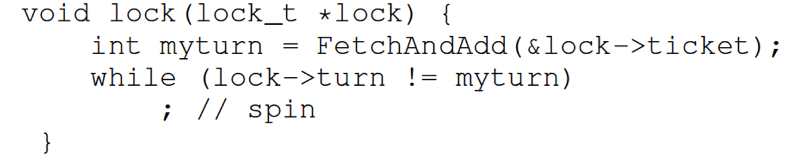
Ticket Lock
Initial value tickets=0 turn=0
 | Ticket | Turn
A lock(), A enters CS | 1 | 0
B lock(), spin-waits | 2 | 0
C lock(), spin-waits | 3 | 0
 | myturn
A | 0
B | 1
C | 2

Slide 17
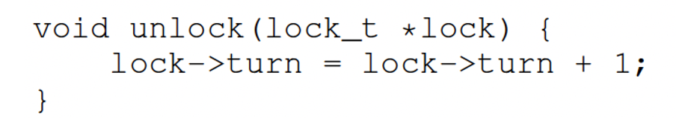
Ticket Lock
Initial value tickets=0 turn=0
 | Ticket | Turn
A lock(), A enters CS | 1 | 0
B lock(), spin-waits | 2 | 0
C lock(), spin-waits | 3 | 0
A unlock(), B enters CS | 3 | 1
A lock(), spin-waits | 4 | 1
 | myturn
A | 3
B | 1
C | 2

Slide 18
Ticket Lock
Initial value tickets=0 turn=0
 | Ticket | Turn
A lock(), A enters CS | 1 | 0
B lock(), spin-waits | 2 | 0
C lock(), spin-waits | 3 | 0
A unlock(), B enters CS | 3 | 1
A lock(), spin-waits | 4 | 1
B unlock(), C enters CS | 4 | 2
C unlock(), A enters CS | 4 | 3
A unlock() | 4 | 4
 | myturn
A | 3
B | 1
C | 2
Notes:
Initial State:
tickets = 0: No threads have requested the lock yet.
turn = 0: No threads are currently holding the lock.
Step-by-Step Execution:
Thread A Calls lock(): Thread A increments tickets to 1.
Thread A's ticket number is 0 (the value of tickets before incrementing).
Since turn = 0, Thread A enters the critical section immediately.
Thread B Calls lock(): Thread B increments tickets to 2.
Thread B's ticket number is 1.
Since turn = 0, Thread B spins, waiting for its turn.
Thread C Calls lock(): Thread C increments tickets to 3.
Thread C's ticket number is 2.
Since turn = 0, Thread C also spins, waiting for its turn.
Thread A Calls unlock(): Thread A increments turn to 1, signaling that it's now Thread B's turn.
Thread B stops spinning and enters the critical section.
Thread B Calls unlock(): Thread B increments turn to 2, signaling that it's now Thread C's turn.
Thread C stops spinning and enters the critical section.
Thread C Calls unlock(): Thread C increments turn to 3, signaling that no threads are currently waiting for the lock.
Fairness in Ticket Locks
Threads acquire locks in the exact order they request them, as determined by their ticket numbers.
This prevents starvation because every thread will eventually get its turn once it has acquired a ticket.
Unlike basic spinlocks (e.g., Test-and-Set or Compare-and-Swap), ticket locks provide fairness by maintaining an explicit order of access.
Advantages of Ticket Locks
Fairness: Ensures threads are served in FCFS order.
Starvation-Free: Every thread holding a ticket will eventually acquire the lock.
Simple Implementation: Relies on atomic operations like fetch-and-add.
Disadvantages of Ticket Locks
Busy Waiting (Spin-Waiting): Threads waiting for their turn spin continuously, consuming CPU resources.
Scalability Issues: On systems with many CPUs, cache contention can arise because all threads frequently read and write shared variables (tickets and turn).

Slide 19
Outlines
Semaphore
Semaphore operations
Binary Semaphore
Semaphore for ordering
Semaphore for P/C
Deadlock
Semaphore for P/C without deadlock

Slide 20

Semaphores
Semaphores were proposed by a Dutch computer scientist Dijkstra in late 60s
Definition: a Semaphore has a non-negative integer value and supports the following operations:
Set value when you initialize
wait(): also called Down() or P(): an atomic operation that waits for semaphore to become positive, then decrements it by 1
signal(): also called Up() or V(): an atomic operation that increments the semaphore by 1, waking up a waiting thread, if any
20
Notes:
Main synchronization primitive used in original UNIX
This of this as the signal() operation
No otjhTechnically examining value after initialization is not allowed.
An object with an integer value
Introduced by E. W. Dijkstra
Manipulate with two routines
sem_wait(s) P(s) down(s)
sem_post(s) V(s) up(s)
Motivation: Avoid busy waiting by blocking a process execution until some condition is satisfied

Slide 21
Semaphores Like Integers Except…
Semaphores are like integers, except:
No negative values
Only operations allowed are wait() and signal() – cannot read or write value, except initialization
Operations must be atomic
Two calls to wait() together can’t decrement value below zero
Thread going to sleep in wait() won’t miss wakeup from signal() – even if both happen concurrently
Semaphore from railway analogy
Here is a semaphore initialized to 2, to allow two trains to enter the two tracks in the middle
Value=2
Value=1
Value=0
Value=1
Value=0
Value=2
21

Slide 22
Implementing Semaphores w/ test&set
Use TAS, but only busy-wait to atomically check guard value (very short waiting time)
int guard = 0;
int value = 0;
wait() {
// Short busy-wait time while (TestAndSet(guard)); if (value == 0) {
guard = 0;
put thread on wait queue;
sleep(); } else { value = value - 1; guard = 0; } }
signal() { // Short busy-wait time while (TestAndSet(guard)); if any thread in wait queue { take thread off wait queue; place on ready queue; } else { value = value + 1; } guard = 0;
}
22
Notes:
Note: sleep() and release the lock (set guard=0) must be atomic. Similar to the case on slide “Interrupt re-enable in going to sleep”. (can do this in software without hardware support).

Slide 23
Two Uses of Semaphores
Mutual Exclusion (value = 0 or1)
Also called “Binary Semaphore” or “mutex”.
Can be used for mutual exclusion as a lock:
sem.wait(); //Critical section sem.signal();
Scheduling Constraints (value >= 0)
Allow thread 1 to wait for a signal from thread 2
thread 2 wakes up thread 1 when a given event occurs
Example: a thread calls ThreadJoin to wait for another thread to finish:
sem = 0;
ThreadJoin{ sem.wait(); }
ThreadFinish{ sem.signal(); }
23

Slide 24
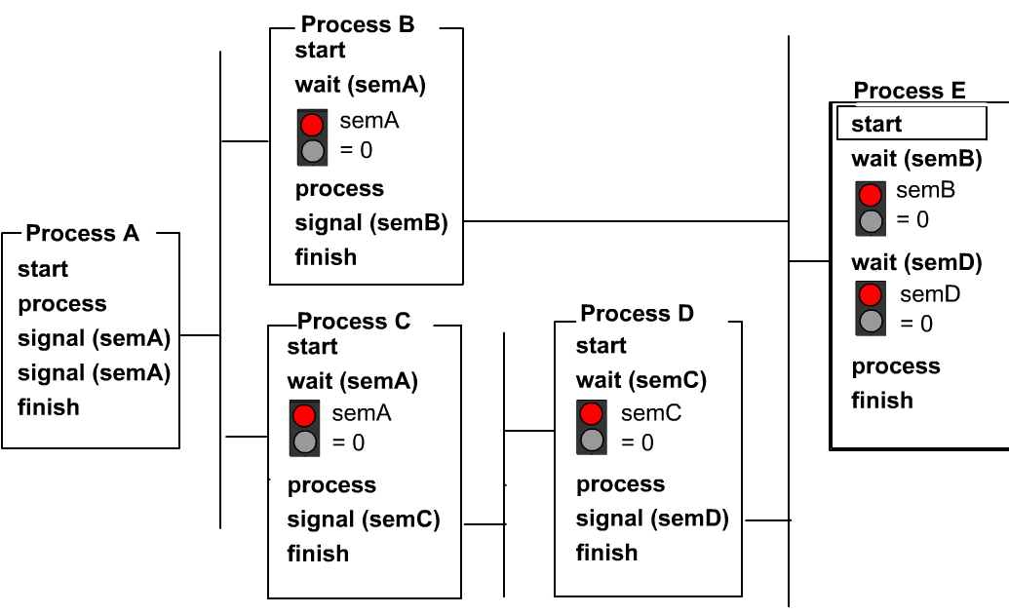
Using Semaphores for Scheduling
Consider 5 threads A, B, C, D, E. They must execute based on the partial ordering below, regardless of the ordering of process start (e.g., if E starts before B and D finishes, it will be blocked waiting for B and D to finish before it can execute)
Thread B
Thread B
Thread E
Thread A
Thread E
Thread C
Thread D
Thread A
Thread C
Thread D
Syntax here is slightly different: wait(sem) and signal(sem) instead of sem.wait() and sem.signal().

Slide 25




Producer/Consumer Problem
A classical synchronization problem, also called the bounded-buffer problem
A buffer has a bounded size
Examples of Producer/Consumer Problems:
Web servers:
Producer puts requests in a queue
Consumers picks requests from the queue to process
Linux Pipes
Coke vending machine
Producer can put limited number of cokes in machine
Consumer can’t take cokes out if machine is empty
producer
consumer

Slide 26
Producer/Consumer Problem
Correctness Constraints:
When buffer is full, producer must wait
When buffer is empty, consumer must wait
Only one thread can manipulate buffer at a time (mutual exclusion)
Use a separate semaphore for each constraint
Semaphore fullSlots; // consumer’s constraint
Semaphore emptySlots;// producer’s constraint
Semaphore mutex; // mutual exclusion
Consumer reads and removes data items from buffer (destructive read)
Producer writes data items to buffer
Bounded buffer
fullSlots==3, emptySlots==4
26
Notes:
Consumer must wait for producer to fill buffers, if no full slots (fullSlots == 0)
Producer must wait for consumer to empty buffers, if no empty slots (emptySlots == 0)
Synchronization between producers
Synchronization between producers and consumers
Producing/Consuming to/from buffer require locking
Remember why we need mutual exclusion
Because computers are stupid
Imagine if in real life: the delivery person is filling the machine and somebody comes up and tries to stick their money into the machine

Slide 27

Solution to P/C Problem
semaphore fullSlots = 0; //Initially, no data item
semaphore emptySlots = bufSize;//Initially, all slots empty
semaphore mutex = 1;
Producer(item) { emptySlots.wait();//Wait until empty slots available mutex.wait(); Enqueue(item); mutex.signal(); fullSlots.signal(); }
Consumer() { fullSlots.wait( //Wait until full slots available mutex.wait(); item = Dequeue(); mutex.signal(); emptySlots.signal(); return item; }
mutex protects integrity of the queue within critical sections
fullSlots signals 1 more data item
emptySlots
signals 1 more empty slot
27
Notes:
//Tell consumer there is //1 more data item

Slide 28
Discussion about Solution
Decrease # of empty slots
Increase # of occupied slots
Two semaphores
Producer does: emptyBuffer.wait(), fullBuffer.signal()
Consumer does: fullBuffer.wait(), emptyBuffer.signal()
Decrease # of occupied slots
Increase # of empty slots
Producer(item) { mutex.wait(); emptySlots.wait(); Enqueue(item); fullSlots.signal(); mutex.signal(); } Consumer() { mutex.wait();
fullSlots.wait(); item = Dequeue(); emptySlots.signal(); mutex.signal(); return item; }
Can we put mutex.wait()/signal() outside of emptySlots and fullSlots wait()/signal()?
No! This may cause deadlock if producer calls mutex.wait(), blocks waiting for Consumer to call mutex.signal. Consumer calls fullSlots.wait(), blocks waiting for Producer to call fullSlots.signal().
28
Notes:
Is order of V’s important?
No, except that it might affect scheduling efficiency What if we have 2 producers or 2 consumers?
Do we need to change anything?

Slide 29

Deadlock
Definition: A set of threads are said to be in a deadlock state when every thread in the set is waiting for an event that can be caused only by another thread in the set
Conditions for Deadlock
Mutual exclusion
Only one thread at a time can use a given resource
Hold-and-wait
Threads hold resources allocated to them while waiting for additional resources
No preemption
Resources cannot be forcibly removed from threads that are holding them; can be released only voluntarily by each holder
Circular wait
There exists a circle of threads such that each holds one or more resources that are being requested by next thread in the circle
Wanted
Resource 1
Held
Thread 1
Thread 2
Resource 2
Held
Wanted
Not a perfect analogy, just a fun image!
Notes:
Permanent blocking of a set of processes that share multiple resources. Each process in the set is waiting for a resource that only another process in the set can make available
Blocking is caused by processes waiting for resources that are in use by other processes waiting for other resources
e.g., Process A owns Res 1 and is waiting for Res 2 Process B owns Res 2 and is waiting for Res 1
Neither process can proceed, so they are in a deadlock
Four conditions for deadlock
Mutual exclusion
Only one process at a time can use a resource
Hold and wait
Process holding at least one resource is waiting to acquire additional resources held by other processes
No preemption
Resources are released only voluntarily by the processes
Circular wait
Cyclic waiting pattern
Mutual exclusion
Only one process at a time can use a resource.
Hold and wait
Process holding at least one resource is waiting to acquire additional resources held by other processes.
No preemption
Resource cannot be forcibly removed from a process; can be released only voluntarily by the process.
Circular wait
A circle of processes exists such that each process holds at least one resource needed by the previous process in the circle

Slide 30

More Than Mutual Exclusion
Mutual exclusion
No two threads access a critical section at the same time
Thread A and B don’t run at the same time
Locks
Condition
A thread wishes to check whether a condition is true before execution
Thread B runs after thread A completes
Condition variables and semaphores

Slide 31
Condition Variables (CV)
Semaphores are dual purpose: They are used for both mutex and scheduling constraints
Condition variables are synchronization primitives:
A queue of waiting threads
A thread waits for a condition to be true and can put itself into the queue
Other thread can wake up one or more waiting threads
Used with mutex to prevent race conditions
Two functions:
wait(CV…): put itself on the waiting queue
Signal(CV,…): Send signal to CV when it is done
Notes:
Problem is that semaphores are dual purpose: They are used for both mutex and scheduling constraints
Example: the fact that flipping of P's in bounded buffer gives deadlock is not immediately obvious. How do you prove correctness to someone?
Cleaner idea: Use locks for mutual exclusion and condition variables for scheduling constraints Definition: Monitor: a lock and zero or more condition variables for managing concurrent access to shared data Some languages like Java provide this natively
Most others use actual locks and condition variables
A "Monitor" is a paradigm for concurrent programming!
An explicit queue that threads can put themselves
when some condition is not as desired
A conditional variable allows a thread to wait for a particular condition to be true before continuing execution. The thread can signal the condition variable to wake up one or more waiting threads when the condition becomes true.

Slide 32
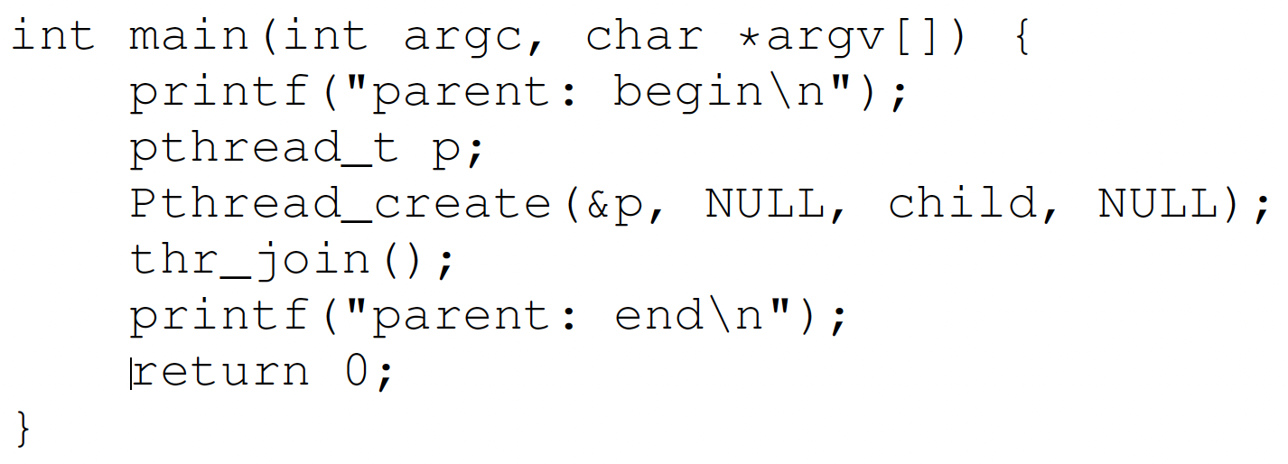
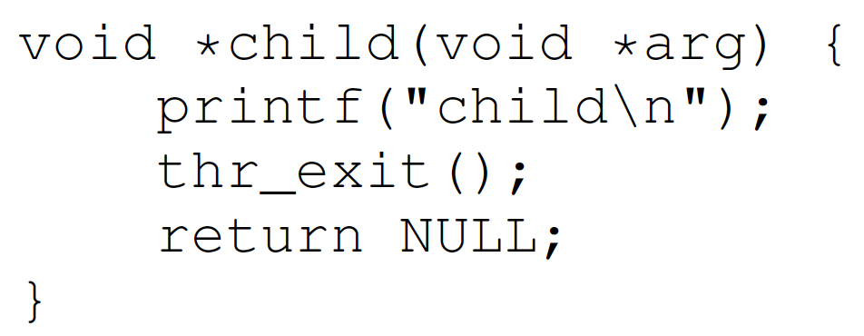
Condition Variables (CV)
A parent waits for the child by calling thr_join(); the child signals completion by calling thr_exit(). We need to implement thr_join() and thr_exit() with CV.
Parent
wait
signal
Child

Slide 33
Incorrect: CV with Only Lock
Child thr_exit() function:
Line A: Child thread locks the mutex (pthread_mutex_lock(&m)).
Line B: It signals the condition variable (pthread_cond_signal(&c)) to notify the parent that it has completed.
Line C: It then unlocks the mutex (pthread_mutex_unlock(&m)).
Parent thr_join() function:
Line X: Parent thread locks the mutex (pthread_mutex_lock(&m)).
Line Y: It waits on the condition variable (pthread_cond_wait(&c, &m)). This releases the mutex and puts the parent to sleep until it is signaled.
Line Z: Once signaled, it reacquires the mutex and then unlocks it (pthread_mutex_unlock(&m)).
The program assumes that the parent will always call thr_join() (and thus wait on the condition variable) before the child calls thr_exit() to signal. If this ordering is not guaranteed, there is a race condition:
If the child calls thr_exit() before the parent starts waiting on pthread_cond_wait, the signal (pthread_cond_signal) may be missed because condition variables do not queue signals if no thread is waiting at that moment. As a result, the parent could block indefinitely on pthread_cond_wait.
//Child
void thr_exit(){
Pthread_mutex_lock(&m);//A
Pthread_cond_signal(&c);//B
Pthread_mutex_unlock(&m);}//C
//Parent
void thr_join(){
Pthread_mutex_lock(&m);//X
Pthread_cond_wait(&c, &m);//Y
Pthread_mutex_unlock(&m);}//Z
Scenario 1: Parent calls thr_join() first. Works correctly.
Parent | X | Y |  |  |  | Z
Child |  |  | A | B | C
Scenario 2: Child calls thr_exit() first. Parent blocks forever!
Parent |  |  |  | X | Y
Child | A | B | C

Slide 34
Incorrect: CV with Flag & Lock
//Child
bool child_done = false; //Shared state
void thr_exit(){
pthread_mutex_lock(&m);
child_done = true; //Set flag
pthread_cond_signal(&c); //Signal parent
pthread_mutex_unlock(&m);
}
//Parent
void thr_join(){
pthread_mutex_lock(&m);
if(!child_done){ //Check flag
pthread_cond_wait(&c, &m);//Wait only if needed
}
pthread_mutex_unlock(&m);
}
Add a Boolean flag child_done:
The child_done flag ensures that even if pthread_cond_signal occurs before pthread_cond_wait, the parent will not block indefinitely because it will detect that child_done is already set.
Spurious wakeup problem:
The program assumes that once the parent thread is awakened, the condition child_done is guaranteed to be true. But it is possible for child_done to be false.
The parent thread may be awakened by the system without any signal from the child thread (i.e., pthread_cond_signal has not been called), since system-level events such as interrupts, signals, or other system-specific mechanisms may cause a thread to wake up prematurely. This is called spurious wakeups.
Notes:
Spurious wakeups usually happen because in between the time when the condition variable was signaled and when the awakened thread was finally able to run, another thread ran first and changed the condition again. In general, if multiple threads are awakened, the first one to run will find the condition satisfied, but the others may find the condition unsatisfied. In this way, there is a race condition between all the awakened threads. The first thread to run will win the race and find the condition satisfied, while the other threads will lose the race, and experience a spurious wakeup’
Example Scenario
The parent thread calls thr_join() and enters pthread_cond_wait.
A spurious wakeup occurs, causing pthread_cond_wait to return prematurely.
Since the condition (child_done) is only checked once with an if, the parent thread assumes it can proceed, even though the child has not yet called thr_exit() or set child_done = true.
The use of a loop around pthread_cond_wait ensures correctness in case of spurious wakeups.

Slide 35
Correct: CV with Flag & Lock
//Child
bool child_done = false; //Shared state
void thr_exit(){
pthread_mutex_lock(&m);
child_done = true; //Set flag
pthread_cond_signal(&c); //Signal parent
pthread_mutex_unlock(&m);
}
//Parent
void thr_join(){
pthread_mutex_lock(&m);
while(!child_done){ //Check flag
pthread_cond_wait(&c, &m);//Wait only if needed
}
pthread_mutex_unlock(&m);
}
Adding a Boolean flag child_done and using while(!child_done) to check the flag, makes the program robust and avoids race conditions.
The child_done flag ensures that even if pthread_cond_signal occurs before pthread_cond_wait, the parent will not block indefinitely because it will detect that child_done is already set.
The use of a while loop around pthread_cond_wait ensures correctness in case of spurious wakeups.

Slide 36
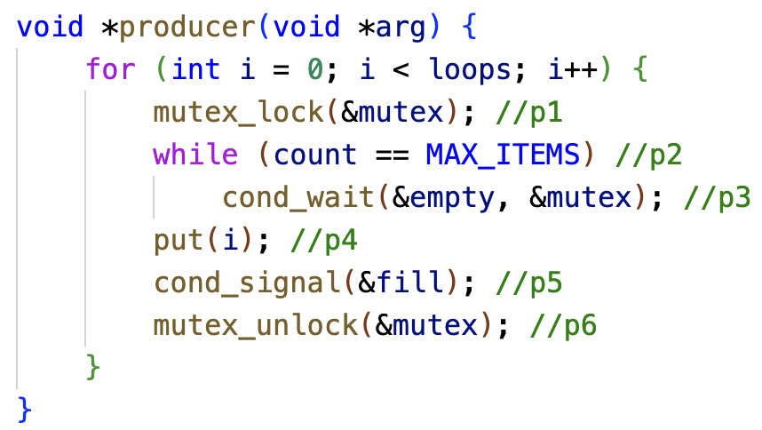
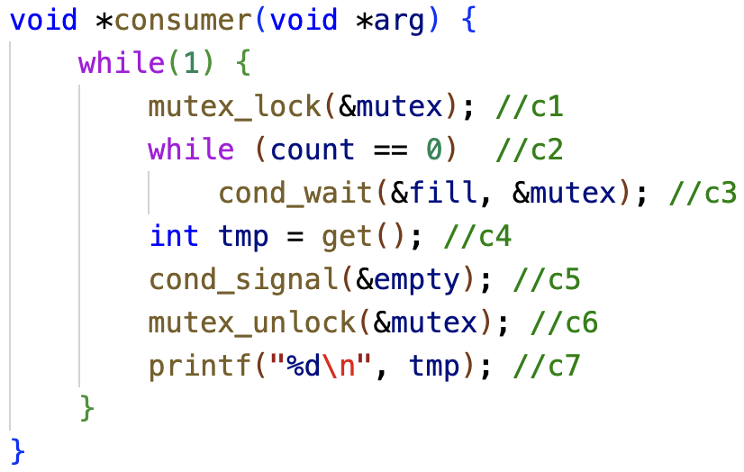
Recap
Producer/Consumer Problem
Condition Variable for Producer/Consumer Problem
Two CVs and while loop

Slide 37
Recap
Locks --- mutual execution
Only one thread must execute critical section
Hardware support – atomical execution
Test-and-set and compare-and-swap
Busy-waiting --- spinlock
Metrics to evaluate locks:
Correctness: mutual execution
Fairness: no starvation
Performance: no high cost to acquire and release a lock
Ticket locks --- No starvation

Slide 38
Summary
Locks: provide mutual exclusion
Spinlocks:
Test-And-Set()
Compare-and-swap()
Producer/consumer problem
Condition variable
Properly use CVs
Have a state
Use mutex to ensure no race condition
Recheck the state (while)

Slide 39
Quiz: Race Conditions
Consider the two threads each executing t1 and t2. Values of shared variables y and z are initialized to 0.
t1:
1 t1(){ |  | t2: | 1 | t2(){
2 | int x; |  | 2 |  | y = 1;
3 | x = y + z; |  | 3 |  | z = 2;
4 } |  |  | 4 | }
Q. Give all possible final values for x and the corresponding order of execution of instructions in t1 and t2.
1) t1 runs to the end first; then t2 runs to the end: x = 0+0 = 0
2) t2 to line 2; then t1 to the end; then t2 to the end: x = 1+0 = 1
3) t2 to the end; then t1 to the end: x = 1+2 = 3
Are there other possibilities giving additional values?

Slide 40
Quiz: Race Conditions
Addition operation x=y+z consist of multiple machine instructions in assembly language:
fetch operand y into register r1
fetch operand z into register r2
add r1 + r2, store result in r3
store r3 in memory location of x
If a task switch to t2 occurs between machine instructions A and B; then t2 runs to completion before switching back to t1, then:
y is read as 0 (t2 didn’t set y yet)
z is read as 2 (t2 sets z before execution instruction B of add. in t1)
the sum is then x = 0 + 2 = 2
t1: |  |  | t2:
1 t1() { |  |  | 1 t2() {
2 | int x; |  | 2 | y = 1;
3 4 } | x = y + z; |  | 3 4 } | z = 2;

Slide 41
Quiz: Race Conditions
Q. Give a solution using semaphores and wait/signal operations.
Solution: we protect the addition x = y + z within a critical section, using a binary semaphore (mutex). This code guarantees that x can never have the value 1 or 2, possible values are x = 0, 3 (Line “int x” can be outside or inside the critical section with no difference.)
t1:
0 sem s = 1; |  | t2: | 1 t2() {
1 t1() { |  |  | 2 s.wait();
2 | int x; |  | 3 y = 1;
3 | s.wait(); |  | 4 z = 2;
4 | x = y + z; |  | 5 s.signal();
5 | s.signal(); |  | 6 }
6 }

Slide 42
Quiz: Semaphores
t1:
1 int t1() { |  | t2: | 1 int t2() {
2 | printf("w"); |  | 2 | printf("o");
3 | printf("d"); |  | 3 | printf("r");
4 } |  |  | 4 | printf("l");
 |  |  | 5 6 } | printf("e");
Q. Use semaphores and insert wait/signal calls into the two threads so that only “wordle” is printed.
t1: t2:
t1 has to run first to print "w", so s1 should be initialized to 1.
t2 has to wait until the "w" has been printed by t1, then it is woken up by t1 calling s2.signal(), so s2 should be initialized to 0.
0 sem s1=1,s2=0; 1 int t2() {
1 int t1() {
2
3
4
5
6
7
8
9 }
s2.wait();
printf("o");
printf("r");
s1.signal();
s2.wait();
printf("l");
printf("e");
2
3
4
5
6
7
8 }
s1.wait();
printf("w");
s2.signal();
s1.wait();
printf("d");
s2.signal();
Notes:
It is signalled by t1, so the initial value of s2 has to be 0.

Slide 43
Quiz: Semaphores II
int t1() {
while(1) {
printf("A");
s_c.signal();
s_a.wait();
6 }
7 }
int t2() {
while(1) {
printf("B");
s_c.signal();
s_b.wait();
6 }
7 }
int t3() {
while(1) {
s_c.wait();
s_c.wait();
printf("C");
s_a.signal();
s_b.signal();
8 }
9 }
semaphore s_a=0, s_b=0, s_c=0;
Q. Which strings can be output when running the 3 threads in parallel?
Either t1 or t2 could start first, so the first letter can be A or B
Then both t1 and t2 signal s_c, only after both have signalled s_c, t3 can start and print C
t3 signals s_a and s_b, which start in arbitrary order again
Accordingly, the output is a regular expression ((AB|BA)C)+
Print A or B in arbitrary order, then print C, then the process repeats
Notes:
Here, we have used a regular expression to indicate the structure of a text pattern. Regular expressions (short: regexps) are a common tool in Unix

Slide 44
Quiz: Deadlocks
int x=0, y=0, z=0; semaphore lock1=1, lock2=1;
1 int t1() { 1 int t2() {
2
3
4
5
6
7
8
9 }
z = z + 2; lock1.wait(); x = x + 2;
2
3
4
5
6
7
8
9 }
lock2.wait();
y = y + 1; lock1.wait(); x = x + 1;
lock1.signal(); lock2.signal(); z = z + 1;
lock2.wait(); lock1.signal(); y = y + 2; lock2.signal();
a. Executing the threads in parallel could result in a deadlock. Why?
t1 runs first until line 4 (so lock1=0, lock2=1) ↯ switch to t2
t2 starts and runs until line 3 (so lock1=0, lock2=0) ↯ back to t1
t1 waits for lock2 in line 5 ↯ switch to t2, waits for lock1 in line 4
This results in a mutual waiting condition which is not resolved
Note that this deadlock does not occur in all execution/task switch orders!

Slide 45
Quiz: Deadlocks
int x=0, y=0, z=0; semaphore lock1=1, lock2=1;
1 int t1() {
2 z = z + 2;
lock1.wait();
x = x + 2;
lock2.wait();
lock1.signal();
y = y + 2;
lock2.signal();
9 }
1 int t2() {
2
3
lock2.wait();
y = y + 1; lock1.wait(); x = x + 1;
lock1.signal(); lock2.signal(); z = z + 1;
4
5
6
7
8
9 }
Q. Executing the threads in parallel could result in a deadlock. Why?
t2 runs first until line 2 (so lock2=0, lock1=1); switch to t1
t1 starts and runs until line 3 (so lock1=0, lock2=0); back to t2
t2 waits for lock2 in line 4; switch to t1, waits for lock1 in line 5
Note: There are other possible interleavings, as long as each thread grabs one lock and requests the other. You can remove all other statements and only leave the lock wait() instructions and get into this deadlock.)
Notes:
Are there other execution orders leading to a deadlock?

Slide 46
Quiz: Deadlocks
int x=0, y=0, z=0; semaphore lock1=1, lock2=1;
Q. What are the possible values of x, y and z in the deadlock state?
t1 runs until Line 5 lock2.wait() and t2 runs until Line 4 lock1.wait(), so x = 2, y = 1, z = 2
Q. What are the possible values of x, y and z if the program finishes successfully without a deadlock?
t1 runs first to the end, then t2 (or vice versa): x=3, y=3, z=3
In t1, lock1.signal() sets lock1=1, lock2.signal() sets lock2=1, this exiting the critical sections protected by lock1 and lock2.
Since Line 2 of t1 “z=z+2”, and Line 8 of t2 “z=z+1” are not protected within a critical section, a thread switch may occur in the middle of each line, e.g.,
t2 Line 8 reads z=0; before z is written back; switch to t1 Line 2, run t1 to the end; switch to t2 Line 8, write back z=0+1=1.
Or, t1 Line 2 reads z=0; before z is written back; switch to t2 Line 2, run t2 to the end; switch to t1 Line 2, write back z=0+2=2.
Note: to prevent deadlocks, every thread should acquire locks in the same order, e.g. both acquire lock1 before lock2, or both acquire lock2 before lock1
1 int t1() { |  |  | 1 | int t2() {
2 | z = z + 2; |  | 2 |  | lock2.wait();
3 | lock1.wait(); |  | 3 |  | y = y + 1;
4 | x = x + 2; |  | 4 |  | lock1.wait();
5 | lock2.wait(); |  | 5 |  | x = x + 1;
6 | lock1.signal(); |  | 6 |  | lock1.signal();
7 | y = y + 2; |  | 7 |  | lock2.signal();
8 | lock2.signal(); |  | 8 |  | z = z + 1;
9 } |  |  | 9 | }
Notes:
Semaphores -> locks + condition variables
Binary semaphores -> locks
Semaphore for ordering
Semaphore for P/C

