Slide 1
CSC 112: Computer Operating Systems Lecture 2 Protection: Processes and Kernels
Department of Computer Science,
Hofstra University
Acknowledgement: Lecture slides based on UC Berkeley CS 162: Operating Systems and System Programming

Slide 2
Recall: Operating System
An operating system implements a virtual machine for the application whose interface is more convenient than the raw hardware interface (convenient = security, reliability, portability)
Application 1
Application 2
Application 3
Operating System
Hardware

Slide 3



Recall: Three main hats
Referee
Manage protection, isolation, and sharing of resources
Illusionist
Provide clean, easy-to-use abstractions of physical resources
Glue
Provides a set of common services

Slide 4
Evaluation Criteria
Performance
Efficiently, with low overhead and equitably.
Reliability
System does what it supposed to do
Security
Minimise vulnerability to attack
Portability
No need to change abstractions when hardware changes

Slide 5
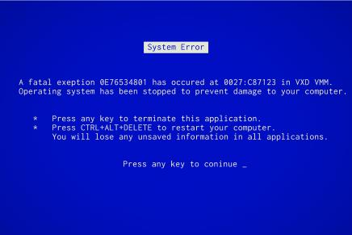

Evaluation Criteria: Reliability
System does what it is supposed to do
OS failures catastrophic!
Availability: mean time to failure + mean time to repair

Slide 6
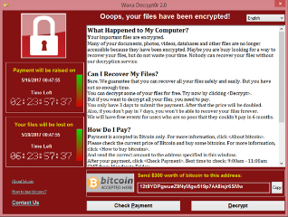
Evaluation Criteria: Security
Minimize vulnerability to attack
Integrity: Computer’s operation cannot be compromised by a malicious attacker
Privacy: data stored on computer accessible to authorized users
Enforcement Policy
How the OS ensures only permitted actions are allowed
Security Policy
What is permitted

Slide 7
Evaluation Criteria: Portability
A portable abstraction does not change as the hardware changes
Can’t rewrite application (or OS!) every time
Must plan for hardware that does not exist yet!
Application
Abstract Machine Interface
Operating System
Hardware Abstraction Layer
Hardware

Slide 8
Topic Breakdown
Process Abstraction and API
Threads and Concurrency
Virtualizing the CPU
Scheduling
Virtual Memory
Virtualizing Memory
Paging
IO devices
Persistence
File Systems
Challenges with distribution
Distributed Systems
Data Processing & Storage

Slide 9
Topic Breakdown
Process Abstraction and API
Threads and Concurrency
Virtualizing the CPU
Scheduling
Virtual Memory
Virtualizing Memory
Paging
IO devices
Persistence
File Systems
Challenges with distribution
Distributed Systems
Data Processing & Storage

Slide 10
Side Note: Mechanisms vs Policy
Mechanism
Low-level methods or protocols that implement a needed piece of functionality
Policy
Algorithms for making decisions within the OS.
Use the mechanism.
A Brake Pedal!
“I brake when I see a stop sign”

Slide 11
Goals for Today
What are the requirements of a good VM abstraction? For protection
What is a process?
How does the kernel use processes to enforce protection?
When does one switch from kernel to user mode and back?

Slide 12

The OS will protect you
Protection is necessary to preserve the virtualization abstraction
Protect applications from other application’s code
(reliability, security, privacy)
Protect OS from the application
Protect applications against inequitable resource utilisation
(memory, CPU time)
OS

Slide 13
A process (simplified)
A process is an instance of a running program
CPU
Memory
(address space)
Registers
IO information
Store code, data, stack, heap
Program Counter, Stack Pointer
Regular registers
Open files (and others)

Slide 14

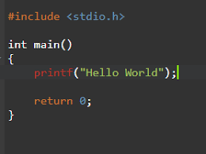
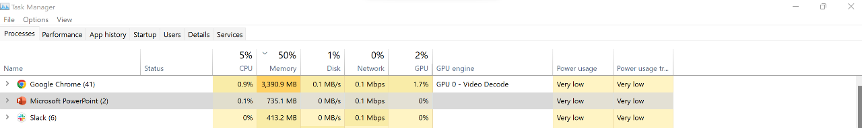
From program to process
Executable image, instructions and data
./helloworld
crooks@laptop> ./helloworld
crooks@laptop> ./helloworld
Physical Memory
Code
Data
Heap
Stack
Code
Data
Heap
Stack

Slide 15
Process Life Cycle
A process can be in one of several states:
(real OSes have additional variants)
Descheduled
Dying
Running
Ready
Scheduled
Request I/O
Finish I/O
Blocked

Slide 16
Process Management by the OS
Process Control Block (or process descriptor)
in OS stores necessary metadata
PC
Stack Ptr
Registers
PID
UID
List of open files
Process State
…

Slide 17
PCB (in the kernel)
enum procstate { UNUSED, EMBRYO, SLEEPING, RUNNABLE, RUNNING, ZOMBIE };
// Per-process state
struct proc {
uint sz; // Size of process memory (bytes)
pde_t* pgdir; // Page table
char *kstack; // Bottom of kernel stack for this process
enum procstate state; // Process state
int pid; // Process ID
struct proc *parent; // Parent process
struct trapframe *tf; // Trap frame for current syscall
struct context *context; // swtch() here to run process
void *chan; // If non-zero, sleeping on chan
int killed; // If non-zero, have been killed
struct file *ofile[NOFILE]; // Open files
struct inode *cwd; // Current directory
char name[16]; // Process name (debugging)
};
In Linux: task_struct defined in <linux/sched.h>
Xv6 Kernel (proc.h)

Slide 18
Many Processes
Process List stores all processes
struct {
struct spinlock lock;
struct proc proc[NPROC];
} ptable;
Xv6 Kernel (proc.c)
Run Queues
Lists all PCBs in READY state
Wait Queues
Lists all PCBs in BLOCKED state

Slide 19
The Illusionist and the Referee
Illusionist
Give every process the illusion of running on a private CPU
Give every process the illusion of running on private memory
Referee
Manage resources to allocate to each process
Isolate process from all other processes and protect OS

Slide 20
Operating System Kernel
Lowest level of OS running on system.
Kernel is trusted with full access to all hardware capabilities
All other software (OS or applications) is considered untrusted
Applications
Untrusted
Rest of OS
Trusted
Operating System Kernel
Untrusted
Hardware

Slide 21

User vs Kernel
Application/User Code (Untrusted)
Run all the processor with all potentially dangerous operations disabled
Kernel Code (Trusted)
Runs directly on processor with unlimited rights
Performs any hardware operations
But run on the same machine!

Slide 22
Recall: CPU Instruction Cycle (from CS61c)
Memory
Processor
next
PC:
Instruction fetch
instruction
Decode
decode
Registers
Execute
ALU
data

Slide 23

Dual Mode Operation
Hardware to the rescue!
Use a bit to enable two modes of execution
In User Mode
Processor checks each instruction before executing it
Executes a limited (safe) set of instructions
In Kernel Mode
OS executes with protection checks off
Can execute any instructions

Slide 24
Hardware must support
Privileged Instructions
Unsafe instructions cannot be executed in user mode
2) Memory Isolation
Memory accesses outside a process’s address space prohibited
3) Interrupts
Ensure kernel can regain control from running process
4) Safe Transfers
Correctly transfer control from user-mode to kernel-mode and back

Slide 25
Req 1/4: Privileged Instructions
Cannot change privilege level (set mode bit)
Cannot change address space
Cannot disable interrupts
Cannot perform IO operations
Cannot halt the processor

Slide 26
How can an application do anything useful …
Asks for permission to access kernel mode!
System calls Transition from user to kernel mode only at specific locations specified by the OS
Exceptions User mode code attempts to execute a privileged operation. Generates a processor exception which passes control to kernel at specific locations
More on safe control transfers later

Slide 27
Hardware must support
Privileged Instructions
Unsafe instructions cannot be executed in user mode
2) Memory Isolation
Memory accesses outside a process’s address space prohibited
3) Interrupts
Ensure kernel can regain control from running process
4) Safe Transfers
Correctly transfer control from user-mode to kernel-mode and back

Slide 28
Req 2/4: Memory Protection
OS and applications both resident in memory
Application should not read/write kernel memory
(or other apps memory)

Slide 29
Virtual Memory is Hard!
Process Abstraction and API
Threads and Concurrency
Virtualizing the CPU
Scheduling
Virtual Memory
Virtualizing Memory
Paging
IO devices
Persistence
File Systems
Challenges with distribution
Distributed Systems
Data Processing & Storage

Slide 30
Hardware must support
Privileged Instructions
Unsafe instructions cannot be executed in user mode
2) Memory Isolation
Memory accesses outside a process’s address space prohibited
3) Interrupts
Ensure kernel can regain control from running process
4) Safe Transfers
Correctly transfer control from user-mode to kernel-mode and back

Slide 31
Req 3/4: Interrupts
Kernel must be able to regain control of the processor
Hardware to the rescue! (Again x 2)
Hardware Interrupts
Set to interrupt processor after a specified delay or specified event and transfer control to (specific locations) in Kernel.
Resetting timer is a privileged operation

