Slide 1
CS162 Operating Systems and Systems Programming Lecture 3 Processes (Continued)
Professor Natacha Crooks
https://cs162.org/
Slides based on prior slide decks from David Culler, Ion Stoica, John Kubiatowicz, Alison Norman and Lorenzo Alvisi

Slide 2
Goals for today
What hardware support is necessary to enable protection?
The Stack?
How to switch from user mode to kernel mode and back?

Slide 3
Hardware must support
Privileged Instructions
Unsafe instructions cannot be executed in user mode
2) Memory Isolation
Memory accesses outside a process’s address space prohibited
3) Interrupts
Ensure kernel can regain control from running process
4) Safe Transfers
Correctly transfer control from user-mode to kernel-mode and back

Slide 4
Req 4/4: Safe Control Transfer
How do safely/correctly transition from executing user process to executing the kernel?
System Calls
2) Exceptions
3) Interrupts
Asynchronous
Can be maskable or non-maskable
Synchronous Events (trapping)

Slide 5
Safe Control Transfer: System Calls
User program requests OS service
Transfers to kernel at well-defined location
Synchronous/non-maskable
Read input/write to screen, to files, create new processes, send network packets, get time, etc.
How many system calls in Linux 3.0 ?
15 b) 336 c) 1021 d) 21121
ANS: 336
https://man7.org/linux/man-pages/man2/syscalls.2.html

Slide 6
System Calls are the “Narrow Waist”
Simple and powerful interface allows separation of concern
Eases innovation in user space and HW
Word Processing
Compilers
Web Browsers
Email
Databases
Web Servers
Application / Service
Portable OS Library
OS
User
System Call
Interface
System
Portable OS Kernel
Software
Platform support, Device Drivers
Hardware
x86
PowerPC
ARM
PCI
Ethernet (1Gbs/10Gbs)
802.11 a/g/n/ac
SCSI
Graphics
Thunderbolt

Slide 7
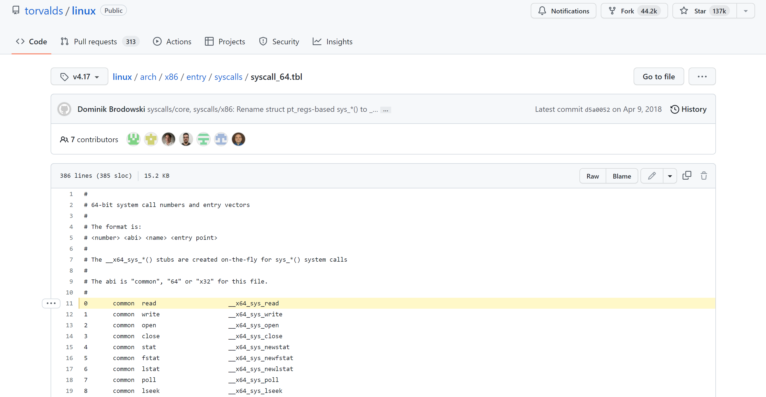
System Calls in Linux

Slide 8
Safe Control Transfer: Exceptions
Any unexpected condition caused by user program behaviour
Stop executing process and enter kernel at specific exception handler
Synchronous and non-maskable
Process missteps (division by zero, writing read-only memory)
Attempts to execute a privileged instruction in user mode
Debugger breakpoints!

Slide 9
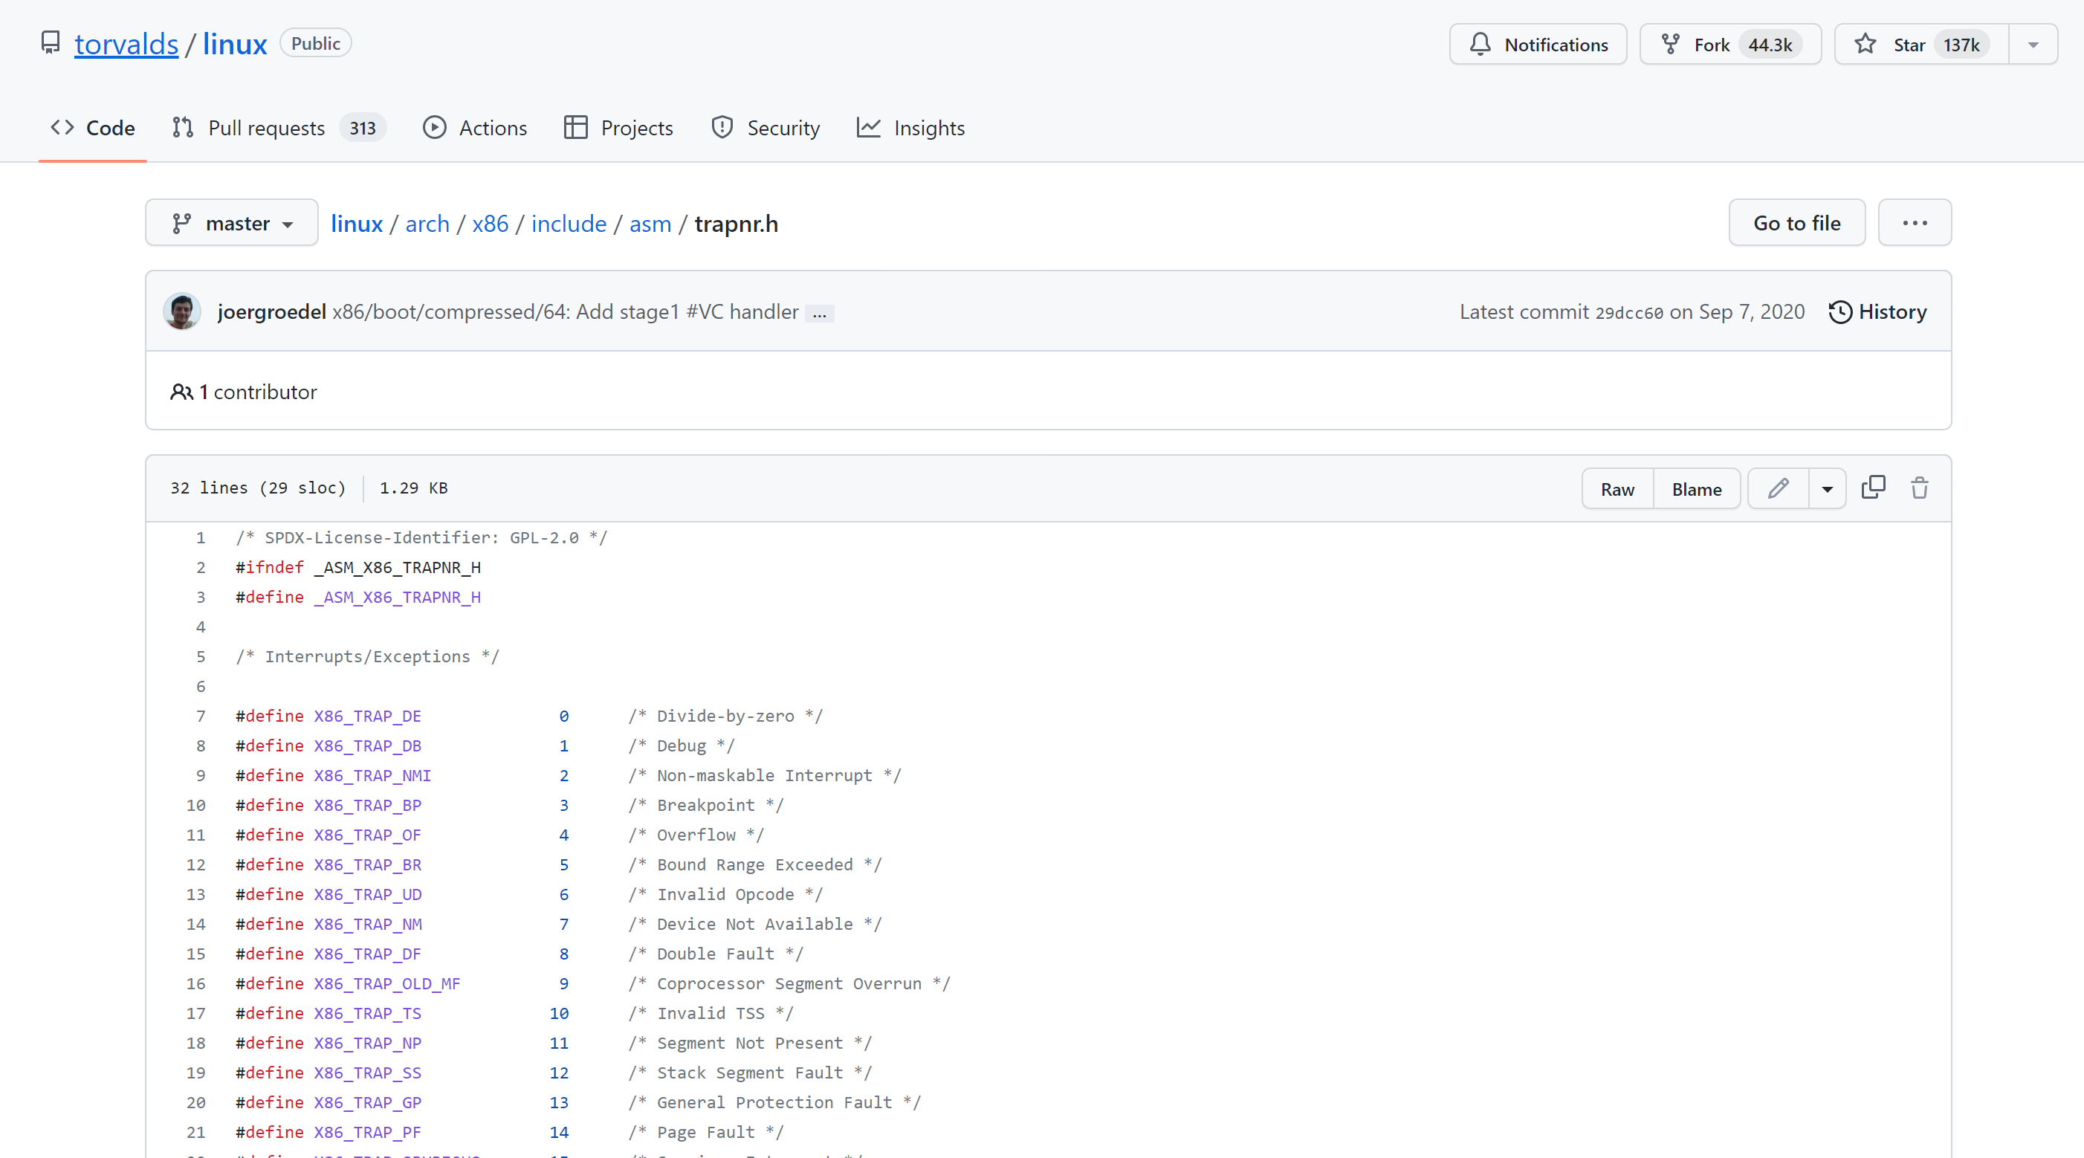
Exceptions in Linux

Slide 10
Safe Control Transfer: Interrupts
Asynchronous signal to the processor that some external event has occurred and may require attention
When process interrupt, stop current process and enter kernel at designated interrupt handler
Timer Interrupts, IO Interrupts, Interprocessor Interrupts

Slide 11
Safe Control Transfer: Kernel->User
New Process Creation
Kernel instantiates data structures, sets registers, switches to user mode
Resume after an exception/interrupt/syscall
Resume execution by restoring PC, registers, and unsetting mode
Switching to a different process
Save old process state. Load new process state (restore PC, registers). Unset mode.

Slide 12
Goal 2: The Stack is Back (Review)
Address Space Of Process
Address Space Of Process
Stack
0xFFFFFFFF
Stack Contains temporary data such as method/function parameters, return address and local variables.
Heap Dynamically allocated memory to a process during its run time.
int foo() {
int a;
Foo* foo= malloc(sizeof(foo));
}
Heap
Data
Code
0x00000000

Slide 13
Goal 2: User -> Kernel Mode

Slide 14
Goal 3: User -> Kernel Mode
Key Requirement:
Malicious user program (or IO device) cannot corrupt the kernel.
Interrupts, exceptions or system calls handled similarly
=> fewer code paths, fewer bugs.
Limited Entry
Cannot jump to arbitrary code in kernel
2) Atomic Switch
Switch from process stack to kernel stack
3) Transparent Execution
Restore prior state to continue program

Slide 15
Interrupt Handling Roadmap
Processor detects interrupt
Suspend user program and switch to kernel stack
Identify interrupt type and invoke appropriate interrupt handler
4) Restore user program

Slide 16

Don’t (Hardware) Interrupt Me
OS is cool
int add(int a, int b) {
int result = a+b;
return result;
}
What happens when I type “OS is cool” on my keyboard while the Add program is running?

Slide 17
1) Interrupt Detection (Hardware)
OS is cool
PIC
Device sends electric signal interrupt request (IRQ) over interrupt request line to programmable interrupt controller (PIC)

Slide 18
1) Interrupt Detection (Hardware)
OS is cool
PIC
APIC converts IRQ to a vector number and sends signal to processor
Processor detects interrupt
INTR
Processor

Slide 19
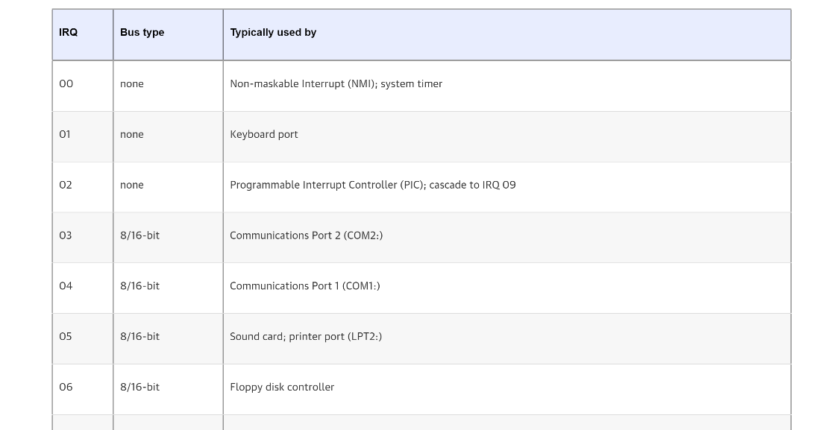
IRQs

Slide 20
2) Save Recovery State (Hardware)
Save register values (recovery state) for process recovery
int add(int a, int b) {
int result = a+b;
return result;
}
Which registers need to be saved by hardware to restore program?
Stack Pointer (esp)
Program Counter (eip)
Execution Flags / Program Status Word (Eflags)

Slide 21
3) Switching (atomically) to Kernel Stack
int add(int a, int b) {
int result = a+b;
return result;
}
Switches stack pointer to base of kernel stack
ebp
X=?
10
Pushes recovery state onto the new stack
(+ optional error code)
5
EIP
ebp
Stack Pointer
result
PSW
User Stack
Instruction Pointer
Error Code
Question 1:
Why did hardware need to save registers before switching to kernel stack?
Question 2:
Why do we need a separate kernel stack?
Integrity and privacy concerns
Must overwrite EIP/SP when switching!

Slide 22
A Tale of Two Stacks
enum procstate { UNUSED, EMBRYO, SLEEPING, RUNNABLE, RUNNING, ZOMBIE };
// Per-process state
struct proc {
uint sz; // Size of process memory (bytes)
pde_t* pgdir; // Page table
char *kstack; // Bottom of kernel stack for this process
enum procstate state; // Process state
int pid; // Process ID
struct proc *parent; // Parent process
struct trapframe *tf; // Trap frame for current syscall
struct context *context; // swtch() here to run process
void *chan; // If non-zero, sleeping on chan
int killed; // If non-zero, have been killed
struct file *ofile[NOFILE]; // Open files
struct inode *cwd; // Current directory
char name[16]; // Process name (debugging)
};
Xv6 Kernel (proc.h)

Slide 23
4) Invoke Interrupt Handler (Hardware)
Interrupt vector is an index
into Interrupt Vector Table
(or interrupt descriptor table).
32
rtc_handler
33
keyboard_handler
…
floppy_handler
127
disk_handler
Index contains appropriate
Interrupt Handler Routine
IDT Table in Linux
Control Unit sets EIP to handler
Stack Pointer
PSW
Instruction Pointer
Handler saves all remaining user registers into stack and implements necessary logic
(Transition software)
Error Code
Eax
Ebx
…
Kernel Stack

Slide 24
5) Return to Program
Pop all user registers from kernel stack (restore register state)
Invoke iret instruction to pop saved EIP, EFLAGS, and SP registers from kernel’s exception stack to relevant registers
Return to user mode
Stack Pointer
PSW
ebp
Instruction Pointer
X=?
Error Code
10
Eax
5
Ebx
EIP
…
ebp
result
Kernel Stack
User Stack

Slide 25
Concurrent Interrupts
What happens if an interrupt happens while processing an interrupt?
Hardware provides instruction to temporarily defer delivery of interrupt (disable interrupt), and re-enable them when safe (enable interrupt)
Interrupts are disabled when an interrupt handler is running
Periods during which interrupts are disabled should be very short!

Slide 26
Interrupt Summary
1) Device sends signal to APIC
2) Processor detects interrupt
3) Save Recovery State and switch to Kernel Stack
4) Jump to interrupt handler table at appropriate vector. Invoke interrupt handler
5) Restore user program

Slide 27
What about syscalls?
System calls are user functions that request services from the OS. Described as function call, with a name, parameters and return value.
Good news!
Syscalls are handled (almost) identically to interrupts.

Slide 28
What about syscalls?
32
rtc_handler
Syscalls issue a “trap” instruction (int 0x80)
Generated interrupt will trigger exception vector 128!
33
keyboard_handler
…
floppy_handler
127
disk_handler
128
syscall_handler
How does handler know which syscall to execute?
System Call number fed in to %eax register.
System call number entry into system call dispatch table,
What about parameters and return values?
Propagated through registers.
Warning: Parameters must be carefully checked.

Slide 29
What about syscalls?
Four differences:
1) Extra-layer of indirection (system call table)
2) Leverage registers for parameters/values
3) When executing iret, increment EIP by one to go to next instruction
4) Usually, interrupts not disabled

Slide 30
What about exceptions?
It’s the same!

Slide 31
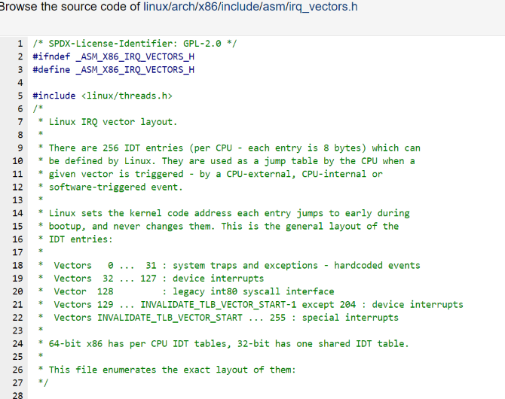
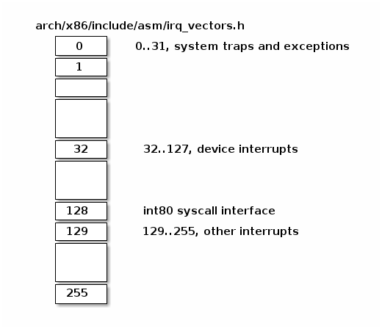
The magic of the IVT
Single, well-defined entry point in the kernel helps with security

Slide 32
Tension between performance and simplicity
Accessing IDT can be slow if not in cache.
Syscalls very common, can we make them cheaper?
Allocate a special register (machine specific register) to directly store address of system call dispatch table
Store register call in the rax register
But backwards compatibility …

Slide 33
Goals for today
(Continued) Hardware support for dual mode
61C Review: The Stack
How to switch from user mode to kernel mode and back?
Privileged Instructions, Memory Isolation, Timer Interrupts, Safe Context Switching.
Stack Pointer, Frame Pointer, Program Counter
Switch to specified location in kernel & atomic.
Interrupts, Syscalls, Exceptions handled identically. Use of the interrupt vector table

