Slide 1
CSC 112: Computer Operating Systems Lecture 7 Cache
Department of Computer Science,
Hofstra University

Slide 2
Agenda
Memory Hierarchy
Cache Performance
Direct Mapped Caches
Set Associative Caches
Multiprocessor Cache Consistency

Slide 3
Storage in a Computer
Processor
holds data in register file (~100 Bytes)
Registers accessed on sub-nanosecond timescale
Memory (we’ll call “main memory”)
More capacity than registers (~Gbytes)
Access time ~50-100 ns
Hundreds of clock cycles per memory access?!

Slide 4
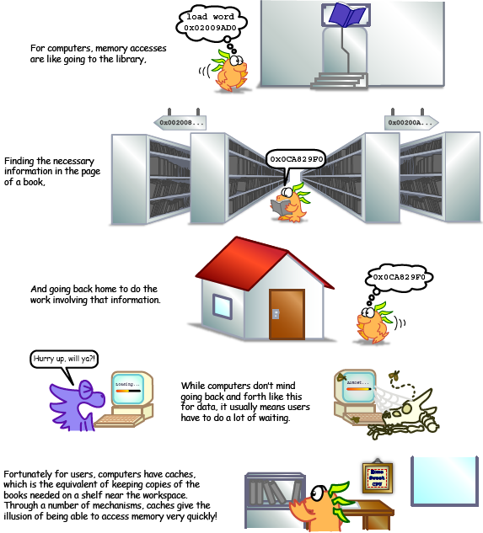
Library Analogy
Writing a report on a specific topic.
While at library, check out books and keep them on desk.
If need more, check them out and bring to desk.
But don’t return earlier books since might need them
Limited space on desk; Which books to keep?
You hope this collection of ~10 books on desk enough to write report, despite 10 being only 0.00001% of books in the library
4

Slide 5
Locality
Principle of Locality: Programs access small portion of address space at any instant of time
Temporal Locality (locality in time)
If a memory location is referenced then it will tend to be referenced again soon
Spatial Locality (locality in space)
If a memory location is referenced, the locations with nearby addresses will tend to be referenced soon
5
Notes:
How does the memory hierarchy work? Well it is rather simple, at least in principle.
In order to take advantage of the temporal locality, that is the locality in time, the memory hierarchy will keep those more recently accessed data items closer to the processor because chances are (points to the principle), the processor will access them again soon. Analogy: Go back to read the same book multiple timesWhen go to bookshelf, pick up multiple nearby books on the same topic since related books are together
In order to take advantage of the spatial locality, not ONLY do we move the item that has just been accessed to the upper level, but we ALSO move the data items that are adjacent to it.
+1 = 15 min. (X:55)

Slide 6
Does Locality Exist?
Instruction accesses spend a lot of time on the same page (since accesses mostly sequential, loop body tends to be small)
Data accesses have less locality, but still some, depending on application…
Stack accesses (push, pop…) have definite locality of reference

Slide 7
How does hardware exploit principle of locality?
Offer a hierarchy of memories where
closest to processor is fastest (and most expensive per bit so smallest)
furthest from processor is largest (and least expensive per bit so slowest)
Goal is to create illusion of memory almost as fast as fastest memory and almost as large as biggest memory of the hierarchy
Processor and memory speed mismatch leads to the addition of cache
7

Slide 8
Memory Hierarchy
Wanted: size of the largest memory available, speed of the fastest memory available
Approach: Memory Hierarchy
Successively higher levels contain “most used” data from next lower level
Exploit temporal & spatial locality to present programmer with as much memory as is available in the cheapest technology at the speed offered by the fastest technology
As we go down the memory hierarchy
Decreasing cost per bit, Increasing capacity
Increasing access time, Decreasing frequency of access
The fastest memory is usually volatile (loses information when the power is off). Examples: register, cache, main memory. Referred to as primary memory.
Non-volatile memory (continues to store information when the power is off) is usually slower. Examples: flash memory, internal and external hard drives, SSD, tape, etc. Referred to as secondary or auxiliary memory.
1 nsec
registers
< 1KB
1.5 nsec
Cache
8 MByte
6 nsec
Main Memory
(RAM volatile. ROM non-volatile)
10 GByte
Flash Memory (non-volatile, rewritable)
5 msec
DISK
3000 GByte
CD, DVD, USB memory stick
Notes:
(flash that holds the BIOS, or removable flash),
Principle of locality + memory hierarchy presents programmer with ≈ as much memory as is available in the cheapest technology at the ≈ speed offered by the fastest technology

Slide 9
Typical Memory Hierarchy
Managed in Hardware
Managed in Software - OS
?
Processor
Secondary Storage (Disk)
TLB
PT
L2 Cache
Registers
L1 Cache
Secondary Storage (SSD)
PT
PT
Main
Memory
(DRAM)
PT
TLB
L3 Cache (shared)
L2 Cache
Registers
L1 Cache
Accessed in Hardware
Speed (ns):
0.3
1
3
10-30
100
100,000 (0.1 ms)
10,000,000
(10 ms)
Size (bytes):
100Bs
10kBs
100kBs
MBs
GBs
100GBs
TBs

Slide 10
Registers and Cache
CPU registers are on-chip resources, with access speed comparable to CPU clock speed
Size 64 bits for 64-bit machines, size 32 bits for 32-bit machines, etc.
Cache may be on-chip or off-chip. It is slower and larger than registers, but much faster than main memory
The next few instructions, and data that will be needed will be loaded into cache in anticipation of faster access by the processor.
Cache contains a subset of content of main memory
As a pun, often use $ (“cash”) as abbreviation for cache, e.g. D$ = Data Cache, I$ = Instruction Cache
CPU
Registers
Main memory
Cache
10
Notes:
Implemented with same integrated circuit processing technology as processor, integrated on-chip: faster but more expensive than DRAM memory

Slide 11
Cache Architectures
Modern processors have an on-chip cache called an L1 cache
Typically separate L1 caches for instructions and data
Most processors have multiple levels of caches between the L1 cache and the main memory with different sizes, e.g., 2nd and 3rd level of cache, called the L2 (L3) cache.
L2 cache can be on-chip or off-chip (connected to the CPU via a bus)
L3 cache is typically off-chip
Unified cache (containing both instructions and data)
L
CPU
registers
L1 cache
(instructions)
L3
cache
registers
L1 cache
(instructions)
L1 cache
(data)
core1
L2 Cache
L1 cache
(data)
registers
L1 cache
(instructions)
Main
memory
L1 cache
(data)
core2
L2 Cache
Main
memory
L2 Cache
Example cache config (uniprocessor)
Example cache config (multicore processor)
11
Notes:
between the L1 cache a
With advancing technology, have more room on die for bigger L1 caches and for second level cache – normally a unified L2 cache (i.e., it holds both instructions and data,) and in some cases even a unified L3 cache
nd the main memory Shared cache requires more complicated cache controller
Individual caches are more difficult to keep coherent (properly synchronized)
Modern processors have an on-chip cache called an

Slide 12
Memory Hierarchy Technologies
Caches use SRAM (Static RAM) for speed and technology compatibility
Fast (typical access times of 0.5 to 2.5 ns)
Low density (6 transistor cells), higher power, expensive
Static: content will last as long as power is on
Main memory uses DRAM (Dynamic RAM) for size (density)
Slower (typical access times of 50 to 70 ns)
High density (1 transistor cells), lower power, cheaper ($20 to $40 per GB in 2011)
Dynamic: needs to be “refreshed” regularly (~ every 8 ms)
Consumes 1% to 2% of the active cycles of the DRAM
Cache vs RAM: The Speed Difference Explained
https://www.youtube.com/watch?v=ammQYLcyebA&list=PL38NNHQLqJqYnNrTenxBvGJSPCkV9EOWk&index=5
12
Notes:
Size comparison: DRAM/SRAM is 4 to 8 times
Cost/cycle time comparison SRAM/DRAM is 8 to 16 times
http://parts.digikey.com/1/parts/1211303-ic-sram-1mbit-10ns-32soj-cy7c109d-10vxi.html
Quantity discount 10ns 1MBit SRAM $2.24, $17/Mbyte, $1700/100 Mbyte, $17000/GByte
http://www.frys.com/template/harddrives
DRAM: 4GB @ $70 or $17.50 per GB
24GB@$800 = $33/Gbyte
http://www.frys.com/category/Outpost/Hard+Drives+&+Memory/Memory/Notebook+Memory/Apple+-+Mac++Memory/
DDR2 1GB @ $25 per
DDR3 1 GB @ $37.5 per
FLASH Media
Approx. $2 per Gbyte

Slide 13
How is the Hierarchy Managed?
Registers ↔ memory
By compiler (or assembly level programmer)
Cache ↔ main memory
Cache has a number of slots, each N Byes long, and can hold one N-Byte cache block (also called a cache line)
The cache controller hardware moves instructions (and data) between main memory and cache in blocks
Each time a copy of a new cache block is loaded into a cache slot, the original content of the block at that address is overwritten
Main memory ↔ disks (secondary storage)
By the operating system (virtual memory)
Virtual to physical address mapping with page tables
By the programmer (files)
Block – Unit of transfer between memory and cache
Processor
4-8 bytes (word)
Increasing distance from the processor
L1$
8-32 bytes (block)
L2$
16-128 bytes (block)
Main Memory
4,096+ bytes (page)
Secondary Memory
(Relative) size of the memory at each level
13
Notes:
The main memory can contain many more cache blocks than there are slots in the cache
one such block (N bytes of memory) is called a cache block mapping assisted by the hardware (TLB)

Slide 14
Caching Hit & Cache Miss
When accessing a memory address:
cache hit: the requested memory address is found in the cache, i.e., cache block is valid and contains the proper memory address, so read from cache (fast). Proportion of accesses that are hits is called the hit rate
cache miss: the requested memory address is not in the cache, i.e., cache block is invalid, or refers to the wrong memory address, so read from memory (slow). Proportion of accesses that are misses is called the miss rate = 1 – hit rate
14
Notes:
A cache hit occurs when a requested memory address is found in the cache.
A cache miss occurs when it is necessary to access the slower main memory (or lower-level cache) to find the information. , 2 things can happen

Slide 15
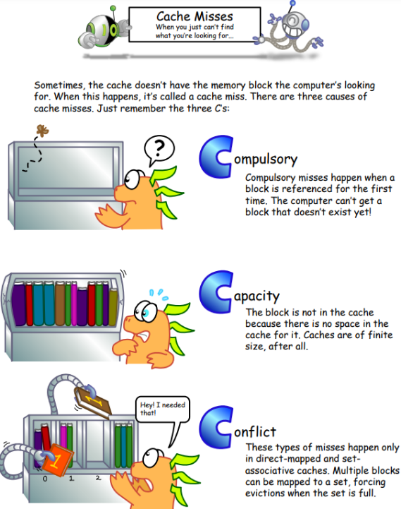
Sources of Cache Misses:3Cs
Compulsory misses (cold start or process migration, 1st reference):
First access to block impossible to avoid; small effect for long running programs
Solution: increase block size (increases miss penalty; very large blocks could increase miss rate)
Capacity misses:
Cache cannot contain all blocks accessed by the program
Solution: increase cache size (may increase access time)
Conflict misses (collision):
Multiple memory locations mapped to the same cache location
Solution 1: increase cache size
Solution 2: increase associativity (may increase access time)
Notes:
(Capacity miss) That is the cache misses are due to the fact that the cache is simply not large enough to contain all the blocks that are accessed by the program.
The solution to reduce the Capacity miss rate is simple: increase the cache size.
Here is a summary of other types of cache miss we talked about.
First is the Compulsory misses. These are the misses that we cannot avoid. They are caused when we first start the program.
Then we talked about the conflict misses. They are the misses that caused by multiple memory locations being mapped to the same cache location.
There are two solutions to reduce conflict misses. The first one is, once again, increase the cache size. The second one is to increase the associativity.
For example, say using a 2-way set associative cache instead of directed mapped cache.
But keep in mind that cache miss rate is only one part of the equation. You also have to worry about cache access time and miss penalty. Do NOT optimize miss rate alone.
Finally, there is another source of cache miss we will not cover today. Those are referred to as invalidation misses caused by another process, such as IO , update the main memory so you have to flush the cache to avoid inconsistency between memory and cache.
http://csillustrated.berkeley.edu/PDFs/handouts/cache-2-misses-handout.pdf
+2 = 43 min. (Y:23)

Slide 16
Average Memory Access Time (AMAT)
Proc
AMAT = Hit Rate_{L1} x Hit Time_{L1} + Miss Rate_{L1} x Miss Time_{L1}
Hit Rate_{L1} + Miss Rate_{L1} = 1 Hit Time_{L1} = Time to get value from L1 cache. Miss Time_{L1} = Hit Time_{L1} + Miss Penalty_{L1} Miss Penalty_{L1} = AVG Time to get value from lower level (DRAM)
So, AMAT = Hit Time_{L1} + Miss Rate_{L1} x Miss Penalty_{L1}
Example: Assume one level of cache. One cache access takes 1 clock cycle, i.e., Hit Time = 1 cycle. One main memory access takes 100 cycles. Any instruction or data not in cache will have to be accessed in main memory and moved to cache before being accessed: i.e., Miss penalty = 100 cycles (main memory access time), Miss Time =100+1=101 cycles (main memory access time + cache access time)
For miss rate of x, AMAT is a linearly increasing function with x:
AMAT = (1-x)*1 + x*101 = 1 + x*100 cycles
L1 Cache
DRAM
Notes:
Average Memory Access Time (AMAT) is the average to access memory considering both hits and misses
AMAT = Hit rate * Hit Time + Miss rate * Miss Time
= (1 - Miss rate) * Hit Time + Miss rate * Miss Time
= Hit Time + Miss rate * Miss penalty
Where Miss Time = Hit Time + Miss penalty

Slide 17
Multiple Cache Levels
Main Memory
How to reduce Miss Penalty?
Multiple cache levels to reduce expensive main memory accesses
L2$
L1$
CPU
Mem
Access
.
.
.
Miss
Hit
Miss
Hit
Path of Data Back to CPU
17

Slide 18
AMAT for Multiple Levels of Caches
Proc
AMAT = Hit Time_{L1} + Miss Rate_{L1} x Miss Penalty_{L1}
Miss Penalty_{L1} = AVG time to get value from lower level (L2) = Hit Time_{L2} + Miss Rate_{L2} x Miss Penalty_{L2} Miss Penalty_{L2} = Average Time to fetch from below L2 (DRAM)
AMAT = Hit Time_{L1} +
Miss Rate_{L1} x (Hit Time_{L2} + Miss Rate_{L2} x Miss Penalty_{L2})
And so forth (final miss penalty is Main Memory access time).
Example: L1 Hit Time 1 cycle, L1 Miss Rate 0.02, L2 Hit Time 5 cycles, L2 Miss
Rate 0.05, Main Memory access time 100 cycles.
L1 Cache only, no L2: AMAT = 1 + 0.02*100 = 3 cycles
With L2 Cache: AMAT = 1 + 0.02*(5 + .05*100) = 1.2 cycles
L1 Cache
L2 Cache
DRAM
Notes:
1 cycle L1 Hit Time, 2% L1 Miss Rate, 5 cycle L2 Hit Time, 5% L2 Miss Rate.
100 cycle Main Memory access time
Local miss rate – the fraction of references to one level of a cache that miss
Local Miss rate L2$ = $L2 Misses / L1$ Misses
Global miss rate – the fraction of references that miss out of all memory accesses in system.
L2$ local miss rate >> than the global miss rate
Global Miss rate = L2$ Misses / Total Accesses
= L2$ Misses / L1$ Misses x L1$ Misses / Total Accesses
= Local Miss rate L2$ x Local Miss rate L1$ Local vs. Global Miss Rates
AMAT Calculation used Local Miss Rate.
AMAT = L1 Hit Time + L1 Miss Rate * L1 Miss Penalty L1 Miss Penalty = L2 Hit Time + L2 Miss Rate * L2 Miss Penalty
and so forth (final miss penalty is Main Memory access time)
Example: L1 Hit Time 1 cycle, L1 Miss Rate 0.02, L2 Hit Time 5 cycles, L2 Miss Rate 0.05, Main Memory access time 100 cycles.
No L2 Cache: AMAT = 1 + .02*100 = 3 cycles
With L2 Cache: AMAT = 1 + .02*(5 + .05*100) = 1.2 cycles
Example:
Assume one level of cache. One cache access takes 1 clock cycle, i.e., Hit Time = 1 cycle
One main memory access takes 100 cycles. Any instruction or data not in cache will have to be accessed in main memory and moved to cache before being accessed: i.e., Miss penalty = 100 cycles (main memory access time), Miss Time =100+1=101 cycles (main memory access time + cache access time)
For miss rate of x, AMAT is a linearly increasing function with x:
AMAT = (1-x)*1 + x*101 = 1 + x*100 cycles
AMAT = 1 + 0.02x50 = 2 AMAT = Hit Time + Miss rate x Miss penalty
What is the AMAT for a processor with a 200 psec clock, a miss penalty of 50 clock cycles, a miss rate of 0.02 misses per instruction and a cache access time of 1 clock cycle?
1 + 0.02 x 50 = 2 clock cycles
Or 2 x 200 = 400 psecs

Slide 19
Cache Design Considerations
Different design considerations for L1$ and L2$
L1$ focuses on fast access: minimize hit time to achieve shorter clock cycle, e.g., smaller $.
Since miss penalty of L1$ is significantly reduced by presence of L2$, so can be smaller/faster even with higher miss rate
L2$ (and L3$) focus on low miss rate: reduce penalty of long main memory access times: e.g., Larger $ with larger block sizes/higher levels of associativity
Since fast hit time is less important than low miss rate due to high miss penalty
Global miss rate – the fraction of references that miss in all levels of a multilevel cache. It dictates how often we must access the main memory.
19
Notes:
Local miss rate – the fraction of references to one level of a cache that miss L2$ hit time determines L1$’s miss penalty
L2$ local miss rate >> than the global miss rate

Slide 20
Cache Associativity
Direct Mapped (DM): memory block maps to exactly one cache block
Fully Associative (FA): allow a memory block to be mapped to any cache block
n-way Set Associative (SA): divide cache into sets, each of which consists of n addresses (“ways”) to place memory block
Cache set index=(block address) modulo (# sets in the cache)
A block can be placed in any of the n addresses (ways) of the cache set it belongs to.
20
Notes:
All of the tags of all of the elements of the set must be searched for a match.

Slide 21
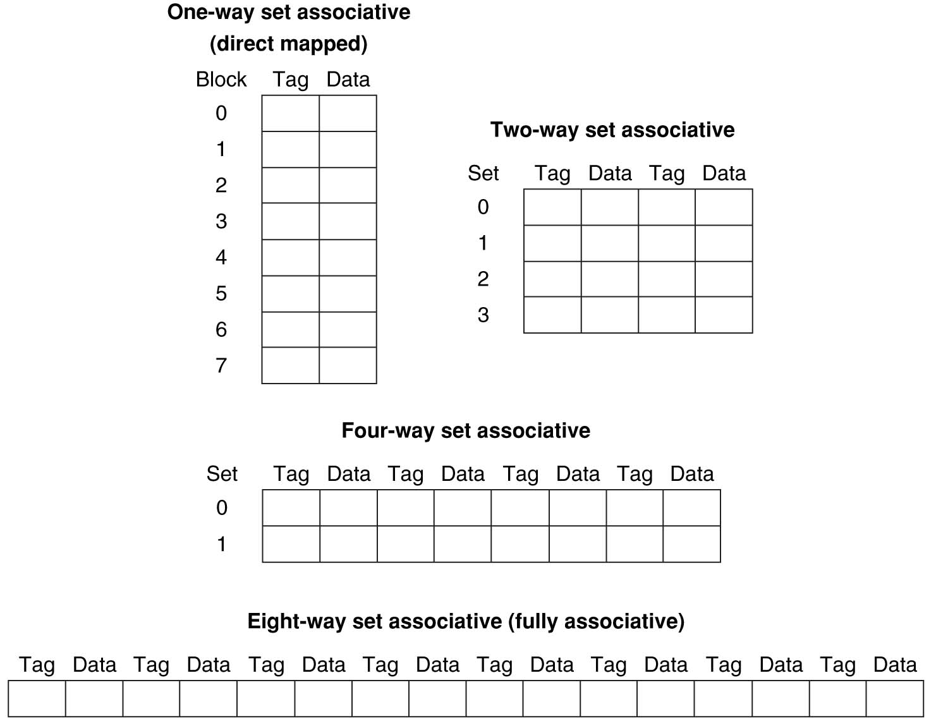
Example: 8-Block cache with different organizations
Cache: 8 blocks, each 4 Bytes. # cache blocks is equal to number of sets x associativity.
DM (1-way SA): 8 sets x 1 block per set
2-way SA: 4 sets x 2 blocks per set
4-way SA: 2 sets x 4 blocks per set
FA (4-way SA): 1 set x 8 blocks per set
For fixed cache size, increasing associativity decreases number of sets while increasing number of blocks per set.
Notes:
With 8 blocks, 8-way SA is same as FA.

Slide 22
Tag, Index, Offset
Index used to identify the cache set
Index = (memory block address (Tag+Index)) modulo (# sets in the cache)
I bits <=> 2^{I} sets in cache
Tag used to distinguish between multiple memory blocks that map to a given set index
If no cache block in the set matches the tag, then declare cache miss.
Offset used to select data within a block; which byte within a block is referenced?
O bits <=> 2^{O} bytes per block
Block Address
Block
offset
Tag
Index
Set Select
Data Select
Notes:
n-bit Index means cache has 2^{n} blocks
n-bit Offset means a block is 2^{n} bytes
Index = (block address) modulo (# of blocks in the cache (4))
Cache is smaller than memory
Multiple blocks in memory map to a single block in the cache
Need some way of determining the identity of the block.
Memory address format:
Upper bits of memory address (Tag) determine which block in memory the block came from.
Middle bits of memory address (Index) determine which block in the cache the block is stored.
Lower bits of address (Offset) determine which byte within a block it refers to.
Many caching applications don’t have this field

Slide 23
DM cache: Tag, Index, Offset
Each block in memory maps to one block in the cache.
Index: which cache block (row in the cache) is the memory block mapped to?
Tag: which block in memory did the cache block come from?
Offset: which column of the cache block is the Byte stored?
Block Address
Block
offset
Tag
Index
Block Select
Data Select
Notes:
the remaining bits after offset and index are determined; these are
once we’ve found correct cache block
since multiple memory blocks can map to the same cache set
specifies the cache block index (which “row” of the cache)
I bits <=> 2^{I} blocks in cache

Slide 24
DM cache: Example
0000xx
0001xx
0010xx
0011xx
0100xx
0101xx
0110xx
0111xx
1000xx
1001xx
1010xx
1011xx
1100xx
1101xx
1110xx
1111xx
Each memory block is mapped to exactly one block in the cache.
Tag: upper 2 bits → 4 memory addresses mapped to the same cache block index. Compare the cache tag to the high-order 2 memory address bits (Tag) to tell if the memory block is in the cache
Index: middle 2 bits → 4 blocks in cache; Index defines which cache block index the mem address is mapped to. Index = (block address) modulo (# blocks in the cache (4)).
Offset: lower 2 bits → 4 bytes (1 word) per block; Offset defines the byte within the cache block.
Block
Index
Valid
Tag
Data
00
01
10
11
1bit
2bits
4Bytes
Cache: 4 blocks, each 4 Bytes
Index to determine which cache block
Tag to determine if it’s the right memory block
Offset to determine which byte within the block
Main Memory - 6-bit addresses
(16 blocks, each 4 Bytes)
Valid bit indicates whether an entry contains valid information – if the bit is not set, there cannot be a match for this block
Notes:
For lecture
Valid bit indicates whether an entry contains valid information – if the bit is not set, there cannot be a match for this block
Q: Is the mem block in cache?
Only need to check this single location to see if block is in cache.
What if we flip positions of Tag and Index? Have Index as higher-order bits, and Tag as lower-order bits?
Bad idea: Neighboring blocks in memory are mapped to the same cache block, since they share the same Index value;
if memory blocks are accessed sequentially, then each new incoming cache block will immediately replace the previous block at the same cache block, causing cache thrashing → cannot exploit spatial locality.

Slide 25
Word vs. Byte
Most modern CPUs, e.g., MIPS, operate with words (4 bytes), since it is convenient for 32-bit arithmetic. Entire words will be transferred to and from the CPU. Hence the only possible byte offsets are multiples of 4.
When we use words as the unit of memory size, we leave out the last 2 bits of offset for byte addressing

Slide 26
DM cache: Example 2
8-bit address space. Tag: 3 bits, Index: 2 bits, Offset: 3 bits
Index 2 bits → 2^2=4 cache blocks
Tag 3 bits → 2^3=8 memory addresses mapped to each cache index
Offset 3 bits → 8 Bytes/block,
Cache size = 4 blocks * 8 Bytes/block = 32 Bytes (8 words)
Byte Offset
V | Tag | 000 | 001 | 010 | 011 | 100 | 101 | 110 | 111
00
1 W O R D
1 W O R D
Index
01
10
11
Notes:
2 words (

Slide 27
DM cache: Example 3
32-bit address space. Tag: 20 bits; Index: 8 bits; Offset: 4 bits
Index 8 bits → 2^8=256 cache blocks
Tag 20 bits → 2^20=1 million memory addresses mapped to each cache index
Offset 4 bits → 2^4=16 Bytes (4 words) /block
Cache size = 256 blocks * 16 Bytes/block = 4K Bytes (1K words)
Byte offset
Hit
31 30 . . . 13 12 11 . . . 4 3 2 1 0
Data
Tag
20
8
Block offset
Index
Index
Valid
Tag
Data (words)
0
1
2
.
.
.
253
254
255
20
and
27
32

Slide 28
DM cache: Memory Access Example
Consider the 6-bit memory address example; sequence of memory address accesses (Byte offset bits are ignored, so only 4-bit word addresses: Tag 2b; Index 2b)
0 1 2 3 4 3 4 15
Start with an empty cache - all blocks initially marked as not valid
0000 0001 0010 0011 0100 0011 0100 1111
0
miss
1
miss
2
miss
3
miss
00 Mem(0)
00 Mem(0)
00 Mem(0)
00 Mem(1)
00 Mem(0)
00 Mem(1)
00 Mem(2)
00 Mem(1)
00 Mem(2)
00 Mem(3)
Time
4
miss
3
hit
4
hit
15
miss
01
(4)
00 Mem(0)
00 Mem(1)
00 Mem(2)
00 Mem(3)
01 Mem(4)
00 Mem(1)
00 Mem(2)
00 Mem(3)
01 Mem(4)
00 Mem(1)
00 Mem(2)
00 Mem(3)
01 Mem(4)
00 Mem(1)
00 Mem(2)
00 Mem(3)
11
(15)
Time
8 requests, 6 misses
Notes:
For lecture
Reference string is word addresses (or block number since we are using one word blocks) – i.e., the low order two bits used to selected the byte in the 32-bit word are ignored

Slide 29
DM cache: larger block size helps take advantage of spatial locality
Each cache block holds 2 words; so Tag 2b; Index 1b; Offset 1b (for 1 of 2 words in block, not Bytes. Offset 3b for Byte address)
0 1 2 3 4 3 4 15
Start with an empty cache - all blocks initially marked as not valid
0000 0001 0010 0011 0100 0011 0100 1111
0
miss
1
hit
2
miss
00 Mem(1) Mem(0)
00 Mem(1) Mem(0)
00 Mem(1) Mem(0)
00 Mem(3) Mem(2)
3
hit
4
miss
3
hit
01
(5)
(4)
00 Mem(1) Mem(0)
00 Mem(1) Mem(0)
01 Mem(5) Mem(4)
00 Mem(3) Mem(2)
00 Mem(3) Mem(2)
00 Mem(3) Mem(2)
4
hit
15
miss
01 Mem(5) Mem(4)
01 Mem(5) Mem(4)
11
00 Mem(3) Mem(2)
00 Mem(3) Mem(2)
(15)
(14)
8 requests, 4 misses
Notes:
to take advantage for spatial locality want a cache block that is larger than word word in size.
Show the 4-bit address mapping – 2-bits of tag, 1-bit of set address (index), 1-bit of word-in-block select

Slide 30
Recall: DM cache: Example
0000xx
0001xx
0010xx
0011xx
0100xx
0101xx
0110xx
0111xx
1000xx
1001xx
1010xx
1011xx
1100xx
1101xx
1110xx
1111xx
Each memory block is mapped to exactly one block in the cache.
Tag: upper 2 bits → 4 memory addresses mapped to the same cache block index. Compare the cache tag to the high-order 2 memory address bits (Tag) to tell if the memory block is in the cache
Index: middle 2 bits → 4 blocks in cache; Index defines which cache block index the mem address is mapped to. Index = (block address) modulo (# blocks in the cache (4)).
Offset: lower 2 bits → 4 bytes (1 word) per block; Offset defines the byte within the cache block.
Block
Index
Valid
Tag
Data
00
01
10
11
1bit
2bits
4Bytes
Cache: 4 blocks, each 4 Bytes
Index to determine which cache block
Tag to determine if it’s the right memory block
Offset to determine which byte within the block
Main Memory - 6-bit addresses
(16 blocks, each 4 Bytes)
Valid bit indicates whether an entry contains valid information – if the bit is not set, there cannot be a match for this block
Notes:
For lecture
Valid bit indicates whether an entry contains valid information – if the bit is not set, there cannot be a match for this block
Q: Is the mem block in cache?
Only need to check this single location to see if block is in cache.
What if we flip positions of Tag and Index? Have Index as higher-order bits, and Tag as lower-order bits?
Bad idea: Neighboring blocks in memory are mapped to the same cache block, since they share the same Index value;
if memory blocks are accessed sequentially, then each new incoming cache block will immediately replace the previous block at the same cache block, causing cache thrashing → cannot exploit spatial locality.

Slide 31
2-Way SA cache: Example
0000xx
0001xx
0010xx
0011xx
0100xx
0101xx
0110xx
0111xx
1000xx
1001xx
1010xx
1011xx
1100xx
1101xx
1110xx
1111xx
Each memory block is mapped to a cache set with two blocks.
Tag: upper 3 bits → 8 memory addresses mapped to the same cache set index. Compare all the cache tags in the set to the high-order 3 memory address bits (Tag) to tell if the memory block is in the cache
Index: middle 1 bit → 2 sets of blocks in cache; Index defines which cache set index the mem address is mapped to. Index = (block address) modulo (# sets in the cache (2)).
Offset: lower 2 bits → 4 bytes (1 word) per block; Offset defines the byte within the cache block.
Set
Index
Way
V
Tag
Data
0
0
1
0
1
1
Cache: 2 sets, 4 blocks, each 4 Bytes
Index to determine which cache set
Tag to determine if it’s the right memory block
Offset to determine which byte within the block
Main Memory - 6-bit addresses
(16 blocks, each 4 Bytes)
Notes:
Q: Is it there?
Compare all the cache tags in the set to the to the 3 tag bits tell if the memory block is in the cache
For lecture
Tag: upper 3 bits → 8 memory addresses mapped to the same cache set index
Index: middle 1 bit → 2 sets of blocks in cache; Index defines which set index the mem address is mapped to, by modulo 2 arithmetic
Offset: lower 2 bits → 1 word (4 bytes) per block; Offset defines the byte within the cache block
Q: Is the mem block in cache?
Only need to check this single location to see if block is in cache.
What if we flip positions of Tag and Index? Have Index as higher-order bits, and Tag as lower-order bits?
Bad idea: Neighboring blocks in memory are mapped to the same cache block, since they share the same Index value;
if memory blocks are accessed sequentially, then each new incoming cache block will immediately replace the previous block at the same cache block, causing cache thrashing → cannot exploit spatial locality.

Slide 32
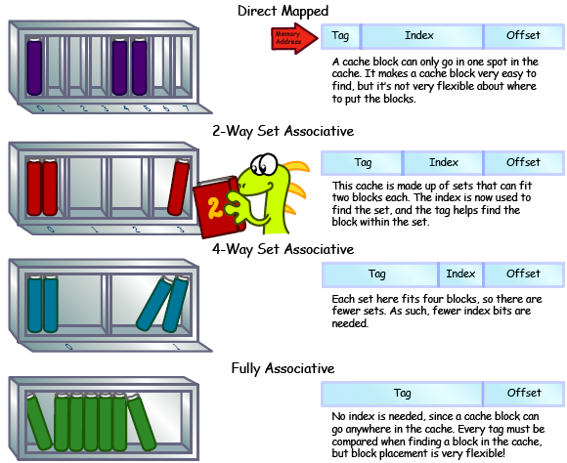
Notes:
Illustration from http://csillustrated.berkeley.edu/PDFs/cache-types.pdf

Slide 33
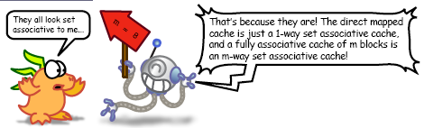

Slide 34
Range of SA Caches
For a fixed-size cache, each increase by a factor of two in associativity doubles the number of blocks per set (i.e., the number or ways) and halves the number of sets – decreases the size of the index by 1 bit and increases the size of the tag by 1 bit
Used for tag compare
Selects the set
Selects the word in the block
Tag
Index
Block offset
Byte offset
Increasing associativity
Decreasing associativity
DM (only one way)
Smaller tags, only a single comparator
FA (only one set)
Tag is all the bits except
block and byte offset
34
Notes:
For lecture
In 2008, the greater size and power consumption of CAMs generally leads to 2-way and 4-way set associativity being built from standard SRAMs with comparators with 8-way and above being built using CAMs
Example: moving from 20-bit Tag,

Slide 35
Cache associativity example
Consider 5-bit memory address, with 2^5=32 memory blocks. Where can memory block 12 be placed in a cache with 8 blocks?
32-Block Address Space:
Block
no.
1 1 1 1 1 1 1 1 1 1 2 2 2 2 2 2 2 2 2 2 3 3
0 1 2 3 4 5 6 7 8 9 0 1 2 3 4 5 6 7 8 9 0 1 2 3 4 5 6 7 8 9 0 1

Slide 36
Recall Example: 8-Block cache with different organizations
Cache: 8 blocks, each 4 Bytes. # cache blocks is equal to number of sets x associativity.
DM (1-way SA): 8 sets x 1 block per set. (Tag 2b, Index 3b, Offset 4b.)
2-way SA: 4 sets x 2 blocks per set (Tag 3b, Index 2b, Offset 4b.)
4-way SA: 2 sets x 4 blocks per set (Tag 4b, Index 1b, Offset 4b.)
FA (4-way SA): 1 set x 8 blocks per set (Tag 5b, Index 0b, Offset 4b.)
For fixed cache size, increasing associativity decreases number of sets while increasing number of blocks per set.
Notes:
With 8 blocks, 8-way SA is same as FA.

Slide 37
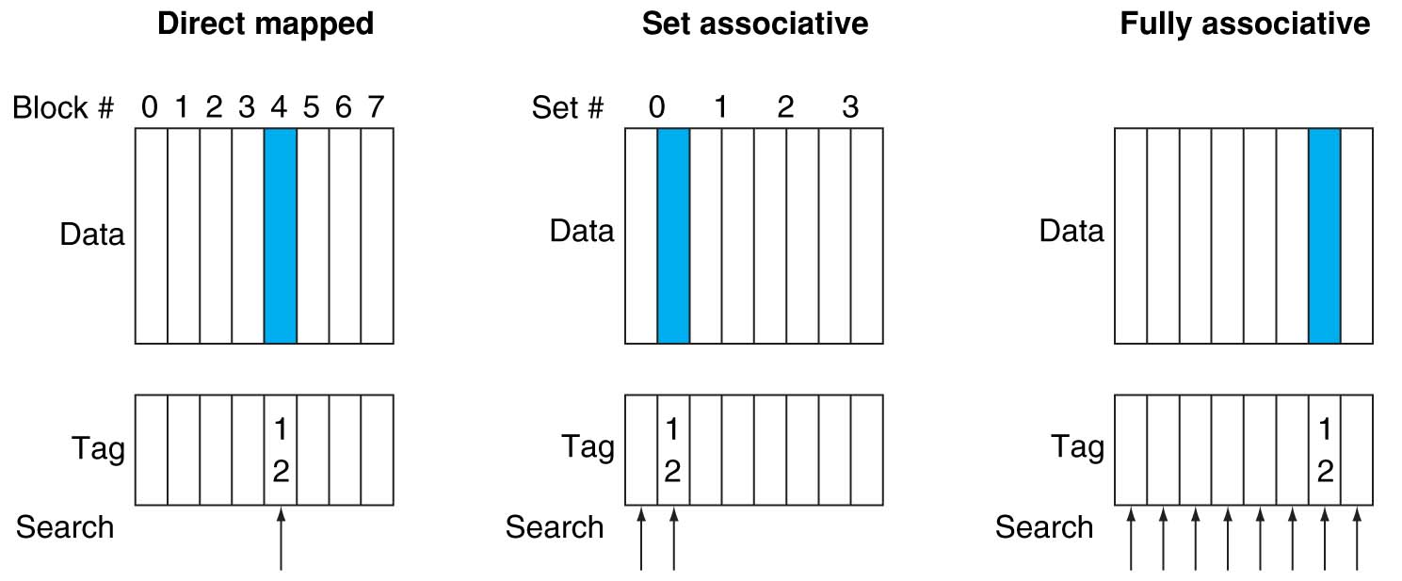
Cache associativity example con’t
DM: 8 sets x 1 block per set. Mem block 12 is always mapped to cache block index = 12 mod 8 = 4.
2-way SA: 4 sets x 2 blocks per set. Mem block 12 is mapped to cache set index = 12 mod 4 = 0; can be placed in either one of the 2 blocks in the mapped set.
FA: 1 set x 8 blocks per set. Mem block 12 can be placed in any cache block.
37
Notes:
mem block 12 in 8 block cache:
(8 cache blocks) 4 sets x 2-ways,

Slide 38
Example: 4-Word DM cache, worst-case memory reference sequence
Consider the sequence of memory accesses
0(0000) 4(0100) 0 4 0 4 0 4
Start with an empty cache - all blocks initially marked as not valid
0
miss
01
4
miss
00
0
miss
01
4
miss
4
4
0
00 Mem(0)
00 Mem(0)
01 Mem(4)
00 Mem(0)
00
0
miss
0
01
4
miss
4
00
0
miss
0
01
4
miss
4
01 Mem(4)
00 Mem(0)
01 Mem(4)
00 Mem(0)
8 requests, 8 misses
Ping pong effect due to conflict misses - two memory locations that map into the same cache block.
Notes:
For class handout

Slide 39
Example: 4-Word 2-Way SA cache with same memory reference sequence
Consider the sequence of memory accesses
0(0000) 4(0100) 0 4 0 4 0 4
Start with an empty cache - all blocks initially marked as not valid
0
miss
4
miss
0
hit
4
hit
000 Mem(0)
000 Mem(0)
000 Mem(0)
000 Mem(0)
010 Mem(4)
010 Mem(4)
010 Mem(4)
8 requests, 2 misses
Avoids the conflict misses due to ping pong effect in a DM cache, since now two memory locations (0 and 4) that map into the same cache set can co-exist!
39
Notes:
For lecture
Another sample string to try 0 1 2 3 0 8 11 0 3

Slide 40
Recall: DM cache: Example 3
32-bit address space. Tag: 20 bits; Index: 8 bits; Offset: 4 bits
Index 8 bits → 2^8=256 cache blocks
Tag 20 bits → 2^20=1 million memory addresses mapped to each cache index
Offset 4 bits → 2^4=16 Bytes (4 words) /block
Cache size = 256 blocks * 16 Bytes/block = 4K Bytes (1K words)
Byte offset
Hit
31 30 . . . 13 12 11 . . . 4 3 2 1 0
Data
Tag
20
8
Block offset
Index
Index
Valid
Tag
Data (words)
0
1
2
.
.
.
253
254
255
20
and
40
32

Slide 41
SA cache: Example 2
31 30 . . . 13 12 11 . . . 2 1 0
Byte offset
32-bit address space. Tag: 22 bits; Index: 6 bits; Offset: 4 bits
Index 6 bits → 2^6=64 cache sets, 4 blocks per set
Tag 22 bits → 2^22=4 million memory addresses mapped to each cache set
Offset 4 bits → 2^4=16 Bytes (4 words) /block
Cache size = 256 blocks * 16 Bytes/block = 4K Bytes (1K words)
Tag
22
6
Index
Index
V
Tag
Data
V
Tag
Data
V
Tag
Data
V
Tag
Data
0
1
2
.
.
.
62
63
64
0
1
2
.
.
.
62
63
64
0
1
2
.
.
.
62
63
64
0
1
2
.
.
.
62
63
64
Way 0
Way 1
Way 2
Way 3
32
4x1 select
Hit
Data
41
Notes:
32-bit address space. Tag: 22 bits; Index: 8 bits; Offset: 2 bits
4 Bytes/block, cache size = 4 Ways * 2⁸=256 blocks/way * 4 Bytes/block = 4K Bytes (1K words)
2^22=4 million memory addresses mapped to each cache set index (blue line)

Slide 42
Explanations
This is called a 4-way set associative cache because there are 4 cache blocks for each cache index.
The cache index selects a set from the cache.
The 4 tags in the set are compared in parallel with the upper 4 bits (Tag) of the memory address.
If no tags match the memory address tag, we have a cache miss.
Otherwise, we have a cache hit and we will select the data from the way where the tag match occurs.
SA cache
Pro: miss rate is lower.
Con: hit time is larger. A N-way SA cache needs N parallel comparators for tag comparisons followed by a multiplexer instead of just one comparator for DM cache, and it is slower than DM cache due to this extra multiplexer delay.
Notes:
2⁸ = 256 sets each with four ways (each with one block)
This is called a 4-way set associative cache because there are four cache entries for each cache index. Essentially, you have four direct mapped cache working in parallel.
This is how it works: the cache index selects a set from the cache. The four tags in the set are compared in parallel with the upper bits of the memory address.
If no tags match the incoming address tag, we have a cache miss.
Otherwise, we have a cache hit and we will select the data from the way where the tag matches occur.
This is simple enough. What is its disadvantages?
Must choose appropriate set (multiplexer) before data is available
First of all, a N-way set associative cache will need N comparators instead of just one comparator (use the right side of the diagram for direct mapped cache).
A N-way set associative cache will also be slower than a direct mapped cache because of this extra multiplexer delay.
Finally, for a N-way set associative cache, the data will be available AFTER the hit/miss signal becomes valid because the hit/mis is needed to control the data MUX.
For a direct mapped cache, that is everything before the MUX on the right or left side, the cache block will be available BEFORE the hit/miss signal (AND gate output) because the data does not have to go through the comparator.
This can be an important consideration because the processor can now go ahead and use the data without knowing if it is a Hit or Miss. Just assume it is a hit.
Since cache hit rate is in the upper 90% range, you will be ahead of the game 90% of the time and for those 10% of the time that you are wrong, just make sure you can recover.
You cannot play this speculation game with a N-way set-associative cache because as I said earlier, the data will not be available to you until the hit/miss signal is valid.
+2 = 38 min. (Y:18)

Slide 43
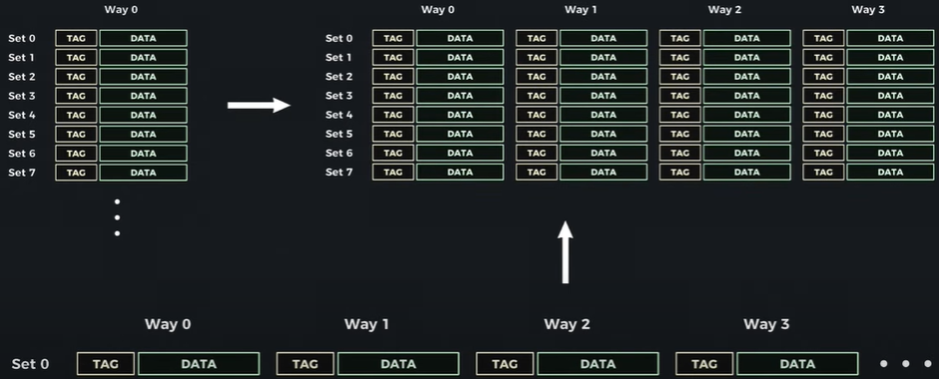
YouTube: How Cache Works Inside a CPU
DM Cache
SA Cache
DM Cache
FA Cache
How Cache Works Inside a CPU
https://www.youtube.com/watch?v=zF4VMombo7U&list=PL38NNHQLqJqYnNrTenxBvGJSPCkV9EOWk&index=1

Slide 44
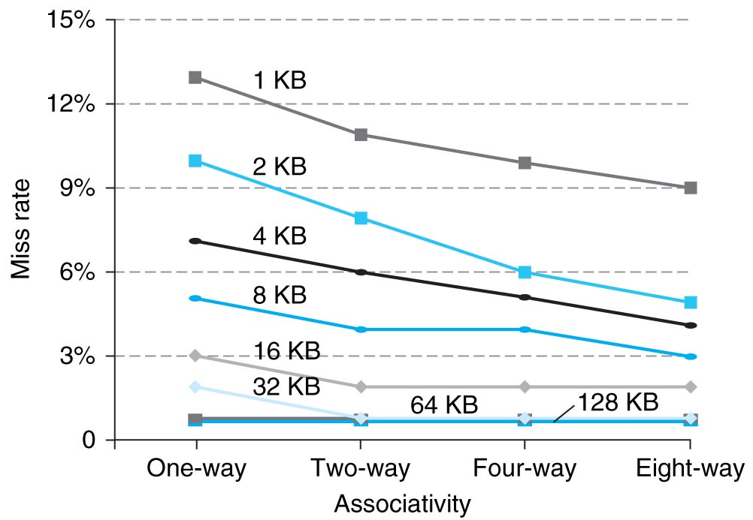
Miss rate vs. Associativity
Choice of DM or SA depends on the tradeoff between hit time and miss rate.
As cache size increases, relative improvement from associativity increases only slightly; since the overall miss rate of a larger cache is lower, the opportunity for reducing the miss rate decreases and the absolute improvement in miss rate from associativity shrinks significantly.
Largest gains are in going from DM to 2-way SA (20%+ reduction in miss rate)
44
Notes:
cost of a miss versus the cost of implementation

Slide 45
Miss rate vs. cache block size and cache size
Miss rate always decreases with increasing cache size (for any associativity)
As cache block size increases from a single byte, the miss rate will decrease at first.
It is likely that bytes near a needed byte will be accessed at about the same time.
But as cache block size increases the number of lines decreases.
Miss rate goes up if cache block size becomes a significant fraction of the cache size because the number of blocks that can be held in the same size cache is smaller (increasing capacity misses)
Useful cache blocks may be kicked out prematurely.
Performance depends on the application workload, associativity, and replacement algorithm.
Notes:
Cache design space
Cache size and cache block size
Determined to optimize access time
Associativity
Which cache blocks may be loaded into which cache slots
Can any block go in any slot, or is there a mapping function to define rules governing which block can be place in which slot
Replacement algorithm
When is a cache block in a cache slot replaced by another cache block
NOTE: MB/s = 1/nsec * 1000
As cache block size increases past its optimal value then the miss rate may begin to increase
it becomes more probable that the next access will involve the cache block that was just removed, i.e.,
A more serious problem is that the miss penalty goes up, since it is the time to fetch the block from the next lower level of the hierarchy and load it into the cache.

Slide 46
Caching Policy: Write-Back + Write-Allocate
Write-Back: Data is written to the cache first and marked as "dirty“. Main memory is updated only when a dirty cache block is evicted. This reduces the number of writes to slower main memory, improving performance.
Write-Allocate: On a write miss (when the data is not in the cache), a cache block is allocated, and the data is written to the cache. This makes future writes or reads to the same location faster.
Example: CPU writes to memory address A, which is not in the cache:
A write miss occurs. The write-allocate policy loads the memory block containing A into the cache. The CPU writes data to the cache block and marks it as "dirty“. Later, when the dirty cache block containing A is evicted, the updated data is written back to main memory.
Benefit: This approach minimizes memory writes and improves performance for workloads with frequent writes to the same location, which are mostly absorbed by the cache and do not go to main memory.
Notes:
Write-Through: Data is written simultaneously to both the cache (if present) and main memory. This ensures that main memory always has the most up-to-date data.
No-Write-Allocate: On a write miss, no cache block is allocated. Instead, data is written directly to main memory without involving the cache.
Example: CPU writes to memory address A, which is not in the cache:
A write miss occurs. The no-write-allocate policy skips loading A into the cache. The CPU writes directly to main memory, bypassing the cache.
Benefit: This approach avoids polluting the cache with data that may not be reused, which can be advantageous for workloads with infrequent writes or streaming data.
Read misses (I$ and D$)
Stall execution, fetch the block from the next level in the memory hierarchy, put it in the cache, send requested word to processor, and then let execution resume
Write misses (D$ only)
Write allocate: fetch the block from memory to cache, then write the word to cache
or
No-write allocate: skip the cache and just write the word to memory
Example: Consider a DM cache with 2-word (8-byte) cache block size. Assume we do a 4-byte write to memory location 0x000000 and causes a cache miss. Do we have to load the entire block (Bytes 0-7) from memory to cache before we write the cache tag and the 4-byte data into Bytes 0-3?
If we load the block before writing, it is called write-allocate.
If not, it is called write-no-allocate. In this case, you need to invalidate the entire cache block. Otherwise, you may have half of the cache block (Bytes 0-3) referring to one memory block, and the other half (Bytes 4-7) referring to another memory block, both mapped to the same cache index!

Slide 47
Caching Policy: Write-Through + No-Write-Allocate
Write-Through: Data is written simultaneously to both the cache (if present) and main memory. This ensures that main memory always has the most up-to-date data.
No-Write-Allocate: On a write miss, no cache block is allocated. Instead, data is written directly to main memory without involving the cache.
Example: CPU writes to memory address A, which is not in the cache:
A write miss occurs. The no-write-allocate policy skips loading A into the cache. The CPU writes directly to main memory, bypassing the cache.
Benefit: This approach avoids polluting the cache with data that may not be reused, which can be advantageous for workloads with infrequent writes or streaming data.
Notes:
Two policies to maintain cache-memory consistency.
Write-Through: write cache and write through the cache to memory
Pro: read misses do not result in writes
Con: Every write goes to memory, too slow (can add Write Buffer to allow processor to continue once data in Buffer)
Write-Back: write only to cache and then write cache block back to memory when evict block from cache
Include a dirty bit to cache block (writing to a block makes it “dirty”), and only write back if bit is set
Pro: repeated writes hit in cache, only single write to memory per block
Con: read miss may require write back of dirty block
Clean miss: the block being replaced is clean
Dirty miss: the block being replaced is dirty and needs to be written back to memory
Typical combinations:
Write-back + write allocate
Hoping for a subsequent writes (or reads) to the same location, which is now cached.
Write-through + no-write allocate
Consecutive writes have no advantage, since all writes go to memory
https://courses.cs.washington.edu/courses/cse378/09wi/lectures/lec18-annotated.pdf
Too slow, so include Write Buffer to allow processor to continue once data in Buffer, Buffer updates memory in parallel to processor
not sent to DRAM processor not held up on writes
WT:
WB:
Pro: repeated writes not sent to DRAM processor not held up on writes
Con: More complex Read miss may require write back of dirty block
Clean miss: the block being replaced is clean
Dirty miss: the block being replaced is dirty and needs to be written back to memory

Slide 48
Caching Policy Tradeoffs
Performance vs Consistency:
Write-back improves performance but risks losing data if the system crashes before eviction.
Write-through ensures consistency but incurs higher latency due to immediate writes.
Cache Utilization:
Write-allocate optimizes for future accesses but may evict useful blocks.
No-write-allocate avoids unnecessary evictions but doesn’t benefit from caching for future writes.
Policy | Cache Behavior on Write Miss | Memory Update Timing | Best For
Write-Back + Write-Allocate | Allocates block; writes to cache | On eviction | Write-intensive workloads
Write-Through + No-Write-Allocate | Writes directly to memory; no allocation | Immediate | Read-heavy or streaming workloads
CPU Cache Write Policies Explained
https://www.youtube.com/watch?v=wfVy85Dqiyc&list=PL38NNHQLqJqYnNrTenxBvGJSPCkV9EOWk&index=3
Cache Hierarchy: How Modern CPU Caches Are Organized
https://www.youtube.com/watch?v=7yrK_9PderQ&list=PL38NNHQLqJqYnNrTenxBvGJSPCkV9EOWk&index=4

Slide 49
Cache Block Replacement Policy
If a cache block in a SA or FA cache needs to be replaced due to a cache miss, typical replacement policy is Least Recently Used
Hardware keeps track of access history
Replace the block that has not been used for the longest time, since it is less likely to be reused due to temporal locality
For DM cache, each memory block is mapped to a unique cache slot, hence no need for replacement policy
49
Notes:
Random Replacement
Hardware randomly selects a cache block and throws it out
When miss occurs, which way’s block selected for replacement?
Least Recently Used (LRU): one that has been unused the longest
Must track when each way’s block was used relative to other blocks in the set
For 2-way SA $, one bit per set → set to 1 when a block is referenced; reset the other way’s bit (i.e., “last used”)
Example of a Simple “Pseudo” LRU Implementation
Assume 64 Fully Associative entries in a set.
Hardware replacement pointer points to one cache entry
Whenever access is made to the entry the pointer points to:
Move the pointer to the next entry
Otherwise: do not move the pointer

Slide 50
The Cache Design Space
Several interacting dimensions
Cache size
Block size
Associativity
Write-through vs. write-back
Write-allocate vs write-no-allocate
Replacement policy (for SA and FA caches)
Optimal choice is a compromise
Depends on access characteristics
Workload
Use (I-cache, D-cache)
Depends on technology / cost
Cache Size
(Associativity)
Block Size
Bad
Good
Factor A
Factor B
Less
More
Notes:
No fancy replacement policy is needed for the direct mapped cache.
As a matter of fact, that is what cause direct mapped trouble to begin with: only one place to go in the cache--causes conflict misses.
Besides working at Sun, I also teach people how to fly whenever I have time.
Statistic have shown that if a pilot crashed after an engine failure, he or she is more likely to get killed in a multi-engine light airplane than a single engine airplane.
The joke among us flight instructors is that: sure, when the engine quit in a single engine stops, you have one option: sooner or later, you land. Probably sooner.
But in a multi-engine airplane with one engine stops, you have a lot of options. It is the need to make a decision that kills those people.

Slide 51
Improving Cache Performance: Summary
1. Reduce hit time
Smaller cache
1 word blocks (no multiplexor/selector to pick word)
2. Reduce miss rate
Bigger cache size
Larger blocks (16 to 64 bytes typical)
More flexible placement by increasing associativity
3. Reduce miss penalty
Smaller blocks
Use multiple cache levels
Write-back instead of write-through
Notes:
Faster memory access bandwidth

Slide 52
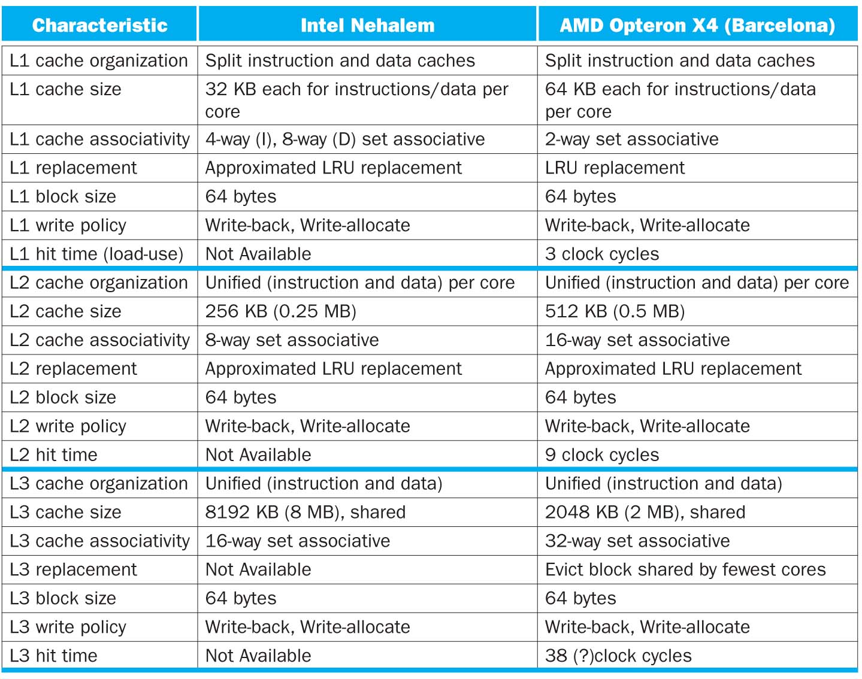
Intel Nehalem and AMD Opteron
L1→L2→L3
Size increasing
Associativity increasing
Both cause hit time to increase, and miss rate to decrease
Notes:
4 cores, 32KB I$/32-KB D$ L1$, 512KB L2$. L1$ and L2$ are private to each core
Share one single 8-MB L3$

Slide 53
Keeping Multiple Caches Coherent
HW architect’s job is to keep cache values coherent across multiple cores with shared memory.
One approach: When any processor has cache miss or writes, notify other processors via bus or interconnection network
If only reading, many processors can have copies
If a processor writes, invalidate all other copies, and write through to memory
53
Notes:
Shared written result can “ping-pong” between caches

Slide 54
Shared Memory and Caches
What if?
Processors 1 and 2 read Memory[1000] (value 20)
P0
P1
P2
Cache
1000 20
1000 20
Cache
Cache
Interconnection Network
Memory
20
I/O
54

Slide 55
Shared Memory and Caches
What if?
Processors 1 and 2 read Memory[1000]
Processor 0 writes Memory[1000] with 40
Processor 0
write-invalidates
other copies
1000
P0
P1
P2
1000 40
1000 20
1000 20
Cache
Cache
Cache
Interconnection Network
1000 40
Memory
I/O
55

Slide 56
False Sharing
Suppose block size is 32 bytes
Suppose Processor 0 reading and writing variable X, Processor 1 reading and writing variable Y
Suppose X is at address 4000, Y in 4012
Two variables are in the same cache block, even though they have different addresses
Effect called false sharing
56
Notes:
How can you prevent it?

Slide 57
Summary #1/2: Cache
Principle of Locality:
Program likely to access a relatively small portion of the address space at any instant of time.
Temporal Locality: Locality in Time
Spatial Locality: Locality in Space
Three Major Categories of Cache Misses:
Compulsory misses:
e.g., cold start misses.
Capacity misses:
Can be reduced by increasing cache size
Conflict misses
Can be reduced by increasing cache size and/or associativity
57
Notes:
Let’s summarize today’s lecture. I know you have heard this many times and many ways but it is still worth repeating.
Memory hierarchy works because of the Principle of Locality which says a program will access a relatively small portion of the address space at any instant of time.
There are two types of locality: temporal locality, or locality in time and spatial locality, or locality in space.
So far, we have covered three major categories of cache misses.
Compulsory misses are cache misses due to cold start. You cannot avoid them but if you are going to run billions of instructions anyway, compulsory misses usually don’t bother you.
Conflict misses are misses caused by multiple memory location being mapped to the same cache location.
The nightmare scenario is the ping pong effect when a block is read into the cache but before we have a chance to use it, it was immediately forced out by another conflict miss.
You can reduce Conflict misses by either increase the cache size or increase the associativity, or both.
Finally, Capacity misses occurs when the cache is not big enough to contains all the cache blocks required by the program. You can reduce this miss rate by making the cache larger.
There are two write policy as far as cache write is concerned. Write through requires a write buffer and a nightmare scenario is when the store occurs so frequent that you saturates your write buffer.
The second write polity is write back. In this case, you only write to the cache and only when the cache block is being replaced do you write the cache block back to memory.
Use a write buffer to hold dirty blocks being replaced so don’t have to wait for the write to complete before reading. Check write buffer on read miss – may get lucky
+3 = 77 min. (Y:57) How to Calculate 3C’s using Cache Simulator
Compulsory: set cache size to infinity and fully associative, and count number of misses
Capacity: Change cache size from infinity, usually in powers of 2, and count misses for each reduction in size
16 MB, 8 MB, 4 MB, … 128 KB, 64 KB, 16 KB
Conflict: Change from fully associative to n-way set associative while counting misses
Fully associative, 16-way, 8-way, 4-way, 2-way, 1-way
The Principle of Locality:
Program likely to access a relatively small portion of the address space at any instant of time.
Temporal Locality: Locality in Time
Spatial Locality: Locality in Space
Three Categories of Cache Misses:
Compulsory Misses: sad facts of life. Example: cold start misses.
Conflict Misses: increase cache size and/or associativity
Capacity Misses: increase cache size
Cache Organizations:
Direct Mapped: single block per set
Set associative: more than one block per set
Fully associative: all entries equivalent

Slide 58
Summary #2/2: Cache
Cache organizations:
Direct Mapped (DM): single block per set
Set Associative (SA): more than one block per set
Fully Associative (FA): all blocks in one set
Set associativity - reduce cache miss rate
Memory block maps into more than 1 cache block
N-way: N possible locations in a cache set to hold a memory block
Lots of cache parameters!
Block size, cache size, associativity, write-back vs. write-through, write-allocate, etc.
Multi-level caches - reduce cache miss penalty
Optimize first level to be fast
Optimize 2nd and 3rd levels to minimize the memory access penalty

Slide 59
Quiz
Q: Consider 32-bit address space; a DM cache with size 32 KB; each cache block is 8 words. What is the TIO breakdown?
ANS: T=17, I=10, O=5
8-word per block => 32 bytes / block => O = 5
32 KB / (32 bytes / block) = 2^10 blocks total => I = 10
T = 32 – 10 – 5 = 17
Q: Consider 32-bit address space; a 4-way SA cache with size 32 KB; each cache block is 8 words. What is the TIO breakdown?
ANS: T=19, I=8, O=5 (Tag 19b, Index 8b, Offset 5b)
8-word per block => 32 bytes / block => O = 5
32 KB / (32 bytes / block) = 2^10 blocks total
2^10 blocks / (4 blocks / set) = 2^8 sets total => I = 8
T = 32 – 8 – 5 = 19
Q: Consider 32-bit address space; an FA cache with size 32 KB; each cache block is 8 words. What is the TIO breakdown?
ANS: T=27, I=0, O=5
8-word per block => 32 bytes / block => O = 5
FA cache => I = 0
T = 32 – 0 – 5 = 27
59
Notes:
Index bits will index into sets
32-bit address space, 32 KB 4-way SA cache with 8-word blocks. What is the breakdown of TIO bits?
32-bit address space, 32 KB FA cache with 8-word blocks.

Slide 60
Quiz con’t
Q: Consider 32-bit address space; a DM cache with size 16 KB; each cache block is 4 words. What is the TIO breakdown?
ANS: T=18, I=10, O=4
4-word per block => 16 bytes / block => O = 4
16 KB / (16 bytes / block) = 2^10 blocks total => I = 10
T = 32 – 10 – 4 = 18
Q: Consider 32-bit address space; a 2-way SA cache with size 16KB; each cache block is 4 words. What is the TIO breakdown?
ANS: T=19, I=9, O=4
4-word per block => 16 bytes / block => O = 4
16 KB / (16 bytes / block) = 2^10 blocks total
2^10 blocks / (2 blocks / set) = 2^9 sets total => I = 9
T = 32 – 9 – 4 = 19
Q: Consider 32-bit address space; an FA cache with size 16KB; each cache block is 4 words. What is the TIO breakdown?
ANS: T=27, I=0, O=5
4-word per block => 16 bytes / block => O = 4
FA cache => I = 0
T = 32 – 0 – 4 = 28
Notes:
Cache size = 16 * 2^10 bytes
cache block size = 16 bytes
Set size = cache block size * set associativity = 16 bytes * 2 = 32 bytes
Number of sets = 16 * 2^10 bytes / 32 bytes = 2^9
Index bits = 9
Offset bits = 4
Tag bits = 32 – 9 – 4 = 19
A:
Cache size = 16KB = 16 * 2^10 bytes
Cache block size = 4 words = 4 * 4 bytes = 16 bytes = 2^4
Number of cache blocks= 16 * 2^10 bytes / 16 bytes = 2^10
Index bits = 10
Offset bits = 4
Tag bits = 32 – 10 – 4 = 18

Slide 61
Quiz con’t
Q: How many 32-bit integers can be stored in a DM cache with 15 tag bits, 15 index bits, and 2 offset bits?
A: Each cache block is 2^2=4 Bytes and can store one 32-bit integer. The cache has a total number of 2^15=32K blocks, hence it can store 32K integers. (The tag bits are irrelevant here since it is related to memory size, not cache size)
Notes:
Q: You are trying to access memory byte address 0x3434 in a system with a 16 bit address space. What are the corresponding tag, index and offset for a 32-line direct-mapped cache with 1 word blocks? (in hex)
A: The cache has TIO breakdown of 9:5:2 (1 word = 4 Bytes → 2 Offset Bits; 32-line cache → 5 Index Bits; 16-(5+2)=9 Tag Bits.) Memory address 0x3434 in binary is 0011010000110100 (Online hex converter: Online hex converter: http://easycalculation.com/hex-converter.php)
You are trying to access memory byte address 0x3434 in a system with a 16 bit address space. What are the corresponding tag, index and offset for a 16-line direct-mapped cache with 4 word blocks? (in hex)
You are trying to access memory byte address 0x3434 in a system with a 16 bit address space. What are the corresponding tag, index and offset for a 1kiB direct-mapped cache with 2 word blocks? (in hex)
What is the ratio of data bits to total bits in a 128 byte write-back direct-mapped cache that has 2-word blocks and is part of a 64-bit byte-addressed memory system?

Slide 62
Quiz con’t
For a given cache size, a larger block size can cause a lower hit rate than a smaller one.
True. A large block size leads to fewer cache blocks.
If you know your computer’s cache size, you can often make your code run faster.
True. By tuning your code to be cache-aware.
Memory hierarchies take advantage of spatial locality by keeping the most recent data items closer to the processor.
False. This is called temporal locality.
Notes:
If the block size gets too big, fetches become more expensive and the big blocks force out more useful data.

