Slide 1
CSC 112: Computer Operating Systems Lecture 4 Deadlocks
Department of Computer Science,
Hofstra University
Acknowledgement: Lecture slides based on UC Berkeley CS 162: Operating Systems and System Programming

Slide 2

Deadlock
Definition: A set of threads are said to be in a deadlock state when every thread in the set is waiting for an event that can be caused only by another thread in the set
Conditions for Deadlock
Mutual exclusion
Only one thread at a time can use a given resource
Hold-and-wait
Threads hold resources allocated to them while waiting for additional resources
No preemption
Resources cannot be forcibly removed from threads that are holding them; can be released only voluntarily by each holder
Circular wait
There exists a circle of threads such that each holds one or more resources that are being requested by next thread in the circle
Wanted
Resource 1
Held
Thread 1
Thread 2
Resource 2
Held
Wanted
Not a perfect analogy, just a fun image!
Notes:
Permanent blocking of a set of threades that share multiple resources. Each thread in the set is waiting for a resource that only another thread in the set can make available
Blocking is caused by threades waiting for resources that are in use by other threades waiting for other resources
e.g., thread A owns Res 1 and is waiting for Res 2 thread B owns Res 2 and is waiting for Res 1
Neither thread can proceed, so they are in a deadlock
Four conditions for deadlock
Mutual exclusion
Only one thread at a time can use a resource
Hold and wait
thread holding at least one resource is waiting to acquire additional resources held by other threades
No preemption
Resources are released only voluntarily by the threades
Circular wait
Cyclic waiting pattern
Mutual exclusion
Only one thread at a time can use a resource.
Hold and wait
thread holding at least one resource is waiting to acquire additional resources held by other threades.
No preemption
Resource cannot be forcibly removed from a thread; can be released only voluntarily by the thread.
Circular wait
A circle of threades exists such that each thread holds at least one resource needed by the previous thread in the circle

Slide 3
Starvation vs Deadlock
Starvation: thread waits indefinitely
Example, low-priority thread waiting for resources constantly in use by high-priority thread
Deadlock: circular dependency waiting for resources
Deadlock ⇒ Starvation but not vice versa
Starvation can end (but doesn’t have to)
Deadlock can’t end without external intervention
Notes:
Starvation vs. Deadlock
Starvation: thread waits indefinitely
Deadlock: circular waiting for resources

Slide 4
Bridge Crossing Analogy
Each segment of road can be viewed as a resource
Car must own the segment under them
Must acquire segment that they are moving into
For bridge: must acquire both halves
Traffic only in one direction at a time
Problem occurs when two cars in opposite directions on bridge: each acquires one segment and needs next
If a deadlock occurs, it can be resolved if one car backs up (preempt resources and rollback)
Several cars may have to be backed up
Starvation is possible
Heavy traffic going east ⇒ no car can go west
Honk!

Slide 5
Train Example (Wormhole-Routing for Network-on-Chip)
Circular dependency (Deadlock!)
Each train wants to turn right, but blocked by other trains
Similar problems occur for Network-on-Chip
One solution:
Force ordering of channels (fixed global order on resource requests)
Protocol: Always go horizontal (east-west) first, then vertical (north-south)
Called “dimension ordering” (X then Y)
Disallowed
By Rule

Slide 6
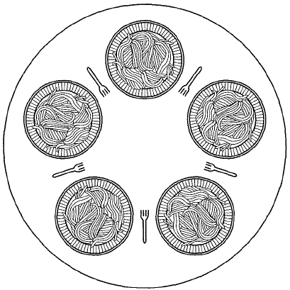
Dining philosophers
5 forks/5 philosophers
Need two forks to eat
What if all grab left fork at same time?
Deadlock!
How to fix deadlock?
Make one of them give up a fork
Eventually everyone will get chance to eat
How to prevent deadlock?
Never let philosopher take last fork if no hungry philosopher has two forks afterwards
DINING-PHILOSOPHERS PROBLEM: SIMPLIFIED
https://www.youtube.com/watch?v=VSkvwzqo-Pk
Notes:
Philosopher will grab any one they can

Slide 7
Handling Deadlocks
Deadlock prevention
Make sure one of the conditions necessary to create a deadlock cannot be present in the system
Deadlock detection
Resource Allocation Graph (cannot handle multi-instance resources well)
Banker’s algorithm for detecting (potential) deadlocks
Deadlock recovery
Let deadlock happen
Monitor the system state periodically to detect when deadlock occurs
Take action to break the deadlock

Slide 8
Deadlock Prevention Techniques
Break “mutual exclusion” by spooling resources
Break “hold and wait” condition: Make all threades request everything they’ll need at the beginning.
Problem: Predicting future is hard, tend to over-estimate resources
Example:
If need 2 forks, request both at same time (our solution to dining philosopher problem)
Break “circular wait” condition:
Force all threades to request resources in a particular order to prevent cyclic use of resources. Example:
Request disk, then memory, then…
Recall: simple solution to dining philosopher problem
May not be practical, since runtime resource usage pattern is generally unknown
Banker’s algorithm can prevent future “circular wait” conditions by detecting potential deadlocks
Break “no preemption” condition:
Forcibly remove resources from threads
Condition | Approach
Mutual exclusion | Spooling
Hold and wait | request all resources initially
Circular wait | Request resources in a particular order
No preemption | Take resources away
Notes:
Figure 6-14. Summary of approaches to deadlock prevention.

Slide 9
Spooling
A single daemon thread directly uses the resource; other threades send their requests to the daemon, e.g.:
The resource is no longer directly shared by multiple threades
Proc 1
Printing
Daemon
Printer
Proc 2

Slide 10
Request all resources initially
Disallow hold-and-wait
Make each thread request all resources at the same time and block until all resources are available to be granted simultaneously
One solution to Dining Philosopher problem
May be inefficient
thread may have to wait a long time to get all its resources when it could have proceeded and completed a significant portion of it work with the resouces that were already available
Resources allocated to a thread may remain unused for long periods of time blocking other threades
threades may not know all resources they will require in advance.
Notes:
How do we prevent deadlock from happening under any circumstances within our application?
Direct prevention: Design to avoid deadlock (no circular waits possible)
Indirect prevention: prevent the occurrence of one of the necessary conditions
Generally need mutual exclusion so that is not a good candidate to disallow

Slide 11
Order resources numerically
Prevent circular wait
Define a total order of resources; If a thread holds certain resources, it can subsequently request only resources that follow the types of held resources in the total order.
This prevents a thread from requesting a resource that might cause a circular wait.
Example; all threads requests sem1 before sem2
Another solution to Dining Philosopher’s problem
Introduces inefficiencies and can deny resources unnecessarily.
semaphore sem1, sem2;
void t1( ) {
sem1.wait();
sem2.wait();
//Critical Section
sem2.post();
sem1.post();
}
void t2( ) {
sem2.wait();
sem1.wait();
//Critical Section
sem1.post();
sem2.post();
}
semaphore sem1, sem2;
void t1( ) {
sem1.wait();
sem2.wait();
//Critical Section
sem2.post();
sem1.post();
}
void t2( ) {
sem1.wait();
sem2.wait();
//Critical Section
sem2.post();
sem1.post();
}
Possible deadlock
No deadlock
Notes:
May be impossible to re-request the same resource
Example: no deadlock (Order resources numerically)
if thread L has resource 1 and thread J has resource 3, the thread L can request resource 3, but thread J cannot request resource I and cause deadlock

Slide 12
Take resources away
Allow preemption. Can be implemented different ways
If a thread holding a resource is denied another resource and forced to wait, it must relinquish the resource it is holding and request it again (if needed) when the blocked resource is available
If a thread requests a resource that is in use (usually by a lower priority thread), the thread using the resource will be preempted and the resource will be supplied to the requesting thread.
Requires additional OS complexity
Mainly used for deadlock recovery, not prevention
Notes:
(more later)

Slide 13
Ostrich algorithm
Ignore the possibility of deadlock, maybe it won’t happen
In some situations this may even be reasonable, but not in all
If a deadlock in a thread will happen only once in 100 years of continuous operation we may not want to make changes that will likely decrease efficiency to avoid that rare event.
Events will occur randomly, we don’t know that the 1 in 100 years will not occur in 1 second. If a deadlock in a thread will happen on average once per minute, we probably want to do something other than implement the ostrich algorithm and ignore it
In mission critical applications, the ostrich algorithm approach is inappropriate if a catastrophic failure may result from a deadlock
Notes:
https://tenor.com/en-GB/search/ostrich-head-in-sand-gifs

Slide 14
Resource-allocation graph (RAG)
System Model
A set of threades P₁, P₂, . . ., P_{n}
Resource types R₁, R₂, . . ., R_{m}
CPU cycles, memory space, I/O devices
Each resource type R_{i} has W_{i} instances.
Each thread utilizes a resource as follows:
Request() / Use() / Release()
Resource-Allocation Graph (RAG):
V is partitioned into two types:
P = {P₁, P₂, …, P_{n}}, set of threades in the system.
R = {R₁, R₂, …, R_{m}}, set of resource types in system
request edge – directed edge P₁ → R_{j}
assignment edge – directed edge R_{j} → P_{i}
Symbols
P₁
P₂
R₁
R₂

Slide 15
RAG for deadlock detection
For any given sequence of requests for and releases of resources a RAG can be constructed
We check the graph
no cycle → no deadlock
Each resource has a single instance AND cycle → deadlock (necessary and sufficient)
Each resource has multiple instances AND cycle → maybe deadlock (but not sufficient condition)
Need Banker’s algorithm to detect deadlocks
R2
Resource 2 held by Thread 2
Resource 2 requested by Thread 2
P1
P2
R1
Resource 1 requested by Thread 2
Resource 1 held by Thread 2
A RAG with a deadlock
Notes:
deadlock IMPLIES cycle (necessary condition)

Slide 16
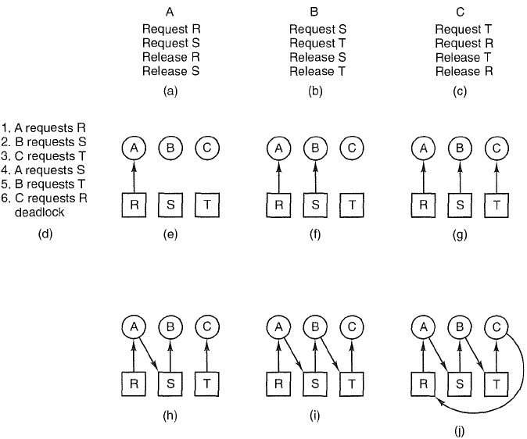
A deadlock example

Slide 17
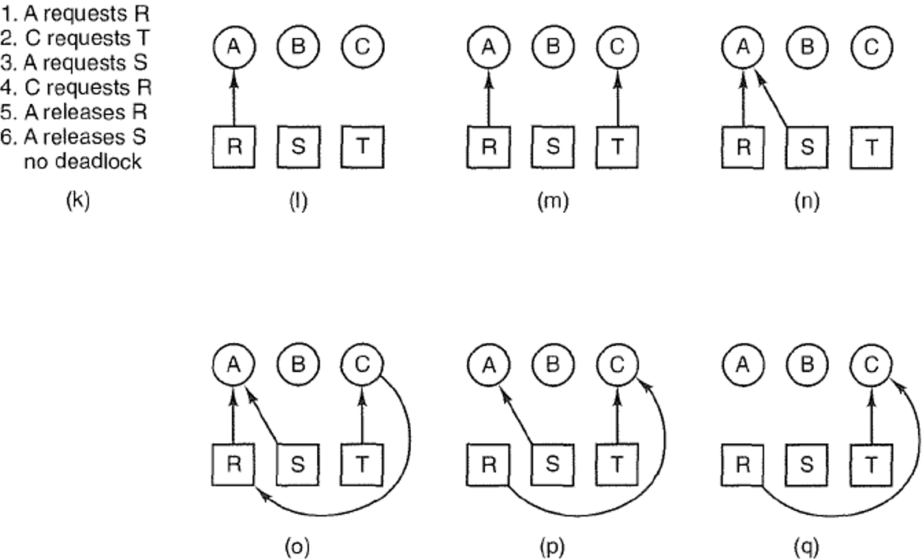
Deadlock is avoided by delaying B’s request
Notes:
Figure 6-4. An example of how deadlock occurs and how it can be avoided.

Slide 18
Resource Allocation Graph Examples
R₁
R₂
R₁
R₂
R₁
T₂
T₁
T₂
T₃
T₁
T₂
T₃
T₁
T₃
R₃
T₄
R₄
R₃
R₂
R₄
No Cycle;
No Deadlock
Deadlock (cycle R₃->T₂->R₂->T₃
And cycle R₃->T₁->R₁->T₂->R₂->T₃
Cycle,
but No Deadlock
(T₂ or T₄ may release
res later)
Notes:
Animation: http://cs.uttyler.edu/Faculty/Rainwater/COSC3355/Animations/deadlock.htm

Slide 19
Banker’s algorithm for deadlock detection
To avoid deadlocks we need to be able to detect them, preferably before they occur.
RAG can only detect deadlocks reliably for the case of single-instance resources.
Banker’s algorithm is more general and can deal with multiple-instance resources. It is used to recognize when it is safe to allocate resources
Analyze the state of the system; If the state is unsafe, take actions to break actual or potential deadlocks and bring the system back to a safe state
Do not grant additional resources to a thread if this allocation might lead to a deadlock

Slide 20
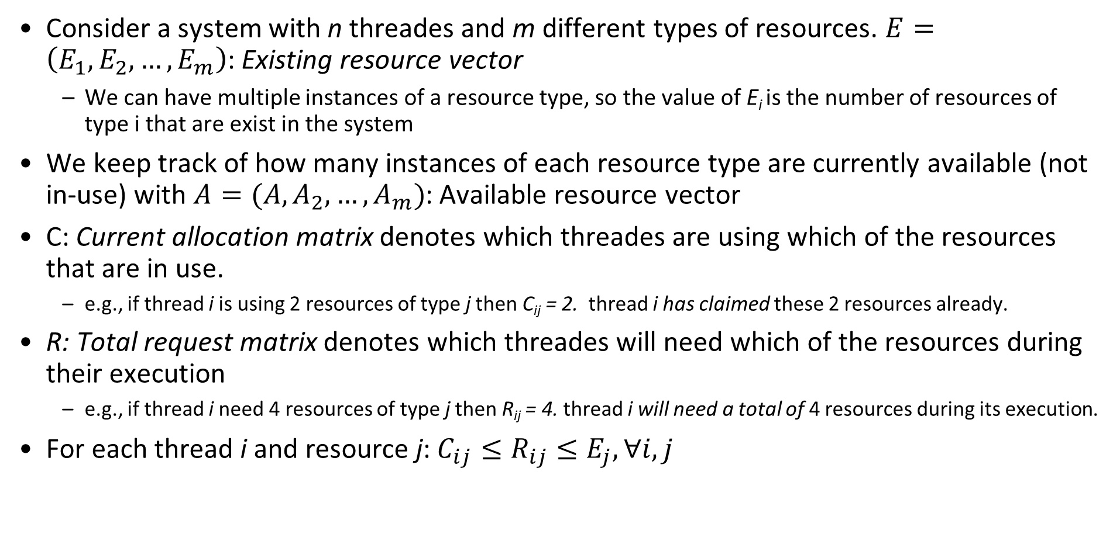
Problem Definition
Consider a system with n threades and m different types of resources. $E=\left(E_{1},E_{2}, …, E_{m}\right)$: Existing resource vector
We can have multiple instances of a resource type, so the value of E_{i} is the number of resources of type i that are exist in the system
We keep track of how many instances of each resource type are currently available (not in-use) with $A=(A,A_{2}, …, A_{m})$: Available resource vector
C: Current allocation matrix denotes which threades are using which of the resources that are in use.
e.g., if thread i is using 2 resources of type j then C_{ij} = 2. thread i has claimed these 2 resources already.
R: Total request matrix denotes which threades will need which of the resources during their execution
e.g., if thread i need 4 resources of type j then R_{ij} = 4. thread i will need a total of 4 resources during its execution.
For each thread i and resource j: $C_{ij}≤R_{ij}≤E_{j},∀i, j$
Notes:
Every resource is either allocated or available
thread i will need these 4 resource
No thread can claim more than the total amount of resources in the system; No thread is allocated more resources of any type than the thread originally claimed to need

Slide 21
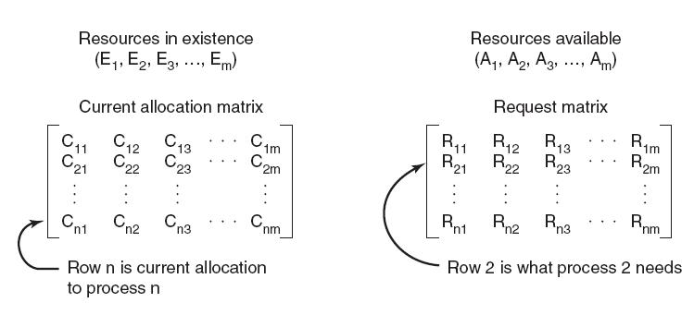
Four data structures encode current state of the system
Total
Notes:
Figure 6-6. The four data structures
Define the state of a thread to be a list of the number of resources of each available type presently allocated to it, and the maximum number of resources of each type it will need simultaneously
The state of the system is an aggregate of the states of all the threades in the system along with the number of available and allocated resources of each type, encoded in the following:
E (Existing resource vector)
A (Available resource vector)
R (Total Request matrix)
C (Current allocation matrix)

Slide 22
Safe states and unsafe states
The state of the system can be either safe or unsafe
A safe state is a state in which there exists at least one sequence of resource allocations that will allow all threades in the system to complete without deadlock
An unsafe state is a state in which there exists no sequence of resource allocation that will complete all threades in the system without deadlock
Each time a resource is requested, determine the state of the system after the resource is allocated, and if that state is safe or unsafe (will potentially deadlock). If the state will be unsafe we block the thread and do not allocate the requested resources (to avoid potential deadlock)

Slide 23
Bankers algorithm: preliminaries
Compute R-C: Resources needed matrix
To determine if a thread i can run to completion, we need to compare two vectors:
(R-C)_{i}: row i in the matrix R-C of unmet resource needs
A: available resources vector A
(R-C)_{i} <= A if (R_{ij} –C_{ij}) <= A_{j} for all resource type j

Slide 24
Banker’s algorithm
Algorithm CheckSafety() for checking to see if a state is safe:
Compute resources needed R-C
ook for a thread i that can run to completion by finding an unmarked row i with (R-C)_{i} ≤ A. If no such row exists, system will eventually deadlock since no thread can run to completion
Assume thread of row i requests all resources it needs and finishes. Mark thread i as completed, free all its resources and add the i-th row of C to the A vector
Repeat steps 1 and 2 until either all threades marked terminated (initial state is safe) or no thread is left whose resource needs can be met (there is a deadlock, so initial state is unsafe).
Notes:
Look for an unmarked thread, P_{i} , for which the i-th row of R is less than or equal to A.
If such a thread is found, add the i-th row of C to A, mark the thread as completed, and go back to step 1.
If no such thread exists, the algorithm terminates.
If (R_{Lk} –C_{Lk}) ≤ A_{k} for all k)

Slide 25
Banker’s algorithm cont’
When a thread makes a request for one or more resources:
Update the state of the system assuming the requests are granted.
Determine if the resulting state is a safe state by calling CheckSafety()
If so grant the request for resources.
Otherwise, block the thread request until it is safe to grant it.

Slide 26
An example system: starting state
4 threads P1 through P4; 4 resource types with 10, 5, 6, 5 instances each.
Current system state encoded in matrices R, C and vectors E, A.
Total request matrix
Current allocation matrix
Resources in existence
Resources available
A is obtained by subtracting each column sum of C from E
10-(1+5+2+0)=2, 5-(0+1+1+0)=3
6-(0+1+1+2)=2, 5-(0+1+0+0)=4
Notes:
Resources in existence
Resources available
(E1, E2, E3, ..., Em)
(A1, A2, A3, ..., Am)
Total Request matrix
Current allocation matrix

Slide 27
Request to check for safety
Assume the starting state is a safe state (can be checked with Banker’s algorithm)
P2 is now requesting 2 more of Resource 1 and 1 more of Resource 3
Do we grant this request? Might this request cause deadlock?
Step 1: Calculate the state of the system if this request is filled
Step 2: determine if the new state is a safe state with Bankers algorithm

Slide 28
An example system: new state
Total request matrix
Current allocation matrix
Resources needed matrix
Resources in existence
Resources available
A is obtained by subtracting each column sum of C from E
10-(1+7+2+0)=0, 5-(0+1+1+0)=3
6-(0+2+1+2)=1, 5-(0+1+0+0)=4

Slide 29
An example: is new state safe
Check row 1 of matrix R-C
(R-C)₁ = [2, 2, 2, 1] > A
P1 cannot run to completion

Slide 30
An example: is new state safe
Check row 2 of matrix R-C
(R-C)₂ = [0, 0, 1, 0] <= A
Allocate resources and run P2 to completion;
Free all its resources and add them to A:
A=[0 3 1 4]+[7 1 2 1] = [7 4 3 5]

Slide 31
An example: is new state safe
Row 2 thread marked as completed
Check row 1 of matrix R-C again
(R-C)₁ = [2, 2, 2, 1] <= A
Allocate resources and run P1 to completion;
Free all its resources and add them to A:
A = [7 4 3 5] + [1 0 0 0]=[8 4 3 5]

Slide 32
An example: is new state safe
Check row 3 of matrix R-C
(R-C)₃ = [1, 0, 3, 0] <= A
Allocate resources and run P3 to completion;
Free all its resources and add them to A:
A = [8 4 3 5] + [2 1 1 0] = [10 5 4 5]

Slide 33
An example: is new state safe
Check row 4 of matrix R-C
(R-C)₄ = [4, 2, 0, 1] <= A
Allocate resources and run P4 to completion
Free all its resources and add them to A:
A = [10 5 4 5] + [0 0 2 0] = [10 5 6 5]

Slide 34
An example: is new state safe
Now:
All thread can complete successfully. Therefore, the starting state is a safe state
Allocate the requested resources (2 more of resource 1 and 1 more of resource 3) to P2, and proceed with execution of all threads
Notes:
thread 2 is now requesting 2 more of resource 1 and 1 more of resource 3

Slide 35
Next Request to Check for Safety
Now start from this new safe state, and consider the next request for resources
Thread 1 is now requesting 1 more of resource 3
Do we grant this request? Might this request cause deadlock?
Step 1: Calculate the state of the system if this request is filled
Step 2: Determine if the new state is a safe state, use the bankers algorithm

Slide 36
New starting state: next request, is this state safe?
Check all rows
(R-C)₁ = [2, 2, 1, 1] (R-C)₁ > A
(R-C)₂ = [0, 0, 1, 0] (R-C)₂ > A
(R-C)₃ = [1, 0, 3, 0] (R-C)₃ > A
(R-C)₄ = [4, 2, 1, 0] (R-C)₄ > A
No thread can run to completion. The state is unsafe, as threades may be deadlocked

Slide 37
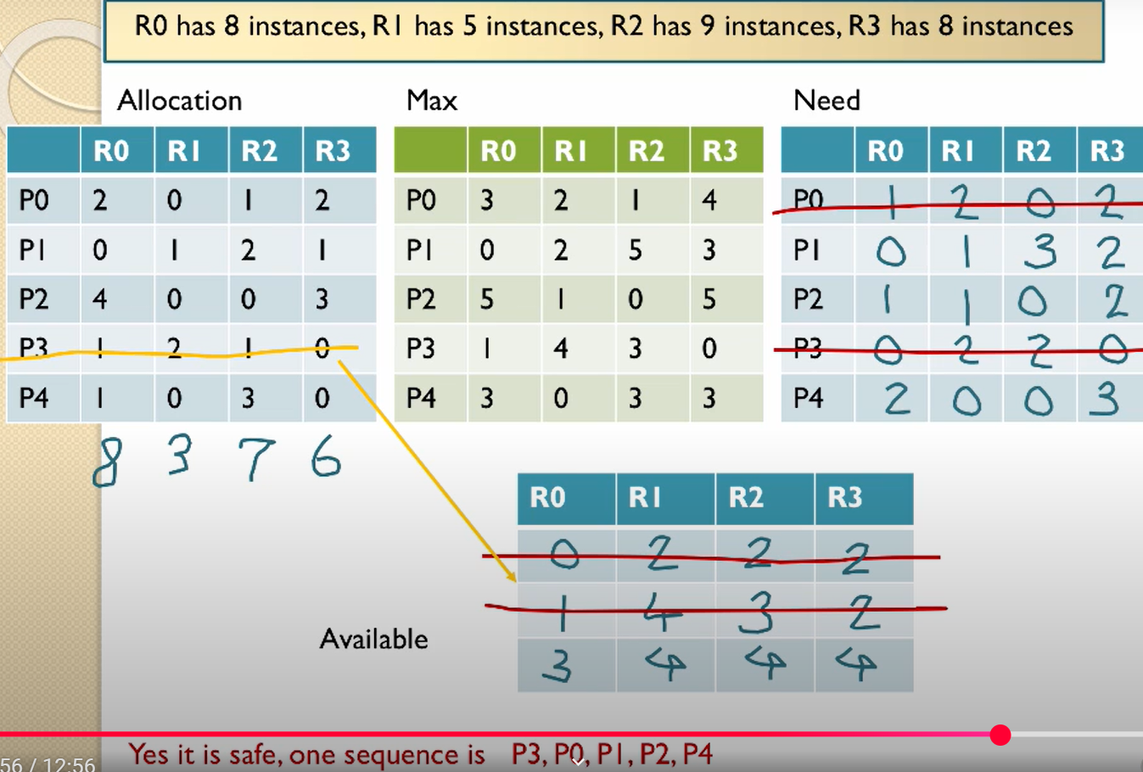
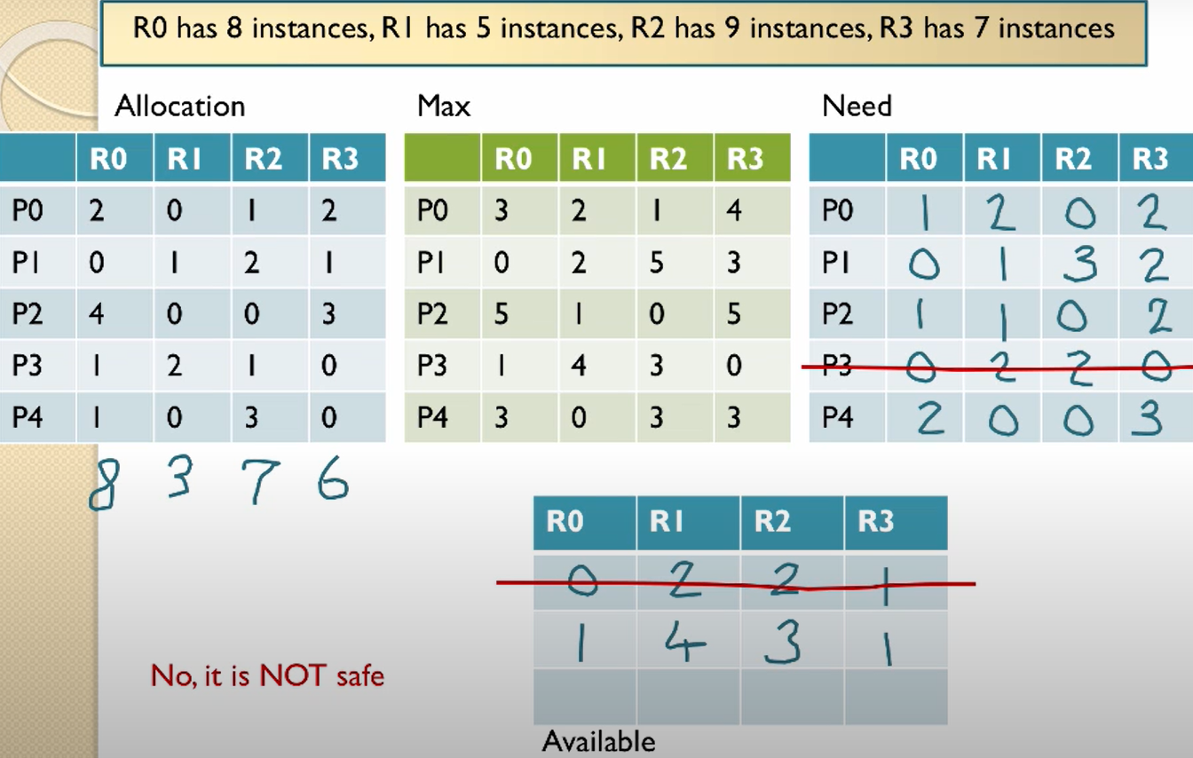
Video tutorial of Bankers algorithm
Deadlock avoidance: https://www.youtube.com/watch?v=AvPjOyeJbBM

Slide 38
Unsafe state vs. deadlock
The unsafe state indicates not that the system is deadlocked or will become deadlocked, but that there is potential for deadlock if the system operates in that state. Thus, to avoid deadlock, we do not allow the system to allocate resources that would put it into an unsafe state.
This is a conservative strategy. It is possible that threads blocked because of a risk of deadlock would not in fact cause a deadlock during execution
We are basing deadlock detection on worst case assumptions
The thread may use ALL the resources it needs at any time

Slide 39
Banker’s algo applied to Dinning Philosophers
State is safe if when a philosopher tries to take a fork, either
It is not the last fork,
Or it is the last fork, but someone will have 2 forks afterwards.
Equivalently: do not let a philosopher take the last fork if no one will have 2 forks afterwards.
Consider N philosophers
If each of the N-1 philosophers holds his left fork, then the N^{th} philosopher will be prevented from taking the last fork.
If a philosopher is holding his left fork, he can safely pick up his right fork if available, and vice versa.
If one or more philosophers are holding 2 forks and eating, then any remaining forks can be picked up safely by any other philosopher.
Banker’s algorithm can be used to verify each of these scenarios

Slide 40
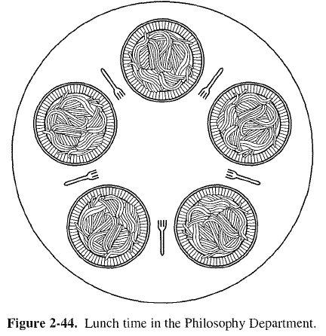
Banker’s algo applied to Dinning Philosophers cont’
Model each fork as a separate resource, since each philosopher can only pick up his left and right forks.
Suppose we have 5 philosophers numbered 1-5, and 5 forks numbered 1-5; philosopher i has left fork numbered i, and right fork (i+1)%5.
4
5
4
5
3
1
3
1
2
2

Slide 41
When 4 philosophers each holds his left fork
Total Request matrix
Current allocation matrix
Resources in existence
Resources available
Philosophers 1-4 each is holding his left fork. If the 5th philosopher makes a request for his left fork, should we grant it?

Slide 42
The deadlocked state when each holds his left fork
Total Request matrix
Current allocation matrix
Resources in existence
Resources available
No. Here is the deadlock state reached if the request is granted.

Slide 43
Multi-Armed Lawyers
Consider a large table with IDENTICAL multi-armed alien lawyers. In the center is a pile of chopsticks. In order to eat, a lawyer must have one chopstick in each hand. The lawyers are so busy talking that they can only grab one chopstick at a time. Design a deadlock-free algorithm using monitors and Bankers algorithm. Assume total number of chopsticks >= number of hands of each lawyer, so at least one lawyer can eat.
It is not a generalization of the 2-armed Dining Philosophers problem. Since the chopsticks are in a pile at center of the table, we should model them as a single resource with multiple instances, instead of multiple resources for the Dining Philosophers, where each fork (chopstick) has a fixed position in-between two philosophers. Hence the R and C matrices have a single column.
Ack: this example is taken from UC Berkeley CS162 course.
Notes:
https://people.eecs.berkeley.edu/~kubitron/courses/cs162-F07/exams/fa07mt1-solutions.pdf

Slide 44
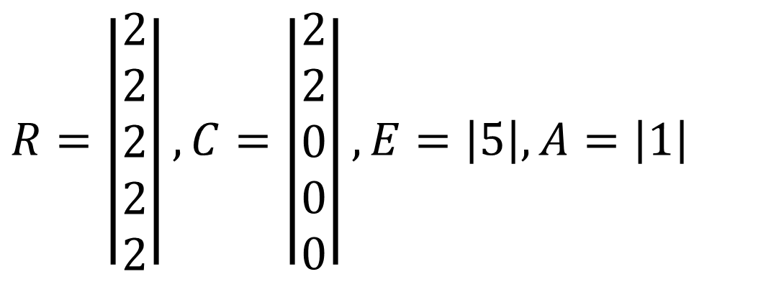
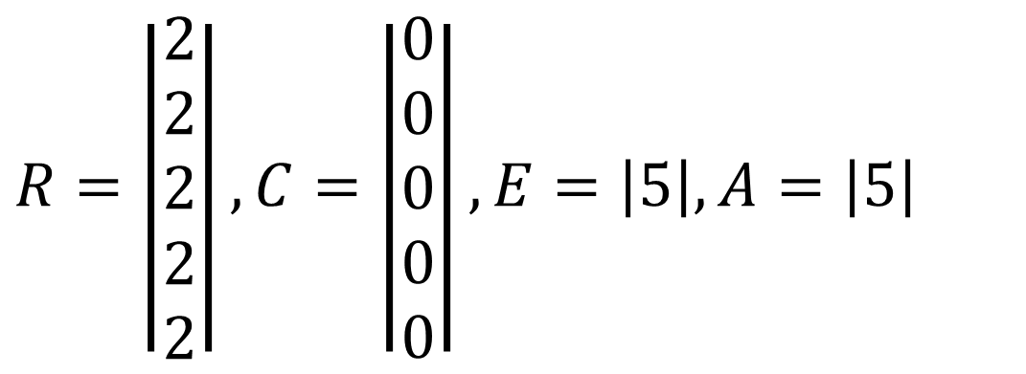
Example: 5 Lawyers, each with 2 arms, 5 chopsticks
Total Request matrix R (NumArms=2)
Current allocation matrix C
Resources in existence E
Resources available A
$$R=\left|\begin{matrix}2 \\ 2 \\ 2 \\ 2 \\ 2\end{matrix}\right|,C=\left|\begin{matrix}0 \\ 0 \\ 0 \\ 0 \\ 0\end{matrix}\right|, E=\left|5\right|, A=\left|5\right|$$
$$R=\left|\begin{matrix}2 \\ 2 \\ 2 \\ 2 \\ 2\end{matrix}\right|,C=\left|\begin{matrix}2 \\ 2 \\ 0 \\ 0 \\ 0\end{matrix}\right|, E=\left|5\right|, A=\left|1\right|$$
Initially, all chopsticks are free.
Two lawyers grab two chopsticks each and start eating. No other lawyers can eat.

Slide 45
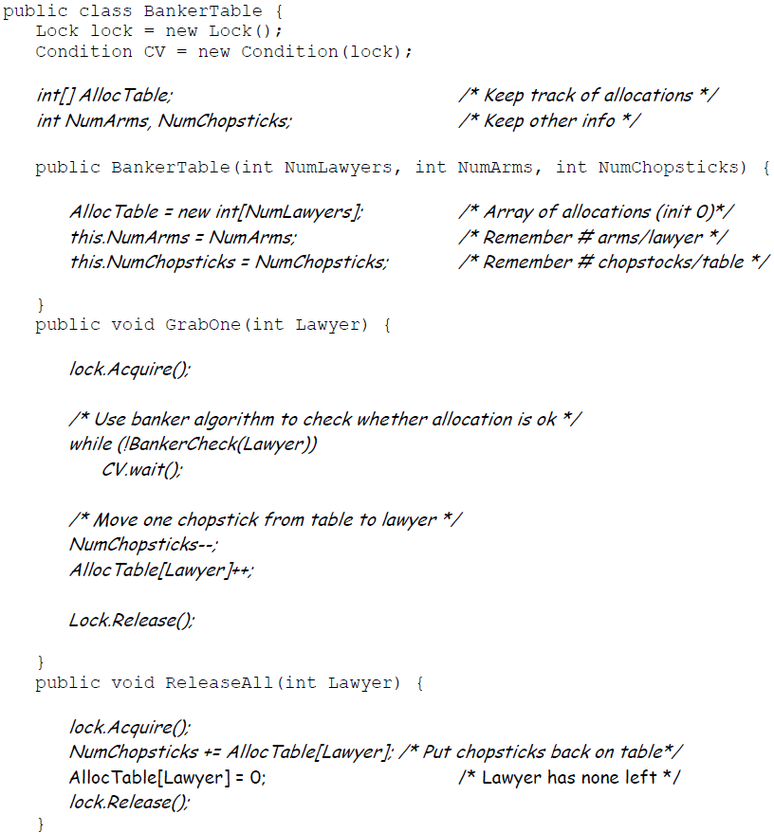
Multi-Armed Lawyers Solution w/ Monitors
GrabOne() allows a lawyer to grab one chopstick. It puts a lawyer to sleep if he cannot be granted a chopstick without potentially deadlocking the system.
ReleaseAll() allows a lawyer to release all chopsticks that he is holding. It wakes up any other lawyers that can proceed.
BankerCheck() method takes a Lawyer number, checks resources, and returns true if a given lawyer can be granted one new chopstick.
Notes:
Assume Mesa-style monitor, hence while loop is used in GrabOne().

Slide 46
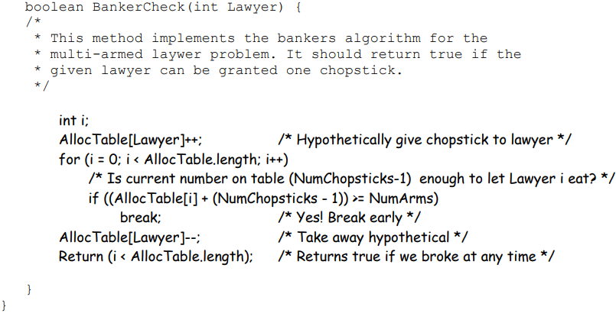
BankerCheck()
State is safe if when a lawyer tries to take a chopstick, either
It is the last chopstick, but someone (lawyer i) will have NumArms chopsticks afterwards
Or it is the 2nd to last chopstick, but someone (lawyer i) will have NumArms-1 chopsticks afterwards
Or it is the 3rd to last chopstick, but someone (lawyer i) will have NumArms-2 chopsticks afterwards …
And so on…
Q: Why didn’t we check for the case of NumChopsticks == 0?
A: In this case, (NumChopsticks-1) == -1, hence the if statement would always fail – exactly what we would want to do when NumChopsticks == 0.
In its general form, the Banker’s algorithm makes multiple passes through the set of resource takers for deadlock detection. But this particular application allows the BankerCheck() method to take a single pass though the Lawyers’ allocations. This is because every resource taker has identical properties: every Lawyer has the same NumArms (maximum allocation). As a result, if we can find a single Lawyer that can finish, given the remaining resources, we know that all Lawyers can finish. Reason: once that Lawyer finishes and returns their resources we know that there will be at least NumArms chopsticks on the table – hence everyone else can potentially finish. Thus, we don’t have to go through the exercise of returning resources and reexamining the remaining Lawyers (as in the general Banker’s algorithm).
Notes:
(We don’t have to check for the case in which NumChopsticks == 0, since this would mean that (NumChopsticks-1) == -1, then the if statement would always fail – exactly what we would want to do when NumChopsticks == 0.)

Slide 47
Minimum Resource Constraint
In all our problem formulations, we have assumed there are a minimum number of resources to allow at least one thread to finish. Without this constraint, the system cannot even start execution, hence the problem is ill-defined.
Consider the dining philosophers problem with a single fork, or no fork available.

Slide 48
When to run Banker’s algorithm?
Run it each time a resource allocation request is made. This can be expensive.
Run it periodically driven by a timer interrupt. A longer period between checks gives
Higher efficiency due to less calculation involved in the checking
Undetected deadlocks can persist for longer times
What to do if an actual deadlock is detected?
Notes:
When a periodic system check is done
The state of the system is determined
Banker’s algorithm is run
Then either
System is in a safe state: no deadlock
System is in an unsafe safe state: maybe deadlocked

Slide 49
Deadlock recovery
Abort all deadlocked threades:
most common solution implemented in OSs.
Rollback:
Back up each thread periodically.
in case of deadlock roll back to the previous backup (checkpoint).
It is possible the deadlock may reoccur.
Usually the deadlock will not reoccur due to the nondeterministic nature of the execution of concurrent threades (there may be a different interleaving of instruction executions the next time).

Slide 50
Deadlock recovery: 2
Successively abort deadlocked threads.
Abort 1 deadlocked thread at a time.
Then check if the deadlock still occurs
If it does abort the next thread.
If it does not, continue execution of the remaining threades without aborting any more threades.
Successively preempt resources from blocked threads
Preempt 1 deadlocked resource in 1 thread.
Roll back that thread to the point where the preempted resource was allocated.
Check if deadlock still occurs
If it does preempt resource from the next thread.
If it does not, continue execution of the remaining threades without preempting any more resources.

Slide 51
Choosing threads/resources
For options 3 and 4 it is necessary to choose which of the possibly deadlocked threads to abort or which resource to preempt (and the possibly deadlocked thread to preempt it from)
Can base this decision on different criteria
Lowest priority
Most estimated run time remaining
Least number of total resources allocated
Smallest amount of CPU consumed so for

Slide 52
Issues
None of these approaches is appropriate for all types of resources
Some threads (like updating a database) cannot be killed and rerun safely.
Some resources cannot be safely preempted (some of these like printers can be preempted if spooling is used).
Some threads cannot be rolled back.
How do you roll back shared variables that have been successively updated by multiple threads.
Thread rollback is expensive.
Successive checkpoints must save both image and state.
Multiple checkpoints need to be saved for a thread.

Slide 53
Communication deadlocks
Thread A sends a request message to thread B, and then blocks until B sends back a reply message.
Suppose that the request message gets lost. A is blocked waiting for the reply. B is blocked waiting for a request asking it to do something. Deadlocked.
Deadlock not due to shared resources but due to message communication.

Slide 54
Summary of Banker’s algorithm
Look one step ahead: upon receiving a request from a thread, assume the request is granted hypothetically, run deadlock detection algorithm to evaluate if the system is in a safe state.
A state is safe if from this state, there exists a sequence of thread executions {P₁, P₂, … P_{n}} with P₁ requesting all remaining resources, finishing, then T₂ requesting all remaining resources, etc..that can finish successfully.
Grant the request if next state is safe.
Algorithm allocates resources dynamically, and allows the sum of maximum resource needs of all current threades to be greater than total resources
It is a conservative algorithm, since each thread must declare the maximum resource requests, which may be a pessimistic estimate of the actual resource requests at runtime.
Notes:
Technique: pretend each request is granted, then run deadlock detection algorithm, ([R_{i}]-[C_{i}] ≤ [A]) Grant request if result is deadlock free (conservative!)
Evaluate requests from each thread, and grant all its requests if feasible
Toward right idea:
State maximum resource needs in advance
Allow particular thread to proceed if:
(available resources - #requested) ≥ max remaining that might be needed by any thread

