Slide 1
CSC 112: Computer Operating Systems Lecture 4 Deadlocks
Department of Computer Science,
Hofstra University
Acknowledgement: Lecture slides based on UC Berkeley CS 162: Operating Systems and System Programming

Slide 2

Deadlock
Definition: A set of processes are said to be in a deadlock state when every process in the set is waiting for an event that can be caused only by another process in the set
Conditions for Deadlock
Mutual exclusion
Only one process at a time can use a given resource
Hold-and-wait
processes hold resources allocated to them while waiting for additional resources
No preemption
Resources cannot be forcibly removed from processes that are holding them; can be released only voluntarily by each holder
Circular wait
There exists a circle of processes such that each holds one or more resources that are being requested by next process in the circle
Wanted
Resource 1
Held
process 1
process 2
Resource 2
Held
Wanted
Not a perfect analogy, just a fun image!
Notes:
Permanent blocking of a set of processes that share multiple resources. Each process in the set is waiting for a resource that only another process in the set can make available
Blocking is caused by processes waiting for resources that are in use by other processes waiting for other resources
e.g., process A owns Res 1 and is waiting for Res 2 process B owns Res 2 and is waiting for Res 1
Neither process can proceed, so they are in a deadlock
Four conditions for deadlock
Mutual exclusion
Only one process at a time can use a resource
Hold and wait
process holding at least one resource is waiting to acquire additional resources held by other processes
No preemption
Resources are released only voluntarily by the processes
Circular wait
Cyclic waiting pattern
Mutual exclusion
Only one process at a time can use a resource.
Hold and wait
process holding at least one resource is waiting to acquire additional resources held by other processes.
No preemption
Resource cannot be forcibly removed from a process; can be released only voluntarily by the process.
Circular wait
A circle of processes exists such that each process holds at least one resource needed by the previous process in the circle

Slide 3
Starvation vs Deadlock
Starvation: process waits indefinitely
Example, low-priority process waiting for resources constantly in use by high-priority process
Deadlock: circular dependency waiting for resources
Starvation can end (but doesn’t have to)
Deadlock cannot end without external intervention
Notes:
Starvation vs. Deadlock
Starvation: process waits indefinitely
Deadlock: circular waiting for resources

Slide 4
Bridge Crossing Analogy
Each segment of road can be viewed as a resource
Car must own the segment under them
Must acquire segment that they are moving into
For bridge: must acquire both halves
Traffic only in one direction at a time
Problem occurs when two cars in opposite directions on bridge: each acquires one segment and needs next
If a deadlock occurs, it can be resolved if one car backs up (preempt resources and rollback)
Several cars may have to be backed up
Starvation is possible
Heavy traffic going east ⇒ no car can go west
Honk!

Slide 5
Train Example (Wormhole-Routing for Network-on-Chip)
Circular dependency (Deadlock!)
Each train wants to turn right, but blocked by other trains
Similar problems occur for Network-on-Chip
One solution:
Force ordering of channels (fixed global order on resource requests)
Protocol: Always go horizontal (east-west) first, then vertical (north-south)
Called “dimension ordering” (X then Y)
Disallowed
By Rule

Slide 6
Handling Deadlocks
Deadlock prevention
Make sure one of the conditions necessary to create a deadlock cannot be present in the system
Deadlock detection
Resource Allocation Graph (cannot handle multi-instance resources well)
Banker’s algorithm for detecting (potential) deadlocks
Deadlock recovery
Let deadlock happen
Monitor the system state periodically to detect when deadlock occurs
Take action to break the deadlock

Slide 7
Deadlock Prevention/Recovery Techniques
Break “mutual exclusion” by spooling resources
Break “hold and wait” condition: Make all processes request everything they’ll need at the beginning.
Problem: Predicting future is hard, tend to over-estimate resources
Let each philosopher pick up both left and right forks atomically within a critical section (L3, “Semaphore-based Solution I”)
Break “circular wait” condition:
Force all processes to request resources in a particular order.
May not be practical, since runtime resource usage pattern is generally unknown
Let each philosopher pick up lower-numbered fork before higher-numbered fork (modulo N) (L3, “Semaphore-based Solution III”)
Banker’s algorithm can prevent future “circular wait” conditions by detecting potential deadlocks
Break “no preemption” condition:
Forcibly remove resources from process
Condition | Approach
Mutual exclusion | Spooling
Hold and wait | request all resources initially
Circular wait | Request resources in a particular order
No preemption | Take resources away
Notes:
Figure 6-14. Summary of approaches to deadlock prevention.

Slide 8
(1) Spooling
A single daemon process directly uses the resource; other processes send their requests to the daemon, e.g.:
The resource is no longer directly shared by multiple processes
Proc 1
Printing
Daemon
Printer
Proc 2

Slide 9
(2) Request all resources initially
Disallow hold-and-wait
Make each process request all resources at the same time, and block until all resources are available to be granted simultaneously
May be inefficient
Process may have to wait a long time to get all its resources when it could have proceeded and completed a significant portion of it work with currently granted resources
Resources allocated to a process may remain unused for long periods of time, blocking other processes
processes may not know all resources they will require in advance.
Notes:
How do we prevent deadlock from happening under any circumstances within our application?
Direct prevention: Design to avoid deadlock (no circular waits possible)
Indirect prevention: prevent the occurrence of one of the necessary conditions
Generally need mutual exclusion so that is not a good candidate to disallow

Slide 10
(3) Order resources numerically
Prevent circular wait
Define a total order of resources; If a process holds certain resources, it can subsequently request only resources that follow the types of held resources in the total order.
This prevents a process from requesting a resource that might cause a circular wait.
Example; all processes requests sem1 before sem2
Another solution to Dining Philosopher’s problem
Introduces inefficiencies and can deny resources unnecessarily.
semaphore sem1, sem2;
void t1( ) {
sem1.wait();
sem2.wait();
//Critical Section
sem2.post();
sem1.post();
}
void t2( ) {
sem2.wait();
sem1.wait();
//Critical Section
sem1.post();
sem2.post();
}
semaphore sem1, sem2;
void t1( ) {
sem1.wait();
sem2.wait();
//Critical Section
sem2.post();
sem1.post();
}
void t2( ) {
sem1.wait();
sem2.wait();
//Critical Section
sem2.post();
sem1.post();
}
Possible deadlock
No deadlock
Notes:
May be impossible to re-request the same resource
Example: no deadlock (Order resources numerically)
if process L has resource 1 and process J has resource 3, the process L can request resource 3, but process J cannot request resource I and cause deadlock

Slide 11
(4) Take resources away
Allow preemption. Can be implemented in different ways
Abort all deadlocked processes: most common solution implemented in OSs.
If a process holding a resource is denied another resource and forced to wait, it must relinquish the resource it is holding and request it again (if needed) when the blocked resource is available
If a process requests a resource that is in use (usually by a lower priority process), the process using the resource will be preempted and the resource will be supplied to the requesting process.
Requires additional OS complexity
Used for deadlock recovery, not prevention
Notes:
(more later)

Slide 12
Ostrich algorithm
Ignore the possibility of deadlock, maybe it won’t happen
In some situations this may even be reasonable, but not in all
If a deadlock in a process will happen only once in 100 years of continuous operation we may not want to make changes that will likely decrease efficiency to avoid that rare event.
In mission critical applications, the ostrich algorithm approach is inappropriate if a catastrophic failure may result from a deadlock.
Notes:
https://tenor.com/en-GB/search/ostrich-head-in-sand-gifs

Slide 13
Resource-allocation graph (RAG)
System Model
A set of processes P₁, P₂, . . ., P_{n}
Resource types R₁, R₂, . . ., R_{m}
CPU cycles, memory space, I/O devices
Each resource type R_{i} has W_{i} instances.
Each process utilizes a resource as follows:
Request() / Use() / Release()
Resource-Allocation Graph (RAG):
V is partitioned into two types:
P = {P₁, P₂, …, P_{n}}, set of processes in the system.
R = {R₁, R₂, …, R_{m}}, set of resource types in system
request edge – directed edge P₁ → R_{j}
assignment edge – directed edge R_{j} → P_{i}
Symbols
P₁
P₂
R₁
R₂

Slide 14
RAG for deadlock detection
For any given sequence of requests for and releases of resources a RAG can be constructed
We check the graph
no cycle → no deadlock
Each resource has a single instance AND cycle → deadlock (necessary and sufficient)
Each resource has multiple instances AND cycle → maybe deadlock (but not sufficient condition)
Need Banker’s algorithm to detect deadlocks
R2
Resource 2 held by process 2
Resource 2 requested by process 2
P1
P2
R1
Resource 1 requested by process 2
Resource 1 held by process 2
A RAG with a deadlock
Notes:
deadlock IMPLIES cycle (necessary condition)

Slide 15
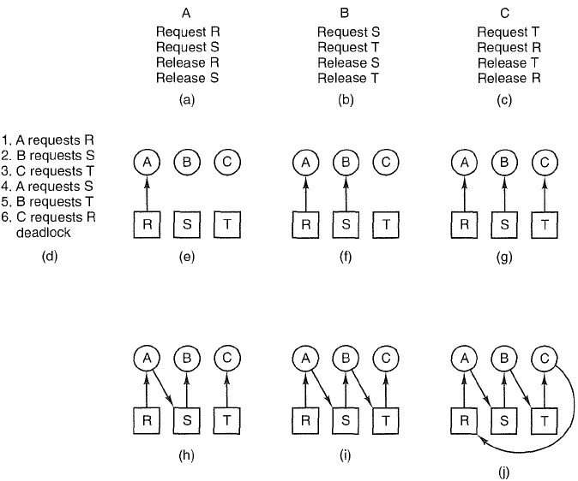
A deadlock example

Slide 16
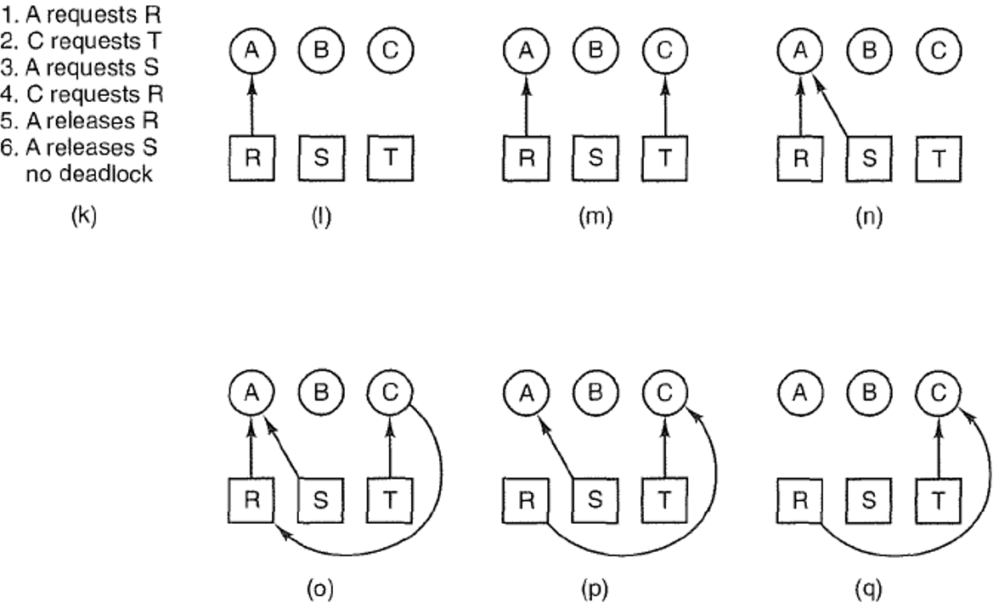
Deadlock is avoided by delaying B’s request
Notes:
Figure 6-4. An example of how deadlock occurs and how it can be avoided.

Slide 17
Resource Allocation Graph Examples
R₁
R₂
R₁
R₂
R₁
T₂
T₁
T₂
T₃
T₁
T₂
T₃
T₁
T₃
R₃
T₄
R₄
R₃
R₂
R₄
No Cycle;
No Deadlock
Deadlock (cycle R₃->T₂->R₂->T₃
And cycle R₃->T₁->R₁->T₂->R₂->T₃
Cycle,
but No Deadlock
(T₂ or T₄ may release
res later)
Notes:
Animation: http://cs.uttyler.edu/Faculty/Rainwater/COSC3355/Animations/deadlock.htm

Slide 18
Banker’s algorithm for deadlock detection
To avoid deadlocks we need to be able to detect them, preferably before they occur.
RAG can only detect deadlocks reliably for the case of single-instance resources.
Banker’s algorithm is more general and can deal with multiple-instance resources. It is used to recognize when it is safe to allocate resources
Analyze the state of the system; If the state is unsafe, take actions to break actual or potential deadlocks and bring the system back to a safe state
Do not grant additional resources to a process if this allocation might lead to a deadlock
Banker's Algorithm was developed by Edsger Dijkstra, inspired by the way banks manage loans to ensure they do not run out of resources.
It ensures that loans are only granted if the bank can still meet the withdrawal needs of all its account holders, even in the worst-case scenario where everyone withdraws their funds simultaneously. Similarly, in computing, the algorithm ensures that resources are allocated to processes in a way that avoids unsafe states or deadlocks
Notes:
The algorithm was developed by Edsger Dijkstra and is primarily used in operating systems for deadlock avoidance and safe resource allocation.

Slide 19
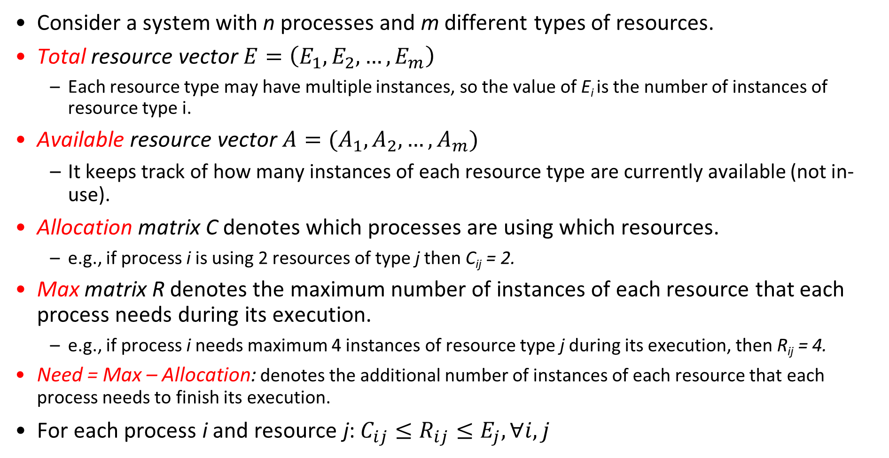
Problem Definition
Consider a system with n processes and m different types of resources.
Total resource vector $E=\left(E_{1},E_{2}, …, E_{m}\right)$
Each resource type may have multiple instances, so the value of E_{i} is the number of instances of resource type i.
Available resource vector $A=(A_{1},A_{2}, …, A_{m})$
It keeps track of how many instances of each resource type are currently available (not in-use).
Allocation matrix C denotes which processes are using which resources.
e.g., if process i is using 2 resources of type j then C_{ij} = 2.
Max matrix R denotes the maximum number of instances of each resource that each process needs during its execution.
e.g., if process i needs maximum 4 instances of resource type j during its execution, then R_{ij} = 4.
Need = Max – Allocation: denotes the additional number of instances of each resource that each process needs to finish its execution.
For each process i and resource j: $C_{ij}≤R_{ij}≤E_{j},∀i, j$
Notes:
Every resource is either allocated or available
process i will need these 4 resource
No process can claim more than the total amount of resources in the system; No process is allocated more resources of any type than the process originally claimed to need

Slide 20
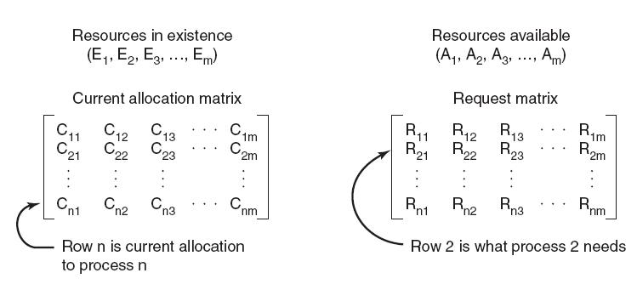
Four data structures encode current state of the system
Total
Available
Allocation
Max
Notes:
Figure 6-6. The four data structures
Define the state of a process to be a list of the number of resources of each available type presently allocated to it, and the maximum number of resources of each type it will need simultaneously
The state of the system is an aggregate of the states of all the processes in the system along with the number of available and allocated resources of each type, encoded in the following:
E (Existing resource vector)
A (Available resource vector)
R (Total Request matrix)
C (Current allocation matrix)

Slide 21
Safe states and unsafe states
The state of the system can be either safe or unsafe
A safe state is a state in which there exists at least one sequence of resource allocations that will allow all processes in the system to complete without deadlock, i.e., there exists a sequence of process executions {Pi, Pj, … Pk} with Pi requesting all remaining resources, finishing, then Pj requesting all remaining resources, ..., until all processes complete successfully.
An unsafe state is a state in which there exists no sequence of resource allocations that will allow all processes in the system to complete without deadlock.

Slide 22
Banker’s algorithm
Look one step ahead: upon receiving a request from a process, assume the request is granted hypothetically, run deadlock detection algorithm to evaluate if the system is in a safe state.
Grant the request if next state is safe.
Algorithm allocates resources dynamically, and allows the sum of maximum resource needs of all current processes to be greater than total resources
It is a conservative algorithm, since each process must declare the maximum resource requests, which may be a pessimistic estimate of the actual resource requests at runtime.
Notes:
Each time a resource is requested, determine the state of the system after the resource is allocated, and if that state is safe or unsafe (will potentially deadlock). If the state will be unsafe, we deny the requested resources.
Technique: pretend each request is granted, then run deadlock detection algorithm, ([R_{i}]-[C_{i}] ≤ [A]) Grant request if result is deadlock free (conservative!)
Evaluate requests from each process, and grant all its requests if feasible
Toward right idea:
State maximum resource needs in advance
Allow particular process to proceed if:
(available resources - #requested) ≥ max remaining that might be needed by any process

Slide 23
Banker's algorithm: preliminaries
Compute Need = Max – Allocation
To determine if a process i can run to completion, compare two vectors:
(Need)_{i}: row i in the Need Matrix of unmet resource needs
A: available resources vector A
(Need)_{i} <= A if Need_{ij} <= A_{j} for all resource types j

Slide 24
Banker’s algorithm
Algorithm CheckSafety() for checking to see if a state is safe:
Compute Need = Max – Allocation
Look for a process i that can run to completion by finding an unmarked row i with (Need)_{i} ≤ A. If no such row exists, system will eventually deadlock since no process can run to completion
Assume process i requests all resources it needs and finishes. Mark process i as completed, free all its resources and add the i-th row of Allocation to the Available vector
Repeat steps 1 and 2 until either all processes are marked as completed (initial state is safe), or no process is left whose resource needs can be met (there is a deadlock, so initial state is unsafe).
Notes:
Look for an unmarked process, P_{i} , for which the i-th row of R is less than or equal to A.
If such a process is found, add the i-th row of C to A, mark the process as completed, and go back to step 1.
If no such process exists, the algorithm terminates.
If (R_{Lk} –C_{Lk}) ≤ A_{k} for all k)

Slide 25
Banker’s algorithm cont’
When a process makes a request for one or more resources:
Update the state of the system assuming the requests are granted.
Determine if the resulting state is a safe state by calling CheckSafety()
If so grant the request for resources.
Otherwise, block the process request until it is safe to grant it.

Slide 26
An example system: starting state
4 processes P1 through P4; 4 resource types with 10, 5, 6, 5 instances each.
Current system state encoded in matrices R, C and vectors E, A.
Max
Allocation
Total
Available
Available is obtained by subtracting each column sum of C from E
10-(1+5+2+0)=2, 5-(0+1+1+0)=3
6-(0+1+1+2)=2, 5-(0+1+0+0)=4
Notes:
Resources in existence
Resources available
(E1, E2, E3, ..., Em)
(A1, A2, A3, ..., Am)
Total Request matrix
Current allocation matrix

Slide 27
Request to check for safety
Assume the starting state is a safe state (can be checked with Banker’s algorithm)
P2 is now requesting 2 more instances of Resource 1 and 1 more instance of Resource 3
Do we grant this request? Might this request cause deadlock?
Step 1: Calculate the state of the system if this request is fulfilled
Step 2: determine if the new state is a safe state with Banker’s algorithm

Slide 28
An example: new state
Max
Allocation
Need = Max – Allocation
Total
Available
A is obtained by subtracting each column sum of C from E
10-(1+7+2+0)=0, 5-(0+1+1+0)=3
6-(0+2+1+2)=1, 5-(0+1+0+0)=4

Slide 29
An example: is new state safe
Check row 1 of Need matrix
(Need)₁ = [2, 2, 2, 1] > A
P1 cannot run to completion
Max
Allocation
Need
Total
Available

Slide 30
An example: is new state safe
Check row 2 of Need matrix
(Need)₂ = [0, 0, 1, 0] <= A
Allocate resources and run P2 to completion;
Free all its resources and add them to A:
A=[0 3 1 4]+[7 1 2 1] = [7 4 3 5]
Max
Allocation
Need
Total
Available

Slide 31
An example: is new state safe
Check row 1 of Need matrix again
(Need)₁ = [2, 2, 2, 1] <= A
Allocate resources and run P1 to completion;
Free all its resources and add them to A:
A = [7 4 3 5] + [1 0 0 0]=[8 4 3 5]
Process 2 marked as completed
Max
Allocation
Need
Total
Available

Slide 32
An example: is new state safe
Check row 3 of Need Matrix
(Need)₃ = [1, 0, 3, 0] <= A
Allocate resources and run P3 to completion;
Free all its resources and add them to A:
A = [8 4 3 5] + [2 1 1 0] = [10 5 4 5]
Max
Allocation
Need
Total
Available

Slide 33
An example: is new state safe
Check row 4 of Need Matrix
(Need)₄ = [4, 2, 0, 1] <= A
Allocate resources and run P4 to completion
Free all its resources and add them to A:
A = [10 5 4 5] + [0 0 2 0] = [10 5 6 5]
Max
Allocation
Need
Total
Available

Slide 34
An example: is new state safe
Now:
All process can complete successfully. Therefore, the starting state is a safe state
Allocate the requested resources (2 more instances of resource 1 and 1 more instance of resource 3) to P2, and proceed with execution of all processes
Max
Allocation
Need
Total
Available
Notes:
process 2 is now requesting 2 more of resource 1 and 1 more of resource 3

Slide 35
Next Request to Check for Safety
Now start from this new safe state, and consider the next request for resources: Process 1 is now requesting 1 more instance of resource 3.
Do we grant this request? Might this request cause deadlock?
Step 1: Calculate the state of the system if this request is filled
Step 2: Determine if the new state is a safe state, use Banker's algorithm
Max
Allocation
Need
Total
Available

Slide 36
New starting state: next request, is this state safe?
Check all rows
(Need)₁ = [2, 2, 1, 1] not <= A
(Need)₂ = [0, 0, 1, 0] not <= A
(Need)₃ = [1, 0, 3, 0] not <= A
(Need)₄ = [4, 2, 1, 0] not <= A
Max
Allocation
Need
Total
Available
No process can run to completion. The state is unsafe, so we deny Process 1’s request for 1 more instance of resource 3.

Slide 37
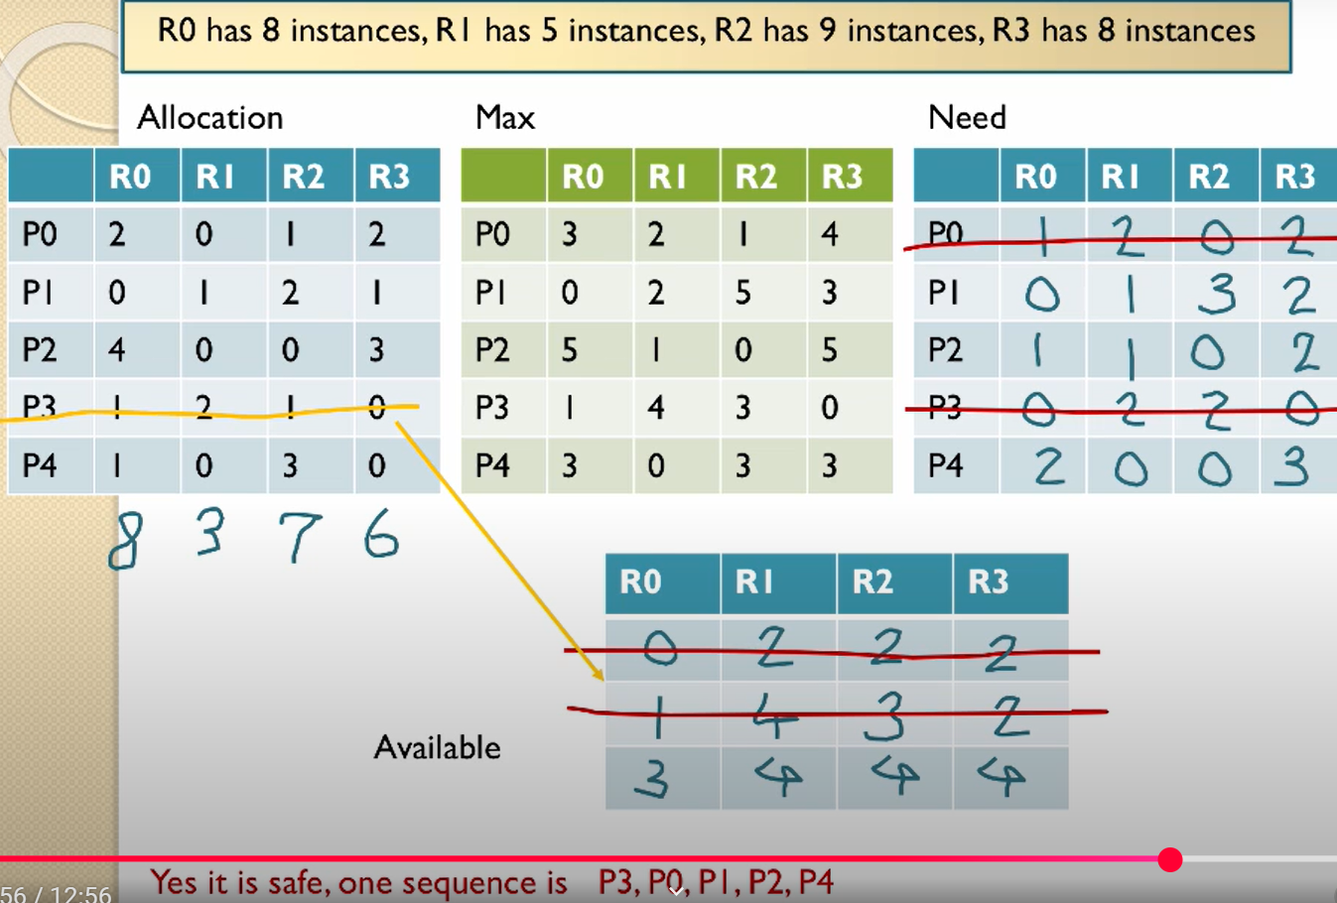
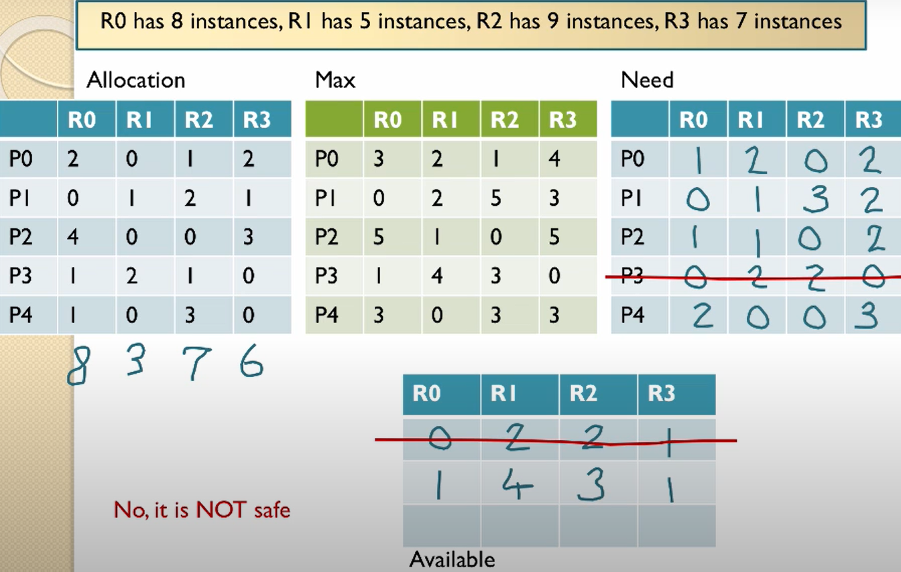
Video tutorial of Banker's algorithm I
Deadlock avoidance https://www.youtube.com/watch?v=AvPjOyeJbBM
Total resources: [8, 5, 9, 8]

Slide 38
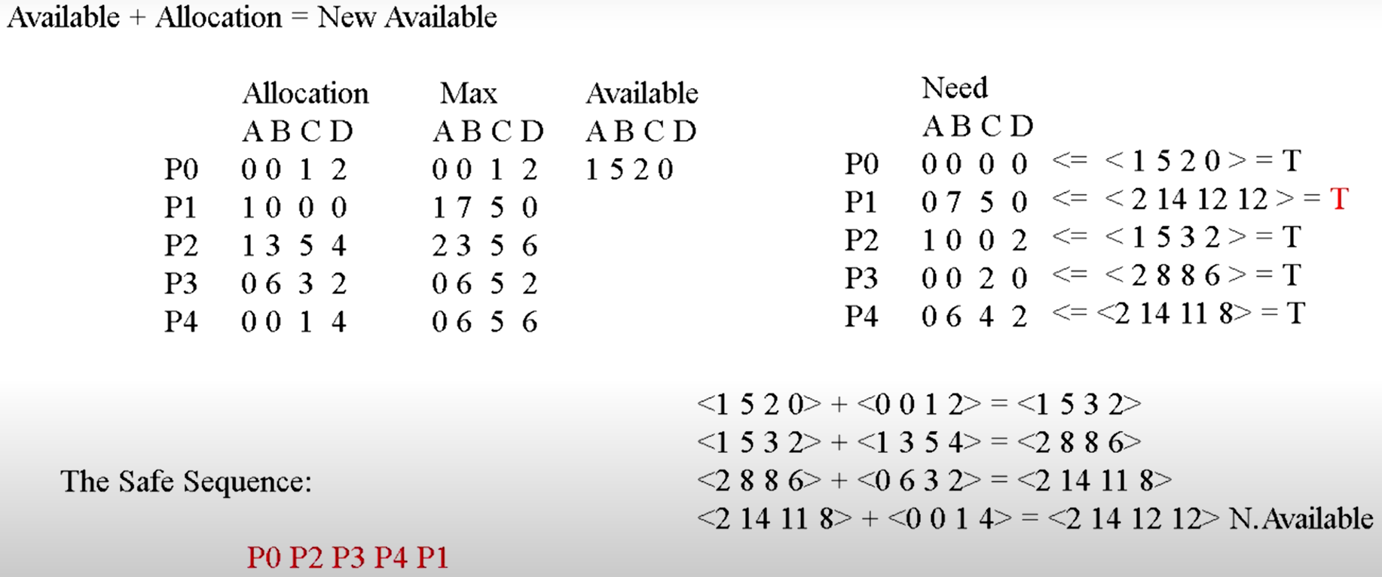
Video tutorial of Banker's algorithm II
Banker's Algorithm explained https://www.youtube.com/watch?v=T0FXvTHcYi4
Total resources: [3, 14, 12, 12]

Slide 39
Banker’s algo applied to Dining Philosophers
Consider N philosophers and N forks.
(1) If each of the N-1 philosophers holds his left fork, then the N^{th} philosopher will be prevented from taking the last fork.
(2) If a philosopher is holding one fork, he can safely pick up the other fork.
(3) If one or more philosophers are holding 2 forks and eating, then any remaining forks can be picked up safely by any other philosopher.
Banker’s algorithm can be used to verify each of these scenarios. Let’s focus on scenario (1) next.
Notes:
State is safe if when a philosopher tries to take a fork, either
It is not the last fork,
Or it is the last fork, but someone will have 2 forks afterwards.
Equivalently: do not let a philosopher take the last fork if no one will have 2 forks afterwards.
5 forks/5 philosophers
Need two forks to eat
What if all grab left fork at same time?
Deadlock!
How to fix deadlock?
Make one of them give up a fork
Eventually everyone will get chance to eat
How to prevent deadlock?
Never let philosopher take last fork if no hungry philosopher has two forks afterwards

Slide 40
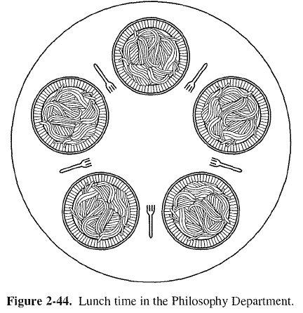
Banker’s algo applied to Dinning Philosophers cont’
Model each fork as a separate resource, since each philosopher can only pick up his left and right forks.
Suppose we have 5 philosophers numbered 1-5, and 5 forks numbered 1-5; philosopher i has left fork numbered i, and right fork (i+1)%5. (Here indices start from 1 instead of 0 in Lecture 3.)
4
5
4
5
3
1
3
1
2
2

Slide 41

Four philosophers each holding his left fork
Max
Allocation
Need
0
1
0
1
$$R−C$$
0
1
0
1
1
1
Total
Available
Philosophers 1-4 each is holding his left fork. We can use Banker’s algorithm to check that the current state is safe, e.g., with execution sequence of P4, P3, P2, P1, P5.
Now, if philosopher 5 makes a request for his left fork, should we grant it?

Slide 42
Five philosophers each holding his left fork
Max
Allocation
Need
0
1
0
1
0
1
0
1
1
Total
Available
No. Here is the deadlock state reached if the request is granted.

Slide 43
Minimum Resource Constraint
In all our problem formulations, we have assumed there are a minimum number of resources to allow at least one process to finish. Without this constraint, the system cannot even start execution, hence the problem is ill-defined.
Consider the dining philosophers problem with a single fork, or no fork available.

Slide 44
When to run Banker’s algorithm?
Run it each time a resource allocation request is made. This can be expensive.
Run it periodically driven by a timer interrupt. A longer period between checks gives:
Higher efficiency due to less calculation involved in the checking.
Undetected deadlocks can persist for longer times.
Notes:
When a periodic system check is done
The state of the system is determined
Banker’s algorithm is run
Then either
System is in a safe state: no deadlock
System is in an unsafe safe state: maybe deadlocked

Slide 45
Communication deadlocks
process A sends a request message to process B, and then blocks until B sends back a reply message.
Suppose that the request message gets lost. A is blocked waiting for the reply. B is blocked waiting for a request asking it to do something. Deadlocked.
Deadlock not due to shared resources but due to message communication.

