Slide 1
CSC 112: Computer Operating Systems Lecture 4 Deadlocks Exercises
Department of Computer Science,
Hofstra University
Acknowledgement: Lecture slides based on UC Berkeley CS 162: Operating Systems and System Programming

Slide 2

Banker’s Algorithm: 4 philosophers each holding his left fork
Max
Allocation
Need
0
1
0
1
$$R−C$$
0
1
0
1
1
1
Available resources after completion of each process
Total
Available
 | R1 | R2 | R3 | R4 | R5
 | 0 | 0 | 0 | 0 | 1
Suppose we have 5 philosophers P1-P5, and 5 forks R1-R5; philosopher Pi has left fork Ri, and right fork R(i+1)%5. Philosophers P1-P4 each is holding his left fork.
Run Banker’s algorithm to check if the current state is safe. If yes, give a safe sequence of process completions and fill in the table with the sequence of process completions without deadlock, and available resources after the completion of each process.

Slide 3
Multi-Armed Lawyers
Consider a large table with IDENTICAL multi-armed alien lawyers. In the center is a pile of chopsticks. In order to eat, a lawyer must have one chopstick in each hand. The lawyers are so busy talking that they can only grab one chopstick at a time. Design a deadlock-free algorithm using monitors and Bankers algorithm. Assume total number of chopsticks >= number of hands of each lawyer, so at least one lawyer can eat.
It is not a generalization of the 2-armed Dining Philosophers problem. Since the chopsticks are in a pile at center of the table, we should model them as a single resource with multiple instances, instead of multiple resources for the Dining Philosophers, where each fork (chopstick) has a fixed position in-between two philosophers. Hence the R and C matrices have a single column.
Ack: this example is taken from UC Berkeley CS162 course.
Notes:
https://people.eecs.berkeley.edu/~kubitron/courses/cs162-F07/exams/fa07mt1-solutions.pdf

Slide 4
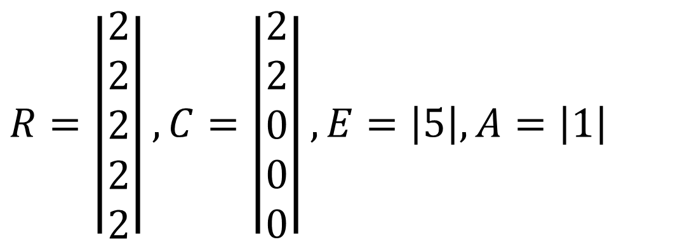
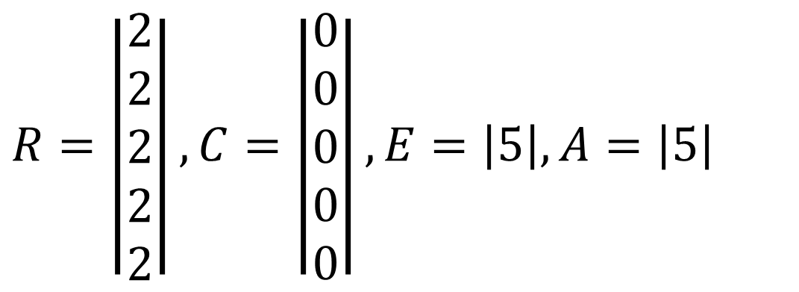
Example: 5 Lawyers, each with 2 arms, 5 chopsticks
Total Request matrix R (NumArms=2)
Current allocation matrix C
Resources in existence E
Resources available A
$$R=\left|\begin{matrix}2 \\ 2 \\ 2 \\ 2 \\ 2\end{matrix}\right|,C=\left|\begin{matrix}0 \\ 0 \\ 0 \\ 0 \\ 0\end{matrix}\right|, E=\left|5\right|, A=\left|5\right|$$
$$R=\left|\begin{matrix}2 \\ 2 \\ 2 \\ 2 \\ 2\end{matrix}\right|,C=\left|\begin{matrix}2 \\ 2 \\ 0 \\ 0 \\ 0\end{matrix}\right|, E=\left|5\right|, A=\left|1\right|$$
Initially, all chopsticks are free.
Two lawyers grab two chopsticks each and start eating. No other lawyers can eat.

Slide 5
Quiz: Dining Lawyers I
Is it possible for the system to get into deadlock?

Slide 6
Quiz: Dining Lawyers I
If each lawyer has 2 arms, and there is a pile of knives and forks at center of the table. Assume there are at least 1 knife and 1 fork, so at least one lawyer can eat. (There is no other constraint on the numbers of knives, forks, or lawyers.) Each lawyer follows the following steps:
(1) Pick up a knife
(2) Pick up a fork
(3) Eat
(4) Return the knife and fork to the pile
Q: Can the system be deadlocked?

Slide 7
Quiz: Dining Lawyers II
If each lawyer has 4 arms, and there is a pile of knives and forks at center of the table. Assume there are at least 2 knives and 2 forks, so at least one lawyer can eat. Each lawyer follows the following steps:
(1) Pick up 2 knives atomically
(2) Pick up 2 forks atomically
(3) Eat
(4) Return the knives and forks to the pile
Q: Can the system be deadlocked?

Slide 8
Quiz: Dining Lawyers III
If each lawyer has 4 arms, and there is a pile of knives and forks at center of the table. Assume there are at least 2 knives and 2 forks, so at least one lawyer can eat. Each lawyer follows the following steps:
(1) Pick up a knife
(2) Pick up another knife
(3) Pick up a fork
(4) Pick up another fork
(5) Eat
(6) Return the knife and fork to the pile
Q1: Can the system be deadlocked?
Q2: What if each lawyer may have a different number of arms, and may request a different ratio of knives vs. forks?

Slide 9

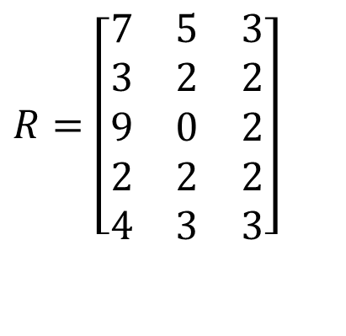

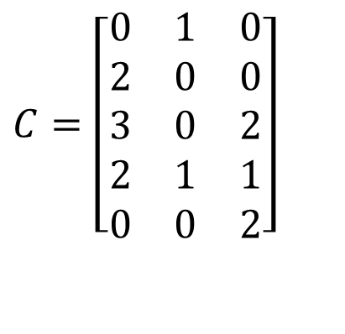
Quiz: Banker’s algorithm
4 threads P0 through P4; 4 resource types with 10, 5, 6, 5 instances each.
Current system state encoded in matrices R, C and vector E.
Total Request matrix
Current allocation matrix
$$R=\left[\begin{matrix}7 & 5 & 3 \\ 3 & 2 & 2 \\ 9 & 0 & 2 \\ 2 & 2 & 2 \\ 4 & 3 & 3\end{matrix}\right]$$
$$C=\left[\begin{matrix}0 & 1 & 0 \\ 2 & 0 & 0 \\ 3 & 0 & 2 \\ 2 & 1 & 1 \\ 0 & 0 & 2\end{matrix}\right]$$
Resources in existence
Resources available
$$E=\left[\begin{matrix}10 & 5 & 7\end{matrix}\right]$$
$$A=\left[\begin{matrix}3 & 3 & 2\end{matrix}\right]$$

Slide 10
Quiz: Deadlocks II
Is there a possible deadlock?
1 Semaphore L1=1, L2=1, L3=1;
2
// Thread 1:
L1.wait();
L2.wait();
// critical section requiring L1 and L2 locked.
L2.post();
L1.post();
9
// Thread 2:
L3.wait();
L1.wait();
// critical section requiring L3 and L1 locked.
L1.post();
L3.post();
16
// Thread 3:
L2.wait();
L3.wait();
// critical section requiring L2 and L3 locked.
L3.post();
L2.post();

