Slide 1
CSC 112: Computer Operating Systems Lecture 6 Real-Time Scheduling
Department of Computer Science,
Hofstra University
Acknowledgement: Lecture slides based on Buttazzo, Hard Real-Time Computing Systems

Slide 2
Outline
Introduction to RTOS and Real-Time Scheduling
Fixed-Priority Scheduling
Earliest Deadline First Scheduling
Least Laxity First (LLF) Scheduling
Preemptive vs. Non-Preemptive Scheduling
Multiprocessor Scheduling
Resource Synchronization Protocols (for Fixed-Priority Scheduling)

Slide 3
Introduction to RTOS and Real-Time Scheduling

Slide 4
Embedded Control Systems
An embedded control system co´nsists of:
The system-under-control (SUT)
may include sensors and actuators
The controller/computer
sends signals to the system according to a predetermined control objective
In the old days, each control task runs on a dedicated CPU
No RTOS, bare metal
No need for scheduling
Just make sure that task execution time < deadline
Now, multiple control tasks share one CPU
Multitasking RTOS
Need scheduling to make sure all tasks meet deadlines
D/A
actuators
SUT
A/D
sensors
Controller/computer
Thread or process (task)
Resource

Slide 5
Requirements
The tight interaction with the environment requires the system to react to events within precise timing constraints
Timing constraints are imposed by the dynamics of the environment
The real-time operating system (RTOS) must be able to execute tasks within timing constraints

Slide 6
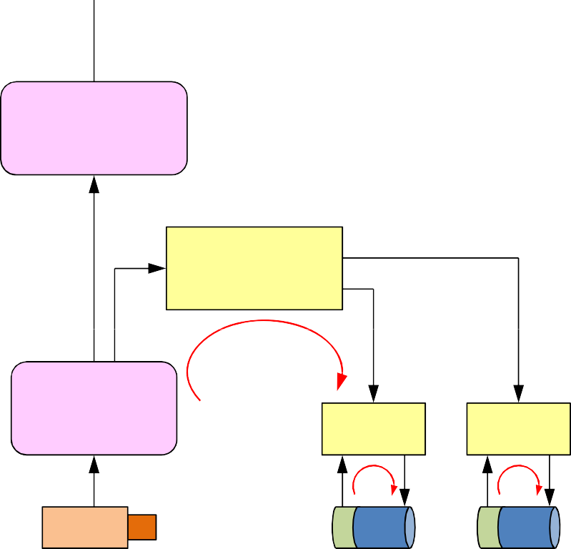
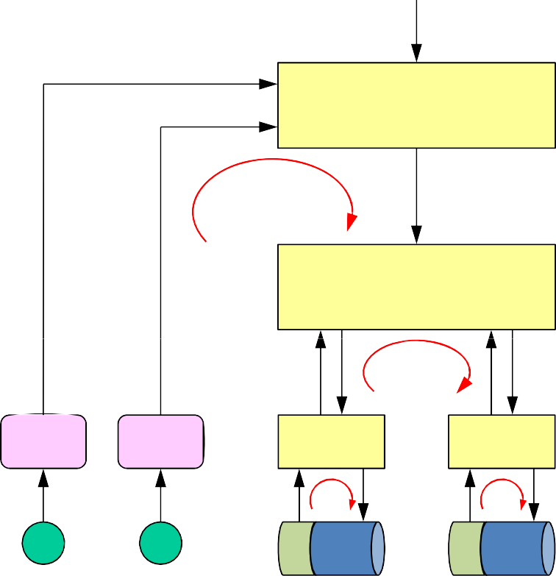





A Robot Control Example
Consider a robot equipped with:
two actuated wheels
two proximity (US) sensors
a mobile (pan/tilt) camera
a wireless transceiver
Goal:
follow a path based on visual feedback
avoid obstacles
visual−based navigation
100 ms
obstacle avoidance
object recognition
10 ms
visual tracking
vehicle control
5 ms
feature extraction
20 ms
motor control
motor control
1 ms
motor control
motor control
1 ms
camera
pan
tilt
US1 US2
mot_dx
mot_sx
Notes:
send complete robot status every 20 ms

Slide 7


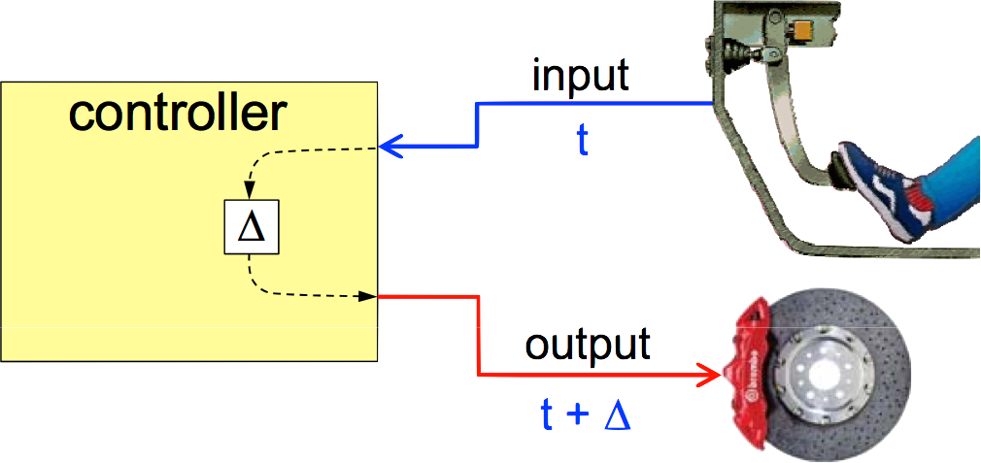
Real-Time Systems
A computer system that is able to respond to events within precise timing constraints
A system where the correctness depends not only on the output values, but also on the time at which results are produced
A real-time system is not a necessarily a real fast system
Speed is always relative to a specific environment
Running faster is good, but does not guarantee hard real-time constraints
The objective of a real-time system is to guarantee the worst-case timing behaviour of each individual task
The objective of a fast system is to optimize the average-case performance
A system with fast average-case performance may not meet worst-case requirements, e..g.,
There was a person who drowned in a river with average depth of 6 inches
x (t)
RT system Environment
t
y (t+Δ)
Notes:
response time of a task set.

Slide 8
RTOS Requirements
Timeliness: results must be correct not only in their value but also in the time domain
provide kernel mechanism for time management and for handling tasks with explicit timing constraints and different criticality
Predictability: system must be analyzable to predict the consequences of any scheduling decision
if some task cannot be guaranteed within time constraints, system must notify this in advance, to handle the exception (plan alternative actions)
Efficiency: operating system should optimize the use of available resources (computation time, memory, energy)
Robustness: must be resilient to peak-load conditions
Fault tolerance: single software/hardware failures should not cause the system to crash
Maintainability: modular architecture to ensure that modifications are easy to perform

Slide 9
Sources of Nondeterminism
Architecture
cache, pipelining, interrupts, DMA
Operating System (our focus in this lecture)
scheduling, synchronization, communication
Language
lack of explicit support for time
Design Methodologies
lack of analysis and verification techniques

Slide 10



Task
The concept of concurrent tasks reflects the intuition about the functionality of embedded systems.
Task here can refer to either process or thread, depending on the underlying RTOS support
Tasks help us manage timing complexity:
multiple execution rates
multimedia
automotive
asynchronous input
user interfaces
communication systems
activation time a_{i}
Task τ_{i}
start time s_{i}
Execution time C_{i}
finish time f_{i}
activation
Ready queue
τ₃ τ₂ τ₁
dispatching termination
CPU
“activation” = “arrival” = “request” = “release” time

Slide 11
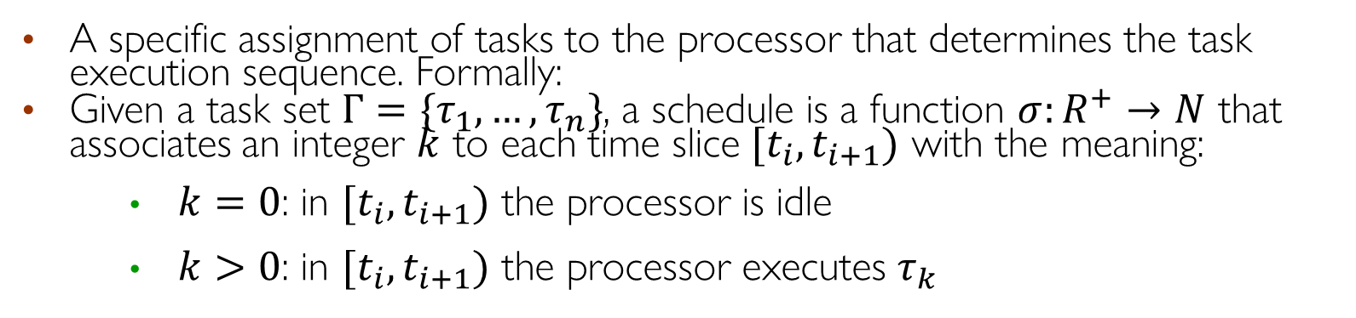
Schedule
A specific assignment of tasks to the processor that determines the task execution sequence. Formally:
Given a task set $Γ=\{τ_{1},…,τ_{n}\}$, a schedule is a function $σ:R^{+}→N$ that associates an integer $k$ to each time slice $[t_{i},t_{i+1})$ with the meaning:
$k=0$: in $[t_{i},t_{i+1})$ the processor is idle
$k>0$: in $[t_{i},t_{i+1})$ the processor executes $τ_{k}$
idle
τ₁ τ₂ τ₃
idle
σ(t)
3
2
1
0
t₁ t₂
t₃
t₄
t
At times t₁, t₂,…: context switch to a different task
Notes:
Deciding the order of a set of tasks with certain known characteristics (periodicity, execution time) on a limited set of processing units, subject to a set of constraints on the completion time of each task.

Slide 12
Preemptive vs. Nonpreemptive Scheduling
A scheduling algorithm is:
preemptive: if the active job can be temporarily suspended to execute a more important job
non-preemptive: if the active job cannot be suspended, i.e., always runs to completion
priority
τ₁
τ₂
τ₃
0
2
4
6
8 10 12 14 16 18 20
σ(t)
3
2
1
0
0
2
4
6
8 10 12 14 16 18 20
Preemptive scheduling example
Notes:
● + Exception handling: timely response to issues
Different levels of importance or criticality: preemption executes most critical tasks
Running tasks may be suspended and placed in the ready queue

Slide 13
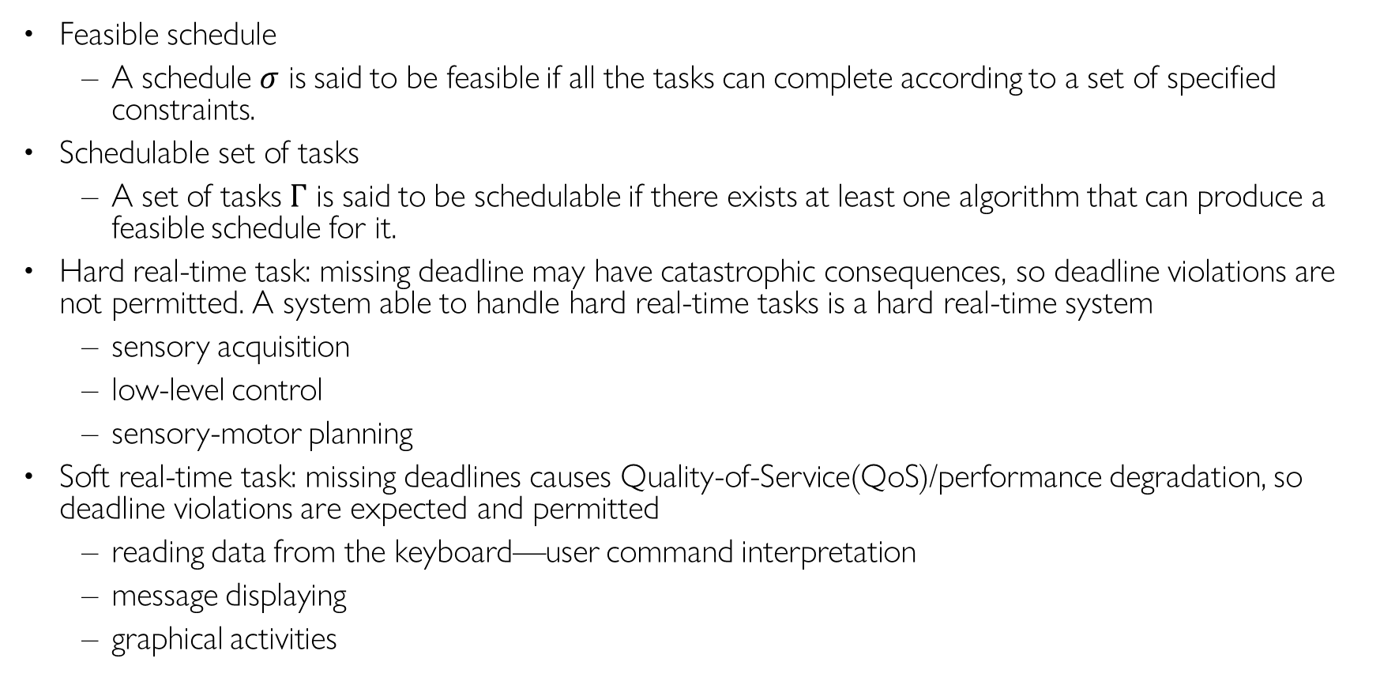
Definitions
Feasible schedule
A schedule $σ$ is said to be feasible if all the tasks can complete according to a set of specified constraints.
Schedulable set of tasks
A set of tasks $Γ$ is said to be schedulable if there exists at least one algorithm that can produce a feasible schedule for it.
Hard real-time task: missing deadline may have catastrophic consequences, so deadline violations are not permitted. A system able to handle hard real-time tasks is a hard real-time system
sensory acquisition
low-level control
sensory-motor planning
Soft real-time task: missing deadlines causes Quality-of-Service(QoS)/performance degradation, so deadline violations are expected and permitted
reading data from the keyboard—user command interpretation
message displaying
graphical activities
Notes:
Deciding the order of a set of tasks with certain known characteristics (periodicity, execution time) on a limited set of processing units, subject to a set of constraints on the completion time of each task.
Hard Real-Time System if it can handle hard tasks
HARD tasks
All jobs must meet their deadlines. Missing deadlines may cause catastrophic consequences.
e.g., sensor reading, motor control.
SOFT tasks
Missing deadlines is not desirable but causes only Quality-of-Service(QoS) degradation.
e.g., reading data from keyboard, user command interpretation, message display
A system able to handle HARD tasks is a hard real-time system

Slide 14
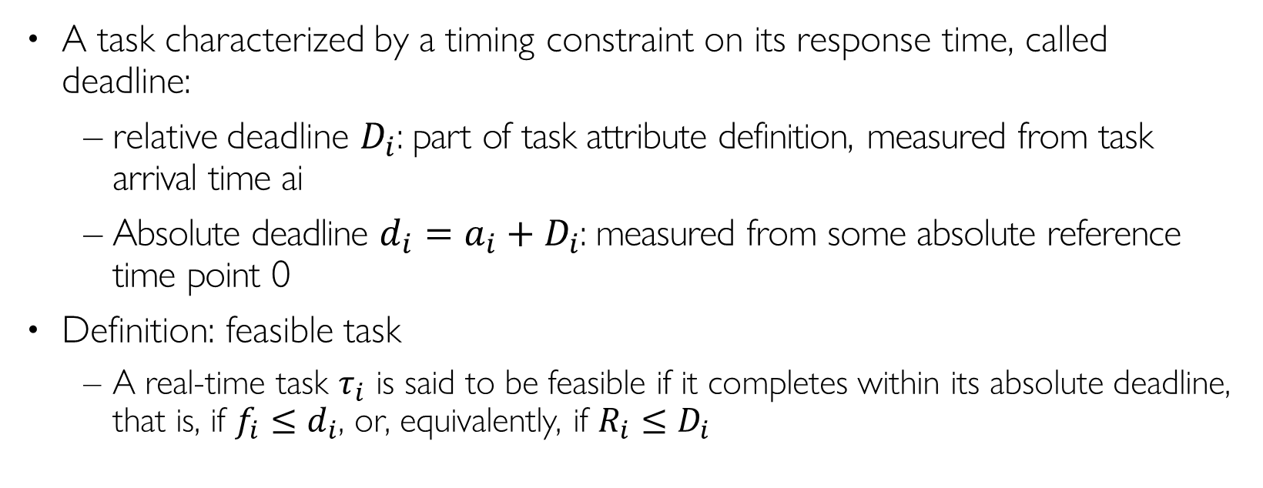
Real-Time Task
A task characterized by a timing constraint on its response time, called deadline:
relative deadline $D_{i}$: part of task attribute definition, measured from task arrival time ai
Absolute deadline ${d_{i}=a_{i}+D}_{i}$: measured from some absolute reference time point 0
Definition: feasible task
A real-time task $τ_{i}$ is said to be feasible if it completes within its absolute deadline, that is, if $f_{i}≤d_{i}$, or, equivalently, if $R_{i}≤D_{i}$
relative deadline D_{i}
τ_{i}
a_{i} s_{i}
response time R_{i}
f_{i}
t
d
i
absolute deadline (d_{i} = a_{i} + D_{i})
Notes:
“Completion time” = fi - si = Ri – (si- ai)

Slide 15
Tasks and Jobs
A task running several times on different input data generates a sequence of instances (jobs)
Upwards arrow: task arrival or release times; downwards arrow: task deadlines
Activation mode:
Periodic tasks: the task is activated by the operating system at predefined time intervals
Aperiodic tasks: the task is activated at an event arrival
Job 1
τi,1
Job 2
τi,2
Job 3
τi,3
Ci
τi
ai,1
ai,k
ai,k+1
t
Notes:
Time-driven

Slide 16


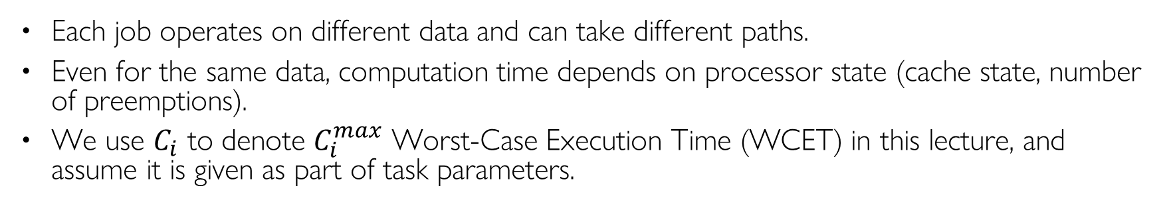
Estimating WCET is Not Easy
Each job operates on different data and can take different paths.
Even for the same data, computation time depends on processor state (cache state, number of preemptions).
We use $C_{i}$ to denote $C_{i}^{max}$ Worst-Case Execution Time (WCET) in this lecture, and assume it is given as part of task parameters.
?
loop
?
Distribution
(probability density function)
?
timer
min
max
execution time
C_{i}
C_{i}

Slide 17
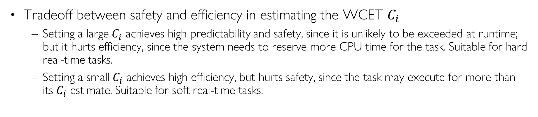
Predictability/Safety vs. Efficiency
Tradeoff between safety and efficiency in estimating the WCET $C_{i}$
Setting a large $C_{i}$ achieves high predictability and safety, since it is unlikely to be exceeded at runtime; but it hurts efficiency, since the system needs to reserve more CPU time for the task. Suitable for hard real-time tasks.
Setting a small $C_{i}$ achieves high efficiency, but hurts safety, since the task may execute for more than its $C_{i}$ estimate. Suitable for soft real-time tasks.
Distribution
(probability density function)
execution time
C_{i}
min
C_{i}
avg
C_{i}
max
C_{i} estimate
unsafe
efficient
safe
Notes:
where deadline violations may cause severe consequencesIt is a parameter related to the consequences of missing the deadline
Hard: missing deadline may have catastrophic consequences
Hard Real-Time System if it can handle hard tasks
sensory acquisition
low-level control
sensory-motor planning
Soft: missing a deadline causes performance degradation
reading data from the keyboard—user command interpretation
message displaying
graphical activities
Value, v_{i} = the relative importance of a task wrt other tasks

Slide 18
Jitter
It is a measure of the time variation of a periodic event:
Finish-time Jitter
τ_{i}
fi,1
fi,2
fi,3
Start-time Jitter
τ_{i}
si,1 si,2 si,3
Completion-time Jitter (I/O Jitter)
τ_{i}
si,1
fi,1
si,2
fi,2
si,3
fi,3
Notes:
max (t_{k} – a_{k}) – min (t_{k} – a_{k})
k k
max | (t_{k} – a_{k}) – (f_{k-1} – a_{k-1}) |

Slide 19

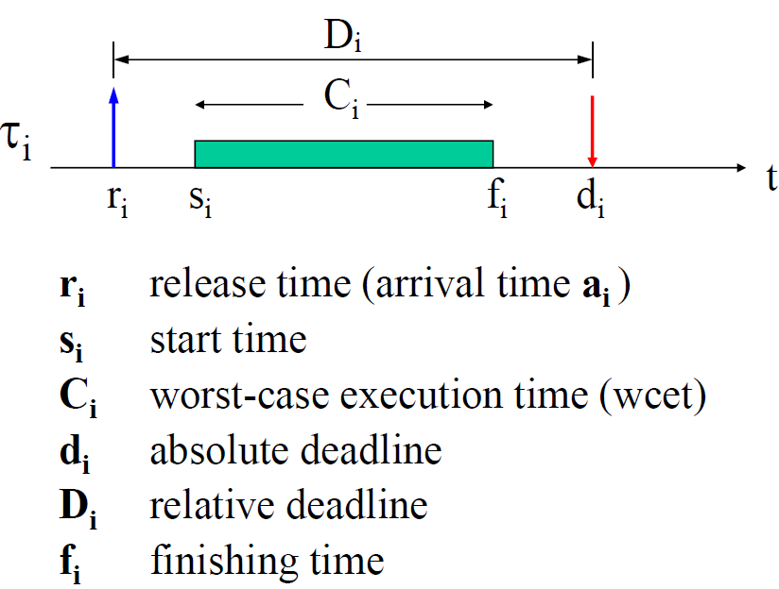

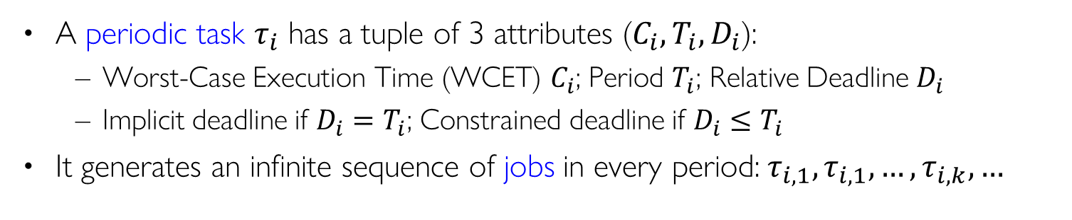

Periodic Task
A periodic task $τ_{i}$ has a tuple of 3 attributes ($C_{i}, T_{i}{, D}_{i}$):
Worst-Case Execution Time (WCET) $C_{i}$; Period $T_{i}$; Relative Deadline $D_{i}$
Implicit deadline if $D_{i}=T_{i}$; Constrained deadline if $D_{i}≤T_{i}$
It generates an infinite sequence of jobs in every period:$τ_{i,1},τ_{i,1},…,τ_{i,k}, …$
input
C
i
output
wait()
timer (period T_{i} )
τi (Ci , Ti , Di )
Ci
Ti
job τik
ai,1 = Φi
ai,k
ai,k+1
t
task phase or
Release offset
ai,k di,k
= Φi + (k−1) T_{i}
= a_{i,k} + D_{i}
often
Di = Ti
A job of task $τ_{i}$
Multiple jobs released by task $τ_{i}$
Notes:
Consider a periodic task τ₁(C₁,T₁,D₁) with phase Φ₁, where:
C₁ = 10 ms, T₁ = 50 ms, D₁ = 25 ms, and Φ₁ = 100 ms
What is τ₁’s utilization factor?
Is τ₁ feasible?
What is τ_{1,1}’s absolute deadline?
What is τ_{1,1}’s laxity?
What is τ_{1,2}’s release time?
Can τ_{1,1} and τ_{1,2} have different laxity?
Can τ_{1,1} and τ_{1,2} have different slack?
If τ_{1,2}’s slack is 10ms, what is τ_{1,s}’s finishing time?
What is τ_{1,2}’s response time?
With a 2-CPU machine, can τ_{1,2} and τ_{1,3} have the same release time?
Can τ_{1,2} and τ_{1,3} have the same finishing time?

Slide 20

Aperiodic & Sporadic Task
Aperiodic task: jobs may arrive at arbitrary time instants
Sporadic task: arrival times with a minimum interarrival time constraint
Aperiodic:
ai,k+1 > ai,k
minimum interarrival time
Sporadic:
ai,k+1
≥ a_{i,k} + T_{i}
job τik
τi
Ci
Ci
Ci
ai,1
ai,k
ai,k+1
t

Slide 21
Types of Constraints
Timing constraints
Deadline, jitter
Precedence constraints
Relative ordering among task executions
Resource constraints
Synchronization when accessing mutually-exclusive resources (shared data)

Slide 22














Precedence Constraints
stereo vision
Tasks must be executed with specific precedence relations, specified by a Directed Acyclic Graph (Precedence Graph)
Example application of parts inspection in a factory. Tasks:
Image acquisition (acq1, acq2)
Edge detection (edge1, edge2)
Shape detection (shape), pixel disparities (disp)
Height determination (height), recognition (rec)
processing
recognition
acq1
acq2
edge1
edge2
disp
shape
depth
rec
Notes:
Precedence graph?

Slide 23
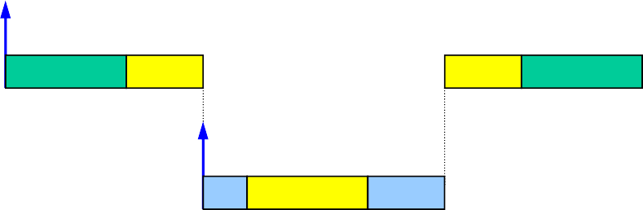
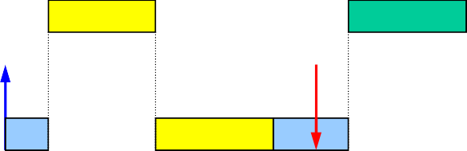
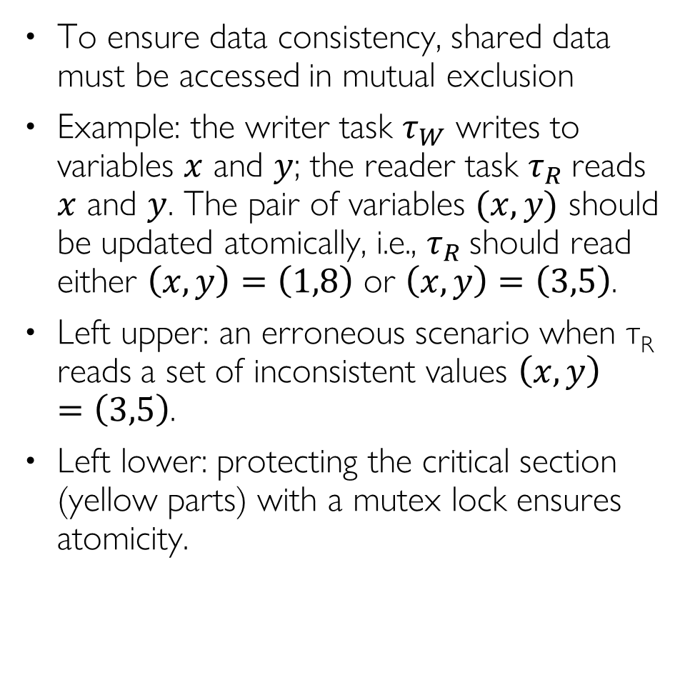
Resource Constraints
To ensure data consistency, shared data must be accessed in mutual exclusion
Example: the writer task $τ_{W}$ writes to variables $x$ and $y$; the reader task $τ_{R}$reads $x$ and $y$. The pair of variables $(x,y)$ should be updated atomically, i.e., $τ_{R}$ should read either $\left(x,y\right)=\left(1,8\right)$ or $\left(x,y\right)=\left(3,5\right)$.
Left upper: an erroneous scenario when τ_{R} reads a set of inconsistent values $\left(x,y\right)=\left(3,5\right)$.
Left lower: protecting the critical section (yellow parts) with a mutex lock ensures atomicity.
τ_{W}
x = 3
y = 5
τ_{R}
x = 1
y = 8
x = 1
y = 5
τ_{W}
τ_{R}
x=1
y=5
read
Erroneous scenario with no lock protection
τ_{W}
x = 3
y = 5
τ_{R}
x = 1
y = 8
x = 1
y = 8
τ_{W}
x = 1
y = 8
τ_{R}
read
Δ
Correct scenario with lock protection

Slide 24
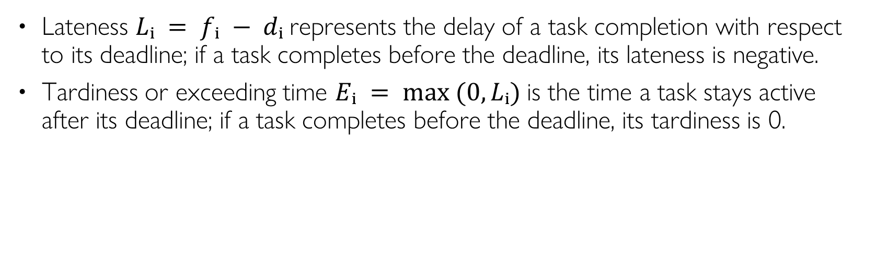
Scheduling Metrics
Lateness $Lᵢ = fᵢ − dᵢ$represents the delay of a task completion with respect to its deadline; if a task completes before the deadline, its lateness is negative.
Tardiness or exceeding time $Eᵢ = max ⁡(0, Lᵢ)$is the time a task stays active after its deadline; if a task completes before the deadline, its tardiness is 0.
Notes:
Using the above definitions, we have dᵢ ≥ rᵢ + Cᵢ

Slide 25
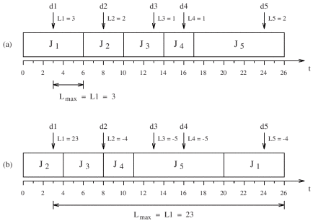
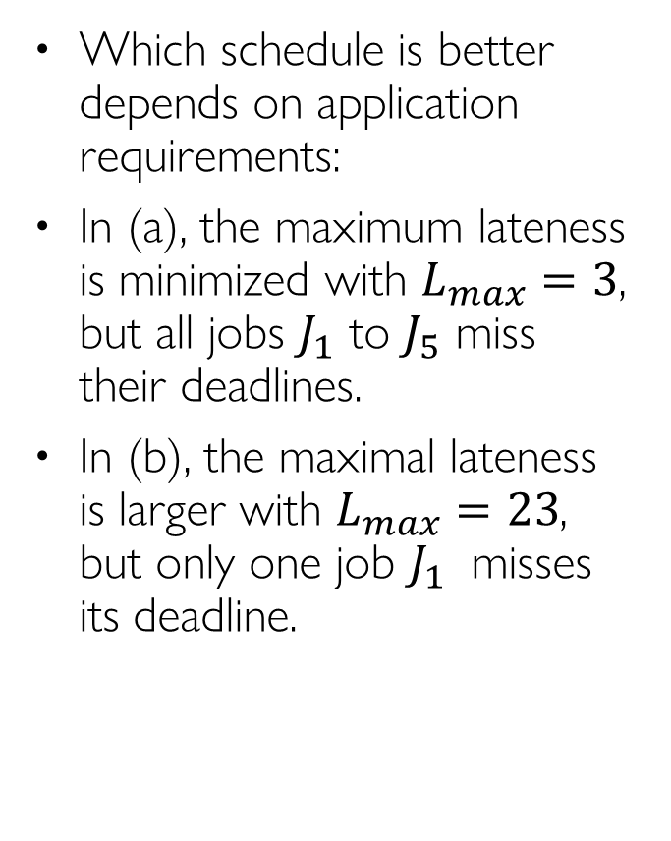
Example: Lateness
Which schedule is better depends on application requirements:
In (a), the maximum lateness is minimized with $L_{max}=3$, but all jobs $J_{1}$ to $J_{5}$ miss their deadlines.
In (b), the maximal lateness is larger with $L_{max}=23$, but only one job $J_{1}$ misses its deadline.

Slide 26
Scheduling Algorithms
Static cyclic scheduling (offline)
All task invocation times are computed offline and stored in a table; Runtime dispatch is a simple table lookup
Online scheduling;
Fixed priority scheduling
Each task is assigned a fixed priority; Runtime dispatch is priority-based
Dynamic priority scheduling
Task priorities are assigned dynamically at runtime, e.g., Earliest Deadline First (EDF), Least-Laxity First (LLF)
Non-real-time scheduling, e.g., round-robin, multi-level queue…

Slide 27
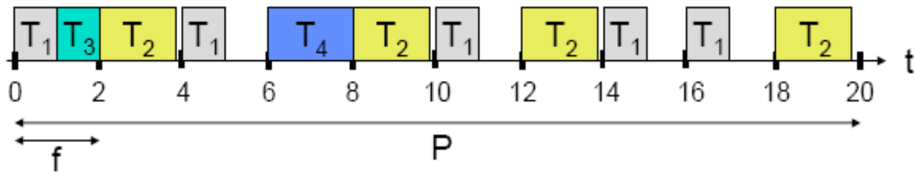
Static Cyclic Scheduling
The same schedule is executed once during each hyper-period (least common multiple of all task periods in a taskset).
The hyper-period is partitioned into frames of length f.
If a task’s WCET exceeds f, then programmer needs to cut it to fit within a frame, and save/restore program state manually
The schedule is computed offline and stored in a table. Runtime task dispatch is a simple table lookup.
Pros:
Deals with precedence, exclusion, and distance constraints
Efficient, low-overhead for runtime task dispatch
Lock-free at runtime
Cons:
Task table can get very large if task periods are relatively prime
Maintenance nightmare: complete redesign when new tasks are added, or old tasks are deleted
Not widely used
Except in certain safety-critical systems such as avionic systems
Notes:
Execution timeline is an infinite sequence of hyper periods
Online monitoring and exception handling (babbling idiot prevention)
Advantages:
Deals with precedence, exclusion, and distance constraints
Efficient, low-overhead for runtime task dispatch
Lock-free at runtime
Online monitoring and exception handling (babbling idiot prevention)
Disadvantages:
Not efficient for event-driven workload
Maintenance nightmare
Complete redesign when new tasks are added, or old tasks are deleted

Slide 28
Fixed-Priority Scheduling

Slide 29
Fixed Priority Scheduling
Each task is assigned a fixed priority for all its invocations
Pros:
Predictability
Low runtime overhead
Temporal isolation during overload
Cons:
Cannot achieve 100% utilization in general, except when task periods are harmonic
Widely used in most commercial RTOSes and CAN bus

Slide 30
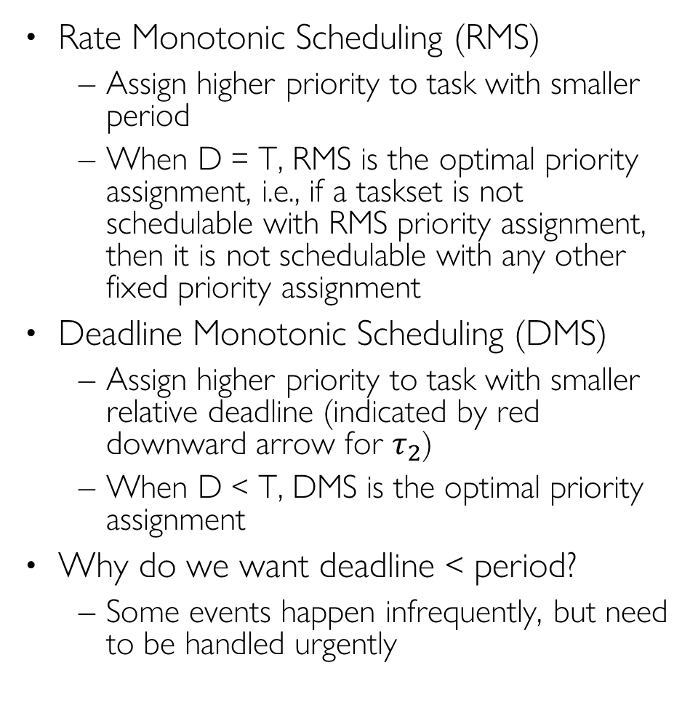
Rate Monotonic & Deadline Monotonic Scheduling
Rate Monotonic Scheduling (RMS)
Assign higher priority to task with smaller period
When D = T, RMS is the optimal priority assignment, i.e., if a taskset is not schedulable with RMS priority assignment, then it is not schedulable with any other fixed priority assignment
Deadline Monotonic Scheduling (DMS)
Assign higher priority to task with smaller relative deadline (indicated by red downward arrow for $τ_{2}$)
When D < T, DMS is the optimal priority assignment
Why do we want deadline < period?
Some events happen infrequently, but need to be handled urgently
τ1
0
25
50
75
100
τ2
0
40
80
τ3
0
100
τ1
0
25
50
75
100
τ2
0
40
80
τ3
0
100
Notes:
RTA also applies to DMS

Slide 31
Two Schedulability Analysis Approaches
Utilization bound test
Calculate total CPU utilization and compare it to a known bound
Polynomial time complexity
Pessimistic: sufficient but not necessary condition for schedulability
Response Time Analysis (RTA)
Calculate Worst-Case Response Time R_{i} for each task Tau_{i} and compare it to its deadline D_{i}
Pseudo-polynomial time complexity
An algorithm runs in pseudo-polynomial time if its running time is polynomial in the numeric value of the input (which is exponential in the length of the input – its number of digits).
Accurate: necessary and sufficient condition for schedulability
Notes:
refers to a class of algorithms whose running time is polynomial in the numeric value of the input but not necessarily in the input size (the number of bits required to represent the input). This distinction arises because the numeric value of an input can be exponentially larger than its representation in bits.

Slide 32



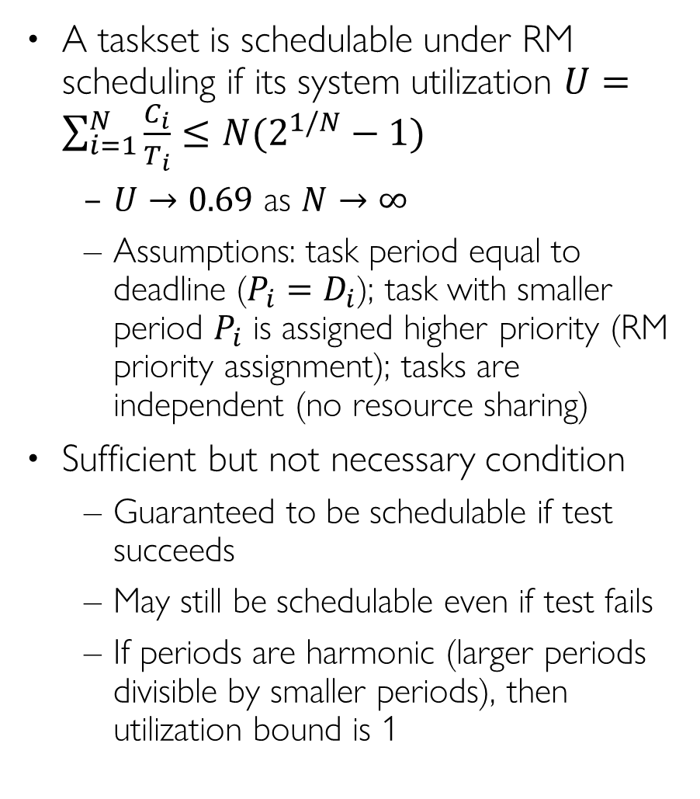
Utilization Bound Test
# Tasks | RM Util Bound
1 | 1.00
2 | 0.828
3 | 0.780
4 | 0.757
5 | 0.743
10 | 0.718
inf | 0.693
A taskset is schedulable under RM scheduling if its system utilization $U=\sum_{i=1}^{N}{\frac{C_{i}}{T_{i}}}≤N(2^{1/N}−1)$
$U→0.69$ as $N→∞$
Assumptions: task period equal to deadline ($P_{i}=D_{i}$); task with smaller period $P_{i}$ is assigned higher priority (RM priority assignment); tasks are independent (no resource sharing)
Sufficient but not necessary condition
Guaranteed to be schedulable if test succeeds
May still be schedulable even if test fails
If periods are harmonic (larger periods divisible by smaller periods), then utilization bound is 1
CPU%
100
90
80
70
60
50
40
30
20
10
0
RM UB Test
69%
# tasks
1 2 3 4 5 6 7 8 9 10
Notes:
(not deadline-monotonic!) Applies to rate-monotonic priority assignmentA taskset is schedulable under RM scheduling if its system utilization $U=\sum_{i=1}^{N}{\frac{C_{i}}{T_{i}}}≤N(2^{1/N}−1)$
$U→0.69$ as $N→∞$
Assumptions: task period equal to deadline ($P_{i}=D_{i}$); task with smaller period $P_{i}$ is assigned higher priority (RM priority assignment); tasks are independent (no resource sharing)

Slide 33
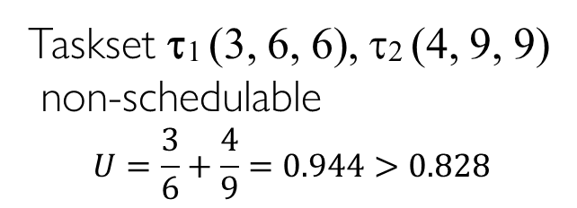
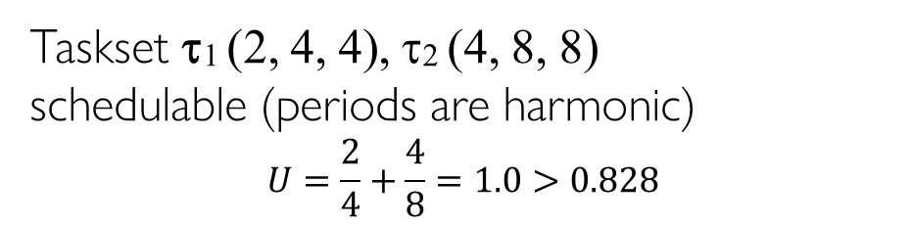
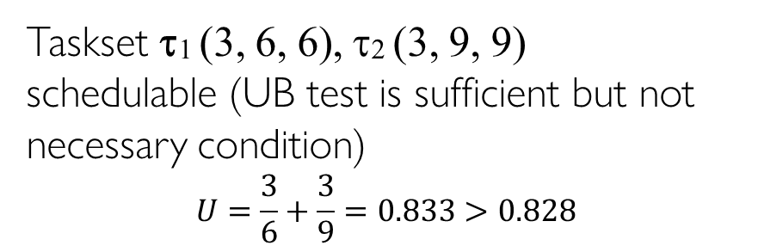
Utilization Bound Test Examples
We use the notation τi (Ci, Ti, Di) to denote task τi with WCET Ci Period Ti, Deadline Di
τ1
Taskset τ1 (3, 6, 6), τ2 (4, 9, 9)
non-schedulable
$$U=\frac{3}{6}+\frac{4}{9}=0.944>0.828$$
0
3
6
9
12
15
18
τ2
0
3
6
9
12
15
18
deadline miss
Taskset τ1 (3, 6, 6), τ2 (3, 9, 9)
schedulable (UB test is sufficient but not necessary condition)
$$U=\frac{3}{6}+\frac{3}{9}=0.833>0.828$$
τ1
0
3
6
9
12
15
18
τ2
0
3
6
9
12
15
18
τ1
Taskset τ1 (2, 4, 4), τ2 (4, 8, 8)
schedulable (periods are harmonic)
$$U=\frac{2}{4}+\frac{4}{8}=1.0>0.828$$
0
4
8
12
16
τ2
0
4
8
12
16

Slide 34
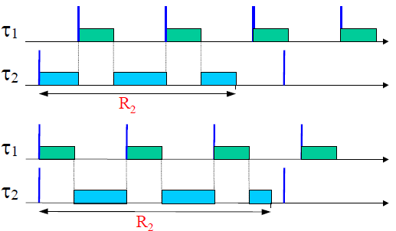
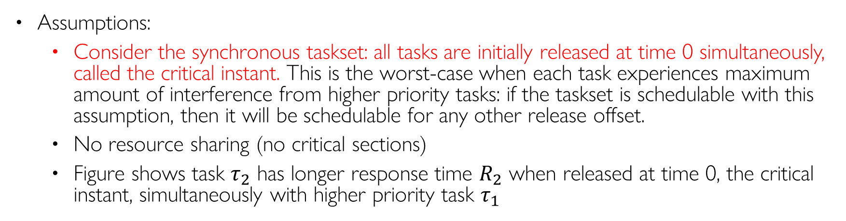
Response Time Analysis (RTA)
Assumptions:
Consider the synchronous taskset: all tasks are initially released at time 0 simultaneously, called the critical instant. This is the worst-case when each task experiences maximum amount of interference from higher priority tasks: if the taskset is schedulable with this assumption, then it will be schedulable for any other release offset.
No resource sharing (no critical sections)
Figure shows task $τ_{2}$ has longer response time $R_{2}$ when released at time 0, the critical instant, simultaneously with higher priority task $τ_{1}$
Notes:
Synchronous taskset: all tasks are released at time 0 simultaneously.
This is the worst-case: if taskset is schedulable with this assumption, then it will be schedulable for any other release offset
Let’s explain this equation with the example taskset

Slide 35
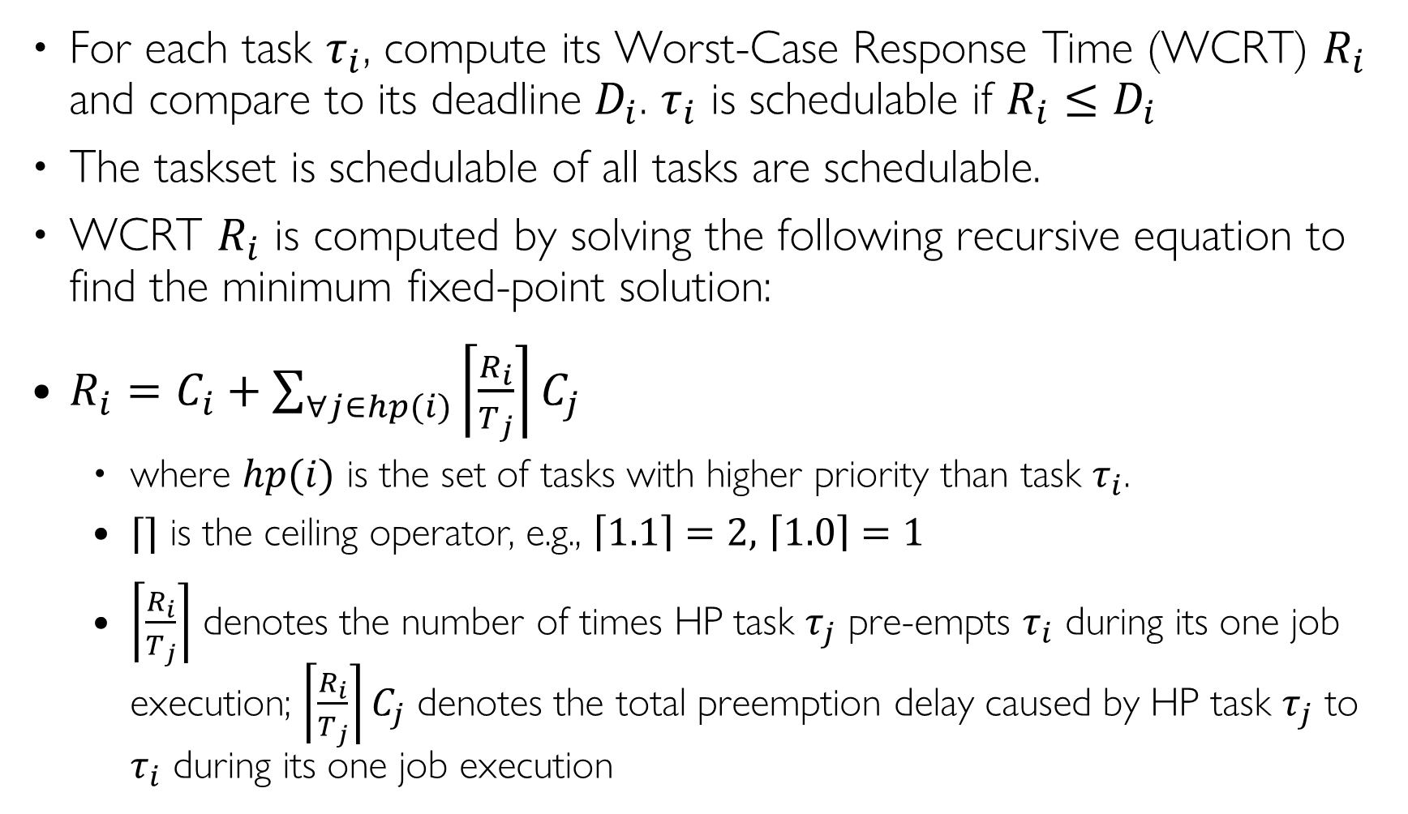
Response Time Analysis (RTA)
For each task $τ_{i}$, compute its Worst-Case Response Time (WCRT) $R_{i}$ and compare to its deadline $D_{i}$. $τ_{i}$ is schedulable if ${R_{i}≤D}_{i}$
The taskset is schedulable of all tasks are schedulable.
WCRT $R_{i}$ is computed by solving the following recursive equation to find the minimum fixed-point solution:
$R_{i}=C_{i}+\sum_{∀j∈hp(i)}{\left\lceil \frac{R_{i}}{T_{j}}\right\rceil C_{j}}$
where $hp(i)$ is the set of tasks with higher priority than task $τ_{i}$.
$⌈⌉$ is the ceiling operator, e.g., $\left\lceil 1.1\right\rceil =2,$ $\left\lceil 1.0\right\rceil =1$
$\left\lceil \frac{R_{i}}{T_{j}}\right\rceil$ denotes the number of times HP task $τ_{j}$ pre-empts $τ_{i}$ during its one job execution; $\left\lceil \frac{R_{i}}{T_{j}}\right\rceil C_{j}$ denotes the total preemption delay caused by HP task $τ_{j}$ to $τ_{i}$ during its one job execution
Notes:
Synchronous taskset: all tasks are released at time 0 simultaneously.
This is the worst-case: if taskset is schedulable with this assumption, then it will be schedulable for any other release offset
Let’s explain this equation with the example taskset

Slide 36
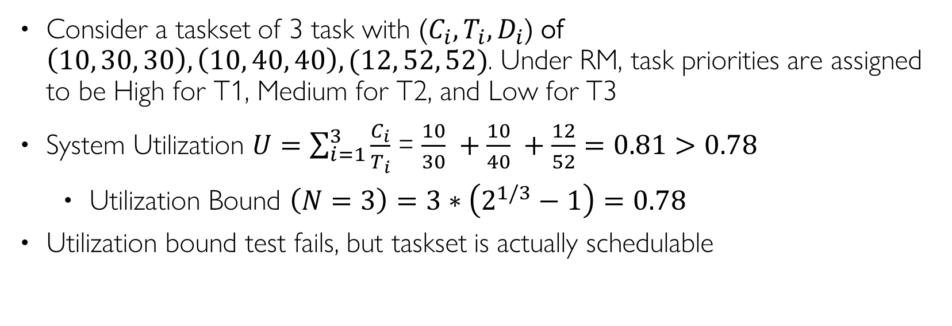
An Example Taskset
Consider a taskset of 3 task with ($C_{i}, T_{i}{, D}_{i}$) of $\left(10, 30, 30\right),\left(10, 40, 40\right),(12, 52, 52)$. Under RM, task priorities are assigned to be High for T1, Medium for T2, and Low for T3
System Utilization $U=\sum_{i=1}^{3}{\frac{C_{i}}{T_{i}}}$ = $\frac{10}{30} +\frac{10}{40} +\frac{12}{52}=0.81>0.78$
Utilization Bound $\left(N=3\right)=3∗\left(2^{1/3}−1\right)=0.78$
Utilization bound test fails, but taskset is actually schedulable
Task | T=D | C | Prio
T1 | 30 | 10 | H
T2 | 40 | 10 | M
T3 | 52 | 12 | L

Slide 37

Task T1
Task | T=D | C | Prio
T1 | 30 | 10 | H
T2 | 40 | 10 | M
T3 | 52 | 12 | L
T1 is the highest priority task, with no interference from other tasks $hp\left(1\right)=∅$
$R_{1}=C_{1}+0=10$
$R_{1}<D_{1}$, so T1 is schedulable
Task
T1
T1
0
10
20
30
40
50
Time

Slide 38
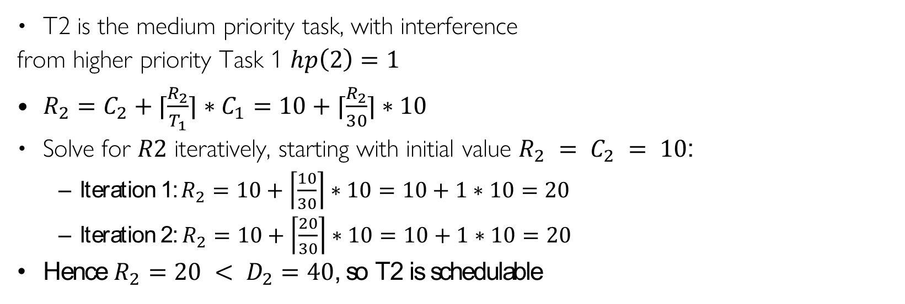
Task T2
Task | T=D | C | Prio
T1 | 30 | 10 | H
T2 | 40 | 10 | M
T3 | 52 | 12 | L
T2 is the medium priority task, with interference
from higher priority Task 1 $hp\left(2\right)=1$
$R_{2}=C_{2}+⌈\frac{R_{2}}{T_{1}}⌉∗C_{1}=10+⌈\frac{R_{2}}{30}⌉∗10$
Solve for $R2$ iteratively, starting with initial value $R_{2} = C_{2} = 10$:
Iteration 1: $R_{2}=10+\left\lceil \frac{10}{30}\right\rceil ∗10=10+1∗10=20$
Iteration 2: $R_{2}=10+\left\lceil \frac{20}{30}\right\rceil ∗10=10+1∗10=20$
Hence $R_{2}=20 < D_{2}=40$, so T2 is schedulable
Task
T1
T1
T2
T2
0
10
20
30
40
50
Time

Slide 39
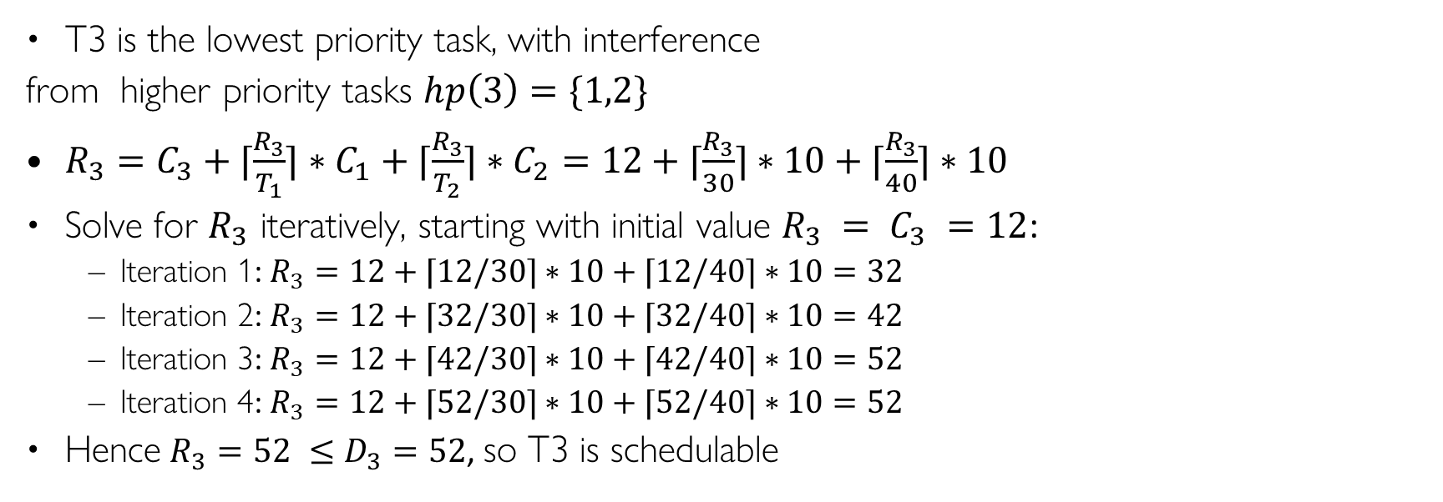
Task T3
Task | T=D | C | Prio
T1 | 30 | 10 | H
T2 | 40 | 10 | M
T3 | 52 | 12 | L
T3 is the lowest priority task, with interference
from higher priority tasks $hp\left(3\right)=\{1,2\}$
$R_{3}=C_{3}+⌈\frac{R_{3}}{T_{1}}⌉∗C_{1}+⌈\frac{R_{3}}{T_{2}}⌉∗C_{2}=12+⌈\frac{R_{3}}{30}⌉∗10+⌈\frac{R_{3}}{40}⌉∗10$
Solve for $R_{3}$ iteratively, starting with initial value $R_{3} = C_{3} =12$:
Iteration 1: $R_{3}=12+⌈12/30⌉∗10+⌈12/40⌉∗10=32$
Iteration 2: $R_{3}=12+⌈32/30⌉∗10+⌈32/40⌉∗10=42$
Iteration 3: $R_{3}=12+⌈42/30⌉∗10+⌈42/40⌉∗10=52$
Iteration 4: $R_{3}=12+⌈52/30⌉∗10+⌈52/40⌉∗10=52$
Hence $R_{3}=52 ≤D_{3}=52$, so T3 is schedulable
0
Task
T1
T1
T2
T2
T3
T3
0
10
20
30
40
50
Time

Slide 40

RTA for T3: Initial Condition
Task | T=D | C | Prio
T1 | 30 | 10 | H
T2 | 40 | 10 | M
T3 | 52 | 12 | L
T2
Initially $R_{3} = 12$
We have not taken into account any preemption delays from higher priority tasks T1 and T2 yet
Task
T1
T1
T2
T2
T3
0
10
12
20
30
40
50
Time

Slide 41
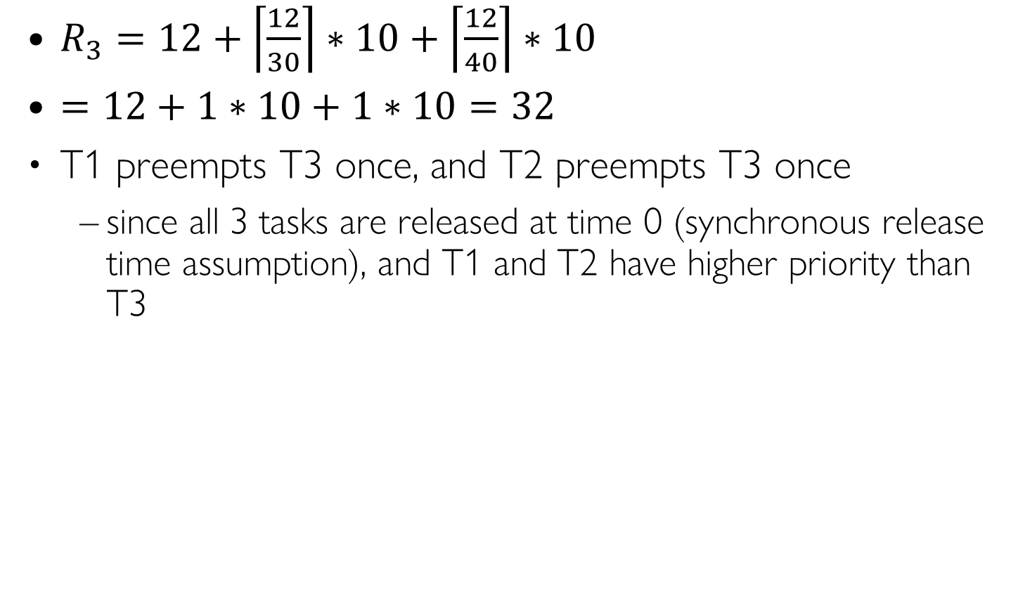
RTA for Task 3: Iteration 1
Task | T=D | C | Prio
T1 | 30 | 10 | H
T2 | 40 | 10 | M
T3 | 52 | 12 | L
$R_{3}=12+\left\lceil \frac{12}{30}\right\rceil ∗10+\left\lceil \frac{12}{40}\right\rceil ∗10$
$=12+1∗10+1∗10=32$
T1 preempts T3 once, and T2 preempts T3 once
since all 3 tasks are released at time 0 (synchronous release time assumption), and T1 and T2 have higher priority than T3
Task
T1
T1
T2
T2
T3
0
10
20
30
32
40
50
Time

Slide 42
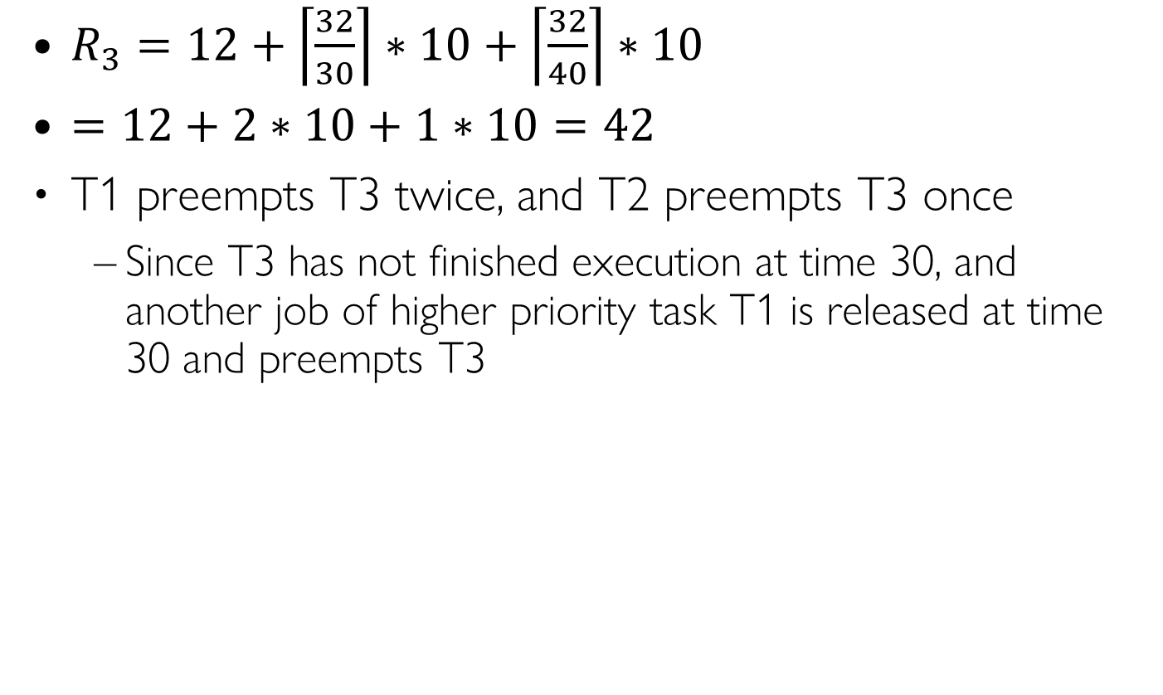
RTA for Task 3: Iteration 2
Task | T=D | C | Prio
T1 | 30 | 10 | H
T2 | 40 | 10 | M
T3 | 52 | 12 | L
$R_{3}=12+\left\lceil \frac{32}{30}\right\rceil ∗10+\left\lceil \frac{32}{40}\right\rceil ∗10$
$=12+2∗10+1∗10=42$
T1 preempts T3 twice, and T2 preempts T3 once
Since T3 has not finished execution at time 30, and another job of higher priority task T1 is released at time 30 and preempts T3
Task
T1
T1
T2
T2
T3
T3
0
10
20
30
40
42
50
Time
Notes:
R3 = 12 + ceil(32/30)*10 + ceil(32/40)*10 = 42

Slide 43
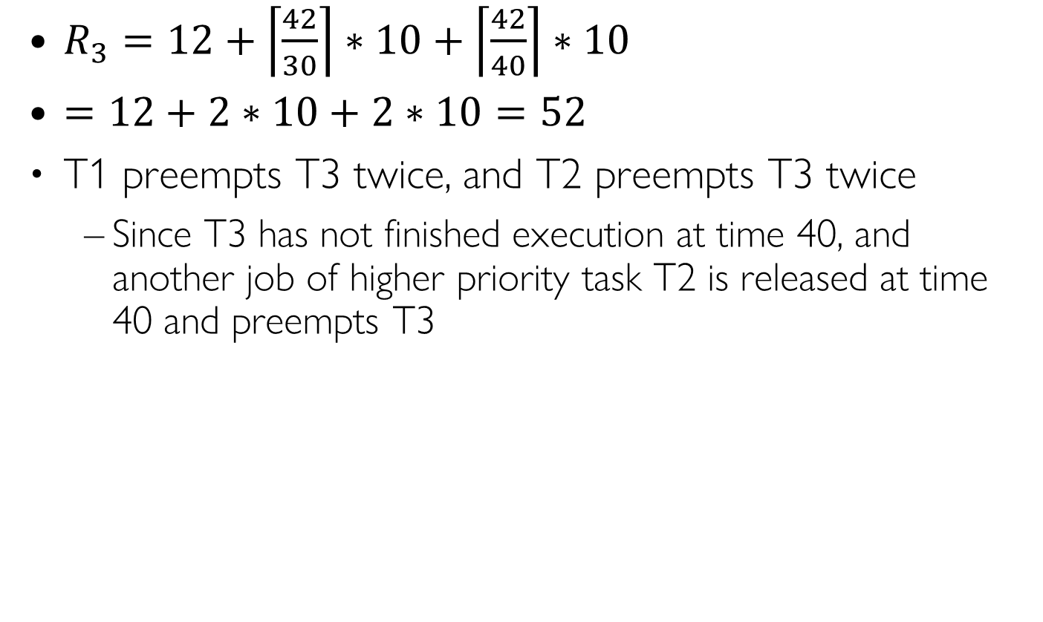
RTA for Task 3: Iteration 3
Task | T=D | C | Prio
T1 | 30 | 10 | H
T2 | 40 | 10 | M
T3 | 52 | 12 | L
$R_{3}=12+\left\lceil \frac{42}{30}\right\rceil ∗10+\left\lceil \frac{42}{40}\right\rceil ∗10$
$=12+2∗10+2∗10=52$
T1 preempts T3 twice, and T2 preempts T3 twice
Since T3 has not finished execution at time 40, and another job of higher priority task T2 is released at time 40 and preempts T3
Task
T1
T1
T2
T2
T3
T3
0
10
20
30
40
50
52
Time

Slide 44
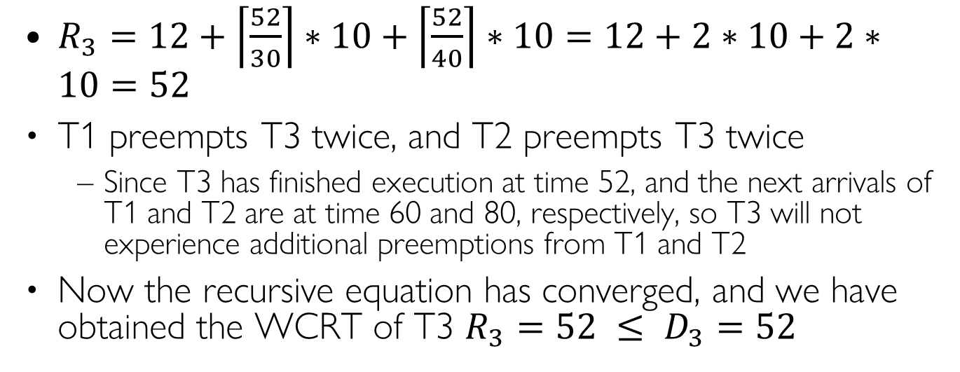
RTA for Task 3: Iteration 4
Task | T=D | C | Prio
T1 | 30 | 10 | H
T2 | 40 | 10 | M
T3 | 52 | 12 | L
$R_{3}=12+\left\lceil \frac{52}{30}\right\rceil ∗10+\left\lceil \frac{52}{40}\right\rceil ∗10=12+2∗10+2∗10=52$
T1 preempts T3 twice, and T2 preempts T3 twice
Since T3 has finished execution at time 52, and the next arrivals of T1 and T2 are at time 60 and 80, respectively, so T3 will not experience additional preemptions from T1 and T2
Now the recursive equation has converged, and we have obtained the WCRT of T3 $R_{3}=52 ≤ D_{3}=52$
Task
T1
T1
T2
T2
T3
T3
0
10
20
30
40
50
52
Time
Notes:
$$R_{3} = 52 ≤D_{3} = 52$$

Slide 45
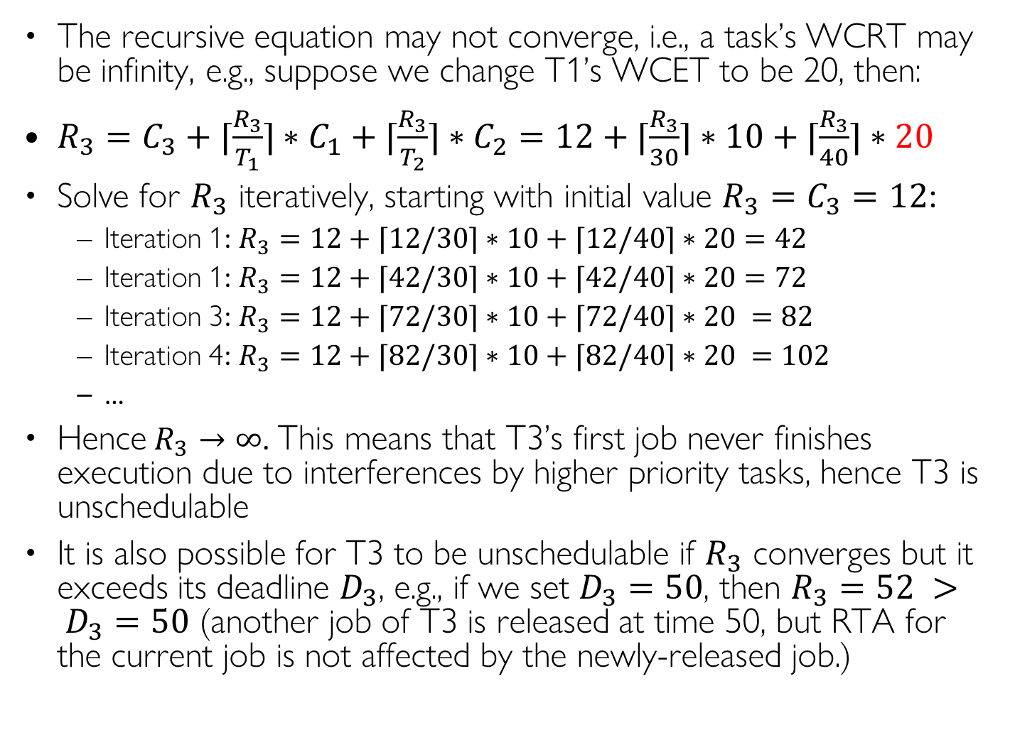
When T3 is Unschedulable
The recursive equation may not converge, i.e., a task’s WCRT may be infinity, e.g., suppose we change T1’s WCET to be 20, then:
$R_{3}=C_{3}+⌈\frac{R_{3}}{T_{1}}⌉∗C_{1}+⌈\frac{R_{3}}{T_{2}}⌉∗C_{2}=12+⌈\frac{R_{3}}{30}⌉∗10+⌈\frac{R_{3}}{40}⌉∗20$
Solve for $R_{3}$ iteratively, starting with initial value $R_{3}=C_{3}=12$:
Iteration 1: $R_{3}=12+⌈12/30⌉∗10+⌈12/40⌉∗20=42$
Iteration 1: $R_{3}=12+⌈42/30⌉∗10+⌈42/40⌉∗20=72$
Iteration 3: $R_{3}=12+⌈72/30⌉∗10+⌈72/40⌉∗20 =82$
Iteration 4: $R_{3}=12+⌈82/30⌉∗10+⌈82/40⌉∗20 =102$
…
Hence $R_{3}→∞$. This means that T3’s first job never finishes execution due to interferences by higher priority tasks, hence T3 is unschedulable
It is also possible for T3 to be unschedulable if $R_{3}$ converges but it exceeds its deadline $D_{3}$, e.g., if we set $D_{3}=50$, then $R_{3}=52 > D_{3}=50$ (another job of T3 is released at time 50, but RTA for the current job is not affected by the newly-released job.)
Task | T=D | C | Prio
T1 | 30 | 10 | H
T2 | 40 | 20 | M
T3 | 52 | 12 | L
0
Task | T=D | C | Prio
T1 | 30 | 10 | H
T2 | 40 | 10 | M
T3 | 50 | 12 | L

Slide 46
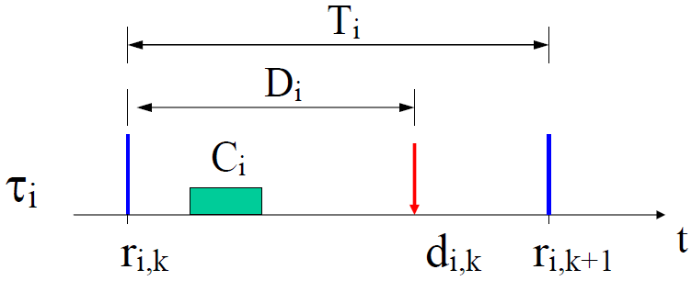
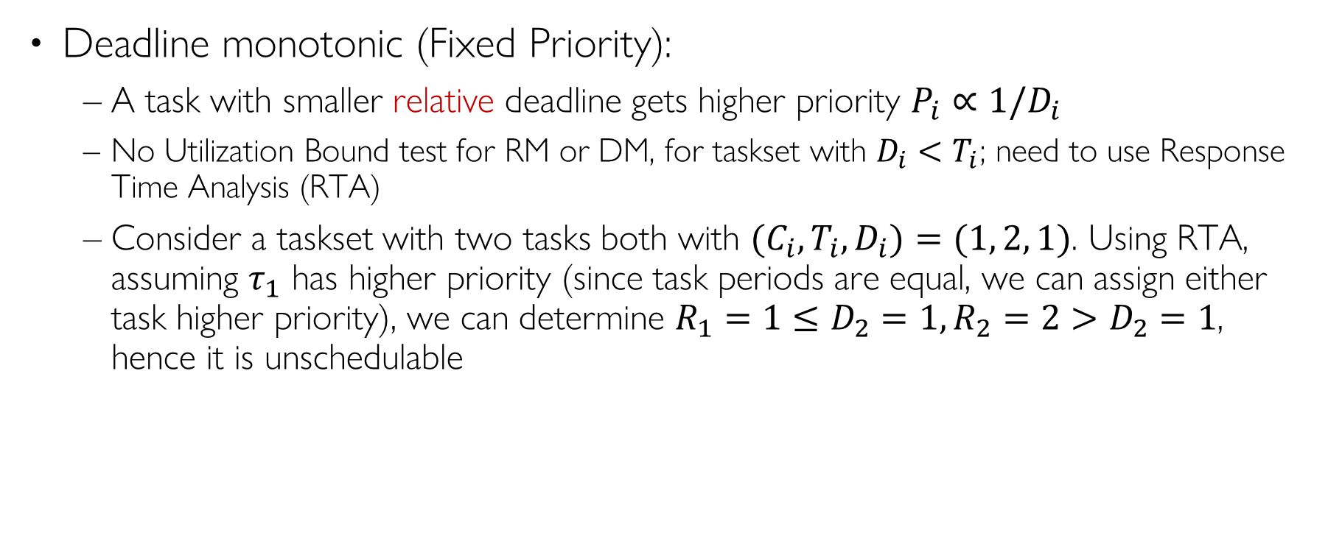
RM with D < T
Deadline monotonic (Fixed Priority):
A task with smaller relative deadline gets higher priority $P_{i}∝1/D_{i}$
No Utilization Bound test for RM or DM, for taskset with $D_{i}<T_{i}$; need to use Response Time Analysis (RTA)
Consider a taskset with two tasks both with ${(C}_{i},T_{i}, D_{i})=(1, 2, 1)$. Using RTA, assuming $τ_{1}$ has higher priority (since task periods are equal, we can assign either task higher priority), we can determine $R_{1}=1≤D_{2}=1, R_{2}=2>D_{2}=1$, hence it is unschedulable
Notes:
Schedulability analysis need to be changed (discussions omitted) but we can not use it to determine schedulability
Overhead: EDF typically exhibits less frequent preemptions ⇒ lower overhead
Overrun behavior (U > 1): EDF – automatic “period rescaling”, RM – complete blocking of lower priority tasks Transient: Task overrun can cause deadline miss of EDF: arbitrary task RM: only lower priority task If we don’t know which task will overrun, the result is the same. Jitter and latency: RM has no jitter only for the highest-priority task. In overall comparison, EDF provides better results (smaller release-time jitter a smaller input-output latency) Resource reservation: Simpler in case of EDF (see future lecture)

Slide 47
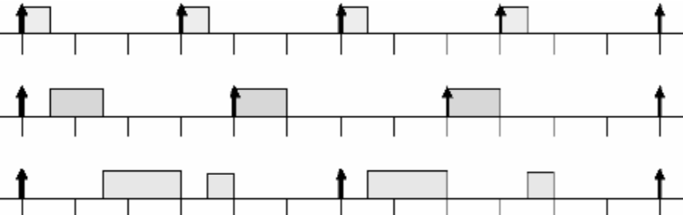
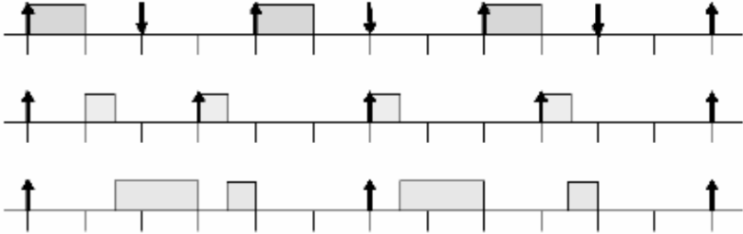


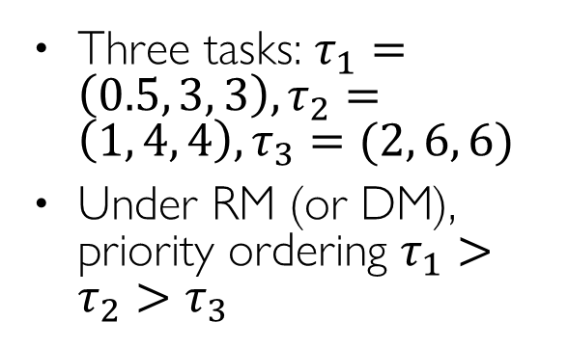


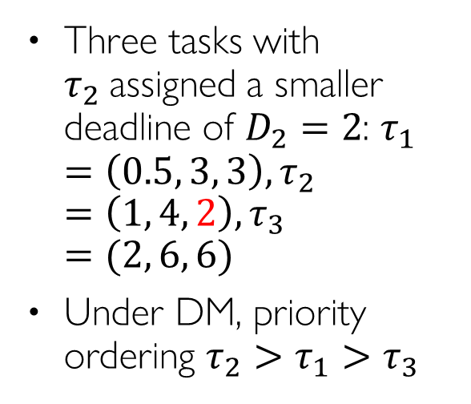


RM vs. DM Example
Three tasks: $τ_{1}=\left(0.5, 3, 3\right), τ_{2}=\left(1, 4, 4\right), τ_{3}=(2, 6, 6)$
Under RM (or DM), priority ordering $τ_{1}>τ_{2}>τ_{3}$
$$τ_{1}$$
$$τ_{2}$$
$$τ_{3}$$
0
3
6
9
12
Three tasks with $τ_{2}$assigned a smaller deadline of $D_{2}=2$: $τ_{1}=\left(0.5, 3, 3\right), τ_{2}=\left(1, 4, 2\right), τ_{3}=(2, 6, 6)$
Under DM, priority ordering $τ_{2}>τ_{1}>τ_{3}$
$$τ_{2}$$
$$τ_{1}$$
$$τ_{3}$$
0
3
6
9
12

Slide 48
Earliest Deadline First (EDF) Scheduling

Slide 49
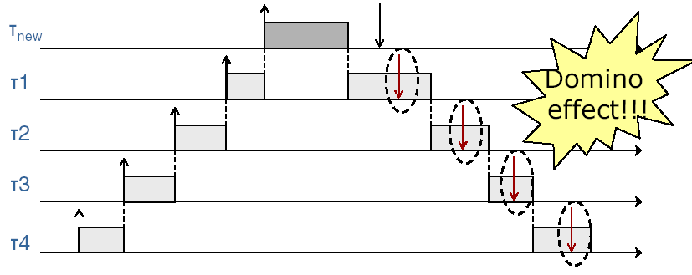
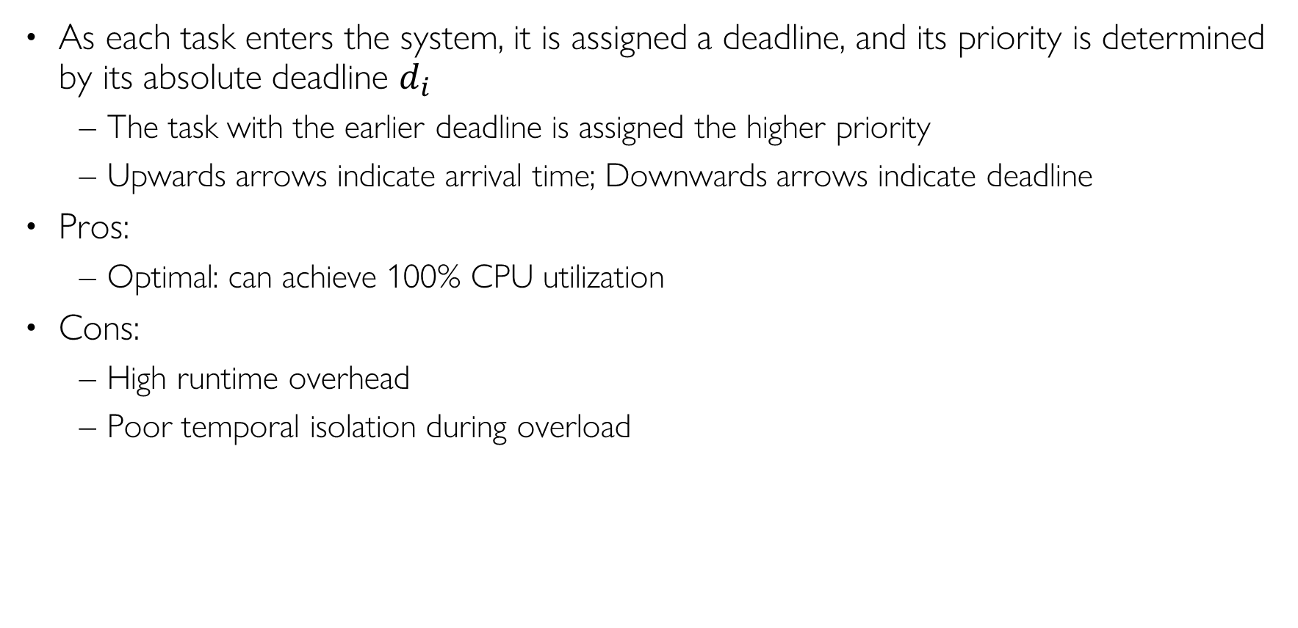
Earliest Deadline First (EDF)
As each task enters the system, it is assigned a deadline, and its priority is determined by its absolute deadline $d_{i}$
The task with the earlier deadline is assigned the higher priority
Upwards arrows indicate arrival time; Downwards arrows indicate deadline
Pros:
Optimal: can achieve 100% CPU utilization
Cons:
High runtime overhead
Poor temporal isolation during overload
Arrival time
Deadline
Notes:
EDF minimizes lateness of the “most tardy task” [Dertouzos, 1974]
Earliest Deadline First (EDF)
Each job is assigned a deadline upon its arrival
Task with earlier deadline is assigned higher priority
Pros: can achieve 100% utilization
Cons: high runtime overhead, lack of temporal protection for HP tasks

Slide 50
EDF Scheduling Example
Say you have two tasks, both released at time 0
T1 has WCET 5 ms, with deadline of 20 ms
T2 has WCET 10 ms, with deadline of 12 ms
Non-EDF scheduling: T1 before T2, T2 misses its deadline at 12
EDF scheduling: T2 before T1, both tasks meet their deadlines
T2 Deadline
T1 Deadline
T1 before T2
T1
T2
0
5
15
20
T2 before T1
T2
T1
0
5
15
20
Notes:
This is a simple example of EDF. Since it’s not widely used in the auto industry, we will not consider it further.

Slide 51

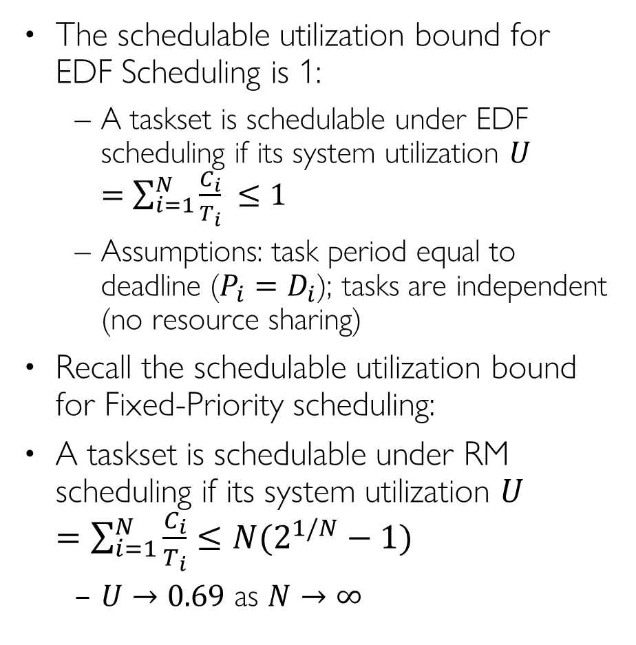
Schedulable Utilization Bound: RM vs. EDF
The schedulable utilization bound for EDF Scheduling is 1:
A taskset is schedulable under EDF scheduling if its system utilization $U=\sum_{i=1}^{N}{\frac{C_{i}}{T_{i}}} ≤1$
Assumptions: task period equal to deadline ($P_{i}=D_{i}$); tasks are independent (no resource sharing)
Recall the schedulable utilization bound for Fixed-Priority scheduling:
A taskset is schedulable under RM scheduling if its system utilization $U=\sum_{i=1}^{N}{\frac{C_{i}}{T_{i}}}≤N(2^{1/N}−1)$
$U→0.69$ as $N→∞$
RM
EDF
CPU%
100
90
80
70
60
50
40
30
20
10
0
100%
69%
# tasks
1 2 3 4 5 6 7 8 9 10

Slide 52
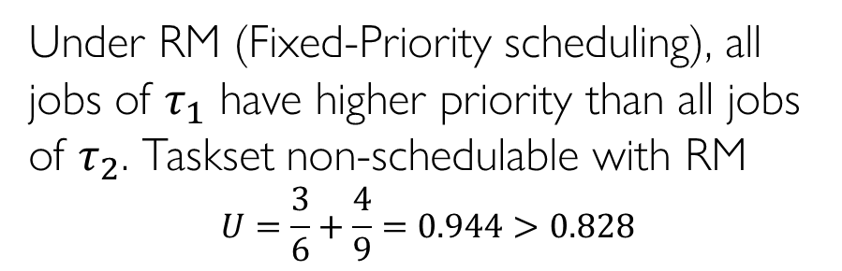
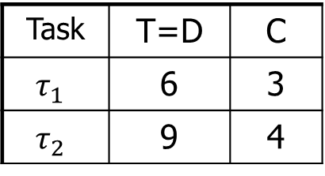
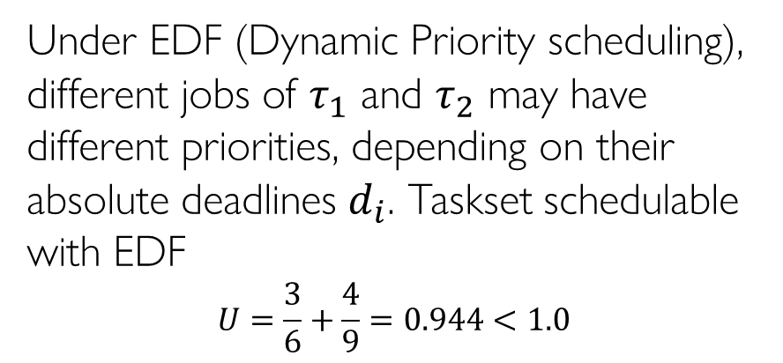
RM vs. EDF Example
Task | T=D | C
$$τ_{1}$$ | 6 | 3
$$τ_{2}$$ | 9 | 4
Under RM (Fixed-Priority scheduling), all jobs of $τ_{1}$ have higher priority than all jobs of $τ_{2}$. Taskset non-schedulable with RM
$$U=\frac{3}{6}+\frac{4}{9}=0.944>0.828$$
τ1
0
3
6
9
12
15
18
>
>
>
priority
τ2
0
3
6
9
12
15
18
deadline miss
Under EDF (Dynamic Priority scheduling), different jobs of $τ_{1}$ and $τ_{2}$ may have different priorities, depending on their absolute deadlines $d_{i}$. Taskset schedulable with EDF
$$U=\frac{3}{6}+\frac{4}{9}=0.944<1.0$$
τ1
0
3
6
>
9
12
15
18
>
>
=
priority
τ2
0
3
6
9
12
15
18
When two jobs have equal priority, the newly arrived job does not preempt the running job

Slide 53
RM vs. EDF: Robustness under Overload
Under permanent overload, with CPU utilization U > 1
Under EDF, all tasks execute at a slower rate with “period rescaling”, i. e., all tasks are delayed evenly
Under RM, higher priority tasks are protected while lower priority tasks are delayed or complete blocked
Recall Slide 25 Example Lateless
Under transient overload, when some job overruns (executes longer than expected temporarily)
Under EDF, task overruns can cause deadline miss of arbitrary task
Under RM: task overruns only affect lower priority tasks
Conclusion: RM offers better temporal isolation for higher priority tasks
Notes:
Not transient overload
This occurs

Slide 54
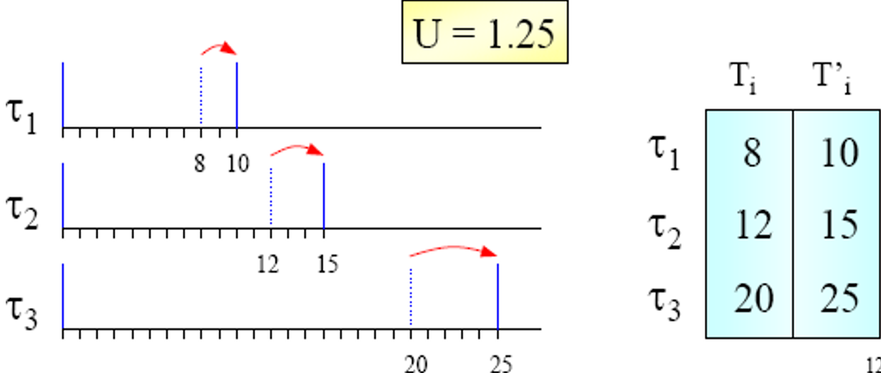

EDF Period Rescaling
Theorem on Period Rescaling [Cervin et al. 2003]:
If system utilization $U > 1$, tasks are executed with an average period $T_{i}^{′}=T_{i}U$ under EDF scheduling

Slide 55
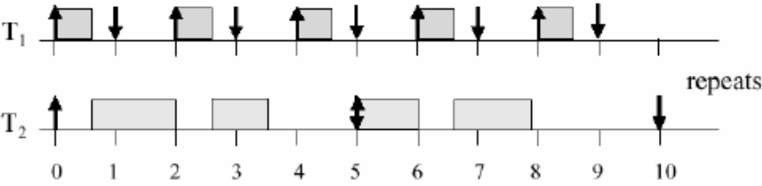

EDF with D < T
Earliest Deadline First (Dynamic-Priority):
A task with smaller absolute deadline gets higher priority $P_{i}∝1/d_{i}$
Instead of Utilization Bound of 1, we use Density Bound of 1
Density of task $τ_{i}$ is defined as $δ_{i}=\frac{C_{i}}{min(D_{i},T_{i}) }$. Taskset is schedulable if system density does not exceed 1: $δ=\sum_{i}{δ_{i}}≤1$ (sufficient but not necessary condition)
Process Demand Analysis can be used as necessary and sufficient condition (discussion omitted)
Consider a taskset with two tasks both with ${(C}_{i},T_{i}, D_{i})=(1,2,1)$. It is obviously unschedulable under EDF. System utilization is $U=\frac{1}{2}+\frac{1}{2}=1$; System density $Δ=\frac{1}{1}+\frac{1}{1}=2$. However we cannot determine schedulabiity based on $Δ >1$.
Consider a taskset with two tasks $τ_{1}=\left(0.6, 2, 1\right), τ_{2}=(2.3, 5, 5)$. $∆ =\frac{0.6}{1}+\frac{2.3}{5}= 1.06$. Yet the taskset is schedulable under EDF:

Slide 56
Least Laxity First (LLF) Scheduling

Slide 57





Least Laxity First (LLF)
LLF assigns priority to jobs dynamically based on their laxity (slack)
With absolute deadline $d_{i}$ and remaining execution time $e_{i}$, laxity of $τ_{i}$’s job at time $t$ is $l_{i}= d_{i} – t – e_{i}$. Job with the smallest laxity has the highest priority
If an active job runs in the previous time slot, then its laxity remains the same, as $t$ is incremented by 1, and $e_{i}$ is decremented by 1
If an active job does not run in the previous time slot, then its laxity is decremented by 1, as $t$ is incremented by 1, and $e_{i}$ remains the same
While an active job waits and does not run, its laxity decreases and its priority increases
EDF and LLF are both optimal scheduling algorithms, i.e., they both have schedulable utilization bound of 1
LLF incurs frequent context switches, hence is less practical than EDF
$$l_{i}$$
$$e_{i}$$
t
$d_{i}$
Notes:
At any time t the slack (or laxity) of a job with deadline at D is equal D − t − x, where x is the remaining portion of the job.

Slide 58

RM, EDF, LLF Example
Task | T=D | C
T1 | 5 | 2
T2 | 6 | 3
Task
T1
T1
T1
T2
T2
0 | 1 | 2 | 3 | 4 | 5 | 6 | 7 | 8 | 9 | 10 | 11 | 12
Time
Time | τ₁ Laxity | τ₂ Laxity | Running Task
t=0 | 5-0-2=3 | 6-0-3=3 | $τ₁$ (tie)
t=1 | 5-1-1=3 | 6-1-3=2 | $$τ₂$$
t=2 | 5-2-1=2 | 6-2-2=2 | $τ₂$(tie)
t=3 | 5-3-1=1 | 6-3-1=2 | $$τ₁$$
t=4 | $τ₁$ done | 6-4-1=1 | $$τ₂$$
t=5 | 10-5-2=3 | $τ₂$ done | $$τ₁$$
t=6 | 10-6-1=3 | 12-6-3=3 | $τ₁$ (tie)
t=7 | $τ₁$ done | 12-7-3=2 | $$τ₂$$
EDF and RM have the same schedule
Task
T1
T1
T1
T1
T2
T2
T2
0 | 1 | 2 | 3 | 4 | 5 | 6 | 7 | 8 | 9 | 10 | 11 | 12
Time
LLF has more frequent context switches

Slide 59
Preemptive vs. Non-Preemptive Scheduling

Slide 60

Preemptive vs. Non-Preemptive Scheduling
Non-preemptive scheduling pros:
It reduces runtime overhead
Less context switches
No mutex locks needed for critical sections
It preserves program locality, improving the effectiveness of CPU cache
As a result, task WCET becomes smaller and execution time distribution becomes more predictable (shown on right)
Sometimes NP scheduling can improve schedulability
Cons:
Reduced schedulability
Scheduling anomalies
Preemptive scheduling pros:
Better schedulability (higher CPU utilization)
Cons:
Runtime overhead due to frequent context-switches
Destroys program locality so task WCET becomes larger
Notes:
Pipeline mechanisms, Prefetch queues
It reduces stack size, since no more than one task can be active, and tasks can share the same stack space

Slide 61

Sometimes NP Scheduling Improves Schedulability
An example where NP scheduling improves schedulability (for fixed-priority scheduling)

Slide 62


Disadvantage of NP Scheduling: Reduced Schedulability
In general, NP scheduling reduces schedulability. The utilization bound under NP scheduling drops to zero due to blocking time
An example with with two tasks T1 and T2, CPU utilization of nearly 0, yet non-schedulable.
If $C2$ (WCET of T2)$≥ T1$ (period of T1), then the taskset is non-schedulable with arbitrarily small system CPU utilization $\frac{C_{1}}{T_{1}}+\frac{C_{2}}{T_{2}}→\frac{0}{T_{1}}+\frac{C_{2}}{∞}$ (when $C1$ goes to 0 and $T2$ goes to infinity)
This example is valid whether $τ1$ or $τ2$ has higher priority: even if $τ1$ has higher priority, it may be released very shortly after $τ2$ is released at time 0, and it has to wait for $τ2$ to finish due to NP scheduling
T1
T2
Notes:
Non preemption reduces schedulability (analysis must take blocking times into account); Non preemption reduces schedulability (analysis must take blocking times into account);
Schedulable utilization bound drops to zero.
Here is an example with CPU utilization of nearly 0, yet non-schedulable.

Slide 63


Disadvantage of NP Scheduling: Scheduling Anomalies
Scheduling anomaly: doubling the processor speed (reducing task execution times by half) makes task $τ_{1}$ miss its deadline
Notes:
I have given an overview of the basic concepts of real-time scheduling
Focus on static priority scheduling
Commercial tools from TimeSys and Tripac Software make it easier to do schedulability analysis
However, it is good to know the internals of these tools

Slide 64
Multiprocessor Scheduling

Slide 65
Multiprocessor models
Identical multiprocessors:
each processor has the same computing capacity
Uniform multiprocessors:
different processors have different computing capacities
Heterogeneous multiprocessors:
each (task, processor) pair may have a different computing capacity
MP scheduling
Many NP-hard problems, with few optimal results, mainly heuristic approaches
Only sufficient schedulability tests

Slide 66
Multiprocessor Models
Identical multiprocessors: each processor has the same speed
Task T1
Task T2
P1
P2
P3
background – problem – results

Slide 67
Multiprocessor Models
Uniform multiprocessors: different processors have different speeds
Task T1
Task T2
y
y/2
y/3
x
x/2
x/3
P1
P2
P3
speed = 1
speed = 2
speed = 3
background – problem – results

Slide 68
Multiprocessor Models
Heterogeneous multiprocessors: each (task, processor) pair may have a different relative speed, due to specialized processor architectures
Task T1
Task T2
y
y
1.5 y
Number-crunching task:
x
x/2
x/2
x/3
x/3
Graphics-intensive task:
CPU
DSP chip
Graphics co-processor
background – problem – results

Slide 69
Global vs partitioned scheduling
Global scheduling
All ready jobs are kept in a common (global) queue; when selected for execution, a job can be dispatched to an arbitrary processor, even after being preempted
Partitioned scheduling
Each task may only execute on a specific processor
Global scheduling:
Single system-wide queue
Partitioned scheduling:
per-processor queues
CPU1
τ₁
CPU1
τ₁
τ₅
τ₄
τ₁
τ₅
τ₄
τ₃
τ₂
τ₁
CPU2
τ₂
τ₃
τ₂
CPU2
τ₂
CPU3
τ₃
CPU3
Notes:
A task may execute on any processor
A preempted job may resume on any processor
All ready tasks are kept in a common (global) queue
When selected for execution, a task can be dispatched to an arbitrary processor, even after being preempted
Single system-wide queue or multiple per-processor queues:

Slide 70
Global Scheduling vs. Partitioned Scheduling
Global Scheduling
Advantages:
Runtime load-balancing across cores
More effective utilization of processors and overload management
Supported by most multiprocessor operating systems
Windows, Linux, MacOS...
Disadvantages:
Low schedulable utilization
Weak theoretical framework
Partitioned Scheduling
Advantages:
Mature scheduling framework
Uniprocessor scheduling theory scheduling are applicable on each core; uniprocessor resource access protocols (PIP, PCP…) can be used
Partitioning of tasks can be done by efficient bin-packing algorithms
Disadvantages:
No runtime load-balancing; surplus CPU time cannot be shared among processors
Notes:
Unused processor time can easily be reclaimed
Easier re-scheduling (dynamic loads, selective shutdown, etc.)
Number of preemptions
Weak theoretical framework
Migration cost: can be mitigated by proper HW (e.g., MPCore’s Direct Data Intervention)
• Poor resource utilization for hard timing constraints
– No more than 50% resource utilization can be guaranteed
• Suffers from several scheduling anomalies
– Sensitive to period adjustments
Lower average response time

Slide 71

Partitioned Scheduling
Scheduling problem reduces to:
Bin-packing
problem
+
Uniprocessor
scheduling
problem
τ₁
τ₃
τ₅
τ₂
τ₄
NP-hard
Well known
Various heuristics algorithms
First Fit (FF)
Best Fit (BF)
Worst Fit (WF)
Next Fit (NF)
EDF
U_{tot} ≤ 1
RM
(RTA)
...
Notes:
FF, NF, BF, FFDU, BFDD, etc.
in the
strong sense
Global (work-conserving) and partitioned approaches are incomparable
Two steps:
1. Determine a mapping of tasks to processors
2. Perform run-time scheduling
The Earliest Deadline First (EDF) scheduling algorithm
- provably optimal (utilization bound = 1.0) on uniprocessors
Partitioned with EDF 
Assign tasks to the processors, such that no processor’s capacity is exceeded
Schedule each processor using EDF

Slide 72

Partitioned Scheduling
Bin-packing algorithms:
The problem concerns packing objects of varying sizes in boxes (”bins”) with some optimization objective, e.g., minimizing number of used boxes (best-fit), or minimizing the maximum workload for each box (worst-fit)
Application to multiprocessor scheduling:
Bins are represented by processors and objects by tasks
The decision whether a processor is ”full” or not is derived from a utilization-based feasibility test.
Since optimal bin-packing is a NP-complete problem, partitioned scheduling is also NP-complete
Example: Rate-Monotonic-First-Fit (RMFF): (Dhall and Liu, 1978)
Let the processors be indexed as 1, 2, …
Assign the tasks to processor in the order of increasing periods (that is, RM order)
For each task $τ_{i}$, choose the lowest previously-used processor j such that $τ_{i}$, together with all tasks that have already been assigned to processor j, can be feasibly scheduled according to the utilization-based schedulability test
Additional processors are added if needed
Notes:
Complexity of schedulability analysis for partitioned scheduling: (Leung & Whitehead, 1982)
The problem of deciding whether a task set is schedulable on m processors with respect to partitioned scheduling is NP-complete
Consequence:
There cannot be any pseudo-polynomial time algorithm for finding an optimal partition of a set of tasks unless P = NP.
Assumptions:
Independent, periodic tasks
Preemptive, uniprocessor scheduling (RM)

Slide 73
Assumptions for Global Scheduling
Identical multiprocessors
Work-conserving:
At each instant, the highest-priority jobs that are eligible to execute are selected for execution upon the available processors
No processor is ever idle when the ready queue is non-empty
Preemption and Migration support
For global schedulers, a preempted task can resume its execution on a different processor with 0 overhead
Cost of preemption/migration integrated into task WCET
No job-level parallelism
the same job cannot be simultaneously executed on more than one processor
Notes:
The m highest priority ready jobs are always executing on m processors
Work-conserving scheduler
No processor is ever idle when the ready queue is non-empty
Independent tasks
The independence assumtion can be later removed, considering blocking times and shared resource protocols.
a processor is never left idle while an active job exists
Task execution is assumed to be ”greedy”:
If higher-priority tasks occupy all processors, a lower-priority task cannot grab a processor until the execution of a higher priority task is complete.
Task execution is assumed to be ”greedy”:
If higher-priority tasks occupy all processors, a lower-priority task cannot grab a processor until the execution of a higher priority task is complete.

Slide 74
Source of Difficulty
The “no job-level parallelism” assumption leads to difficult scheduling problems
“The simple fact that a task can use only one processor even when several processors are free at the same time adds a surprising amount of difficulty to the scheduling of multiple processors” [Liu’69]
CPU1
CPU2
CPU3
Notes:
The ”root of all evil” in global scheduling: (Liu, 1969)
Few of the results obtained for a single processor generalize directly to the multiple processor case; bringing in additional processors adds a new dimension to the scheduling problem. The simple fact that a task can use only one processor even when several processors are free at the same time adds a surprising amount of difficulty to the scheduling of multiple processors.

Slide 75
Global scheduling example
CPU1
τ₁
Global queue
(ordered according to a given policy)
CPU2
τ₅
τ₄
τ₃
τ₂
τ₁
τ₂
CPU3
τ₃
The first m jobs in the queue are scheduled upon the m CPUs
Notes:
There is a global queue in which ready tasks ready are placed, according to a certain policy. When there is a free CPU the first task is removed from the queue and is scheduled. When a new task arrives with priority higher than one of the executing tasks, it preempts the executing task with lowest priority. If a task on a different CPU finishes its execution, the preempted task can “migrate” to the free CPU and continue its execution.

Slide 76

Global scheduling example
CPU1
τ₁
Global queue
(ordered according to a given policy)
CPU2
τ₅
τ₄
τ₂
τ₅
τ₃
τ₃
τ₄
τ₂
τ₂
τ₁
τ₁
CPU3
τ₃
τ₄
When a job $τ_{3}$ finishes its execution, the next job in the queue $τ_{4}$ is scheduled on the available CPU

Slide 77

Global scheduling example
CPU1
τ₁
Global queue
(ordered according to a given policy)
CPU2
τ₅
τ₅
τ₂
τ₄
τ₃
τ₄
τ₃
τ3
τ₂
τ₂
τ₁
τ₁
τ₃
CPU3
τ₄
τ3
When a new higher priority job $τ_{3}$ arrives, it preempts the job with lowest priority $τ_{4}$ among the executing ones

Slide 78

Global scheduling example
CPU1
τ₁
τ₄
Global queue
(ordered according to a given policy)
CPU2
τ₅
τ₄
τ₂
τ₅
τ₃
τ₄
τ₃
τ₃
τ₄
τ₂
τ₃
τ₁
τ₂
CPU3
τ₄
τ3
When another job $τ_{1}$ finishes its execution, the preempted job $τ_{4}$ can resume its execution. Net effect: $τ_{4}$ “migrated” from
CPU3 to CPU1

Slide 79
Global vs. Partitioned
Global (work-conserving) and partitioned scheduling algorithms are incomparable:
There are tasksets that are schedulable with a global scheduler, but not with a partitioned scheduler, and vice versa.

Slide 80

Global vs Partitioned (FP) Scheduling
Task | T=D | C | Prio
T1 | 2 | 1 | H
T2 | 3 | 2 | M
T3 | 3 | 2 | L
A taskset schedulable with global scheduling, but not partitioned scheduling. System utilization $U=\frac{1}{2}+\frac{2}{3}+\frac{2}{3}=1.83$
Global FP scheduling is schedulable with priority assignment p₁>p₂>p₃ (or p₂>p₁>p₃)
Partitioned scheduling is unschedulable, since assigning any two tasks to the same processor will cause that processor’s utilization to exceed 1.
A feasible execution trace under global scheduling
Notes:
½+2/3+2/3=
ot feasible for partitioned scheduling, since any two tasks’ combined utilization will exceed 1.
Three tasks T₁(1,2); T₂(2,3); T₃(2,3) with notation: (WCET, period)

Slide 81

Global vs Partitioned (FP) Scheduling
Task | T=D | C | Prio
T1 | 6 | 4 | 4(H)
T2 | 12 | 7 | 3
T3 | 12 | 4 | 2
T4 | 24 | 10 | 1(L)
A taskset schedulable with partitioned scheduling, but not global scheduling. System utilization $U=\frac{4}{6}+\frac{7}{12}+\frac{4}{12}+\frac{10}{24}=2.0$, hence the two processors must be fully utilized with no possible idle intervals
At time 7, T4 runs on Processor 2
Partitioned FP scheduling with RM priority assignment (p₁>p₂>p₃>p₄) is schedulable. T1, T3 assigned to Processor 1; T2, T4 assigned to Processor 2. Both processors have utilization 1.0, and harmonic task periods
Global FP scheduling with RM priority assignment p₁>p₂>p₃>p₄ is unschedulable. Compared to partitioned scheduling, the difference is at time 7, when T3 (with higher priority than T4) runs on Processor 2. This causes idle intervals on Processor 1 [10,12] and [22,24], since only one task T4 is ready during these time intervals
A feasible execution trace
under partitioned scheduling
At time 7, T3 runs on Processor 2
Idle
Idle
An infeasible execution trace
under global scheduling
Notes:
4/6+7/12+4/12+10/24=
Not feasible for partitioned scheduling, since any two tasks’ combined utilization will exceed 1.
Partitioned scheduling is feasible
Four tasks τ₁=(4,6); τ₂=(7,12); τ₃=(4,12); τ₄=(10,24)

Slide 82
Difficulties of Global Scheduling
Dhall’s effect
With RM, DM and EDF, some low-utilization task sets can be unschedulable regardless of how many processors are used.
Scheduling anomalies
Decreasing task execution time or increasing task period may cause deadline misses
Hard-to-find worst-case
The worst-case does not always occur when a task arrives at the same time as all its higher-priority tasks
Dependence on relative priority ordering (omitted)
Changing the relative priority ordering among higher-priority tasks may affect schedulability for a lower-priority task
Notes:
A critical instant does not always occur when a task arrives at the same time as all its higher-priority tasks.

Slide 83


Dhall’s effect
Global RM/DM/EDF can fail at very low utilization
Example: m processors, n=m+1 tasks. Tasks $τ_{1}, …, τ_{m}$ are light tasks, with small $C_{i}=1$, $T_{i}=D_{i}=T−1$; Task $τ_{m+1}$ is a heavy task, with large $C_{i}=T$, $T_{i}=D_{i}=T$;
For global RM/DM/EDF, Task $τ_{m+1}$ has lowest priority, so $τ_{1}, …, τ_{m}$ must run on m processors starting at time 0, causing $τ_{m+1}$to miss its deadline
One solution: assign higher priority to tasks with higher utilization
m light tasks
1 heavy task
U_{tot}→1
Deadline
Miss
T
Notes:
A critical instant does not always occur when a task arrives at the same time as all its higher-priority tasks.

Slide 84

Hard-to-Find Worst-Case
For uniprocessor scheduling, the worst case occurs when all tasks are initially released at time 0 simultaneously, called the critical instant (Recall Slide Response Time Analysis (RTA)). This is not true for multiprocessor scheduling.
The worst-case for a task does not always occur at time 0 when it arrives at the same time as all its higher-priority tasks.
Response time for task $τ_{3}$ is maximized for its 2nd job $τ_{3,2}$ (8-4=4), which does not arrive at the same time as its higher priority tasks; not for its 1st job $τ_{3,1}$(3-0=3), which arrives at the same time as its higher priority tasks
Notes:
Recall that knowledge about the critical instant is a fundamental property in
A critical instant does not always occur when a task arrives at the same time as all its higher-priority tasks.

Slide 85
MP Scheduling Anomalies
Decrease in processor demand (decreasing task execution time or increasing task period) may cause deadline misses!
Anomaly 1
Decrease in processor demand from higher-priority tasks can increase the interference on a lower-priority task because of change in the time when the tasks execute
Anomaly 2
Decrease in processor demand of a task negatively affects the task itself because change in the task arrival times cause it to suffer more interference
Notes:
EDF does not suffer from execution-time anomalies, but does suffer from period anomalies.

Slide 86



Scheduling Anomaly Example 1
Two processors and total taskset utilization $∑U_{i}=1.83$
With Task a’s period $T_{a}=3$, WCRT of task c is $R_{c}=12≤D_{c}=12.$ $R_{c}=C_{c}+I_{c}=8+I_{c}$, where $I_{c}=2+1+1=4$is interference by higher priority tasks a and b. (Task c experiences inference when both processors are busy executing higher priority tasks a and b.) Task c is schedulable but saturated, as any increase in its WCET or interference would make it unschedulable.
With Task a’s period $T_{a}=4$, WCRT of task c is $R_{c}=14>D_{c}=12.$ $R_{c}=8+I_{c}$where $I_{c}=2+2+2=6$. This is because execution segments of tasks a and b on two processors are aligned in time, thus causing more interference to task c
Task c deadline
at 12
Task | T=D | C | Util | Prio
a | 3 | 2 | 0.67 | H
b | 4 | 2 | 0.5 | M
c | 12 | 8 | 0.67 | L
Interference of 2
Interference of 1
Interference of 1
0
12
Task | T=D | C | Util | Prio
a | 4 | 2 | 0.5 | H
b | 4 | 2 | 0.5 | M
c | 12 | 8 | 0.67 | L
Task c deadline
at 12
Interference of 2
Interference of 2
Interference of 2
0
14

Slide 87


Scheduling Anomaly Example 2
Two processors and total task utilization $∑U_{i}=1.8$
With Task c’s period $T_{c}=10$, WCRT of task c is $R_{c}=10≤D_{c}=10.$ $R_{c}=C_{c}+I_{c}=7+3=10$, where $I_{c}=2+1=3$ is interference by higher priority tasks a and b. Its 1st job meets its deadline at time 10. This schedule repeats in future periods, hence task c is schedulable but saturated, as any increase in its WCET or interference would make it unschedulable.
Task c’s 1st job’s deadline at 10
Task | T=D | C | Util | Prio
a | 4 | 2 | 0.5 | H
b | 5 | 3 | 0.6 | M
c | 10 | 7 | 0.7 | L
Interference of 2
Interference of 1

Slide 88


Scheduling Anomaly Example 2
With Task c’s period $T_{c}=11$, WCRT of task c is $R_{c}=12>D_{c}=10.$ Its 1st job has response time $C_{c}+I_{c}=7+3=10≤D_{c}=11$, where $I_{c}=2+1=3$, but this is not task c’s WCRT.
Its 2nd job has response time $C_{c}+I_{c}=7+5=12>D_{c}=11$, where $I_{c}=1+2+2=5$. The 2nd job finishes at time 11+12=23, and misses its deadline at time 22.
Another example where the worst-case for task c does not occur at time 0 when it arrives at the same time as all its higher-priority tasks
Task | T=D | C | Util | Prio
a | 4 | 2 | 0.5 | H
b | 5 | 3 | 0.6 | M
c | 11 | 7 | 0.64 | L
Interference of 2
Interference of 1
0
a
c
Interference of 1
Interference of 2
Interference of 2
c
b
20
23
Task c’s 1st job’s deadline at 11
Task c’s 2nd job’s deadline at 22
Notes:
critical instant

Slide 89
Resource Synchronization Protocols
(for Fixed-Priority Scheduling)

Slide 90









Resource Sharing
Some shared resources do not allow simultaneous accesses but require mutual exclusion. A piece of code executed under mutual exclusion constraints is called a critical section.
When two tasks access shared resource, mutexes or binary semaphores are used to protect critical sections.
Each shared resource R_{i} must be protected by a semaphore S_{i}, and each critical section (CS) using resource R_{i} must begin with wait(S_{i}) and end with signal(S_{i})
A task waiting for an exclusive resource is said to be blocked on that resource. Otherwise, it proceeds by entering the critical section and holds the resource. When a task leaves a critical section, the associated resource becomes free.
Tasks blocked on the same resource are kept in a queue. When a running task invokes wait(S_{i}) when S_{i} is locked, it enters a waiting state, until another task invokes signal(S_{i}) to unlock S_{i}
globlal memory buffer
wait(s)
x = 3;
y = 5;
signal(s)
wait(s)
a = x+1;
b = y+2;
c = x+y;
signal(s)
write
int x;
int y;
read
Notes:
Examples of common resources: data structures, variables, main memory area, file, set of registers, I/O unit, … . Examples of common resources: data structures, variables, main memory area, file, set of registers, I/O unit, … .
Many shared resources do not allow simultaneous accesses but require mutual exclusion (exclusive resources). A piece of code executed under mutual exclusion constraints is called a critical section.
A task waiting for an exclusive resource is said to be blocked on that resource. Otherwise, it proceeds by entering the critical section and holds the resource. When a task leaves a critical section, the associated resource becomes free.
Waiting state caused by resource constraints:

Slide 91








Blocking Time
Lower-priority tasks can cause delay to higher-priority tasks due to blocking time
If higher priority task $τ_{1}$ tries to lock a semaphore that is locked by lower priority task $τ_{2}$, $τ_{1}$ blocks until $τ_{2}$ unlocks the semaphore, and $τ_{1}$ experiences a blocking delay $Δ$.
Since typical Critical Sections are very short, it seems this blocking time delay $Δ$. Is bounded by the longest critical section in lower-priority tasks, hence acceptable?
No, blocking delay may be unbounded!
τ₁
τ₂
Δ
τ₁
τ₂
CS
CS
Notes:
It seems that the maximum blocking time for τ1 is equal to the length of the critical section of τ2, but …

Slide 92

Example Taskset
system utilization $U=\frac{5}{50}+\frac{250}{500}+\frac{1000}{3000}=0.93>0.780$
Since utilization exceeds the Utilization Bound of 0.780 of 3 tasks under RM scheduling, we cannot determine schdulability by the Utilization Bound test
RTA shows that the taskset is schedulable by computing WCRT of each task (without shared resources):
$RA=C_{A}+0=5+0=5$
$RB=C_{B}+\left\lceil \frac{R_{B}}{T_{A}}\right\rceil ⋅C_{A}=250+\left\lceil \frac{R_{B}}{50}\right\rceil ⋅5=280$
$RC=C_{C}+\left\lceil \frac{R_{C}}{T_{A}}\right\rceil ⋅C_{A}+\left\lceil \frac{R_{C}}{T_{B}}\right\rceil ⋅C_{B}=1000+\left\lceil \frac{R_{C}}{50}\right\rceil ⋅5+\left\lceil \frac{R_{C}}{500}\right\rceil ⋅250=2500$
Task | T | D | C | Prio
A | 50 | 10 | 5 | H
B | 500 | 500 | 250 | M
C | 3000 | 3000 | 1000 | L
Notes:
1000+250+1250=2500

Slide 93

Priority Inversion
Task | T | D | C | Prio
A | 50 | 10 | 5 | H
B | 500 | 500 | 250 | M
C | 3000 | 3000 | 1000 | L
HP: High-Priority; MP: Medium-Priority; LP: Low-Priority
t: LP C locks s
t+∆: HP task A preempts LP task C
t+2: MP task B is invoked, but cannot start running due to HP task A running
t+3: HP task A tries to lock s, blocks since LP task C is holding s; MP task B starts running
t+253: MP task B finishes; LP task C starts running
t+254: LP task C unlocks s; HP last A starts running, but it already missed its deadline long ago!

Slide 94

Priority Inversion and Priority Inheritance
Priority inversion happened
High priority task (A) is blocked by low-priority task (B) for an unbounded interval of time.
More than the longest critical section of B
In 1997, this bug caused the Mars pathfinder to freeze up occasionally without explanation, and then starts working again
Fixed by uploading a software patch enabling Priority-Inheritance Protocol (PIP)
When a task locks a semaphore, it inherits the highest priority of all tasks blocked waiting for the semaphore
A task in a CS increases its priority if it blocks other higher priority tasks, by inheriting the highest priority among those tasks it blocks.
$P_{CS}=\max{\{P_{k}|τ_{k} blocked on CS\}}$

Slide 95

With PIP
Task | T | D | C | Prio
A | 50 | 10 | 5 | H
B | 500 | 500 | 250 | M
C | 3000 | 3000 | 1000 | L
t: LP C locks s
t+∆: HP task A preempts LP task C
t+2: MP task B is invoked, but cannot start running due to HP task A running
t+3: HP task A tries to lock s, blocks since LP task C is holding s; C inherits A’s priority and starts running
MP task B cannot start running, hence cannot cause unbounded blocking to HP task A
t+4: LP task C unlocks s, and returns to its regular Low priority; HP task A locks s and starts running
t+5: HP task A finishes and meets its deadline.

Slide 96


PIP Properties
PIP does not prevent deadlocks. Classic deadlock scenario:
LP task $τ_{2}$ locks s₁ at time t
HP task $τ_{1}$ starts running after t and locks s₂, and tries to lock s₁, blocked by $τ_{2}$
$τ_{2}$ inherits $τ_{1}$’s priority and starts running
$τ_{2}$ tries to lock s₂, but $τ_{1}$ holds s₂. Deadlocked!

Slide 97


PIP Properties
Chained blocking:
Theorem: task $τ_{i}$ can be blocked at most once by each lower priority task
If n is the number of tasks with priority less than $τ_{i}$, and m is the number of semaphores on which $τ_{i}$ can be blocked, then
Theorem: $τ_{i}$ can be blocked at most for the duration of min(n, m) critical sections
Priority Ceiling Protocol is a more advanced protocol, which prevents deadlocks and reduces blocking time
priority
τ₁
B₁ B₂ B₃
τ₂
τ₃
τ₄

Slide 98

Schedulability Analysis
Schedulable utilization bound for RM scheduling with blocking time:
A taskset is schedulable under RM scheduling with blocking time if
$∀i,$ priority level i utilization $U_{i}=\sum_{k=1}^{i−1}{\frac{C_{k}}{T_{k}}+\frac{C_{i}+B_{i}}{T_{i}}}≤i(2^{1/i}−1)$
Response Time Analysis (RTA) for RM scheduling with blocking time:
WCRT $R_{i}$ is computed by solving the following recursive equation:
$R_{i}=C_{i}+B_{i}+\sum_{∀j∈hp(i)}{\left\lceil \frac{R_{i}}{T_{j}}\right\rceil C_{j}}$
where $B_{i}$ is the maximum blocking time experienced by task $τ_{i}$ due to shared resources

Slide 99
Scheduling Anomaly w/ Resource Synchronization
Doubling processor speed causes T1 to miss its deadline
(Yellow part denotes a critical section shared by T1 and T2)

Slide 100
Online Resources
Real-Time Scheduling Models, Marilyn Wolf
https://www.youtube.com/watch?v=WloSQ7ZEKXk
RMS and EDF, Marilyn Wolf
https://www.youtube.com/watch?v=oHMC2aO8GII

