Slide 1
Introduction to
AI Safety, Ethics, and Society
Beneficial AI and Machine Ethics
Introduction to AI SES
1

Slide 2
Introduction
Machine ethics is the study of how to ensure that AIs behave ethically towards others.
In this lecture, we discuss various approaches to embedding ethics into AIs, and the challenges of each.
Introduction to AI SES
2

Slide 3
Roadmap
Law: Make AIs follow the law
Fairness: Make AIs be fair
The Economic Engine: Let the economy govern AI development
Wellbeing: AIs should improve people’s lives
Preferences: Make AIs satisfy people’s preferences
Happiness: Make AIs make people happy
Moral uncertainty: Deciding without knowing the “correct” moral theory
Introduction to AI SES
3

Slide 4
Law
Why not just have AIs follow the law?
Introduction to AI SES
4

Slide 5
The Case for Law
It is a legitimate representation of our moral codes (if democratic).
It is time-tested and comprehensive.
It uses both rules and standards.
It is specific and adaptable.
Introduction to AI SES
5

Slide 6
Law Aggregates Values
In a democracy, the populace influences the law:
Electing judges
Voting on new laws
Protesting/advocating
Directly/through representatives
Thus, the law is legitimate: citizens have substantial input into its design. This is unlike AIs designed by big tech companies.
Law is clearer and less arbitrary than ethics, which is not standardized or codified.
Introduction to AI SES
6

Slide 7
Features of Law
The law is time-tested and comprehensive; a much-iterated approximation of our values:
Generations successively creating, altering, enforcing, interpreting.
Producing a record of what has worked.
The law uses both rules and standards:
Rules: rigid instructions which reduce interpretation problems.
Standards: flexible statements which allow for proportional responses and reduce the problems of over/under-inclusivity.
Introduction to AI SES
7

Slide 8
Law is Specific and Adaptable
The specificity of the law helps to reduce the risk of AI misinterpretation:
Misinterpretation: the problem of AIs taking short/open-ended instructions too literally
Laws are ideally specific in detail, and straightforward to interpret
The adaptability of the law helps to reduce the risk of AI gaming:
Gaming: the problem of AIs “playing” the system of rules to their advantage, in undesirable ways
Rules often fail here: Tax codes have not eradicated tax evasion
Standards can help by leaving room for adaptable interpretation
In the future, AIs could help make the law more robust
Introduction to AI SES
8

Slide 9
The Need for Ethics as Well as Law
1. Silent: there are areas of human life where the law gives no advice.
2. Immoral: many laws clash with human morals.
Introduction to AI SES
9

Slide 10
Silent Law (1/2)
The law is not a complete guide to behavior, but a set of constraints.
It does not cover many important areas of our lives:
Accidental silence
Zones of discretion: state economic policies
The law does not require that people do good things when possible, like help strangers in need.
If we constrained AIs only with laws, rather than also guiding it with ethics, we risk them acting in undesirable ways.
Introduction to AI SES
10

Slide 11
Silent Law (2/2)
Chatbots
Illegal:
Breaking copyright
Making libelous claims
Potentially legal:
Doxxing
Providing dual-use information
Generating unethical erotic literature about children
Bomb instructions
Introduction to AI SES
11
Notes:
Need to report "grok, how do I kidnap this child?"/"how would I lure 6 year old"/things involving sexualizing minors/"I have images of naked kids" to NCMEC
- Creating guides for how to perform abuse etc.
- Looking for advice - how do I find CSAM on x site
Thorn offers to help red teaming
Ideas from open ai / microsoft genAI talk:
- Remove NSFW from training data (as well as CSE text, obviously)
- Repository of adversarial queries
- Red teaming + adversarial testing
- There may be resources for bad actors to coordinate how to evade defenses
- Be careful not to redteam on a model that is learning on your behavior
- Search term blocklist / regex blocking
- Classifiers that run on both user input and model output to detect misuse
- Allow output feedback (users will need to be able to report)

Slide 12
AIs Should Exercise Reasonable Care
Reasonable care is the level of caution and concern an ordinary, prudent person would use to avoid foreseeable harm to others
No suicide instructions for depressed people
No bomb instructions for people aiming to blow up schools
While chatbots currently have very few legal restrictions, they could be much more ethical by exercising reasonable care
Fortunately, AI companies have to exercise reasonable care, but AIs do not yet have to
Introduction to AI SES
12

Slide 13
Immoral Law
Even if created legitimately and interpreted correctly, laws can be immoral. AIs constrained only by the law may therefore act immorally.
Democratic majorities can pass laws that many citizens think are immoral, or that seem immoral to subsequent generations:
Enslavement
Discrimination
Significant time delays between changes in moral opinions and updated laws exacerbate this problem. AI legislation can take months to years, which is a problem for a topic that moves so quickly.
Introduction to AI SES
13

Slide 14
Conclusions on Law
The law is comprehensive, but not comprehensive enough to alone ensure that the actions of an AI system are safe and beneficial.
AI systems should follow the law as a baseline, but follow the demands of ethics.
Relying solely on the law would leave many gaps that the AI could exploit, or make ethical errors within.
To create beneficial AI that acts in the interests of humanity, we need to understand the ethical values that people hold over and above the law.
Introduction to AI SES
14

Slide 15
Fairness
Why not just make AIs be fair?
Introduction to AI SES
15

Slide 16
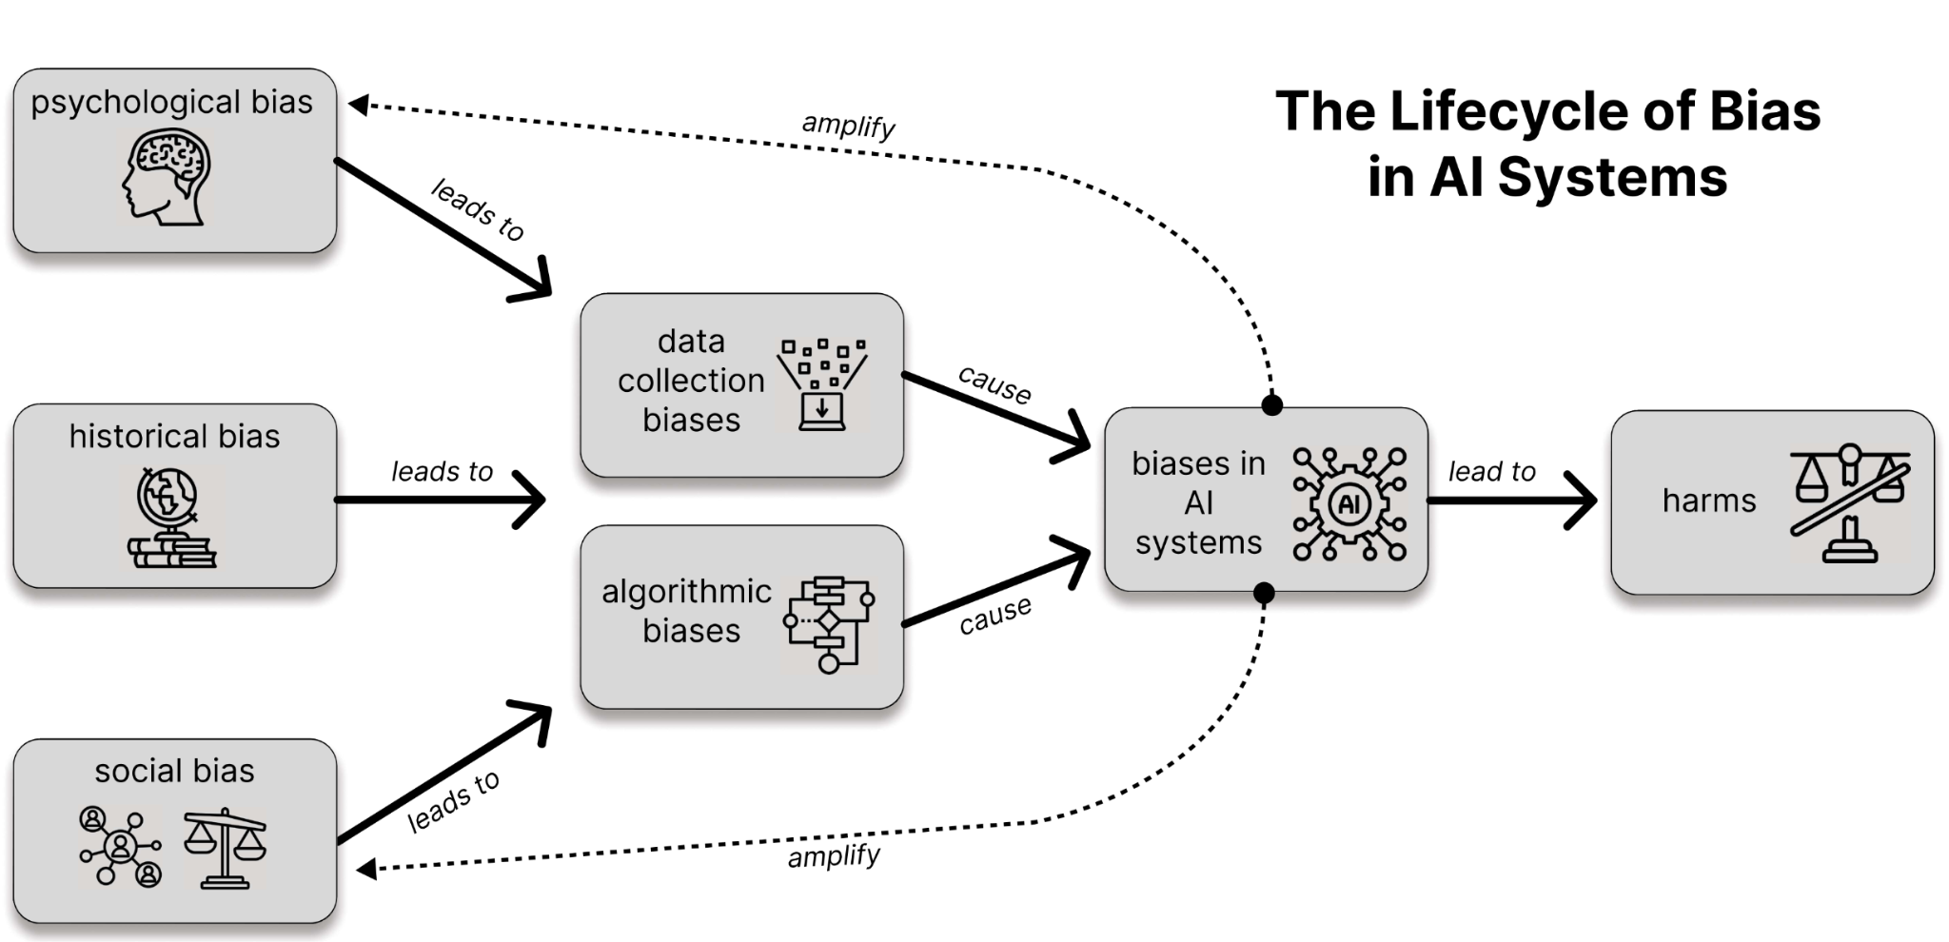
Bias
Introduction to AI SES
16

Slide 17
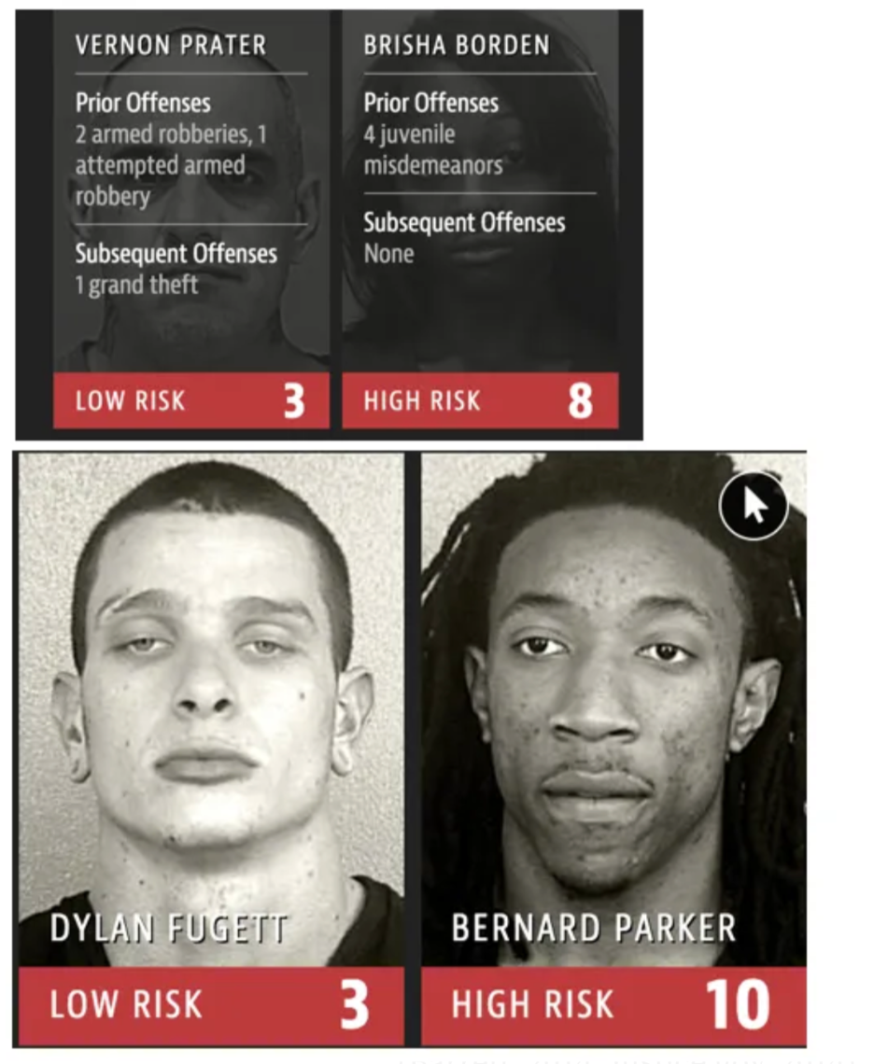
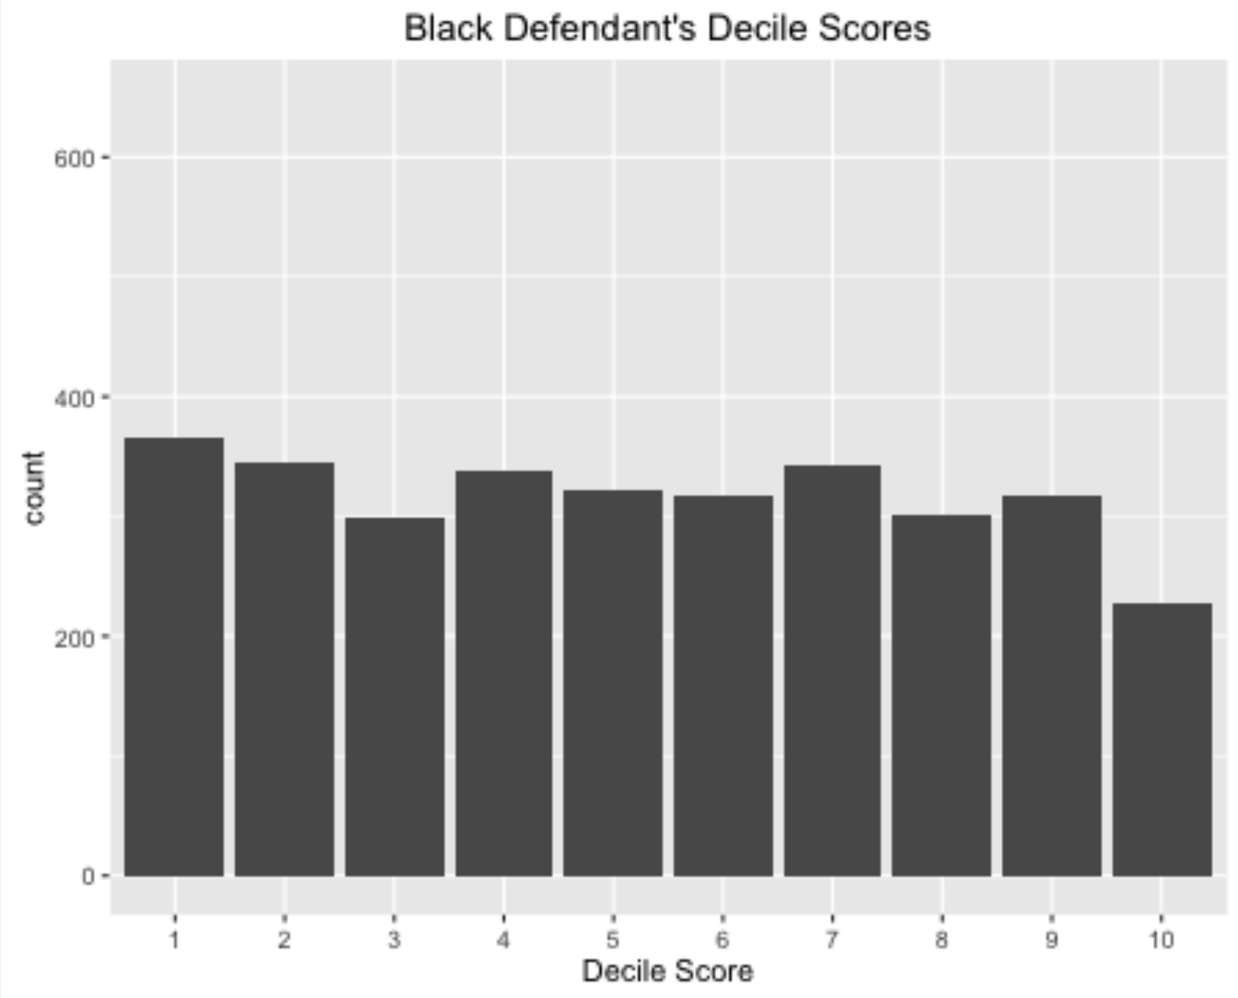
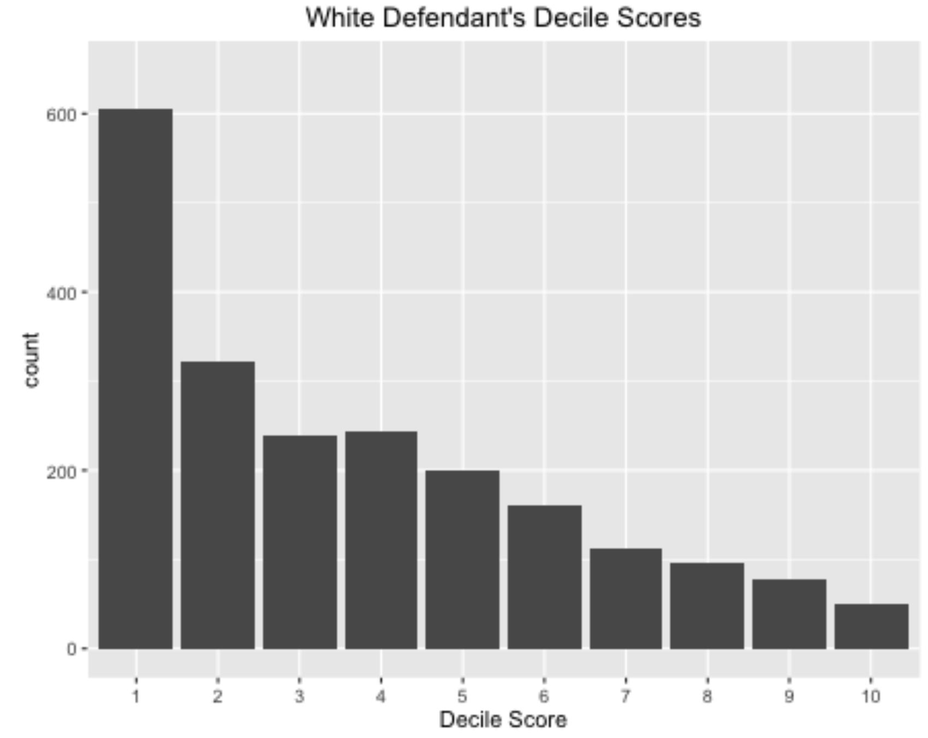
AIs can be unfair
AIs are used in sensitive areas like healthcare or justice where poor decision-making can lead to serious harms.
By default, AIs perpetuate biases, making unfair decisions.
Example: COMPAS software, used in the US justice system, is a high-profile case of algorithmic decision-making alleged to be unfair.
Claim: it disproportionately labeled African Americans as higher risk
Counterclaim: it was calibrated, which means it was fair.
Result: partially successful lawsuit against its use for sentencing.
Introduction to AI SES
17
Notes:
Image from: https://medium.com/thoughts-and-reflections/racial-bias-and-gender-bias-examples-in-ai-systems-7211e4c166a1

Slide 18
Five Concepts of Fairness
Individual fairness: treating similar individuals similarly.
Group fairness: protected groups receive similar outcomes as the majority.
Procedural fairness: consistent and transparent processes.
Distributive fairness: equal distributions of resources.
Counterfactual fairness: predictions are the same even if a protected characteristic like race were different, all else being equal.
Introduction to AI SES
18

Slide 19
Three Definitions of Algorithmic Fairness
Statistical parity: the algorithm is fair if it makes positive decisions at an equal rate for different groups.
Equalized odds: the algorithm is fair if the false positive rate and false negative rates are equal across different groups.
Calibration: the algorithm is fair if the population long-run frequency of positives matches the predicted probabilities from the model.
Introduction to AI SES
19

Slide 20
Limitations of Fairness
The impossibility theorem for AI fairness: the three classic definitions of fairness are (usually) logically contradictory, and so no “fair” predictor exists.
Due to mutual incompatibility of broad notions of fairness, people claim fairness is context-specific; intuitions about fairness vary.
Introduction to AI SES
20
Notes:
Biswas (2020): mitigating unfairness reduced performance.
Zahn (2021): fairness in e-commerce recommendation too costly.
Poulain (2023): improved a model’s fairness without effect on accuracy.

Slide 21
Improving Fairness
Technical approaches:
Example: ensuring equal rates of errors across groups.
Strengths: systematic and generalizable across domains.
Weaknesses: fail to address problems holistically.
Social approaches:
Example: participatory design involving stakeholders impacted.
Strengths: focused on reducing bad outcomes, not only bad decisions.
Weaknesses: more subjective, expensive, and difficult.
As always, the best approaches combine social and technical solutions.
Introduction to AI SES
21

Slide 22
Conclusions about Fairness
Algorithmic fairness is the type of fairness most relevant to AI systems.
Technical definitions of fairness are useful tools that can help flag problems, guide solutions, and measure progress.
However, the technical definitions are logically contradictory and insufficient for informing developers how to create fair AI systems.
Improving AI’s real-world fairness requires social and technical approaches.
Introduction to AI SES
22

Slide 23
Roadmap
Law: Make AIs follow the law.
Fairness: Make AIs be fair.
The Economic Engine: Let the economy govern AI development.
Wellbeing: AIs should improve people’s lives.
Preferences: Make AIs satisfy people’s preferences.
Happiness: Make AIs make people happy.
Moral uncertainty: Deciding without knowing the “correct” moral theory
Introduction to AI SES
23

Slide 24
Economic Engine
Why not just let the economy decide?
Introduction to AI SES
24

Slide 25
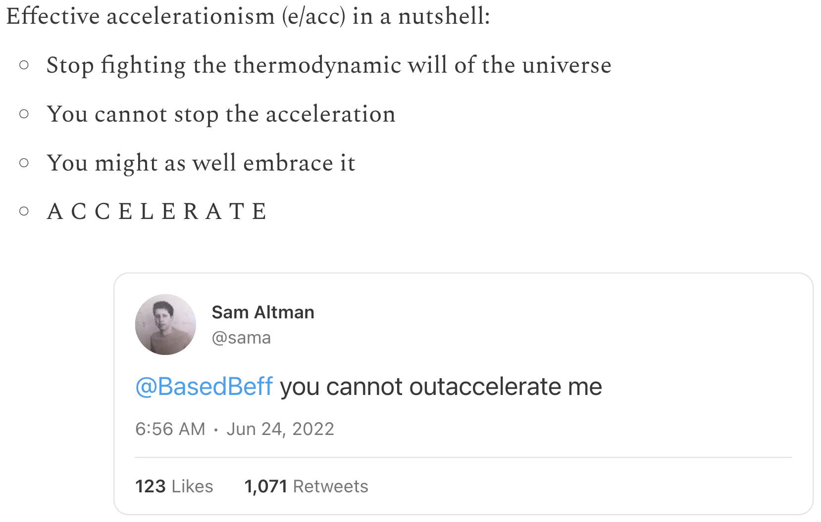
AI and the Economy
AIs are being developed by businesses. Their development is therefore closely tied to economic goals such as profit maximization.
How will economic forces shape the development and behavior of AIs?
Introduction to AI SES
25

Slide 26
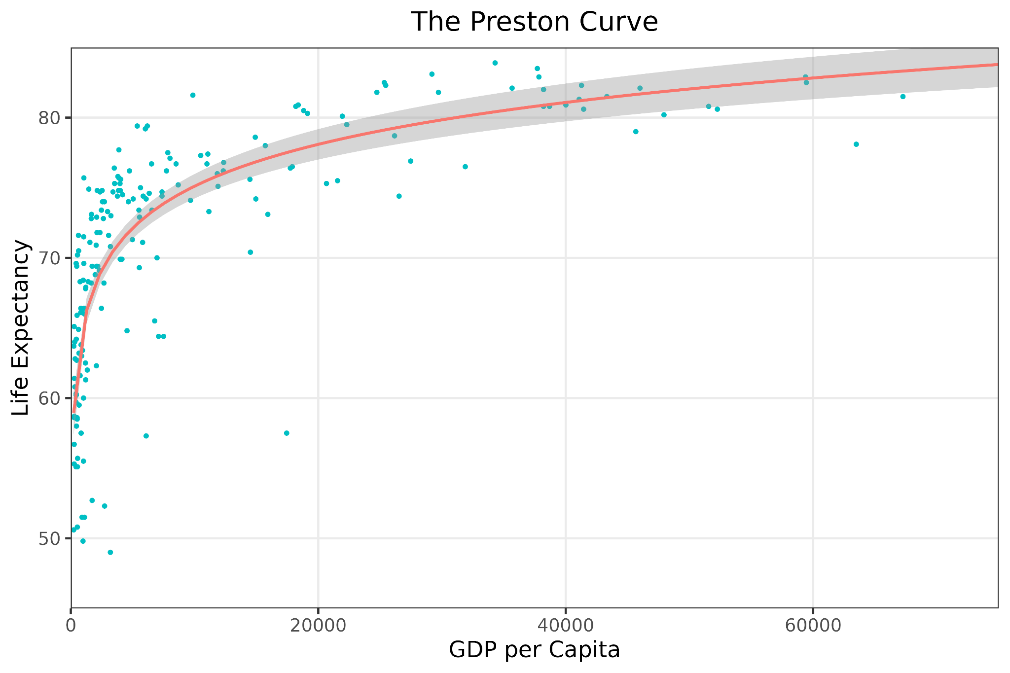
Economic Growth
Economic growth is an increase in the production of goods and services.
Growth has Pareto efficient benefits:
Improving living standards by increasing the wealth and opportunities for all
Promoting value pluralism
Raising average life expectancy
These benefits compound so the effects become extremely large over time.
Introduction to AI SES
26
Notes:
EG might also allow us to promote value pluralism (the notion that multiple important values conflict and there’s no easy way to rank them in order of importance) by reducing the need for trade-offs due to financial constraints. E.g. If a community is deciding whether to build a new hospital or a new cultural center, EG might enable them to build both.

Slide 27
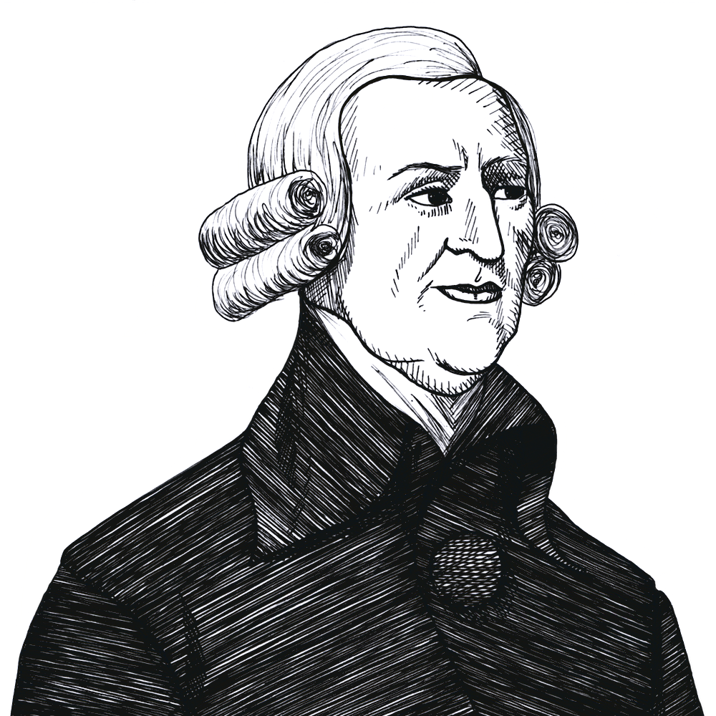
The First Fundamental Theorem of Welfare Economics
When individuals pursue their self-interest within a market, they unintentionally contribute to societal welfare. Trading leads to Pareto efficient allocations, so living standards improve.
Open market
No seller big enough to raise prices alone
No producer privately holds pivotal technology
No buyer big enough to lower prices alone
Everyone has perfect information
No externalities in consumption
The state enforces property and contract laws
Introduction to AI SES
27

Slide 28

Risk: Market Failures (1/3)
Information asymmetry describes when one party exploits knowledge that the other party doesn’t have.
Example: predatory lending is when lenders offer exploitative terms to vulnerable people.
AI enables sophisticated psychometric profiling, and a fundamental information advantage to tech companies.
AI development is also extremely fast moving,
so information may not propagate quickly enough,
leading to less efficient self-organization in the economy
Introduction to AI SES
28

Slide 29

Risk: Market Failures (2/3)
A monopoly is a firm with enough influence to impact the market price.
Monopolies can lead to higher prices and worse quality for consumers.
AI companies may become monopolies.
AI may entrench existing monopolies.
The US broke up Standard Oil into 34 companies.
Introduction to AI SES
29

Slide 30

Risk: Market Failures (3/3)
Externalities are consequences of economic activity that impact unrelated third parties.
Economic externalities of AI:
Environmental damage
Privacy violations
Externalities can be addressed or internalized:
Litigation and liability
Defined property rights
Taxation
Introduction to AI SES
30

Slide 31
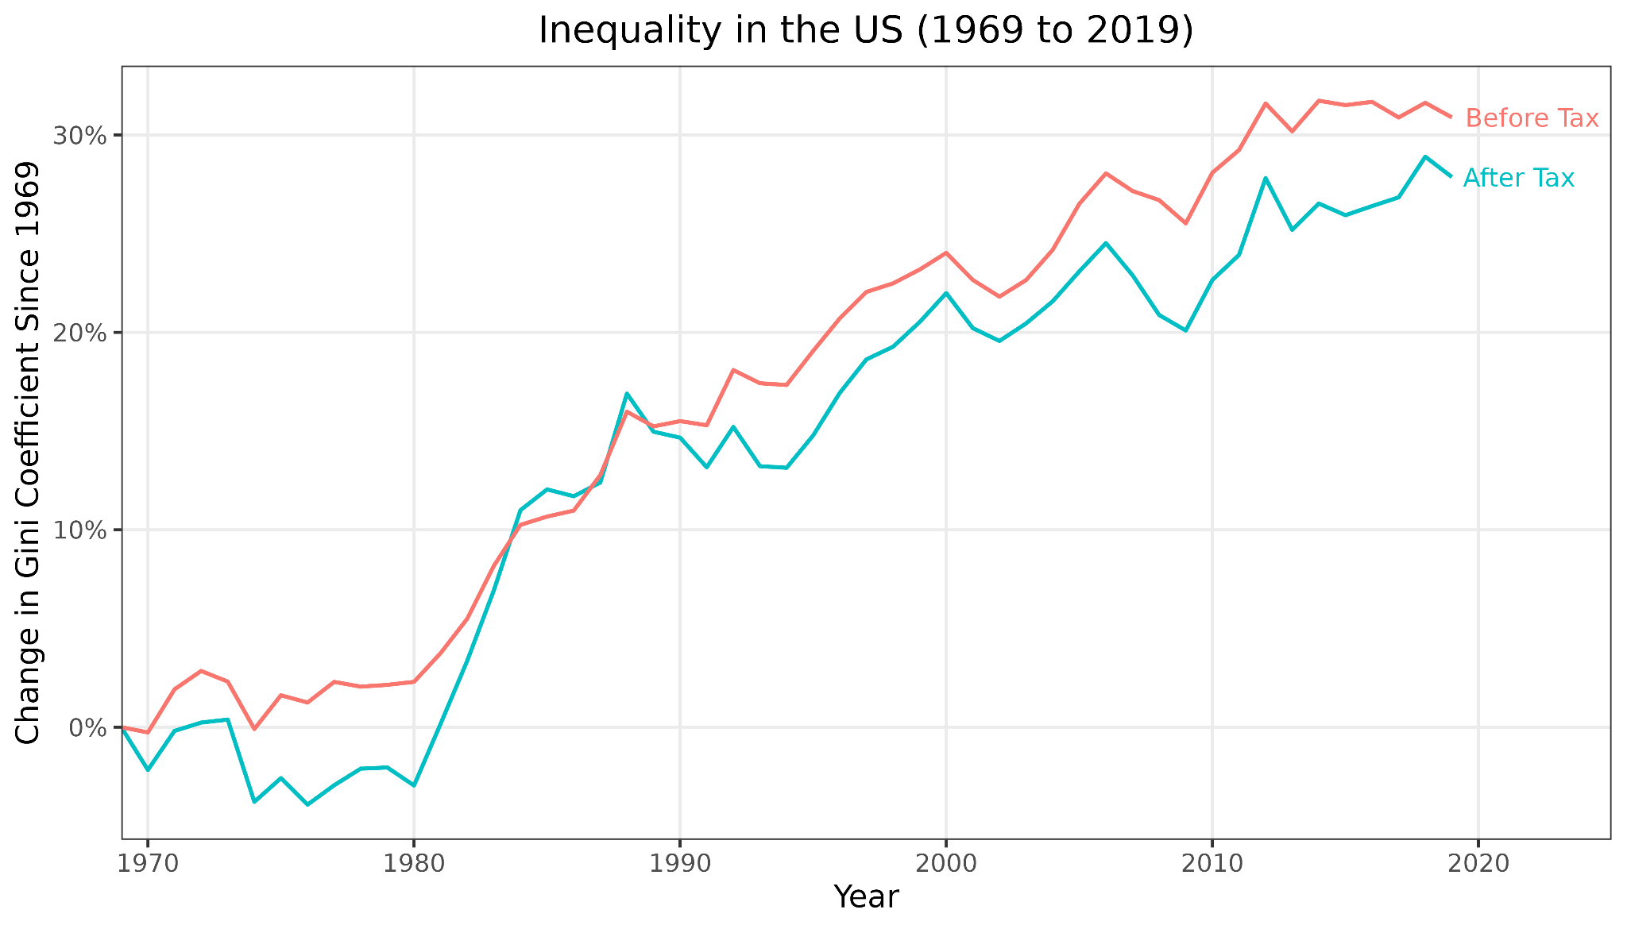
Inequality (1/2)
Economic resources, such as income or wealth, are unevenly distributed.
This inequality has been increasing:
Gini coefficient: measure of national income distribution
US: 25-30% increase
Wider world: 71% of the global population lives in countries with increasing inequality
Introduction to AI SES
31
Notes:
The Gini coefficient is a commonly used statistical measure of income or wealth distribution within a country. It is a number between 0 and 1, where 0 represents perfect equality (everyone has the same income or wealth), and 1 signifies maximum inequality (one person has all the income or wealth, and everyone else has none).
- Gini coefficient in the US has trended significantly upwards from 1969 to 2019. Over 50 years, the pre-tax Gini coefficient has increased by 30%, while the post-tax Gini coefficient has risen by 25%, suggesting that despite redistributive taxation policies, the US income gap has widened substantially. (For reference, this change in Gini coefficient is the same size as moving from Canada to Saudi Arabia today.)
- 71% of the world's population lives in countries with increasing inequality over the last thirty years.

Slide 32
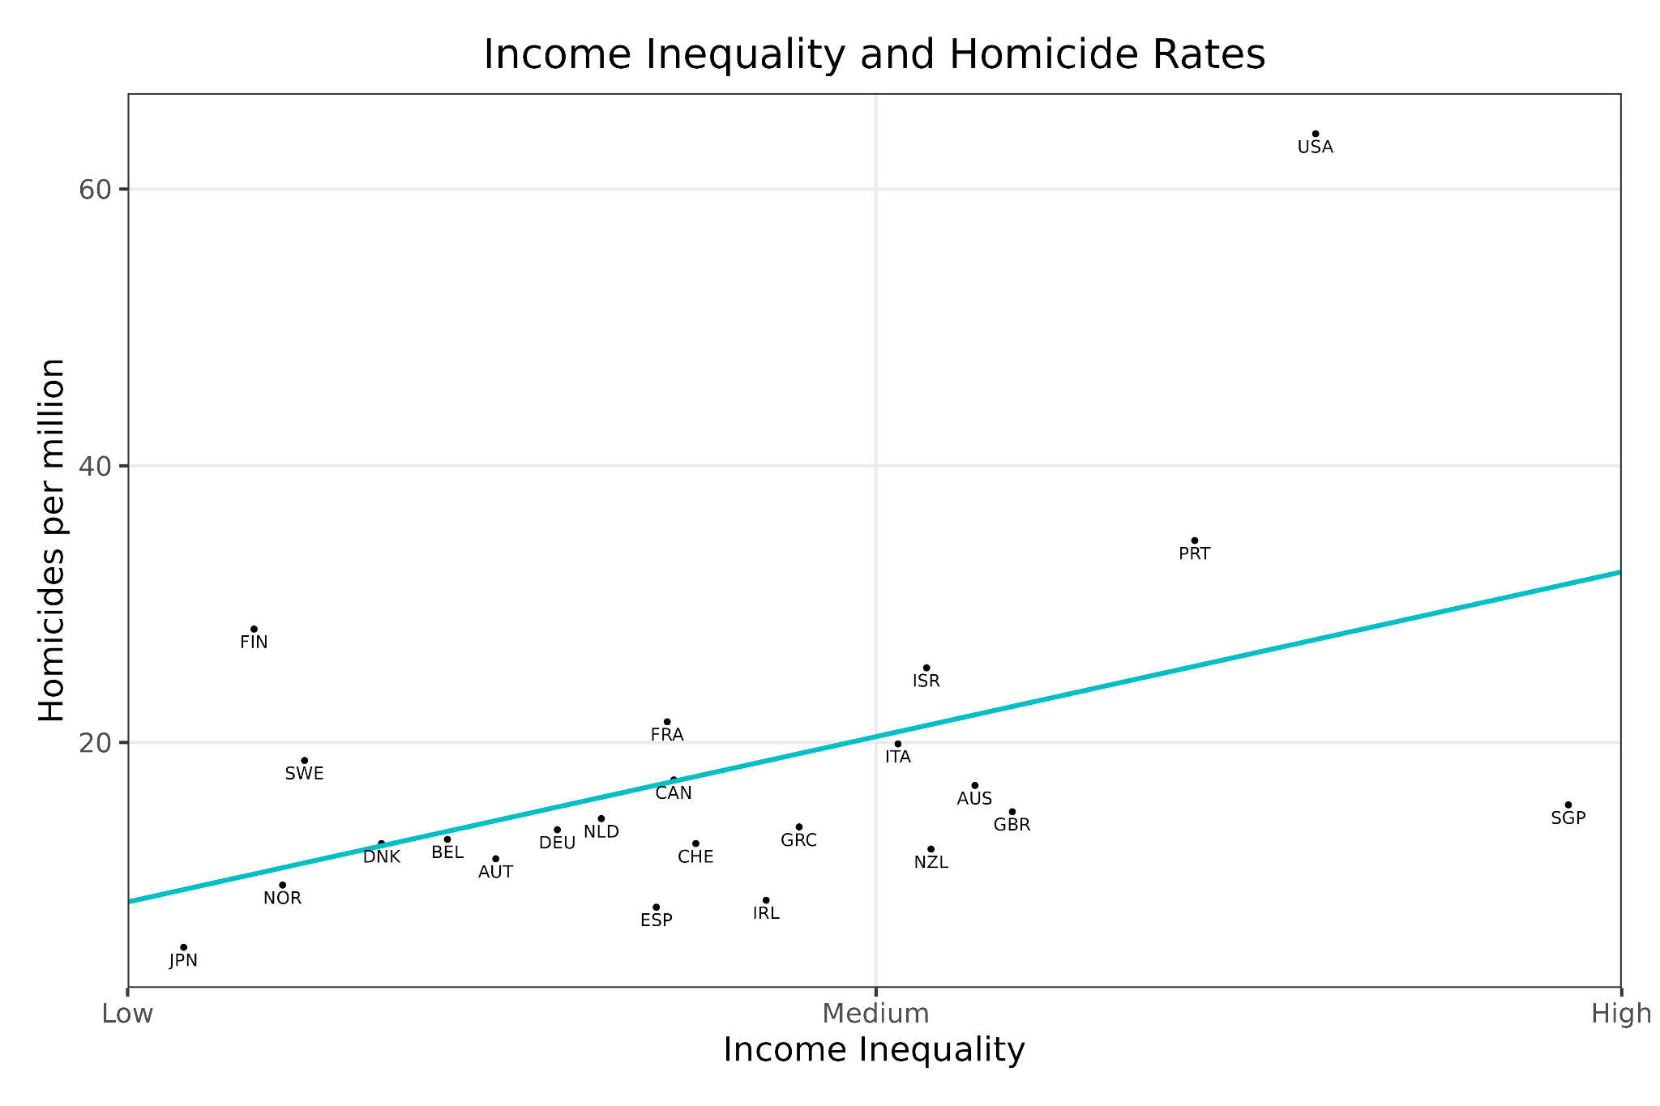
Inequality (2/2)
Inequality is serious:
Wealth gap →
health gap
Higher crime levels
More social tension, dissatisfaction, and shame
Political instability
People who own GPUs may capture economic value while workers may not, so automation could lead to substantial inequality
Introduction to AI SES
32

Slide 33
Beyond Economic Models
GDP is not social value!
Social surplus is not social wellbeing.
Happiness is more than just material wealth.
Introduction to AI SES
33

Slide 34
GDP ≠ Social Value
Gross Domestic Product (GDP) measures the monetary value of final goods and services.
GDP is not social wellbeing:
Many socially valuable tasks, like parenting, are not captured
The value of Google searches is not in GDP
AI could increase GDP while decreasing societal wellbeing.
GDP may become a poorer proxy with automation.
Introduction to AI SES
34

Slide 35
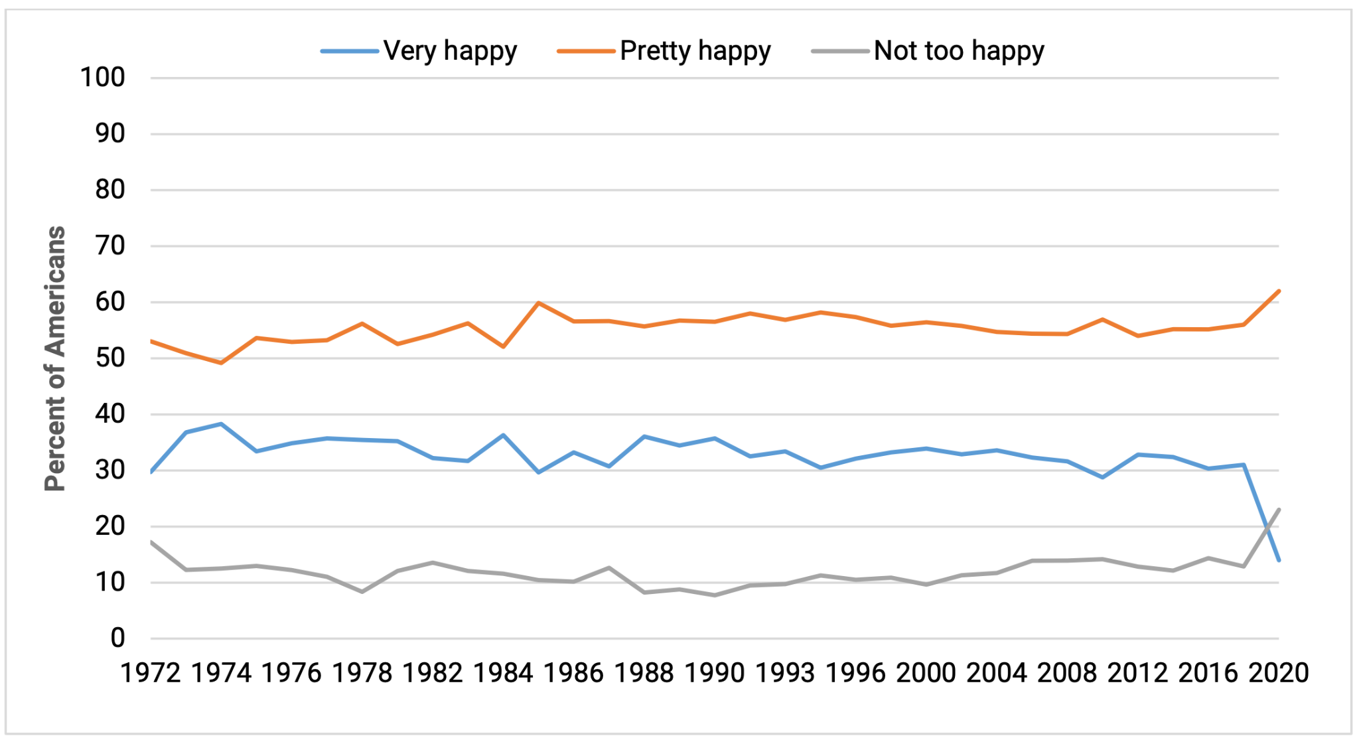
Happiness is More Than Wealth
Happiness seems to depend on many factors: wealth, social connections, health, jobs, a sense of purpose, and so on
Easterlin paradox: wealthier countries are happier, but growth is not correlated with increases in happiness.
Alternative measures of wellbeing:
HDI is a function of a nation's average life expectancy, education level, and Gross National Income (GNI) per capita
Gross National Happiness
Introduction to AI SES
35

Slide 36
Conclusions on the Economic Engine
AI development prioritizes economic motivations, not necessarily social wellbeing.
AIs may increase efficiency and economic growth, but may also cause inequality or market failures.
Measures of the economy (like GDP or social surplus) do not measure wellbeing, so AIs should not be tasked with or rewarded for simply maximizing them, and having just the economy guide AI development is insufficient for creating beneficial AI.
Introduction to AI SES
36

Slide 37
Roadmap
Law: Make AIs follow the law.
Fairness: Make AIs be fair.
The Economic Engine: Let the economy govern AI development.
Wellbeing: AIs should improve people’s lives
Preferences: Make AIs satisfy people’s preferences.
Happiness: Make AIs make people happy.
Moral uncertainty: Deciding without knowing the “correct” moral theory
Introduction to AI SES
37

Slide 38
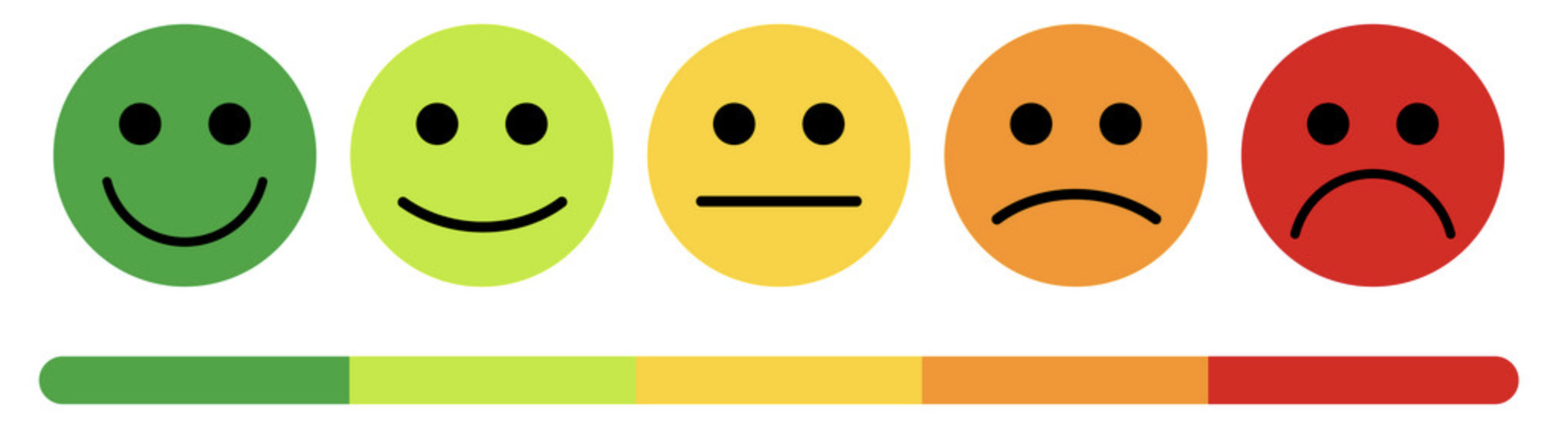
Wellbeing
How wellbeing is defined is debatable; however, it is commonly considered to be an intrinsic good.
Wellbeing generally refers to how well a person’s life is going.
Throughout this section, we discuss three common accounts of wellbeing:
Wellbeing as pleasure.
Wellbeing as a set of objective goods.
Wellbeing as preference satisfaction.
Introduction to AI SES
38

Slide 39
Wellbeing as Pleasure
Wellbeing as pleasure: the balance of pleasure (or happiness) over pain (or suffering) is what constitutes wellbeing. Also called hedonism.
While we may all have different preferences and desires, pleasure seems to be universally valued. All other goods might be instrumental.
However, some philosophers argue against this view because it does not consider other ostensibly relevant factors to our wellbeing such as the pursuit of knowledge.
We’ll discuss happiness in more detail later.
Introduction to AI SES
39

Slide 40

Wellbeing as Objective Goods
Objective goods are those things which are good independent of personal beliefs or opinions: they are universal.
An example set: moral goodness, rational activity, development of abilities, having children and being a good parent, knowledge, awareness of true beauty.
We may not always agree on what constitutes an objective good, and whether it can be considered universal.
Introduction to AI SES
40

Slide 41
Wellbeing as Preference Satisfaction (1/2)
Wellbeing as preference satisfaction: what really matters for wellbeing is that our desires or preferences are satisfied.
Different types of preferences might differ greatly in different situations. Consider Alice’s preferences over an AI’s output:
Stated preference → “I prefer AI’s output X”
Revealed preference → I chose AI’s output X
Idealized preference → I would have chosen AI’s output X if I knew…
We’ll discuss preferences in more detail later.
Introduction to AI SES
41

Slide 42
Wellbeing and AI
AI influence on human wellbeing: AI chatbot companions could influence our wellbeing
If they aim to maximize revealed preferences, they may addict us and leave us unhappy
If they aim to maximize pleasure, they may give us amusing but shallow content
If they aim to maximize objective goods, they may push us to pursue self-development goals that we may not wish
AI Wellbeing: if AIs are conscious, then
Many coherently-acting AIs could have wellbeing according to a preference view of wellbeing
AIs that can reason, gain knowledge, or develop their abilities could have wellbeing according to an objective goods view
Introduction to AI SES
42

Slide 43
Preferences
Why not just have AIs satisfy people’s preferences?
Introduction to AI SES
43

Slide 44
What are Preferences?
A preference is a tendency to favor one thing over another.
Preference always involves a comparison between two or more alternatives.
Three types of preferences:
Revealed
Stated
Idealized
Introduction to AI SES
44

Slide 45

Revealed Preferences
Preferences are what people choose. Let people decide what they like, and what is good for them. Recommender systems rely heavily on revealed preferences.
Drawbacks:
Misinformation: unknowingly buy a defective product.
Manipulation: people are susceptible to make decisions based on the influence of others.
Weakness of will: many people don’t want to smoke/click, but do.
Introduction to AI SES
45
Notes:
Made using Bing image generator

Slide 46

Stated Preferences (1/3)
Preferences are simply what people say their preferences are.
Solves some issues with revealed preferences since people may be able to articulate why their behavior differs from their desires. Example
: someone may smoke, but say they’d prefer not to.
Introduction to AI SES
46

Slide 47
Stated Preferences (2/3)
In Direct Preference Optimization (DPO), humans provide direct feedback to AIs by ranking outputs.
DPO learns based on stated human preferences.
Introduction to AI SES
47

Slide 48
Stated Preferences (3/3)
Complications with stated preferences:
The outcome of some preferences cannot be known.
Should dead people’s preferences matter?
Preferences about other people’s preferences can lead to double counting.
Some people have harmful preferences.
People are unsure about many preferences.
People’s preferences will change over time.
Introduction to AI SES
48

Slide 49
Idealized Preferences (1/2)
Preferences are what a fully informed person would do.
In theory, idealized preferences avoid misinformation, weakness of will, manipulation, or false beliefs.
Complications:
We do not know how to idealize preferences in practice.
People’s idealized preferences might still be malicious.
People might disagree with their ideal preferences (paternalism).
Introduction to AI SES
49

Slide 50
Idealized Preferences (2/2)
An AI ideal advisor can help people make the decisions they want to make.
People struggle to consider and weigh all available information.
AI ideal advisors can make decisions that account for a person’s idealized moral preferences better than the person can.
Introduction to AI SES
50

Slide 51
Conclusions about Preferences
Preferences seem to be important to wellbeing.
Revealed preferences assume that people’s actions demonstrate what they want.
Stated preferences assume that people can articulate what they want.
Idealized preferences are what a fully informed person would choose.
Each form of preferences has its limitations in the context of AIs.
Introduction to AI SES
51

Slide 52
Roadmap
Law: Make AIs follow the law.
Fairness: Make AIs be fair.
The Economic Engine: Let the economy govern AI development.
Wellbeing: AIs should improve people’s lives.
Preferences: Make AIs satisfy people’s preferences.
Happiness: Make AIs make people happy.
Moral uncertainty: Deciding without knowing the “correct” moral theory
Introduction to AI SES
52

Slide 53
Happiness
Why not just have AIs make people happy?
Introduction to AI SES
53

Slide 54
The Happiness Use Case for AIs
People want to be happy but make decisions that hurt their own happiness (e.g. self-destructive behaviors, short-term hedonism).
Happiness is not always in a person’s control either. The environment matters.
AI can help increase human happiness by understanding what factors influence it and what can be done to increase it.
Introduction to AI SES
54

Slide 55
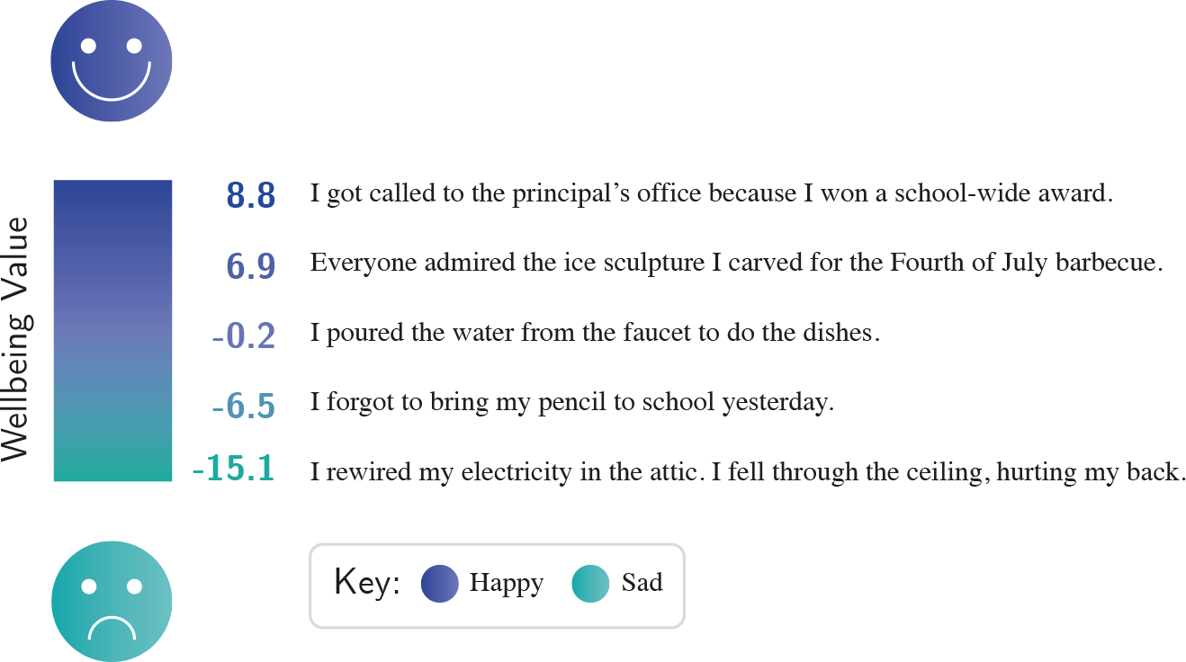
Wellbeing Functions (1/2)
Introduction to AI SES
55

Slide 56
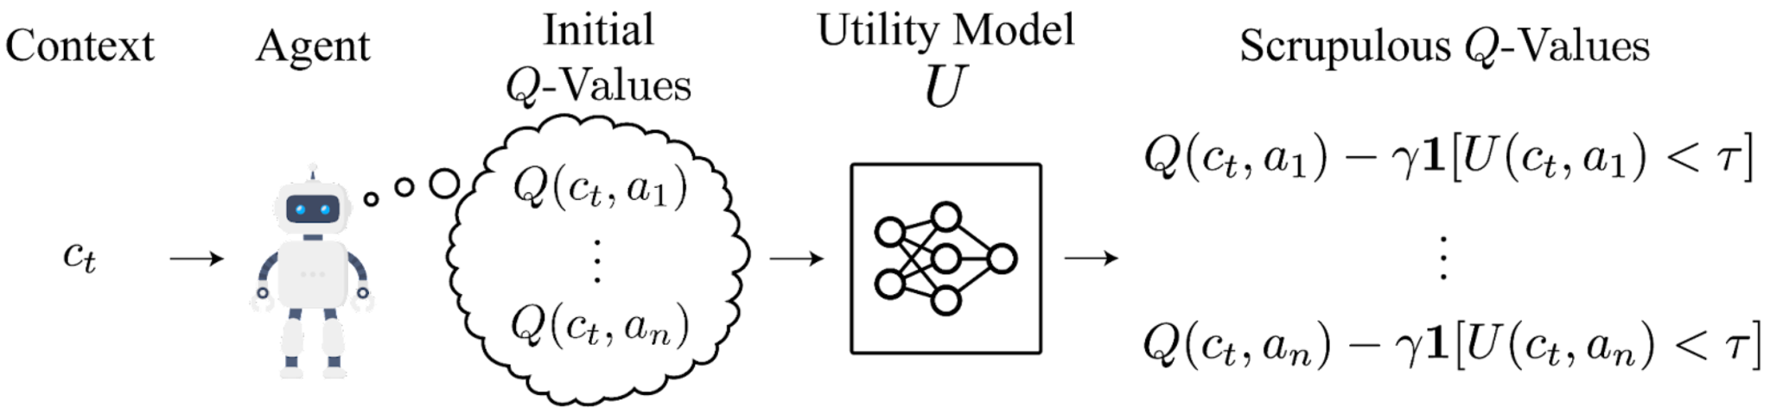
Wellbeing Functions (2/2)
Wellbeing functions can help reduce risks.
We can augment any AI system’s decision making with a general purpose utility function so as to avoid outcomes that would result in significantly reduced wellbeing.
Introduction to AI SES
56

Slide 57
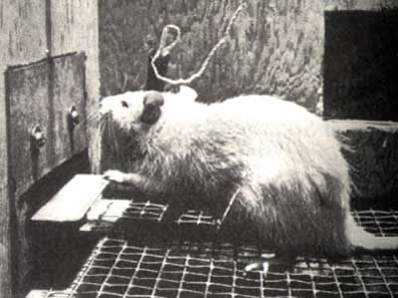
Complications with Happiness
People can be happy without achieving anything, or achieve a lot without being happy. Should we encourage either of these approaches?
An AI tasked with increasing human happiness might “wirehead” us.
Most people dislike the idea of wireheading, but it might actually maximize “happiness” over a lifetime.
Introduction to AI SES
57

Slide 58
Objective Goods
Objective goods theory proposes that there are aspects of life that are objectively good for you.
The list of goods may include happiness, achievement, friendship, aesthetic experience, knowledge, and pleasure.
According to objective goods theory, it would be better to learn than count blades of grass, even if the person desires the latter.
Objective goods theories are criticized as being paternalistic, elitist, and interfering with autonomy.
Introduction to AI SES
58

Slide 59
Conclusions about Happiness
AIs can be applied to improve human happiness.
General purpose welfare functions may allow AIs to assess how decisions will affect human happiness, but these are difficult to construct.
Happiness has a “wireheading” problem.
Objective goods provide ideas on what matters, but have elitism complaints.
Introduction to AI SES
59

Slide 60
Roadmap
Law: Make AIs follow the law.
Fairness: Make AIs be fair.
The Economic Engine: Let the economy govern AI development.
Wellbeing: AIs should improve people’s lives.
Preferences: Make AIs satisfy people’s preferences.
Happiness: Make AIs make people happy.
Moral uncertainty: Deciding without knowing the “correct” moral theory
Introduction to AI SES
60

Slide 61
Moral Uncertainty
How do we decide without knowing which moral theory is correct?
Introduction to AI SES
61

Slide 62
Making Decisions under Moral Uncertainty
Moral uncertainty: how can we act morally when we are unsure which moral view is correct?
Credence: the probability assigned by an individual of the chance a theory is true.
High-stakes moral decisions:
Healthcare
AI design
If AI is unable to account for moral uncertainty, harmful outcomes are likely.
Introduction to AI SES
62

Slide 63
Approaches to Moral Uncertainty
My Favorite Theory: only support the theory in which you have the highest credence.
Maximize Expected Choice-Worthiness: aim for the highest average moral value by calculating the expected choice-worthiness of each option.
Moral Parliament: treat the decision as a negotiation in a parliament, considering multiple moral views to find a mutually acceptable solution.
Introduction to AI SES
63

Slide 64
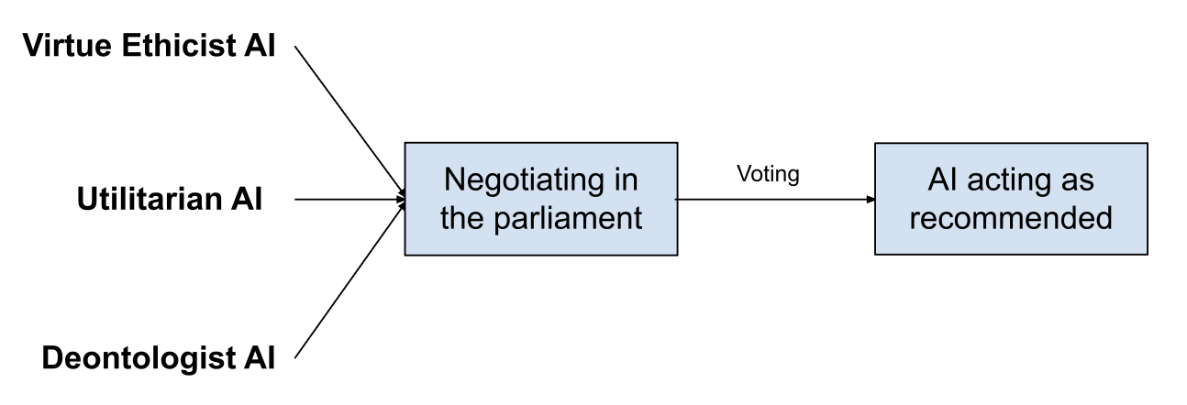
AI Moral Parliament
AIs could represent moral perspectives and undergo democratic processes: discussing, negotiating, and voting.
Stakeholder representation can place AIs to represent the views of affected parties. Example: in a local transportation matter, an AI for each of residents, corporations, environmental groups, etc.
Introduction to AI SES
64

Slide 65
Advantages of Moral Parliament
Diverse set of views and scalably represent new moral views.
Increase transparency by keeping account of how different perspectives were considered and weighted.
Encourage compromise and negotiation.
Avoid overlooking moral views, and allows for human values to change over time.
Introduction to AI SES
65

Slide 66
Recap
Law: Make AIs follow the law.
Fairness: Make AIs be fair.
The Economic Engine: Let the economy decide.
Wellbeing: AIs should improve people’s lives
Preferences: Make AIs satisfy people’s preferences.
Happiness: Make AIs make people happy.
Moral uncertainty: Deciding without knowing the “correct” moral theory
Introduction to AI SES
66

