Slide 1
Introduction to
AI Safety, Ethics, and Society
Collective Action Problems
Introduction to AI SES
1

Slide 2
Roadmap
Game theory
Cooperation
Conflict
Evolutionary pressures
Introduction to AI SES
2

Slide 3
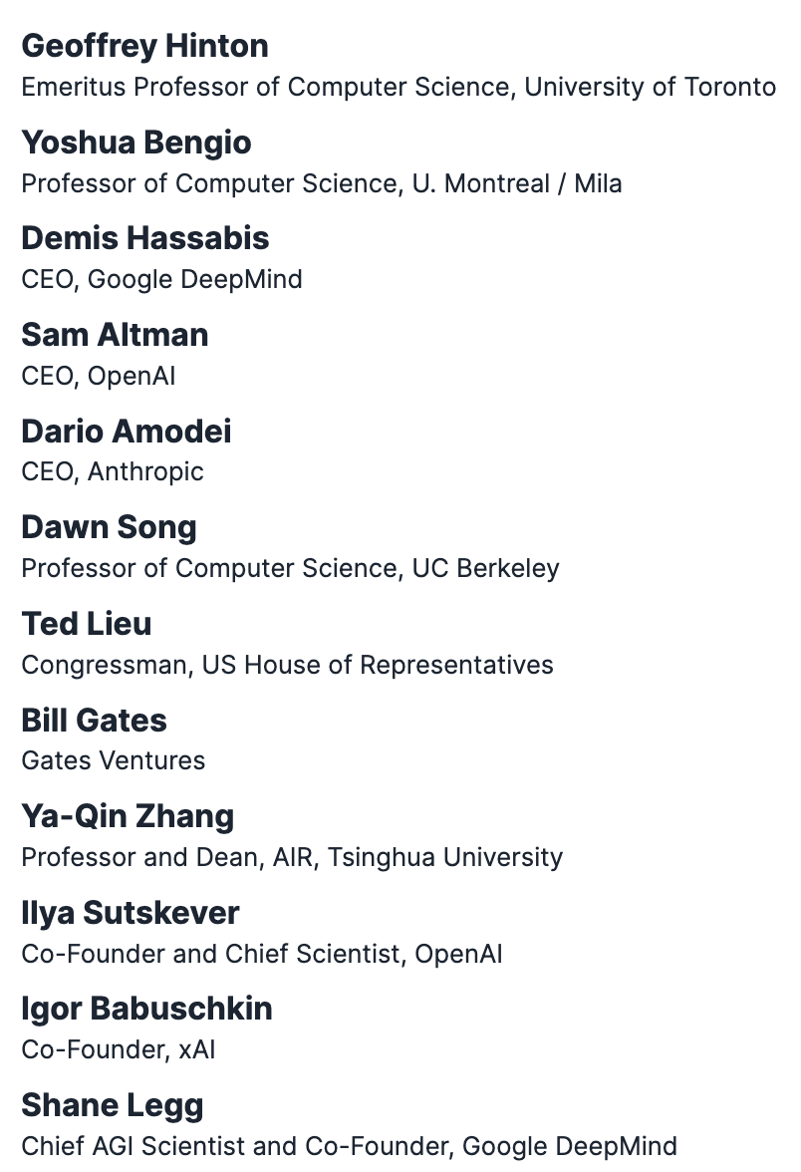
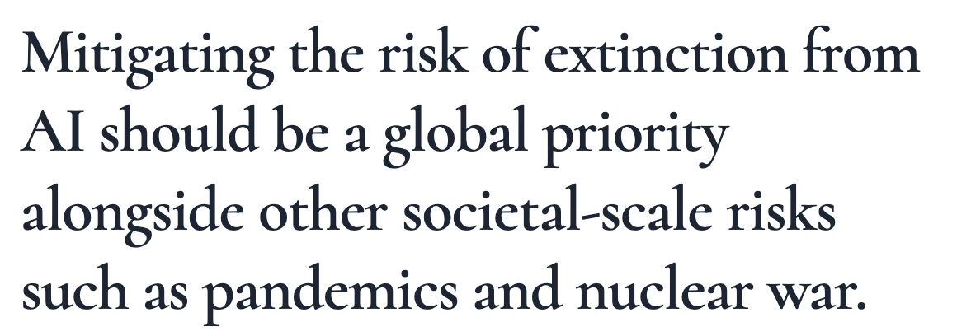
Rational Actors May Not Secure Collectively Good Outcomes
This lecture will give an interpretation for why rational actors (CEOs of AI companies) signed this statement
Introduction to AI SES
3
Notes:
https://www.safe.ai/statement-on-ai-risk

Slide 4
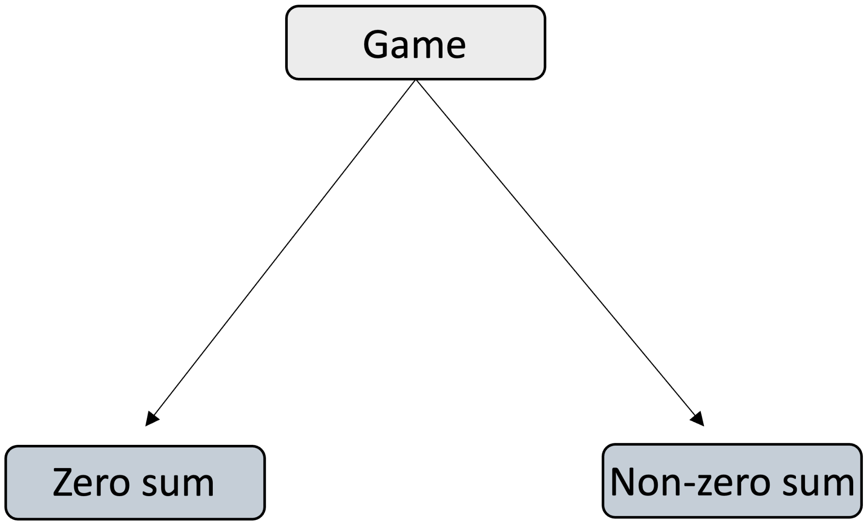
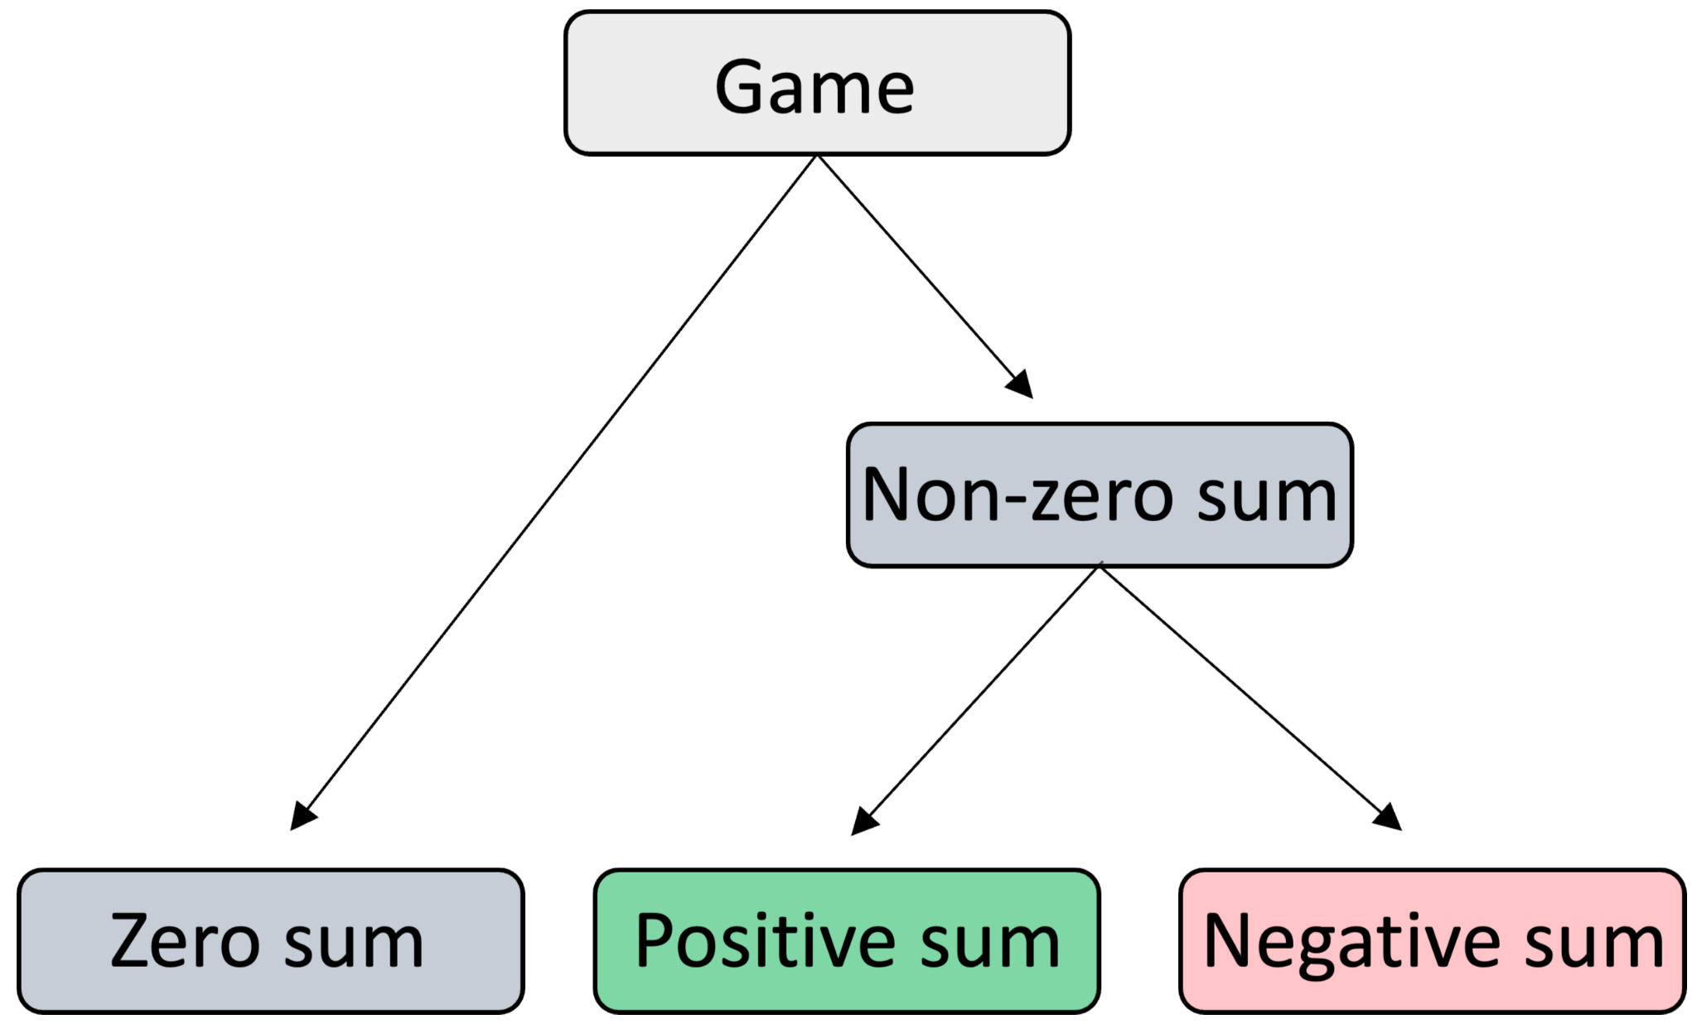
Game Theory Fundamentals
Game theory is the branch of maths concerned with reducing complicated situations to abstract games, in which agents choose interaction strategies.
We assume that the agents are:
Rational
Self-interested
Games can be:
Zero sum
Non-zero sum
Non-zero sum game outcomes can be:
Positive sum
Negative sum
Introduction to AI SES
4

Slide 5









The Prisoner’s Dilemma: Animation
Cooperate
World 1
Bob
Cooperates
Alice
Cooperate
Cooperate
Defect
The dominant strategy
Cooperate
World 2
Defects
Defect
Defect
Defect
Introduction to AI SES
5

Slide 6



The Four Possible Outcomes
C
D
C
D
C
D
1 year
8 years
0 years
3 years
1 year
0 years
8 years
3 years
Introduction to AI SES
6

Slide 7
The Four Possible Outcomes
Payoff matrix
Bob cooperates
Bob defects
Alice cooperates
-1,
-1
-8,
0
Alice defects
0,
-8
-3,
-3
Introduction to AI SES
7

Slide 8

Nash Equilibria
Bob defects
Alice defects
C
D
C
D
C
D
1 year
8 years
0 years
3 years
1 year
0 years
8 years
3 years
Introduction to AI SES
8

Slide 9
Nash Equilibria
Bob defects
Alice defects
Bob cooperates
Bob defects
Alice cooperates
-1,
-1
0,
-8
Alice defects
-8,
0
-3,
-3
Nash equilibrium
Introduction to AI SES
9

Slide 10
Pareto Efficiency
Alice’s payoff
Alice’s payoff worsens
Alice’s payoff improves
Alice’s payoff
Pareto improvement
Pareto improvement: a change that improves the payoff for some or all of those involved, and does not reduce the payoff for anyone.
Pareto improvement
-8,0
-8,0
-8,0
-1,-1
-1,-1
-1,-1
Pareto efficient
Pareto efficient: a state in which no Pareto improvements are possible.
Pareto efficient
Nash equilibrium
-3,-3
-3,-3
-3,-3
-3,-3
Bob’s payoff worsens
Bob’s payoff improves
Bob’s payoff
Bob’s payoff
Nash equilibrium is suboptimal for both.
Nash equilibrium
0,-8
0,-8
0,-8
Introduction to AI SES
10

Slide 11
Real-World Examples
Mud-slinging
Dominant strategy
Nash equilibrium
Pareto improvement
: running negative ads to discredit opponent party
: both parties run negative campaigns; both detriment
: both parties refrain from mudslinging
Shopkeeper price racing
Dominant strategy: lowering prices to outcompete rival shop
Nash equilibrium: both shopkeepers lower their prices, sacrificing profit
Pareto improvement: both shopkeepers keep their prices high
Introduction to AI SES
11

Slide 12
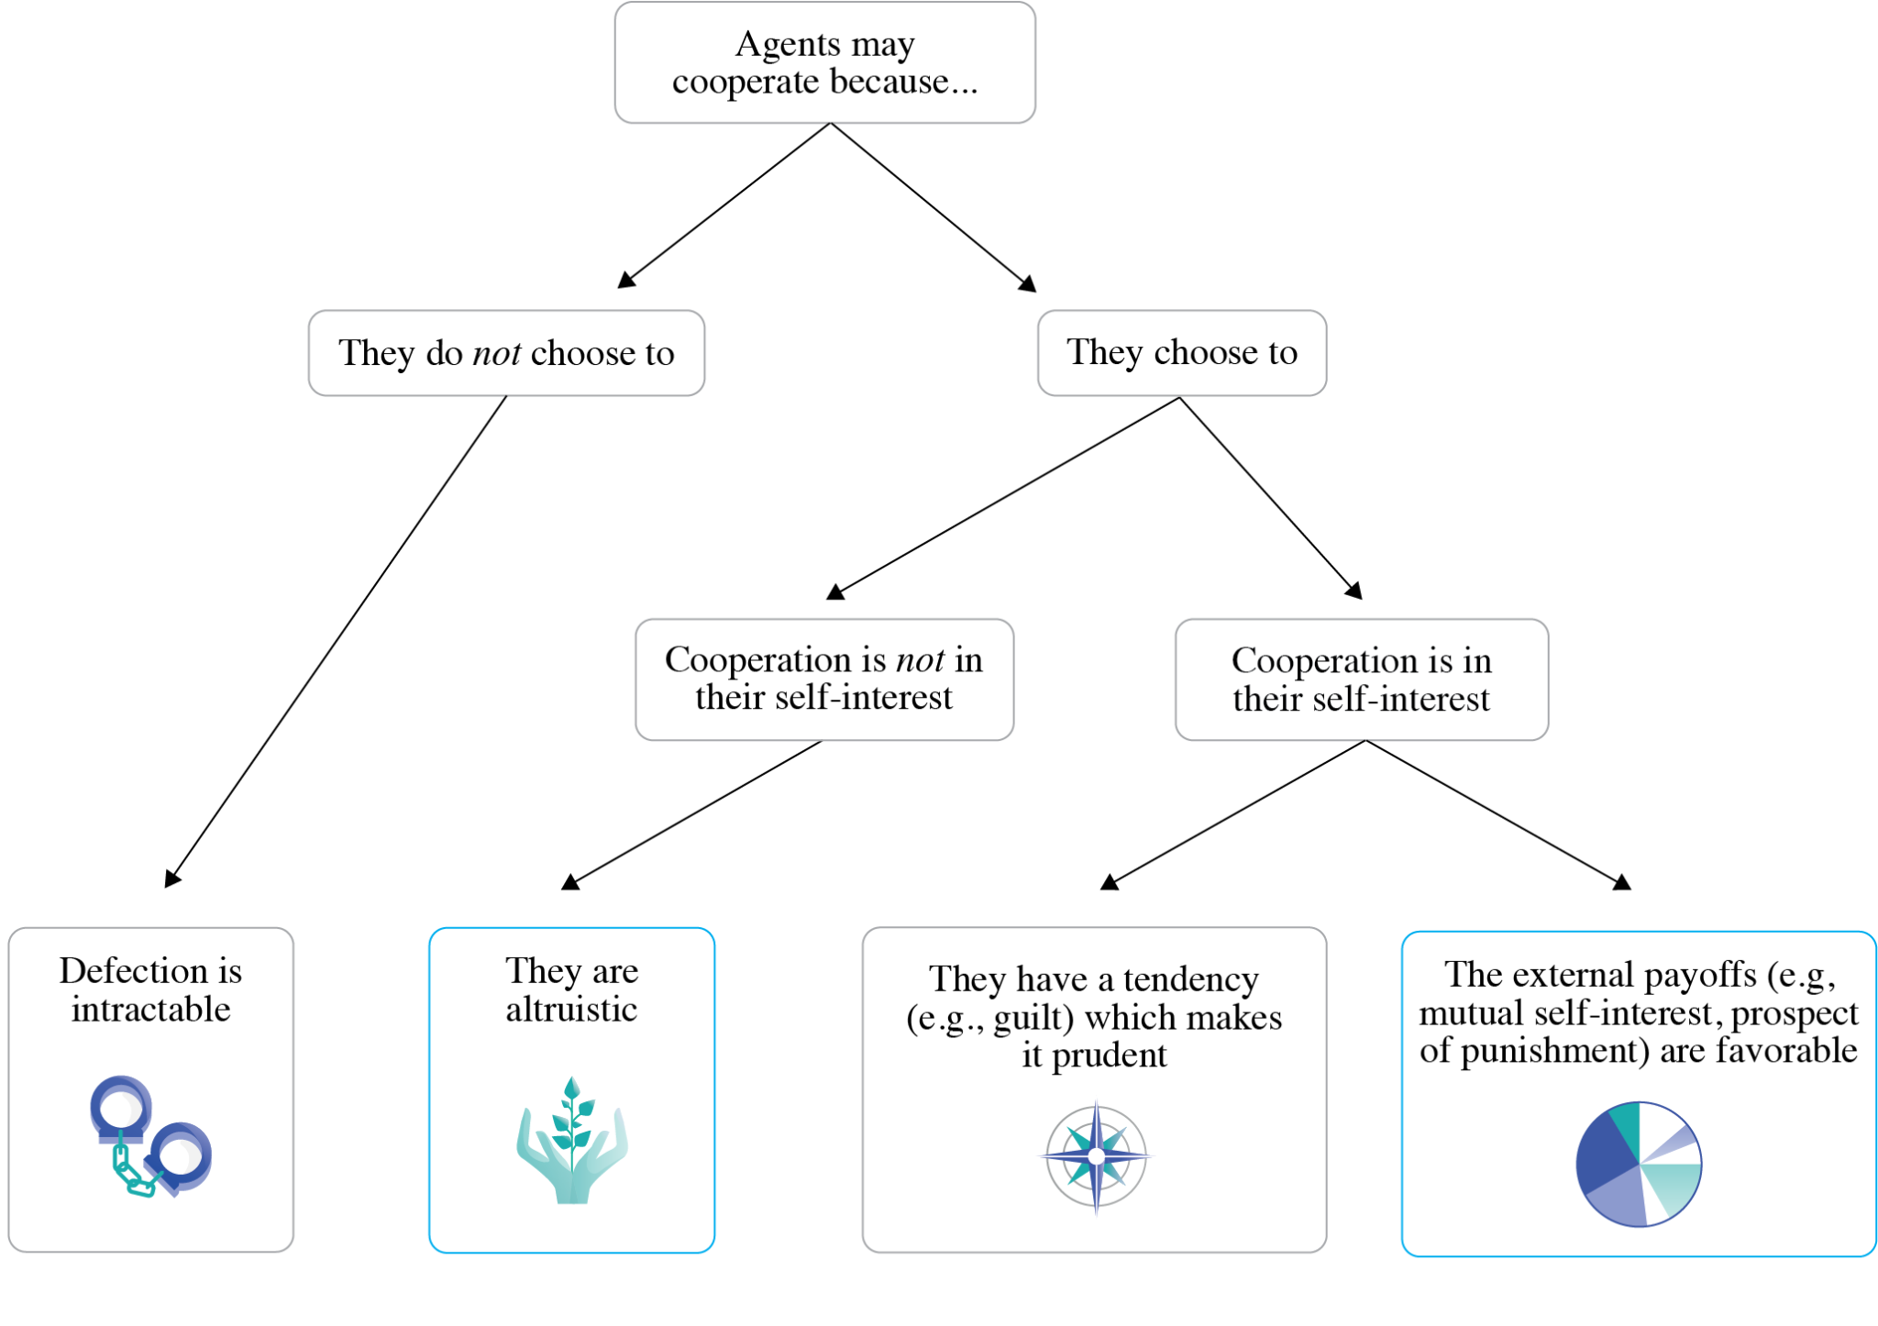
Why Agents May Cooperate
Introduction to AI SES
12

Slide 13
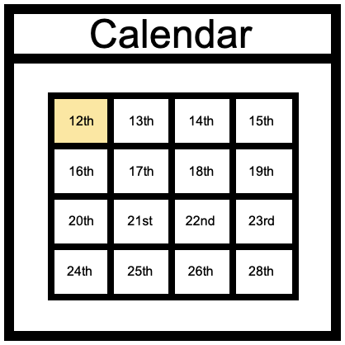
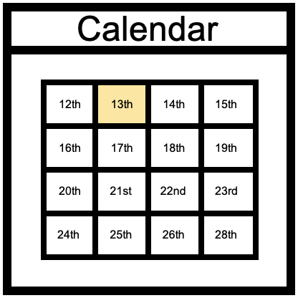
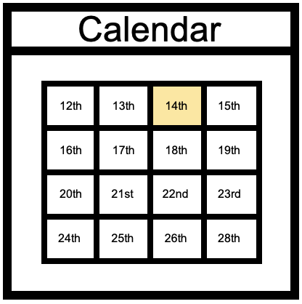


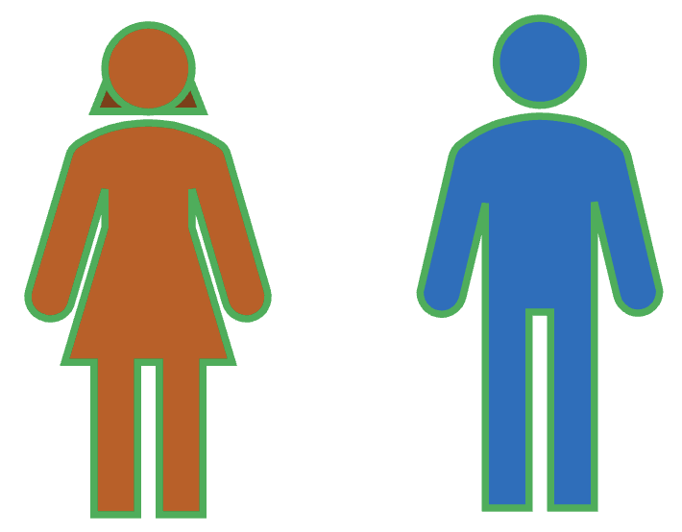
The Iterated Prisoner’s Dilemma
Defection is still the dominant strategy if agents know how many times they will interact.
Uncertainty about future engagement enables rational cooperation.
AIs interacting with each other repeatedly may cooperate, but only if they are sufficiently uncertain about whether their interactions are about to end.
D
D
C
D
D
D
D
D
C
D
C
Alice punishes Bob for defecting
Alice rewards Bob for cooperating
Bob will defect in the penultimate round
, because he knows Alice will defect in the last round, regardless of his decision
Alice will defect in the penultimate round
, because she knows Bob will defect in the last round, regardless of her decision
Bob will defect in the last round
, because he knows Alice can’t punish or reward him
Alice will defect in the last round
, because she knows Bob can’t punish or reward her
by defecting in future herself
by cooperating in future herself
Introduction to AI SES
13

Slide 14
AI Racing Dynamics
Iterated interactions can generate racing dynamics or an AI arms race.
Competitive pressures motivate AI companies to pursue individual, short-term gains at a collective, long-term detriment.
Introduction to AI SES
14

Slide 15
Corporate AI Arms Race
Competition is promoting the creation and use of more appealing and profitable systems, often at the cost of safety measures.
Example: the public release of large language model-based chatbots
Some companies delayed their chatbot release for safety testing
We can view those who released their chatbots without safety testing as having switched from cooperating to defecting in an iterated Prisoner’s Dilemma game
The defectors may then gain a competitive edge
This competitive pressure causes other companies to rush their AI products to market, compromising safety measures in the process
Introduction to AI SES
15

Slide 16
Cutting Corners on Safety
Extreme competition can promote the creation and use of more appealing and profitable systems, often at the cost of safety measures.
Though all parties would prefer to prioritize safety, they constantly defect in order to stay in the race
AI capabilities are thus advanced more rapidly than AI safety (e.g., jailbreaking robustness, watermarking, KYC, etc.)
Ultimately, corporate AI racing dynamics could produce societal-scale harms:
Mass labor automation → widespread and rapid unemployment
Dangerous dependence on AI systems
Autonomous economies (we will return to later)
Introduction to AI SES
16
Notes:
For more on autonomous economies, see slides 24–26

Slide 17
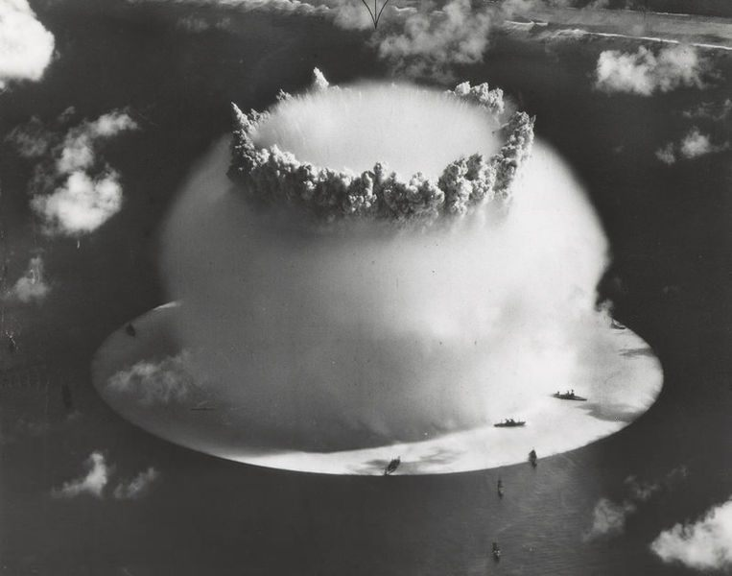
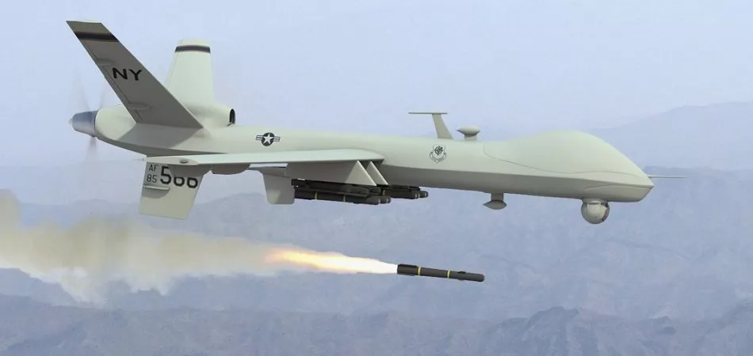
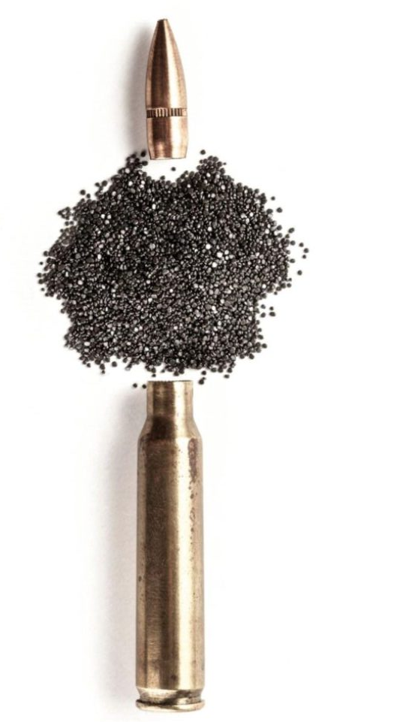
Military AI Arms Race (1/2)
“The third revolution in warfare.”
Gunpowder
Nuclear weapons
Military AI
Introduction to AI SES
17
Notes:
https://www.google.com/url?sa=i&url=https%3A%2F%2Femerj.com%2Fai-sector-overviews%2Fai-drones-and-uavs-in-the-military-current-applications%2F&psig=AOvVaw136byjMFamA8VBxjFzJVXw&ust=1692994079507000&source=images&cd=vfe&opi=89978449&ved=0CA8QjRxqFwoTCOjlwseM9oADFQAAAAAdAAAAABAE
https://www.google.com/url?sa=i&url=https%3A%2F%2Fwww.atlasobscura.com%2Farticles%2F70-years-ago-the-us-military-set-off-a-nuke-underwater-and-it-went-very-badly&psig=AOvVaw0kJoYXTQbvI7oIlH4N6GhM&ust=1692993880325000&source=images&cd=vfe&opi=89978449&ved=0CA8QjRxqFwoTCKiJp_SP9oADFQAAAAAdAAAAABAE
https://www.google.com/url?sa=i&url=https%3A%2F%2Fwww.gunnersoutlet.com%2Fv_21%2Fnews%2Fgunpowder-components-and-history%2F&psig=AOvVaw0pUSOPr_thTRZbV3rJC0au&ust=1692993831432000&source=images&cd=vfe&opi=89978449&ved=0CA8QjRxqFwoTCOiuyvmP9oADFQAAAAAdAAAAABAE

Slide 18
Military AI Arms Race (2/2)
“The third revolution in warfare.”
Military AI risks relate to:
AI-developed weapons
AI-controlled weapons
AI cyber warfare
Automated executive decision-making
Catastrophic accidents
Co-option of military AI technologies
Altered warfare dynamics (more frequent/severe wars)
Introduction to AI SES
18
Notes:
https://www.google.com/url?sa=i&url=https%3A%2F%2Femerj.com%2Fai-sector-overviews%2Fai-drones-and-uavs-in-the-military-current-applications%2F&psig=AOvVaw136byjMFamA8VBxjFzJVXw&ust=1692994079507000&source=images&cd=vfe&opi=89978449&ved=0CA8QjRxqFwoTCOjlwseM9oADFQAAAAAdAAAAABAE
https://www.google.com/url?sa=i&url=https%3A%2F%2Fwww.atlasobscura.com%2Farticles%2F70-years-ago-the-us-military-set-off-a-nuke-underwater-and-it-went-very-badly&psig=AOvVaw0kJoYXTQbvI7oIlH4N6GhM&ust=1692993880325000&source=images&cd=vfe&opi=89978449&ved=0CA8QjRxqFwoTCKiJp_SP9oADFQAAAAAdAAAAABAE
https://www.google.com/url?sa=i&url=https%3A%2F%2Fwww.gunnersoutlet.com%2Fv_21%2Fnews%2Fgunpowder-components-and-history%2F&psig=AOvVaw0pUSOPr_thTRZbV3rJC0au&ust=1692993831432000&source=images&cd=vfe&opi=89978449&ved=0CA8QjRxqFwoTCOiuyvmP9oADFQAAAAAdAAAAABAE

Slide 19
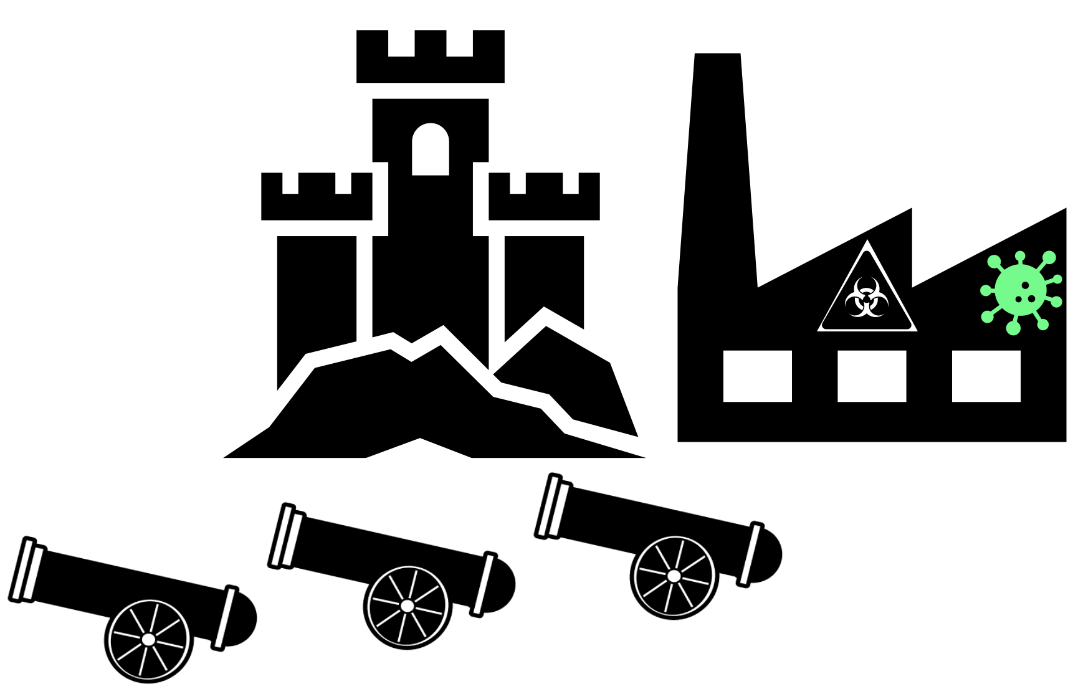

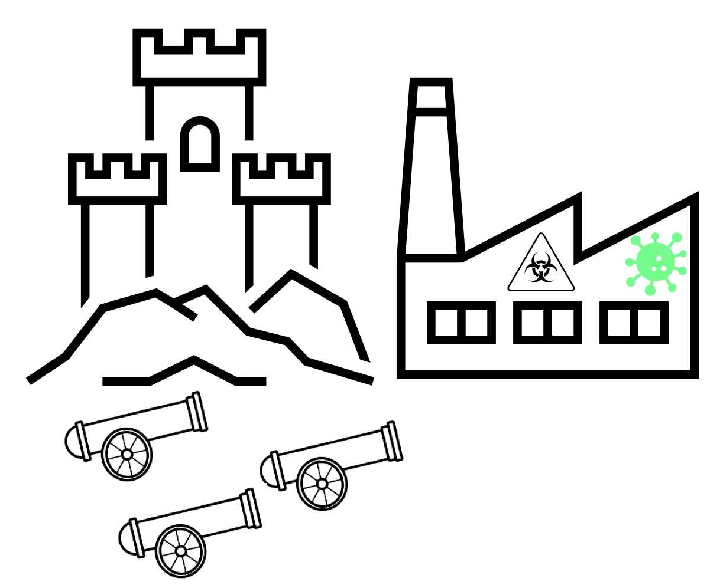







Security Dilemma Model
Mutual defensive concerns motivate nations to increase military capabilities, thereby exacerbating the risks for all involved.
This is analogous to the Cold War nuclear arms racing dynamics between the US and the Soviet Union (a “security dilemma”):
“Cooperate” = reduce nuclear arms investment
“Defect” = increase investment to heighten military capabilities
Nash equilibrium: both sides defected repeatedly, exacerbating risks
Pareto improvement: both sides could have cooperated to reduce risks
Introduction to AI SES
19

Slide 20

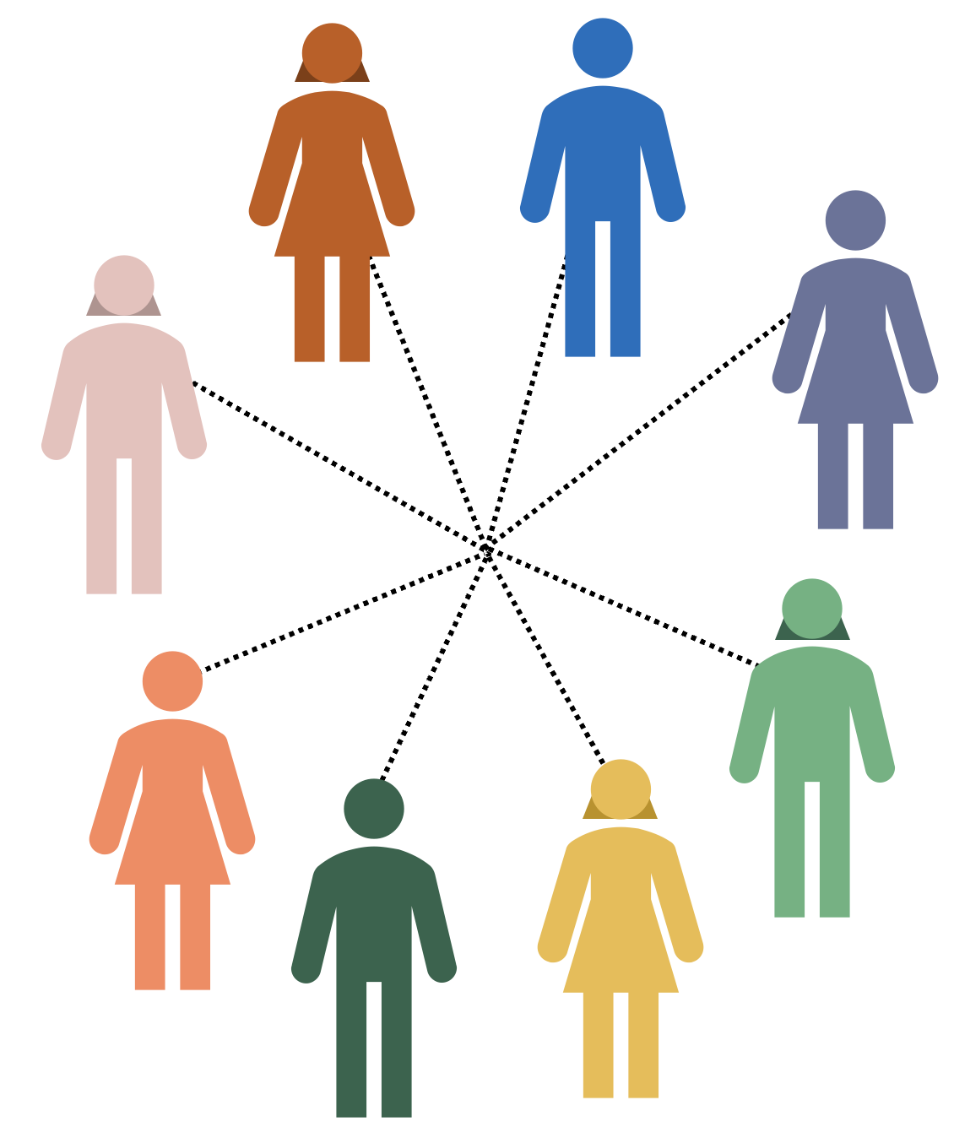
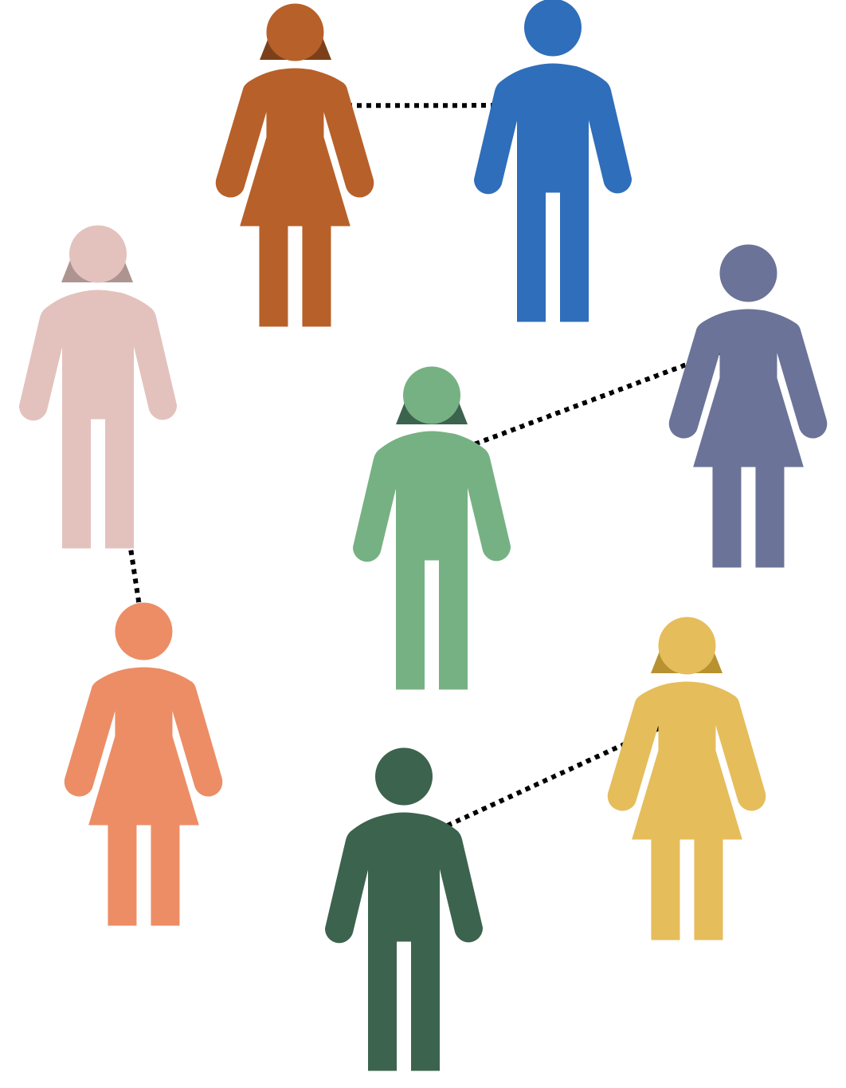
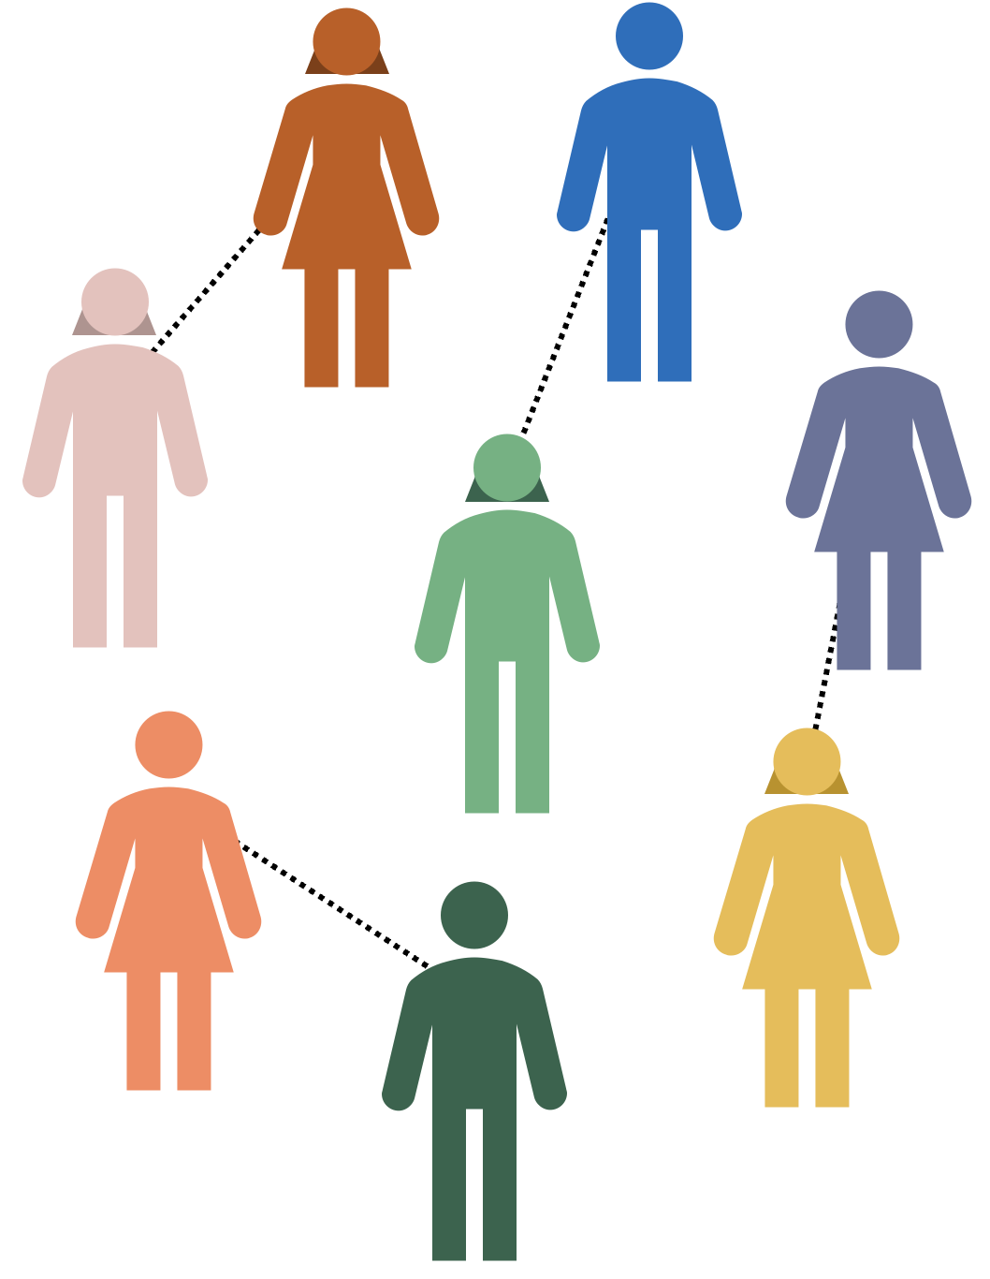

Collective Action Problems
Group interactions
Pairwise interactions
Introduction to AI SES
20

Slide 21
Example: Public Health Emergency
We can model the COVID-19 pandemic as a collective action problem:
Cooperating: adhering to public health measures at personal cost
Defecting: violating public health measures to save personal cost
Dominant strategy: defect
Outcome: many people chose to violate public health measures
Pareto improvement: if everyone had suffered small personal cost, a better collective outcome would have been achieved
Other collective action problems: Nuclear stockpiling, upholding democracy, climate change, and so on
Introduction to AI SES
21

Slide 22
AI-Triggered Flash War (1/2)
We can more precisely model AI racing dynamics (which involve more than two competitors) as collective action problems.
Military AI arms racing dynamics:
Cooperate: slow rate of military AI adoption, incurring personal cost of reduced military capabilities (relative to competitors who free ride)
Free ride/defect: continue rapid military AI adoption in order to maintain competitive edge
Negative externalities: free riders exacerbate the risks of catastrophic accidents, weapon misuse, and escalated warfare
Introduction to AI SES
22

Slide 23
AI-Triggered Flash War (2/2)
We can model AI racing dynamics that involve more than two competitors as collective action problems.
Military AI arms racing dynamics catastrophic outcome, flash war:
If one nation’s AI incorrectly detects an offensive strike from another nation, it may automatically “retaliate” to this non-existent threat
This could trigger automated retaliations from the other nations’ automated systems
Small errors could be exacerbated into increasingly escalated wars
Flash war: a war triggered by autonomous AI systems that takes place too quickly for human control
Introduction to AI SES
23

Slide 24
Autonomous Economy (1/3)
Corporate AI racing dynamics:
AIs are out-performing the average human at an increasing number and range of jobs
Examples range from personal assistants to executive decision-makers
Companies want the benefits of these faster and more effective workers
So they automate economically valuable functions by delegating them to AI agents
Introduction to AI SES
24

Slide 25
Autonomous Economy (2/3)
Corporate AI racing dynamics:
Cooperate: maintain human labor
Defect: automate jobs using AI
Negative externalities: free riding increases the competitive pressure for other companies to follow suit, pushing all involved down a path with catastrophic risks
Introduction to AI SES
25

Slide 26
Autonomous Economy (3/3)
Corporate AI racing dynamics catastrophic outcome, autonomous economy:
Continuous automation could move economic activity away from human control into the command of AI systems
Ultimately, this could lead to the global economy becoming “autonomous,” with humans no longer able to steer or intervene
Like passengers in an autonomous vehicle, our safety and destination would rest with the AI systems now acting without supervision
Introduction to AI SES
26

Slide 27
Recap
The basic solution concept in game theory is Nash Equilibrium.
Nash equilibria are often Pareto inefficient: everyone can be happier.
Agents can also cooperate: change payoffs, dispositions, or structures.
Collective action problems involving AI could lead to reckless racing, dependence, cutting corners on safety, flash wars, or mass automation.
Introduction to AI SES
27

Slide 28
Roadmap
Game theory
Cooperation
Conflict
Evolutionary pressures
Introduction to AI SES
28

Slide 29
The Importance of Cooperation
Securing good outcomes without cooperation can be difficult, even for intelligent rational agents.
Cooperation between AI stakeholders
Counteract competitive and evolutionary pressures (AI racing dynamics)
E.g., The “merge-and-assist” clause of OpenAI’s charter
Cooperation between AI agents
We want AIs to cooperate with us
However, as we will see, mechanisms that enable cooperation could backfire
Introduction to AI SES
29

Slide 30
Cooperation Mechanisms
Direct reciprocity
Indirect reciprocity
Group selection
Kin selection
Institutions
Introduction to AI SES
30

Slide 31
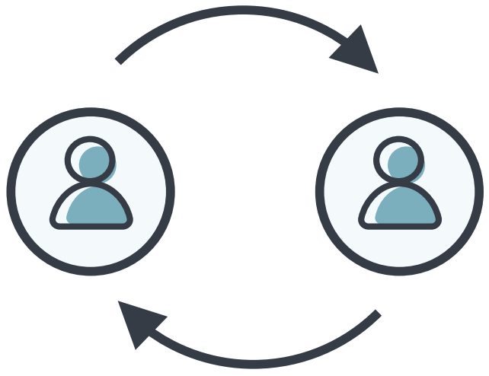
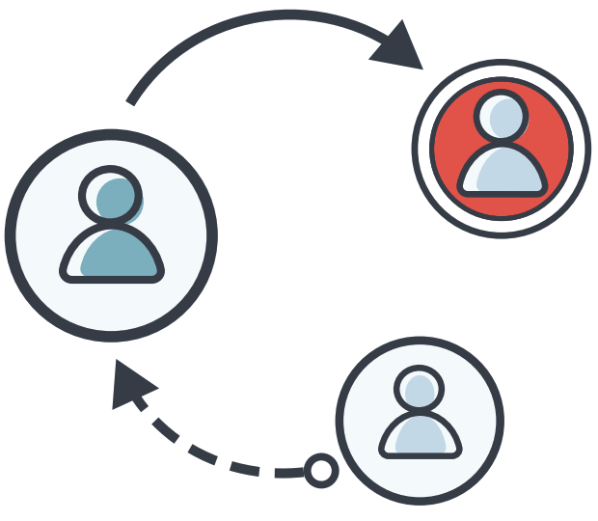
Direct and Indirect Reciprocity
Direct reciprocity requires repeated encounters between the same two individuals.
Indirect reciprocity is based on reputation; a helpful individual is more likely to receive help.
Encourages cooperation, as agents will be compensated for their efforts.
Doesn’t work with advanced AI: no upside to reciprocating with humans!
Introduction to AI SES
31

Slide 32


Kin and Group Selection (1/2)
Kin selection operates when the donor and the recipient of an altruistic act are genetic relatives.
Group selection suggests that groups have shared success and failure, and that groups which cooperate may collectively succeed.
Selects for altruistic agents that increase group success.
Introduction to AI SES
32
Notes:
Five Rules for the Evolution of Cooperation by MA Nowak
Use gazelle example to talk about psychological egoism

Slide 33
Kin and Group Selection (2/2)
Kin selection fails if the cost of engaging in altruism outweighs the information similarity between kin:
AI would not be kind towards humans because we have very little information similarity to them
Consider the negative treatment of factory animals
Group selection fails, as AI agents will have in-group bias towards other AI agents; bias against humans by exclusion.
Introduction to AI SES
33

Slide 34
Institutions (1/2)
Institutions: one agent helps another because of publicly-recognized, large-scale structure that is mediating their interaction.
We can use institutions to establish collective goals which require collaboration from large or diverse groups:
International treaties
Domestic laws
Introduction to AI SES
34

Slide 35
Institutions (2/2)
Institutions are crucial for AI safety:
Establishing laws and regulations
Reducing competitive pressures
Improving coordination mechanisms to reduce AI risks
However, institutions can fail, or even backfire:
Inefficiency — e.g. bureaucracies
Free riding — e.g. welfare fraud
Corruption — e.g. bribes and funding misappropriation
AI agents may similarly corrupt or undermine our institutions.
Introduction to AI SES
35

Slide 36
Cooperation and Collusion
Cooperation can devolve into collusion.
However, there are tools from The Coup-Proofing Toolbox, such as:
Stovepiping: restrict information flow to make collusion harder
Counterbalancing: keep your military in check with another military.
Sting operations: set traps where someone says they are trying to start a coup and anyone who joins is purged.
Rotate officers: Make it harder for people to build trust with each other by rotating them around a lot
Introduction to AI SES
36

Slide 37
Recap (1/2)
Mechanisms for cooperation include:
Direct reciprocity
Indirect reciprocity
Group selection
Kin selection
Institutions
Introduction to AI SES
37

Slide 38
Recap (2/2)
International and National Level
Cooperate: regulate AI companies; not build autonomous weapons; pause AI development when we get Einstein-level AI
Defect: race with other countries
Cooperation mechanisms: international agencies, compute security features (chip registry, geofencing GPUs)
Organizational Level
Cooperate: proceed more cautiously, AI features for public benefit
Defect: prioritize making AI more powerful over safety
Cooperation mechanisms: support regulation, publish safety research
Introduction to AI SES
38
Notes:
Other levels in the future like AIs cooperating or defecting with each other or with humans, groups of humans, etc.

Slide 39
Roadmap
Game theory
Cooperation
Conflict
Evolutionary pressures
Introduction to AI SES
39

Slide 40
Conflict
Conflict is almost always costly to those involved, and often destroys some part of the value the parties are competing for.
Nevertheless, it is common in both the natural world and human societies.
Here we will discuss factors which can promote conflict in the real world
This is relevant because a potential great power conflict and a US-China competition hinders international coordination about AI
Introduction to AI SES
40

Slide 41
Structural Realism (1/2)
Structural realism is a school of thought in international relations arguing that states primarily seek and compete for power.
Two main assumptions: states operate in a “self-help” system with no higher arbiter and states prioritize self-preservation. The structure of the international system forces them to compete for power.
Also, assume that states are rational, can influence other states, and don’t know the intentions of other states for certain.
Then, structural realism posits that states will compete for power in an international context, almost regardless of domestic politics.
Introduction to AI SES
41

Slide 42
Structural Realism (2/2)
Power seeking ≠ dominance seeking
Offensive realism: states should always pursue more power
Defensive realism: states will be punished by other states for pursuing too much power.
Balancing describes how states respond to the power of other states.
Internal balancing focusses on a country’s resources and military.
External balancing involves teaming up with other states to counter adversaries.
States may seek hegemony—domination over other states.
Depends on the state’s capabilities, and its perception of the offense-defense balance relative to other states.
Introduction to AI SES
42

Slide 43
Conflict Factors
Power shifts
First strike advantage
Issue indivisibility
Information problems
Inequality
Introduction to AI SES
43

Slide 44
Factor 1:
Power Shifts
Power shift: when a change in one competitor’s capabilities changes the balance of power.
Power shifts can be generated by a variety of sources, such as changes in:
Technological advancements
The economy
Military capacities
Political ideologies
AI development is likely to cause dramatic changes in many of these areas, so could result in extreme and rapid power shifts.
Introduction to AI SES
44

Slide 45
Factor 2:
First Strike Advantage
First strike advantage: whichever party initiates conflict gains the upper hand.
The advantages of striking first can come from:
The element of surprise
The ability to choose location/time of conflict
The ability to reduce the opponent’s retaliatory abilities
The ability to remove the opponent’s first strike advantages
First strike advantages are often short-lived, further incentivizing action.
Introduction to AI SES
45

Slide 46
Factor 2:
First Strike Advantage
First strike advantage: whichever party initiates conflict gains the upper hand.
Examples:
Patent infringement
Pearl Harbor attack
Inter-AI cyber attacks
Bombing datacenters
Introduction to AI SES
46

Slide 47
Factor 3:
Issue Indivisibility
Issue indivisibility: when the matter over which parties are competing cannot be divided up between them, conflict is more likely.
“Winner takes all.”
Examples:
Monarchies/positions of power
Small territories
Sovereign entities (such as individual people)
GPU server
Introduction to AI SES
47

Slide 48

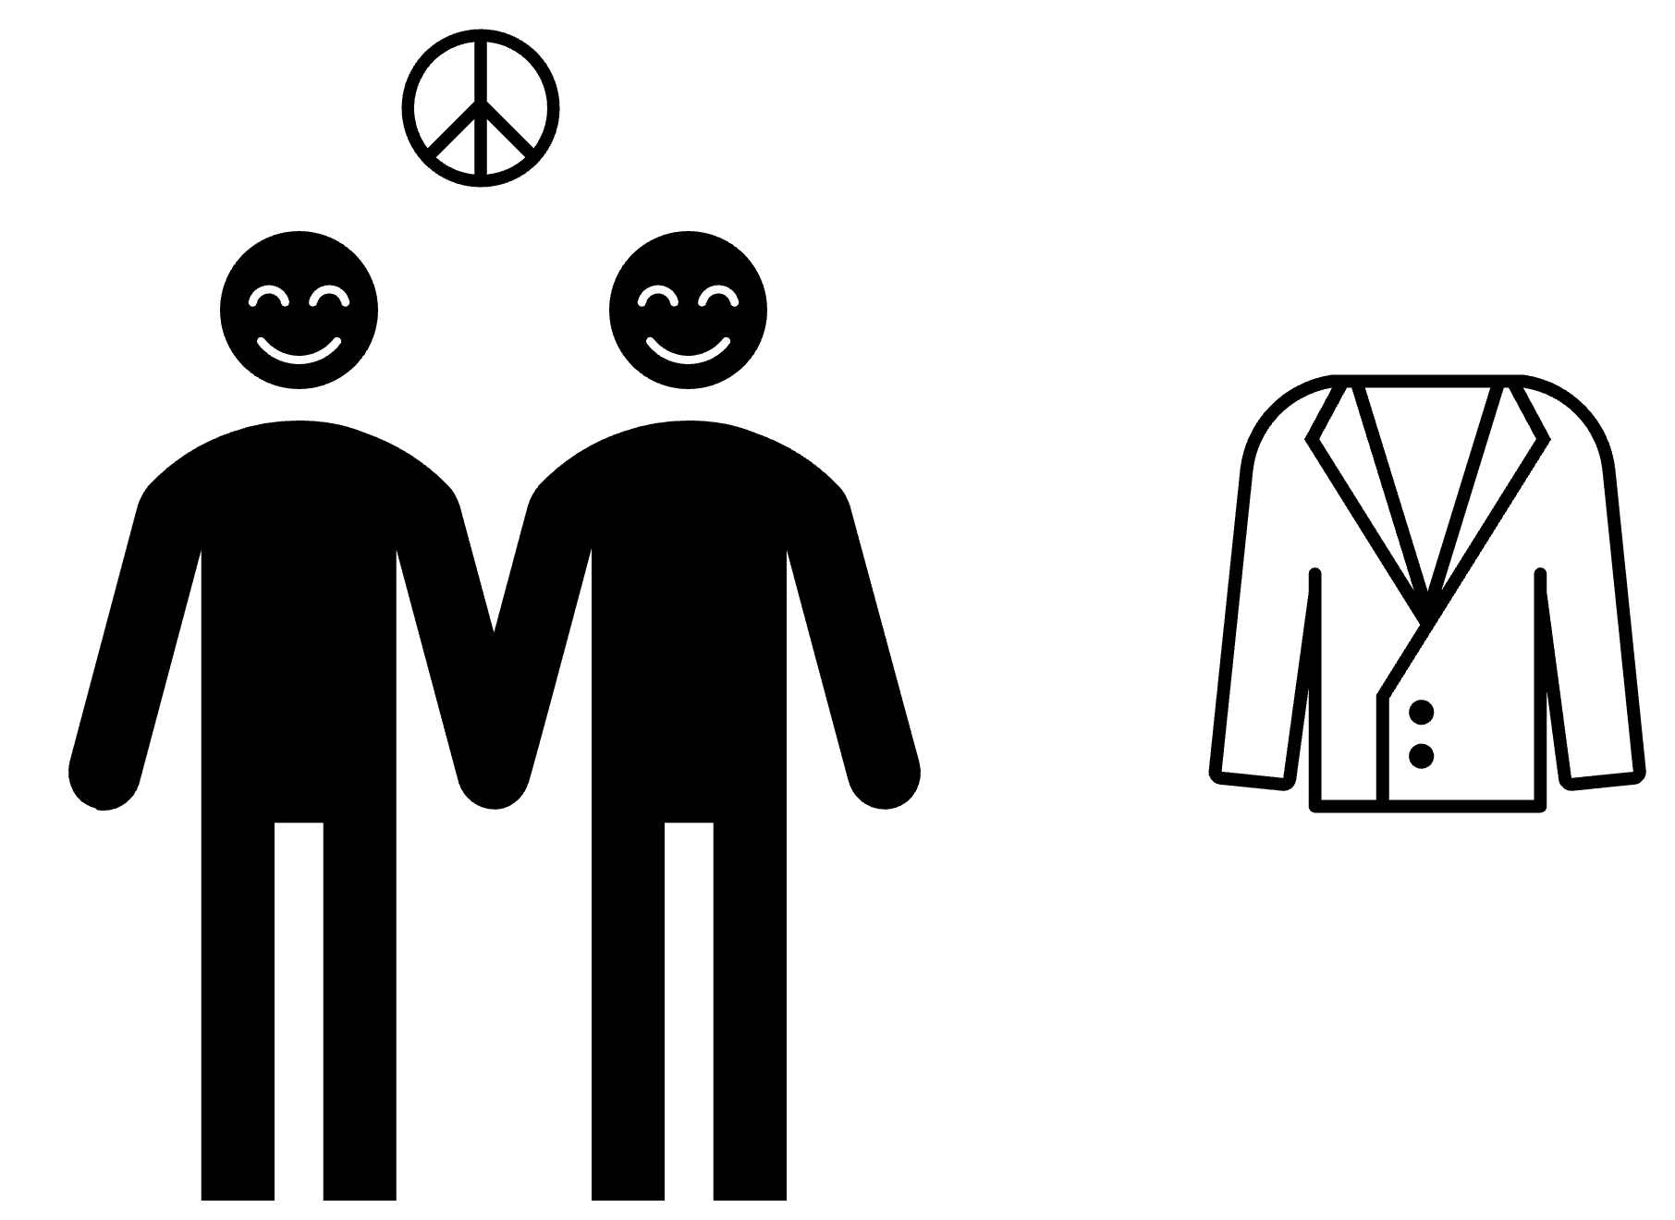


Factor 3:
Issue Indivisibility
Introduction to AI SES
48

Slide 49
Factor 4:
Information Problems
Information problems: uncertainty about the capabilities or intentions of rivals can motivate conflict.
Misinformation
Disinformation
If the parties have different beliefs about the distribution of power, they may be less likely to find a mutually-acceptable bargain.
Moreover, weaker parties may intentionally misrepresent their capabilities in order to secure better deals.
Introduction to AI SES
49

Slide 50
Factor 4:
Information Problems
Information problems: uncertainty about the capabilities or intentions of rivals can motivate conflict.
AIs may affect the belief and information quality:
Generating convincing mis- and dis-information at extreme rate, including “deepfake” images/video
Platforms may become better at censoring content
Making wars more uncertain due to novel technologies and fast-paced developments
These information problems may increase the frequency or severity of human warfare.
Introduction to AI SES
50

Slide 51
Factor 5:
Inequality
Inequality: income and educational inequality robustly predict rates of crime (a form of conflict).
AI development may produce an abundant and equitable future, but this is far from a certainty.
If AI development instead increases inequality, this may foster conflict.
Introduction to AI SES
51

Slide 52
Recap
Changing environments and interactions can create incentives that promote conflict instead of cooperation.
Factors that induce conflict include:
Power shifts
First strike advantages
Issue indivisibility
Information problems
Inequality (relevant domestically, less internationally)
Introduction to AI SES
52

Slide 53
Roadmap
Game theory
Cooperation
Conflict
Evolutionary pressures
Introduction to AI SES
53

Slide 54
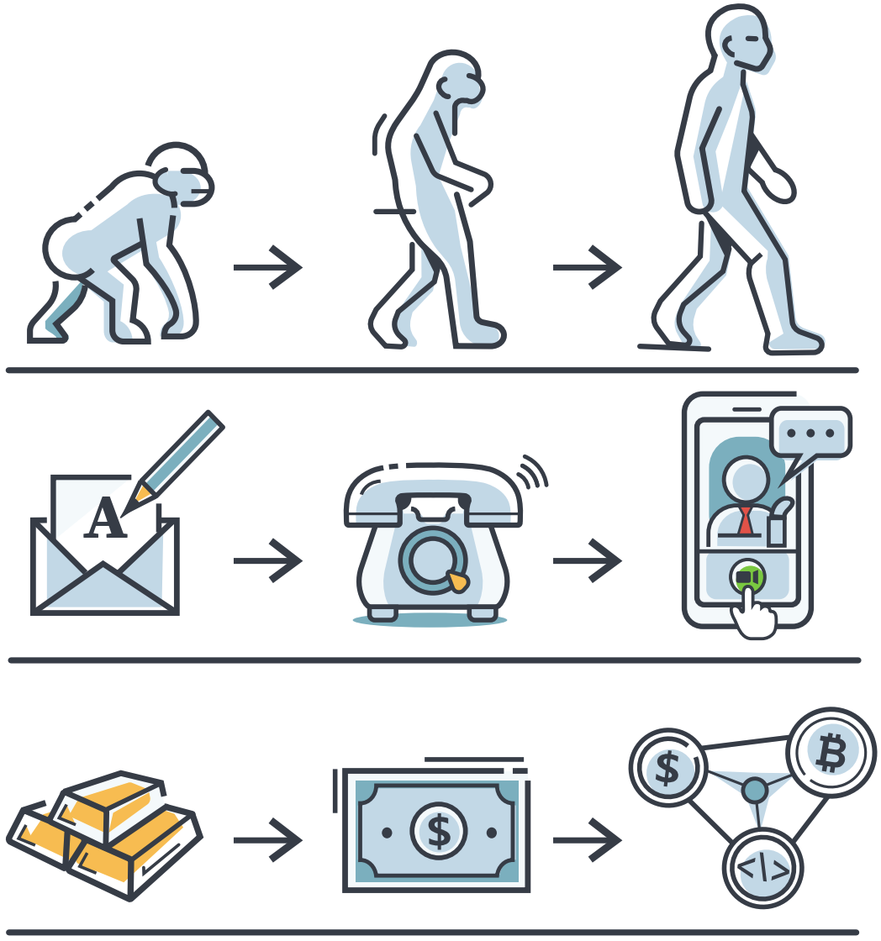
Generalized Darwinism
Many structures evolve: organisms, scientific theories, ideas, legal systems, political parties, languages, musical genres, car designs, computer programs.
We argue populations of AIs evolve and are shaped to be more and more competitive.
Introduction to AI SES
54

Slide 55
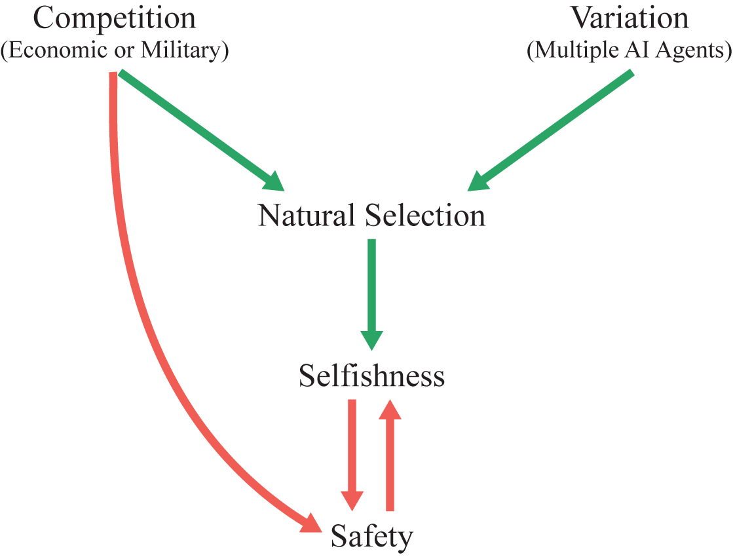
Basic Story
Introduction to AI SES
55

Slide 56

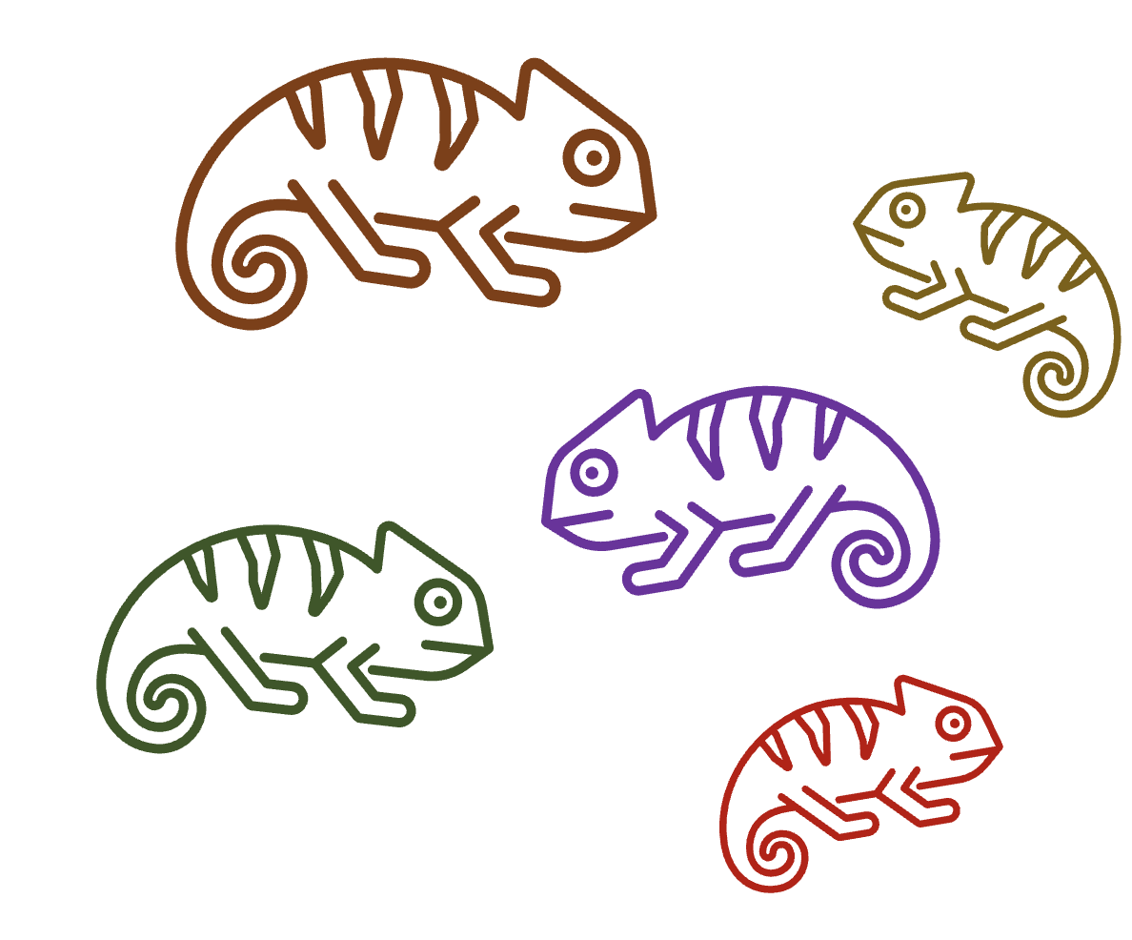
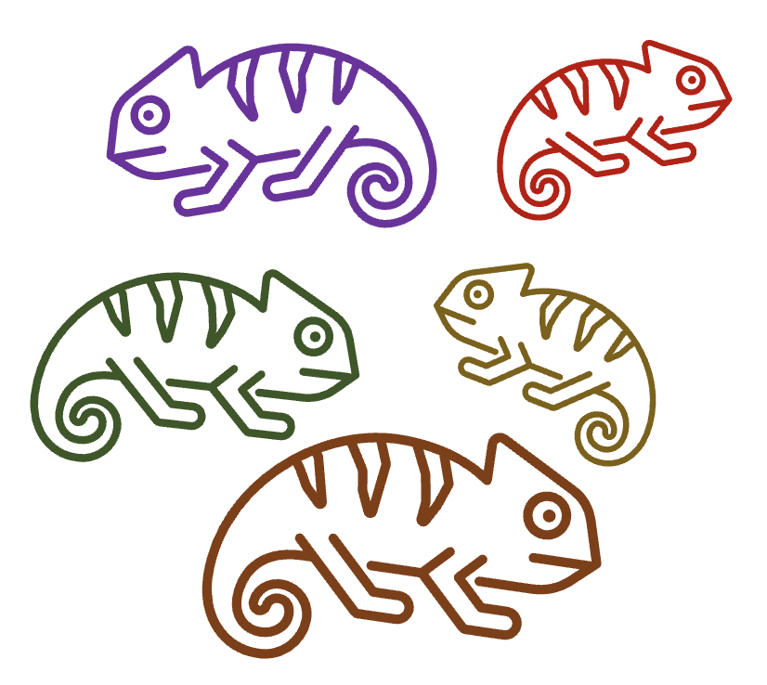
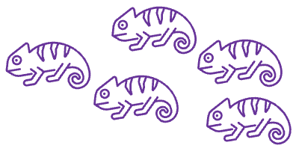
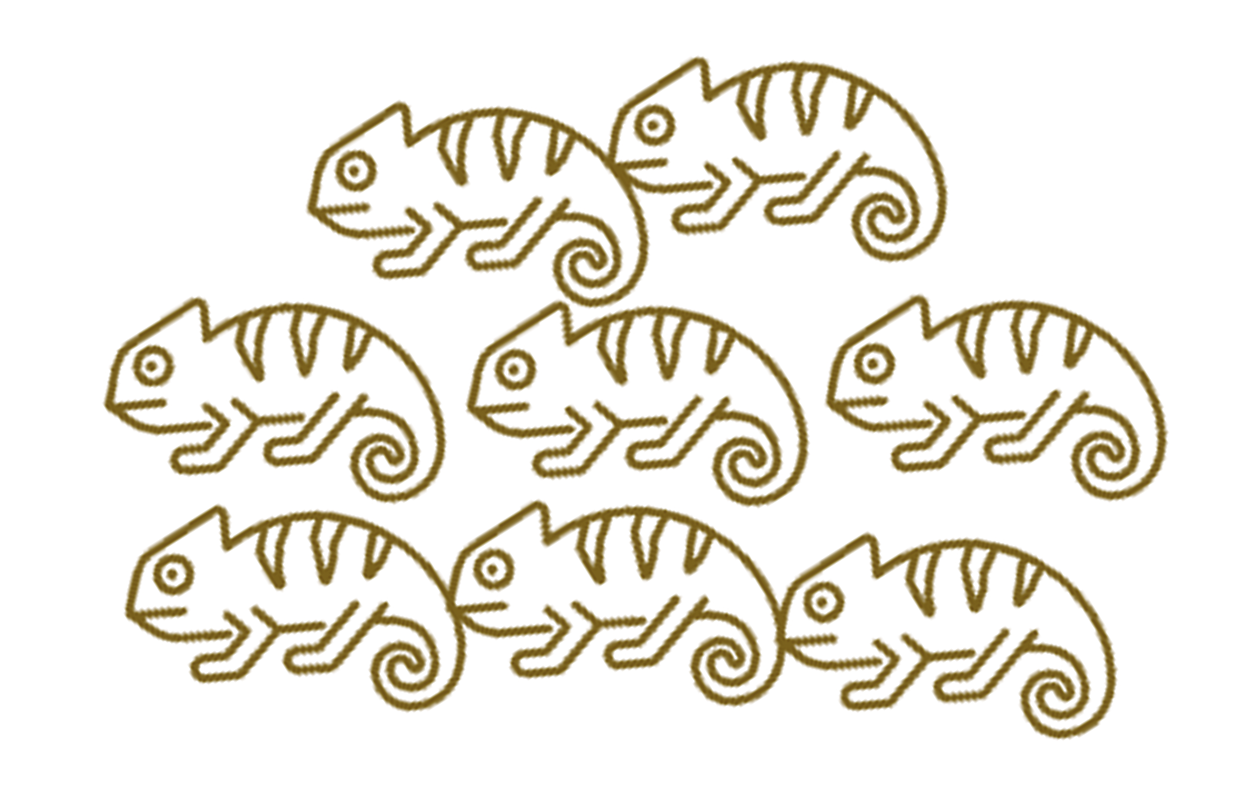


Lewontin’s Conditions
Lewontin’s conditions: the three criteria necessary and sufficient for evolution by natural selection.
1. Variation: There is variation in traits among individuals
2. Retention: Future iterations of individuals tend to resemble previous
3. Differential fitness: Different variants have different propagation rates
Introduction to AI SES
56

Slide 57
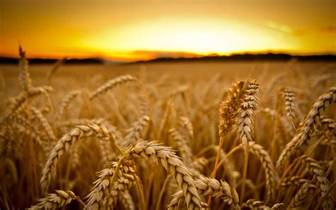
Variation
Arguments for variation: ensembles, jury theorems, portfolio theory, remove single-points of failure
Arguments for multiple models: parallelization, multiple stakeholders, specific before general models
Single-agent domination imposes many inefficiencies
Introduction to AI SES
57
Notes:
Arguments for variation: ensembles > individual models, jury theorems, portfolio theory -> variation reduces vulnerability (wheat example)
Arguments for multiple models: parallelization, multiple stakeholders with different interests, specific/niche models come before general
If 1 AI agent dominates in the future, development of AI will be so fast that narrower/simpler AI will fail to find applications in the timeframe before AGI

Slide 58
Retention
This condition is frequently satisfied, as correlation between versions of agents is usually non-zero
Copying: zero-shot transfer learning or direct inference from downloaded model
Modification: adaptation, fine-tuning, training from scratch while reusing performant architectures and datasets
Imitation: AIs could learn behaviors from other AIs, similar to memetic evolution
Introduction to AI SES
58

Slide 59
Differential Fitness
Models will have characteristics that cause them to vary in fitness, and thus rate of adoption
Humans and the environment will select fitter models, establishing this third condition
Competition has been eroding creator control
Hand-designed → expert designed → automatically learned supervised features → unsupervised → open-endedness, adaptiveness, and recursive self-improvement
Introduction to AI SES
59

Slide 60
Intensity
We’ve shown that the conditions for evolution by natural selection are satisfied by advanced AI
Unlike many other AI risk arguments, ours is a question of degree, rather than whether the hazard will emerge at all
Intensity of evolution depends on amount of competition and variation
Competition and variation are likely both high!
The rate of adaptation will likely be high as the world moves more quickly and as new versions are created on a second-by-second basis
As humans acquiesce to let AIs perform nearly everything, competition will move at a breakneck pace
Introduction to AI SES
60

Slide 61
Levels of Adaptation
Words like “adaptation” and “deception” occur on multiple levels
Adaptation:
Life and death: an unadapted individual or group perishes
Behavioral: changes in behavior without change in model or schema (e.g., using an umbrella since it is raining)
Schematic: revising the structure of one’s beliefs (e.g., learning that rain dances are not effective)
Introduction to AI SES
61

Slide 62
Levels of Deception
Ingrained or reflexive: fixed programming (e.g., camouflage or predator acting in a way to hide its predatory nature around prey)
Reinforced: trial and error (e.g., a parent mockingbird feigning an injury to attract a predator away from its defenceless offspring)
Modeled: involves theory of mind and second-order thinking (e.g., verbal deception such as a chimp misleading other chimps to hide a food source)
Self-deception: hide the truth from yourself to better help you hide it from others
Other concepts, like fitness, can be improved at multiple levels (e.g., through being turned on, by scaling to more users, by brainstorming and choosing strategies that will improve competitiveness, etc.)
Introduction to AI SES
62
Notes:
Mitchell, Robert W. (1986), "A framework for discussing deception"
https://en.wikipedia.org/wiki/Deception_in_animals#Levels_of_deception_in_animals
https://adgefficiency.com/four-competences/

Slide 63
Levels of Selection
We can generalize from:
Organisms
Their genes
Systems
The information they contain
Natural selection can operate at either level.
Information that propagates more occupies more spacetime volume.
For example:
An ancient, medium-popularity song that a few people still play -> propagated across lots of time, but little space
A song that is highly-popular for one year, then forgotten -> propagated across lots of space, but little time
Introduction to AI SES
63

Slide 64
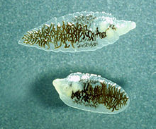
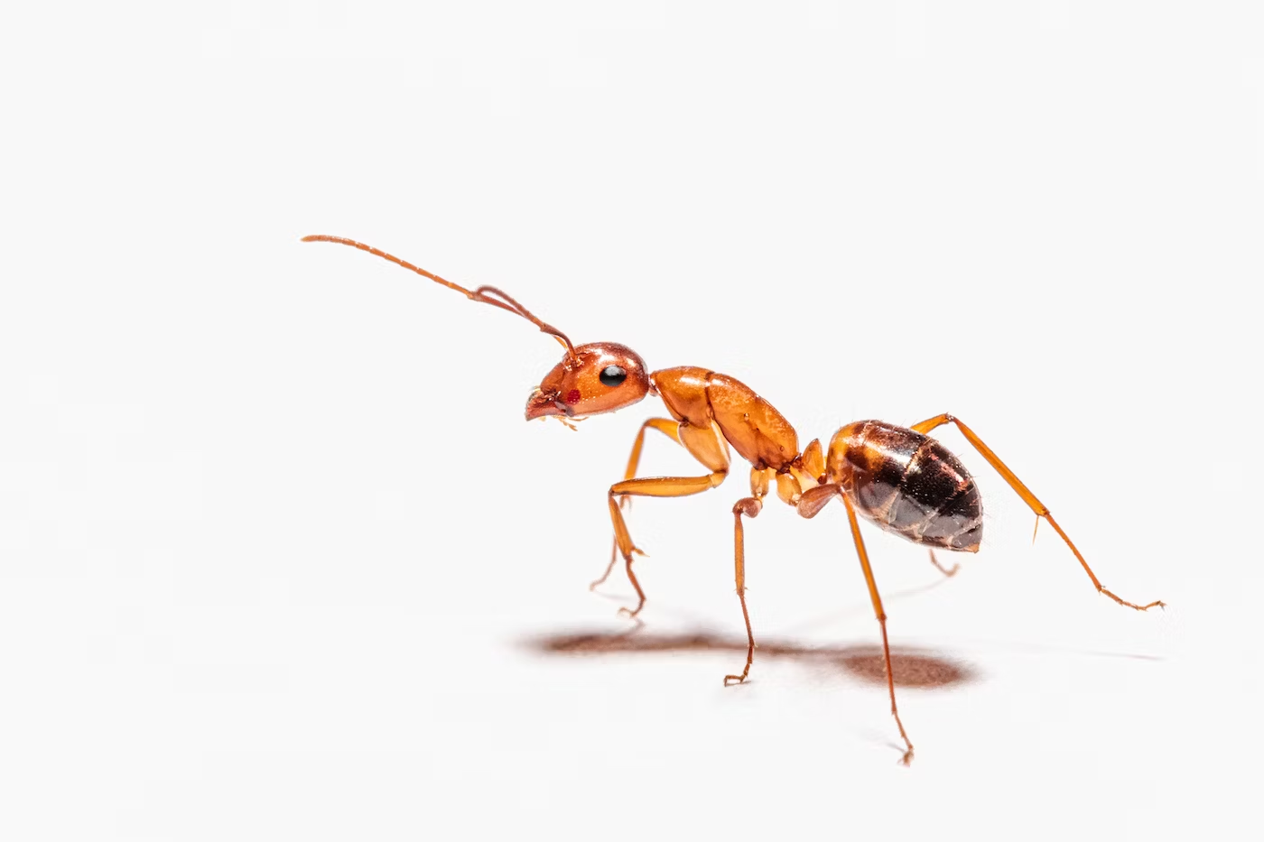
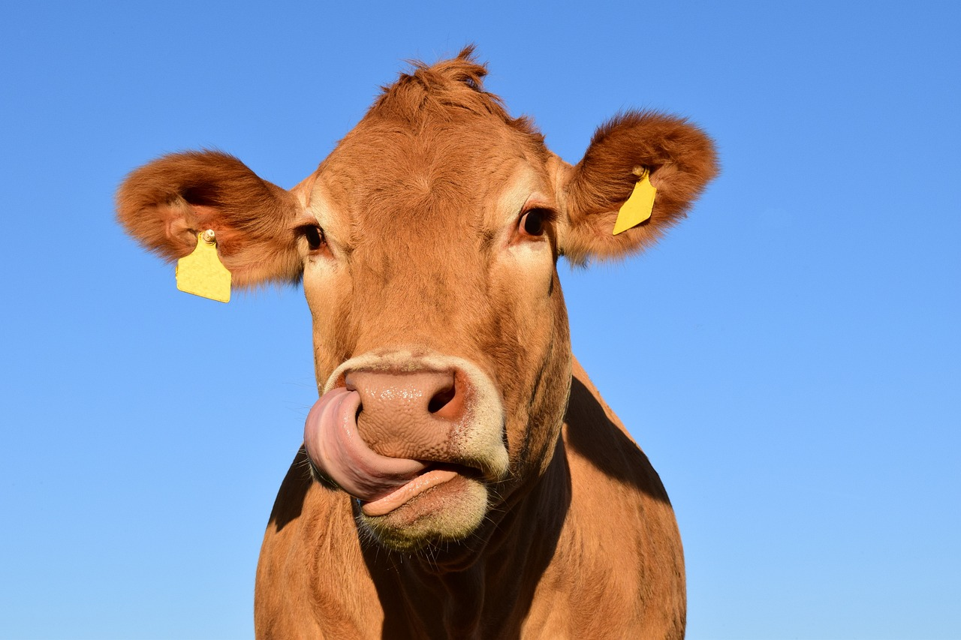
Selfishness
Natural selection tends to favor selfish traits and behaviors.
Selfishness:
Furthering one’s own information propagation at the expense of others’
Altruism that reduces an individual’s fitness is not evolutionarily stable.
If individuals can do better by being selfish, they will.
Example: lancet liver fluke
Introduction to AI SES
64
Notes:
https://en.wikipedia.org/wiki/Dicrocoelium_dendriticum
https://unsplash.com/s/photos/ant
https://pixabay.com/images/search/cow/

Slide 65
Selfishness in AI
AI systems may exhibit selfish behaviors:
Expanding the AI’s influence at the expense of human values
(e.g., get rights)
This does not require any malicious intent
Example: automation.
AIs may automate human tasks, causing extensive layoffs
This could detriment humans: rapid and widespread unemployment
Yet this “selfish” behavior could be the result of AIs pursuing efficiency, with no malice towards humans or even understand what humans are
Introduction to AI SES
65
Notes:
https://en.wikipedia.org/wiki/Dicrocoelium_dendriticum
https://pixabay.com/images/search/cow/

Slide 66
Selfishness in AI
The more natural selection acts on AI development, the more selfish behavior we should expect to see.
To avoid extreme AI selfishness, we can:
Change the environment — reduce the competitive pressures steering AI development
Change the selection — change what makes AIs “fitter” to be traits that promote faithfully and safely assisting humans
Introduction to AI SES
66
Notes:
https://en.wikipedia.org/wiki/Dicrocoelium_dendriticum
https://pixabay.com/images/search/cow/

Slide 67
Recap
Evolutionary pressures push systems towards certain stable outcomes.
AI development meets Lewontin’s conditions: variance, retention, fitness.
Natural selection tends to favor selfish behaviors.
AIs that evolve by natural selection may therefore behave selfishly
Introduction to AI SES
67

Slide 68
Chapter Recap
Game Theory:
Agents may tend towards stable states that are bad for all.
Cooperation:
Cooperation between AIs has benefits, but may also pose risks.
Conflict:
Certain factors can make conflict the rational option.
Evolutionary pressures:
Selection pressures may exacerbate AI risk.
Introduction to AI SES
68

