Slide 1
Introduction to
AI Safety, Ethics, and Society
Artificial Intelligence Fundamentals
Introduction to AI SES
1

Slide 2
Artificial Intelligence
Definitions, history, and types
Introduction to AI SES
2

Slide 3
Definition of AI
There is no single universally-accepted definition of “artificial intelligence.” It is used to describe different (but related) ideas:
Branch of computer science
Type of machine
Tool
Component of a business model
Philosophical idea
Our definition: computer systems that perform tasks typically associated with intelligence such as problem solving, decision making, forecasting.
Introduction to AI SES
3

Slide 4
Modern History of AI
Symbolic AI
First
AI winter
Advancements
in ML
Deep
learning
Recovery
1950
1960
1970
1980
1990
2000
2010
2020
Dartmouth
conference
“ELIZA”
(First chatbot)
“Expert” systems
WWW
invented
Deep Blue
beats
Kasparov
ImageNet
AlphaGo
AlexNet
Transformer
+
LLMs
“Perceptron”
(First neural
network)
Developments:
TBAs, PGMs, and SVMs
ChatGPT
Introduction to AI SES
4

Slide 5
Types of AI
Narrow AI: capable of performing specific tasks only.
Artificial General Intelligence (AGI): capable of performing many cognitive tasks across multiple domains, at human or superhuman levels.
Human-level AI (HLAI): capable of doing virtually everything humans do.
Transformative AI (TAI): systems with a dramatic impact on the world at the level of the industrial revolution.
Superintelligence (ASI): capable of outclassing human performance on virtually all intellectual tasks.
Introduction to AI SES
5

Slide 6
Machine Learning
The models, tasks, data, and types of learning
Introduction to AI SES
6

Slide 7
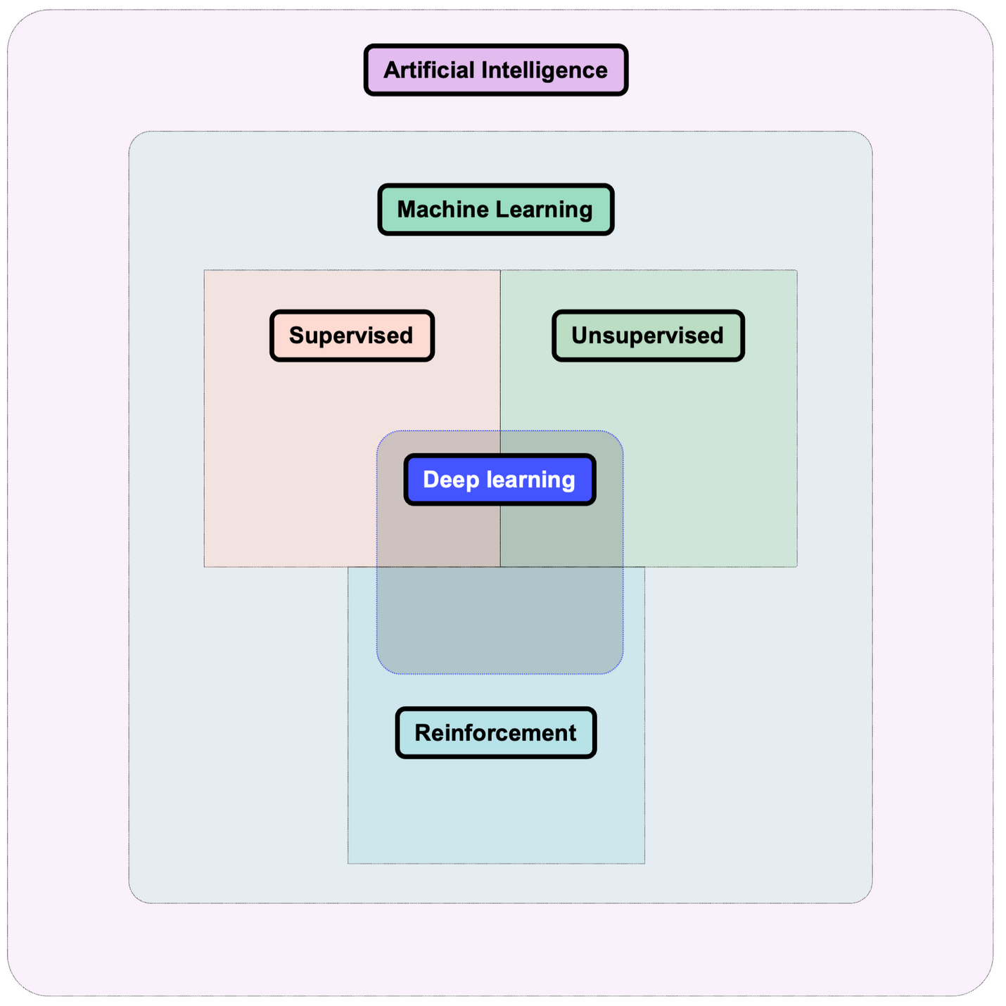
Machine Learning Definitions
Introduction to AI SES
7

Slide 8
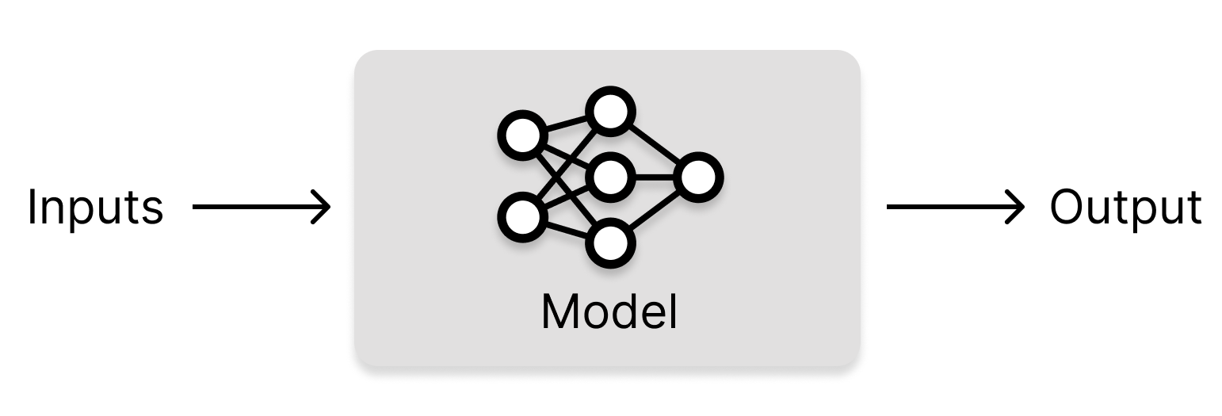
Machine Learning Definitions
Machine learning (ML): developing computer systems that can learn directly from data without following explicit pre-set instructions.
Algorithm: a procedure (recipe) for accomplishing a task.
ML model: an algorithm designed to learn automatically from data by identifying patterns and relationships to make predictions or decisions.
Training data: the data from which ML models learn.
Introduction to AI SES
8

Slide 9
Model Access
Model developers can grant different levels of access to the public.
Closed Models: Operate in a closed system, not accessible for external use or modification, often used internally by organizations.
API Models: Accessible through an interface with usage restrictions, allowing users to query the model without viewing or modifying the underlying model.
Open Models: Fully accessible and modifiable, often part of open-source projects, allowing users to use, modify, and distribute freely.
Introduction to AI SES
9

Slide 10

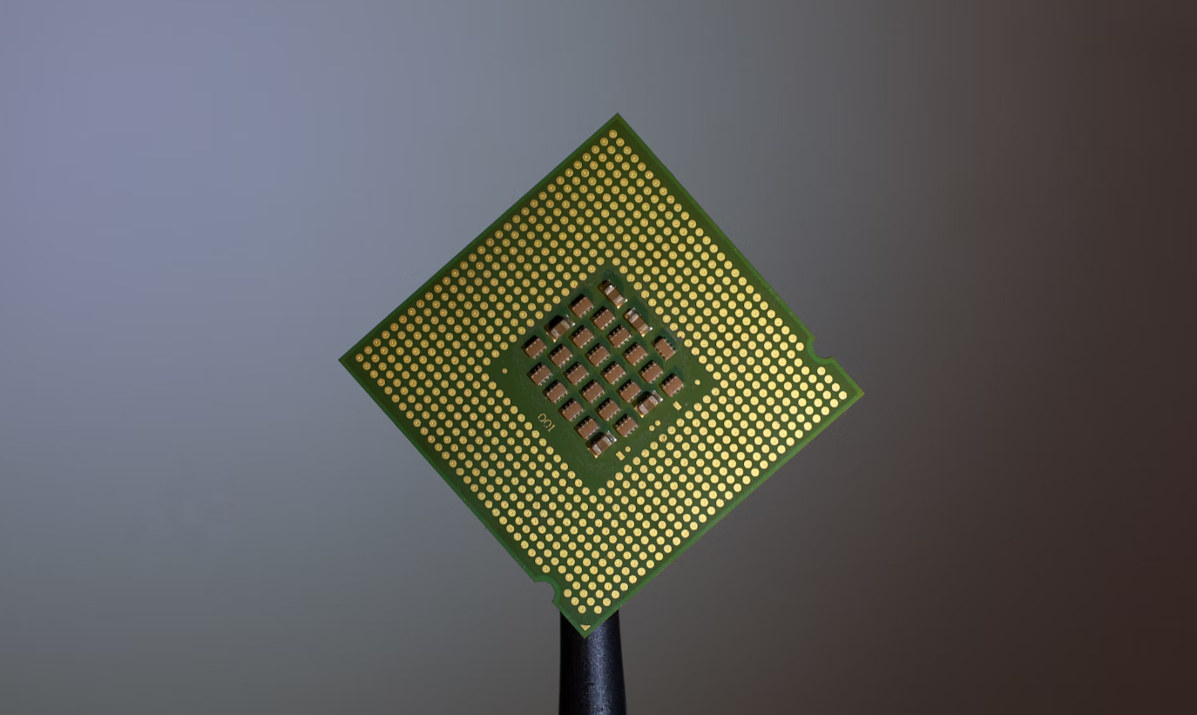
Computational Resources
Compute in ML: Essential for handling the large datasets and complex calculations in machine learning, with GPUs and CPUs being primary examples.
GPUs (Graphics Processing Units):
Parallel processing
CPUs (Central Processing Units):
Sequential processing
Introduction to AI SES
10

Slide 11
Tasks, Inputs, Outputs
Task: What is the primary goal of the ML model?
Inputs: What data does the ML system receive?
Outputs: What does the ML system produce?
Introduction to AI SES
11
Notes:
ML models can be intricate and varied, making understanding their characteristics and distinctions a challenge. It can be helpful to focus on key high-level aspects that almost all ML systems have, to abstract away from the details.

Slide 12

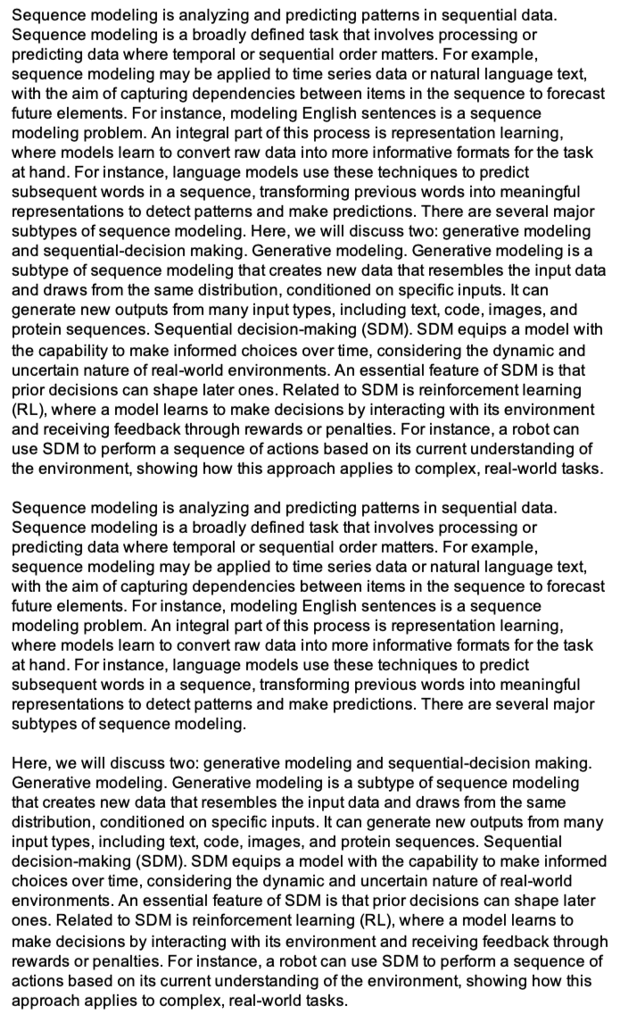
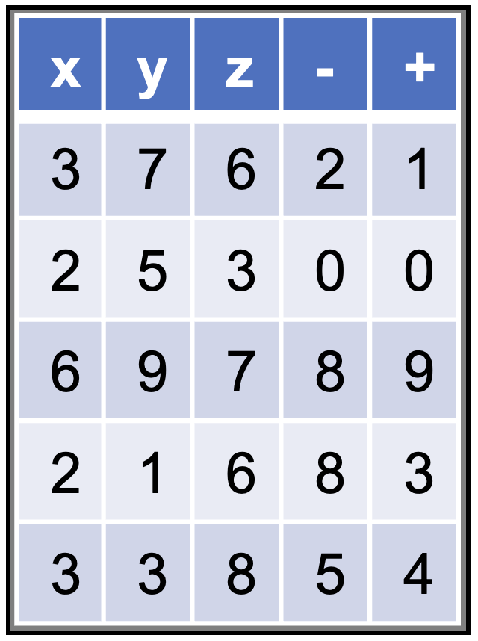

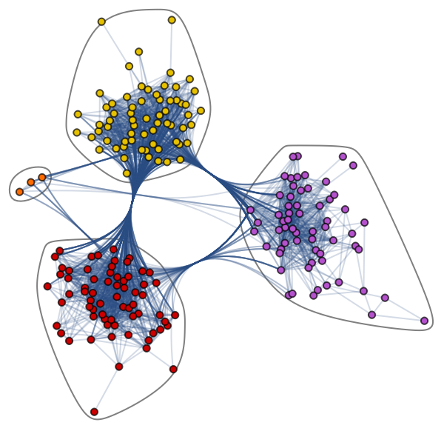
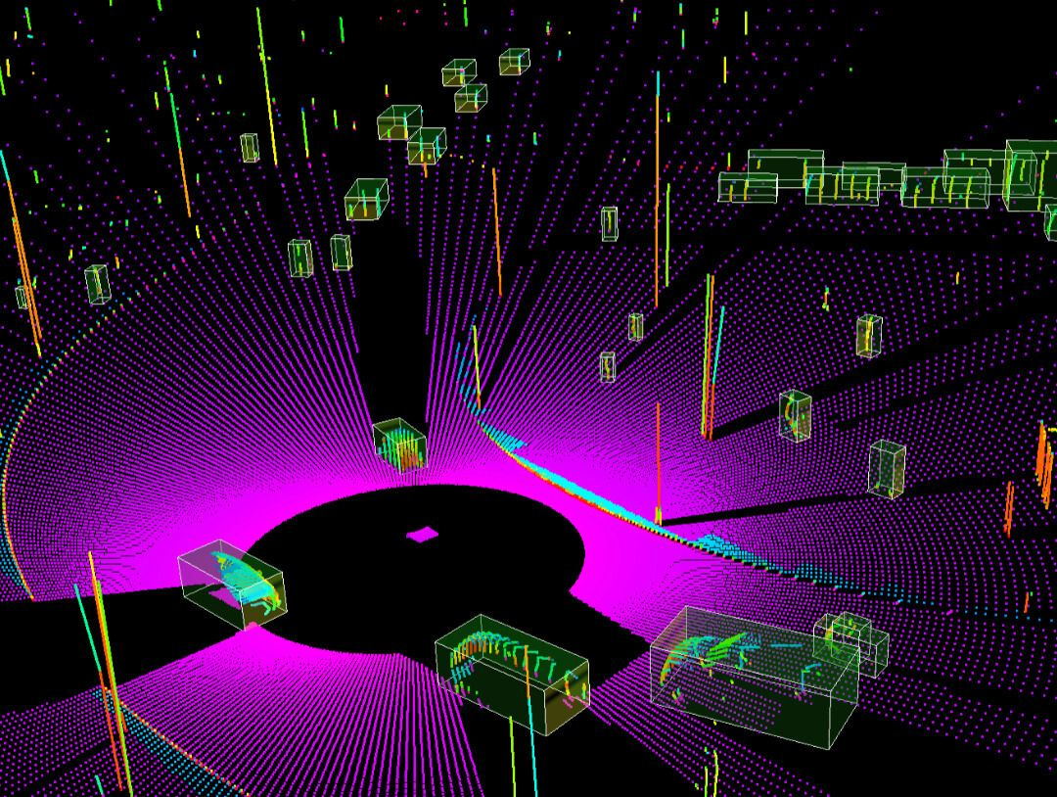
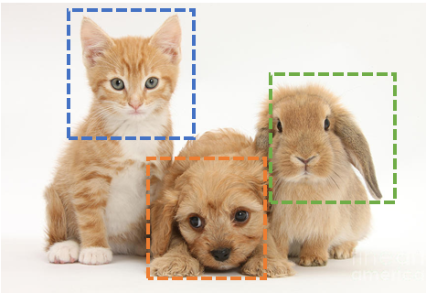
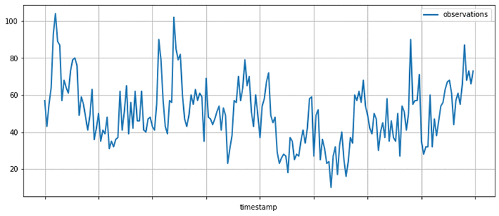
Types of Input Data
Modality: a type of input to an ML model
Major modalities in machine learning:
Tables
Text
Images
Video
Audio
Time series
Graphs
Set values
Introduction to AI SES
12
Notes:
Image classification image from: https://research.aimultiple.com/image-classification/
Graph from: https://www.datacamp.com/tutorial/comprehensive-introduction-graph-neural-networks-gnns-tutorial
Lidar image from: https://www.thinkautonomous.ai/blog/lidar-datasets/

Slide 13
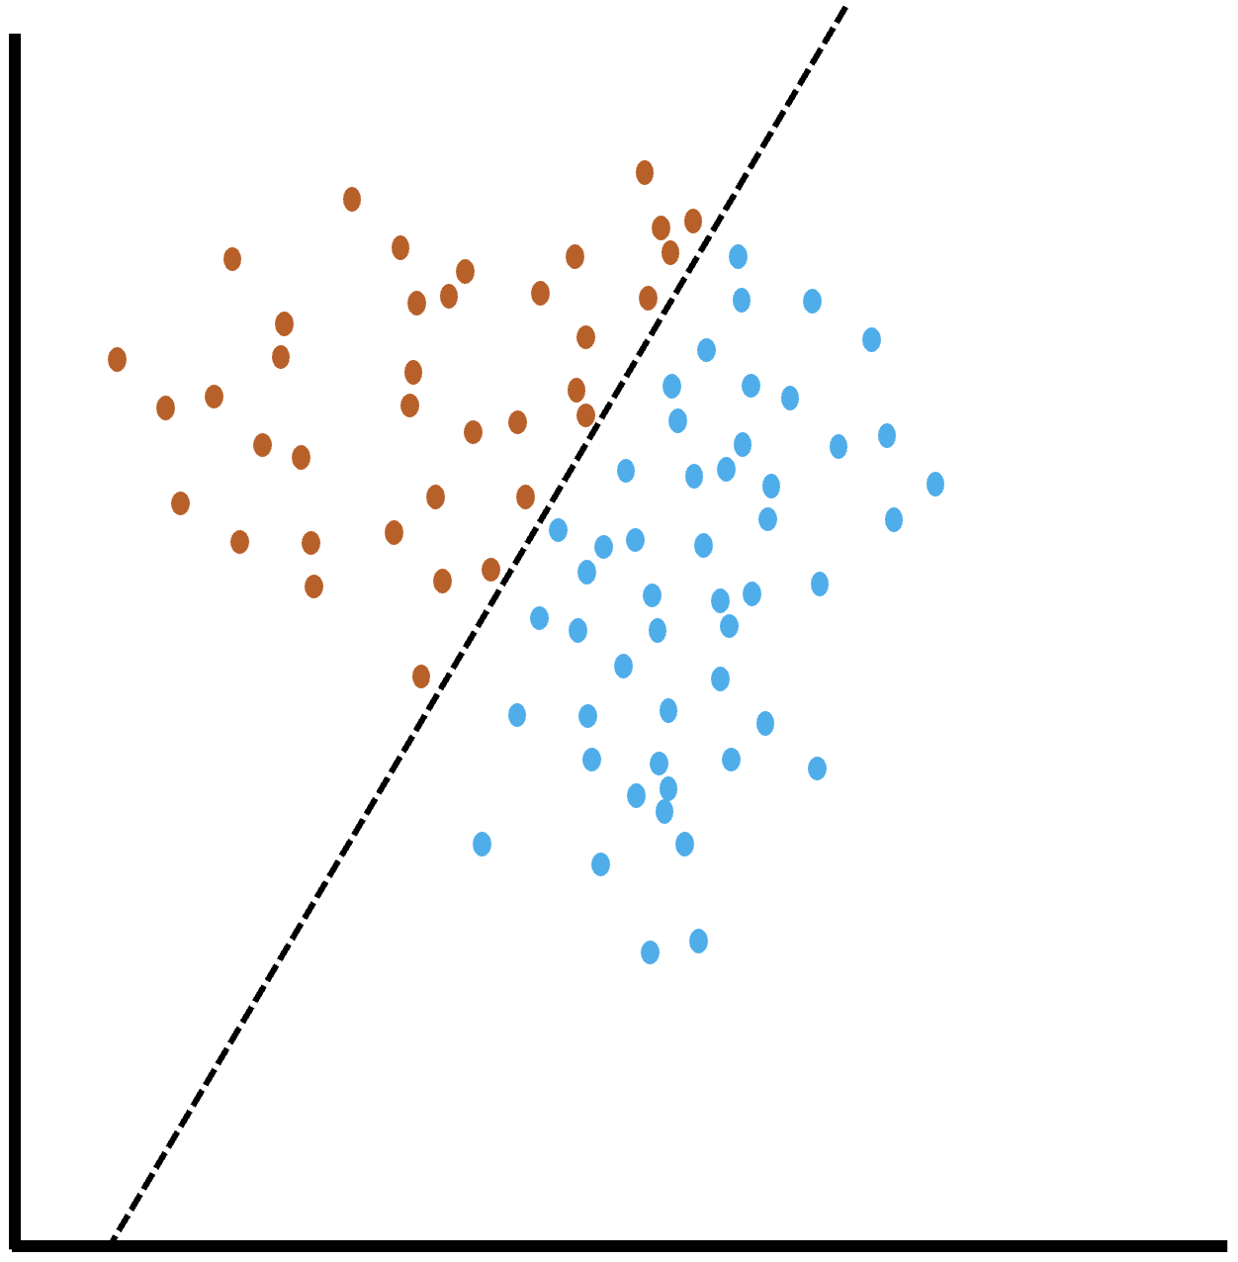
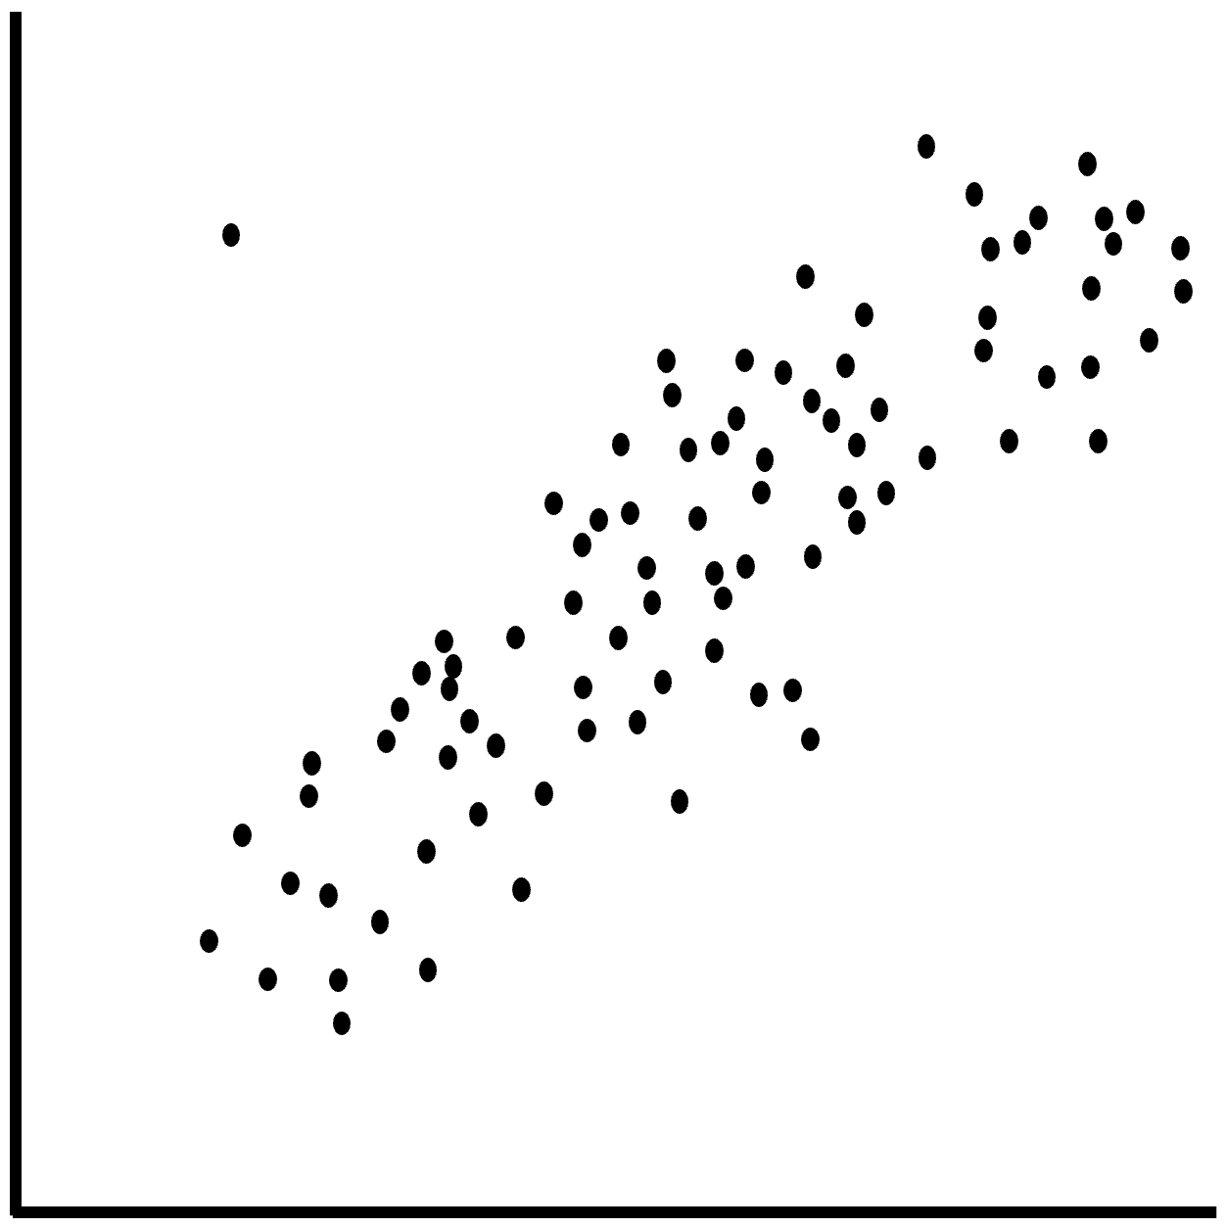
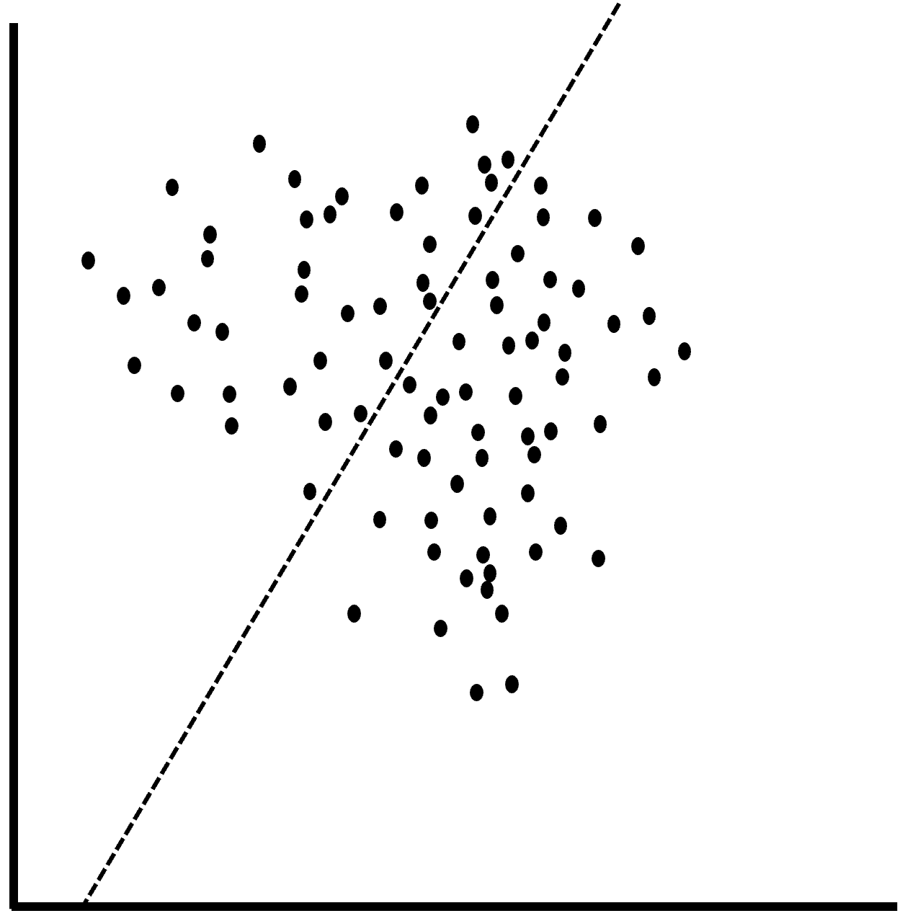
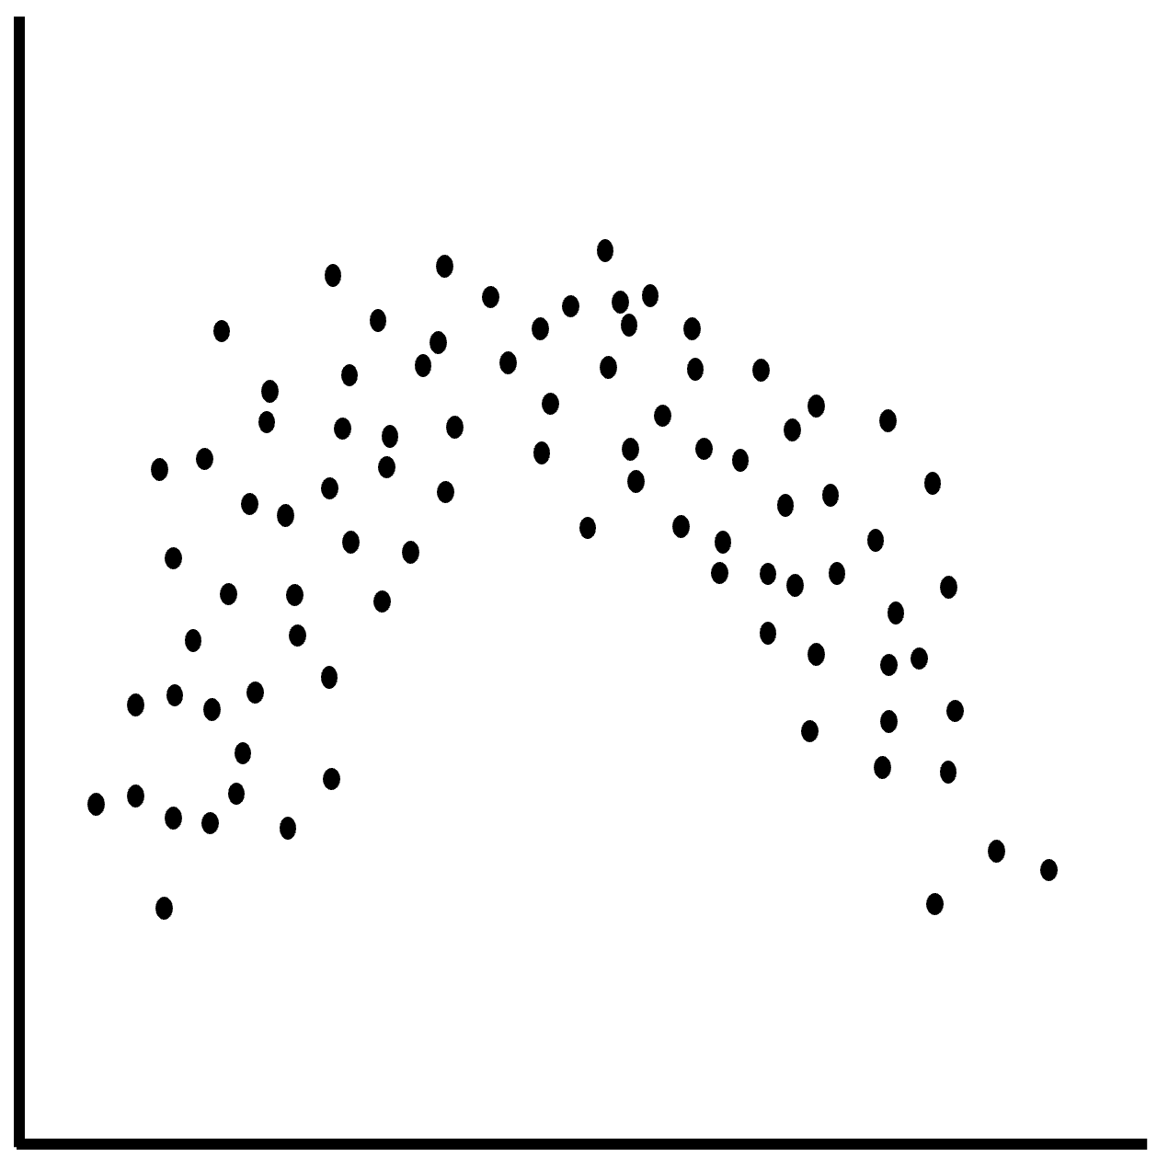
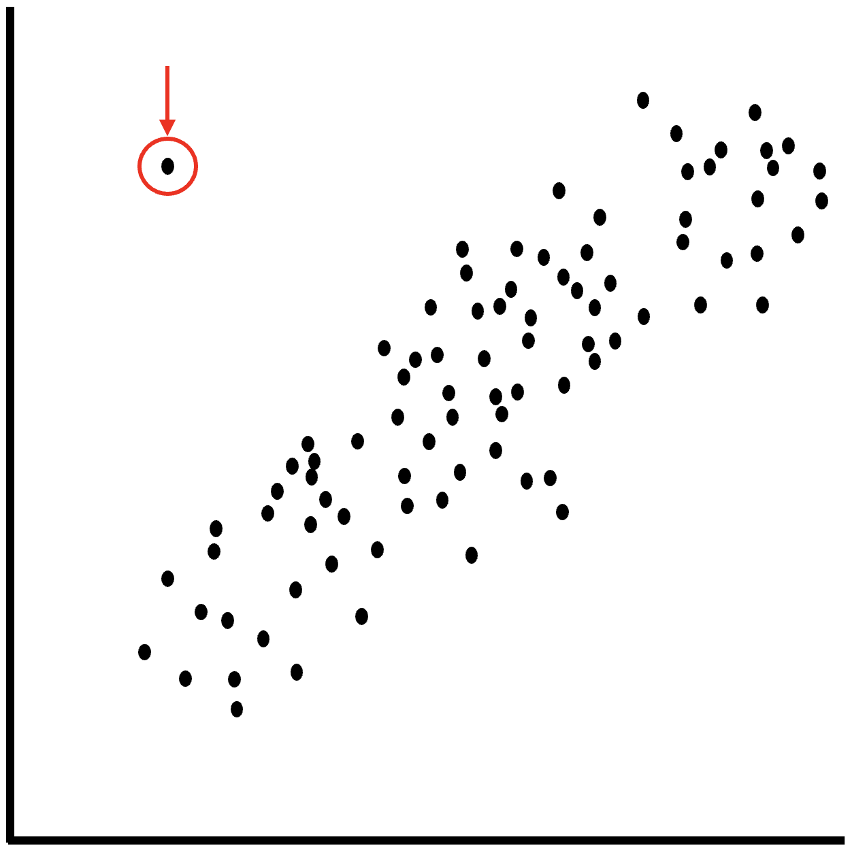
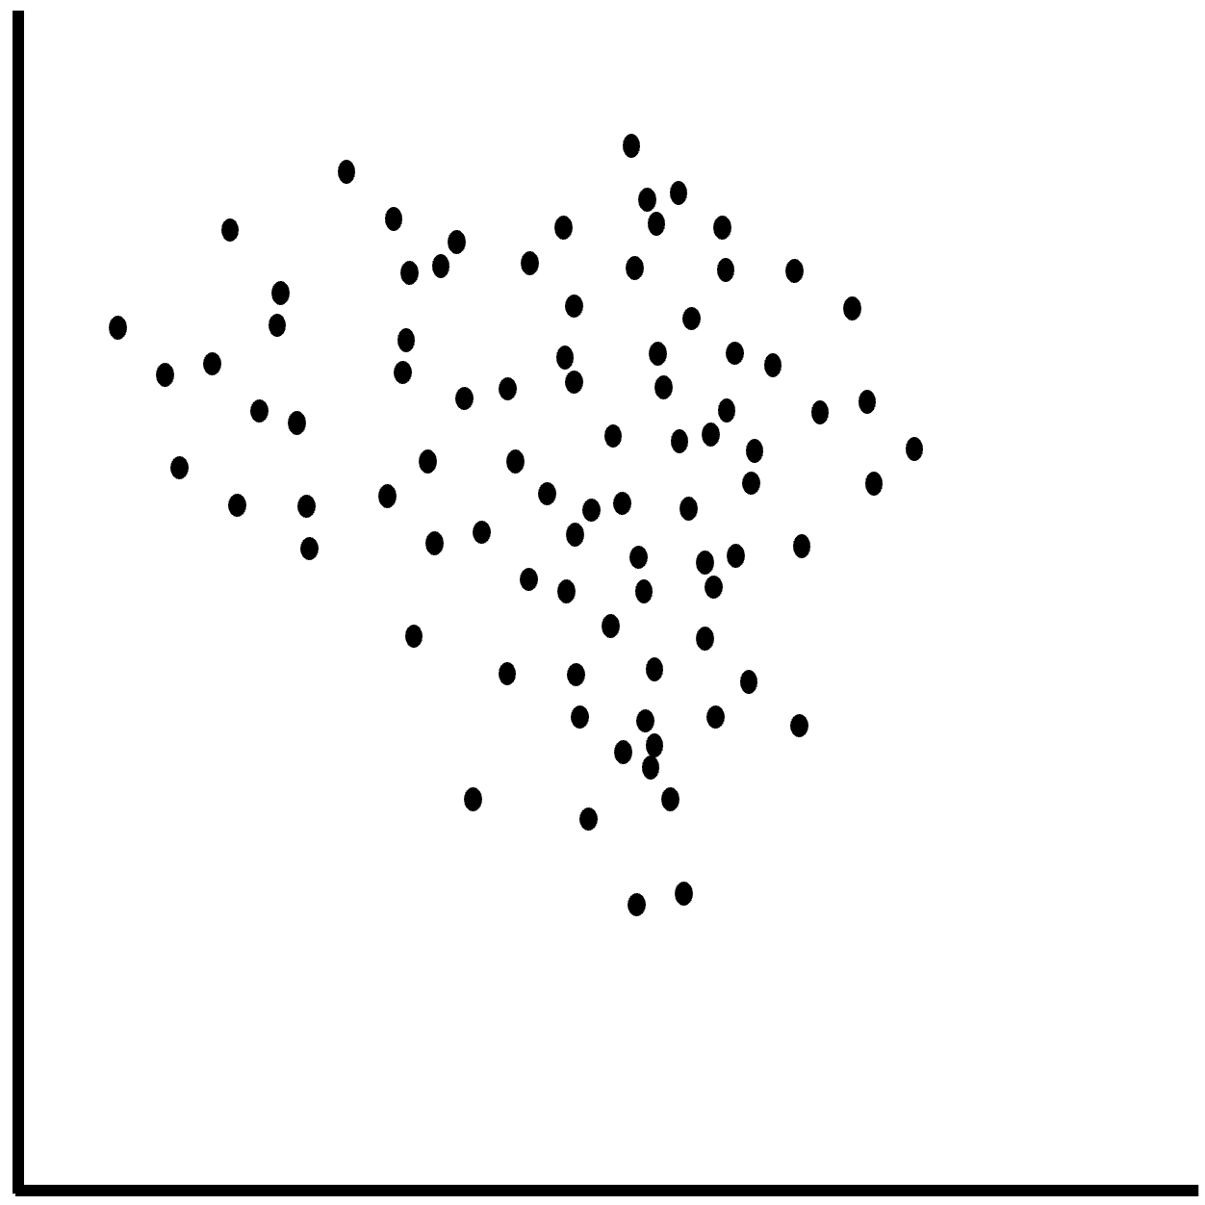
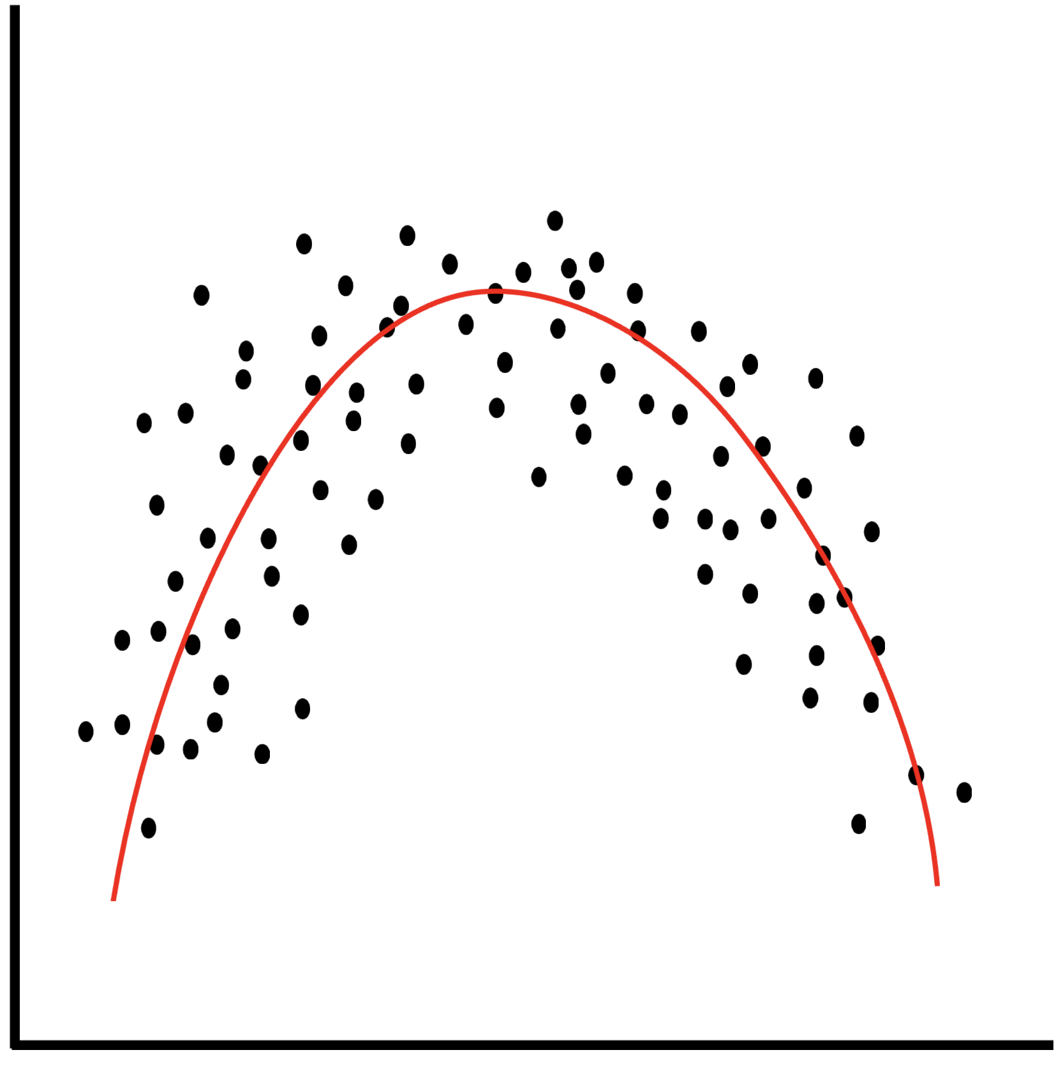
Key ML Tasks
Anomaly
detection
Sequence
modelling
Classification
Regression
Introduction to AI SES
13

Slide 14
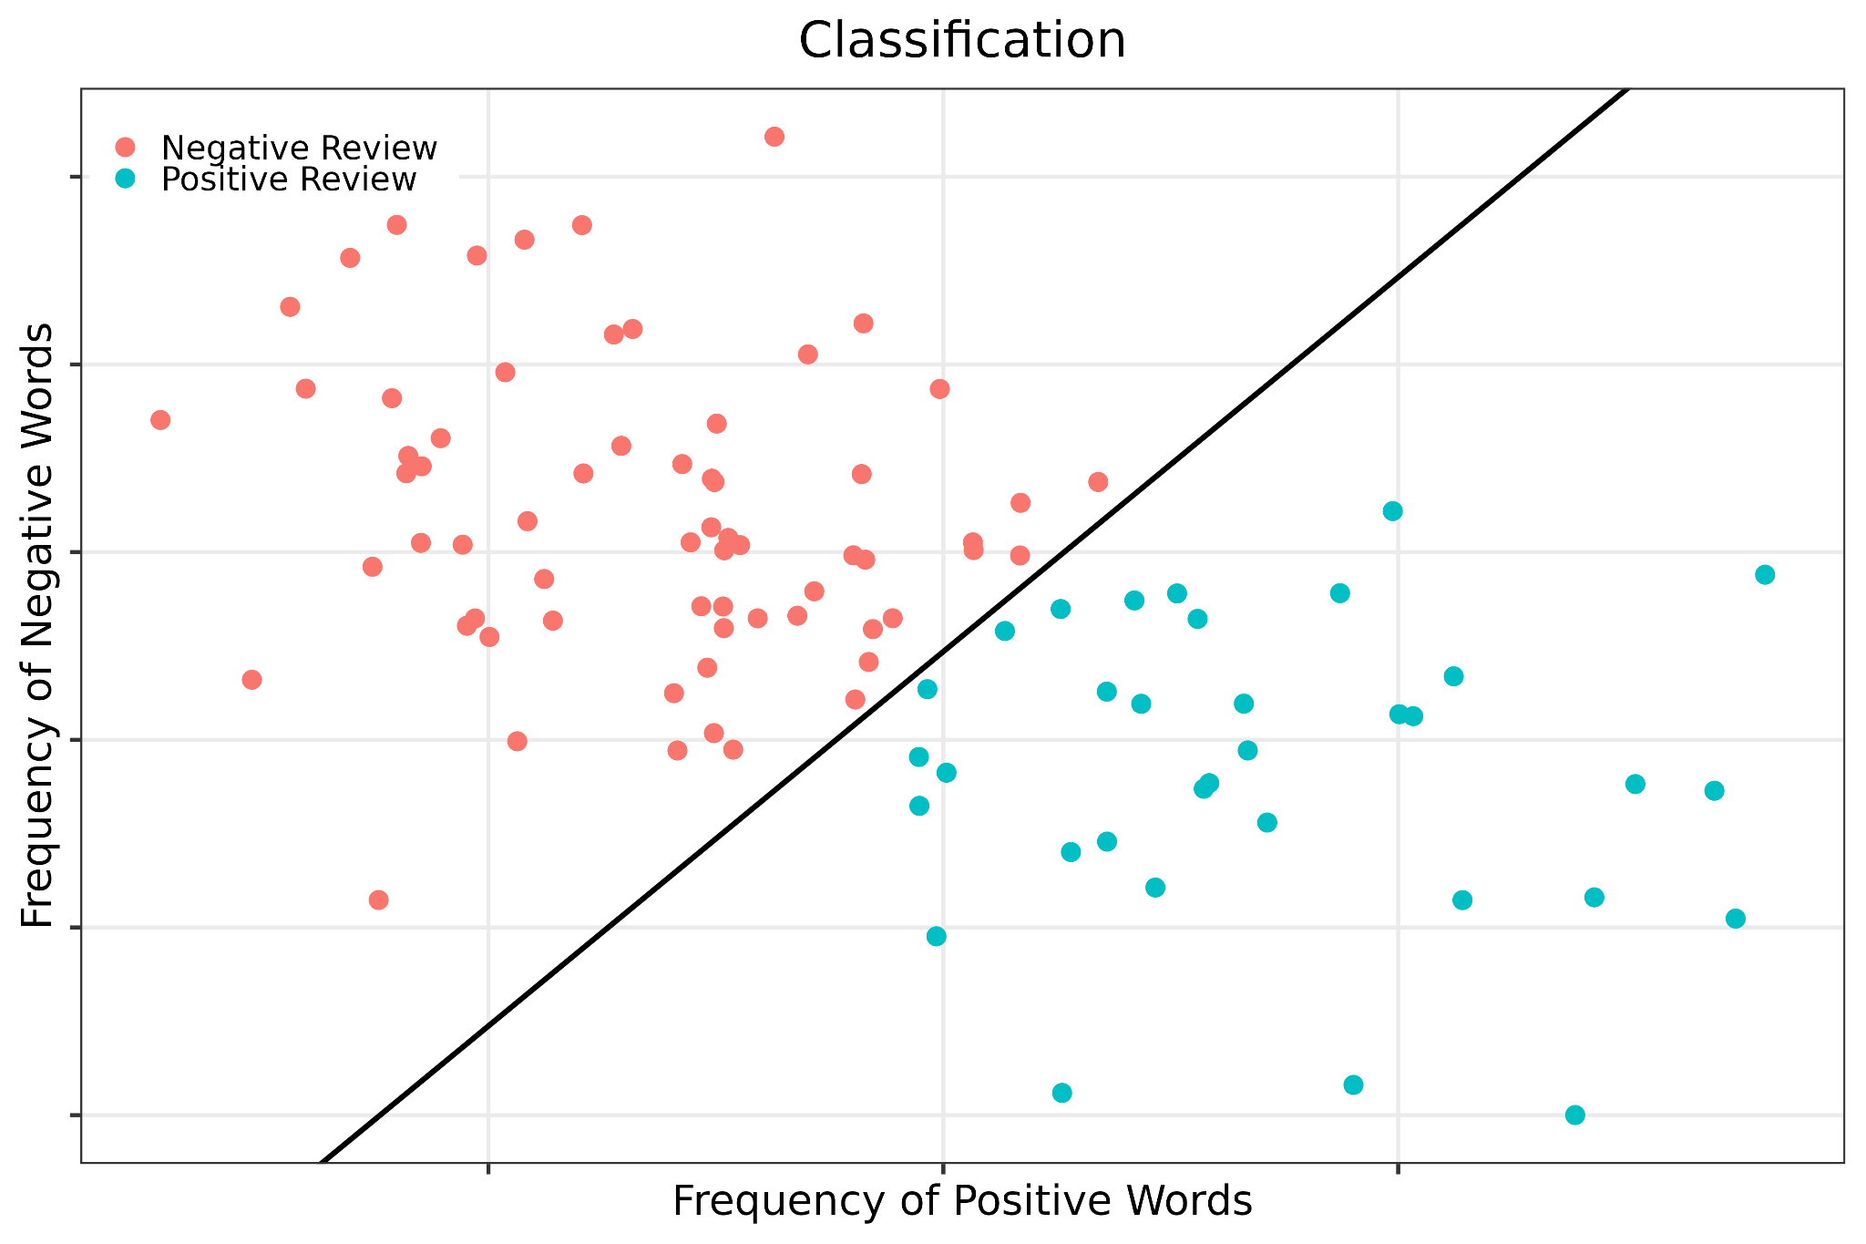
Task 1:
Classification
Classification: predicting categories or “classes” using features of an input data point.
Introduction to AI SES
14

Slide 15
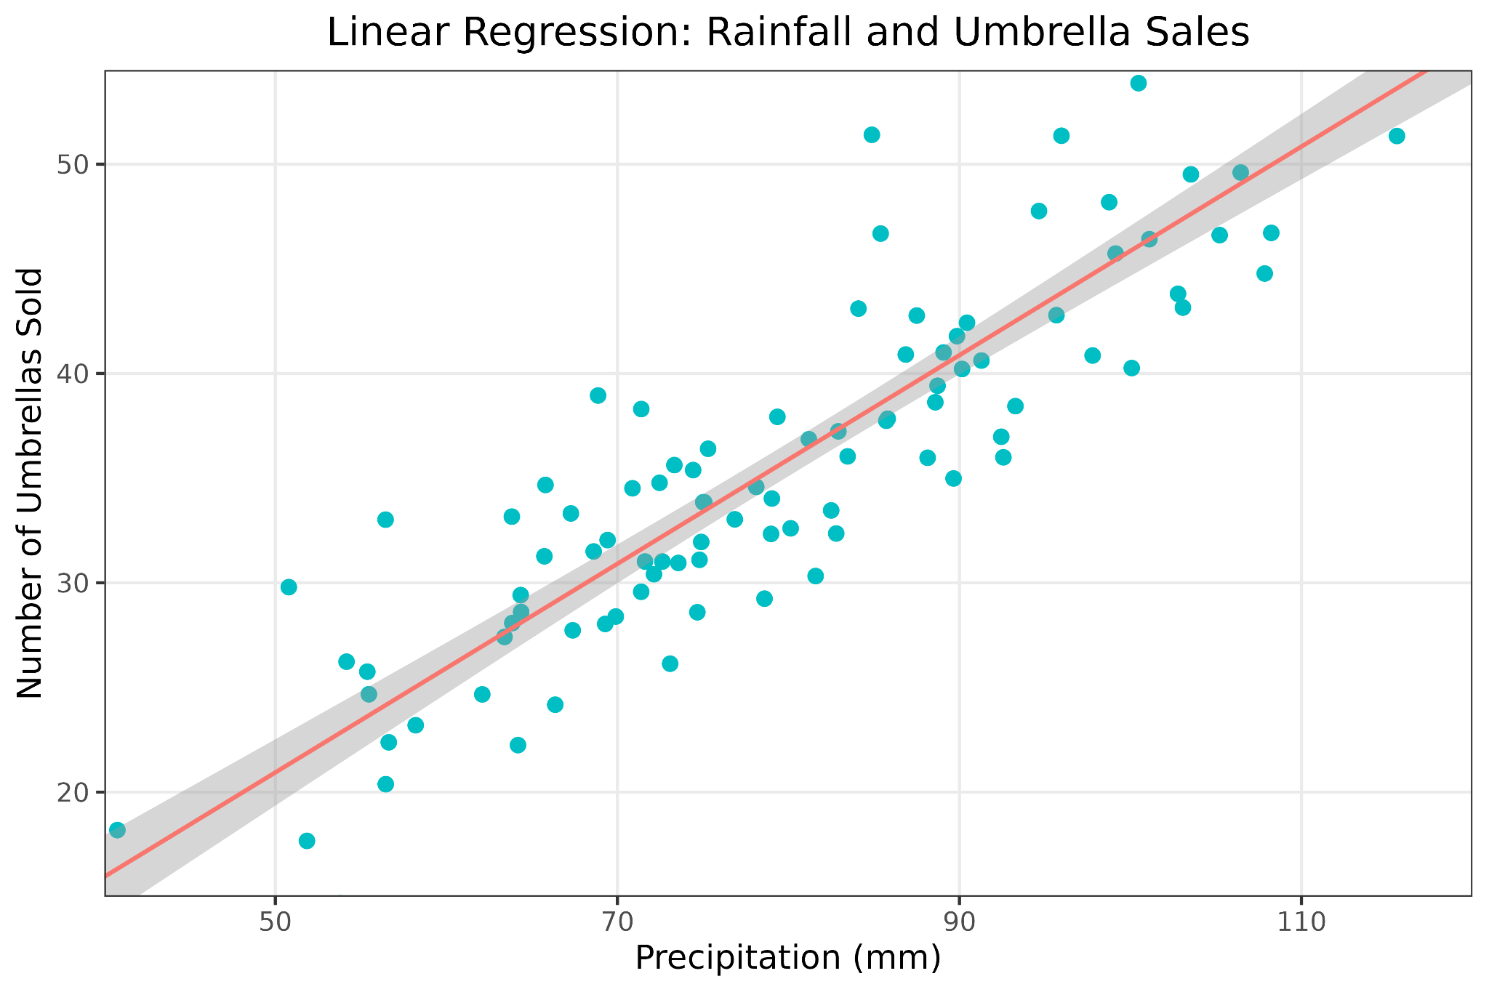
Task 2:
Regression
Regression: predicting numerical outputs using features of input data.
Introduction to AI SES
15

Slide 16
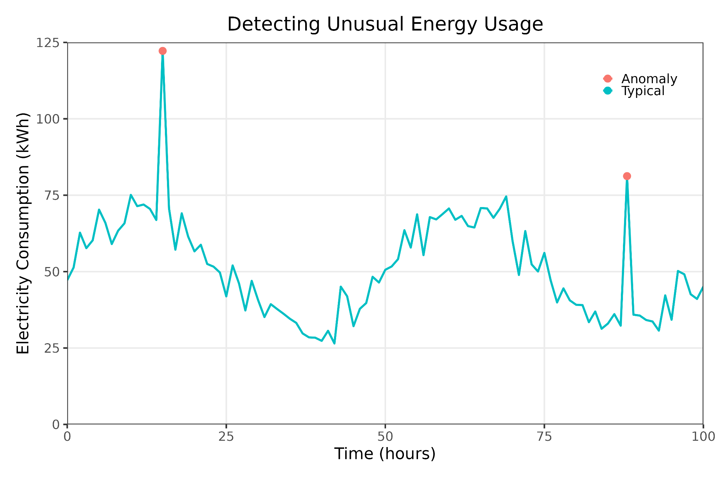
Task 3:
Anomaly Detection
Anomaly detection: identifying outliers or abnormal data points.
Example: black swan detection.
Black swans: events that are rare and unpredictable, yet impactful
Introduction to AI SES
16

Slide 17
Task 4:
Sequence Modeling
Sequence modeling: analyzing and predicting patterns in sequential data.
Generative modeling: creating new data that resembles the input data; ChatGPT is a “generative model”
Introduction to AI SES
17

Slide 18
Components of the ML Pipeline
ML pipeline: a series of interconnected steps in the process of developing a ML model.
Steps:
Data collection
Labeling
Choosing architecture
Training
Evaluation
Deployment
Introduction to AI SES
18

Slide 19
Three Types of Machine Learning
Supervised Learning
Unsupervised Learning
Reinforcement Learning
Introduction to AI SES
19

Slide 20


Type 1:
Supervised Learning
Supervised learning: learning from labeled data.
Learning relationships between input data and output labels
Labels are usually generated by humans
Example: Species identification
Advantage: high accuracy and reliability for large and well-labeled dataset.
Disadvantage: worse performance for loosely-defined tasks, like poetry or image generation; may also require manual labeling.
Introduction to AI SES
20

Slide 21

Type 2:
Unsupervised Learning
Unsupervised learning: learning from unlabeled data.
Discovering and identifying patterns within a dataset to learn the relationships between variables
Also known as “self-supervised learning,” because the model may use these patterns to generate supervisory signals for itself
Examples:
Language models
Image inpainting
Introduction to AI SES
21

Slide 22

Type 2:
Unsupervised Learning
Introduction to AI SES
22

Slide 23
Type 3:
Reinforcement Learning
Reinforcement learning (RL): learning from agent-gathered data.
AI agents making decisions and improving their performance based on responses to their environment
Example: robots navigating environments through trial-and-error.
Introduction to AI SES
23

Slide 24
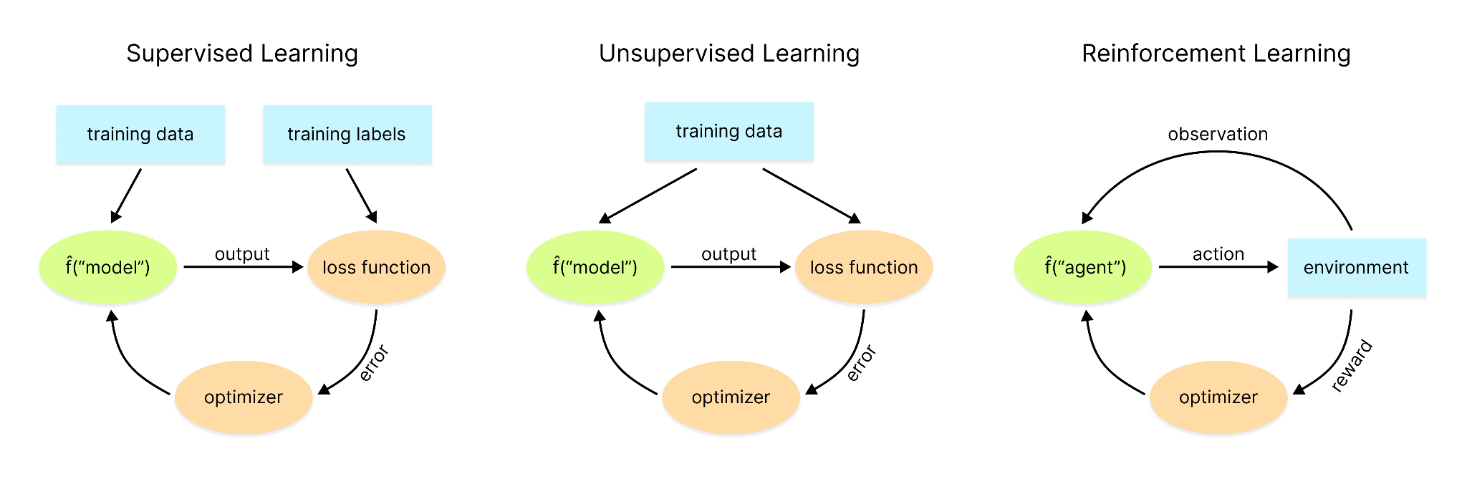
Review of Machine Learning Types
Introduction to AI SES
24

Slide 25
Recap
AIs are computer systems that perform tasks typically associated with intelligence such as problem solving, decision making, forecasting. They can be classified according to their capabilities.
Machine Learning systems can learn directly from data without following explicit pre-set instructions. They are used for tasks like classification, regression, anomaly detection, and sequence modeling.
ML requires data, architecture, training it, evaluating, deploying.
ML can use supervised, unsupervised, and reinforcement learning.
Introduction to AI SES
25

Slide 26
Roadmap
Artificial Intelligence: Definitions, history, and types.
Machine Learning: Models, tasks, data, and learning types.
Deep Learning: The preeminent paradigm.
Scaling Laws: Many AI systems improve predictably with scale.
Introduction to AI SES
26

Slide 27
Deep Learning
The preeminent paradigm
Introduction to AI SES
27

Slide 28
Introduction to Deep Learning
Introduction to AI SES
28

Slide 29
Introduction to Deep Learning
Deep learning (DL):
Uses neural networks: layers of interconnected nodes that transform inputs into outputs, inspired by biological neurons.
Extracts useful patterns from large quantities of data
Useful for learning hierarchical representations of the world
Rule-based systems:
Classic ML:
Deep learning:
Hand-designed features
Hand-designed program
ML Model
Output
Output
Input
DL System
Output
Input
Input
Introduction to AI SES
29

Slide 30
Why Deep Learning Matters
Performance:
Superhuman in some domains (though not reliably so)
Examples: image recognition, chess, and Go
Real-world usefulness:
Wide variety of useful applications
Examples: healthcare, social media, and autonomous vehicles
Scalability:
DL models are highly scalable
Performance tends to improve with more data, rather than tapering off
Introduction to AI SES
30

Slide 31
Chapter Recap
Artificial Intelligence: Definitions, historical development, and types.
Machine Learning: Models, tasks, data, and learning types.
Deep Learning: Fundamental concepts and applications.
Introduction to AI SES
31

