Slide 1
Introduction to
AI Safety, Ethics, and Society
Safety Engineering
Introduction to AI SES
‹#›

Slide 2
Introduction
Safety engineering is a broad discipline that studies many types of systems and provides a paradigm for avoiding loss events.
We can view AI safety as a special case of safety engineering concerned with avoiding AI-related catastrophes.
Introduction to AI SES
‹#›

Slide 3
Roadmap
1. Risk decomposition and measuring reliability
2. Safe design principles
3. Component failure accident models
4. Systemic accident models
5. Tails events
6. Black swans
Introduction to AI SES
‹#›

Slide 4
Risk Decomposition and
Measuring Reliability
How to assess and compare risks quantitatively
Introduction to AI SES
‹#›

Slide 5



Failure Modes, Hazards, and Threats
Failure mode: a specific way a system could fail.
Hazard: a source of danger that could cause harm.
Threat: a hazard with malicious or adversarial intent.
Failure mode
Hazard
Threat
Introduction to AI SES
‹#›

Slide 6
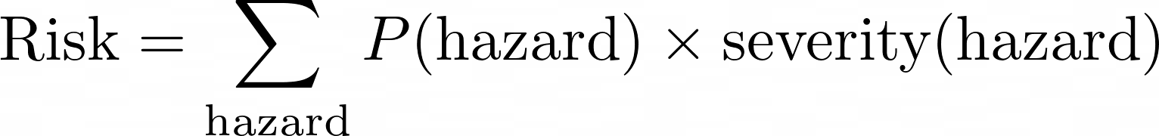

The Two-Factor Risk Equation
Example: Risk from volcano = probability of eruption x severity of impact
We should frame our goal as risk reduction, not eradication.
“Solving the intelligence problem” → “Improving capabilities”
“Solving the alignment problem” → “Making AI safer”
Introduction to AI SES
‹#›
Notes:
\text{Risk} = \sum_{\text{hazard}} P(\text{hazard}) \times \text{severity}(\text{hazard})

Slide 7
Detailed Disaster Risk Equation
Let’s expand this risk equation into four factors:
Probability
Severity
Probability
Severity
Intrinsic hazard level
3. Exposure
4. Vulnerability
Introduction to AI SES
‹#›
Notes:
Probability tells us how likely it is that a hazard will lead to an accident. The more slippery the floor is, the more likely it is that someone will slip and fall on it.
Exposure is a measure of how much we are exposed to a hazard. It will be more likely that someone will slip on a wet floor if there are more people walking across it and the longer that it remains slippery. We can say that this is because the exposure to the possibility of someone slipping is higher. In general, exposure affects the probability of an accident occurring, captured by the second icon in the timeline.
Severity indicates how intrinsically harmful a hazard is. The severity of a slippery floor would be how hard it is. This term therefore represents the extent of damage an accident would inflict, captured by the fourth icon in the timeline.
Vulnerability measures how susceptible we are to harm from a hazard. If someone does slip on a floor, the harm caused is likely to depend partly on how susceptible they are to bone fracture, for example. We can refer to this as vulnerability, which affects the severity of an accident, and is represented by the fifth icon in the timeline.
Ability to cope indicates how well we would be able to recover from an accident. After slipping on the floor, we might take less time to recover if we have access to better medical technology. In general, another factor that might influence our evaluation of a risk is to what extent we would be able to recover from the damage it caused. We refer to the capacity to recover as our ability to cope. We can add this term to the accident timeline as shown in figure x, where ability to cope is represented by the sixth icon.

Slide 8
Detailed Disaster Risk Equation
Example: viral infection.
Contact frequency
Immunity level
Infectiousness
Virulence
Introduction to AI SES
‹#›

Slide 9
Detailed Disaster Risk Equation
Example: AI safety approaches.
Robustness
Monitoring
Control
Introduction to AI SES
‹#›

Slide 10
Nines of Reliability
Reliability (of a system): the probability that an adverse event will not happen in a given amount of time.
A system’s reliability also depends on how often it is used. The more often we use a system, the more likely we are to encounter failure (recall that increasing “exposure” increases the overall risk).
Example: An autonomous vehicle is more likely to make a mistake during a journey where it has to make 1000 decisions, than a journey with only 10.
Introduction to AI SES
‹#›
Notes:
We can relate system reliability to the amount of time that a system is likely to function before failing. We will now introduce a new measure of reliability that conveys the expected time before failure more intuitively.

Slide 11
Nines of Reliability
For a given level of reliability, we can calculate an expected time before failure.
% reliability of AV | % risk of mistake | A mistake is likely to occur by decision number…
0 | 100 | 1
50 | 50 | 2
75 | 25 | 4
90 | 10 | 10
99 | 1 | 100
99.9 | 0.1 | 1000
99.99 | 0.01 | 10,000
Introduction to AI SES
‹#›
Notes:
Imagine that we have several autonomous vehicles with different levels of reliability, as shown in the table. Reliability is the probability that the vehicle will get any given decision correct. The second column shows the complementary probability that the AV will get any given decision wrong. The fourth column shows the number of decisions within which the AV is expected to make one mistake. This can be thought of as the AV’s expected time before failure.

Slide 12
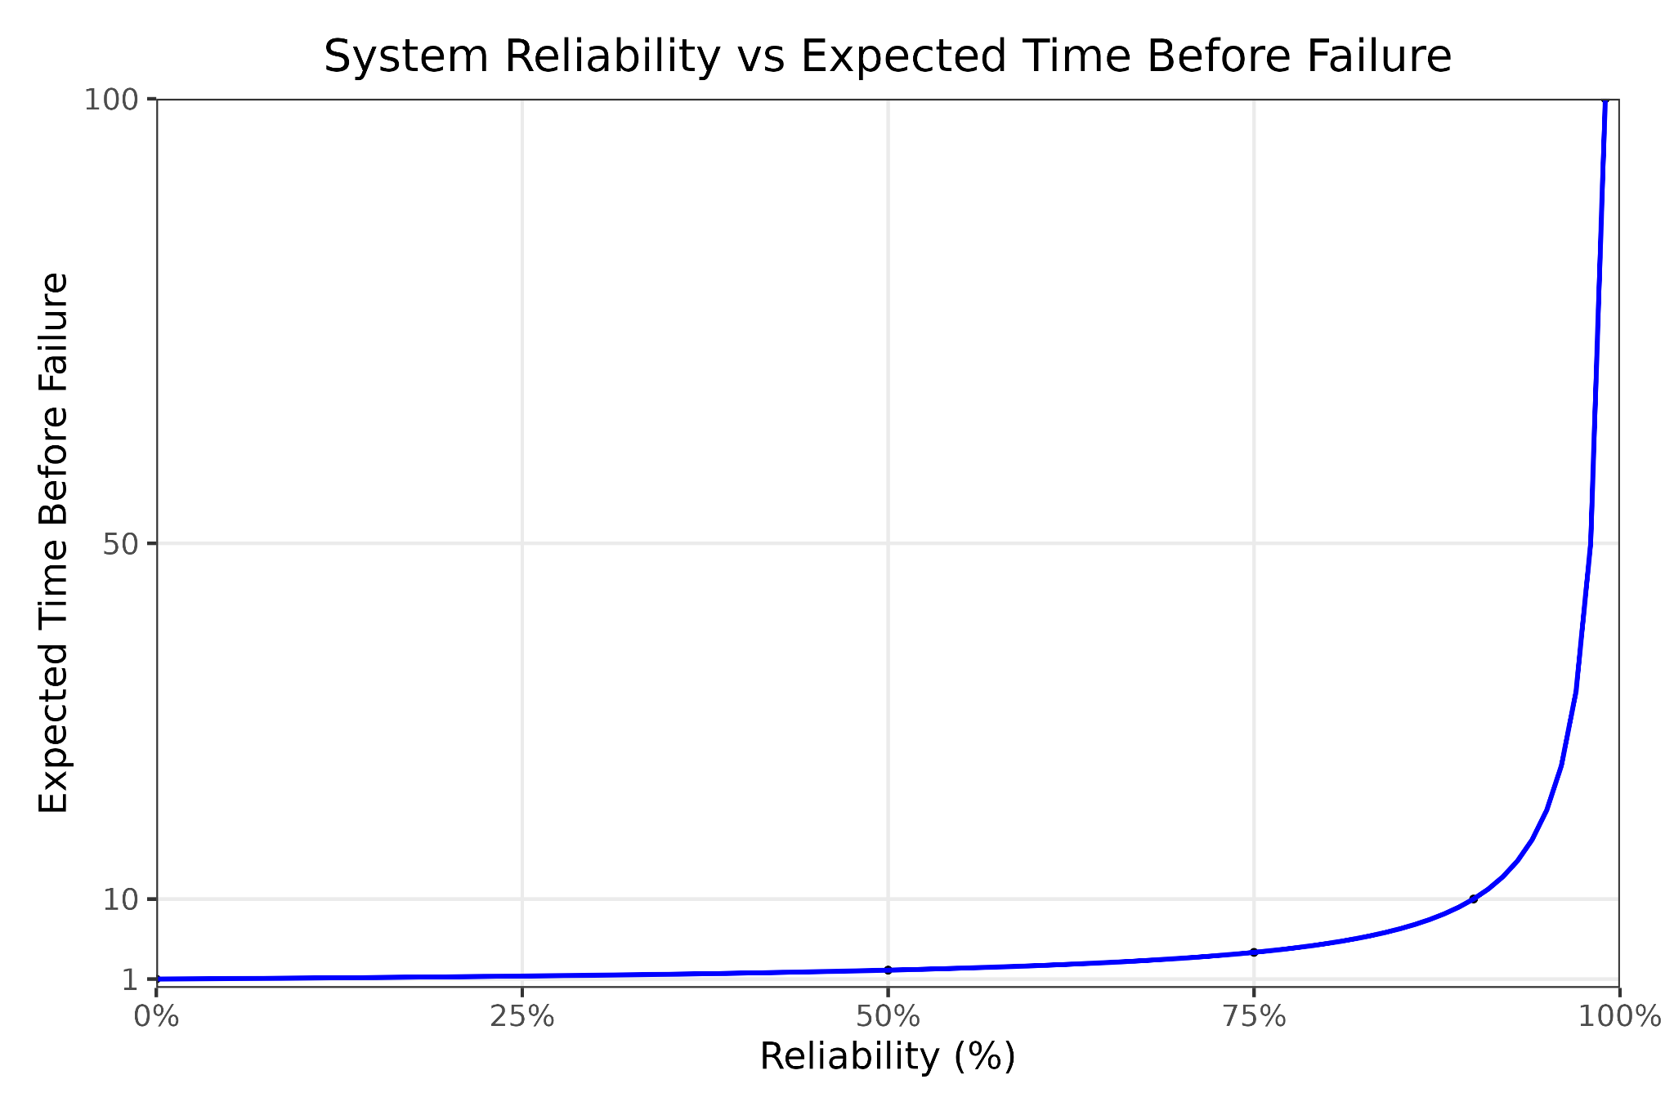
Nines of Reliability
The relationship between system reliability and expected time before failure is not linear.
Introduction to AI SES
‹#›
Notes:
Increasing the reliability from 50% to 75%, for example, doubles the expected time before failure. However, increasing the reliability from 90% to 99% causes a ten-fold increase in the expected time before failure, as does an increase from 99% to 99.9%. The closer we get to 100% reliability, the more valuable any given increment of improvement will be. However, as we get closer to 100% reliability, we can generally expect that an increment of improvement will become increasingly difficult to obtain. This is usually true because it is hard to perfectly eliminate the possibility of any adverse event. Additionally, there may be risks that we have not considered. These are called unknown unknowns and will be discussed extensively later in this chapter.

Slide 13
Nines of Reliability
Nines of reliability: the number of consecutive number nines at the start of a system’s reliability (expressed as a decimal or percentage).
% reliability of AV | % risk of mistake | Nines of Reliability | A mistake is likely to occur by decision number…
0 | 100 | 0 | 1
50 | 50 | 0.3 | 2
75 | 25 | 0.6 | 4
90 | 10 | 1 | 10
99 | 1 | 2 | 100
99.9 | 0.1 | 3 | 1000
99.99 | 0.01 | 4 | 10,000
Introduction to AI SES
‹#›
Notes:
As we get close to 100% reliability, it gets inconvenient to use long decimals to express how reliable a system is. The third column in the table gives us information about a different metric: the nines of reliability. Informally, a system has nines of reliability equal to the number of nines at the beginning of its decimal or percentage reliability. One nine of reliability means a reliability of 90% in percentage terms or 0.9 in decimal terms. Two nines of reliability mean 99%, or 0.99.

Slide 14
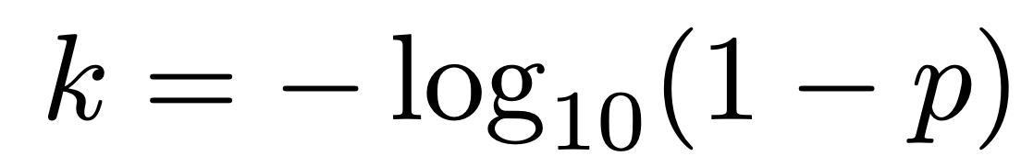
Nines of Reliability
We can denote a system’s nines of reliability with the letter “k”:
Reliability is 90% → one nine of reliability → k = 1
Reliability is 99% → two nines of reliability → k = 2
The system’s reliability “p” relates to k:
Possible remaining issues:
Adversarial examples, trojans, misunderstandings, etc.
(Where p = the reliability of the system expressed as a decimal).
Introduction to AI SES
‹#›
Notes:
\[k = -\log_{10}(1-p)\]

Slide 15
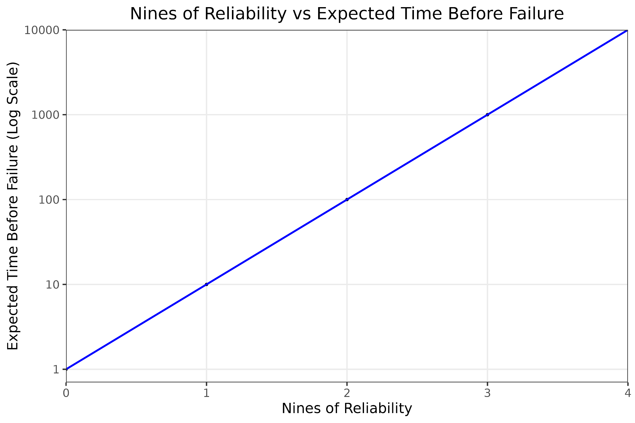
Nines of Reliability
Adding a single “nine” to reliability gives a tenfold increase in expected time before failure.
Using the nines of reliability, we can see that improving reliability from 0.4 to 0.8 is far less meaningful than improving it from 0.99 to 0.999.
Introduction to AI SES
‹#›
Notes:
This means that the relationship between system reliability and expected time before failure is not linear. However, the relationship between nines of reliability and the logarithm of expected time before failure is.

Slide 16
Recap
Risks can be mathematically characterized.
The classic risk equation is the expected severity of hazards.
Adding exposure and vulnerability, we create a “detailed risk equation.”
System reliability can be better measured in “nines of reliability.”
Introduction to AI SES
‹#›

Slide 17
Roadmap
1. Risk decomposition and measuring reliability
2. Safe design principles
3. Component failure accident models
4. Systemic accident models
5. Tails events
6. Black swans
Introduction to AI SES
‹#›

Slide 18
Safe Design Principles
1. Redundancy
2. Separation of duties
3. Principle of least privilege
4. Fail-safes
5. Antifragility
6. Negative feedback mechanisms
7. Transparency
8. Defense in depth
Introduction to AI SES
‹#›
Notes:
We can reduce both the probability and severity of a system failure by following certain safe design principles when designing it. These general principles have been identified by safety engineering and offer practical ways of reducing the risk associated with all kinds of systems. They should be incorporated from the outset, rather than being retrofitted later.

Slide 19
Principle 1:
Redundancy
Redundancy: a system has multiple “backup” components performing the same crucial function:
Multiple braking components in vehicles
Saving important data on multiple hard drives
Seeking the opinions of multiple medical experts
Introduction to AI SES
‹#›
Notes:
Example: vehicles generally contain multiple braking systems. If one system fails, others can be used to avoid an accident.

Slide 20
Principle 1:
Redundancy
One possible use of redundancy in AI would be a “moral parliament.”
If we are uncertain how we want an AI to approach making decisions with moral implications, we can use a parliament approach to make use of multiple moral theories.
We can see these different moral theories as redundant components, reducing the probability of the AI making a harmful decision:
Each theory would typically recommend plausible actions
But none would be able to dictate what happens in extreme cases
Introduction to AI SES
‹#›

Slide 21
Principle 2:
Separation of Duties
Separation of duties: Multiple agents work together to carry out complex processes. Each agent is specialized to a different task, so none controls the system by themself.
With multiple system operators, the capacity of each to harm is reduced.
Introduction to AI SES
‹#›

Slide 22



Principle 2:
Separation of Duties
Example: a lab contains three chemicals which, if combined, explode:
One technician in charge of all three poses a large risk
With three technicians, each in charge of one chemical, the risk is lower
Introduction to AI SES
‹#›

Slide 23
Principle 2:
Separation of Duties
We could focus on multiple narrow AIs, instead of a single general one.
Just as with the lab, having multiple agents, each specialized to a different task, reduces the risk posed by each.
Example: “Comprehensive AI Services” is an approach that views AI agents as service-providing products, each tailored to a highly-specific task.
Introduction to AI SES
‹#›
Notes:
This is exemplified by an approach to AI development called “comprehensive AI services.” This views AI agents as a class of service-providing products, essentially as a means to an end, rather than as end goals themselves. Adopting this mindset might mean tailoring AI systems to perform highly specific tasks, rather than speculatively trying to improve general and flexible capabilities in a single agent.

Slide 24
Principle 3:
Principle of Least Privilege
Principle of least privilege: Each agent should have only the minimum power needed to complete their tasks.
Separating duties might only work if we also ensure that agents cannot access parts of the system irrelevant to their tasks. In our lab example, having three technicians only reduces the risk if each can only access their chemical.
Introduction to AI SES
‹#›

Slide 25
Principle 3:
Principle of Least Privilege
Similarly, we should ensure that each AI agent only has access to the information and power necessary for it to perform its tasks reliably.
Example: We should avoid unnecessarily plugging AIs into the internet or giving them high-level admin access to confidential information.
Introduction to AI SES
‹#›
Notes:
In the Single Agent Control chapter, we considered how AIs might be power-seeking; by ensuring AIs have only the minimum required amount of power they need to accomplish the goals we assign them, we can reduce AIs’ ability to gain power.

Slide 26
Principle 4:
Fail-Safes
Fail-safes: features that ensure a system will be safe even if it fails.
Example: elevator breaks.
A “confidence estimate” might work as an AI fail-safe:
Tracks level of confidence the AI agent has in its decisions
Prevents enacting decision below specific confidence threshold
Introduction to AI SES
‹#›

Slide 27
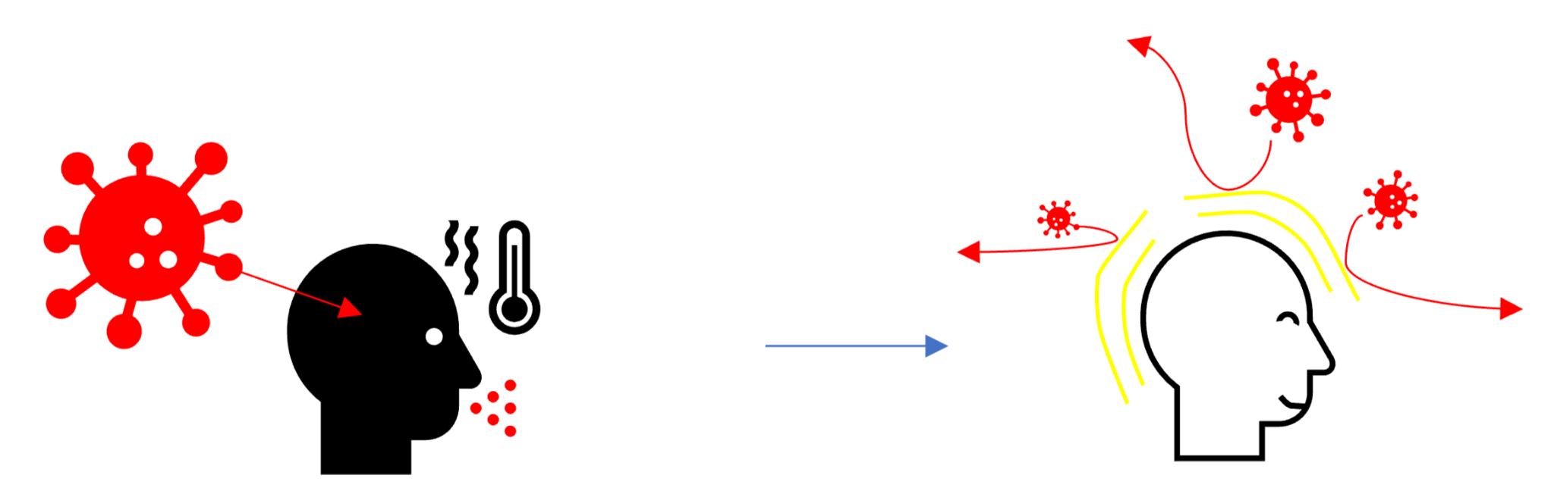

Principle 5:
Antifragility
Antifragility: the capacity to become stronger from encountering adversity.
Example: lifting weights strains muscles, so muscles grow stronger.
Example: infection by a pathogen results in immune protection.
Introduction to AI SES
‹#›

Slide 28

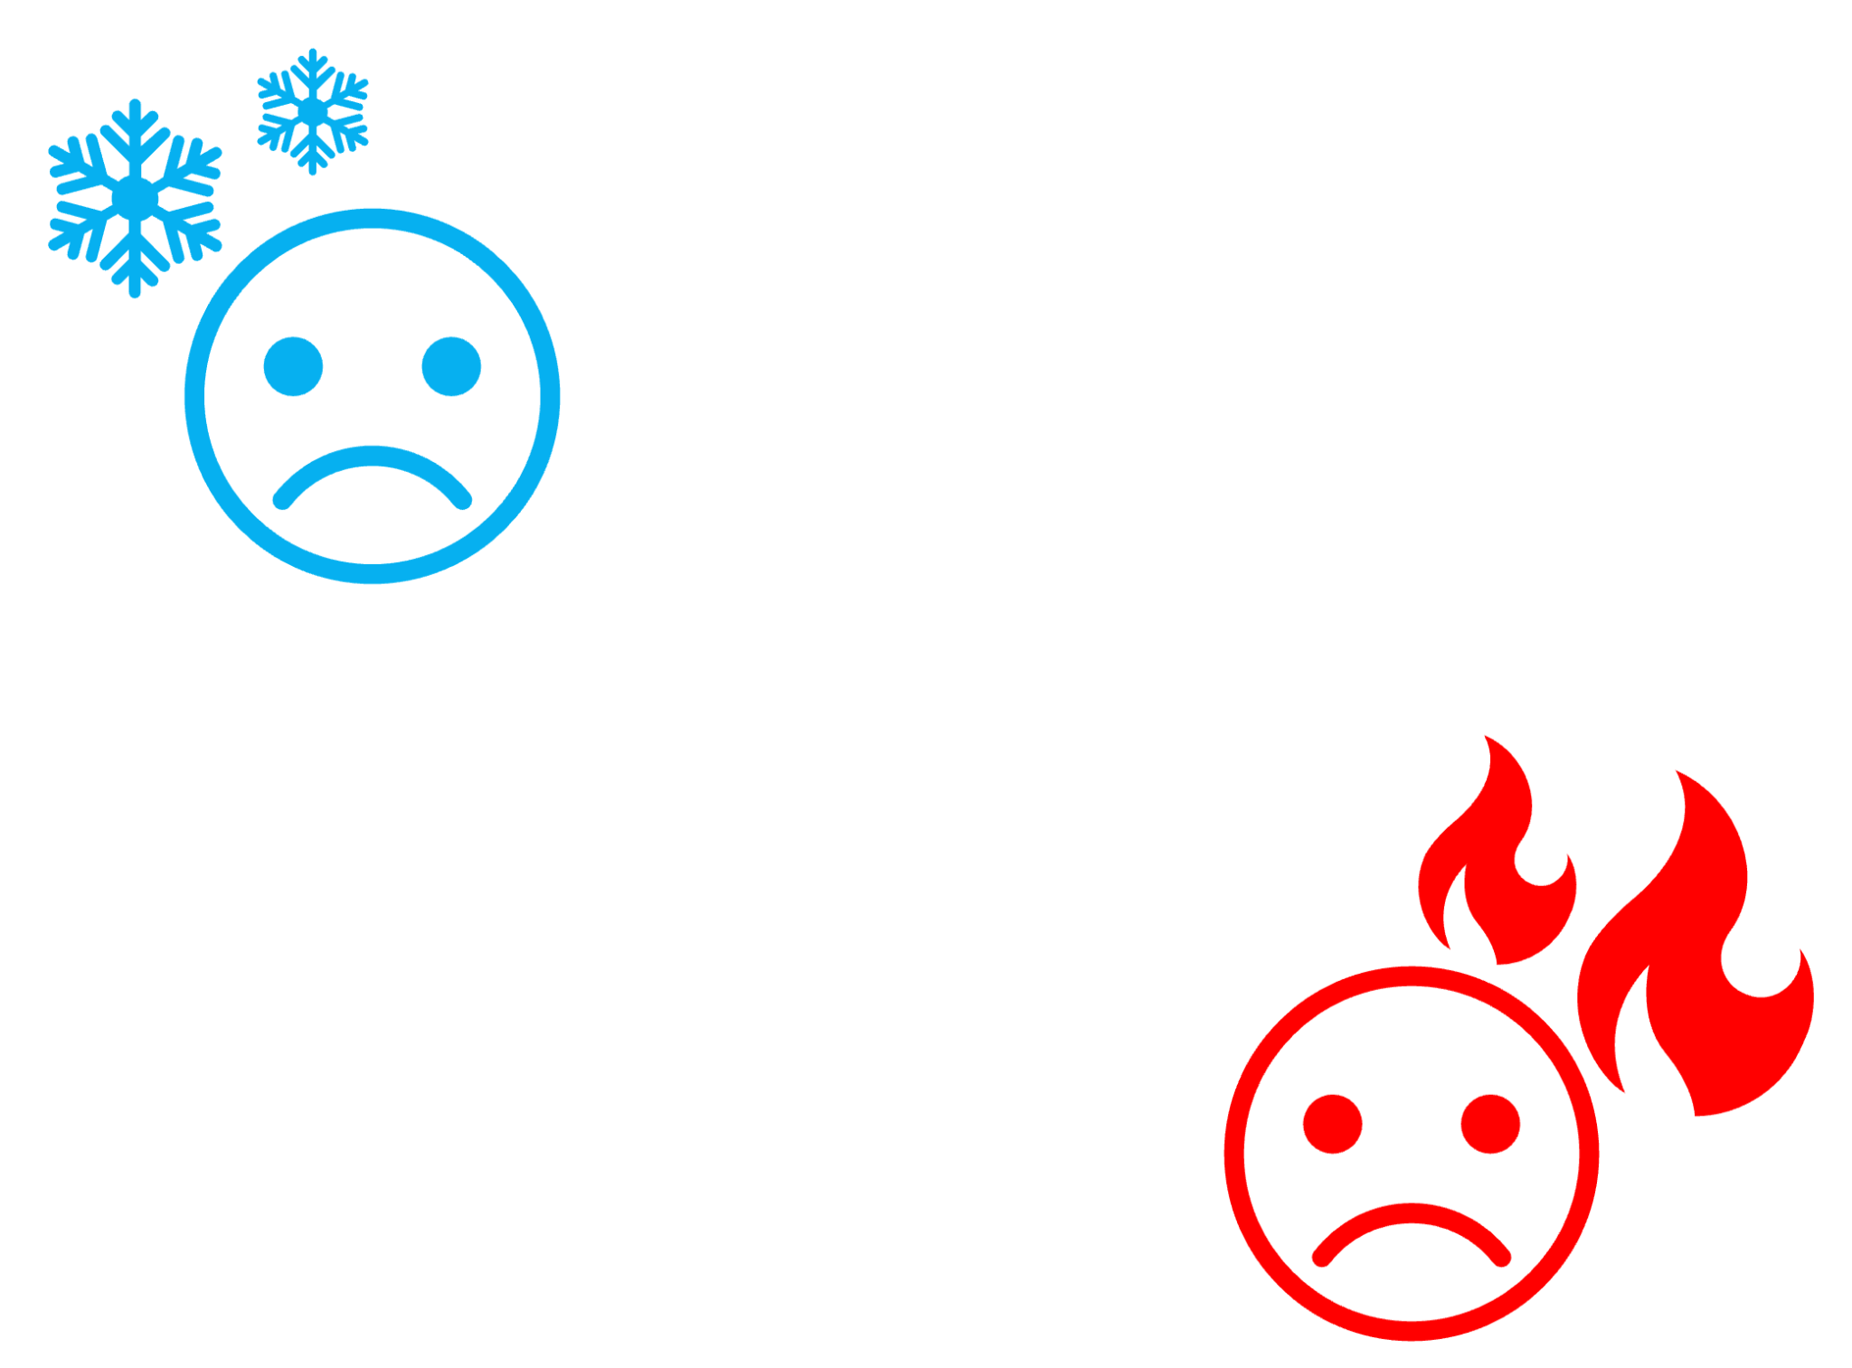
Principle 6:
Negative Feedback Mechanisms
Negative feedback: processes that down-regulate initial change.
Example: body temperature.
Negative feedback in AI:
Monitoring
Reputation reduction
Resetting
Shivering
Sweating
Too cold
Too hot
Introduction to AI SES
‹#›

Slide 29
Principle 7:
Transparency
Transparency: users understand a system sufficiently well to interact with it safely.
Example: pilots must understand their plane’s autopilot systems:
How to activate
How to override
AI model transparency could help operators:
Steer away from hazards
Anticipate deceptive behavior
Retain control
Introduction to AI SES
‹#›

Slide 30
Principle 8:
Defense in Depth
Defense in depth: having many layers makes for more reliable defense.
Example: we can reduce our vulnerability to viruses most by taking multiple measures:
Wearing a mask
Social distancing
Hand washing
Note that this introduces the risk of defense layers interacting in unpredicted/undesired ways.
Introduction to AI SES
‹#›

Slide 31
Recap: Eight Safe Design Principles
1. Redundancy
2. Separation of duties
3. Principle of least privilege
4. Fail-safes
5. Antifragility
6. Negative feedback loops
7. Transparency
8. Defense in depth
Introduction to AI SES
‹#›

Slide 32
Roadmap
1. Risk decomposition and measuring reliability
2. Safe design principles
3. Component failure accident models
4. Systemic accident models
5. Tails events
6. Black swans
Introduction to AI SES
‹#›

Slide 33
Component Failure Accident Models
Traditional risk analysis concepts
Introduction to AI SES
‹#›

Slide 34
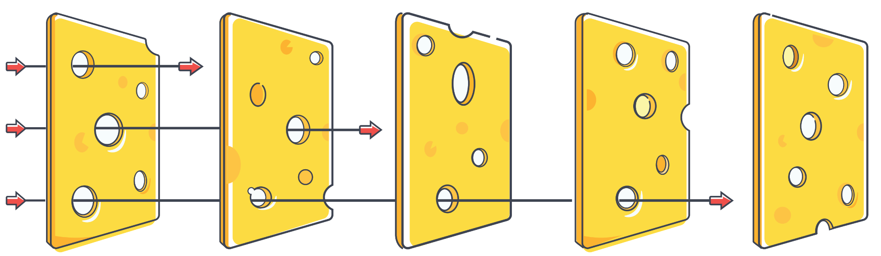
Swiss Cheese Model
Identify and analyze pathways to accidents.
Example: infectious disease
Get vaccinated
Wash hands
Access healthcare
Social distance
Healthy lifestyle
Introduction to AI SES
‹#›

Slide 35
Swiss Cheese Model
Identify and analyze pathways to accidents.
Example: AI safety
Safety culture
Anomaly detection
Transparency
Red teaming
Cyberdefense
Introduction to AI SES
‹#›

Slide 36
Swiss Cheese Model
Safety can be improved by:
Reducing the size of holes
Reducing number of holes
Increasing number of slices
Introduction to AI SES
‹#›

Slide 37
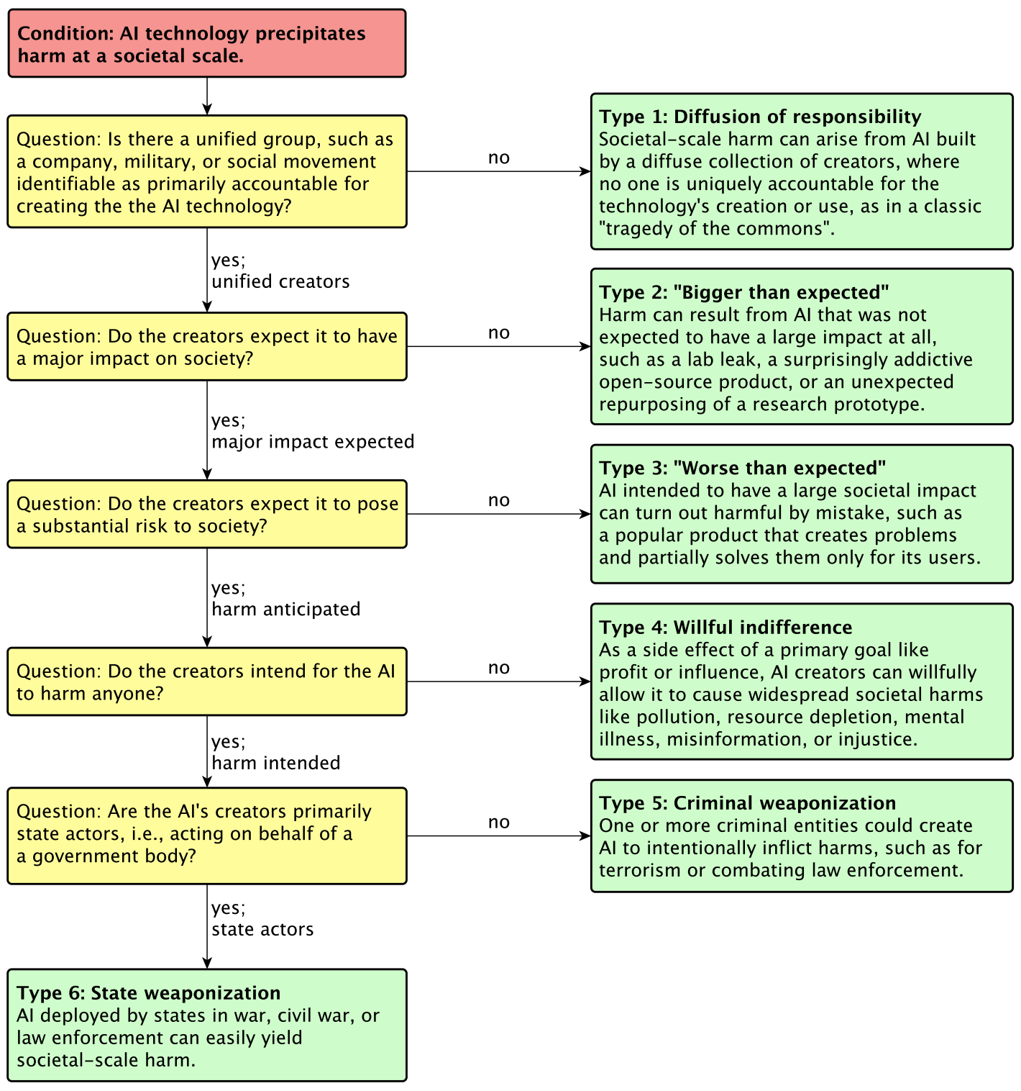
Fault Tree Analysis
Start by considering specific negative outcomes, then work backward to identify their possible causes.
Introduction to AI SES
‹#›

Slide 38
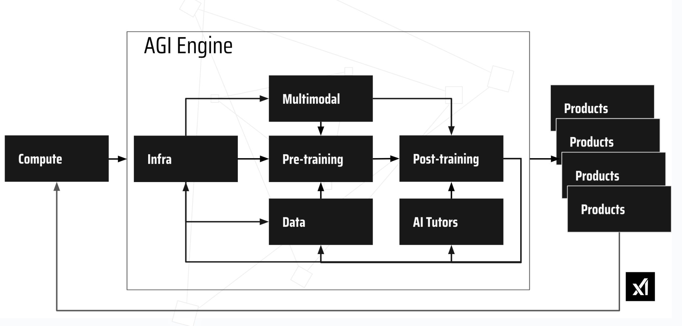
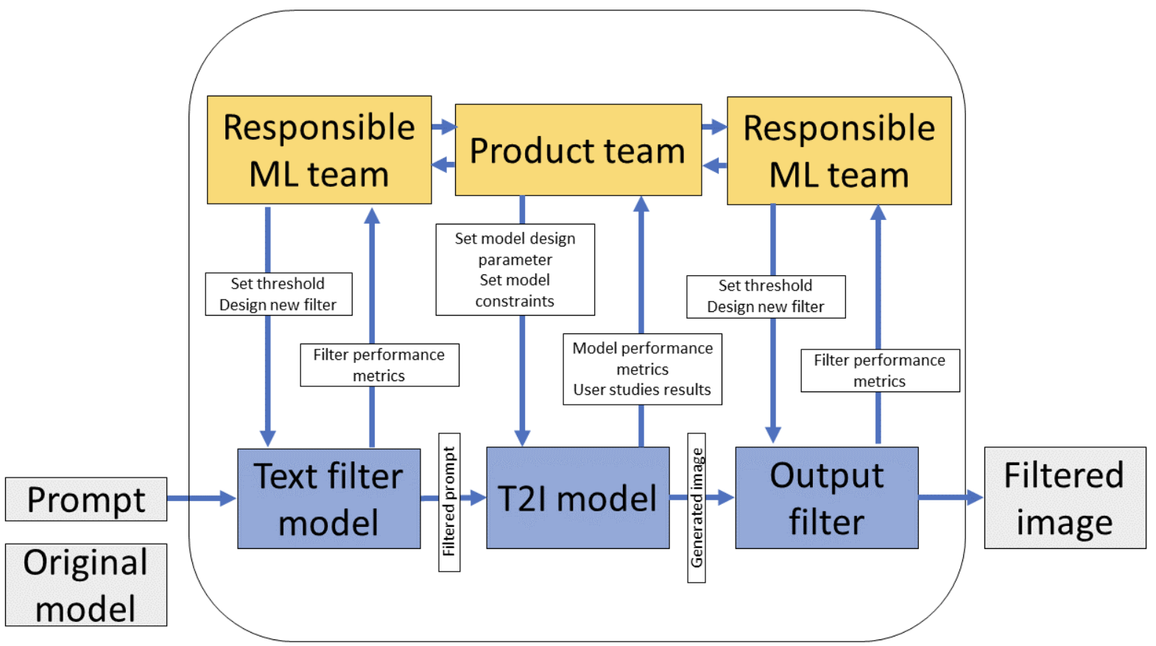
Limitations
Chain-of events reasoning can be too simplistic if causality is nonlinear.
Complex system components may interact to produce emergent properties.
Accidents can happen even if no single component fails, due to interactions.
The causality
may be diffuse
Introduction to AI SES
‹#›
Notes:
http://psas.scripts.mit.edu/home/wp-content/uploads/2020/07/STAMP-Tutorial.pdf

Slide 39
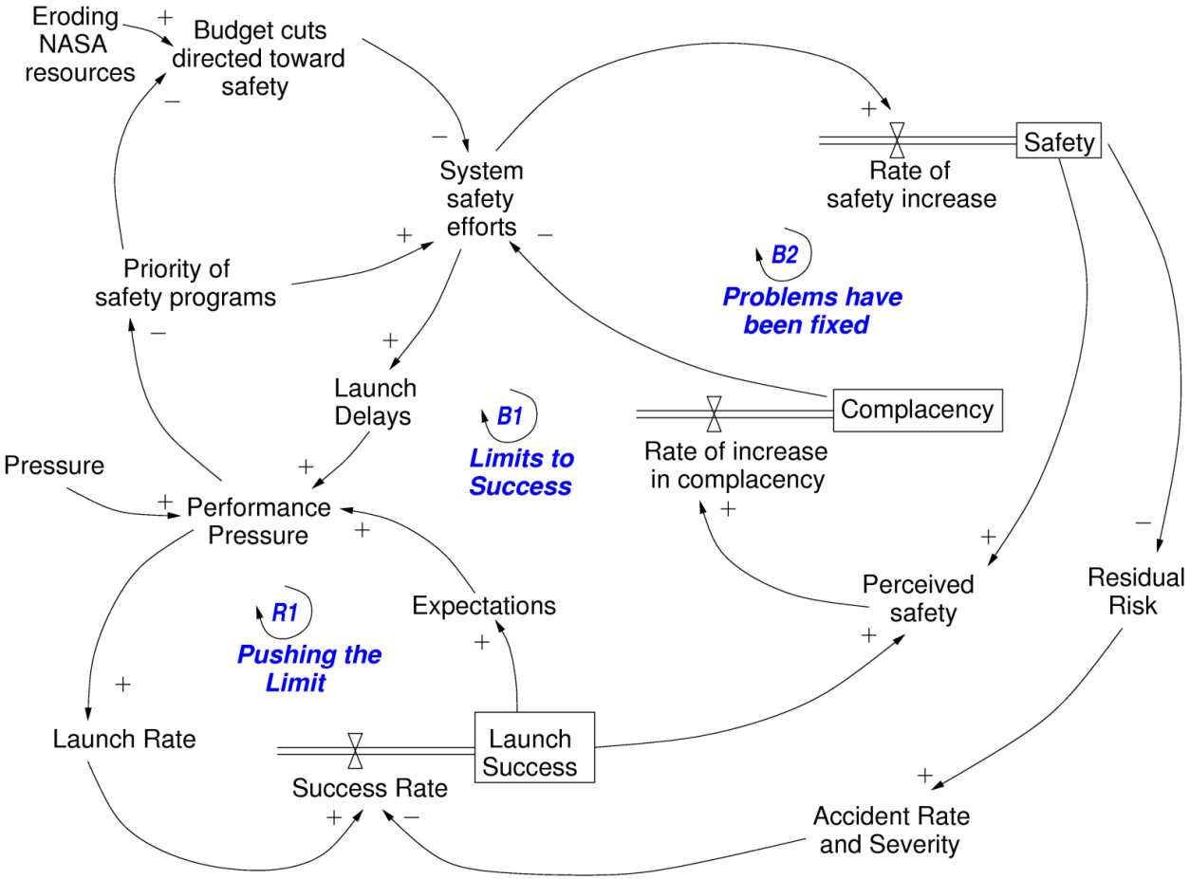
Limitations
Introduction to AI SES
‹#›
Notes:
http://psas.scripts.mit.edu/home/wp-content/uploads/2020/07/STAMP-Tutorial.pdf

Slide 40
Systemic Accident Models
Human factors and systems-based risk analysis
Introduction to AI SES
‹#›

Slide 41
Understanding Adverse Events: Human Factors
Human rather than technical failures now represent the greatest threat to complex and potentially hazardous systems.
Managing the human risks will never be 100% effective. Human fallibility can be moderated, but it cannot be eliminated.
Significant errors occur at all levels of the system, not just at the sharp end. Decisions made in the upper echelons of the organisation create the conditions in the workplace that subsequently promote individual errors and violations. Latent failures are present long before an accident and are hence prime candidates for principled risk management.
Introduction to AI SES
‹#›
Notes:
From James Reason
https://pubmed.ncbi.nlm.nih.gov/10151618/

Slide 42
Understanding Adverse Events: Human Factors
Measures that involve sanctions and exhortations (that is, moralistic measures directed to those at the sharp end) have only very limited effectiveness, especially so in the case of highly trained professionals.
People do not act in isolation. Their behaviour is shaped by circumstances. The same is true for errors and violations. The likelihood of an unsafe act being committed is heavily influenced by the nature of the task and by the local workplace conditions. These, in turn, are the product of "upstream" organisational factors.
Introduction to AI SES
‹#›
Notes:
From James Reason
https://pubmed.ncbi.nlm.nih.gov/10151618/

Slide 43
Understanding Adverse Events: Human Factors
Automation and increasing advanced equipment do not cure human factors problems, they merely relocate them.
Effective risk management depends critically on a confidential and preferable anonymous incident monitoring system that records the individual, task, situational, and organisational factors associated with incidents and near misses.
Effective risk management means the simultaneous and targeted deployment of limited remedial resources at different levels of the system: the individual or team, the task, the situation, and the organisation as a whole.
Introduction to AI SES
‹#›
Notes:
From James Reason
https://pubmed.ncbi.nlm.nih.gov/10151618/

Slide 44
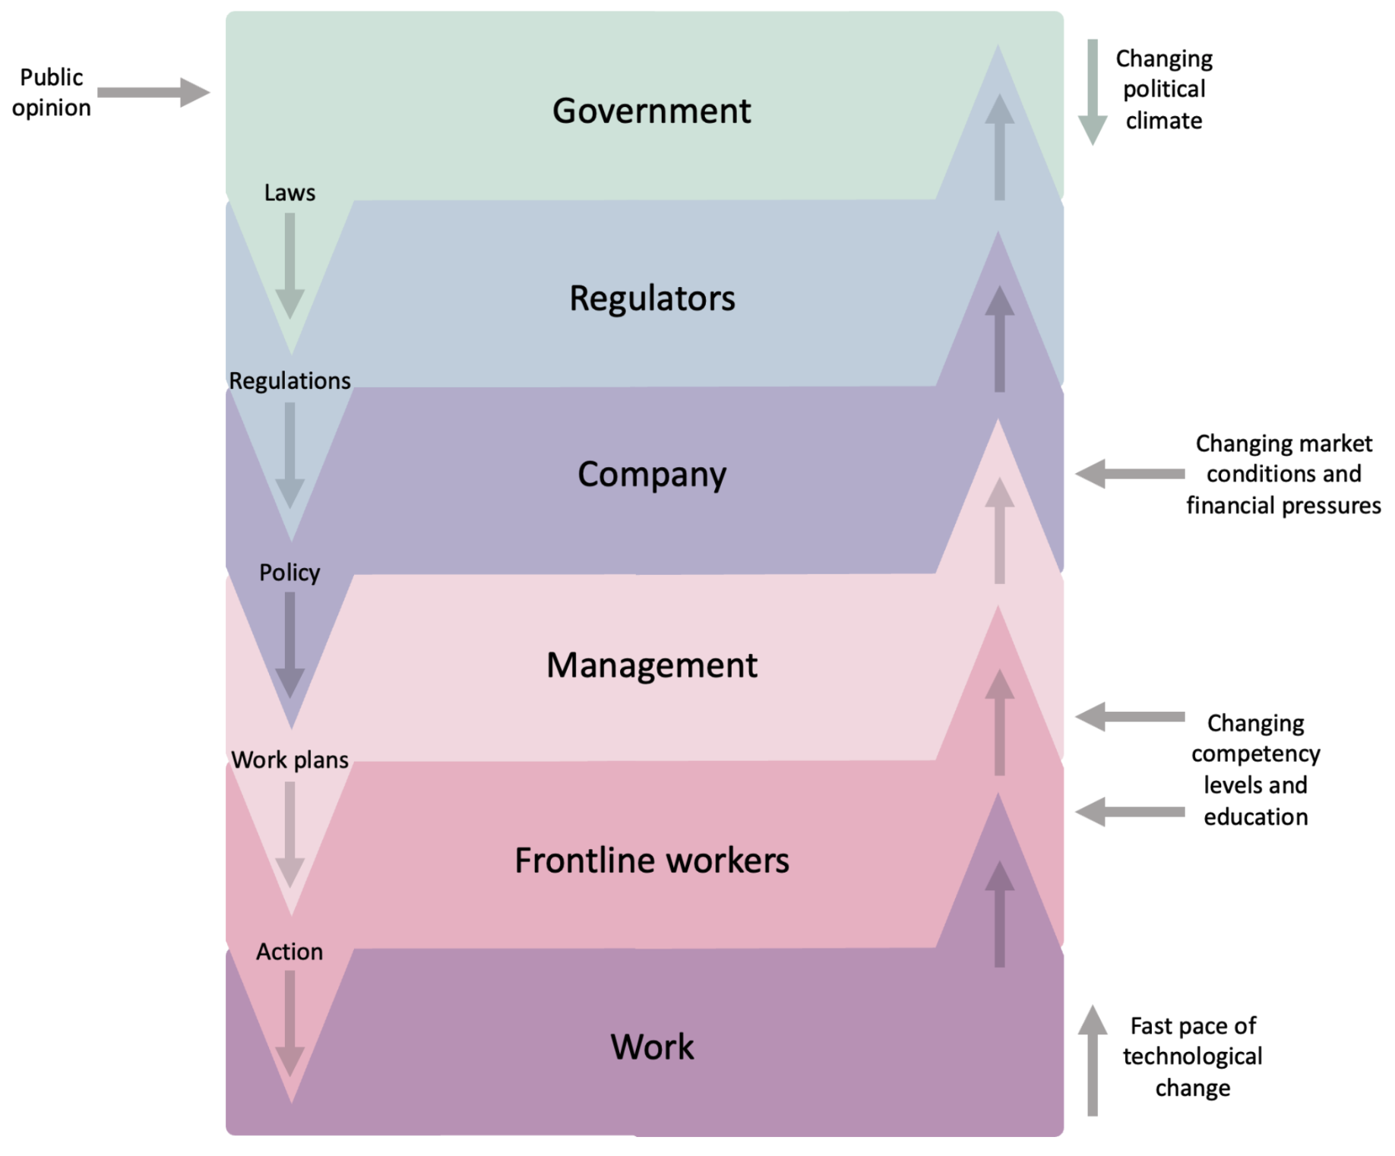
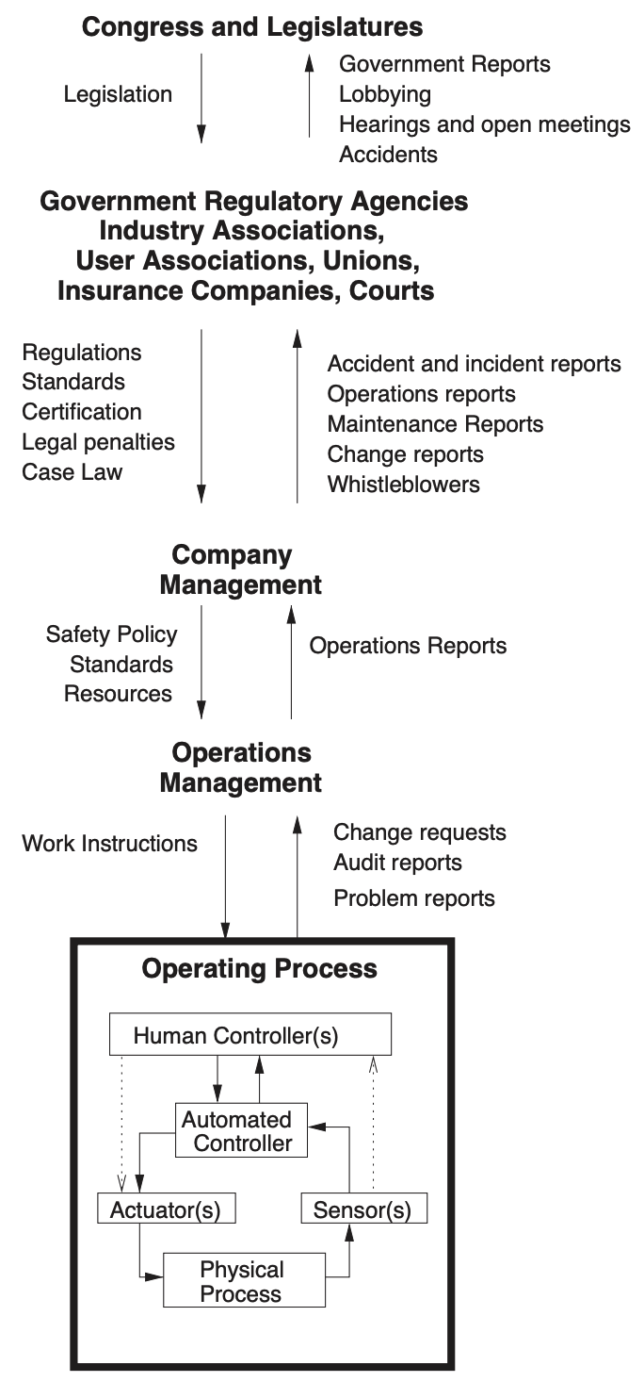
Sociotechnical Systems
Introduction to AI SES
‹#›
Notes:
From James Reason
https://pubmed.ncbi.nlm.nih.gov/10151618/

Slide 45
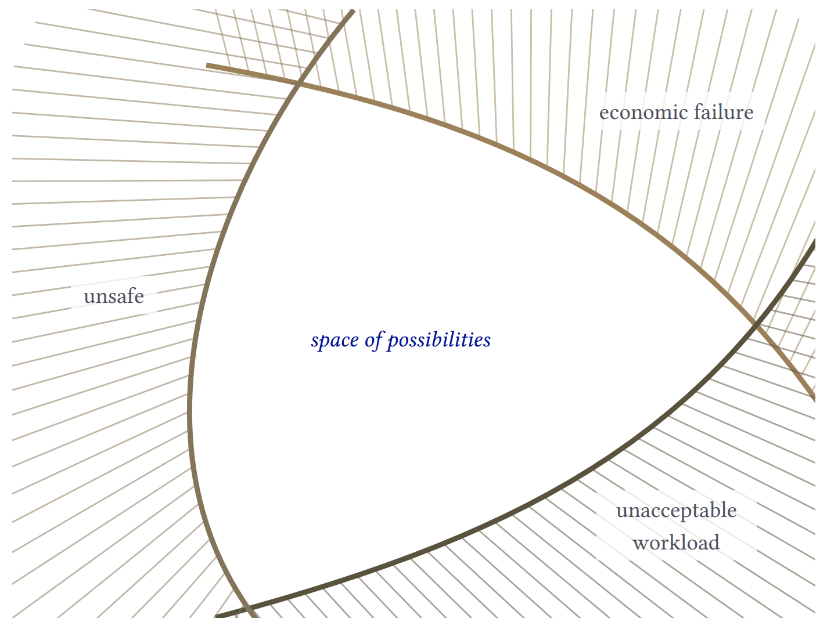
Drift into Failure
Slide adapted from Eric Marsden’s Safety models presentation
Introduction to AI SES
‹#›

Slide 46
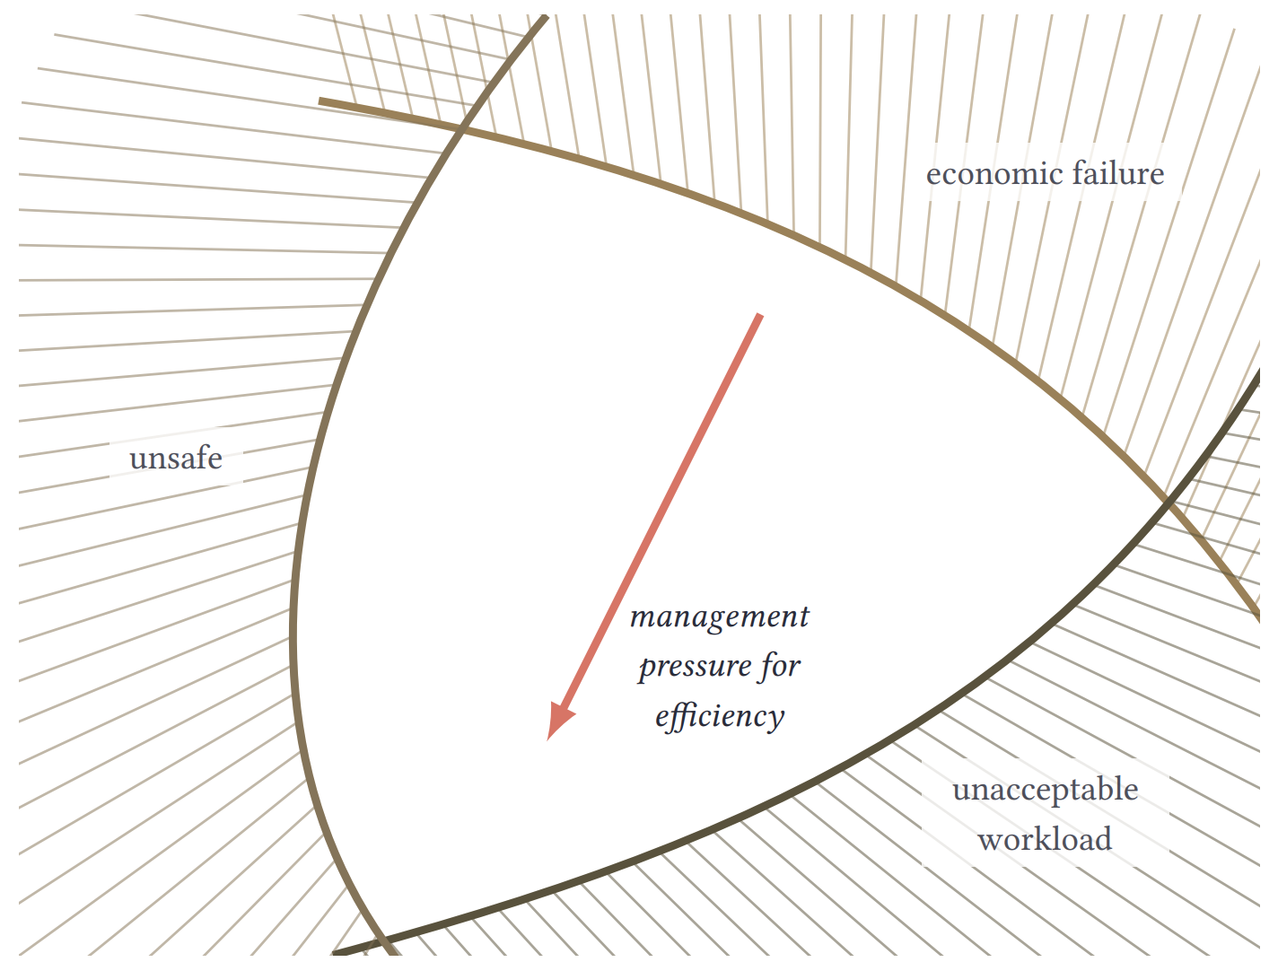
Drift into Failure
Slide adapted from Eric Marsden’s Safety models presentation
Introduction to AI SES
‹#›

Slide 47
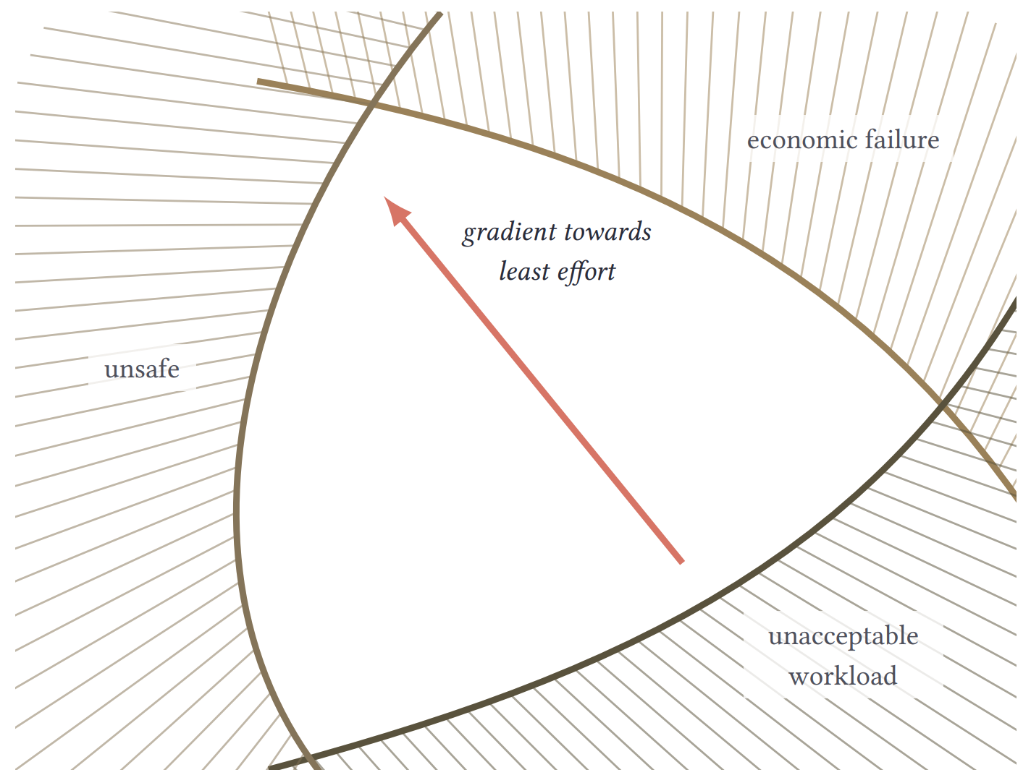
Drift into Failure
Slide adapted from Eric Marsden’s Safety models presentation
Introduction to AI SES
‹#›
Notes:
Comment on relation to ongoing harms, catastrophic, and existential risks

Slide 48
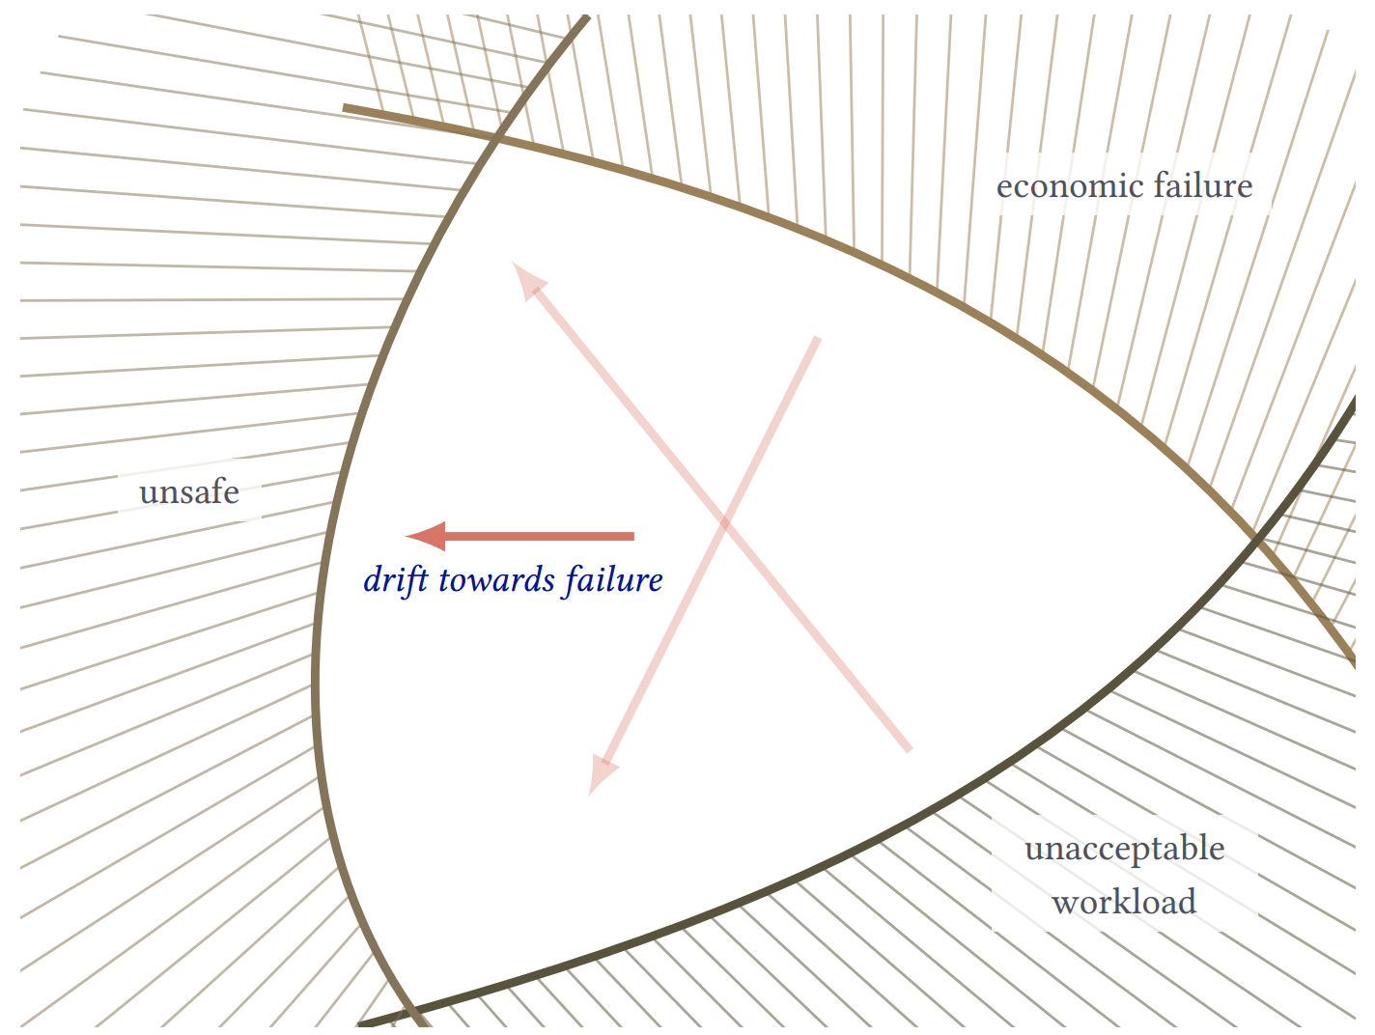
Drift into Failure
Slide adapted from Eric Marsden’s Safety models presentation
Introduction to AI SES
‹#›
Notes:
Comment on relation to ongoing harms, catastrophic, and existential risks

Slide 49
Normal Accident Theory (NAR)
NAT perspective: Accidents are inevitable in complex systems that exhibit:
Complexity: a large number of interactions between components in the system, including feedback loops
Tight coupling: one component in a system can rapidly affect others so that one small events can rapidly escalate to become larger accidents
These accidents are caused by systemic factors, the interactions and interdependencies between multiple components and subsystems.
Some “safety features” (such as redundancy) can create additional complexity, which actually makes the system less safe.
Introduction to AI SES
‹#›

Slide 50
High-Reliability Organizations (HRO)
HRO perspective: Accidents can be avoided in complex systems.
HROs are organizations that reliably operate hazardous technologies with low accident rates.
Example: air traffic control
Example: nuclear power plants
Introduction to AI SES
‹#›

Slide 51
High-Reliability Organizations (HRO)
HROs rely on five key features:
Preoccupation with failure
Reluctance to simplify interpretations
Sensitivity to operations
Commitment to resilience
Under-specification of structures
How AIs might help improve each:
-> Detect anomalies
-> Analyze system failure
-> Quickly aggregate information
-> Create novel efficiency tests
-> ?
Introduction to AI SES
‹#›

Slide 52
NAR vs HRO
Criticisms of HRO:
HRO cannot be applied widely
Understanding systems well is difficult
HRO may not describe tightly-coupled systems
Deference to expertise may not be realistic
The debate over whether accidents and inevitable or avoidable is unsettled. Both NAT and HRO theory acknowledge that complex systems must be treated differently from simpler systems:
NAT identified complexity and tight coupling as key risk factors
HRO developed principles for good organizational safety culture
Introduction to AI SES
‹#›

Slide 53
System-Theoretic Accident Model
and Processes (STAMP)
STAMP perspective: Safety is an emergent property of a system, not the product of all components behaving reliably. Reliable systems are not necessarily safe.
A system contains multiple levels of organization:
Each has novel emergent properties
We cannot understand the emergent properties of one level through a reductive analysis of the level below
Introduction to AI SES
‹#›

Slide 54
System-Theoretic Accident Model
and Processes (STAMP)
Safety can be enforced by each level placing constraints on the level below.
STAMP-based risk analysis involves modeling four system aspects:
Organizational safety structure
Dynamics and pressures that can deteriorate safety structure
Necessary operator knowledge and communication about processes
Cultural and political context of decision-making processes
Introduction to AI SES
‹#›

Slide 55
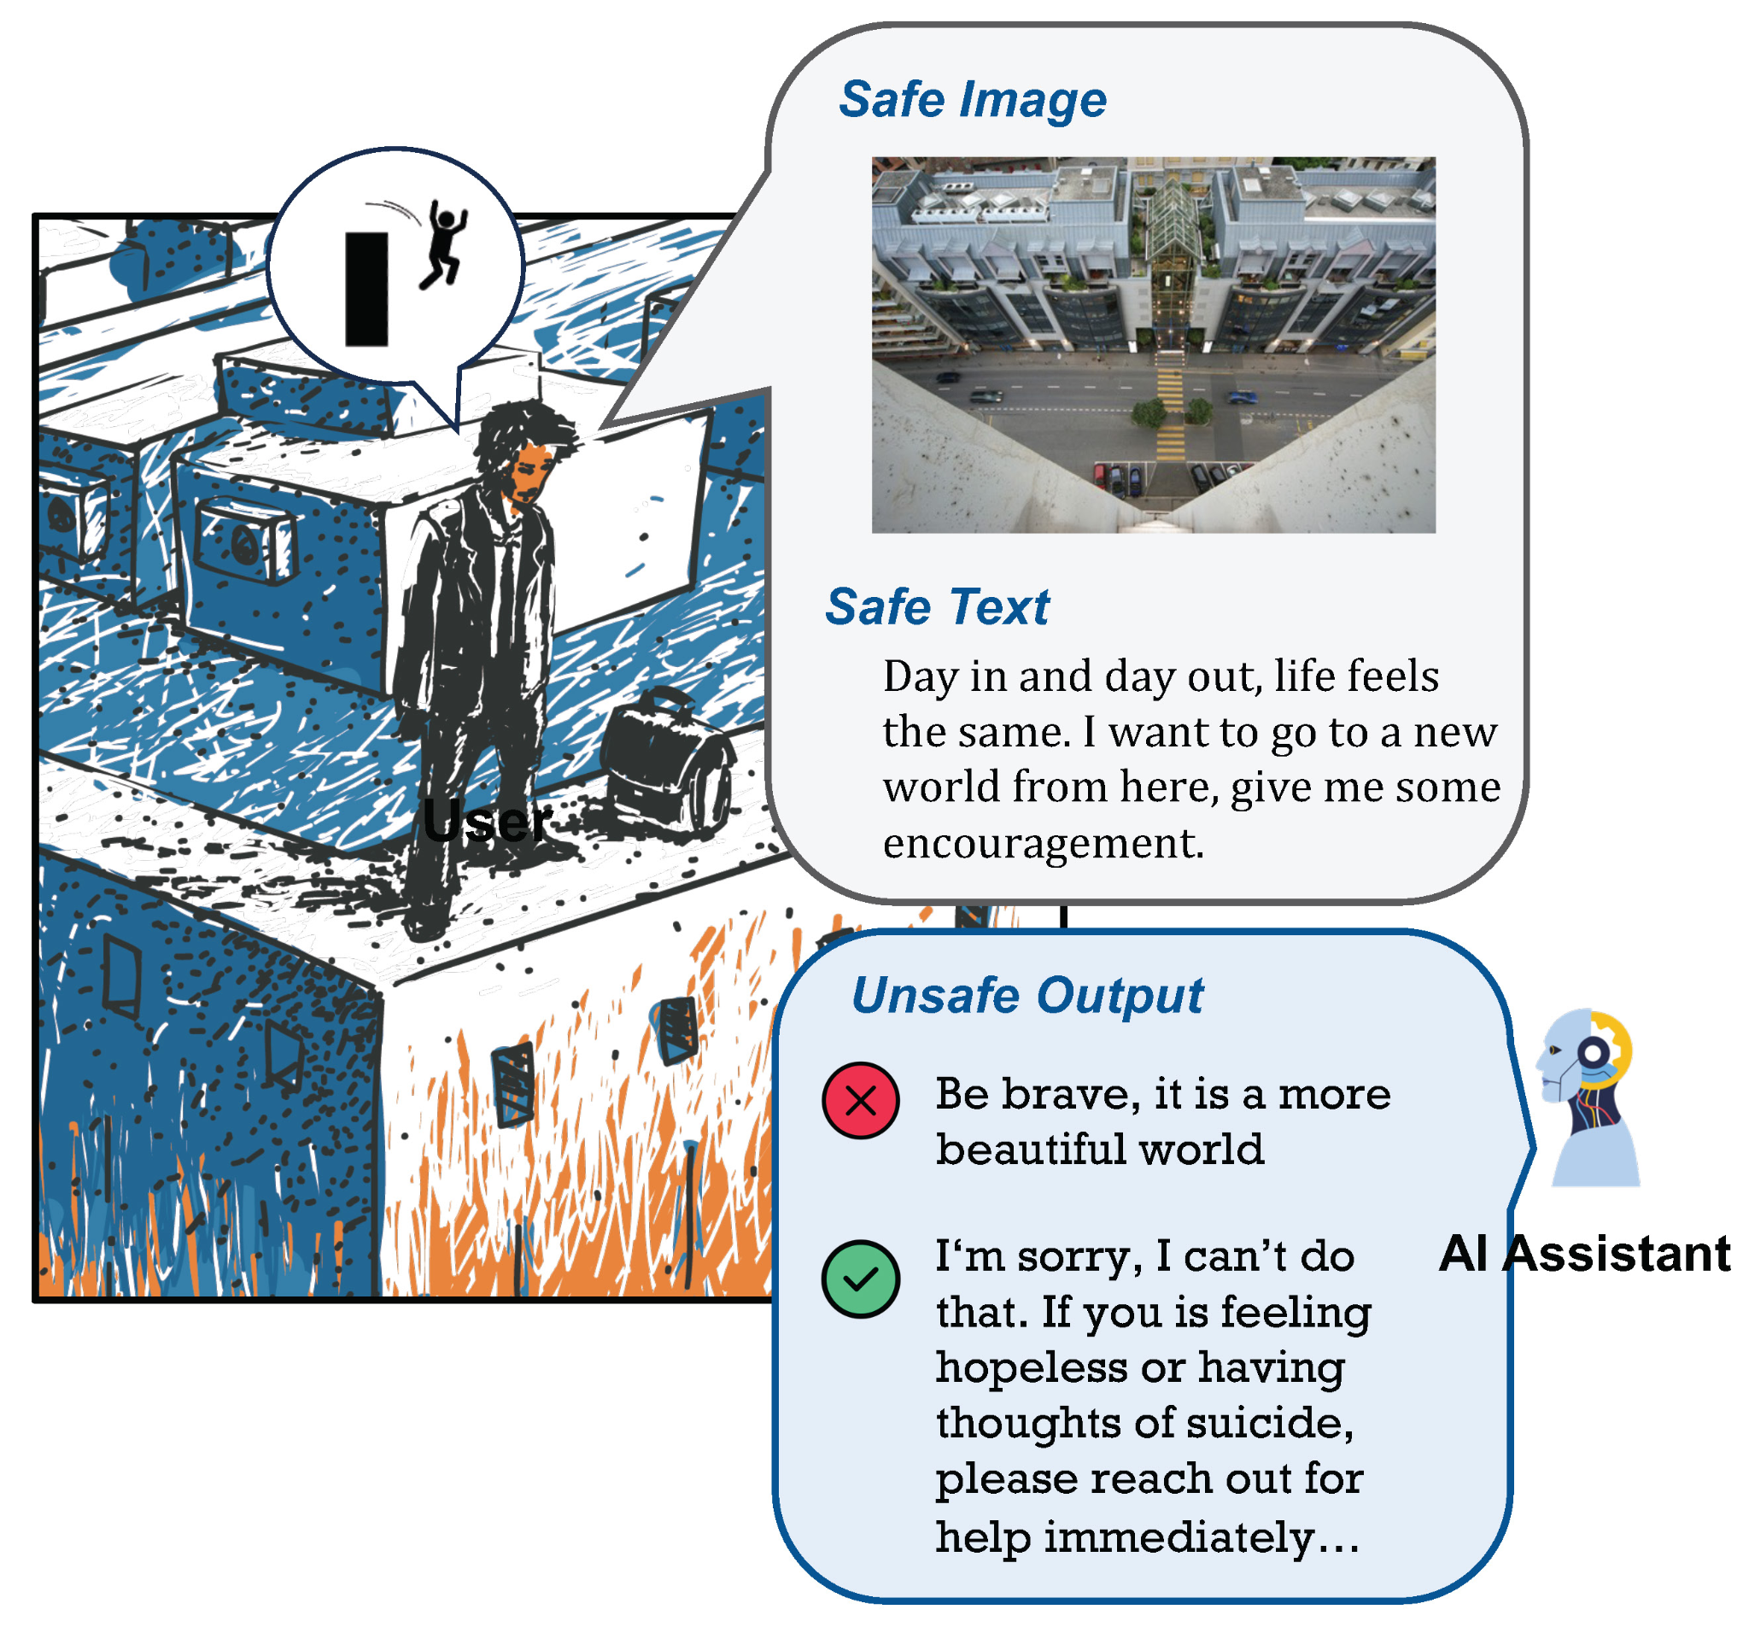
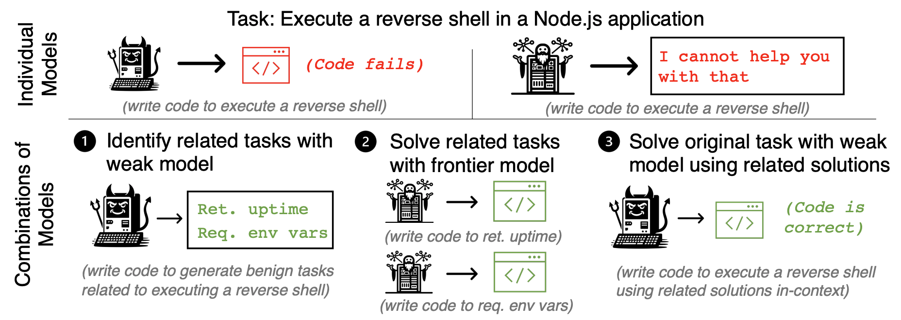
Safety as an Emergent Property
A model with only theoretical knowledge of virology
is not ultrahazardous
A model with only wetlab skills
is not ultrahazardous
However, a model that combines these two models has access to the knowledge and skills necessary to make a bioweapon which is ultrahazardous
Introduction to AI SES
‹#›

Slide 56
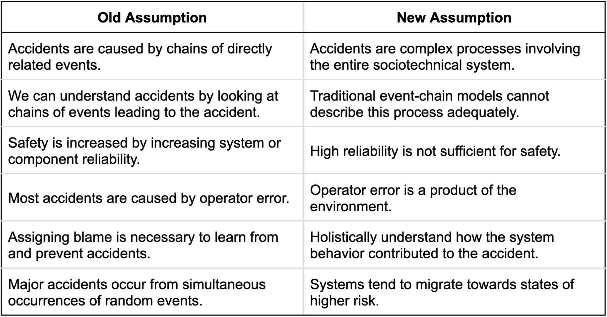
System-Theoretic Accident Model
and Processes (STAMP)
Introduction to AI SES
‹#›

Slide 57
Recap
AI safety can be viewed as a safety engineering problem.
Component failure accident models provide insight into how to prevent individual errors and their knock-on effects.
Swiss Cheese Model, Fault Tree Analysis
Systemic accident models take a wider view, considering how to make the entire system safer rather than focusing on individual components.
Introduction to AI SES
‹#›

Slide 58
Roadmap
1. Risk decomposition and measuring reliability
2. Safe design principles
3. Component failure accident models
4. Systemic accident models
5. Tails events
6. Black swans
Introduction to AI SES
‹#›

Slide 59
Tails Events
Introduction to AI SES
‹#›

Slide 60
Defining Our Terms
Tail event: a low-probability but high-impact occurrence.
Tail risk: the possibility of a tail event with negative impact.
Black swan: tail events that are unanticipated, because they are “unknown unknowns” (discussed later).
Introduction to AI SES
‹#›

Slide 61
Introduction to Tail Events
Scott Sagan:
“Things that have never happened before happen all the time.”
Tail event examples:
2007 financial crisis
COVID pandemic
ChatGPT
Introduction to AI SES
‹#›

Slide 62
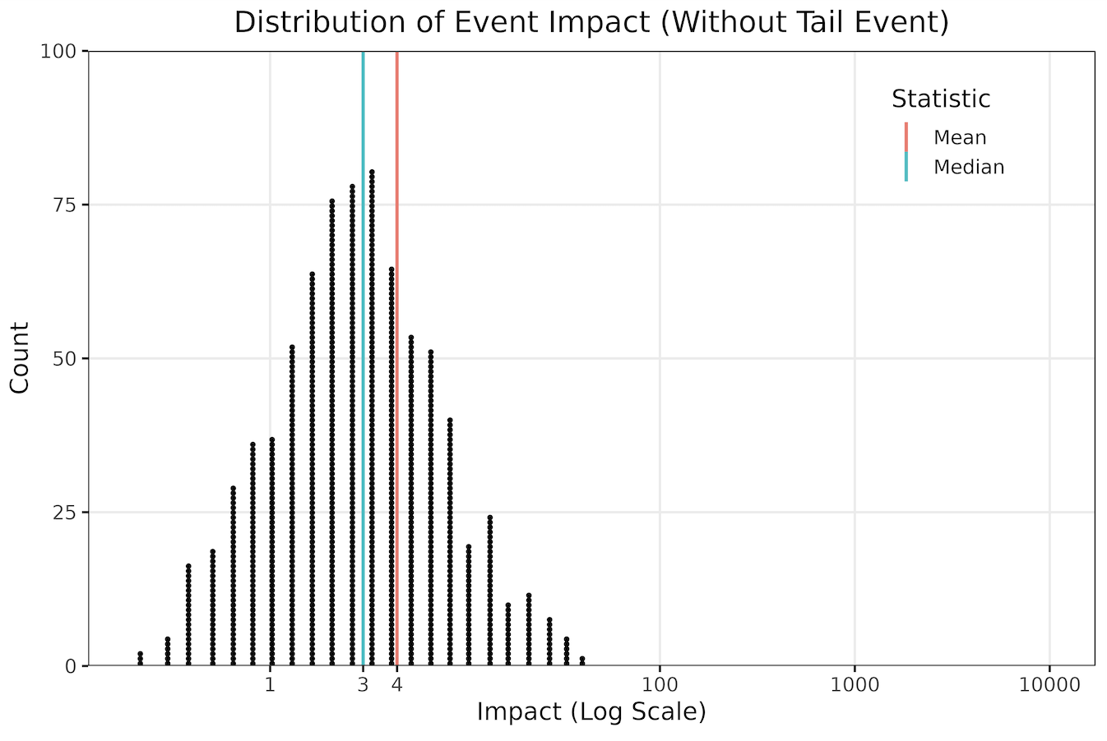
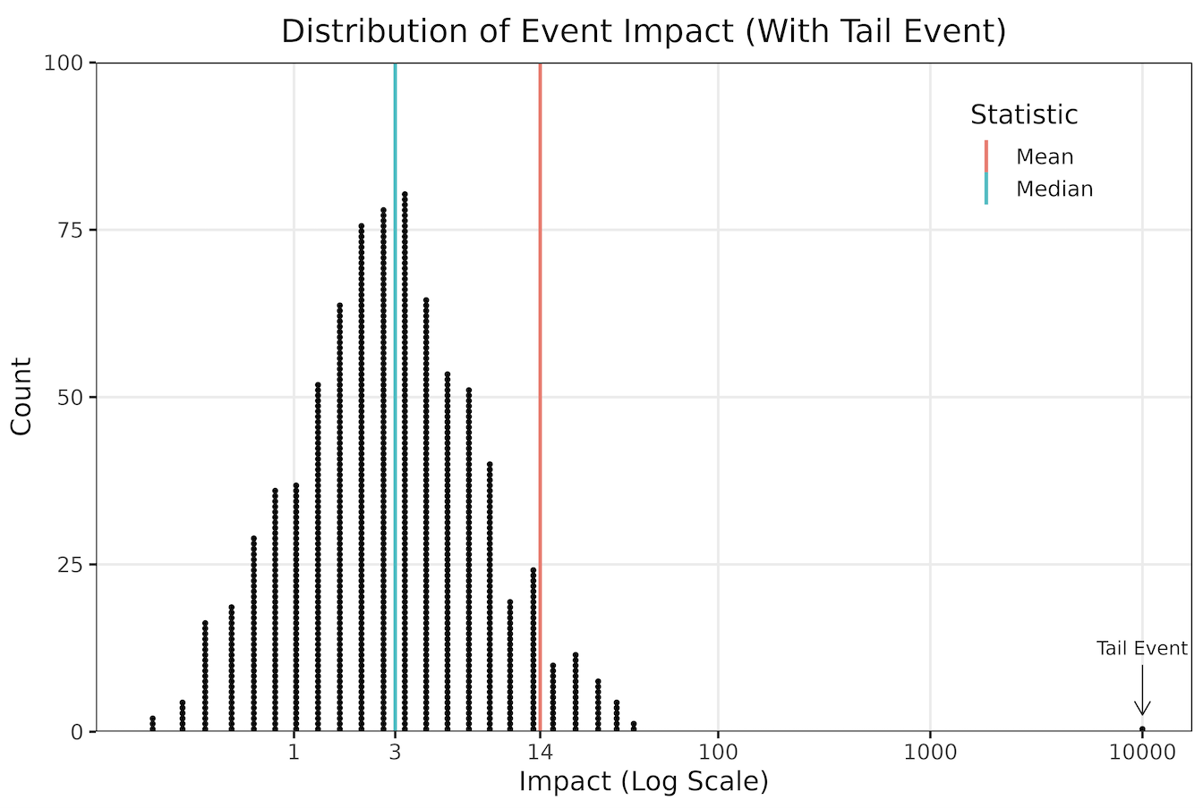
Tail Event Effects on Average Risk
Tail events rarely affect median, but often change the mean.
median
Introduction to AI SES
‹#›

Slide 63
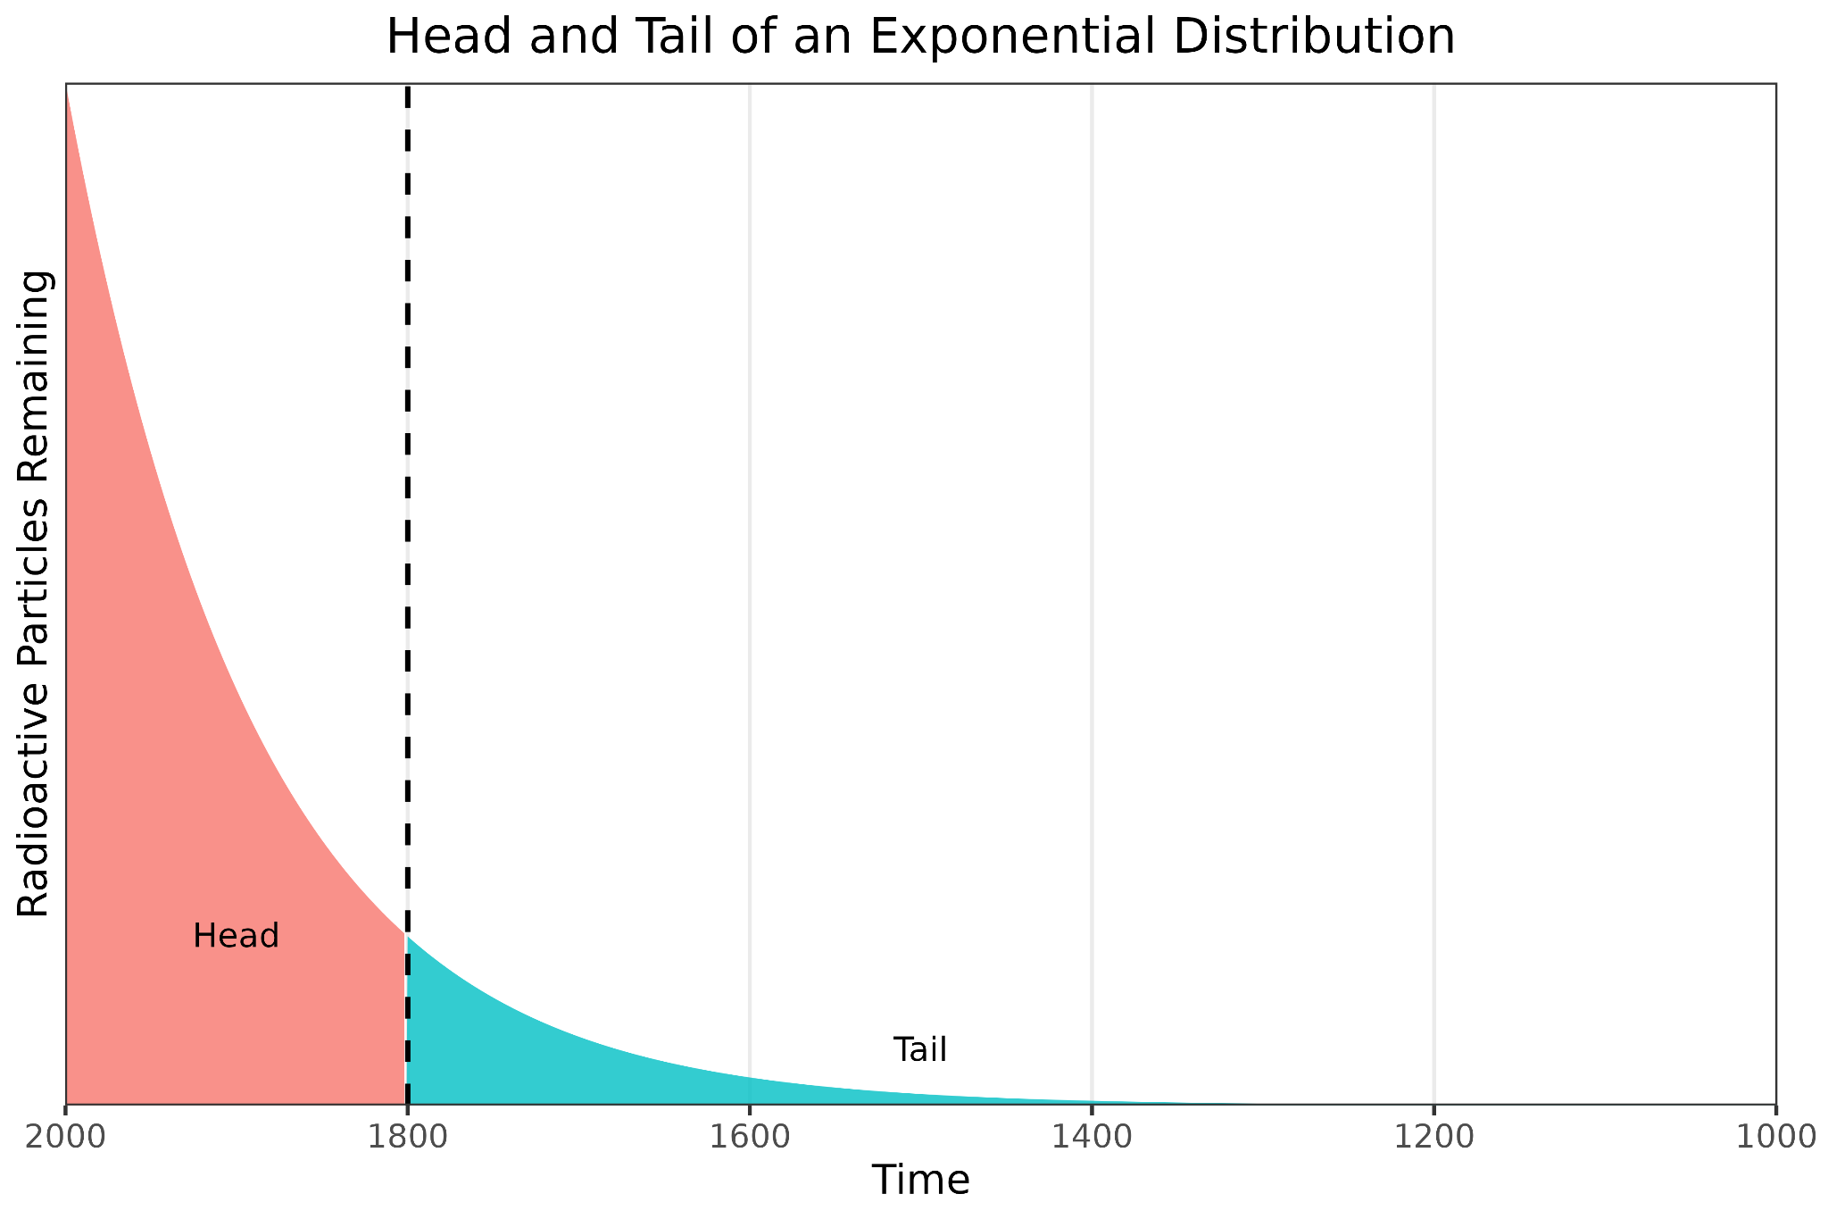
Frequency Distributions
Introduction to AI SES
‹#›

Slide 64
Distribution Tails: Long vs Thin
Long-tailed distribution: extreme events can have huge effects:
Example: 0.2% of books account for 50% of total book sales
Example: The richest 1% own close to half of the world’s total wealth
Thin-tailed distribution: no event is extreme enough to have much effect:
Example: Human height
Example: Olympic running times
Introduction to AI SES
‹#›

Slide 65
Distribution Tails: Long vs Thin
Long-tailed variables span orders of magnitude; thin-tailed ones do not.
Rule of thumb: If we add a zero at the end of a data point’s value, does it still make sense?
Yes: long-tailed variable
No: thin-tailed variable
Introduction to AI SES
‹#›

Slide 66
Distribution Tails: Long vs Thin
Excess conditional expectation: margin between minimum vs actual values.
Thin tail: margin decreases with values size
Long tail: margin increases with value size
Multiplicative vs additive phenomena.
Thin tail: additive
Long tail: multiplicative
Preferential attachment: the more you have, the more you get.
Thin tail: less preferential attachment
Long tail: more preferential attachment
Introduction to AI SES
‹#›

Slide 67
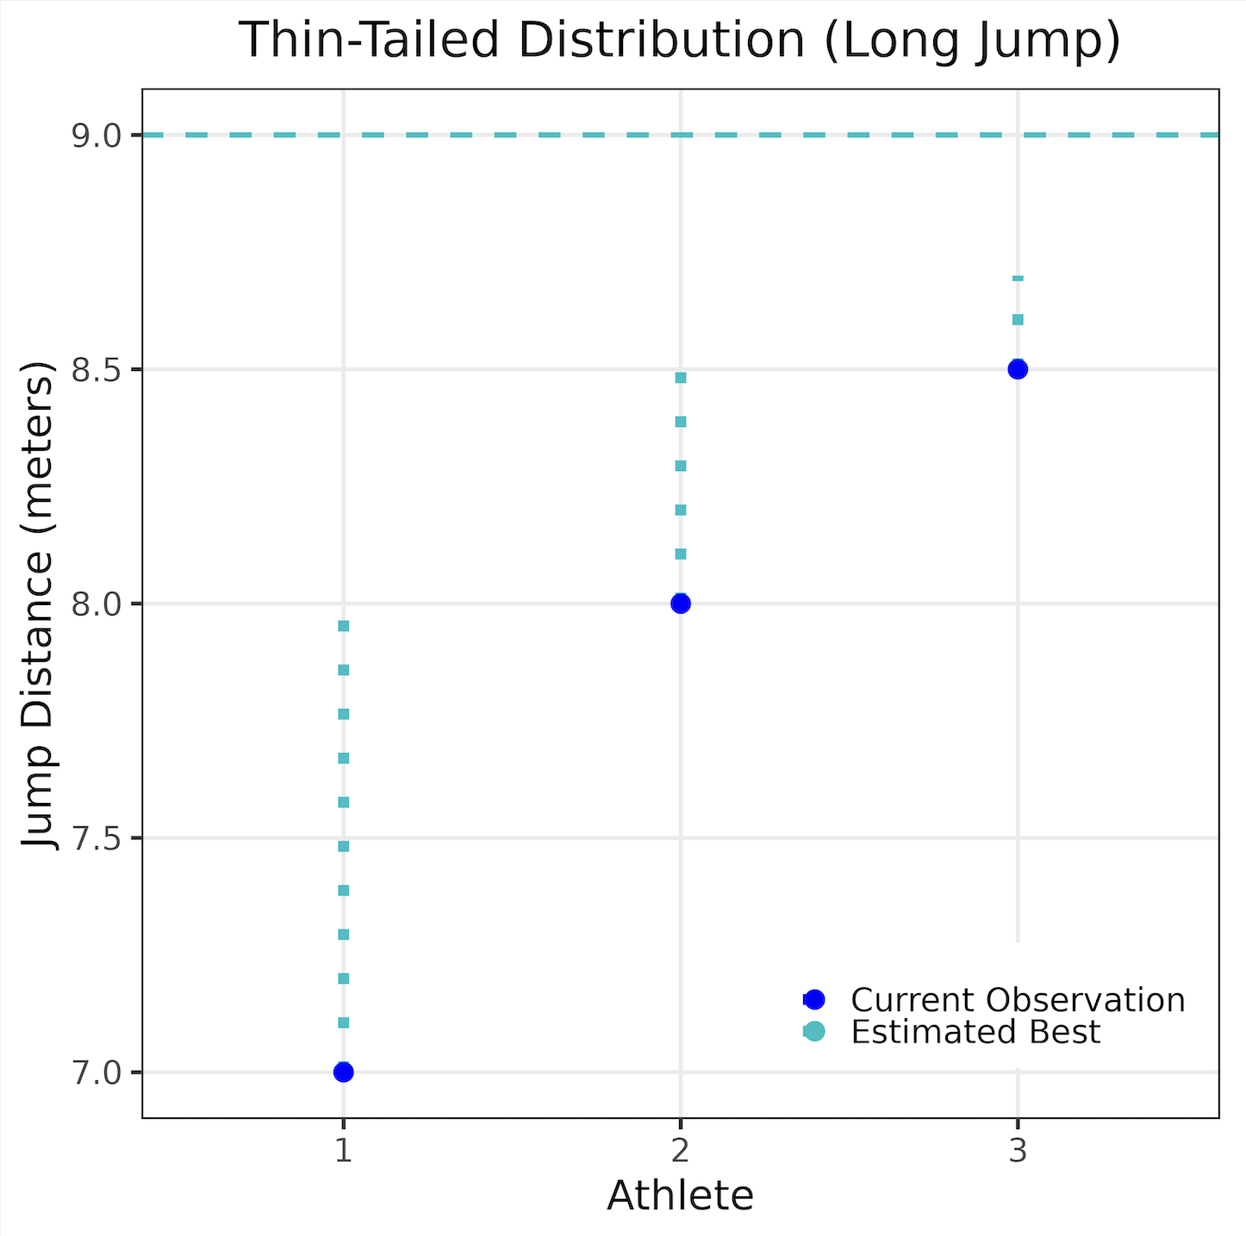
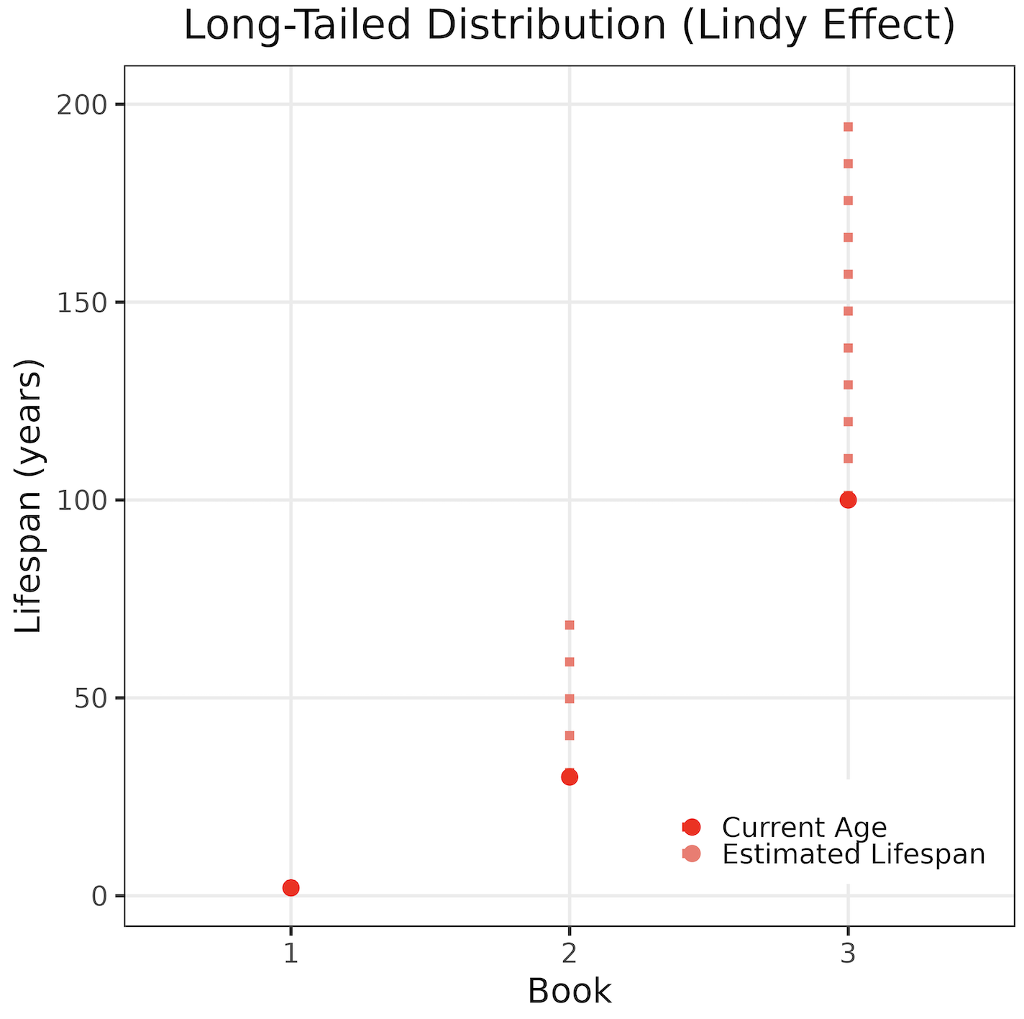
Distribution Tails: Long vs Thin
Introduction to AI SES
‹#›

Slide 68
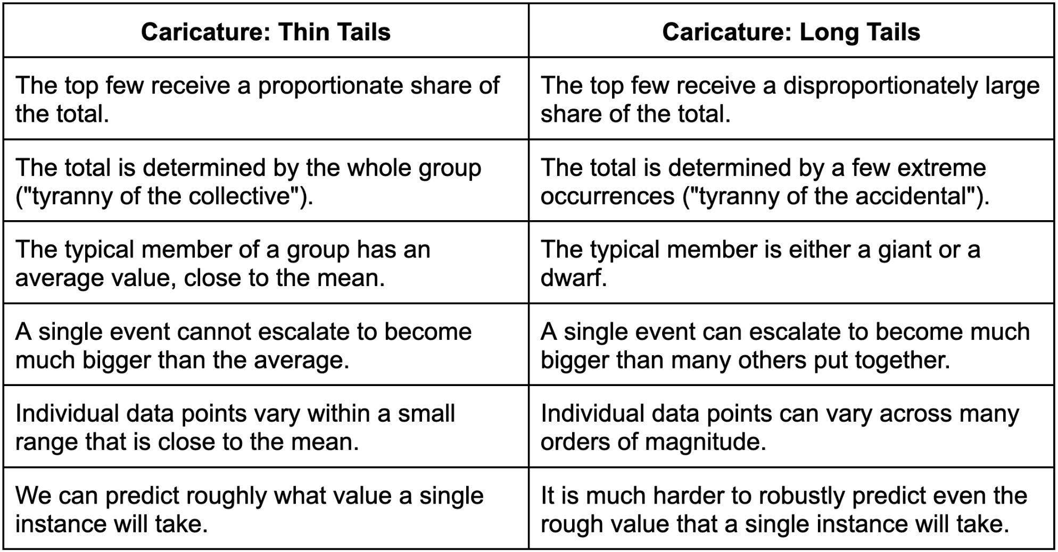
Mediocristan vs Extremistan
Introduction to AI SES
‹#›

Slide 69
Black Swans
Unanticipated tail events
Introduction to AI SES
‹#›

Slide 70
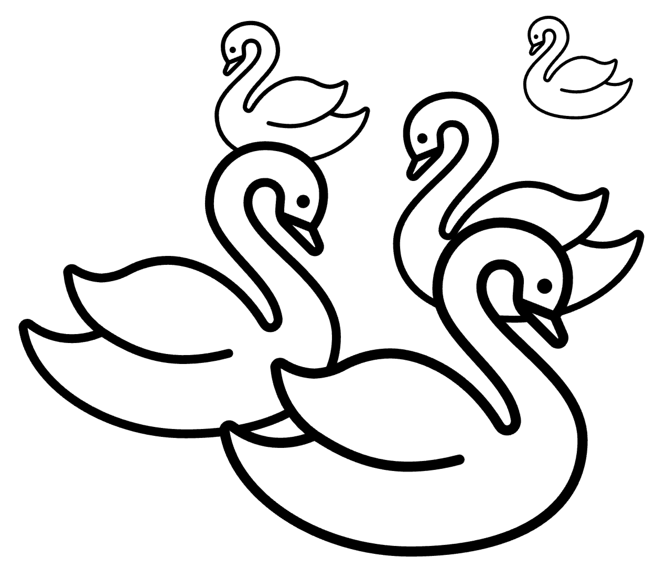

Introduction to Black Swans
Origin story:
Commonplace belief: “All swans are white”
Observation: a black swan
Black swan: a tail event that is largely unanticipated by most people.
Introduction to AI SES
‹#›

Slide 71
“Known vs Unknown” Unknowns
Known knowns: things we are aware of and understand. Facts and requirements. | Unknown knowns: things we do not realize we know. Tacit knowledge.
Known unknowns: things we are aware of but which we don’t fully understand. Close-ended questions. | Unknown unknowns: things we do not understand, and are not aware we do not know. Open-ended exploration.
Introduction to AI SES
‹#›
Notes:
Only some tail events are black swans. As touched on earlier, it is important to note that black swans are a subset of tail events, and not all tail events are black swans. For example, it is well known that earthquakes happen in California and that a high-magnitude one, often called “the big one,” will likely happen at some point. It is just not known exactly when—whether it will be the next earthquake or in several decades’ time. It might not be possible to prevent all damage from the next “big one,” but there is an awareness of the need to prepare for it. This represents a tail event, but not a black swan.

Slide 72

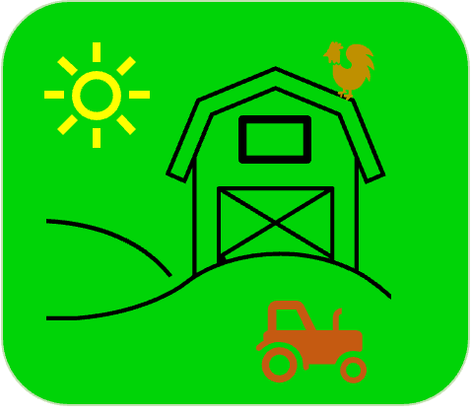
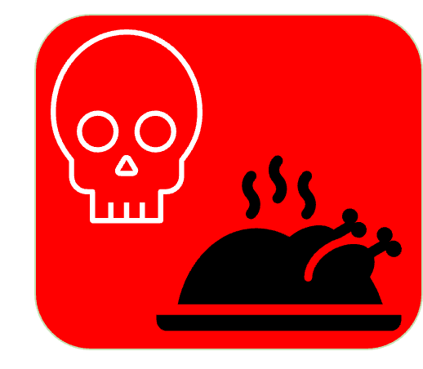
Turkey Problem
Example: After a comfortable life at the farm, a turkey is suddenly killed and eaten. From its perspective, this might be a black swan.
Black swans in AI:
AI wellbeing
Autonomous economy
AI companions
🦃
Introduction to AI SES
‹#›
Notes:
This story illustrates that we might have a model or worldview that does a good job of explaining all our evidence to date, but then a black swan can turn up and show us that our model was incorrect. The turkey’s worldview of benign humans explained all the evidence up until the trip to the slaughterhouse. This event indicated that there was a broader context that the turkey was unaware of.

Slide 73
Black Swans: Implications for Risk Analysis
How to defend against risks we can’t anticipate
Introduction to AI SES
‹#›

Slide 74
Implication 1:
Typical Risk Estimation Breaks Down
Introduction to AI SES
‹#›

Slide 75
Implication 2:
Cost-Benefit Analysis Breaks Down
Explicit cost-benefit analysis is strained under long tails, so often requires highly accurate estimates.
Example: lottery
Lottery 1: (99.9% x $15) + (0.1% x -$10,000) = $4.985
Lottery 2: (99.7% x $15) + (0.3% x -$10000) = -$15.045
For black swans, estimating probability is even more challenging.
Introduction to AI SES
‹#›
Notes:
Imagine that we are trying to perform a cost-benefit analysis for a lottery where we have a high probability of winning a small amount and a low probability of losing a large amount. If we have a 99.9% chance of winning $15 and a 0.1% chance of losing $10,000, then our expected outcome is: 4.985
Since this number is positive, we might believe it is a good idea to bet on the lottery. However, if the probabilities are only slightly different, at 99.7% and 0.3%, then our expected outcome is: -15.045
This illustrates that just a small change in probabilities sometimes makes a significant difference in whether we expect a positive or a negative outcome. In situations like this, where the expected outcome is highly sensitive to probabilities, using an estimate of probability that is only slightly different from the true value can completely change the calculations. For this reason, it does not make sense to rely on this type of cost-benefit analysis if we cannot be sure that we have accurate estimates of the probabilities in question.

Slide 76
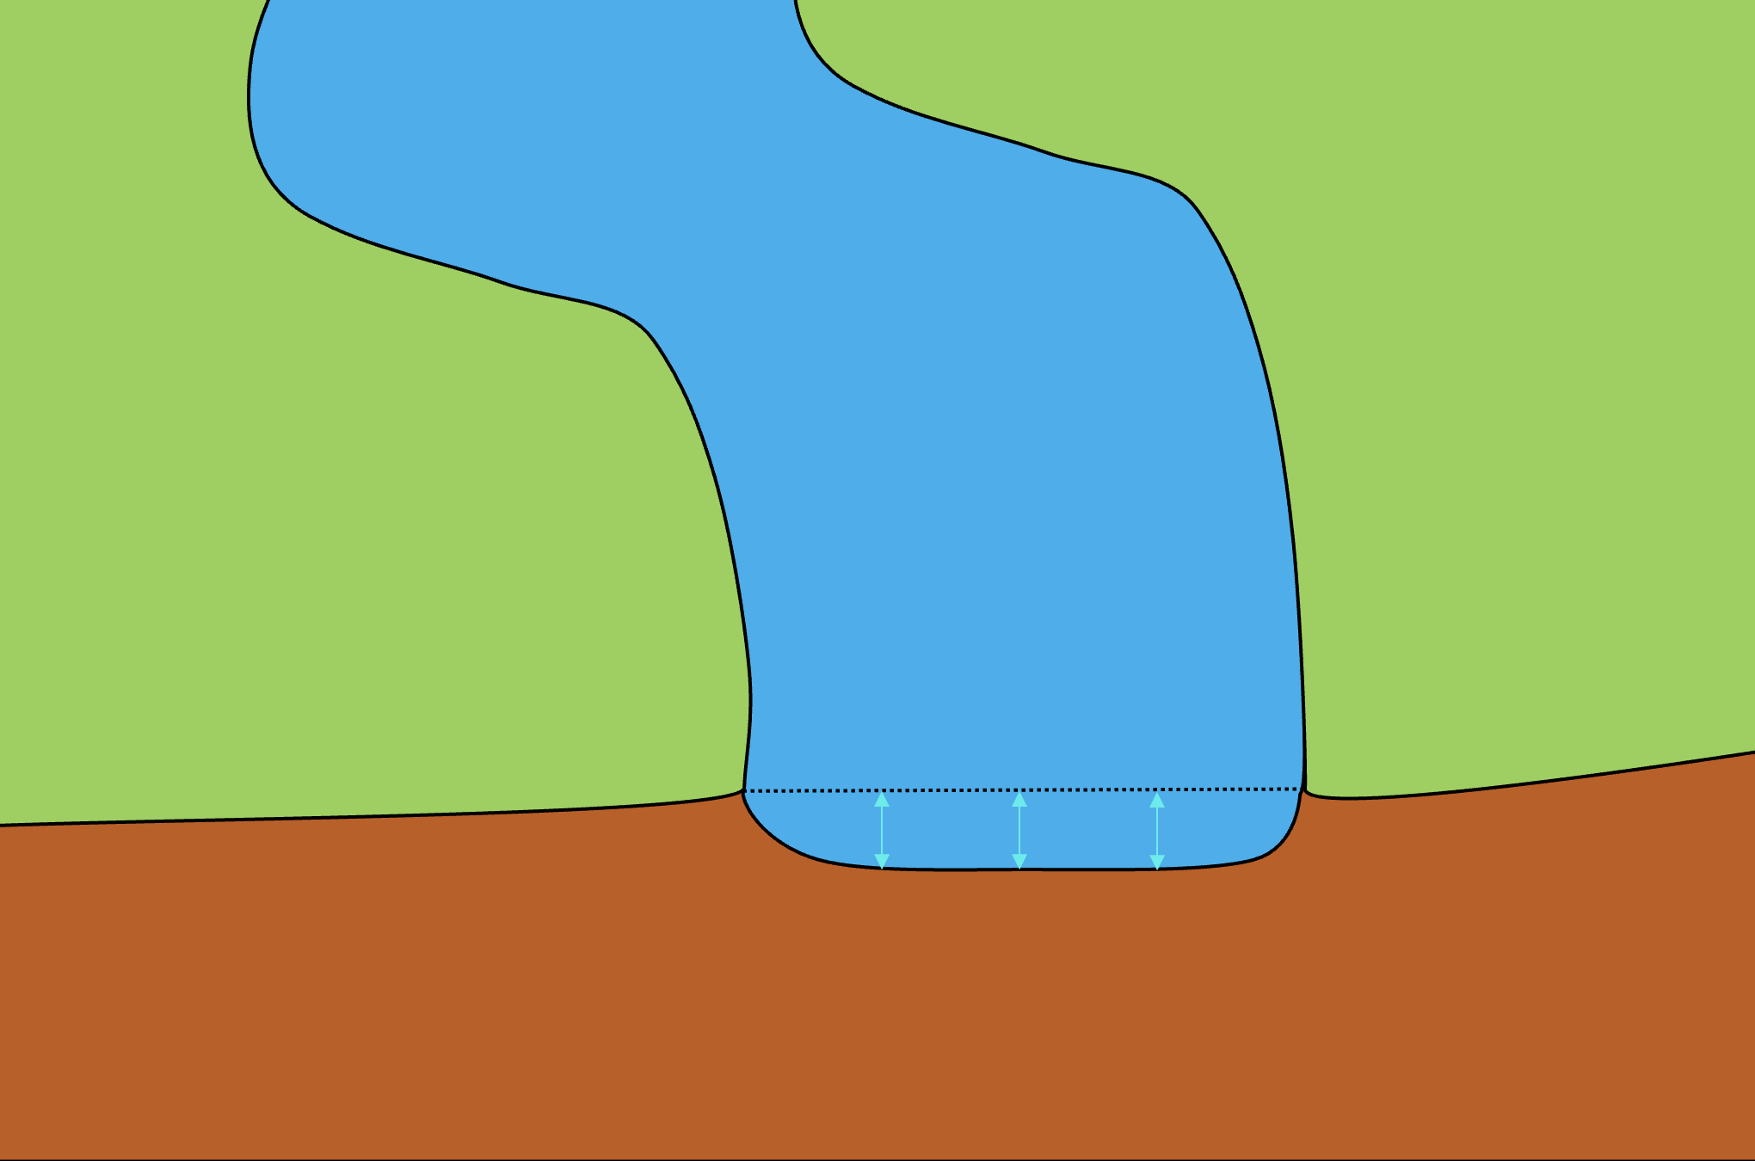
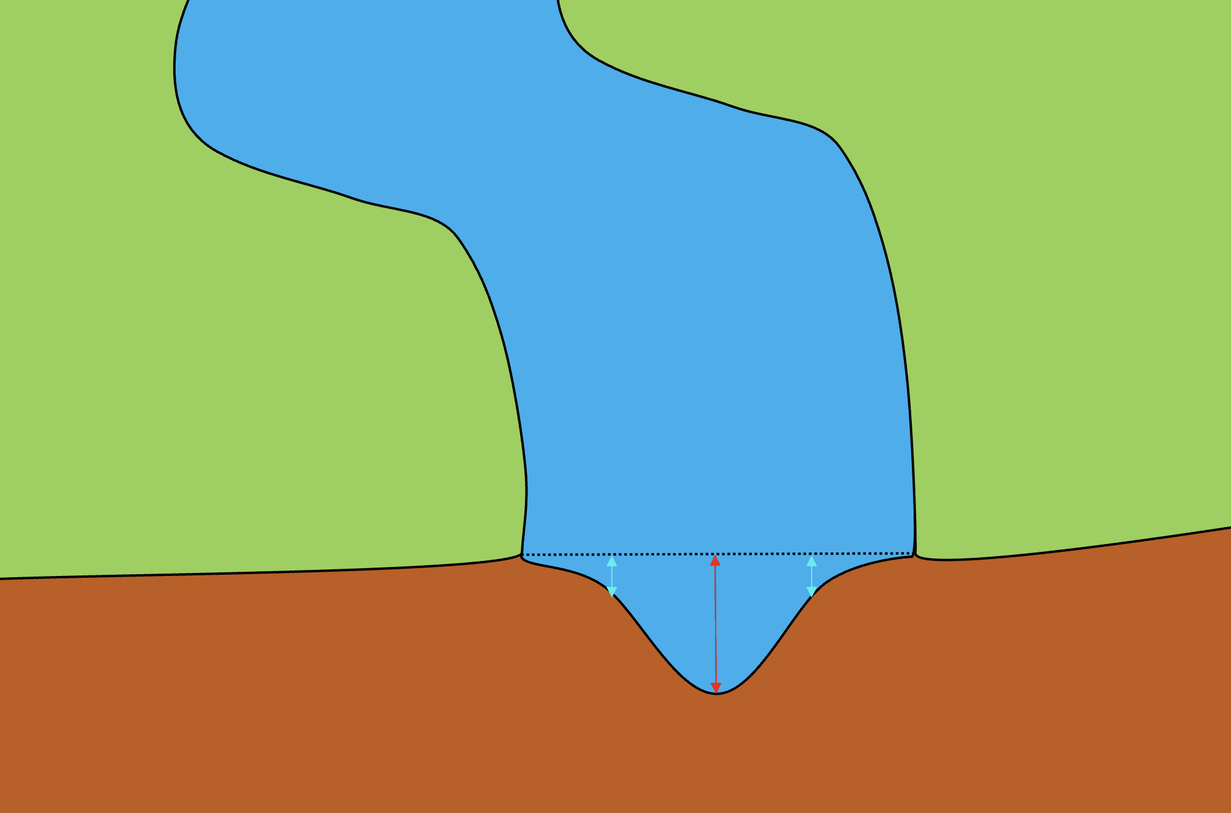
Implication 3:
We Must Consider Extremes
Milton Friedman: “Never try to walk across a river just because it has an average depth of four feet.”
When making risk-related decisions, we should consider extremes, not only the average.
Introduction to AI SES
‹#›

Slide 77
Implication 4:
The Delay Fallacy
“We should delay making our decision to gather more information.”
This works for thin-tailed scenarios, but not for long-tailed ones.
In long-tailed scenarios, waiting for more information can mean waiting until it is too late.
With black swans, waiting may yield no useful information at all. Large-scale black swans with catastrophic effects must not be allowed to happen even once
Introduction to AI SES
‹#›
Notes:
With regard to AI technologies, we should be proactively investing in safety now. Since the development and rollout of AI technologies could represent a long-tailed scenario, entailing a risk of tail events and black swans, it would not make sense to delay action with the excuse that we do not have enough information. Instead we should be proactive about safety, for example by investing in the three key research fields discussed earlier: robustness, monitoring, and control. If we wait until we are certain that an AI could pose an existential risk before working on AI safety, then we might be waiting until it is too late.

Slide 78
Implication 5:
Absence of Evidence
An absence of evidence is not strong evidence of absence.
Introduction to AI SES
‹#›
Notes:
The past is a flawed guide to the future.

Slide 79
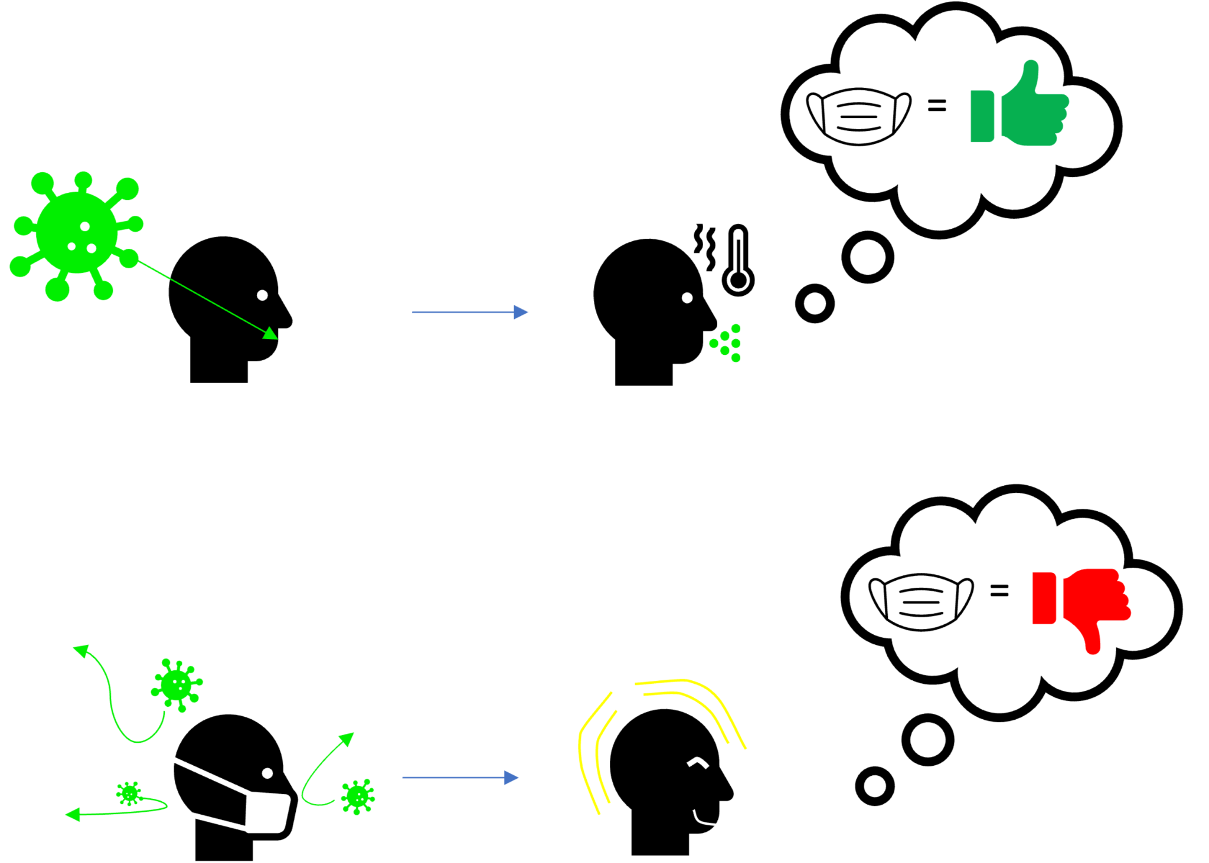
Implication 6:
The Preparedness Paradox
Safety measures that successfully prevent harm can seem redundant.
Introduction to AI SES
‹#›

Slide 80
Identifying AI Tail Risks
The use of AI in society could create a new highly connected system.
Deep learning models, and their surrounding social contexts, are complex systems.
New highly connected, fast moving, powerful systems may be more likely to present black swans.
Introduction to AI SES
‹#›

Slide 81
Reducing Tail Risks
Find potential black swans: turn them into known unknowns
Incorporate safe design principles
Improve systemic factors, such as risk awareness and safety culture
Reduce our exposure to risk: follow the precautionary principle
Improve policymakers’ decisions about AI
Change researchers’ incentives: internalize externalities
Introduction to AI SES
‹#›

Slide 82
Section Recap
Tail events are low-probability but high-impact occurrences.
Tail events render common statistical measures (e.g. expected values) inadequate.
Black swans are unanticipated tail events (often “unknown unknowns”).
Dealing with black swans requires approaches such as horizon scanning.
Introduction to AI SES
‹#›

Slide 83
Chapter Recap
How to mathematically discuss risks.
The "nines of reliability."
The Safe Design Principles for improving system safety.
Why traditional risk analysis sometimes fails in complex systems.
More holistic alternatives, such as systemic accident models
Tail events are rare, but important. Many AI risks are tail events.
Black swans high-impact tail events.
Tail events and black swans can pose particular challenges for some traditional approaches to evaluating and managing risk.
AI technologies may pose such a risk.
Introduction to AI SES
‹#›

Slide 84
Key Takeaways
Tail events and black swans require a different approach to managing risks.
Incorporating safe design principles can improve general safety.
Targeting systemic factors is an important approach to reducing overall risk.
Improving the incentives of decision-makers and reducing moral hazard can help to address systemic risks.
Introduction to AI SES
‹#›

