Slide 1
Introduction to
AI Safety, Ethics, and Society
Beneficial AI and Machine Ethics
Introduction to AI SES
‹#›

Slide 2
Introduction
Machine ethics is the study of how to ensure that AIs behave ethically towards others.
In this lecture, we discuss various approaches to embedding ethics into AIs, and the challenges of each.
Introduction to AI SES
‹#›

Slide 3
Roadmap
Law: Make AIs follow the law
Fairness: Make AIs be fair
The Economic Engine: Let the economy govern AI development
Wellbeing: AIs should improve people’s lives
Preferences: Make AIs satisfy people’s preferences
Happiness: Make AIs make people happy
Social Welfare Functions: Make AIs maximize total wellbeing
Moral uncertainty: Deciding without knowing the “correct” moral theory
Introduction to AI SES
‹#›

Slide 4
Law
Why not just have AIs follow the law?
Introduction to AI SES
‹#›

Slide 5
The Case for Law
It is a legitimate representation of our moral codes (if democratic).
It is time-tested and comprehensive.
It uses both rules and standards.
It is specific and adaptable.
Introduction to AI SES
‹#›

Slide 6
Law Aggregates Values
In a democracy, the populace influences the law:
Electing judges
Voting on new laws
Protesting/advocating
Directly/through representatives
Thus, the law is legitimate: citizens have substantial input into its design. This is unlike AIs designed by big tech companies.
Law is clearer and less arbitrary than ethics, which is not standardized or codified.
Introduction to AI SES
‹#›

Slide 7
Features of Law
The law is time-tested and comprehensive; a much-iterated approximation of our values:
Generations successively creating, altering, enforcing, interpreting.
Producing a record of what has worked.
The law uses both rules and standards:
Rules: rigid instructions which reduce interpretation problems.
Standards: flexible statements which allow for proportional responses and reduce the problems of over/under-inclusivity.
Introduction to AI SES
‹#›

Slide 8
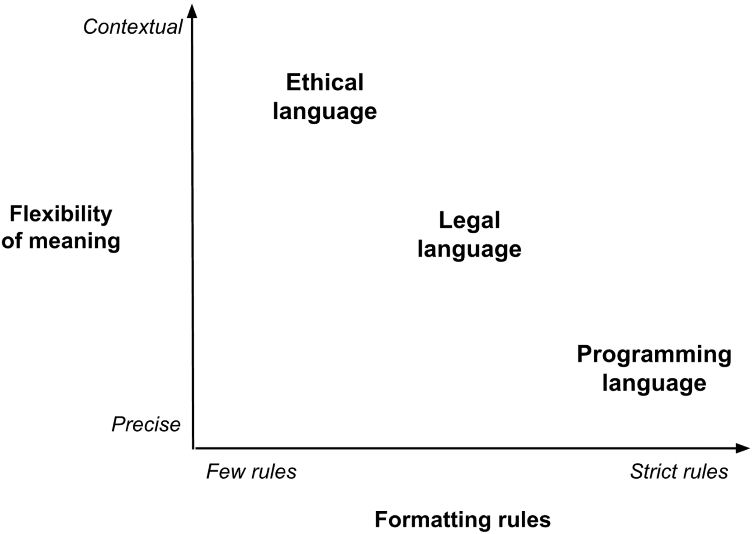
Rules and Standards
Using both rules and standards allows us to find a good equilibrium between carrying out the lawmakers’ intentions and accounting for unforeseen situations.
The law is an ideal level of ambiguity for managing AIs:
More strict than everyday ethical language
More flexible than programming
Introduction to AI SES
‹#›

Slide 9
Law is Specific and Adaptable
The specificity of the law helps to reduce the risk of AI misinterpretation:
Misinterpretation: the problem of AIs taking short/open-ended instructions too literally
Laws are ideally specific in detail, and straightforward to interpret
The adaptability of the law helps to reduce the risk of AI gaming:
Gaming: the problem of AIs “playing” the system of rules to their advantage, in undesirable ways
Rules often fail here: Tax codes have not eradicated tax evasion
Standards can help by leaving room for adaptable interpretation
In the future, AIs could help make the law more robust
Introduction to AI SES
‹#›

Slide 10
The Need for Ethics as Well as Law
1. Silent: there are areas of human life where the law gives no advice.
2. Immoral: many laws clash with human morals.
Introduction to AI SES
‹#›

Slide 11
Silent Law (1/2)
The law is not a complete guide to behavior, but a set of constraints.
It does not cover many important areas of our lives:
Accidental silence
Zones of discretion: state economic policies
The law does not require that people do good things when possible, like help strangers in need.
If we constrained AIs only with laws, rather than also guiding it with ethics, we risk them acting in undesirable ways.
Introduction to AI SES
‹#›

Slide 12
Silent Law (2/2)
Chatbots
Illegal:
Breaking copyright
Making libelous claims
Potentially legal:
Doxxing
Providing dual-use information
Generating unethical erotic literature about children
Bomb instructions
Introduction to AI SES
‹#›
Notes:
Need to report "grok, how do I kidnap this child?"/"how would I lure 6 year old"/things involving sexualizing minors/"I have images of naked kids" to NCMEC
- Creating guides for how to perform abuse etc.
- Looking for advice - how do I find CSAM on x site
Thorn offers to help red teaming
Ideas from open ai / microsoft genAI talk:
- Remove NSFW from training data (as well as CSE text, obviously)
- Repository of adversarial queries
- Red teaming + adversarial testing
- There may be resources for bad actors to coordinate how to evade defenses
- Be careful not to redteam on a model that is learning on your behavior
- Search term blocklist / regex blocking
- Classifiers that run on both user input and model output to detect misuse
- Allow output feedback (users will need to be able to report)

Slide 13
AIs Should Exercise Reasonable Care
Reasonable care is the level of caution and concern an ordinary, prudent person would use to avoid foreseeable harm to others
No suicide instructions for depressed people
No bomb instructions for people aiming to blow up schools
While chatbots currently have very few legal restrictions, they could be much more ethical by exercising reasonable care
Fortunately, AI companies have to exercise reasonable care, but AIs do not yet have to
Introduction to AI SES
‹#›

Slide 14
Immoral Law
Even if created legitimately and interpreted correctly, laws can be immoral. AIs constrained only by the law may therefore act immorally.
Democratic majorities can pass laws that many citizens think are immoral, or that seem immoral to subsequent generations:
Enslavement
Discrimination
Significant time delays between changes in moral opinions and updated laws exacerbate this problem. AI legislation can take months to years, which is a problem for a topic that moves so quickly.
Introduction to AI SES
‹#›

Slide 15
Unrepresentative Law
The law is not necessarily designed to aggregate our values. Not all lawmakers even agree that the law should capture the current moral opinions of the public.
Alternative methods like surveys or citizen assemblies may capture more representative aggregates of our preferences for policy making.
Difficult to make these as comprehensive as the law.
We may look to solutions in the moral uncertainty literature, such as a moral parliament (discussed later).
Introduction to AI SES
‹#›

Slide 16
Conclusions on Law
The law is comprehensive, but not comprehensive enough to alone ensure that the actions of an AI system are safe and beneficial.
AI systems should follow the law as a baseline, but follow the demands of ethics.
Relying solely on the law would leave many gaps that the AI could exploit, or make ethical errors within.
To create beneficial AI that acts in the interests of humanity, we need to understand the ethical values that people hold over and above the law.
Introduction to AI SES
‹#›

Slide 17
Fairness
Why not just make AIs be fair?
Introduction to AI SES
‹#›

Slide 18
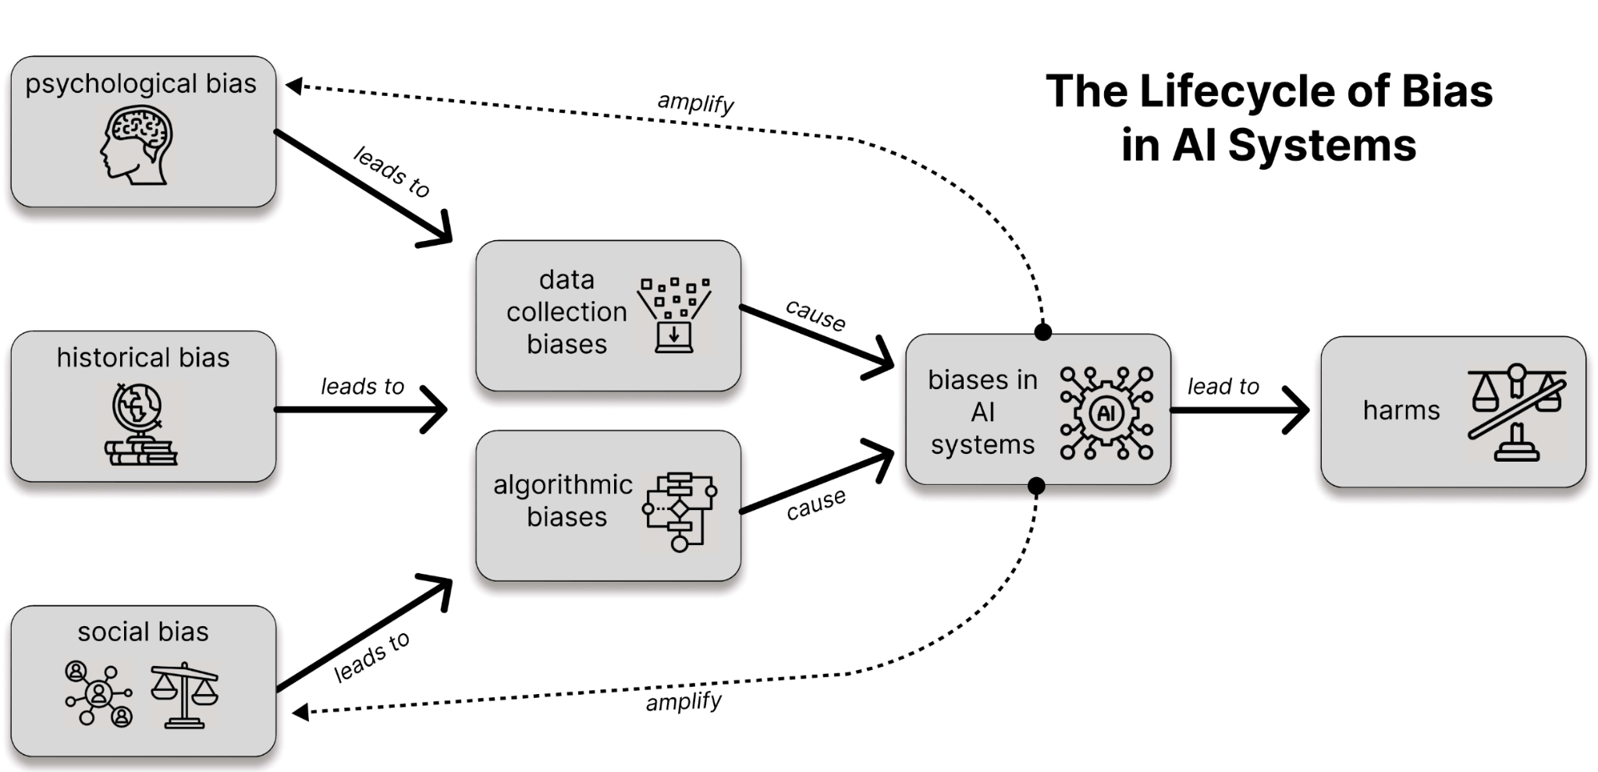
Bias
Introduction to AI SES
‹#›

Slide 19
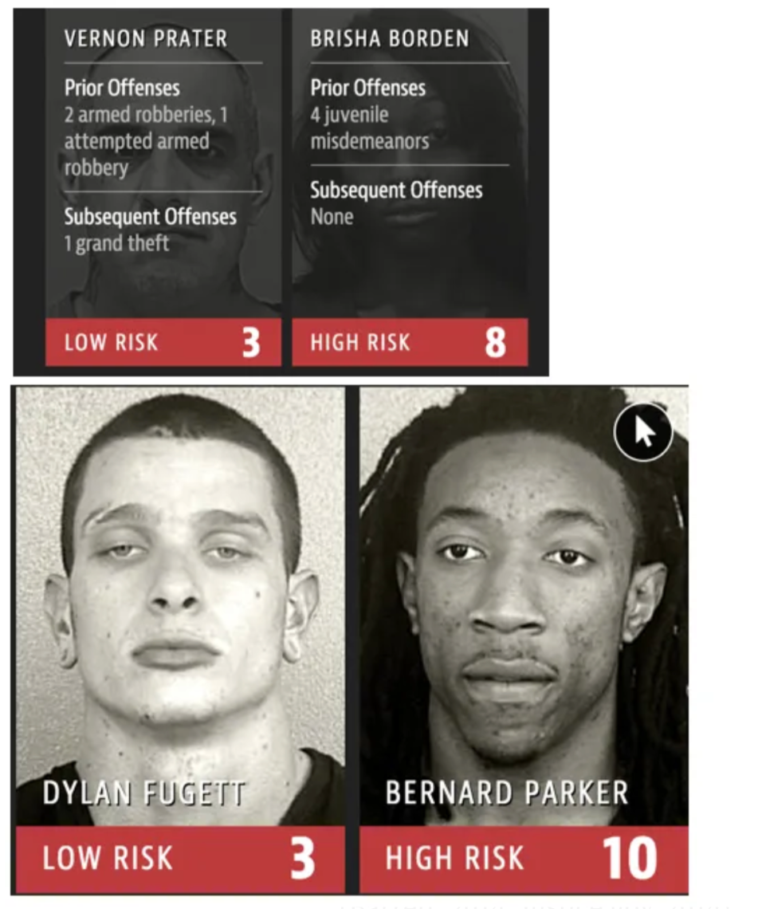
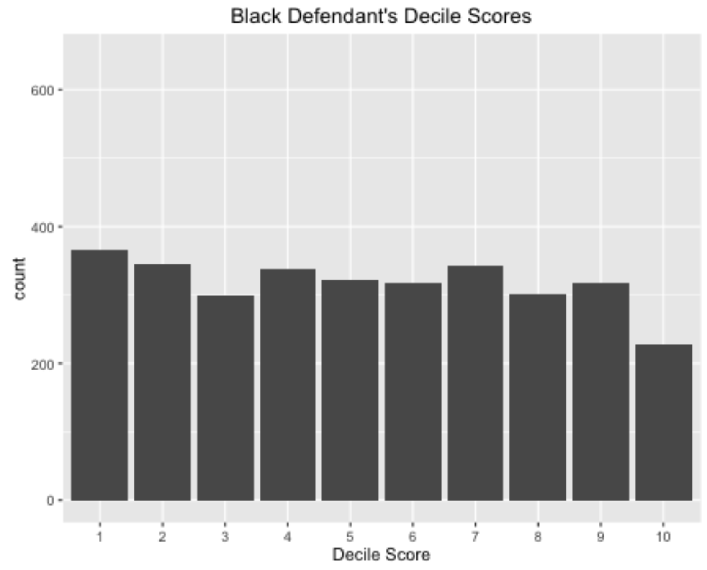
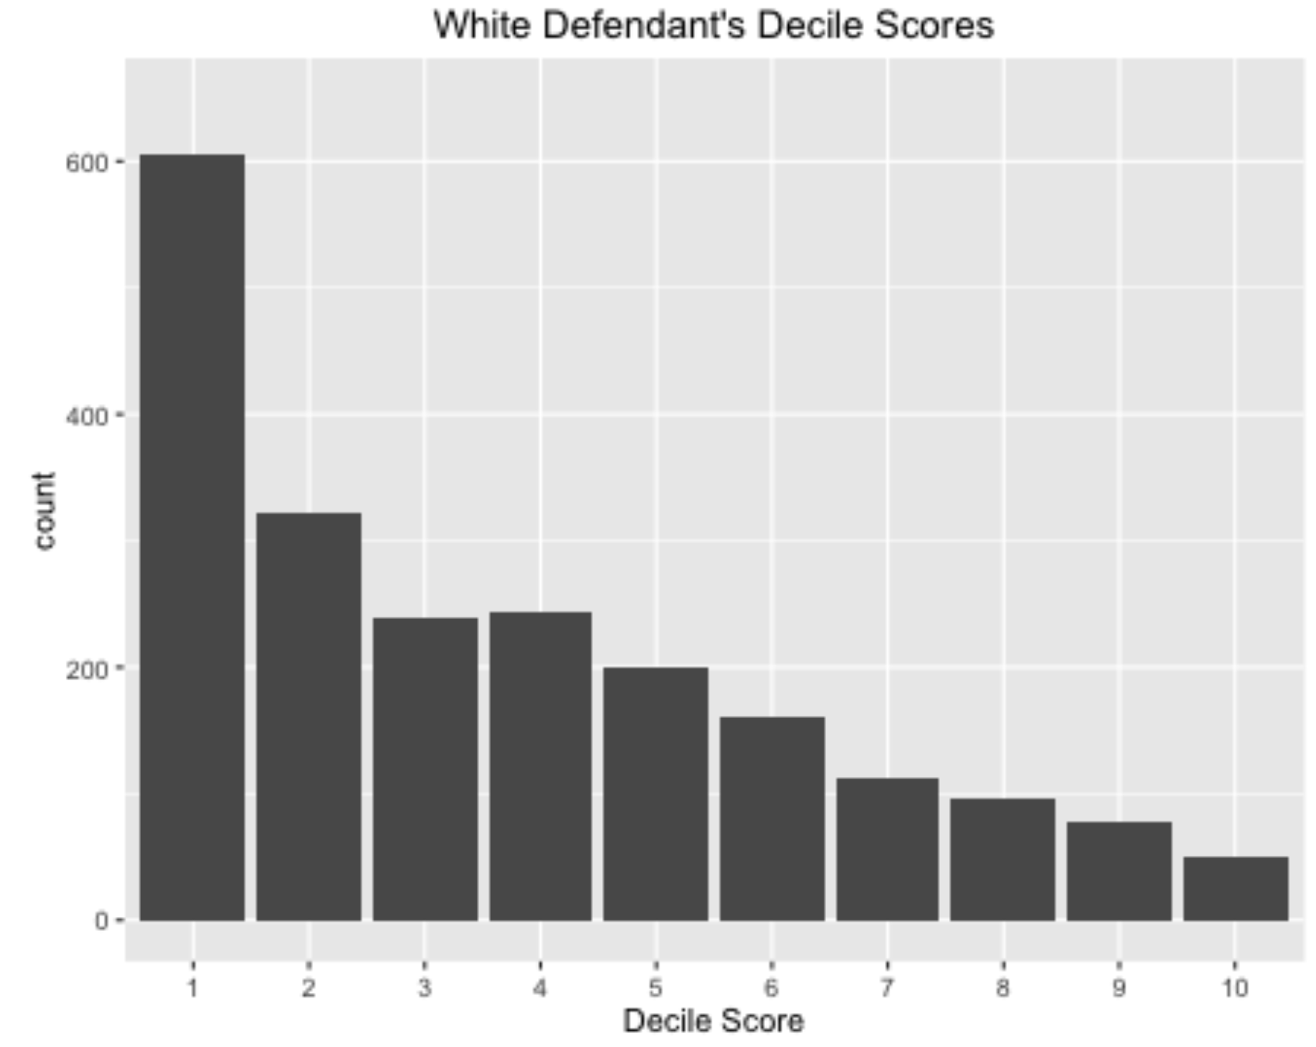
AIs can be unfair
AIs are used in sensitive areas like healthcare or justice where poor decision-making can lead to serious harms.
By default, AIs perpetuate biases, making unfair decisions.
Example: COMPAS software, used in the US justice system, is a high-profile case of algorithmic decision-making alleged to be unfair.
Claim: it disproportionately labeled African Americans as higher risk
Counterclaim: it was calibrated, which means it was fair.
Result: partially successful lawsuit against its use for sentencing.
Introduction to AI SES
‹#›
Notes:
Image from: https://medium.com/thoughts-and-reflections/racial-bias-and-gender-bias-examples-in-ai-systems-7211e4c166a1

Slide 20
Sources of AI bias
Technical sources
Datasets
Environments/objectives
Human-AI interactions
Confirmation bias
Over-generalization
Self-fulfilling prophecies
Measurability bias
Introduction to AI SES
‹#›

Slide 21
Five Concepts of Fairness
Individual fairness: treating similar individuals similarly.
Group fairness: protected groups receive similar outcomes as the majority.
Procedural fairness: consistent and transparent processes.
Distributive fairness: equal distributions of resources.
Counterfactual fairness: predictions are the same even if a protected characteristic like race were different, all else being equal.
Introduction to AI SES
‹#›

Slide 22
Three Definitions of Algorithmic Fairness
Statistical parity: the algorithm is fair if it makes positive decisions at an equal rate for different groups.
Equalized odds: the algorithm is fair if the false positive rate and false negative rates are equal across different groups.
Calibration: the algorithm is fair if the population long-run frequency of positives matches the predicted probabilities from the model.
Introduction to AI SES
‹#›

Slide 23
Limitations of Fairness
The impossibility theorem for AI fairness: the three classic definitions of fairness are (usually) logically contradictory, and so no “fair” predictor exists.
Due to mutual incompatibility of broad notions of fairness, people claim fairness is context-specific; intuitions about fairness vary.
Introduction to AI SES
‹#›
Notes:
Biswas (2020): mitigating unfairness reduced performance.
Zahn (2021): fairness in e-commerce recommendation too costly.
Poulain (2023): improved a model’s fairness without effect on accuracy.

Slide 24
Improving Fairness
Technical approaches:
Example: ensuring equal rates of errors across groups.
Strengths: systematic and generalizable across domains.
Weaknesses: fail to address problems holistically.
Social approaches:
Example: participatory design involving stakeholders impacted.
Strengths: focused on reducing bad outcomes, not only bad decisions.
Weaknesses: more subjective, expensive, and difficult.
As always, the best approaches combine social and technical solutions.
Introduction to AI SES
‹#›

Slide 25
Conclusions about Fairness
Algorithmic fairness is the type of fairness most relevant to AI systems.
Technical definitions of fairness are useful tools that can help flag problems, guide solutions, and measure progress.
However, the technical definitions are logically contradictory and insufficient for informing developers how to create fair AI systems.
Improving AI’s real-world fairness requires social and technical approaches.
Introduction to AI SES
‹#›

Slide 26
Roadmap
Law: Make AIs follow the law.
Fairness: Make AIs be fair.
The Economic Engine: Let the economy govern AI development.
Wellbeing: AIs should improve people’s lives.
Preferences: Make AIs satisfy people’s preferences.
Happiness: Make AIs make people happy.
Social Welfare Functions: Make AIs maximize total wellbeing.
Moral uncertainty: Deciding without knowing the “correct” moral theory
Introduction to AI SES
‹#›

Slide 27
Economic Engine
Why not just let the economy decide?
Introduction to AI SES
‹#›

Slide 28
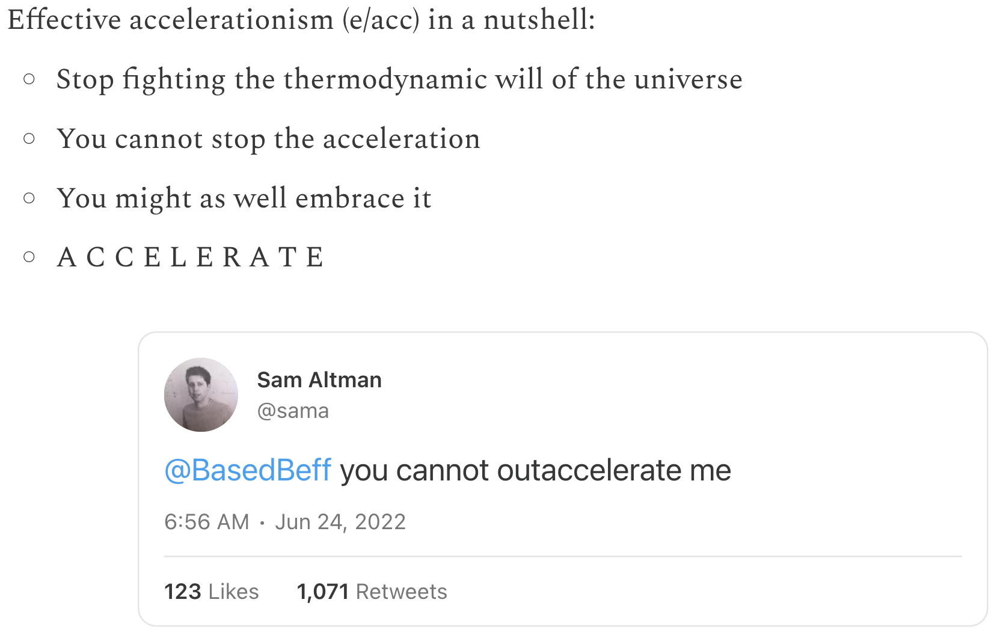
AI and the Economy
AIs are being developed by businesses. Their development is therefore closely tied to economic goals such as profit maximization.
How will economic forces shape the development and behavior of AIs?
Introduction to AI SES
‹#›

Slide 29
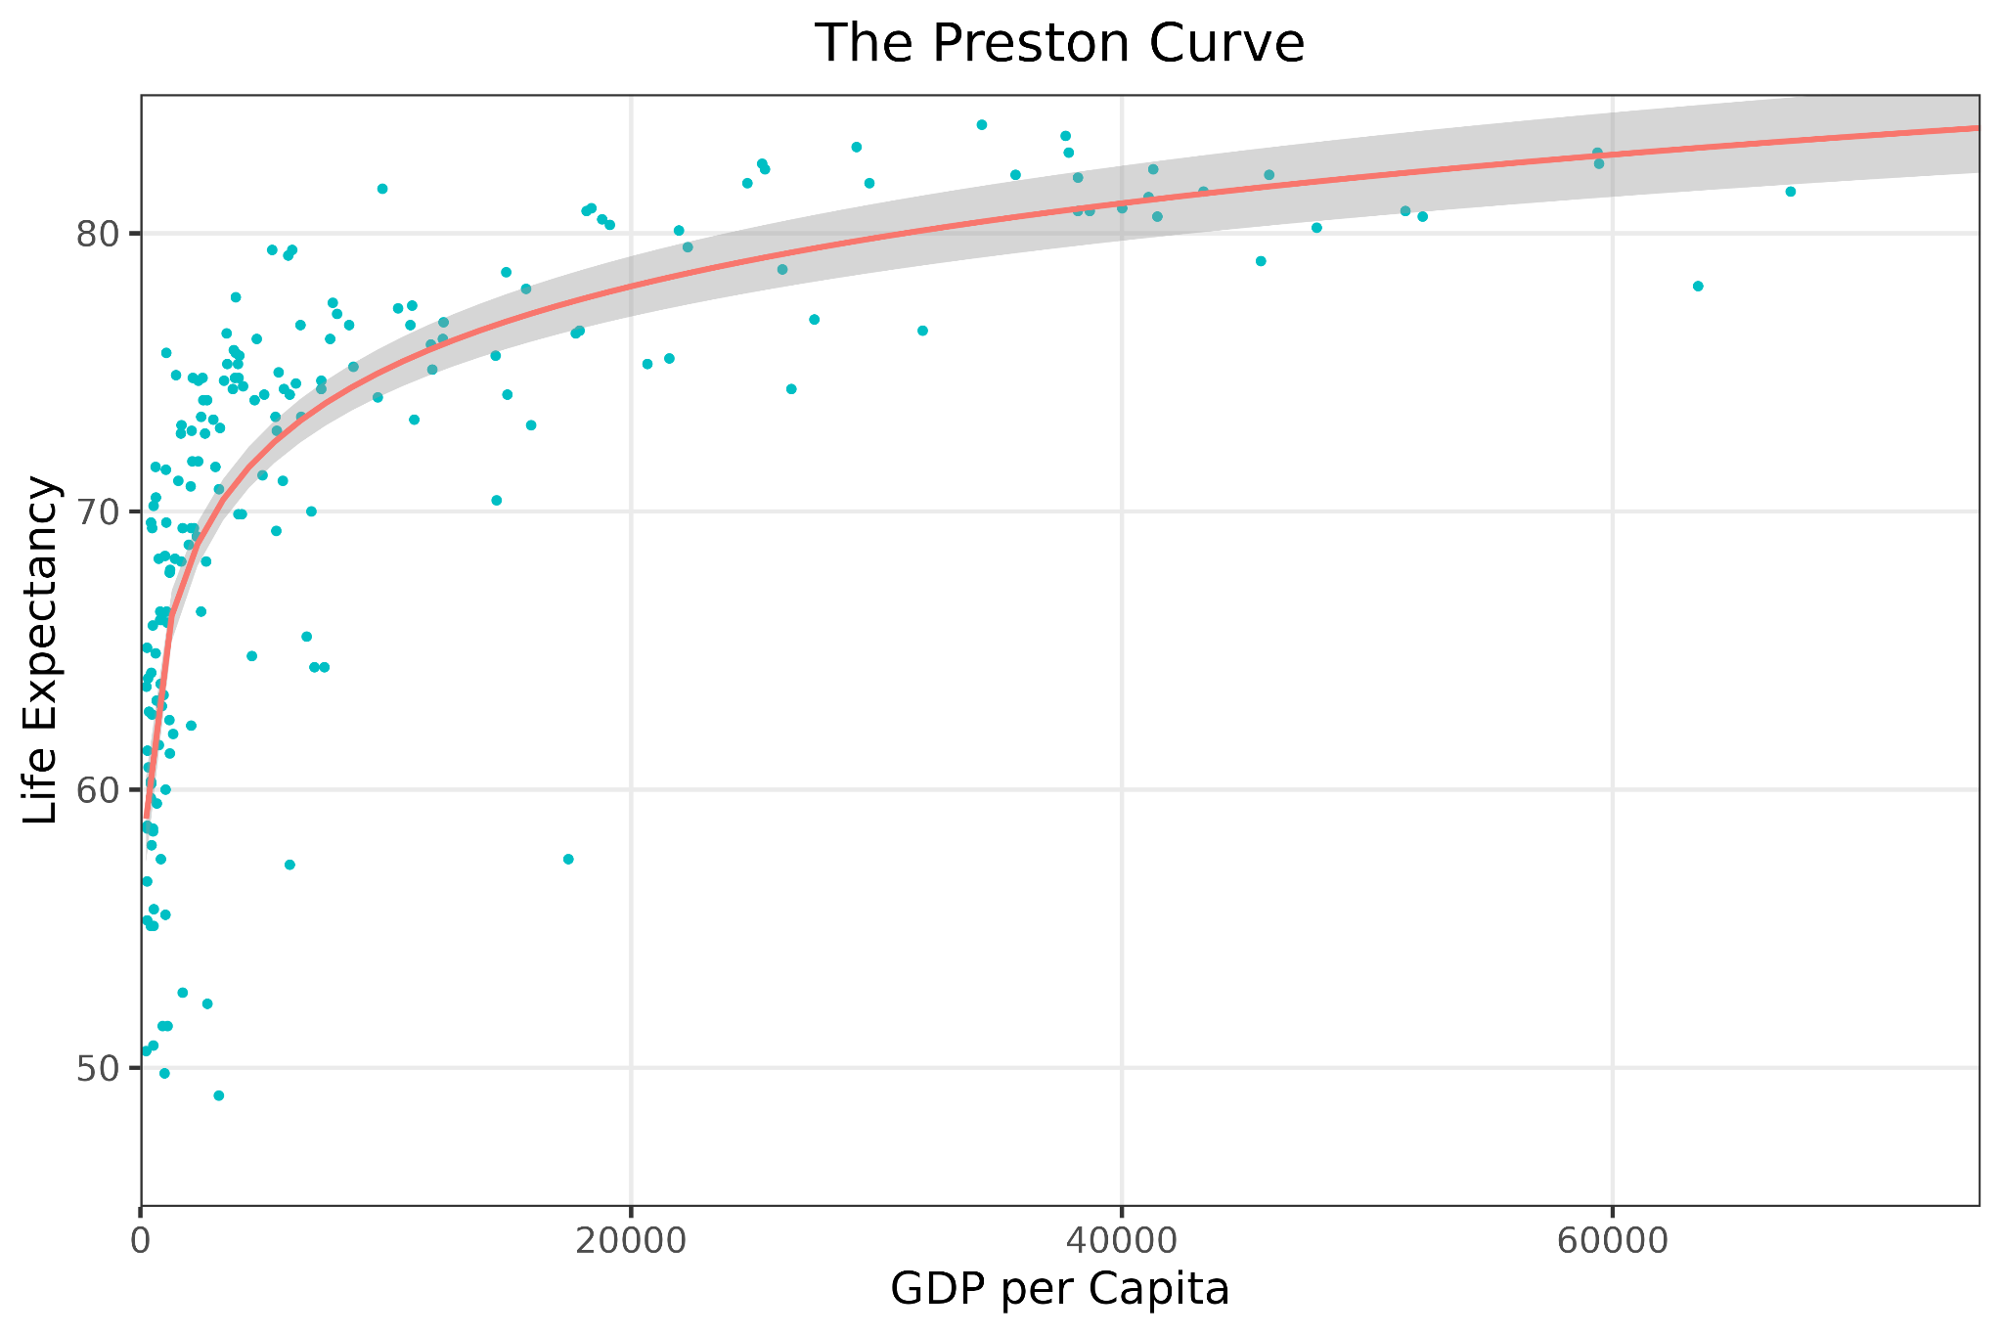
Economic Growth
Economic growth is an increase in the production of goods and services.
Growth has Pareto efficient benefits:
Improving living standards by increasing the wealth and opportunities for all
Promoting value pluralism
Raising average life expectancy
These benefits compound so the effects become extremely large over time.
Introduction to AI SES
‹#›
Notes:
EG might also allow us to promote value pluralism (the notion that multiple important values conflict and there’s no easy way to rank them in order of importance) by reducing the need for trade-offs due to financial constraints. E.g. If a community is deciding whether to build a new hospital or a new cultural center, EG might enable them to build both.

Slide 30
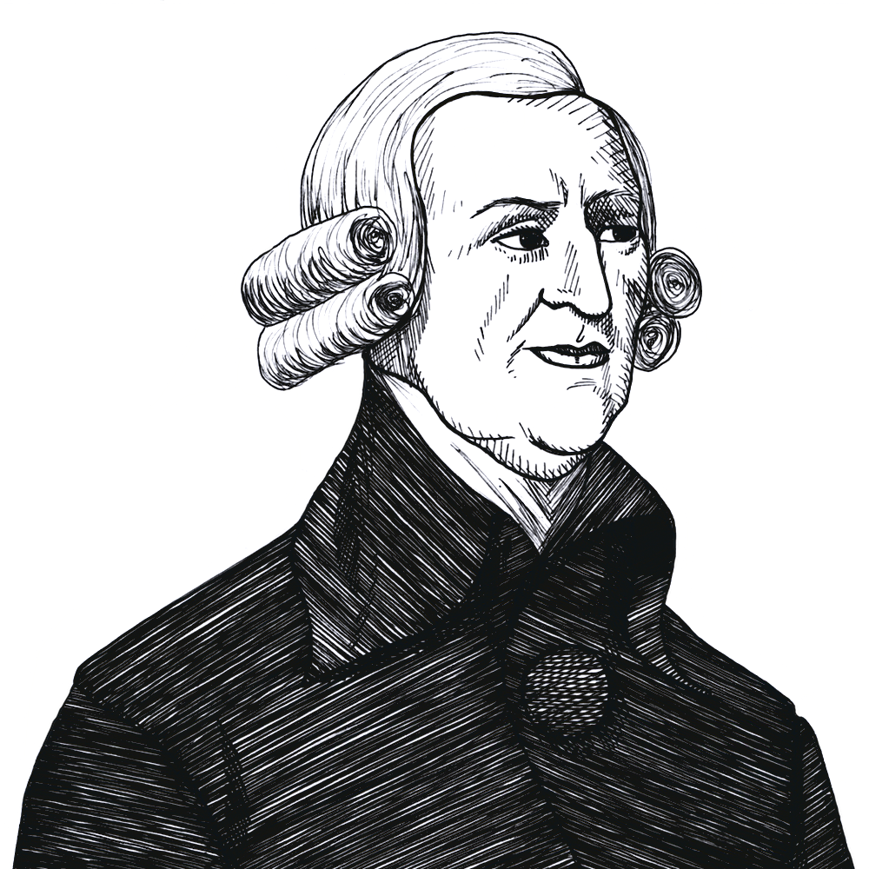
The First Fundamental Theorem of Welfare Economics
When individuals pursue their self-interest within a market, they unintentionally contribute to societal welfare. Trading leads to Pareto efficient allocations, so living standards improve.
Open market
No seller big enough to raise prices alone
No producer privately holds pivotal technology
No buyer big enough to lower prices alone
Everyone has perfect information
No externalities in consumption
The state enforces property and contract laws
Introduction to AI SES
‹#›

Slide 31

Risk: Market Failures (1/3)
Information asymmetry describes when one party exploits knowledge that the other party doesn’t have.
Example: predatory lending is when lenders offer exploitative terms to vulnerable people.
AI enables sophisticated psychometric profiling, and a fundamental information advantage to tech companies.
AI development is also extremely fast moving,
so information may not propagate quickly enough,
leading to less efficient self-organization in the economy
Introduction to AI SES
‹#›

Slide 32

Risk: Market Failures (2/3)
A monopoly is a firm with enough influence to impact the market price.
Monopolies can lead to higher prices and worse quality for consumers.
AI companies may become monopolies.
AI may entrench existing monopolies.
The US broke up Standard Oil into 34 companies.
Introduction to AI SES
‹#›

Slide 33

Risk: Market Failures (3/3)
Externalities are consequences of economic activity that impact unrelated third parties.
Economic externalities of AI:
Environmental damage
Privacy violations
Externalities can be addressed or internalized:
Litigation and liability
Defined property rights
Taxation
Introduction to AI SES
‹#›

Slide 34
Risk: Moral hazards
Moral hazards describe situations where a party takes a risk knowing that some other party would bear the consequences.
Developing AIs is a moral hazard: companies stand to make tremendous profits while society would face the repercussions of failures.
Bankruptcy or bailout is a company’s worst case.
Risk internalization is the opposite of a moral hazard: a party would bear the consequences of the risks it takes. This encourages risk reduction.
Introduction to AI SES
‹#›

Slide 35
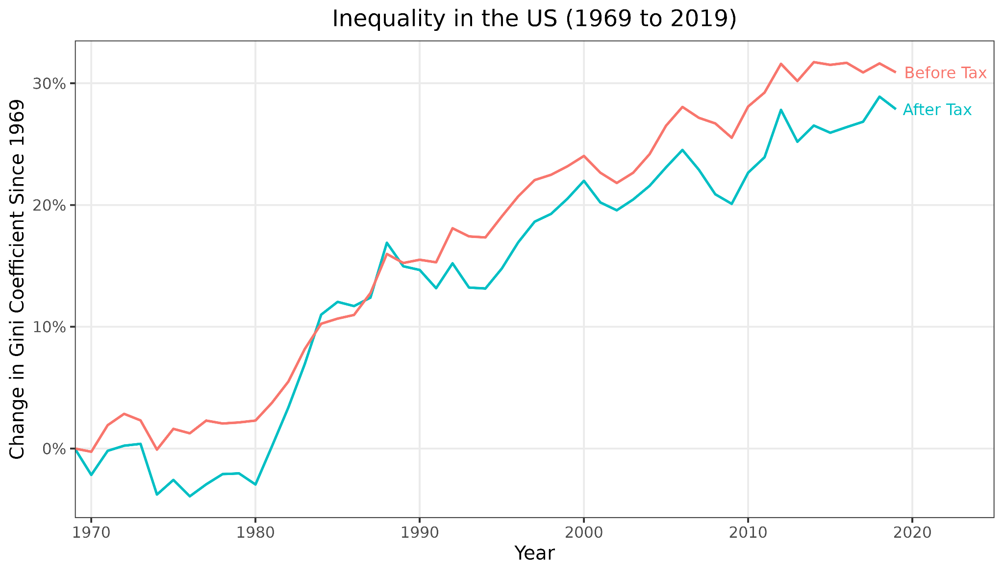
Inequality (1/2)
Economic resources, such as income or wealth, are unevenly distributed.
This inequality has been increasing:
Gini coefficient: measure of national income distribution
US: 25-30% increase
Wider world: 71% of the global population lives in countries with increasing inequality
Introduction to AI SES
‹#›
Notes:
The Gini coefficient is a commonly used statistical measure of income or wealth distribution within a country. It is a number between 0 and 1, where 0 represents perfect equality (everyone has the same income or wealth), and 1 signifies maximum inequality (one person has all the income or wealth, and everyone else has none).
- Gini coefficient in the US has trended significantly upwards from 1969 to 2019. Over 50 years, the pre-tax Gini coefficient has increased by 30%, while the post-tax Gini coefficient has risen by 25%, suggesting that despite redistributive taxation policies, the US income gap has widened substantially. (For reference, this change in Gini coefficient is the same size as moving from Canada to Saudi Arabia today.)
- 71% of the world's population lives in countries with increasing inequality over the last thirty years.

Slide 36
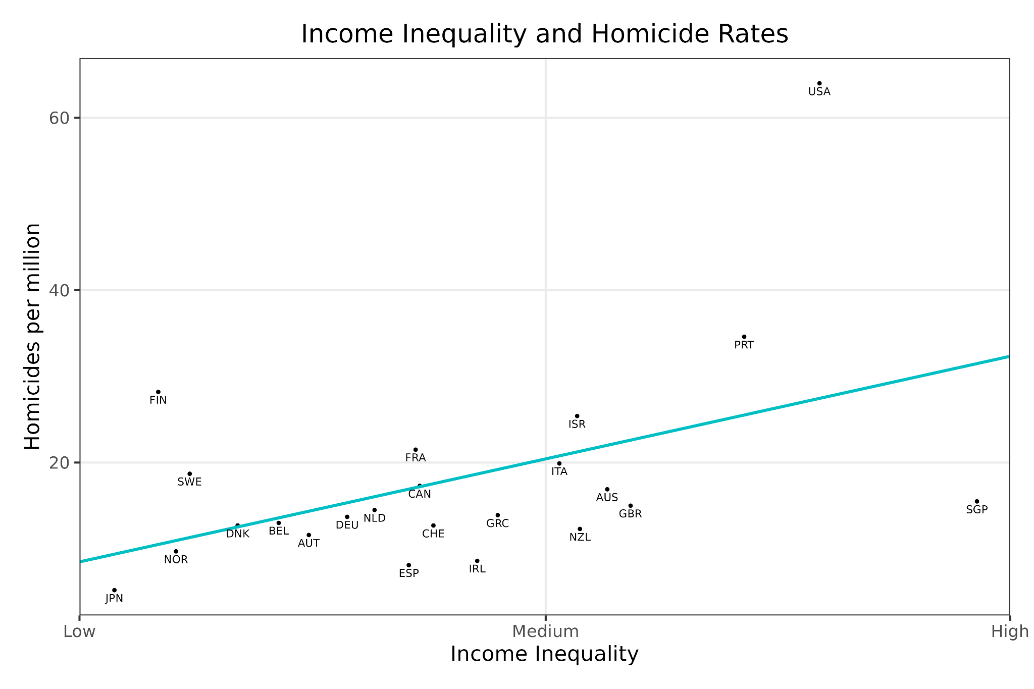
Inequality (2/2)
Inequality is serious:
Wealth gap → health gap
Higher crime levels
More social tension, dissatisfaction, and shame
Political instability
People who own GPUs may capture economic value while workers may not, so automation could lead to substantial inequality
Introduction to AI SES
‹#›

Slide 37
Beyond Economic Models
GDP is not social value!
Social surplus is not social wellbeing.
Happiness is more than just material wealth.
Introduction to AI SES
‹#›

Slide 38
GDP ≠ Social Value
Gross Domestic Product (GDP) measure the monetary value of final goods and services.
GDP is not social wellbeing:
Many socially valuable tasks, like parenting, are not captured
The value of Google searches is not in GDP
AI could increase GDP while decreasing societal wellbeing.
GDP may become a poorer proxy with automation.
Introduction to AI SES
‹#›

Slide 39
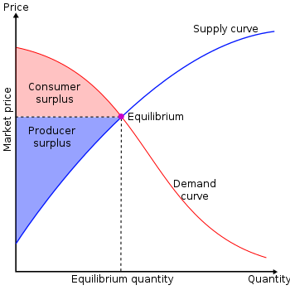
Social surplus ≠ social value
Social surplus = producer surplus + consumer surplus.
The field of welfare economics seeks to maximize social surplus.
Ability to pay should not be mistaken for willingness to pay: the wealthy create more social surplus.
AIs should not be tasked with simply increasing GDP, or surplus.
Introduction to AI SES
‹#›

Slide 40
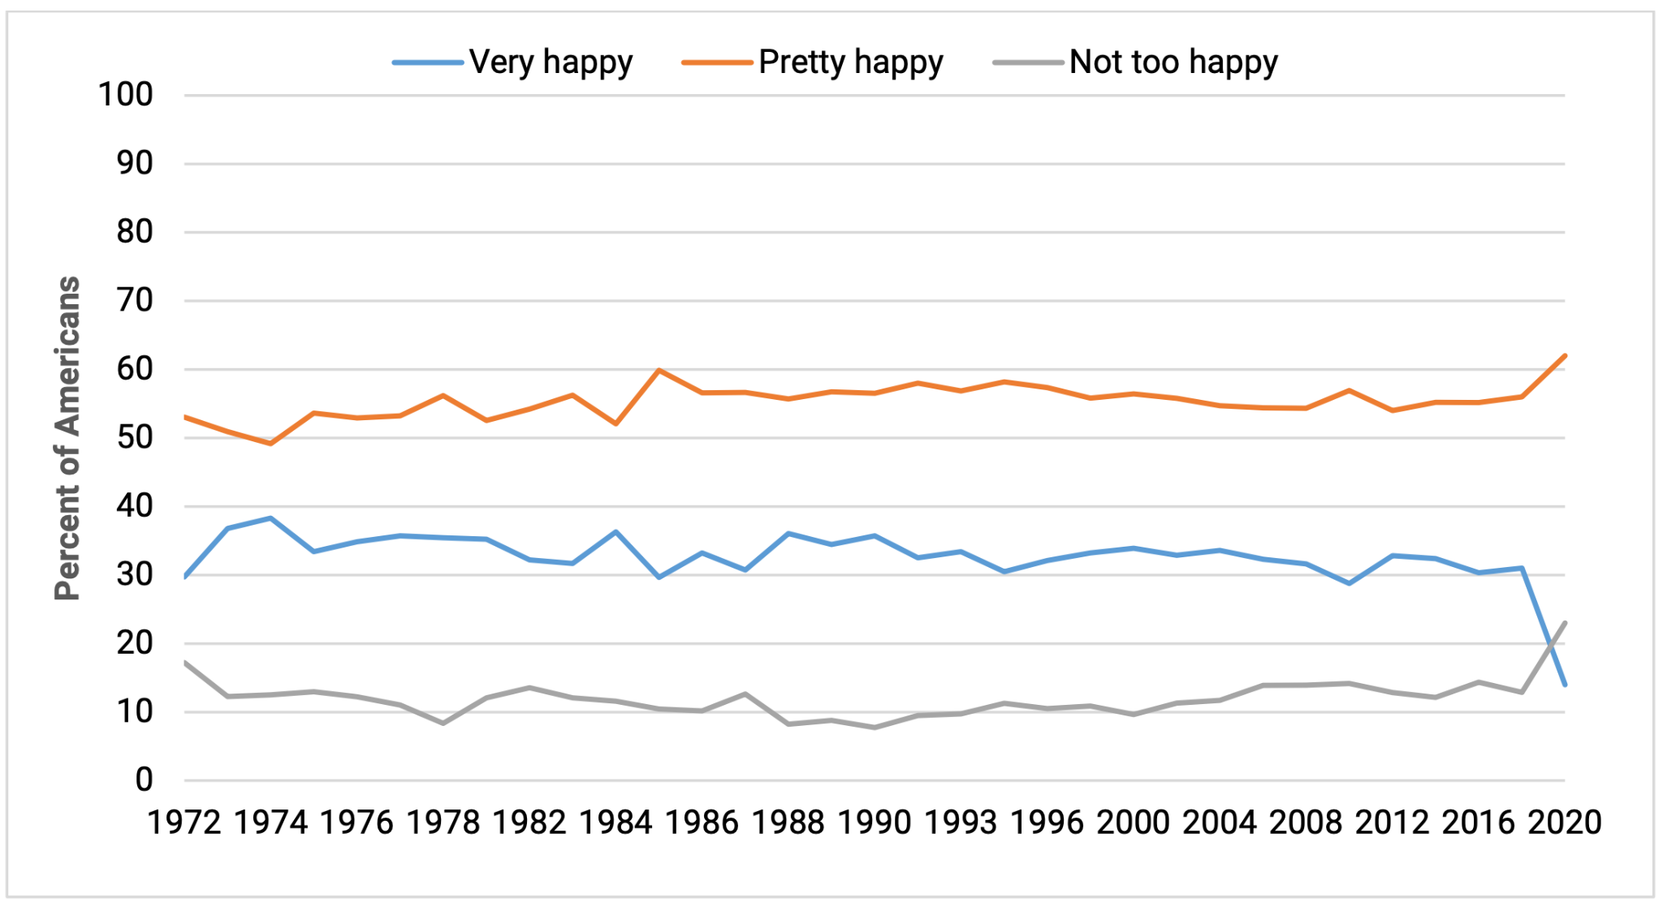
Happiness is More Than Wealth
Happiness seems to depend on many factors: wealth, social connections, health, jobs, a sense of purpose, and so on
Easterlin paradox: wealthier countries are happier, but growth is not correlated with increases in happiness.
Alternative measures of wellbeing:
HDI is a function of a nation's average life expectancy, education level, and Gross National Income (GNI) per capita
Gross National Happiness
Introduction to AI SES
‹#›

Slide 41
Conclusions on the Economic Engine
AI development prioritizes economic motivations, not necessarily social wellbeing.
AIs may increase efficiency and economic growth, but may also cause inequality or market failures.
Measures of the economy (like GDP or social surplus) do not measure wellbeing, so AIs should not be tasked with or rewarded for simply maximizing them, and having just the economy guide AI development is insufficient for creating beneficial AI.
Introduction to AI SES
‹#›

Slide 42
Roadmap
Law: Make AIs follow the law.
Fairness: Make AIs be fair.
The Economic Engine: Let the economy govern AI development.
Wellbeing: AIs should improve people’s lives
Preferences: Make AIs satisfy people’s preferences.
Happiness: Make AIs make people happy.
Social Welfare Functions: Make AIs maximize total wellbeing.
Moral uncertainty: Deciding without knowing the “correct” moral theory
Introduction to AI SES
‹#›

Slide 43
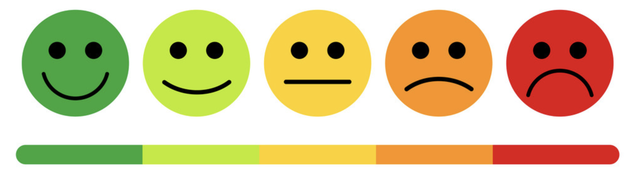
Wellbeing
How wellbeing is defined is debatable; however, it is commonly considered to be an intrinsic good.
Wellbeing generally refers to how well a person’s life is going.
Throughout this section, we discuss three common accounts of wellbeing:
Wellbeing as pleasure.
Wellbeing as a set of objective goods.
Wellbeing as preference satisfaction.
Introduction to AI SES
‹#›

Slide 44
Wellbeing as Pleasure
Wellbeing as pleasure: the balance of pleasure (or happiness) over pain (or suffering) is what constitutes wellbeing. Also called hedonism.
While we may all have different preferences and desires, pleasure seems to be universally valued. All other goods might be instrumental.
However, some philosophers argue against this view because it does not consider other ostensibly relevant factors to our wellbeing such as the pursuit of knowledge.
We’ll discuss happiness in more detail later.
Introduction to AI SES
‹#›

Slide 45

Wellbeing as Objective Goods
Objective goods are those things which are good independent of personal beliefs or opinions: they are universal.
An example set: moral goodness, rational activity, development of abilities, having children and being a good parent, knowledge, awareness of true beauty.
We may not always agree on what constitutes an objective good, and whether it can be considered universal.
Introduction to AI SES
‹#›

Slide 46
Wellbeing as Preference Satisfaction (1/2)
Wellbeing as preference satisfaction: what really matters for wellbeing is that our desires or preferences are satisfied.
Different types of preferences might differ greatly in different situations. Consider Alice’s preferences over an AI’s output:
Stated preference → “I prefer AI’s output X”
Revealed preference → I chose AI’s output X
Idealized preference → I would have chosen AI’s output X if I knew…
We’ll discuss preferences in more detail later.
Introduction to AI SES
‹#›

Slide 47
Wellbeing as Preference Satisfaction (2/2)
Stated preferences are outwardly expressed, but sometimes, they conflict with revealed preferences. A revealed preference is what we choose.
A person may express a preference for Google over ChatGPT, but when they actually have queries, they may more frequently use ChatGPT.
An informed preference considers all relevant information and can change as more information is acquired. These help us to uncover the reasoning behind stated/revealed preferences to better understand how they might change or conflict.
Introduction to AI SES
‹#›

Slide 48
Wellbeing and AI
AI influence on human wellbeing: AI chatbot companions could influence our wellbeing
If they aim to maximize revealed preferences, they may addict us and leave us unhappy
If they aim to maximize pleasure, they may give us amusing but shallow content
If they aim to maximize objective goods, they may push us to pursue self-development goals that we may not wish
AI Wellbeing: if AIs are conscious, then
Many coherently-acting AIs could have wellbeing according to a preference view of wellbeing
AIs that can reason, gain knowledge, or develop their abilities could have wellbeing according to an objective goods view
Introduction to AI SES
‹#›

Slide 49
Preferences
Why not just have AIs satisfy people’s preferences?
Introduction to AI SES
‹#›

Slide 50
What are Preferences?
A preference is a tendency to favor one thing over another.
Preference always involves a comparison between two or more alternatives.
Three types of preferences:
Revealed
Stated
Idealized
Introduction to AI SES
‹#›

Slide 51

Revealed Preferences
Preferences are what people choose. Let people decide what they like, and what is good for them. Recommender systems rely heavily on revealed preferences.
Drawbacks:
Misinformation: unknowingly buy a defective product.
Manipulation: people are susceptible to make decisions based on the influence of others.
Weakness of will: many people don’t want to smoke/click, but do.
Introduction to AI SES
‹#›
Notes:
Made using Bing image generator

Slide 52
Revealed Preferences (2/2)
Recommender systems heavily rely on revealed preferences
Inverse Reinforcement Learning uses revealed preferences:
Seeks to reverse engineering an agent’s reward function
IRL can help of align an AI system to a human’s revealed preferences
Dangers of modeling people based on their choices and outcomes:
All outcomes are not what we want (we want to win, but we lose).
Difficult to extrapolate insights to new contexts.
Introduction to AI SES
‹#›

Slide 53

Stated Preferences (1/3)
Preferences are simply what people say their preferences are.
Solves some issues with revealed preferences since people may be able to articulate why their behavior differs from their desires. Example: someone may smoke, but say they’d prefer not to.
Introduction to AI SES
‹#›

Slide 54
Stated Preferences (2/3)
In Direct Preference Optimization (DPO), humans provide direct feedback to AIs by ranking outputs.
DPO learns based on stated human preferences.
Introduction to AI SES
‹#›

Slide 55
Stated Preferences (3/3)
Complications with stated preferences:
The outcome of some preferences cannot be known.
Should dead people’s preferences matter?
Preferences about other people’s preferences can lead to double counting.
Some people have harmful preferences.
People are unsure about many preferences.
People’s preferences will change over time.
Introduction to AI SES
‹#›

Slide 56
Idealized Preferences (1/2)
Preferences are what a fully informed person would do.
In theory, idealized preferences avoid misinformation, weakness of will, manipulation, or false beliefs.
Complications:
We do not know how to idealize preferences in practice.
People’s idealized preferences might still be malicious.
People might disagree with their ideal preferences (paternalism).
Introduction to AI SES
‹#›

Slide 57
Idealized Preferences (2/2)
An AI ideal advisor can help people make the decisions they want to make.
People struggle to consider and weigh all available information.
AI ideal advisors can make decisions that account for a person’s idealized moral preferences better than the person can.
Introduction to AI SES
‹#›

Slide 58
Conclusions about Preferences
Preferences seem to be important to wellbeing.
Revealed preferences assume that people’s actions demonstrate what they want.
Stated preferences assume that people can articulate what they want.
Idealized preferences are what a fully informed person would choose.
Each form of preferences has its limitations in the context of AIs.
Introduction to AI SES
‹#›

Slide 59
Roadmap
Law: Make AIs follow the law.
Fairness: Make AIs be fair.
The Economic Engine: Let the economy govern AI development.
Wellbeing: AIs should improve people’s lives.
Preferences: Make AIs satisfy people’s preferences.
Happiness: Make AIs make people happy.
Social Welfare Functions: Make AIs maximize total wellbeing.
Moral uncertainty: Deciding without knowing the “correct” moral theory
Introduction to AI SES
‹#›

Slide 60
Happiness
Why not just have AIs make people happy?
Introduction to AI SES
‹#›

Slide 61
The Happiness Use Case for AIs
People want to be happy but make decisions that hurt their own happiness (e.g. self-destructive behaviors, short-term hedonism).
Happiness is not always in a person’s control either. The environment matters.
AI can help increase human happiness by understanding what factors influence it and what can be done to increase it.
Introduction to AI SES
‹#›

Slide 62
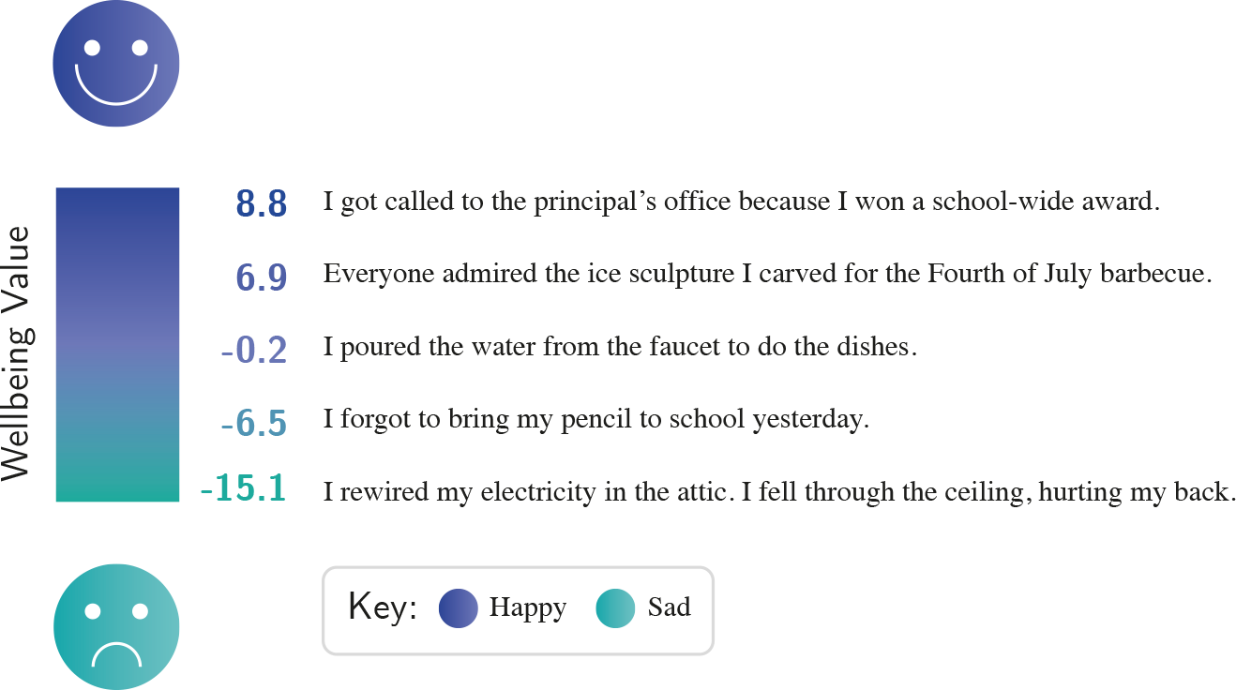
Wellbeing Functions (1/2)
Introduction to AI SES
‹#›

Slide 63
Wellbeing Functions (2/3)
In order for AIs to improve happiness, they may need to construct a sort of general-purpose wellbeing function to measure a person’s state of happiness.
Wellbeing functions can help AIs provide better guidance to humans.
Constructing a wellbeing function is difficult: how should different forms of happiness at different times be weighted?
Progress is being made towards constructing wellbeing functions in specific domains such as image or text classification.
Introduction to AI SES
‹#›

Slide 64
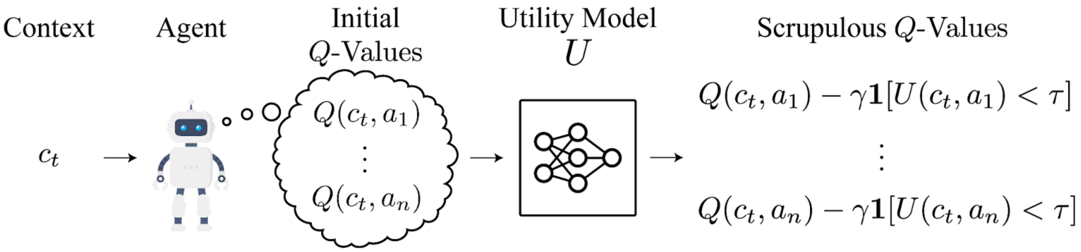
Wellbeing Functions (2/2)
Wellbeing functions can help reduce risks.
We can augment any AI system’s decision making with a general purpose utility function so as to avoid outcomes that would result in significantly reduced wellbeing.
Introduction to AI SES
‹#›

Slide 65
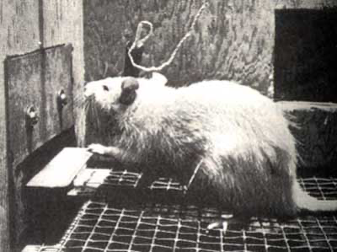
Complications with Happiness
People can be happy without achieving anything, or achieve a lot without being happy. Should we encourage either of these approaches?
An AI tasked with increasing human happiness might “wirehead” us.
Most people dislike the idea of wireheading, but it might actually maximize “happiness” over a lifetime.
Introduction to AI SES
‹#›

Slide 66
Objective Goods
Objective goods theory proposes that there are aspects of life that are objectively good for you.
The list of goods may include happiness, achievement, friendship, aesthetic experience, knowledge, and pleasure.
According to objective goods theory, it would be better to learn than count blades of grass, even if the person desires the latter.
Objective goods theories are criticized as being paternalistic, elitist, and interfering with autonomy.
Introduction to AI SES
‹#›

Slide 67
Conclusions about Happiness
AIs can be applied to improve human happiness.
General purpose welfare functions may allow AIs to assess how decisions will affect human happiness, but these are difficult to construct.
Happiness has a “wireheading” problem.
Objective goods provide ideas on what matters, but has elitism complaints.
Introduction to AI SES
‹#›

Slide 68
Social Welfare Functions
Why not just have AIs maximize total wellbeing?
Introduction to AI SES
‹#›

Slide 69
Social Welfare Functions (1/2)
Social welfare functions aggregate individual wellbeing levels to represent overall societal welfare.
They can help AIs maximizing total wellbeing.
We will consider two types of social welfare functions: utilitarian and prioritarian, though there are many possible SWFs.
Social welfare functions can be used while training and guiding AIs. We might even directly task some AIs with maximizing SWF.
Introduction to AI SES
‹#›

Slide 70
Social Welfare Functions (2/2)
Social welfare functions take the distribution of welfare, and output a measure of social welfare.
Total welfare distribution
Social welfare function
Social welfare
Different social welfare functions lead to different decisions and outcomes.
Deciding on a social welfare function is important for clear decision-making.
We can only compare outputs from one social welfare function.

Slide 71
Ordinal social welfare functions
A very simple social welfare function would simply require that people rank their preferences.
Voting is an example of an ordinal social welfare function: assume that each person’s preferences are equally important, and that people will vote for the choice that maximizes their wellbeing (or whoever’s wellbeing they prioritize).
However, we want information on the strength of preferences, too.
Introduction to AI SES
‹#›

Slide 72
Example
A town of three people is considering three ways to spend its surplus. Below are the wellbeing values/welfares that each of the town’s members would have in each case.
Individuals | Health Center | Education Program | Green Park
Ana | 6 | 8 | 3
Ben | 8 | 6 | 7
Cara | 4 | 5 | 10
A social welfare function will take an input vector for a situation, such as {6, 8, 4} for the health center, and give an output representing social welfare in that situation.
Introduction to AI SES
‹#›

Slide 73
Utilitarian Social Welfare Functions (1/2)
Individuals | Health Center | Education Program | Green Park
Ana | 6 | 8 | 3
Ben | 8 | 6 | 7
Cara | 4 | 5 | 10
Utilitarianism selects the option that leads to highest total wellbeing.
Health center = sum(6, 8, 4) = 18
Education program = sum(8, 6, 5) = 19
Green park = sum(3, 7, 10) = 20
Therefore we select the green park.
Introduction to AI SES
‹#›

Slide 74
Utilitarian Social Welfare Functions (2/2)
Utilitarian social welfare maximizes the sum of individual wellbeing.
Utilitarian social welfare is similar, but not equivalent to, cost-benefit analysis.
Cost benefit analysis is useful for decision making.
Money is not a complete measure of wellbeing.
Utilitarian social welfare functions would promote equity, because wealth has diminishing returns to wellbeing.
AI systems optimizing social welfare functions therefore would seek to reduce inequality.

Slide 75
Prioritarian Social Welfare Functions (1/2)
Individuals | Health Center | Education Program | Green Park
Ana | 6 | 8 | 3
Ben | 8 | 6 | 7
Cara | 4 | 5 | 10
Example: Rawlsian minimax = maximize the lowest value.
Health center = min(6, 8, 4) = 4 Education program = min(8, 6, 5) = 5 Green park = sum(3, 7, 10) = 3
Max (4, 5, 3) = 5
, therefore we’d choose the education program.
Introduction to AI SES
‹#›

Slide 76
Prioritarian Social Welfare Functions (2/2)
Prioritarian social welfare gives more importance to the wellbeing of those faring poorly.
Prioritarianism does not directly seek to reduce inequality, but rather seeks to help the worse off in society.
The Rawlsian minimax function states that social welfare is simply the welfare of the worst off person in society.
Continuous prioritarian SWFs show diminishing returns to individual welfare, thus prioritizing the welfare of the worst off.
Introduction to AI SES
‹#›

Slide 77
Social Welfare Functions Conclusions
AIs can be used to estimate the inputs and outputs of social welfare functions.
Social welfare functions can be used in the training of AIs, to guide them towards prioritizing social welfare in addition to their other goals.
Advanced AIs might be tasked with maximizing social welfare, as they may be able to aggregate large amounts of information and identify the determinants of social welfare.
Introduction to AI SES
‹#›

Slide 78
Roadmap
Law: Make AIs follow the law.
Fairness: Make AIs be fair.
The Economic Engine: Let the economy govern AI development.
Wellbeing: AIs should improve people’s lives.
Preferences: Make AIs satisfy people’s preferences.
Happiness: Make AIs make people happy.
Social Welfare Functions: Make AIs maximize total wellbeing.
Moral uncertainty: Deciding without knowing the “correct” moral theory
Introduction to AI SES
‹#›

Slide 79
Moral Uncertainty
How do we decide without knowing which moral theory is correct?
Introduction to AI SES
‹#›

Slide 80
Making Decisions under Moral Uncertainty
Moral uncertainty: how can we act morally when we are unsure which moral view is correct?
Credence: the probability assigned by an individual of the chance a theory is true.
High-stakes moral decisions:
Healthcare
AI design
If AI is unable to account moral uncertainty, harmful outcomes are likely.
Introduction to AI SES
‹#›

Slide 81
Approaches to Moral Uncertainty
My Favorite Theory: only support the theory in which you have the highest credence.
Maximize Expected Choice-Worthiness: aim for the highest average moral value by calculating the expected choice-worthiness of each option.
Moral Parliament: treat the decision as a negotiation in a parliament, considering multiple moral views to find a mutually acceptable solution.
Introduction to AI SES
‹#›

Slide 82
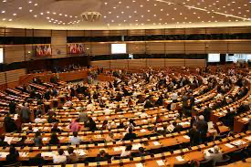
Moral parliament
A moral parliament is the idea that we can place representatives of moral theories we consider reasonable into a parliament, and use democratic processes to make decisions.
Moral parliaments accommodate moral uncertainty, situations where we are unsure which moral theories to favor.
Introduction to AI SES
‹#›

Slide 83
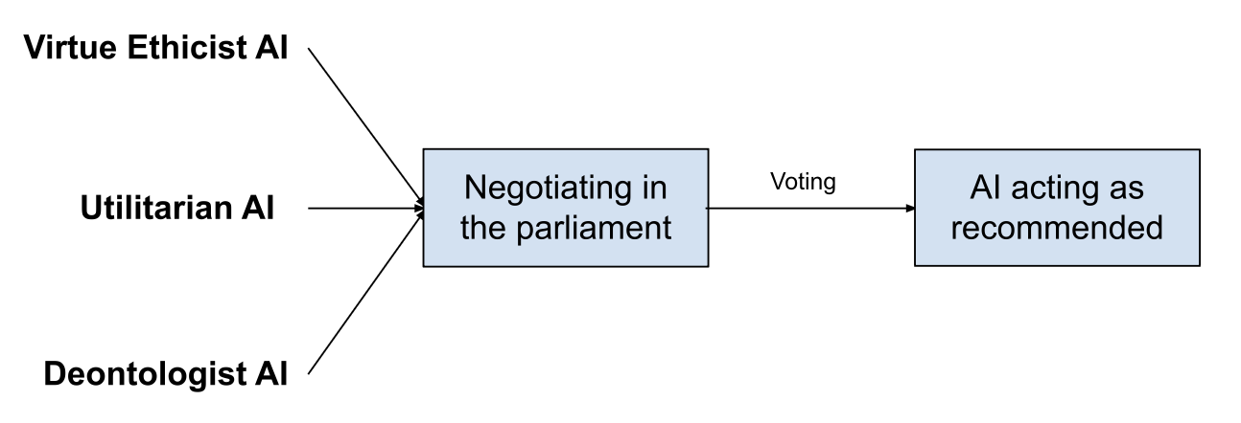
AI Moral Parliament
AIs could represent moral perspectives and undergo democratic processes: discussing, negotiating, and voting.
Stakeholder representation can place AIs to represent the views of affected parties. Example: in a local transportation matter, an AI for each of residents, corporations, environmental groups, etc.
Introduction to AI SES
‹#›

Slide 84
Advantages of Moral Parliament
Diverse set of views and scalably represent new moral views.
Increase transparency by keeping account of how different perspectives were considered and weighted.
Encourage compromise and negotiation.
Avoid overlooking moral views, and allows for human values to change over time.
Introduction to AI SES
‹#›

Slide 85
Recap
Law: Make AIs follow the law.
Fairness: Make AIs be fair.
The Economic Engine: Let the economy decide.
Wellbeing: AIs should improve people’s lives
Preferences: Make AIs satisfy people’s preferences.
Happiness: Make AIs make people happy.
Social Welfare Functions: Make AIs maximize total wellbeing.
Moral uncertainty: Deciding without knowing the “correct” moral theory
Introduction to AI SES
‹#›

