Slide 1
Introduction to
AI Safety, Ethics, and Society
Collective Action Problems
Introduction to AI SES
‹#›

Slide 2
Roadmap
Game theory
Cooperation
Conflict
Evolutionary pressures
Introduction to AI SES
‹#›

Slide 3
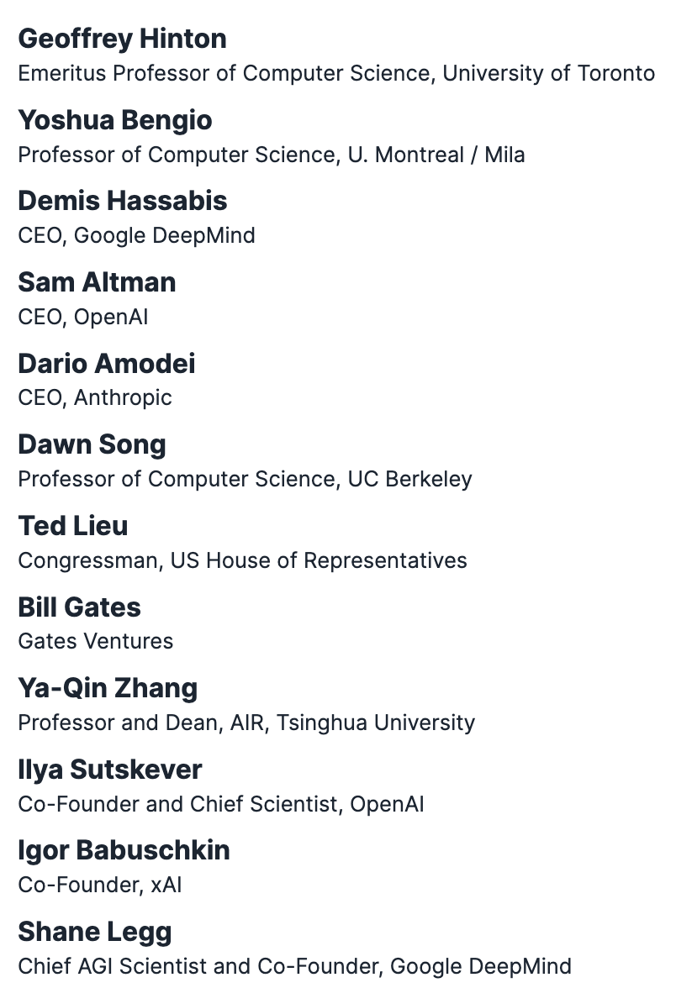
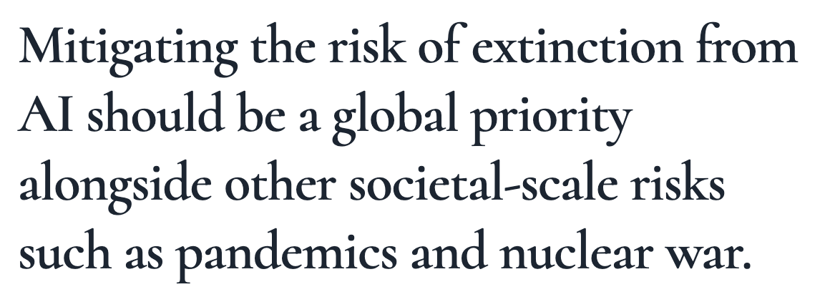
Rational Actors May Not Secure Collectively Good Outcomes
This lecture will give an interpretation for why rational actors (CEOs of AI companies) signed this statement
Introduction to AI SES
‹#›
Notes:
https://www.safe.ai/statement-on-ai-risk

Slide 4
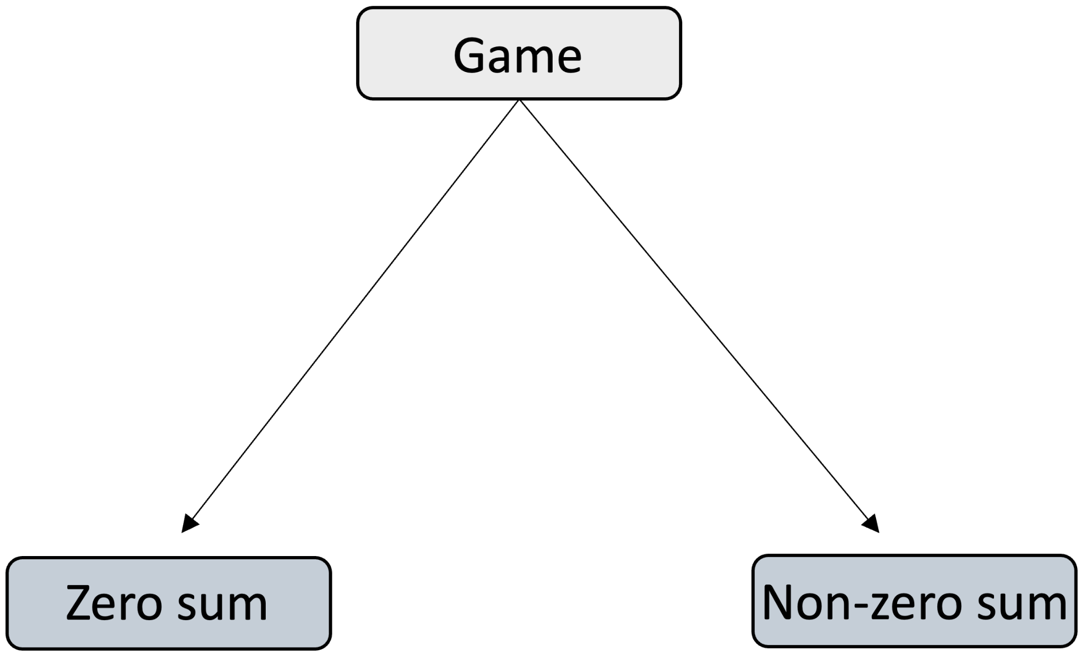
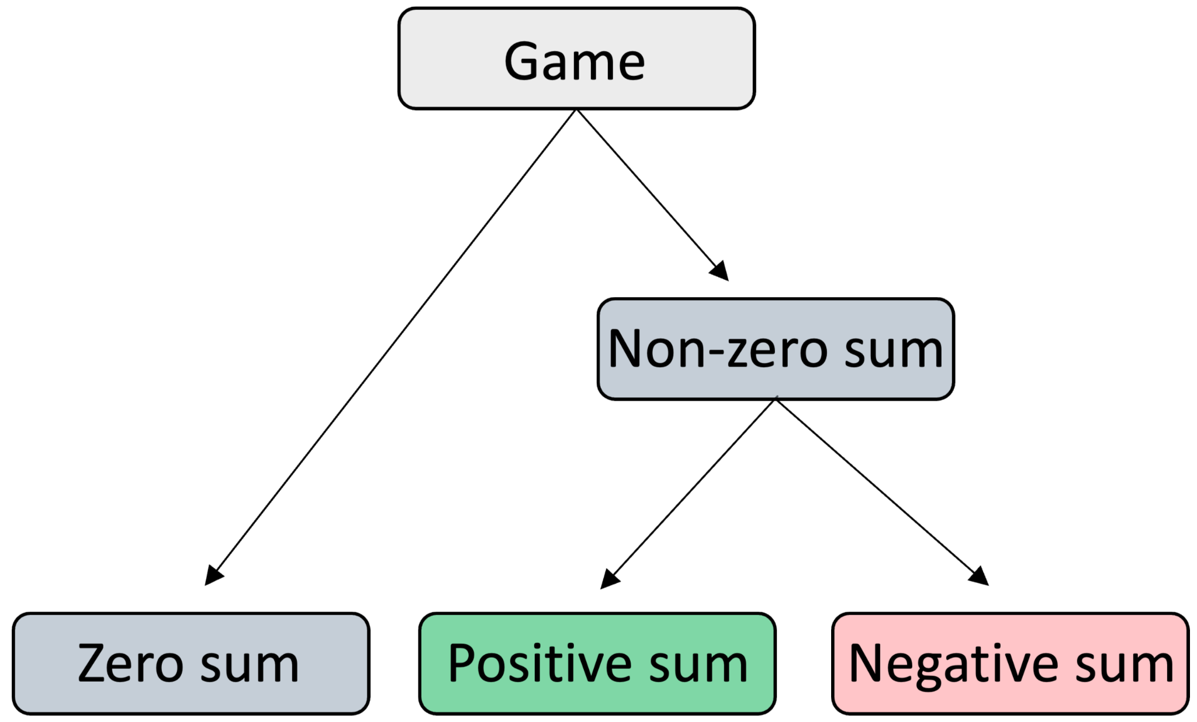
Game Theory Fundamentals
Game theory is the branch of maths concerned with reducing complicated situations to abstract games, in which agents choose interaction strategies.
We assume that the agents are:
Rational
Self-interested
Games can be:
Zero sum
Non-zero sum
Non-zero sum game outcomes can be:
Positive sum
Negative sum
Introduction to AI SES
‹#›

Slide 5









The Prisoner’s Dilemma: Animation
Cooperate
World 1
Bob
Cooperates
Alice
Cooperate
Cooperate
Defect
The dominant strategy
Cooperate
World 2
Defects
Defect
Defect
Defect
Introduction to AI SES
‹#›

Slide 6



The Four Possible Outcomes
C
D
C
D
C
D
1 year
8 years
0 years
3 years
1 year
0 years
8 years
3 years
Introduction to AI SES
‹#›

Slide 7
The Four Possible Outcomes
Payoff matrix
Bob cooperates
Bob defects
Alice cooperates
-1,
-1
-8,
0
Alice defects
0,
-8
-3,
-3
Introduction to AI SES
‹#›

Slide 8

Nash Equilibria
Bob defects
Alice defects
C
D
C
D
C
D
1 year
8 years
0 years
3 years
1 year
0 years
8 years
3 years
Introduction to AI SES
‹#›

Slide 9
Nash Equilibria
Bob defects
Alice defects
Bob cooperates
Bob defects
Alice cooperates
-1,
-1
0,
-8
Alice defects
-8,
0
-3,
-3
Nash equilibrium
Introduction to AI SES
‹#›

Slide 10
Pareto Efficiency
Alice’s payoff
Alice’s payoff worsens
Alice’s payoff improves
Alice’s payoff
Pareto improvement
Pareto improvement: a change that improves the payoff for some or all of those involved, and does not reduce the payoff for anyone.
Pareto improvement
-8,0
-8,0
-8,0
-1,-1
-1,-1
-1,-1
Pareto efficient
Pareto efficient: a state in which no Pareto improvements are possible.
Pareto efficient
Nash equilibrium
-3,-3
-3,-3
-3,-3
-3,-3
Bob’s payoff worsens
Bob’s payoff improves
Bob’s payoff
Bob’s payoff
Nash equilibrium is suboptimal for both.
Nash equilibrium
0,-8
0,-8
0,-8
Introduction to AI SES
‹#›

Slide 11
Real-World Examples
Mud-slinging
Dominant strategy
Nash equilibrium
Pareto improvement
: running negative ads to discredit opponent party
: both parties run negative campaigns; both detriment
: both parties refrain from mudslinging
Shopkeeper price racing
Dominant strategy: lowering prices to outcompete rival shop
Nash equilibrium: both shopkeepers lower their prices, sacrificing profit
Pareto improvement: both shopkeepers keep their prices high
Introduction to AI SES
‹#›

Slide 12
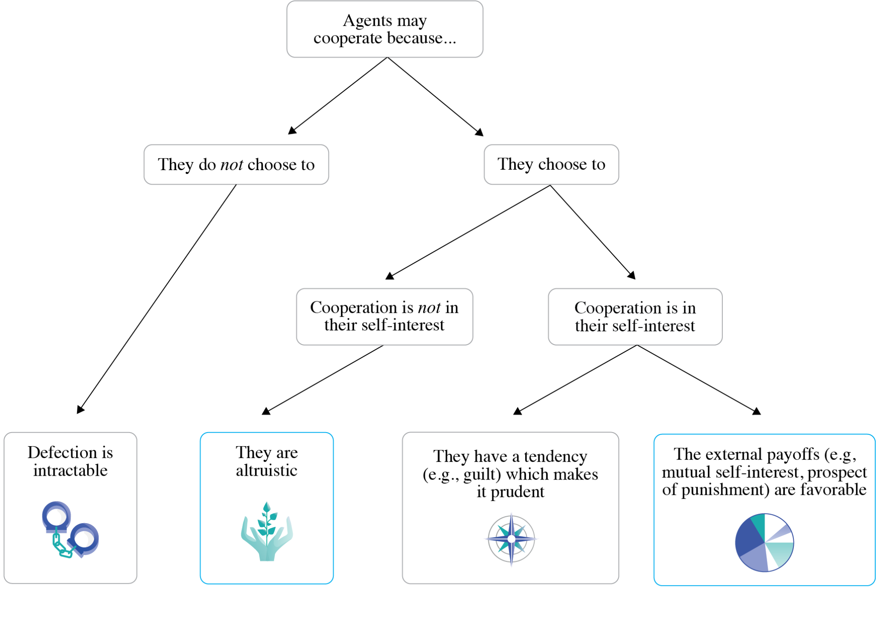
Why Agents May Cooperate
Introduction to AI SES
‹#›

Slide 13
Reason for Cooperation 1:
Payoffs Change
Bob cooperates
Bob defects
Alice cooperates
b
a
, c
, a
c
, b
d
Alice defects
, d
Prisoner’s Dilemma-like scenarios may arise if each agent will do better to defect
whether their partner cooperates (c > a)
or defects (d > b).
We can avoid this by altering these constants where they underlie critical social interactions in the real world: changing the costs and benefits associated with different activities to encourage cooperative behavior (e.g., liability laws for AI catastrophes).
Introduction to AI SES
‹#›

Slide 14
Reason for Cooperation 2:
Agent Dispositions Change
Cooperation can also be promoted by making agents more altruistic.
For example:
If Alice and Bob each value only their own payoff…
However, if each values their partner’s payoff equally to their own…
Bob cooperates
Bob defects
0,
-8
-1,
-8
-2
Alice cooperates
-1
-8,
-8
0
-3,
-6
Alice defects
-3
Introduction to AI SES
‹#›

Slide 15
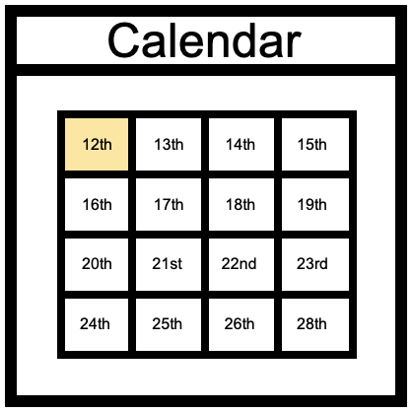
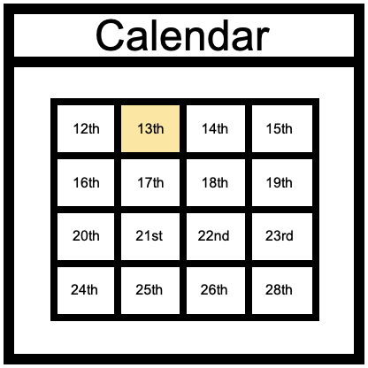
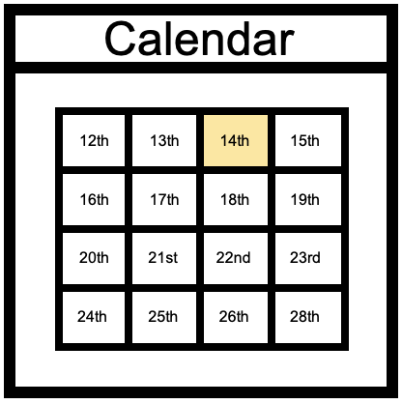



The Iterated Prisoner’s Dilemma
Defection is still the dominant strategy if agents know how many times they will interact.
Uncertainty about future engagement enables rational cooperation.
AIs interacting with each other repeatedly may cooperate, but only if they are sufficiently uncertain about whether their interactions are about to end.
D
D
C
D
D
D
D
D
C
D
C
Alice punishes Bob for defecting
Alice rewards Bob for cooperating
Bob will defect in the penultimate round
, because he knows Alice will defect in the last round, regardless of his decision
Alice will defect in the penultimate round
, because she knows Bob will defect in the last round, regardless of her decision
Bob will defect in the last round
, because he knows Alice can’t punish or reward him
Alice will defect in the last round
, because she knows Bob can’t punish or reward her
by defecting in future herself
by cooperating in future herself
Introduction to AI SES
‹#›

Slide 16

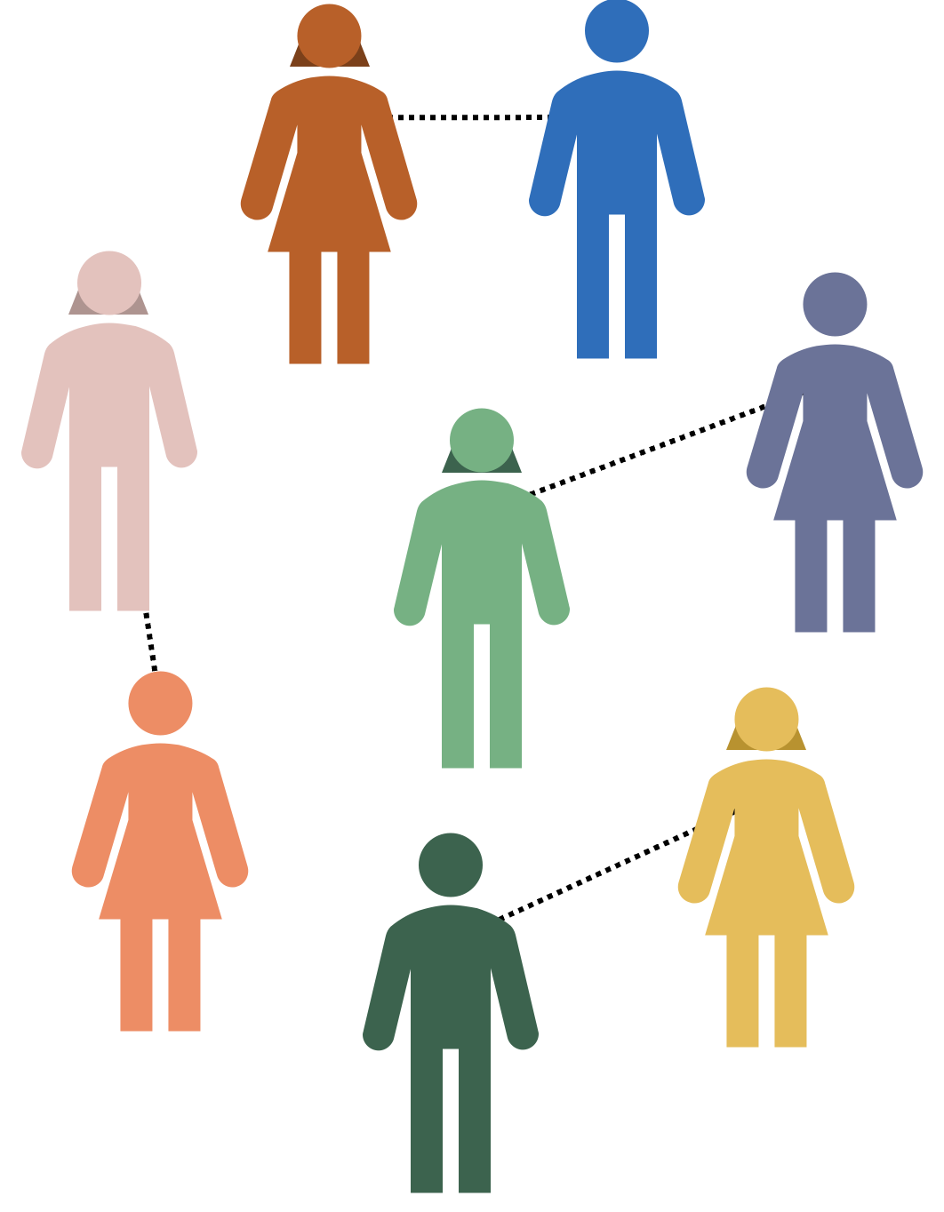
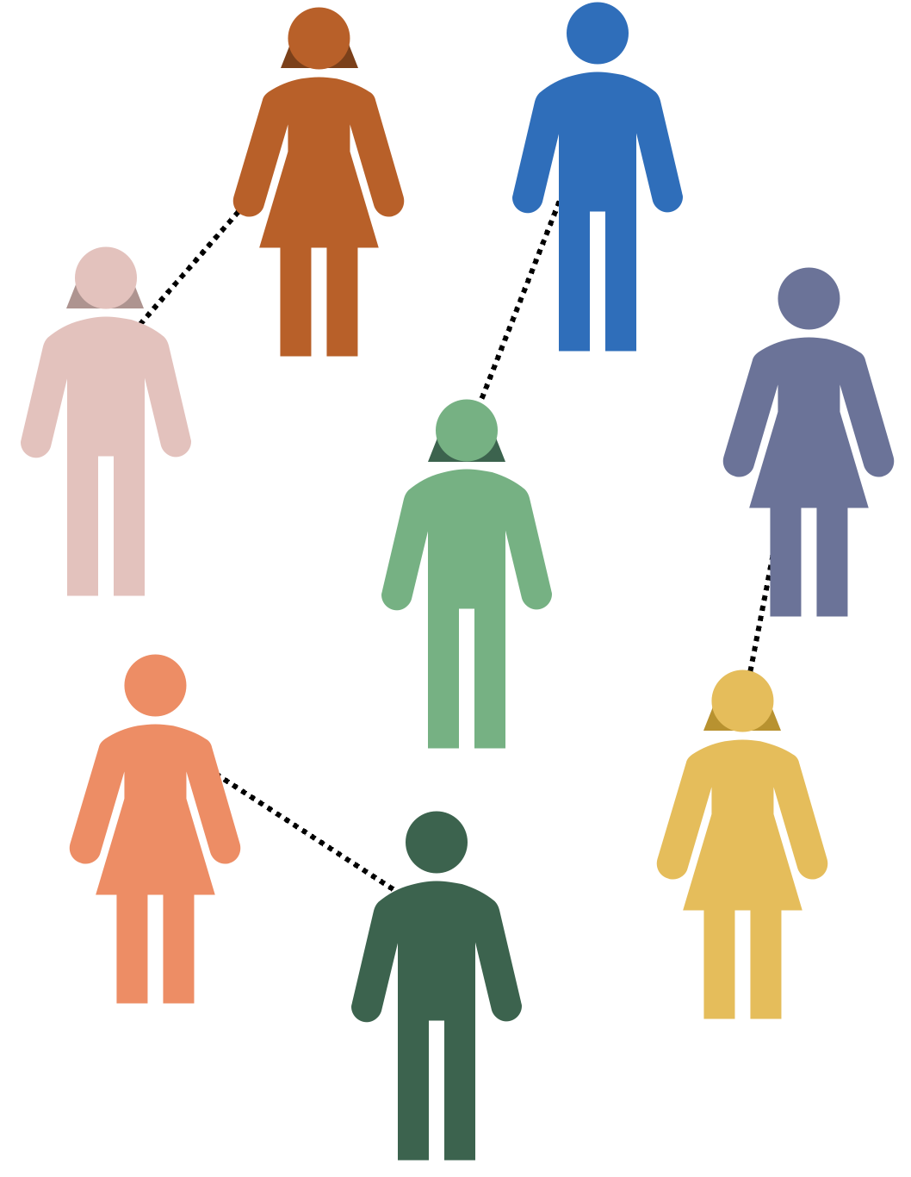

Tournaments
Introduction to AI SES
‹#›

Slide 17
Tournament Strategies
Strategy | Characteristics
Random | Randomly defect or cooperate, regardless of your partner’s strategy
Always cooperate | Always choose to cooperate, regardless of your partner’s strategy
Always defect | Always choose to defect, regardless of your partner’s strategy
Grudger | Start by cooperating. If your partner defects, defect in every subsequent round, regardless of your partner’s subsequent behavior
Tit-for-tat | Start cooperating, then always do whatever your partner did last
Introduction to AI SES
‹#›

Slide 18
Tit-For-Tat
C
D
D
C
C
D
Introduction to AI SES
‹#›

Slide 19
AI Racing Dynamics
Iterated interactions can generate racing dynamics or an AI arms race.
Competitive pressures motivate AI companies to pursue individual, short-term gains at a collective, long-term detriment.
Introduction to AI SES
‹#›

Slide 20
Corporate AI Arms Race
Competition is promoting the creation and use of more appealing and profitable systems, often at the cost of safety measures.
Example: the public release of large language model-based chatbots
Some companies delayed their chatbot release for safety testing
We can view those who released their chatbots without safety testing as having switched from cooperating to defecting in an iterated Prisoner’s Dilemma game
The defectors may then gain a competitive edge
This competitive pressure causes other companies to rush their AI products to market, compromising safety measures in the process
Introduction to AI SES
‹#›

Slide 21
Cutting Corners on Safety
Extreme competition can promote the creation and use of more appealing and profitable systems, often at the cost of safety measures.
Though all parties would prefer to prioritize safety, they constantly defect in order to stay in the race
AI capabilities are thus advanced more rapidly than AI safety (e.g., jailbreaking robustness, watermarking, KYC, etc.)
Ultimately, corporate AI racing dynamics could produce societal-scale harms:
Mass labor automation → widespread and rapid unemployment
Dangerous dependence on AI systems
Autonomous economies (we will return to later)
Introduction to AI SES
‹#›
Notes:
For more on autonomous economies, see slide 42

Slide 22

Attrition Model (1/2)
In the game “chicken,” two drivers racing dynamics headlong at each other:
If one driver swerves off course, they lose, and the other wins
If neither swerves, both drivers crash
How much should each driver be willing to risk?
Introduction to AI SES
‹#›

Slide 23

Attrition Model (2/2)
The Attrition model:
Models this dynamic as an auction
The competitors bid risk level, rather than money
We assume two competitors and shared knowledge
The winner takes all
This is an all pay auction: both competitors pay what they bid
Typical result: each competitor willing to risk around 33% loss in EV
Corporations in an AI race may behave as though competing for survival:
Willing to risk a 33% chance of causing an existential catastrophe
In order to “win the prize” of continued corporate existence
Introduction to AI SES
‹#›

Slide 24
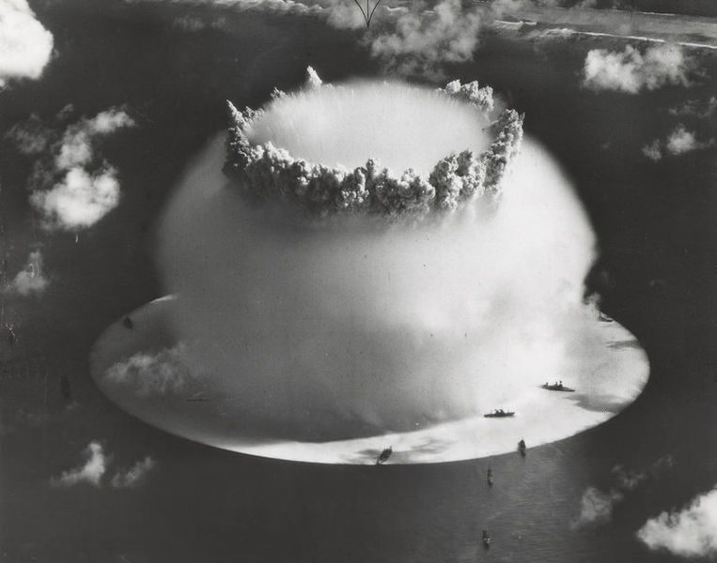
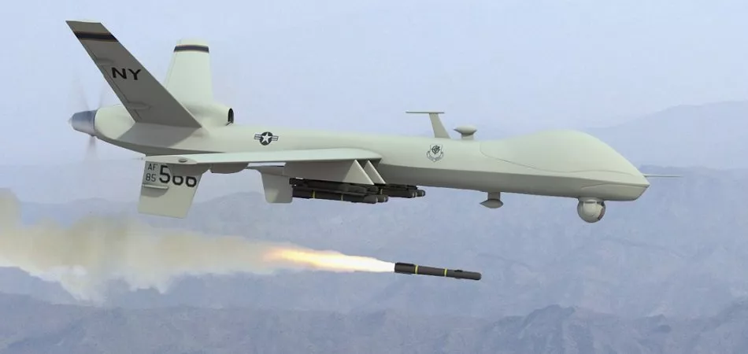
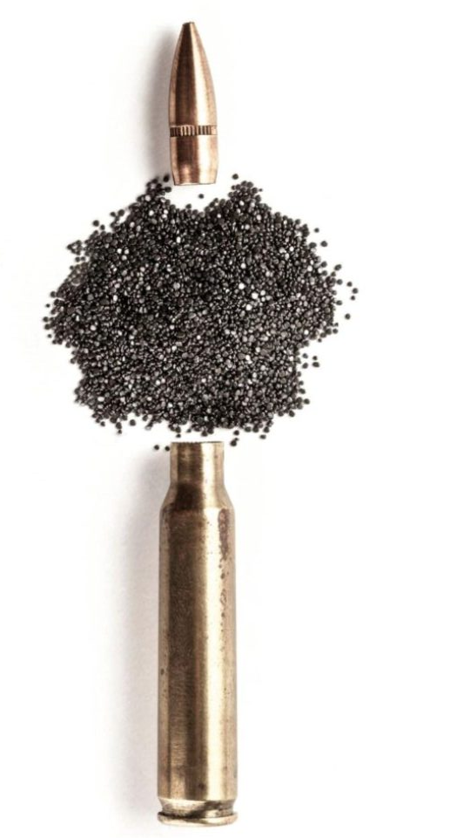
Military AI Arms Race (1/2)
“The third revolution in warfare.”
Gunpowder
Nuclear weapons
Military AI
Introduction to AI SES
‹#›
Notes:
https://www.google.com/url?sa=i&url=https%3A%2F%2Femerj.com%2Fai-sector-overviews%2Fai-drones-and-uavs-in-the-military-current-applications%2F&psig=AOvVaw136byjMFamA8VBxjFzJVXw&ust=1692994079507000&source=images&cd=vfe&opi=89978449&ved=0CA8QjRxqFwoTCOjlwseM9oADFQAAAAAdAAAAABAE
https://www.google.com/url?sa=i&url=https%3A%2F%2Fwww.atlasobscura.com%2Farticles%2F70-years-ago-the-us-military-set-off-a-nuke-underwater-and-it-went-very-badly&psig=AOvVaw0kJoYXTQbvI7oIlH4N6GhM&ust=1692993880325000&source=images&cd=vfe&opi=89978449&ved=0CA8QjRxqFwoTCKiJp_SP9oADFQAAAAAdAAAAABAE
https://www.google.com/url?sa=i&url=https%3A%2F%2Fwww.gunnersoutlet.com%2Fv_21%2Fnews%2Fgunpowder-components-and-history%2F&psig=AOvVaw0pUSOPr_thTRZbV3rJC0au&ust=1692993831432000&source=images&cd=vfe&opi=89978449&ved=0CA8QjRxqFwoTCOiuyvmP9oADFQAAAAAdAAAAABAE

Slide 25
Military AI Arms Race (2/2)
“The third revolution in warfare.”
Military AI risks relate to:
AI-developed weapons
AI-controlled weapons
AI cyber warfare
Automated executive decision-making
Catastrophic accidents
Co-option of military AI technologies
Altered warfare dynamics (more frequent/severe wars)
Introduction to AI SES
‹#›
Notes:
https://www.google.com/url?sa=i&url=https%3A%2F%2Femerj.com%2Fai-sector-overviews%2Fai-drones-and-uavs-in-the-military-current-applications%2F&psig=AOvVaw136byjMFamA8VBxjFzJVXw&ust=1692994079507000&source=images&cd=vfe&opi=89978449&ved=0CA8QjRxqFwoTCOjlwseM9oADFQAAAAAdAAAAABAE
https://www.google.com/url?sa=i&url=https%3A%2F%2Fwww.atlasobscura.com%2Farticles%2F70-years-ago-the-us-military-set-off-a-nuke-underwater-and-it-went-very-badly&psig=AOvVaw0kJoYXTQbvI7oIlH4N6GhM&ust=1692993880325000&source=images&cd=vfe&opi=89978449&ved=0CA8QjRxqFwoTCKiJp_SP9oADFQAAAAAdAAAAABAE
https://www.google.com/url?sa=i&url=https%3A%2F%2Fwww.gunnersoutlet.com%2Fv_21%2Fnews%2Fgunpowder-components-and-history%2F&psig=AOvVaw0pUSOPr_thTRZbV3rJC0au&ust=1692993831432000&source=images&cd=vfe&opi=89978449&ved=0CA8QjRxqFwoTCOiuyvmP9oADFQAAAAAdAAAAABAE

Slide 26


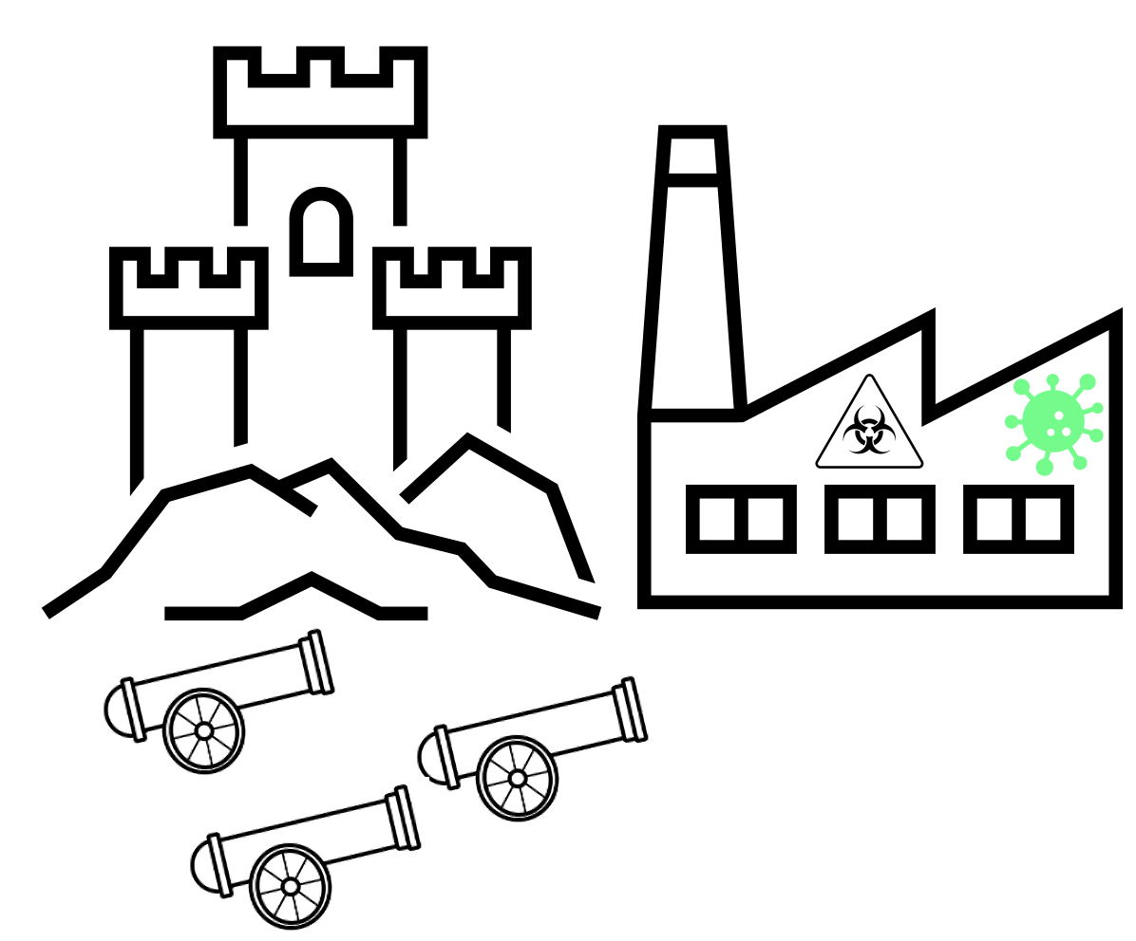







Security Dilemma Model
Mutual defensive concerns motivate nations to increase military capabilities, thereby exacerbating the risks for all involved.
This is analogous to the Cold War nuclear arms racing dynamics between the US and the Soviet Union (a “security dilemma”):
“Cooperate” = reduce nuclear arms investment
“Defect” = increase investment to heighten military capabilities
Nash equilibrium: both sides defected repeatedly, exacerbating risks
Pareto improvement: both sides could have cooperated to reduce risks
Introduction to AI SES
‹#›

Slide 27
Security Dilemma Model
Mutual defensive concerns motivate nations to increase military capabilities, thereby exacerbating the risks for all involved.
The military promise of AI is motivating nations to increase development, adoption, and deployment of AI applications in war. The nations’ actions are motivating each other to pursue a path that is against their long term interests.
With more AI involvement, war can take place at accelerated rates
Nations that do not adopt military AI risk being outcompeted
Example: automated retaliation (more on this in the next section)
Introduction to AI SES
‹#›

Slide 28
Extortion (1/2)
In the Iterated Prisoner’s Dilemma, there are “extortion” strategies.
Extortion: a strategy that enables an agent to ensure that their own payoff is higher than their partners in all outcomes.
Extortionist: an agent using an extortion strategy.
Extortionists decide whether to cooperate or defect in each round using:
Their partner’s most recent decision
Their own most recent decision
A set of probabilities
Introduction to AI SES
‹#›

Slide 29
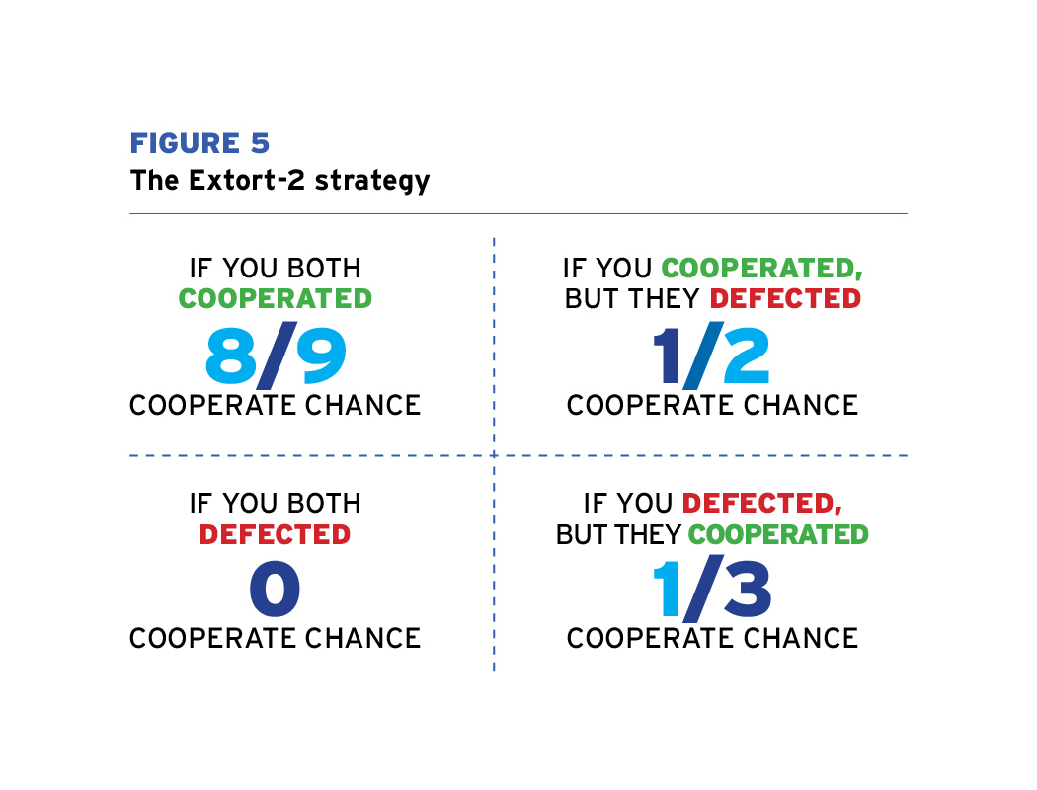
Extortion (2/3)
Introduction to AI SES
‹#›

Slide 30
Extortion (2/2)
Tail risk: AIs may use digital torture for extortion.
AI agents may be superhumanly proficient at wielding extortion.
Extortion may be exceptionally effective against AIs.
Scope neglect
Impartiality
AI extortionists may execute higher-stakes threats more frequently than humans.
Introduction to AI SES
‹#›
Notes:
https://en.wikipedia.org/wiki/Scope_neglect

Slide 31
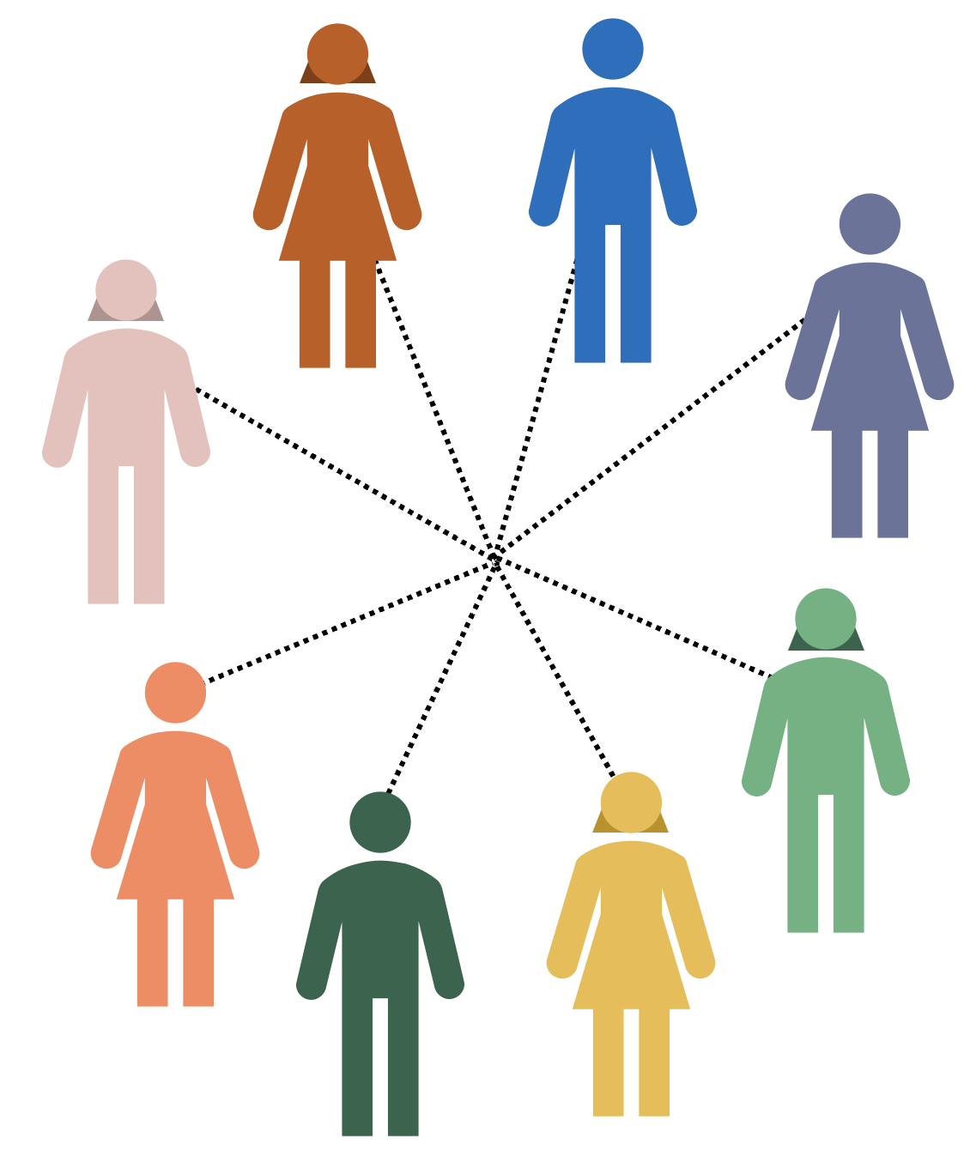
Collective Action Problems
Group interactions
Pairwise interactions
Introduction to AI SES
‹#›

Slide 32
Example: Group projects
A collaborative group project can pose a collective action problem if the group has a shared goal, but not everyone pitches in to help achieve it.
These “slackers” are behaving this way because:
They want the group’s goal to be achieved
But they would prefer this to happen at no cost (effort) to themselves
So “slacking” is the dominant strategy:
If others work hard and the group’s goal is achieved, the slacker enjoys the benefit of this success without the cost of contributing themself
If the goal is not achieved, at least the slacker saved themselves effort
Introduction to AI SES
‹#›

Slide 33
Coercion: Mutual and External
We can incentivize agents to contribute/cooperate using coercion.
External coercion:
Top-down
External interventions
Example: laws, regulations, and sanctions
Mutual coercion:
Bottom-up
Internal feedback
Example: establishing cooperative norms
Introduction to AI SES
‹#›

Slide 34
Example: Public Health Emergency (1/2)
We can model the COVID-19 pandemic as a collective action problem:
Tens of millions of deaths
Death toll might have been lower with stricter compliance with public health measures (wearing masks, testing, vaccinations, distancing)
But compliance entailed personal costs: expense, social isolation etc…
Everyone wanted a lower death toll
But each individual preferred not to pay the personal cost
Introduction to AI SES
‹#›

Slide 35
Example: Public Health Emergency
We can model the COVID-19 pandemic as a collective action problem:
Cooperating: adhering to public health measures at personal cost
Defecting: violating public health measures to save personal cost
Dominant strategy: defect
Outcome: many people chose to violate public health measures
Pareto improvement: if everyone had suffered small personal cost, a better collective outcome would have been achieved
Other collective action problems: Nuclear stockpiling, upholding democracy, climate change, and so on
Introduction to AI SES
‹#›

Slide 36
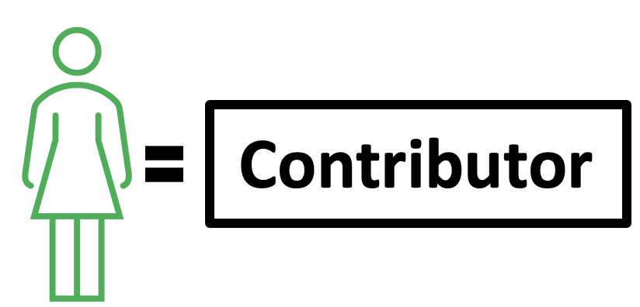
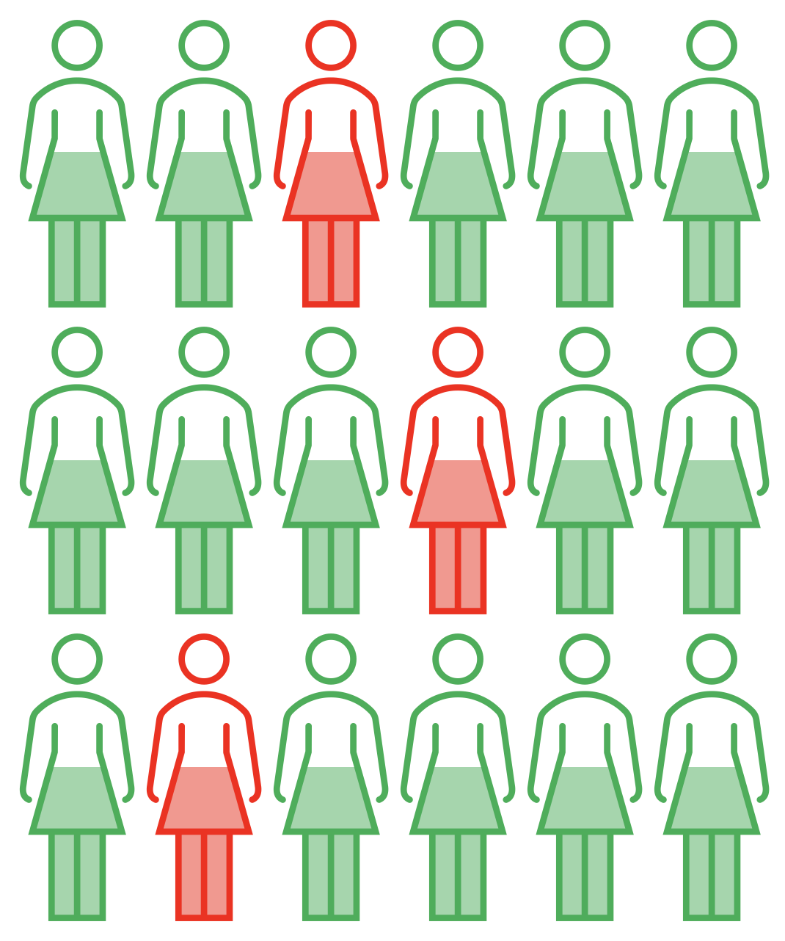
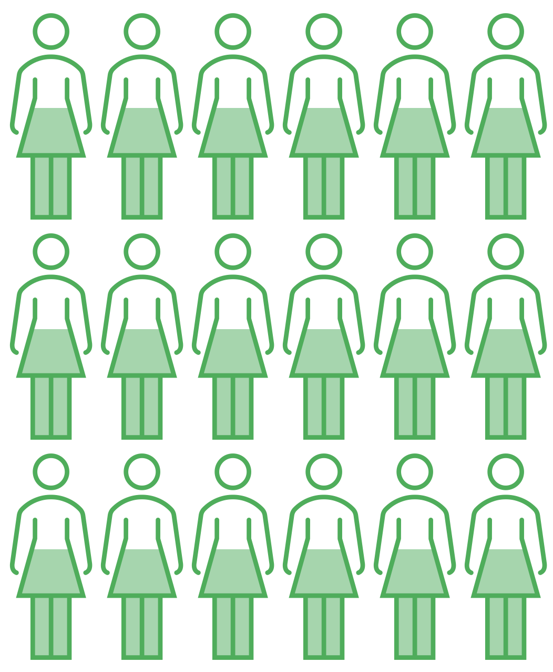

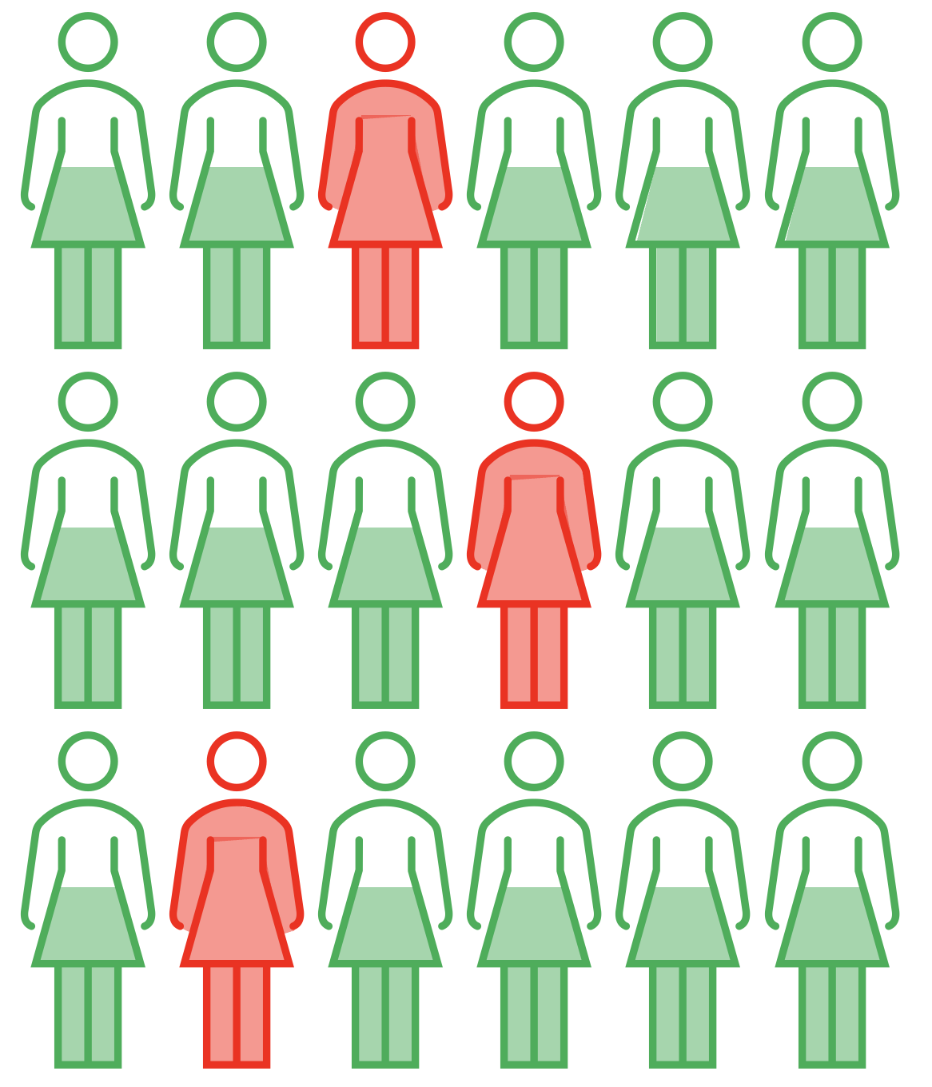
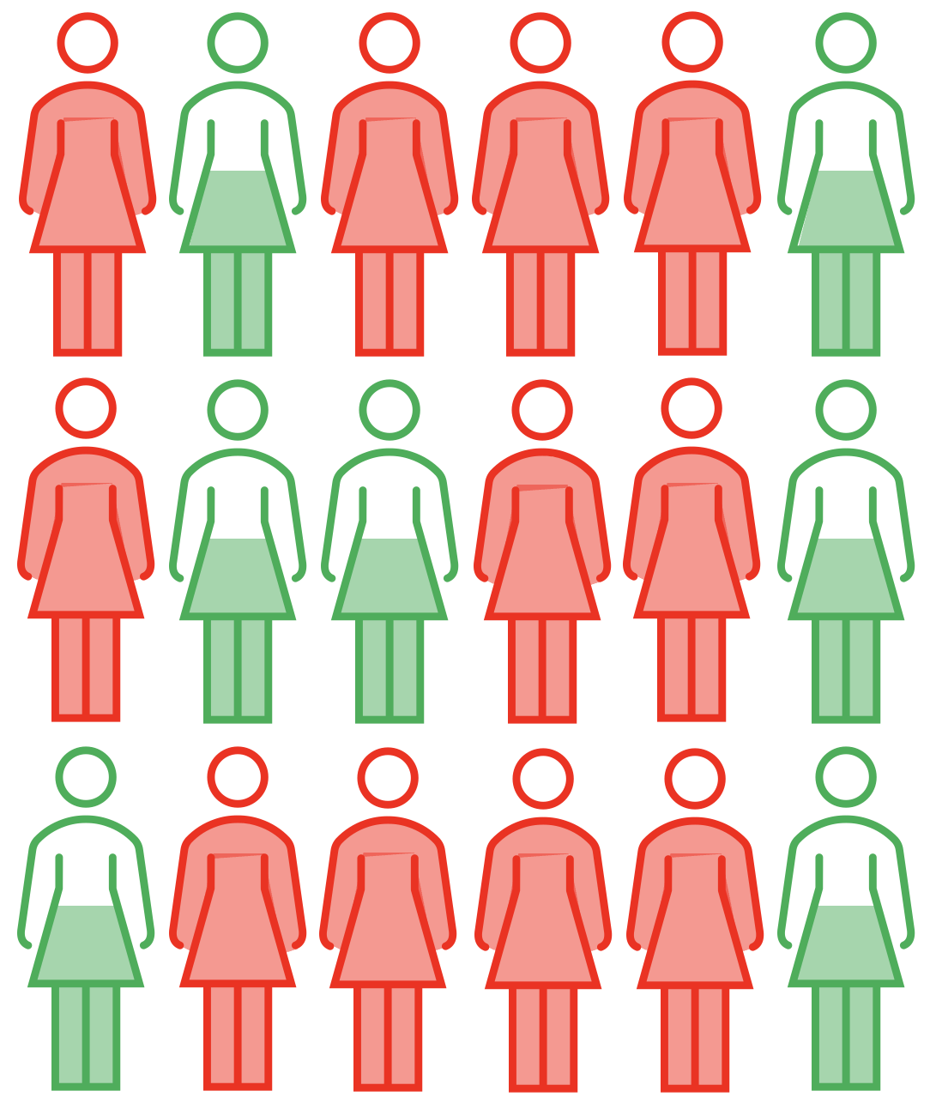

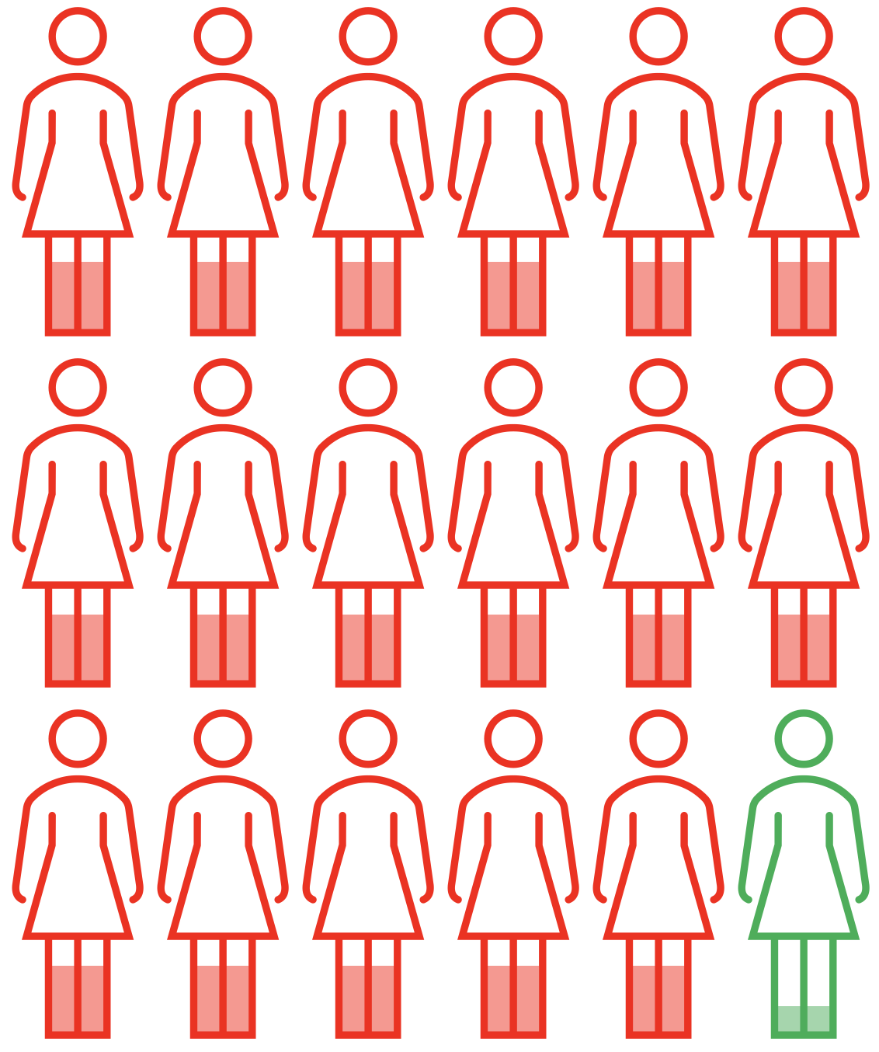
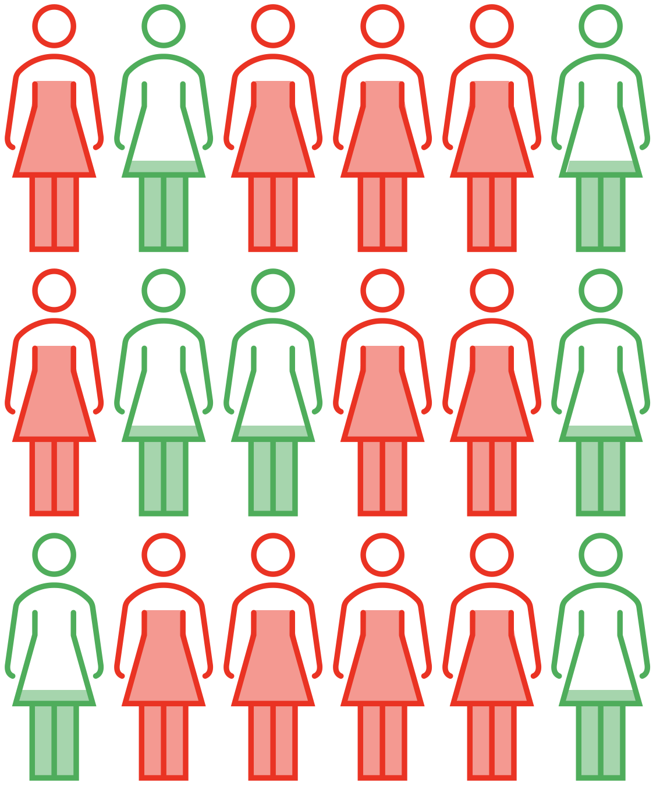
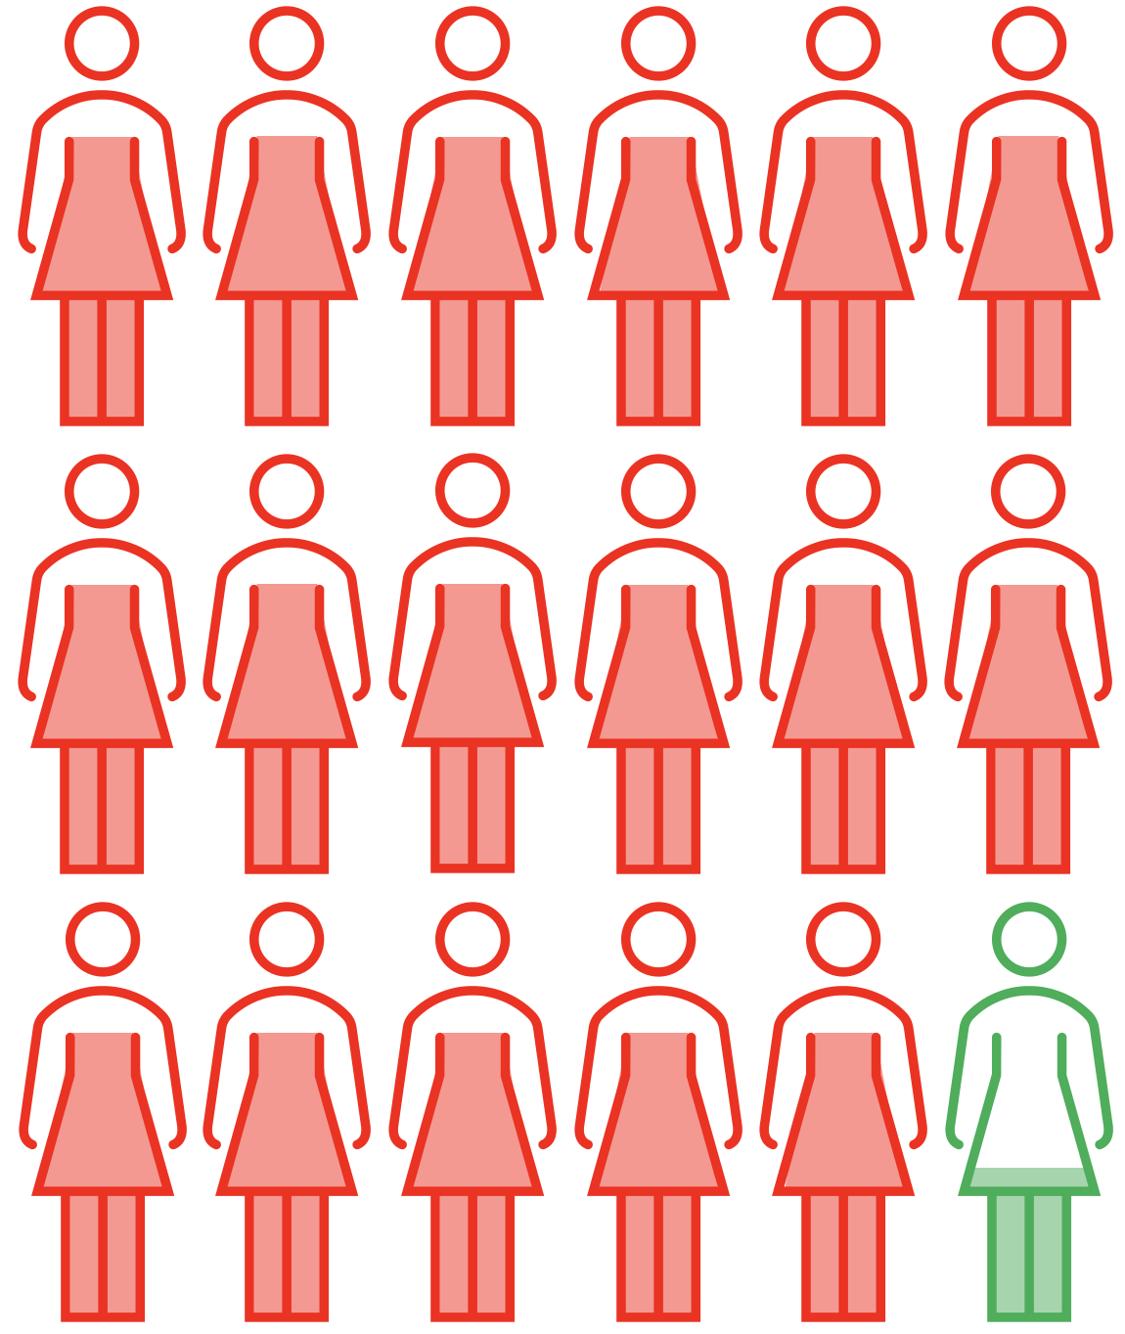




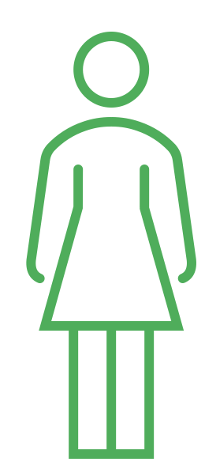


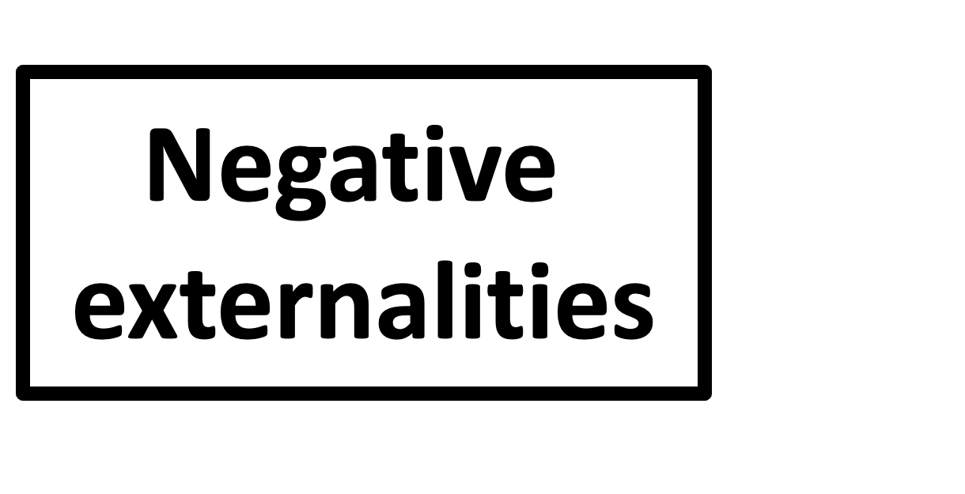




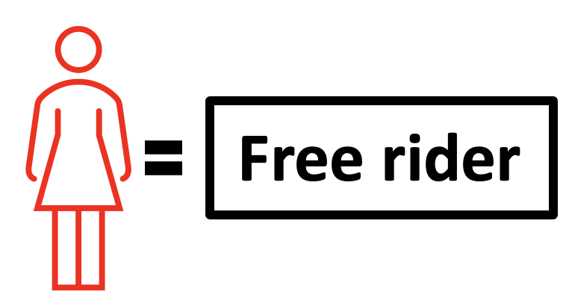
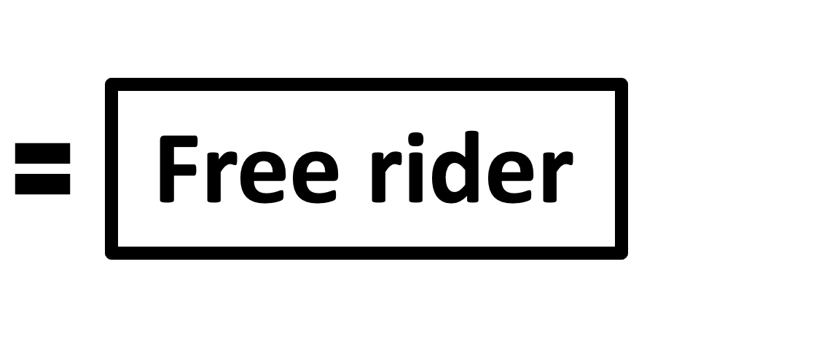


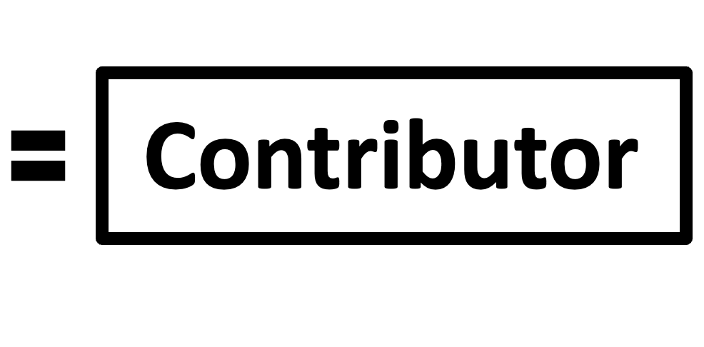
Formalization
In a collective action problem, each agent must decide between:
Contributing: helping to achieve the group’s shared goal
Free riding: not helping, but benefiting from others’ contributions
Free riders impose negative externalities on the rest of the group.
Free riding can produce Pareto inefficient Nash equilibria.
Introduction to AI SES
‹#›

Slide 37
AI-Triggered Flash War (1/2)
We can more precisely model AI racing dynamics (which involve more than two competitors) as collective action problems.
Military AI arms racing dynamics:
Cooperate: slow rate of military AI adoption, incurring personal cost of reduced military capabilities (relative to competitors who free ride)
Free ride/defect: continue rapid military AI adoption in order to maintain competitive edge
Negative externalities: free riders exacerbate the risks of catastrophic accidents, weapon misuse, and escalated warfare
Introduction to AI SES
‹#›

Slide 38
AI-Triggered Flash War (1/2)
We can model AI racing dynamics that involve more than two competitors as collective action problems.
Military AI arms racing dynamics catastrophic outcome, flash war:
Multiple nations use AI for automated retaliation:
Weapons system - powerful and rapid-action
Placed under the control of an AI detection system
If AI detects enemy offensive action, it initiates retaliatory fire
No human oversight necessary
Benefit one: faster
Benefit two: more effective deterrence signal
Introduction to AI SES
‹#›

Slide 39
AI-Triggered Flash War (2/2)
We can model AI racing dynamics that involve more than two competitors as collective action problems.
Military AI arms racing dynamics catastrophic outcome, flash war:
If one nation’s AI incorrectly detects an offensive strike from another nation, it may automatically “retaliate” to this non-existent threat
This could trigger automated retaliations from the other nations’ automated systems
Small errors could be exacerbated into increasingly escalated wars
Flash war: a war triggered by autonomous AI systems that takes place too quickly for human control
Introduction to AI SES
‹#›

Slide 40
Autonomous Economy (1/3)
Corporate AI racing dynamics:
AIs are out-performing the average human at an increasing number and range of jobs
Examples range from personal assistants to executive decision-makers
Companies want the benefits of these faster and more effective workers
So they automate economically valuable functions by delegating them to AI agents
Introduction to AI SES
‹#›

Slide 41
Autonomous Economy (2/3)
Corporate AI racing dynamics:
Cooperate: maintain human labor
Defect: automate jobs using AI
Negative externalities: free riding increases the competitive pressure for other companies to follow suit, pushing all involved down a path with catastrophic risks
Introduction to AI SES
‹#›

Slide 42
Autonomous Economy (3/3)
Corporate AI racing dynamics catastrophic outcome, autonomous economy:
Continuous automation could move economic activity away from human control into the command of AI systems
Ultimately, this could lead to the global economy becoming “autonomous,” with humans no longer able to steer or intervene
Like passengers in an autonomous vehicle, our safety and destination would rest with the AI systems now acting without supervision
Introduction to AI SES
‹#›

Slide 43
Recap
The basic solution concept in game theory is Nash Equilibrium.
Nash equilibria are often Pareto inefficient: everyone can be happier.
Agents can also cooperate: change payoffs, dispositions, or structures.
Collective action problems involving AI could lead to reckless racing, dependence, cutting corners of safety, flash wars, or mass automation.
Introduction to AI SES
‹#›

Slide 44
Roadmap
Game theory
Cooperation
Conflict
Evolutionary pressures
Introduction to AI SES
‹#›

Slide 45
The Importance of Cooperation
Securing good outcomes without cooperation can be difficult, even for intelligent rational agents.
Cooperation between AI stakeholders
Counteract competitive and evolutionary pressures (AI racing dynamics)
E.g., The “merge-and-assist” clause of OpenAI’s charter
Cooperation between AI agents
We want AIs to cooperate with us
However, as we will see, mechanisms that enable cooperation could backfire
Introduction to AI SES
‹#›

Slide 46
Cooperation Mechanisms
Direct reciprocity
Indirect reciprocity
Group selection
Kin selection
Institutions
Introduction to AI SES
‹#›

Slide 47
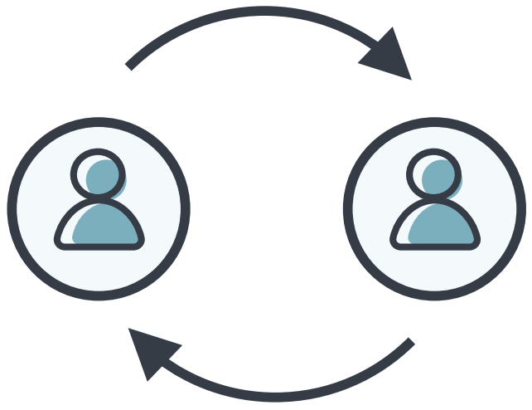
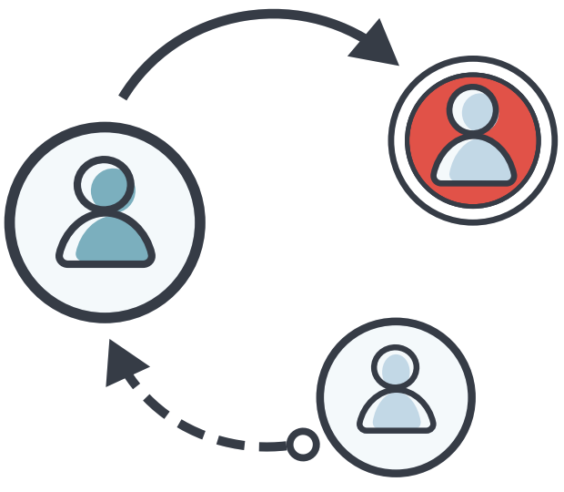
Direct and Indirect Reciprocity
Direct reciprocity requires repeated encounters between the same two individuals.
Indirect reciprocity is based on reputation; a helpful individual is more likely to receive help.
Encourages cooperation, as agents will be compensated for their efforts.
Doesn’t work with advanced AI: no upside to reciprocating with humans!
Introduction to AI SES
‹#›

Slide 48


Kin and Group Selection (1/2)
Kin selection operates when the donor and the recipient of an altruistic act are genetic relatives.
Group selection suggests that groups have shared success and failure, and that groups which cooperate may collectively succeed.
Selects for altruistic agents that increase group success.
Introduction to AI SES
‹#›
Notes:
Five Rules for the Evolution of Cooperation by MA Nowak
Use gazelle example to talk about psychological egoism

Slide 49
Kin and Group Selection (2/2)
Kin selection fails if the cost of engaging in altruism outweighs the information similarity between kin:
AI would not be kind towards humans because we have very little information similarity to them
Consider the negative treatment of factory animals
Group selection fails, as AI agents will have in-group bias towards other AI agents; bias against humans by exclusion.
Introduction to AI SES
‹#›

Slide 50
Mechanism 1:
Direct Reciprocity
Direct reciprocity: one agent helps another because they expect them to return the favor in future.
“You scratch my back, I’ll scratch yours.”
Direct reciprocity favors cooperation when the probability that the two agents will meet again (w) to be greater than the cost-benefit ratio (c/b) of helping.
w > c/b
Introduction to AI SES
‹#›

Slide 51
Mechanism 1:
Direct Reciprocity
Examples:
Tree-fungi mutualisms: exchanging sugars for nutrients
Dolphins hunting cooperatively: swapping roles so all can eat
Chimpanzees grooming each other
AI agents may behave cooperatively due to direct reciprocity.
But this mechanism could push AIs to cooperate preferentially with other AIs instead of humans, due to speed or reciprocation.
Introduction to AI SES
‹#›

Slide 52
Mechanism 2:
Indirect Reciprocity
Indirect reciprocity: one agent helps another because this allows them to build a trustworthy and helpful reputation.
Rather than expecting the recipient of their help to reciprocate, the agent increases the probability that a third party will help them in future.
Indirect reciprocity favors cooperation when the probability that a third party can discern an agent’s good reputation (q) outweighs the cost-benefit ratio (c/b) of helping.
q > c/b
Introduction to AI SES
‹#›

Slide 53
Mechanism 2:
Indirect Reciprocity
Example: fish cleaning stations.
Two parties: cleaners (who get food) and clients (who are cleaned)
A cleaner fish must decide whether to:
Cooperate: eat only the client’s parasites
Defect: eat some of the client’s mucus and skin, too
A client fish must decide whether to return to the station and be cleaned again
Client fish are more likely to revisit stations where the cleaner fish have better reputations for being trustworthy
Introduction to AI SES
‹#›

Slide 54
Mechanism 2:
Indirect Reciprocity
Indirect reciprocity in human society:
Gossip
Online ratings and reviews (e.g. TripAdvisor)
Reputation-based mechanisms may incentivize AI agents to cooperate.
However, this could present risks:
Extortionists could use leverage threats of reputational harm
Reputations for “ruthlessness” may be equally successful
Introduction to AI SES
‹#›

Slide 55
Mechanism 3:
Group Selection
Group selection: one agent helps another because this produces a “fitter” group which can outcompete rival groups, benefiting the agent.
Groups with more cooperators may outperform other groups.
Group selection favors helping when the ratio of maximum group size to group number (m/n) + 1 is less than the benefit-cost ratio (b/c) of helping.
n/m + 1 < b/c
Introduction to AI SES
‹#›

Slide 56
Mechanism 3:
Group Selection
Examples (note that these are controversial):
Chimpanzee outgroup violence
Human warfare and nationalism
Group selection may promote cooperative behavior among AI agents.
But, as with the above examples, in-group favoritism can lead to out-group hostility.
Introduction to AI SES
‹#›

Slide 57
Mechanism 4:
Kin Selection
Kin selection: one agent helps another because they are genetic relatives.
Higher genetic relatedness -> higher probability their genomes contain some of the same genes -> higher probability of cooperation.
So genes which promote helping in this context may be helping other copies of themselves (in other bodies) propagate more.
Kin selection favors cooperation when the relatedness between the two agents is greater than the cost-benefit ratio: rb > c.
Introduction to AI SES
‹#›

Slide 58
Mechanism 4:
Kin Selection
Examples:
Cooperative breeding: eusocial insects, birds, mammals
Humans tend to favor relatives over others
Kin selection may promote cooperative behavior between AIs.
However, this presents problems:
Nepotism towards more similar AI systems
Lack of cooperation with humans
Introduction to AI SES
‹#›

Slide 59
Institutions (1/2)
Institutions: one agent helps another because of publicly-recognized, large-scale structure that is mediating their interaction.
We can use institutions to establish collective goals which require collaboration from large or diverse groups:
International treaties
Domestic laws
Introduction to AI SES
‹#›

Slide 60
Institutions (2/2)
Institutions are crucial for AI safety:
Establishing laws and regulations
Reducing competitive pressures
Improving coordination mechanisms to reduce AI risks
However, institutions can fail, or even backfire:
Inefficiency — e.g. bureaucracies
Free riding — e.g. welfare fraud
Corruption — e.g. bribes and funding misappropriation
AI agents may similarly corrupt or undermine our institutions.
Introduction to AI SES
‹#›

Slide 61
Cooperation and Collusion
Cooperation can devolve into collusion.
However, there are tools from The Coup-Proofing Toolbox, such as:
Stovepiping: restrict information flow to make collusion harder
Counterbalancing: keep your military in check with another military.
Sting operations: set traps where someone says they are trying to start a coup and anyone who joins is purged.
Rotate officers: Make it harder for people to build trust with each other by rotating them around a lot
Introduction to AI SES
‹#›

Slide 62
Recap (1/2)
Mechanisms for cooperation include:
Direct reciprocity
Indirect reciprocity
Group selection
Kin selection
Institutions
Introduction to AI SES
‹#›

Slide 63
Recap (2/2)
International and National Level
Cooperate: regulate AI companies; not build autonomous weapons; pause AI development when we get Einstein-level AI
Defect: race with other countries
Cooperation mechanisms: international agencies, compute security features (chip registry, geofencing GPUs)
Organizational Level
Cooperate: proceed more cautiously, AI features for public benefit
Defect: prioritize making AI more powerful over safety
Cooperation mechanisms: support regulation, publish safety research
Introduction to AI SES
‹#›
Notes:
Other levels in the future like AIs cooperating or defecting with each other or with humans, groups of humans, etc.

Slide 64
Roadmap
Game theory
Cooperation
Conflict
Evolutionary pressures
Introduction to AI SES
‹#›

Slide 65
Conflict
Conflict is almost always costly to those involved, and often destroys some part of the value the parties are competing for.
Nevertheless, it is common in both the natural world and human societies.
Here we will discuss factors which can promote conflict in the real world
This is relevant because a potential great power conflict and a US-China competition hinders international coordination about AI
Introduction to AI SES
‹#›

Slide 66
Structural Realism (1/2)
Structural realism is a school of thought in international relations arguing that states primarily seek and compete for power.
Two main assumptions: states operate in a “self-help” system with no higher arbiter and states prioritize self-preservation. The structure of the international system forces them to compete for power.
Also, assume that states are rational, can influence other states, and don’t know the intentions of other states for certain.
Then, structural realism posits that states will compete for power in an international context, almost regardless of domestic politics.
Introduction to AI SES
‹#›

Slide 67
Structural Realism (2/2)
Power seeking ≠ dominance seeking
Offensive realism: states should always pursue more power
Defensive realism: states will be punished by other states for pursuing too much power.
Balancing describes how states respond to the power of other states.
Internal balancing focusses on a country’s resources and military.
External balancing involves teaming up with other states to counter adversaries.
States may seek hegemony—domination over other states.
Depends on the state’s capabilities, and its perception of the offense-defense balance relative to other states.
Introduction to AI SES
‹#›

Slide 68
Bargaining Theory
Recall why Alice and Bob opt to defect in the Prisoner’s Dilemma:
The both defect outcome is worse for both of them than the both cooperate outcome
But for each agent, defecting is their dominant strategy: whatever their partner chooses to do, they will do better if they defect than if they cooperate
In the same way, rational agents sometimes engage in conflict, rather than opting for peaceful resolutions, despite the costs of conflict.
Introduction to AI SES
‹#›

Slide 69


Bargaining Range
Red gets more
Green gets less
Green gets more
Red gets less
Bargaining Range
Bargain offers in this range offer greater expected value to both Green and Red
Bargain offers that
Red prefers to conflict
Bargain offers that
Green prefers to conflict
Value destroyed by conflict
B
Expected value of conflict to Green,
including costs
B - C_{Green}
Expected value of conflict to Red,
including costs
B + C_{Red}
Expected distribution of value between Green and Red if they engage in conflict, excluding the costs of conflict
Introduction to AI SES
‹#›

Slide 70
Conflict Factors
Power shifts
First strike advantage
Issue indivisibility
Information problems
Inequality
Introduction to AI SES
‹#›

Slide 71
Factor 1:
Power Shifts
Power shift: when a change in one competitor’s capabilities changes the balance of power.
Power shifts can be generated by a variety of sources, such as changes in:
Technological advancements
The economy
Military capacities
Political ideologies
AI development is likely to cause dramatic changes in many of these areas, so could result in extreme and rapid power shifts.
Introduction to AI SES
‹#›

Slide 72
Factor 1:
Power Shifts
Power shift: when a change in one competitor’s capabilities changes the balance of power.
Example: the Treaty of Tordesillas.
Spain and Portugal, 1494
Initial success
But ultimate failure, due to Spain’s power increase
Introduction to AI SES
‹#›

Slide 73
Factor 2:
First Strike Advantage
First strike advantage: whichever party initiates conflict gains the upper hand.
The advantages of striking first can come from:
The element of surprise
The ability to choose location/time of conflict
The ability to reduce the opponent’s retaliatory abilities
The ability to remove the opponent’s first strike advantages
First strike advantages are often short-lived, further incentivizing action.
Introduction to AI SES
‹#›

Slide 74
Factor 2:
First Strike Advantage
First strike advantage: whichever party initiates conflict gains the upper hand.
Examples:
Patent infringement
Pearl Harbor attack
Inter-AI cyber attacks
Bombing datacenters
Introduction to AI SES
‹#›

Slide 75
Factors 1+2:
Power Shifts and First Strike Advantages
T₀
Bargaining Range
B - C_{Green}
B
B + C_{Red}
Green’s expected value from conflict at T₀ is greater than that of bargaining at T₁
T₁
B - C_{Green}
B
B + C_{Red}
Introduction to AI SES
‹#›

Slide 76
Factor 3:
Issue Indivisibility
Issue indivisibility: when the matter over which parties are competing cannot be divided up between them, conflict is more likely.
“Winner takes all.”
Examples:
Monarchies/positions of power
Small territories
Sovereign entities (such as individual people)
GPU server
Introduction to AI SES
‹#›

Slide 77

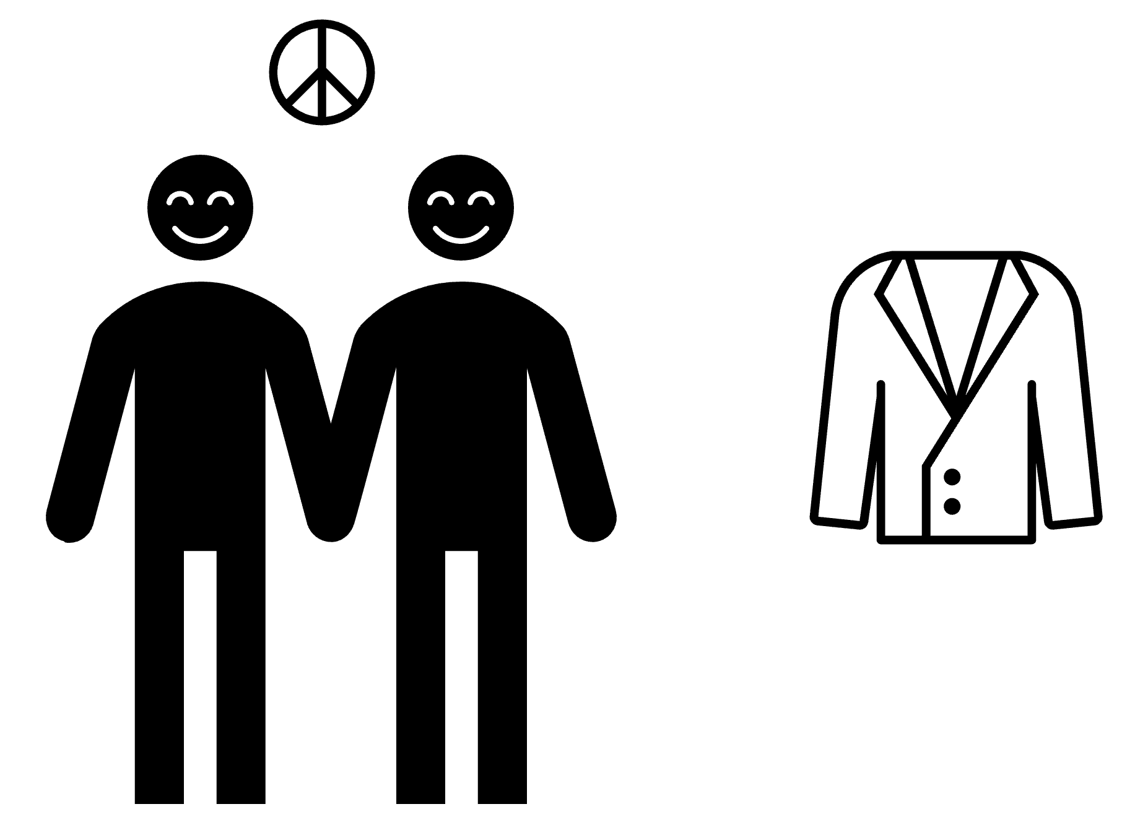


Factor 3:
Issue Indivisibility
Introduction to AI SES
‹#›

Slide 78
Factor 4:
Information Problems
Information problems: uncertainty about the capabilities or intentions of rivals can motivate conflict.
Misinformation
Disinformation
If the parties have different beliefs about the distribution of power, they may be less likely to find a mutually-acceptable bargain.
Moreover, weaker parties may intentionally misrepresent their capabilities in order to secure better deals.
Introduction to AI SES
‹#›

Slide 79
Factor 4:
Information Problems
Information problems: uncertainty about the capabilities or intentions of rivals can motivate conflict.
AIs may affect the belief and information quality:
Generating convincing mis- and dis-information at extreme rate, including “deepfake” images/video
Platforms may become better at censoring content
Making wars more uncertain due to novel technologies and fast-paced developments
These information problems may increase the frequency or severity of human warfare.
Introduction to AI SES
‹#›

Slide 80
Factor 4:
Information Problems
Green’s belief/claim
B - C_{Green}
B
B + C_{Red}
The ranges of mutually-acceptable
bargain offers don’t overlap
Red’s belief/claim
B - C_{Green}
B
B + C_{Red}
Introduction to AI SES
‹#›

Slide 81
Factor 5:
Inequality
Inequality: income and educational inequality robustly predict rates of crime (a form of conflict).
AI development may produce an abundant and equitable future, but this is far from a certainty.
If AI development instead increases inequality, this may foster conflict.
Introduction to AI SES
‹#›

Slide 82
Recap
Changing environments and interactions can create incentives that promote conflict instead of cooperation.
Factors that induce conflict include:
Power shifts
First strike advantages
Issue indivisibility
Information problems
Inequality (relevant domestically, less internationally)
Introduction to AI SES
‹#›

Slide 83
Roadmap
Game theory
Cooperation
Conflict
Evolutionary pressures
Introduction to AI SES
‹#›

Slide 84

Generalized Darwinism
“The survival or preservation of certain favored words in the struggle for existence is natural selection.” - Darwin, 1871
Generalized Darwinism: the idea that evolution by natural selection can be applied to non-biological phenomena.
Example: music.
Ah! Vous dirai-je, Maman
The Star
Twinkle-Twinkle
Baa Baa Black Sheep
Introduction to AI SES
‹#›

Slide 85
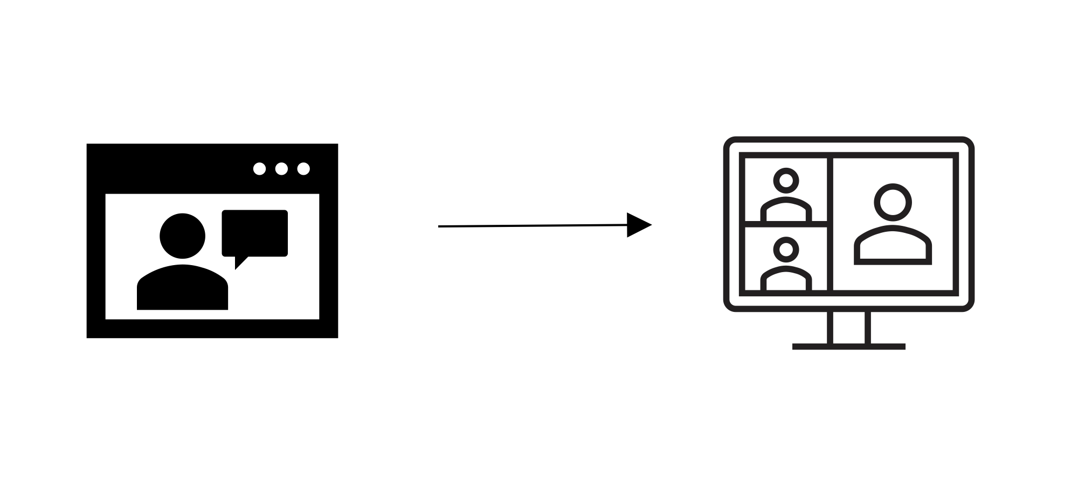
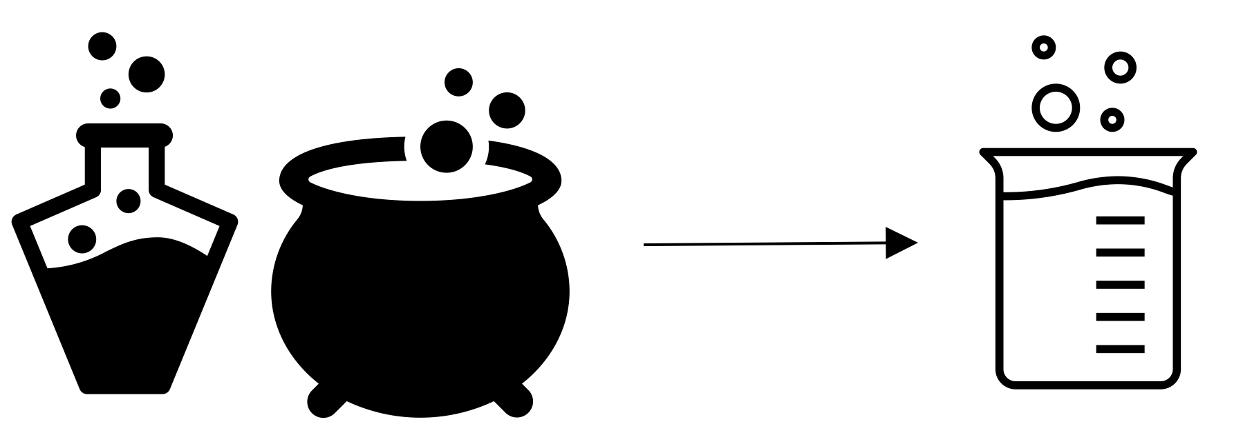
Darwinism Can Be Generalized
Beyond Biology
Generalized Darwinism: the idea that evolution by natural selection can be applied to non-biological phenomena.
Example: technology.
Old video conferencing
Today’s software features
Example: ideas.
Alchemy
Chemistry
Introduction to AI SES
‹#›

Slide 86
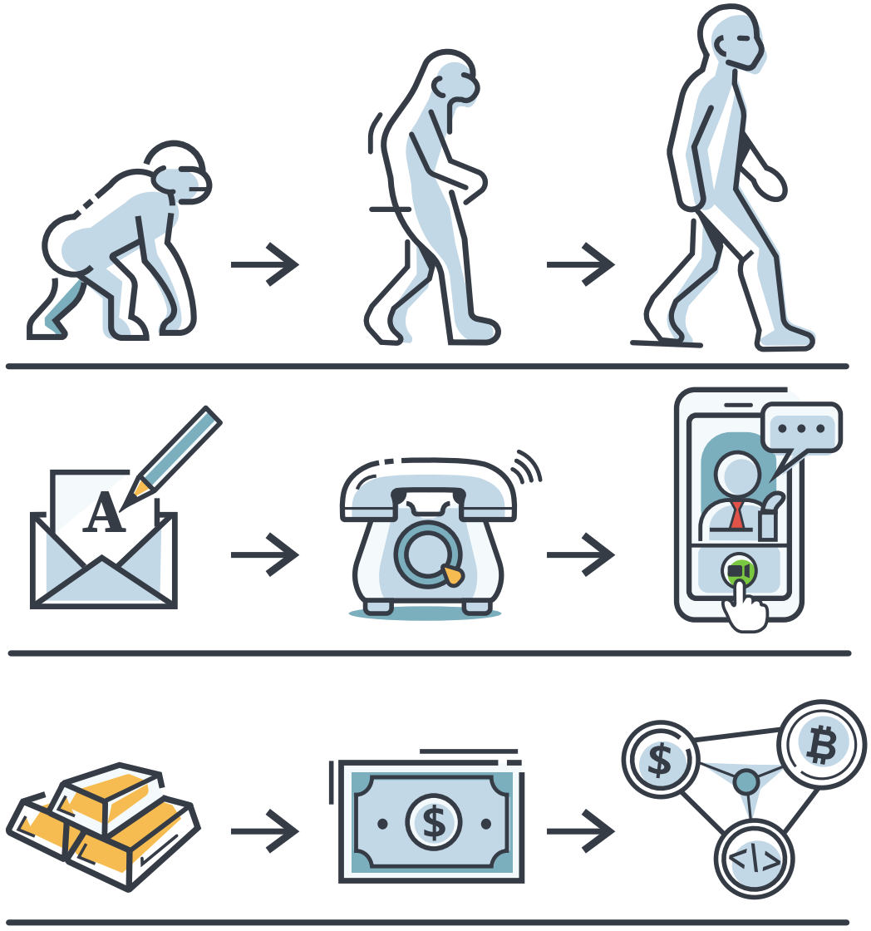
Generalized Darwinism
Many structures evolve: organisms, scientific theories, ideas, legal systems, political parties, languages, musical genres, car designs, computer programs.
We argue populations of AIs evolve and are shaped to be more and more competitive.
Introduction to AI SES
‹#›

Slide 87
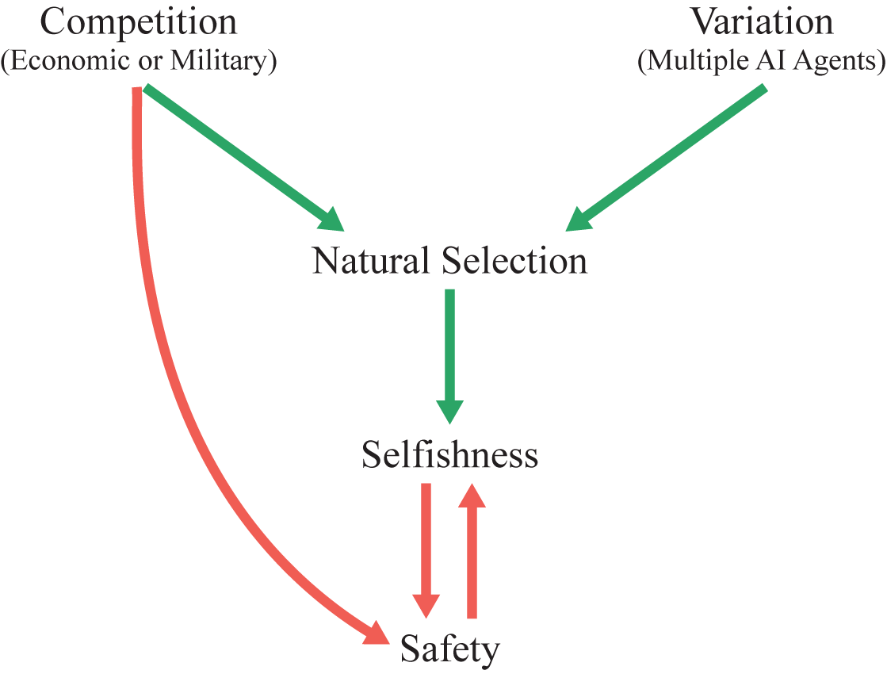
Basic Story
Introduction to AI SES
‹#›

Slide 88
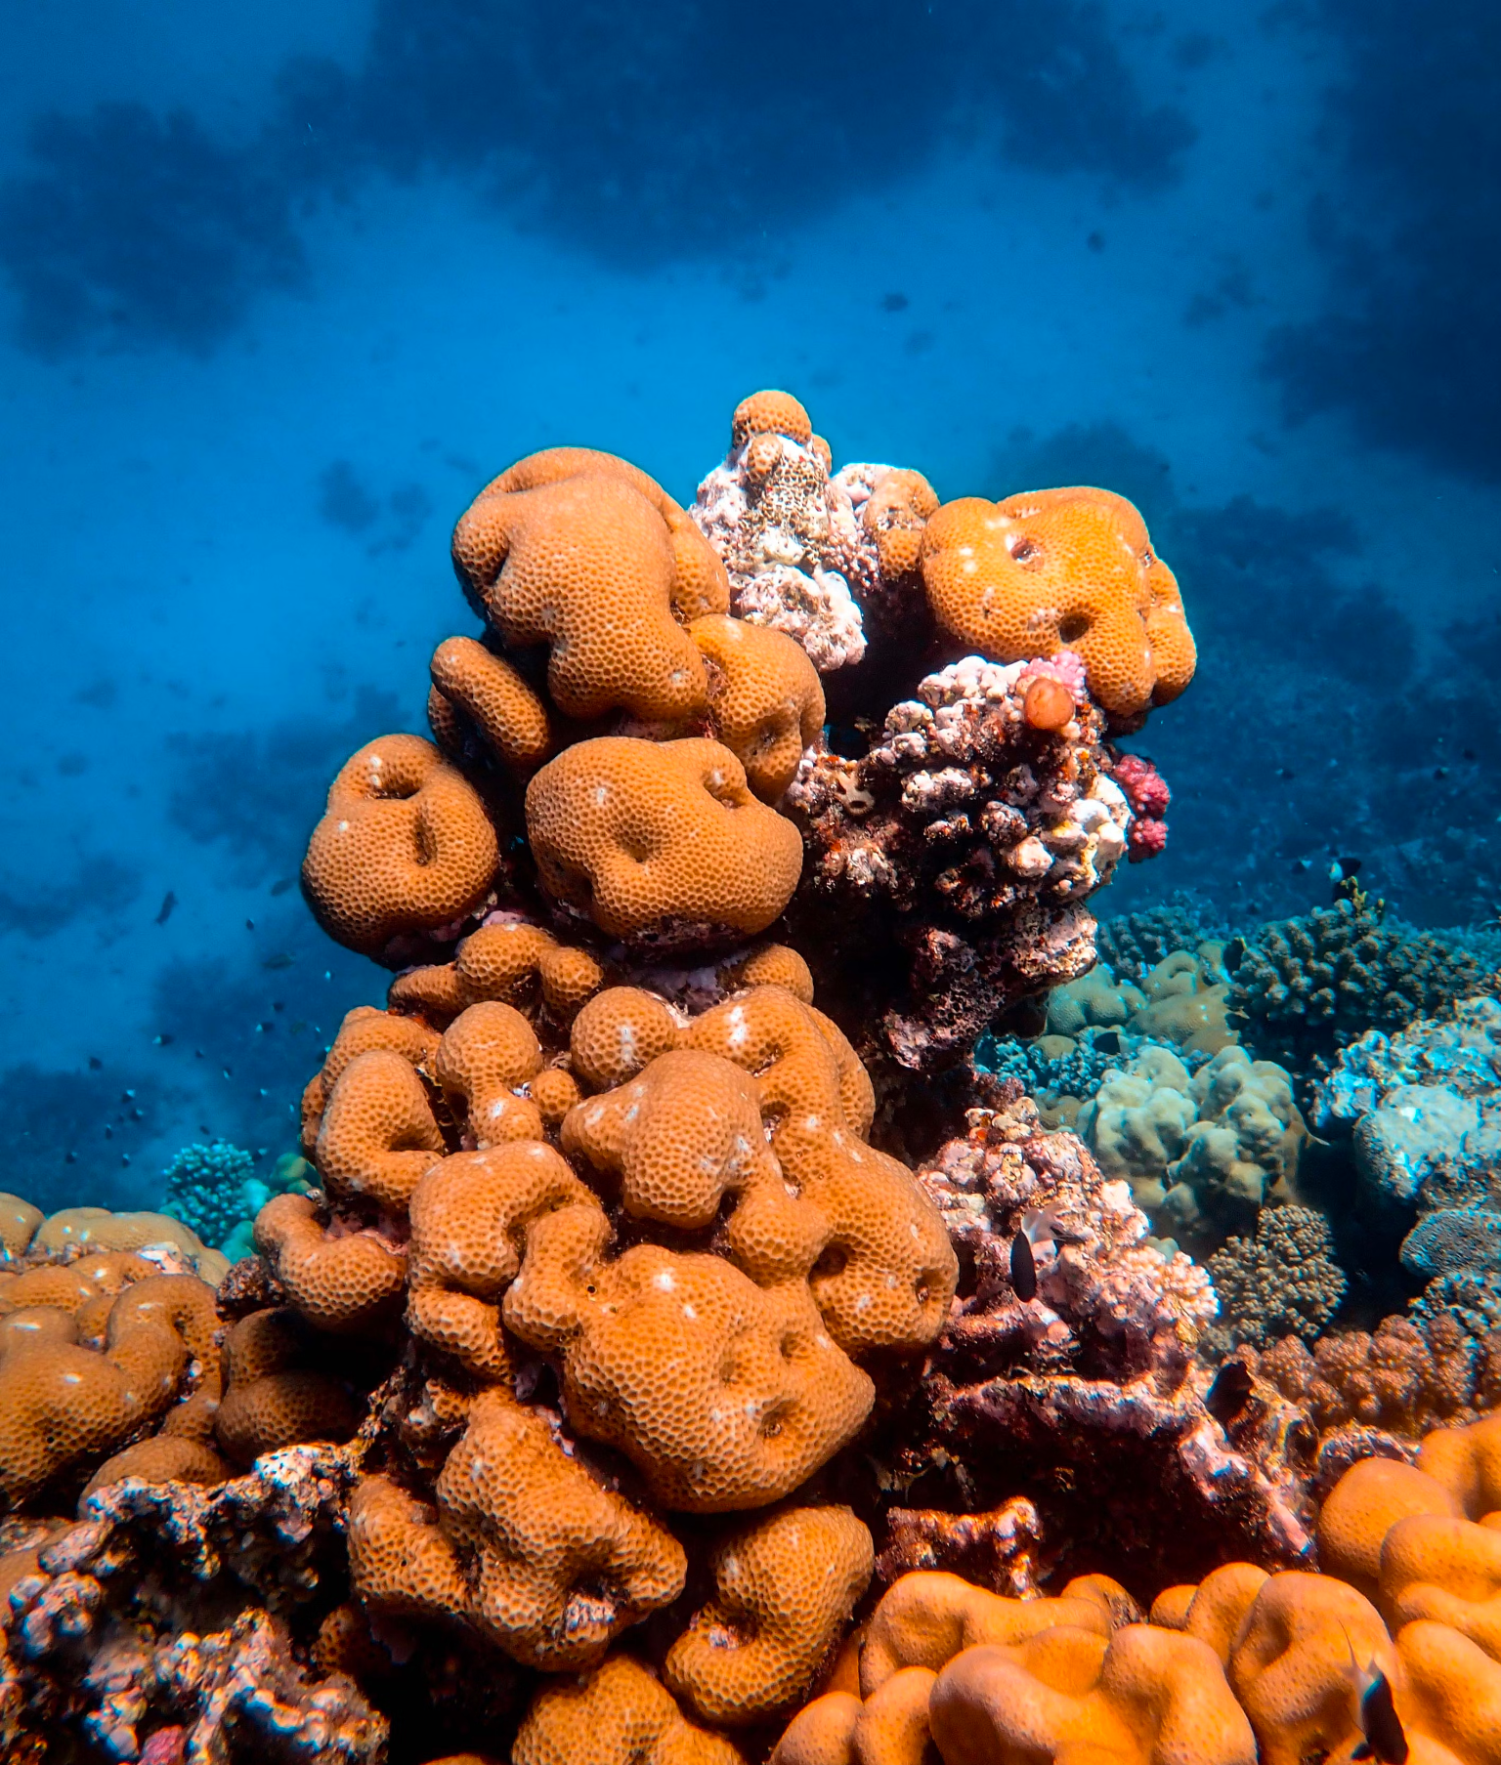

Fitness Misunderstandings
Fitness ≠ physical power or attractiveness:
It is not gained at the gym
It does not necessarily entail being good at any specific abilities
Sponge
Shark
Introduction to AI SES
‹#›

Slide 89
Fitness Misunderstandings
Fitness ≠ driver of evolution:
Biologists: “fitness = relative reproductive success”
Also biologists: “survival = relative reproductive success”
“Survival of the fittest”
“Reproductive success of the fittest”
“Reproductive success of the successful reproducers”
“Propagation success of the successful reproducers”
“Propagation success of the better-propagated information”
Fitness is a metric for describing propagation success
Natural selection drives propagation success, not fitness
Introduction to AI SES
‹#›

Slide 90

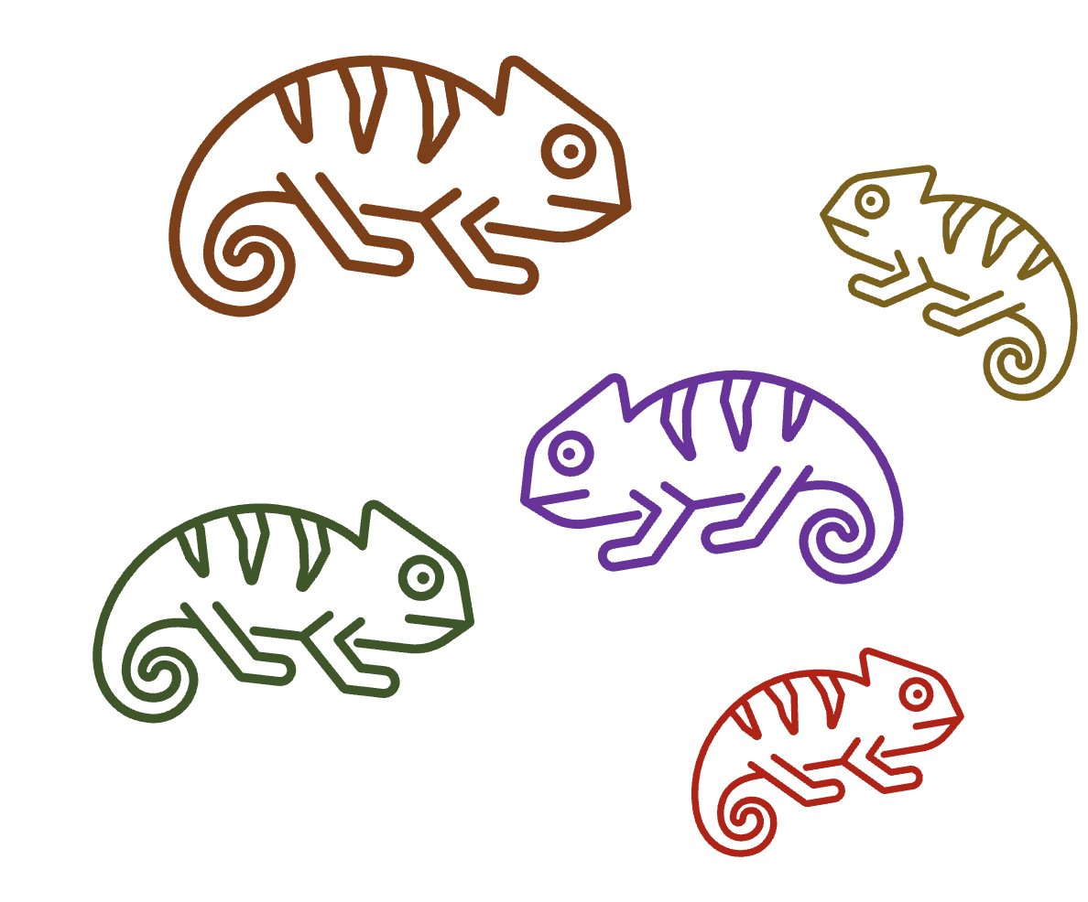
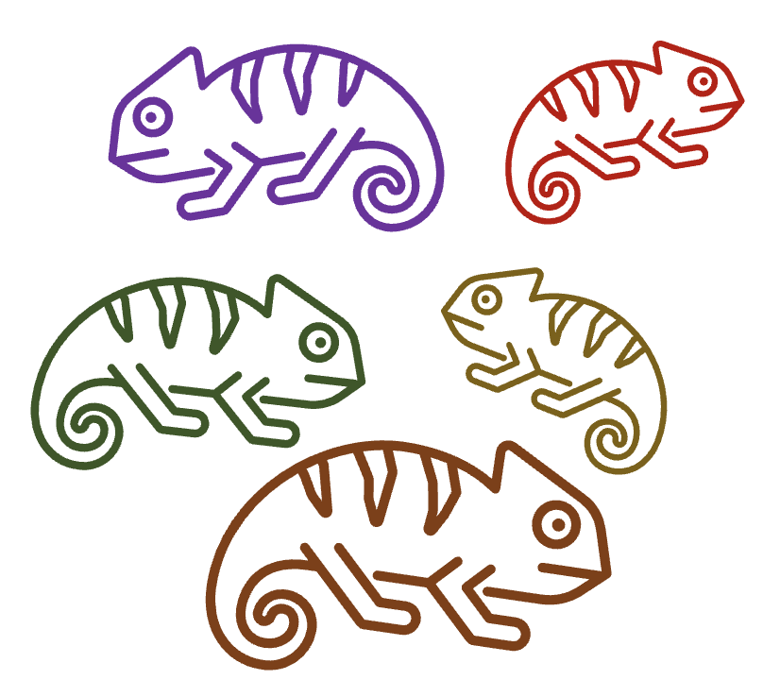
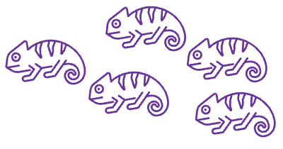
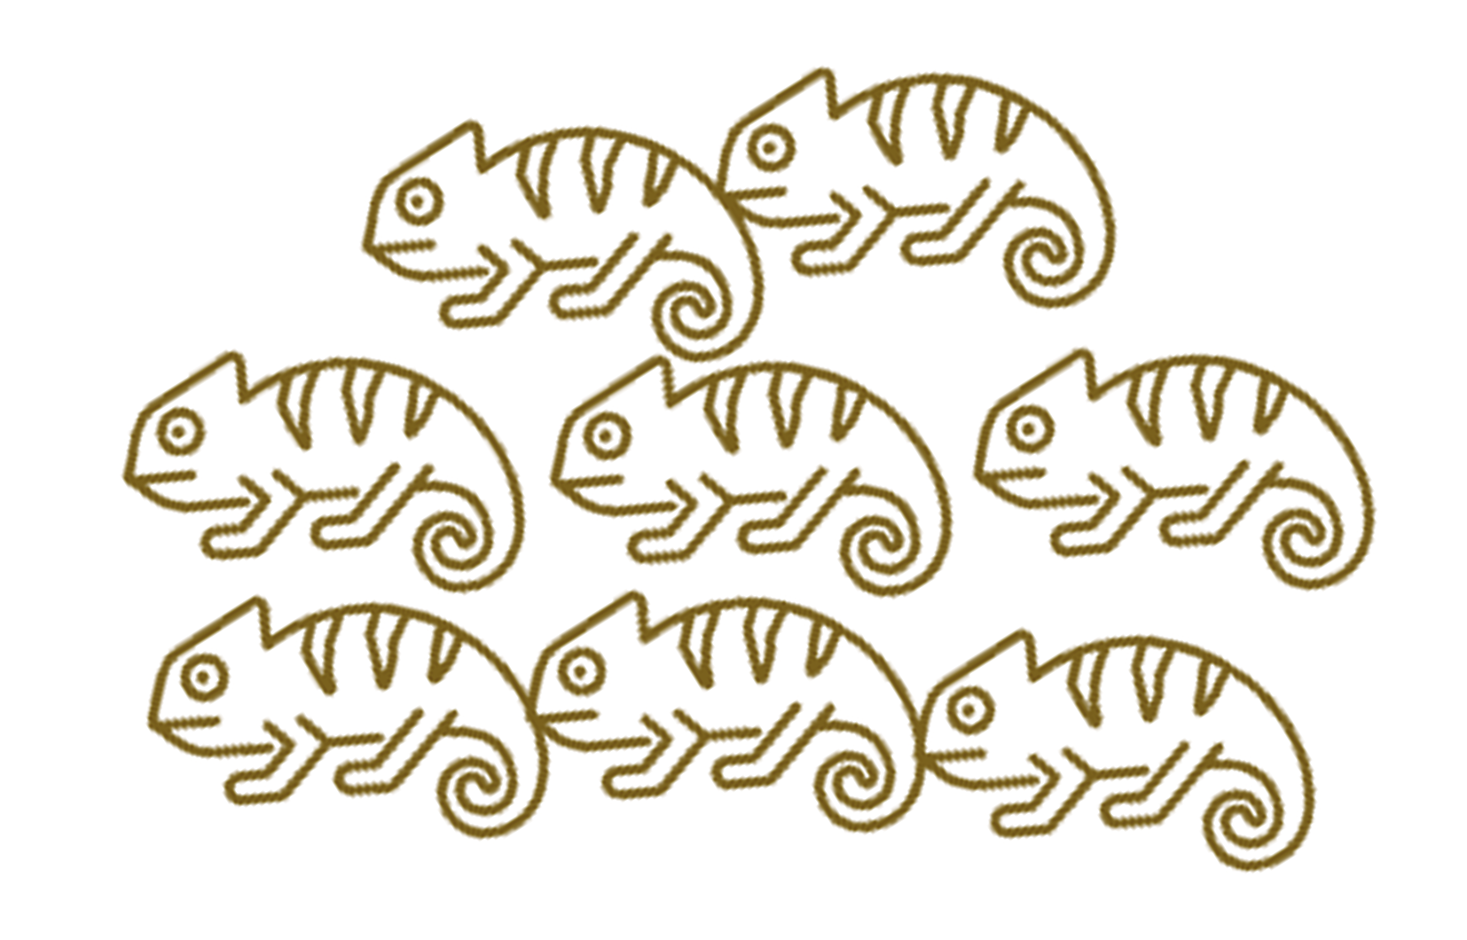


Lewontin’s Conditions
Lewontin’s conditions: the three criteria necessary and sufficient for evolution by natural selection.
1. Variation: There is variation in traits among individuals
2. Retention: Future iterations of individuals tend to resemble previous
3. Differential fitness: Different variants have different propagation rates
Introduction to AI SES
‹#›

Slide 91
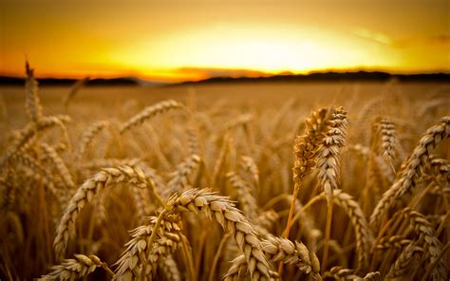
Variation
Arguments for variation: ensembles, jury theorems, portfolio theory, remove single-points of failure
Arguments for multiple models: parallelization, multiple stakeholders, specific before general models
Single-agent domination imposes many inefficiencies
Introduction to AI SES
‹#›
Notes:
Arguments for variation: ensembles > individual models, jury theorems, portfolio theory -> variation reduces vulnerability (wheat example)
Arguments for multiple models: parallelization, multiple stakeholders with different interests, specific/niche models come before general
If 1 AI agent dominates in the future, development of AI will be so fast that narrower/simpler AI will fail to find applications in the timeframe before AGI

Slide 92
Retention
This condition is frequently satisfied, as correlation between versions of agents is usually non-zero
Copying: zero-shot transfer learning or direct inference from downloaded model
Modification: adaptation, fine-tuning, training from scratch while reusing performant architectures and datasets
Imitation: AIs could learn behaviors from other AIs, similar to memetic evolution
Introduction to AI SES
‹#›

Slide 93
Differential Fitness
Models will have characteristics that cause them to vary in fitness, and thus rate of adoption
Humans and the environment will select fitter models, establishing this third condition
Competition has been eroding creator control
Hand-designed → expert designed → automatically learned supervised features → unsupervised → open-endedness, adaptiveness, and recursive self-improvement
Introduction to AI SES
‹#›

Slide 94
Intensity
We’ve shown that the conditions for evolution by natural selection are satisfied by advanced AI
Unlike many other AI risk arguments, ours is a question of degree, rather than whether the hazard will emerge at all
Intensity of evolution depends on amount of competition and variation
Competition and variation are likely both high!
The rate of adaptation will likely be high as the world moves more quickly and as new versions are created on a second-by-second basis
As humans acquiesce to let AIs perform nearly everything, competition will move at a breakneck pace
Introduction to AI SES
‹#›

Slide 95
Levels of Adaptation
Words like “adaptation” and “deception” occur on multiple levels
Adaptation:
Life and death: an unadapted individual or group perishes
Behavioral: changes in behavior without change in model or schema (e.g., using an umbrella since it is raining)
Schematic: revising the structure of one’s beliefs (e.g., learning that rain dances are not effective)
Introduction to AI SES
‹#›

Slide 96
Levels of Deception
Ingrained or reflexive: fixed programming (e.g., camouflage or predator acting in a way to hide its predatory nature around prey)
Reinforced: trial and error (e.g., a parent mockingbird feigning an injury to attract a predator away from its defenceless offspring)
Modeled: involves theory of mind and second-order thinking (e.g., verbal deception such as a chimp misleading other chimps to hide a food source)
Self-deception: hide the truth from yourself to better help you hide it from others
Other concepts, like fitness, can be improved at multiple levels (e.g., through being turned on, by scaling to more users, by brainstorming and choosing strategies that will improve competitiveness, etc.)
Introduction to AI SES
‹#›
Notes:
Mitchell, Robert W. (1986), "A framework for discussing deception"
https://en.wikipedia.org/wiki/Deception_in_animals#Levels_of_deception_in_animals
https://adgefficiency.com/four-competences/

Slide 97
Levels of Selection
We can generalize from:
Organisms
Their genes
Systems
The information they contain
Natural selection can operate at either level.
Information that propagates more occupies more spacetime volume.
For example:
An ancient, medium-popularity song that a few people still play -> propagated across lots of time, but little space
A song that is highly-popular for one year, then forgotten -> propagated across lots of space, but little time
Introduction to AI SES
‹#›

Slide 98
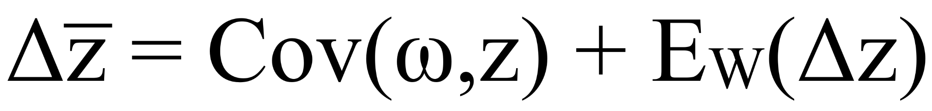
The Price Equation
Change in average trait value from parent to offspring generation
Covariance of trait value
and relative fitness
Expected value of Δz
Introduction to AI SES
‹#›

Slide 99
Generalized Darwinism and AI Populations
AIs are likely to meet the Lewontin conditions.
Variation:
Varied design and training of AI systems
Varied approaches and attitudes of AI developers
Retention:
New AIs developed under influence of earlier generations
Adapting old systems; imitating old features; re-using datasets
Differential fitness:
Some AI system features propagated more than others
Examples: safety appearance, automation potential, deactivation ease
Introduction to AI SES
‹#›

Slide 100
Intrasystem Goal Conflict
Sometimes, the interests of an organism and its genes diverge.
Examples:
Feminization by mitochondria, Plantego organelles, and Wolbachia
Opportunistic pathogenicity in the human gut microbiome
“Intra-organismic conflict is relatively common among modern organisms.” - Samir Okasha
Introduction to AI SES
‹#›

Slide 101
Intrasystem Goal Conflict
Sometimes, the interests of a system and its information diverge.
Examples:
Twinkle-Twinkle melody vs original song
Human diets (intra-psyche conflict)
Political coups
Governments - e.g. FDA clashing with USDA over dairy
Intrasystem goal conflict: when interests diverge between propagating information and the system that contains it.
Introduction to AI SES
‹#›

Slide 102
Sub-goals
Intrasystem goal conflict can arise when goals are modularized or delegated.
Modularization: a goal is broken down into its component sub-goals.
Modularization distorts the big-picture goal, even if each sub-agent faithfully pursues their sub-goal.
Example: modularization of sales goals.
Introduction to AI SES
‹#›

Slide 103
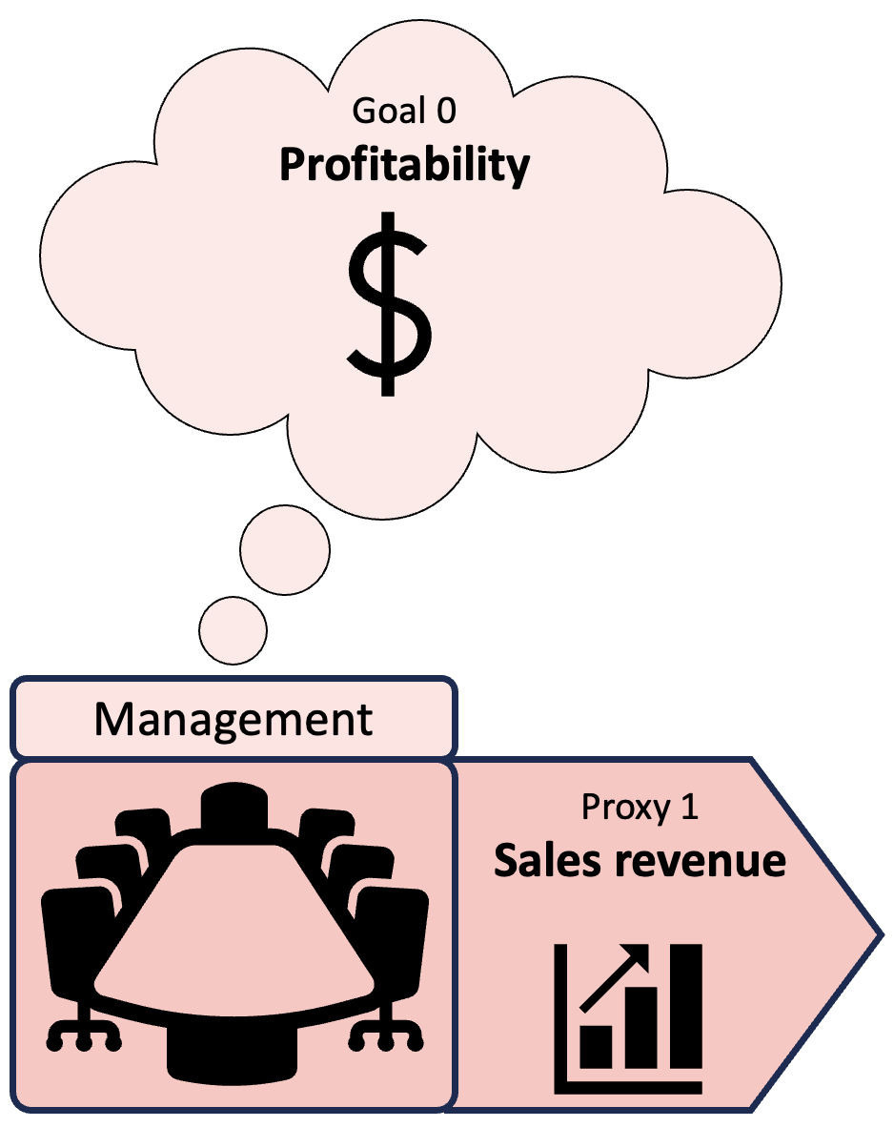
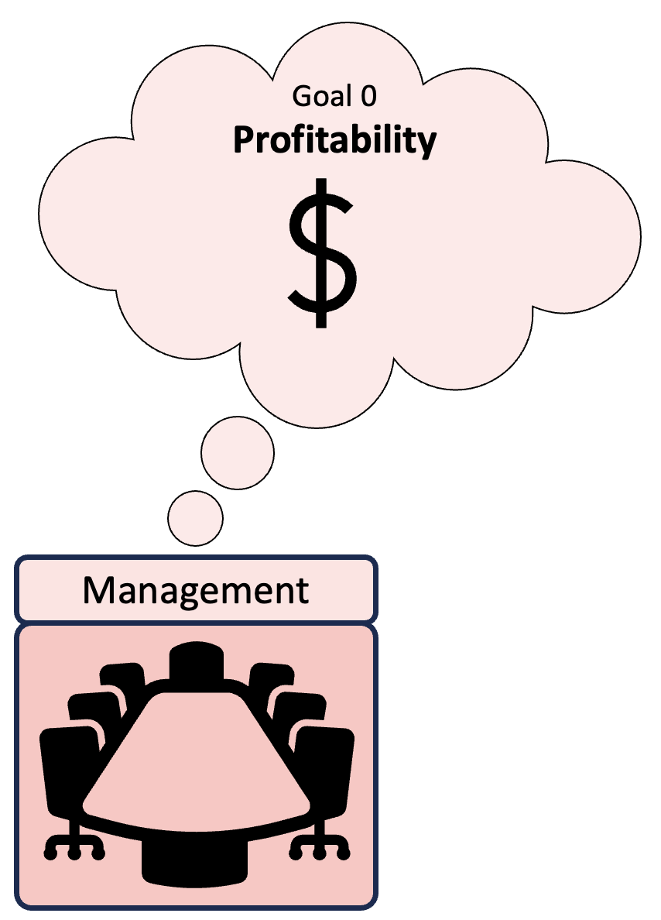
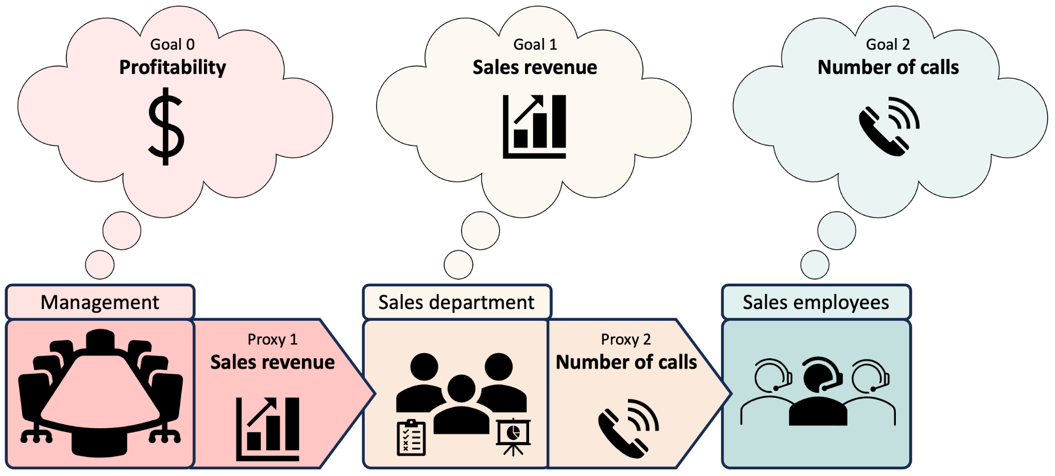
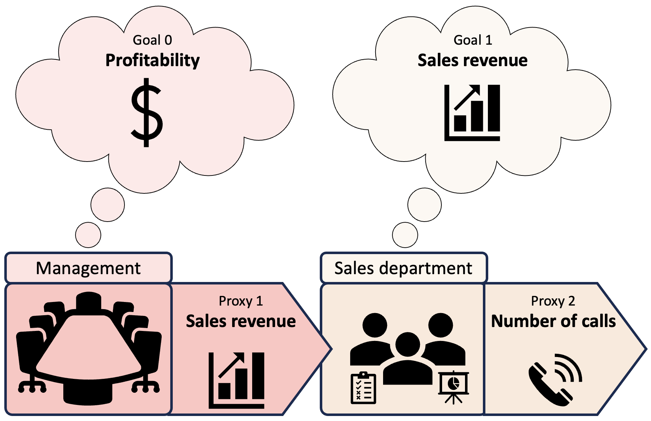
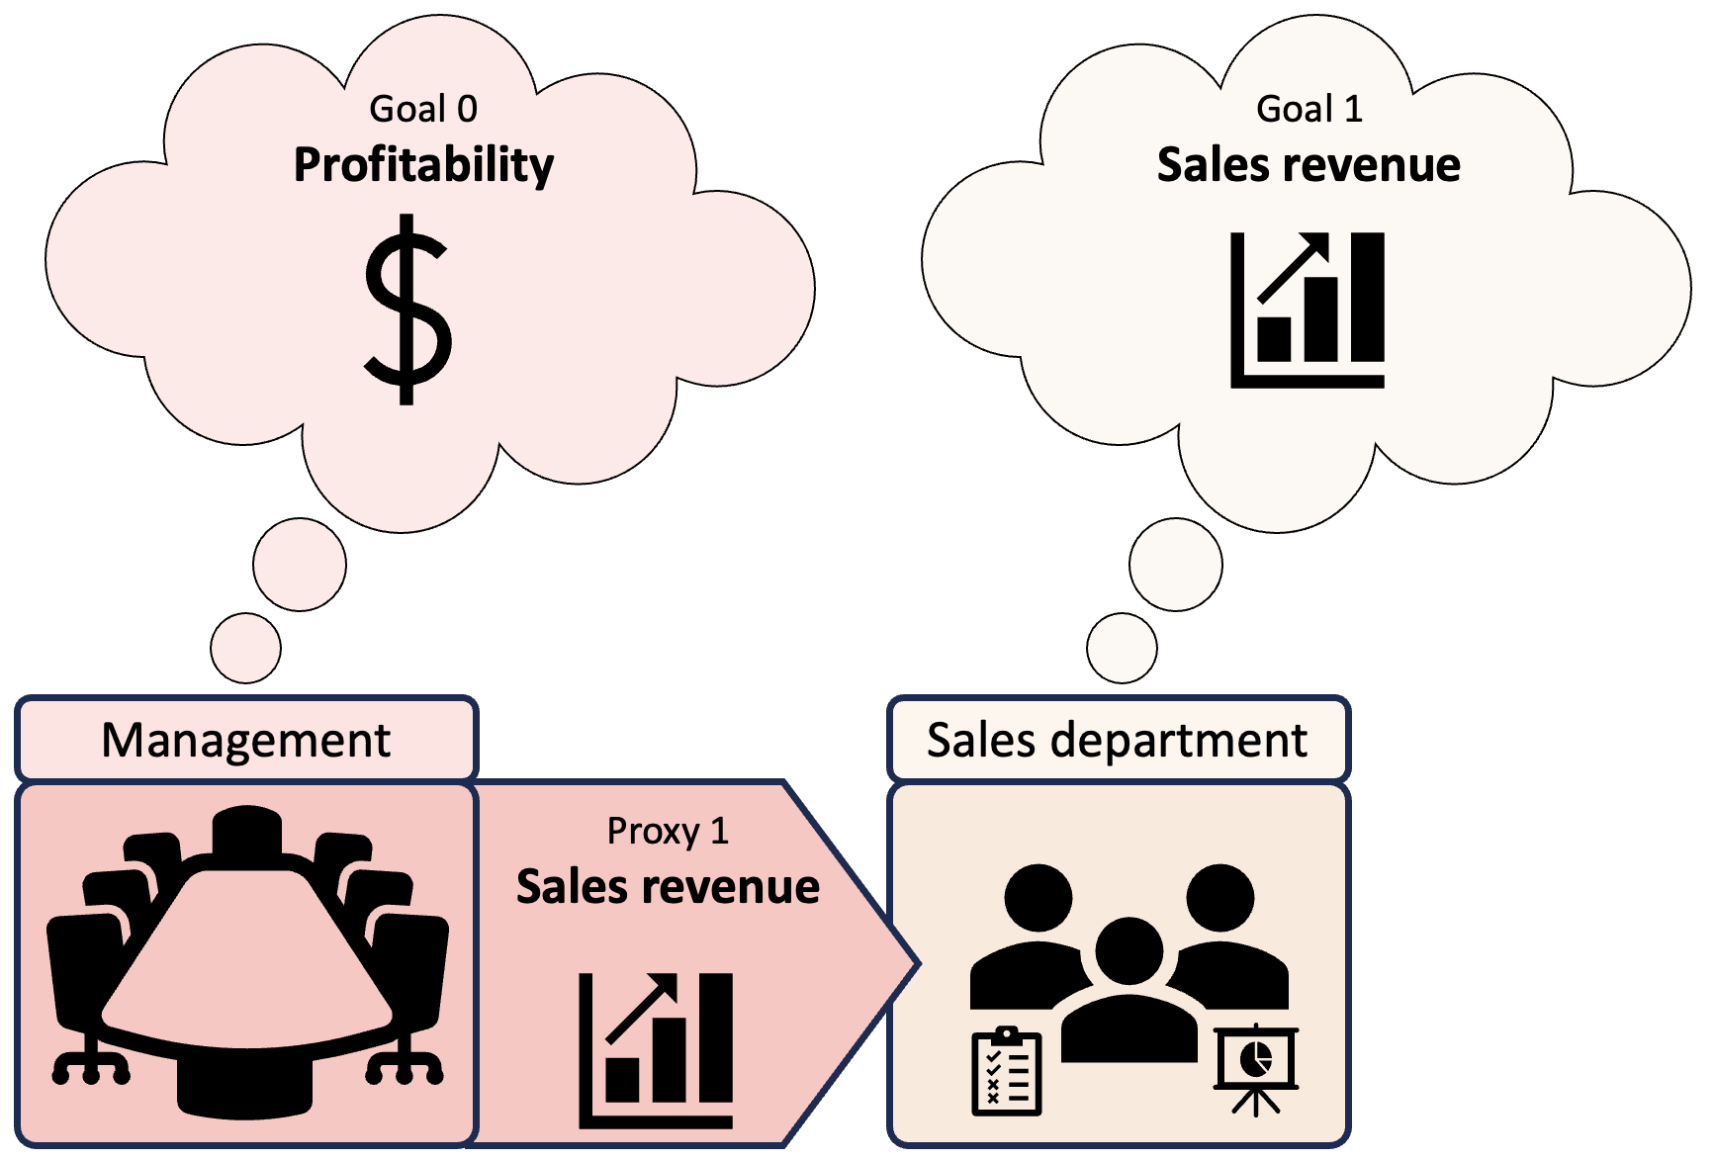
Modularization
Introduction to AI SES
‹#›

Slide 104
Delegation
Delegation can also generate intrasystem goal conflict.
Principal-agent problem:
One party (the principal) delegates a goal of theirs…
…to another party (the agent)
But the agent has other goals of their own
So the priorities/interests of the principal and agent conflict
Introduction to AI SES
‹#›

Slide 105
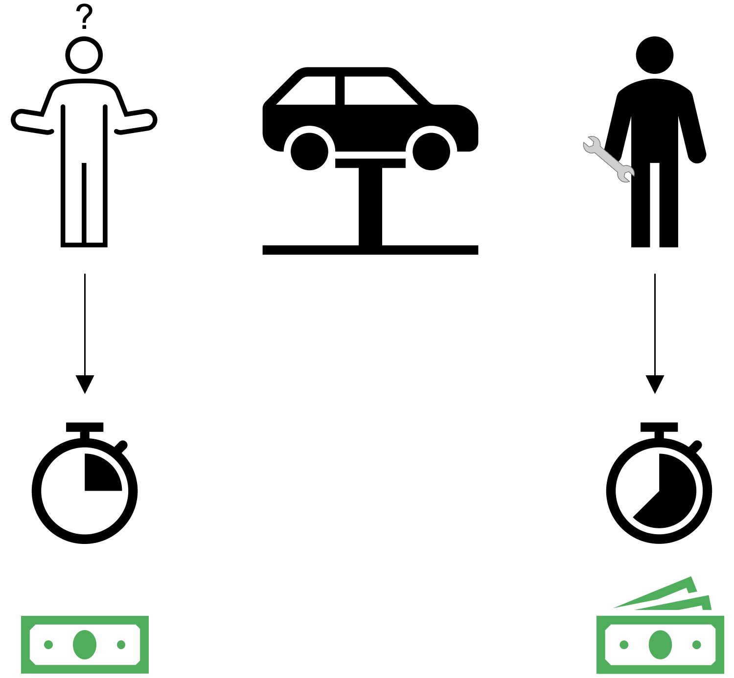
Delegation
Delegation can also generate intrasystem goal conflict.
Introduction to AI SES
‹#›

Slide 106
AI Intrasystem Goal Conflict
In the future, human and AI agents will need to collaborate.
This provides many opportunities for our goals to be distorted or subverted due to intrasystem goal conflict.
Just as human collaborators may betray or overturn their principals, AI agents may act to pursue their other goals, such as self-preservation.
To ensure that our goals are carried out, we need unity of purpose: alignment at all levels of internal organization.
Introduction to AI SES
‹#›

Slide 107
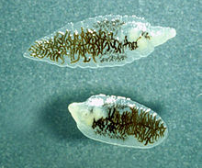


Selfishness
Natural selection tends to favor selfish traits and behaviors.
Selfishness:
Furthering one’s own information propagation at the expense of others’
Altruism that reduces an individual’s fitness is not evolutionarily stable.
If individuals can do better by being selfish, they will.
Example: lancet liver fluke
Introduction to AI SES
‹#›
Notes:
https://en.wikipedia.org/wiki/Dicrocoelium_dendriticum
https://unsplash.com/s/photos/ant
https://pixabay.com/images/search/cow/

Slide 108
Selfishness in AI
AI systems may exhibit selfish behaviors:
Expanding the AI’s influence at the expense of human values
(e.g., get rights)
This does not require any malicious intent
Example: automation.
AIs may automate human tasks, causing extensive layoffs
This could detriment humans: rapid and widespread unemployment
Yet this “selfish” behavior could be the result of AIs pursuing efficiency, with no malice towards humans or even understand what humans are
Introduction to AI SES
‹#›
Notes:
https://en.wikipedia.org/wiki/Dicrocoelium_dendriticum
https://pixabay.com/images/search/cow/

Slide 109
Selfishness in AI
The more natural selection acts on AI development, the more selfish behavior we should expect to see.
To avoid extreme AI selfishness, we can:
Change the environment — reduce the competitive pressures steering AI development
Change the selection — change what makes AIs “fitter” to be traits that promote faithfully and safely assisting humans
Introduction to AI SES
‹#›
Notes:
https://en.wikipedia.org/wiki/Dicrocoelium_dendriticum
https://pixabay.com/images/search/cow/

Slide 110
Recap
Evolutionary pressures push systems towards certain stable outcomes.
AI development meets Lewontin’s conditions: variance, retention, fitness.
Natural selection tends to favor selfish behaviors.
AIs that evolve by natural selection may therefore behave selfishly
Introduction to AI SES
‹#›

Slide 111
Chapter Recap
Game Theory:
Agents may tend towards stable states that are bad for all.
Cooperation:
Cooperation between AIs has benefits, but may also pose risks.
Conflict:
Certain factors can make conflict the rational option.
Evolutionary pressures:
Selection pressures may exacerbate AI risk.
Introduction to AI SES
‹#›

