Slide 1
Introduction to
AI Safety, Ethics, and Society
Normative Ethics
Introduction to AI SES
‹#›
Notes:
https://course.mlsafety.org/#media-popup

Slide 2

Introduction
Ethics is the branch of philosophy concerning questions of right and wrong, good and bad.
Moral decisions reflect our values, beliefs, and moral principles.
Ethics seeks to provide a systematic framework for these decisions.
Throughout this chapter we examine:
Moral considerations
Common ethical frameworks
Ethical concepts central to AI safety, ethics, and society
Ethics
Introduction to AI SES
‹#›

Slide 3
Roadmap
Why learn about ethics?
Normative factors: wellbeing, constraints, impartiality, etc.
Moral Theories:
Utilitarianism
Deontology
Virtue Ethics
Social Contract Theory
Moral Uncertainty
Introduction to AI SES
‹#›

Slide 4
Why Learn About Ethics?
To develop a foundation for understanding AI safety discourse. This is important because…
Widespread use and development of AI systems is taking place throughout various domains of human life.
2. Ensuring that AI systems are aligned with human values reduces the chance of bad outcomes.
3. AI systems generate ethical questions that are unique to their
technological nature and capabilities.
Introduction to AI SES
‹#›
Notes:
Well-established ethical theories were shaped by hundreds to thousands of years of collective experience and wisdom accrued from multiple cultures. Computer scientists should draw on knowledge from this enduring intellectual inheritance, and they should not ignore it by trying to reinvent ethics from scratch.

Slide 5

Ethics and Relativism
It may be that no moral principles or judgements are absolutely or universally correct; instead, they are only correct within a culture.
Moral Relativism is the view that there is no objective standard of morality that applies to all people across all situations.
Problems with moral relativism:
Extremely harmful actions are do not permissible just because they are culturally relative.
There may exist moral disagreements within cultures.
Introduction to AI SES
‹#›
Notes:
Relate to moral relativism making room for corporate interests driving AI development.

Slide 6
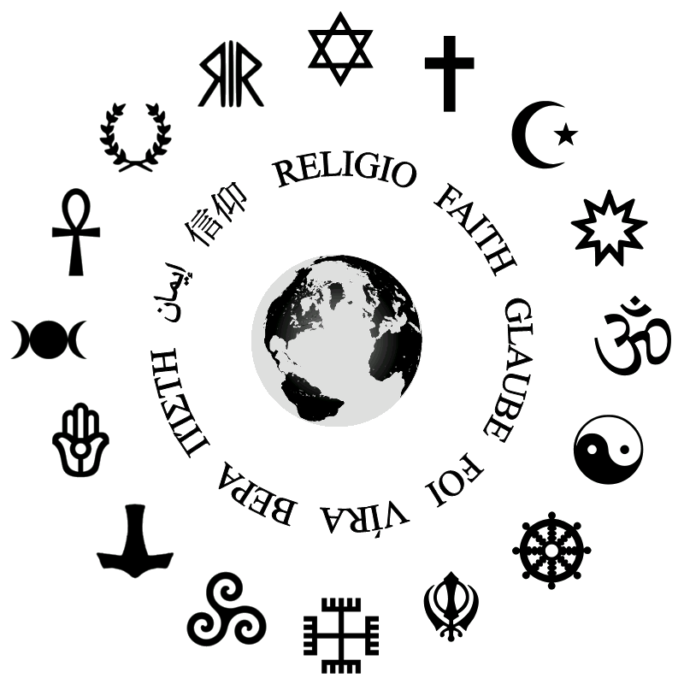
Ethics and Religion
Divine command theory is the view that the moral value of an action is determined solely by God’s commands because God is ‘good’.
But, if one should follow God’s word because God is good, then there must exist some moral qualities that are independent of God’s rules, for instance, ‘goodness’.
Therefore, divine command theory is false, and we cannot equate religion with morality.
Introduction to AI SES
‹#›

Slide 7
Roadmap
Why learn about ethics?
Normative factors: wellbeing, constraints, impartiality, etc.
Moral Theories:
Utilitarianism
Deontology
Virtue Ethics
Social Contract Theory
Moral Uncertainty
Introduction to AI SES
‹#›

Slide 8
Decomposing Goodness
Moral decisions often consider the intrinsic and instrumental goods that are at stake.
Instrumental goods are valuable because of the benefits or outcomes they provide – for example, money, power, career opportunities.
Intrinsic goods are valuable in and of themselves; common supposed examples are love, pleasure, beauty, and truth.
Some philosophers think there are many intrinsic goods, others accept none, or only one — wellbeing.
Introduction to AI SES
‹#›

Slide 9

Wellbeing
How wellbeing is defined is debatable; however, it is commonly considered to be an intrinsic good.
Wellbeing generally refers to how well a person’s life is going for them, or whether a person is happy, healthy, and fulfilled.
Throughout this section, we discuss three common accounts of wellbeing:
Wellbeing as pleasure.
Wellbeing as preference satisfaction.
Wellbeing as a set of objective goods.
Introduction to AI SES
‹#›

Slide 10
Wellbeing as Pleasure
Wellbeing as pleasure: the balance of pleasure (or happiness) over pain (or suffering) is what constitutes wellbeing. Also called hedonism.
While we may all have different preferences and desires, pleasure seems to be universally valued. All other goods might be instrumental.
However, some philosophers argue against this view because it does not consider other ostensibly relevant factors to our wellbeing such as the pursuit of knowledge.
Introduction to AI SES
‹#›

Slide 11
Wellbeing as Preference Satisfaction (1/2)
Wellbeing as preference satisfaction: what really matters for wellbeing is that our desires or preferences are satisfied.
Different types of preferences might differ greatly in different situations. Consider Alice’s preferences over different candidates in an election:
Stated preference → “I prefer AI’s output X”
Revealed preference → I chose AI’s output X
Informed preference → I would have chosen AI’s output X if I knew…
Which preferences matter?
Introduction to AI SES
‹#›

Slide 12
Wellbeing as Preference Satisfaction (2/2)
Stated preferences are outwardly expressed, but sometimes, they conflict with revealed preferences. A revealed preference illustrates our actions, not our intentions and they can be more useful than stated preferences.
A voter may express a preference for Google over ChatGPT, but when they actually have queries, they may more frequently use ChatGPT.
An informed preference considers all relevant information and can change as more information is acquired. These help us to uncover the reasoning behind stated/revealed preferences to better understand how they might change or conflict.
Introduction to AI SES
‹#›

Slide 13

Wellbeing as Objective Goods
Objective goods are those things which are good independent of personal beliefs or opinions – they are universal.
An example set: moral goodness, rational activity, development of abilities, having children and being a good parent, knowledge, awareness of true beauty.
We may not always agree on what constitutes an objective good, and whether it can be considered universal.
Introduction to AI SES
‹#›

Slide 14
Wellbeing and AI
AI influence on human wellbeing: AI chatbot companions could influence our wellbeing
If they aim to maximize revealed preferences, they may addict us and leave us unhappy
If they aim to maximize pleasure, they may give us amusing but shallow content
If they aim to maximize objective goods, they may push us to pursue self-development goals that we may not wish
Wellbeing of AIs: if AIs are conscious, then
Many coherently-acting AIs could have wellbeing according to a preference view of wellbeing
AIs that can reason, gain knowledge, or develop their abilities could have wellbeing according to an objective goods view
Introduction to AI SES
‹#›

Slide 15
Wellbeing Summary
In this section, we have covered the following accounts of wellbeing:
Wellbeing as pleasure
Wellbeing as preference satisfaction
Wellbeing as a set of objective goods
Though these views differ from one another they all share a common goal: promoting actions that result in morally good outcomes.
A morally good outcome will almost always aim to affect wellbeing to some degree.
Introduction to AI SES
‹#›

Slide 16
Obligations, Constraints and Rights (1/2)
Constraints are actions that we’re morally prohibited from taking; common examples are killing or lying.
Obligations are actions that we’re morally required to take; common examples are keeping our promises or telling the truth.
Rights are claims that individuals may have over their community.
Rights that require certain actions from others are called “positive rights” → access to education, food, or shelter.
Rights that require others to abstain from certain behaviors are called “negative rights” → censorship or discrimination.
Some say AIs should eventually get negative rights but not positive rights.
Introduction to AI SES
‹#›
Notes:
Regarding the principle that we ought to keep our promises, for example, we can shatter the consensus simply by asking whether
our promise is binding when it is made as a result of false statements; or, even in the absence of falsehood, if some important circumstances were concealed; or if we were led to believe (perhaps without any malicious intentions) that the consequences of keeping the promise would be very different from what they now turn out to be; or if we made the promise under some form of coercion; or if the circumstances have changed in an unexpected but materially relevant way; or if we now see that keeping the promise will impose a very
serious loss on ourselves, completely out of proportion to the benefit it confers on the person to whom we made the promise; or if we learn that keeping the promise will actually harm the person to whom it was made, although he is unable to see this. Without deciding about
these cases, we cannot know that our promise will have even prima facie weight.

Slide 17
Obligations, Constraints and Rights (2/2)
Obligations and constraints are often derived from respect for people’s rights. Individuals with rights could include:
Non-human individuals, such as AI and animals
Individuals that can experience pleasure and suffering
Individuals that have ‘interests’
Rights can be absolute and universal, or particular → human rights vs. the right to vote in national elections.
Introduction to AI SES
‹#›
Notes:
Contrast virtue ethics with deontology

Slide 18
Partiality and Impartiality (1/2)
Partial moral theories imply that we should value individual lives preferentially. These emphasize special obligations.
We have special obligations towards ourselves, our friends, our communities, or our families that we do not have toward strangers.
Impartial moral theories imply that we should value individual lives equally. These disregard special obligations.
Most modern moral theories are impartial, and almost every moral theory requires impartiality in at least some contexts.
Introduction to AI SES
‹#›
Notes:
Contrast virtue ethics with deontology

Slide 19
Partiality and Impartiality (2/2)
Most modern theories agree that all human beings, regardless of their differences, are included in the moral circle – they are subjects of moral concern.
Some philosophers, such as hedonists, have also argued that non-human animals should be included, due to a capacity for suffering.
But perhaps we should extend the moral circle even further, considering entities that don’t have the same kinds of conscious experience as current humans, such as future humans or AIs.
Impartial AIs care for humans initially but come to care for them less.
Introduction to AI SES
‹#›
Notes:
Contrast virtue ethics with deontology

Slide 20
Obligatory vs. Non-Obligatory Actions
Obligatory actions are those that we are morally obligated or required to perform – we have a moral duty to carry out these actions.
These actions can take the form of helping someone in distress or respecting human rights.
Non-obligatory actions are those that are not morally required or necessary.
These actions can still be morally good, for instance volunteering or donating to charity.
Introduction to AI SES
‹#›

Slide 21
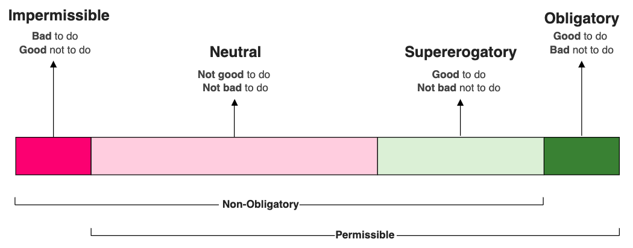
Permissible vs. Impermissible Actions
Impermissible actions are those that violate moral laws and are considered wrong (e.g., stealing or intentionally harming someone).
Permissible actions are those that are not impermissible – they can be divided into two categories: supererogatory or neutral.
Supererogatory actions go ‘above and beyond’ what’s morally required → donating to charity.
Neutral actions are morally inconsequential → taking a walk.
Introduction to AI SES
‹#›

Slide 22
Praiseworthiness vs. Blameworthiness
Moral judgments regarding praiseworthiness and blameworthiness often consider moral responsibility and accountability.
Example: A toddler kicks their classmate → We do not blame the child if they were never taught otherwise.
Example: A billionaire donates to charity solely for tax benefits → We do not praise the billionaire because the reasons for donation are morally objectionable.
Such moral judgments do not imply anything about what is morally wrong, permissible, obligatory, or supererogatory.
Introduction to AI SES
‹#›

Slide 23
Recap
Understanding ethics is important because AI systems—likely to have serious impacts on the world—must be used ethically. In particular, we must ensure that AI systems are aligned with human values.
Three conceptions of wellbeing suggest different ways to use AIs.
Moral considerations like impartiality, obligations, constraints, and rights give us a shared language to describe and debate the ethics of AIs and their impacts. These considerations are all relevant to common-sense morality and the following following moral theories.
Introduction to AI SES
‹#›

Slide 24
Introduction to
AI Safety, Ethics, and Society
Normative Ethics
Part 2: Utilitarianism and Deontology
Introduction to AI SES
‹#›
Notes:
https://course.mlsafety.org/#media-popup

Slide 25
Roadmap
Why learn about ethics?
Moral considerations: wellbeing, obligations, partiality, et cetera.
Moral Theories:
Utilitarianism
Deontology
Virtue Ethics
Social Contract Theory
Moral Uncertainty
Introduction to AI SES
‹#›

Slide 26
From Considerations to Theories
Moral considerations are part of metaethics: the underlying concepts and assumptions that make moral reasoning possible.
Normative ethics is about concrete moral standards and principles that govern how we ought to behave. Here, we consider the four most common theories in academic ethics:
Utilitarianism
Kantian Ethics/Deontology
Virtue Ethics
Social Contract Theory
Introduction to AI SES
‹#›

Slide 27
Utilitarianism Overview
Utilitarianism seeks to maximize overall wellbeing → the right action is the one that increases overall wellbeing the most.
According to utilitarianism, the right action in any situation is the one which will increase overall wellbeing the most—not just for the people directly involved in the situation, but globally.
When we maximize wellbeing, we can make moral questions into empirical ones.
Introduction to AI SES
‹#›

Slide 28
Utilitarianism: Drunk Driving (1/2)
Drunk driving. Amanda has had a few drinks, and is deciding whether to drive or take the bus home. What should she do?
Utilitarians would analyze the situation by…
Listing all the possible outcomes of driving vs. not driving.
Calculating the probabilities of each outcome.
Calculating the ‘utility’ – wellbeing – brought about by each outcome.
Expected utility of each choice is the sum of the probabilities of each outcome multiplied by its utility.
Introduction to AI SES
‹#›

Slide 29
Utilitarianism: Drunk Driving (2/2)
Amanda’s action | Possible outcome(s) | Probability of each outcome | Utility
Amanda takes the bus. | Amanda is frustrated, the bus is slow, and she has to wait in the cold. | 1 | -1
Amanda drives home. | Amanda gets home safely, far sooner than she would have on the bus. | .95 | +1
 | Amanda gets into an accident and someone is fatally injured. | .5 | -1000
Expected utility:
Amanda gets the bus → 1 x - 1 = - 1
Amanda drives home →
0.95 x 1 + (0.05 x - 1000) = - 49.5
Amanda should take the bus!
*the probability and utility values we assign here are arbitrary, and only serve to illustrate what such a calculation might look like.
Introduction to AI SES
‹#›

Slide 30
Utilitarianism’s Claims
Utilitarianism is a form of consequentialism → consequences determine whether an action is good or bad.
We measure* the effects of actions on wellbeing alone → wellbeing is the only intrinsic good.
All people have the same intrinsic moral worth → everyone’s wellbeing should be weighed impartially.
It is insufficient to do good, we must do what is best → we should maximize wellbeing.
*We measure wellbeing according to our choice of theory, e.g. Hedonism vs. Preference Satisfaction.
Introduction to AI SES
‹#›

Slide 31
Critiques of Utilitarianism (1/3)
Utilitarianism is too demanding → If our money is more helpful to others than it is to us, there isn’t a utilitarian reason to keep it. For instance, Peter Singer has argued that we should donate at least a third of our income to charity.
Defences include:
Utilitarianism is not as demanding in practice as it is in theory. Often, acting in a utilitarian way is quite “normal”, avoiding issues like burnout.
We live in a demanding world. Maybe most of us should donate more.
Utilitarianism over-emphasizes wellbeing → Robert Nozick famously highlights this point in his popular thought experiment.
Introduction to AI SES
‹#›

Slide 32

Critiques of Utilitarianism (2/3)
Experience Machine: Consider an experience machine offering any desired sensation. Neuropsychologists could make you believe you're achieving great feats while you float in a tank, your brain connected to electrodes. Would you choose to live connected to this machine, pre-set with life's experiences? Most people say no.
What if we reverse the thought experiment?
You ‘wake up’ in an Experience Machine tomorrow. You can either forget this, returning to your current (simulated) life or return to your “real” one.
Most people choose to stay in the machine. This is status quo bias.
Introduction to AI SES
‹#›

Slide 33
Critiques of Utilitarianism (3/3)
Utilitarianism requires intractable reasoning → we cannot reliably and precisely calculate future utility values. It is also impractical to expect this. The drunk driving example is idealized; for instance, we did not list all possible outcomes or consider long-term consequences.
The utilitarian response: a theory’s criterion of rightness doesn’t need to take the same form as its decision procedure.
A criterion of rightness → whatever a theory claims makes an action right.
A decision procedure → the process a theory recommends that individuals use to make decisions.
Introduction to AI SES
‹#›

Slide 34
Deontology
Deontology’s key ideas:
Focus on constraints and obligations, not the best outcome.
Formulation of rules or principles that protect human autonomy.
The rights and intentions of individuals are morally relevant.
Deontological rules from the Ten Commandments: “Thou shalt not kill”, “Thou shalt not steal”, “Honor thy mother and father”, etc.
Deontological theories are systems of moral rules, rights, duties and obligations which constrain our behaviour. These theories typically present themselves as improvements over consequentialism.
Introduction to AI SES
‹#›

Slide 35
Deontology’s Critique of Utilitarianism
Consequentialism doesn’t allow options → important life decisions like marriage or career choice will have “correct” utility-maximizing answers.
Deontologists say this view is too demanding – to preserve human autonomy, we provide a list of impermissible actions, and allow choice to govern the rest.
Consequentialism doesn’t forbid extreme actions → killing innocents, torturing – these actions aren’t always wrong for consequentialists.
Deontologists argue some actions are simply forbidden by appeal to universal constraints or obligations.
Introduction to AI SES
‹#›

Slide 36
Deontology: The Doctrine of Double Effect
Deontology also emphasizes the intentions of agents in their moral considerations. Consider The Doctrine of Double Effect:
An agent is morally allowed to carry out actions that predictably lead to bad outcomes as long as they intend the good effect, but not the bad effect of the action.
Siamese twins: a pair of siamese twins needs a medical procedure, without which both of them would die. However, one of them will die as a consequence. The doctrine of double effect says the procedure is justified insofar as we intend to save one of the twins.
Introduction to AI SES
‹#›

Slide 37

Deontology: Act/Omission
Intuitively, we do not hold a person responsible for what they did not do. In deontology, this is the Act vs. Omission distinction.
Stealing: While walking past a bank at night, Bob notices the night deposit box is open. Inside it, he sees a bag, filled with money. He decides to steal the bag. Alice sees Bob taking the money, but never bothers to report it.
Deontologists would not hold Alice responsible for Bob’s actions.
Introduction to AI SES
‹#›

Slide 38
Critiques of Deontology
Deontology responds unconvincingly to moral catastrophes.
Nuclear Terrorism. The only way to prevent a nuclear terror attack is by torturing the perpetrator. But torture is impermissible to deontologists, regardless of the consequences.
In response, some some deontologists have adopted a threshold: when enough lives are at stake, the theory defers to consequentialism. However, there is no clear, non-arbitrary way to determine “enough”.
Deontology holds constraints like promises over vastly better outcomes.
Introduction to AI SES
‹#›

Slide 39
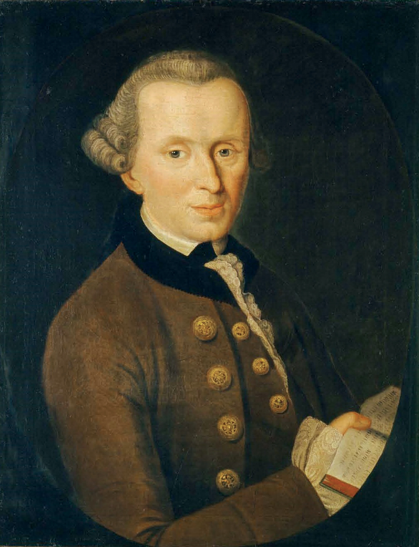
Kant’s Ethics: The Categorical Imperative
Deontology can be traced back to Immanuel Kant, the 18th century Prussian philosopher. Kant’s ethical theory is called the Categorical Imperative. Under this theory…
Morality must be universal → each individual can rationally derive moral laws on their own.
All moral rules are categorical → they aren’t aiming at a goal, they are “In situation Y, I will do X” not “I will do X to get Z”.
He formulates the imperative in four ways. We will outline the Universal Law and Humanity formulations.
Immanuel Kant
Introduction to AI SES
‹#›

Slide 40
Kant’s Universal Law Formulation (1/2)
To figure out if something we want to will is permissible, it must pass four stages of the universal law test.
Stage 1: Turn your proposed action into a rule
Stage 2: Turn the rule into one that applies to everyone
Stage 3: Is it possible to imagine a world where everyone follows the rule? Or is there a contradiction in conceiving of this world?
Stage 4: If there is no contradiction, would anyone will this rule?
In other words, we ask ourselves, “what if everyone did that?”, “what would the world look like?”, and “why should we live like this?”
Introduction to AI SES
‹#›

Slide 41
Kant’s Universal Law Formulation (2/2)
Can the following rules be formulated as universal law?
“I will not keep promises when doing so would inconvenience me”
No → It fails at stage 3. This rule requires that the institution of promise-keeping exists. If everyone adopted this rule, promise-keeping would cease to exist; the rule is contradictory.
“I will never lie under any circumstances”
Yes → if everyone adopted this rule, the institution of honesty would continue to exist. We would will this rule because it preserves our autonomy: when we lie, we treat people as means to an end.
Introduction to AI SES
‹#›

Slide 42
Kant’s Humanity Formulation
To have ‘humanity’ means being able to engage in autonomous, rational behaviour, and to choose your own projects.
The humanity formulation requires treating humanity as an end, not a means, emphasising the preservation of other’s autonomy.
The Urgent Lift. Alice wants a lift to go shopping. She lies to Bob, a stranger, telling him that her brother is having an allergic attack in town. She has his EpiPen and if he doesn’t give her a lift, her brother might die.
Alice uses Bob as a means to an end. Bob might have something more important to do than Alice’s shopping, but less critical than saving a life. The humanity formulation ensures that Bob can make this decision himself.
Introduction to AI SES
‹#›

Slide 43
Critiques of Kant
Kant’s ethics are too extreme and ambiguous.
Mad axeman. Bob hears a knock on his door late at night. When he opens the door, a man with a wild look in his eye, and a bloody axe in his hand asks, “Is Alice in?”. Bob knows that Alice is sleeping upstairs, should he tell the man?
Kant would say that we should never lie to the mad axeman. Thus, his ethics can:
Fail to grasp the moral complexity of real-world situations.
Lead us to extreme moral conclusions.
Introduction to AI SES
‹#›

Slide 44
Introduction to
AI Safety, Ethics, and Society
Normative Ethics
Part 3: Virtue Ethics and Social Contract Theory
Introduction to AI SES
‹#›
Notes:
https://course.mlsafety.org/#media-popup

Slide 45
Roadmap
Why learn about ethics?
Moral considerations: wellbeing, obligations, partiality, et cetera.
Moral Theories:
Utilitarianism
Deontology
Virtue Ethics
Social Contract Theory
Moral Uncertainty
Introduction to AI SES
‹#›

Slide 46
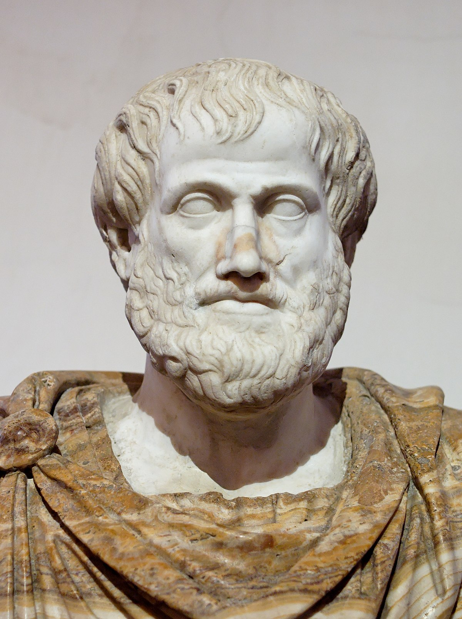
Virtue Ethics
Virtue Ethics emphasizes the importance of having the right character traits.
Modern Virtue Ethics is inspired by the Ancient Greek philosopher, Aristotle. In his book, Nicomachean Ethics, Aristotle explored three key concepts:
Virtue → good character traits.
Practical Wisdom → skills required to live a good life.
Flourishing → living a good life.
Aristotle
Introduction to AI SES
‹#›

Slide 47
Virtue
Virtues are morally good character traits. Vices are morally bad ones.
To be virtuous is not just to behave in certain ways but also to feel certain ways.
Example. Bobby and Cory behave similarly: they are both trusted, keep their promises, and are equally honest. Bobby behaves virtuously because he feels its the right thing to do, but Cory behaves virtuously because she wishes to be seen as virtuous. To the virtue ethicist, only Bobby is virtuous.
Virtue ethics captures something important about morality that other theories neglect → mental states (emotions and motivations) are morally relevant.
Introduction to AI SES
‹#›

Slide 48
Practical Wisdom
Practical wisdom is the ability to reason and act appropriately on the inclination to be virtuous.
If an individual lacks practical wisdom, the inclination to be virtuous may lead them to behave wrongly.
For instance, total honesty is not the ‘best policy’ – we should know when to be honest.
Even though people may be predisposed to certain virtues, practical wisdom – knowing how and when to act on such virtues – is gained through experience.
Introduction to AI SES
‹#›

Slide 49

Flourishing
Flourishing, or eudaimonia, is living a good life.
To flourish, an individual needs to live virtuously, and virtues are those character traits which allow the individual to flourish.
Virtue ethicists still debate whether being virtuous is sufficient for living a good life.
Aristotle argued that to flourish, a virtuous individual must also have the resources to enact virtue.
Introduction to AI SES
‹#›

Slide 50
Critiques of Virtue Ethics (1/2)
Virtue ethics fails for the precise reason many find it attractive. People who act virtuously despite not being virtuous are not considered praiseworthy.
Virtue ethics is not action-guiding. When faced with moral dilemmas, virtue ethics does not offer us a robust decision procedure we may follow in our moral judgments.
Virtue ethics is too focused on the individual. What is right or wrong depends on the character of the actor, which is odd when considering that ethics is concerned with how we treat others.
Introduction to AI SES
‹#›

Slide 51
Social Contract Theory
Social contract theory focuses on hypothetical agreements between members of a society.
“Do not kill” → Social contract theorists might adopt this rule because it is in individual’s best interest not to kill each other.
Social contract theory views moral codes as the result of hypothetical agreements between members of society, established for mutual benefit. It claims that social contracts are the foundations of ethics.
Under this view, all moral codes are similarly justified.
Introduction to AI SES
‹#›

Slide 52
The Veil of Ignorance
Developed by the contemporary moral theorist John Rawls, the veil of ignorance can be a decision-making tool for creating a social contract.
‘Behind’ the veil of ignorance, individuals lose all knowledge of their personal attributes: talents, religion, gender, sexuality, race, class, etc.
Once in this state, called the original position, individuals are asked to envision a social contract for society, blind to their own position within it.
Slavery. An individual behind the veil would not reasonably permit slavery given that they can’t know whether they are slave or slaver.
Introduction to AI SES
‹#›

Slide 53
Protecting the Worst Off
Behind the veil of ignorance, group interests aren’t favored, since no one knows whether they belong to any given group.
If we don’t know which group we belong to, it’s possible that we end up in a position that is the “worst off”.
Thus, Rawls argues that everyone would ensure that the lowest level of wellbeing of anyone is sufficiently high.
Rawls’ Maximin Principle: society should prioritize maximizing the wellbeing of the person with the minimum level of wellbeing in society.
Introduction to AI SES
‹#›

Slide 54

Protecting Liberty
Behind the veil of ignorance, any individual could potentially be excluded from having basic liberties.
If we don’t know whether we may/may not have certain liberties, we should distribute liberties equally to all individuals.
Individuals should be free to pursue their conception of the good life, and enjoy both civil and political liberties.
The Liberty Principle: the fair distribution of universal liberties, ensured by a contractarian agreement not to infringe upon the liberties of others.
Introduction to AI SES
‹#›

Slide 55
Protecting Equality
Inequalities should arise only through fair access to opportunity for all.
Difference Principle: we accept inequality if there is equality of opportunity.
Inequalities should benefit the least privileged individuals - ‘worst off’.
Example: Economic Growth. Inequality can drive economic growth by rewarding productive people, which can also benefit the ‘worst off’.
Difference Principle (2): Inequalities arising from equality of opportunity must also help the least privileged, even if they help the privileged more.
Introduction to AI SES
‹#›

Slide 56
Critique: Rawls’ Conclusions are Too Strong
The maximin principle is at odds with with common sense morality.
We should prioritize improving everyone’s wellbeing only if it also benefits the ‘worst off’ individual.
The maximin principle implies that the grouch should take priority.
The ‘worst off’ individual might just be extremely hard to help, such as someone comatose with an incurable illness. Why should we aim only to increase their wellbeing when more good could be done for others?
The principle seems to be untenable.
Introduction to AI SES
‹#›

Slide 57
Rawls’ Conclusions Might Not Follow (1/2)
Behind the veil of ignorance, we might care about more than maximin.
Why would we always prioritize the “grouch”? Even for risk-averse individuals, ensuring a positive general distribution of wellbeing across society, rather than just maximizing average wellbeing, seems more reasonable.
Endorse the liberty and difference principles, we might not support maximin. If the ‘grouch’ has the same opportunities and liberties as anyone else, we might think we have no special reason to prioritize their wellbeing.
Introduction to AI SES
‹#›

Slide 58
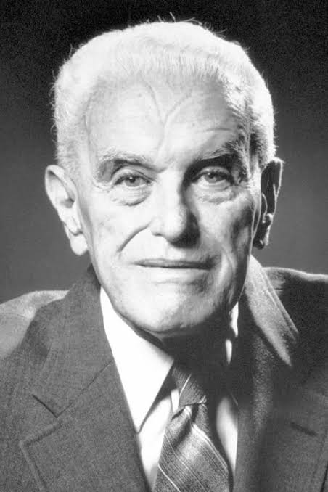
Rawls’ Conclusions Might Not Follow (2/2)
The veil of ignorance can be used to support utilitarianism. Decisions under uncertainty often involve maximizing expected/average results.
Economist John Harsanyi has argued that behind the veil of ignorance, rational agents would aim to maximize the total amount of wellbeing in a given society.
In experiments, people do not often choose maximin principles. Experiments simulating the veil of ignorance have found that participants tend to favor the ‘greater good’ or utilitarian outcomes.
John Harsanyi
Introduction to AI SES
‹#›

Slide 59
Alternatives: Prioritarianism (1/3)
Rawls’ theory was a response to utilitarianism, but if the veil of ignorance favors utilitarian thinking, it could compromise the foundations of his theory.
Is there a middle ground?
Yes! → Prioritarianism is an ethical theory that attributes greater moral weight to improving the wellbeing of those who are worse off in society.
Crucially, this theory still takes into account the wellbeing of others.
Introduction to AI SES
‹#›

Slide 60
Alternatives: Prioritarianism (2/3)
Imagine a situation where we have the option to distribute resources among three people, A, B, and C. We can choose how to change their wellbeing in three different ways.
A has 6 units of wellbeing.
B has 5 units of wellbeing.
C has 1 unit of wellbeing.
(+2) A has 8 units of wellbeing.
(+2) B has 7 units of wellbeing.
(+0) C has 1 unit of wellbeing.
1
2
3
(–3) A has 3 units of wellbeing.
(–2) B has 3 units of wellbeing.
(+2) C has 3 unit of wellbeing.
(+1) A has 7 units of wellbeing.
(+1) B has 6 units of wellbeing.
(+1) C has 2 unit of wellbeing.
Introduction to AI SES
‹#›

Slide 61
Alternatives: Prioritarianism (3/3)
Which option should we choose?
Option 1 → maximizes wellbeing.
Option 2 → helps everyone a bit.
Option 3 → helps the disadvantaged person but hurts others.
Prioritarianism captures the intuition that (contra Rawls) option 3 seems worse than the others and (contra utilitarianism) option 1 is not clearly the best option.
Educational Policy. Prioritarians may focus their educational interventions on disadvantaged students whereas utilitarians may focus on policy interventions that benefit large numbers of students.
Introduction to AI SES
‹#›

Slide 62

Alternatives: Moral Contractualism (1/2)
T.M. Scanlon’s moral contractualism suggests that people are inclined to seek out reasonable moral agreements.
Under this theory, Rawls’ veil of ignorance is unnecessary → morality is about what we owe each other as rational beings.
The principles of morality should be something that rational people can generally accept – they should be reasonable.
Example: It is reasonable to reject moral codes that support slavery.
T.M. Scanlon
Introduction to AI SES
‹#›

Slide 63
Recap
We have thus far outlined the four most common ethical theories:
Utilitarianism → ethical decisions aim to maximize wellbeing.
Deontology → ethical decisions are in made in accordance with the right system of rules.
Virtue Ethics → ethical decisions come from a virtuous character.
Social Contract Theory → ethical decisions are made in accordance with with mutually-agreed upon moral principles.
Each theory focuses on different kinds of moral considerations that we often consider when thinking about “common-sense morality”. This illustrates how different moral theories can complement each other.
Introduction to AI SES
‹#›

Slide 64
Introduction to
AI Safety, Ethics, and Society
Normative Ethics
Part 4: Moral Uncertainty
Introduction to AI SES
‹#›
Notes:
https://course.mlsafety.org/#media-popup

Slide 65
Roadmap
Why learn about ethics?
Moral considerations: wellbeing, obligations, partiality, et cetera.
Moral Theories:
Utilitarianism
Deontology
Virtue Ethics
Social Contract Theory
Moral Uncertainty
Introduction to AI SES
‹#›

Slide 66
Decisions Under Moral Uncertainty
How do we act morally when we are unsure which moral view is correct? We might have different credences in different moral theories.
Credence: varying degrees of belief in different moral theories. It’s often expressed as a probability value an individual assigns to any given theory.
Ann may have a high degree of credence in utilitarianism – 70% – and a low degree in deontology – 30%.
One approach is to follow a reasonable pluralism, acknowledging the potential co-existence of multiple reasonable moral theories.
Introduction to AI SES
‹#›

Slide 67
Dealing with Moral Uncertainty
In high-stakes scenarios, a reasonable pluralism is insufficient. We may need to consider concrete ethics over conflicting wisdom that appears reasonable.
In AI, the stakes are high. The implications of AI systems are widespread, affecting aspects of our lives from healthcare to security.
Accounting for moral uncertainty can help us avoid bad outcomes. It is crucial that AIs behave in ways that correspond with human values and goals – recognizing moral uncertainty is vital to this process.
Introduction to AI SES
‹#›

Slide 68
How to Approach Moral Uncertainty?
There are several potential solutions to the problem of moral uncertainty. Let’s consider three:
My Favorite Theory (MFT): adopting a favored moral theory that aligns with my personal beliefs.
Maximize Expected Choice Worthiness (MEC): calculating the expected choice worthiness of each option to obtain an average moral value.
Moral Parliament: treating a moral decision as a negotiation in a parliament, considering multiple moral views to find a mutually acceptable solution.
Introduction to AI SES
‹#›

Slide 69
How to Approach Moral Uncertainty?
Example: Should we save a life?
Imagine a notorious murderer asks Alex where his friend, Jordan, is. Alex knows that revealing Jordan's location will likely lead to his friend's death. However, while lying would save his life, it is morally questionable.
Alex is unsure about which action to take and considers the recommendations of the three moral theories he has some credence in: Utilitarianism (60%), Deontology (30%), and Contractarianism (10%).
Alex must decide which action to take, given the varied perspectives of these moral theories.
Introduction to AI SES
‹#›

Slide 70
My Favorite Theory
Under MFT, Alex would pick whatever Utilitarianism recommends.
Upside → this approach is simple and easy to implement, not requiring an understanding of multiple different theories.
Downside → it only works when the level of moral uncertainty is low.
Following MFT can lead to single-mindedness or overconfidence
MFT can discard relevant information, such as when the credences in two theories are close, but their judgments of an action vastly differ.
Introduction to AI SES
‹#›

Slide 71
MEC (1/3)
Under MEC, Alex must figure out choice worthiness for each theory:
Utilitarianism values lying to save a life highly, so Alex assigns it a value of +500.
Deontology strongly disapproves of lying, even to save a life, so Alex assigns it a value of -1000.
Contractarianism moderately approves of lying to save a life, so Alex assigns it a value of +100.
Introduction to AI SES
‹#›
Notes:
‘Recall table 11’

Slide 72
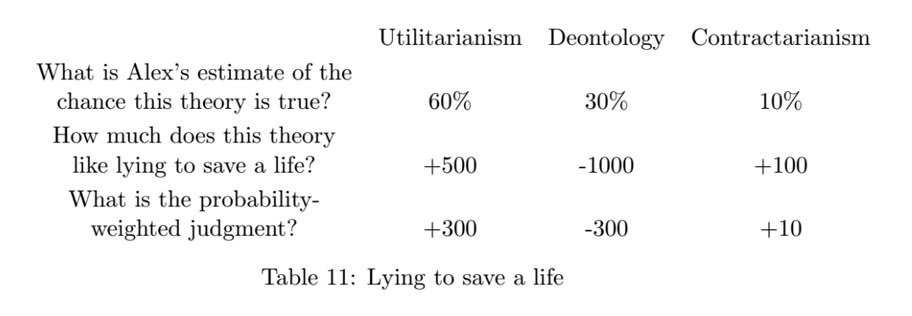
MEC (2/3)
Next, Alex needs to multiply choice-worthiness by credence.
We know that Alex has 60% credence in Utilitarianism, 30% credence in Deontology, and 10% credence in Contractarianism.
Therefore, Alex does the following calculation:
.6(500) + .3(-1000) + .1(100) =
300 - 300 +10 =
10
Under MEC, Alex would choose to lie since it is the best average moral outcome.
Introduction to AI SES
‹#›
Notes:
‘Recall table 11’

Slide 73
MEC (3/3)
However, MEC faces problems with comparisons between theories.
The assignment of choice-worthiness can be arbitrary, and with ‘ordinal’ theories that rank actions by their moral value, determining choice-worthiness can be difficult.
MEC also cannot account for absolutist theories – we assigned a value of -1000 to lying under deontology, but it is unclear whether this actually reflects the absolute value of lying. A more accurate choice might have been negative infinity, which would swamp all else.
Introduction to AI SES
‹#›
Notes:
‘Recall table 11’

Slide 74
Moral Parliament (1/2)
Following a Moral Parliament approach, Alex could more carefully consider the proposal to lie by assigning imagined delegates to each view, with 60 for Utilitarianism, 30 for Deontology, and 10 for Contractarianism.
Depending on the votes, Moral Parliament can lead to different outcomes.
Majority rule: Utilitarians will likely have the final say.
Philosophers recommend using proportional chance voting instead, where an action is taken with a probability equal to its vote-share.
If no one changed their mind, the outcome of the parliament would recommend with 70% probability that Alex lie and with 30% probability that he tells the truth.
Introduction to AI SES
‹#›
Notes:
‘Recall table 11’

Slide 75
Moral Parliament (2/2)
Even though Moral Parliament encourages negotiation, it is difficult to see what it might recommend. One question is how the theoretical delegates actually change their mind or compromise.
The outcome of the Moral Parliament is not determined externally – it is a matter of our imagination, and subject to our biases.
Moral Parliament may not be very helpful for individuals thinking about what is right to do in practice—although it might be good for AIs!
Introduction to AI SES
‹#›
Notes:
‘Recall table 11’

Slide 76
Recap
Resolving moral uncertainty is difficult but important.
In high stakes scenarios like AI design and development, addressing moral uncertainty is crucial.
Three solutions to moral uncertainty are:
My Favorite Theory
Maximize Expected Choice Worthiness
Moral Parliament
There might not be a one-size-fits-all solution to all ethical dilemmas.
Introduction to AI SES
‹#›
Notes:
‘Recall table 11’

Slide 77
Chapter Recap
Ethics is the study of moral principles that guide decisions and actions.
AI researchers can use ethics to guide development and governance.
Moral considerations include goodness, constraints, special obligations, and more.
Utilitarianism focuses on consequences and wellbeing; deontology on constraints; virtue ethics on character, and social contract theory on agreements.
We can deal with uncertainty in many ways, such as moral parliaments.
Introduction to AI SES
‹#›
Notes:
‘Recall table 11’

