Slide 1

Games and the Meaning of Life
Play, Virtue, and Human Flourishing in the Age of AI
Brendan Shea, PhD
Rochester Community and Technical College PHIL 1150: Computing and AI Ethics

Slide 2
Before We Begin: The Button
There is a button. Press it and you get, instantly and permanently, everything you would otherwise have had to work for:
• Every skill you wanted, at the level you wanted it
• Every win, already won
• The body, the grades, the job, the friendships
No side effects. No catch. Nobody is harmed. You simply have it all, starting now.
Commit before we go on
Hands up for press. Hands up for don’t. Then, to anyone who did not press: what exactly were you protecting? Whatever you name is what this entire lec-ture is about.

Slide 3
Central Questions
• What is a game — and what separates play from work?
• Do video games build or erode our moral character?
• Why does every generation fear the latest entertainment medium?
• Suits argues that in a perfect world, life would consist of games — is he right?
• If AI takes over most human labor, what gives our lives meaning?
The Big Idea
Games are not a retreat from the serious business of life — they may be its deepest expression.

Slide 4
Connections to Previous Lectures
Lecture 2 (Virtue Ethics): Aristotle: character is formed by habituation — we become what we repeatedly do. Games are what millions repeatedly do.
Lecture 7 (AI): Complex goal-directed behavior in games raises the same questions as AI: does it constitute genuine agency?
Lecture 8 (Work and Automation): If AI eliminates human labor, Suits’ philosophy of games is one of the most serious answers to “what then?”
Lecture 11 (Robot Rights): Suits argues life is already a game we are playing. Could AI systems someday participate in that game?
Discussion
Is play the opposite of work, or its complement — or could it someday be its replacement?

Slide 5
Lecture Outline
Part I: What Is Play?
Part II: Defining Games
Part III: Games, Moral Panic, and the Work Ethic Part IV: Video Games — Harm or Benefit?
Part V: Virtue Ethics and Video Games
Part VI: Life as a Game — Suits’ Grasshopper Part VII: AI, Post-Work, and the Meaning of Life

Slide 6
Play as a Human Universal
Games and play appear in every human culture:
• Dice in ancient Mesopotamia (c. 3000 BCE); board games in Egypt and China
• The Greek Olympics (776 BCE) — athletic competition as civic ritual
• Children’s play in every society — a near-universal feature of mammalian development
Yet philosophers have long been ambivalent:
• Play is voluntary and autotelic (done for its own sake)
• This makes it look trivial — or dangerously attractive
• Aristotle distinguished leisure (schole) from mere amusement
Discussion
Can something be both unserious and deeply important?

Slide 7
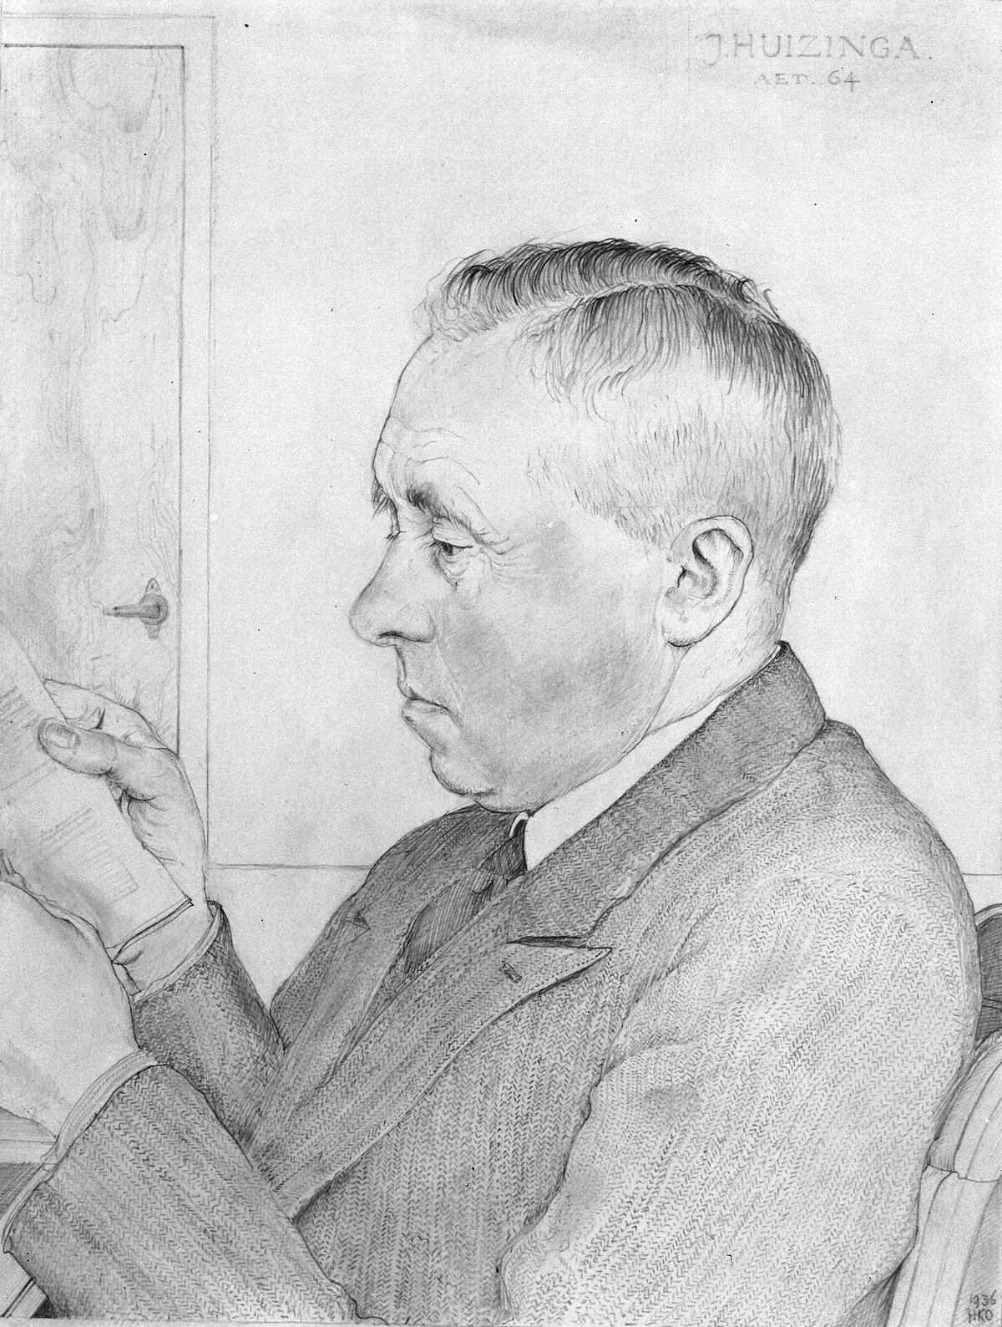
Johan Huizinga and Homo Ludens (1938)
Homo Ludens and the Magic Circle — huizinga_homo_ludens
Huizinga argued that play is culture’s foundation. Homo sapiens and homo faber both miss something: we are homo ludens — the playing human.
Play occurs in a magic circle: a special, bounded space en-tered voluntarily, where ordinary rules are suspended and the game’s own rules reign.
Johan Huizinga (1872–1945). Portrait, public domain, via Wikimedia Commons.

Slide 8
Features of Play
Huizinga identifies defining features of genuine play (huizinga_homo_ludens):
What Makes Something Play
• Free: entered voluntarily
• Separate: enclosed in its own time and space
• Uncertain: outcome not predetermined
• Unproductive: creates no goods outside itself
• Make-believe: a “second reality”
The Puzzle
If play is unproductive and separate from real life, why does it matter so much?
And if the magic circle can be shattered by stepping outside it, how can play bear the weight of life’s meaning?
This is the tension Suits will try to resolve.

Slide 9
Lecture Outline
Part I: What Is Play?
Part II: Defining Games
Part III: Games, Moral Panic, and the Work Ethic Part IV: Video Games — Harm or Benefit?
Part V: Virtue Ethics and Video Games
Part VI: Life as a Game — Suits’ Grasshopper Part VII: AI, Post-Work, and the Meaning of Life

Slide 10
The Problem of Defining “Game”
What do these have in common?
Chess Poker Solitaire Hopscotch
Tennis Minecraft Candy Crush Hide-and-seek
Wittgenstein: there is no single essence — only “family resemblances.” Suits disagreed:
Suits (suits_grasshopper)
“I propose to demonstrate that games can be defined, and that Wittgenstein is wrong.”
Why It Matters
If we can say precisely what a game is, we can ask what games do — to our character, our sense of meaning, and our understanding of life.

Slide 11
Suits’ Definition: The Three Elements
Playing a Game — suits_grasshopper
To play a game is to attempt to bring about a specific state of affairs (prelusory goal), using only means permitted by rules (constitutive rules), where the rules prohibit more efficient means, and where such rules are accepted because they make the activity possible (lusory attitude).
1. Prelusory Goal
The goal describable without the game: get the ball in the hole; reach the other side of the board.
2. Constitutive Rules
Rules that define the game by prohibiting efficient means: you must use a club; a bishop moves diagonally.
3. Lusory Attitude
Voluntary acceptance of the rules — not despite but because they make the game possible.

Slide 12
The Golf Example
The Simplest Example: Golf
The prelusory goal of golf is to get a small ball into a series of holes in the ground. This is easy — you could just walk up and drop the ball in. Done in two minutes.
Instead, golfers use clubs, start far away, and count every stroke. These rules make the goal
much harder — and that is the point.
The player who carries the ball to the hole achieved the prelusory goal but abandoned the game. Cheating means you haven’t really won anything.
Suits’ famous summary: a game is “the voluntary acceptance of unnecessary obstacles.”

Slide 13
Caillois: Four Types of Games
Roger Caillois classified games into four types (caillois_man_play):
Agôn
Competition: skill determines the winner.
Chess, tennis, esports.
Alea Mimicry
Chance: fate
Ilinx
Vertigo: altered sensation. Roller coasters, VR, ex-treme sports.
Role-play: pre-
determines the
tending to be
outcome. Dice, roulette, loot boxes.
someone else. Theatre, RPGs, The Sims.
Video Games as Hybrid
Fortnite combines all four: competition (agôn), random loot (alea), character skins (mimicry), and kinesthetic excitement (ilinx).

Slide 14
Nguyen: Games as an Art Form for Agency
Games as Agency as Art — nguyen_games_agency
C. Thi Nguyen argues that what makes games unique as an art form is not what they repre-sent, but what they do to the player’s agency. A game designer crafts a form of striving — a temporary set of motivations and values.
When you play, you adopt temporary goals: to capture the king, to survive the next wave. This borrowed agency is the art.
What This Explains
• Why games feel meaningful even if outcomes “don’t matter”
• Why bad game design feels like an imposition
Nguyen’s Warning
Games can hijack values. Leaderboards re-place genuine goals with gamified metrics we then import into the rest of our lives.

Slide 15
Discussion: Is This a Game?
Testing Suits’ Definition
Apply the three-part test to each. Does it have a prelusory goal, constitutive rules, and a lusory attitude?
1. A mobile “idle game” that plays itself while you sleep
2. A loot box: pay money for a randomized in-game reward
3. A job simulation (Stardew Valley): you “work” in the game voluntarily
Which pass Suits’ test? Which fail — and does it matter?

Slide 16
Lecture Outline
Part I: What Is Play?
Part II: Defining Games
Part III: Games, Moral Panic, and the Work Ethic Part IV: Video Games — Harm or Benefit?
Part V: Virtue Ethics and Video Games
Part VI: Life as a Game — Suits’ Grasshopper Part VII: AI, Post-Work, and the Meaning of Life

Slide 17
Plato and Aristotle on Play
Plato’s Suspicion
In the Republic, Plato argued that poetry and performance corrupted the soul by appealing to the lower, emotional parts of the psyche (plato_republic).
The state must control what stories are told. The wrong spectacles form the wrong character.
Aristotle’s Defense
Aristotle distinguished amusement (mere relaxation) from leisure (schole): freely chosen activity pursued for its own sake — the highest human good (aristotle_nicomachean).
Work exists for the sake of leisure, not the reverse.
Discussion
Is today’s video game debate closer to Plato (wrong content corrupts) or Aristotle (is this the right use of leisure)?

Slide 18
The Protestant Work Ethic
Work as a Calling — weber_protestant_ethic
Weber argued that the Reformation produced a new attitude: for Calvinist Protestants, dili-gence in one’s earthly calling was a sign of divine election. Idleness became sinful.
This ethic shaped industrial capitalism even after its religious roots faded.
Consequences for attitudes toward games:
• Play became morally suspect for adults
• Work became intrinsically virtuous, independent of what it produced
• The Suits/Keynes vision of a leisure society felt threatening, not liberating
Discussion
Do you feel guilty spending an afternoon playing a video game? Where does that feeling come from?

Slide 19
The Moral Panic Pattern
Moral Panic
A moral panic is a widespread social reaction to a perceived threat, usually focused on a new cultural product associated with young people.
Era
Target
Alleged Harm
1800s
1950s
1970s–80s
1990s–2000s
2010s
“Penny dreadful” fiction Comic books
Dungeons & Dragons Video game violence Social media
Crime, immorality Juvenile delinquency Satanism, suicide Mass shootings
Depression, radicalization
The Pattern
New medium → young people adopt it → moral authorities warn → calls for restriction → research finds effects smaller than feared.

Slide 20

Video Games Enter the Scene
A brief history:
• 1972: Pong — first hit arcade game
• 1977: Atari 2600 brings games into homes
• 1985: NES; Super Mario Bros.
• 1993–94: Mortal Kombat triggers Senate hearings; ESRB ratings created
• 2004: World of Warcraft; MMO era
• 2008: iPhone App Store; mobile explosion
• 2020s: 3 billion players; $200B/year revenue
The Atari 2600 (1977). Photo by
Evan-Amos. Public domain, via Wikimedia Commons.

Slide 21
Lecture Outline
Part I: What Is Play?
Part II: Defining Games
Part III: Games, Moral Panic, and the Work Ethic Part IV: Video Games — Harm or Benefit?
Part V: Virtue Ethics and Video Games
Part VI: Life as a Game — Suits’ Grasshopper Part VII: AI, Post-Work, and the Meaning of Life

Slide 22
The Violence Debate: The Concern
Anderson’s Meta-Analyses
Anderson et al. found that exposure to violent video games correlates with increased ag-gressive thoughts, feelings, and behavior and decreased empathy, across Eastern and Western cultures (anderson_violent_video_games).
Habituation and Virtual Violence
1. Aristotle: character is formed by habituation — we become what we repeatedly do.
2. Violent games involve repeatedly simulating and being rewarded for violence.
3. Therefore, they tend to form more aggressive, less empathetic dispositions.

Slide 23
The Violence Debate: The Critique
Ferguson’s Methodological Critique — ferguson_video_game_debate
• Publication bias: studies with effects are more likely published
• Inconsistent measures: “aggression” measured by noise blasts, not real violence
• Small effect sizes: tiny and of questionable practical significance
• Confounds: gamers differ from non-gamers in many ways
The Empirical Picture
Youth violence declined while gaming rose sharply. High-gaming nations (Japan, South Ko-rea) have very low rates of violent crime. Effects are real but likely overstated.

Slide 24
Gaming Disorder: When Gaming Becomes a Problem
WHO Gaming Disorder — who_gaming_disorder_2019
WHO added Gaming Disorder to ICD-11 (2019). Criteria: impaired control over gaming, increasing priority over other activities, continuation despite negative consequences, and symptoms present for 12+ months. Estimated prevalence: ∼3–4% of gamers.
Self-Determination Theory — ryan_deci_sdt
Problematic gaming is often a symptom, not a cause. People whose needs for autonomy, competence, and relatedness are unmet in real life may use games as a substitute — but the game cannot solve the underlying deficit.

Slide 25
Predatory Design: Loot Boxes
Loot Boxes and Gambling Mechanics
A loot box is a purchasable randomized in-game reward. Key features:
• Variable-ratio reinforcement: the most powerful compulsive schedule (same as slot machines)
• Disguised cost: “coins” or “gems” obscure real money spent
• Child targeting: prevalent in games with large young audiences
Belgium banned loot boxes as gambling (2018); a similar Dutch ruling was overturned on appeal in 2022.
Nguyen’s Warning Revisited
Predatory design uses game mechanics not to scaffold genuine agency, but to exploit psychological vulnerabilities for profit.

Slide 26
You Be the Judge: Is a Loot Box a Slot Machine?
The split decision
Belgium banned loot boxes as gambling in 2018. A Dutch ruling went the same way and was then overturned on appeal in 2022. Same mechanic, same continent, opposite answers.
Three benches: the studio, a parents’ group, and the gaming commission that has to write the rule.
• Studio: nobody loses money — you always get something, and it is entertainment
• Parents: variable-ratio rewards bought with real money, sold to children
• Commission: you must produce one enforceable sentence
Write the rule, then break it
Draft your one sentence. Now find the ordinary, harmless game your rule acci-dentally bans — there is always one. Fix it without letting the loot box back in.

Slide 27
McGonigal: Reality Is Broken
Key Thinker
Jane McGonigal (b. 1977), game de-signer and researcher. Reality Is Broken (2011): games deliver meaning more reli-ably than ordinary life
(mcgonigal_reality_broken).
What Games Do Better Than Reality
McGonigal’s four features of game-based meaning:
1. Urgent optimism: a clear problem you believe you can solve
2. Social fabric: cooperation and connection
3. Blissful productivity: satisfying hard work
4. Epic meaning: participating in something larger
Games are “unnecessary obstacles we volunteer to tackle”
— in tackling them we become more resilient and connected.

Slide 28
Games as Persuasion: Ian Bogost
Procedural Rhetoric — bogost_persuasive_games
Bogost argues games make arguments through procedural rhetoric: through the rules and mechanics the player enacts, not just words or images. You experience the argument from inside.
Games as Arguments
Spent (2011): make impossible choices (rent or medicine) and experience the structure of poverty.
Papers, Please (2013): bureaucratic rules implicate you in injustice — the mechanics are the argument.
Discussion
Can a game change your mind about an ethical issue in ways an essay cannot?

Slide 29
Lecture Outline
Part I: What Is Play?
Part II: Defining Games
Part III: Games, Moral Panic, and the Work Ethic Part IV: Video Games — Harm or Benefit?
Part V: Virtue Ethics and Video Games
Part VI: Life as a Game — Suits’ Grasshopper Part VII: AI, Post-Work, and the Meaning of Life

Slide 30
Aristotle’s Habituation and the Magic Circle
Does practice inside the magic circle shape character outside it?
The Transfer Argument
1. Character is formed by repeated action and emotion (aristotle_nicomachean).
2. Games involve thousands of hours of repeated action and emotion.
3. Therefore, gaming habits shape real character.
The Magic Circle Reply
The game frame is known to be artifi-cial. In-game violence is not real vio-lence. The lusory attitude brackets in-game actions from ordinary moral evalu-ation (ferguson_video_game_debate).
The Balance
Games likely shape emotional dispositions and attention, but the transfer depends heavily on the type of game, hours played, and social context.

Slide 31
Vallor’s Technomoral Virtues Applied to Gaming
Does gaming cultivate or erode the virtues we need to flourish? (vallor_technology_virtues)
Virtue Games Can Cultivate Games Can Erode Courage
Persistence through difficulty
Perspective-taking in narra-tive games
Shared goals in cooperative games
Managing resources, deferred rewards
Accepting loss, learning from failure
Risk-free “death” undermines stakes
Dehumanization in competitive play
Toxic competition; harassment
Addictive loops undermine con-trol
Rage-quitting; “gamer” toxicity
Empathy
Justice
Self-regulation Humility

Slide 32
Cooperative Games as Virtue Laboratories
The Positive Case
Cooperative multiplayer games may cultivate virtue:
• Overcooked: real-time coordination, communication, patience under pressure
• Portal 2 (co-op): requires trust, joint problem-solving, perspective-taking
• Among Us: social deduction, reading others, managing trust
These games require others to succeed — they are not practice for solipsism.
Esports: Achievement or Exploitation?
Professional gaming is a $1.8B industry. Esports athletes train 10–14 hours/day but face
burnout, injury, and short careers. Genuine sport, or exploitation?

Slide 33
Discussion: Character and the Screen
Discussion
1. Think about a game you’ve played for many hours. Did it change anything about how you think, feel, or behave outside the game?
2. A parent bans Grand Theft Auto but allows Fortnite. What ethical framework is she using? Is she right?
3. Could a game be morally obligatory — one we should play because of what it teaches?
What role, if any, should ethics play in our gaming choices?

Slide 34
Lecture Outline
Part I: What Is Play?
Part II: Defining Games
Part III: Games, Moral Panic, and the Work Ethic Part IV: Video Games — Harm or Benefit?
Part V: Virtue Ethics and Video Games
Part VI: Life as a Game — Suits’ Grasshopper Part VII: AI, Post-Work, and the Meaning of Life

Slide 35
The Grasshopper’s Story
The Grasshopper and the Ants — suits_grasshopper
Suits reimagines Aesop’s fable. The Grasshopper, dying in winter while the industrious Ants are warm and fed, is unrepentant. He spent the summer playing — and this was not failure.
His challenge to the Ants: “What are you working for?” The Ants work to survive — but what is the point of surviving? To be comfortable enough to do . . . what?
His answer: the end of work is leisure, and the highest form of leisure is play — voluntary, rule-governed striving for its own sake.
Suits
“The Grasshopper lives as if the Utopia were already here.”

Slide 36
The Utopian Paradox
Suits’ Utopia
Imagine a world where every material need is automatically satisfied — by perfect technol-ogy, or by AI. No one needs to work. What do people do?
Suits: they play games, because games are the only rational activity remaining.
The Utopian Paradox Argument
1. In utopia, all instrumental activities are handled automatically.
2. The only remaining activities are those pursued for their own sake.
3. Games are activities pursued via voluntarily accepted obstacles.
4. Therefore, in utopia, all rational activity takes the form of games.

Slide 37
Life Is a Game
Suits (suits_grasshopper)
“Utopia is a world where games are played . . . the very problems of life become the game of life.”
What This Implies
• Obstacles in life are conditions for meaning, not problems to eliminate
• A life with all difficulty removed would be meaningless
• Striving is not a means to an end; it is the end
The Hollow Obstacle Problem
Can you sustain the lusory attitude — genuinely caring about the outcome — when you know the obstacle was in-vented purely so you could overcome it?

Slide 38
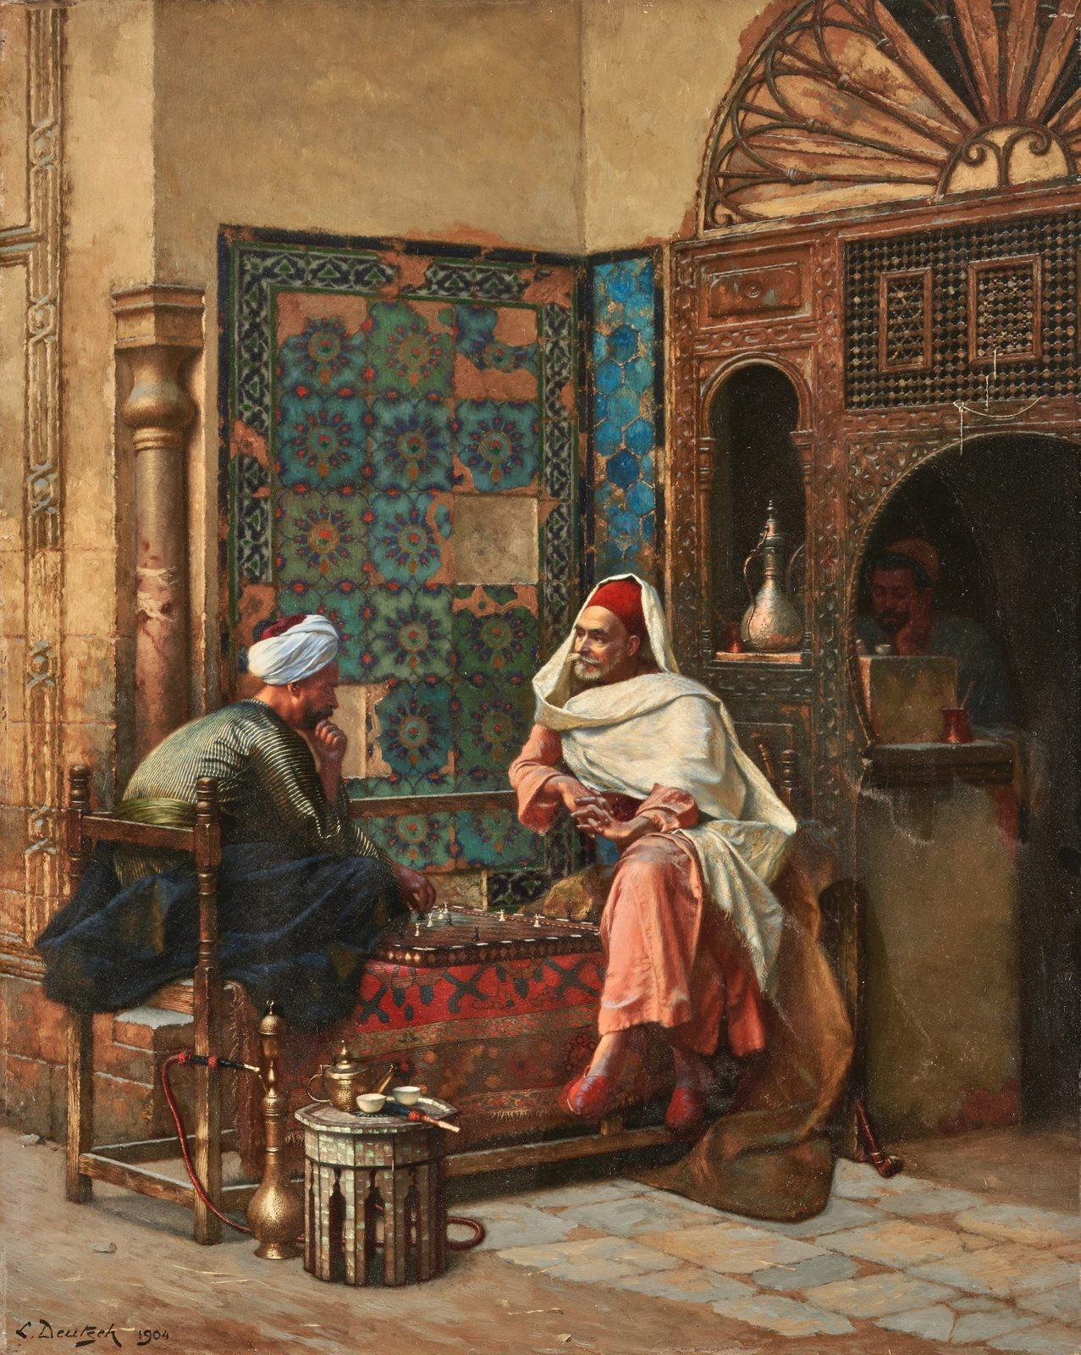
Games as the Human Constant
Chess has been played for 1,500 years. It produces no food, builds no shelter — its obstacles are entirely artificial. Yet it has been called a form of art, a meditation, and a battle.
The persistence of games across history suggests they do not distract from life’s meaning — they express it. This is Suits’ central point.
Ludwig Deutsch, The Chess Players (1904). Public domain, via Wikimedia Commons.

Slide 39
Keynes’ Prediction: The Leisure Problem
Economic Possibilities for keynes_economic_possibilities
Our
Grandchildren
—
In 1930, Keynes predicted that by ∼2030, productivity would allow 15-hour work weeks. The real challenge, he thought, would be the problem of leisure: how to “live wisely and agreeably and well.”
We are more productive than Keynes imagined — yet most people work more, not less. Why?
• Inequality: gains went to capital, not distributed as leisure
• Work ethic: identity remains tied to productive labor
• The Suits problem: we are not sure what we would do with leisure

Slide 40
Lecture Outline
Part I: What Is Play?
Part II: Defining Games
Part III: Games, Moral Panic, and the Work Ethic Part IV: Video Games — Harm or Benefit?
Part V: Virtue Ethics and Video Games
Part VI: Life as a Game — Suits’ Grasshopper Part VII: AI, Post-Work, and the Meaning of Life

Slide 41
The AI Leisure Question
Chapter 8 examined how AI transforms labor. The question here is philosophical:
The Central Question
If AI handles most productive work, what gives human life meaning? This is not just about income (addressed by UBI proposals) — it is about purpose, identity, and flourishing.
Three responses:
1. The Suits/McGonigal view: We will play games — and this is genuinely wonderful.
2. The skeptical view: Manufactured obstacles feel hollow without genuine stakes.
3. The augmentation view: Human-AI collaboration is itself a new kind of meaningful game.

Slide 42
Position 1: The Grasshopper Was Right
McGonigal’s Optimism
If games already deliver meaning more reliably than work, a post-work world need not be a crisis:
• Lives spent in creative games: art, athletics, philosophy, music
• Games as real problem-solving: McGonigal’s Foldit used gamers to solve protein-folding problems that stumped automated algorithms
The equation work = virtue is a historical accident (Weber), not a metaphysical necessity.
Historical Note
The Athenian ideal: a free citizen liberated from labor to engage in politics, philosophy, and art. Aristotle endorsed this — the question is whether it can be generalized democratically.

Slide 43
Position 2: The Skeptical View
Can Manufactured Obstacles Satisfy?
Suits’ utopia may require sustained self-deception: caring about winning while knowing winning is ultimately unimportant.
Two concerns:
1. Stakes: Meaningful striving may need genuine consequences — the farmer’s crop actually feeds people; the surgeon’s skill actually saves lives.
2. Inequality: Post-work utopia may be for some only; for many, the end of work means
poverty and precarity.
Graeber’s Counterpoint
Graeber argued many existing jobs are already “bullshit” — socially useless by workers’ own admission (graeber_bullshit_jobs). The transition to a games-based life may be less radical than it sounds.

Slide 44
Position 3: Human-AI Collaboration as a New Game
The Augmentation View
The work/play dichotomy may dissolve in a world of human-AI collaboration:
• A scientist uses AI for hypotheses, then designs and interprets experiments
• A teacher whose AI handles assessment, freeing time for mentorship and relationship
The human contribution resembles play: voluntary, creative, rule-governed engagement pursued partly for its own sake.
Vallor’s Framing (vallor_technology_virtues)
Not just “what will we do?” but “what kind of people will we become?” Virtues cultivated in games — persistence, creativity, humility, care — are exactly the virtues needed in an AI-transformed world.

Slide 45
Final Discussion: A Life of Games?
Discussion
1. Suits says the Grasshopper is right: playing games is the ideal human life. Do you agree? What counts as a “game” in this sense?
2. Is there a difference between playing Stardew Valley (farming simulation) and actually farming? Does it matter morally?
3. If AI makes most work unnecessary, should we welcome the Grasshopper’s world, resist
it, or try to redesign work so it retains meaning even when unnecessary?
What would a genuinely good post-work society look like?

Slide 46
Key Concepts i
Huizinga play is culture’s foundation; the magic circle is a voluntary, rule-bound space separate from ordinary life.
Suits a game = prelusory goal + constitutive rules + lusory attitude (voluntary acceptance of unnecessary obstacles).
Caillois four types — agôn, alea, mimicry, ilinx; video games combine all four.
Nguyen games sculpt agency itself — but can hijack values via gamification.
Moral panic pattern each new medium triggers the same fears; effects are usually overstated.
Video game effects violence research contested; gaming disorder real but rare; cooperative games may cultivate virtue.
Suits’ Grasshopper in utopia (or a post-AI world), only games remain rational — they exist purely for their own sake.
Vallor virtues cultivated through games shape who we become in an AI-transformed world.

Slide 47
References i

