Slide 1

CSC175 TODO
Computer Networking: A Top-Down Approach 8th edition Jim Kurose, Keith Ross Pearson, 2020
Acknowledgement: Based on the textbook’s website: https://gaia.cs.umass.edu/kurose_ross/index.php
Notes:
Version History
8.0 (May 2020)
All slides reformatted for 16:9 aspect ratio
All slides updated to 8th edition material
Use of Calibri font, rather that Gill Sans MT
Add LOTS more animation throughout
added new 8th edition material on middleboxes (and Internet arch), Net neutrality, buffering …
lighter header font
8.2 (July 2023), changes from 8.0:
some minor updates (e.g., IPv6 stats updated) but not much has changed.

Slide 2
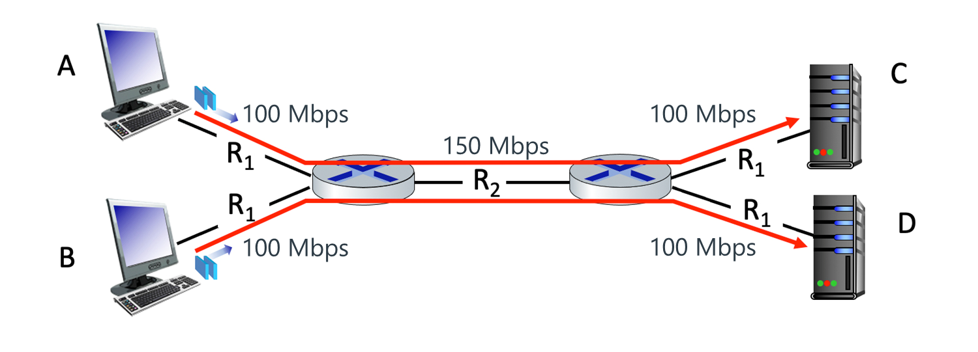
Problematic is both senders are active.
1.4-05b. Performance: End-to-end Delay. Consider again the network shown above. Assume that the propagation delay is 10 ms per link. Note that each of the two sessions has a 3-hop path from source to destination.
Suppose Sender B is idle and only Sender A is active. What is the end-to-end delay of a packet from when it first begins transmission at Sender A, until it is received in full by Receiver C? Assume store-and forward packet transmission. You can assume the queueing delays are zero.
Notes:
1.4-05b. Performance: End-to-end Delay. Consider again the network shown above. Assume that the propagation delay is 10 ms per link. Note that each of the two sessions has a 3-hop path from source to destination.
Suppose Sender B is idle and only Sender A is active. What is the end-to-end delay of a packet from when it first begins transmission at Sender A, until it is received in full by Receiver C? Assume store-and forward packet transmission. You can assume the queueing delays are zero.

Slide 3
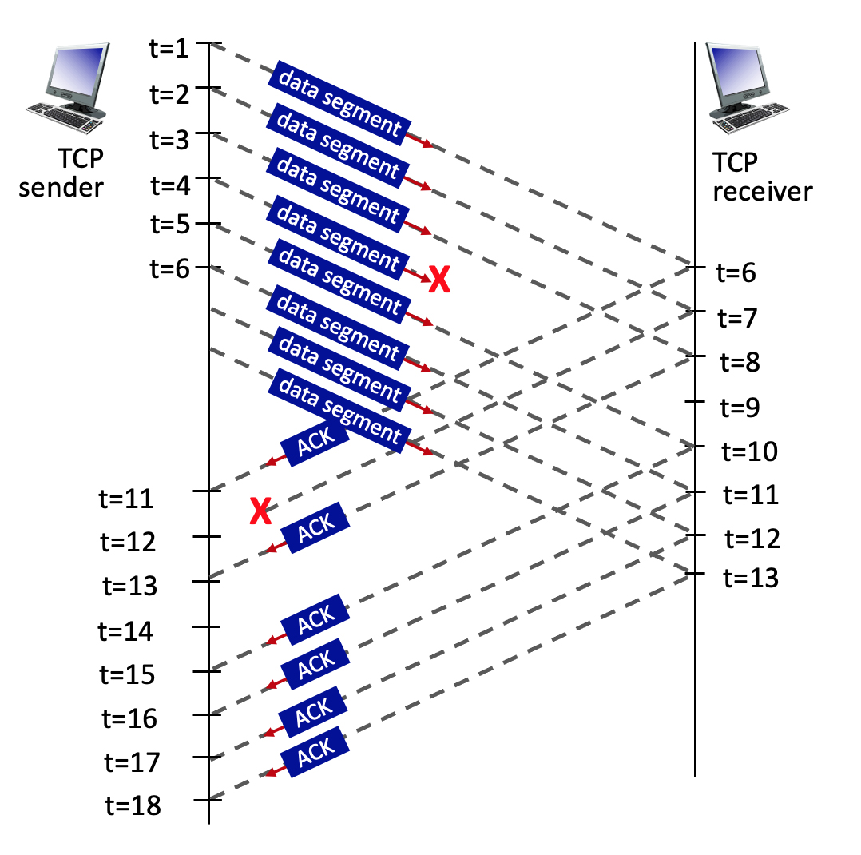
3.7-1a. TCP congestion control example (a). Consider the figure below, where a TCP sender sends 8 TCP segments at t = 1, 2, 3, 4, 5, 6, 7, 8. Suppose the initial value of the sequence number is3.7-1a. TCP congestion control example (a). Consider the figure below, where a TCP sender sends 8 TCP segments at t = 1, 2, 3, 4, 5, 6, 7, 8. Suppose the initial value of the sequence number is 0 and every segment sent to the receiver each contains 100 bytes. The delay between the sender and receiver is 5 time units, and so the first segment arrives at the receiver at t = 6. The ACKs sent by the receiver at t = 6, 7, 8, 10, 11, 12 are shown. The TCP segments (if any) sent by the sender at t = 11, 13, 15, 16, 17, 18 are not shown.
The segment sent at t=4 is lost, as is the ACK segment sent at t=7.
What is the sender action at t = 11 upon receipt of the ACK?
0 and every segment sent to the receiver each contains 100 bytes. The delay between the sender and receiver is 5 time units, and so the first segment arrives at the receiver at t = 6. The ACKs sent by the receiver at t = 6, 7, 8, 10, 11, 12 are shown. The TCP segments (if any) sent by the sender at t = 11, 13, 15, 16, 17, 18 are not shown.
The segment sent at t=4 is lost, as is the ACK segment sent at t=7.
What is the sender action at t = 11 upon receipt of the ACK?
Notes:
3.7-1a. TCP congestion control example (a). Consider the figure below, where a TCP sender sends 8 TCP segments at t = 1, 2, 3, 4, 5, 6, 7, 8. Suppose the initial value of the sequence number is3.7-1a. TCP congestion control example (a). Consider the figure below, where a TCP sender sends 8 TCP segments at t = 1, 2, 3, 4, 5, 6, 7, 8. Suppose the initial value of the sequence number is 0 and every segment sent to the receiver each contains 100 bytes. The delay between the sender and receiver is 5 time units, and so the first segment arrives at the receiver at t = 6. The ACKs sent by the receiver at t = 6, 7, 8, 10, 11, 12 are shown. The TCP segments (if any) sent by the sender at t = 11, 13, 15, 16, 17, 18 are not shown.
The segment sent at t=4 is lost, as is the ACK segment sent at t=7.
What is the sender action at t = 11 upon receipt of the ACK?
0 and every segment sent to the receiver each contains 100 bytes. The delay between the sender and receiver is 5 time units, and so the first segment arrives at the receiver at t = 6. The ACKs sent by the receiver at t = 6, 7, 8, 10, 11, 12 are shown. The TCP segments (if any) sent by the sender at t = 11, 13, 15, 16, 17, 18 are not shown.
The segment sent at t=4 is lost, as is the ACK segment sent at t=7.
What is the sender action at t = 11 upon receipt of the ACK?

Slide 4
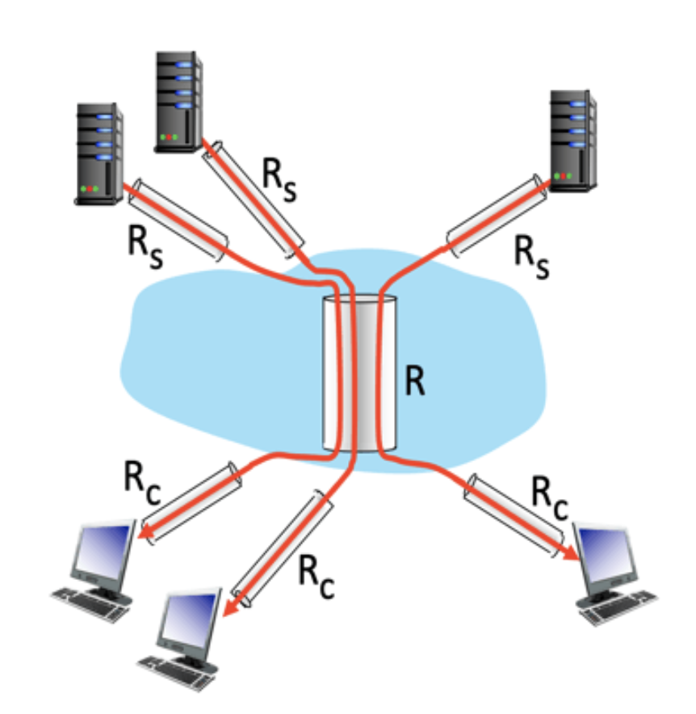
1.4.11 Computing maximum throughput. Consider the scenario shown below, with 10 different servers (three shown) connected to 10 different clients over ten three-hop paths. The pairs share a common middle hop with a transmission capacity of R = 300 Mbps. The four links from the servers to the shared link have a transmission capacity of R_{S} = 90 Mbps. Each of the four links from the shared middle link to a client has a transmission capacity of R_{C} = 50 Mbps.
What is the end-end maximum throughput on one of the the-hop paths, assuming all servers are sending at the maximum rate possible to their clients?

Slide 5
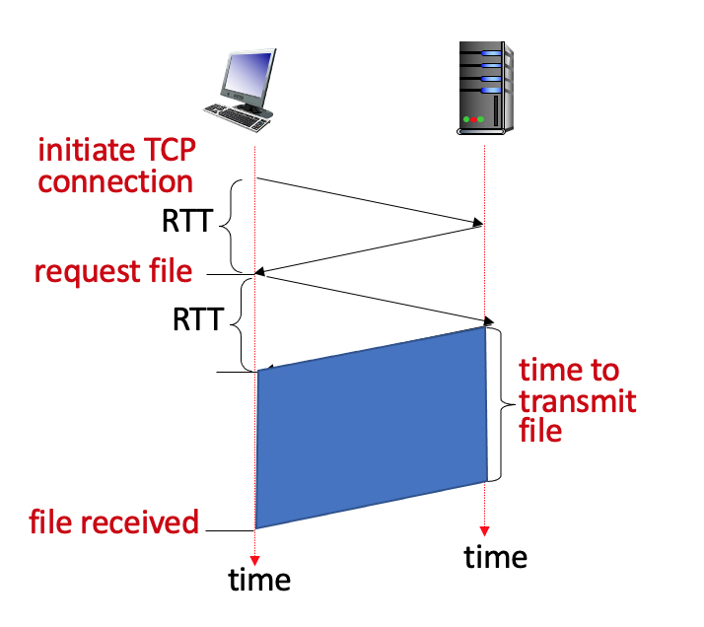
2.2-05. Download delays for 100 objects (HTTP 1.0). Consider an HTTP 1.0 client and server. The RTT delay between the client and server is 2 seconds. Suppose the time a server needs to transmit an object into its outgoing link is 3 seconds, as shown below for the first of these 100 requests.
You can assume that any other HTTP message not containing an object sent by the client and server has a negligible (zero) transmission time. Suppose the client makes 100 requests, one after the other, waiting for a reply to a request before sending the next request. Using HTTP 1.0, how much time elapses between the client transmitting the first request, and the receipt of the last requested object?

Slide 6
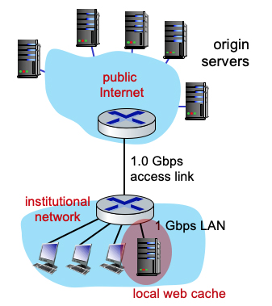
2.2-08. Download delays for 100 objects (HTTP 1.1 with local web caching). Consider an HTTP 1.1 client and server. The RTT delay between the client and server is 2 seconds. Suppose the time a server needs to transmit an object into its outgoing link is 3 seconds.
There is also a local web cache, as shown in the figure below, with negligible (zero) propagation delay and object transmission time. The client makes 100 requests one after the other, waiting for a reply before sending the next request. All requests first go to the cache (which also has a 2.0 sec. RTT delay to the server but zero RTT to the client).
How much time elapses between the client transmitting the first request, and the receipt of the last requested object, assuming no use of the IF-MODIFIED-SINCE header line anywhere, and assuming that 50% of the objects requested are "hits" (found) in the local cache?
Notes:
2.2-08. Download delays for 100 objects (HTTP 1.1 with local web caching). Consider an HTTP 1.1 client and server. The RTT delay between the client and server is 2 seconds. Suppose the time a server needs to transmit an object into its outgoing link is 3 seconds.
There is also a local web cache, as shown in the figure below, with negligible (zero) propagation delay and object transmission time. The client makes 100 requests one after the other, waiting for a reply before sending the next request. All requests first go to the cache (which also has a 2.0 sec. RTT delay to the server but zero RTT to the client).
How much time elapses between the client transmitting the first request, and the receipt of the last requested object, assuming no use of the IF-MODIFIED-SINCE header line anywhere, and assuming that 50% of the objects requested are "hits" (found) in the local cache?

