Slide 2
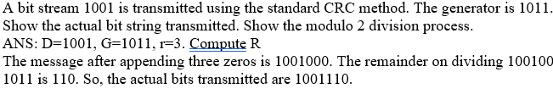
1
0
1
0
1 0 1 1
1 0 0 1 0 0
0
1 0 1 1
0 1 0 0
0 0 0 0
1 0 1 0 1
1
1 0 0 0
1 1 1 1 0
0
1 0 1 1
0 1 1 1 0
1
0 1 1 0
1 0 1 0 1
1
0 0 1 0 1
0
1 1 1 1 0
0
0 1 1 1 0
1
0 0 1 0 1
0

Slide 3
Quiz Block Cipher
[6 points] Consider the 3-bit block cipher in the Table below
Plain | 000 | 001 | 010 | 011 | 100 | 101 | 110 | 111
Cipher | 110 | 111 | 101 | 100 | 011 | 010 | 000 | 001
Suppose the plaintext is 100101100.
Initially assume that CBC is not used. What is the resulting ciphertext?
Suppose Trudy sniffs the ciphertext. Assuming she knows that a 3-bit block cipher without CBC is being employed (but doesn’t know the specific cipher), what can she surmise?
Now, suppose that CBC is used with IV=111. What is the resulting ciphertext?

Slide 4
Quiz Block Cipher ANS
Plain | 000 | 001 | 010 | 011 | 100 | 101 | 110 | 111
Cipher | 110 | 111 | 101 | 100 | 011 | 010 | 000 | 001
Initially assume that CBC is not used. What is the resulting ciphertext?
ANS: Ciphertext for plaintext 100101100 is 011010011, since 100 maps to 011, 101 maps to 010, 100 maps to 011
(b) Suppose Trudy sniffs the ciphertext. Assuming she knows that a 3-bit block cipher without CBC is being employed (but doesn’t know the specific cipher), what can she surmise?
ANS: Without CBC, each identical plaintext block will always map to the same ciphertext block. This makes it easier for Trudy to recognize patterns in repeated blocks of data. If Trudy intercepts enough ciphertexts, she could perform frequency analysis on the blocks. For example, if certain ciphertext blocks appear more frequently, she might guess that they correspond to more common plaintext blocks (like spaces or common letters in text). Or if it is known that the message always starts out with certain predefined fields, then the cryptanalyst may have a number of known plaintext-ciphertext pairs to work with.
(c) Now, suppose that CBC is used with IV=111. What is the resulting ciphertext?
ANS: With CBC and IV = 111, resulting ciphertext for plaintext 100101100 is 100111100. See next page.
Notes:
Let's break down the problem step by step based on the information provided in the table and the questions asked.
### Given:
- The 3-bit block cipher is represented as a mapping between plaintext and ciphertext:
$$
\begin{array}{|c|c|}
\hline
\text{Plaintext} & \text{Ciphertext} \\
\hline
000 & 110 \\
001 & 111 \\
010 & 101 \\
011 & 100 \\
100 & 011 \\
101 & 010 \\
110 & 000 \\
111 & 001 \\
\hline
\end{array}
$$
### (a) **Without CBC: What is the resulting ciphertext for the plaintext `100101100`?**
The plaintext `100101100` is a sequence of 9 bits, which we can divide into three 3-bit blocks:
- First block: `100`
- Second block: `101`
- Third block: `100`
Using the table provided, we can map each block of plaintext to its corresponding ciphertext:
- `100` maps to `011`
- `101` maps to `010`
- `100` maps to `011`
Thus, the resulting ciphertext is the concatenation of these three ciphertext blocks:
$$
\text{Ciphertext} = 011010011
$$
### (b) **What can Trudy surmise if she sniffs the ciphertext and knows a 3-bit block cipher without CBC is being used?**
If Trudy intercepts the ciphertext but does not know the specific cipher being used, she can infer certain things based on her knowledge of how block ciphers work:
1. **Block Size**: Since she knows it's a 3-bit block cipher, she can deduce that each group of 3 bits in the intercepted ciphertext corresponds to one block of plaintext.
2. **Frequency Analysis**: If Trudy intercepts enough ciphertexts, she could perform frequency analysis on the blocks. For example, if certain ciphertext blocks appear more frequently, she might guess that they correspond to more common plaintext blocks (like spaces or common letters in text).
3. **No CBC Weakness**: Without CBC (Cipher Block Chaining), each identical plaintext block will always map to the same ciphertext block. This makes it easier for Trudy to recognize patterns in repeated blocks of data.
However, without knowing the specific mapping between plaintext and ciphertext, Trudy cannot directly decrypt the message unless she somehow discovers or guesses this mapping.
### (c) **With CBC and IV = 111: What is the resulting ciphertext for the plaintext `100101100`?**
When CBC (Cipher Block Chaining) is used, each plaintext block is XORed with the previous ciphertext block (or with the Initialization Vector (IV) for the first block) before being encrypted.
1. **IV = 111**: The first step is to XOR the first plaintext block with the IV.
- First plaintext block: `100`
- IV: `111`
- XOR result: $$ 100 \oplus 111 = 011 $$
Now we encrypt this result (`011`) using our cipher table:
- `011` maps to `100`.
So, the first ciphertext block is `100`.
2. **Second Block**: Now we XOR the second plaintext block with the first ciphertext block:
- Second plaintext block: `101`
- First ciphertext block: `100`
- XOR result: $$ 101 \oplus 100 = 001 $$
Now we encrypt this result (`001`) using our cipher table:
- `001` maps to `111`.
So, the second ciphertext block is `111`.
3. **Third Block**: Finally, we XOR the third plaintext block with the second ciphertext block:
- Third plaintext block: `100`
- Second ciphertext block: `111`
- XOR result: $$ 100 \oplus 111 = 011 $$
Now we encrypt this result (`011`) using our cipher table:
- `011` maps to `100`.
So, the third ciphertext block is `100`.
Thus, when using CBC with IV = 111, the resulting ciphertext is:
$$
\text{Ciphertext} = 100111100
$$
### Final Answer Summary:
- **(a)** Without CBC, resulting ciphertext for plaintext `100101100`:
$$ \text{Ciphertext} = 011010011 $$
- **(b)** Trudy can infer that it's a 3-bit cipher and may use frequency analysis but cannot directly decrypt without knowing the specific mapping.
- **(c)** With CBC and IV = 111, resulting ciphertext for plaintext `100101100`:
$$ \text{Ciphertext} = 100111100 $$
Citations:
[1] https://ppl-ai-file-upload.s3.amazonaws.com/web/direct-files/657250/670d6e33-bf04-4786-8da4-9b8cff7bf69b/Temp.pdf

Slide 5
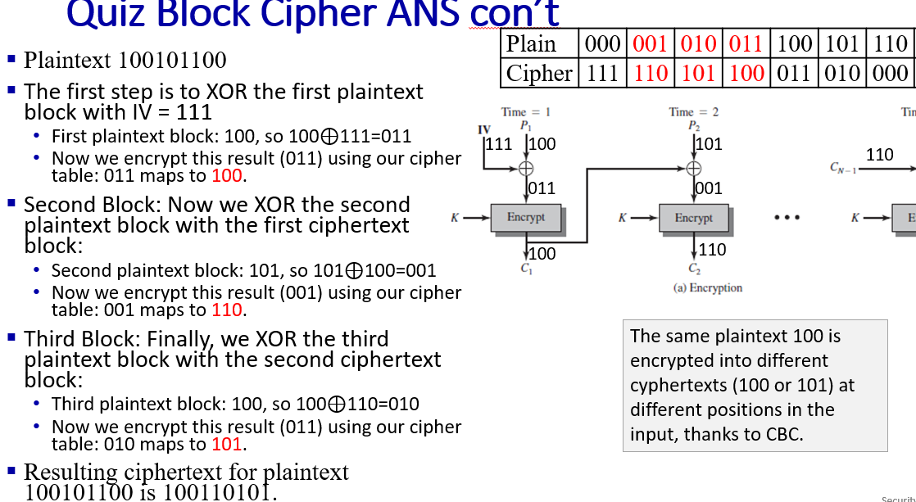
Quiz Block Cipher ANS con’t
Plain | 000 | 001 | 010 | 011 | 100 | 101 | 110 | 111
Cipher | 110 | 111 | 101 | 100 | 011 | 010 | 000 | 001
The first step is to XOR the first plaintext block with IV = 111
First plaintext block: 100, so 100⊕111=011
Now we encrypt this result (011) using our cipher table: 011 maps to 100.
Second Block: Now we XOR the second plaintext block with the first ciphertext block:
Second plaintext block: 101, so 101⊕100=001
Now we encrypt this result (001) using our cipher table: 001 maps to 111.
Third Block: Finally, we XOR the third plaintext block with the second ciphertext block:
Third plaintext block: 100, so 100⊕111=011
Now we encrypt this result (011) using our cipher table: 011 maps to 100.
Resulting ciphertext for plaintext 100101100 is 100111100.

Slide 7

EVPN: Ethernet VPNs (aka VXLANs)
7
9
15
1
5
1
3
7
2
8
10
16
IP
datagram
Ethernet
frame
16
2
4
6
8
…
…
…
Sunnyvale
data center
Bangalore
data center
Ethernet
Layer-2 Ethernet switches logically connected to each other (e.g., using IP as an underlay)
Ethernet frames carried within IP datagrams between sites
“tunneling scheme to overlay Layer 2 networks on top of Layer 3 networks ... runs over the existing networking infrastructure and provides a means to "stretch" a Layer 2 network.” [RFC 7348]

Slide 8
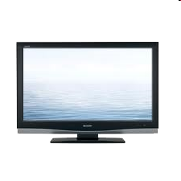



Cable access network: FDM, TDM and random access!
Internet frames, TV channels, control transmitted
downstream at different frequencies
cable headend
…
CMTS
…
splitter
cable
modem
ISP
cable modem
termination system
multiple downstream (broadcast) FDM channels: up to 1.6 Gbps/channel
single CMTS transmits into channels
multiple upstream channels (up to 1 Gbps/channel)
multiple access: all users contend (random access) for certain upstream channel time slots; others assigned TDM

Slide 9
Cable access network:
MAP frame for
Interval [t1, t2]
CMTS
Downstream channel i
Upstream channel j
cable headend
t₁
t₂
Residences with cable modems
Minislots containing
minislots request frames
Assigned minislots containing cable modem
upstream data frames
DOCSIS: data over cable service interface specification
FDM over upstream, downstream frequency channels
TDM upstream: some slots assigned, some have contention
downstream MAP frame: assigns upstream slots
request for upstream slots (and data) transmitted random access (binary backoff) in selected slots

Slide 10
Dijkstra's Algorithm vs. Bellman-Ford Algorithm
Dijkstra's Algorithm:
Uses a priority queue to select the next vertex to process.
Greedily selects the vertex with the smallest tentative distance to source node.
Works only on graphs with non-negative edge weights.
Bellman-Ford Algorithm:
Iteratively relaxes all edges V-1 times, where V is the number of vertices.
Does not use a priority queue.
Can handle graphs with negative edge weights, and can detect negative cycles.
Dijkstra's algorithm is faster and more efficient for graphs with non-negative weights, the Bellman-Ford algorithm is more versatile as it can handle negative weights and detect negative cycles, albeit at the cost of lower efficiency.
Notes:
Dijkstra's Algorithm:
- Finds the shortest path from a single source vertex to all other vertices in a graph with non-negative edge weights.
**Bellman-Ford Algorithm:**
- Finds the shortest path from a single source vertex to all other vertices in a graph, even with negative edge weights.
- Can detect negative cycles in the graph.
## Edge Weight Handling
**Dijkstra's Algorithm:**
- Works only on graphs with non-negative edge weights.
**Bellman-Ford Algorithm:**
- Can handle graphs with negative edge weights.
- Can detect negative cycles.
## Performance
Dijkstra's Algorithm:
- More efficient for graphs with non-negative weights.
- Time complexity: O(V log V + E) with a binary heap implementation, where V is the number of vertices and E is the number of edges.
**Bellman-Ford Algorithm:**
- Generally slower than Dijkstra's.
- Time complexity: O(VE), where V is the number of vertices and E is the number of edges.
## Implementation

Slide 11
The DV Algorithm
A router transmits its distance vector to each of its neighbors in a routing packet.
Each router receives and saves the most recently received distance vector from each of its neighbors.
A router recalculates its distance vector when:
It receives a distance vector from a neighbor containing different information than before.
It discovers that a link to a neighbor has gone down.
The DV calculation is based on minimizing the cost to each destination
Dx(y) = Estimate of least cost from x to y
C(x,v) = Node x knows cost to each neighbor v
Dx = [Dx(y): y ? N ] = Node x maintains distance vector
Node x also maintains its neighbors' distance vectors
– For each neighbor v, x maintains Dv = [Dv(y): y ? N ]

Slide 12
From time-to-time, each node sends its own distance vector estimate to neighbors.
When a node x receives new DV estimate from any neighbor v, it saves v’s distance vector and it updates its own DV using B-F equation:

Slide 13
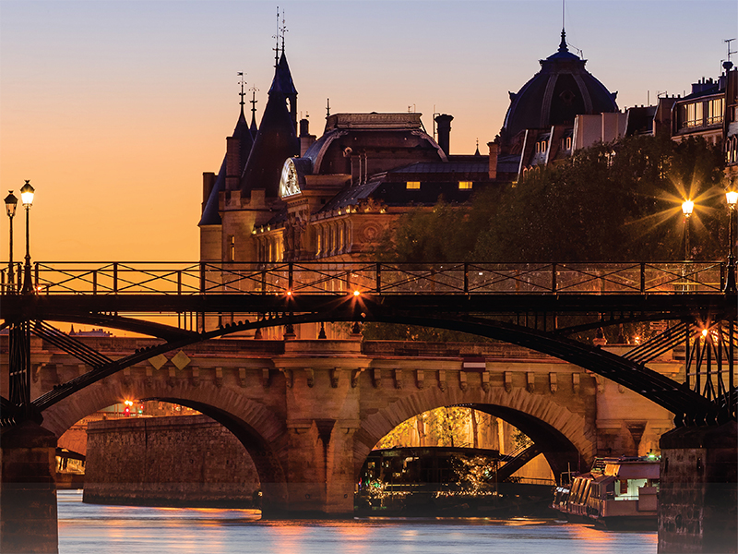
Network layer: “data plane” roadmap
Network layer: overview
data plane
control plane
What’s inside a router
input ports, switching, output ports
buffer management, scheduling
IP: the Internet Protocol
datagram format
addressing
network address translation
IPv6
Generalized Forwarding, SDN
match+action
OpenFlow: match+action in action
Middleboxes

Slide 14
IP addresses: how to get one?
IMPORTANT
That’s actually two questions:
Q: How does a host get IP address within its network (host part of address)?
Q: How does a network get IP address for itself (network part of address)
How does host get IP address?
hard-coded by sysadmin in config file (e.g., /etc/rc.config in UNIX)
DHCP: Dynamic Host Configuration Protocol: dynamically get address from as server
“plug-and-play”

Slide 15
DHCP: Dynamic Host Configuration Protocol
IMPORTANT
goal: host dynamically obtains IP address from network server when it “joins” network
can renew its lease on address in use
allows reuse of addresses (only hold address while connected/on)
support for mobile users who join/leave network
DHCP overview:
host broadcasts DHCP discover msg [optional]
DHCP server responds with DHCP offer msg [optional]
host requests IP address: DHCP request msg
DHCP server sends address: DHCP ack msg

Slide 16
Question 4.3-06
4.3-06. Plug-and-play. What is meant by saying that DHCP is a "plug and play" protocol?
The host needs to “plug” (by wire or wirelessly) into the local network in order to access (“play” in) the Internet
No manual configuration is needed for the host to join the network., (Correct answer)
The network provides an Ethernet jack for a host’s Ethernet adapter., (Incorrect answer)

Slide 17
Network layer: “data plane” roadmap
Network layer: overview
What’s inside a router
IP: the Internet Protocol
Generalized Forwarding
Middleboxes
middlebox functions
evolution, architectural principles of the Internet

Slide 18
The IP hourglass
IMPORTANT
HTTP
SMTP
RTP
…
Internet’s “thin waist”:
one network layer protocol: IP
must be implemented by every (billions) of Internet-connected devices
QUIC
DASH
many protocols in physical, link, transport, and application layers
TCP
UDP
IP
Ethernet
…
PPP
PDCP
WiFi
Bluetooth
copper radio fiber

Slide 19
The IP hourglass, at middle age
IMPORTANT
HTTP
SMTP
RTP
…
QUIC
DASH
Internet’s middle age “love handles”?
middleboxes, operating inside the network
TCP
UDP
caching
NAT
IP
NFV
Firewalls
Ethernet
…
PPP
PDCP
WiFi
Bluetooth
copper radio fiber

Slide 20
Question 4.5-2
4.5-2. The "thin waist" of the Internet. What protocol (or protocols) constitutes the "thin waist" of the Internet protocol stack?

Slide 21
802.11 frame: addressing
2
2
6
6
6
2
6
0 - 2312
4
frame
control
duration
address
1
address
2
address
3
seq
control
address
4
payload
CRC
Address 1: MAC address of wireless host or AP to receive this frame
Address 4: used only in ad hoc mode
Address 3: MAC address of router interface to which AP is attached
Address 2: MAC address
of wireless host or AP
transmitting this frame

Slide 22



802.11 frame: addressing
Internet
H1
R1
802.3 Ethernet frame
R1 MAC addr
H2 MAC addr
MAC dest addr
MAC source addr
AP MAC addr
H1 MAC addr
R1 MAC addr
address 1
address 2
address 3
802.11 WiFi frame

Slide 23
802.11 frame: addressing
duration of reserved
transmission time (RTS/CTS)
frame sequence # (for reliable data transfer)
2
2
6
6
6
2
6
0 - 2312
4
frame
control
duration
address
1
address
2
address
3
seq
control
address
4
payload
CRC
2
2
4
1
1
1
1
1
1
1
1
protocol
version
type
subtype
to
AP
from
AP
more
frag
retry
power
mgt
more
data
WEP
rsvd
frame type (RTS, CTS, ACK, data)

