Slide 1
Brief Preview of the Semester
Links
Bandwidth and Propagation Delay
Pipe Diagrams
Overloaded Links
Brief Preview of the Semester
Lecture 3, Spring 2026
Notes:
okay so something I promised you last time which I didn't give to you so I'll give to you now is a brief preview
11:39
of all the things you're going to see so now that we've given you a highlevel overview of all the things you're going
11:45
to see in the semester and some of the fundamental ideas behind networking how
11:50
the network works why the network was designed the way that it is what a packet looks like when it travels
11:56
through the network we can now give you a whole preview of all all the things you're going to see it's basically just
12:01
little topics that you've already seen in these first three lectures but we'll dive into them in a lot more detail

Slide 2
Brief Preview of the Semester
Lectures 1–3: Networking Principles.
Layering and headers.
Design principles.
Links, life of a packet.
Lectures 4–9: Routing (Layer 3).
Routing: How do routers know where to forward packets?
Addressing: How do we address end hosts?
How do you build an industrial-strength router in hardware?
Notes:
so
12:07
you've already done the first three lectures those were our basic networking principles we talked about the layers of
12:14
the internet we talked about how packets get wrapped in headers as they work down the stack and unwrapped as they work
12:20
their way up we talked about all those design principles for why the internet is built the way that it is the end to
12:26
end principle d multiplexing the narrow waist we talked about statistical
12:32
multiplexing and sharing of resources and last time we talked about what a link looks like how you measure the
12:38
quality of a link and what a packet does when it travels through the network so once you have these three lectures
12:44
you're actually all set to start on Project one and project one really just
12:49
reminds you about all of these principles and asks you to build a neat little networking utility called trace
12:55
route so hope you're enjoying that so the next six lectures starting today and
13:01
running for the next six lectures we are now going to zoom in on routing for a long time and this happens at layer
13:08
three so you can think about Layer Three is the one that connects all the routers and the hosts to each other on the
13:14
entire global internet and we're going to answer a question about routing which is how do routers actually know how to
13:20
forward packets when I receive a packet how do I know that okay this packet is for Bob and Bob is that way or this
13:27
packet is for Alice and Al is that way how does the router know where everyone is that's the fundamental question
13:33
behind routing we're going to spend a lot of time answering that we'll also along the way see how you actually
13:39
assign addresses to end hosts turns out the network doesn't call them Alice and
13:44
Bob we actually give them addresses and we'll talk about how you assign those and as a fun little Topic at the end
13:50
we'll see how you build an industrial strength router so we'll open up a router and see what all the hardware
13:56
components are and in this section you'll get a project to do which is all about routing so that's this entire unit
14:04
I think this is most of the stuff on the midterm but don't quote me on
14:09
that okay and

Slide 3
Brief Preview of the Semester
Lectures 10–13: Reliability (Layer 4).
TCP: How do end hosts communicate reliably?
Congestion control: How do we ensure end hosts don't overload the links?
Lectures 14–15: Applications (Layer 7).
DNS: How do we map names to addresses?
HTTP: How do we build applications on top of the network?
Lectures 16–17: End-to-End Picture.
ARP and DHCP: What happens when you join the network for the first time?
NAT: How do we make sure there's enough addresses for everybody?
TLS: How do we secure network connections against attackers?
Notes:
then after that after the midterm maybe we switch into layer four
14:15
and we start thinking about how do you actually build a reliable protocol so we showed you that little super simple Bob
14:21
sending 10 packets reliability protocol and some people pointed out there are some bugs in that that we didn't really
14:27
address and you're right a real solid state-of-the-art reli reliability protocol will take us four lectures to
14:34
build so we're going to spend two lectures building TCP to ensure reliability and then we'll spend two
14:40
more lectures talking about congestion control so that we ensure that the NH host don't overload the links and these
14:47
are associated with the third project which is all about transport and implementing
14:52
TCP and then after that two lectures at layer seven so we're basically moving up the stack and at layer seven there
14:59
there's two applications that we'll talk about one of them is DNS one of them is HTTP I won't talk about them any further
15:05
here because you'll get them a lot later but there are examples of things that we can build on top of the network to make
15:12
everything work and once we've traveled across all the layers in lecture 16 and 17 we'll go back and clean up all the
15:19
little missing pieces that we haven't really touched yet to form what we call the end to endend picture so by lecture
15:26
17 you will finally get the ultimate picture of what exactly happens when I send a packet from point A to point B
15:32
all of the missing pieces will get filled in we'll go through all these protocols that didn't really fit anywhere else but have to be covered and
15:40
we'll also spend a little bit of time at Layer Two and everything will be connected up so we'll spend a lot of time at layers three four and seven and
15:47
once we do that we'll Circle back and tie it all together in lectures 16 and 17 so that's the next part of the
15:57
semester

Slide 4
Brief Preview of the Semester
Lectures 18–21: Datacenters.
How do we build a network to connect servers in high-performance datacenters?
SDN: Can we centralize control to improve performance?
Host networking, RDMA: How can we optimize performance at the end hosts?
Lectures 22–23: Beyond Client-Server.
Multicast: How do we support group communication (e.g. Google Docs)?
Collectives: How do we design networks to support AI training?
Lectures 24–25: Wireless.
How do we design wireless communication at Layers 1 and 2?
How do we design cellular networks?
Notes:
okay and then near the end we'll have some other topics that didn't
16:02
really fit in the networking stack but are still really important so in lectur
16:08
18 through 21 we're going to talk about data centers so this is a pretty new
16:13
topic it's pretty state-of-the-art and we're going to talk about building networks to connect up servers at a high
16:18
performance data center so to give you a little preview you can imagine I don't know Facebook or YouTube is probably
16:25
running this big building full of computers and those computers have to talk to each each other how do you build
16:30
networks in that special context lectures 18 19 20 and 21 will tell you
16:35
all about that that's pretty cool and then lectures 22 and 23 these are even newer additions to the class they're
16:42
called Beyond client server it's what we called it and basically we'll think about some newer applications at the
16:48
internet such as like Google Docs where you want to communicate in a group and also how do you use networks to support
16:55
AI training that's pretty cool this I think is the newest lecture we've made apparently it's a Super Hot Topic in
17:00
research so look forward to that and then lectures 24 through 25 as a bit of a dessert will give you a quick tour of
17:08
Wireless so it turns out designing Wireless Communications comes with it comes with its own set of challenges so
17:15
we'll take a look at what it means If instead of thinking of links as wires we think of them as Wireless Communications
17:22
so you get one lecture on wireless communication one lecture on cellular networks like how does your phone access
17:27
the internet if even though it's not connected to anything we'll talk about that and we'll be all done so that's the
17:34
overview of the semester a lot of the things that we're talk going to talk about you've already gotten a little preview of in the three lectures so far
17:43
but we'll just spend a lot of time digging into them and then at the end you get all these neat applications and
17:49
things that are pretty hot now and active areas of research which is pretty
17:54
cool any thoughts on the brief preview
18:01
yeah data centers seem cool I hope uh I agree they're pretty cool I hope you think so as well when we get to
18:10
it okay so to

Slide 5
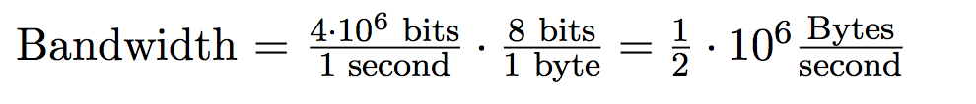
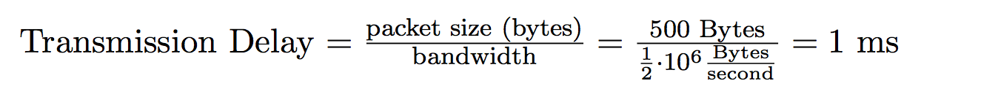
Transmission Delay: Example
Propagation Delay
Bandwidth = 4Mbps
Capacity = Delay × Bandwidth

Slide 6
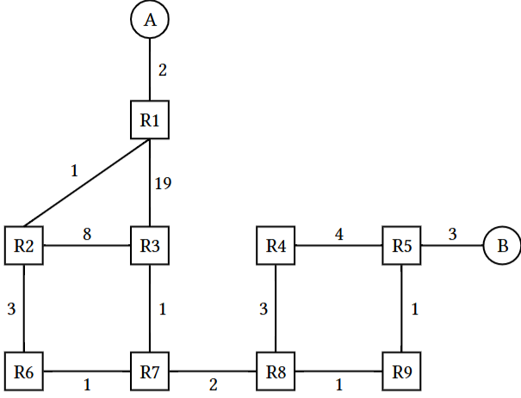
Q. Link-State Routing ANS
1.1 After convergence, what route does R7 think its packet will take to Host B?
ANS: R7 → R8 → R9 → R5 → B
EVENT: The R8-to-R9 link goes down.
1.2 R8 and R9 have recomputed their routes but have not yet sent updates to other routers. What route does R7 think its packet will take to Host B?
ANS: Same, R7 → R8 → R9 → R5 → B
1.3 What route does it actually take?
ANS: R7 → R8 → R4 → R5 → B
1.4 Assume all nodes are now aware of the new network state and have recomputed their routes. What route does a packet take from R3 to Host A?
ANS: R3 → R7 → R6 → R2 → R1 → A
X

Slide 7
Q. Link-State Routing ANS
EVENT: The cost of the R1-to-R2 link increases to 100.
1.5 R2 and R1 recompute their routes but have not yet sent updates to other routers. What route does R2 think its packet will take to Host A?
ANS: R2 → R6 → R7 → R3 → R1 → A
1.6 What route does it actually take?
ANS; R2 → R6 → R2 (loop)
1.7 Which additional routers must receive the routing updates and recompute their routes for all routers to be able to successfully send packets to Host A?
ANS; R3, R6, R7
1.8 All routers except R3 have received the routing updates and recomputed their routes. Which routers can successfully send packets to Host A?
ANS: None of the routers (except R1)
100
X

Slide 8
Trie: An Introduction
L02: Dictionary ADT, Tries
Tries view its keys as:
Strings (a sequence of characters)
Many sequences share common prefixes
Each level of the tree represents an index in the string
Children at that level represent possible characters at that index
This trie stores the set of strings: awls, a, sad, same, sap, sam
Nodes that complete a string are marked in purple
Two ways to fail a contains() check:
If we fall off the tree, or if the final node isn’t purple (not a key)
a
s
w
a
Input String | Fall Off? / Is Key? | Result
contains(“sam”) | hit / purple | True
contains(“sa”) | hit / white | False
contains(“a”) | hit / purple | True
contains(“saq”) | fell off / n/a | False
l
d
m
p
s
e
Notes:
Structure and Purpose
Trees:
How to deal with a and awls?
Mark which nodes complete a string (shaded nodes)
General-purpose data structure for representing hierarchical relationships
Each node can contain any type of data
Nodes typically have a value and references to child nodes
Tries:
Specialized tree structure for storing and retrieving strings efficiently
Also known as a prefix tree
Optimized for operations on strings or sequences
Node Content
Trees:
Each node stores a value directly
Tries:
Nodes typically do not store complete strings
The path from the root to a node represents a string or prefix
Characters are stored along the edges between nodes

Slide 9
Trie Operations
L02: Dictionary ADT, Tries
Tries are defined by 3 types:
An “alphabet”: the domain of the characters
A “key”: a sequence of “characters” from the alphabet
A “value”: the usual Dictionary value
Tries Prefix matching
Keys are sequences that can have prefixes
Longest prefix
longestPrefixOf("sample")
Want: {"sam"}
Prefix match
findPrefix("sa")
Want: {"sad", "sam", "same", "sap"}
a
s
w
a
l
d
m
p
s
e
Notes:
Structure and Purpose A trie data structure implements the Dictionary and Set
Tries store sequential keys
… which enables very efficient prefix operations like findPrefix
Tries have many different implementations
Could store HashMap/TreeMap/any-dictionary within nodes
Trees:
How to deal with a and awls?
Mark which nodes complete a string (shaded nodes)
General-purpose data structure for representing hierarchical relationships
Each node can contain any type of data
Nodes typically have a value and references to child nodes
Tries:
Specialized tree structure for storing and retrieving strings efficiently
Also known as a prefix tree
Optimized for operations on strings or sequences
Node Content
Trees:
Each node stores a value directly
Tries:
Nodes typically do not store complete strings
The path from the root to a node represents a string or prefix
Characters are stored along the edges between nodes

Slide 10
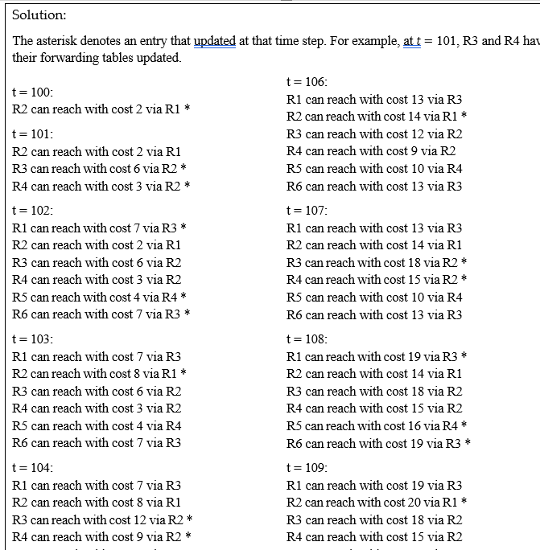
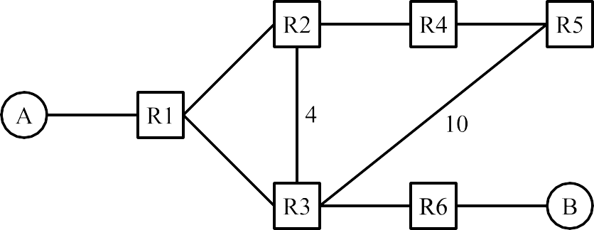

Slide 11
Ack-Based Loss Detection: Cumulative Acks
Cumulative acks: Declare loss if k duplicate acks are received.
k = 3 was chosen historically (empirical compromise between reordering and loss).
Example: Later packets (6, 7, 8) received, but there's a gap, so the "up to 4" cumulative ack cannot increase.
Sender
I received 3 copies of "up to 4" (plus the original).
That means 3 extra packets were received (and none of them are 5).
I'll assume 5 is lost and resend it.
up to 1
up to 2
up to 3
up to 4
up to 4
up to 4
up to 4
ack for 6 dup #1
ack for 7 dup #2
ack for 8 dup #3
Notes:
Example:
Sender transmits
Seq 1000
Seq 2000
Seq 3000 Dropped in flight
Seq 4000
Seq 5000
Seq 6000
Receiver acks:
ACK 2000 (I have received up to Seq 1999, and am expecting Seq 2000)
ACK 3000 (I have received up to Seq 2999, and am expecting Seq 2000)
ACK 3000 (I have received up to Seq 2999, and am expecting Seq 2000)
ACK 3000 (I have received up to Seq 2999, and am expecting Seq 2000)
ACK 3000 (I have received up to Seq 2999, and am expecting Seq 2000)
ACK 3000 (I have received up to Seq 2999, and am expecting Seq 2000)
Duplicate ACKs indicate packet loss/reorder
If we receive acks for 1, 2, 3, 4, 6, 7, 8, 9, we probably lost 5.
Declare a packet lost if k subsequent packets are acked.
k = 3 is common.

Slide 12
Send window: [1000, 1400)
1000
1400
1500
1600
1400
First un-ACKed byte
Send window: [1300, 1700) = [1300, 1699]
1300
1400
1500
1600
1700
First un-ACKed byte
Send window: [1400, 1800)
1300
1400
1500
1600
1700
1800
First un-ACKed byte

