Slide 1
CSC 112: Computer Operating Systems Lecture 6 Real-Time Scheduling Exercises
Department of Computer Science,
Hofstra University

Slide 2
Q1. Schedulability under RM or EDF
Determine schedulability of the following tasksets under (1) Rate Monotonic (RM) scheduling, using Utilization Bound test and/or Response Time Analysis (RTA) to determine taskset schedulability. (2) Earliest Deadline First (EDF) scheduling, using Utilization Bound test. We use the notation τi (Ci, Ti, Di) to denote task τi with WCET Ci Period Ti, Deadline Di (c.f. Slide 33 in Lecture 6)
1) Taskset τ1 (3, 6, 6), τ2 (4, 9, 9)
2) Taskset τ1 (3, 6, 6), τ2 (3, 9, 9)
3) Taskset τ1 (3, 6, 6), τ2 (2, 9, 9)
4) Taskset τ1 (2, 4, 4), τ2 (4, 8, 8)
5) Taskset τ1 (2, 5, 5), τ2 (4, 7, 7)
6) Taskset τ1 (1, 2, 2), τ2 (2.5, 5, 5)
# Tasks | RM Util Bound
1 | 1.00
2 | 0.828
3 | 0.780

Slide 3
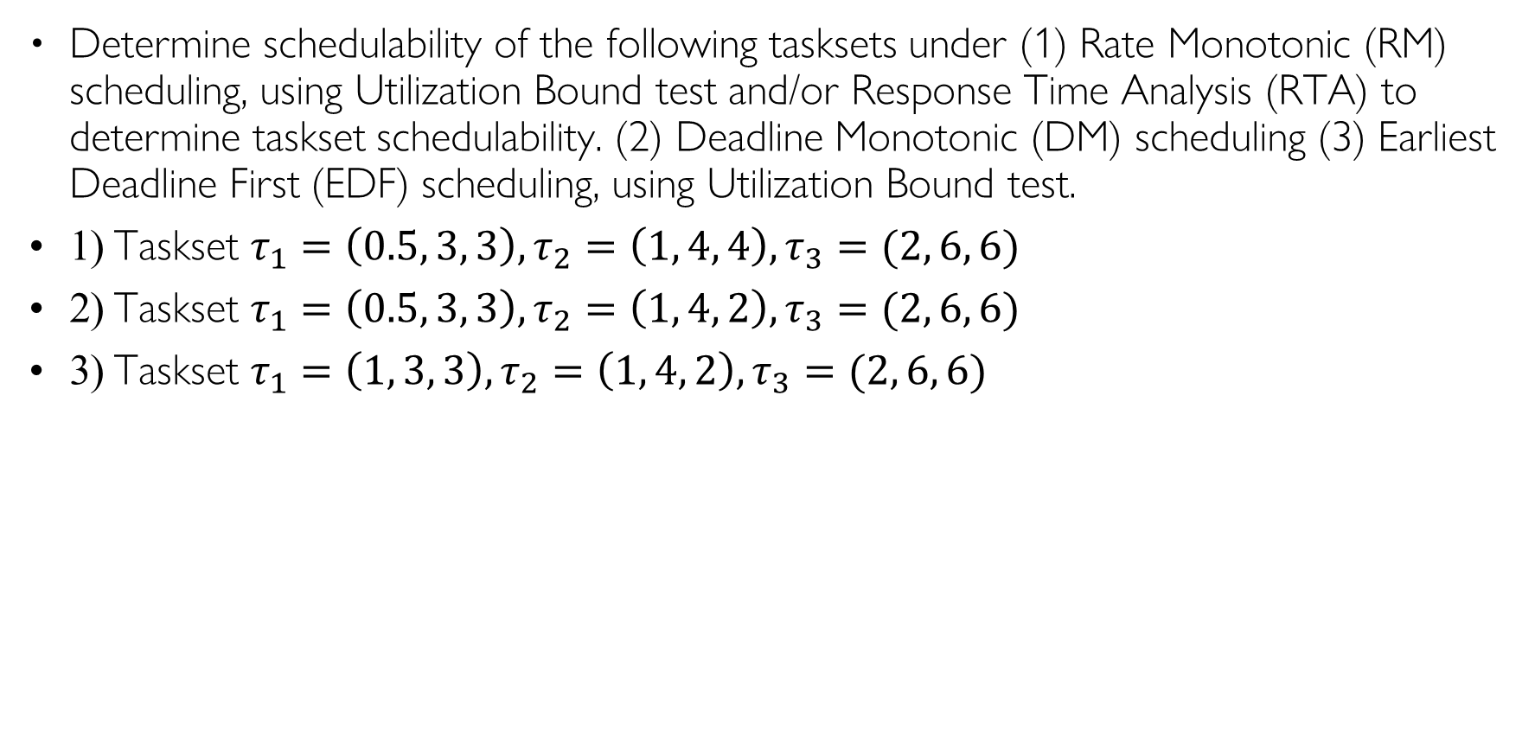
Q2. Schedulability under RM, DM, or EDF
Determine schedulability of the following tasksets under (1) Rate Monotonic (RM) scheduling, using Utilization Bound test and/or Response Time Analysis (RTA) to determine taskset schedulability. (2) Deadline Monotonic (DM) scheduling (3) Earliest Deadline First (EDF) scheduling, using Utilization Bound test.
1) Taskset $τ_{1}=\left(0.5, 3, 3\right), τ_{2}=\left(1, 4, 4\right), τ_{3}=(2, 6, 6)$
2) Taskset $τ_{1}=\left(0.5, 3, 3\right), τ_{2}=\left(1, 4, 2\right), τ_{3}=(2, 6, 6)$
3) Taskset $τ_{1}=\left(1, 3, 3\right), τ_{2}=\left(1, 4, 2\right), τ_{3}=(2, 6, 6)$

Slide 4
Q3 RM, EDF, LLF
Consider the set of 2 periodic tasks whose period, deadline and WCET parameters are given.
1. For each scheduling algorithm (RM, EDF, LLF), draw the Gantt chart by filling in the table with the task ID that runs in each time slot until time 10, and calculate the WCRT for each task.
2. Under RM scheduling, use utilization bound and Response Time Analysis (RTA) to determine taskset schedulability.
Time | τ₁ Laxity | τ₂ Laxity | Running Task
t=0
t=1
t=2
t=3
t=4
t=5
t=6
t=7
t=8
T=9
Task ID | T=D | C | RM Resp. Time | EDF Resp. Time | LLF Resp. Time
1 | 8 | 3
2 | 10 | 4
RM
EDF
LLF
Time | 0 | 1 | 2 | 3 | 4 | 5 | 6 | 7 | 8 | 9 | 10
Gantt Chart

