Slide 1
CMPT 300 Introduction to Operating Systems
Page Replacement Algorithms

Slide 2
Demand Paging
Modern programs require a lot of physical memory
Memory per system growing faster than 25%-30%/year
But they don’t use all their memory all of the time
90-10 rule: programs spend 90% of their time in 10% of their code
Wasteful to require all of user’s code to be in memory
Solution: use main memory as cache for disk
Processor
Control
Caching
Tertiary
Storage
(Tape)
Second
Level
Cache
(SRAM)
Main
Memory
(DRAM)
Secondary
Storage
(Disk)
Datapath
On-Chip
Cache

Slide 3
Illusion of Infinite Memory
∞
TLB
Page
Table
Physical
Memory
512 MB
Disk
500GB
Virtual
Memory
4 GB
Disk is larger than physical memory ⇒
In-use virtual memory can be bigger than physical memory
Combined memory of running processes much larger than physical memory
More programs fit into memory, allowing more concurrency
Principle: Transparent Level of Indirection (page table)
Supports flexible placement of physical data
Data could be on disk or somewhere across network
Variable location of data transparent to user program
Performance issue, not correctness issue

Slide 4
Demand Paging is Caching
Since Demand Paging is Caching, must ask:
What is block size?
1 page
What is organization of this cache (i.e. direct-mapped, set-associative, fully-associative)?
Fully associative: arbitrary virtual→physical mapping
How do we find a page in the cache when look for it?
First check TLB, then page-table traversal
What is page replacement policy? (i.e. LRU, Random…)
This requires more explanation… (kinda LRU)
What happens on a miss?
Go to lower level to fill miss (i.e. disk)
What happens on a write? (write-through, write back)
Write-back. Need dirty bit!

Slide 5
Demand Paging Example
Since Demand Paging like caching, can compute average access time! (“Effective Access Time”)
EAT = Hit Rate x Hit Time + Miss Rate x Miss Time
Example:
Memory access time = 200 nanoseconds
Average page-fault service time = 8 milliseconds
Suppose p = Probability of miss, 1-p = Probably of hit
Then, we can compute EAT as follows:
EAT = (1 – p) x 200ns + p x 8 ms
= (1 – p) x 200ns + p x 8,000,000ns
= 200ns + p x 7,999,800ns
If one access out of 1,000 causes a page fault, then EAT = 8.2 μs:
This is a slowdown by a factor of 40!
What if want slowdown by less than 10%?
200ns x 1.1 < EAT ⇒ p < 2.5 x 10⁻⁶
This is about 1 page fault in 400000!

Slide 6
What Factors Lead to Misses?
Compulsory Misses:
Pages that have never been paged into memory before
How might we remove these misses?
Prefetching: loading them into memory before needed
Need to predict future somehow! More later.
Capacity Misses:
Not enough memory. Must somehow increase size.
One option: Increase amount of DRAM (not quick fix!)
Another option: If multiple processes in memory: adjust percentage of memory allocated to each one!
Conflict Misses:
They do not exist in virtual memory, since it is a “fully-associative” cache

Slide 7
Replacement policy
Why do we care about Replacement Policy?
Replacement is an issue with any cache
Particularly important with pages
The cost of being wrong is high: must go to disk
Must keep important pages in memory, not toss them out
FIFO (First In, First Out)
Throw out oldest page. Be fair – let every page live in memory for same amount of time.
Bad – throws out heavily used pages instead of infrequently used
RANDOM:
Pick random page for every replacement
Typical solution for TLB’s. Simple hardware
Pretty unpredictable – makes it hard to make real-time guarantees
MIN (Minimum):
Replace page that won’t be used for the longest time
Great (provably optimal), but can’t really know future…
But past is a good predictor of the future …
Notes:
Policy Misses:
Caused when pages were in memory, but kicked out prematurely because of the replacement policy
How to fix? Better replacement policy

Slide 8
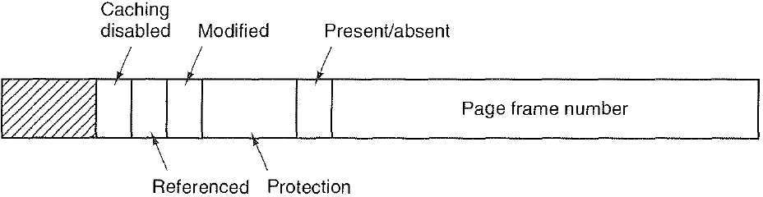
Recall: What is in a Page Table Entry (PTE)?
Page frame number. Physical memory address of this page
Present/absent bit, also called valid bit. If this bit is 1, the page is in memory and can be used. If it is 0, the page is not currently in memory. Accessing a page table entry with this bit set to 0 causes a page fault to get page from disk.
Protection bits tell what kinds of access are permitted on the page. 3 bits, one bit each for enabling read, write, and execute.
Modified (M) bit, also called dirty bit, is set to 1 when a page is written to
Referenced (R) bit, is set whenever a page is referenced, either for reading or writing.
M and R bits are very useful to page replacement algorithms
Caching disabled bit, important for pages that map onto device registers rather than memory
Notes:
Protection bits checked on every access to see if allowed
Read: can read, but not write page
Read/Write: read or write data on page
Execute: Can fetch instructions from page
Valid = Valid page table entry
When the virtual page can be found in physical memory.
(vs. found on disk or not yet allocated)
Address same format previous slide (10, 10, 12-bit offset)
Intermediate page tables called “Directories”
What is in a Page Table Entry (or PTE)?
Pointer to next-level page table or to actual page
Permission bits: valid, read-only, read-write, write-only
Page table includes a flag (dirty bit) to indicate if the page has been modified since it was last synced with virtual memory.
The flag is reset when the page is saved to virtual memory
When a page is removed from physical memory
If the dirty bit is set it will be written to virtual memory
If the dirty bit is not set it will be abandoned and overwritten
The page table includes a flag to indicate if the page has been accessed.
OS has a paging management time period defined. Each time this time period ends the accessed bit (R bit) for each page is reset to 0
Each time the page is accessed the R bit is set to 1, and the last accessed time is updated to reflect the time of the most recent access

Slide 9
R & M bits
Referenced (R) bit indicates if the page has been used recently.
Each time the page is referenced (read or written to), the R bit is set to 1.
OS defines a clock period for paging management. Every clock period, the R bit for each page is reset to 0.
R=0 → page is old (not used for some time)
R=1 → page is new (recently used)
Modified (M) bit indicates if the page has been modified (written to) since it was last synced with disk.
The flag is reset when the page is saved to disk
When a page is removed from physical memory
M=1 → it will be saved to disk
M=0 → it will be abandoned and not saved to disk
Notes:
, and the last accessed time is updated to reflect the time of the most recent access
Recall “R” (reference) bit per physical page PTE:
Hardware sets R bit on each reference
If use bit isn’t set, means not referenced in a long time

Slide 10
Demand Paging Mechanisms
PTE helps us implement demand paging
Present ⇒ Page in memory, PTE points at physical page
Absent ⇒ Page not in memory; use info in PTE to find it on disk when necessary
Suppose user references page with Absent PTE?
Memory Management Unit (MMU) traps to OS
Resulting trap is a “Page Fault”
What does OS do on a Page Fault?:
Choose an old page to replace
If old page modified, write page contents back to disk
Change its PTE and any cached TLB to be invalid
Load new page into memory from disk
Update PTE, invalidate TLB for new entry
Continue thread from original faulting location
TLB for new page will be loaded when thread continues!
While pulling pages off disk for one process, OS runs another process from ready queue
Suspended process sits on wait queue

Slide 11
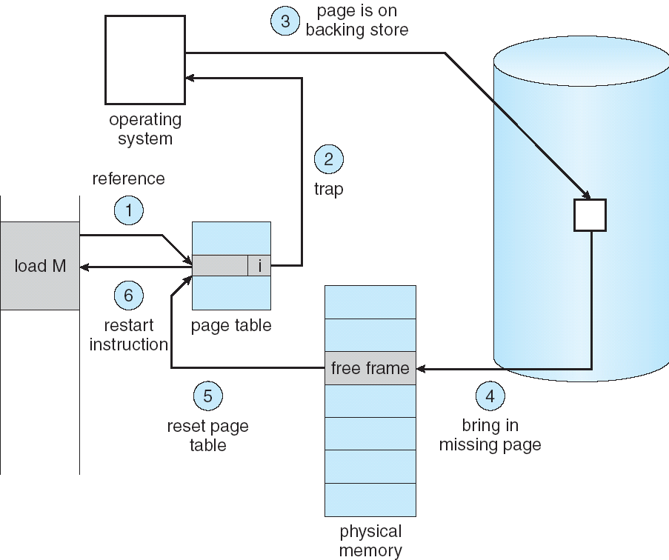
Steps in Handling a Page Fault

Slide 12
Page Replacement Algorithms
Optimal (OPT)
Not recently used (NRU)
First-In, First-Out (FIFO)
Second chance (SC)
Least recently used (LRU)
Not frequently used (NFU)
Aging algorithm
Clock algorithm
Working set
WSClock

Slide 13
OPT page replacement
Replace page that won’t be used for the longest time
Optimal, but infeasible in practice, since can’t really know future…
Makes good comparison case, however

Slide 14
Not recently used (NRU)
Use the referenced and modified bits in the page table entries. 4 possibilities:
Not referenced, not modified
Not referenced, modified (reference cleared on clock interrupt)
Referenced, not modified
Referenced, modified
When a page fault occurs, find any page in group 1, failing that any page in group 2, failing that any page in group 3, failing that any page in group 4. If there is more than one page in the lowest group, randomly choose one page from the group.
Rationale: replace the page that has not been referenced or modified.
Notes:
Use the accessed and modified bits in the page table entries. Gives 4 possibilities
Not referenced not modified
Not referenced modified (reference cleared on clock interrupt)
Referenced not modified
Reference modified
When a page fault occurs, find any page in group 1, failing that any page in group 2, failing that any page in group 3, failing that any page in group 4. If there is more than one page in the lowest group containing pages randomly choose one page from the group of pages.
Problem: it never forgets anything; heavily used items remain heavily used forever

Slide 15
FIFO
Throw out oldest page.
Be fair – let every page live in memory for same amount of time.
Bad, because it tends to throw out heavily used pages instead of infrequently used pages
Second-chance algorithm avoids this problem by giving recently-used pages a second chance
Notes:
Maintain a list of pages presently in page frames
When a page is placed in a page frame in physical memory add it to the end of the list
When a page fault occurs and all slots in physical memory are full remove the first page in the list from memory and replace it with the new page.
Problem: if the page removed is heavily and continuously used it will then have to be reloaded almost immediately (as soon as it is next accessed)

Slide 16
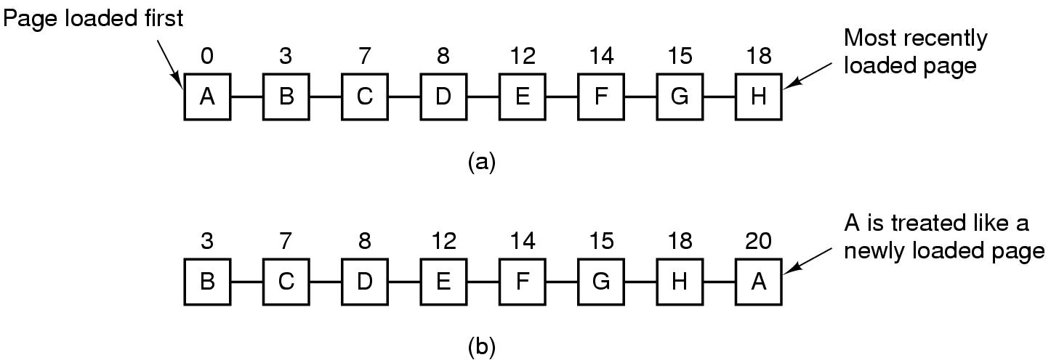
Second-Chance Algorithm
Give recently-used pages a second chance
If the oldest page has R=0, then choose it for replacement; if R=1, then move it to the end, and update its load time as through it’s a new arrival
(a) Pages sorted in FIFO order. (b) Page list if a page fault occurs at time 20 and A has its R bit set. The numbers above the pages are their load times.

Slide 17
Least Recently Used (LRU)
Replace page that hasn’t been used for the longest time
Programs have locality, so if something not used for a while, unlikely to be used in the near future.
Seems like LRU should be a good approximation to OPT.
How to implement LRU? Use a list!
On each use, remove page from list and place at head
LRU page is at tail
Problems with this scheme for paging?
List must be updated at every memory reference; List manipulation is expensive
In practice, people approximate LRU (more later)
Page 6
Page 7
Page 1
Page 2
Head
Tail (LRU)
Notes:
Need to know immediately when each page used so that can change position in list…

Slide 18
Example: FIFO
Consider a cache size of 3 page frames, and following reference stream of virtual pages:
A B C A B D A D B C B
Consider FIFO Page replacement:
FIFO: 7 faults.
When referencing D, replacing A is bad choice, since need A again right away
Ref:
Page:
A
B
C
A
B
D
A
D
B
C
B
1
A
D
C
2
B
A
3
C
B

Slide 19
Example: OPT
Suppose we have the same reference stream:
A B C A B D A D B C B
Consider OPT Page replacement:
5 faults
Where will D be brought in? Look for page not referenced farthest in future (C).
What will LRU do?
Same decisions as OPT here, but won’t always be true!
Ref:
Page:
A
B
C
A
B
D
A
D
B
C
B
1
A
C
2
B
3
C
D

Slide 20
When will LRU perform badly?
Consider the following: A B C D A B C D A B C D
LRU Performs as follows (same as FIFO here):
Every reference is a page fault!
Ref:
Page:
A
B
C
D
A
B
C
D
A
B
C
D
1
A
D
C
B
2
B
A
D
C
3
C
B
A
D

Slide 21
OPT Does much better
But it’s not implementable
Ref:
Page:
A
B
C
D
A
B
C
D
A
B
C
D
1
A
B
2
B
C
3
C
D
Notes:
Consider a cache size of 3 page frames, and following reference stream of virtual pages:
7 0 1 2 0 3 0 4 2 3 0 3 2 1 2 0 1 7 0 1
Run FIFO, OPT and LRU on this example.
Answer:
FIFO: http://cs.uttyler.edu/Faculty/Rainwater/COSC3355/Animations/fifopagereplacement.htm
OPT: http://cs.uttyler.edu/Faculty/Rainwater/COSC3355/Animations/optimalpagereplacement.htm
LRU: http://cs.uttyler.edu/Faculty/Rainwater/COSC3355/Animations/lrupagereplacement.htm

Slide 22
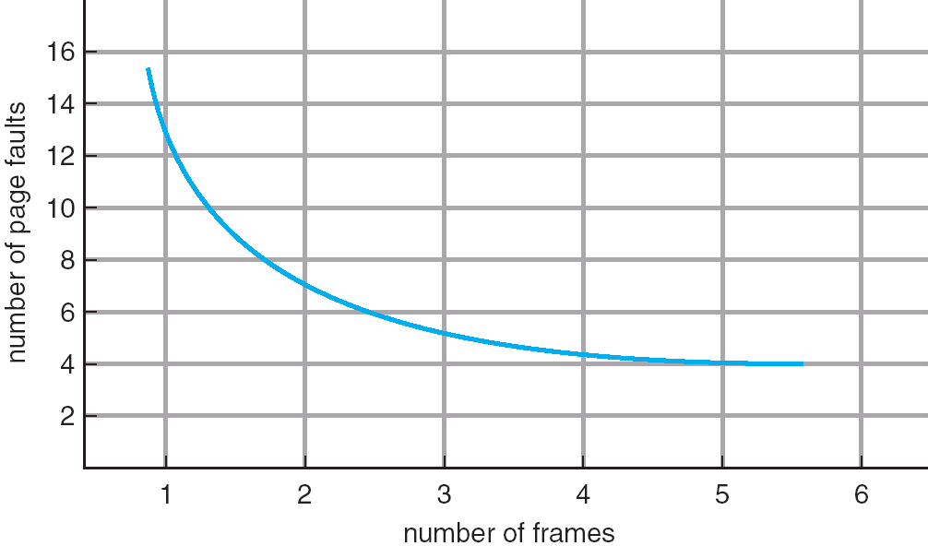
Graph of Page Faults Versus The Number of Page Frames
One desirable property: When you add memory the miss rate goes down
Does this always happen?
Seems like it should, right?
No: BeLady’s anomaly
Certain replacement algorithms (FIFO) don’t have this obvious property!

Slide 23
BeLady’s anomaly
Does adding memory reduce number of page faults?
Yes for LRU and OPT
Not necessarily for FIFO! (Called Belady’s anomaly)
After adding memory:
With FIFO, contents can be completely different
In contrast, with LRU or OPT, contents of memory with X pages are a subset of contents with X+1 Page
Ref:
Page:
A
B
C
D
A
B
E
A
B
C
D
E
1
A
D
E
9 page faults
2
B
A
C
3
C
B
D
Ref:
Page:
A
B
C
D
A
B
E
A
B
C
D
E
1
A
E
D
2
B
A
E
10 page faults
3
C
B
4
D
C

Slide 24
Implementing LRU
Perfect:
Timestamp page on each reference
Keep list of pages ordered by time of reference
Too expensive to implement in reality
Techniques for approximating LRU. Goal is to Replace an old page, not the oldest page
Hardware techniques
64-bit counter
n x n matrix
Software techniques
Not recently used (NRU)
Aging Algorithm
Clock Algorithm
Notes:
Approximate LRU (approx to approx to OPT)

Slide 25
LRU in hardware
Implementation #1:
64 bit counter, C, incremented after every instruction
Each page also has a 64 bit counter
When a page is referenced, C is copied to its counter.
Page with lowest counter is oldest.

Slide 26
LRU in hardware
Implementation #2:
Given n page frames, let M be a n x n matrix of bits initially all 0.
Reference to page frame k occurs.
Set all bits in row k of M to 1.
Set all bits in column k of M to 0.
Row with lowest binary value is least recently used.

Slide 27
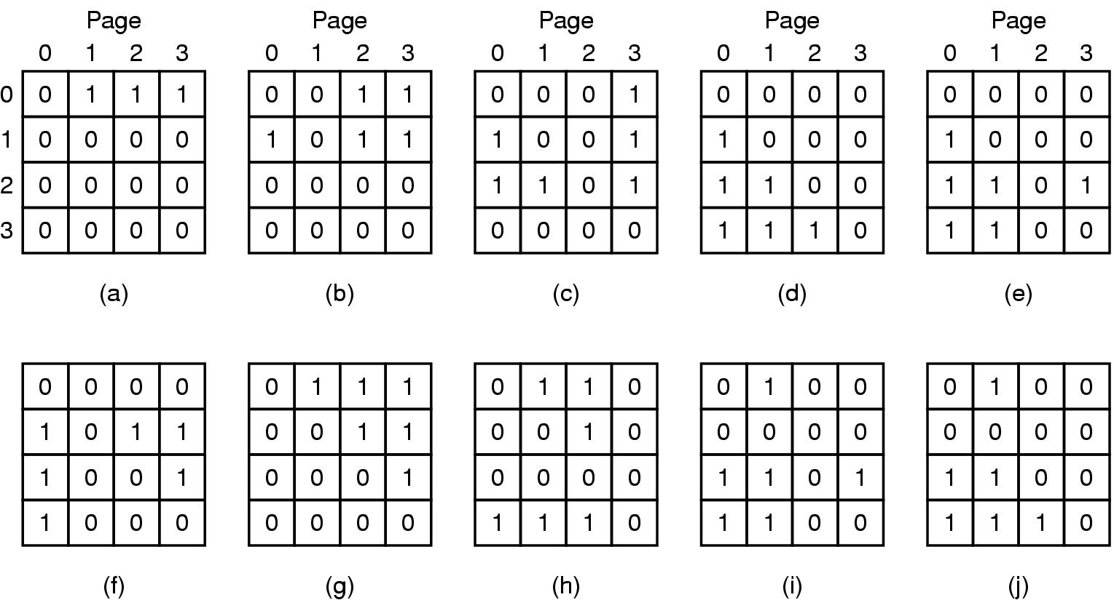
LRU in hardware: implementation #2 example
oldest
Figure 3-17. LRU using a matrix when pages are referenced in the order 0, 1, 2, 3, 2, 1, 0, 3, 2, 3.

Slide 28
Not frequently used (NFU)
A software counter associated with each page, initially zero. At end of each clock period, the operating system scans all the pages in memory.
For each page, the R bit (0 or 1), is added to the counter (arithmetic addition), which roughly keeps track of how often each page has been referenced. When a page fault occurs, the page with the smallest counter is chosen for replacement.
Problem: It never forgets!
So pages that were frequently referenced (during initialization for example) but are no longer needed appear to be FU.

Slide 29
Aging algorithm
Idea: Gradually forget the past
A k-bit software counter is associated with each page, the counter is initialized to 0
Shift all counters to right 1 bit before R bit is added in.
Then R bit is added to MSb (Most Significant (leftmost) bit)
Page with lowest counter value is chosen for removal.
Notes:
It never forgets!
So pages that were frequently referenced (during initialization for example) but are no longer needed appear to be FU.
Solution (called “aging”):
Shift all counters to right 1 bit before R bit is added in.
Then R bit is added to MSb (leftmost bit) instead of LSb (rightmost bit).
Page w/ lowest value is chosen for removal.
A k-bit software counter is associated with each page, the counter is initialized to 0
At the end of each time interval the OS scans to determine which pages are in physical memory
For each of these pages the bits in the page counters are shifted right 1 bit and the value of the R flag for the page replaces the leftmost bit, and the R bit is reset to 0.
The page with the smallest value in its counter is chosen as the page to be replaced by the new page

Slide 30
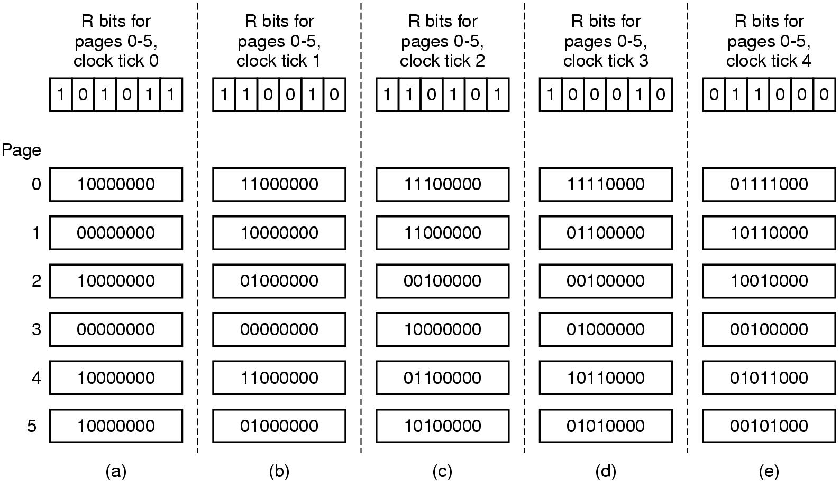
Aging algorithm example
Shown are six pages for five clock periods. The five clock periods are represented by (a) to (e).

Slide 31
Aging vs. LRU
Aging has a finite history of memory
Consider aging with an 8-bit counter with value 0. It cannot distinguish between a page referenced 9 clock periods ago, and another referenced 1000 block periods ago.
If the counter has infinitely many bits, then it implements LRU exactly.
8 bits generally enough
If clock period is 20ms, a history of 160ms is perhaps adequate

Slide 32
Clock Algorithm
A variant of second-chance algorithm
Recall “R” (reference) bit in PTE:
Hardware sets R bit on each reference
Instead of clearing R periodically (with “clock period” mentioned before) driven by OS timer, clear it at page-fault events
Arrange physical page frames in a circle with single clock hand. On each page fault:
Advance clock hand (not real-time)
Check R bit:
R=1→used recently; clear and leave alone
R=0→selected candidate for replacement
Will always find a page or loop forever?
Even if all R bits set, will eventually loop around ⇒ FIFO
Notes:
Nachos hardware sets use bit in the TLB; you have to copy this back to page table when TLB entry gets replaced
If use bit isn’t set, means not referenced in a long time

Slide 33
Clock Algorithm
Set of all pages
in Memory
Single Clock Hand:
Advances only on page fault!
Check for pages not used recently
Mark pages as not used recently
What if hand moving slowly?
Not many page faults and/or find page quickly
What if hand is moving quickly?
Lots of page faults and/or lots of reference bits set
One way to view clock algorithm: Partitioning of pages into two groups: young and old
Animation: http://gaia.ecs.csus.edu/~zhangd/oscal/ClockFiles/Clock.htm (usrname/passwd: CSC139/csus.os.prin)
(Uncheck “use modified bit” button. Note that it uses “U” instead of “R” for the reference bit.)
Notes:
(Modified bit in the animation is not considered here)

Slide 34
N^{th} Chance version of Clock Algorithm
N^{th} chance algorithm: Give page N chances
OS keeps counter per page: # sweeps
On page fault, OS checks R bit:
R=1⇒clear R bit and also set counter to N (ref’ed in last sweep)
R=0⇒decrement count; if count=0, replace page
Means that clock hand has to sweep by N times without page being used before page is replaced
How do we pick N?
Why pick large N? Better approx to LRU
If N ~ 1K, really good approximation
Why pick small N? More efficient
Otherwise might have to look a long way to find free page
What about dirty pages?
Takes extra overhead to replace a dirty page, so give dirty pages an extra chance before replacing?
Common approach:
Clean pages, use N=1
Dirty pages, use N=2

Slide 35
Allocation of Page Frames
How do we allocate memory (page frames) among different processes?
Does every process get the same fraction of memory? Different fractions?
Should we completely swap some processes out of memory?
Each process needs minimum number of pages
Want to make sure that all processes that are loaded into memory can make forward progress
Notes:
(Memory Pages) Example: IBM 370: 6 pages to handle SS MOVE instruction:
instruction is 6 bytes, might span 2 pages
2 pages to handle from
2 pages to handle to

Slide 36
Possible Replacement Scopes:
Possible Replacement Scopes:
Global replacement – process selects replacement frame from set of all frames; one process can take a frame from another
Achieve effective utilization of memory through sharing
Local replacement – each process selects from only its own set of allocated frames
Achieve memory isolation among processes

Slide 37
Fixed/Priority Allocation
Equal allocation (Fixed Scheme):
Every process gets same amount of memory
Example: 100 frames, 5 processes⇒process gets 20 frames
Proportional allocation (Fixed Scheme)
Allocate according to the size of process
Computation proceeds as follows:
s_{i} = size of process p_{i} and S = Σs_{i}
m = total number of frames
a_{i} = allocation for p_{i} =
Priority Allocation:
Proportional scheme using priorities rather than size
Same type of computation as previous scheme
Possible behavior: If process p_{i} generates a page fault, select for replacement a frame from a process with lower priority number
Notes:
Perhaps we should use an adaptive scheme instead???
What if some application just needs more memory?

Slide 38
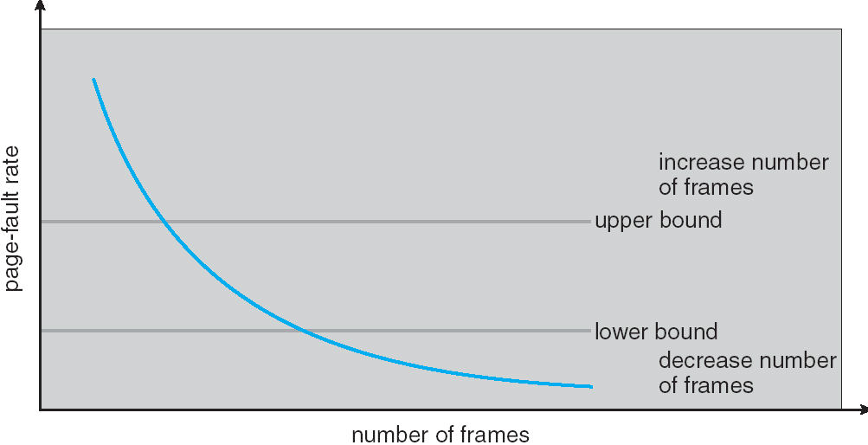
Page-Fault Frequency Allocation
Can we reduce Capacity misses by dynamically changing the number of pages/application?
Establish “acceptable” page-fault rate
If actual rate too low, process loses frame
If actual rate too high, process gains frame
Question: What if we just don’t have enough memory?

Slide 39
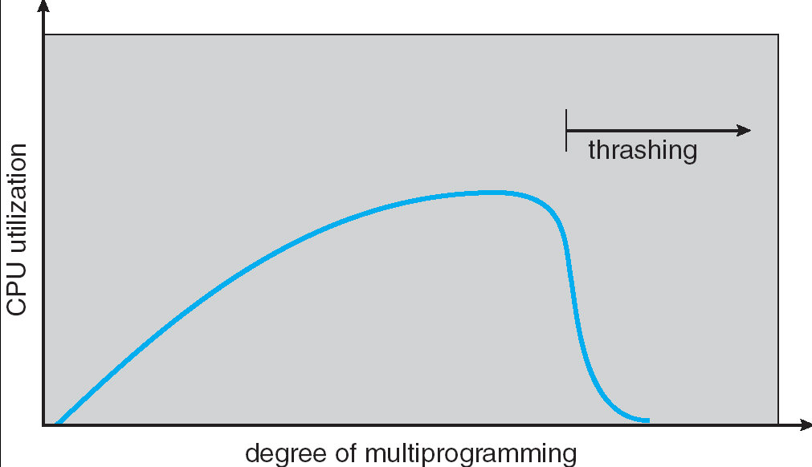
Thrashing
If a process does not have “enough” pages, the page-fault rate is very high. This leads to:
low CPU utilization
operating system spends most of its time swapping to disk
Thrashing ≡ a process is busy swapping pages in and out
Questions:
How do we detect Thrashing?
What is best response to Thrashing?
Notes:
Example: one program, touches 50 pages (each equally likely). Have only 40 physical page frames.
How bad is this?
- Does your program run at 80% speed?
- Does your program run at 20% speed?
Performance is really bad
If we have enough pages, 200 ns/ref, but if too few pages, assume every 5th page reference causes a page fault
= 4 refs x 200 ns
1 page fault x 10 ms for disk I/O
= 5 refs, 10 ms + 800 ns => 2 ms/ref (not 100 MIPS, but 500 IPS! Factor of 10,000)
Machine appears to have stopped!

Slide 40
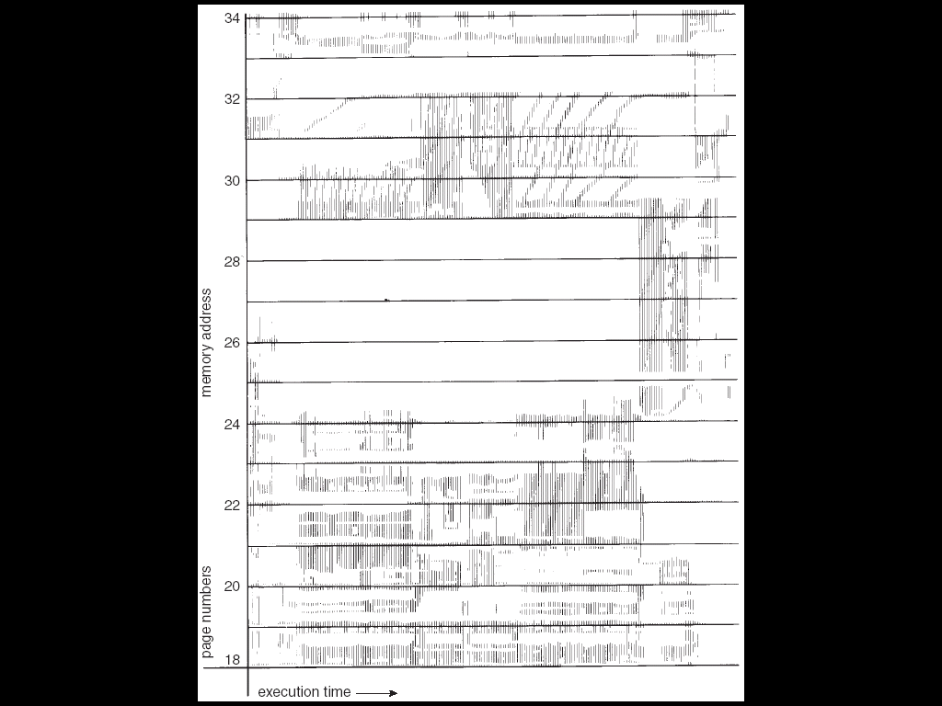
Locality In A Memory-Reference Pattern
Program Memory Access Patterns have temporal and spatial locality
Group of Pages accessed along a given time slice called the “Working Set”
Working Set defines minimum number of pages needed for process to behave well
Not enough memory for Working Set⇒Thrashing
Better to swap out process?

Slide 41
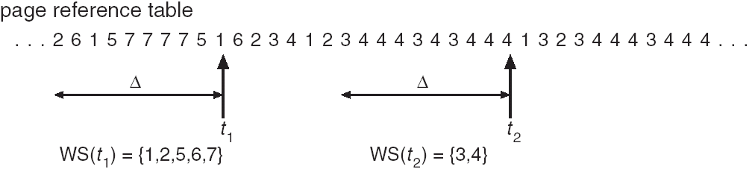
Working-Set Model
Δ ≡ working-set window ≡ fixed number of page references
Example: 10 million references
WS_{i} (working set of Process P_{i}) = total set of pages referenced in the most recent Δ (varies in time)
if Δ too small will not encompass entire locality
if Δ too large will encompass several localities
if Δ = ∞ ⇒ will encompass entire program
D = Σ|WS_{i}| ≡ total demand frames
if D > m ⇒ Thrashing
Policy: if D > m, then suspend one of the processes
This can improve overall system behavior by a lot!
Notes:
Animation: http://cs.uttyler.edu/Faculty/Rainwater/COSC3355/Animations/workingset.htm

Slide 42
What about Compulsory Misses?
Recall that compulsory misses are misses that occur the first time that a page is seen
Pages that are touched for the first time
Pages that are touched after process is swapped out/swapped back in
Clustering:
On a page-fault, bring in multiple pages “around” the faulting page
Since efficiency of disk reads increases with sequential reads, makes sense to read several sequential pages
Working Set Tracking:
Use algorithm to try to track working set of application
When swapping process back in, swap in working set

Slide 43
Maintaining WS: A Simple Way
Store page numbers in a shift register of length k, and with every memory reference, we do
Shift the register left one position, and
Insert the most recently referenced page number on the right
The set of k page numbers in the register is the working set.
Too expensive to do this for each memory reference.
p1 | p2 | … | pk
p2 | p3 | … | p(k+1)
Page (k+1) is referenced
The most recent page
the oldest page

Slide 44
Implementation: Defining a working set
Since not practical to keep history of past Δ memory references, use working set window of τ ms.
e.g., instead of defining working set as those pages used during previous 10 million references, define it as pages used during past working set window of 100ms
Note: not wall-clock time! If a process starts running at time T, and runs for 40ms at time T+100ms, it’s execution time is 40ms. (the other 60ms is used for running other processes)
We use the term current virtual time to denote execution time of a process since its start
Working set of a process is set of pages it referenced during the past τ ms of virtual time
Notes:
(that is the R bit). This means the pages accessed in the last N seconds of CPU time used by the process OS must keep track of which pages are part of a processes working set
When a process is swapped out of physical memory, all its pages may be swapped out
The working set will give us a good idea of the pages we should load when we bring the swapped process back into physical memory (we may want to preload these rather than wait for them to be requested)
Note: not wall-clock time! If a process starts running at time T, and runs for 40ms at time T+100ms, it’s execution time is 40ms. (the other 60ms is used for running other processes)
We use the term current virtual time to denote execution time of a process since its start

Slide 45
Working set algorithm
Recall: the R bit of a PTE is cleared every clock period. Assume the working set window τ ms spans multiple clock periods.
On every page fault, the page table is scanned to look for a suitable page to evict. The R bit of each PTE is examined.
If R=1 the page has been accessed this clock period and is part of WS.
Its Time of last use is updated to the present time.
If R=1 for all pages in memory, a random page is evicted
If R=0 the age (difference between the present time and Time of last use) is determined.
If age > τ, then the page is no longer considered to be part of WS. It may be removed and replaced with the new page
If age ≤ τ, then the page is still in WS. If all pages in physical memory are still in WS, the oldest one is chosen for eviction

Slide 46
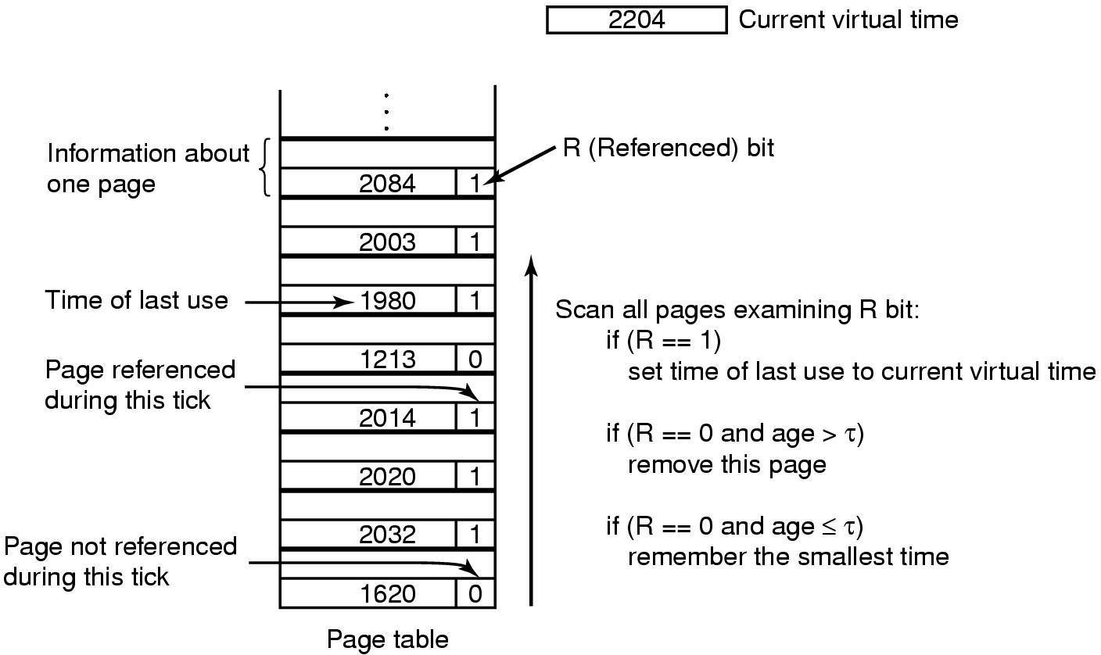
Working set algorithm example

Slide 47
WSClock algorithm
Basic working set algorithm requires entire page table to be scanned at every page fault until a victim is located
WSClock algorithm is a combination of Clock algorithm and working set algorithm:
Instead of clearing R periodically driven by OS timer, clear it at page-fault events
Arrange physical page frames in a circle with single clock hand. On each page fault:
Advance clock hand (not real time)
Check R bit:
R=1→used recently; clear and leave alone
R=0→additional checking for page age:
If age > τ, not in WS; selected candidate for replacement
If age ≤ τ, in WS. If all pages in physical memory are still in WS, the oldest one is chosen for eviction
Worst-case same as working set algorithm, but average case much better
(Note: this is a simplified version of WSClock that does not consider the modified bit. The algorithm in textbook is more complex.)
Notes:
Check R bit:
R=1→used recently; clear and leave alone
R=0→
If age > τ, not in WS; selected candidate for replacement
If age ≤ τ,

Slide 48
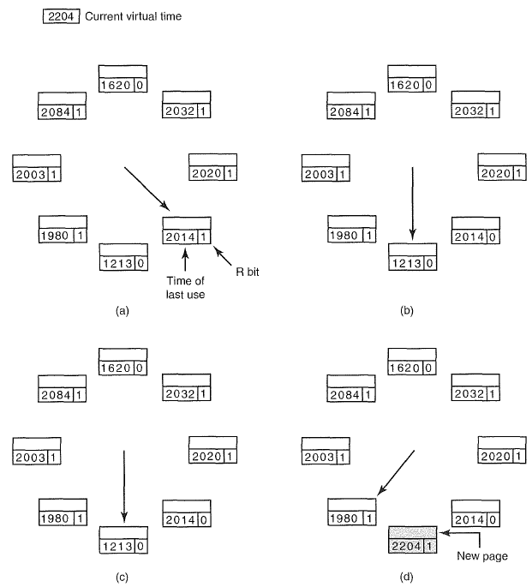
Operations of the WSClock algorithm.
(a) and (b) give an example of what happens when R = 1. (c) and (d) give an example of R = 0 and age > τ.

Slide 49
Summary
Replacement algorithms
OPT: Replace page that will be used farthest in future
FIFO: Place pages on queue, replace page at end
Second-chance: giving recently-used pages a second chance
LRU: Replace page used farthest in past
Approximations to LRU
NFU & Aging:
Keep track of recent use history for each page
Clock Algorithm:
Arrange all pages in circular list
Sweep through them, marking as not “in use”
If page not “in use” for one pass, than can replace
N^{th}-chance clock algorithm
Give pages multiple passes of clock hand before replacing
Working Set:
Set of pages touched by a process recently
Working set algorithm:
Tries to keep each working set in memory
Thrashing: a process is busy swapping pages in and out
Process will thrash if working set doesn’t fit in memory
Need to swap out a process

Slide 50
Summary
Algorithm | Comment
Optimal | Not implementable, good as benchmark
NRU | Very crude
FIFO | Might throw out important pages
Second chance | Big improvement over FIFO
Clock | Realistic
LRU | Excellent, but difficult to implement exactly
NFU | Fairly crude approximation to LRU
Aging | Efficient algorithm approximates LRU well
Working set | Somewhat expensive to implement
WSClock | Good efficient algorithm

