Slide 1
1D Bin Packing
(or “CP? Who cares?”)
A case study

Slide 2
[SR1] BIN PACKING
INSTANCE: Finite set U of items, a size s(u) in Z⁺ for each u in U, a
positive integer bin capacity B, and a positive integer K.
QUESTION: Is there a partition of U into disjoint sets U₁, U₂, …, U_{k}
such that the sum of the sizes of the items in each U_{i} is B or less?
Garey & Johnson
“Computers and Intractability: A guide to the theory of NP-Completeness”

Slide 3
An example
data = 42 63 67 57 93 90 38 36 45 42
n = 10 // 10 numbers
m = 5 // 5 bins
c = 150 // bin capacity of 150
Can we pack the above 10 numbers into 5 bins such that the
sum of the numbers in each bin is less than or equal to 150?
Note: the above 10 numbers sum to a total of 579
579/150 = 3.86

Slide 4
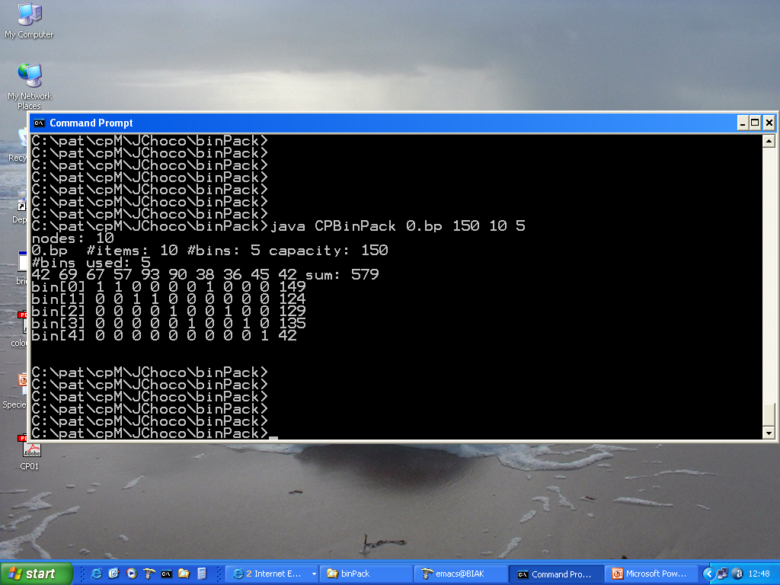

Slide 5
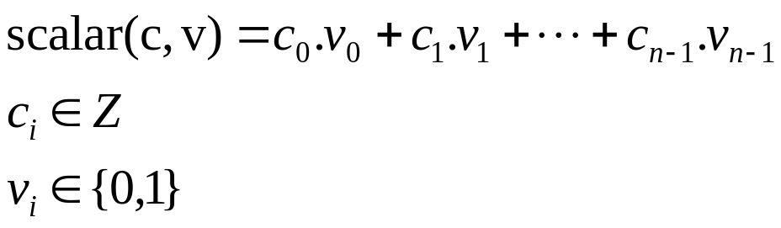
1st stab
Typical constraint for one bin
Read in the numbers into array called data
Associate an array of constrained integer variables v with a bin
v_{i} is 1 if and only if the i^{th} number is in that bin

Slide 6
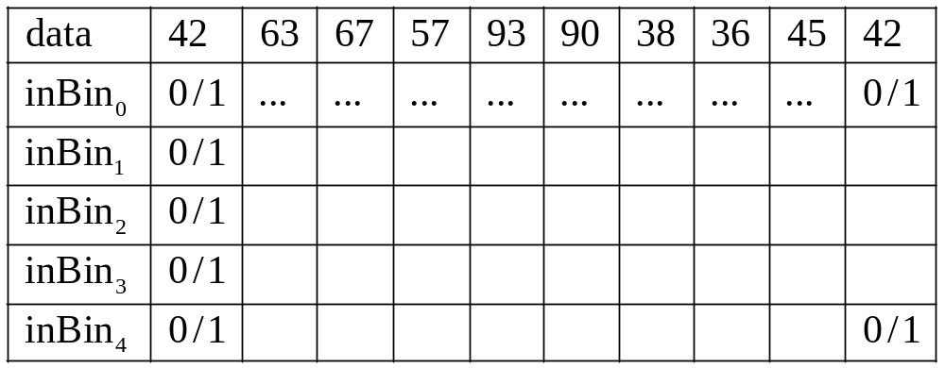
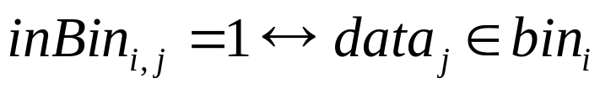
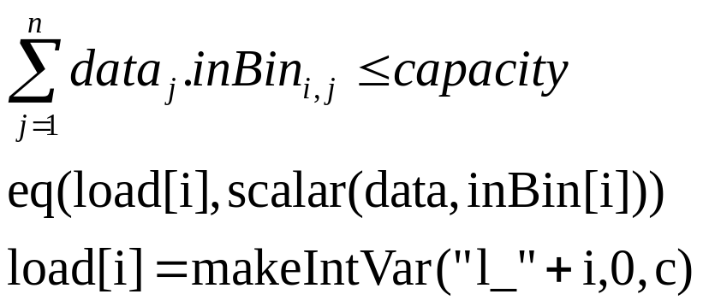
More specifically
The sum of the numbers in a bin is less than or equal to its capacity

Slide 7
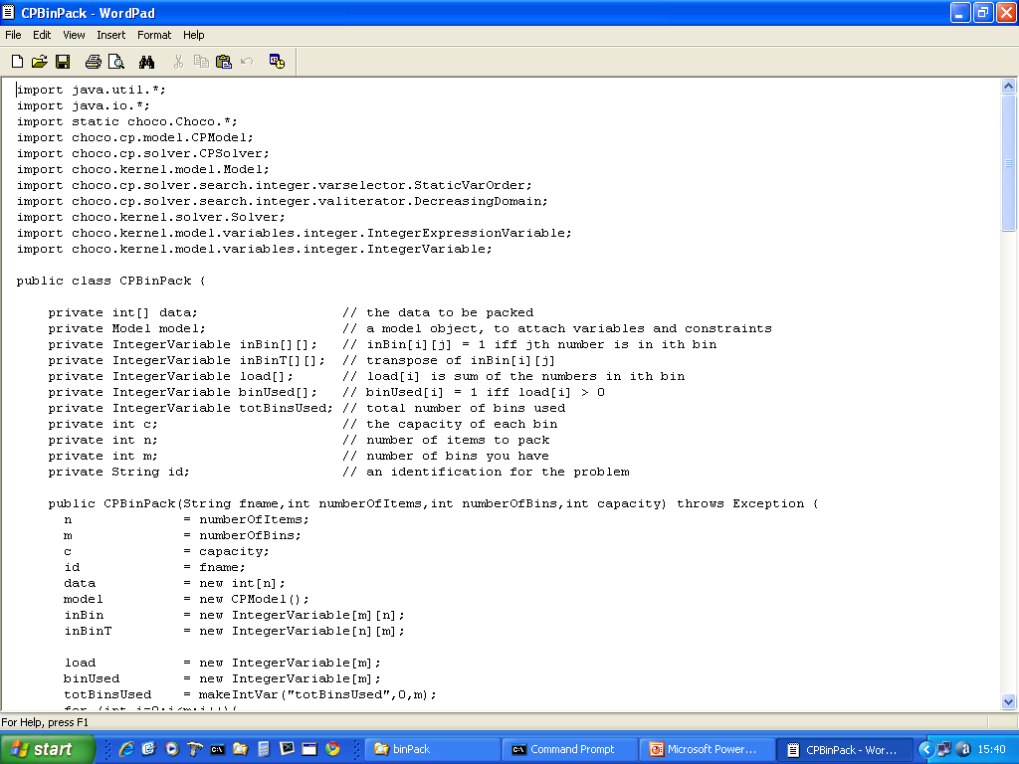

Slide 8
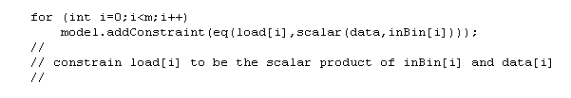
load[i] is the sum of the numbers in the ith bin
where load[i] is a constrained integer variable with domain [0 .. C]

Slide 9
Note 1
We have n.m 0/1 constrained integer variables
Question: How big is the potential state space?

Slide 10
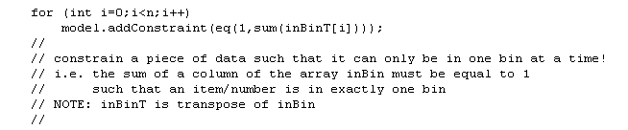
Only in one place at any one time!
A number data[i] can only be in one bin at any one time!
Therefore, the number of 1’s in any column must be exactly 1

Slide 11
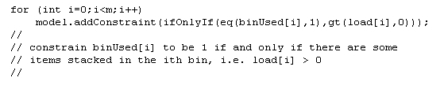
Is a bin used?
If there are numbers in a bin then that bin is used.
binUsed[i] = 1 iff and only if load[i] > 0
Where binUsed is 0/1 constrained integer variable

Slide 12
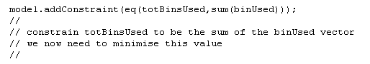
How many bins are used?
Sum up the number of bins used and ensure that this
is less than or equal to the number of bins that we have
totBinsUsed is a constraint integer variable with domain [0..m]

Slide 13
Program has the following command line inputs
fname
The name of a file containing 100 or more numbers
c
The (uniform) capacity of each bin
n
The number of numbers to read from file fname
m
The number of bins
Program finds first solution and displays
number of nodes, and the solution

Slide 14
Remember … we will optimise via a sequence of decision problems
Keep reducing the number of bins until no solution

Slide 15
It does nothing!
What is it doing?
What is search doing?

Slide 16
Decisions, decisions ☺
What are the decision variables?!

Slide 17
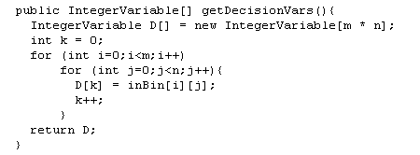
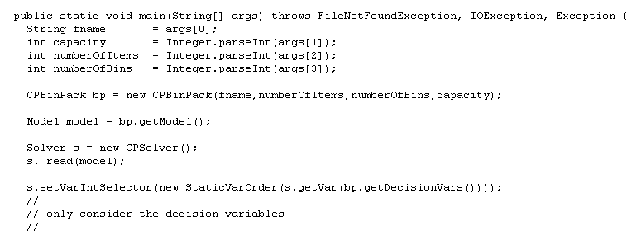

Slide 18
It is so slow!
Why is it so slow?
What is search doing?

Slide 19

Value Ordering!

Slide 20
It’s still slow!

Slide 21
Is there a heuristic?
1st fit decreasing

Slide 22
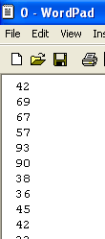
93 90 69 67 57 45 42 42 38 36
sorted

Slide 23
Bin Packing
First fit decreasing algorithm
A B C D E F
With the first fit decreasing algorithm we sort the blocks into descending order first.
6
5
4
3
3
3
2
2
1

Slide 24
Bin Packing
First fit decreasing algorithm
A B C D E F
Now we use the first fit algorithm
6
5
4
3
3
3
2
2
1

Slide 25
Bin Packing
First fit decreasing algorithm
6
A B C D E F
Now we use the first fit algorithm
5
4
3
3
3
2
2
1

Slide 26
Bin Packing
First fit decreasing algorithm
5
6
5
A B C D E F
Now we use the first fit algorithm
4
3
3
3
2
2
1

Slide 27
Bin Packing
First fit decreasing algorithm
4
4
6
5
4
A B C D E F
Now we use the first fit algorithm
3
3
3
2
2
1

Slide 28
Bin Packing
First fit decreasing algorithm
3
3
3
6
5
4
3
A B C D E F
Now we use the first fit algorithm
3
3
2
2
1

Slide 29
Bin Packing
First fit decreasing algorithm
3
3
3
6
3
5
4
3
A B C D E F
Now we use the first fit algorithm
3
2
2
1

Slide 30
Bin Packing
First fit decreasing algorithm
3
3
3
3
6
3
5
4
3
3
A B C D E F
Now we use the first fit algorithm
2
2
1

Slide 31
Bin Packing
First fit decreasing algorithm
2
2
6
2
3
5
4
3
3
A B C D E F
Now we use the first fit algorithm
2
1

Slide 32
Bin Packing
First fit decreasing algorithm
2
2
2
2
6
2
3
5
2
4
3
3
A B C D E F
Now we use the first fit algorithm
1

Slide 33
Bin Packing
First fit decreasing algorithm
1
6
1
2
3
5
2
4
3
3
A B C D E F
Now we use the first fit algorithm
We have packed them into 5 bins.

Slide 34


Slide 35
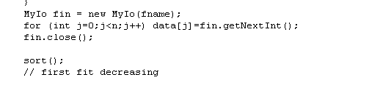
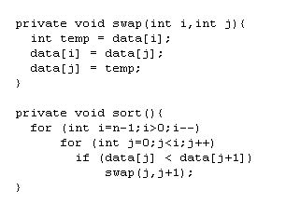

Slide 36
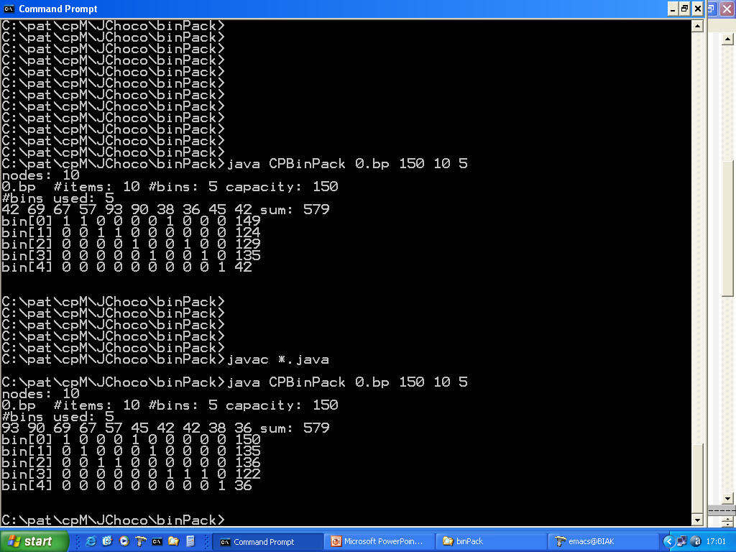

Slide 37
Slow proving optimality
Don’t have a test that sum of numbers over capacity
is less than or equal to the number of bins available!

Slide 38
Symmetries?
Are there any symmetries that are slowing down search?
Can we remove those symmetries?
What are the symmetries in this problem?

Slide 39
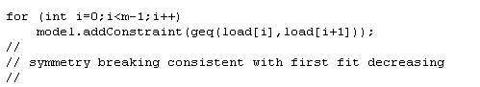
Symmetries?
Why not insist that load[i] >= load[i+1]?
How about “lex” ordering between rows of inBin?

Slide 40
Is there another model?
?

Slide 41
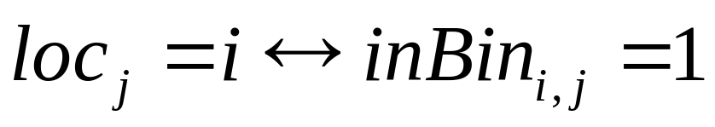
An alternative (and it’s consequences)?
Introduce an array of constrained integer variables
loc[j] with domain [0..m]
Consequences:
Array loc is now decision variables
No longer need to insist that sums of columns of inBin equal 1
Question: what’s the size of the state space now?

Slide 42
So?
What have we learned?
Identify the decision variables
What is the size of the state space?
What is the size of the model?
What is value ordering doing to the search?
Can we use any heuristics?
Are there symmetries that we can break?
Are there any simple/redundant tests/constraints overlooked?
Is there an alternative model?

Slide 43
And let’s not forget the big question …
9. Why are we using constraint programming?
Answers?

