Slide 1
CSCI1600: Embedded and Real Time Software
Lecture 27: Real Time Scheduling II
Steven Reiss, Fall 2016

Slide 2
Rate Monotonic Scheduling
Consider (8,4) , (10,2) , (12,3)
Utilization = 0.5 + 0.2 + 0.25 = 0.95
RM fails: (WHY)
Are the tasks schedulable?

Slide 3
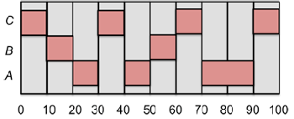
Dynamic Priority Scheduling
Priorities are changed dynamically for different tasks
Otherwise same simplifying assumptions
Approaches to assigning priorities
Basic idea: give priority to the job that needs it the most
Least laxity (least slack) first
Earliest deadline first

Slide 4
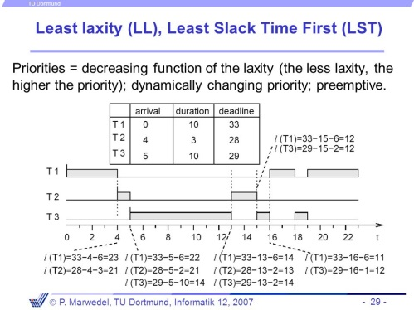
Least Laxity First
Laxity = time until deadline – compute time remaining
This is a measure of how stressed we are to finish the job
Small laxity implies high priority

Slide 5
Least Laxity Scheduling
(8,4) , (10,2) , (12,3)
0 :Laxity = 4, 8, 9
1 : Laxity = 4, 7, 8
2 : Laxity = 4, 6, 7
3 : Laxity = 4, 5, 6
4 : Laxity = X, 4, 5
5 : Laxity = X, 4, 4
6 : Laxity = X, X, 3
7 : Laxity = X, X, 3
8 : Laxity = 4, X, 3
9 : Laxity = 4, X, X
10 : Laxity = 4, 8, X
11 : Laxity = 4, 7, X
12 : Laxity = X, 7, 9 …

Slide 6
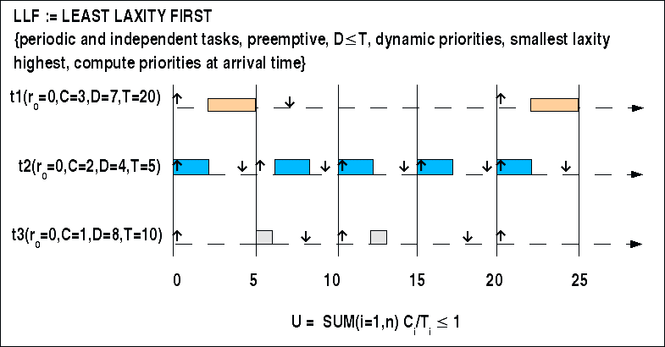
Least Laxity First
Is optimal
Can schedule as long as utility is <= 1
Is complex
When do priorities change
The laxity of a task changes dynamically
If it is not currently executing
How would you implement this
Generally not used
Too much context switching, bookkeeping
Can we approximate it?

Slide 7
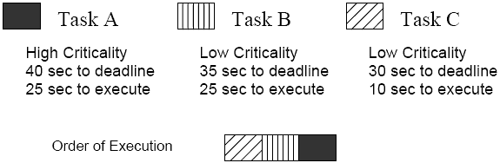
Earliest Deadline First (EDF)
Put tasks in priority queue based on actual deadline
Time when job needs to be done
Priorities change only when a job is added
EDF is also optimal
If the utility is <= 1 then EDF will create a schedule
Can transform any feasible schedule into an EDF one
But this is based on assumptions
Perfect periodic tasks, zero overhead, independence

Slide 8
Earliest Deadline First Scheduling
(8,4) , (10,2) , (12,3)
0 : [8,10,12]
8 : [ 10, 12, 16]
10 : [ 12, 16, 20 ]

Slide 9
EDF Scheduling
P1(4,1), P2(6,3), P3(10,3)
Why is this sufficient?

Slide 10

EDF Seems Ideal
Easy to implement, optimal, …
But only in an ideal world
If the workload is briefly non-schedulable
Then both fail dramatically and unpredictably
Choices are based on deadlines, not importance
Work hard to display MPG rather than firing airbag
Work only with idealized situations
We need to relax the simplifying conditions
Sporadic and aperiodic tasks

Slide 11
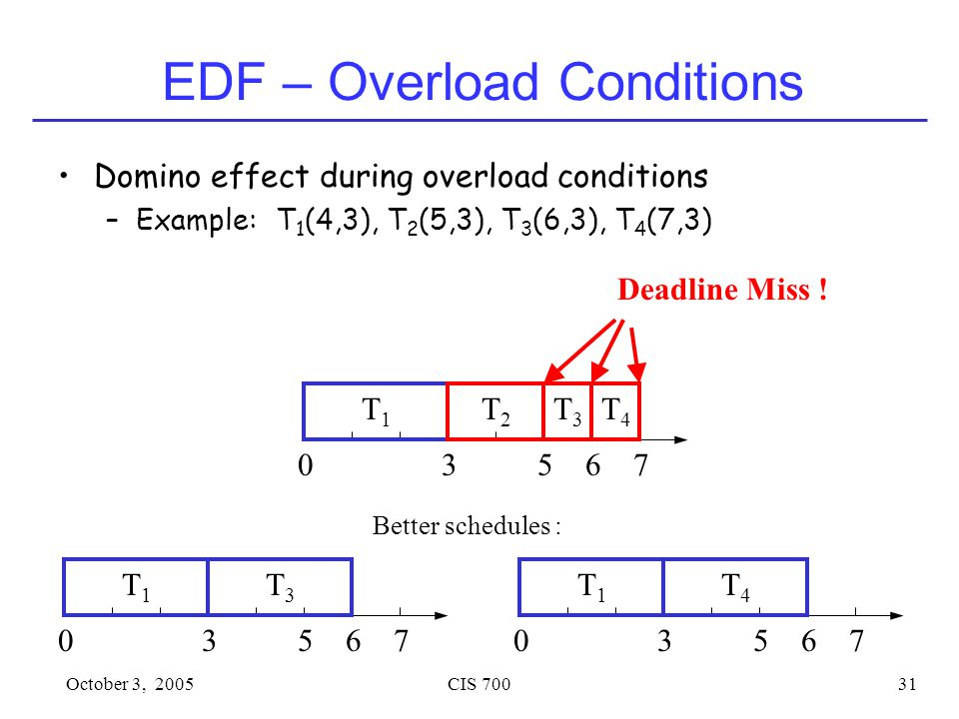
Handling Overloads
Why bother
Tasks might take longer than expected
Sporadic tasks (interrupts, etc.)
Might be unavoidable
In EDF if one job is late and the system is loaded
Then ALL future jobs might be late
Techniques
What might you want to do?

Slide 12
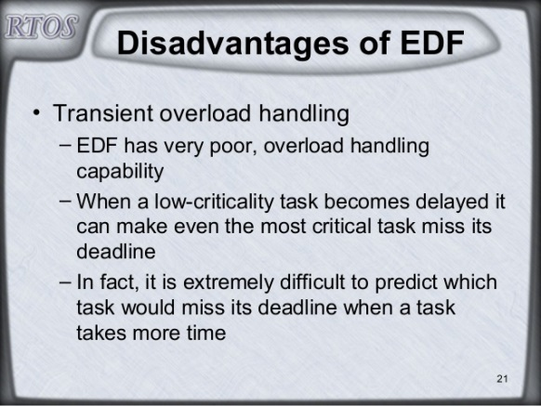
Techniques for Handling Overload
Techniques
Schedule late jobs at lower priority than on-time jobs
Change non-critical jobs to optional when late jobs occur
Discard jobs that cannot complete
Tradeoffs
What are the effects of each of these
What might you use in practice
Depends on application

Slide 13
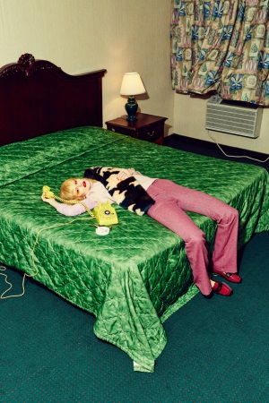
Relaxing Constraints
Non-preemptability
Resource Contention
Self-suspension
Context Switching time
Sporadic and aperiodic jobs
Job dependencies
Multiple cores/threads/processors

Slide 14
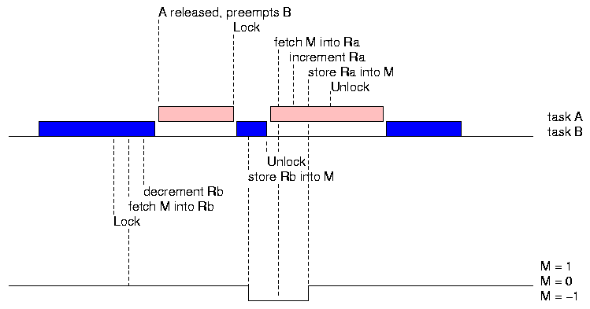
Relaxing Non-Preemptability
Compute maximum time a task might be non-preemptable
Compute maximum time a task might be delayed
By a non-preemptable task
Only need to consider tasks of lower priority
Add this to its execution time when deriving schedule

Slide 15
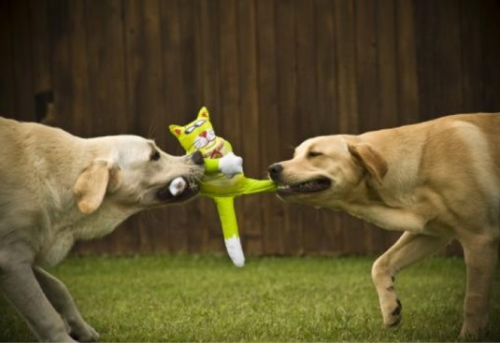
Resource Contention
Recall what can happen with locks and priorities
Even without deadlock and race conditions
Can have priority inversions

Slide 16
Priority Protocols
Blocked!
τ₁
L L L
R L
τ₂
L L
...
τ₃
L L L R
R
0
t
t+2
t+3
t+253
t+254

Slide 17
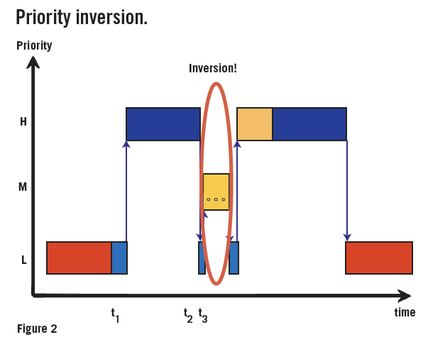
Fixing Priority Inversions
Make critical sections non-preemptable
This works, but …
Critical tasks can be delayed

Slide 18
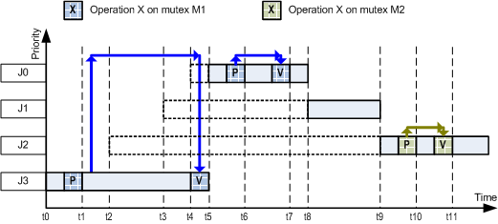
Immediate Priority Ceiling Protocol
Assign priorities based on resources
Associate a priority ceiling p with each resource r
The highest priority task that can lock it
No task with priority >= p is allowed to lock r
Task acquiring r runs at priority p

Slide 19
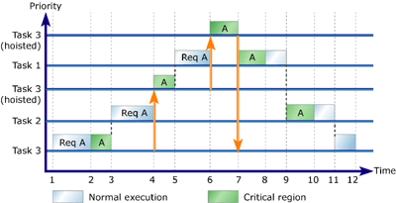
Priority Inheritance Protocol
Priority inheritance protocol
If Ti blocks Tk, execute Ti with priority min(i,k)
Change priority of a task someone is blocked by it
Which should you use?

Slide 20
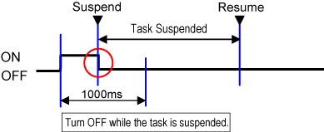
Handling Self-Suspension
Why would this ever happen?
Wait for I/O operations, etc.
Split into two tasks
Second task might have a shorter deadline
Take the suspension time into account when computing schedule

Slide 21
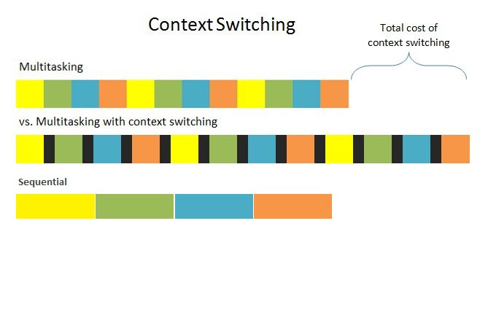
Handling Context Switching Time
Compute the max # of context switches for a task
From its period and higher priority tasks
Worst case
Add the context switching time * max
To the execution time of the task

Slide 22
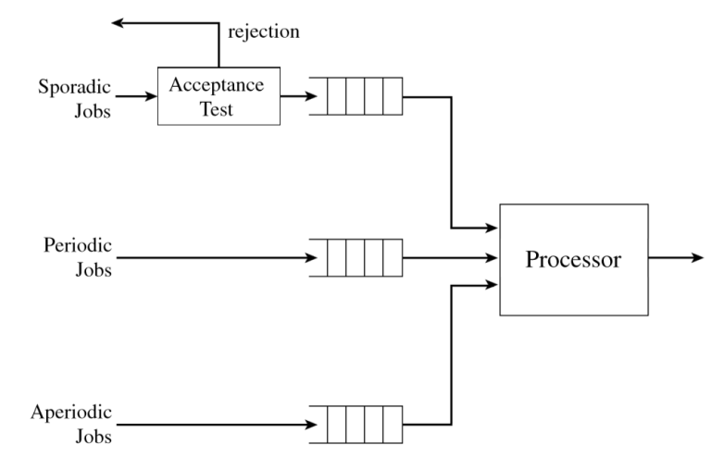
Sporadic Tasks
Sporadic tasks
Arise occasionally
Hard deadlines
Question: how to schedule these
How to accommodate in RM/DM or EDF schedules
Goal
Tell accept/reject when job is submitted
If accepted, then job will meet its deadline

Slide 23
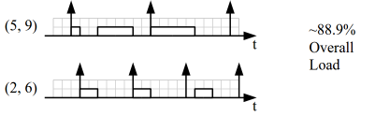
Sporadic Jobs and EDF Schedules
EDF will find a schedule as long as U <= 1
Keep track of U for the current system
Utilization of the periodic tasks
Plus the U for all accepted sporadic tasks
Compute U’ as current U plus U of the sporadic task
If this is <= 1 then accept
Otherwise reject

Slide 24
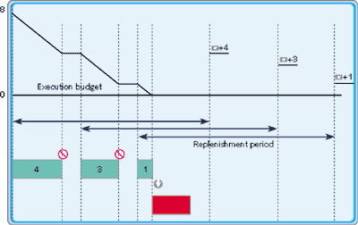
Sporadic Jobs and RM Schedules
What guarantees can we make here?
U <= x where x depends on the number of tasks
This allows us to use the same approach
Just check with <= X for appropriate X

Slide 25

Homework
Read 12.5
Exercise 12.5

Slide 26
Aperiodic Job Scheduling
Aperiodic Tasks
Arise occasionally
Soft deadlines
Might be prioritized
Goal: minimize worst/average case performance

Slide 27
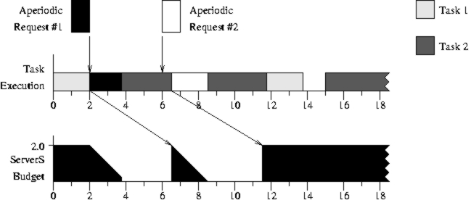
Simple Aperiodic Scheduling
Run aperiodic tasks in open slots
How to schedule them
Round robin
Prioritized round robin
Run tasks with higher priorities first
Allocate CPU time according to priority
This gives no guarantees of performance
And complicates the scheduler

Slide 28
Priority Ceiling Protocol
Original Priority Ceiling Protocol
Task’s priority is raised when a higher-priority task tries to acquire the lock
Raised to priority ceiling of the resource
Task can acquire a lock r only if the task’s priority is strictly higher than the priority ceilings of all locks currently held by other tasks

