Slide 1
Task scheduling

Slide 2
Definitions
•A schedule σis said to be feasible if all the tasks are able to complete within a set of constraints.
•A set of tasks Γ is said to be schedulable if there exists a feasible schedule for it.
2

Slide 3
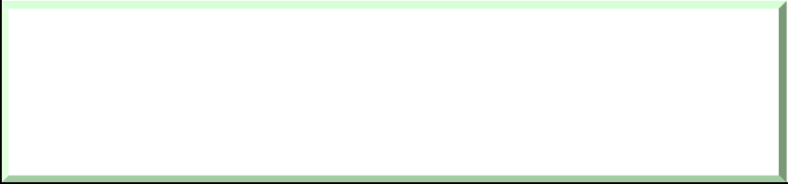

The general scheduling problem
Given a set Γof n tasks, a set P of m processors, and a set R of r resources, find an assignment of P and R to Γwhich produces a feasible schedule.
Γ P R
Scheduling algorithm
σ
feasible
3

Slide 4
Complexity
•In 1975, Garey and Johnson showed that the general scheduling problem is NP hard.
•However, polynomial time algorithms can be found under particular conditions.
4

Slide 5
Simplifing assumptions
•Single processor
•Omogeneous task sets
•Fully preemptive tasks
•Simultanoeus activations
•No precedence constraints
•No resource constraints
5

Slide 6
Algorithm tassonomy
•Preemptive vs. Non Preemptive
•Static vs. dynamic
•On line vs. Off line
•Best Effort vs. Optimal
6

Slide 7
Static vs. Dynamic
Static
scheduling decisions are taken based on fixed parameters, statically assigned to tasks before activation.
Dynamic
scheduling decisions are taken based on parameters that can change with time.
7

Slide 8
Off-line vs. On-line
Off-line
all scheduling decisions are taken before task activation: the schedule is stored in a table.
On-line
scheduling decisions are taken at run time on the set of active tasks.
8

Slide 9
Best-Effort vs. Optimal
Best-Effort
do their best to find a feasible schedule, if there exists one, but they do not guarantee that.
Optimal
Always find a feasible schedule if there exists one.
9

Slide 10
Classical scheduling policies
•First Come First Served
•Shortest Job First
•Priority Scheduling
•Round Robin
Not suited for real-time systems
10

Slide 11
First Come First Served
It assigns the CPU to tasks based on their arrival times.
READY queue
CPU
Non preemptive
Dynamic
On line
Best effort
σ
t
11

Slide 12

First Come First Served
- Very unpredictable
response times strongly depend on task arrivals.
r₁ r₂ r₃
R₁ = 20 R₂ = 26 R₃ = 26
τ₁ τ₂ τ₃
8 12 16 20 24 28
t
0 4
r₃ r₂ r₁
32
R₁ = 26 R₂ = 8 R₃ = 2
τ₃ τ₂
τ₁
t
0
4
8
12
16
20
24
28
32
12

Slide 13
Shortest Job First
(SJF)
the shortest
It selects the task with computation time.
Non preemptive or preemptive
Static (C_{i} is a constant parameter)
It can be used on line or off-line
It minimizes the average response time
13

Slide 14
SJF Optimality
≠SJF
σ
σ’
L
S
S
L
t
r₀
f_{S}’ < f_{L}
f_{L}’ = f_{S}
f_{S}’ + f_{L}’ ≤ f_{S} + f_{L}
n
R (σ') = ¹ ∑
1
n
n
( f ' −r ) ≤
∑ i i
( f −r ) =R (σ)
n
i i
i=1
i=1
14

Slide 15
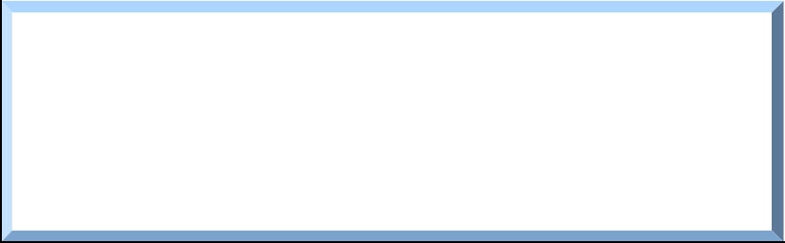

SJF Optimality
σ σ’ σ’’ . . . σ*
R (σ) ≥ R (σ') ≥ R (σ'') . . .
≥ R (σ*)
σ* = σ_{SJF}
is the minimum response time achievable by any algorithm
R (σ_{SJF} )
15

Slide 16
SJF suited for Real-Time?
- It is not optimal in the sense of feasibility
d₁ d₂ d₃
τ₃
A ≠SJF feasible
τ₁
4 8 12
SJF not feasible
τ₃ τ₂
4 8 12
τ₂
t
0
16
20
24
28 32
d₂ d₃
d₁
τ₁
t
0
16
20
24
28
32
16

Slide 17
Priority Scheduling
Each task is assigned a priority: p_{i} ∈[0, 255]
The task with the highest priority is selected for execution.
Tasks with the same priority are served FCFS.
Preemptive
Static or dynamic
On line
17

Slide 18
Priority Scheduling
Problem: starvation
low priority tasks may experience long delays due to the preemption of high priority tasks.
A solution: aging
priority increases with waiting time
NOTE:
p_{i} ∝1/C_{i}
p_{i} ∝1/r_{i}
⇒ SJF
⇒ FCFS
18

Slide 19
Round Robin
The ready queue is served as FCFS, but ...
Each task τ_{i} cannot execute more than Q time units (Q = time quantum).
When Q expires, τ_{i} is put back in the queue.
READY queue
CPU
Q expired
19

Slide 20

Round Robin
n = number of tasks in the system nQ nQ
t
Q
R ≅ (nQ) ^{Ci} = nC
i
Q
i
Time sharing
Each task runs as it was executing alone on a virtual processor n times slower than the real one.
20

Slide 21
Round Robin
if Q > max (C_{i}) then RR ≡FCFS
if Q ≅context switch time (δ) then
n(Q + δ) n(Q + δ)
t
Q + δ
_{= nC} ⎛Q +δ⎞
R ≅ n(Q +δ) ^{Ci}
⎜ ⎟
i
Q
i
Q
⎝ ⎠
21

Slide 22
Real-Time Algorithms
Tasks can be scheduled by
•relative deadlines D_{i}
•absolute deadlines d_{i}
D_{i}
(static) (dynamic)
d_{i}
22

Slide 23
Earliest Due Date
It selects the task with the earliest relative
deadline [Jackson’ 55].
All tasks arrive simultaneously
Fixed priority (D_{i} is known in advance)
Preemption is not an issue
It minimizes the maximum lateness (L_{max})
23

Slide 24
Lateness
L_{i} = f_{i} −d_{i}
L_{i} > 0
d_{i}
L_{i} < 0
r_{i}
f_{i}
r_{i}
f_{i}
d_{i}
24

Slide 25


Maximum Lateness
^{L}max
= max_{i} (L_{i})
if (L_{max} < 0) then
no task misses its deadline
25

Slide 26
EDD Optimality
≠EDD
σ
σ’
B A
A
B
t
r₀
f_{a}’ < f_{b} f_{b}’ = f_{a}
= f_{a} −d_{a}
d_{a} d_{b}
^{L}max ^{= L}a
L_{a}’ = f_{a}’ −d_{a} < f_{a} −d_{a}
L_{b}’ = f_{b}’ −d_{b} < f_{a} −d_{a}
^{L’}max ^{< L}max
26

Slide 27
EDD Optimality
σ σ’ σ’’
. . .
σ*
L_{max} (σ) ≥ L_{max} (σ') ≥ L_{max} (σ'') . . . ≥ L_{max} (σ*)
σ* = σ_{EDD}
is the minimum value achievable by any algorithm
^{L}max ^{(σ}SJF ⁾
27

Slide 28
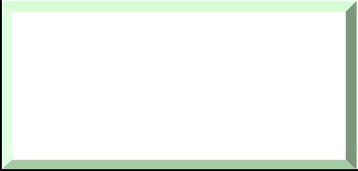

EDD - Guarantee test (off line)
τ₁
τ₂
τ₃
τ₄
t
f₁ f₂ f₃
A task set Γis feasible if
f₄
∀i f_{i} ≤ d_{i}
f_{i} =∑C_{k}
k =1
∀i ∑C_{k} ≤D_{i}
k =1
i
i
28

Slide 29
Earliest Deadline First
It selects the task with the earliest absolute
deadline [Horn 74].
Tasks may arrive at any time
Dynamic priority (d_{i} depends on arrival)
Full preemptive tasks
It minimizes the maximum lateness (L_{max})
29

Slide 30
EDF Example
30

Slide 31
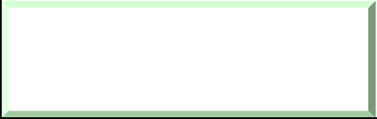

EDF Guarantee test (on line)
c₁(t)
c₂(t)
c₃(t)
c₄(t)
t
∀i ∑c_{k} (t) ≤ d_{i} −t
k =1
i
31

Slide 32
Complexity Issues
EDD
•O(n log n) to order the task set
•O(n) to guarantee the whole task set
EDF
•O(n) to insert a new task in the queue
•O(n) to guarantee a new task
32

