Slide 1
정보 검색 특론
Information Retrieval and Web Search
Lecture 1: 소개

Slide 2
정보검색 관련 기술
문헌정보학과, Information Science
  SGML
  ns = “dc”
  Topic map
컴퓨터공학
  알고리즘
  인공지능, 자연언어처리
    Indexing, 분류, 기계학습
언어학
  언어분석

Slide 3
종류
단일언어 ⬄ 다중언어
  기계번역
N-gram ⬄ 언어분석
일반문서 ⬄ 인터넷 문서
규칙에 의한 접근 ⬄ 통계적 접근
구조적 정보 ⬄ 반구조적 정보 ⬄ 비구조적 정보
문서검색 ⬄ 멀티미디어 검색
  이 강의는 문서 검색을 대상으로 함
  Table, …

Slide 4
경향
단순 질의 ➔ 고도 질의 (1970-1980)
  Boolean ➔ natural query ➔ natural language query
  스트링 비교(grep) ➔ 색인 ➔ 의미 기반 검색
  Q&A
중용량 ➔ 대용량, 초대용량 (1995-2005)
검색결과: 단순제공 ➔ 순위화 ➔ 분류 ➔ Topic
검색내용: 문서 ➔ trend

Slide 5
최근 응용
심리적 안정? 농담
Trend 분석
광고 지원 플랫폼
  ETRI
  감정, 느낌 따위 검색
  스마트폰용 검색
지도검색
멀티미디어 검색
  인물검색: 웃는 모습
모바일 검색(스마트폰)
  다중 정보로부터 검색

Slide 6
간략한 과정
문서 수집
  수작업, robot
문서 전처리
문서 분석
문서 색인
  색인어 사전 구축, 색인어와 문서 id 부여
역파일 생성
  색인어 기준으로 각 문서 내용 정렬
  문서를 색인어별로 merge
    내부, 외부 merge
역파일 저장
문서 검색
  질의어 색인
  질의 확장
  질의
재질의
  Relevance feedback
  질의 변경

Slide 7
용어
GREP
INDEX
INCIDENCE MATRIX
TERM
BOOLEAN RETERIAL MODEL
DOCUMENTS
COLLECTION, CORPUS
INFORMATION NEED, QUERY, REVELENCE
  TOPIC
PRECESION/RECALL

Slide 8
용어(계속)
INVERTED INDEX/FILE
DICTIONARY/VOCABULARY/LEXICON
docID
DOCUMENT FREQUENCY
POSTING, POSTINGS LIST

Slide 9
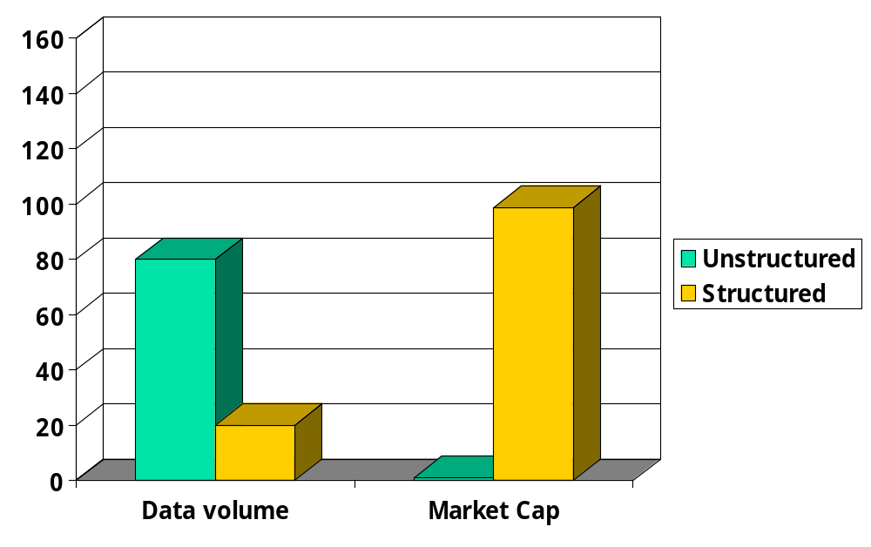
Unstructured (text) vs. structured (database) data in 1996

Slide 10
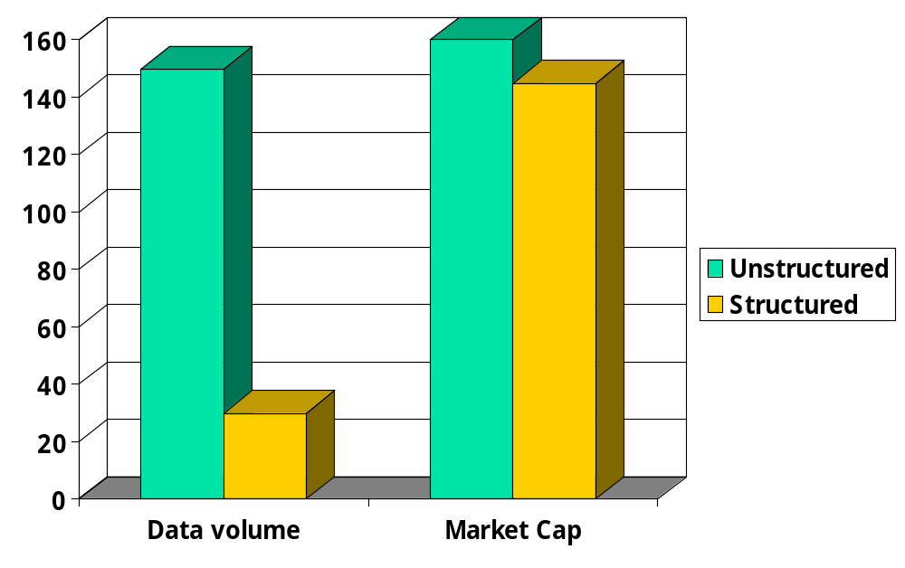




Unstructured (text) vs. structured (database) data in 2006

Slide 11
Unstructured data in 1650
Which plays of Shakespeare contain the words Brutus AND Caesar but NOT Calpurnia?
One could grep all of Shakespeare’s plays for Brutus and Caesar, then strip out lines containing Calpurnia?
  Slow (for large corpora)
  NOT Calpurnia is non-trivial
  Other operations (e.g., find the word Romans near countrymen) not feasible
  Ranked retrieval (best documents to return)
    Later lectures

Slide 12
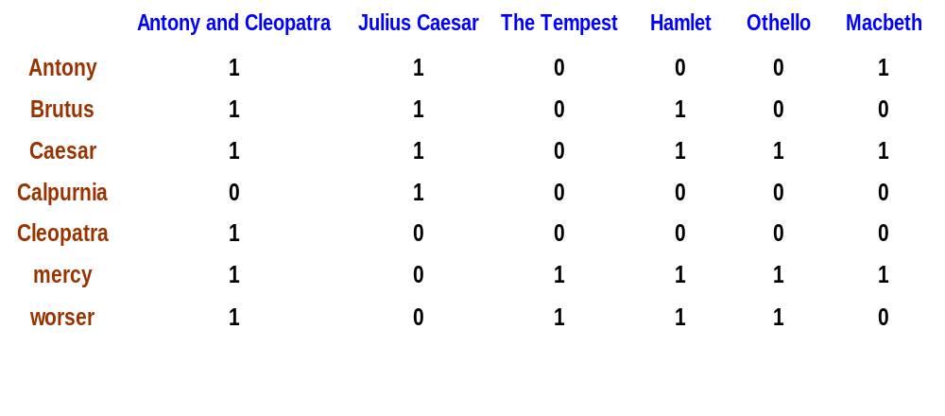
Term-document incidence
1 if play contains word, 0 otherwise
Brutus AND Caesar but NOT Calpurnia

Slide 13
Incidence vectors
So we have a 0/1 vector for each term.
To answer query: take the vectors for Brutus, Caesar and Calpurnia (complemented) ➔ bitwise AND.
110100 AND 110111 AND 101111 = 100100.

Slide 14
Answers to query
Antony and Cleopatra, Act III, Scene ii
Agrippa [Aside to DOMITIUS ENOBARBUS]: Why, Enobarbus,
When Antony found Julius Caesar dead,
He cried almost to roaring; and he wept
When at Philippi he found Brutus slain.
Hamlet, Act III, Scene ii
Lord Polonius: I did enact Julius Caesar I was killed i' the
Capitol; Brutus killed me.

Slide 15
Bigger corpora
Consider N = 1M documents, each with about 1K terms.
Avg 6 bytes/term incl spaces/punctuation
  6GB of data in the documents.
Say there are m = 500K distinct terms among these.

Slide 16
Can’t build the matrix
500K x 1M matrix has half-a-trillion 0’s and 1’s.
But it has no more than one billion 1’s.
  matrix is extremely sparse.
What’s a better representation?
  We only record the 1 positions.
Why?

Slide 17
Inverted index
For each term T, we must store a list of all documents that contain T.
Do we use an array or a list for this?
Brutus
2
4
8
16
32
64
128
Calpurnia
1
2
3
5
8
13
21
34
Caesar
13
16
What happens if the word Caesar is added to document 14?

Slide 18
Inverted index
Linked lists generally preferred to arrays
  Dynamic space allocation
  Insertion of terms into documents easy
  Space overhead of pointers
Posting
Brutus
2
4
8
16
32
64
128
Calpurnia
1
2
3
5
8
13
21
34
Caesar
13
16
Dictionary
Postings lists
Sorted by docID (more later on why).

Slide 19





Inverted index construction
Documents to
be indexed.
Friends, Romans, countrymen.
Tokenizer
Token stream.
Friends
Romans
Countrymen
More on
these later.
Linguistic modules
Modified tokens.
friend
roman
countryman
Indexer
friend
2
4
roman
1
2
Inverted index.
countryman
13
16

Slide 20
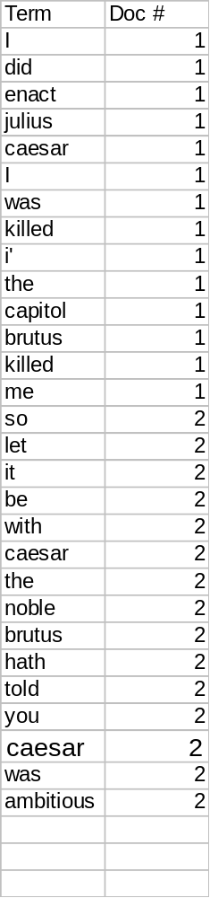
Indexer steps
Sequence of (Modified token, Document ID) pairs.
Doc 1
Doc 2
I did enact Julius
Caesar I was killed
i' the Capitol;
Brutus killed me.
So let it be with
Caesar. The noble
Brutus hath told you
Caesar was ambitious

Slide 21
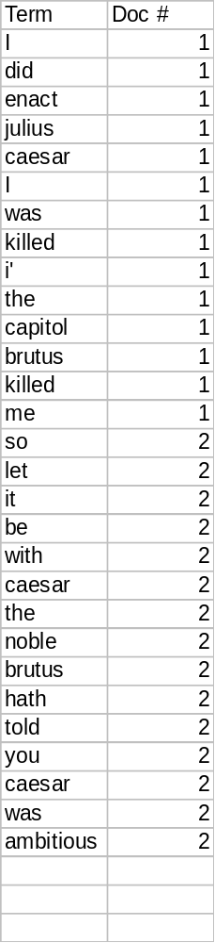
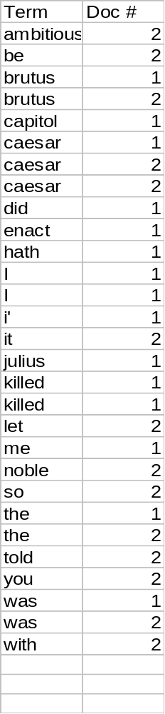
Sort by terms.
Core indexing step.

Slide 22
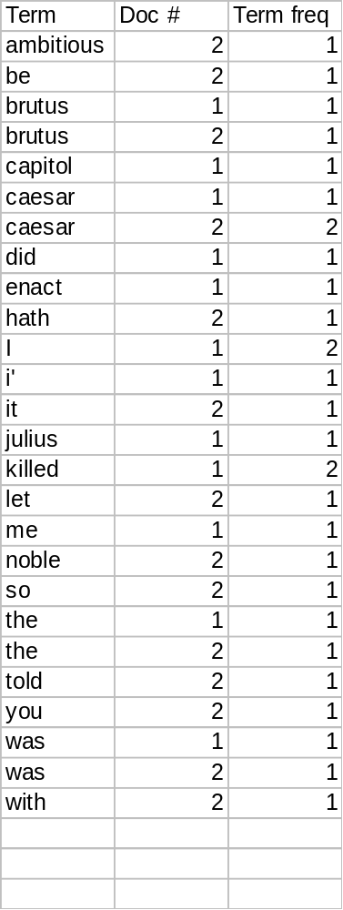
Multiple term entries in a single document are merged.
Frequency information is added.
Why frequency?
Will discuss later.

Slide 23
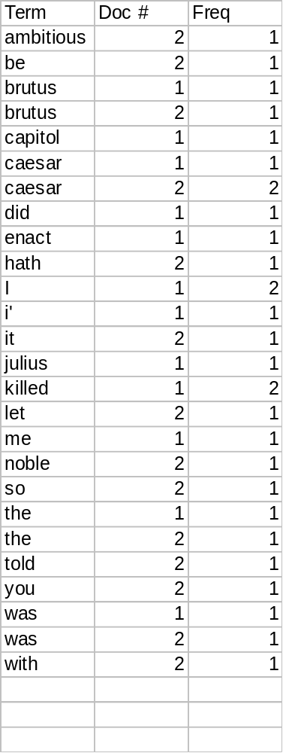
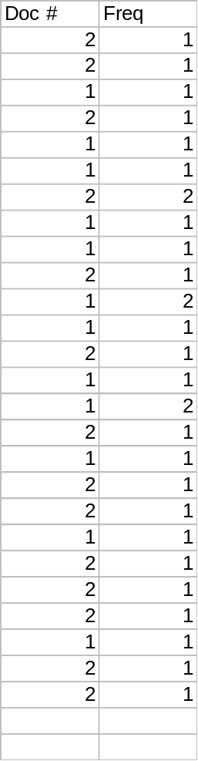
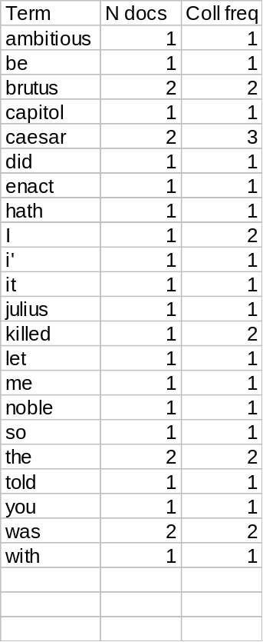
The result is split into a Dictionary file and a Postings file.

Slide 24
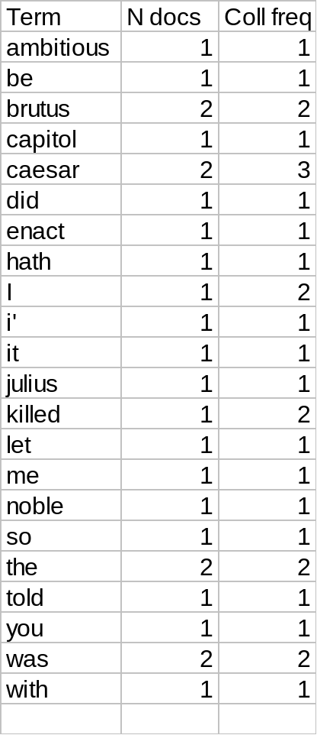
Where do we pay in storage?
Will quantify the storage, later.
Terms
Pointers

Slide 25
The index we just built
Today’s focus
How do we process a query?
  Later - what kinds of queries can we process?

Slide 26
Query processing: AND
Consider processing the query:
  Brutus AND Caesar
  Locate Brutus in the Dictionary;
    Retrieve its postings.
  Locate Caesar in the Dictionary;
    Retrieve its postings.
  “Merge” the two postings:
2
4
8
16
32
64
128
Brutus
1
2
3
5
8
13
21
34
Caesar

Slide 27
The merge
Walk through the two postings simultaneously, in time linear in the total number of postings entries
2
2
4
4
8
8
16
16
32
64
128
32
64
128
Brutus
2
8
1
Caesar
1
2
2
3
5
5
8
8
13
13
21
21
34
3
34
If the list lengths are x and y, the merge takes O(x+y)
operations.
Crucial: postings sorted by docID.

Slide 28
Boolean queries: Exact match
The Boolean Retrieval model is being able to ask a query that is a Boolean expression:
  Boolean Queries are queries using AND, OR and NOT to join query terms
    Views each document as a set of words
    Is precise: document matches condition or not.
Primary commercial retrieval tool for 3 decades.
Professional searchers (e.g., lawyers) still like Boolean queries:
  You know exactly what you’re getting.

Slide 29
Example: WestLaw http://www.westlaw.com/
Largest commercial (paying subscribers) legal search service (started 1975; ranking added 1992)
Tens of terabytes of data; 700,000 users
Majority of users still use boolean queries
Example query:
  What is the statute of limitations in cases involving the federal tort claims act?
  LIMIT! /3 STATUTE ACTION /S FEDERAL /2 TORT /3 CLAIM
/3 = within 3 words, /S = in same sentence

Slide 30
Example: WestLaw http://www.westlaw.com/
Another example query:
  Requirements for disabled people to be able to access a workplace
  disabl! /p access! /s work-site work-place (employment /3 place)
Note that SPACE is disjunction, not conjunction!
Long, precise queries; proximity operators; incrementally developed; not like web search
Professional searchers often like Boolean search:
  Precision, transparency and control
But that doesn’t mean they actually work better….

Slide 31
Boolean queries:
More general merges
Exercise: Adapt the merge for the queries:
Brutus AND NOT Caesar
Brutus OR NOT Caesar
Can we still run through the merge in time O(x+y) or what can we achieve?

Slide 32
Merging
What about an arbitrary Boolean formula?
(Brutus OR Caesar) AND NOT
(Antony OR Cleopatra)
Can we always merge in “linear” time?
  Linear in what?
Can we do better?

Slide 33
Query optimization
What is the best order for query processing?
Consider a query that is an AND of t terms.
For each of the t terms, get its postings, then AND them together.
Brutus
2
4
8
16
32
64
128
Calpurnia
1
2
3
5
8
16
21
34
Caesar
13
16
Query: Brutus AND Calpurnia AND Caesar

Slide 34
Query optimization example
Process in order of increasing freq:
  start with smallest set, then keep cutting further.
This is why we kept
freq in dictionary
Brutus
2
4
8
16
32
64
128
Calpurnia
1
2
3
5
8
13
21
34
Caesar
13
16
Execute the query as (Caesar AND Brutus) AND Calpurnia.

Slide 35
More general optimization
e.g., (madding OR crowd) AND (ignoble OR strife)
Get freq’s for all terms.
Estimate the size of each OR by the sum of its freq’s (conservative).
Process in increasing order of OR sizes.

Slide 36
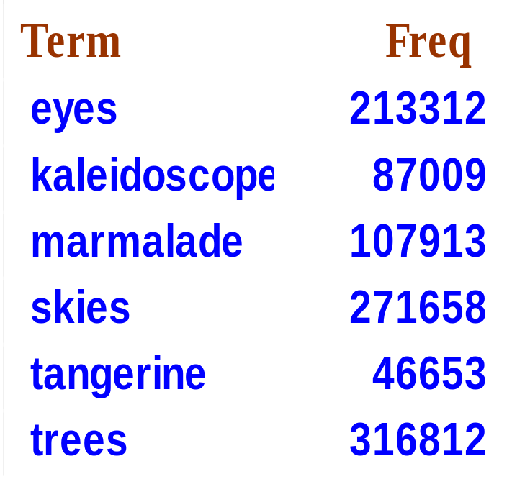
Exercise
Recommend a query processing order for
(tangerine OR trees) AND
(marmalade OR skies) AND
(kaleidoscope OR eyes)

Slide 37
Query processing exercises
If the query is friends AND romans AND (NOT countrymen), how could we use the freq of countrymen?
Exercise: Extend the merge to an arbitrary Boolean query. Can we always guarantee execution in time linear in the total postings size?
Hint: Begin with the case of a Boolean formula query: in this, each query term appears only once in the query.

Slide 38
Exercise
Try the search feature at http://www.rhymezone.com/shakespeare/
Write down five search features you think it could do better

Slide 39
What’s ahead in IR?
Beyond term search
What about phrases?
  Stanford University
Proximity: Find Gates NEAR Microsoft.
  Need index to capture position information in docs. More later.
Zones in documents: Find documents with (author = Ullman) AND (text contains automata).

Slide 40
Evidence accumulation
1 vs. 0 occurrence of a search term
  2 vs. 1 occurrence
  3 vs. 2 occurrences, etc.
  Usually more seems better
Need term frequency information in docs

Slide 41
Ranking search results
Boolean queries give inclusion or exclusion of docs.
Often we want to rank/group results
  Need to measure proximity from query to each doc.
  Need to decide whether docs presented to user are singletons, or a group of docs covering various aspects of the query.

Slide 42
IR vs. databases:
Structured vs unstructured data
Structured data tends to refer to information in “tables”
Employee
Manager
Salary
Smith
Jones
50000
Chang
Smith
60000
Ivy
Smith
50000
Typically allows numerical range and exact match
(for text) queries, e.g.,
Salary < 60000 AND Manager = Smith.

Slide 43
Unstructured data
Typically refers to free text
Allows
  Keyword queries including operators
  More sophisticated “concept” queries e.g.,
    find all web pages dealing with drug abuse
Classic model for searching text documents

Slide 44
Semi-structured data
In fact almost no data is “unstructured”
E.g., this slide has distinctly identified zones such as the Title and Bullets
Facilitates “semi-structured” search such as
  Title contains data AND Bullets contain search
    … to say nothing of linguistic structure

Slide 45
More sophisticated semi-structured search
Title is about Object Oriented Programming AND Author something like stro*rup
where * is the wild-card operator
Issues:
  how do you process “about”?
  how do you rank results?
The focus of XML search.

Slide 46
Clustering and classification
Given a set of docs, group them into clusters based on their contents.
Given a set of topics, plus a new doc D, decide which topic(s) D belongs to.

Slide 47
The web and its challenges
Unusual and diverse documents
Unusual and diverse users, queries, information needs
Beyond terms, exploit ideas from social networks
  link analysis, clickstreams ...
How do search engines work? And how can we make them better?

Slide 48
More sophisticated information retrieval
Cross-language information retrieval
Question answering
Summarization
Text mining
…

