Slide 1


Generative Design
Programming Environments for
Guilherme Ferreira
Instituto Superior Técnico

Slide 2
Problem
Survey
Solution
Conclusion

Slide 3
1
Problem

Slide 4
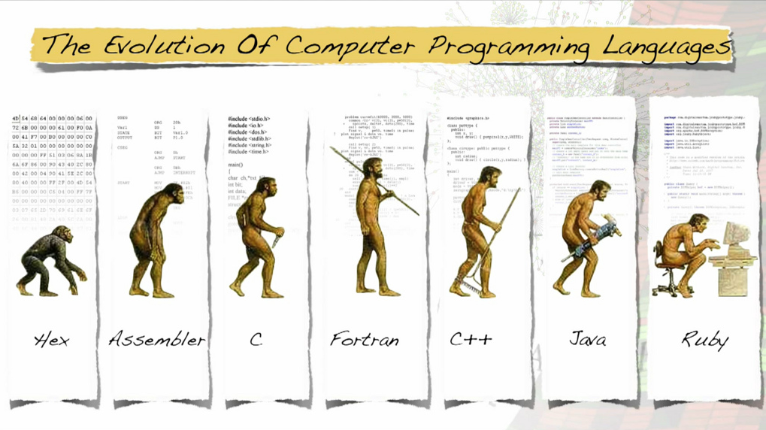
“To understand a program, you must become both the machine and the program” --- Alan Perlis
© 2015 by the ACM Magazine for Students

Slide 5
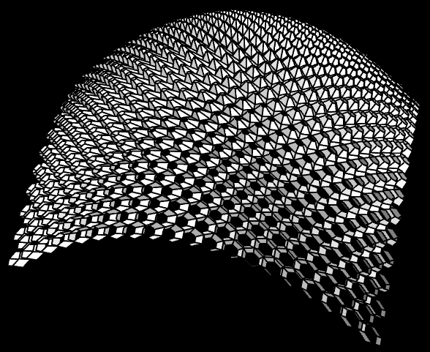
Generative Design Environments
(define (skin-open-srf srf panel panel-f panel-h att)
(sphere att 0.03)
(iterate-quads
(lambda (h0 h1 h2 h3)
(panel (list-ref h0 4)
(list-ref h0 3)
(list-ref h1 4)
(list-ref h2 1)
(list-ref h2 0)
(list-ref h3 1)
panel-f panel-h att))
(iterate-quads
(lambda (p0 p1 p2 p3)
(let* ((a (ptf p0 p3 0.17))
(b (ptf p0 p1 1/2))
(f (ptf p0 p3 1/2))
(j (ptf p3 p2 1/2))
(e (ptf b j 2/3))
(k p1)
(l p2)
(c (ptf k l 0.17))
(d (ptf k l 1/2))
(w (ptf k l 2/3))
(g (ptf (ptf p0 p3 2/3) (ptf p1 p2 2/3) 3/2))
(h (ptf p3 p2 3/2))
(i (ptf k l 1.17)))
(panel a b c d e f panel-f panel-h att)
(list a b c d e f)))
(transpose-matrix srf))))
(define (hex-panel-1 p0 p1 p2 p3 p4 p5 f h att)
...)
(define (hex-panel-2 p0 p1 p2 p3 p4 p5 f h att)
...)

Slide 6
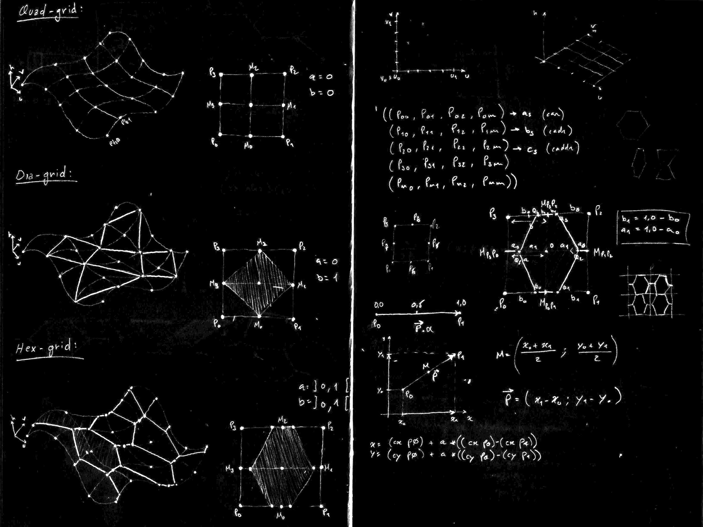
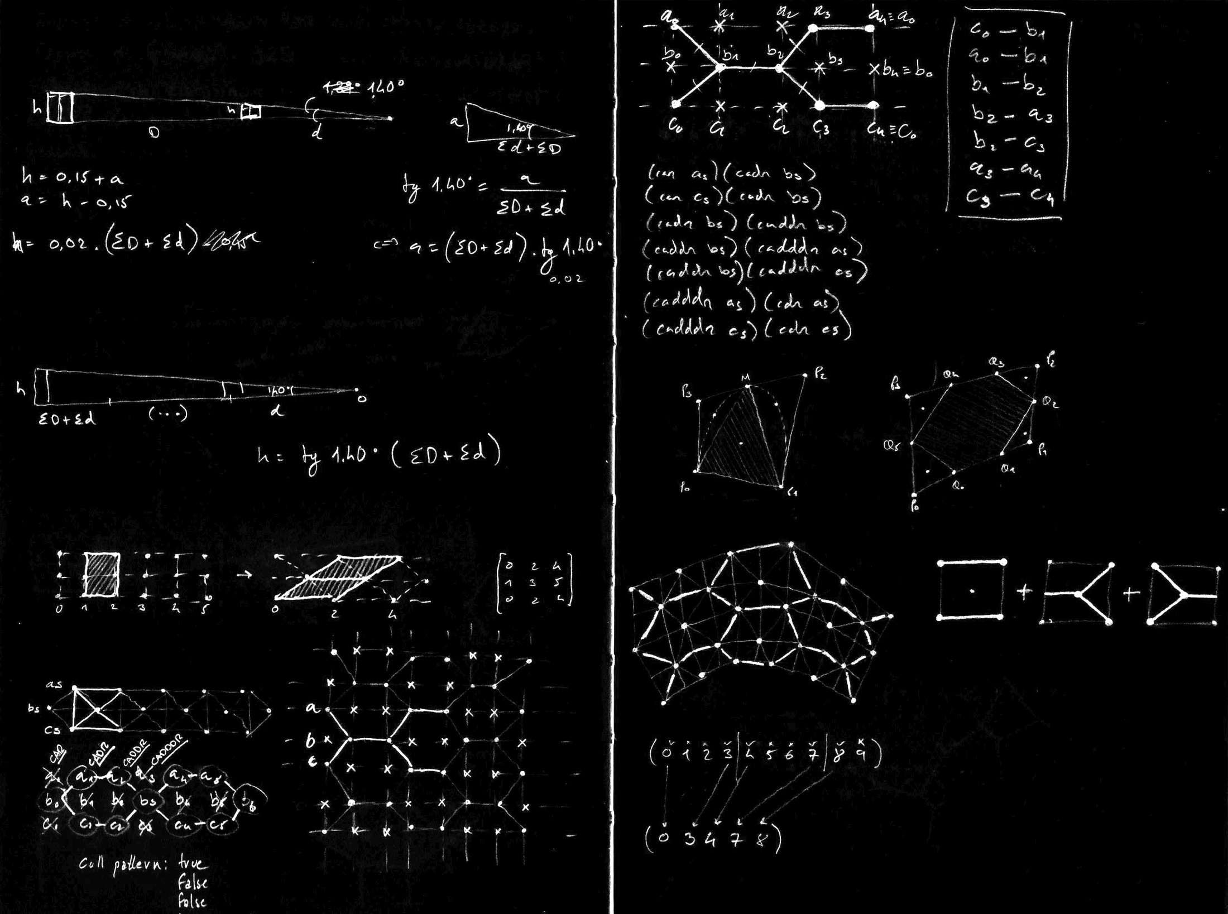
People understand what they can see

Slide 7
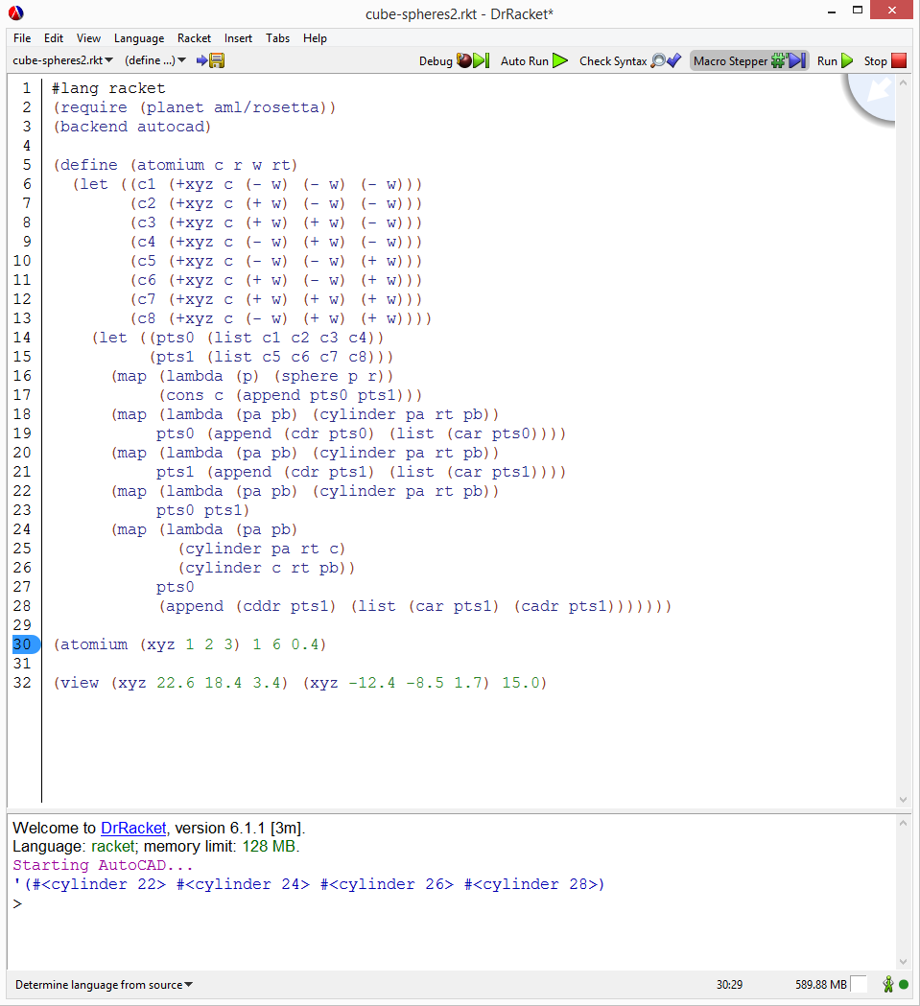
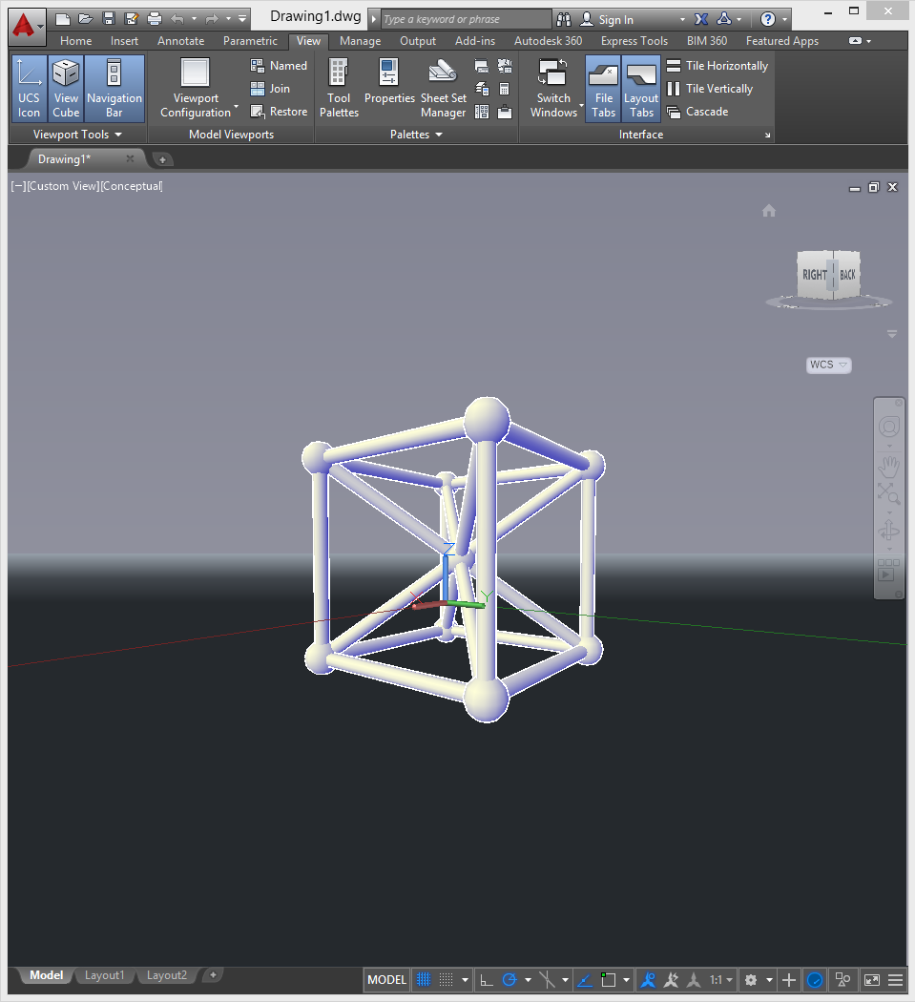
Creators need a medium connection

Slide 8
Creators need a medium connection

Slide 9
2
Survey

Slide 10
3
Solution

Slide 11
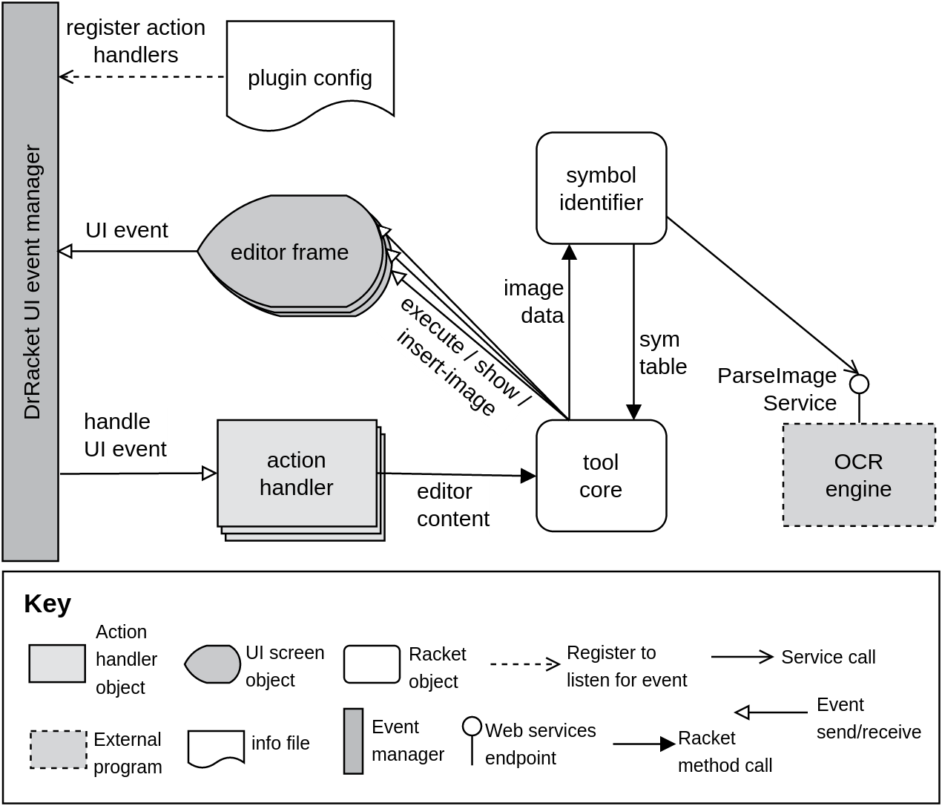

Slide 12
3
Conclusion

